Slide 1
Mike McCulley, Senior Officer
BC Wildfire Service Research & Innovation
BIRS Climate Change and Financial Risk Workshop 2022

Slide 2
BC Wildfire Service Research and Innovation Program
Vision
The BCWS is a national leader in wildfire research and innovation, generating knowledge and actionable insights for the benefit of all emergency response agencies.
Mission
To lead and support research and innovative initiatives that provide solutions to wildfire management and natural hazard emergency preparedness and response challenges for the Province of B.C. by leveraging collaborations and partnerships
.

Slide 3
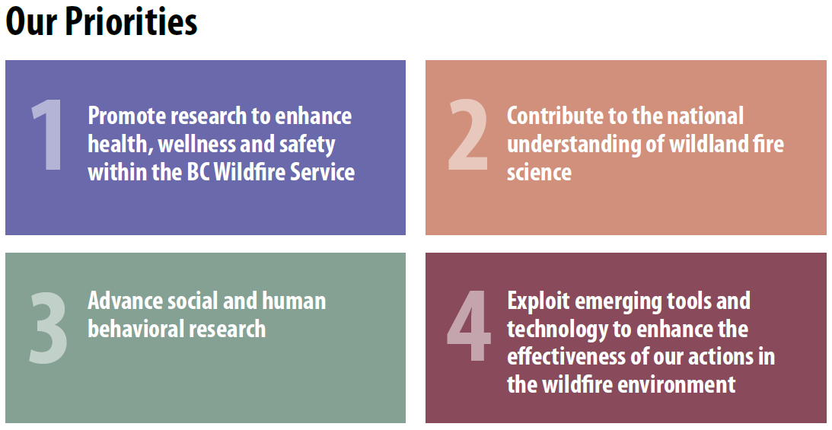
BC Wildfire Service Research & Innovation: Business Modernization
Facilitate research • Innovation trials
Student engagement • Broad collaborations

Slide 4
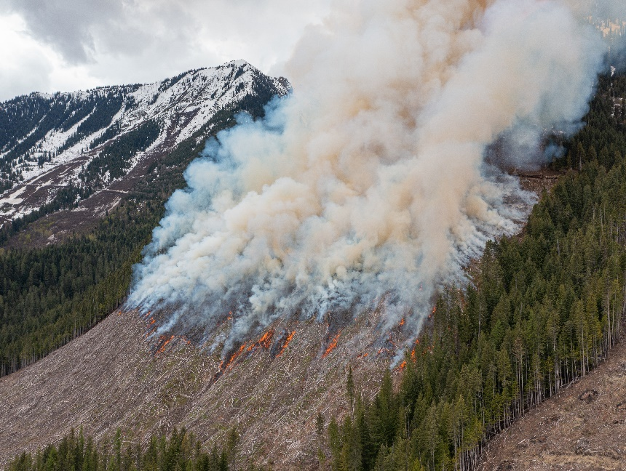
Wildland fire science
Contribute to the national understanding of wildland fire science on topics that span the areas of cultural and prescribed fire; wildfire prevention, preparedness, response and management; and predictive services
-Quantify wildfire hazard and risk over varying spatial and temporal scales
-Evaluate the effectiveness of wildfire management strategies including prevention, preparedness, and response
-Increase understanding of wildfire economics
-Assess the predictive accuracy and uncertainty associated with our predictive models, tools, and forecast
-Engage in cultural and prescribed burning research

Slide 5
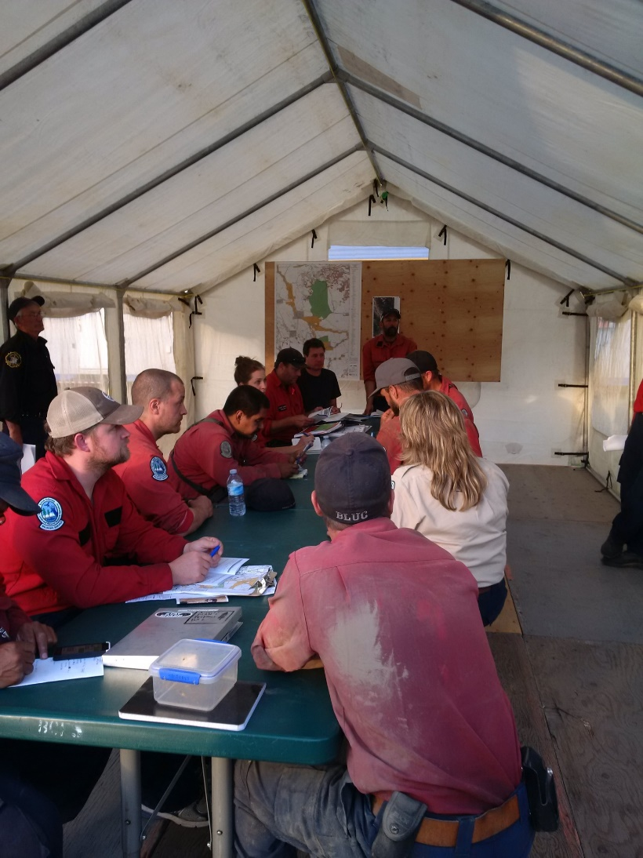
Social and human behaviour
Advance social and human behavioral research
-Provide science-based recommendations to improve communications within Incident Command Structure (ICS), on the fireline, and with other government agencies.
-Provide support to the evacuation readiness protect team through knowledge translation.

Slide 6
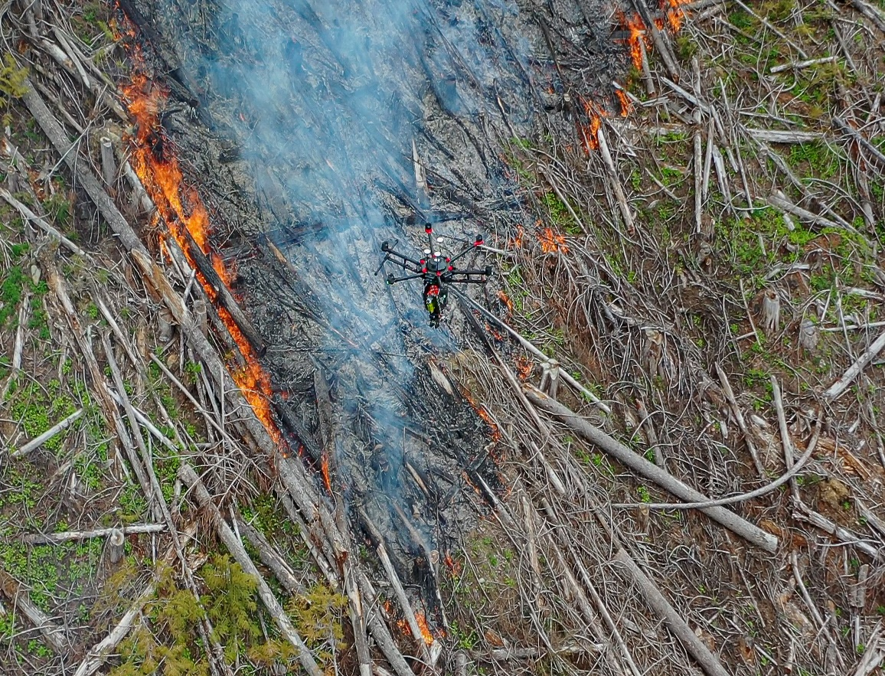
Technology and equipment
Exploit emerging tools and technology to enhance the effectiveness of our actions in the wildfire environment
-Improve communications connectivity at incident and fire centre levels
-Amplify impact of aerial assets by conducting research of airtanker action affect and expand use of RPAS technology
-Enhance suite of detection tools available to operational staff.

Slide 7
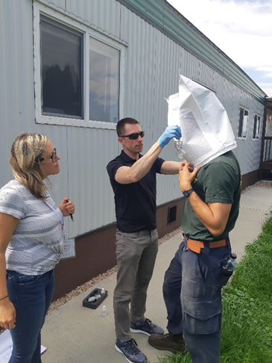
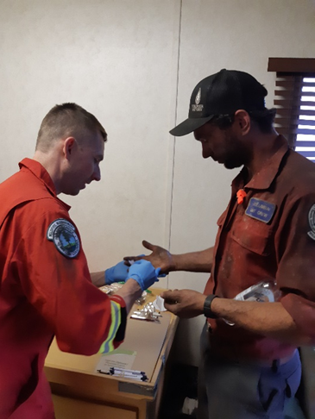
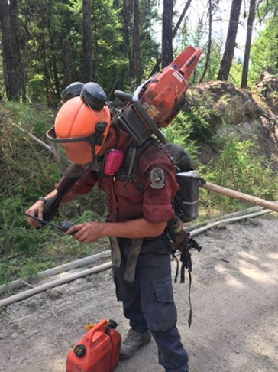
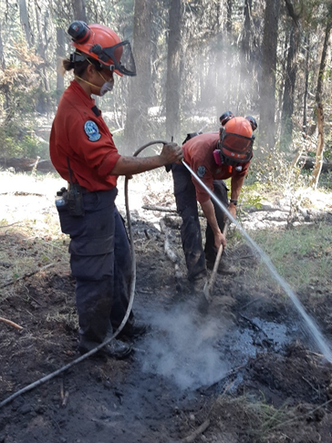
Health, wellness and safety
Promote research to enhance health, wellness, and safety within the BC Wildfire Service.
-Provide Research and Innovation expertise and coordinate research as required to support and evaluate shifts made to Occupational Safe Work Standard #2 (Staff Health and Fatigue Management)
-Reduce smoke exposure and inhalation through evidence-based interventions.
-Support the BCWS shift to Total Worker Health (mental, physical, psychological, emotional) through research and innovative trials of services and products

Slide 8
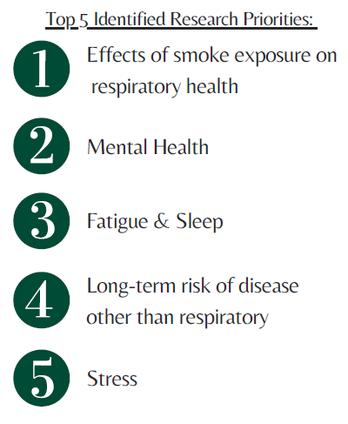
University of Northern British Columbia Scoping Review
Dr. Chelsea Pelletier and Mike Eadie
Goals
Scoping Review Findings
Survey/Interviews Findings
Next Steps: Research selection and communications

Slide 9
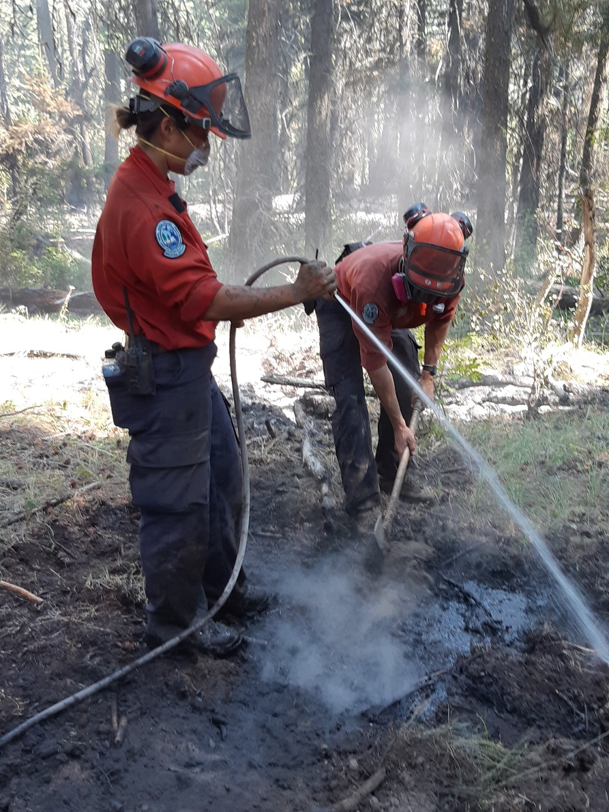
Smoke

Slide 10
More Smoke

Slide 11
Key Projects
Exposures in wildland firefighting
Dr. Nicola Cherry, University of Alberta
Psychosocial health & safety in wildland firefighting
Dr. Leduc & Dr. Dorman, Centre for Research on Occupational Safety and Health (CROSH) Laurentian University
Psychological Health and Safety Management System

Slide 12
Other Initiatives
Mask development (CROSH, Vendors, WorkSafe BC, staff)
CO monitor trial
Fatigue studies (vendor trials, Andrew Jeklin, Dr. Jelena Brcic)
COVID protocols
Camp infrastructure improvements (what and how)
Occupational Athlete (fitness regimes, physiotherapy)
Fire Equipment COP-improve equipment
Visual identity-ties to health and wellness
Knowledge translation-applying what we have learned
Leaning from other agencies
Supporting Organizational Development/Safety and Wellness program initiatives (ie mental wellness app, CO monitors, etc)

Slide 13
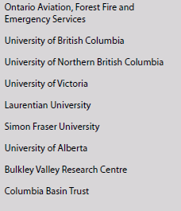
Partnerships of Note

