Slide 1
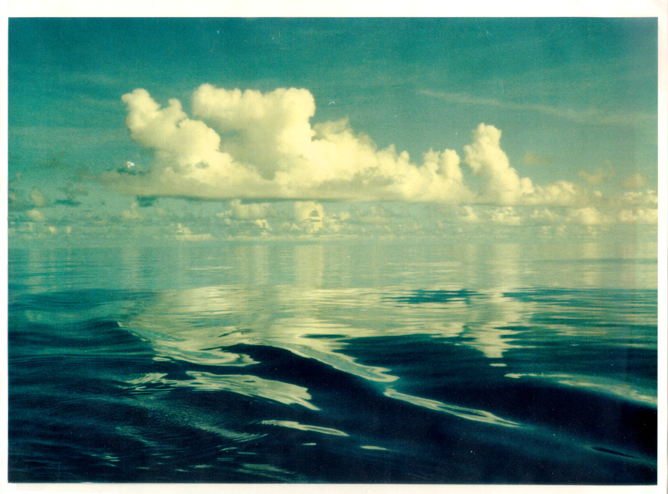
Diurnal Cycle, Mesoscale Circulations in the ABL, and the MJO
Richard H. Johnson
Colorado State University
& Paul Ciesielski, Jennifer Cotturone, Andy Newman, Brian McNoldy
West Pacific Warm Pool, early Dec 1992 (Xin Lin)

Slide 2
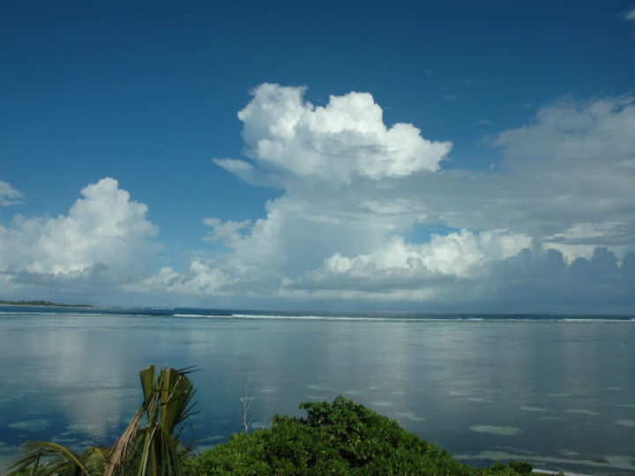
Normalized Amplitude, Mean Diurnal Cycle of Annual Rainfall (1998-2007)
Nocturnal maxima generally over oceans, along coastlines
Afternoon/evening maxima over land…but also interior ocean basins and other offshore areas
TRMM 3B42v6
[Evening (12-23 LT) minus Morning (00-11 LT) Rain]
÷
[Annual Mean Rainfall]
(excluding areas with < 100 mm rainfall per year)

Slide 3
Over the majority of the tropical open ocean areas, precipitation is nocturnal
An important exception: light-wind conditions over tropical oceans where a shallow diurnal warm layer develops in the upper ocean
Example: western Pacific during the inactive phase of the MJO, as seen during 1992-93 TOGA COARE; also the Indian Ocean during MISMO 2006 and VASCO-CIRENE 2007
Diurnal Cycle over Open Ocean

Slide 4
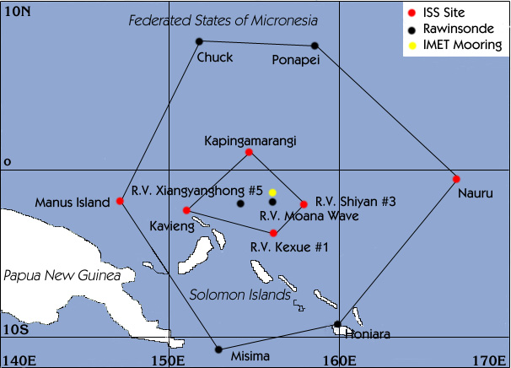
TOGA COARE
Nov 92 – Feb 93
OSA
IFA

Slide 5
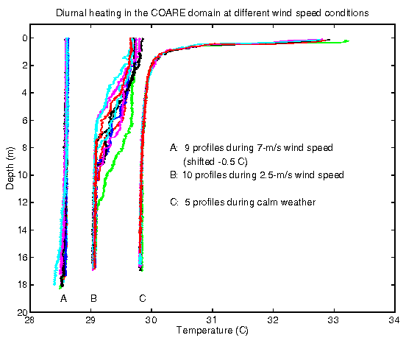
Diurnal Warm Layer
Soloviev and Lukas (1997)

Slide 6
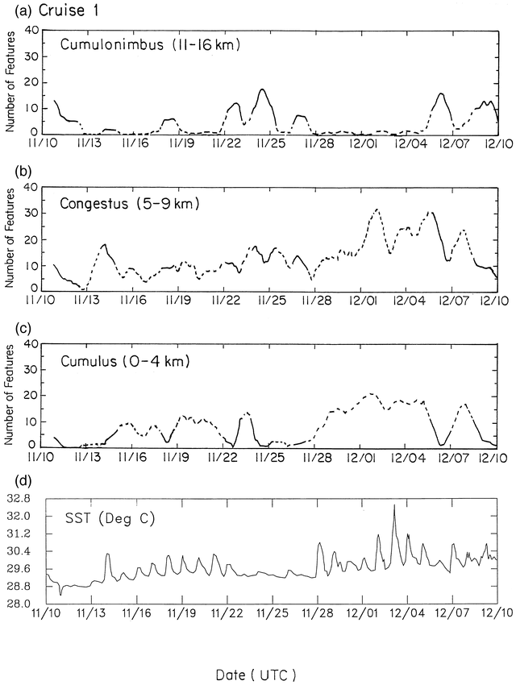
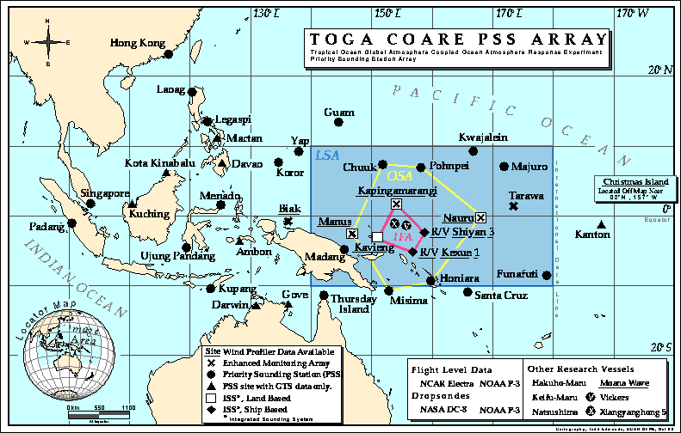
Inactive, light-wind phase of MJO
MIT Radar
NOVEMBER-DECEMBER 1992
Gradual increase in precipitating cumulus and congestus cloud populations
SST exhibits strong diurnal signal
Afternoon maximum in shallow cu and cg on these days
SST increasing
(Johnson et al. 1999)

Slide 7
(Duvel et al. 2008)
SST PERTURBATION RELATED TO ISO
Seychelles-Chagos Thermocline Ridge

Slide 8
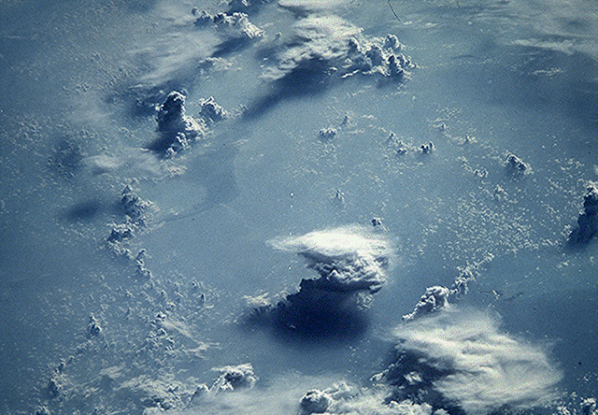
Mesoscale circulations (open cells)
152°E
154°E
156°E
2°N
2°N
“Benard cells”
~ 30 km scale
EQ
EQ
★
2°S
2°S
R/V Vickers
Mesoscale circulations promote isolated cumulus and showers
3 December 1992 – Light-wind day

Slide 9
11-hour MIT Radar Loop 7am-6pm
3 December 1992
100 km
50 km

Slide 10
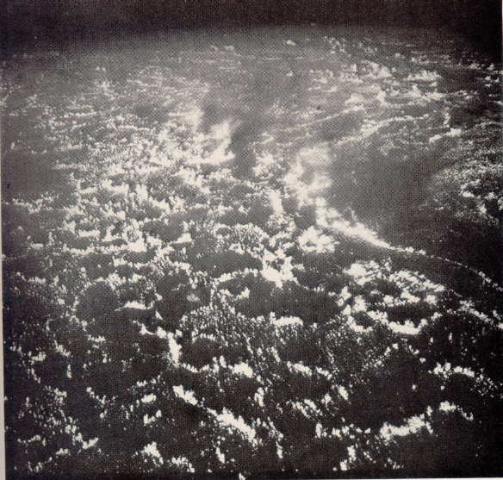
20 July 1966
Tropical Pacific Gemini 10
Agee (1982)

Slide 11
TOGA COARE
OSA
IFA

Slide 12
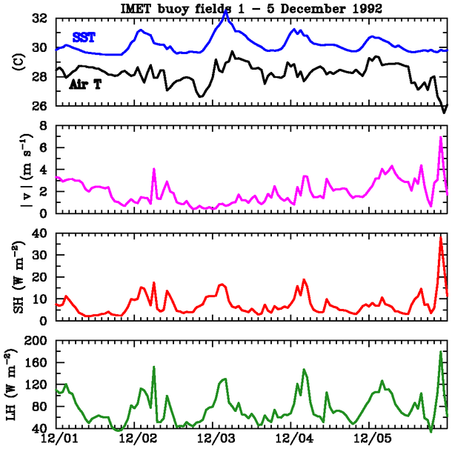
Large amplitude diurnal cycle – SST, sensible and latent heat fluxes – on light wind days
NOON
WIND SPEED
SENSIBLE HEAT FLUX
Fairall et al. (1996) bulk flux algorithm, includes low-wind gustiness
LATENT HEAT FLUX

Slide 13
Mesoscale circulations (open cells)
152°E
154°E
156°E
2°N
2°N
“Benard cells”
~ 30 km scale
EQ
EQ
2°S
2°S
R/V Shiyan 3
3 December 1992 – Light-wind day

Slide 14
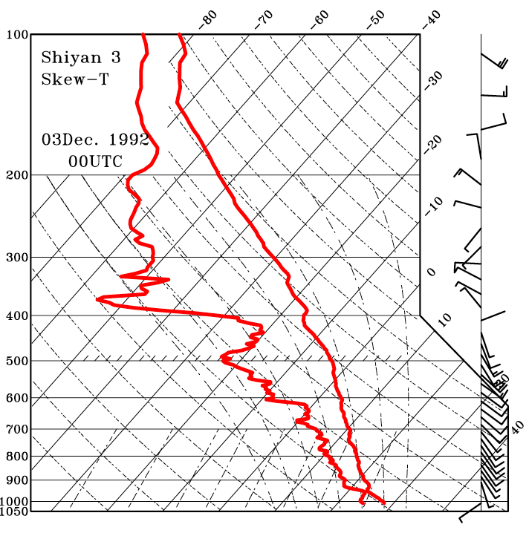
Late morning (1000 L)

Slide 15
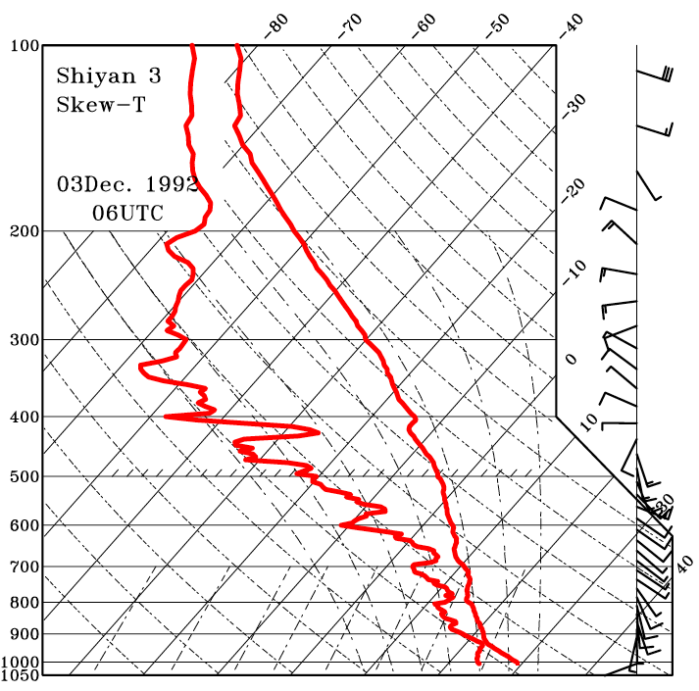
Afternoon (1600 L)

Slide 16
Slight afternoon moistening
Afternoon warmer, deeper mixed layer

Slide 17
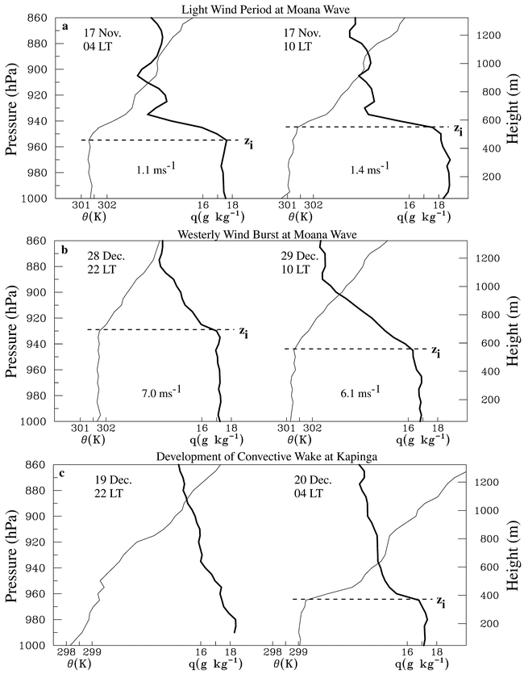
Mixed layers identified using θ and q profiles

Slide 18
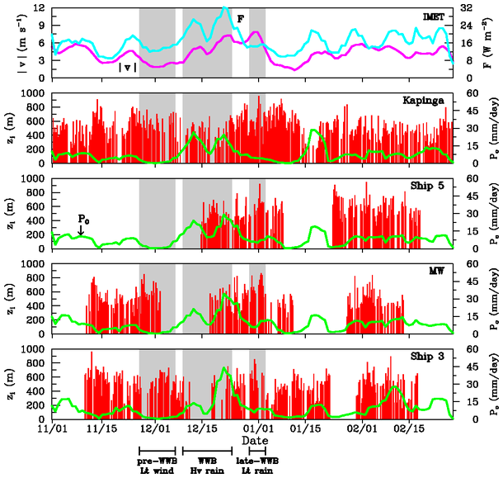
Mixed layer during TOGA COARE shallowest during heavy rain periods, deepest during and just after WWB
ML depth varies on MJO to diurnal time scale
Johnson et al. (2001)

Slide 19
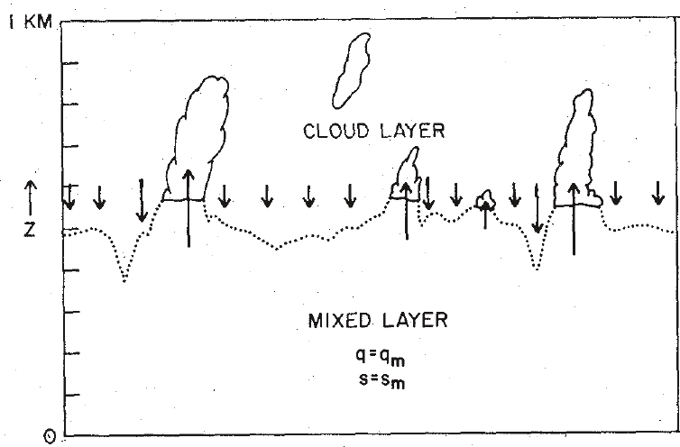
Cumulus cloud base is at mixed layer top; subsidence between cumulus suppresses the mixed layer
(Deardorff 1975)

Slide 20
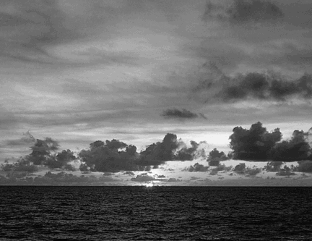
What causes deep ML during WWB?
low-level drying
WWB
EQ
Strong drying above PBL, large separation between LCL and z_{i}
q
WWB
Reduction in shallow cloud population
wind speed
increase in z_{i} & eventual recovery of shallow cumulus
subsequent remoistening

Slide 21
Kapingamarangi observations over four months
Light wind, lower-tropospheric moistening
No apparent systematic change in LCL, z_{i}
Pre-WWB: 27 Nov – 7 Dec

Slide 22
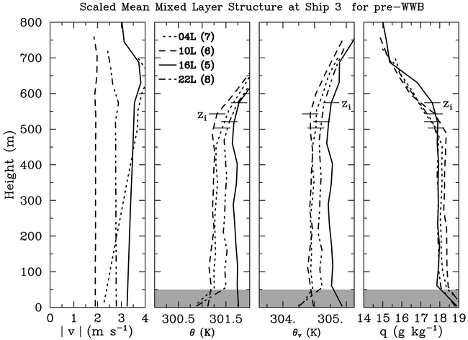
Diurnal Variation in ML during pre-WWB (27 Nov – 7 Dec)
AFTERNOON MOISTENING
Afternoon mixed layer is warmest, deepest, driest
Moistening above ML in afternoon
AFTERNOON DRYING

Slide 23
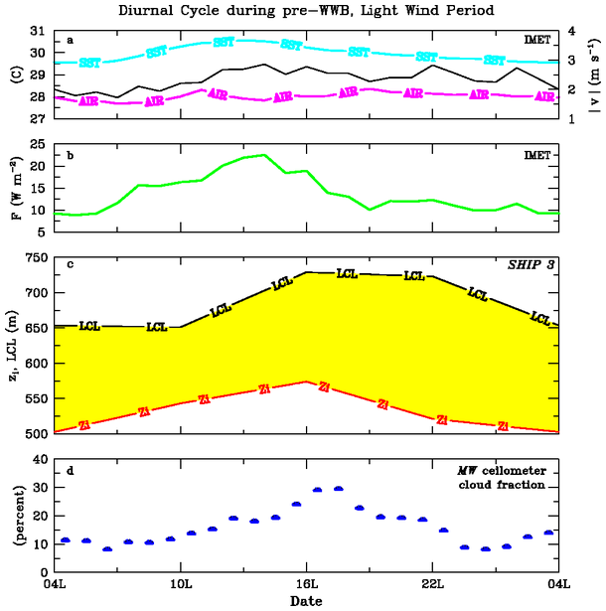
SST peak near noon, buoyancy flux peak early afternoon
As LCL – z_{i} decreases, cloud fraction (CF) increases, peaking in late afternoon (more ML eddies reach LCL)
Dry air entrainment into ML decreases CF during evening
Weak secondary CF peak in early morning
SST
|v|
AIR T
SURFACE BUOYANCY FLUX
NOON
LCL
MIXED LAYER DEPTH
CLOUD FRACTION

Slide 24
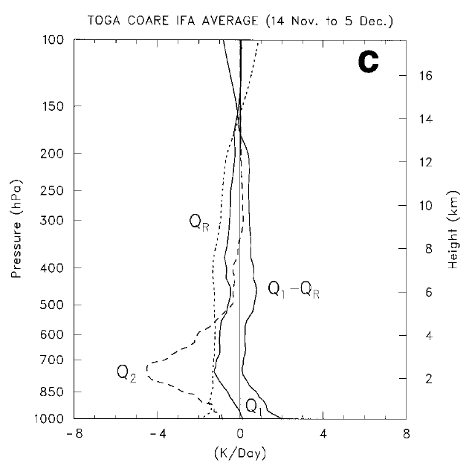
Moistening by shallow cumulus
(Johnson and Lin 1997)

Slide 25
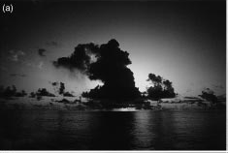
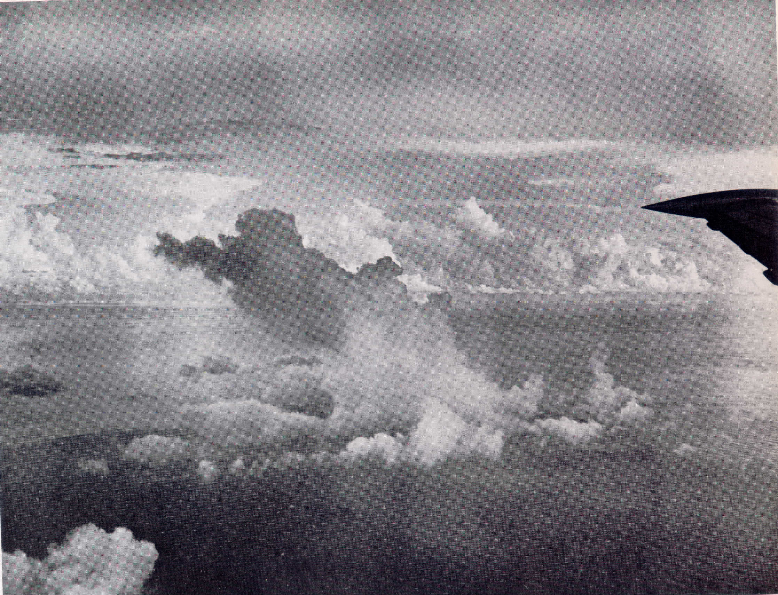
Moistening can occur if many of the clouds are nonprecipitating
TOGA COARE 29 or 30 Nov 1992
Photo by C. DeMott
Western Pacific 1957
Photo by J. Simpson

Slide 26
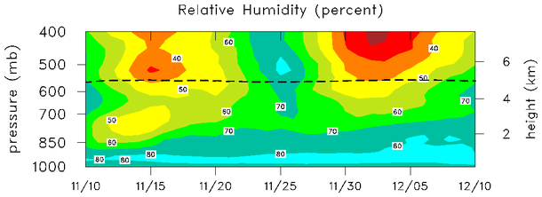
MIT radar
Increasing populations of congestus and cumulus clouds…
moisten the lower troposphere…
preconditioning it for deep convection
increasing SST
Nov 10
Dec 10
(e.g., “discharge-recharge” theory of MJO: Bladé and Hartmann 1993)
Diurnal cycle is important part of this process and enhancement of cloud growth by mesoscale circulations
0°C

Slide 27
Open Cells
~ 30 km
Mesoscale circulations lead to localized areas of enhanced boundary layer moistening, deeper cloud growth than would otherwise occur

Slide 28
Summary and Conclusions
Mixed layer during TOGA COARE varies on multiple time scales – MJO to diurnal (to convective)
Strong coupling between mixed layer and convective cloud populations during COARE
During light-wind conditions, a shallow diurnal warm layer develops in the upper ocean
Afternoon maximum in shallow cumulus in light-wind conditions: contributes to deepening of moist layer, clouds organized into open cells (light winds)
Mesoscale circulations: contribute to enhanced localized lifting and further moistening aloft

Slide 29
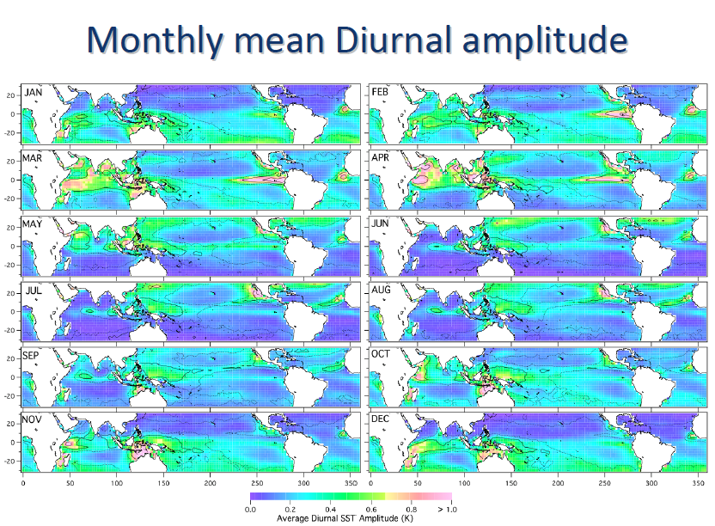
(Duvel et al. 2008)
OGCM forced with ERA40

Slide 30
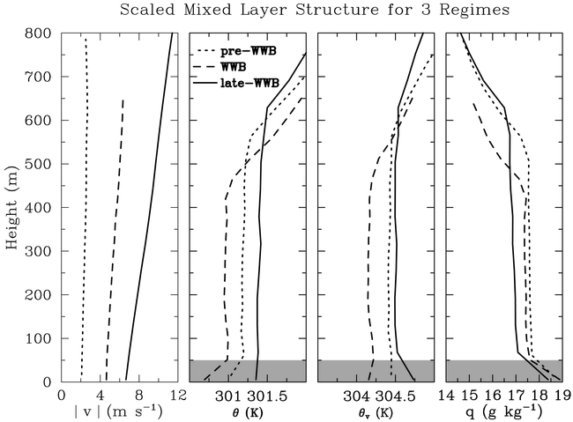
Pre-WWB: intermediate ML depth, highest q
WWB/heavy rain: shallowest ML depth, intermediate q
Late-WWB: deepest , driest ML
-Hvy Rain

