Slide 1
Four mini-talks on ground-state DFT
Kieron Burke
UC Irvine Chemistry and Physics
General ground-state DFT
Semiclassical approach
Potential functional approximations
PERSISTENCE OF CHEMISTRY IN THE LIMIT OF LARGE ATOMIC NUMBER
http://dft.uci.edu

Slide 2
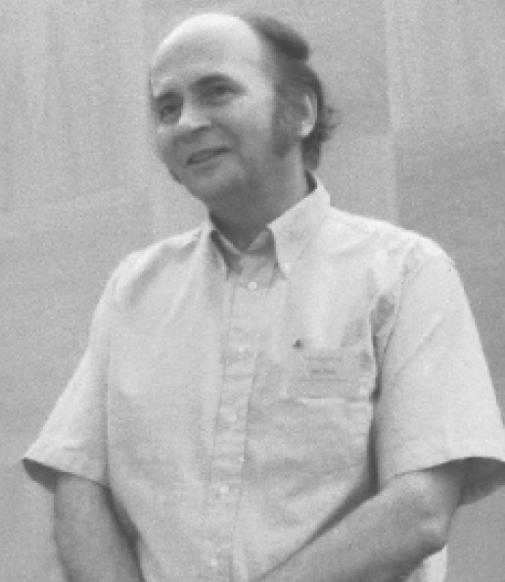
General ground-state DFT
Kieron Burke & John Perdew

Slide 3
John Intro I
KOHN-SHAM THEORY FOR THE GROUND STATE ENERGY E AND SPIN DENSITIES
OF A MANY-ELECTRON SYSTEM.
THE MOST WIDELY-USED METHOD OF ELECTRONIC STRUCTURE CALCULATION IN QUANTUM CHEMISTRY, CONDENSED MATTER PHYSICS, & MATERIALS ENGINEERING.
NOT AS POTENTIALLY ACCURATE AS MANY-ELECTRON WAVEFUNCTION METHODS, BUT COMPUTATIONALLY MORE EFFICIENT, ESPECIALLY FOR SYSTEMS WITH VERY MANY ELECTRONS.

Slide 4
John Intro 2
MANY-ELECTRON HAMILTONIAN
GROUND-STATE WAVEFUNCTION
GROUND-STATE SPIN DENSITIES (σ=↑ OR ↓)
SPIN DENSITY FUNCTIONAL FOR G. S. ENERGY
KINETIC ENERGY FOR NON-INTERACTING ELECTRONS WITH G. S.
SPIN DENSITIES
EXCHANGE-CORRELATION ENERGY

Slide 5
John Intro 3
KOHN-SHAM METHOD: INTRODUCE ORBITALS
FOR THE NON-INTERACTING SYSTEM
THE EULER EQUATION TO MINIMIZE AT FIXED N IS THE KOHN-SHAM SELF-CONSISTENT ONE-ELECTRON EQUATION
OCCUPIED ORBITALS HAVE
(AUFBAU PRINCIPLE)

Slide 6
John Intro 4
LOCAL AND SEMI-LOCAL APPROX.` FOR
LOCAL SPIN DENSITY APPROXIMATION (LSDA)
XC ENERGY PER PARTICLE OF AN ELECTRON GAS OF UNIFORM
GENERALIZED GRADIENT APPROX. (GGA)
GIVES A BETTER DESCRIPTION OF STRONGLY INHOMOGENOUS SYSTEMS (E.G., ATOMS & MOLECULES)
PERDEW-BURKE-ERNZERHOF 1996 (PBE) GGA:
CONSTRUCTED NON-EMPIRICALLY TO SATISFY EXACT CONSTRAINTS.

Slide 7
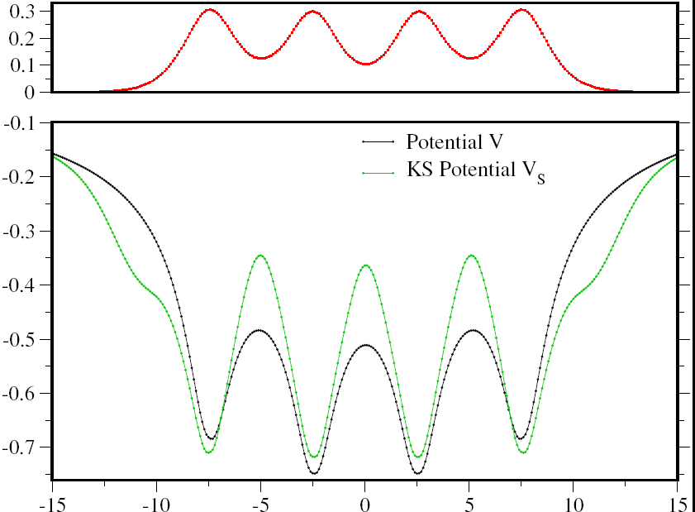
First ever KS calculation with exact E_{XC}[n]
Used DMRG (density-matrix renormalization group)
1d H atom chain
Miles Stoudenmire, Lucas Wagner, Steve White

Slide 8
Some important challenges in ground-state DFT
Systematic, derivable approximations to E_{XC}[n]
Deal with strong correlation (Scuseria, Prodan, Romaniello)
Systematic, derivable, reliable, accurate, approximations to T_{S}[n]

Slide 9
Functional approximations
Original approximation to E_{XC}[n] : Local density approximation (LDA)
Nowadays, a zillion different approaches to constructing improved approximations
Culture wars between purists (non-empirical) and pragmatists.
This is NOT OK.

Slide 10
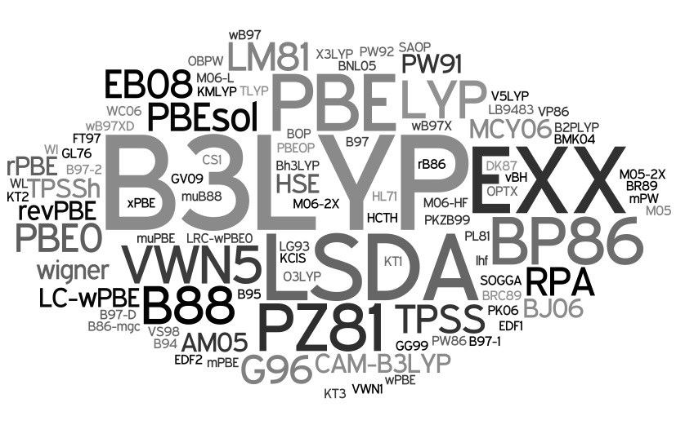
Too many functionals
Peter Elliott

Slide 11
Things users despise about DFT
No simple rule for reliability
No systematic route to improvement
If your property turns out to be inaccurate, must wait several decades for solution
Complete disconnect from other methods
Full of arcane insider jargon
Too many functionals to choose from
Can only be learned from another DFT guru

Slide 12
Things developers love about DFT
No simple rule for reliability
No systematic route to improvement
If a property turns out to be inaccurate, can take several decades for solution
Wonderful disconnect from other methods
Lots of lovely arcane insider jargon
So many functionals to choose from
Must be learned from another DFT guru

Slide 13

Modern DFT development
It must have sharp steps for stretched bonds
It’s tail must decay like -1/r
It keeps H₂ in singlet state as R→∞

Slide 14
Semiclassical underpinnings of density functional approximations
Peter Elliott, Donghyung Lee, Attila Cangi
UC Irvine, Chemistry and Physics

Slide 15
Difference between T_{s} and E_{xc}
Pure DFT in principle gives E directly from n
  Original TF theory of this type
  Need to approximate T_{S} very accurately
  Thomas-Fermi theory of this type
  Modern orbital-free DFT quest.
  Misses quantum oscillations such as atomic shell structure
KS theory uses orbitals, not pure DFT
  Made things much more accurate
  Much better density with shell structure in there.
  Only need approximate E_{XC}[n].

Slide 16
The big picture
We show local approximations are leading terms in a semiclassical approximation
This is an asymptotic expansion, not a power series
Leading corrections are usually NOT those of the gradient expansion for slowly-varying gases
Ultimate aim: Eliminate empiricism and derive density functionals as expansion in ħ.

Slide 17
More detailed picture
Turning points produce quantum oscillations
  Shell structure of atoms
  Friedel oscillations
  There are also evanescent regions
Each feature produces a contribution to the energy, larger than that of gradient corrections
For a slowly-varying density with Fermi level above potential everywhere, there are no such corrections, so gradient expansion is the right asymptotic expansion.
For everything else, need GGA’s, hybrids, meta-GGA’s, hyper GGA’s, non-local vdW,…

Slide 18
What we might get
We study both T_{S} and E_{XC}
For T_{S}:
  Would give orbital-free theory (but not using n)
  Can study atoms to start with
  Can slowly start (1d, box boundaries) and work outwards
For E_{XC}:
  Improved, derived functionals
  Integration with other methods

Slide 19
A major ultimate aim: E_{XC}[n]
Explains why gradient expansion needed to be generalized (Relevance of the slowly-varying electron gas to atoms, molecules, and solids J. P. Perdew, L. A. Constantin, E. Sagvolden, and K. Burke, Phys. Rev. Lett. 97, 223002 (2006).)
Derivation of β parameter in B88 (Non-empirical 'derivation' of B88 exchange functional P. Elliott and K. Burke, Can. J. Chem. 87, 1485 (2009).).
PBEsol Restoring the density-gradient expansion for exchange in solids and surfaces J.P. Perdew, A. Ruzsinszky, G.I. Csonka, O.A. Vydrov, G.E. Scuseria, L.A. Constantin, X. Zhou, and K. Burke, Phys. Rev. Lett. 100, 136406 (2008))
  explains failure of PBE for lattice constants and fixes it at cost of good thermochemistry
  Gets Au⁻ clusters right

Slide 20
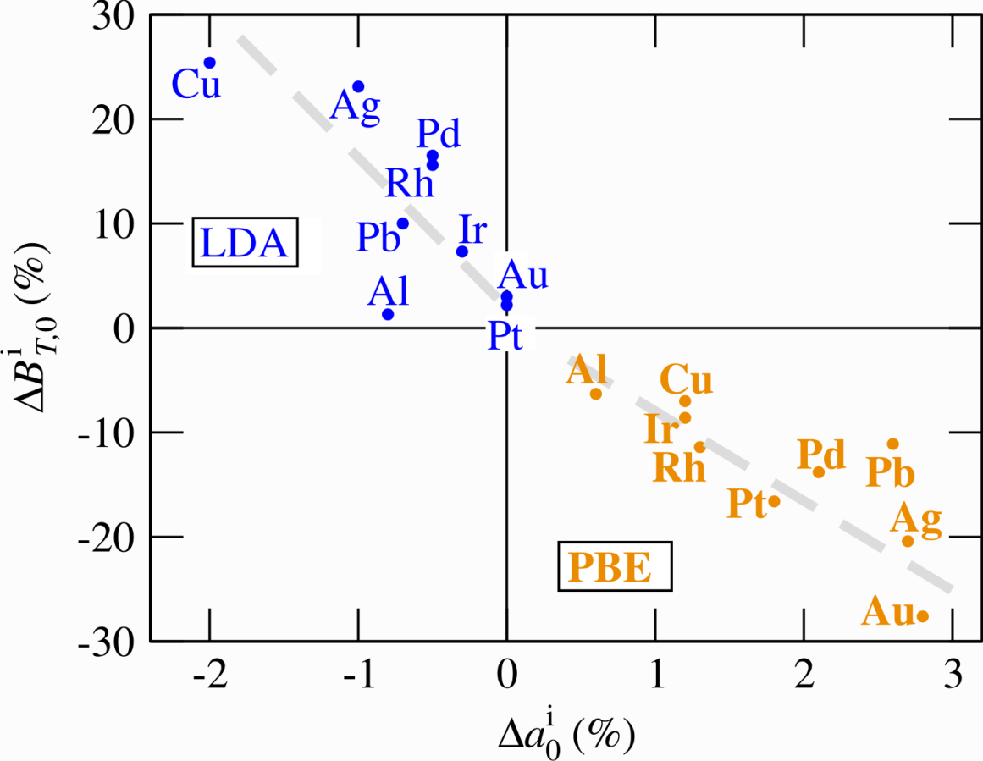
Improvements of PBEsol
Structural and Elastic Properties
Errors in LDA/GGA(PBE)-DFT computed lattice constants and
bulk modulus with respect to experiment
→ Fully converged results
(basis set, k-sampling,
supercell size)
→ Error solely due to
xc-functional
→ GGA does not outperform
LDA
→ characteristic errors of
<3% in lat. const.
< 30% in elastic const.
→ LDA and GGA provide
bounds to exp. data
→ provide “ab initio
error bars”
Blazej Grabowski, Dusseldorf
Inspection of several xc-functionals is critical to estimate
predictive power and error bars!

Slide 21
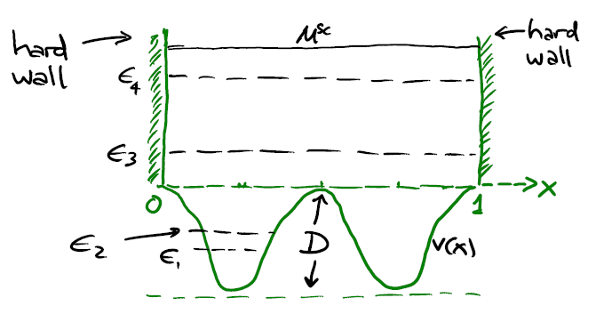
Test system for 1d T_{s}
v(x)=-D sin^{p}(mπx)

Slide 22
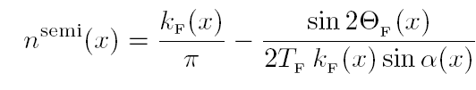






Semiclassical density for 1d box
TF
Classical momentum:
Classical phase:
Fermi energy:
Classical transit time:
Elliott, Cangi, Lee, KB, PRL 2008

Slide 23
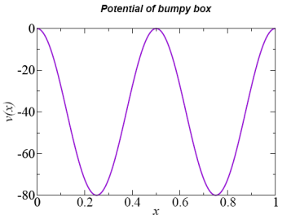
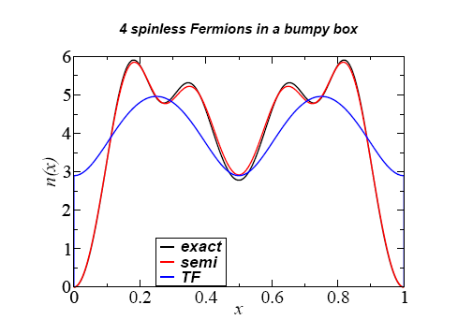
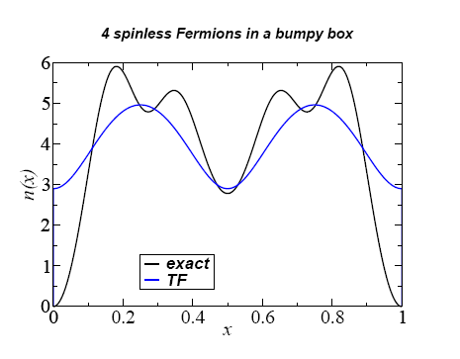
Density in bumpy box
Exact density:
  T^{TF}[n]=153.0
Thomas-Fermi density:
  T^{TF}[n^{TF}]=115
Semiclassical density:
  T^{TF}[n^{semi}]=151.4
  ΔN < 0.2%

Slide 24
A new continuum
Consider some simple problem, e.g., harmonic oscillator.
Find ground-state for one particle in well.
Add a second particle in first excited state, but divide ħ by 2, and resulting density by 2.
Add another in next state, and divide ħ by 3, and density by 3
…
→∞

Slide 25

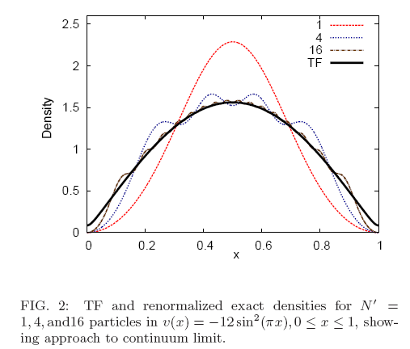

Continuum limit
Leading corrections to local approximations Attila Cangi, Donghyung Lee, Peter Elliott, and Kieron Burke, Phys. Rev. B 81, 235128 (2010).
Attila Cangi

Slide 26
Getting to real systems
Include real turning points and evanescent regions, using Langer uniformization
Consider spherical systems with Coulombic potentials (Langer modification)
Develop methodology to numerically calculate corrections for arbitrary 3d arrangements

Slide 27
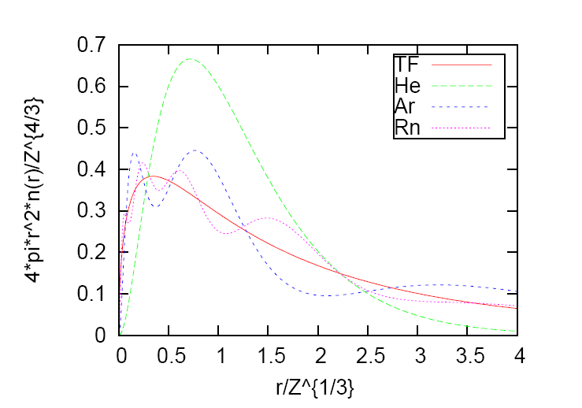
Classical limit for neutral atoms
For interacting systems in 3d, increasing Z in an atom, keeping it neutral, approaches the classical continuum, ie same as ħ→0 (Lieb 81)

Slide 28
Non-empirical derivation of density- and potential- functional approximations
Attila Cangi
UC Irvine Physics and Chemistry
&
Peter Elliott, Hunter College, NY
Donghyung Lee, Rice, Texas
E.K.U. Gross, MPI Halle
http://dft.uci.edu

Slide 29

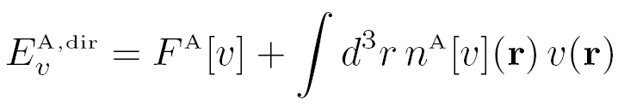
New results in PFT
Universal functional of v(r):
Direct evaluation of energy:

Slide 30

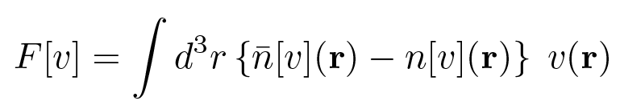
Coupling constant:
New expression for F:

Slide 31
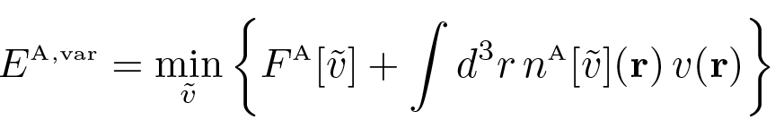


Variational principle
Necessary and sufficient condition for same result:

Slide 32

All you need is n[v](r)
Any approximation for the density as a functional of v(r) produces immediate self-consistent KS potential and density

Slide 33



Evaluating the energy
With a pair T_{s}^{A}[v] and n_{s}^{A}[v](r), can get E two ways:
Both yield same answer if

Slide 34



Coupling constant formula for energy
Choose any reference (e.g., v₀(r)=0) and write
Do usual Pauli trick
Yields T_{s}[v] directly from n[v]:

Slide 35
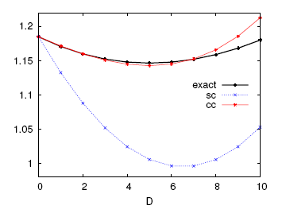
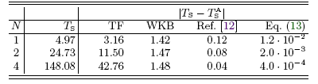
Accuracy and minimization
For box problems, v(x)=-D sin²πx, D=5
Use wavefunctions at different D to calculate E[v]
CC results much more accurate
CC has minimum at given potential

Slide 36
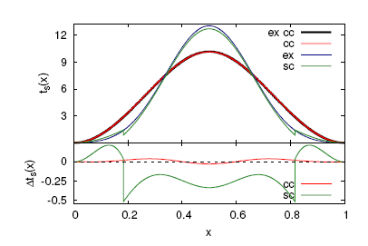
Different kinetic energy density
CC formula gives DIFFERENT kinetic energy density (from any usual definitions)
But approximation much more accurate globally and point-wise than with direct approximation

Slide 37
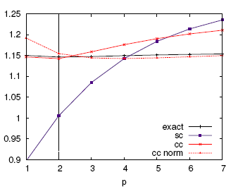
Not perfect
Now make variations in p:
V(x)=-D sin^{p} πx
Still CC much more accurate
Minimum not quite correct
Generally, need to satisfy symmetry:
δn_{s}(r)/δv(r’)=δn_{s}(r’)/δv(r)

Slide 38

PERSISTENCE OF CHEMISTRY IN THE LIMIT OF LARGE ATOMIC NUMBER
JOHN P. PERDEW
PHYSICS
TULANE UNIVERSITY
NEW ORLEANS
CO-AUTHORS FROM U. C. IRVINE:
LUCIAN A. CONSTANTIN
JOHN C. SNYDER
KIERON BURKE

Slide 39
John B1
THE PERIODIC TABLE OF THE ELEMENTS SHOWS A QUASI-PERIODIC VARIATION OF CHEMICAL PROPERTIES WITH ATOMIC NUMBER Z. THE IONIZATION ENERGY I=E₊₁ – E₀ OF AN ATOM INCREASES ACROSS EACH ROW OR PERIOD, AS A SHELL IS FILLED, BUT DECREASES DOWN A COLUMN, AS THE ATOMIC NUMBER INCREASES AT FIXED ELECTRON CONFIGURATION.
THE VALENCE-ELECTRON RADIUS DECREASES ACROSS A PERIOD, BUT INCREASES DOWN A COLUMN.

Slide 40
John B2
DO THESE TRENDS PERSIST IN THE NON-RELATIVISTIC LIMIT OF LARGE ATOMIC NUMBER Z→∞?
EXPERIMENT CANNOT ANSWER THIS QUESTION, BUT KOHN-SHAM THEORY CAN!
WHAT IS KNOWN SO FAR ABOUT THE NON-RELATIVISTIC Z→∞ LIMIT?
TOTAL ENERGY E = -AZ^{7/3} +BZ² +CZ^{5/3}+…
THE SIMPLE THOMAS-FERMI APPROX. (LSDA FOR T_{S}, & NEGLECT OF E_{XC}) GIVES THE CORRECT E = -AZ^{7/3} LEADING TERM.

Slide 41
John B3
THE Z→∞ LIMIT OF I IS
THOMAS-FERMI APPROX. I^{TF} = 1.3 eV
EXTENDED TF APPROX. . I^{ETF} = 3.2 eV
(TFSWD)
PROVEN TO BE FINITE IN HF THEORY (Solovej)
THE Z→∞ LIMIT OF THE VALENCE-ELECTRON RADIUS IS
5Å
THESE RESULTS SHOW NO PERSISTENCE OF CHEMICAL PERIODICITY.
BUT ARE THEY CORRECT?
ONLY KOHN-SHAM THEORY CAN ACCOUNT FOR SHELL STRUCTURE.

Slide 42
John B4
WE HAVE PERFORMED KOHN-SHAM CALCULATIONS (LSDA, PBE-GGA, AND EXACT EXCHANGE OEP) FOR ATOMS WITH UP TO 3,000 ELECTRONS, FROM THE MAIN OR sp BLOCK OF THE PERIODIC TABLE.
WE TOOK THE ELECTRON SHELL-FILLING FROM MADELUNG`S RULE:
SUBSHELLS nl FILL IN ORDER OF INCREASING n+l, AND, FOR FIXED n+l, IN ORDER OF INCREASING n.

Slide 43
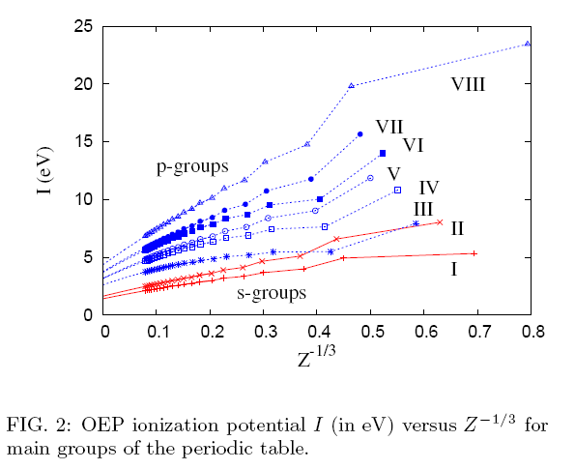
Ionization as Z→∞

Slide 44
John B5
WE SOLVED THE KOHN-SHAM EQUATIONS ON A RADIAL GRID, USING A SPHERICALLY-AVERAGED KOHN-SHAM POTENTIAL. FOR EACH COLUMN, WE PLOTTED I vs. Z^{-1/3} FOR Z^{-1/3} > 0.07, AND FOUND A NEARLY-LINEAR BEHAVIOR FOR
0.07 < Z^{-1/3} < 0.2
Z=3000
Z=125
THEN WE EXTRAPOLATED QUADRATICALLY TO Z^{-1/3} =0 OR Z = ∞.

Slide 45
John Tab 1
LIMITING Z→∞ IONIZATION ENERGIES
 |  | (eV)
 | GROUP OR COLUMN | LSDA | GGA (PBE)
ns | I | 1.9 | 1.8
 | II | 2.4 | 2.3
np | III | 3.3 | 3.1
 | IV | 3.8 | 3.7
 | V | 4.2 | 4.2
 | VI | 4.3 | 4.1
 | VII | 4.7 | 4.6
 | VIII | 5.2 | 5.1
AS Z→∞ DOWN A COLUMN, I DECREASES TO A COLUMN-DEPENDENT LIMIT, WHICH INCREASES ACROSS A PERIOD.
THE PERIODIC TABLE BECOMES PERFECTLY PERIODIC.

Slide 46
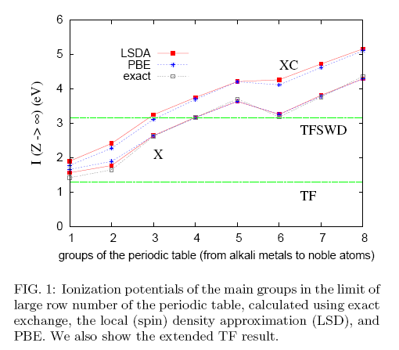
Z→∞ limit of ionization potential
Shows even energy differences can be found
Looks like LDA exact for E_{X} as Z→∞.
Looks like finite E_{C} corrections
Looks like extended TF (treated as a potential functional) gives some sort of average.
Lucian Constantin, John Snyder, JP Perdew, and KB, JCP 2010

Slide 47

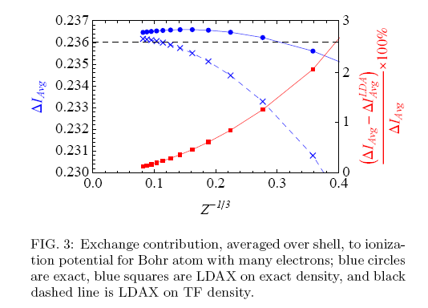
Exactness for Z→∞ for Bohr atom
Using hydrogenic orbitals to improve DFT
John C Snyder

Slide 48
John B6
THE AVERAGE OF I OVER COLUMNS, IN THE Z→∞ LIMIT, IS CLOSE TO THE EXTENDED TF LIMIT OF 3.2 eV.
RADIAL IONIZATION DENSITY
WE EXTRAPOLATED THIS VERY CAREFULLY, THEN COMPUTED THE LIMITING VALENCE-ELECTRON RADIUS

Slide 49
John Tab 2
 |  | bohr
 | GROUP OR COLUMN |  | GGA (PBE)
ns | I | 14.1
 | II | 13.6
np | III | 10.2
 | IV | 9.8
 | V | 9.5
 | VI | 9.4
 | VII | 9.1
 | VIII | 8.8
THE VALENCE-ELECTRON RADIUS INCREASES DOWN A COLUMN TO A COLUMN-DEPENDENT LIMIT THAT DECREASES ACROSS A PERIOD. THE AVERAGE OF OVER COLUMNS IS CLOSE TO THE TF LIMITING VALUE OF 9 bohr.

Slide 50
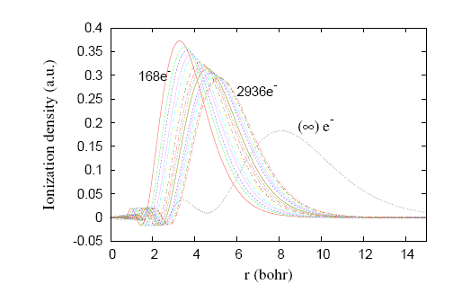
Ionization density as Z→∞

Slide 51
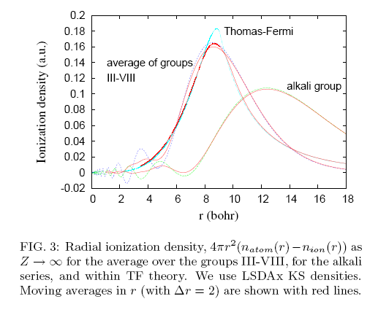
Ionization density as Z→∞

Slide 52
John Conc
CONCLUSIONS
THE OBSERVED CHEMICAL TRENDS OF THE KNOWN PERIODIC TABLE SATURATE IN THE NON-RELATIVISTIC Z→∞ LIMIT, IN WHICH THE PERIODIC TABLE BECOMES PERFECTLY PERIODIC.
THE Z→∞ ATOMS HAVE LARGE VALENCE-ELECTRON RADII AND SMALL IONIZATION ENERGIES, SUGGESTING A LIMITING CHEMISTRY OF LONG WEAK BONDS.

Slide 53
John Conc 2
THE AVERAGES OF AND OVER COLUMNS ARE DESCRIBED RATHER WELL BY TF AND ETF.
LSDA AND GGA AGREE CLOSELY IN THE Z→∞ LIMIT.
AT THE EXCHANGE-ONLY (NO CORRELATION) LEVEL, LSDA AND GGA BECOME EXACT OR NEARLY EXACT FOR I AS Z→∞ .
(MORE NEARLY SO FOR THE np THAN FOR THE ns SUBSHELLS).

Slide 54
John future
FUTURE WORK
WE WILL CHECK IF THE MADELUNG`S-RULE CONFIGURATIONS SATISFY THE AUFBAU PRINCIPLE FOR LARGE Z.
WE WILL CALCULATE THE LIMITING Z→∞ ELECTRON AFFINITIES.
OUR CONCLUSIONS ARE BASED UPON NUMERICAL CALCULATION AND EXTRAPOLATION. CAN THEY BE PROVED RIGOROUSLY?

Slide 55
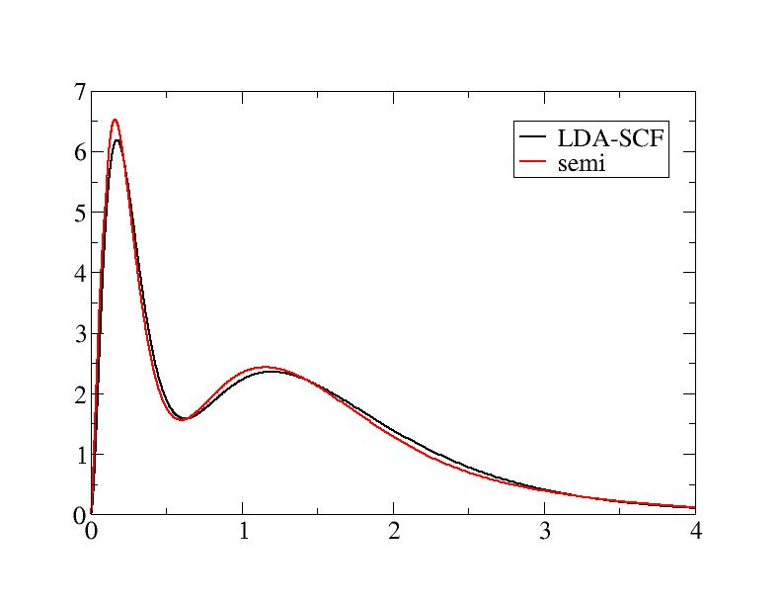
Orbital-free potential-functional for C density (Dongyung Lee)
4πr²ρ(r)
I(LSD)=11.67eV
PFT:ΔI=0.24eV
I(expt)=11.26eV
r

Slide 56
Simple math challenges
Why do you study variational properties of approximate functionals?
Give us mathematical rigor for PFT
Prove results for large Z ionization potentials
Help us with asymptotic expansions
Thanks to students and NSF

