Slide 1
Advanced TDDFT
Kieron Burke and friends
UC Irvine Chemistry and Physics
http://dft.uci.edu

Slide 2
Challenges in TDDFT
Rydberg and continuum states
Polarizabilities of long-chain molecules
Optical response/gap of solid
Double excitations
Long-range charge transfer
Conical Intersections
Quantum control phenomena
Other strong-field phenomena ?
Coulomb blockade in transport
Coupled electron-ion dynamics

Slide 3
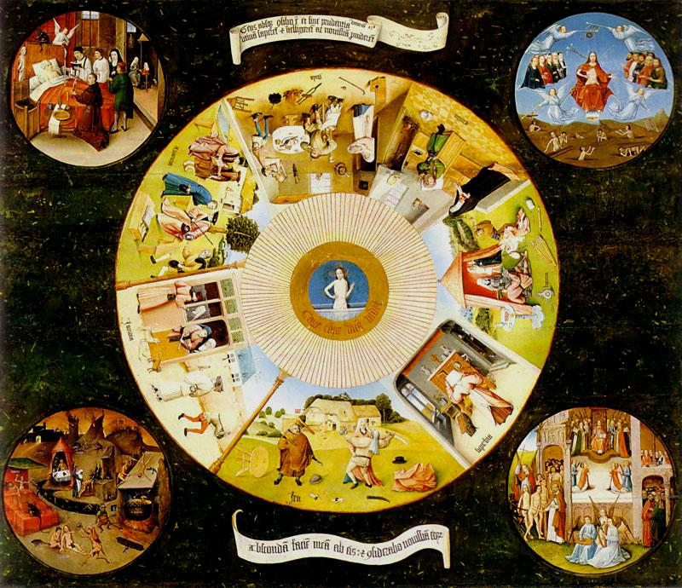
Hieronymus Bosch: The Seven Deadly Sins and the Four Last Things (1485, oil on panel)
K. Burke, J. Werschnik, and E.K.U.Gross, J.Chem.Phys. 123, 062206 (2005).

Slide 4
Sin of the ground state
Hieronymus Bosch: The Seven Deadly Sins and the Four Last Things (1485, oil on panel)
K. Burke, J. Werschnik, and E.K.U.Gross, J.Chem.Phys. 123, 062206 (2005).

Slide 5
Sin of the ground state
Sin of locality
Hieronymus Bosch: The Seven Deadly Sins and the Four Last Things (1485, oil on panel)
K. Burke, J. Werschnik, and E.K.U.Gross, J.Chem.Phys. 123, 062206 (2005).

Slide 6
Sin of the ground state
Sin of locality
Hieronymus Bosch: The Seven Deadly Sins and the Four Last Things (1485, oil on panel)
K. Burke, J. Werschnik, and E.K.U.Gross, J.Chem.Phys. 123, 062206 (2005).
Sin of forgetfulness

Slide 7
Sin of the ground state
Sin of locality
Hieronymus Bosch: The Seven Deadly Sins and the Four Last Things (1485, oil on panel)
K. Burke, J. Werschnik, and E.K.U.Gross, J.Chem.Phys. 123, 062206 (2005).
Sin of forgetfulness
Sin of Ψ

Slide 8
G: Sin of the ground state
L: Sin of locality
TDDFT’s 4 deadly sins
Hieronymus Bosch: The Seven Deadly Sins and the Four Last Things (1485, oil on panel)
K. Burke, J. Werschnik, and E.K.U.Gross, J.Chem.Phys. 123, 062206 (2005).
F: Sin of forgetfulness
O: Sin of Ψ

Slide 9
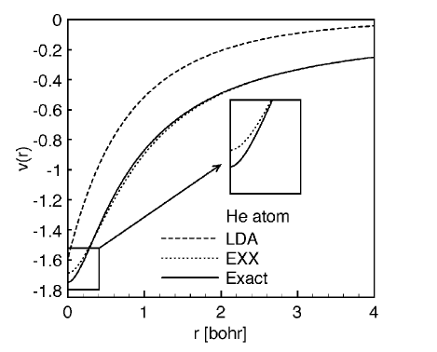
Sin of the ground state
Errors in a ground-state calculation, especially the potential, cause errors in the positions of the KS orbital energies

Slide 10
Rydberg states
Can show poor potentials from the ground-state produce oscillator strength, but in continuum
Quantum defect is determined by interior of atom, so can calculate even with ALDA
Accurate Rydberg Excitations from Local Density Approximation A. Wasserman, N.T. Maitra, and K. Burke, Phys. Rev. Lett. 91, 263001 (2003); Rydberg transition frequencies from the Local Density Approximation A. Wasserman and K. Burke, Phys. Rev. Lett. 95, 163006 (2005)

Slide 11
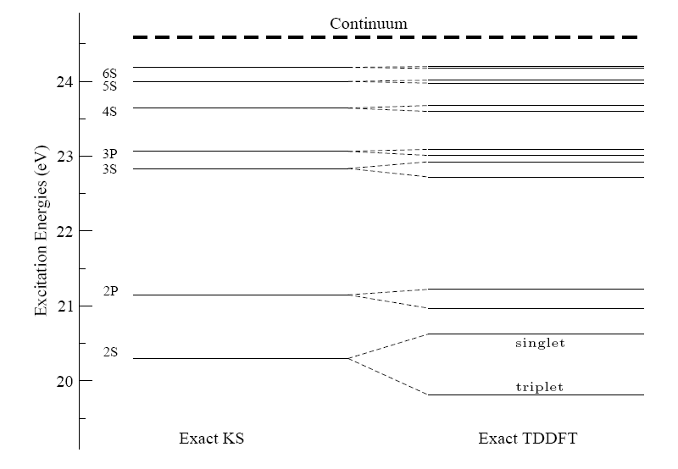
How good the KS response is

Slide 12
Quantum defect of Rydberg series
I=ionization potential, n=principal, l=angular quantum no.s
Due to long-ranged Coulomb potential
Effective one-electron potential decays as -1/r.
Absurdly precise test of excitation theory, and very difficult to get right.

Slide 13
Be s quantum defect: expt
Top: triplet, bottom: singlet

Slide 14
Be s quantum defect: KS

Slide 15
Be s quantum defect: RPA
KS=triplet
f_{H}
RPA

Slide 16
Be s quantum defect: ALDAX

Slide 17
Be s quantum defect: ALDA

Slide 18
Continuum states
Put entire system in box
Find excitation energies as function of box size.
Extract phase shifts
Time-dependent density functional theory of high excitations: To infinity, and beyond M. van Faassen and K. Burke, Phys. Chem. Chem. Phys. 11, 4437 (2009).

Slide 19
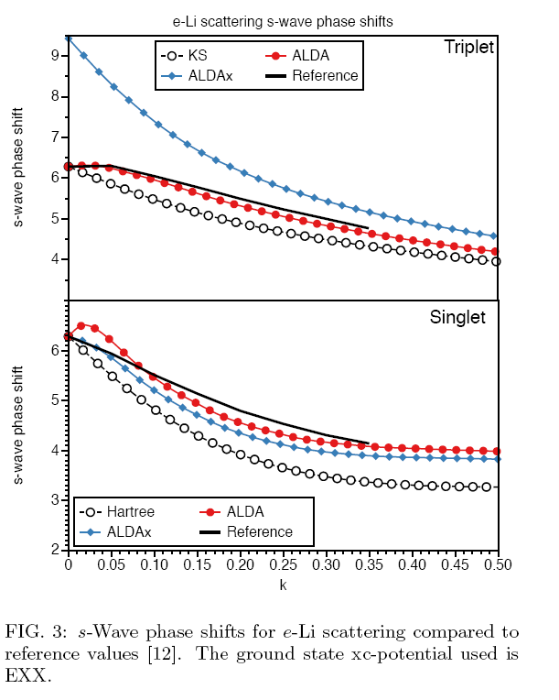
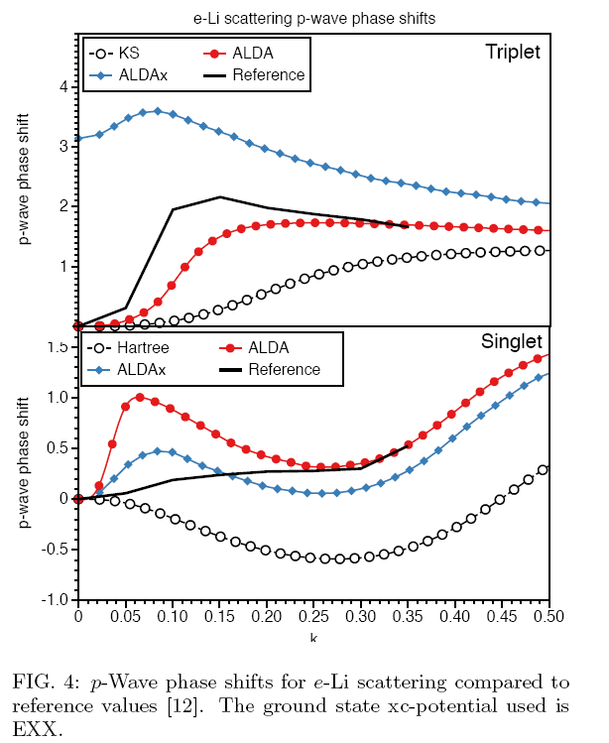
Electron scattering from Li

Slide 20
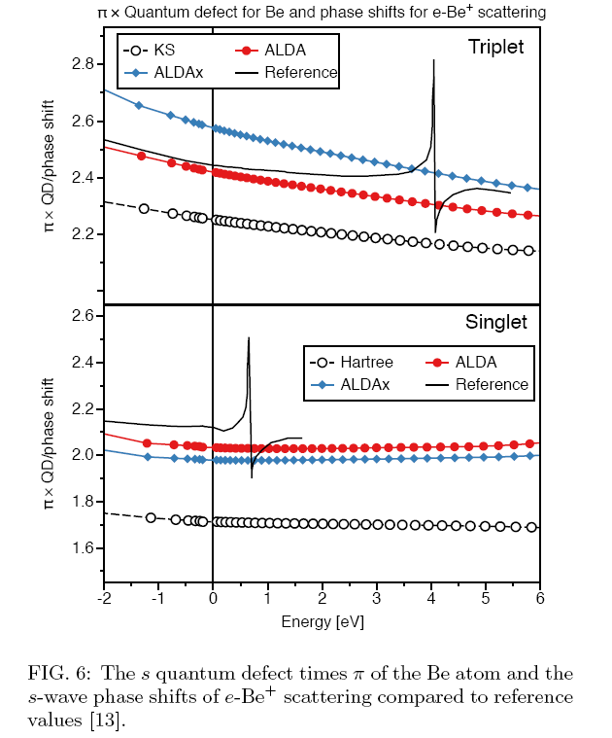
Resonances missing in adiabatic TDDFT
Double excitation resonances in Be

Slide 21
Sin of forgetfulness
Almost all calculations use adiabatic approximation, such as ALDA
Kernel is purely real and frequency-independent
Can show that only get single excitations in that case.

Slide 22
Memory and initial-state dependence
Always begin from some non-degenerate ground-state.
Initial state dependence subsumed via ground-state DFT.
If not in ground-state initially, find some pseudo prehistory starting from ground state.
Memory in time-dependent density functional theory N.T. Maitra, K. Burke, and C. Woodward, Phys. Rev. Letts. 89, 023002 (2002).

Slide 23
7. Where the usual approxs. fail Double Excitations
Excitations of interacting systems generally involve mixtures of SSD’s that have either 1,2,3…electrons in excited orbitals:
single-, double-, triple- excitations
χ_{s} -- poles only at single KS excitations
χ – poles at true states that are mixtures of singles, doubles, and higher excitations
χ has more poles than χ_{s}
? How does f_{xc} generate more poles to get states of multiple excitation character?

Slide 24

7. Where the usual approxs. fail Double Excitations
Exactly Solve a Simple Model: one KS single (q) mixing with a nearby double (D)
Invert and insert into Dyson-like eqn for kernel →dressed SPA (i.e. ω-dependent):
Strong non-adiabaticity!

Slide 25
7. Where the usual approxs. fail Double Excitations
General case: Diagonalize many-body H in KS subspace near the double ex of interest, and require reduction to adiabatic TDDFT in the limit of weak coupling of the single to the double
→
NTM, Zhang, Cave,& Burke JCP (2004), Casida JCP (2004)
Example: short-chain polyenes
Lowest-lying excitations notoriously difficult to calculate due to significant double-excitation character.
Cave, Zhang, NTM, Burke, CPL (2004)
Note importance of accurate double-excitation description in coupled electron-ion dynamics – propensity for curve-crossing
Levine, Ko, Quenneville, Martinez, Mol. Phys. (2006)

Slide 26
7. Where the usual approxs. fail Long-Range Charge-Transfer Excitations
TDDFT typically severely underestimates long-range CT energies
Important process in biomolecules, large enough that TDDFT may be only feasible approach !
Eg. Zincbacteriochlorin-Bacteriochlorin complex
(light-harvesting in plants and purple bacteria)
Dreuw & Head-Gordon, JACS 126 4007, (2004).
TDDFT predicts CT states energetically well below local fluorescing states. Predicts CT quenching of the fluorescence.
! Not observed !
TDDFT error ~ 1.4eV

Slide 27
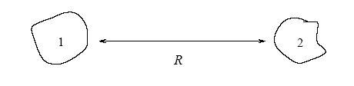

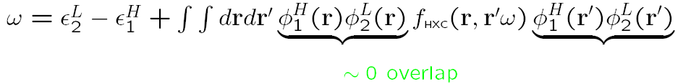

7. Where the usual approxs. fail Long-Range Charge-Transfer Excitations
Why do the usual approxs in TDDFT fail for these excitations?
First, we know what the exact energy for charge transfer at long range should be:
exact
Why TDDFT typically severely underestimates this energy can be seen in SPA
-A_{s,2}
-I₁
i.e. get just the bare KS orbital energy difference: missing xc contribution to acceptor’s electron affinity, A_{xc,2}, and -1/R
(Also, usual g.s. approxs underestimate I)

Slide 28
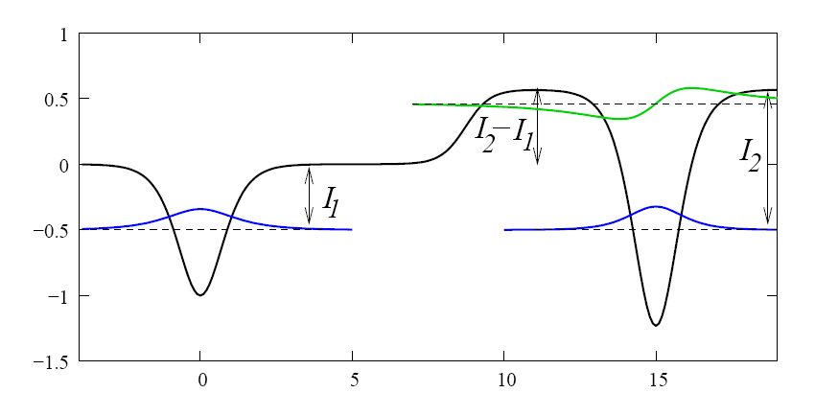
7. Where the usual approxs. fail Long-Range Charge-Transfer Excitations
What are the properties of the unknown exact xc functional that must be included to get long-range CT energies correct ?
Exponential dependence of the kernel on the fragment separation R,
fxc ~ exp(aR)
For transfer between open-shell species, need strong frequency-dependence in the kernel.
As one pulls a heteroatomic molecule apart, interatomic step develops in vxc that re-aligns the 2 atomic HOMOs → near-degeneracy of molecular HOMO & LUMO → static correlation, crucial double excitations!
“LiH”
Tozer (JCP, 2003), Gritsenko & Baerends (PRA, 2004), Maitra (JCP, 2005), Tawada etc, Scuseria etc

Slide 29
Sin of locality
In an adiabatic approximation using a local or semilocal functional, the kernel is a contact interaction (or nearly so).

Slide 30
Complications for solids and long-chain polymers
Locality of XC approximations implies no corrections to (g=0,g’=0) RPA matrix element in thermodynamic limit!
f_{H} (r-r’) =1/|r-r’|, but f_{xc}^{ALDA} = δ⁽³⁾(r-r’) f_{xc}^{unif}(n(r))
As q->0, need q² f_{xc} -> constant to get effects.
Consequences for solids with periodic boundary conditions:
  Polarization problem in static limit
  Optical response:
    Don’t get much correction to RPA, missing excitons
    To get optical gap right, because we expect fxc to shift all lowest excitations upwards, it must have a branch cut in w starting at EgKS

Slide 31
Two ways to think of solids in Ε fields
A: Apply Εsin(qx), and take q->0
  Keeps everything static
  Needs great care to take q->0 limit
B: Turn on TD vector potential A(t)
  Retains period of unit cell
  Need TD current DFT, take w->0.

Slide 32
Relationship between q→0 and ω→0
Find terms of type: C/((q+ng)²-ω²)
For n finite, no divergence; can interchange q->0 and ω->0 limits
For n=0:
  if ω=0 (static), have to treat q->0 carefully to cancel divergences
  if doing q=0 calculation, have to do t-dependent, and take ω->0 at end

Slide 33
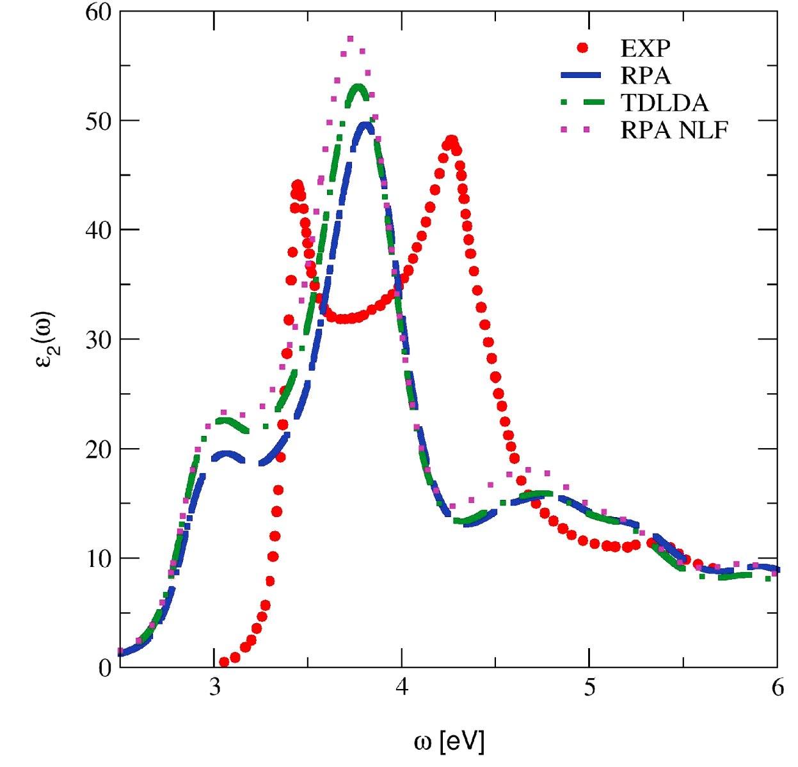
6. TDDFT in solids Optical absorption of insulators
Silicon
RPA and ALDA both bad!
►absorption edge red shifted
(electron self-interaction)
►first excitonic peak missing
(electron-hole interaction)
Why does the ALDA fail??
G. Onida, L. Reining, A. Rubio, RMP 74, 601 (2002)
S. Botti, A. Schindlmayr, R. Del Sole, L. Reining Rep. Prog. Phys. 70, 357 (2007)

Slide 34
6. TDDFT in solids Optical absorption of insulators: failure of ALDA
Optical absorption requires imaginary part of macroscopic dielectric function:
where
limit:
Long-range excluded,
so RPA is ineffective
Needs
component to
correct
But ALDA is constant
for

Slide 35
6. TDDFT in solids Long-range XC kernels for solids
● LRC (long-range correlation) kernel
(with fitting parameter α):
● TDOEP kernel (X-only):
Simple real-space form: Petersilka, Gossmann, Gross, PRL 76, 1212 (1996)
TDOEP for extended systems: Kim and Görling, PRL 89, 096402 (2002)
● “Nanoquanta” kernel (L. Reining et al, PRL 88, 066404 (2002)
pairs of KS
wave functions
matrix element of screened
Coulomb interaction (from
Bethe-Salpeter equation)

Slide 36
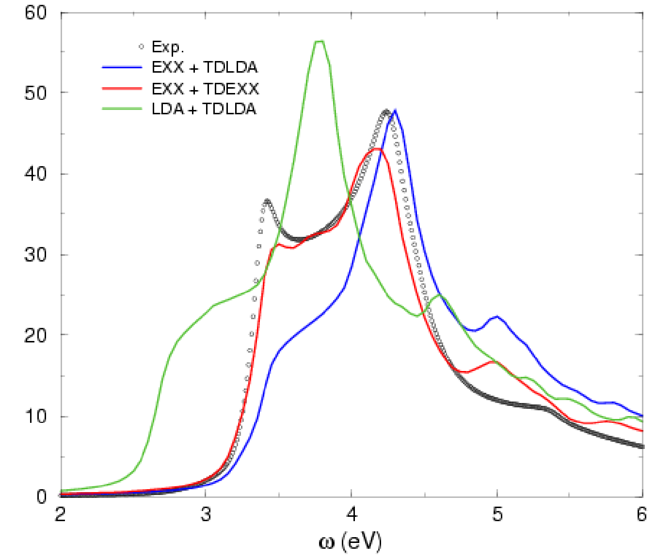
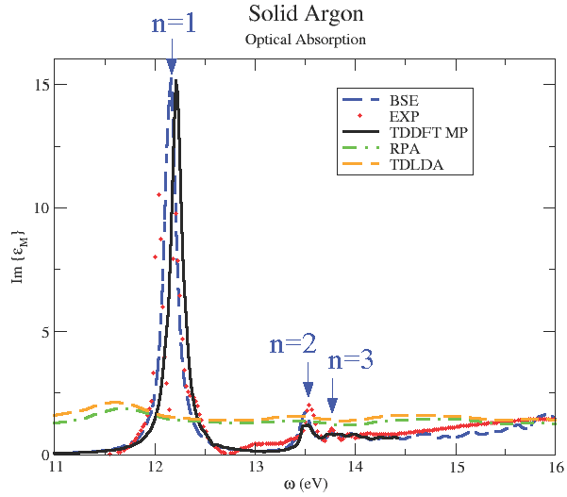
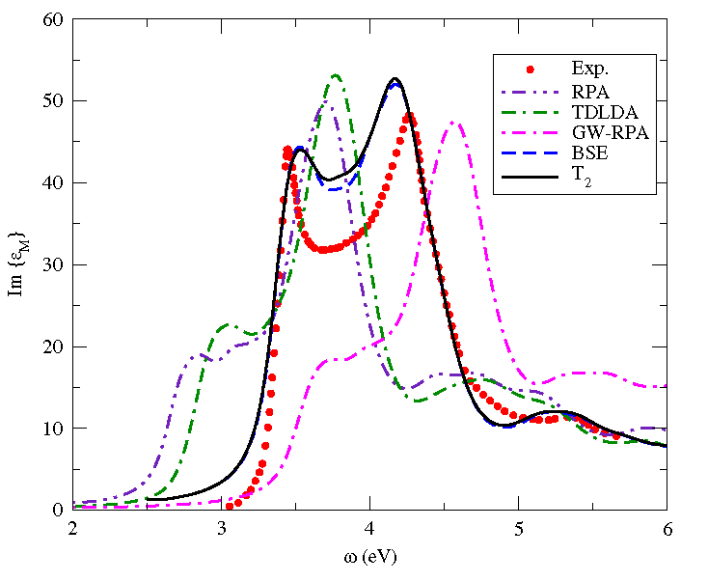
6. TDDFT in solids Optical absorption of insulators, again
Kim & Görling
Silicon
Reining et al.
F. Sottile et al., PRB 76, 161103 (2007)

Slide 37
6. TDDFT in solids Extended systems - summary
► TDDFT works well for metallic and quasi-metallic systems already
at the level of the ALDA. Successful applications for plasmon modes
in bulk metals and low-dimensional semiconductor heterostructures.
► TDDFT for insulators is a much more complicated story:
● ALDA works well for EELS (electron energy loss spectra), but
not for optical absorption spectra
● difficulties originate from long-range contribution to f_{xc}
● some long-range XC kernels have become available,
but some of them are complicated. Stay tuned….
● Nonlinear real-time dynamics including excitonic effects:
TDDFT version of Semiconductor Bloch equations
V.Turkowski and C.A.Ullrich, PRB 77, 075204 (2008)

Slide 38
TD current DFT
RG theorem I actually proves functional of j(r,t).
Easily generalized to magnetic fields
Naturally avoids Dobson’s dilemma: Gross-Kohn approximation violates Kohn’s theorem.
Gradient expansion exists, called Vignale-Kohn (VK).
TDDFT is a special case
Gives tensor fxc, simply related to scalar fxc (but only for purely longitudinal case).

Slide 39
Currents versus densities
Origin of current formalism: Gross-Kohn approximation violates Kohn’s theorem.
Equations much simpler with n(r,t).
But, j(r,t) more general, and can have B-fields.
No gradient expansion in n(r,t).
n(r,t) has problems with periodic boundary conditions – complications for solids, long-chain conjugated polymers

Slide 40
Beyond explicit density functionals
Current-density functionals
  VK Vignale-Kohn (96): Gradient expansion in current
  Various attempts to generalize to strong fields
  But is just gradient expansion, so rarely quantitatively accurate
Orbital-dependent functionals
  Build in exact exchange, good potentials, no self-interaction error, improved gaps(?),…

Slide 41
Basic problem for thermo limit
Uniform gas:

Slide 42
Basic problem for thermo limit
Uniform gas moving with velocity v:

Slide 43
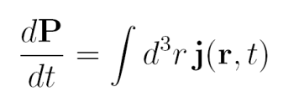
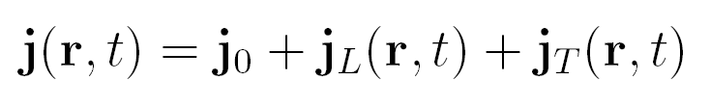

Polarization problem
Polarization from current:
Decompose current:
  where
Continuity:
First, longitudinal case:
  Since j₀(t) not determined by n(r,t), P is not!
What can happen in 3d case (Vanderbilt picture frame)?
  In TDDFT, j_{T} (r,t) not correct in KS system
  So, P_{s} not same as P in general.
  Of course, TDCDFT gets right (Maitra, Souza, KB, PRB03).

Slide 44
Improvements for solids: currents
Current-dependence: Snijders, de Boeij, et al – improved optical response (excitons) via ‘adjusted’ VK
Sometimes yields improved polarizabilities of long chain conjugated polymers.
But VK not good for finite systems (de Boeij et al, Ullrich and KB, JCP04).

Slide 45
Improvements for solids: orbital-dependence
Reining, Rubio, etc.
Find what terms needed in f_{xc} to reproduce Bethe-Salpeter results.
Reproduces optical response accurately, especially excitons, but not a general functional.
In practice, folks use GW susceptibility as starting point, so don’t need effective fxc to have branch cut

Slide 46
Sin of THE WAVEFUNCTION
In strong field physics, often want observables that cannot be extracted directly from n(r,t)
Not predicted even with exact v_{xc}[n](r,t)
Classic examples:
  Double ionization probability for atoms
  Quantum control: Push system into first electronic excited state.

Slide 47
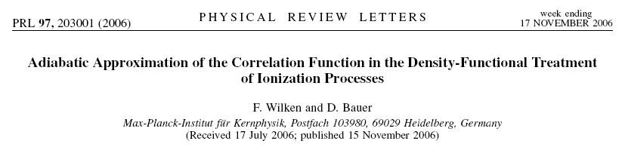
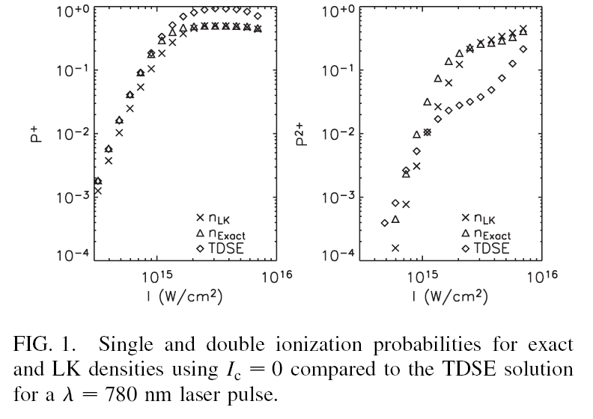
Double ionization knee

Slide 48
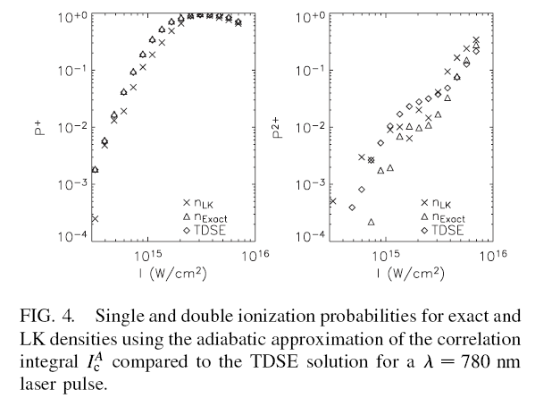
Double ionization knee

Slide 49
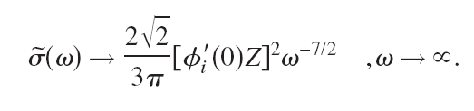
A fly in the ointment
Consider high-frequency limit of photoabsorption from Hydrogen:
Must Kohn-Sham oscillator strengths be accurate at threshold? Z.-H. Yang, M. van Faassen, and K. Burke, J. Chem. Phys. 131, 114308 (2009).

Slide 50
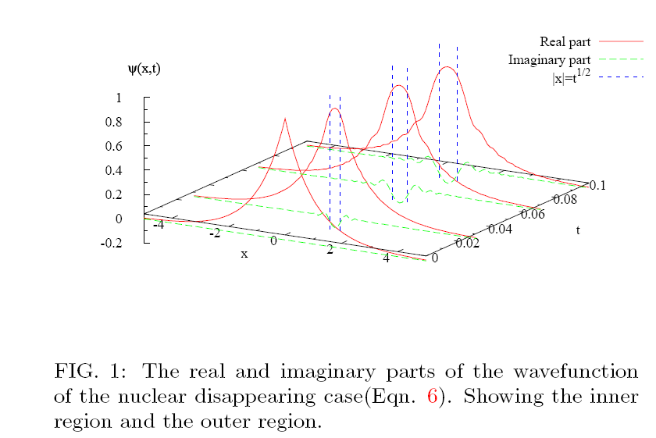
TD QM with cusps
Initial wavefunction has cusp, then free propagation.
φ₀=Z^{1/2} e ^{-Z|x|}
Zenghui Yang and Neepa Maitra (in prep)

Slide 51
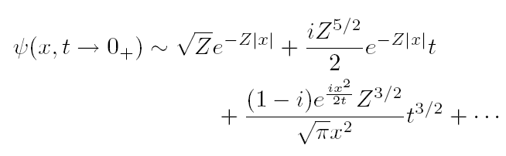
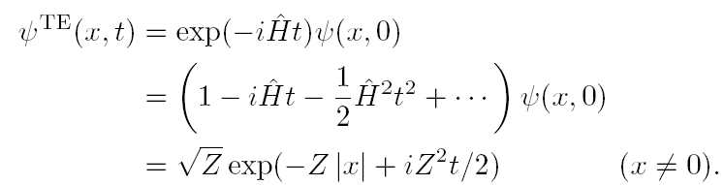
Short-time behavior

Slide 52

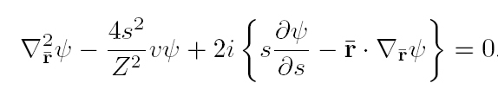
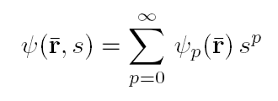
Procedure for dealing with cusp

Slide 53

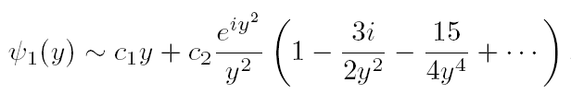
To find short-time behavior
Method of dominant balance

Slide 54
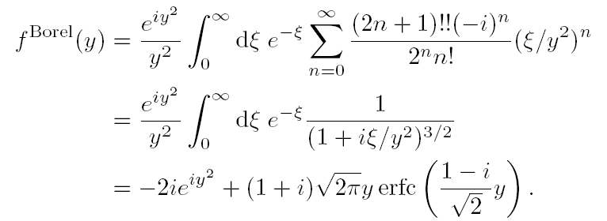
Resumming infinite series
Yields exact answer, including short times

Slide 55
RG with cusps
Seems to be true even for H atom in an E-field.
Means wavefunctions, densities, etc. are not Taylor-expandable
RG theorem survives because formal solution is not normalizable; densities not quite the same.
Again, help with math…

Slide 56
Quiz: Sins in TDDFT
Rydberg and continuum states (G)
Optical response/gap of solid (L)
Double ionization (O)
Double excitations (F)
Long-range charge transfer (GLF)
Quantum control phenomena (O)
Polarizabilities of long-chain molecules (L)
Coulomb blockade in transport (G)
Rydberg and continuum states
Optical response/gap of solid
Double ionization
Double excitations
Long-range charge transfer
Quantum control phenomena
Polarizabilities of long-chain molecules
Coulomb blockade in transport

Slide 57
Math challenges
Avoid Taylor expansion in RG theorem
Understanding and building in memory effects
Charge transfer excitations for biochemistry
General purpose functional for solids with excitons
Thanks to DOE and students.

