Slide 1
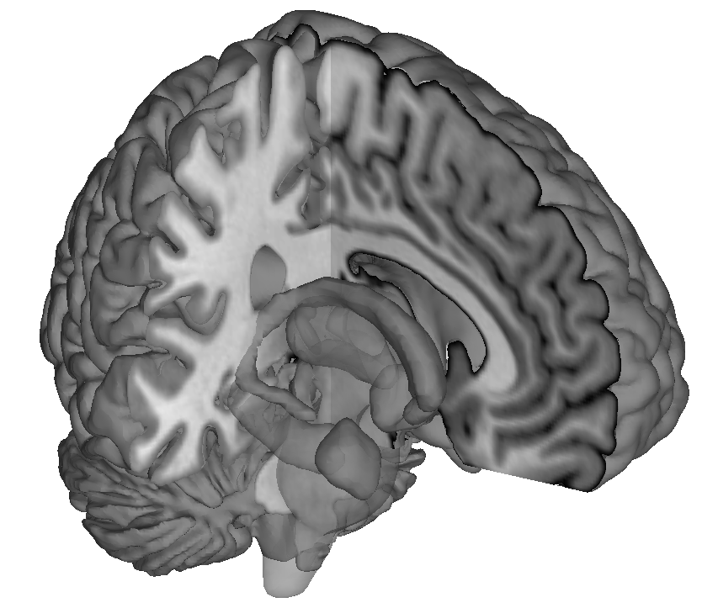
Dynamic Connectivity: Pitfalls and Promises
Martin Lindquist
Department of Biostatistics
Johns Hopkins University

Slide 2
Dynamic Connectivity
To date, most resting state fMRI studies have assumed that the functional connectivity between distinct brain regions is constant across time.
Recently, there has been interest in quantifying possible dynamic changes in connectivity.
Research classifying connectivity into distinct states has demonstrated that the amount of time spent in specific states and the number of transitions between states, vary due to meaningful individual differences (e.g., age or disease status).
Notes:
Changes in both the strength and directionality of functional connections have been observed to vary across experimental runs (Hutchison et al., 2013). It is thought that this temporally varying information may be used to provide insight into the fundamental properties of brain networks.

Slide 3
Dynamic Connectivity
Detecting reliable, neuronally-relevant non-stationarities is difficult due to low signal-to-noise ratio, physiological artifacts and variation in signal mean and variance over time.
It is unclear whether observed fluctuations in connectivity should be attributed to neuronal activity or noise.
There remains uncertainty regarding the appropriate analysis strategy to use and how to interpret results.

Slide 4
Sliding Windows
The most widely deployed technique is the sliding window approach, where a time window of fixed length is selected, and data points within that window are used to compute the correlation.
In contrast, in the tapered sliding-window approach, the window is first convolved with a Gaussian kernel, allowing points to gradually enter and exit from the window as it moves across time.

Slide 5
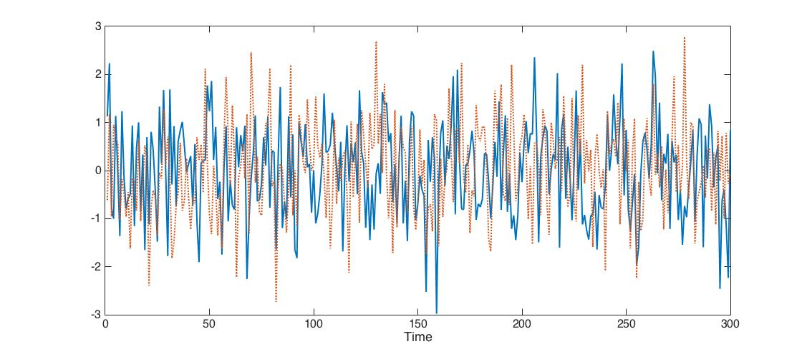
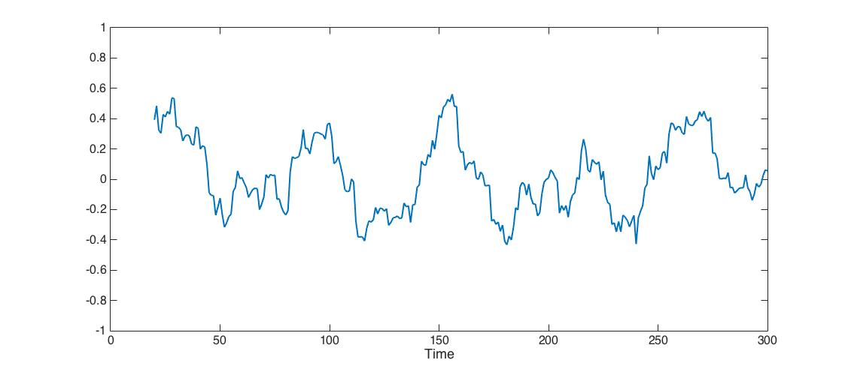
Dynamic Connectivity
Data
Sliding window w = 20
Lindquist et al. 2014

Slide 6
Example
The estimated max correlation using null data of length T, analyzed using sliding windows of lengths w = 15, 30, 60 and 120.
T=150
T=300
T=600
T=1000
MW15
MW30
MW60
MW120
MW15
MW30
MW60
MW120
MW15
MW30
MW60
MW120
MW15
MW30
MW60
MW120

Slide 7
DCC
Dynamic Conditional Correlations (DCC) is a multivariate GARCH model.
Fit GARCH model to each time series
Compute standardized residuals
Use EWMA-type method to compute time-varying correlation matrix

Slide 8
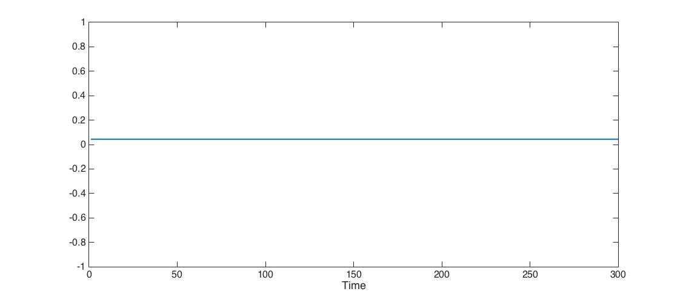
Dynamic Connectivity
Data
Sliding window w = 20
DCC
Lindquist et al. 2014

Slide 9
Example
The estimated max correlation using null data of length T analyzed using DCC.
T=150
T=300
T=600
T=1000
DCC
DCC
DCC
DCC

Slide 10
Summarizing Information
An interesting aspect about studying dynamic correlations is that it actually increases the number of data points.
The input data is a p×T matrix, where p is the number of regions and T the number of time points.
The output is a series of T p×p matrices summarizing the connectivity at each time point.
Critical need for summary statistics that can be used to find meaningful individual differences.

Slide 11
Summarizing Information
There are a number of possible summaries:
The average dynamic correlation and the variability in dynamic correlation in each edge.
If involved in frequent state-changes, edges should exhibit consistently higher variation in correlation.
Connectivity ‘state’ matrices, which are connectivity patterns that subjects tend to return to during the course of an experiment.
Can be summarized based on patterns of connectivity within each state, and used to compute the dwell time each subject spends in a given state.

Slide 12
Determining Brain States I
The standard approach towards determining coherent brain states across subjects is to perform clustering on the results of the dynamic connectivity analysis.
Procedure:
Assess dynamic connectivity on each subject
Concatenate the data from all subjects
Perform k-means clustering and let centroids represent ‘brain states’
Assess dwell time in each state

Slide 13
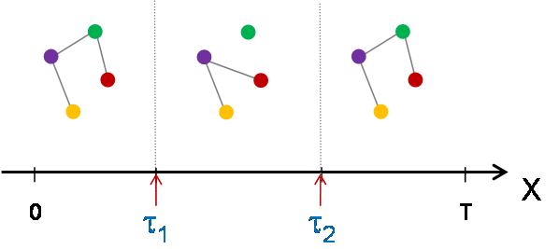
Determining Brain States II
Alternatively, one can use a change point method that partitions the time course into distinct intervals based on changing FC patterns between ROIs.
Dynamic Connectivity Regression (Cribben et al. 2012)
Dynamic Connectivity Detection (Xu et al. 2015)

Slide 14
Approach
Partition the data into two sets: one consisting of time {1:t} and another consisting of {t+1:T}. Estimate the parameters for both partitions and compute a combined score (likelihood/BIC).
Repeat Step 1 setting t=t+1;
Find the time point which produces the largest increase in the combined score. If it is greater than the score of the entire data set, split the data into two segments at that point.
Apply Steps (1)-(3) recursively to each segment until no further partitioning is possible.

Slide 15
Reliability
We performed a reliability study using two data sets with test-retest resting state fMRI data.
Kirby 21 and Human Connectome Project
We evaluated the reliability of certain metrics used to assess dynamic FC.
Mean and variance of the dynamic correlation
Dynamic states and dwell time
Reliability assessed using both the intra-class correlation coefficient (ICC; edge-wise reliability) and image intra-class correlation (I2C2; omnibus reliability).

Slide 16
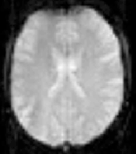
I2C2
Y₁₂(v)
Y₂₂(v)
Y_{K2}(v)
………….
Y₁₁(v)
Y₂₁(v)
Y_{K1}(v)
Shou et al. 2014

Slide 17
Kirby Data
Resting-state fMRI (rfMRI) data from 20 subjects were analyzed.
Each subject had two 7-min rfMRI runs (TR 2s).
Group-average brain parcellations were obtained by applying spatial-ICA (Q=39).
Subject-specific parcel time series used as input data for our analysis.
21 characterized as signal, 18 as noise components.
Applied sliding window (n=30), tapered sliding window (n=22, σ=3) and DCC.
Computed mean and variance of dynamic correlation.
Assessed reliability using ICC and I2C2.
Applied DCD and K-means to determine brain states.

Slide 18
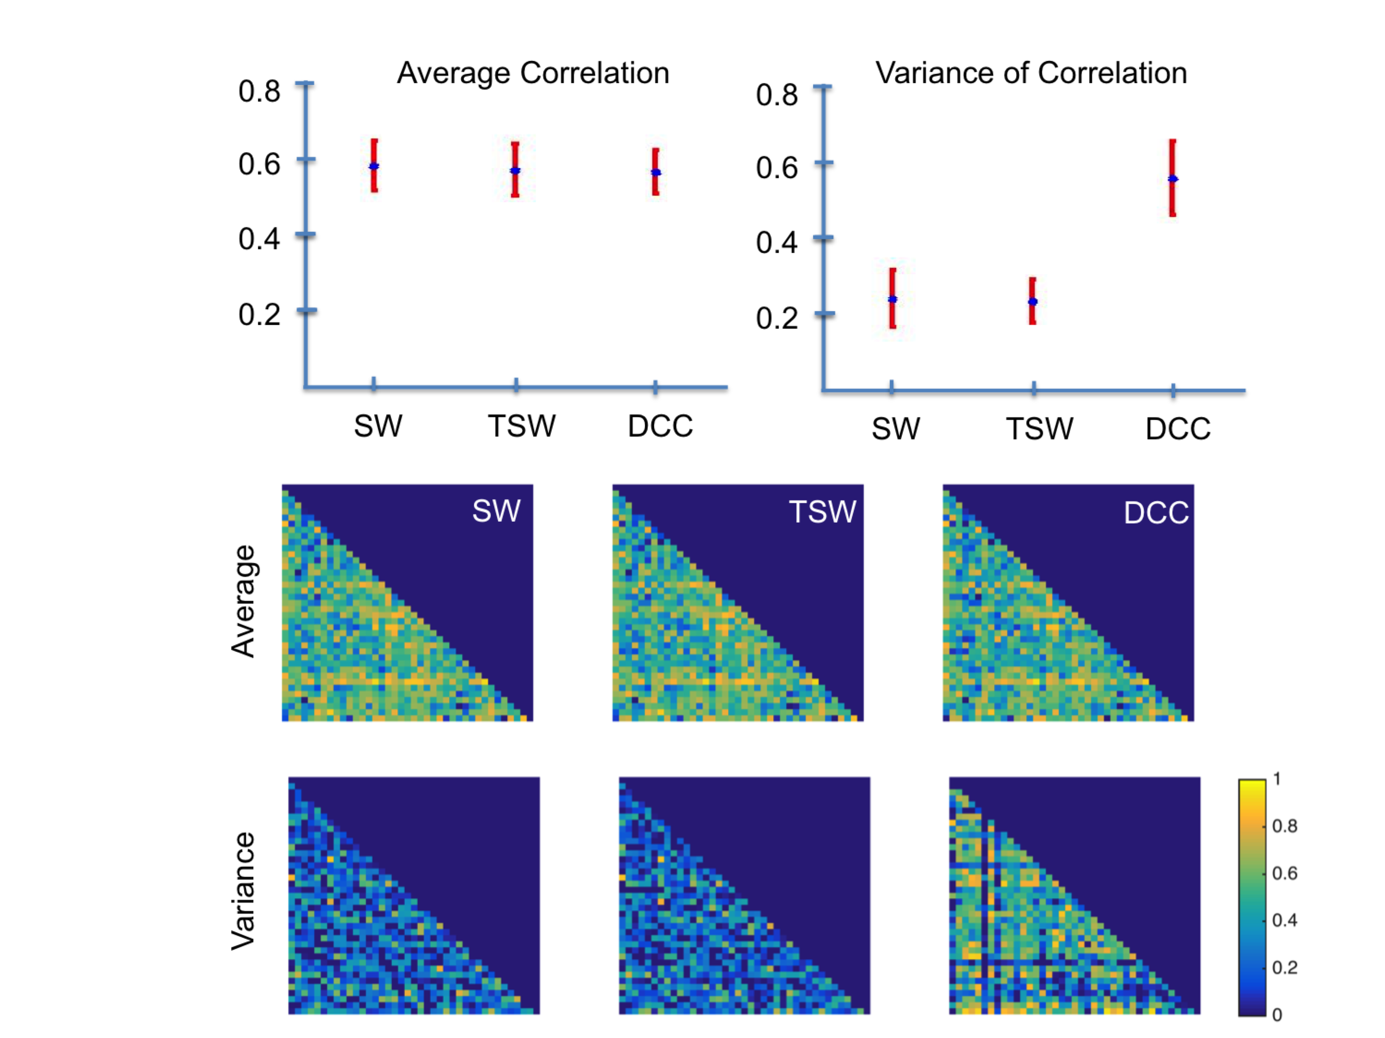
Reliability
ICC
I2C2

Slide 19
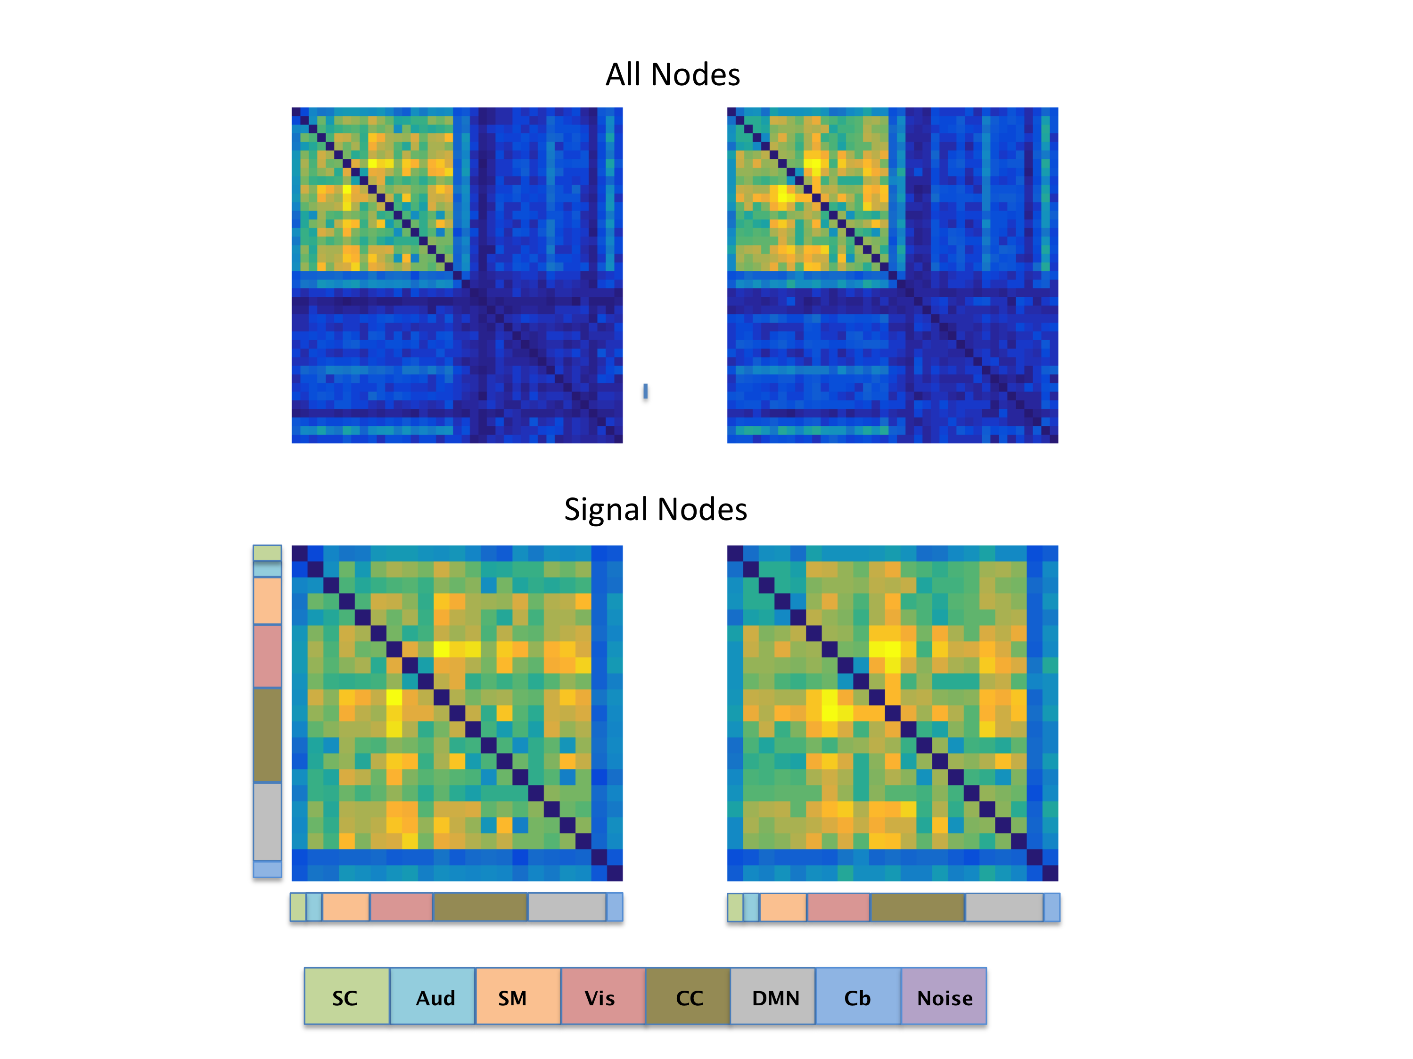
Variance of the Dynamic Correlation

Slide 20
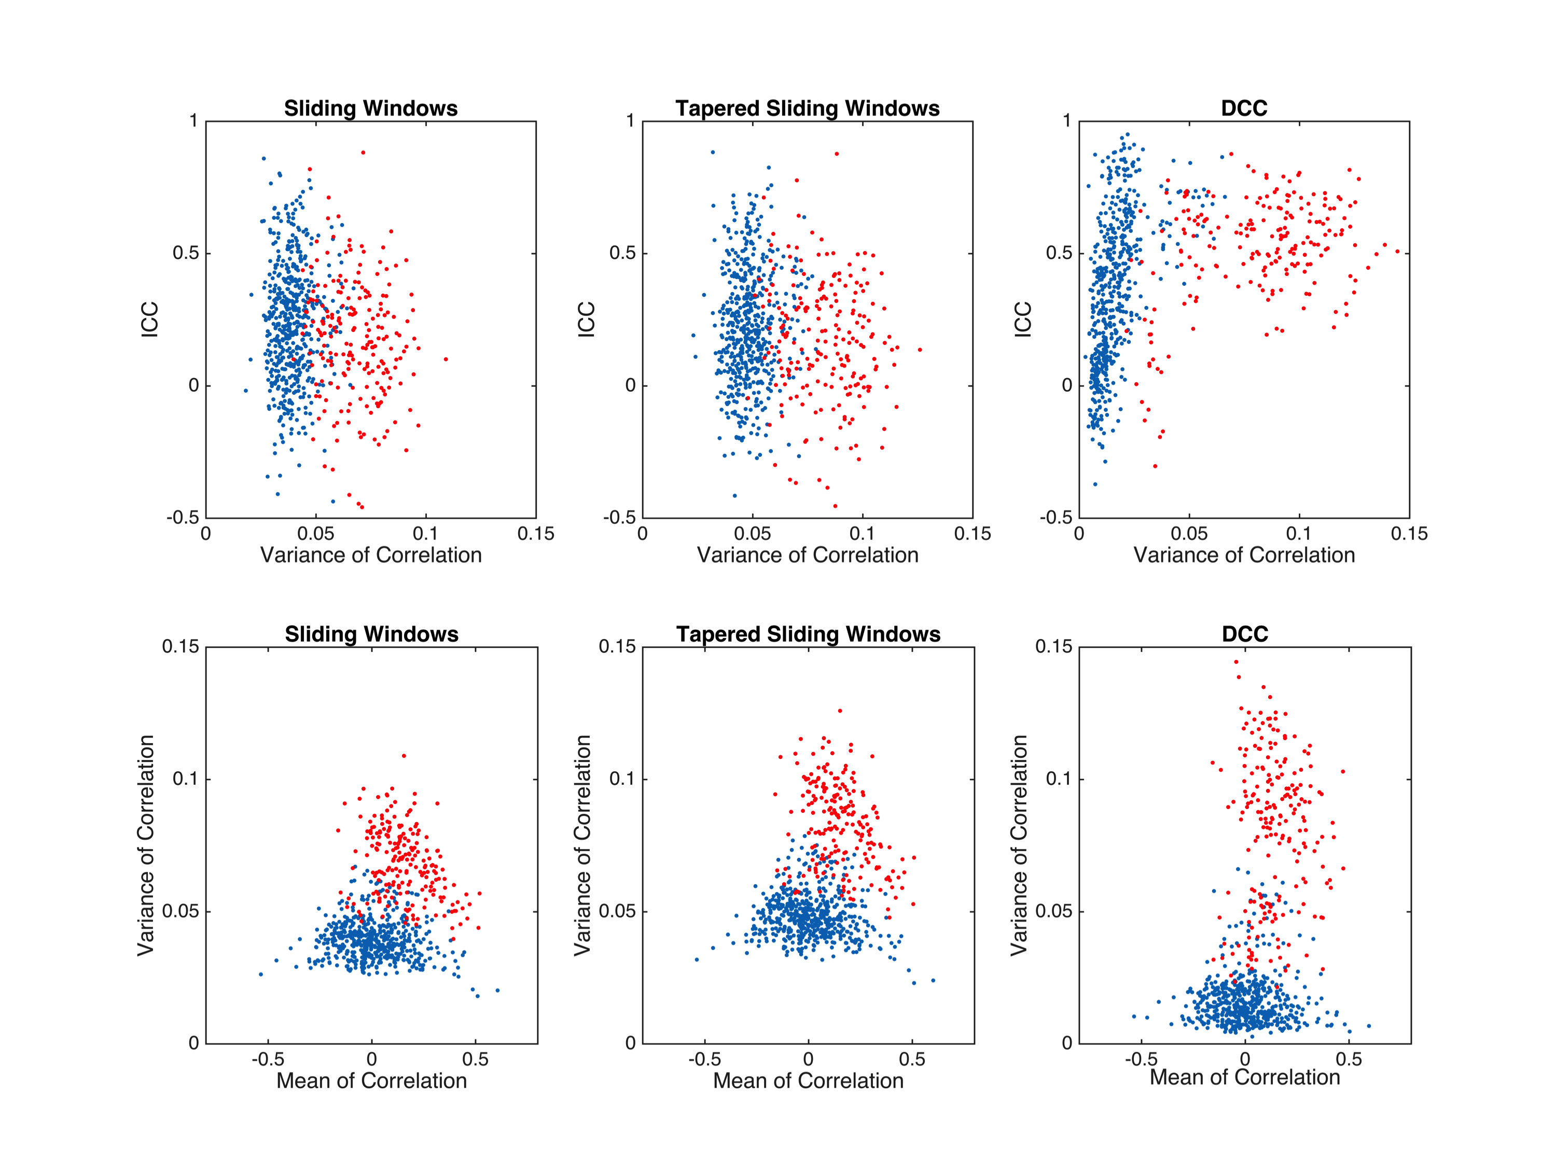
Signal & Noise

Slide 21
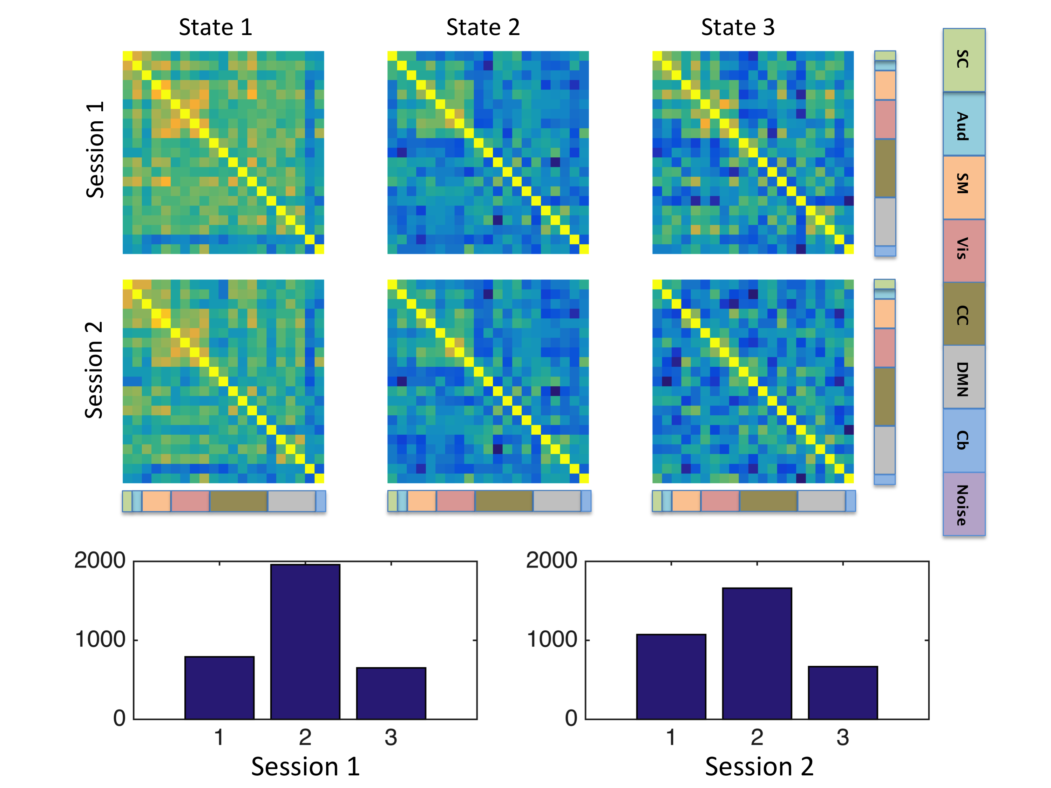
Brain States – DCC/k-means

Slide 22
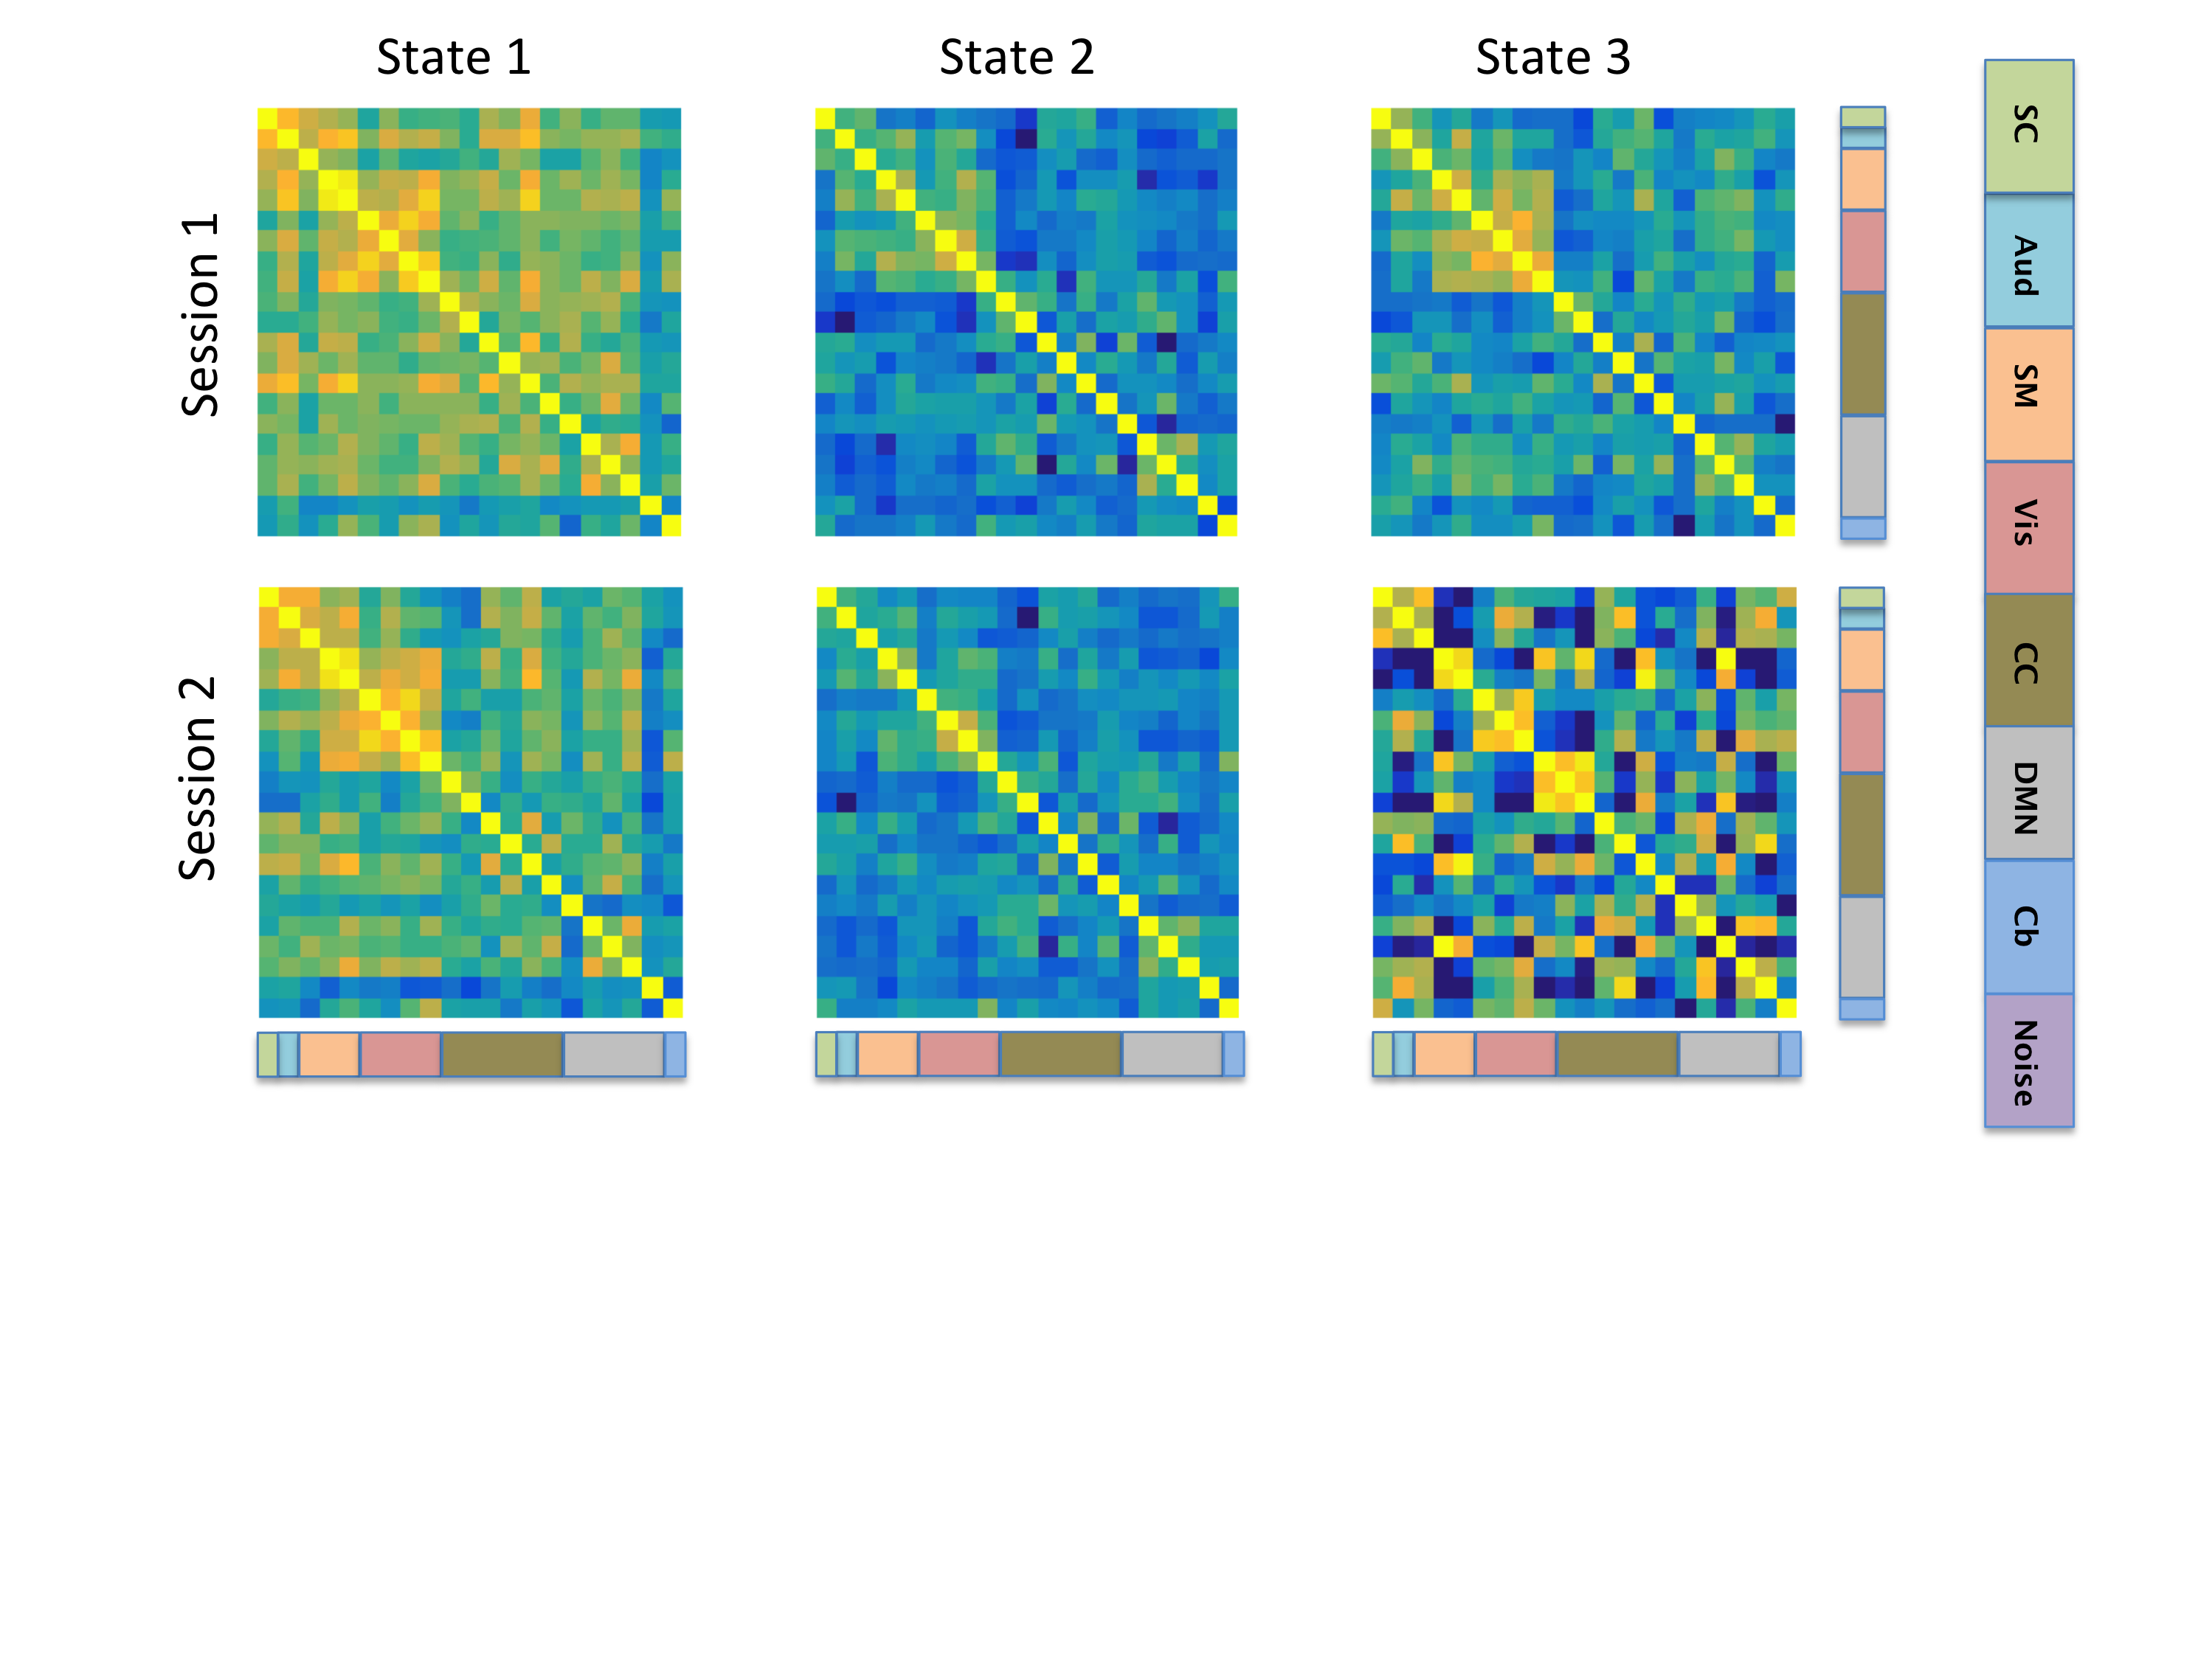
Brain States - DCD

Slide 23
HCP Data
Resting-state fMRI (rfMRI) data from 461 subjects were analyzed.
Each subject had four 15-min rfMRI runs (TR 0.72s).
Group-average brain parcellations were obtained by applying spatial-ICA (Q=50).
Subject-specific parcel time series used as input data for our analysis.
Applied sliding window (n=30, 60, 120), and DCC.
Computed mean and variance of dynamic correlation.
Assessed reliability using ICC and I2C2.
Applied DCD and K-means to determine brain states.

Slide 24
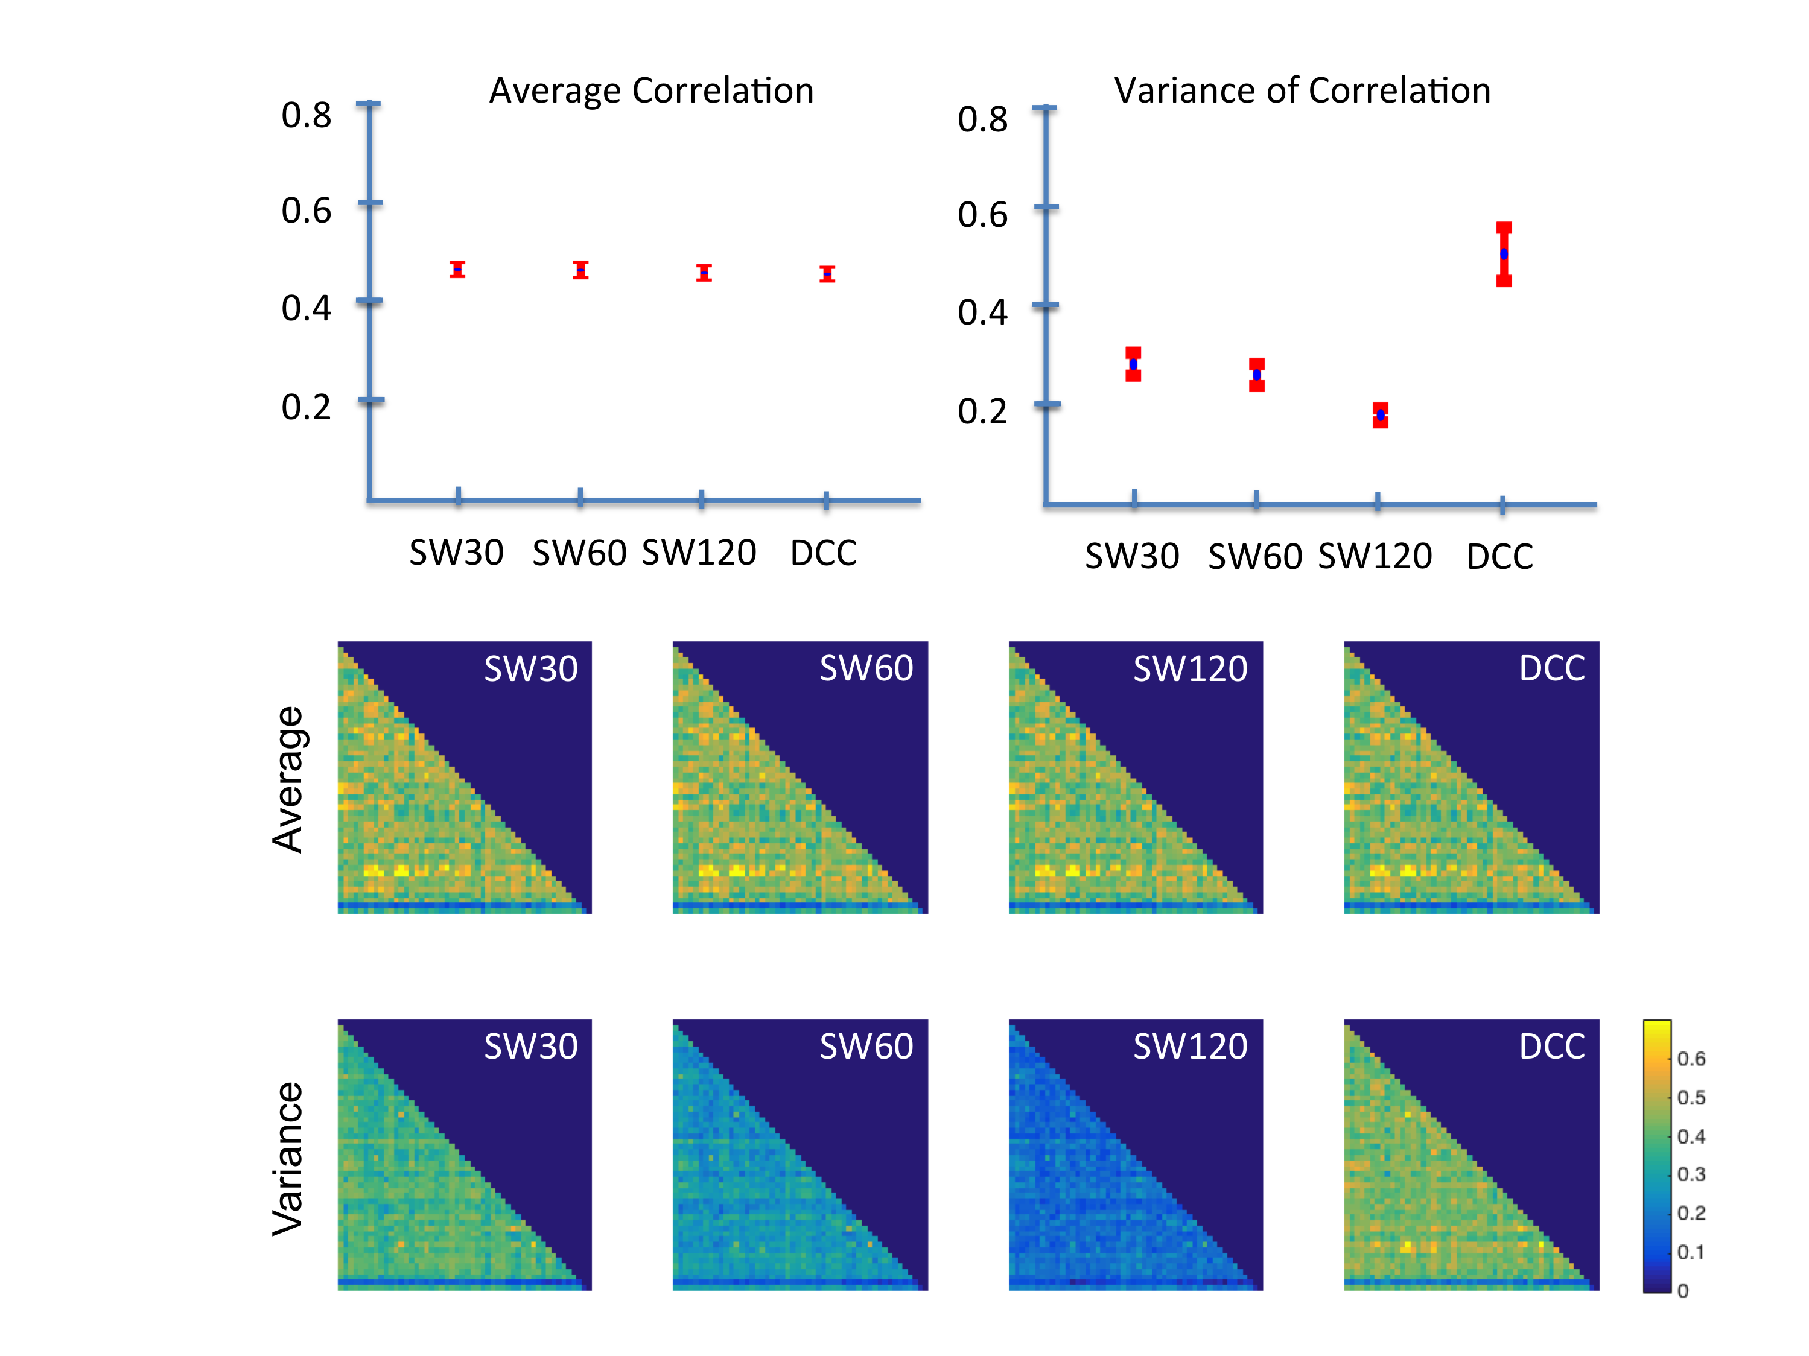
Reliability
ICC
I2C2

Slide 25
Variance of the Dynamic Correlation

Slide 26
Signal & Noise

Slide 27
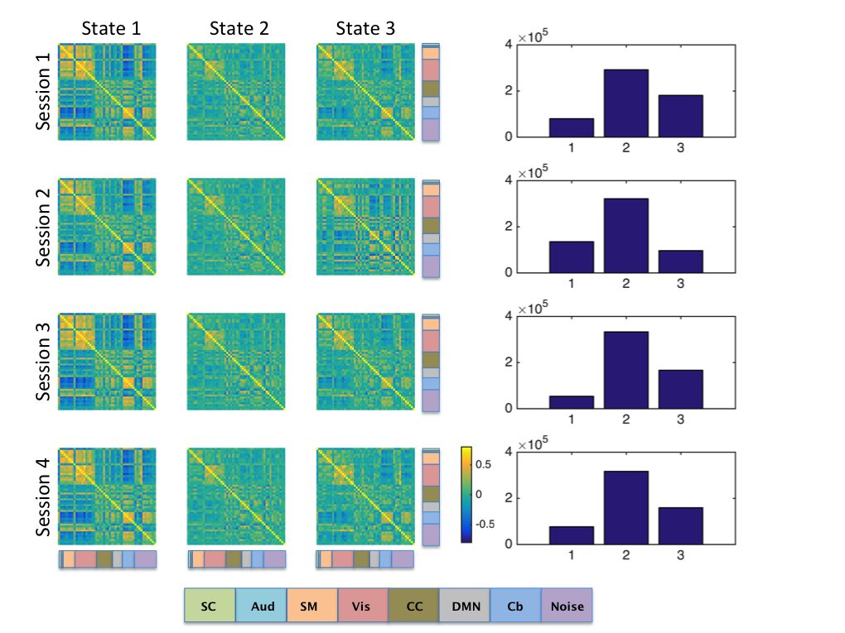
Brain States – DCC/k-means

Slide 28
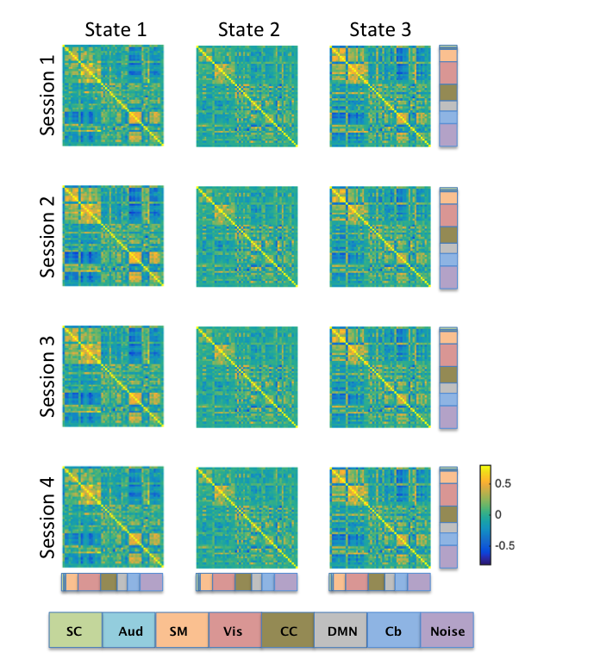
Brain States - DCD

Slide 29
Conclusions
We compared several variants of the sliding-windows technique with a model-based approach.
We evaluated the reproducibility of metrics computed from dynamic FC.
Found moderately strong reproducibility of the average correlation, lower for the variance.
Comparable to other fMRI analyses (e.g. seed analysis).
DCC provides more reproducible results for the variance and separated signal from non-signal.
Found that we could reliably asses both brain states and dwell time.

Slide 30
Thanks
Joint work with Anita Barber, Ann Choe, Jessica Cohen, Mary-Beth Nebel, Yuting Xu, and Brian Caffo.
References:
Funding:
Martin Lindquist, Yuting Xu, Mary Beth Nebel, and Brain Caffo (2014). Evaluating Dynamic Bivariate Correlations in Resting-state fMRI: A comparison study and a new approach. NeuroImage, 101, 531–546.
NIH - R01 EB016061

Slide 31
Thanks
Thank you for your attention.
Coursera fMRI class available on demand.

