Slide 1

Detection, attribution of long-term change, and event attribution
Francis Zwiers
PCIC, University of Victoria
BIRS, 14 June 2016
Photo: F. Zwiers (Strait of Juan de Fuca)

Slide 2
Introduction
Enormous interest in event attribution
  Event and media driven (eg, Calgary floods, Fort McMurray fires)
  Questions are mostly retrospective
Requires “rapid response” science
  Recently assessed by US National Academies of Science (2016)
Topics for this talk
  Detection and attribution of long-term change
  Event attribution
  Discussion

Slide 3

Detection and Attribution
of long term change
Photo: F. Zwiers (Marsh Wren)

Slide 4
D&A of long-term change
Definitions
  Detection – identifying that a change has occurred
  Attribution – evaluating contributions from causal factors
Methods
  Involve simple statistical models
  Complex implementation due to data volumes (which are both small and large)
Usual assumptions
  Key forcings have been identified
  Signals and noise are additive
  Climate models simulate large-scale patterns of response correctly
Leads to a regression formulation

Slide 5
Observations (HadCRUT4)
Multi-model mean (ALL forcings)
1901-1910
1901-1910
1911-1920
1911-1920
1921-1930
1921-1930
1931-1940
1931-1940
1941-1950
1941-1950
1951-1960
1951-1960
1961-1970
1961-1970
1971-1980
1971-1980
1981-1990
1981-1990
1991-2000
1991-2000
2001-2010
2001-2010
11 decades (1901-1911 to 2001-2011)
Y
X
After Weaver and Zwiers (2000)
Evaluate
scaling factors
Evaluate residuals

Slide 6
Observations (HadCRUT4)
Multi-model mean (ALL forcings)
1901-1910
1901-1910
1911-1920
1911-1920
1921-1930
1921-1930
1931-1940
1931-1940
1941-1950
1941-1950
1951-1960
1951-1960
1961-1970
1961-1970
1971-1980
1971-1980
1981-1990
1981-1990
1991-2000
1991-2000
2001-2010
2001-2010
11 decades (1901-1911 to 2001-2011)
Two (of hundreds) pre-industrial control run “chunks” (CanESM2)
1901-1910
1901-1910
1911-1920
1911-1920
1921-1930
1921-1930
1931-1940
1931-1940
1941-1950
1941-1950
1951-1960
1951-1960
1961-1970
1961-1970
1971-1980
1971-1980
1981-1990
1981-1990
1991-2000
1991-2000
2001-2010
2001-2010

Slide 7
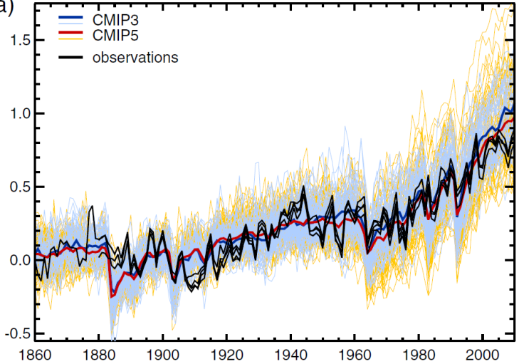
It is extremely likely that human influence has been the dominant cause of the observed warming since the mid-20th century.
Global warming attribution
Global mean temperature relative to 1880-1919
Trend in global surface temperature (1951-2010)
All forcings
Jones et al, 2013
See also Figure 10.1, IPCC WG1 AR5
Figure TS.10, IPCC WG1 AR5

Slide 8
Detection and Attribution Summary
Concerned with long term change
Quantifies how the mean state (or some other statistic) has changed over time due to forcing
Examples
  Global and regional mean temperature
    Large body of literature, very high confidence
  Temperature extremes
    Growing literature, high confidence
  Precipitation extremes
    Emerging evidence, medium or lower confidence

Slide 9
Some concerns
Most studies implicitly assume Gaussian noise (generally not a large concern)
Sampling variability in the estimation of the noise covariance matrix is not accounted for well
  Hannart (2016) proposes a solution
Most studies treat inter-model differences as sampling variability equivalent to internal variability
  Hannart et al (2014) proposes a partial solution
  Ribes et al (2016) propose an alternative approach
  In reality, we do not have a comprehensive statistical framework that allows us to describe how the available ensembles of opportunity have been obtained

Slide 10
Some concerns …
Many studies still use ad-hoc methods for covariance matrix regularization (e.g., EOF-truncation)
  Some now use better approaches (e.g., the Ledoit-Wolf (2004) estimator) following Ribes et al (2013a, 2013b)
Many studies do not discuss basic assumptions
  Key forcings have been identified (and thus there are no other confounding influences)
  Additivity of signals and noise, independence of noise on mean state
Tendency to attribute based only on statistical evidence (see discussion in Mitchell et al., 2001)

Slide 11
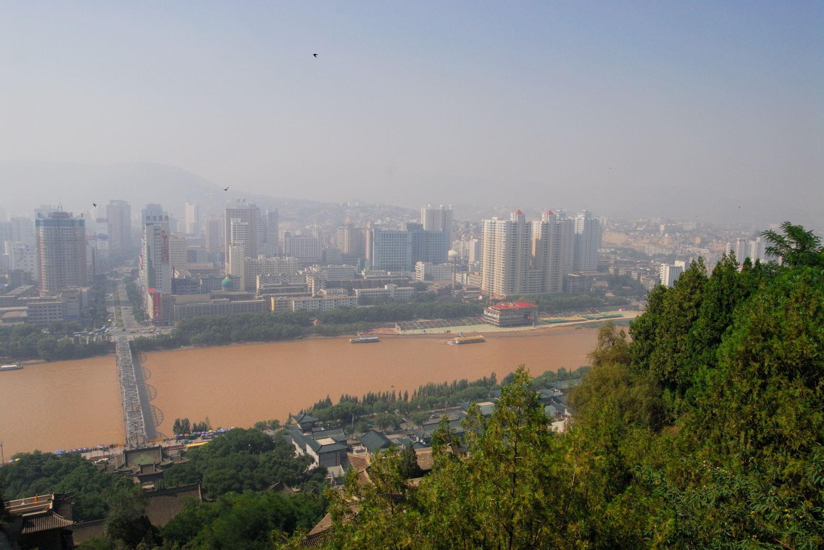
D&A of changes in extremes
- a temperature example
Photo: F. Zwiers (Lanzhou)
See WCRP summer school on extremes, ICTP, July, 2014
Notes:
Five approaches are described – one in detail, 4 others more generally

Slide 12
An approach to D&A on extremes using EV theory
Several available indices are “block maxima”
  Temperature: TNn, TXn, TNx, TXx
  Precipitation: RX1day, RX5day
Suggests using the “Generalized Extreme Value” (GEV) distribution, and incorporating the effects of forcing via its parameters
An example is Zwiers et al, 2011

Slide 13
GEV distribution
  Based on limit theory which predicts that the distribution of block maxima will converge to a Generalized Extreme Value distribution as blocks become large
  Distribution function
  m-block return value (blocks are often years)
  Density function

Slide 14
Working assumption
External forcing affects only the GEV location parameter μ
Parallel to the regression approach
  Estimates the conditional mean (“location parameter”) of the Gaussian distribution

Slide 15
How do we get the expected pattern of change in μ?
  For a given climate model and forcing, assume M runs
  10M years of output for each decade
    → 10M block maxima x_{tlk} for decade t at grid box k
    t=1, … , N decades
    l=1, … , 10M simulated years for decade t
  Use these 10M block maxima to estimate GEV parameters for decade t at grid box k
  → estimate N+2 parameters μ_{tk}, σ_{k} and ξ_{k} at each grid box
  Do this via maximum likelihood

Slide 16
Maximum likelihood estimation of μ_{tk}, σ_{k} and ξ_{k}
  Maximize the joint likelihood
  Equivalently, minimize the negative log-likelihood
  Do this at individual grid boxes k

Slide 17
How do we model the observed extremes?
  Use the GEV distribution
    we have observed block maxima
  Make the location parameter signal-dependent as follows
    where
  and is the multi-model ensemble mean of the location parameter estimates for grid box k in decade t from the forced simulations
  Parameters to be estimated from obs are
  Note that β is the same at all locations k
{

Slide 18
  Fit the GEV distribution to observations at all grid boxes simultaneously by minimizing
  where
  Do this using the profile likelihood technique

Slide 19
Parallels with standard D&A
  Single scaling factor to modify the space-time pattern of change in model simulated location parameters
  Like OLS rather than TLS because we don’t take uncertainty in model derived location factors into account
  Non-optimized because the likelihood function does not represent dependence between extremes at different locations
Unlike standard D&A
  Uncertainty analysis was not based on control variability because daily output was not available from CMIP3 control runs – used a block bootstrap approach instead

Slide 20
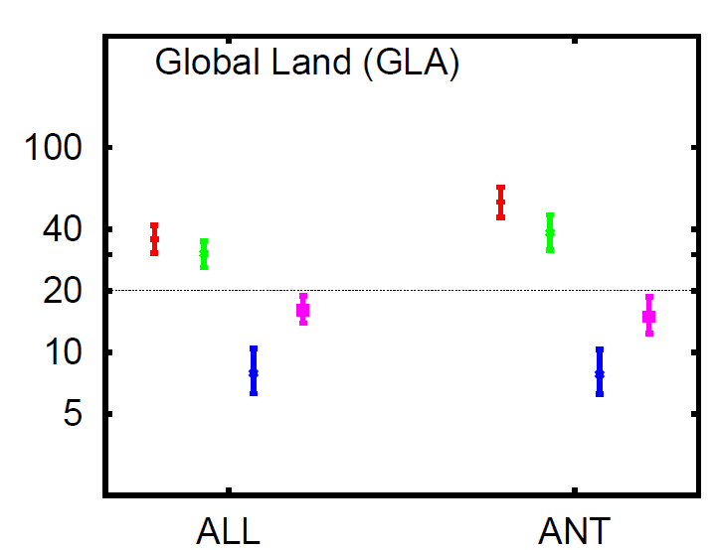
Global Results
Scaling factors and bootstrapped 5-95% uncertainty ranges
Implied change in waiting times for 20-year event (1990’s vs 1960’s)
Zwiers, et al., 2011, J Climate
TNn, TXn, TNx, TXx

Slide 21
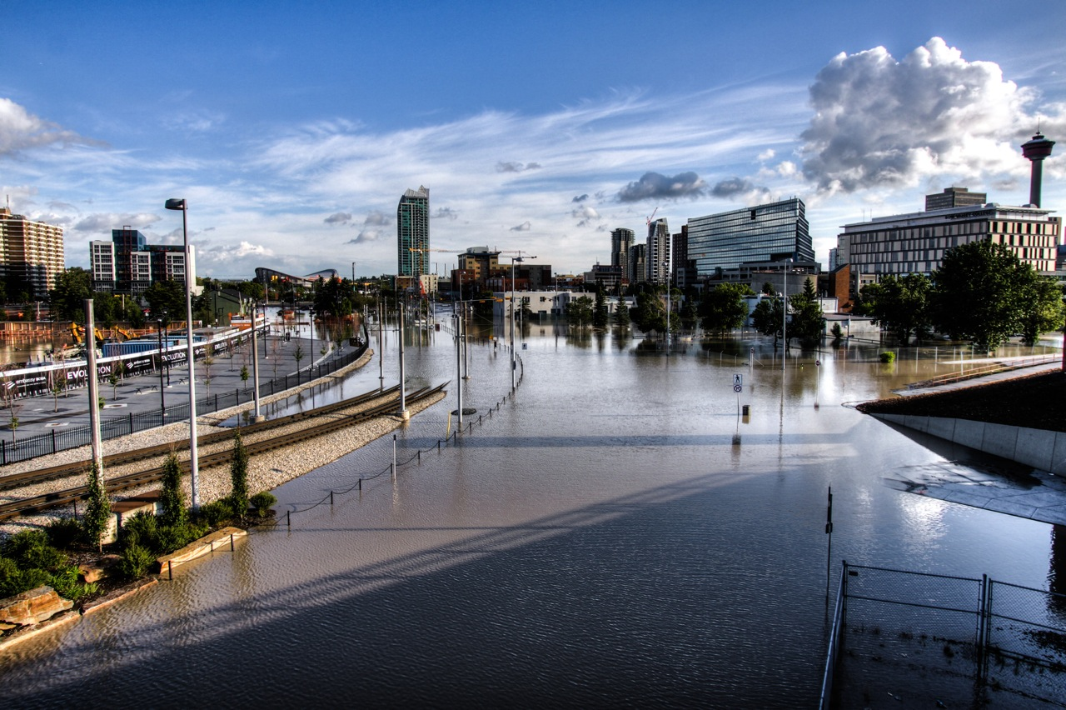
Event attribution
Calgary East Village (June 25, 2013), courtesy Ryan L.C. Quan

Slide 22
Event attribution
The public asks: Did human influence on the climate system …
  Cause the event?
Most studies ask: Did it …
  Affect its odds?
  Alter its magnitude?
Some think we should reframe the question …
  Rather than “Did human influence …” (which requires comparison with a counterfactual world)
  Ask “How much (eg, of a given storm’s precipitation) is due to the attributed warming (eg, in the storm’s moisture source area)” (after Trenberth et al, 2015)
Notes:
The former allows statistical analyses that inform risk assessment
The latter is much more physically based and recognizes that human influence has a role in every event given that the composition of the atmosphere is not that of the preindustrial state.

Slide 23
Most studies
Compare factual and “counterfactual” climates
  Counterfactual → the world that might have been if we had not emitted the ~600GtC that have been emitted since preindustrial
These studies almost always
  Define a class of events rather than a single event
  Use a probabilistic approach
Shepherd (2016) defines this as “risk based”
  Contrasts it with a “storyline” based approach
  i.e., analysis of the specific event that occurred
Notes:
The former allows statistical analyses that inform risk assessment
The latter is much more physically based and recognizes that human influence has a role in every event given that the composition of the atmosphere is not that of the preindustrial state.

Slide 24
“Framing” event attribution studies
Event type
  Class vs individual
Analysis approach and approach
  “risk based” or “storyline”
Event definition
  What spatial scale, duration, etc
Which risk-based question
  Did climate change alter the odds, or the magnitude?
What factors should be taken into account
  “Conditioning”
  e.g., coincident SST anomaly pattern
  The NAS Report (2016) struggled with these distinctions
Notes:
The former allows statistical analyses that inform risk assessment
The latter is much more physically based and recognizes that human influence has a role in every event given that the composition of the atmosphere is not that of the preindustrial state.

Slide 25
“Conditioning” examples
Did human influence alter its likelihood
Did human influence alter its magnitude

Slide 26
Recent examples
China’s very hot summer of 2013
  Sun et al. (2014)
  Condition only on anthropogenic forcing
Calgary floods
  Teufel et al (accepted, Clim Dyn)
  Condition on anthropogenic forcing and SSTs
  Uses both risk based and storyline approachs
Arctic low sea-ice extent events
  Kirchmeier-Young et al (submitted, J Climate)
  Extreme low summer minimum of Sept, 2012
  Extreme low winter maximum of March, 2015

Slide 27

China’s Summer of 2013
Photo: F. Zwiers (Lijiang – Black Dragon Pool)

Slide 28
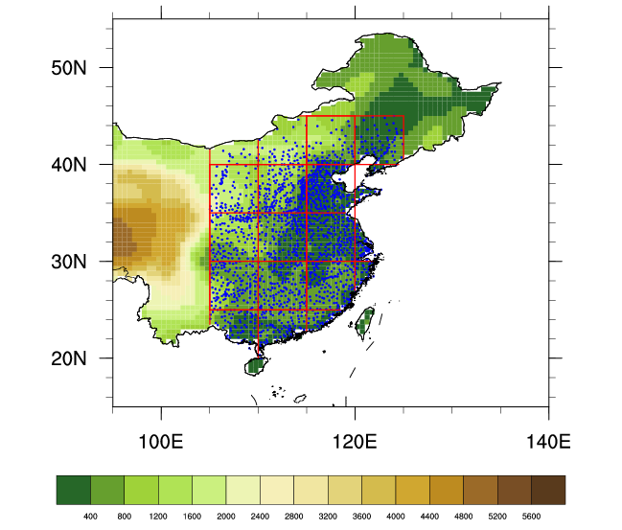
JJA mean temperature in Eastern China
Sun et al, Nature Climate Change, 2014
1.1°C
°C
Anomaly relative to 1955-1984
The 5 hottest summers have all occurred since 2000
(2013, 2007, 2000, 2010 and 2011)
Eastern China is densely observed
1749 stations (1955 onwards)
JJA mean temperature increased 0.82°C over 1955-2013
records were broken at more than 45% of stations in JJA 2013

Slide 29
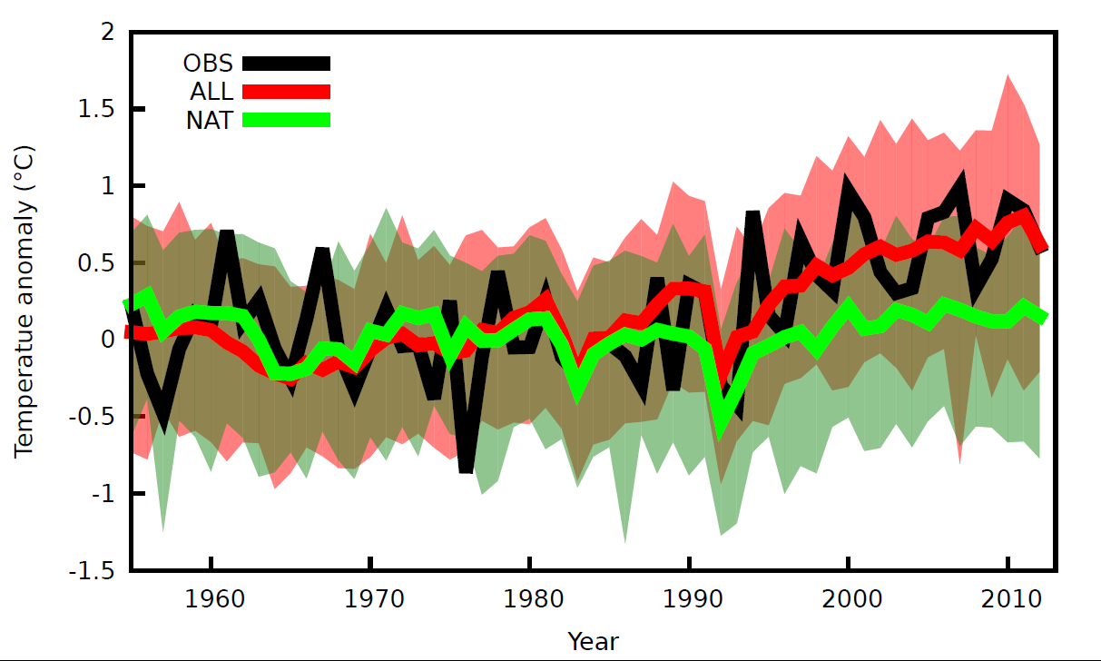
Observed and simulated JJA mean temperature in Eastern China (1955-2012)
Sun et al, Nature Climate Change, 2014
125 (26)
49 (12)
Anomalies relative to 1955-1984
The multi-model ensemble mean (ALL forcing)
well simulates the observed temperature record.
Notes:
Shading shows 5-95% range

Slide 30
Detection and attribution results for change JJA climate over 1955-2012
ALL forcing → 0.82°C (0.57°C, 1.07°C)
NAT forcing → 0.03°C (-0.00°C, 0.07°C)
Urban warming may be responsible for part of the “ALL” attributed warming - possibly 0.21°C (0.16°C, 0.26°C)
Notes:
Note that large scale forcing and urban warming combined have a similar affect on risk of hot summers.

Slide 31
How rare was JJA of 2013?
1.1°C
°C
Sun et al, Nature Climate Change, 2014
Anomaly relative to 1955-1984
1.1°C ≈ 3.5 SD above the 1955-1984 mean
Estimated event frequency
  once in 270-years in control simulations
  once in 29-years in “reconstructed” observations
  once in 4.3 years relative to the climate of 2013
Fraction of Attributable Risk in 2013: (p₁ – p₀)/p₁≈ 0.984
Prob of “sufficient causation”: PS=1-((1-p₁)/(1-p₀)) ≈ 0.23
Notes:
FAR=PN=1-p1/p0=0.984
PS =1-((1-p1)/(1-p0))=0.23

Slide 32
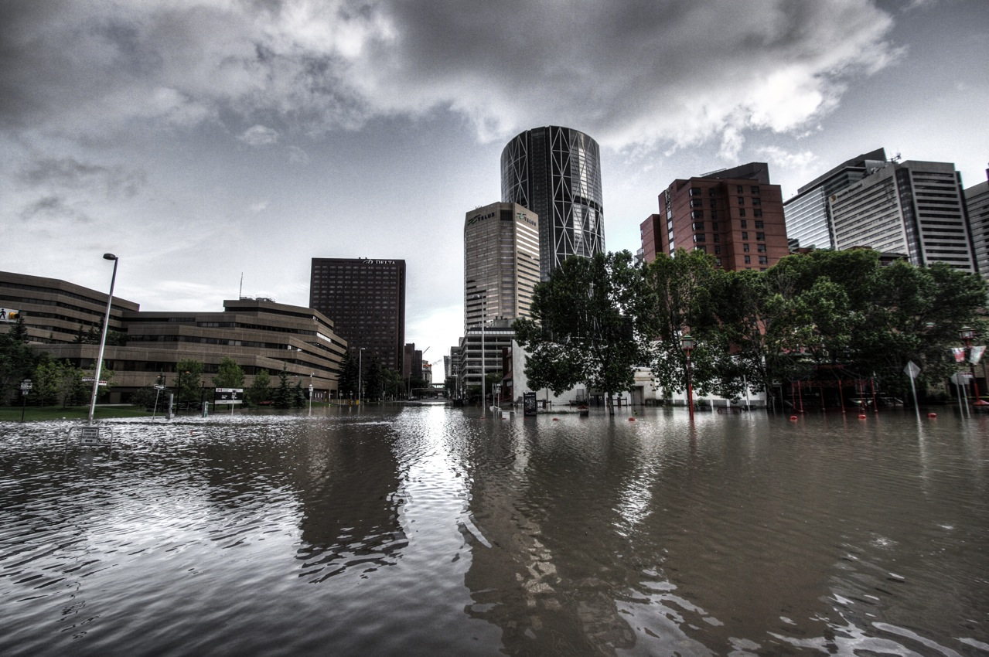
Calgary flood, 2013
Looking towards downtown Calgary from Riverfront Avenue (June 21, 2013), courtesy Ryan L.C. Quan

Slide 33
Calgary floods (Teufel et al, accepted)
Southern Alberta MJ max 1-day precip
Distribution of annual May-June maximum 1-day southern-Alberta precipitation in CRCM5 under factual and counter-factual conditions (conditional on prevailing global pattern of SST anomalies)
Frequency doubles (~25-yr → ~12 yr)
Magnitude increases ~10%
FAR=PN≈0.5
PS≈0.04
Notes:
Observed (dashed line) is from CaPA
Solid lines are CRCM-5 “ref” simulations (0.11 deg resolution, ERA-Int driven, launched at 6 hourly intervals beginning 00Z June 12, continuing to 00Z June 22)
Factual and counterfactual simulated with CRCM5 variable resolution mode (0.5 degree over N. America, 2 degree elsewhere).
Counterfactual uses 1850 anthropogenic forcing, observed SST patterns adjusted to 1850 using CanESM2, GFDL-ESM2M, and GISS-E2-H
Factual and counterfactual ensembles contain 1000 simulations for each SST configuration (4000 runs in total).
Runs are launched hourly beginning 08Z 20 Nov 2012. Initial conditions are from a longer spin-up runs that start early in 2012 (one spin up for each SST configuration)

Slide 34
Calgary floods (Teufel et al, accepted)
Distribution of annual May-June maximum 1-day Bow River Basin precipitation in CRCM5 under factual and counter-factual conditions (conditional on prevailing global pattern of SST anomalies)
Notes:
Anthropogenic signal less apparent at the scale of the BRB

Slide 35
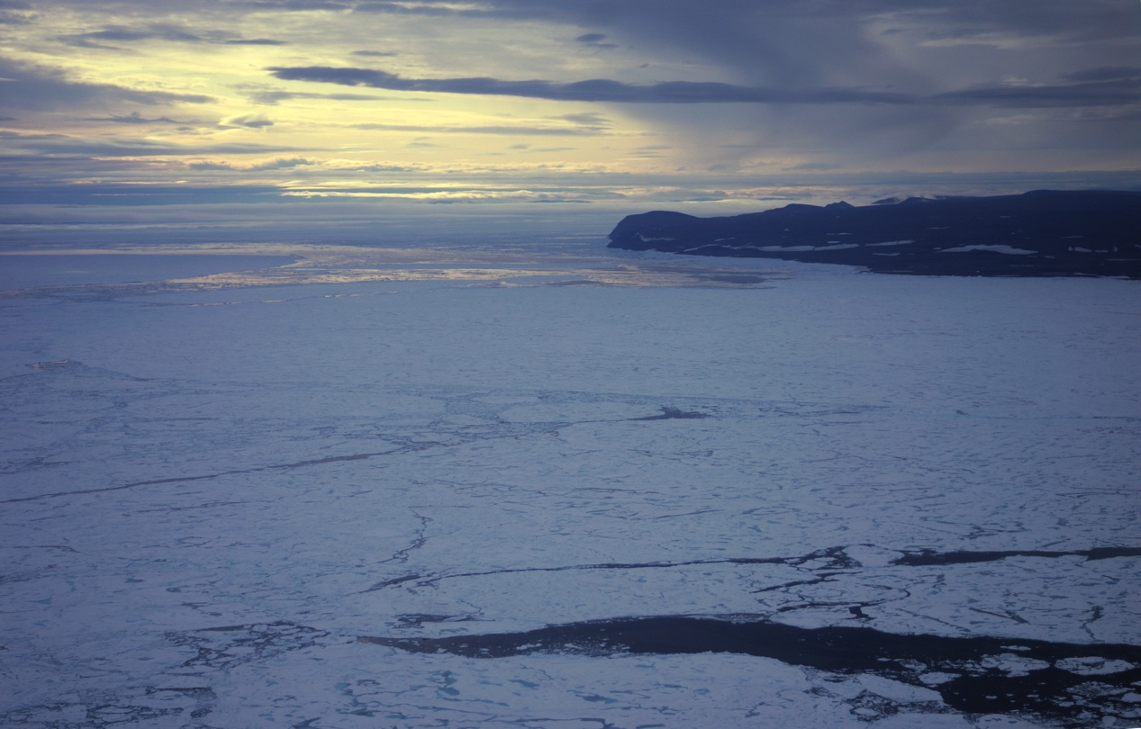
Arctic sea-ice extent extremes
Photo: F. Zwiers (approach to Alert, Aug., 2009)

Slide 36
Ensembles of ALL and NAT Forcing
Simulate Arctic sea ice extent (SIE) under anthropogenic + natural forcings (ALL) and only natural forcings (NAT) and compare the probabilities of occurrence of a particular extreme event under each forcing.
September
N = 50
N = 30
N = 35
Notes:
September SIE for ALL in blue and NAT in green; plotting ensemble mean and shading is p5-p95 across ensemble; observations in black
Notes: CESM1 uses collection of segments from PIC; also using IPSL (chosen for its high bias) but only 3 ensemble members

Slide 37
Internal Variability Comparison
Standard Deviation of annual mean SIE after trend removal
How does model internal variability compare to observations?
Compare standard deviation of each annual SIE time series with observed (black line).
ALL NAT PIC
A linear trend has been removed from ALL and OBS before the standard deviation is computed.
Most models show more variability than observations
Generally good agreement between forcing scenarios
CESM1 underestimates variability in Sep.
Notes:
Calculated standard deviation over 1979-2012 for each realization
Boxplots showing spread across realizations for each model and forcing scenario (colors)
Removed linear trend from each ALL realization and the obs before calculating standard deviation
- Plotting for annual means here; only noteworthy difference for monthly is CESM1 underestimating in Sep.

Slide 38
Detection/Attribution Results
How much of the observed temporal pattern in SIE can be explained by the ALL and NAT responses?
ALL and ANT forcing signals detected with almost all models for both annual and Sep. and are generally consistent in magnitude with observations
Notes:
Scaling factors and 90% Cis for 1-signal ALL (Blue) and two signal ANT (raspberry) and NAT (green)
Filled squares mean RCT was passed; open indicates model variability is too low (none failed with model variability too high)

Slide 39
Defining SIE Extreme Events
Notes:
Time series of ensemble means (colors by model, darker shade is ALL, lighter is NAT) for 4 methods of defining SIE events:
Absolute values (what is realized from the model)
Anomalies relative to 1981-2010
Fraction of the 1979 mean
5-year means (due to limits of CMIP5 data, will use period ending in 2012)

Slide 40
Event Attribution Methods
Pool data from all ensemble members for each decade
Fit density curves
Integrate to determine probability of an event more extreme than each anomaly threshold
Compare probability of event under ALL forcing with the probability of the same event under NAT forcing
Notes:
Plotting density curves for CanESM2 anomalies for 4 decades; ALL in blue, NAT in green
500 values (50 ensemble members x 10 years) into each curve

Slide 41
Event Attribution Results – Sep.
All models indicate an event of a magnitude equal to or more extreme than the 2012 record minimum would be exceptionally unlikely to occur under natural forcing alone. ALL forcing is a necessary, but not sufficient cause.
Notes:
Curves of FAR,PS,RR for an event more extreme than the given threshold (x-axis) using the anomalies and for the 2003-2012 decade (limited by CMIP5)
Vertical bar at observed 2012 event
Cutting off RR plot at 10**6
Resampled pool of data (from years in decade and ensemble members) to estimate uncertainty

Slide 42
Event Attribution Results – Mar.
Both models indicate ALL forcing is a necessary condition for the 2015 event.
In CanESM2 it is also almost a sufficient condition.
Notes:
Same but for March and using 2011-2020 decade; vertical bar is 2015 event

Slide 43
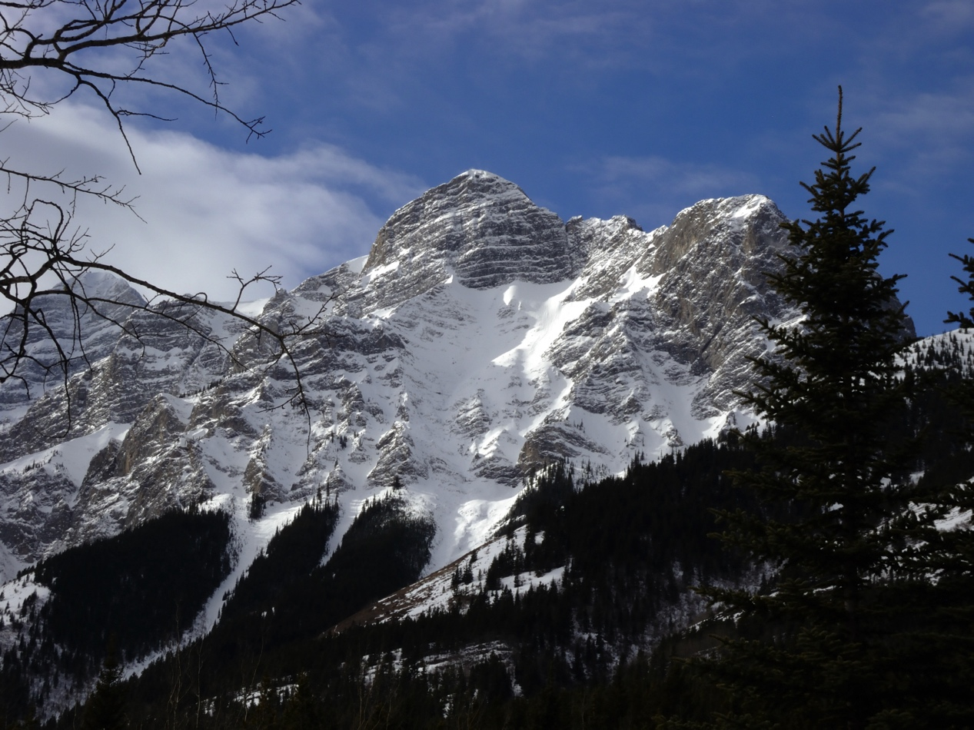
Some unresolved issues
Photo: F. Zwiers

Slide 44
Retrospective vs prospective
Most studies are prompted by specific events
Alternatively, could study pre-defined events
Distribution of annualJJA temperature in the 2000’s relative to 1961-90 in East Asia with and without ANT forcing
Fraction of
Attributable Risk
JJA mean temperature
°C
Christidis et al, 2014
°C

Slide 45
Some unresolved issues
Event characterization
  Class vs individual, risk-based vs storyline
  Individual is not synonymous with storyline
  Data assimilation approach of Hannart et al (2016)
Event definition
Dependence on models
Counterfactual state specification uncertainty when conditional approach is used
Selection bias
  Need objective event selection criteria
Communications
  At each stage media and response/recovery cycle

Slide 46

Questions?
Photo: F. Zwiers

