Slide 1
BIRS Workshop on Uncertainty Modeling in the Analysis of
Weather, Climate and Hydrological Extremes
Assessing Climate Extremes across Scales
From Global to Regional Climate Modeling to Decision-making
Jana Sillmann
and many contributors
BIRS Center, Banff, June 13-17

Slide 2
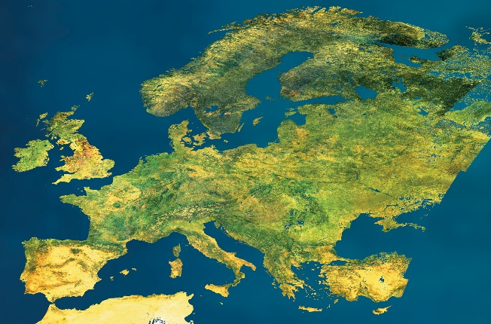
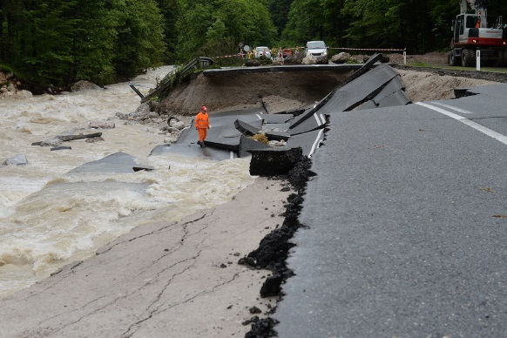
WCRP Grand Challenges on Understanding and Predicting Weather and Climate Extremes
Global
Regional
Local
Century Decade Season Month Week Day Hour

Slide 3
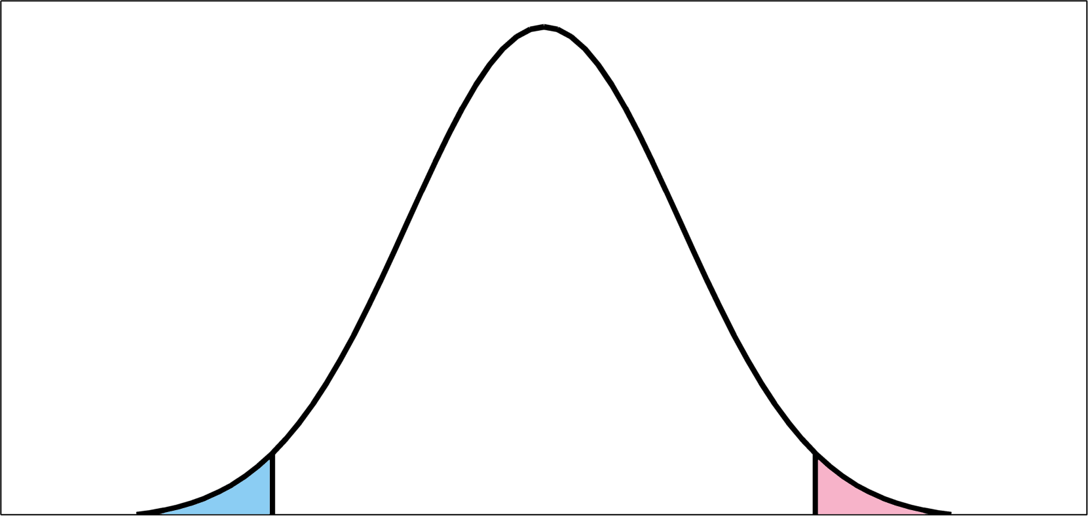
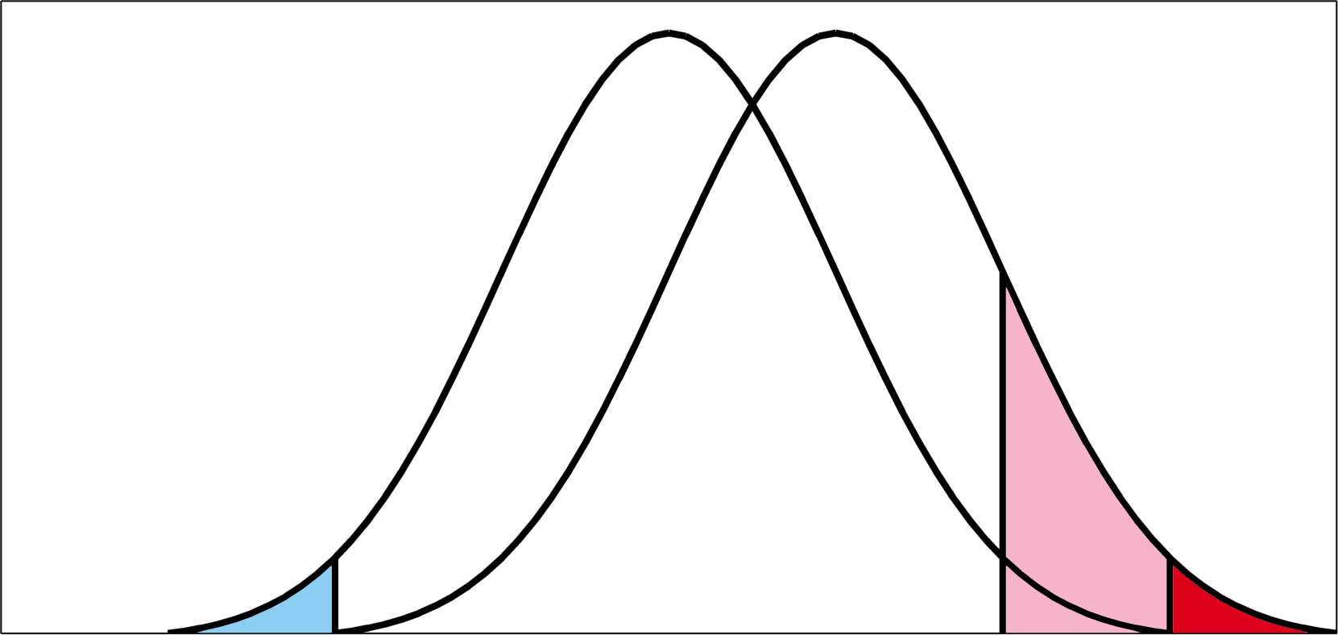
Challenges
Extreme events are rare in space and time
Universally valid definitions
Lack of observational data
Scale mismatch between observation
and model output
Approaches in IPCC AR5
Indices for climate extremes, such as defined by the
Expert Team on Climate Change Detection and Indices (ETCCDI)
Extreme value analysis → Return values/periods
Increase in mean
More
hot
weather
IPCC AR4 WGI
Previous
climate
Less cold weather
More
record hot weather
New
climate
Cold
Average
Hot

Slide 4
Outline
Climate Extremes on Global Scale
Model Evaluation
Climate Extremes on Regional Scale
Statistical Modeling incorporating Uncertainty
Outlook: Decision-making under Uncertainty

Slide 5
Outline
Climate Extremes on Global Scale
Model Evaluation
Climate Extremes on Regional Scale
Statistical Modeling incorporating Uncertainty
Outlook: Decision-making under Uncertainty

Slide 6
http://etccdi.pacificclimate.org/list_27_indices.shtml
developed an internationally coordinated set of climate indices - core set consists of 27 descriptive indices
FD, ID, SU, TR
TX_{n}, TN_{n}, TX_{x}, TN_{x}
TN10p, TX10p, TN90p, TX90p
CSDI, WSDI
GSL, DTR
Rx1day, Rx5day
SDII
R10mm, R20mm, Rnnmm
CDD, CWD
R95pTOT, R99pTOT
PRCPTOT
Increase in mean
More
hot
weather
IPCC AR4 WGI
Previous
climate
Less cold weather
More
record hot weather
New
climate
Cold
Average
Hot
focus on counts of days crossing a threshold; either absolute/fixed thresholds or percentile/variable thresholds relative to local climate

Slide 7
http://etccdi.pacificclimate.org/

Slide 8
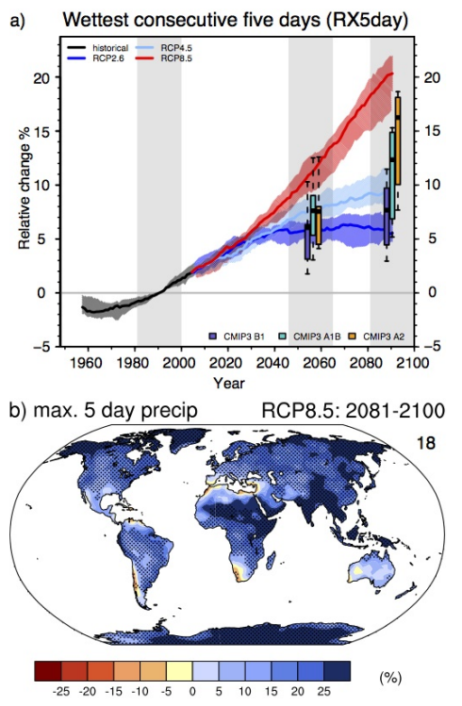
1. Climate Extremes on a Global Scale
IPCC AR4 (2007)
CMIP3 models
IPCC SREX (2012)
CMIP3 models
IPCC AR5 (2013)
CMIP3/CMIP5

Slide 9
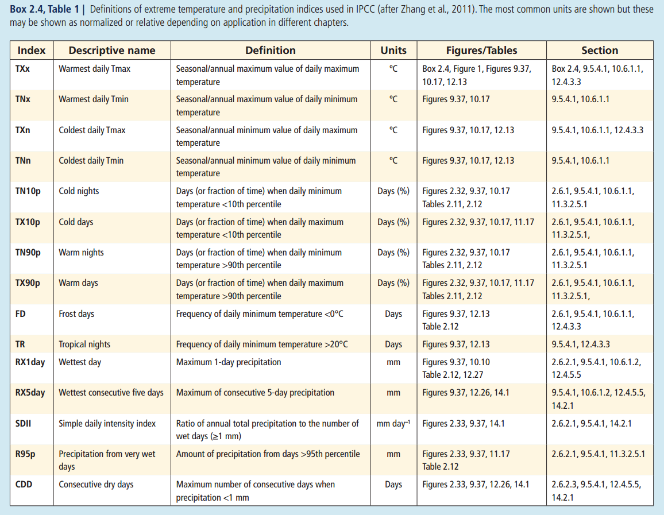
1. Climate Extremes on a Global Scale
Indices for Climate Extremes (IPCC AR5)
IPCC 2013

Slide 10
1. Climate Extremes on a Global Scale
www.climdex.org

Slide 11
1. Climate Extremes on a Global Scale
Observations and Climate Models
Observations
(www.climdex.org)
Reanalyses
(ERA40, ERAInterim, NCEP1, NCEP2)
Global Climate Models
(CMIP3 and CMIP5)
Indices
Archive
http://www.cccma.ec.gc.ca/data/climdex/index.shtml
Sillmann et al. JGR 2013a, b

Slide 12
Outline
Climate Extremes on Global Scale
Model Evaluation
Climate Extremes on Regional Scale
Statistical Modeling incorporating Uncertainty
Outlook: Decision-making under Uncertainty

Slide 13
2. Model Evaluation
Model Performance Metrics
We assess individual model performance compared to four reanalyses using
relative error estimates, which describe model performance relative to each other.
Calculation of root-mean square error (RMSE) statistic for each annual index (i):
subtracting the model index (X_{i}) from the re-analysis index (Y_{i})
and squaring the difference,
(b) averaging the difference over global land
(c) taking the square root of the field average:
(d) Relative RMSE (RMSE'):
with RMSEmedian being the median of RMSE for all models (i.e. typical model
performance in the multimodel ensemble)

Slide 14
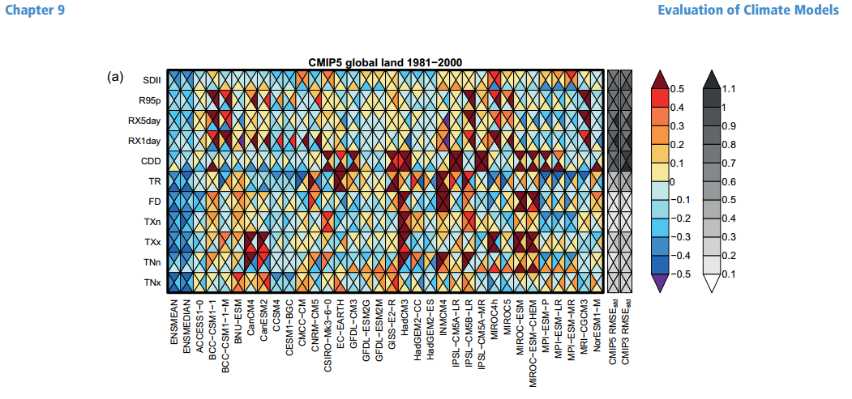
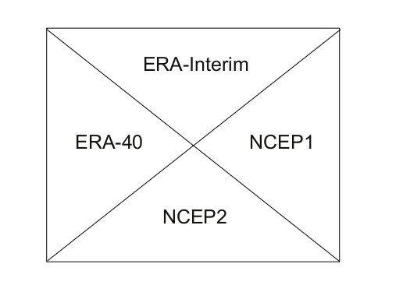
2. Model Evaluation
IPCC AR5 WGI
worse
Root Mean Square Error (RMSE)
Reanalyses
better
based on Sillmann et al. JGR 2013a
Differences between reanalyses can be as large as intermodel spread
Need for better global coverage of observations and improvement of reanalysis products
Model and reanalysis performance depends on region and index under consideration
Notes:
Reanalyses are distinct from, but complement, more ‘traditional’ statistical approaches to assessing the raw observations. They aim to produce continuous reconstructions of past atmospheric states that are consistent with all observations as well as with atmospheric physics as represented in a numerical weather prediction model, a process termed data assimilation. Unlike real-world observations, reanalyses are uniform in space and time and provide non-observable variables (e.g., potential vorticity).

Slide 15
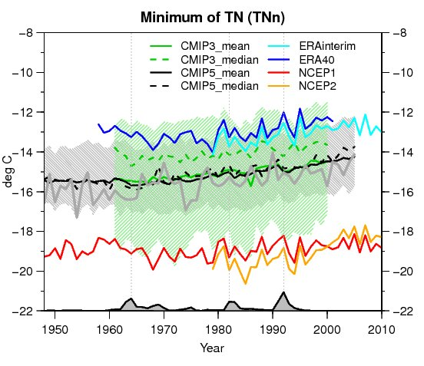
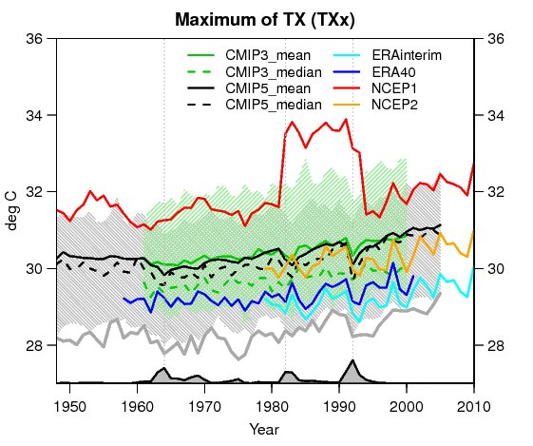
2. Model Evaluation
Absolute Difference
Coldest daily Tmin (TNn)
Warmest daily Tmax (TXx)
Sillmann et al. JGR 2013a
Notes:
Reanalyses are distinct from, but complement, more ‘traditional’ statistical approaches to assessing the raw observations. They aim to produce continuous reconstructions of past atmospheric states that are consistent with all observations as well as with atmospheric physics as represented in a numerical weather prediction model, a process termed data assimilation. Unlike real-world observations, reanalyses are uniform in space and time and provide non-observable variables (e.g., potential vorticity).

Slide 16
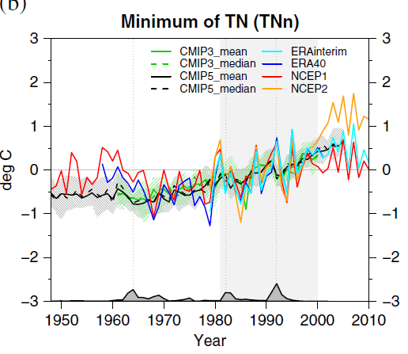
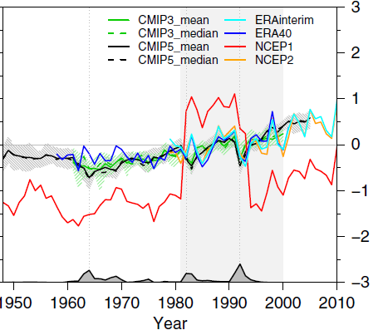
2. Model Evaluation
Anomalies
Coldest daily Tmin (TNn)
Warmest daily Tmax (TXx)
Sillmann et al. JGR 2013a
Notes:
Reanalyses are distinct from, but complement, more ‘traditional’ statistical approaches to assessing the raw observations. They aim to produce continuous reconstructions of past atmospheric states that are consistent with all observations as well as with atmospheric physics as represented in a numerical weather prediction model, a process termed data assimilation. Unlike real-world observations, reanalyses are uniform in space and time and provide non-observable variables (e.g., potential vorticity).

Slide 17
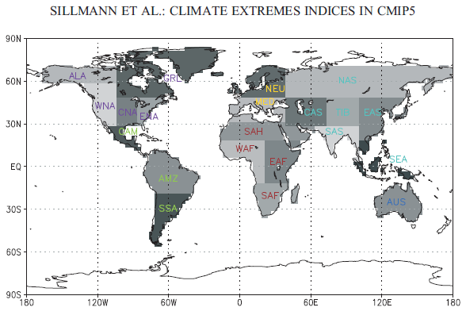
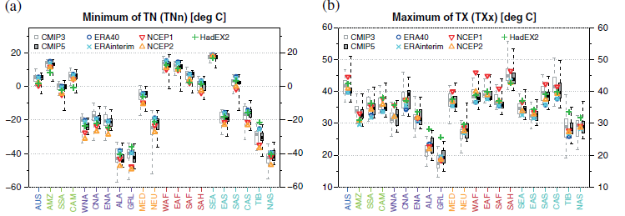
2. Model Evaluation
Regional Assessment

Slide 18
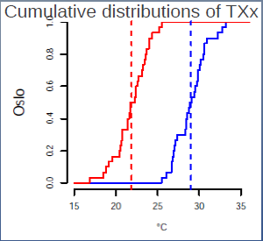
2. Model Evaluation
Model Evaluation using Proper Skill Scores
Development of model evaluation tools to compare the full distributions of observed and modeled extreme temperatures using monthly indices
Thorarinsdottir et al. 2013
Notes:
Reanalyses are distinct from, but complement, more ‘traditional’ statistical approaches to assessing the raw observations. They aim to produce continuous reconstructions of past atmospheric states that are consistent with all observations as well as with atmospheric physics as represented in a numerical weather prediction model, a process termed data assimilation. Unlike real-world observations, reanalyses are uniform in space and time and provide non-observable variables (e.g., potential vorticity).

Slide 19
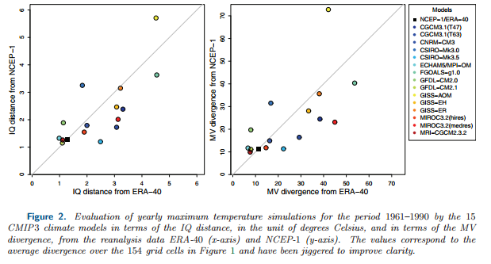
2. Model Evaluation
Model Evaluation using Proper Skill Scores
T L Thorarinsdottir, T Gneiting and N Gissibl Using proper divergence functions to evaluate climate models SIAM/ASA Journal on Uncertainty Quantification, 1(1): 522-534, 2013
Notes:
Reanalyses are distinct from, but complement, more ‘traditional’ statistical approaches to assessing the raw observations. They aim to produce continuous reconstructions of past atmospheric states that are consistent with all observations as well as with atmospheric physics as represented in a numerical weather prediction model, a process termed data assimilation. Unlike real-world observations, reanalyses are uniform in space and time and provide non-observable variables (e.g., potential vorticity).

Slide 20
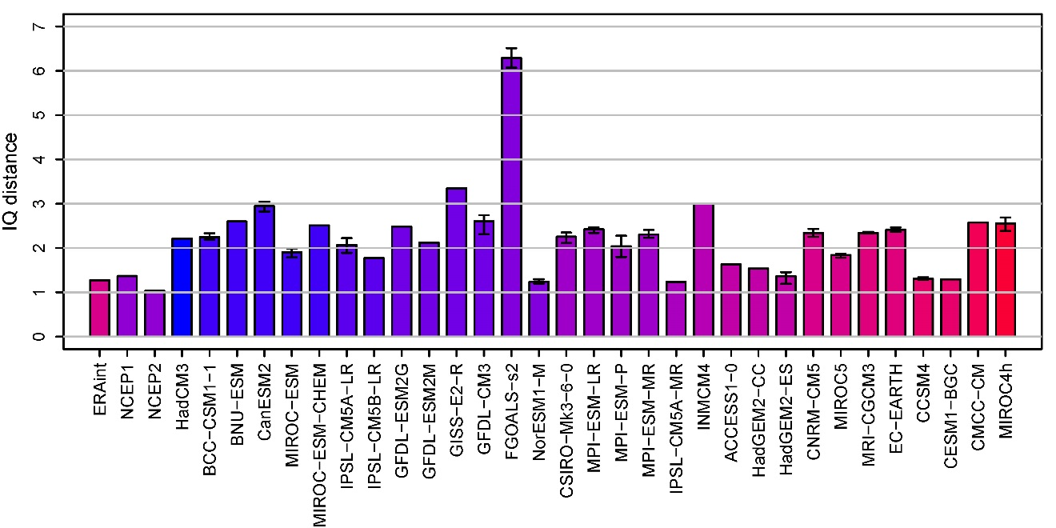
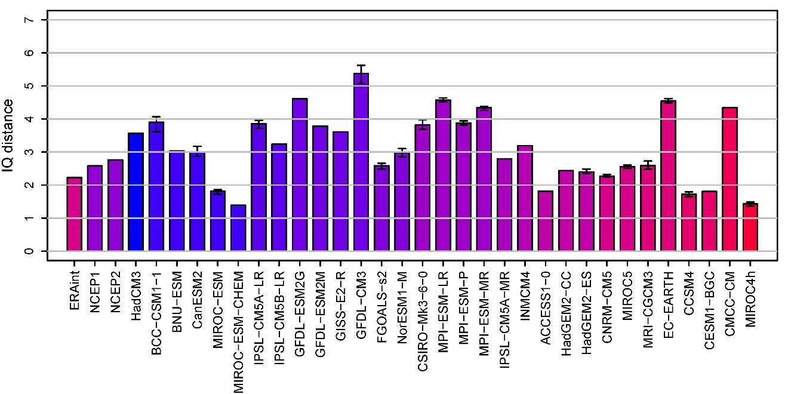
2. Model Evaluation
Model Evaluation using Proper Skill Scores
Development of model evaluation tools to compare the full distributions of observed (HadEX2) and modeled extreme temperatures using monthly indices
Europe
TXx- Monthly Maximum of Tmax
North America
Reanalyses
CMIP5 models
Sillmann, Thorarinsdottir & Gissibl, in prep.
Notes:
Reanalyses are distinct from, but complement, more ‘traditional’ statistical approaches to assessing the raw observations. They aim to produce continuous reconstructions of past atmospheric states that are consistent with all observations as well as with atmospheric physics as represented in a numerical weather prediction model, a process termed data assimilation. Unlike real-world observations, reanalyses are uniform in space and time and provide non-observable variables (e.g., potential vorticity).

Slide 21
2. Model Evaluation
Challenges/Research Questions
What scores are currently available to assess extremes?
How to calculate them based on an ensemble, and how to evaluate deterministic forecasts using scores?
Quality and availability of the underlying reference dataset (e.g., reanalysis or observations)
Methods applied need to account for uncertainty, also in the observations → New data sources (e.g. satellite or remote sensing data)
Application and development of model performance metrics suited for extremes statistics (e.g., new scores, divergence or comparison measures for distributions)
http://www.wcrp-climate.org/extremes-modeling-wkshp-about
Notes:
Reanalyses are distinct from, but complement, more ‘traditional’ statistical approaches to assessing the raw observations. They aim to produce continuous reconstructions of past atmospheric states that are consistent with all observations as well as with atmospheric physics as represented in a numerical weather prediction model, a process termed data assimilation. Unlike real-world observations, reanalyses are uniform in space and time and provide non-observable variables (e.g., potential vorticity).

Slide 22
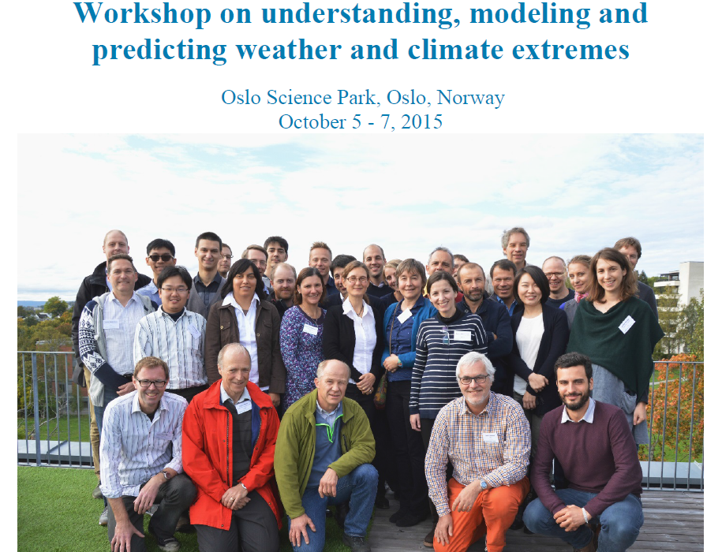

Slide 23
Outline
Climate Extremes on Global Scale
Model Evaluation
Climate Extremes on Regional Scale
Statistical Modeling incorporating Uncertainty
Outlook: Decision-making under Uncertainty

Slide 24
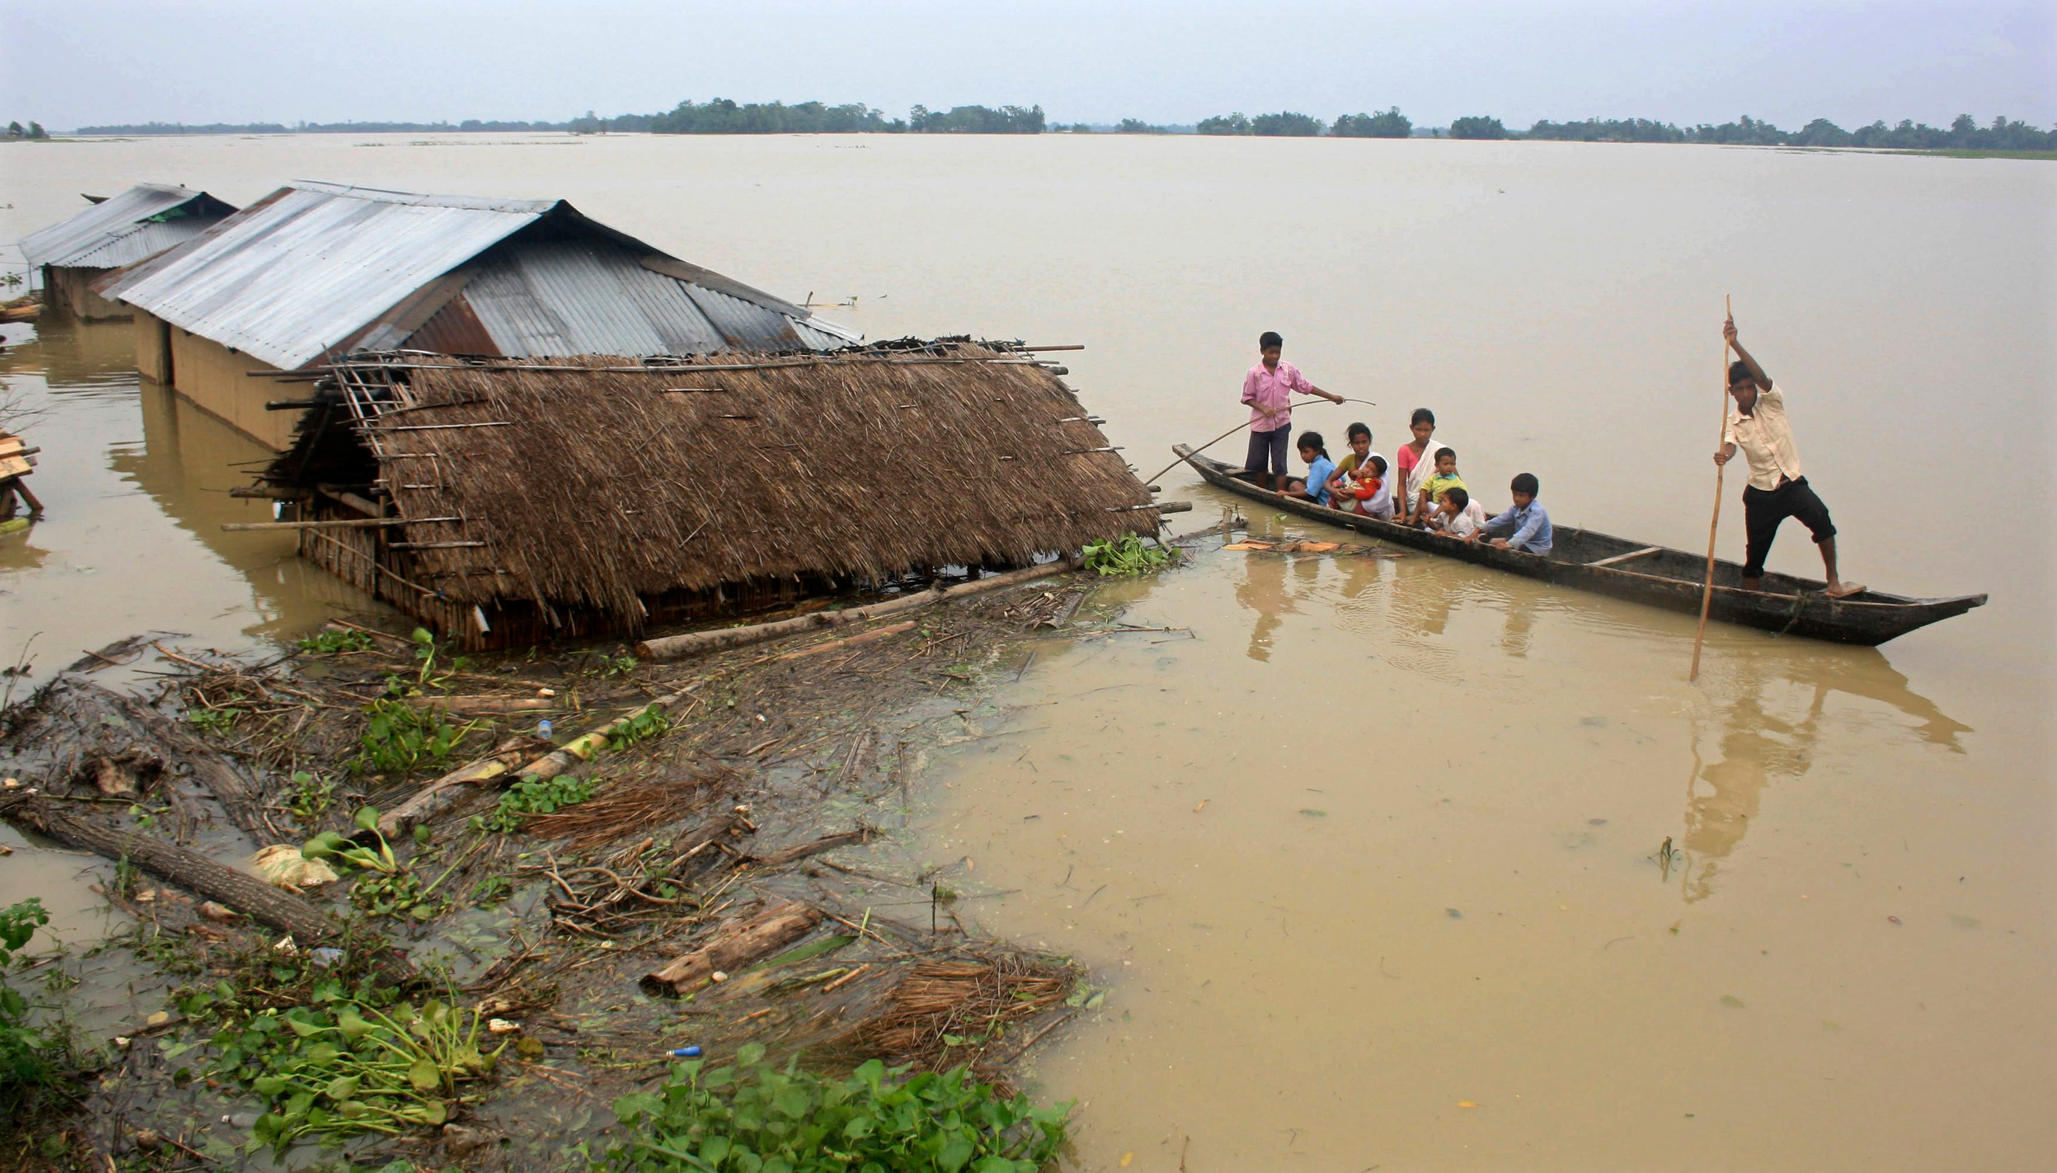
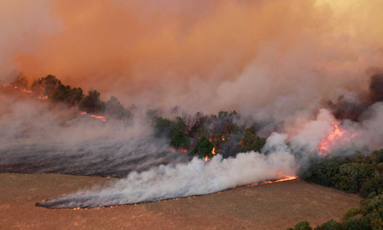
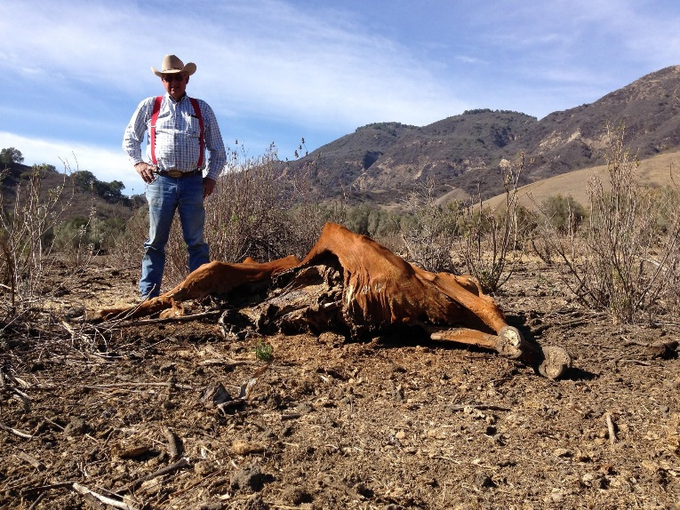
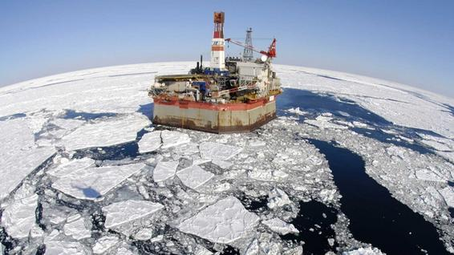
3. Climate Extremes on Regional Scales
Getting to the scales of impacts …
Century Decade Season Month Week Day Hour

Slide 25
3. Climate Extremes on Regional Scales
Global Climate Models
(multi- and single model ensembles)
Global
Reanalyses
(ERA40, ERAInterim, NCEP1, NCEP2)
Regional
Regional Climate Models
(CORDEX)
Local
Observations
Do we have the necessary observations?
Century Decade Season Month Week Day Hour

Slide 26
3. Climate Extremes on Regional Scales
Extreme Heat Waves
Russian Heat Wave 2010 in E-OBS
Regional Climate Models – EURO-CORDEX
Russo, Sillmann & Fischer, ERL, 2015
Heatwave Magnitude Index daily (HWMId)

Slide 27
3. Climate Extremes on Regional Scales
Extreme Heat Waves
Regional Climate Models – EURO-CORDEX
Future Climate
Top ten European heat waves
Russo, Sillmann & Fischer (2015)
Over the next 2 decades increased probability of extreme heatwaves may regionally be masked or amplified by internal variability

Slide 28
3. Climate Extremes on Regional Scales
Global Climate Models
(multi- and single model ensembles)
Global
Reanalyses
(ERA40, ERAInterim, NCEP1, NCEP2)
Regional
CanESM2
50-member ensemble
Regional Climate Models
(CORDEX)
Local
Observations
Century Decade Season Month Week Day Hour

Slide 29
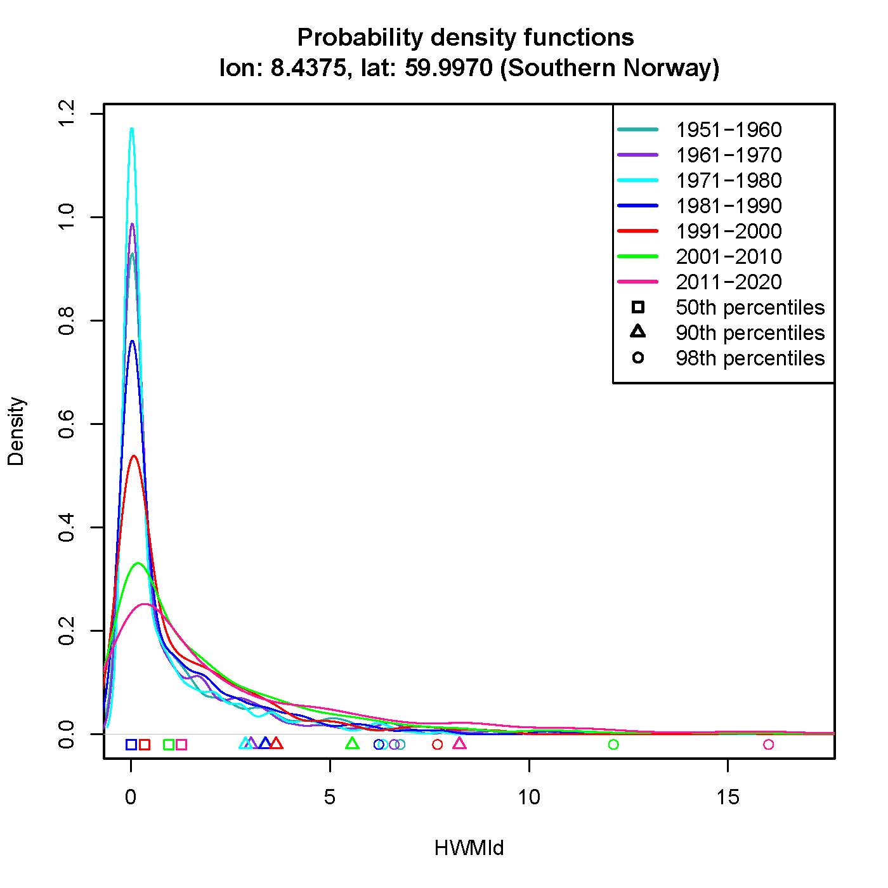
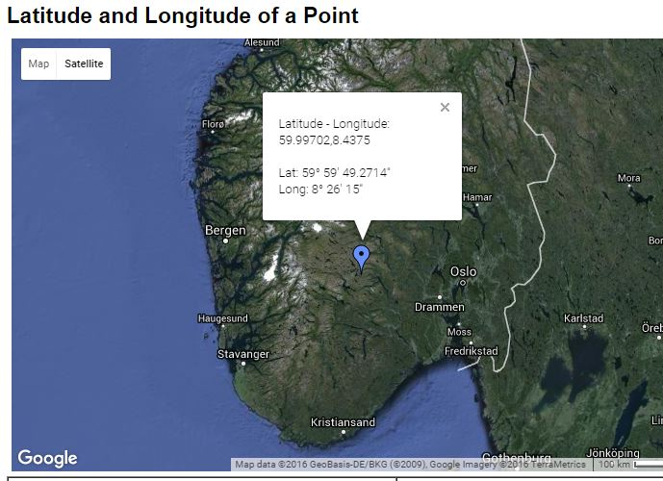
3. Climate Extremes on Regional Scales
Distribution of heatwaves in a 50-member ensemble

Slide 30
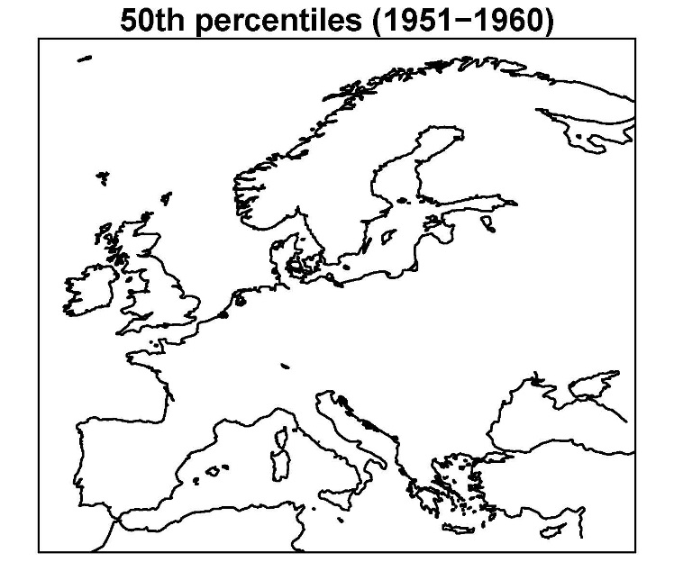
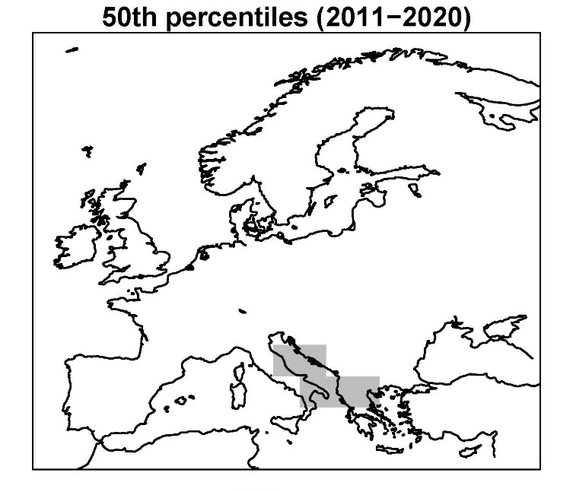
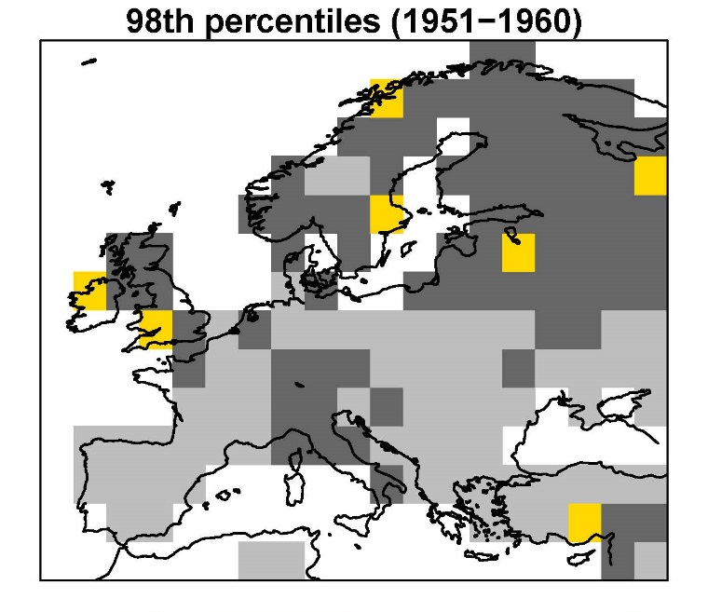
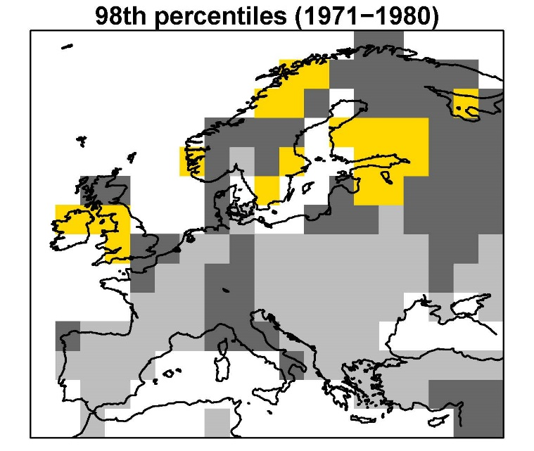
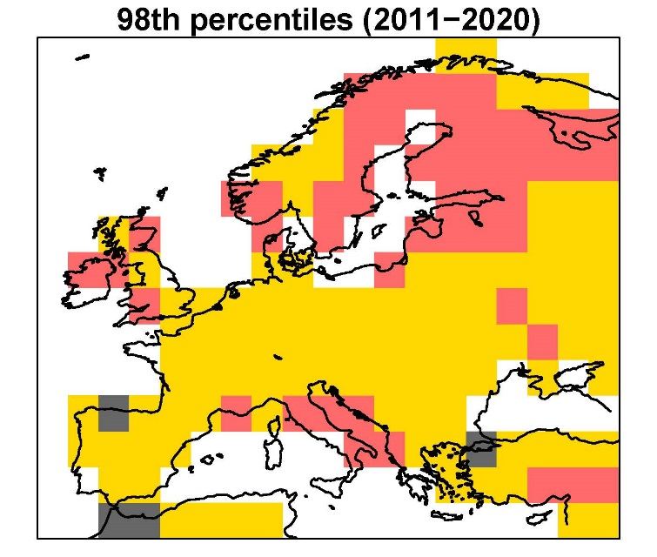
3. Climate Extremes on Regional Scales
MEDIAN
EXTREME

Slide 31
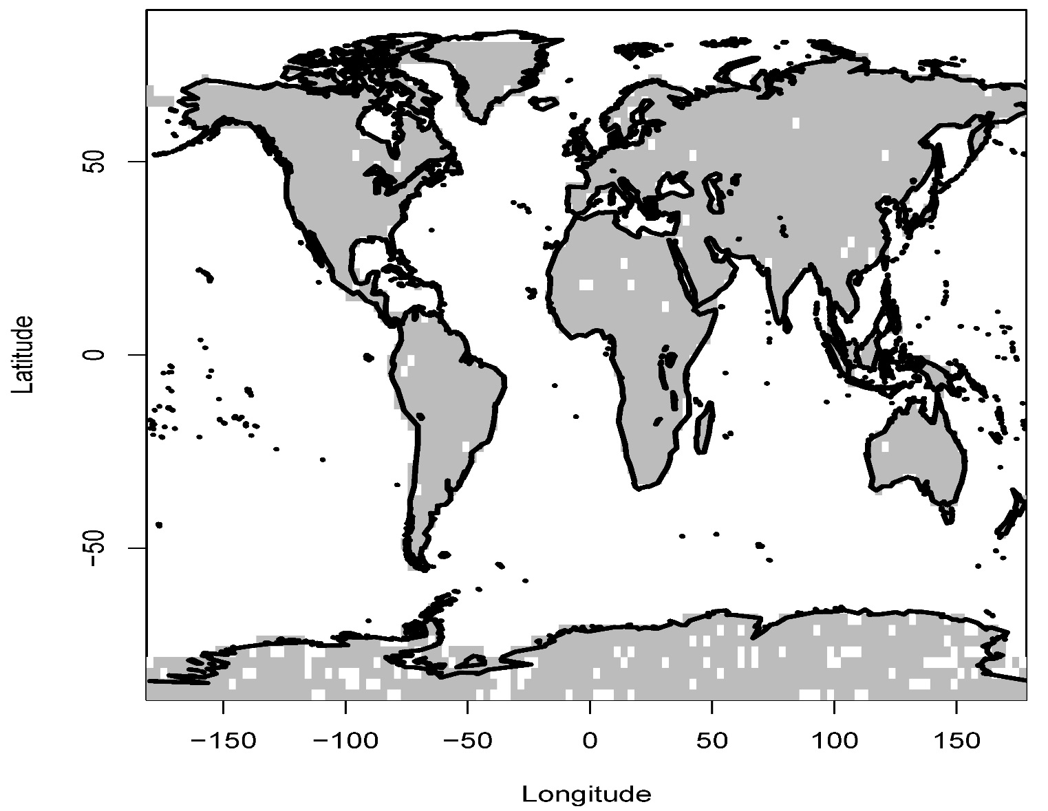
3. Climate Extremes on Regional Scales
Fitting Generalized Extreme Value (GEV) distribution
Testing Goodness-of-Fit (KS-test)
p-value < 0.1
p-value > 0.1

Slide 32
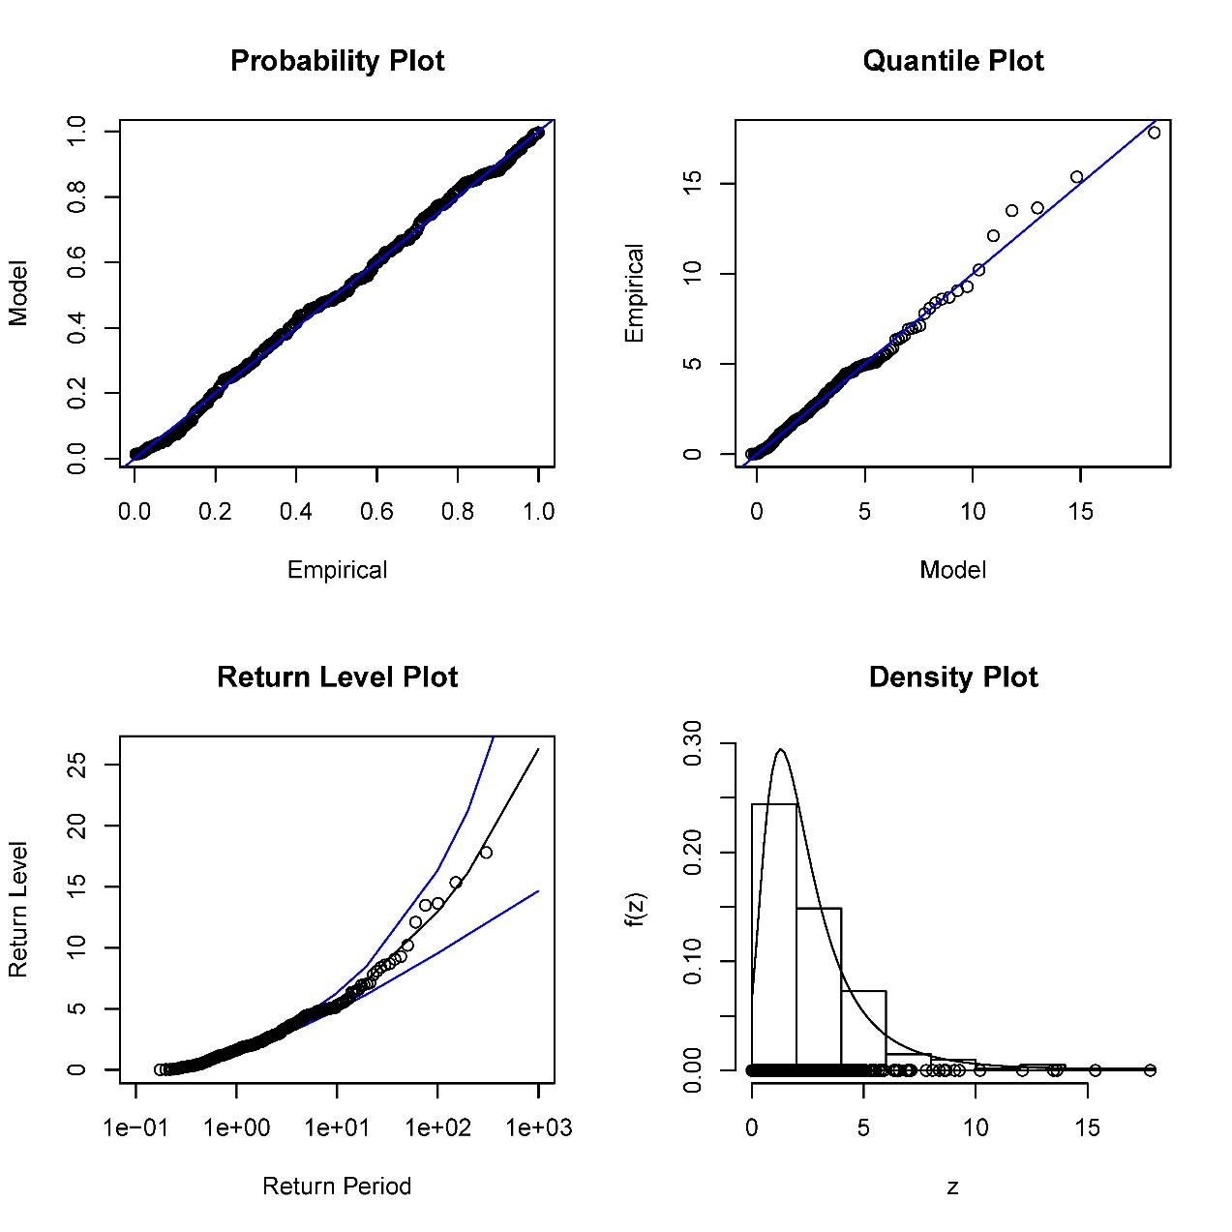
4. Climate Extremes on Regional Scales
Testing Goodness-of-Fit: Good Fit

Slide 33
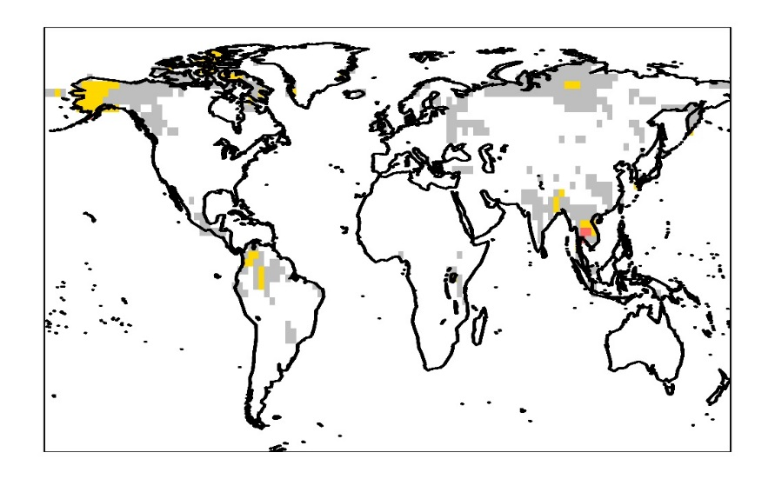
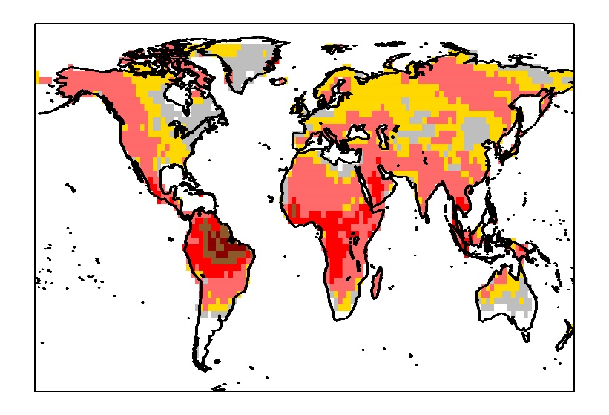
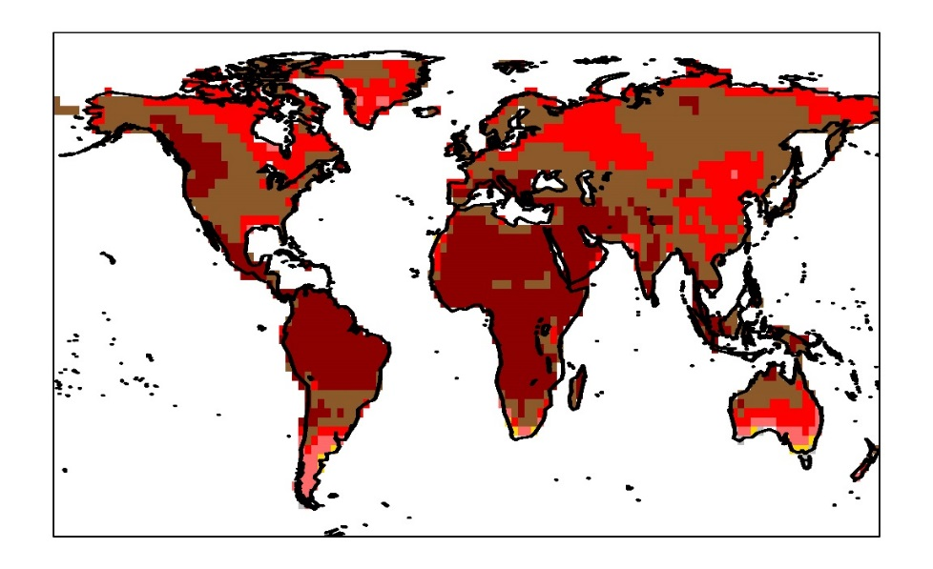
3. Climate Extremes on Regional Scales
10-yr Return Values Estimates from GEV
1991-2000 (historical)
2031-2040 (RCP8.5)
2091-2100 (RCP8.5)

Slide 34
3. Climate Extremes on Regional Scales
Challenges/Research Questions
Need to improve our understanding of the mechanisms that lead to the occurrence of extreme events
Value of single measurements (i.e. case studies of single events) versus robust statistics (ensembles?) over a series of similar events or regions for model evaluation
Both dynamic and thermodynamic processes play a role, which is important to distinguish when evaluating model simulations and for the prediction of extremes
http://www.wcrp-climate.org/extremes-modeling-wkshp-about
Notes:
Reanalyses are distinct from, but complement, more ‘traditional’ statistical approaches to assessing the raw observations. They aim to produce continuous reconstructions of past atmospheric states that are consistent with all observations as well as with atmospheric physics as represented in a numerical weather prediction model, a process termed data assimilation. Unlike real-world observations, reanalyses are uniform in space and time and provide non-observable variables (e.g., potential vorticity).

Slide 35
Outline
Climate Extremes on Global Scale
Model Evaluation
Climate Extremes on Regional Scale
Statistical Modeling incorporating Uncertainty
Outlook: Decision-making under Uncertainty

Slide 36
4. Statistical Modeling incorporating Uncertainty
Sources of Uncertainty
Climate
Modes of climate variability
Changes in Extremes
Natural Variability
More
hot
weather
Previous
climate
Anthropogenic Climate Change
Less cold weather
More
record hot weather
New
climate
Cold
Average
Hot
Greenhouse Gases
Aerosols/Short-lived climate forcers (SLCF)

Slide 37
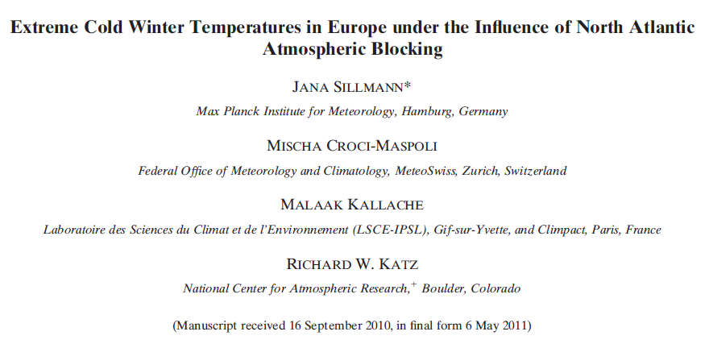
4. Statistical Modeling incorporating Uncertainty
Uncertainty from Natural Variability
Atmospheric blocking
Climate
Natural Variability
Anthropogenic Climate Change

Slide 38
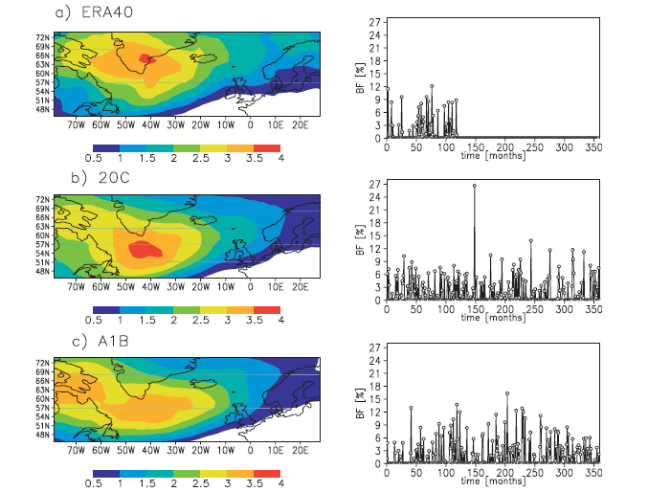
4. Statistical Modeling incorporating Uncertainty
Climatology of North Atlantic Atmospheric Blocking
Reanalysis
Climate model- present
Climate model- future
Sillmann et al. 2011

Slide 39
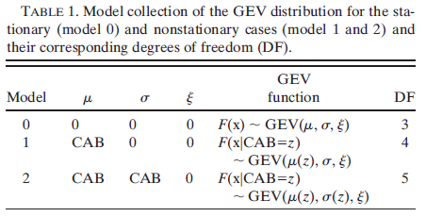
4. Statistical Modeling incorporating Uncertainty
Atmospheric Blocking as co-variate in GEV
Sillmann et al. 2011

Slide 40
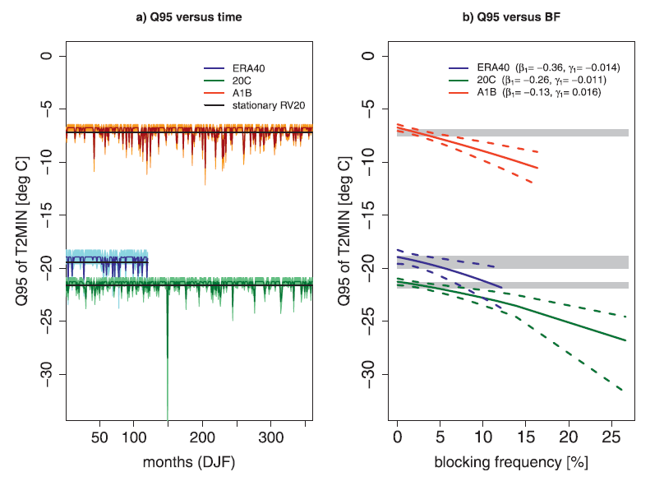
4. Statistical Modeling incorporating Uncertainty
Atmospheric Blocking as co-variate in GEV
Sillmann et al. 2011

Slide 41
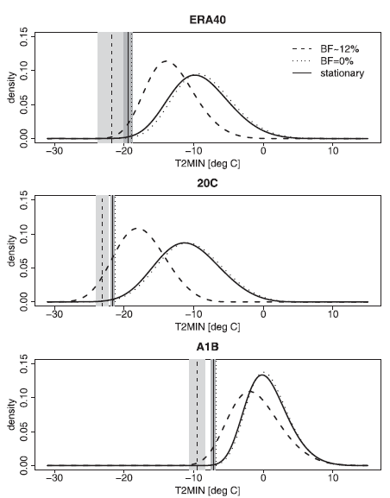
4. Statistical Modeling incorporating Uncertainty
Atmospheric Blocking as co-variate in GEV
Reanalysis
Climate model- present
Climate model- future
Sillmann et al. 2011

Slide 42
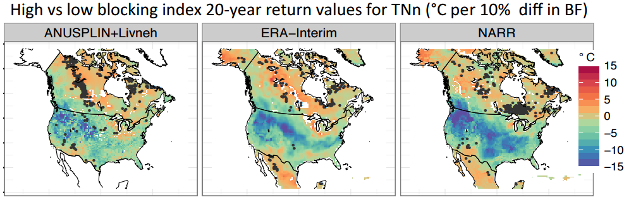
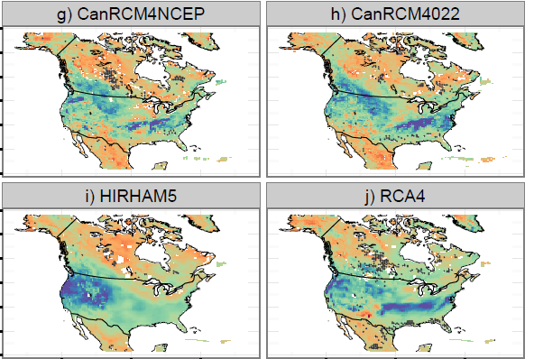
4. Statistical Modeling incorporating Uncertainty
Cold Spells and Atmospheric Blocking
Regional Climate Models – North America
Obs
Re-analysis
The influence of atmospheric blocking on extreme winter minimum temperatures in
North America
Whan, Zwiers & Sillmann, 2016
RCMs

Slide 43
4. Statistical Modeling incorporating Uncertainty
Challenges/Research Questions
Climate model simulations at different resolutions (global to regional) necessary to understand and simulate extremes and their changes
Non-stationary extreme values distribution can help to include important processes in the estimation of return values/periods and enables quantification of uncertainties
How to use non-stationary return values/periods in standards and design values?
Notes:
Reanalyses are distinct from, but complement, more ‘traditional’ statistical approaches to assessing the raw observations. They aim to produce continuous reconstructions of past atmospheric states that are consistent with all observations as well as with atmospheric physics as represented in a numerical weather prediction model, a process termed data assimilation. Unlike real-world observations, reanalyses are uniform in space and time and provide non-observable variables (e.g., potential vorticity).

Slide 44
Outline
Climate Extremes on Global Scale
Model Evaluation
Climate Extremes on Regional Scale
Statistical Modeling incorporating Uncertainty
Outlook: Decision-making under Uncertainty

Slide 45
5. Outlook
Decision-making under Uncertainty
Economic Decision Support Tools
Traditional
Multi-criteria analysis
Accounting for uncertainty
Cost-benefit analysis
Iterative risk (adaptive) management
Cost-effectiveness analysis
Decision support tools
Robust decision making
Portfolio analysis
Real options analysis
Rule based decision support for uncertainty
de Bruin 2015

Slide 46
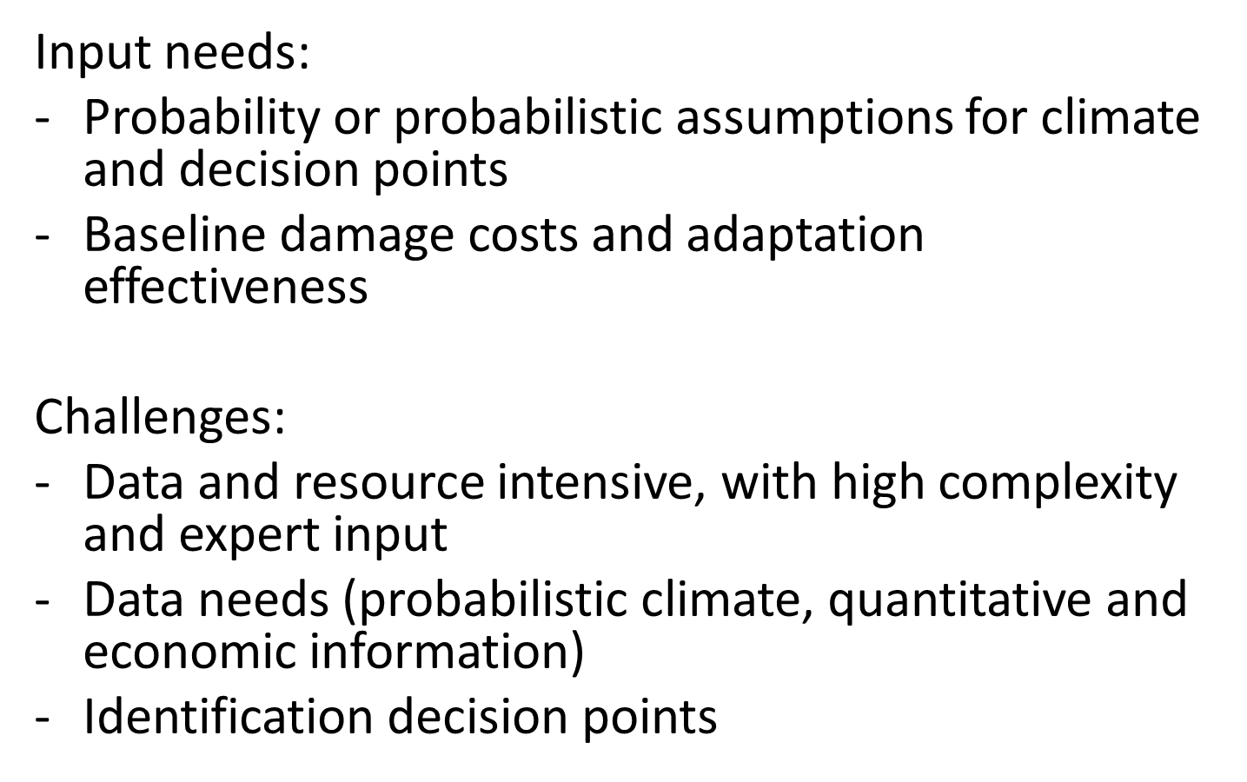
5. Outlook
Decision-making under Uncertainty
Real Options Analysis
Real options analysis
de Bruin 2015

Slide 47
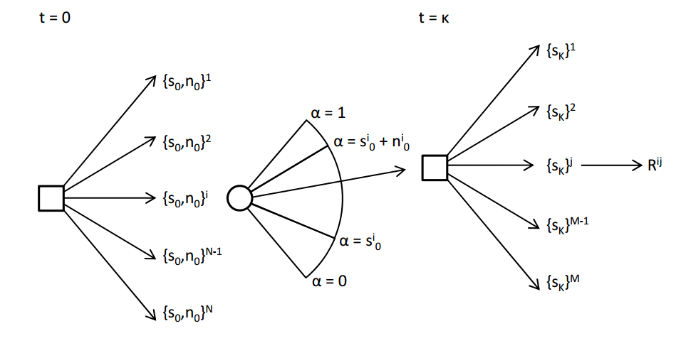
5. Outlook
Decision-making under Uncertainty
Real Options Analysis
Tailored climate information
Uncertainty
Decision Tree
de Bruin and Ansink, Clim Change Econ, 2011

Slide 48
Conclusions
Observations, observations, observations …
Process understanding is key to model evaluation and uncertainty assessment
How sophisticated can we go with using statistics, but still being able to apply it to large climate simulations (i.e. thousands of grid points, large ensembles) and «real world» applications?

Slide 49
Thank You!
http://www.cicero.uio.no/no/employee/35/jana-sillmann

Slide 50
4. Regional Modeling
Global Climate Models
(multi- and single model ensembles)
Global
Reanalyses
(ERA40, ERAInterim, NCEP1, NCEP2)
Regional
Regional Climate Models
(CORDEX)
Local
WRF
15km and 3km
Observations
Century Decade Season Month Week Day Hour

Slide 51
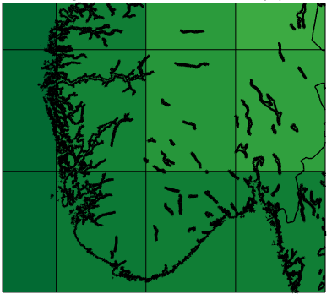
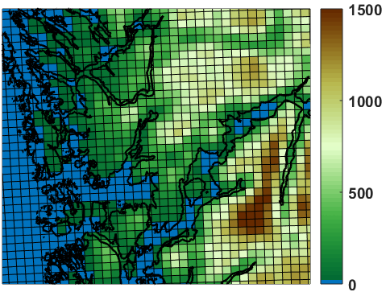
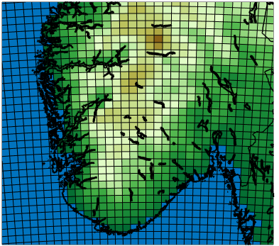
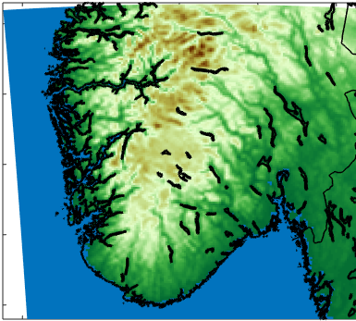
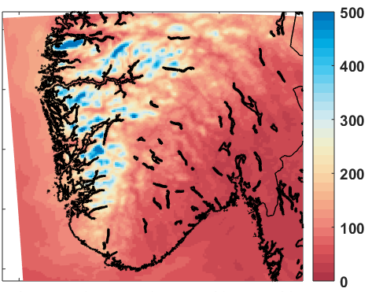
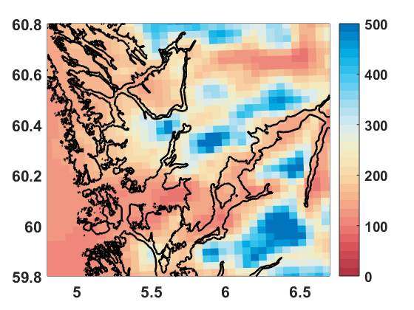
4. Regional Modeling
Extreme Precipitation – High-Resolution
Terrain height (m)
GCM
RCM
2.5° lon x 1.9 ° lat
15 km x 15 km
3 km x 3 km
Summer precipitation (mm/month)
GCM
RCM
Courtesy of Øivind Hodnebrog, projects HYPRE and SUPER @

