Slide 1
A plethora of uncertainty
The challenge of evaluating models and constraining projections given abundant internal variability?
Erich Fischer
ETH Zurich, Switzerland

Slide 2
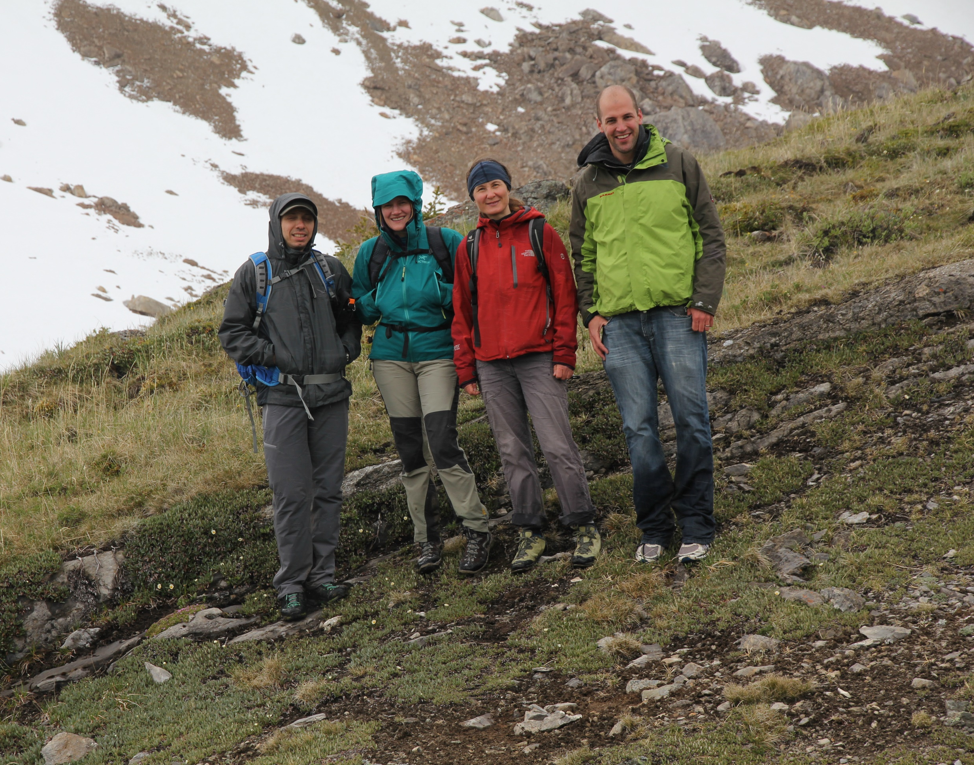

Slide 3
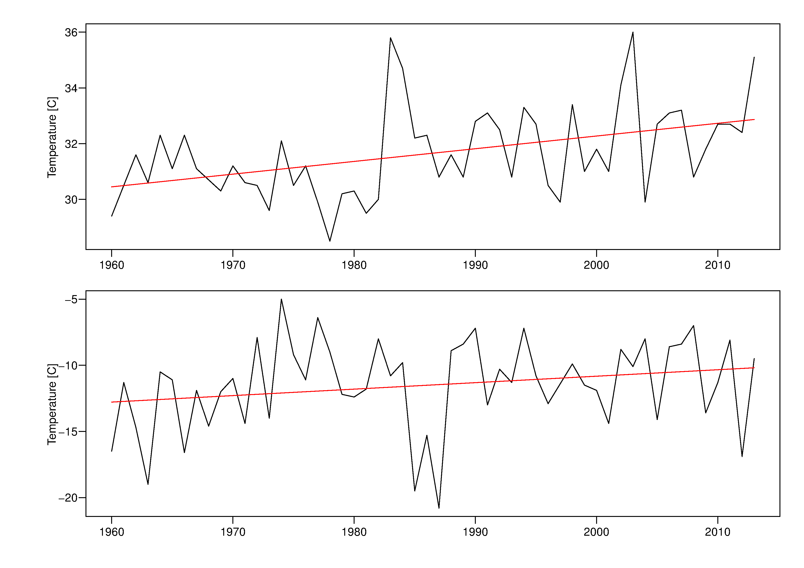
Trends in hot days and cold nights in Zurich
Hot extremes (TXx)
Cold extremes (TNn)
Data: Meteoschweiz

Slide 4
Why using climate models?
Analysis of changes in extremes is limited by the data availability
Studying very rare events requires very long data series
Climate models are promising tools to make progress in our understand of extremes…
… but we need to understand their strength and limitations

Slide 5
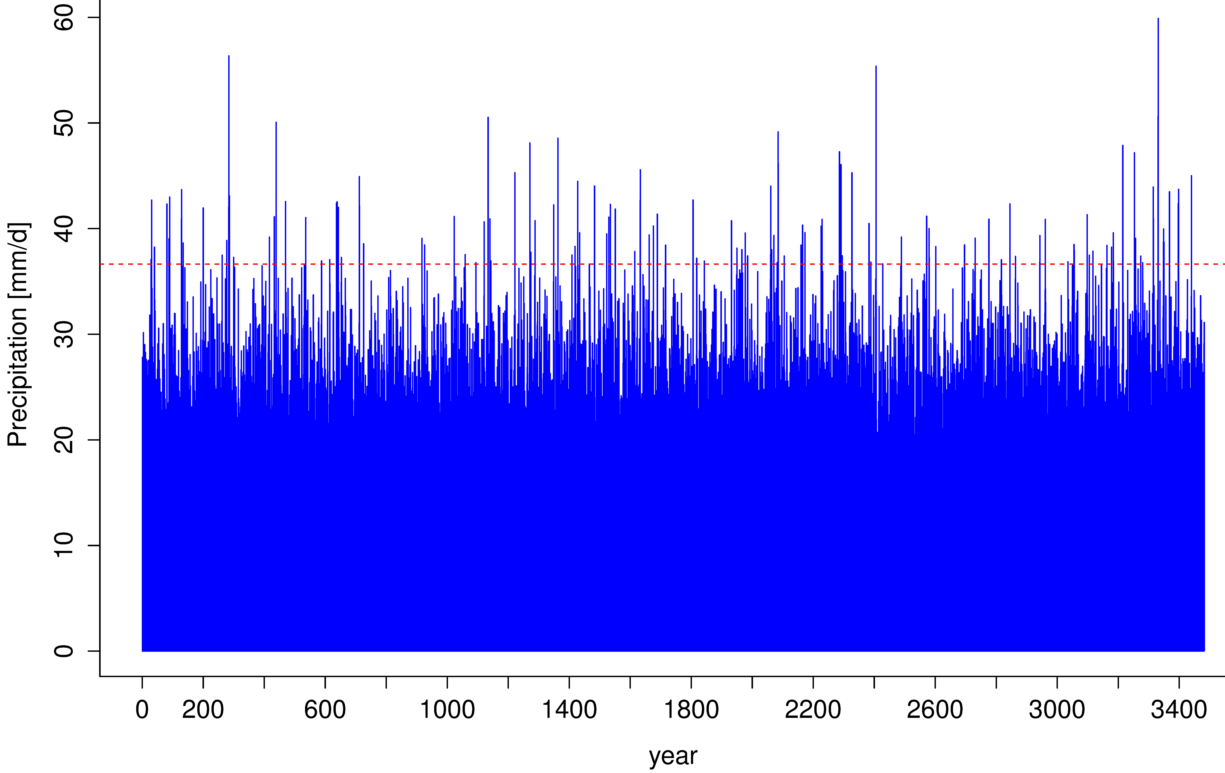
Large multi-centennial variability?
Daily precipitation in Central Europe in pre-industrial control run
99.99th percentile

Slide 6
Quantifying high-return value extremes
Return periods of precipitation over southwest Congo
99.99th percentile
Otto et al. 2014, Phil. Trans. R. Soc.

Slide 7
Some definitions of «moderate extremes»
Heavy precipitation Rx1day: max. 1-day precipitation
Rx5day: max. 5-day precipitation
Hot extremes TXx: annual temperature maxima
Cold extremes TNn: annual temperature minima

Slide 8
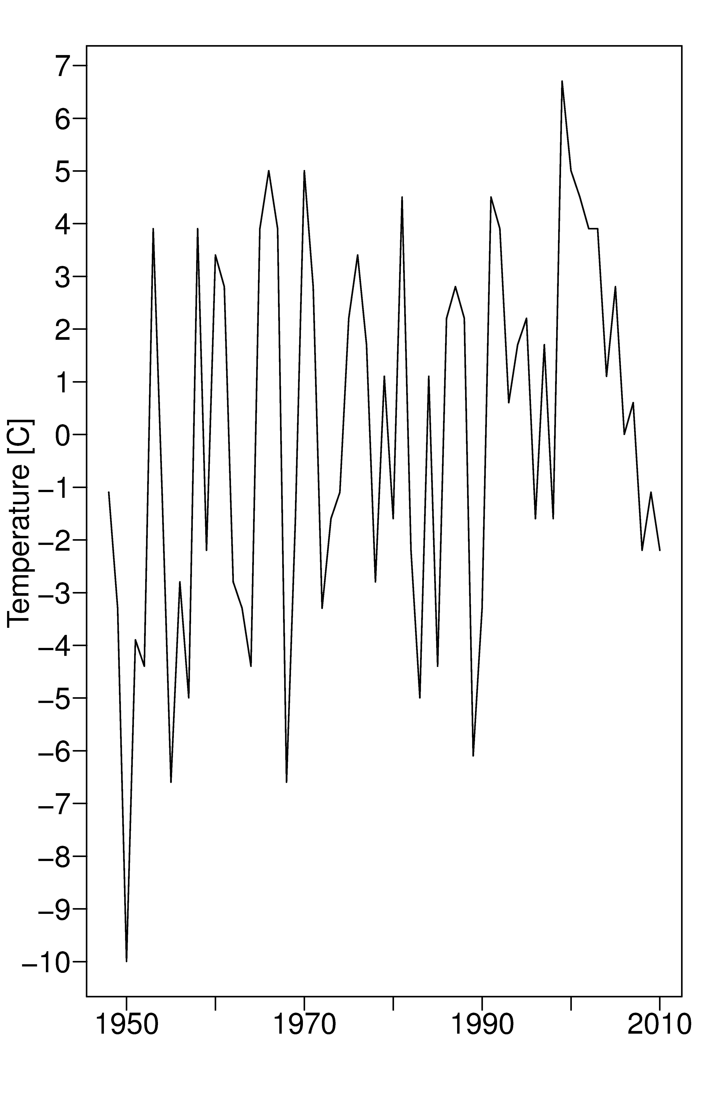
Internal variability matters…
Seattle, cold extremes
… even more so for extremes
Deser et al., 2012, Nature CC

Slide 9
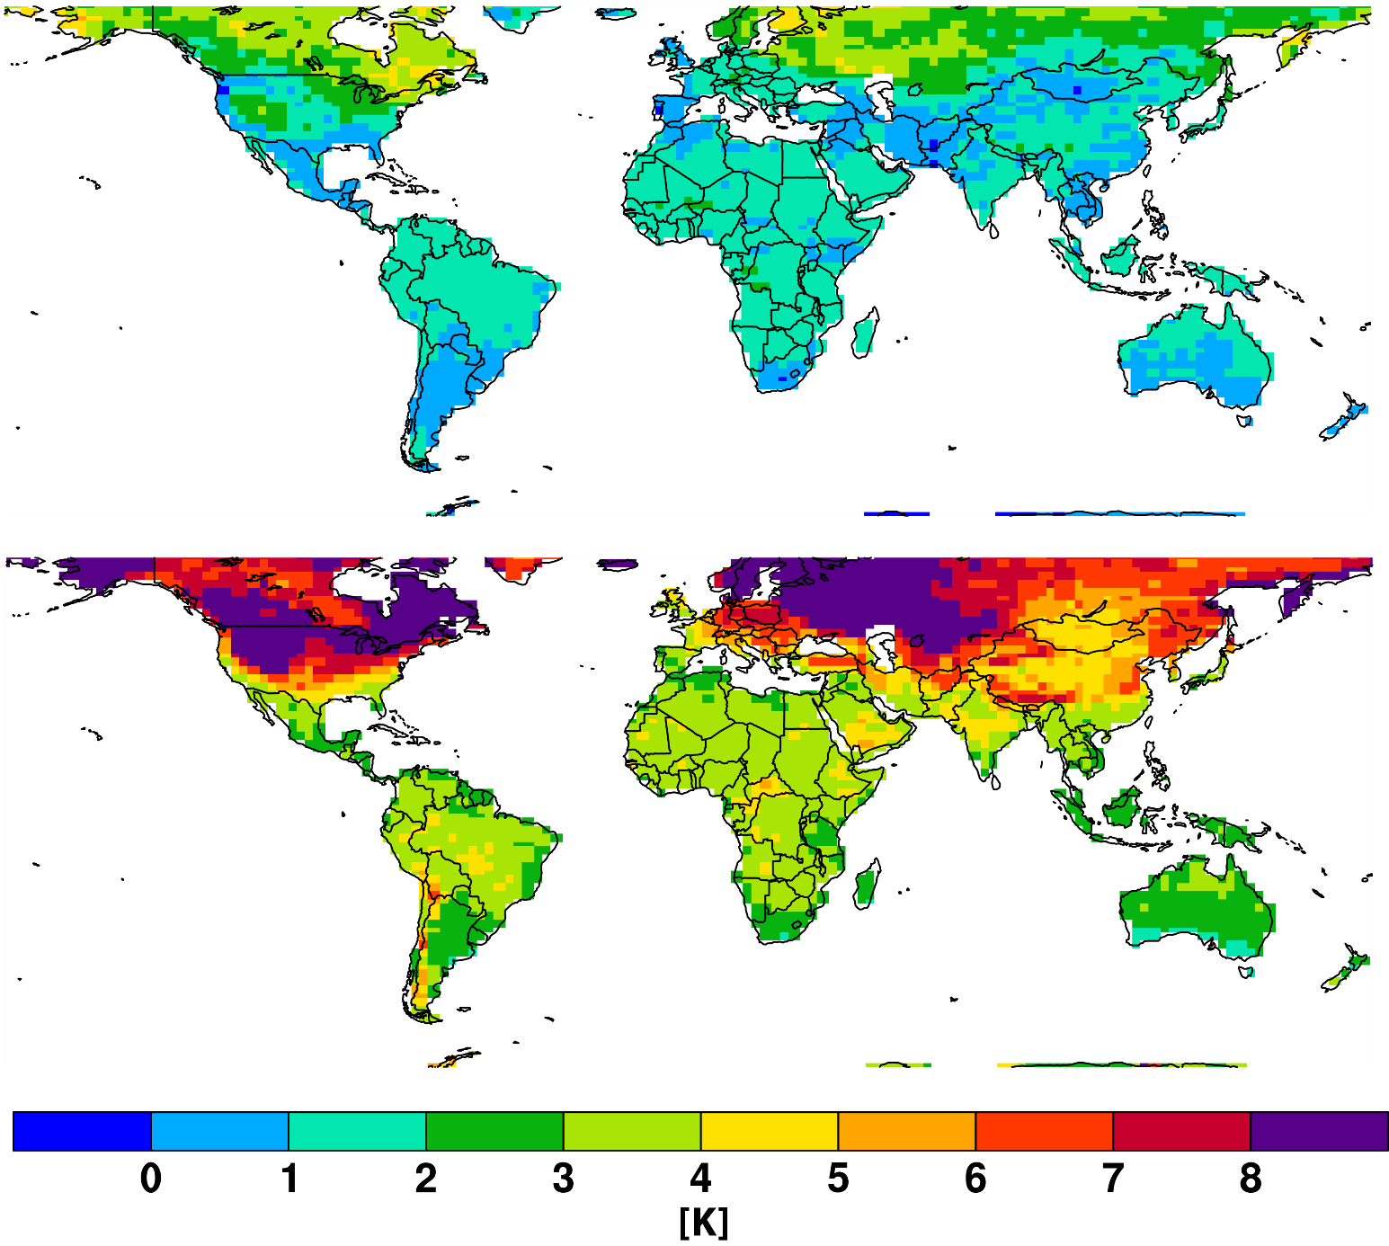
Uncertainties in cold extremes are very large
Model uncertainties too large to make statement about changes in temperature extremes?
Cold extremes TNn: annual temperature minima 2041-60 wrt 1986-2005
(RCP8.5)
CMIP5 low estimate
CMIP5 high estimate
Fischer et al., 2013, Nature CC

Slide 10
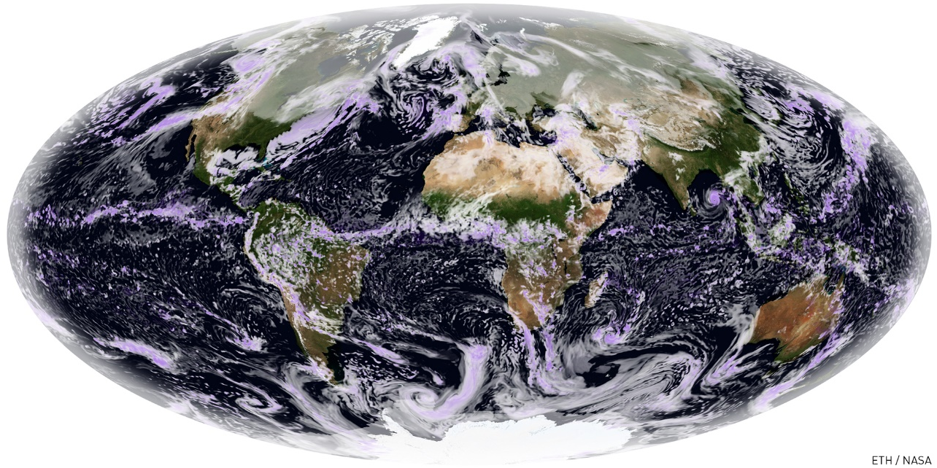
What if we had the perfect model?

Slide 11
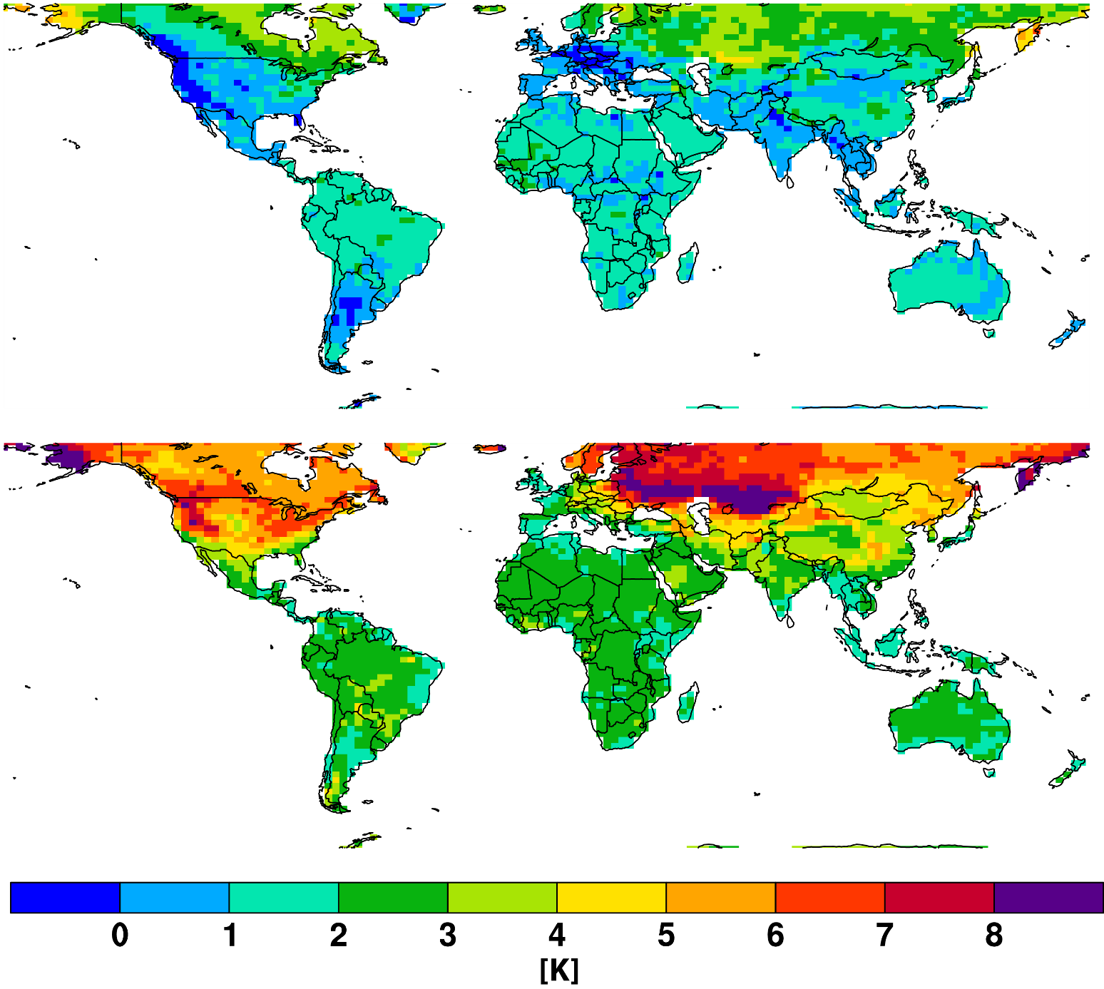
Largely due to internal variability
Cold extremes (TNn) 2041-60 wrt 1986-2005
(RCP8.5)
CESM-IC low estimate
CESM-IC high estimate
Fischer et al., 2013, Nature CC

Slide 12
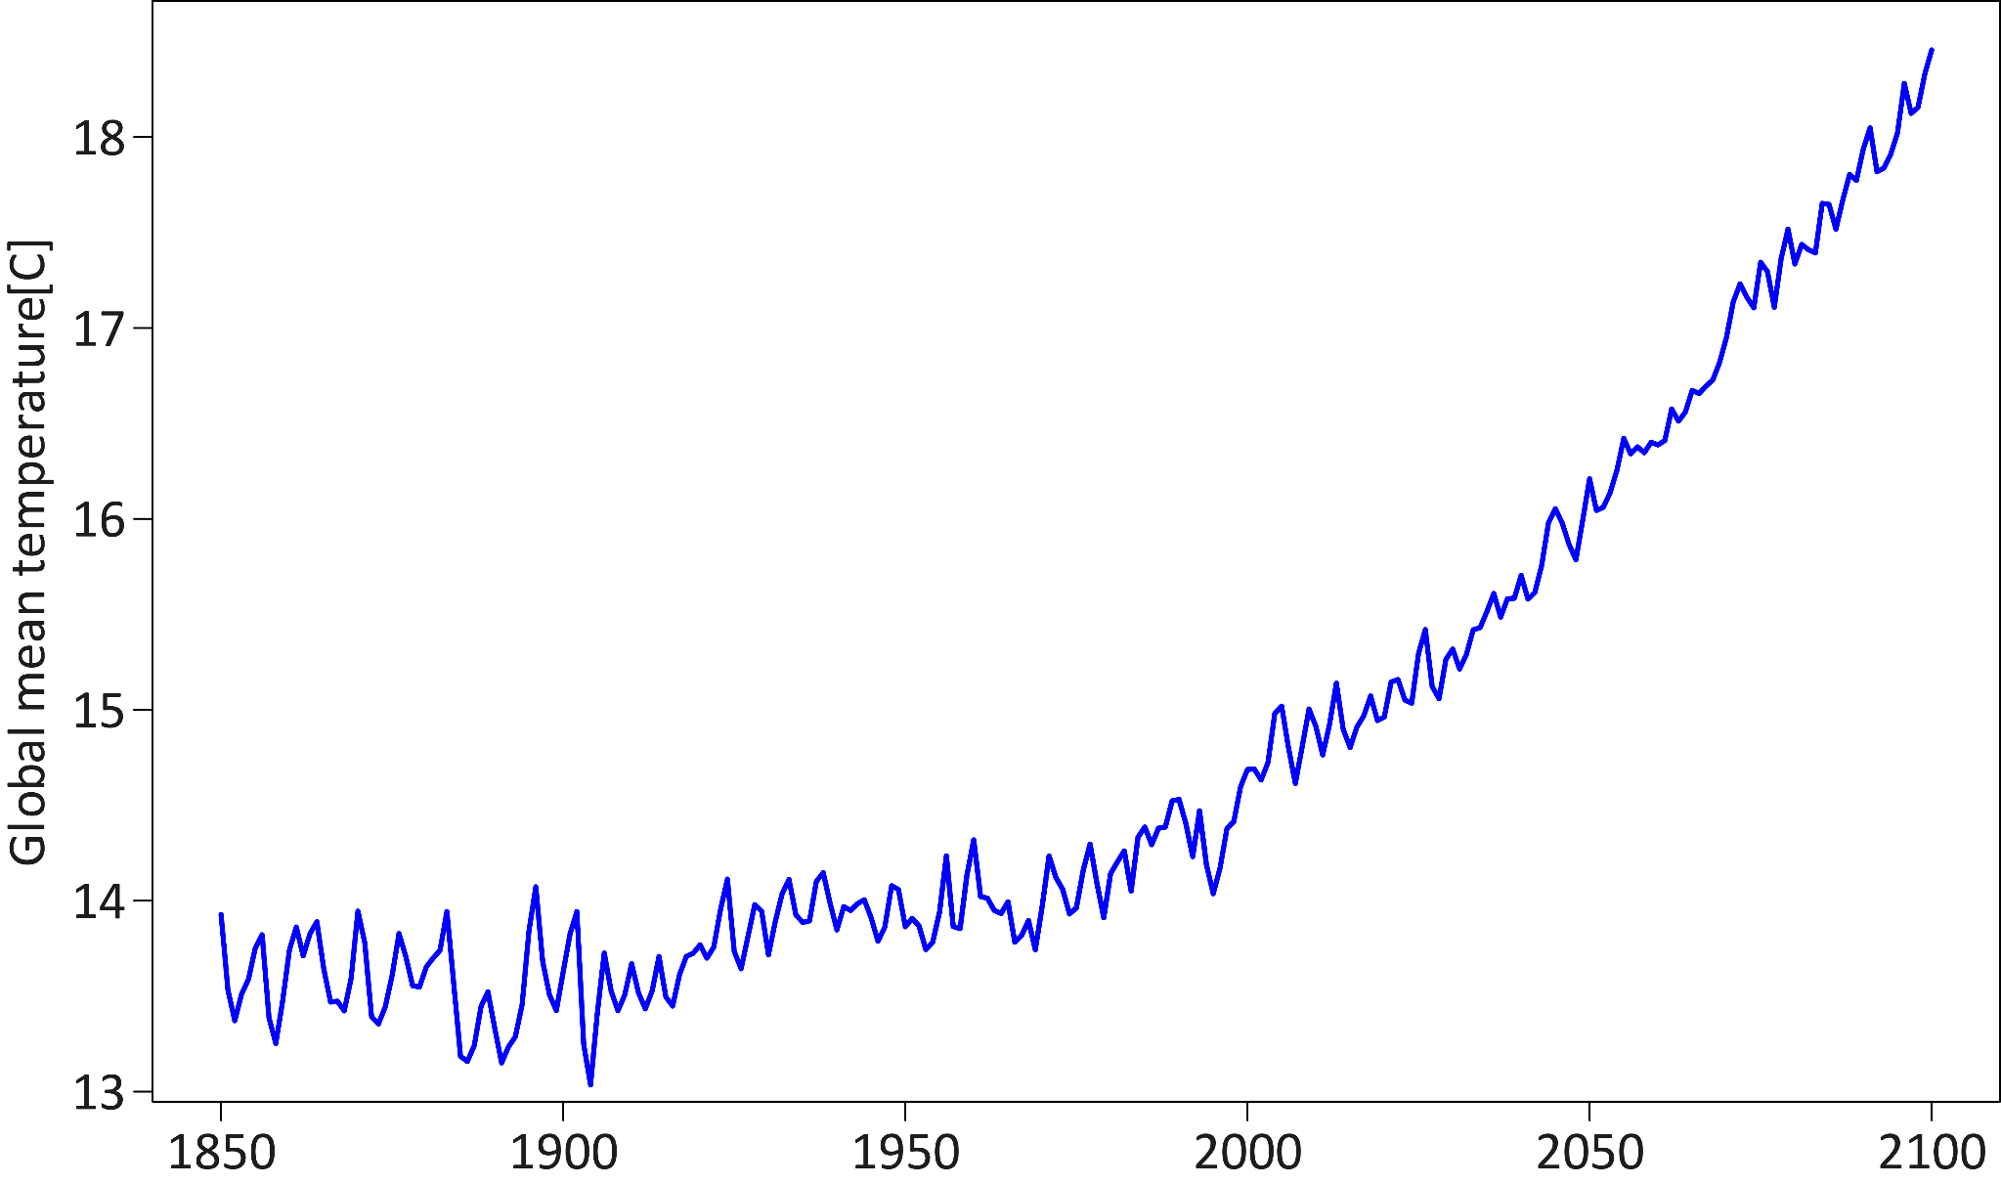
Initial condition ensemble setup
Experimental setup CESM-IC
Fully-coupled Earth System Model
CESM (CAM4) 1950-2100
Historical forcing and RCP8.5
Reference simulation
Fischer et al., 2013, Nature CC

Slide 13
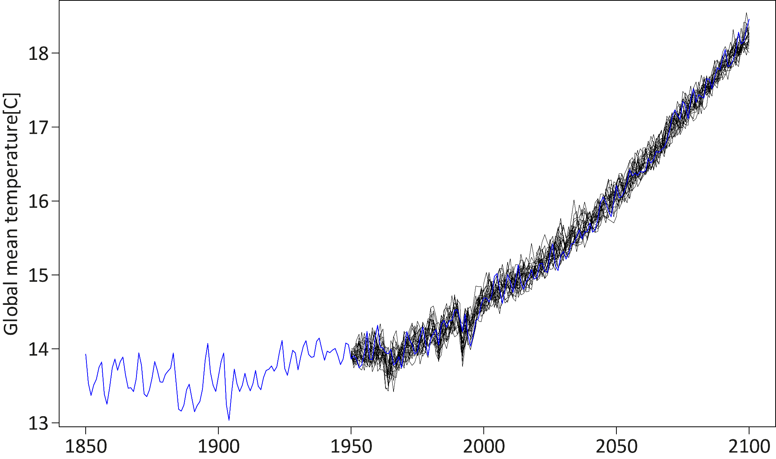
Atmospheric perturbation
Experimental setup CESM-IC
Fully-coupled Earth System Model
CESM (CAM4) 1950-2100
Historical forcing and RCP8.5
similar to Deser et al. (2012)
Reference simulation
21 pert. members
Fischer et al., 2013, Nature CC

Slide 14
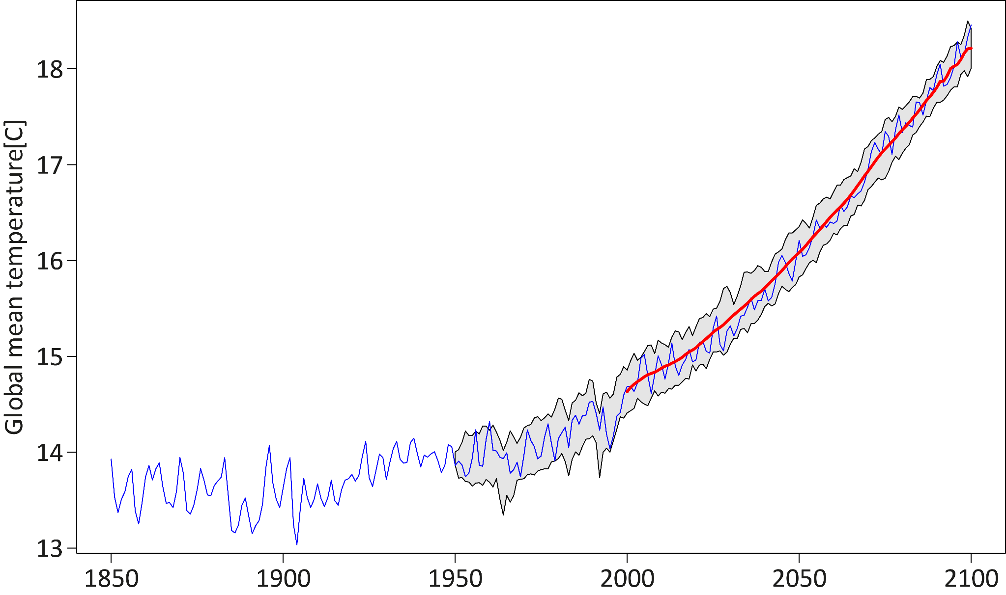
Some terminology
This uncertainty is
quasi-irreducible
Reference simulation
Uncertainty range due to internal variability
Forced signal

Slide 15
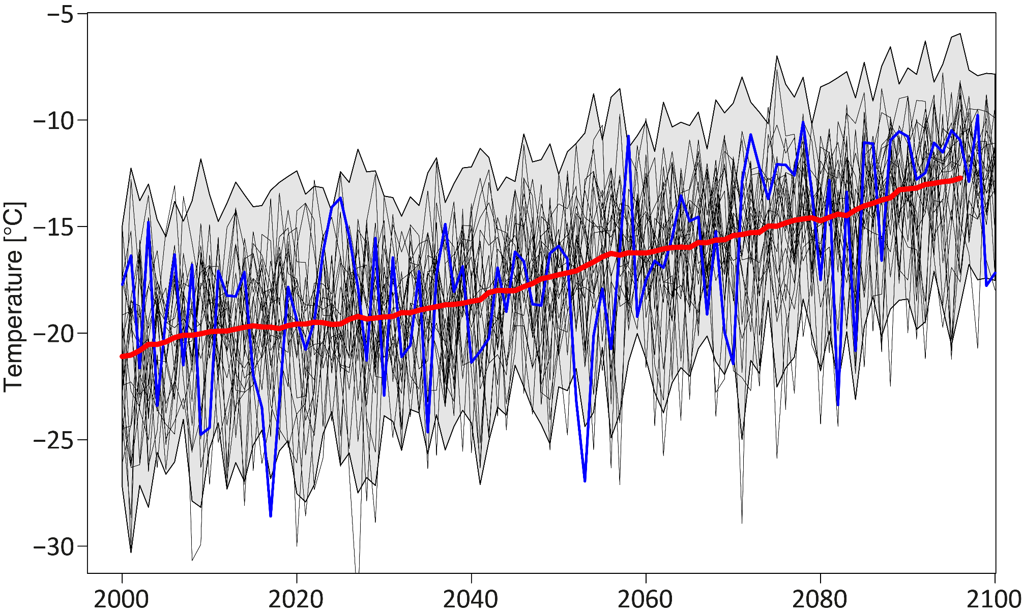
Large internal variability at regional scale
Coldest nights (TNn) averaged over Northern Europe
Reference simulation
Uncertainty range due to internal variability
Forced signal

Slide 16
Largely due to internal variability
Cold extremes (TNn) 2041-60 wrt 1986-2005
(RCP8.5)
CESM-IC low estimate
CESM-IC high estimate
Fischer et al., 2013, Nature CC

Slide 17
Take home message
Internal variability is the major source of uncertainty for the frequency of extremes by the mid-century

Slide 18

No clue where we are going?

Slide 19
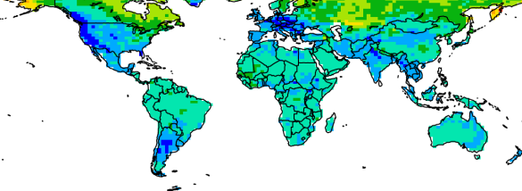
No clue where we are going?
Low estimate

Slide 20
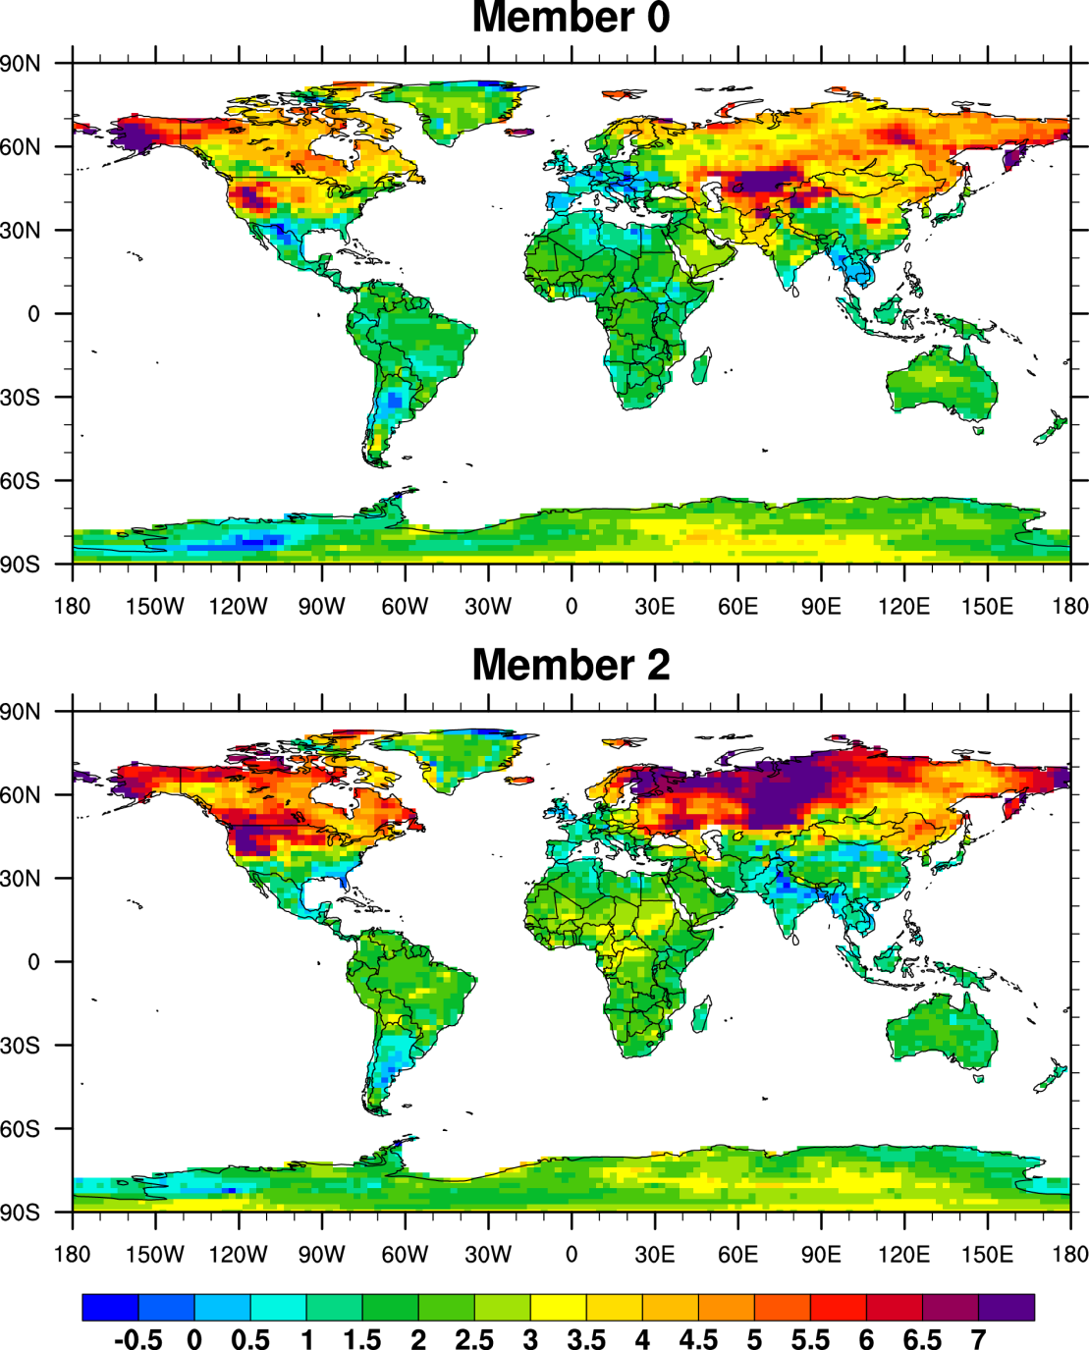
Internal variability affects location of changes
Member 1
Atmospheric internal variability primarily affects the location of the greatest changes
Member 2

Slide 21
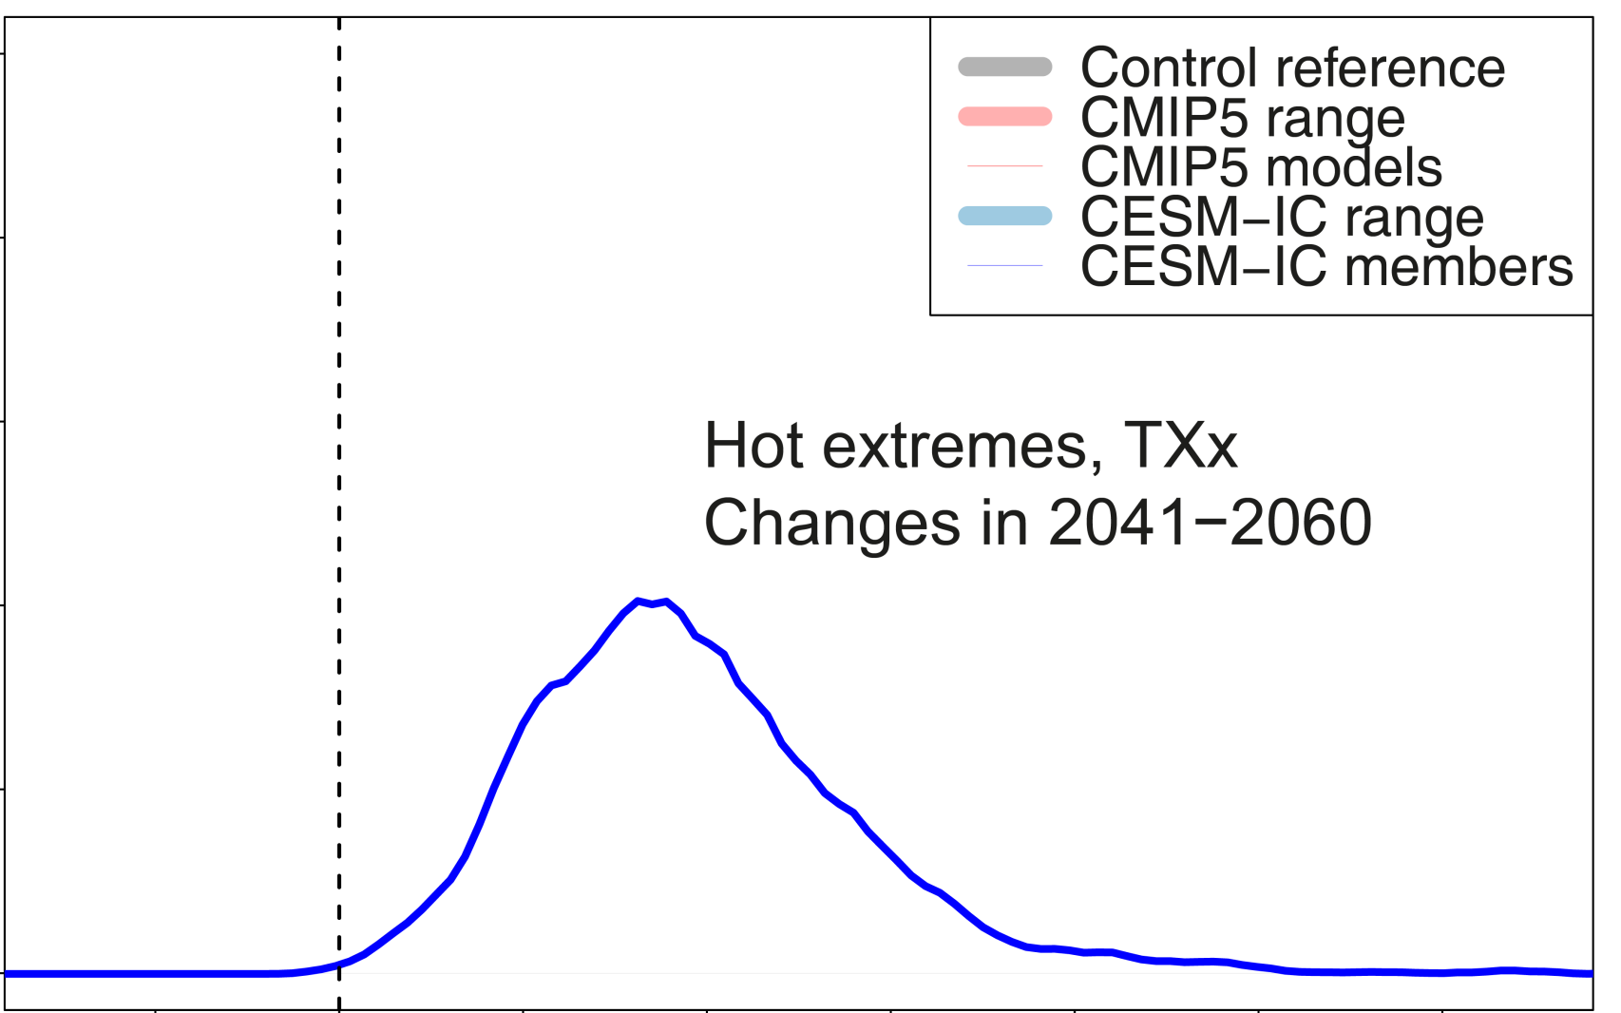
A simple spatial perspective
Fischer et al., 2013, Nature CC

Slide 22
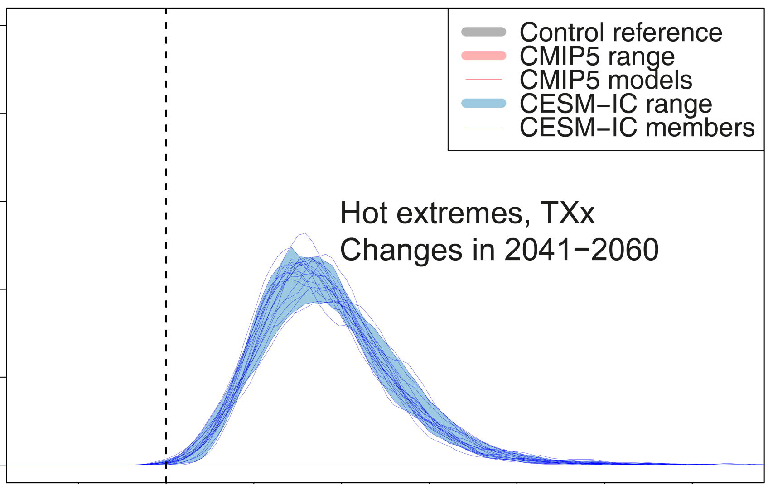
Members agree on spatial PDF
wrt 1986–2005
Fischer et al., 2013, Nature CC

Slide 23
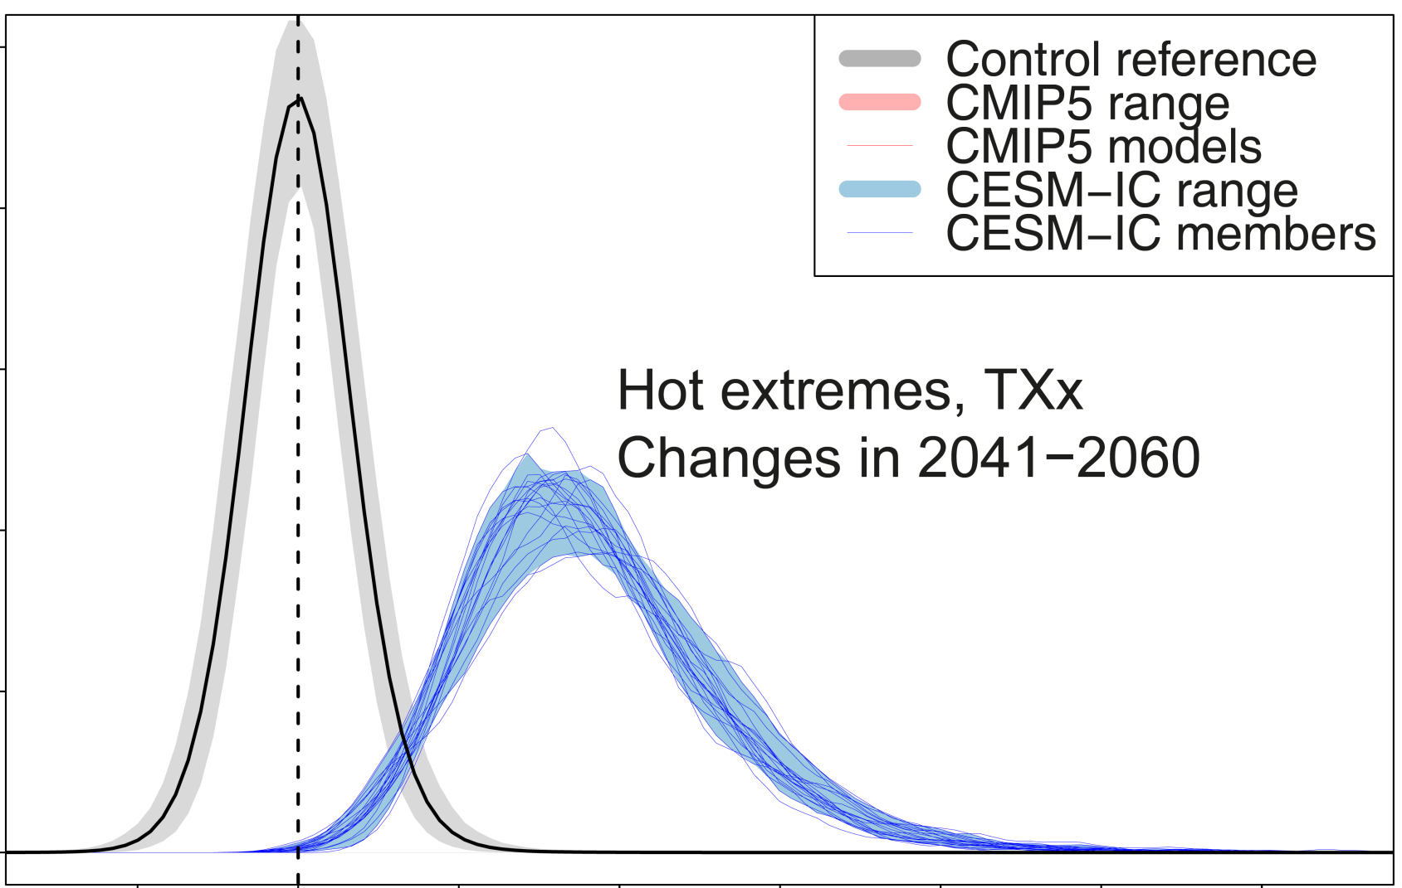
Hot extremes emerge within decades
wrt 1986–2005
Fischer et al., 2013, Nature CC

Slide 24
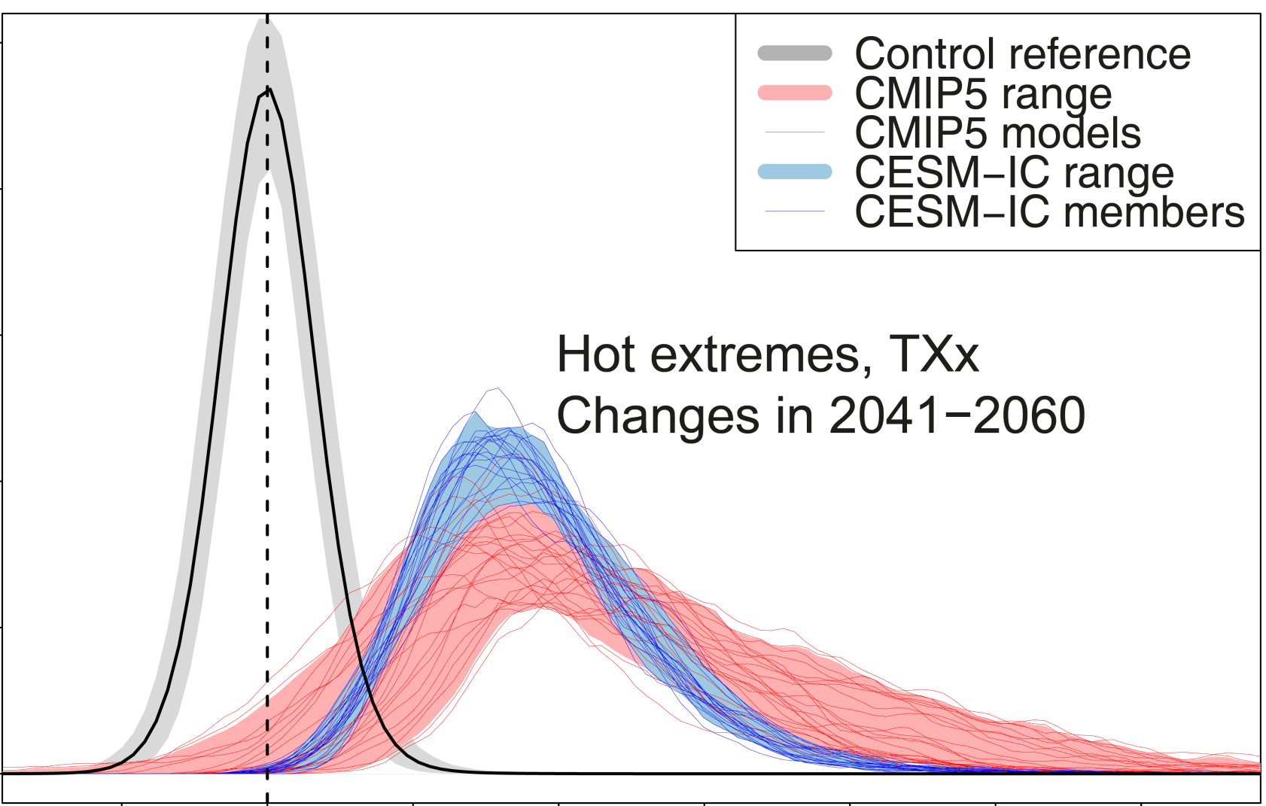
Major changes in hot extremes in all models
wrt 1986–2005
Fischer et al., 2013, Nature CC

Slide 25
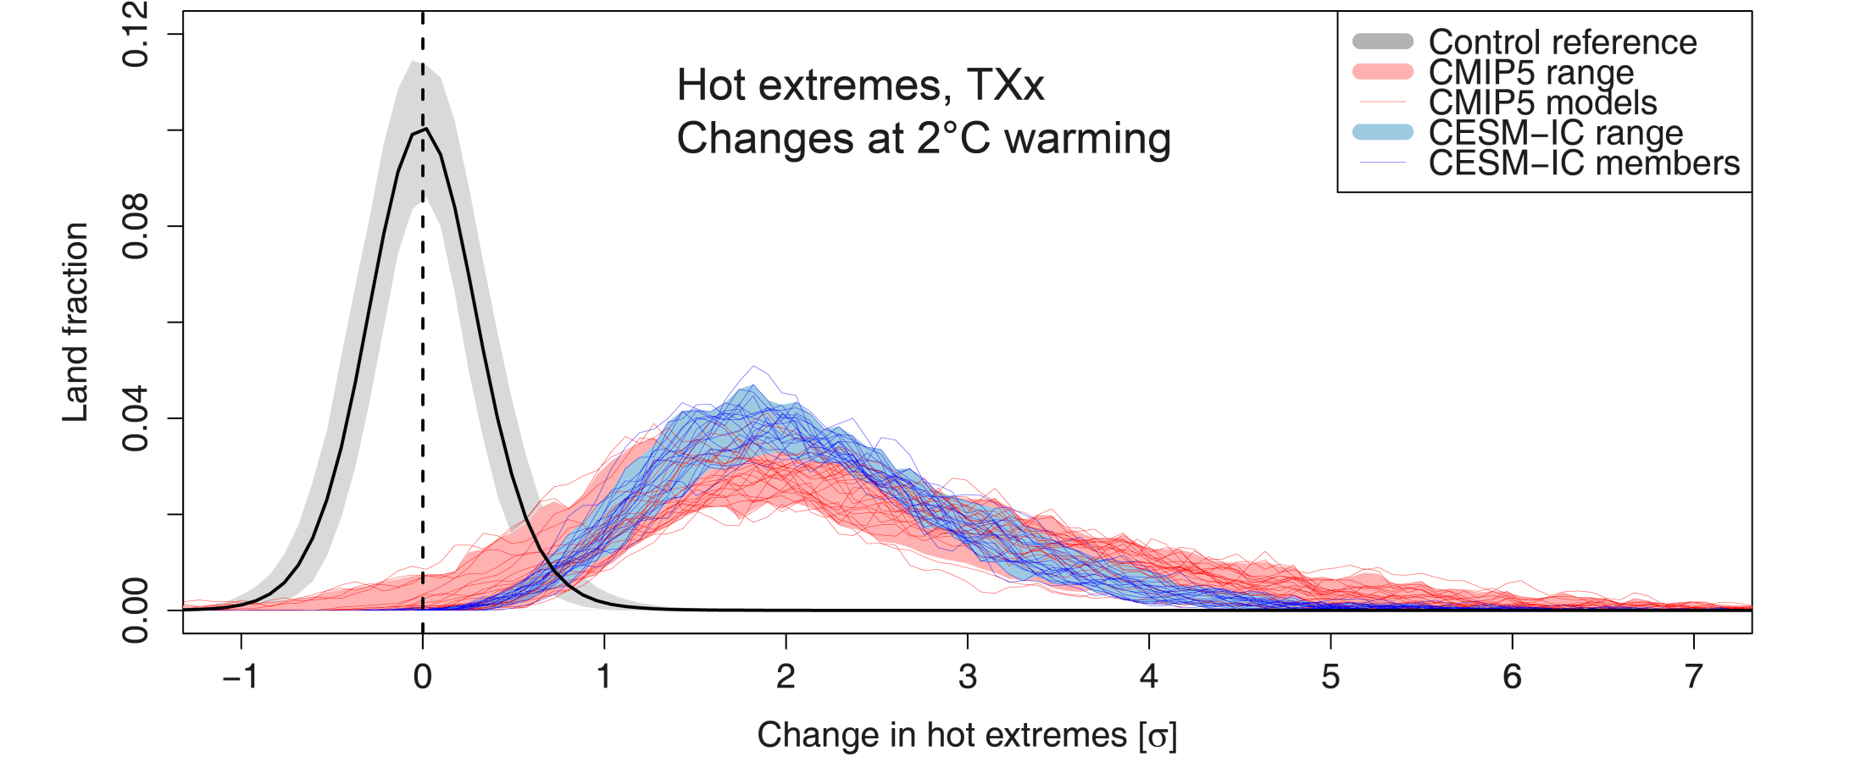
Good agreement on changes at 2°C warming
Multi-model mean is often misleading
Fischer et al., 2013, Nature CC

Slide 26
Likely heavy precipitation intensification
Fischer et al., 2013, Nature CC

Slide 27
Take home message
Models agree on the change in the spatial PDF of changes in extremes

Slide 28
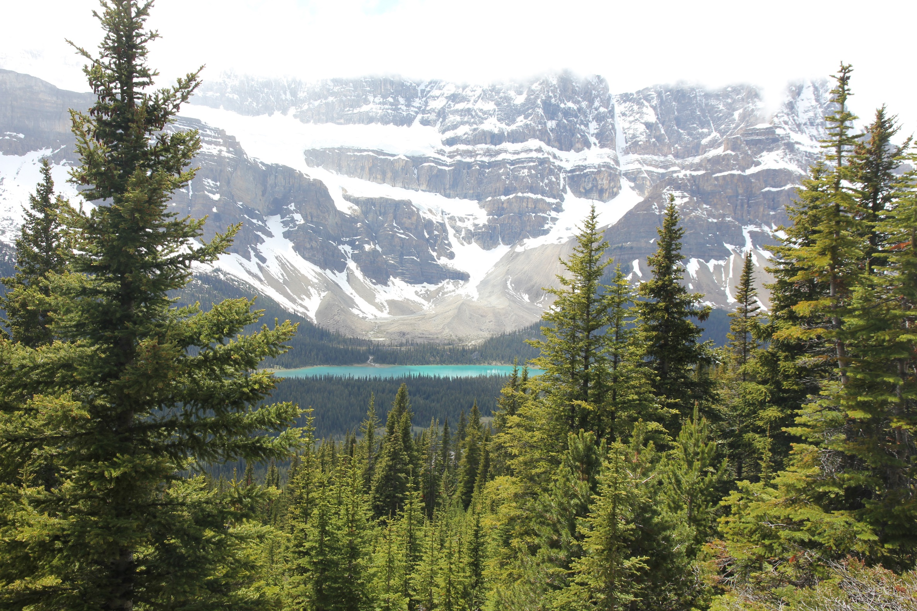
Forced response vs. actual outcome

Slide 29
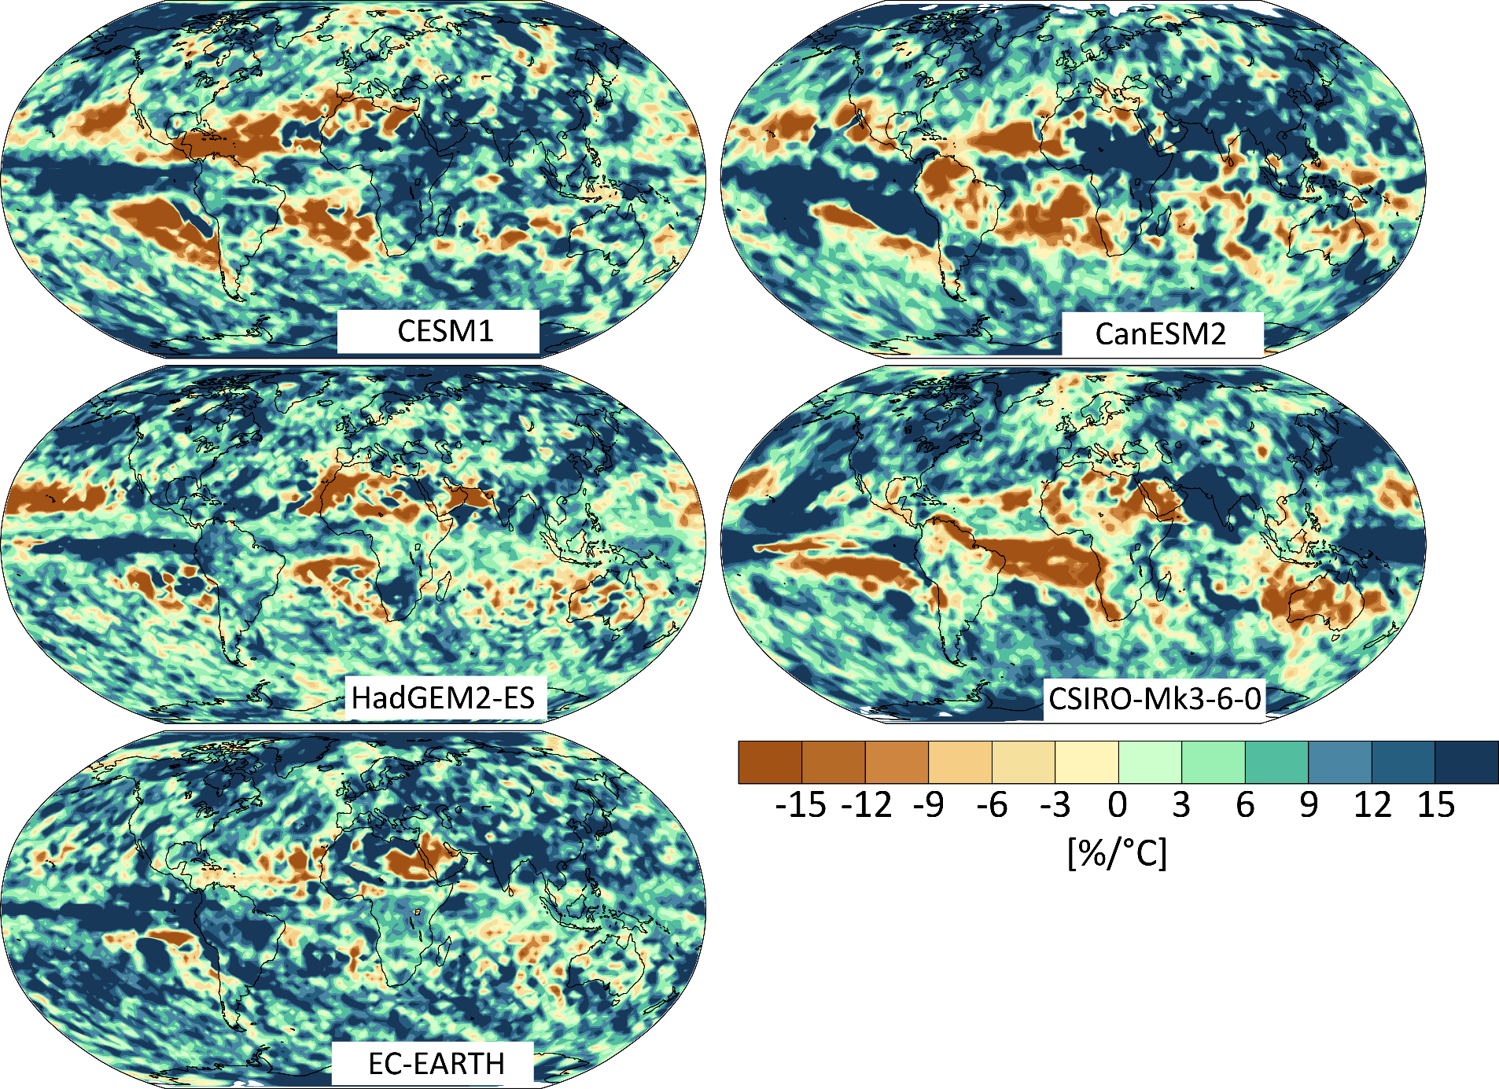
Poor agreement on heavy precip pattern
Annual precipitation maxima change (Rx1day) in 20th century

Slide 30
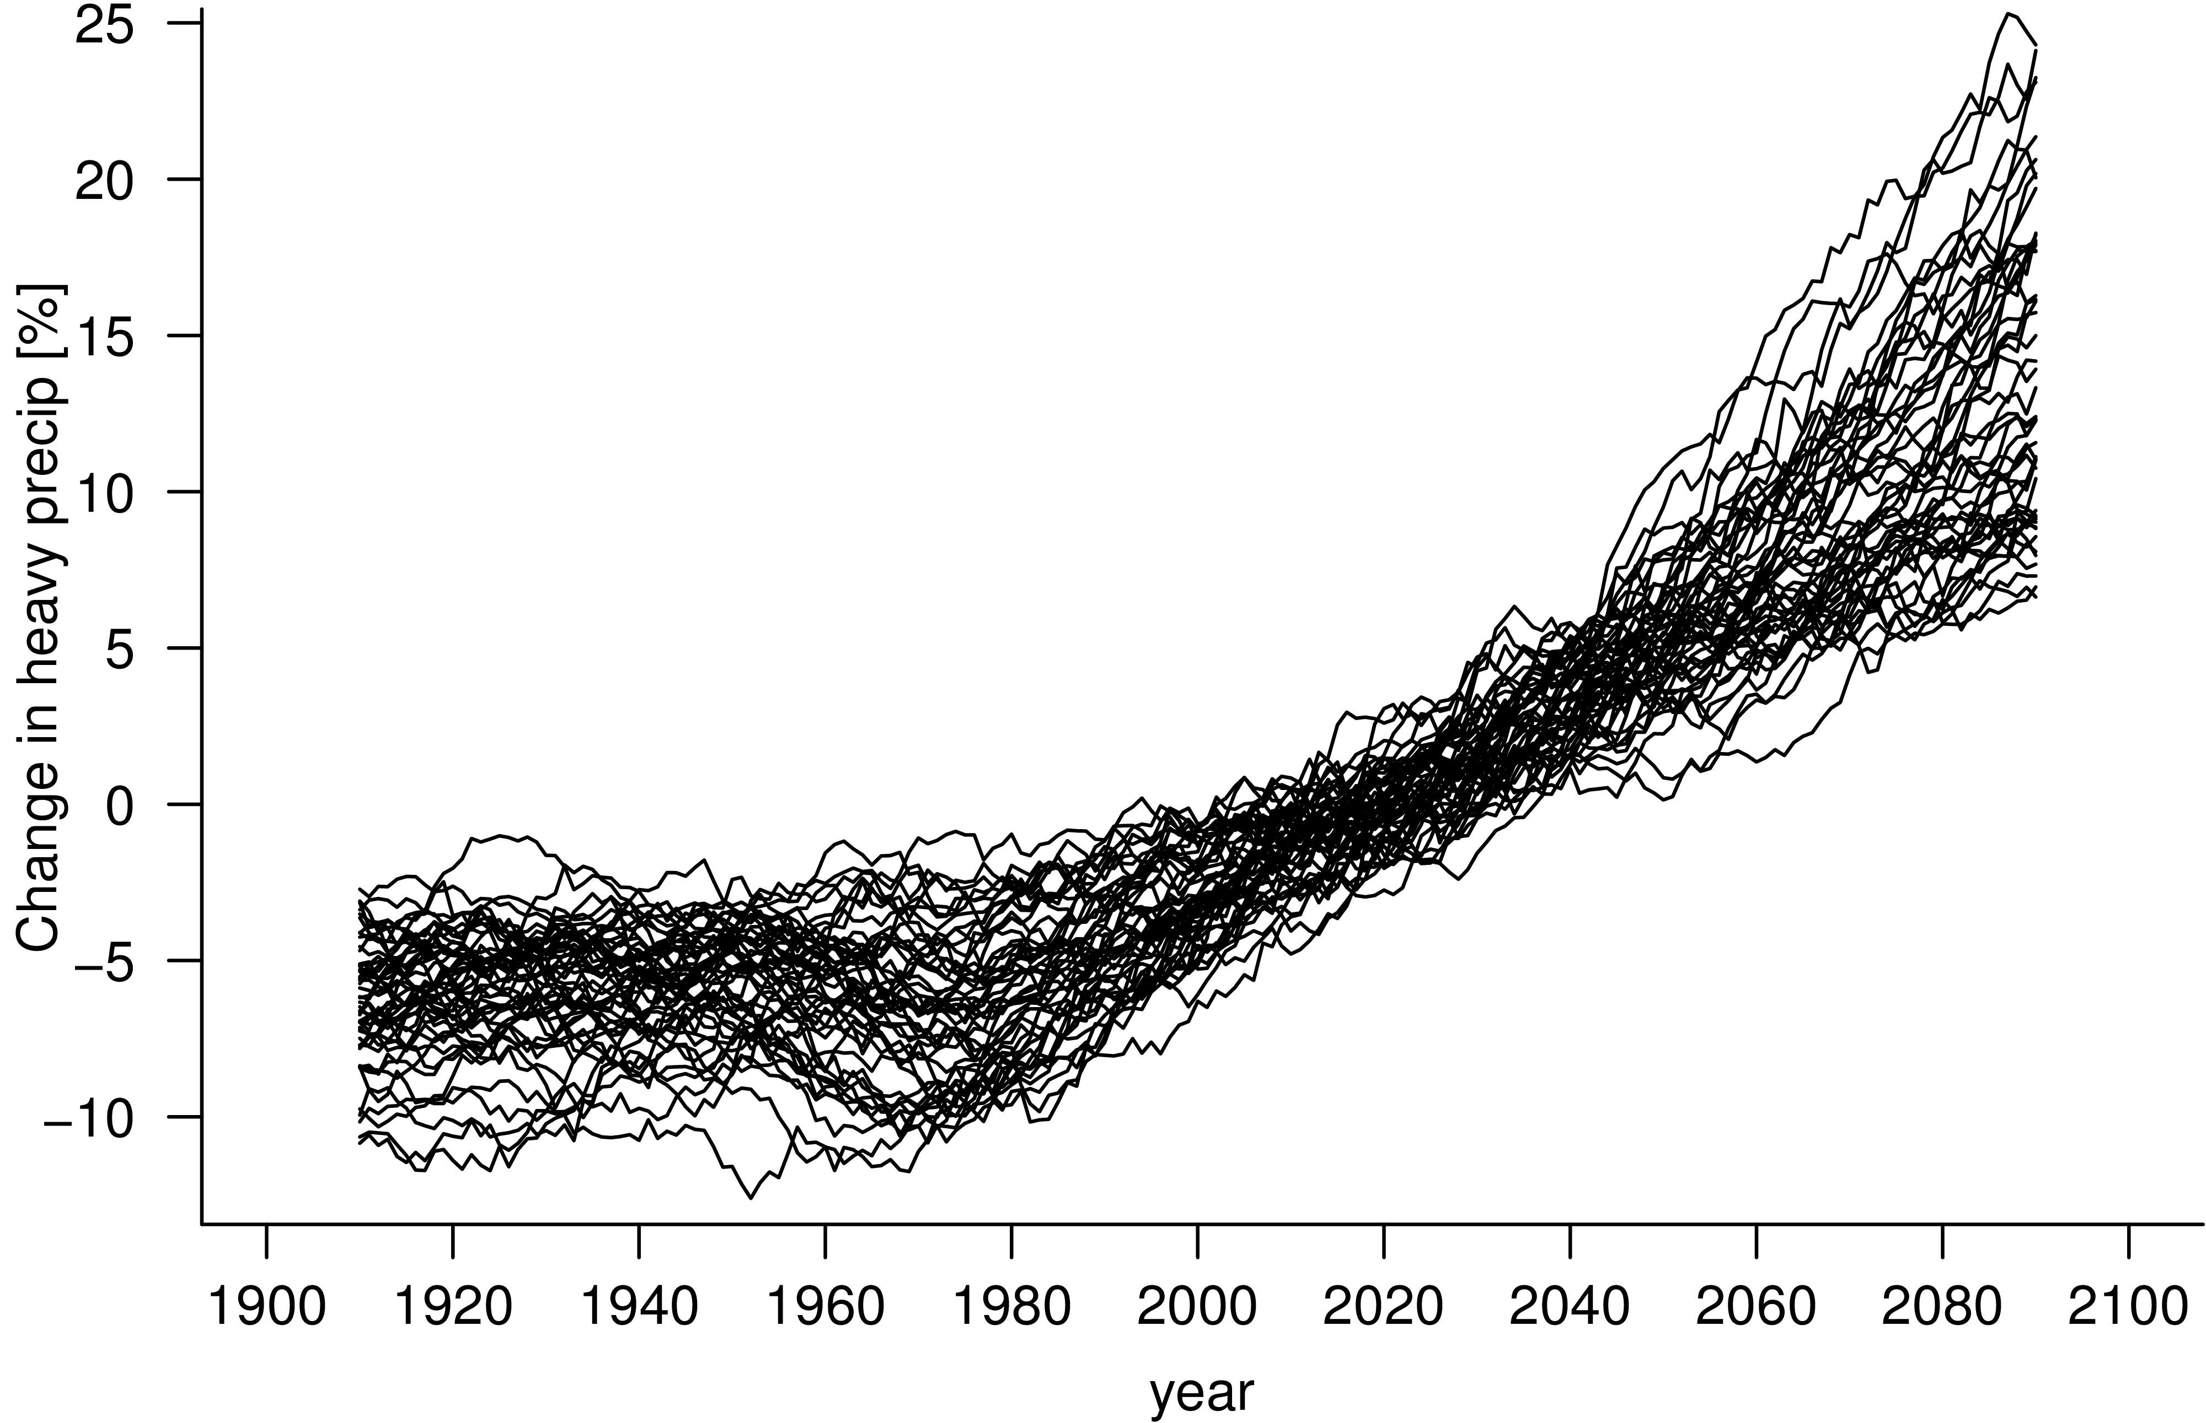
Large differences even in running means
20-yr running means of annual precipitation maxima (N Europe)

Slide 31
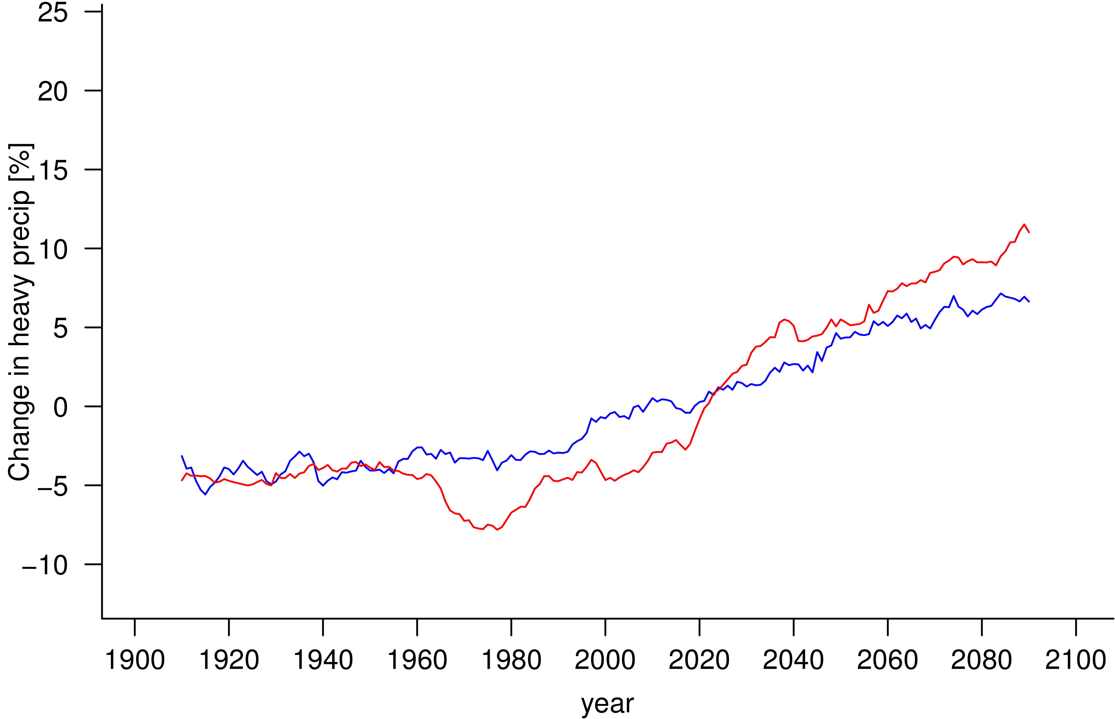
Two example model runs
2 distinct model simulations
CESM1 (CAM4)
CSIRO-Mk3-6-0

Slide 32
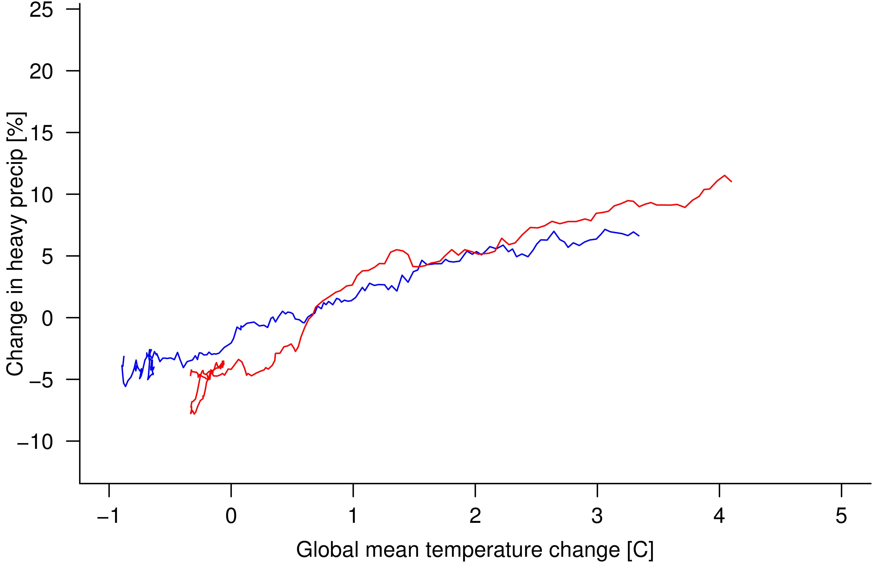
Scaling with global mean temperature
CESM1 (CAM4)
CSIRO-Mk3-6-0
A substantial fraction of the uncertainty relates to the mean warming

Slide 33
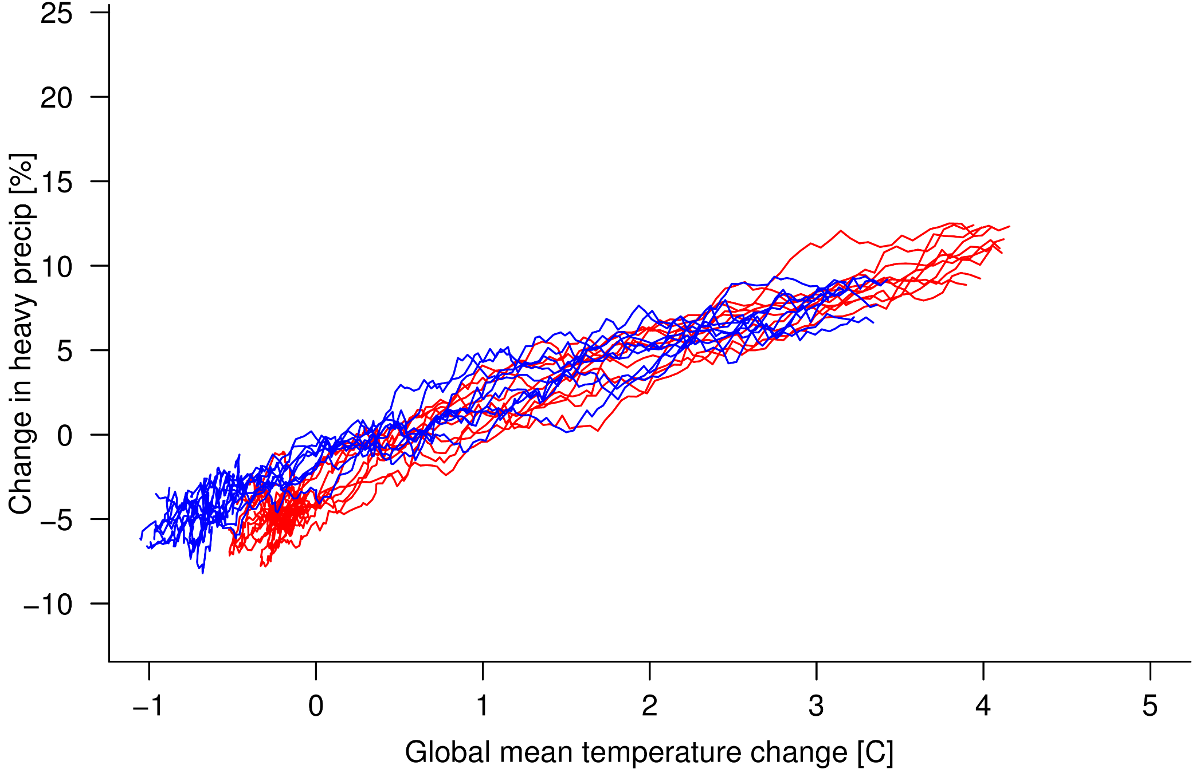
Scaling with global mean temperature
CESM1 (CAM4)
CSIRO-Mk3-6-0

Slide 34
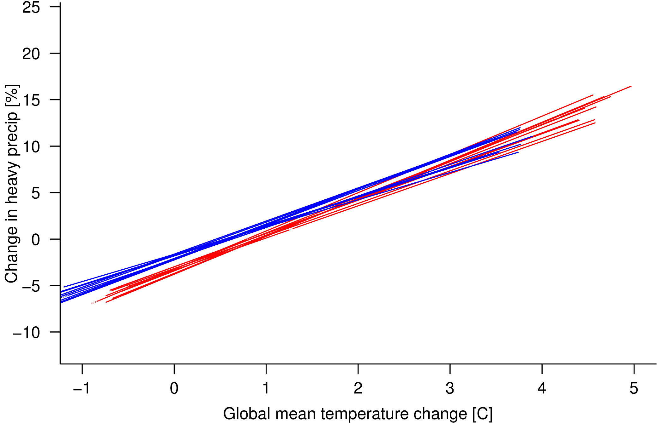
High agreement in forced signal
CESM1 (CAM4): 3.4%/°C
CSIRO-Mk3-6-0: 3.8%/°C

Slide 35
Poor agreement in observational period
Pattern correlation: r=0.04
Fischer et al., 2014, GRL

Slide 36
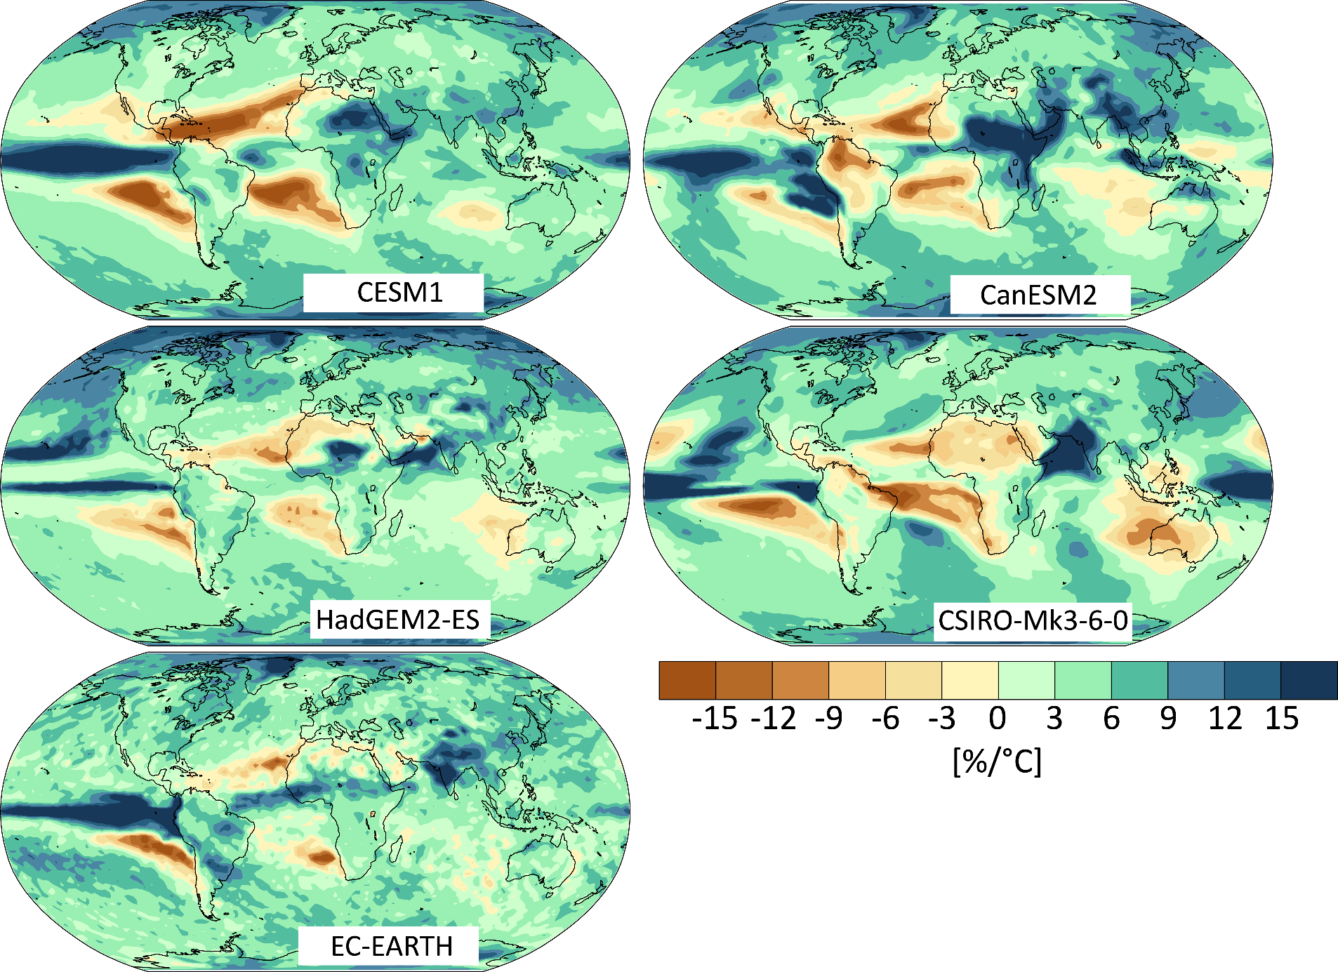
High agreement in forced signal
The forced response is relevant for the expected outcome
Pattern correlation: r=0.59
Across CMIP5 models: r=0.51
Fischer et al., 2014, GRL
see also Zhang et al. 2013, GRL

Slide 37
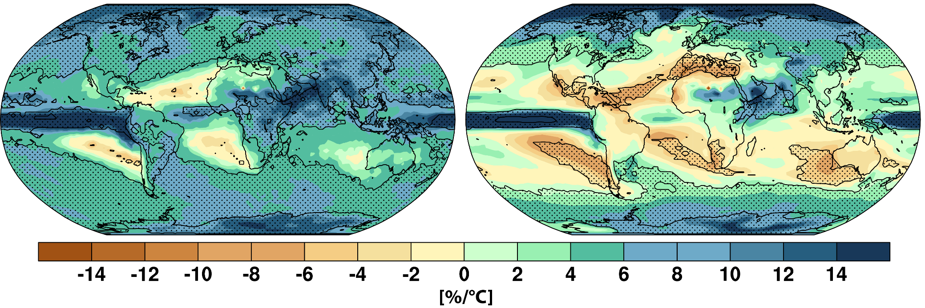
Heavy precip more robust than mean precip
Change in heavy precipitation
Change in annual mean precipitation
Stippled if 80% of CMIP5 models agree on sign of forced response
Stippled area fraction: 73%
Stippled area fraction: 27%
Fischer et al., 2014, GRL
see also Zhang et al. 2013, GRL

Slide 38
Take home message
Response pattern of extremes is more consistent across models than widely recognized

Slide 39
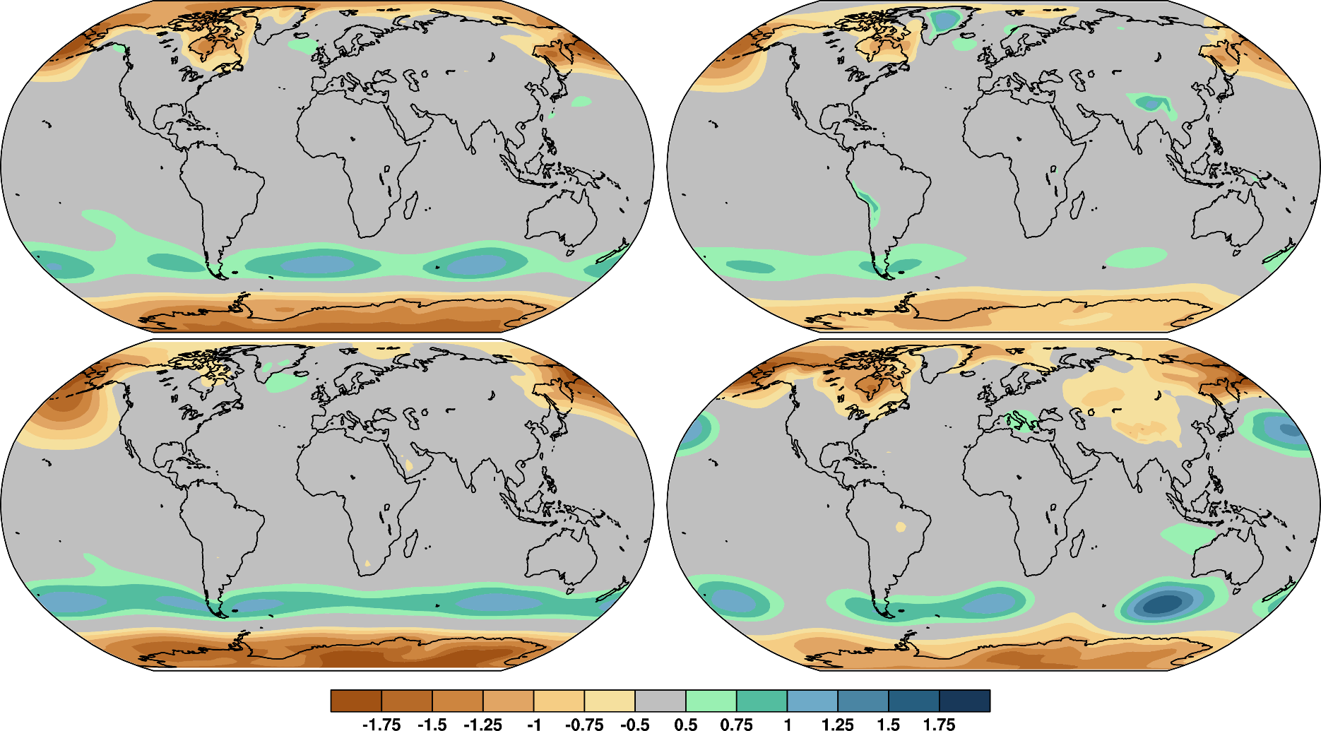

Small forced SLP response in NH mid-lats
Stippled area fraction: 73%
[hPa/K]

Slide 40
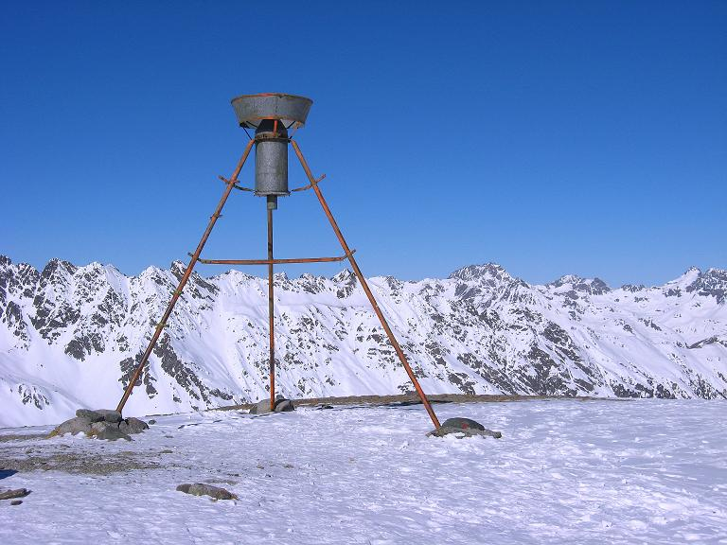
Models consistent – but wrong?

Slide 41
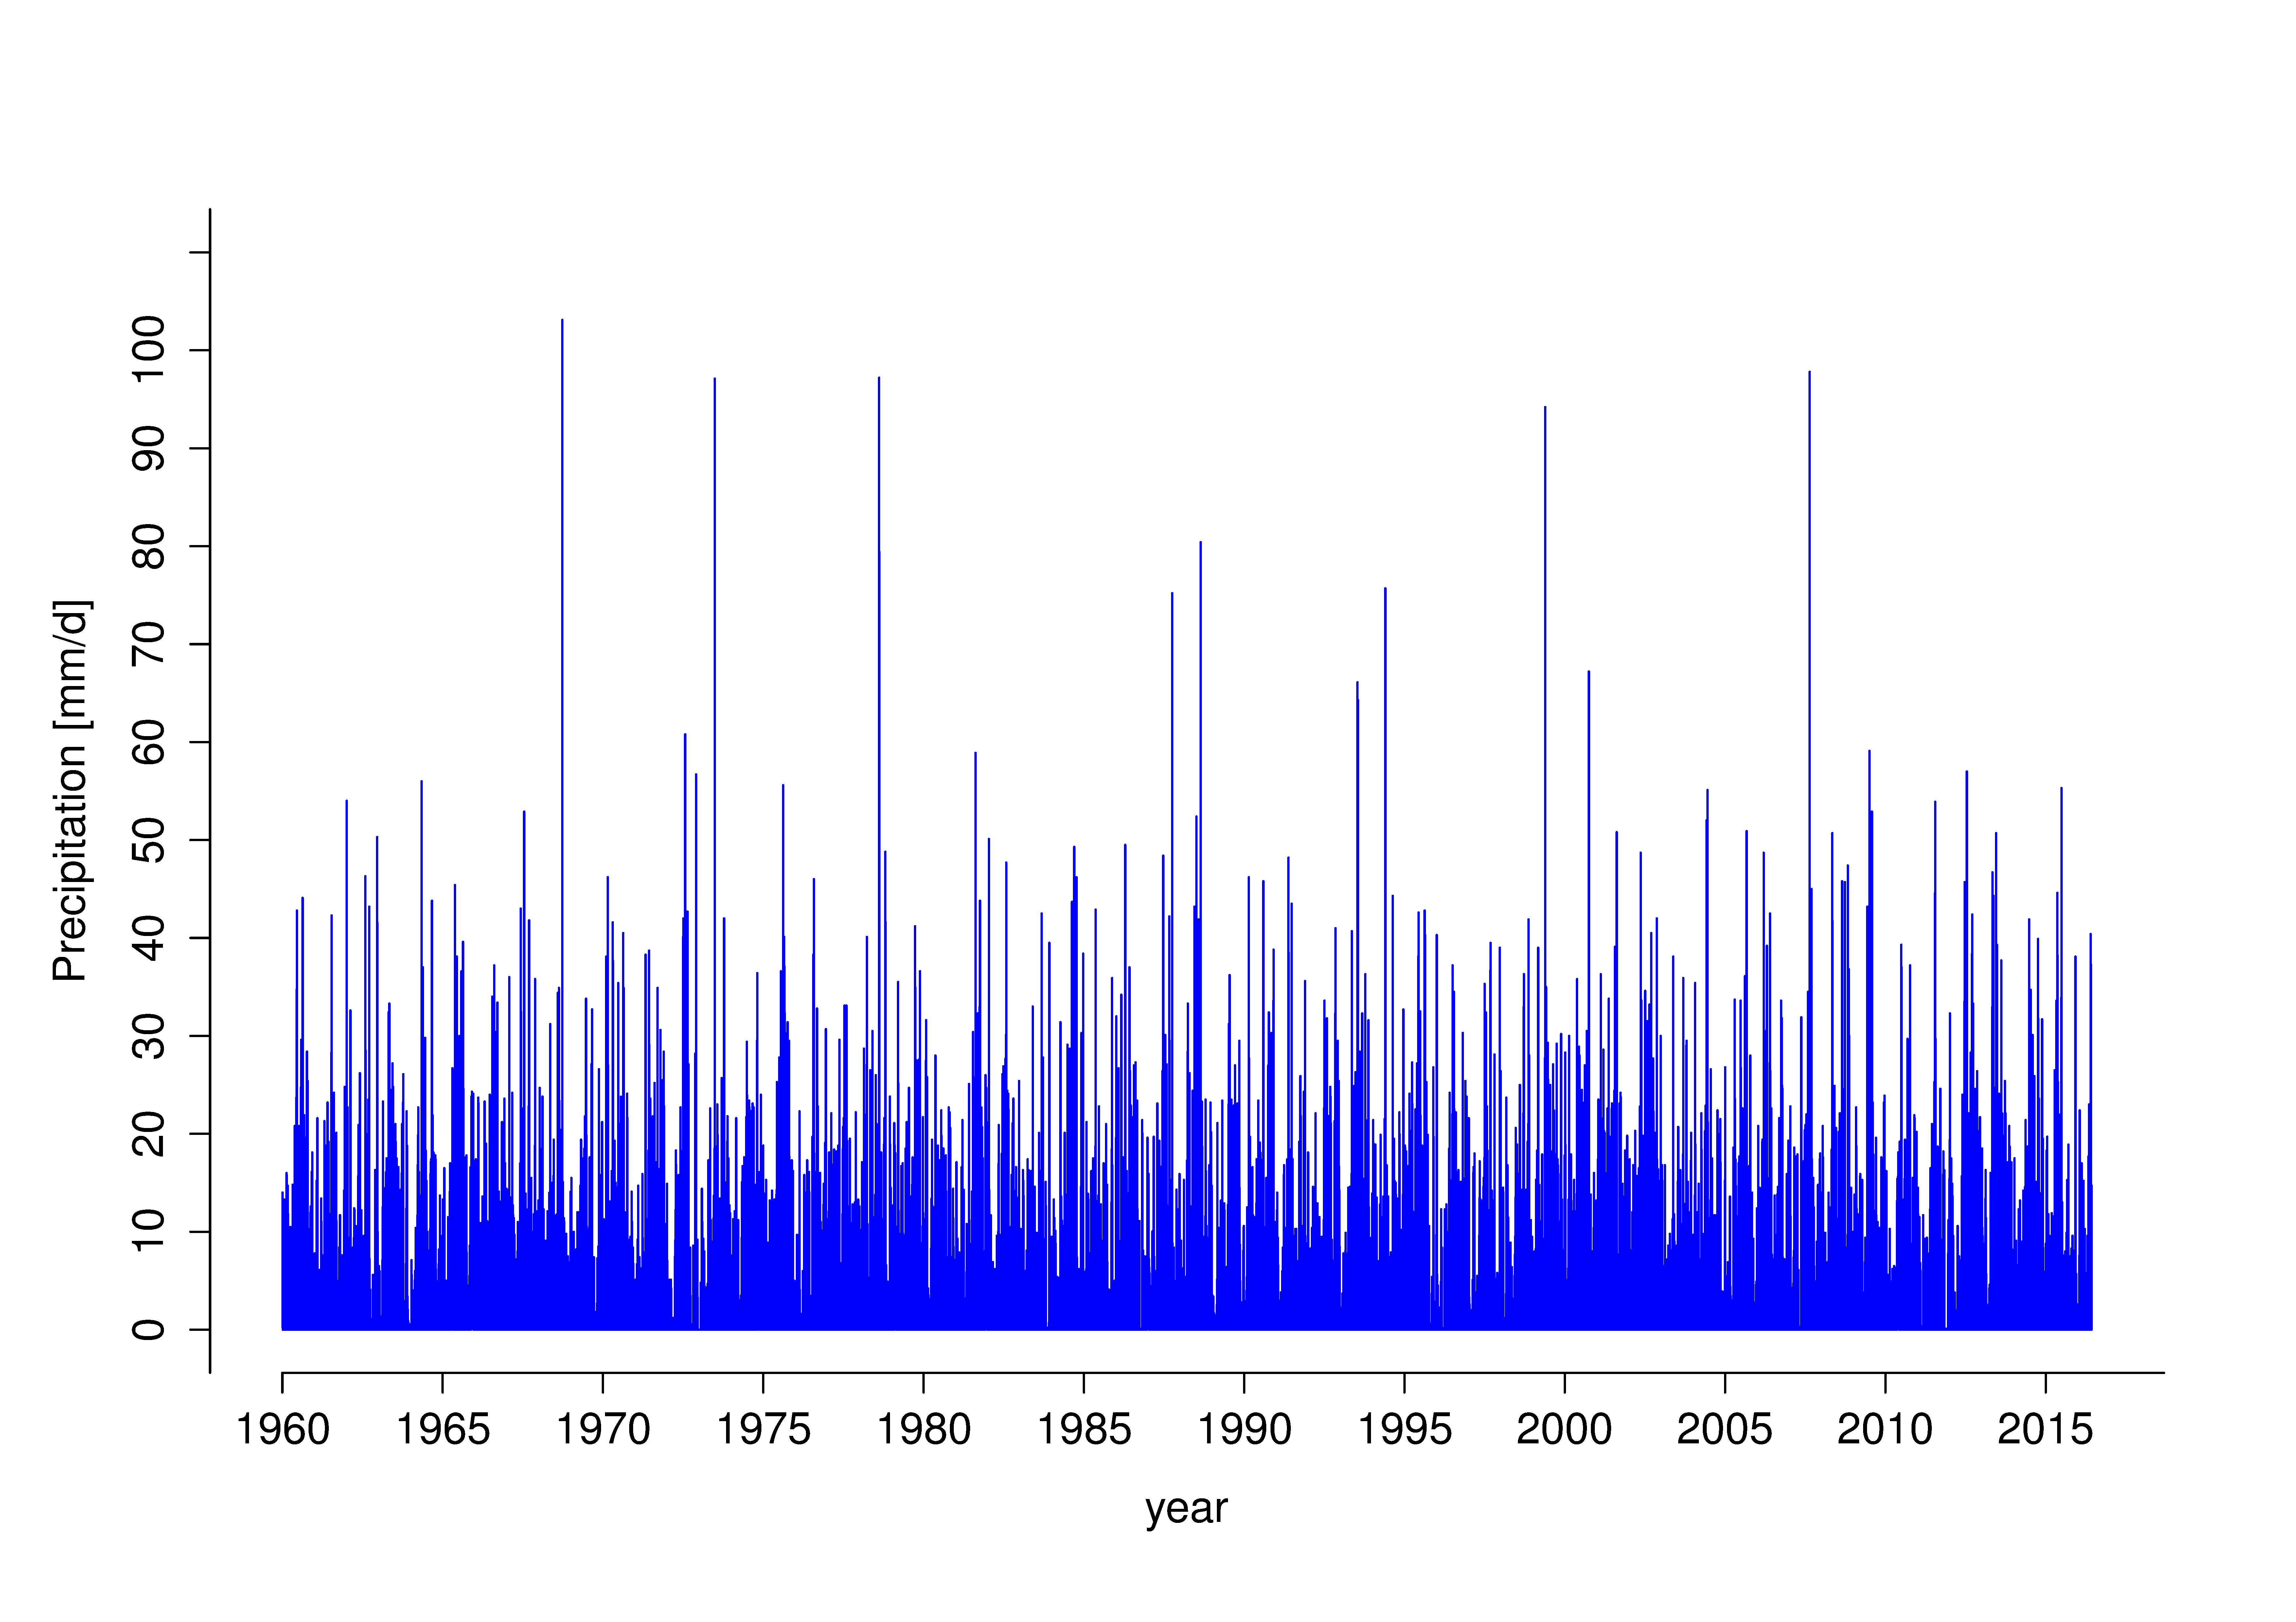
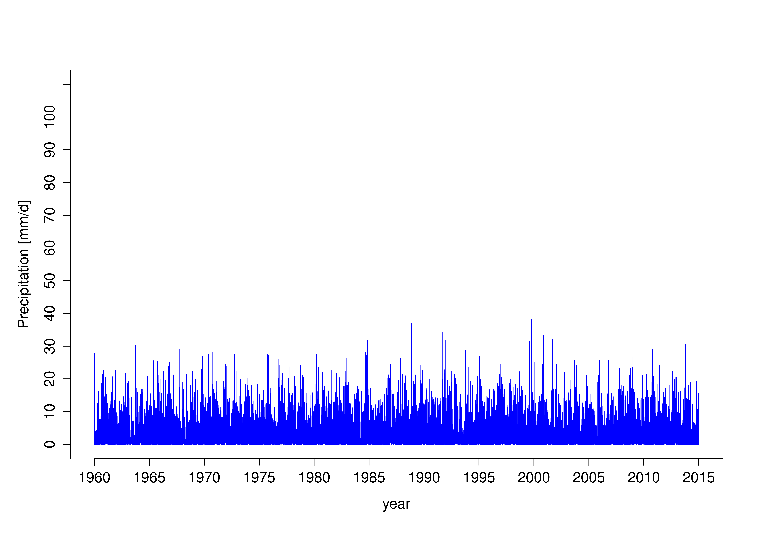
Comparing apples and oranges

Slide 42
Challenge
How should we evaluate the present-day precipitation distribution in GCMs?

Slide 43
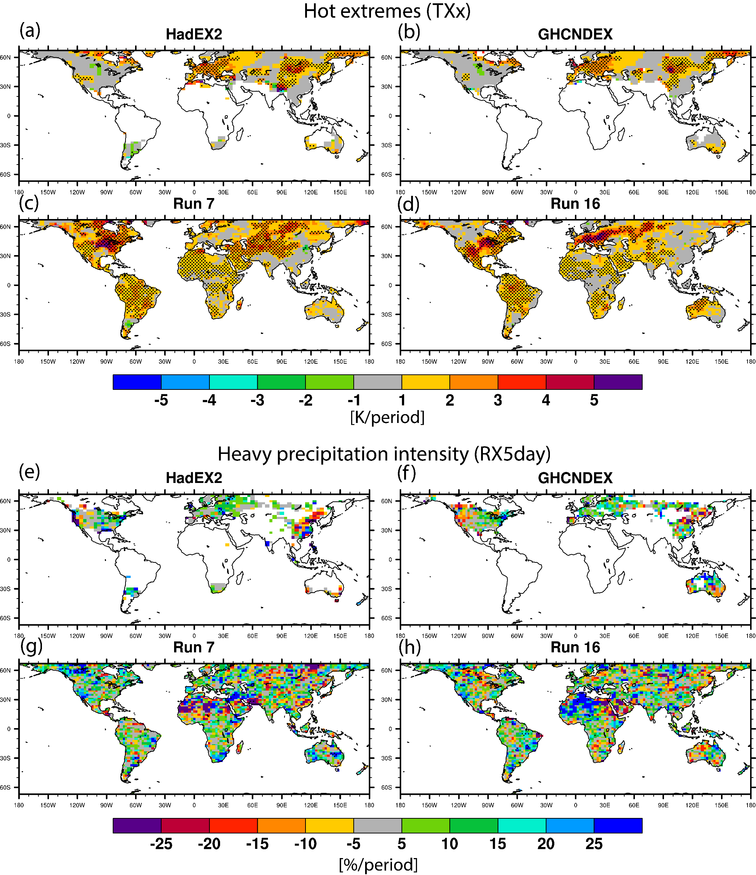
The local perspective
Long-term trends are somewhat less sensitive to gridding and resolution
Fischer and Knutti 2014b, GRL

Slide 44
The local perspective
Ideally we could evaluate the forced response
Fischer and Knutti 2014b, GRL

Slide 45
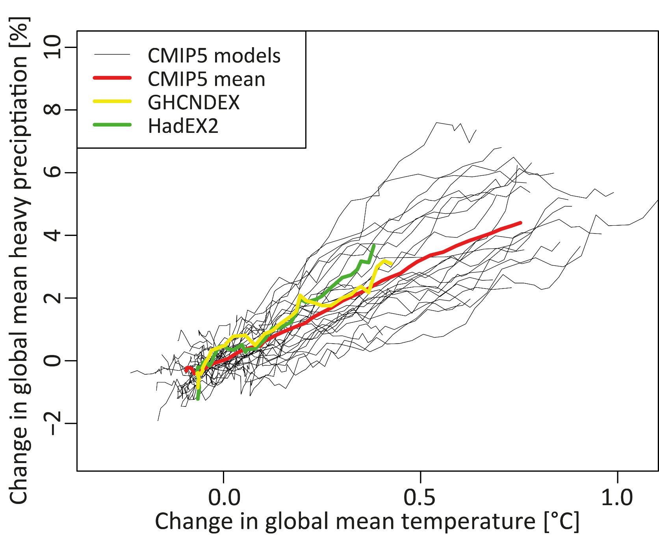
The global perspective

Slide 46
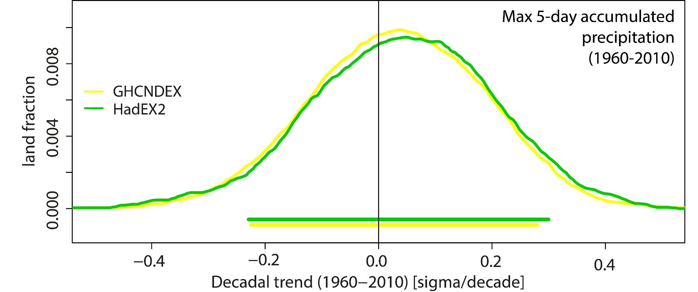
The spatial perspective
Fischer and Knutti 2014b, GRL

Slide 47
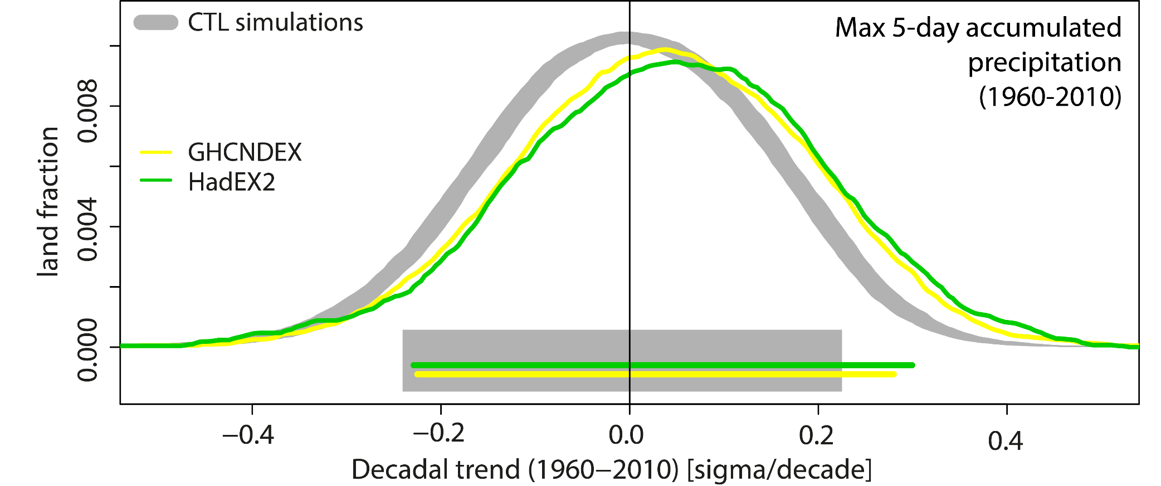
A simple detection approach
Fischer and Knutti 2014b, GRL

Slide 48
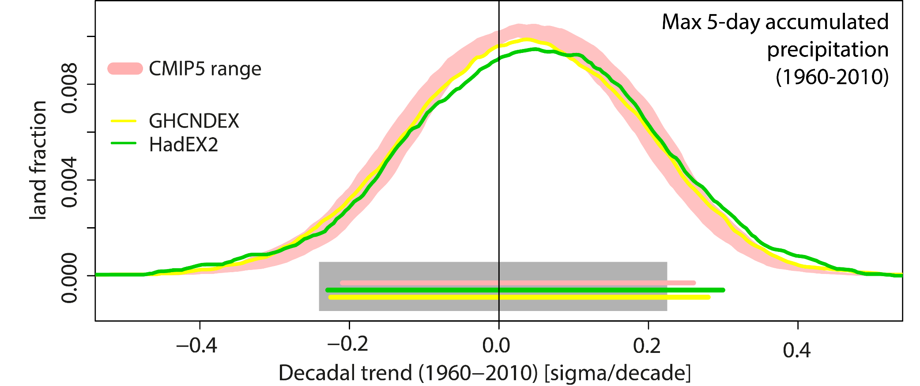
Good agreement with GCMs
Fischer and Knutti 2014b, GRL

Slide 49
Consistent with station data
Westra et al. 2013, J Climate

Slide 50
Majority of stations shows positive scaling
Westra et al. 2013, J Climate

Slide 51
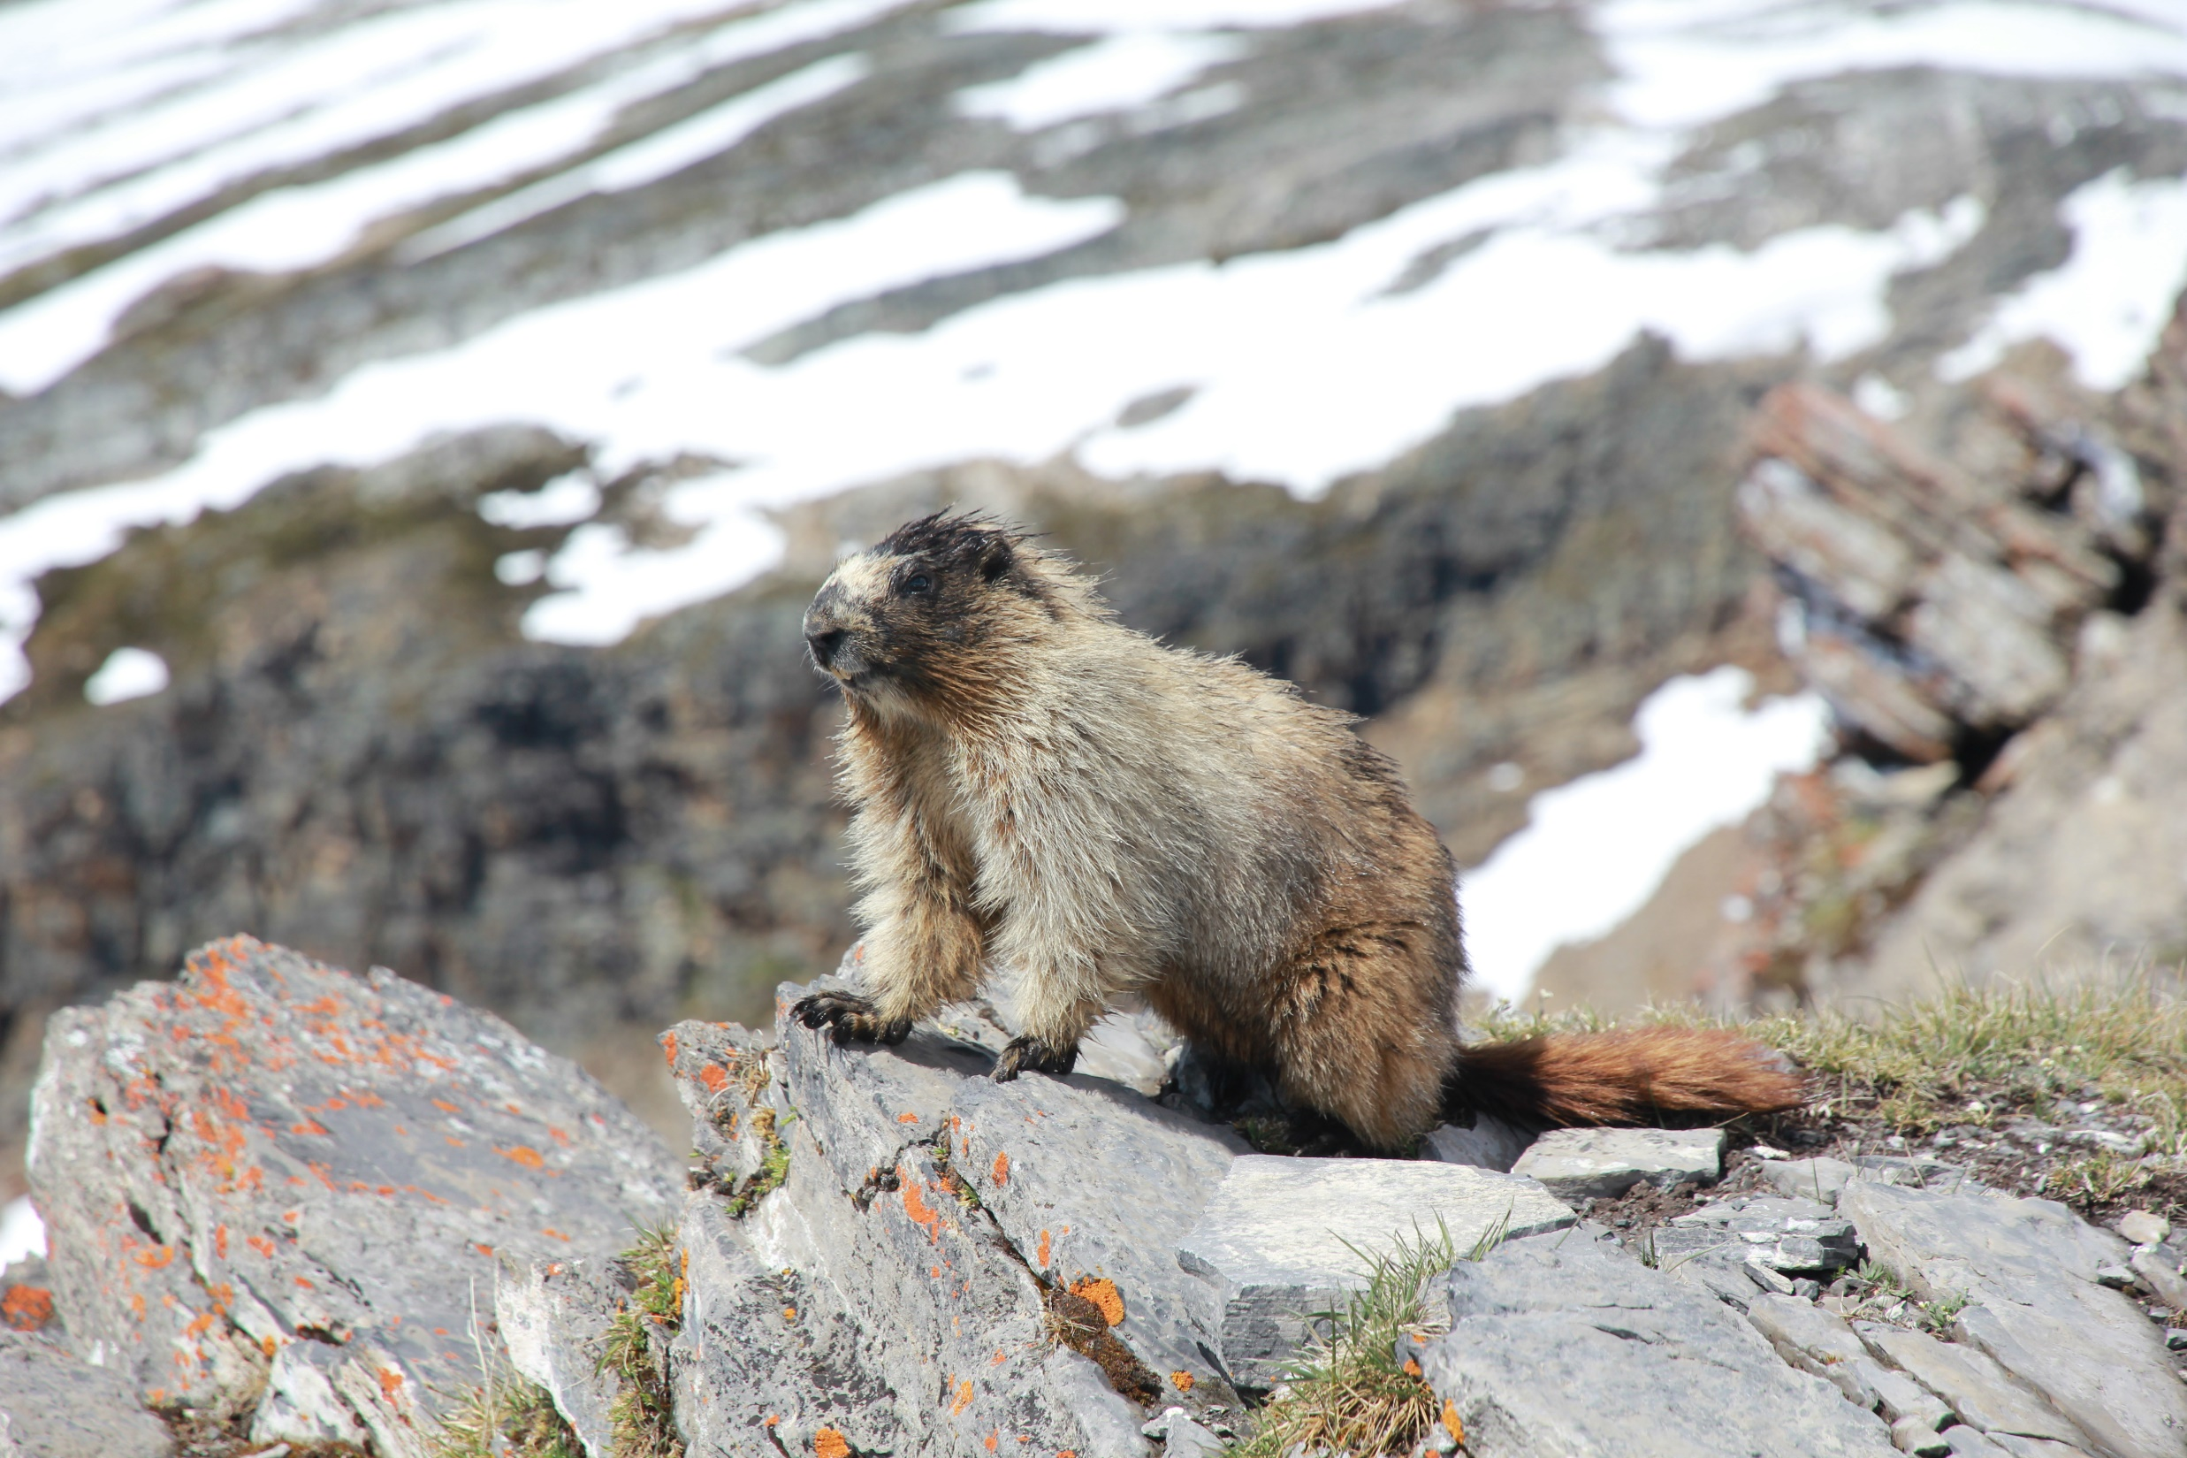
Do we find a signal at the smaller scales?

Slide 52
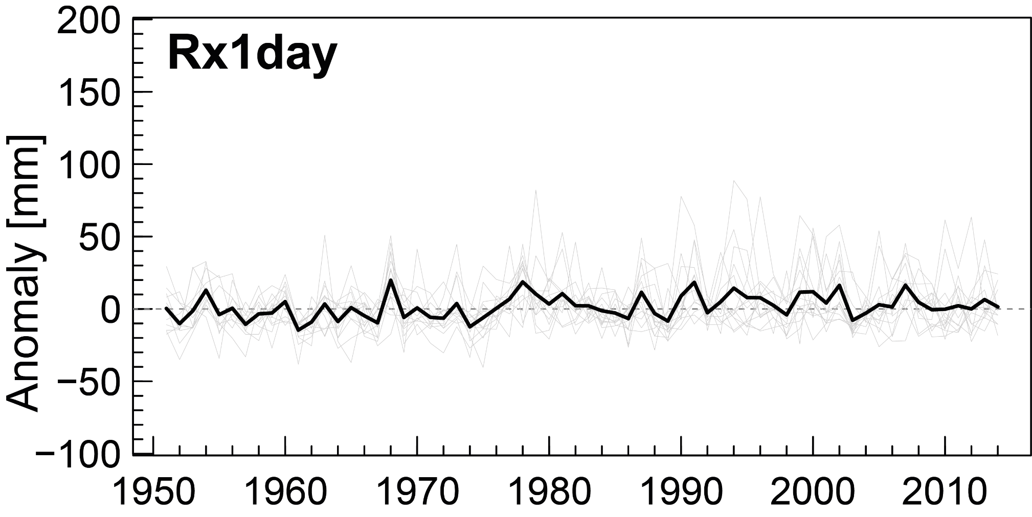
No change in Swiss flood damage…

Slide 53
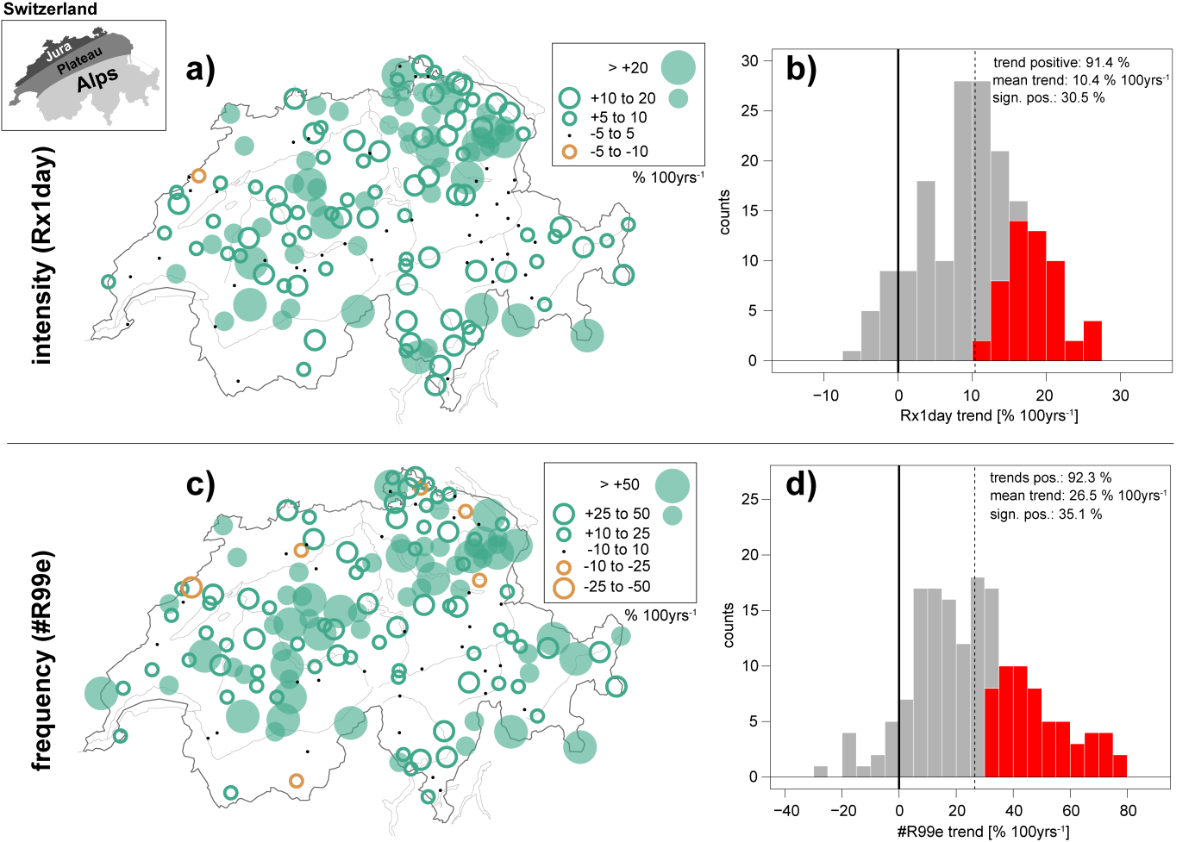
Majority of stations show increase
Scherrer et al. 2016, J Geophys Res

Slide 54
More wettening than drying in Switzerland
Scherrer et al. 2016, J Geophys Res

Slide 55
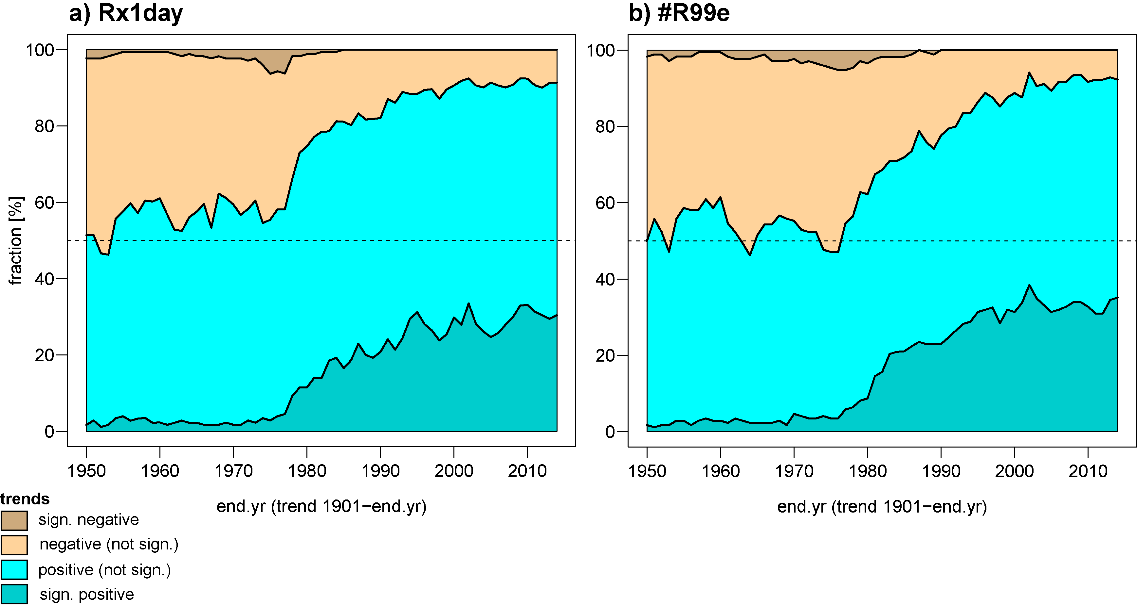
Emergence of a signal
End year of trends starting in 1901
Scherrer et al. 2016, J Geophys Res

Slide 56
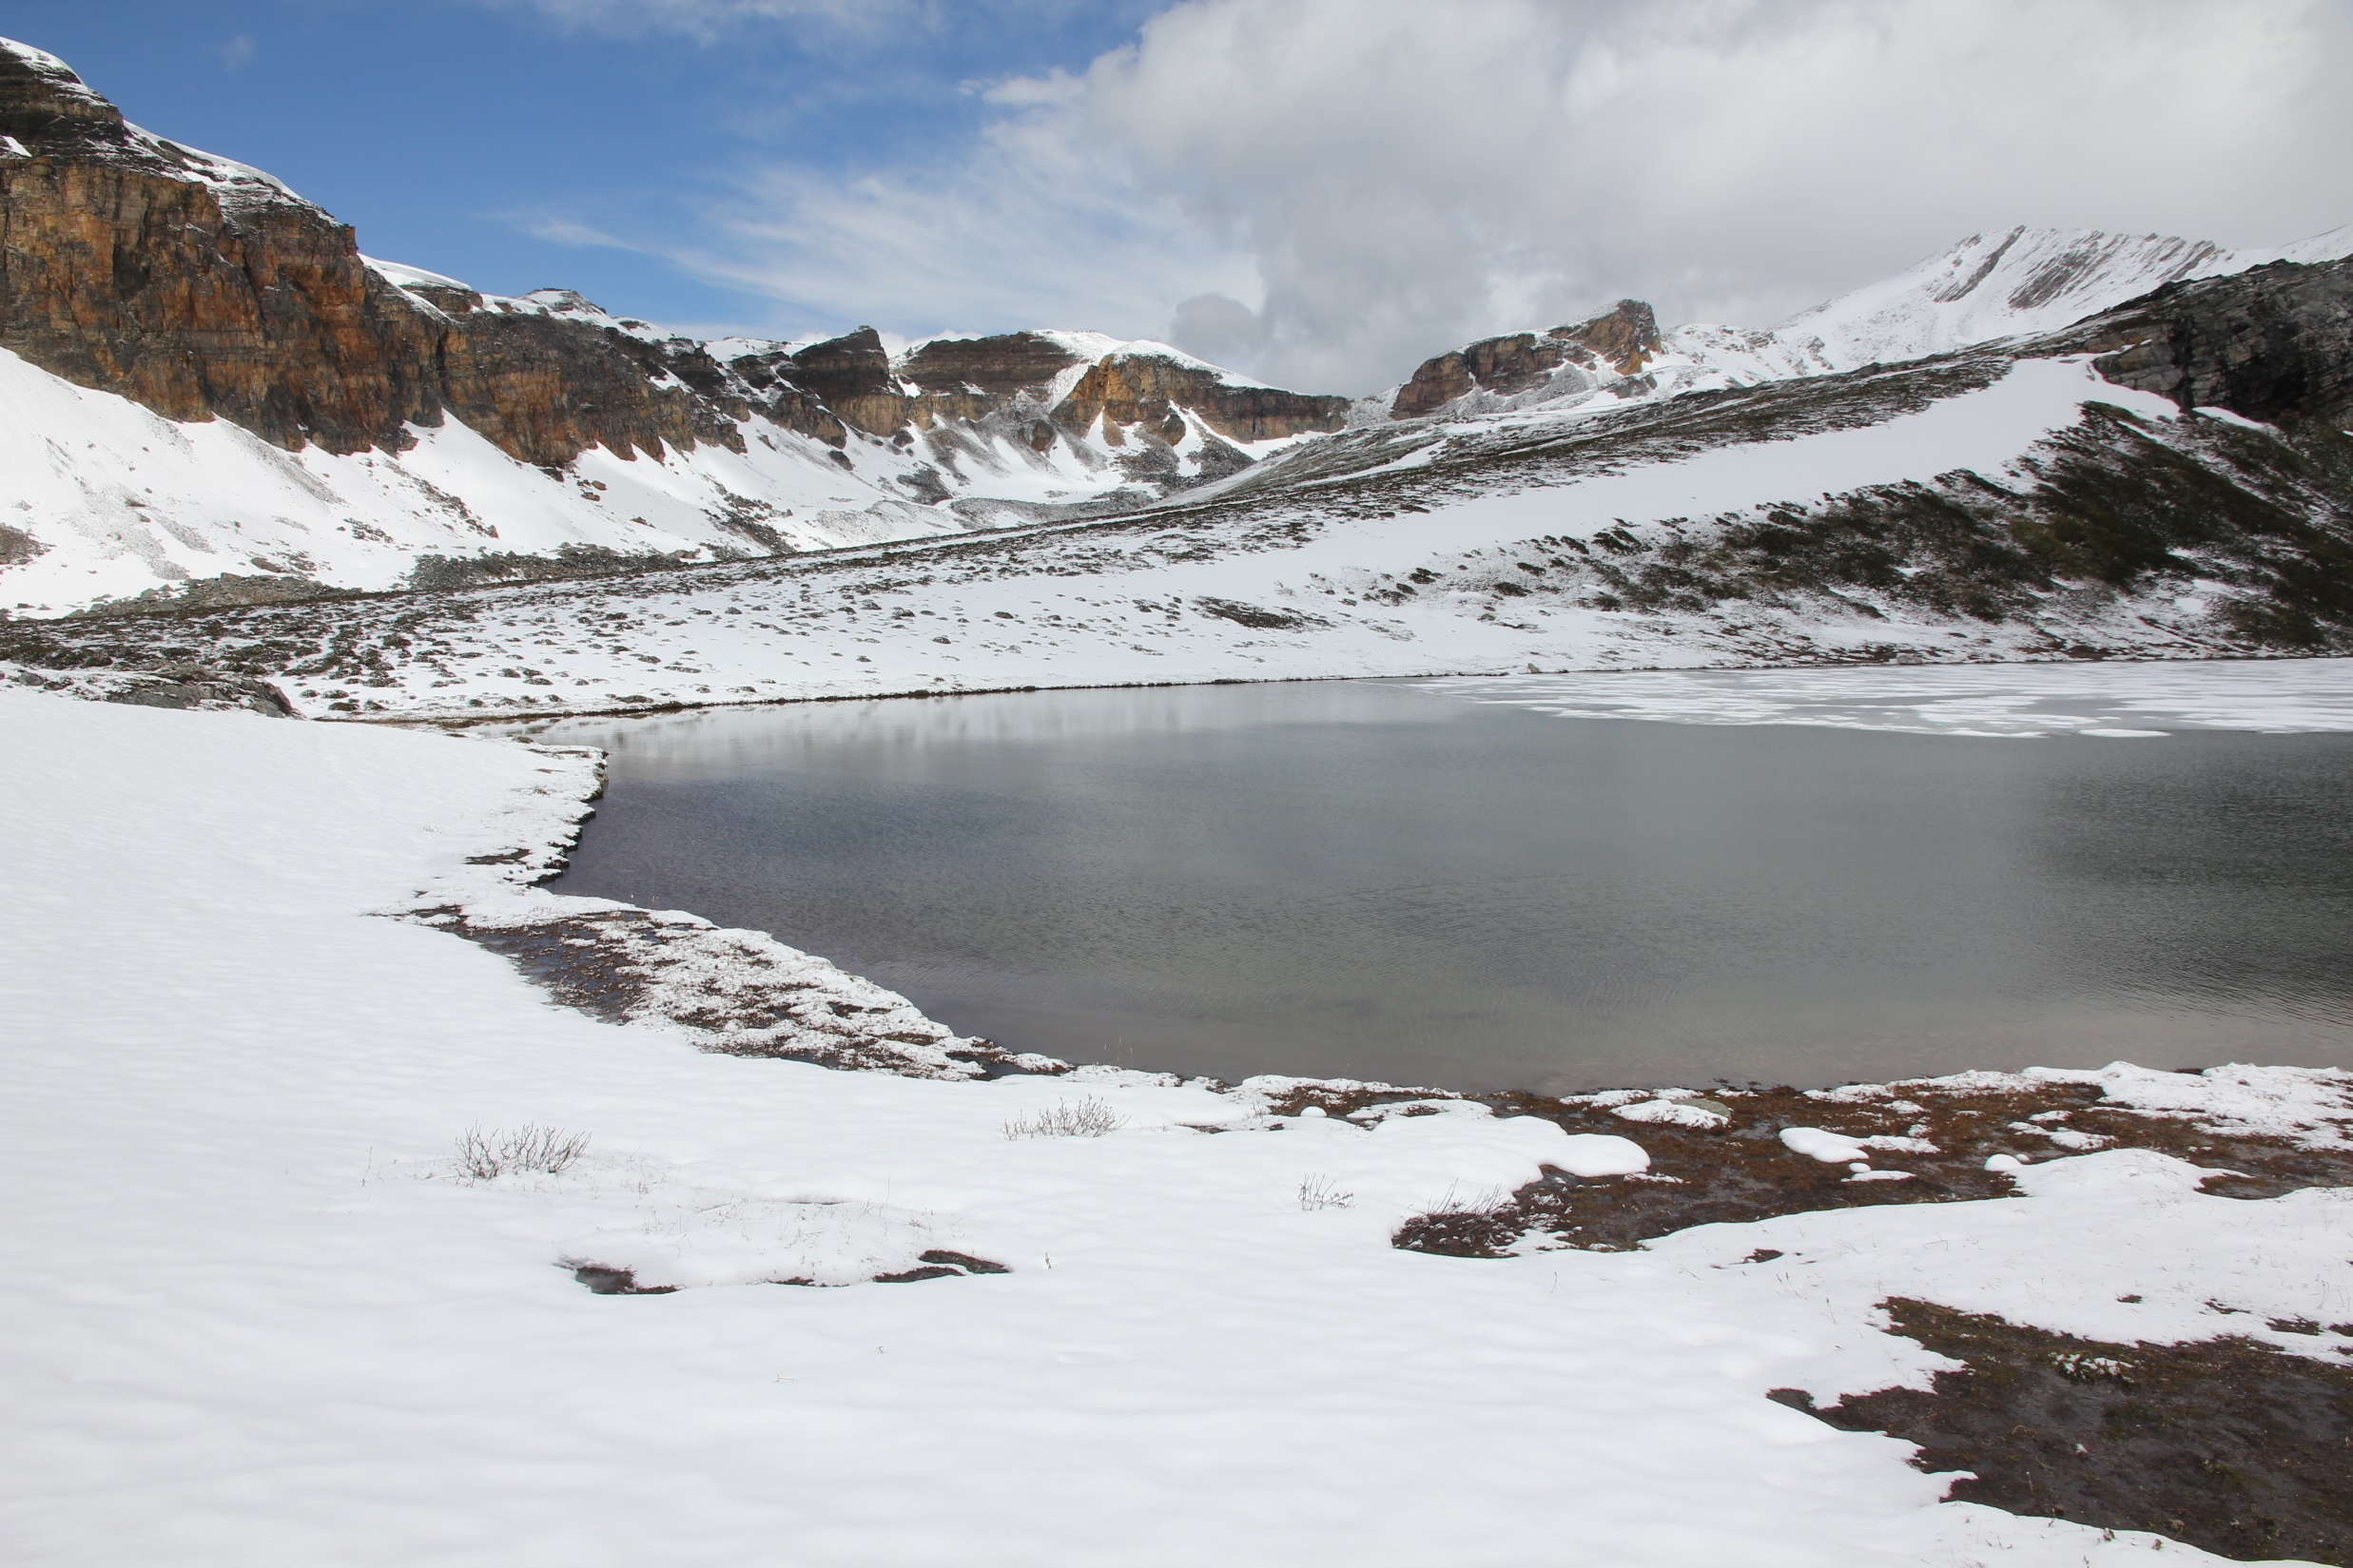
Can models capture the changes
in continental-scale precipitation?

Slide 57
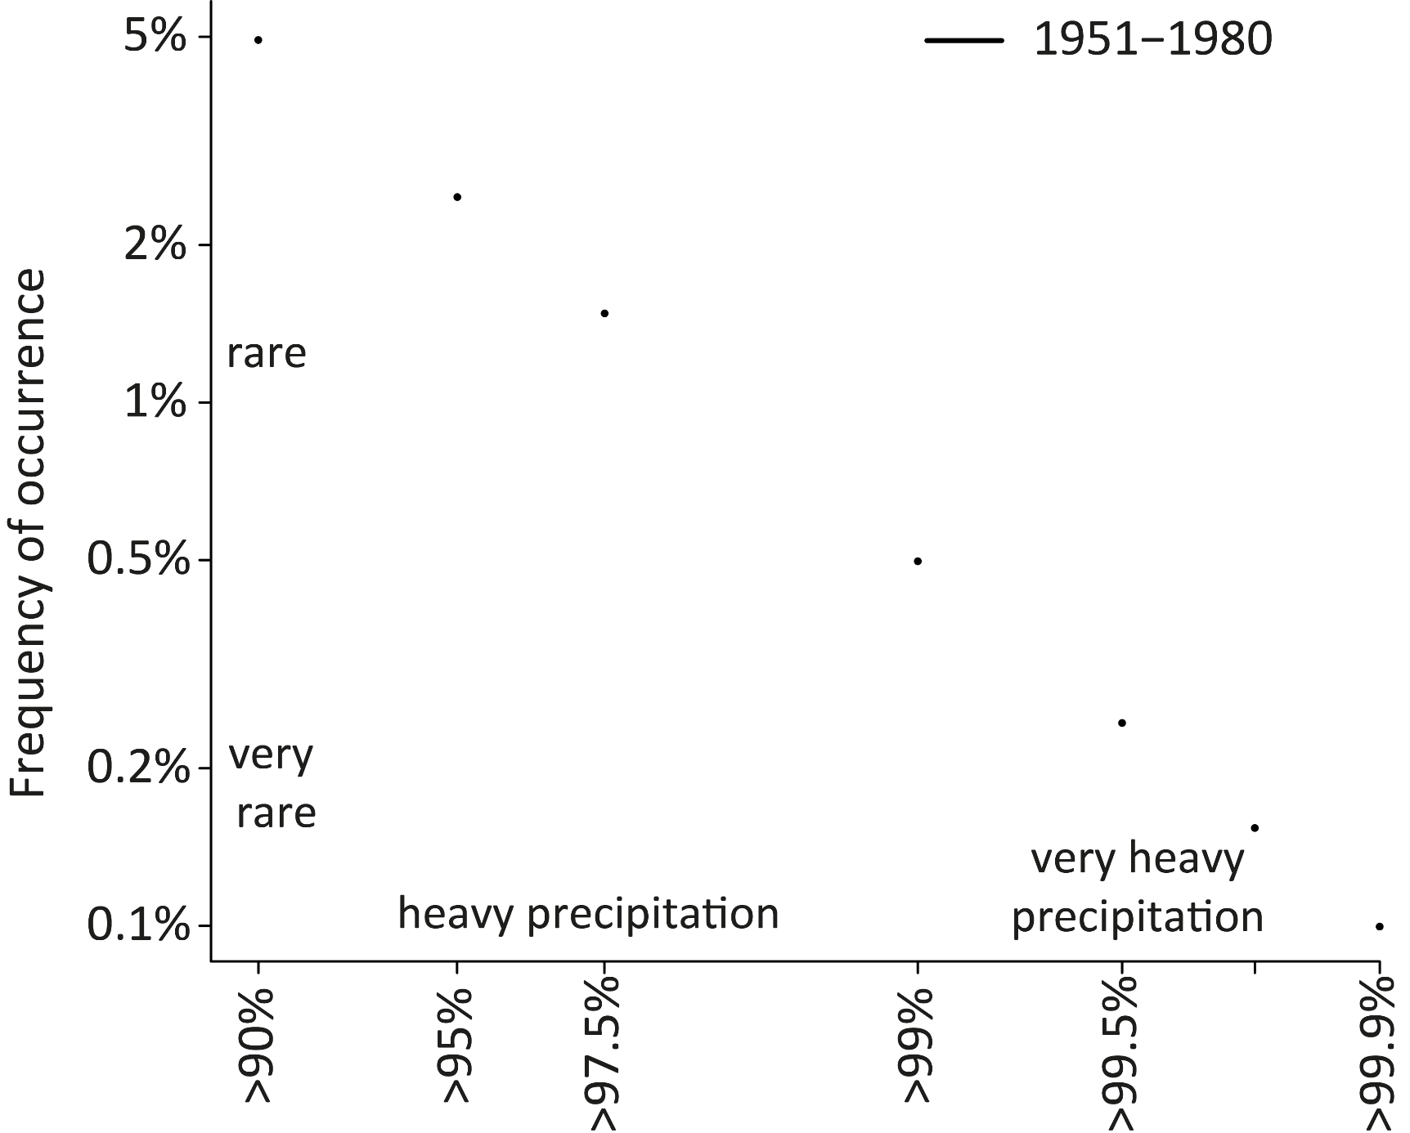
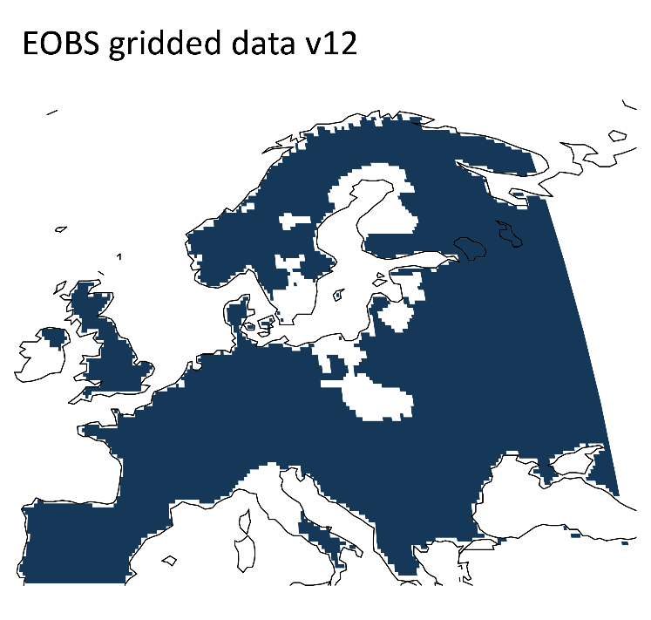
Observed daily percentiles in Europe
All-day percentiles based on daily gridded EOBS data

Slide 58
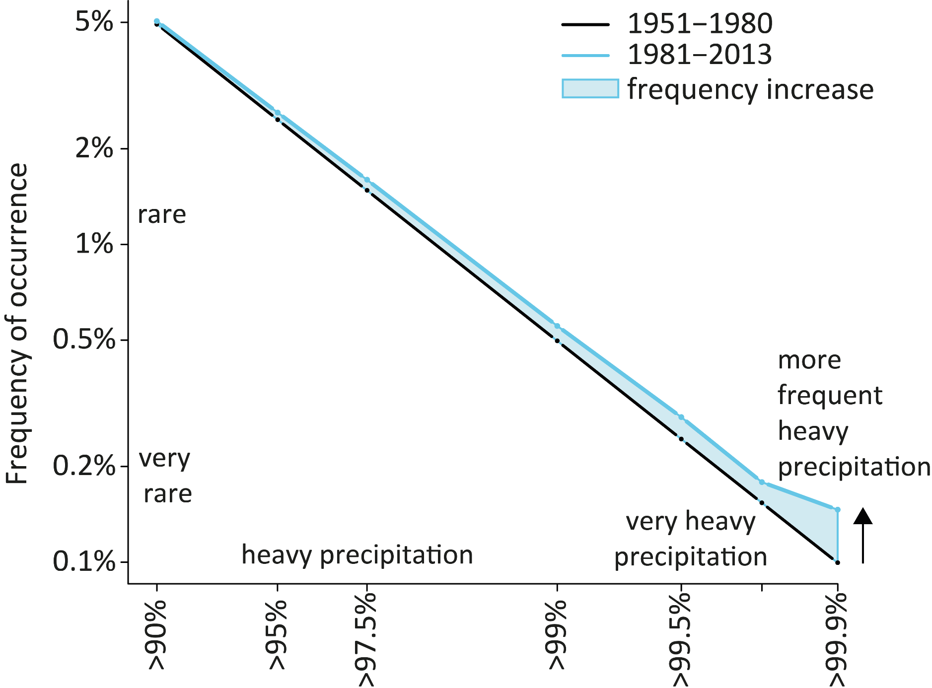
Observation-based schematic
An observation-based schematic useful for outreach?

Slide 59
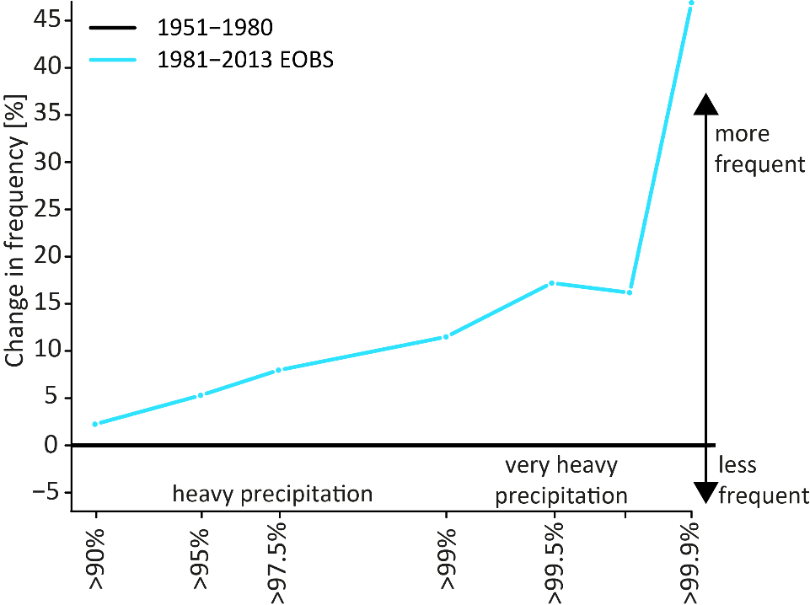
More very wet days

Slide 60
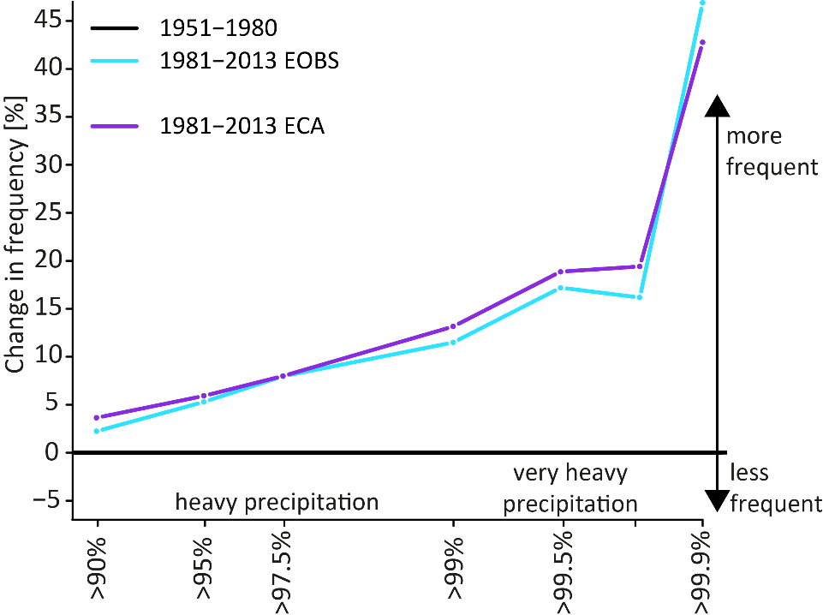
Station and grid observations are consistent

Slide 61
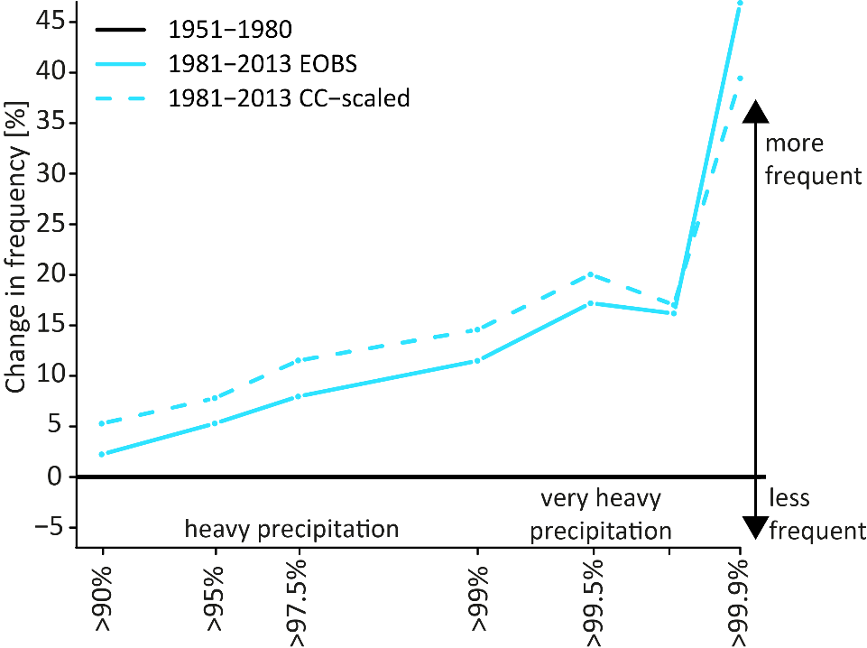
Remarkably consistent with CC-scaling

Slide 62
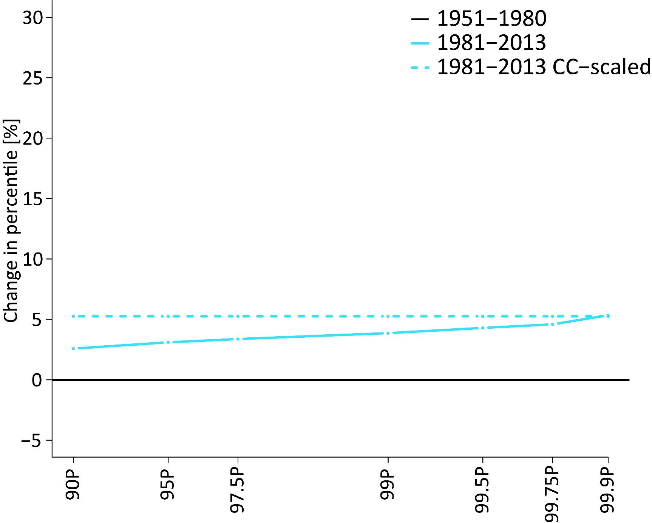
Change in percentiles

Slide 63
Remarkably consistent with CC-scaling

Slide 64
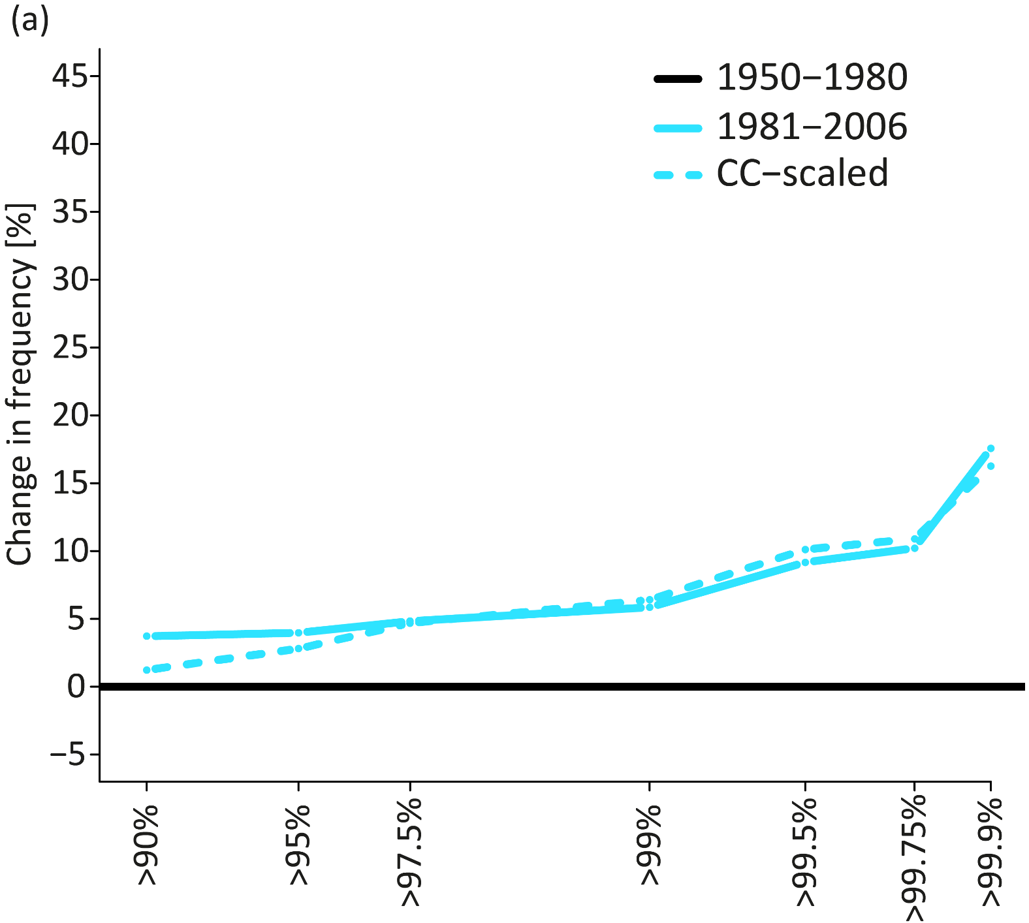

Consistent changes over the eastern US

Slide 65
Remarkably consistent with CC-scaling

Slide 66
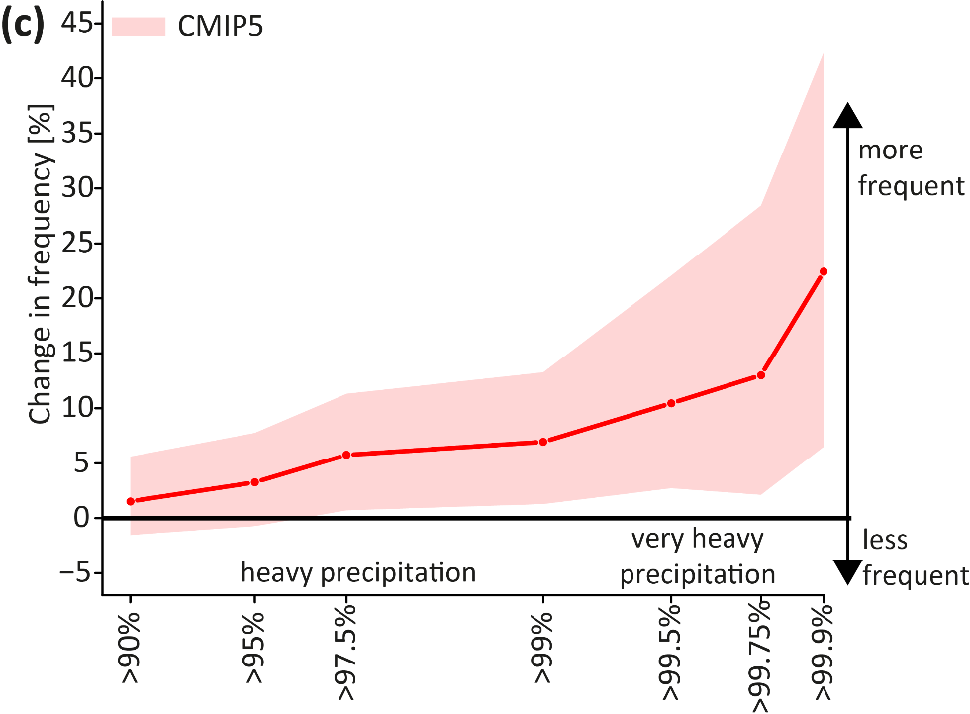
Consistent with climate models
Despite deficiencies in the representation of present-day extremes GCMs capture changes reasonably well

Slide 67

EURO-CORDEX even lower?

Slide 68

The higher resolved – the lower the change?
Different warming
Internal var. in precipitation
Different precip response
Different grid resolution

Slide 69

Good agreement at 3°C when regridded
For same level of warming changes are very consistent

Slide 70
Challenge
In what changes should we have confidence despite parameterized convection?

Slide 71


Slide 72

The human influence

Slide 73

What fraction of all globally occurring heavy precipitation or hot extremes is
attributable to warming?

Slide 74

Pre-industrial precipitation series
Percentiles defined on all days in pre-industrial control simulations
99.99th percentile

Slide 75

Pre-industrial precipitation distribution
probability

Slide 76


Noisy changes at one grid point
probability

Slide 77

Heavy precipitation averaged over N Europe
probability
Smooth increase in probability of heavy precipitation days in one GCM

Slide 78
Heavy precipitation days over N Europe
probability
Robust response across 25 CMIP models

Slide 79


The more extreme – the greater the increase
$$PR= \frac{P\text{2}\text{°}C}{Ppre ind}$$

Slide 80

The more extreme – the greater the increase
$$PR= \frac{P\text{2}\text{°}C}{Ppre ind}$$

Slide 81

Global land-only probability ratio
1.4-2.0 times more heavy precipitation days across the globe

Slide 82

Probability ratio at 2°C warming
Multi-model mean exceedance of
pre-industrial 99% quantile of daily precipitation

Slide 83
Global land-only probability ratio
1.4-2.0 times more heavy precipitation days across the globe

Slide 84

Non-linear increase with warming

Slide 85


The attributable fraction of occurrence
FAR = 1- $\frac{PPre ind}{P0.85°C}$
Observed
+0.85°C
18% [10-28%] of all globally occurring heavy precipitation days are attributable to warming

Slide 86

The more extreme – the more is attributable

Slide 87

Low present-day variability – high change
Exceedance of pre-industrial 99% quantile of
daily temperature at 2°C warming

Slide 88

Global warming targets matter
2°C
Twice as many warm extremes at 2°C than 1.5°C warming
1.5°C
Observed

Slide 89

Majority of warm extremes attributable
Observed
+0.85°C
75% [61-86%] of all globally occurring daily warm extremes are attributable to observed warming

Slide 90

Heat stress – a multivariate problem
Karachi Pakistan 2015

Slide 91
Human discomfort
uncomfortable
comfortable
Wilby and Dessai, 2010, Nature CC

Slide 92

Human discomfort
uncomfortable
Relative humidity [%]
comfortable
Temperature [°C]

Slide 93

Heat stress in Southern Australia
CMIP5 models (1% hottest days 1986-2005)
Temperature [°C]
Relative humidity [%]
Major model spread and biases in T and RH
Fischer and Knutti, 2012, Nature CC

Slide 94



Heat stress in Southern Australia
Model biases in combined indicator are substantially smaller than anticipated
Relative humidity [%]
Temperature [°C]
Fischer and Knutti, 2012, Nature CC

Slide 95

Consistent with first principles
Southern Australia
Central North America
T_{eq} isolines
W isolines
T_{eq} equivalent temperature
T 2m air temperature
L_{v} latent heat of vaporization
q specific humidity
Fischer and Knutti, 2013, Nature CC

Slide 96

Warmer models tend to have lower RH
T vs. RH correlation across GCMs (1% hottest days in 1986-2005)
Covariability holds even for projections -> reduced uncertainty
Fischer and Knutti, 2012, Nature CC

Slide 97

Reduction in model spread
Spread would be locally 3-4x larger
Fischer and Knutti, 2013, Nature CC

Slide 98
Wildfire probability
low wildfire risk
Relative humidity [%]
high wildfire risk
Temperature [°C]

Slide 99

The hotter, the drier the air
∆T vs. ∆RH (1% hottest days)
2081-2100 wrt 1986-2005
Fischer and Knutti, 2012, Nature CC

Slide 100

The hotter, the drier the air
Fischer and Knutti, 2012, Nature CC

Slide 101
Take home message
Multi-variate approaches may reveal impact-relevant changes that are more robust than widely recognized

Slide 102
Conclusions
At local scale internal variability and the chaotic nature of weather will dominate for several decades
Models have well-known limitations and process-based evaluation is crucial … but challenging
Models show reasonably consistent changes in temperature and heavy rainfall extremes at continental to global scales
Accounting for internal variability and covariability is vital

Slide 103
Some references mentioned…
Fischer, E.M., and R. Knutti, 2013: Robust joint projections for humidity and temperature extremes, Nature Climate Change, 3, 120-126, doi:10.1038/nclimate1682.
Fischer, E.M., U. Beyerle and R. Knutti, 2013: Robust spatially aggregated projections of climate extremes, Nature Climate Change, doi:10.1038/nclimate2051.
Fischer, E.M., and R. Knutti, 2014: Detection of spatially aggregated changes in temperature and precipitation extremes, Geophys. Res. Lett., 10.1002/2013GL058499.
Fischer, E.M., J. Sedlacek, E. Hawkins and R. Knutti, 2014: Models agree on forced response pattern of precipitation and temperature extremes, Geophys. Res. Lett., 10.1002/2014GL062018.
Fischer, E.M., and R. Knutti, 2015: Anthropogenic contribution to global occurrence of heavy-precipitation and high-temperature extremes, Nature Climate Change, doi:10.1038/nclimate2051
Scherrer, S. C., E. M. Fischer, R. Posselt, M. A. Liniger, M. Croci-Maspoli, and R. Knutti, 2016: Emerging trends in heavy precipitation and hot temperature extremes in Switzerland, J. Geophys. Res., 121, 2626{2637, doi:10.1002/2015JD024634.
Fischer, E.M., and R. Knutti, 2016: Observed heavy precipitation increase confirms theory and early models, Nature Climate Change, revised

Slide 104

Seasonality of changes

Slide 105

Seasonality of changes

