Slide 1


Understanding and attributing extremes: three methodological proposals
BIRS Workshop - Uncertainty Modeling in the Analysis of Weather,
Climate and Hydrological Extremes
Alexis Hannart,
IFAECI, CNRS
14 June 2016
Notes:
This is an Argentinean - European collaboration which includes Jean Louis Dufresne, Reto Knutti, Chao Li and Carolina Vera.

Slide 2
Colleagues
South America
  Sammy Metref – IFAECI, CNRS, Argentina
  Manuel Pulido – Department of Physics, UNN, Argentina
  Juan Ruiz – IFAECI, CONICET, Argentina
Europe
  Marc Bocquet – Ecole des Ponts, Paris Tech, France
  Freddy Bouchet – ENS Lyon, France
  Alberto Carrassi – Mohn-Sverdrup Center, NERSC, Norway
  Philippe Naveau – LSCE, CNRS, France
  Fredi Otto –Oxford University, UK
North America
  Judea Pearl – UCLA, USA
  Michael Ghil – UCLA, USA and ENS, France
  Francis Zwiers – PCIC, University of Victoria, Canada

Slide 3
Outline
Data Assimilation
Rare event simulation
Structural causal theory
Conclusion

Slide 4
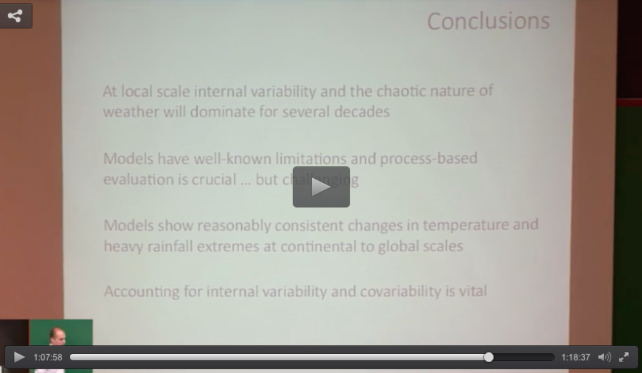
Eric’s conclusion: need for process-based model evaluation

Slide 5
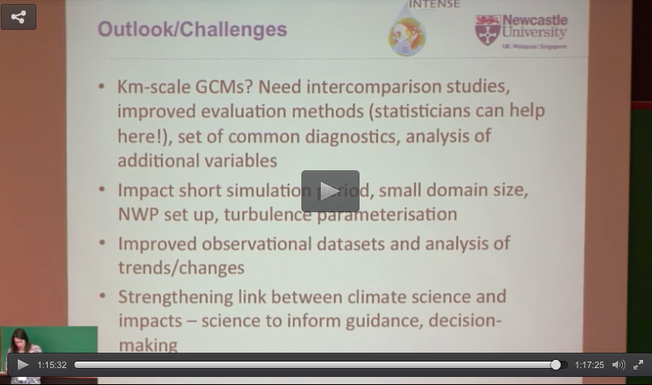
Hayley’s conclusion: need for process-based model evaluation

Slide 6
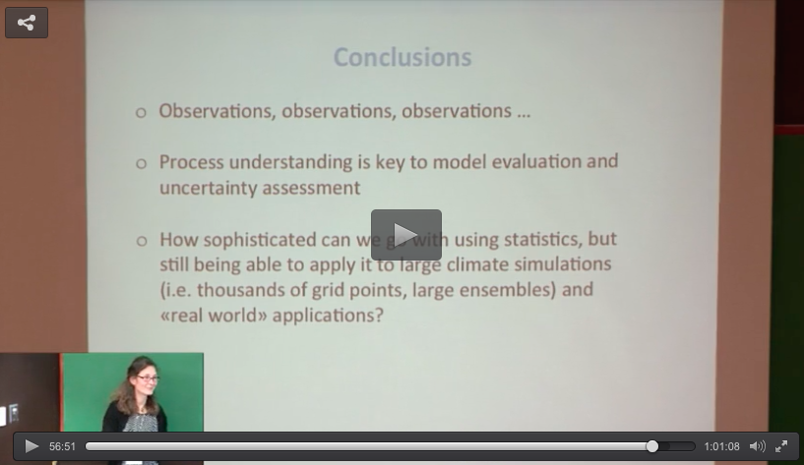
Jana’s conclusion: need for process-based model evaluation

Slide 7
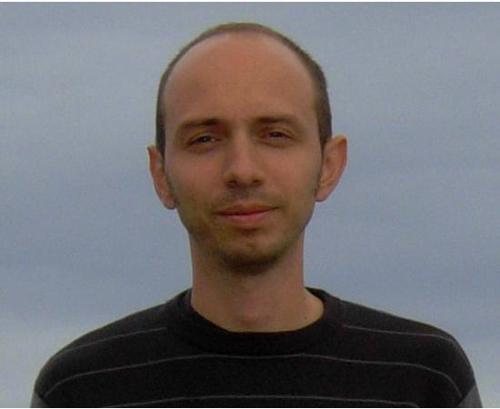
Andrea’s conclusion: need for process-based model evaluation
Need for process-based model evaluation.
Andrea Toreti

Slide 8
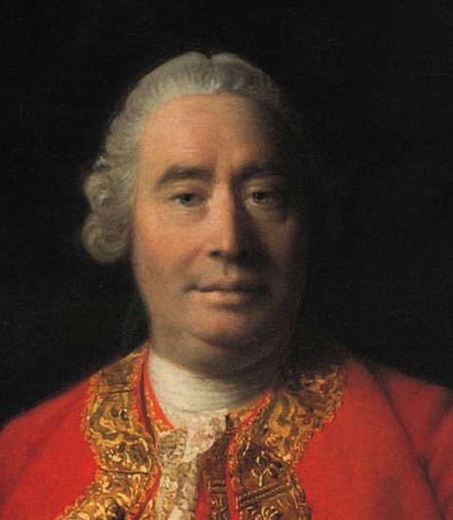
Hume’s conclusion: need for process-based model evaluation
« A cause is something that makes a difference from what would have happened without it. »
David Hume

Slide 9
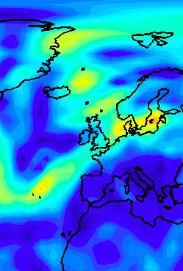
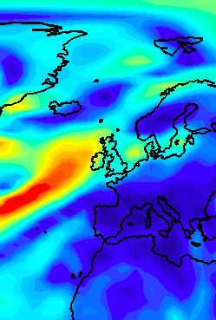
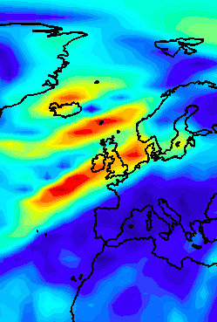

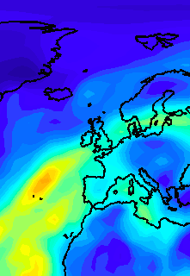
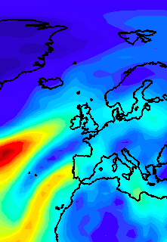
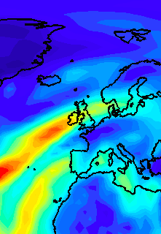

Attributing an event: need for process-based model evaluation
Causally attributing an event = comparing the ability of a factual model and of a counterfactual model to reproduce the event.
Winter storm, Dec. 2015
2 dec. 2015
3 dec. 2015
6 dec. 2015
Factual
Model
wind speed
(…)
Counterfactual
Model
prec. water
(…)

Slide 10
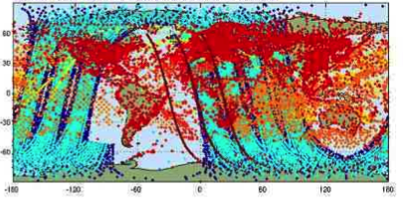
Process-based model evaluation: challenges
Issues associated with observations:
  Missing/erroneous/indirect
  Inhomogeneous spatial coverage.
Raw observations

Slide 11

Process-based model evaluation: challenges
Issues associated with method:
  Spatial and temporal dependence: how to factor?
  Multiple variables: how to combine?
  Large datasets and models: how to compute?
?

Slide 12
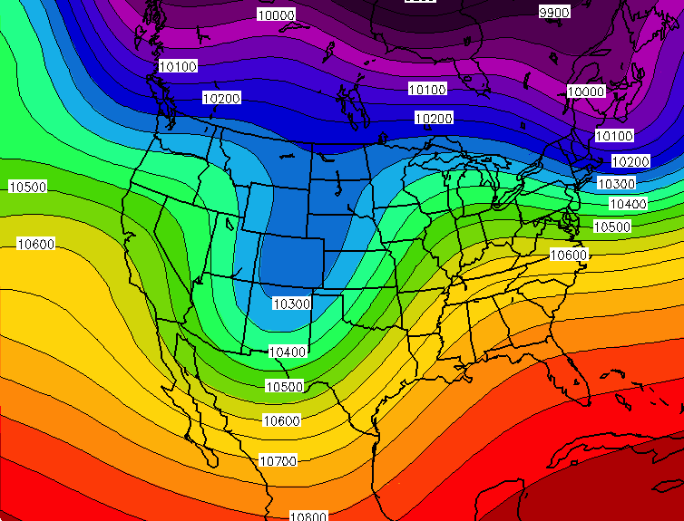
Process-based model evaluation: challenges
Reanalysis addresses some of theses issues but are model-based => do not provide a clean read.
Model 1
Raw observations
Reanalysis
comparison
Model 2
Model 3
…
Model n

Slide 13
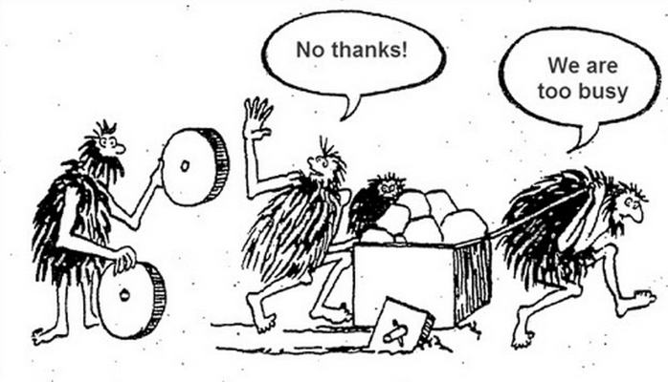
What to do?

Slide 14

What to do?

Slide 15
Process-based model evaluation: a proposal
The very process of reanalysing raw observations in a model may answer the question.
Model 1
Raw observations
Reanalysis

Slide 16
Process-based model evaluation: a proposal
The very process of reanalysing raw observations in a model may answer the question.
Model 1
Raw observations
Reanalysis
informative model-obs confrontation

Slide 17
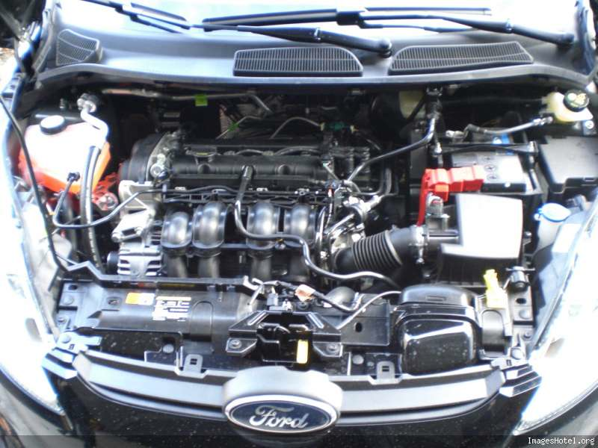
Process-based model evaluation: a proposal
The very process of reanalysing raw observations in a model may answer the question.
Model 1
Raw observations
Reanalysis
Data Assimilation

Slide 18
References
Carrassi A., M. Bocquet, A. Hannart and M. Ghil (2016) Estimating model evidence using data assimilation, Q. J. R. Meteorol. Soc., in revision.
Hannart A., A. Carrassi, M. Bocquet, M. Ghil, P. Naveau, M. Pulido, J. Ruiz, P. Tandeo (2015) DADA: Data Assimilation for the Detection and Attribution of Weather and Climate-related Events, Clim. Change.
Winiarek V., J. Vira, M. Bocquet, M Sofiev and O. Saunier (2011) Towards the operational estimation of a radiological plume using data assimilation after a radiological accidental atmospheric release. Atmos. Env., 45:2944-2955

Slide 19
General problem
We have access to observations of a trajectory of a system of interest (extreme or not):
Several plausible models / assumptions / parameterizations are available to physically represent this dynamic behaviour:
2 dec. 2015
3 dec. 2015
6 dec. 2015
wind speed
(…)
prec. water
(…)
Model 1
Model 2
Model n
(…)

Slide 20
General problem
We have access to observations of a trajectory of a system of interest (extreme or not):
Several plausible models / assumptions / parameterizations are available to physically represent this dynamic behaviour:
Observations are in fact:
- heterogeneous in time
and space,
indirect,
noisy.
Model 1
Model 2
Model n
(…)

Slide 21
General problem
Question: which model better represents observations? Why?
Useful to:
  diagnose which modeling choices are best,
  choose parameters,
  compare models.
Model 1
Model 2
(…)
Model n
improve forecast

Slide 22
General problem
Question: which model better represents observations? Why?
Proposal: tackle this as a statistical goodness-of-fit problem.
Observational (and model) error makes a probabilistic framework possible.
Model 1
Model 2
(…)
Model n

Slide 23
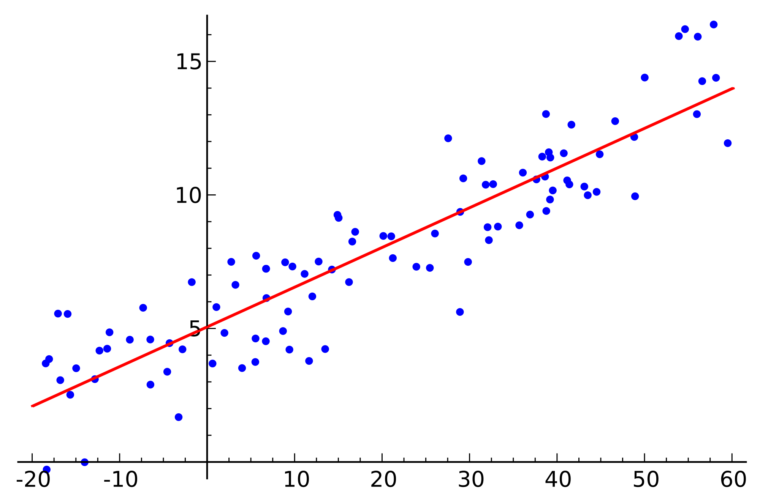


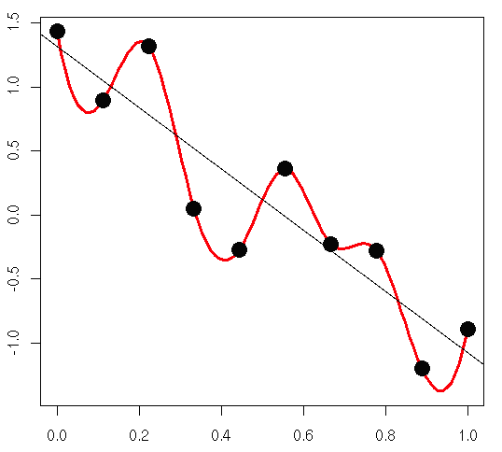
Which model fits better the data?
General problem in statistics.
  model selection,
  model evaluation.
Likelihood is an option.
  y: observations
  θ: model parameters
  likelihood:
  maximized likelihood:
Problem of overfitting: gives a benefit to more complex models even when not relevant.

Slide 24
Which model fits better the data?
Likelihood alone is not satisfactory as a skill metric, need to factor model complexity.
Several approaches:
  cross-validation,
  penalty term added to likelihood (BIC, AIC, ad-hoc, …),
  marginal likelihood (Bayes factor), …
Marginal likelihood:
Can we derive marginal likelihood
for weather and climate models?

Slide 25


Extension of marginal likelihood to weather/climate models
How to turn a numerical model into a statistical one?
Hidden Markov Model:
Dynamic equation:
Observational equation:

Slide 26


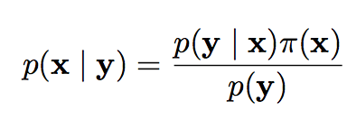
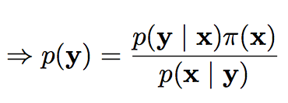
Extension of marginal likelihood to weather/climate models
Difficulty: the number of parameters (or hidden state) is enormous
The integration is intractable in general.
Some solutions:
  approximations.
  closed formula in particular case (e.g. Gaussian).
  Bayes theorem

Slide 27
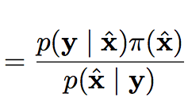
Extension of marginal likelihood to weather/climate models
Difficulty: the number of parameters (or hidden state) is enormous.
The integration is intractable in general.
Some solutions:
  approximations.
  closed formula in particular case (e.g. Gaussian).
  Bayes theorem

Slide 28
General idea: solve the problem using data assimilation
Data assimilation may be viewed as a Baysian inference of x given y.
Observations:
multiple
sensors
State vector:
atmospheric
model
Y
X
Goal: deriving the PDF of X conditional on Y = y
high dimensional Bayesian update.

Slide 29
General idea: solve the problem using data assimilation
Data assimilation may be viewed as a Baysian inference of x given y.
Any time observations are assimilated, the marginal likelihood of the assimilated observation can be derived as a by-product.
Use DA infrastructure/expertise to evaluate the performance of models.

Slide 30
Outlook of Data Assimilation: origins
Observations:
multiple
sensors
State vector:
atmospheric
model
Numerical Weather Prediction requires to initialize the model
every six hours with new observations.

Slide 31
Outlook of Data Assimilation: evolution
Trend: expansion towards new applications, general framework
for interfacing large models and observations.
Examples:
initialization:
  weather forecast
  climate prediction (seasonal to decadal)
  nowcasting (storm, tornadoes)
reconstruction:
  reanalysis
  paleoclimate
  carbon cycle
  Earth’s core
  Oil reservoir
estimation: model parameters
DADA: real time causal analysis of weather events
Observations:
multiple
sensors
State vector:
large physical
model

Slide 32
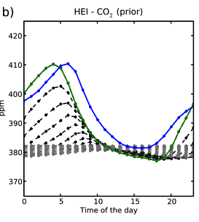
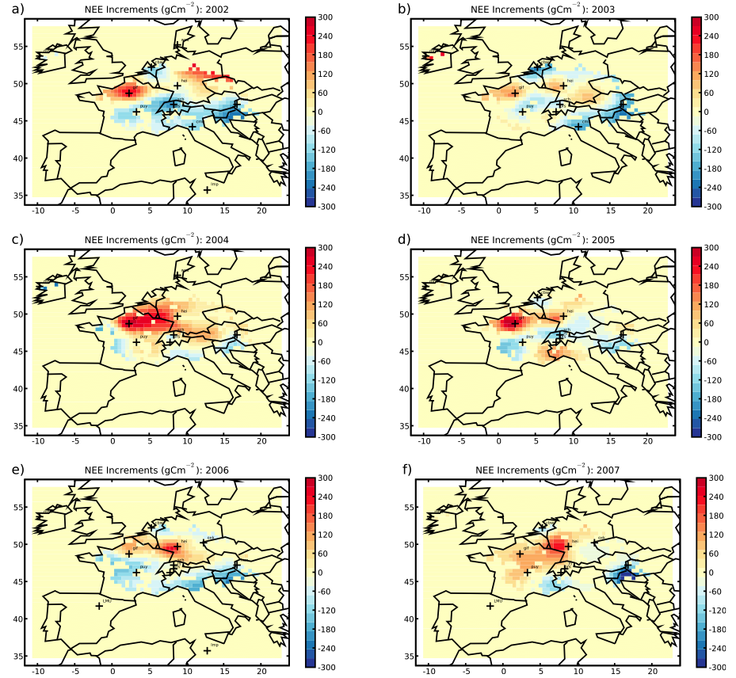
Example: reconstruction of carbon fluxes
Atmospheric
Model
+
Data
Assimilation
CO2 fluxes
CO2 ground
concentration

Slide 33
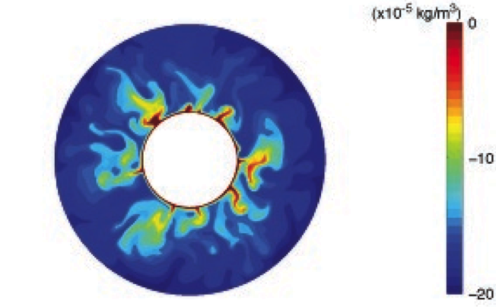
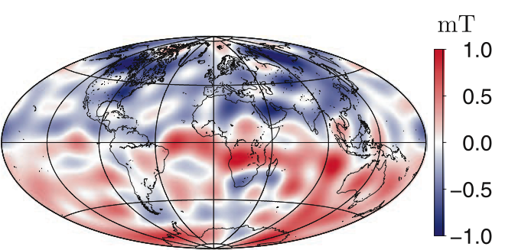
Example: reconstruction of Earth’s core
Geodynamo
Model
+
Data
Assimilation
Earth’s core
structure
Magnetic Field

Slide 34
Outlook of Data Assimilation: algorithms
Exact solution under linear assumption + Gaussian.
  KF: Kalman filter (1960)
Approximated dolutions under nonlinear assumption + Gaussian.
  EKF: Extended Kalman filter (1971)
  EnKF: Ensemble Kalman filter (1993)
  ETKF: Ensemble Transform Kalman filter (1998)
  LETKF: Local Ensemble Transform Kalman filter (2007)
  LETKF-N: Finite size Local Ensemble Transform Kalman filter (2011)
  …
Challenges: algorithmic efficiency in high dimension
  Matrix manipulation.
  Additional assumptions for implementation.

Slide 35
General idea: solve the problem using data assimilation
Data assimilation may be viewed as a Baysian inference of x given y.
Any time observations are assimilated, the marginal likelihood of the assimilated observation can be derived as a by-product.
Problem:
  only an approximation
  implementation issues
Use DA infrastructure/expertise to evaluate the performance of models.
Start by testing this idea in simple
testbed models (Lorenz 95) and
intermediate complexity atmospheric model (Speedy).

Slide 36
Data assimilation: a Gaussian filtering procedure
Assumptions:
Hidden Markov
model
Dynamic equation:
Observational equation:
  v_{t} and w_{t} Gaussian error terms with covariance Q and R;
  M is the model with F_{t} external forcing;
  H is the observation operator.

Slide 37
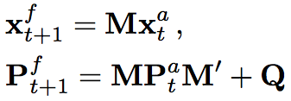
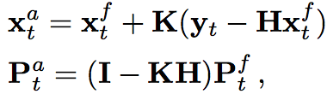

Data assimilation: a Gaussian filtering procedure
Assumptions:
Hidden Markov
model
Solution:
Gaussian linear
approximation
Dynamic equation:
Observational equation:
  v_{t} and w_{t} Gaussian error terms with covariance Q and R;
  M is the model with F_{t} external forcing;
  H is the observation operator.
Propagation equation:
Update equation:

Slide 38
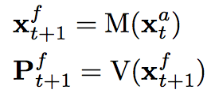
Data assimilation: an ensemble-based, Gaussian, filtering procedure
Assumptions:
Hidden Markov
model
Solution:
Gaussian linear
approximation
Dynamic equation:
Observational equation:
  v_{t} and w_{t} Gaussian error terms with covariance Q and R;
  M is the model with F_{t} external forcing;
  H is the observation operator.
Propagation equation:
Update equation:

Slide 39
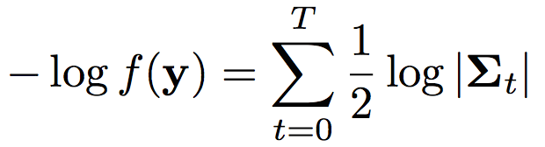

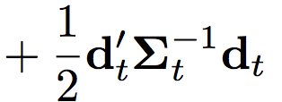
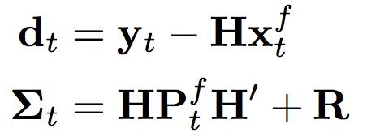
The likelihood is a by-product of data assimilation
Solution:
Gaussian linear
approximation
By-product:
PDF of
observation y
Propagation equation:
Update equation:
Likelihood equation:
  with:

Slide 40
The likelihood is a by-product of data assimilation
Likelihood :
  with:
Accounts for observational noise and inhomogeneity
Spatial-temporal-variable aggregation

Slide 41
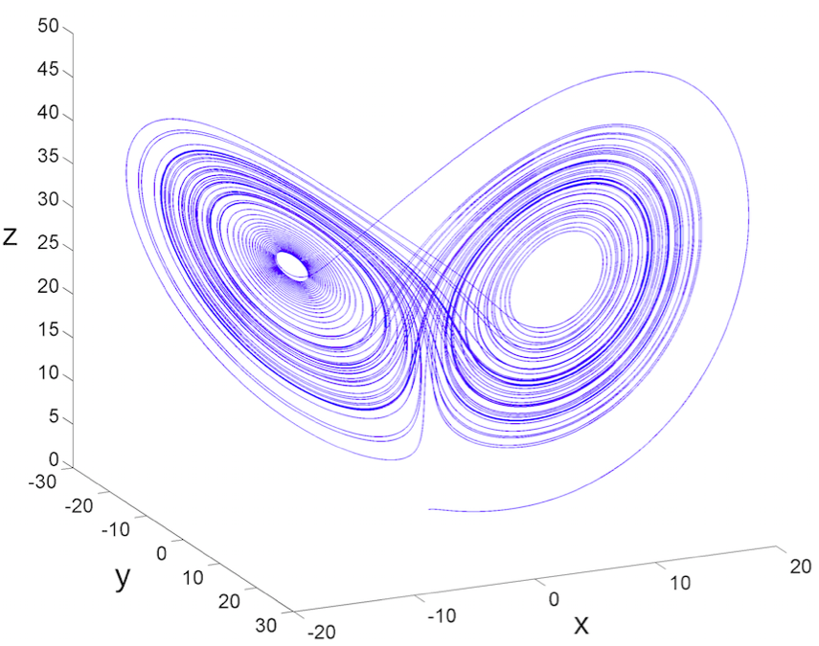
Test in the forced Lorenz model
A trajectory in the state space

Slide 42
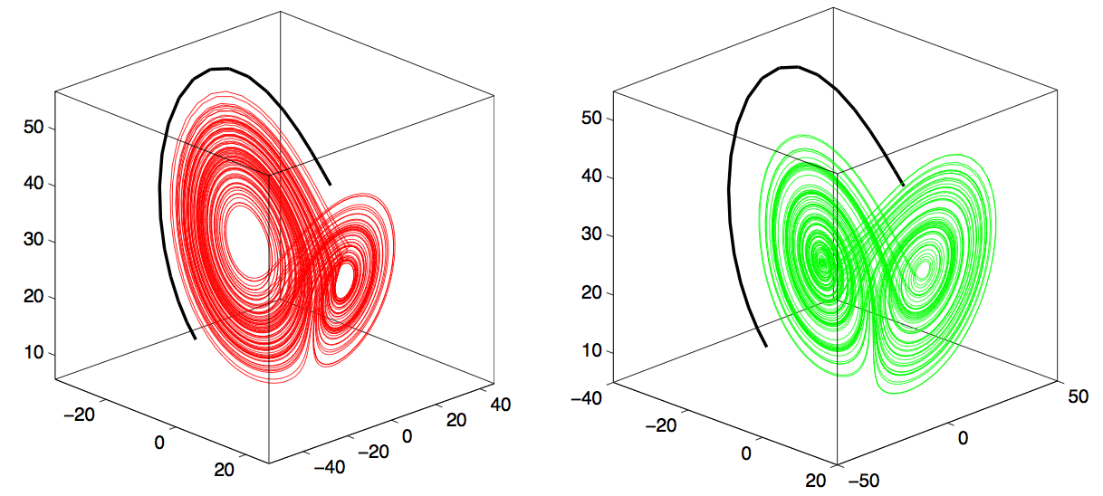
Test in the forced Lorenz model
Model 1 (λ = 40)
Model 2 (λ = 0)
o
o
o
o
o
o
o
o
o
o
o
o
o
o
o
o
o
o
o
o
o
o
o
o
o
o
o
o
piece of a trajectory + observations
Which is best? (observations come from model 1)

Slide 43
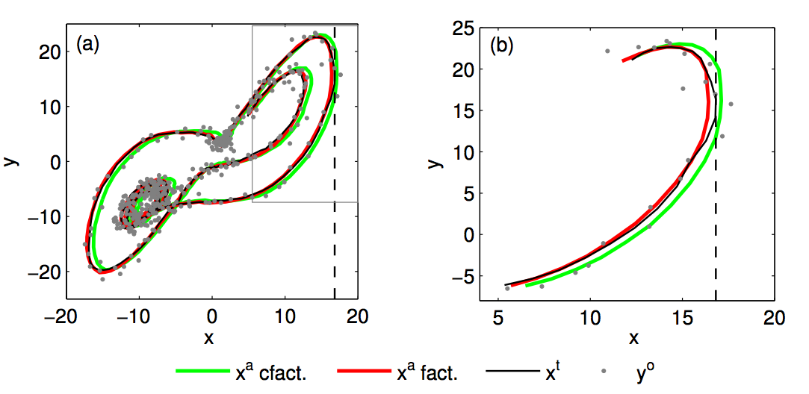
Test in the forced Lorenz model
Marginal likelihood of the observed trajectory is derived for both models by assimilating observations.

Slide 44
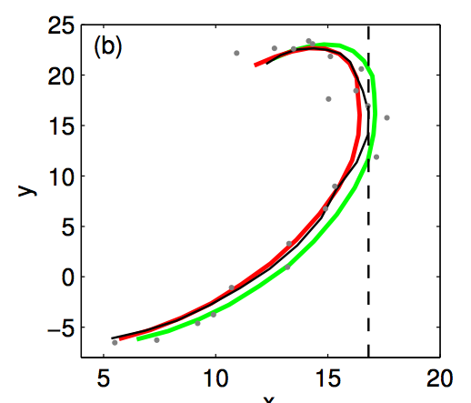
Test in the forced Lorenz model
The reconstruction of the correct model
is usually slightly better than the one of
the wrong model.

Slide 45
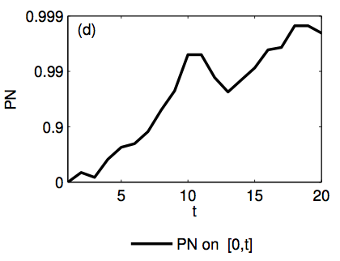
Test in the forced Lorenz model
The reconstruction of the correct model is usually slightly better than the one of the wrong model.
Small local differences pile up into a large amount of likelihood difference overall.
log p₁ / p₂
significance level

Slide 46
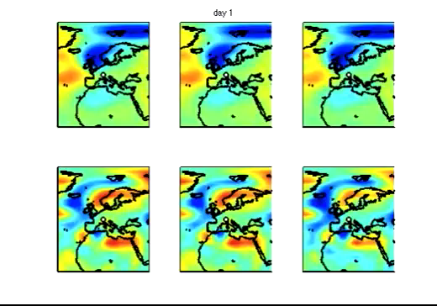
Test in the ICTP AGCM model
model 1
reanalysis
model 2
reanalysis
truth
geopotential
heigth
surface
temperature

Slide 47
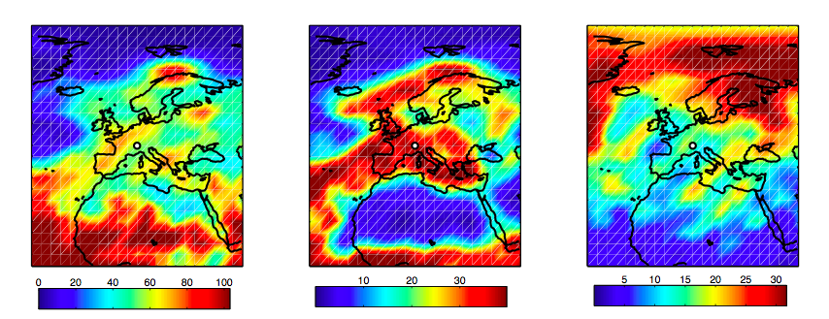
Test in the ICTP AGCM model
log p₁ / p_{2 :} spatial/variable contributions
surface temperature
wind
geopotential heigth

Slide 48
Issue: accuracy of approximation
The Gaussian assumption is actually an approximation, hence the obtained value of marginal likelihood is also an approximation.
Different assimilation methods are possible, yielding different values:
  EnKF
  IEnKS
  En-4D-Var
Comparison to the “true” value (very accurate approximation)
  Gauss Hermite Quadrature,
  Monte Carlo with large sample ( n = 10⁶).
Which DA method provides the best estimate?

Slide 49
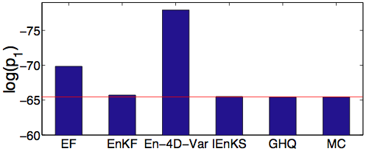
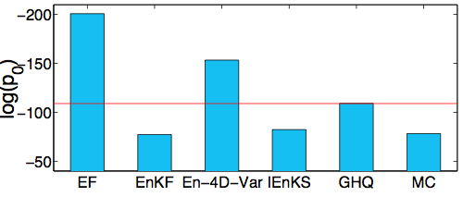
Test in the forced Lorenz model: accuracy of approximation
In case the model is correct:
In case the model is not correct:
log p
EnKF gives
acceptable
results.
log p

Slide 50
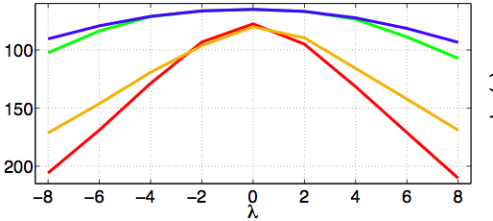
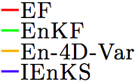
Test in the forced Lorenz model: parameter estimation
Marginal likelihood maximization
Large dependence to method/assumptions
May still be useful if the same method is used.

Slide 51
Summary
Marginal likelihood appears to be a possible metric to evaluate the ability of a model to represent a given sequence of observations.
Data Assimilation appears to be a reasonable solution to compute marginal likelihood.
Offers the advantage to synergize with existing infrastructure and expertise, especially regarding observational error.
Research under way:
  Experiments using larger models (ICTP AGCM, WRF)
  Implementation on real case studies.
  Theoretical and practical challenges for computing the likelihood (determinant, localization, …)

Slide 52
Outline
Data Assimilation
Rare event simulation
Structural causal theory
Conclusion

Slide 53
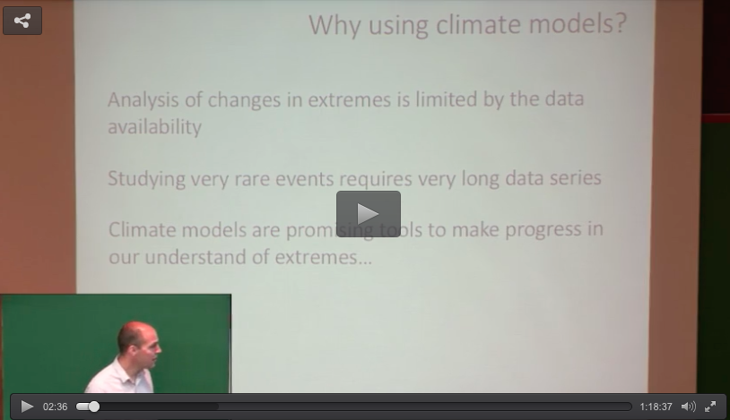
Eric’s conclusion: need for model simulations of very rare events

Slide 54
Hume’s conclusion: need for model simulations of very rare events
Need for model simulations of very rare events (« A cause is something that makes a difference from what would have happened without it. »)
Causally attributing an event = comparing the probability of the
event in a factual model and in a counterfactual model.
David Hume

Slide 55
Attributing an event: need for model simulations of very rare events
Causally attributing an event = comparing the probability of the event in a factual model and in a counterfactual model.
Winter storm, Dec. 2015
2 dec. 2015
3 dec. 2015
6 dec. 2015
Factual
Model
p₁
wind speed
(…)
Counterfactual
Model
prec. water
(…)
p₀

Slide 56
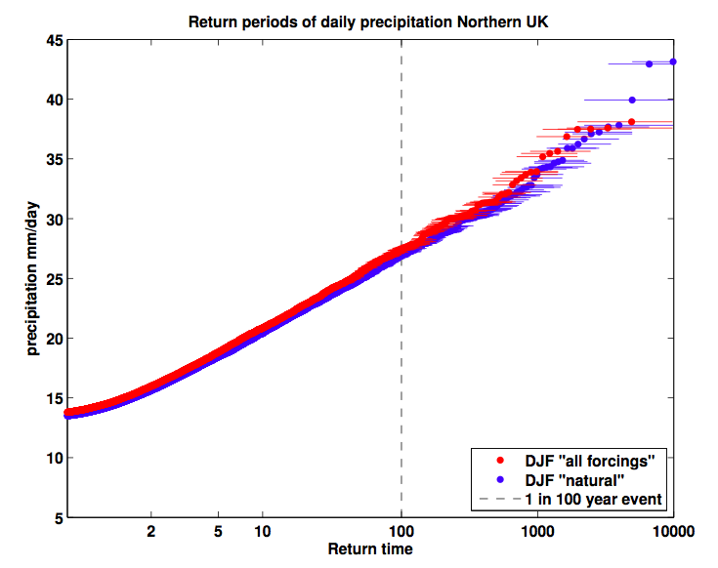
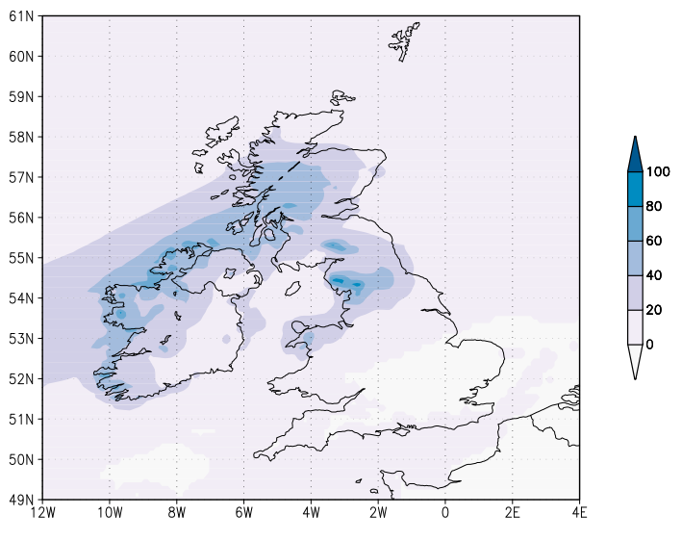
Attributing an event: need for model simulations of very rare events
p₁ = 1/83
p₀ = 1/100

Slide 57

Evaluating the probability of a rare climate or weather event
Questions:
What is the probability of occurrence of event E?
Is this probability changing?
Approaches:
Past observations.
Numerical simulations.

Slide 58
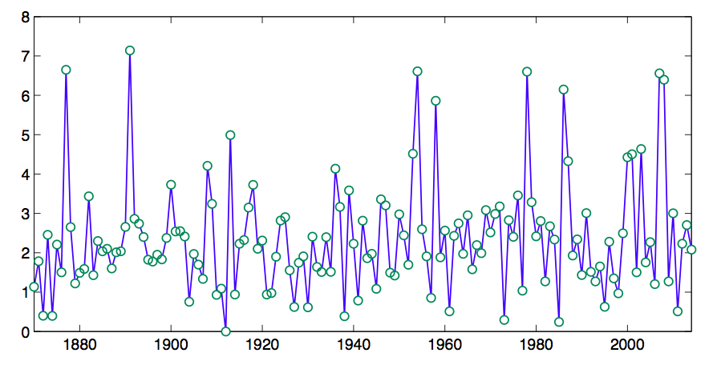
Inference from past observations
Fitting a statistical model to the underlying time series (ϕ(y_{t}))_{t=1,..,T}
  stationary
  non stationary (e.g. linear trend, nonlinear trend, change-point,…)
Comparing the fit and conclude w.r.t. stationarity/non stationarity.
Inferring the desired probability at present time.
Observed time series
threshold u
ϕ(y)
t

Slide 59
Inference from past observations
Fitting a statistical model to the underlying time series (ϕ(y_{t}))_{t=1,..,T}
  stationary
  non stationary (e.g. linear trend, nonlinear trend, change-point,…)
Comparing the fit and conclude w.r.t. stationarity/non stationarity.
Inferring the desired probability at present time.
Observational scarcity: rare events are rare.
Instrumental biases: inhomogeneities (Hannart et al. 2014).
Robustness and high sensitivity to modeling assumptions w.r.t. tails and nonstationarity (“model risk”).
Issues:
Risk estimates may be insufficiently reliable.

Slide 60
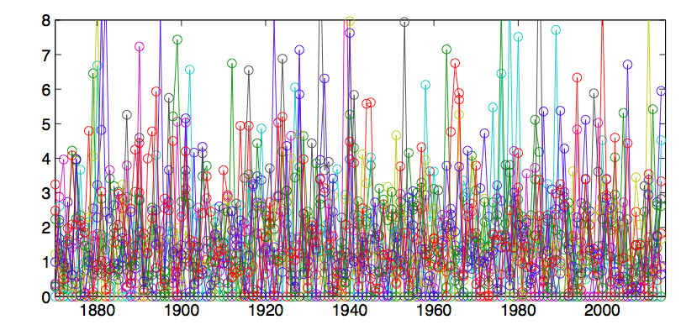
Inference from numerical simulations
Generating a large ensemble of simulations:
  either full time series under factual climate change forcings.
  or two end points: pre-industrial (~counterfactual) and present (=factual).
Estimating the probability of occurrence and its increase, from the ensemble.
Similar to an attribution analysis.
Simulated time series
threshold u
ϕ(y)
t

Slide 61
Inference from numerical simulations
Generating a large ensemble of simulations:
  either full time series under factual climate change forcings.
  or two end points: pre-industrial (~counterfactual) and present (=factual).
Estimating the probability of occurrence and its increase, from the ensemble.
Similar to an attribution analysis.
Advantages:
More data.
Synergy with attribution.
Possibility to obtain probability estimates for the future.
Issues:
Model error.
Computational cost for very rare events.

Slide 62
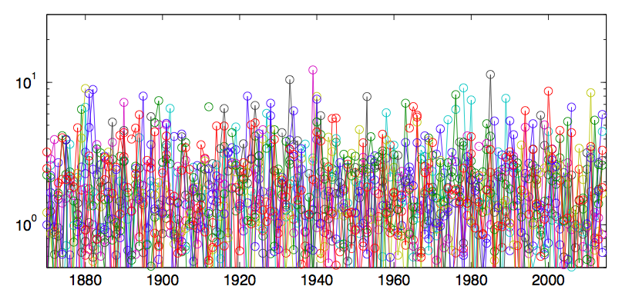
Inference from numerical simulations
very rare events may never occur even in a large ensemble.
Simulated time series
threshold u
ϕ(y)
t

Slide 63
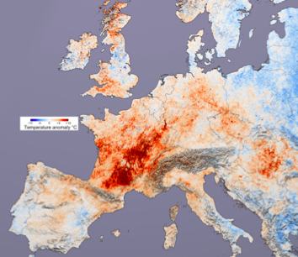
Inference from numerical simulations
very rare events may never occur even in a large ensemble.
example: estimates of the return time of the 2003 European
heatwave range from 500 years to 40,000 years.

Slide 64
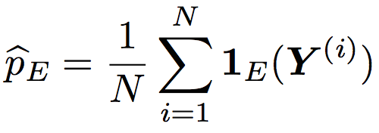
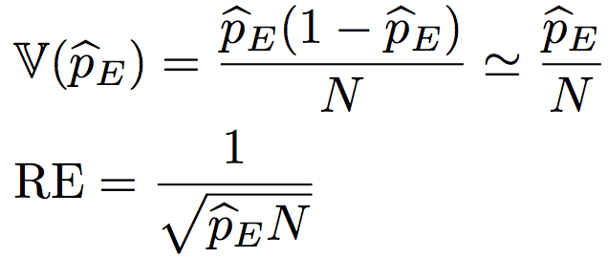
Inference from numerical simulations – the issue
Estimating a small probability through brute force direct simulation:
Generate a large number of samples and count:
Variance and relative error: ￼
To estimate a return time of ~5000 years with a 10% error,
one needs a 500,000 years of simulation.

Slide 65

References
Freddy Bouchet, CNRS and Ecole Normale Supérieure Lyon
project Transitions, European Research Council, 2014-2019
Wouters J. and F. Bouchet (2016) Rare event computation in deterministic chaotic systems using genealogical particle analysis, Statistical Mechanics (submitted).
Bucklew J. A. (2004) Introduction to rare event
simulation, Springer.

Slide 66




Rare event simulation is a thematical field in statistics
Main underlying idea: importance sampling
Assume we can sample from the PDF:
Then we can derive a new estimator:
The variance may be substantially improved with an adequate L:

Slide 67

Rare event simulation is a thematical field in statistics
Main underlying idea: importance sampling
For a stochastic process: interacting particle algorithm
threshold u
ϕ(y)
t

Slide 68



Rare event simulation – illustration in the L95 model
Dynamic equation:
A trajectory:
space
time

Slide 69
Rare event simulation – illustration in the L95 model
The function ϕ is the total energy.
The interacting particle algorithm is applied.
threshold u
ϕ(y)
ϕ(y)
t
t

Slide 70

Rare event simulation – illustration in the L95 model
The function ϕ is the total energy.
The interacting particle algorithm is applied.
Probabilities of exceedances are accurately estimated at a much lower computational expense.
brute force
rare event
sampling
probability
threshold

Slide 71
Summary
It is possible to use importance sampling in dynamical systems (e.g. interacting particle algorithm).
For the deterministic L95 model, probabilities of order 10⁻¹⁶ can be sampled as easily as probabilities of order 10⁻³.
This technique might be applied for a realistic climate models and/or an emulator thereof.
Theoretical research and numerical experiments are under way.

Slide 72
Outline
Data Assimilation
Rare event simulation
Structural causal theory
Conclusion

Slide 73
References
Hannart A., M. Ghil, P. Naveau, F. E. L. Otto, S. Seneviratne, M. F. Wehner, F. Zwiers (2016) Attribution of extreme climate and weather events: class-level and singular causation, Nat. Clim. Change (under review).
Hannart A., J. Pearl, F. E. Otto, M. Ghil (2016) Causal counterfactual theory for the attribution of weather and climate-related events, Bull. Am. Met. Soc., 97:1, 99-110.
Hannart A., P. Naveau (2016) Maximizing causation probabilities to assess climate changes, J. Clim. (under review).
Pearl, J., 2000: Causality: Models, Reasoning, and Inference. Cambridge University Press, 384 pp.

Slide 74
Detection and Attribution (D&A)
Do we identify a discernible human influence on global climate ?
  Short answer: Yes.
  Increasing level of confidence:
Implications for mitigation and adaptation policy.
• 1995 (AR2)
« The evidence (…) suggests a discernible human influence »
• 2001 (AR3)
« The warming (..) is attributable to human activities »
• 2007 (AR4)
« The warming (..) is very likely due to anthropogenic GHG. »
• 2013 (AR5)
« The warming (..) is virtually certainly due to … GHG. »

Slide 75
Detection and Attribution (D&A)
Do we identify a discernible human influence on a single weather or climate-related event ?
  Short answer: it depends.
  More recent topic.
  Growing number of studies.
  Diverse statements.
Implications for:
  mitigation and adaptation policy,
  litigation in courts,
  insurance, loss and damage mechanisms (e.g. Warsaw 2013),
  physical understanding of the event.

Slide 76


Detection and Attribution (D&A) - conventional methods
Trend attribution
Event attribution
take advantage of contrasted responses of different causal factors in models.
evidence the existence of these patterns in climate record.
optimal fingerprinting:
define the event based on threshold exceedance of an ad-hoc climate index.
derive the likelihood of the event in two model ensembles:
  factual world (e.g. HIST) => p1
  counterfactual world (e.g. NAT) => p0
fraction of attributable risk:
Emergence of new approaches for both topics.

Slide 77
Questions
Attribution: Process of evaluating the relative contributions of multiple causal factors to a change or event with an assignment of confidence.
(IPCC guidance paper)
Is it possible to define « causality » more precisely ?
Is it possible to quantify « causal evidence » more rigorously ?
Is it possible to justify the causal claims regarding the anthropogenic influence on climatic events more formally ?
Can we formulate a unified « causal evidencing framework » for climate science ?

Slide 78
Short answer: Yes
Causality has long been a much debated matter, long philosophical tradition.
A research topic in cognitive science / logic / computing science.
  Emergence of a « consensual » theory (1980s-1990s).

Slide 79

Pearl’s structural causal theory
A general theoretical corpus on causality. Turing Award 2004.
Clear semantics and sound logic for causal reasoning.
Defines causality – traditionally a deterministic notion – in probabilistic terms.
Applied in many fields
(e.g. economics, epidemiology)
J. Pearl (2000), Causality: models, reasoning
and inference, Cambridge University Press.

Slide 80

Overview of the theory - probabilistic framework
A probabilistic framework
  handle all factors, observed and not observed.
  allow for uncertainty on causal assessments.
  notion of dependence between random variables.
  notion of conditional independence.
Let X, Y, Z be random variables.
  X is independent of Z conditionally on Y iif

Slide 81
Overview of the theory - conditional independence
Let X, Y, Z, W be random variables (e.g. binary).
  X: barometer
  Y: rain
  Z: road wet
  W: low pressure system

Slide 82


Overview of the theory - conditional independence
Let X, Y, Z, W be random variables (e.g. binary).
  X: barometer
  Y: rain
  Z: road wet
  W: low pressure system

Slide 83

Overview of the theory - conditional independence
Conditional independence factorization:
Let X, Y, Z be random variables (e.g. binary).
  X: barometer
  Y: rain
  Z: road wet
  W: low pressure system

Slide 84

Overview of the theory - oriented graphs
Oriented graphs:
  visual representation of the conditional independence structure of a joint distribution

Slide 85
Overview of the theory - oriented graphs
Oriented graphs:
  Visual representation of the conditional independence structure of a joint distribution
  Well-suited to encode causal dependence relationships.
  Typical signatures of causality:
    independent causes become dependent conditional on their common effect.
    dependent effects become independent conditional on their common cause.

Slide 86

Overview of the theory - oriented graphs
Oriented graphs:
  Visual representation of the conditional independence structure of a joint distribution
  Well-suited to encode causal dependence relationships.
  Typical signatures of causality:
    independent causes become dependent conditional on their common effect.
    dependent effects become independent conditional on their common cause.
general population
selected population
smart
smart
beautiful
beautiful

Slide 87
Overview of the theory - oriented graphs
Application: Discover causal relationships by estimating the joint distribution
Spirtes P., C. Glymour, and R. Scheines (2006). Causation, Prediction, and Search, 2nd ed., MIT Press, Cambridge, US.

Slide 88



Overview of the theory - interventional probability
Limitation of oriented graphs
  identifiability: several causal graphs are compatible with the same pdf (and hence with the same observations).
  Need for disambiguation.
experimentation

Slide 89

Overview of the theory - interventional probability
New notion:
  intervention do(X=x)
  interventional probability P(Y l do(X=x)) = P(Y_{x})
the probability of rain forcing the barometer to decrease,
in an experimental context in which the barometer is manipulated
the probability of rain knowing that the barometer is decreasing,
in a non-experimental context in which the barometer evolution is left unconstrained

Slide 90
Causality has two facets
Necessary
Causation
Sufficient
Causation
Nec. & Suf.
Causation

Slide 91
Probabilities of causation
Probability of necessary causation = probability that the effect is removed when the cause is turned off, conditional on the fact that the effect and the cause were initially present.
Necessary
Causation
Sufficient
Causation
Nec. & Suf.
Causation

Slide 92
Probabilities of causation
Probability of sufficient causation = probability that the effect appears when the cause is turned on, conditional on the fact that the effect and the cause were initially absent.
Necessary
Causation
Sufficient
Causation
Nec. & Suf.
Causation

Slide 93



Probabilities of causation
Necessary
Causation
Sufficient
Causation
Nec. & Suf.
Causation

Slide 94




Probabilities of causation

Slide 95
Probabilities of causation
For rare events, both p₁ and p₀ are small.
PS and PNS are always low, only PN may be high.

Slide 96




Events are attributable, in a necessary causation sense.
anthropogenic
emissions
is the right quantity to look at.
intense
SACZ
anticyclonic
conditions
heatwave

Slide 97
Does FAR represent a fraction of attributable risk ?
anthropogenic
emissions
FAR = 0.8
intense
SACZ
anticyclonic
conditions
heatwave

Slide 98
Does FAR represent a fraction of attributable risk ?
anthropogenic
emissions
FAR = 0.8
intense
SACZ
FAR2 = 0.2 ?
anticyclonic
conditions
heatwave

Slide 99
Does FAR represent a fraction of attributable risk ?
anthropogenic
emissions
PN1 = FAR1 = 0.8
intense
SACZ
PN2 = FAR2 = 0.9*
anticyclonic
conditions
PN3 = FAR3 = 0.9*
FAR does not represent a
share of causality. FARs do not
sum up to one.
PN could be used instead.
heatwave
*stylized

Slide 100



Event definition: formalization
Denote a high-dimensional space-time random vector concatenating all observable variables
a scalar index and E the event:
realization y
event E

Slide 101
Event definition: formalization
Denote a high-dimensional space-time random vector concatenating all observable variables
a scalar index and E the event:
realization y
event E

Slide 102
Event definition: formalization
Denote a high-dimensional space-time random vector concatenating all observable variables
a scalar index and E the event:
realization y
event E

Slide 103
Illustration: December 2013 heatwave in Buenos Aires
December 2013 temperature anomaly
Hannart et al. (2015), BAMS

Slide 104



Definition 1: December temperature exceeds a threshold
For instance, a heatwave may be defined as:
  where T_{st} is surface temperature at location s and time t,
  denotes a spatial domain and a temporal domain.
In our illustration, = central Argentina and = December 2013.

Slide 105





Definition 1: December temperature exceeds a threshold
PDFs of Dec. Temperature
Probabilities of Causation
acceptable range
T (°C)
A tight definition (high u) maximizes PN.
A loose definition (low u) maximizes PS.
A well-balanced definition maximizes PNS and trades off PN/PS, yet yields a low PNS (= 0.35).

Slide 106


Definition 2: the increase in frequency exceeds a threshold
Let us now focus on the fact that the risk of heatwave over central Argentina has increased during the past century.
observed risk = 1/60
observed risk = 9/54

Slide 107


Definition 2: the increase in frequency exceeds a threshold
PDFs of change in risk of heatwave
Probabilities of Causation
acceptable range
If the focus is the increase in risk, then an optimal threshold can again be chosen to maximize PNS:
p0 = 0.02 and p1 = 0.99
high PS, PN and PNS, with PNS = 0.97

Slide 108

Definition 3: event exactly as it occurred
We want to identify all the features of this unique event that
reveal the causal influence of a forcing, with no a priori.
These may be different every time and should be
observation-dependent.

Slide 109



Definition 3: event exactly as it occurred
The event is unique and has probability zero in both worlds:
Hence the probability of sufficient causation is always zero:
What happens to the probability of necessary causation?

Slide 110


Definition 3: event exactly as it occurred
Let us take the radius r to zero. We have:
where f₁(y) is the PDF of the random variable Y in point y in the factual world and f₀(y) is the same quantity in the counterfactual one.

Slide 111
Take aways
Causality can be probabilistically quantified.
Causality has three facets: PN, PS, PNS.
The probabilities of causation can be derived straightforwardly in climate attribution because the forcings are exogenous,
An in silico approach must be taken. The latter introduces a large dependence to assumptions on model error.
Need for process-based model evaluation !

Slide 112
Take aways
Causal theory provides useful insights and semantics for communication purposes.
  it may mitigate some statements,
  it may strengthen others.
  FAR may be a misnomer.
The amount of causal evidence and the balance between PN, PS and PNS is greatly affected by event definition.
Causal theory could be applied for trend attribution as well.

Slide 113

Thank you
Founders of Dadaïsm, Zürich, 1916

Slide 114
Statements w.r.t. Argentinian heatwave
PN | PS | PNS
high | low | low
high | high | high
veryhigh | veryhigh | veryhigh
Statement on this particular heatwave w.r.t. year 2013:
  The Argentinian heat wave of December 2013 was likely (p=80%) caused in part by anthropogenic forcings..
Statement on this particular heatwave w.r.t. the instrumental period:
  It is likely (p=88%) that anthropogenic forcing is the main cause of the Argentinian heatwave of 2013 occurring at least once over the instrumental period.
Statement on the increase in the frequency of heatwaves:
  It is extremely likely (p=97%) that GHG is the main cause of the increase in the frequency of heatwaves over central Argentina observed during the instrumental period.

Slide 115
Defining the probabilities of causation – how it works
ON with proba q
ON with proba p
Assumptions:
  switch X is on with proba p.
  other switch is on with proba q.
  switches are independent.

Slide 116
Defining the probabilities of causation – how it works
All possible states of the world
proba = pq
proba = p(1-q)
proba = (1-p)q
proba = (1-p)(1-q)

Slide 117

Defining the probabilities of causation – how it works
1
States satisfying to
proba = pq
proba = p(1-q)
proba = (1-p)q
proba = (1-p)(1-q)

Slide 118
Defining the probabilities of causation – how it works
States satisfying to
2
intervention
proba = pq
proba = p(1-q)
proba = (1-p)q
proba = (1-p)(1-q)

Slide 119
Defining the probabilities of causation – how it works
States satisfying to
proba = pq
proba = p(1-q)
proba = (1-p)q
proba = (1-p)(1-q)
3
PN = 1

Slide 120
Defining the probabilities of causation – how it works
All possible states of the world
proba = pq
proba = p(1-q)
proba = (1-p)q
proba = (1-p)(1-q)

Slide 121

Defining the probabilities of causation – how it works
1
States satisfying to
proba = pq
proba = p(1-q)
proba = (1-p)q
proba = (1-p)(1-q)

Slide 122
Defining the probabilities of causation – how it works
States satisfying to
2
intervention
proba = pq
proba = p(1-q)
proba = (1-p)q
proba = (1-p)(1-q)

Slide 123
Defining the probabilities of causation – how it works
States satisfying to
proba = pq
proba = p(1-q)
proba = (1-p)q
proba = (1-p)(1-q)
3
PS = (1-p)q / {(1-p)q + (1-p)(1-q)} = q

Slide 124
Defining the probabilities of causation
PN = 1, PS = q, PNS = q.
PN = 1-q, PS = 1, PNS = 1-q
PN = 1, PS = 1, PNS = 1

Slide 125





Possible application to any causal situation
external
forcings
climate
system
climate and
weather events
Switch X
human
emissions
trends
volcanic
aerosols
weather
events
solar
activity
…
Bulb Y
…

Slide 126
Possible application to any causal situation
external
forcings
climate
system
climate and
weather events
Switch X
human
emissions
trends
volcanic
aerosols
weather
events
solar
activity
…
Bulb Y
…

Slide 127

Overview of the theory - necessary and sufficient causation
How to calculate PN, PS and PNS ?
  difficult in general.
  closed formula under the assumption of monotonicity:
  where:
  p1 = P( Y=1 l X = 1 ) : factual probability of the event
  p0 = P( Y=1 l X = 0 ) : counterfactual probability of the event

Slide 128
Defining the “effect” event is critical in a climatic context
Switching X on causes bulb Y to light.
The “cause” event
is well-defined
The “effect” event
is well-defined

Slide 129
Defining the “effect” event is critical in a climatic context
Switching X on causes bulb Y to light.
Smoking causes disease Y.
The “cause” event
is well-defined
The “effect” event
is well-defined
The “cause” event
is reasonably well-defined
The “effect” event
is well-defined

Slide 130
Defining the “effect” event is critical in a climatic context
Switching X on causes bulb Y to light.
Smoking causes disease Y.
The “cause” event
is well-defined
The “effect” event
is well-defined
The “cause” event
is reasonably well-defined
The “effect” event
is well-defined
Is this a population-level claim
or an individual-level claim?

Slide 131
Defining the “effect” event is critical in a climatic context
Switching X on causes bulb Y to light.
Smoking causes disease Y.
Forcing X causes weather event Y.
The “cause” event
is well-defined
The “effect” event
is well-defined
The “cause” event
is reasonably well-defined
The “effect” event
is well-defined
Is this a population-level claim
or an individual-level claim?
The “cause” event
is well-defined
The “effect” event
may not be well-defined
Is this a general claim
or a singular event claim?
Time scale ?
Spatial scale ?

Slide 132

Influence of the event chosen on the probabilities of causation
Let us now focus on the fact that the Dec. 2013 heatwave was the most intense ever recorded over this area.

Slide 133
Influence of the event chosen on the probabilities of causation
Let us now focus on the fact that the Dec. 2013 heatwave was the most intense ever observed over this area.
The PDFs of the most intense value can be obtained directly from previous PDFs:

Slide 134


Influence of the event chosen on the probabilities of causation
PDFs of max Dec. Temperature
Probabilities of Causation
2013
obs.
2013
obs.
acceptable
range
An optimal threshold from a PNS perspective is u = 23.8°C.
p0 = 0.04: the event is very rare in the counterfactual world.
p1 = 0.92: almost systematic in the factual world.

Slide 135
Influence of the event chosen on the probabilities of causation
PDFs of max Dec. Temperature
Probabilities of Causation
2013
obs.
2013
obs.
acceptable
range
If the focus is on the fact that the 2013 heatwave occured over the instrumental period:
high PS, PN and PNS with PNS = 0.88

Slide 136
Event attribution - necessary and sufficient causation
Which matters for event attribution: PN, PS or PNS ?
The ex post perspective (judge) :
  «who is to blame for the weather event that occurred ?»
  insurance, compensation, loss and damage mechanisms (e.g. Warsaw 2013)
  PN matters, not PS.
The ex ante perspective (policy maker)
  «what should be done today w.r.t. events that may occur in the future?»
  PS matters for assessing the cost of inaction, PN for assessing the benefit of action.
The dissemination perspective (media, IPCC)
  PNS is a trade off between PN and PS.
  good candidate for a single metric as it avoids explaining the distinction.
PN, PS and PNS all matter

