Slide 1
Optimal Control in Integrodifference Equations
Suzanne Lenhart

Slide 2
Outline
Optimal Control Background
Harvest Example
Gypsy Moth

Slide 3
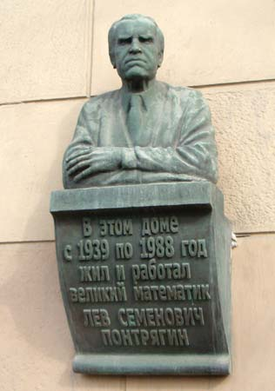
WHO ?

Slide 4
Lev Semyonovich Pontryagin,
monument on a building on
Leninsky Prospekt, Moscow.

Slide 5
Optimal control and
Pontryagin's Maximum Principle
Pontryagin and his collaborators developed optimal control theory for ordinary differential equations about 1950.
Pontryagin's KEY idea was the introduction of the adjoint
variables to attach the differential equations to the objective functional (like a Lagrange multiplier attaching a constraint to a pointwise optimization of a function). This principle gives necessary conditions for optimal controls and states.
WE NEED TO DERIVE OUR OWN NECESSARY CONDITIONS HERE.

Slide 6
Basic Idea
Start with a system for modeling the situation
Decide where to put the controls and on their bounds
---balancing opposing factors in functional
Design an appropriate objective functional
After proving existence of optimal control, derive necessary conditions for the optimal control
WILL GIVE MORE DETAILS
Compute the optimal control numerically
---investigate dependence on various parameters

Slide 7
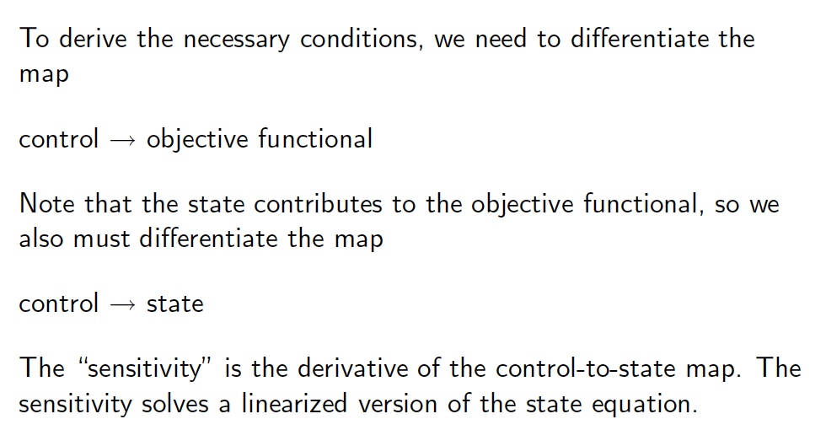
NECESSARY CONDITIONS

Slide 8
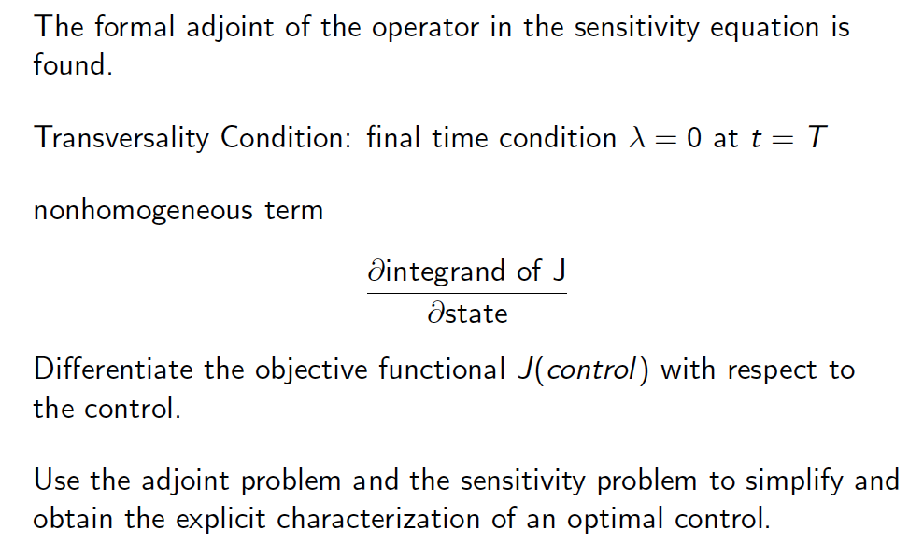
CHARACTIZATION OF OPTIMAL CONTROL

Slide 9
ORDER OF EVENTS IN OPTIMAL CONTROL OF HARVESTING MODELS WITH
INTEGRODIFFERENCE EQUATIONS
Lenhart and Peng Zhong (DCDS, 2013)
EVENTS:
GROWTH, DISPERSAL, HARVEST

Slide 12
MAXIMIZE PROFIT

Slide 14
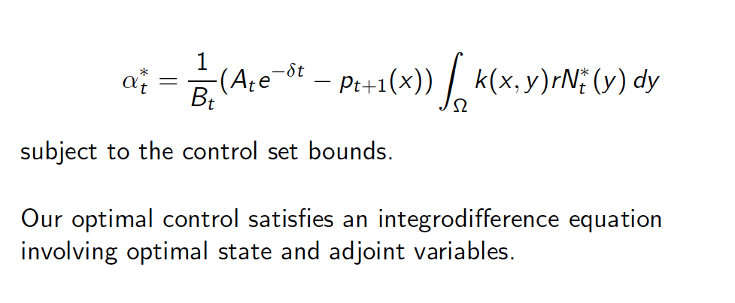
With Quadratic Costs: V term

Slide 15
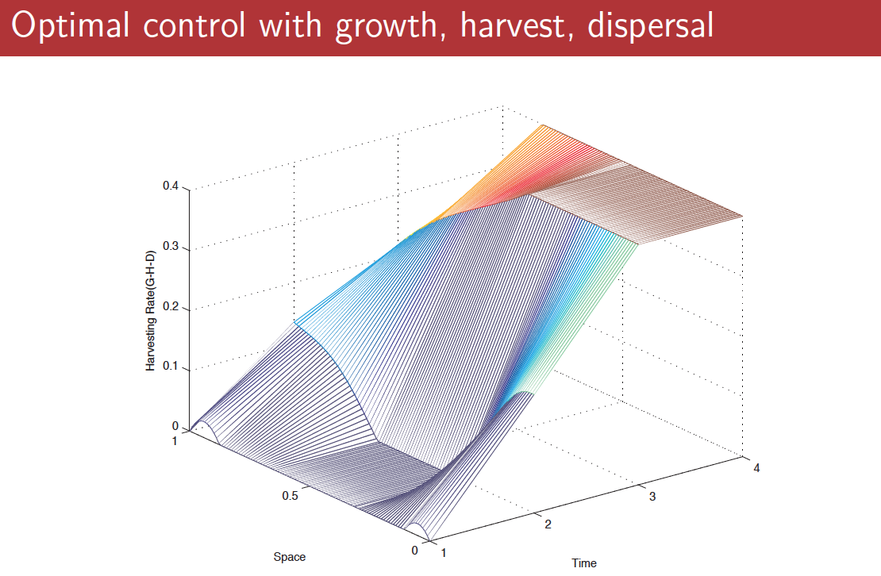

Slide 17
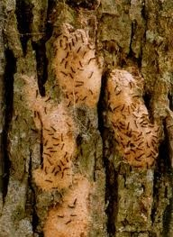
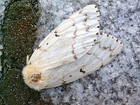
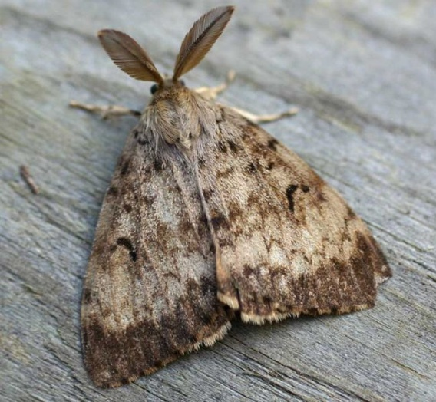
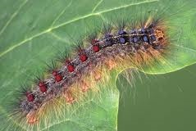
Gypsy Moth
Gypsy Moth
Lymantria dispar
Europe and Asia

Slide 18
Ch 2: Non-Spatial
Goal
Investigate management strategies in gypsy moth models using optimal control techniques.
spatial temporal models with integrodifference equations

Slide 19
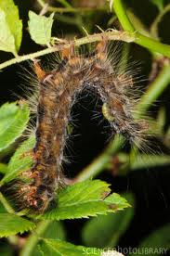
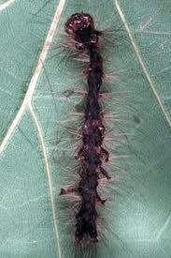
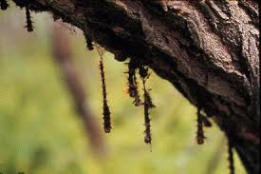
Population dynamics
Pathogens
Outbreaks collapse after 1-3 years
Result of disease epizootics
Gypsy moth nucleopolyhedrosis virus (NPV)
Regulate population at high densities

Slide 20
THIS WORK
M. Martinez, K. A. J. White and S. Lenhart, Optimal control of integrodifference equations in a pest-pathogen system, Disc. and Conti. Dynamical Systems B
2015.
In US, continuing work of Sandy Leibhold
and Greg Dwyer and Kyle Haynes and others

Slide 21
Model formulation
N density of gypsy moth population
Z density of virus population (nucleopolydrosis virus)
u control (via Gypchek) with yearly time steps

Slide 22
Population Dynamics
For F and G, we use ideas from
Nicholson-Bailey model

Slide 23
Population Dynamics
the average per capita number of moths produced
Probability that a moth does not become infected
Density dependent probability
that a new moth will survive until next
generation

Slide 24
Population Dynamics
Probability that virus survives
over winter
Probability that
Moth gets infected
Number of viral spores
Provided by a moth cadaver

Slide 25
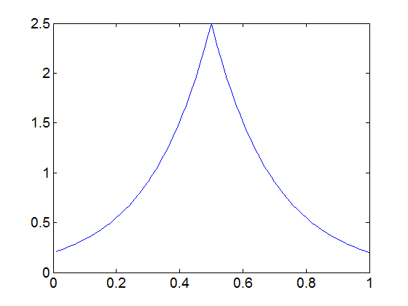
Kernels
Describe the dispersal of the population
Laplace, fat tails

Slide 26
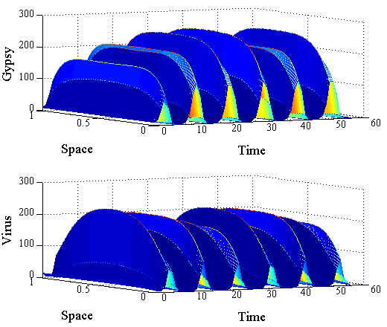
Oscillations with spatial model

Slide 27
Objective functional
Cost for spray
Function of control
Damage caused by defoliation
Density of Gypsy Moth
Lebesgue measurable

Slide 28
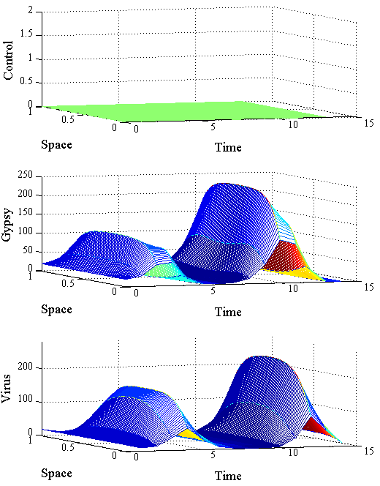
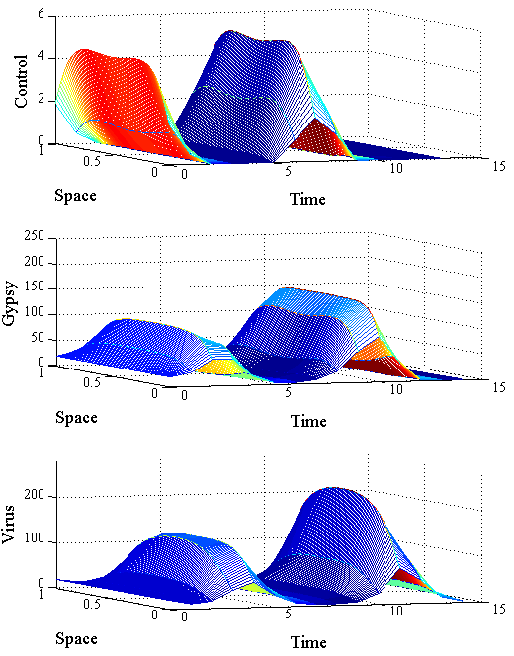
Results with no control (left) vs. control
With constant spatial IC

Slide 29
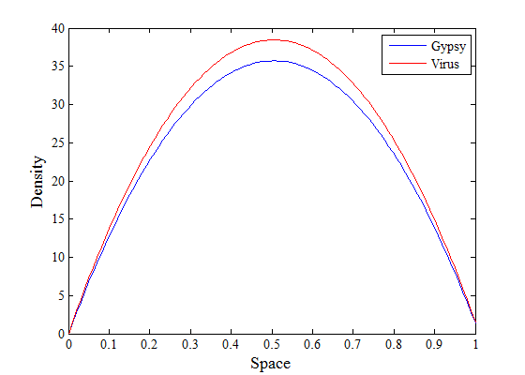
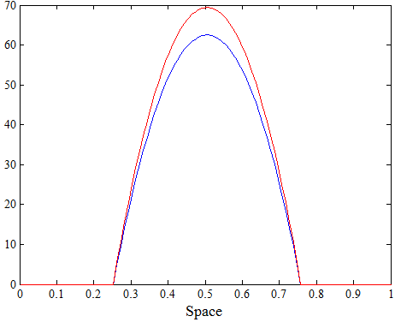
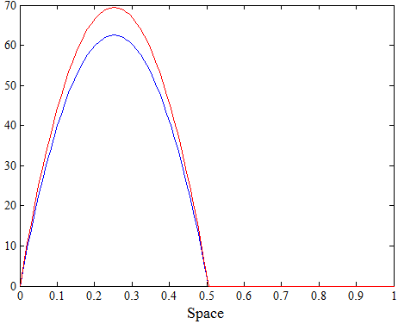
Spatial Initial Conditions
Aggregate

Slide 30
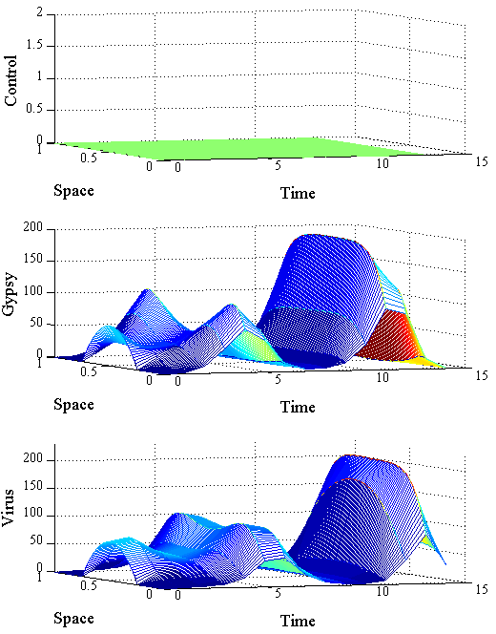
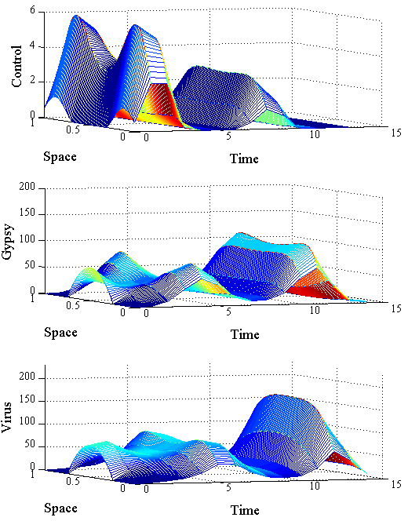
Results using the middle IC

Slide 31
Results, rotated view of OC

Slide 32
Conclusions
New results in Optimal Control Theory
Apply biocontrol where gypsy moth is at low densities
In future, try other control techniques besides optimal control, like adaptive management, feedback control and adaptive control.

Slide 33
Acknowledgements
Thanks

