Slide 1

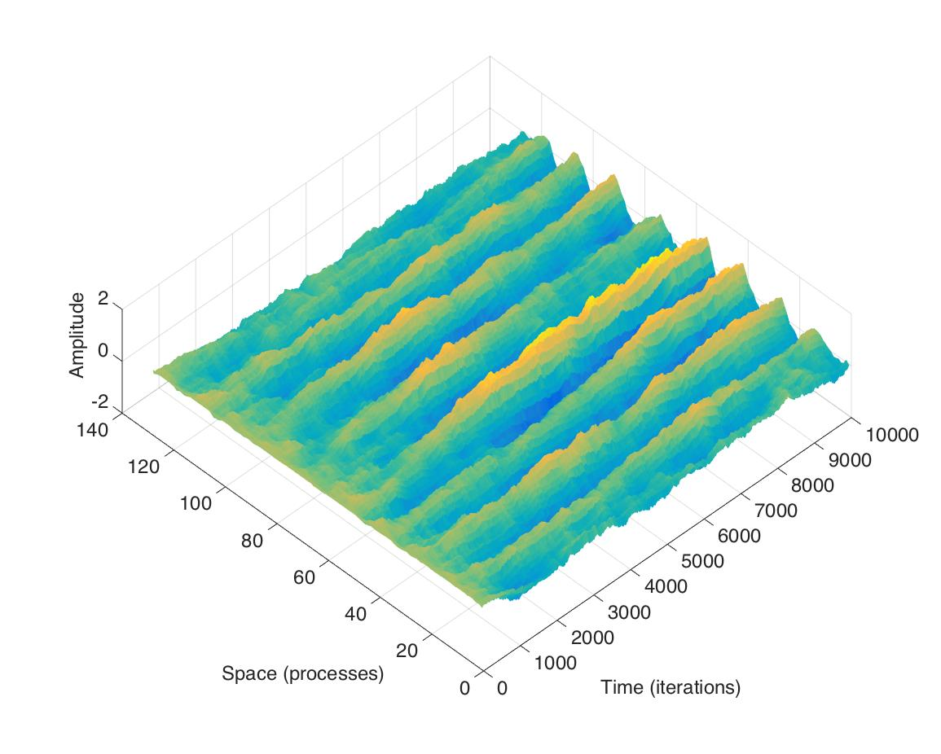
Pattern Formation via Stochastic Neural Field Equations
Lawrence M. Ward
Priscilla E. Greenwood
University of British Columbia
Vancouver, Canada
Funded by NSERC of Canada
BIRS Banff 2/2017

Slide 2
A time-evolving spatial pattern
BIRS Banff 2/2017
Notes:
Describe axes

Slide 3
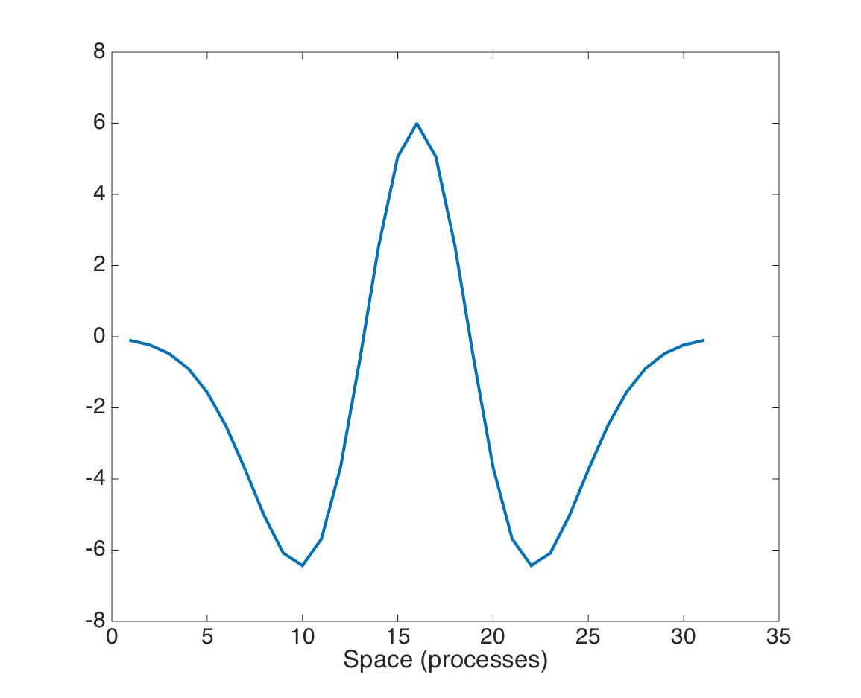
A stochastic neural field equation
Periodic boundary.
For σ= 0, c ≥ 1, the solution damps to 0 for many w(x-y).
For σ> 0 there is a stochastic neural field process with a
(non-trivial) stationary law.
r=radius of noise spatial smoothing
A Mexican Hat
BIRS Banff 2/2017
Notes:
Why study this? (mention Kilpatrick talk) Expanded paragraph from a paper on spatial patterns of coupled quasi-cycle oscillators. Realized we didn’t understand the simplest NFE yet.Describe equation. Damping here resembles damping to fixed point in linearized W-C-like equations. We will show that spatial patterns, like quasi-cycles, are revealed and sustained by noise. Space-time noise: r

Slide 4
Murray’s equations for Mexican Hat and dispersion relation
for k an excitable wave number
where W(k) is the Fourier transform of w(x)
BIRS Banff 2/2017
Notes:
Solved deterministic equation using ansatz u(t)=a exp(lambda t + ikx) to get equations for k_max and W(k) that we use in what follows.

Slide 5
Murray’s equations for W(k) and k_{max}
BIRS Banff 2/2017

Slide 6
Excitable wave numbers (k)
BIRS Banff 2/2017

Slide 7
Effect of c
b₁ = 1, cW(k_{max}) > 1
BIRS Banff 2/2017

Slide 8
Effect of c =2
BIRS Banff 2/2017

Slide 9
Spatial PSD measure of pattern
Numerical solutions of 128 discretized stochastic neural field equations for 10k iterations (Euler-Maruyama, Δt=0.001s) to produce paths
Spatial PSD computed as spectrogram across space of average amplitude Y(t,x) across 500-iteration time blocks (1-500, 750-1250, …. 9501-10000).
BIRS Banff 2/2017

Slide 10
Number of cycles as function of k_{max}
BIRS Banff 2/2017

Slide 11
Damping (no noise)
BIRS Banff 2/2017

Slide 12
Effect of noise (c=30)
BIRS Banff 2/2017

Slide 13
Spatial smoothing of noise (c=0)
BIRS Banff 2/2017

Slide 14
Optimal (r,c) = (smoothing, coupling)
BIRS Banff 2/2017

Slide 15
Take Home
Simple deterministic evolving neural field with Mexican Hat convolution kernel damps to a ‘fixed point’ spatially, even when excitable wave numbers are present
Added noise can reveal and sustain the spatial pattern
Spatial smoothing of noise also creates a spatial pattern
Smoothing and convolution kernel interact to create optimal conditions for sustained spatial pattern (narrow PSD peak uniformly over time)
BIRS Banff 2/2017

