Slide 1

Stochastic modeling and data assimilation for satellite observations
Shane Keating University of New South Wales, Sydney
Workshop on Transport in Unsteady Flows
Banff International Research Station, 20 January 2017

Slide 2

Complex physical processes with multiple interacting space and time scales
  The curse of dimensionality/ensemble size
Dynamics unknown or imperfectly modeled
Spares/irregular/noisy observations

Slide 3
Stochastic DA methodology
Linear stochastic forecast model:
Widely used as a simple model for the turbulent exchange of energy to/from a “sea” of eddies

Slide 4
Stochastic DA methodology
Linear stochastic forecast model:
Widely used as a simple model for the turbulent exchange of energy to/from a “sea” of eddies
Linear response
Stochastic forcing
Complex-valued
mode amplitude
Stochastic model parameters

Slide 5
Stochastic DA methodology
Exact path-wise solution for forecast
  analytic forecast mean and covariance
Linear dynamics with Gaussian unbiased noise
  Each mode evolves independently but can be coupled by observations, e.g. aliasing (more later!)
Kalman filter solution is optimal (Least squares)

Slide 6
Stochastic DA methodology
Stochastic model parameters simply related to climatological energy and correlation function (e.g. Harlim and Majda Mon. Wea. Rev. 2010)
Can also be estimated “on-the-fly” from the observations themselves (more later)

Slide 7
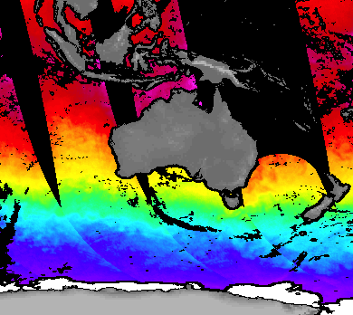
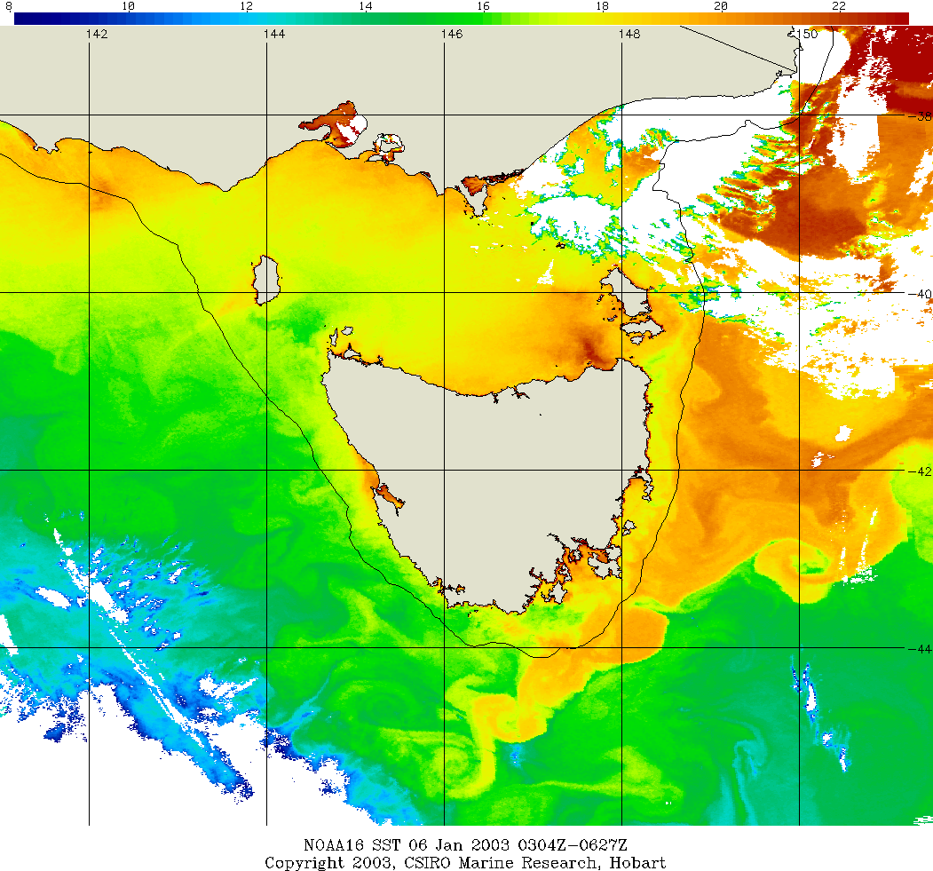
Microwave SST (AMSR-E)
Infrared SST (AVHRR)
Sea-surface temperature reveal footprint of submesoscale flow:
Passive microwave observations (subskin temperature) have spatial resolutions of 20-50 km and can penetrate clouds
Infrared observations (skin temperature) have spatial resolutions of 1 km but are obscured by clouds

Slide 8


Derive super-resolved SST images by combining microwave images with statistical knowledge from infrared observations
Exploit spatial aliasing of small scales by coarse observations
Original image
Subsampled image

Slide 9
Aliasing of sparse observations
0
1
N-1
N
0
1
M-1
M
Fourier transform on fine grid:
Fourier transform on coarse grid:

Slide 10
Aliasing of sparse observations
N x N resolved modes
M x M resolved modes
Coarse-grid modes are superposition of fine-grid modes in same aliasing set.

Slide 11
Filtering sparse observations
Observation: Low-resolution observations with aliased information about small scales
Forecast: Quasi-linear stochastic model using parameters from available high-resolution obs
Kalman Filter
Analysis: Super-resolved SST image with resolution given by high-resolution forecast model

Slide 12
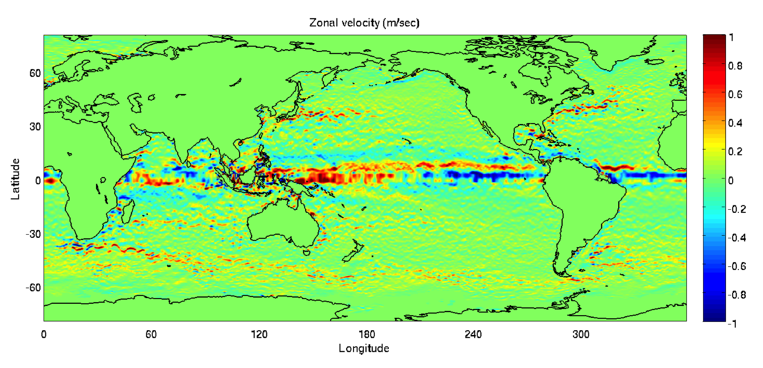
Zonal velocity
Quasigeostrophic model driven by Forget (2010) hydrography.
Assume that surface density anomalies are dominated by SST.
Synthetic daily temperature observations over a 90-day period with both microwave (40 km) and infrared (5 km) resolutions.
Infrared observations used to learn stochastic parameters.

Slide 13
Super-resolved SST
SST snapshots: Subtropical Pacific
Notes:
Discuss effective diffusivity calculation using this?

Slide 14
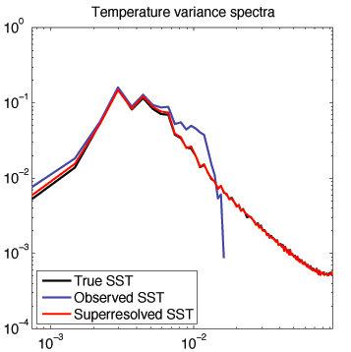
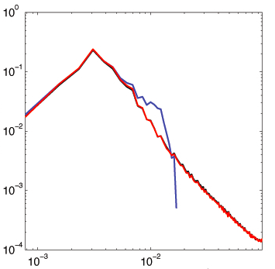
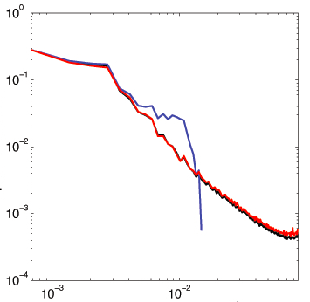
Temperature variance spectrum:
Antarctic Circumpolar Current
Gulf Stream
Subtropical Pacific
Antarctic Circumpolar Current
Gulf Stream
Equatorial Pacific
Isotropic wavenumber (km⁻¹)
Effect of aliasing can be seen in spurious variance in observations near the limit of resolution
Super-resolved estimate correctly redistributes variance to small scales

Slide 15
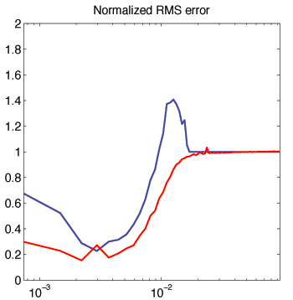
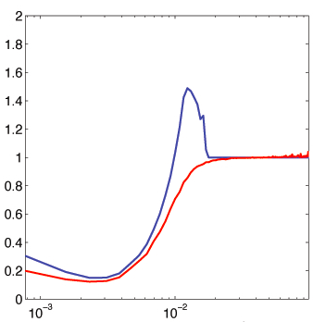
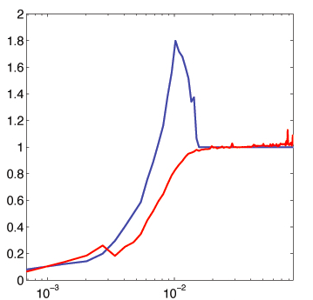
RMS error:
Antarctic Circumpolar Current
Gulf Stream
Subtropical Pacific
Antarctic Circumpolar Current
Gulf Stream
Equatorial Pacific
Isotropic wavenumber (km⁻¹)
Effect of aliasing can be seen in spurious variance in observations near the limit of resolution
Super-resolved estimate correctly redistributes variance to small scales

Slide 16
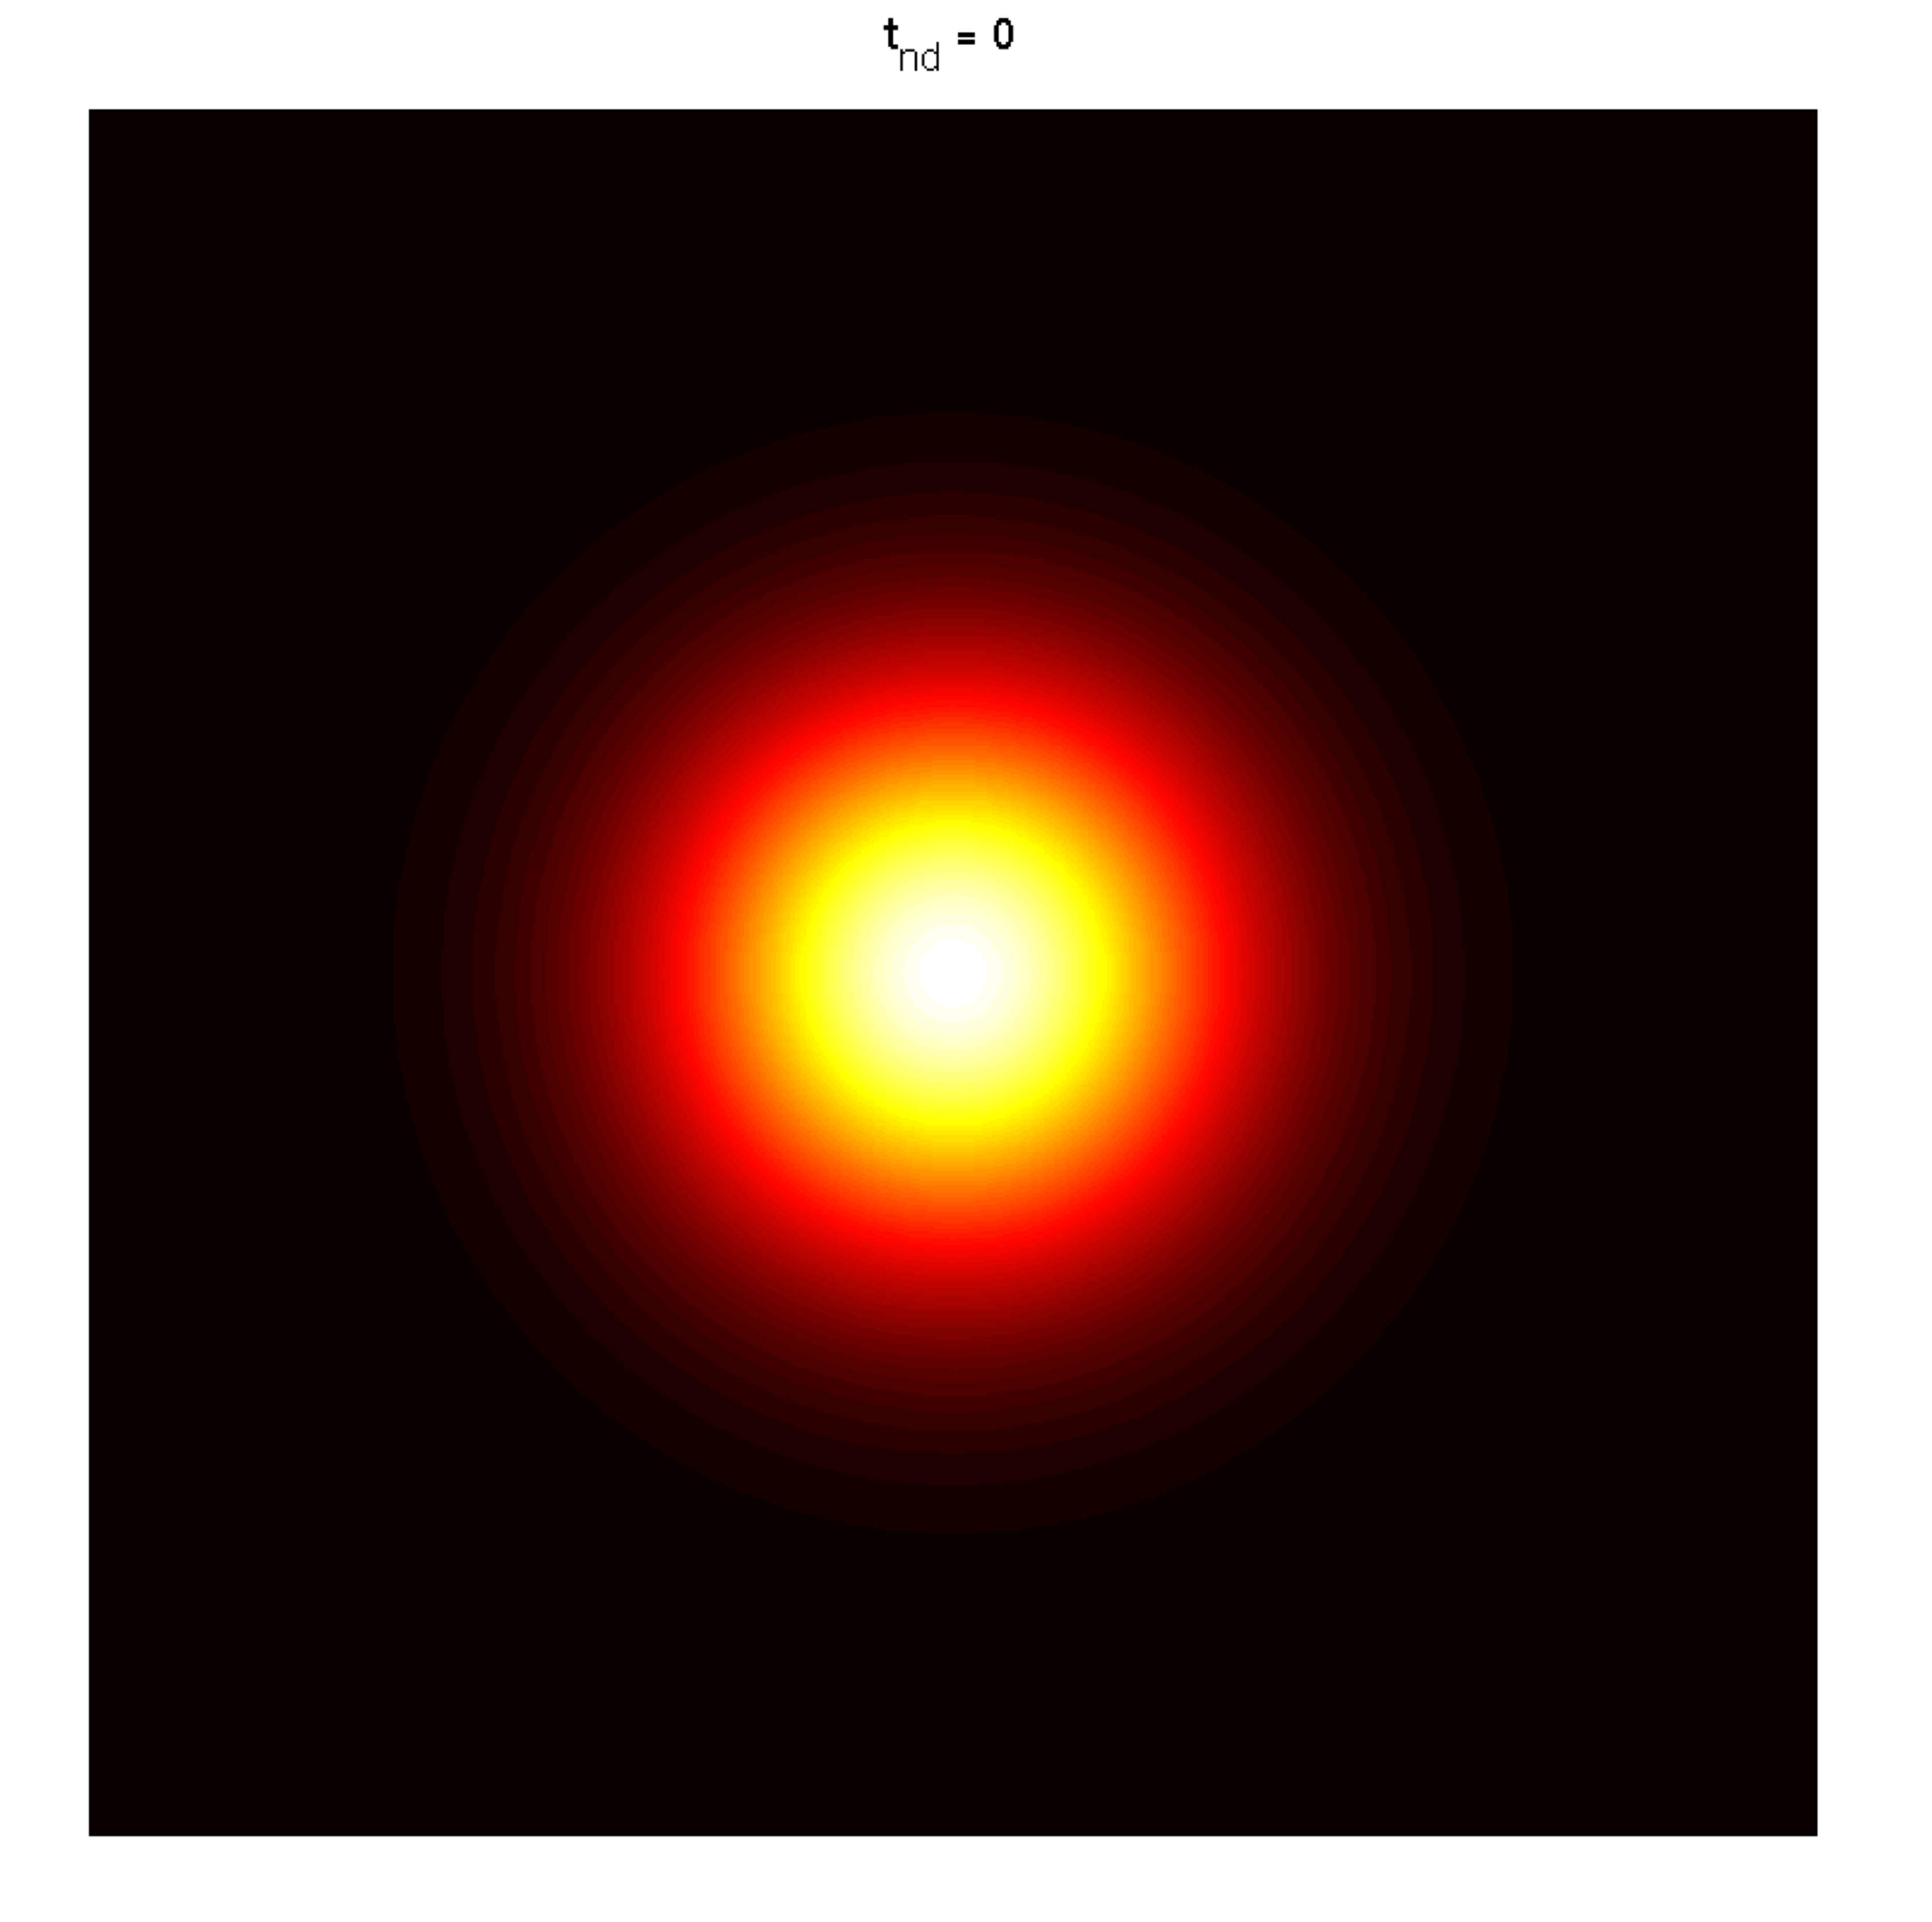
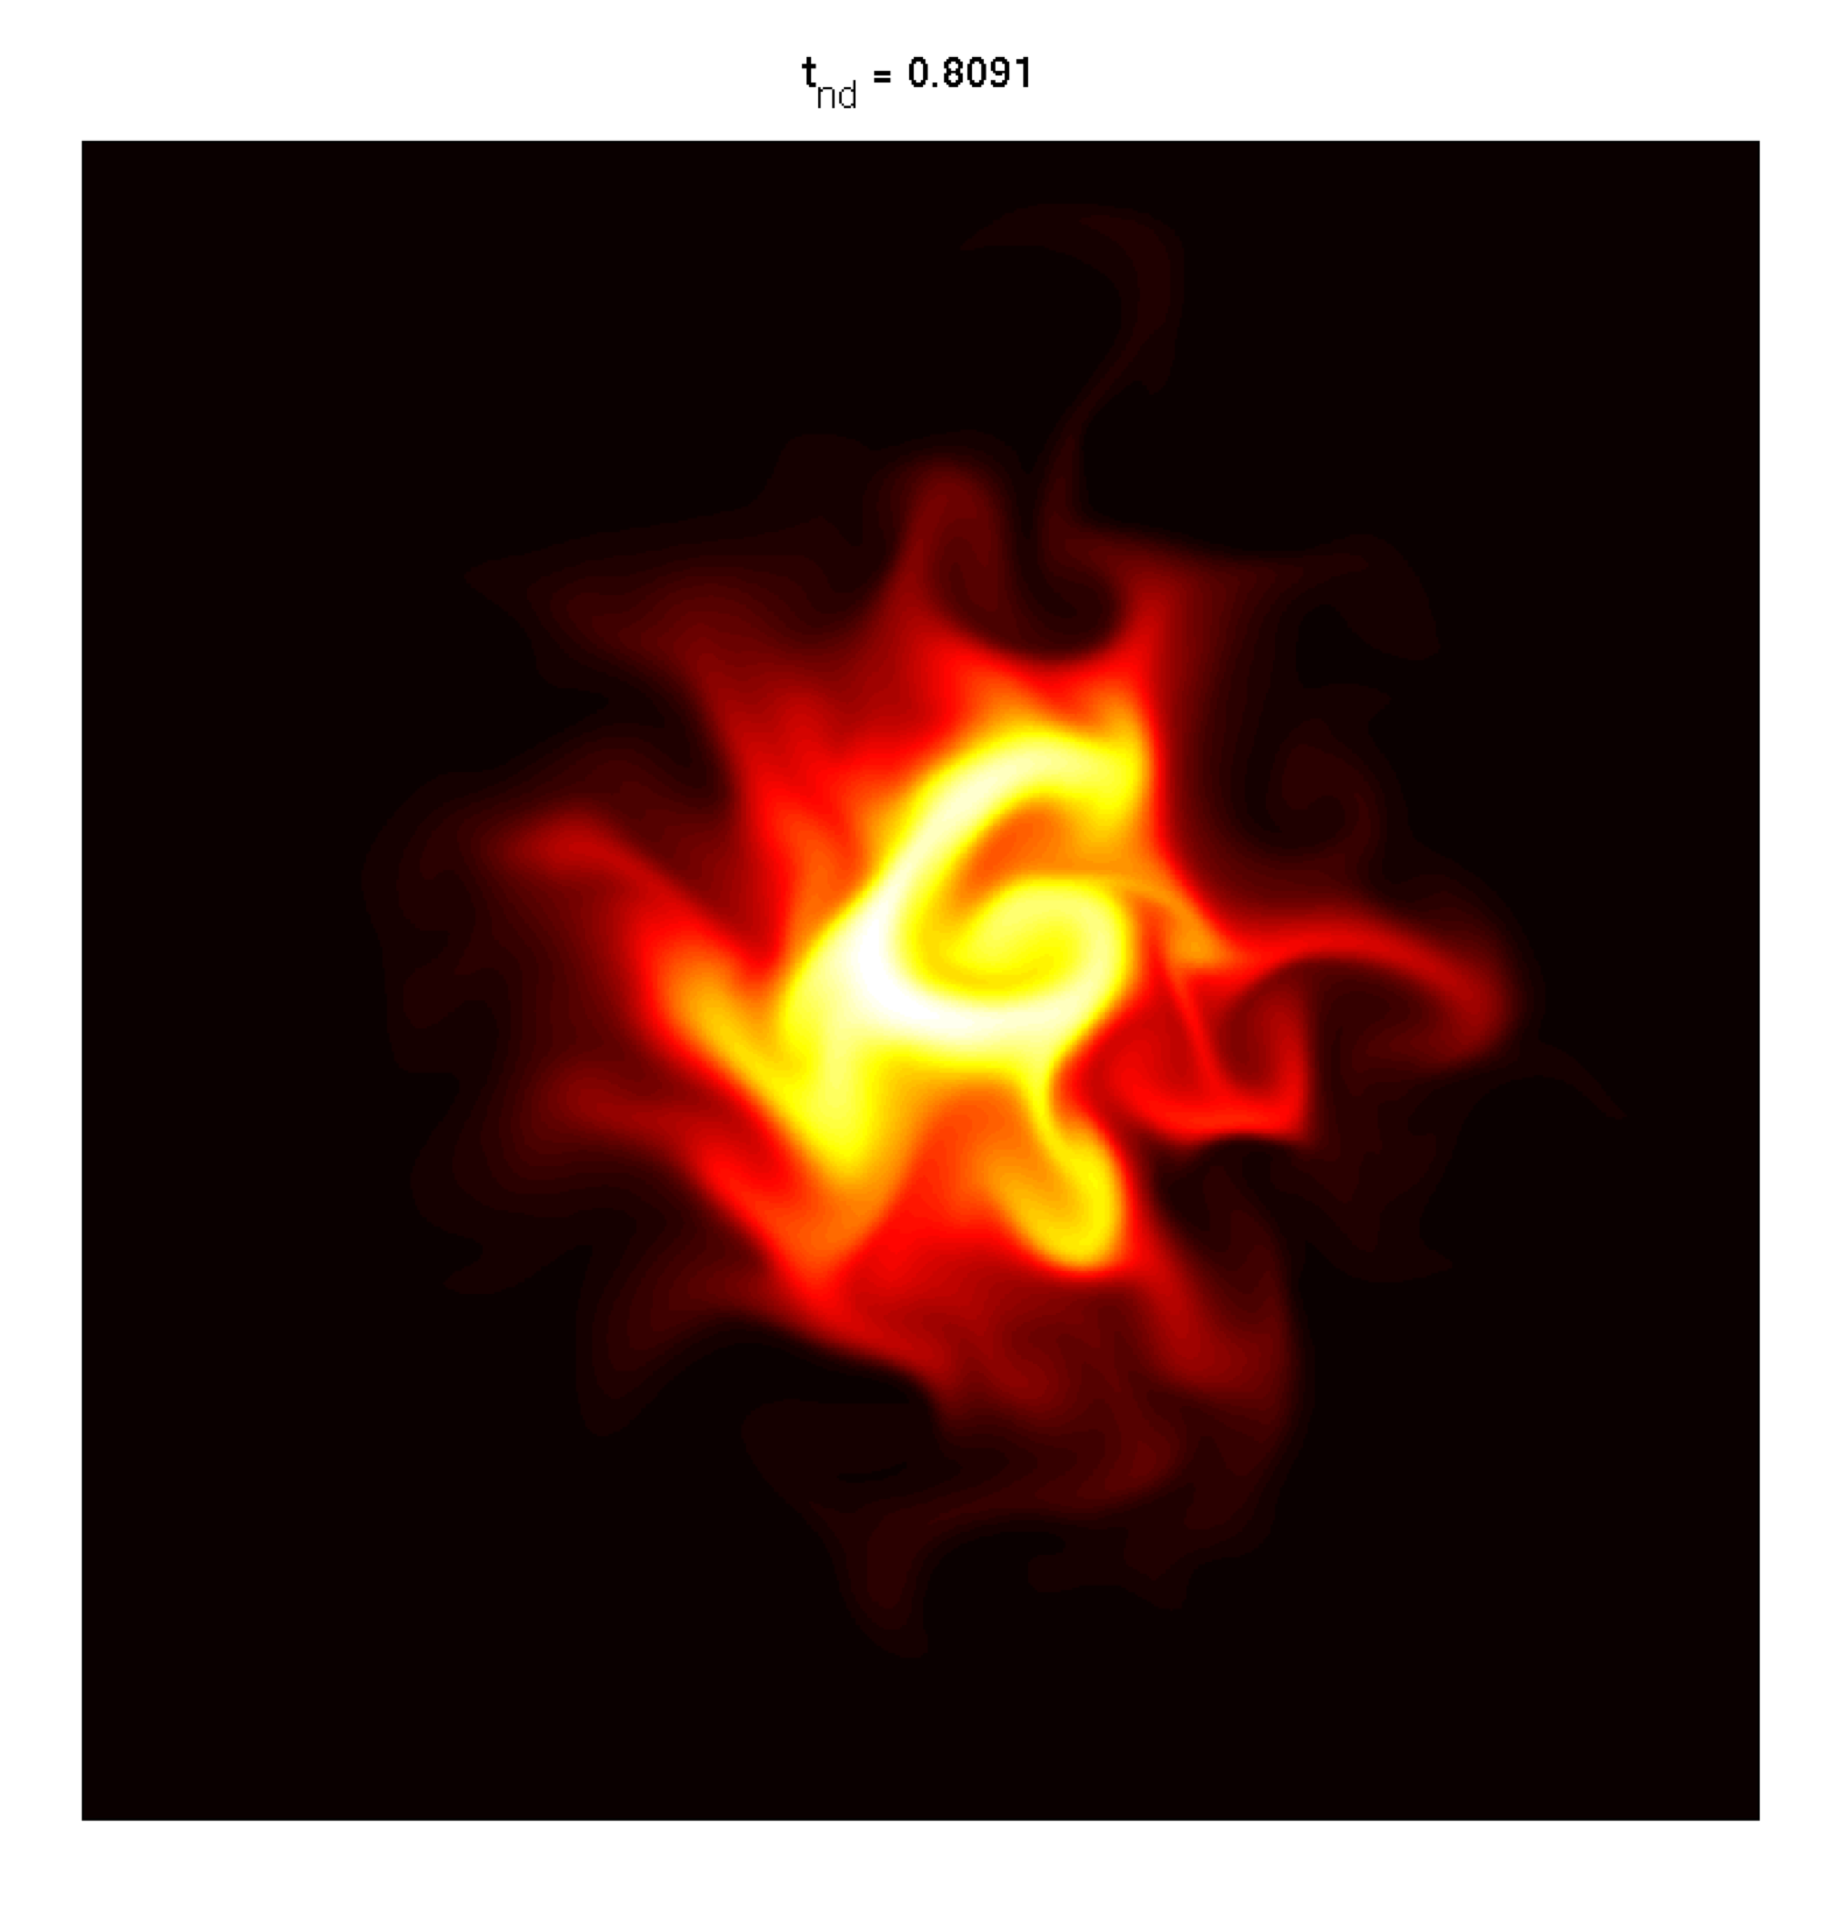
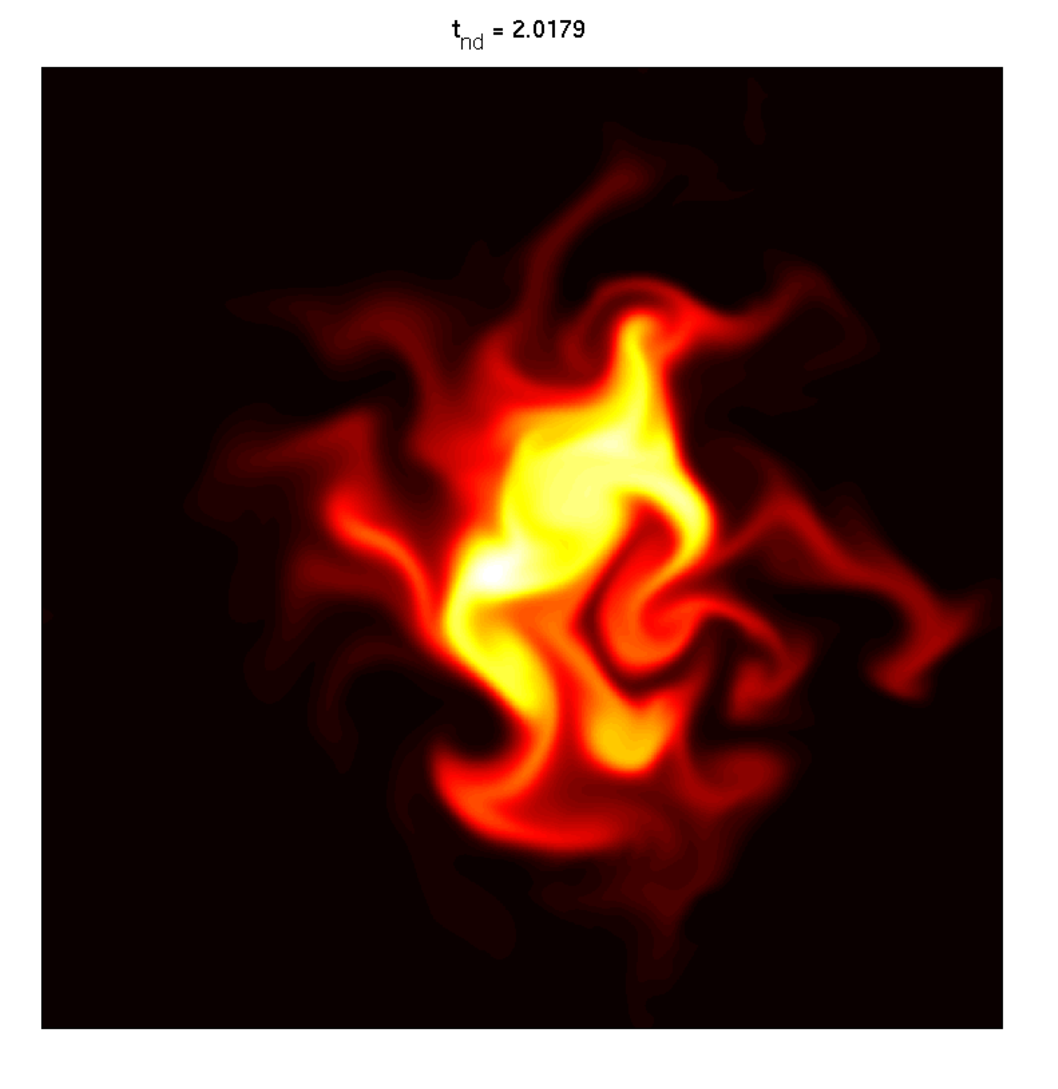
Effective diffusion across tracer contours
Tracer coordinates : area enclosed by C
K_{eff} is an effective diffusivity across tracer contours (Nakamura J. Atm. Sci. 1996,
Shuckburgh and Haynes Phys. Fluids 2003)

Slide 17
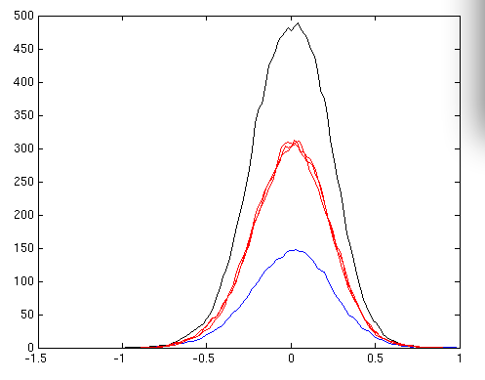
Diffusivity enhancement κ_{eff} / κ
Diffusivity
enhancement
True temperature
Observed
Superresolved
Sea-surface temperature anomaly (°C)

Slide 18
Meridional heat flux
Global poleward ocean transport
(Petawatts)
Primary component of global heat balance
Major uncertainty: heat transport due to eddies
Key challenges:
  sparseness in vertical
  sparseness in horizontal
  sparseness in time
  sign-indefinite quadratic
Ganachaud & Wunsch (Nature 2000)

Slide 19
Idealized test case
High latitude test case:
Observed eddy scale 80 km
Spatial resolution 100 km

Slide 20
Eddy heat flux in the Phillips model
Explicitly a function of both upper and lower layers
Sensitive to horizontal spatial resolution
Heat flux spectrum
Optimally interpolated heat flux

Slide 21
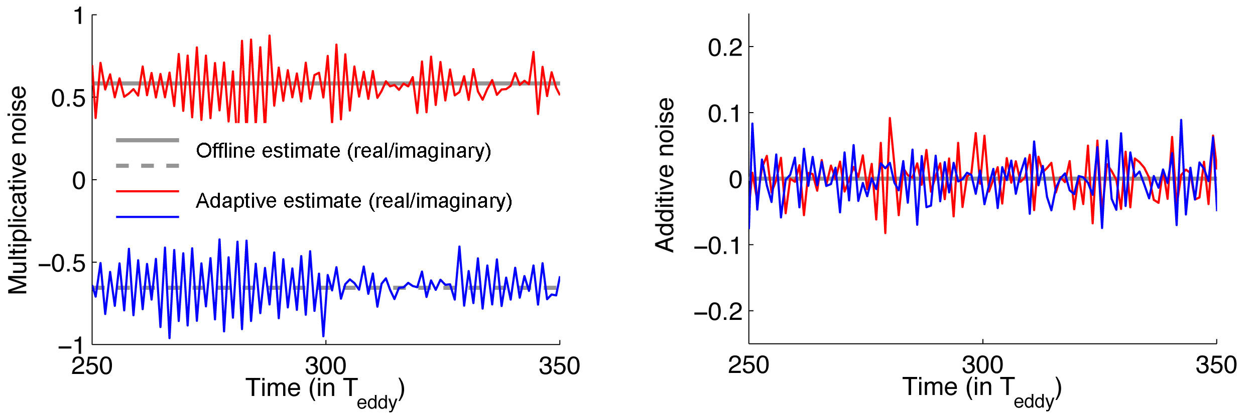
Adaptive parameter estimation
  Offline parameter estimation
  Adaptive parameter estimation

Slide 22
Adaptive parameter estimation
  Offline parameter estimation
  Adaptive parameter estimation
Regression fit to time-mean energy and correlation time.

Slide 23
Adaptive parameter estimation
  Offline parameter estimation
  Adaptive parameter estimation
Regression fit to time-mean energy and correlation time.
High filtering skill for broad range of parameters.

Slide 24
Adaptive parameter estimation
Observed wavenumber
Aliased wavenumber
High latitude normalized heat flux
High latitude normalized heat flux
High latitude normalized heat flux
Time (in T_{eddy})
Time (in T_{eddy})
Time (in T_{eddy})

Slide 25
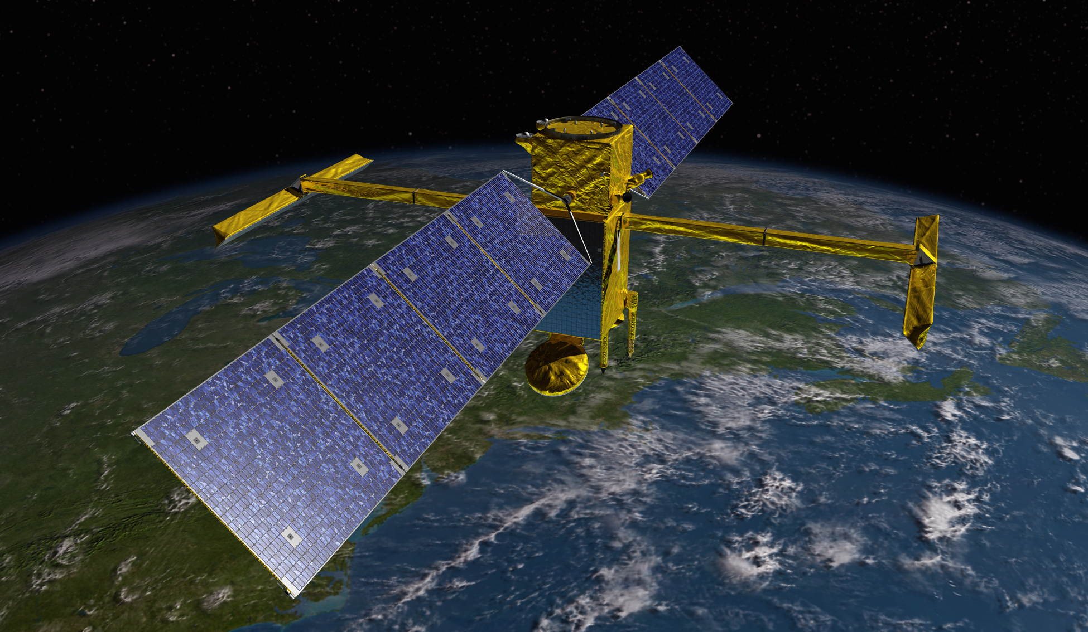
Over the horizon
NASA/JPL
Surface Water Ocean Topography (SWOT) mission will resolve kilometer-scale dynamics at ocean surface.
Need for new analytical tools to put this data to work!

Slide 26
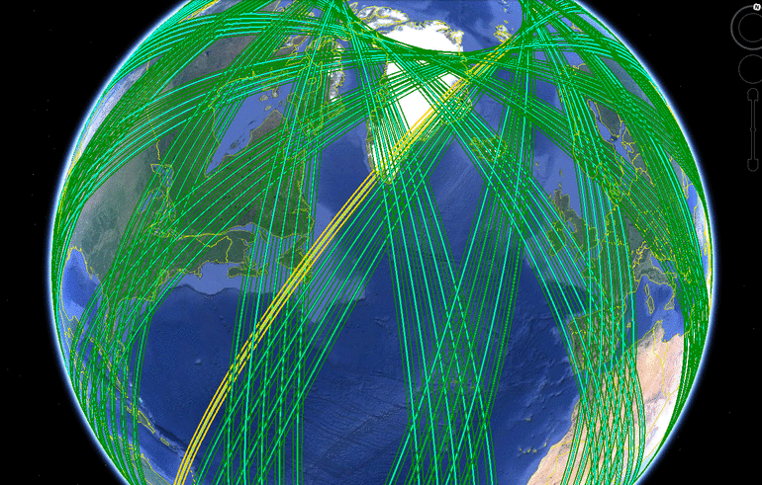
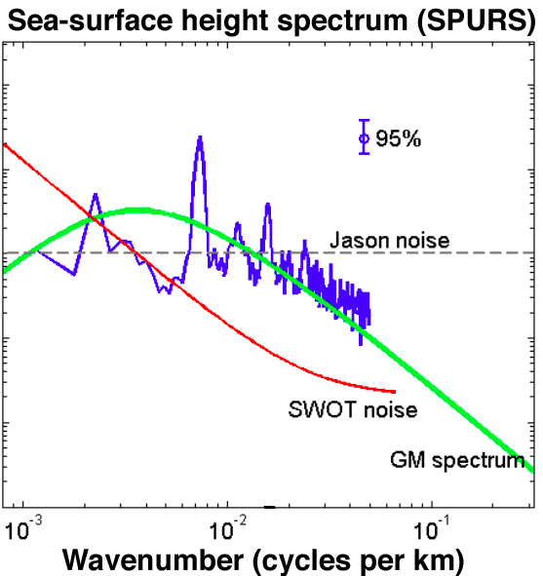
Over the horizon
AVISO/Google
Sampling time ~ 20 days
How interpolate high-res spatial data in time?
The curse of dimension: too hard for standard DA
SSH = geostrophic flow
+ internal waves
+ turbulence
Filter waves + turbulence using stochastic models

Slide 27
Assimilating satellite observations is a wicked problem with many interacting scales, unknown dynamics, and sparse data
Stochastic DA uses inexpensive linear stochastic forecast models to represent subgrid turbulent dynamics
Estimate stochastic model parameters from climatology or using adaptive parameterization
Exploit spatial aliasing to super-resolve satellite images

Slide 28
Extra material

Slide 29
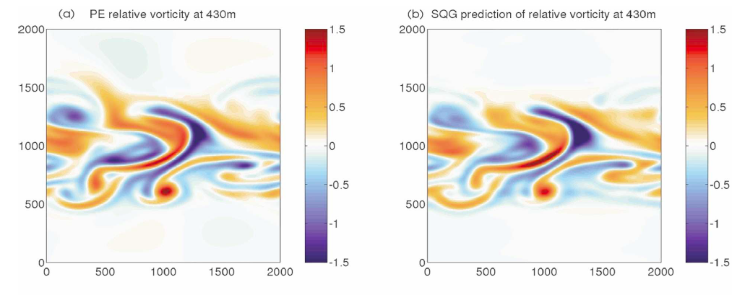
Upper ocean flow reconstruction
Lapeyre & Klein (2006)
Surface quasigeostrophic (SQG) model: Interior streamfunction slaved to surface density/temperature (Lapeyre & Klein 2006)
Streamfunction is smoothed version of temperature: Microwave SST reconstructs flow with resolution of O(100) km.

Slide 30
Upper ocean flow reconstruction
True PV at 200m
PV from perfect SST
PV from observed SST
PV from super-res SST
Lapeyre and Klein (2006): model interior PV with empirically derived vertical profile function:
Even with perfect observations of SST, Surface QG methods have a depth of validity varies regionally.
Super-resolved SST results in improved subsurface stream-function reconstruction compared with raw observations.

Slide 31
Upper ocean flow reconstruction
ACC
Gulf Stream
Subtropical Pacific
Even with perfect observations of SST, SQG methods have a depth of validity that varies regionally.
Argues for inclusion of interior dynamics: Lapeyre (2009), Ponte and Klein (2013), Wang et al. (2013).
However, super-resolved SST results in improved surface mode reconstruction compared with raw observations.

Slide 32
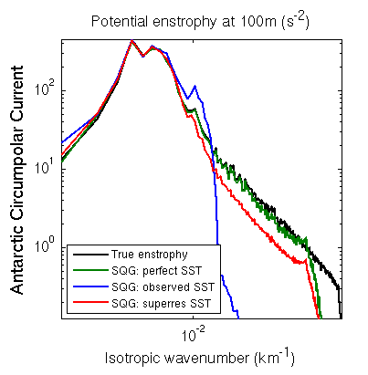
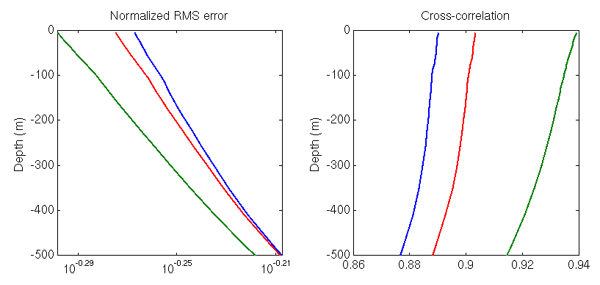
Upper ocean flow reconstruction
Lapeyre and Klein (2006): model interior PV with empirically derived vertical profile function:
Even with perfect observations of SST, Surface QG methods have a depth of validity varies regionally.
Super-resolved SST results in improved subsurface stream-function reconstruction compared with raw observations.

Slide 33
Sensitivity to clouds and observing period:
Accuracy of small-scale statistics calculated using high-resolution images depends on quality of data
Model effect of imperfect data by randomly discarding frames (“clouds”) or shortening observing period

Slide 34
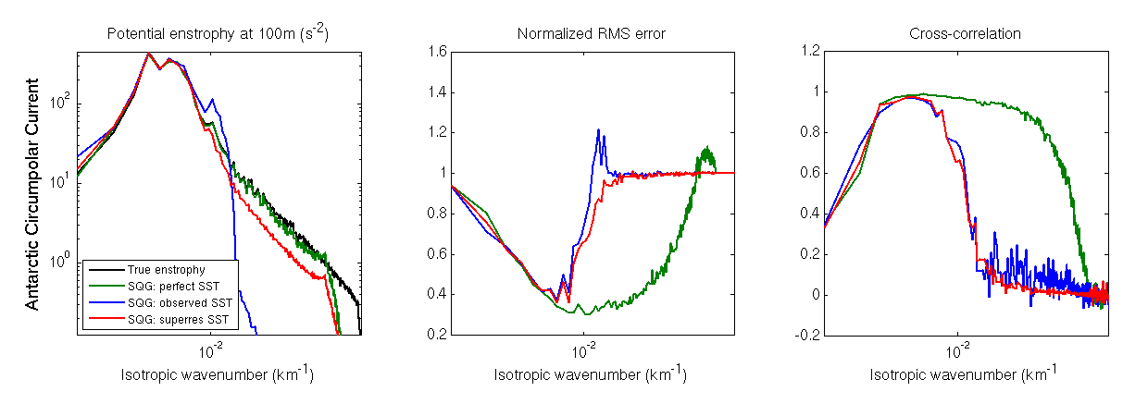
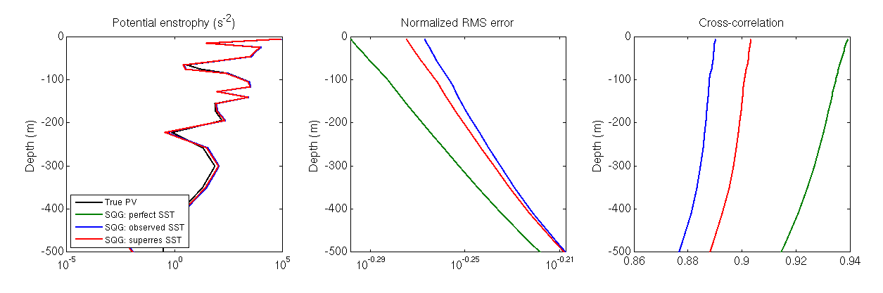
Upper ocean flow reconstruction

Slide 35
Data Assimilation
Data assimilation seeks the best guess of the system state by combining noisy, incomplete observations with a model forecast.
Unobserved Variables
Truth
Observed variables

Slide 36
Data Assimilation
Data assimilation seeks the best guess of the system state by combining noisy, incomplete observations with a model forecast.
Forecast
Unobserved Variables
Truth
Observed variables

Slide 37
Data Assimilation
Data assimilation seeks the best guess of the system state by combining noisy, incomplete observations with a model forecast.
Truth
Forecast
Unobserved Variables
Observation
Observed variables

Slide 38
Data Assimilation
Data assimilation seeks the best guess of the system state by combining noisy, incomplete observations with a model forecast.
Truth
Forecast
Unobserved Variables
Observation
Prediction
Observed variables

Slide 39
Data Assimilation
Data assimilation seeks the best guess of the system state by combining noisy, incomplete observations with a model forecast.
Least squares problem:
Minimize (wrt Truth)
(Forecast – Truth)² +
(Prediction – Observation) ²
weighted by uncertainty.
Truth
Analysis
Forecast
Unobserved Variables
Observation
Prediction
Observed variables

Slide 40
Data Assimilation
Data assimilation seeks the best guess of the system state by combining noisy, incomplete observations with a model forecast.
Filtering is not the same
as projection (e.g. onto
Empirical Orthogonal
functions)
It is a statistical inference
about the full system
constrained by observations.
Information about unobserved variables is obtained because the evolution operator induces correlations with observed variables.
Truth
Analysis
Unobserved Variables
Observed variables

Slide 41
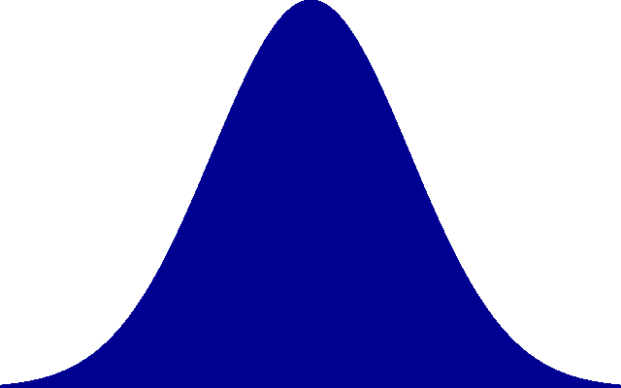

Aliasing of sparse observations
More generally, sample over footprint G(x,y)
l
Coarse-grid Fourier transform is convolved with spectral transfer function G(k,l)
^
G(x)
For a Gaussian sampling footprint of width l, transfer function is a Gaussian of width 1/l
1/l
^
G(k)

Slide 42
Filtering sparse observations
M x M observations of each resolved mode + aliased modes
time

Slide 43
Filtering sparse observations
1. Forecast step:
Make prediction for N x N modes using quasi-linear stochastic model.
Forecast mean and covariance:
Tune parameters to give correct energy and timescales estimated from infrared observations.
time

Slide 44
Filtering sparse observations
2. Update step:
Combine N x N prediction (-) with
M x M observation (~) using Kalman filter solution:
Optimal solution when dynamics and observation operator are linear with unbiased uncorrelated Gaussian noise.
time

Slide 45
Filtering sparse observations
2. Update step:
Combine N x N prediction (-) with
M x M observation (~) using Kalman filter solution:
Optimal solution when dynamics and observation operator are linear with unbiased uncorrelated Gaussian noise.
time

Slide 46
Filtering sparse observations
3. Smoothing step:
Apply Rauch-Tung-Straub smoother to remove unphysical jumps.
Resulting superresolved estimate is a pdf with an effective resolution given by model, not observations.
time

