Slide 1



Particle filter for data assimilation of nonlinear model systems with non-Gaussian noises
Nonlinear and Stochastic Problems in Atmospheric and Oceanic Prediction Workshop
Zheqi Shen, Youmin Tang
1. Second Institute of Oceanography, State Oceanic Administration, Hangzhou, China
2. University of Northern British Columbia, Prince George, Canada
2017.11.22

Slide 2
Outline
The advantage and challenge of particle filters
EnKPF as a hybrid method of EnKF and PF
Localization in particle filters

Slide 3
01
The advantages and challenges of particle filter

Slide 4
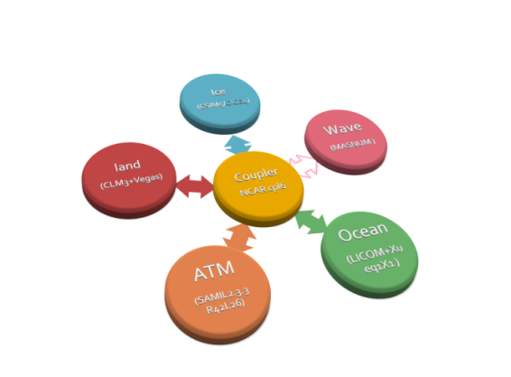
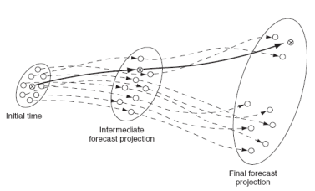
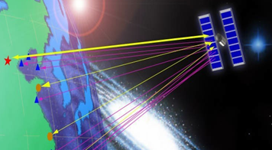

Data assimilation
Numerical models
ICs
Data assimilation methods
Prediction /Simulation
Parameters
$$α=？$$
$$κ=？$$
Observation data

Slide 5
Data assimilation methods
Variational methods
Data assimilation methods
Ensemble Kalman filters
Ensemble-based filters
Particle filters

Slide 6
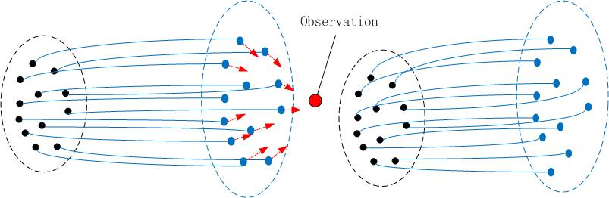
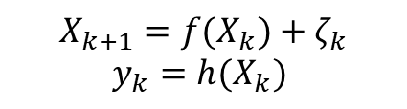
Ensemble Kalman filter
Ensemble Adjustment Kalman filter
State space model
$$X_{k+1}={f(X}_{k})+ζ_{k}$$
$$y_{k}=h(X_{k})$$
Compute the mean and covariance of the forecast state using the ensemble
Compute the posterior mean and covariance of the analysis state by Gaussian assumption
Adjust the ensemble to adapt the analysis mean and covariance
1
2
3

Slide 7
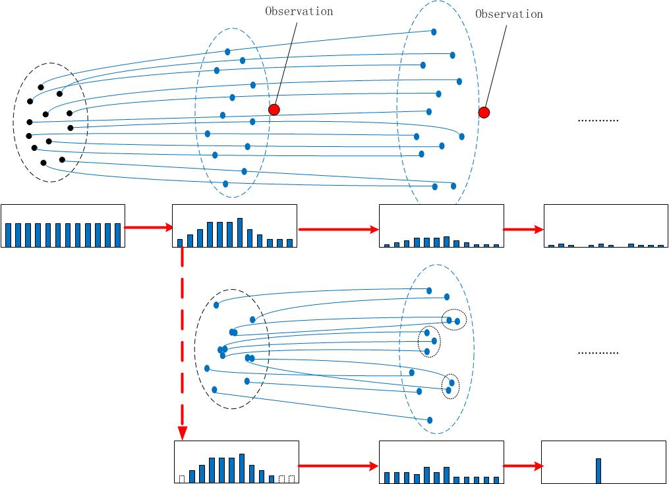
Particle filter
Particle filter
Using observations to update the weights, using weighted mean to give analysis
Resampling is frequently used to redistribute the ensemble according to the weights
The main challenge of PF is the filter degeneracy.

Slide 8
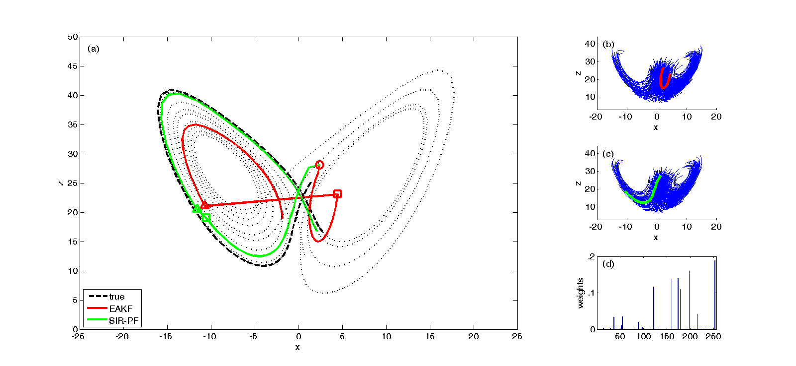
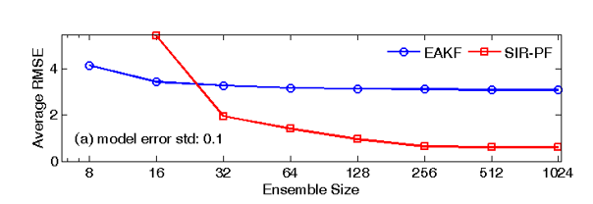

Comparison of PF and EnKF
Lorenz ’63 model:
$\frac{dx}{dt}=σ\left(y−x\right)$
$\frac{dy}{dt}=ρx−y−xz$
$\frac{dz}{dt}=xy−βz$
No Gaussian assumptions
Weights to approximate the full probability density functions (PDFs)

Slide 9
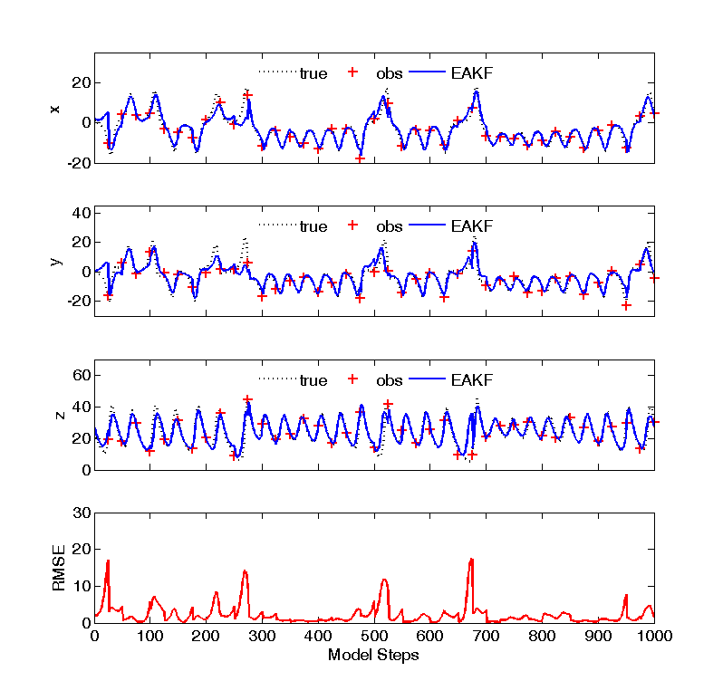
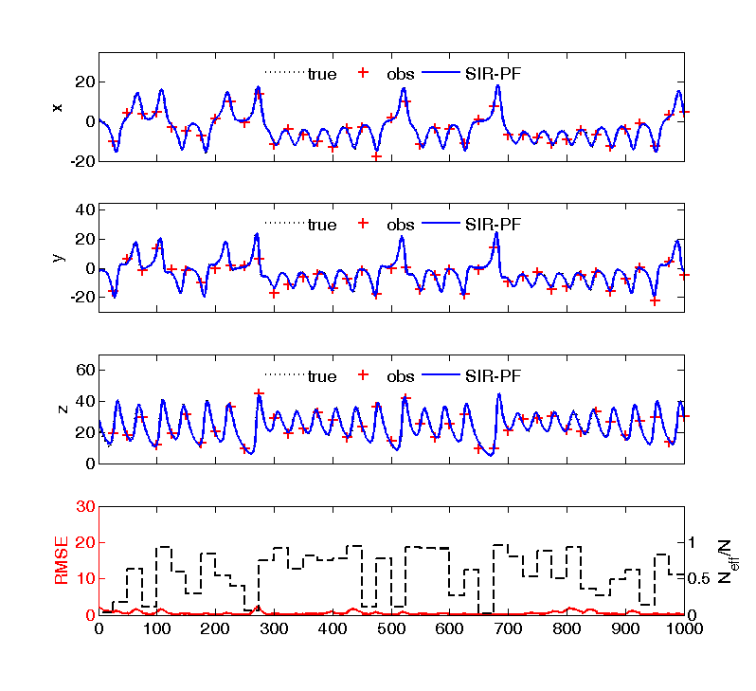
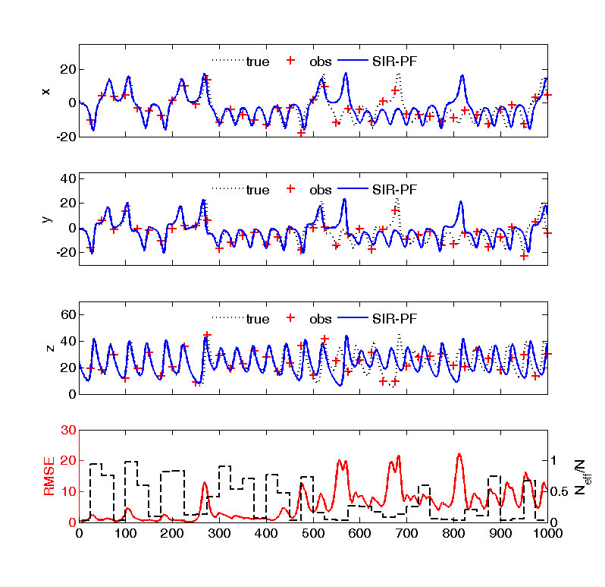
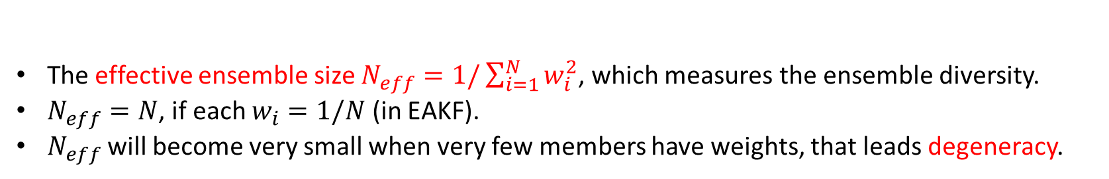
Filter degeneracy
256 members EAKF 256 members PF 32 members PF
The effective ensemble size $N_{eff}=1/\sum_{i=1}^{N}{w_{i}^{2}}$, which measures the ensemble diversity.
$N_{eff}=N$, if each $w_{i}=1/N$ (in EAKF).
$N_{eff}$ will become very small when very few members have weights, that leads degeneracy.

Slide 10
02
Our first attempt to overcome the filter degeneracy
- Ensemble Kalman particle filter

Slide 11
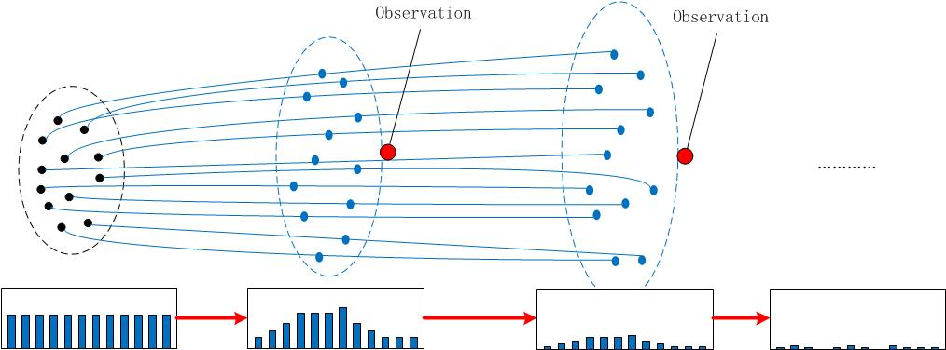
A hybrid method of EnKF and PF
EnKF
Ensemble Kalman particle filter (Frei and Kunsch, 2013)
Modifying the ensemble members
Computing weights and resampling
  In one analysis step
PF

Slide 12

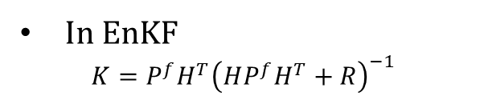
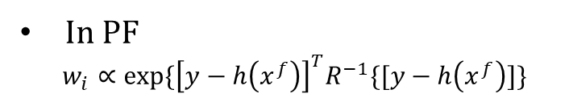
Ensemble Kalman particle filter (EnKPF)
$x_{i}^{u}=x_{i}^{f}+K_{1}\left[y−h\left(x_{i}^{f}\right)\right]$
$K_{1}=P^{f}H^{T}{\left(HP^{f}H^{T}+\frac{R}{γ}\right)}^{−1}$ -- EnKF with inflated observational error
$Q=K_{1}RK_{1}^{T}/γ$
$w_{i}=$ $exp\left\{{\left[y−h\left(x_{i}^{u}\right)\right]}^{T}{\left(\frac{R}{1−γ}+HQH^{T}\right)}^{−1}\left[y−h\left(x_{i}^{u}\right)\right]\right\}, w_{i}=\frac{w_{i}}{\sum{w_{i}}}$
-- computed the weights according to the modified likelihood function
Resampling : $x_{i}^{v}=x_{s(i)}^{u}+ε$ where $s\left(i\right)$ is the resampling index
$x_{i}^{a}=x_{i}^{v}+K_{2}\left(y+ε^{′}−h\left(x_{i}^{v}\right)\right)$
$K_{2}=QH^{T}{\left(HQH^{T}+\frac{R}{1−γ}\right)}^{−1}$ -- update the resampled ensemble
In EnKF
$$K=P^{f}H^{T}{\left(HP^{f}H^{T}+R\right)}^{−1}$$
In PF
$w_{i}∝exp\{{\left[y−h\left(x^{f}\right)\right]}^{T}R^{−1}\{[y−h\left(x^{f}\right)]\}$
The ‘progress correction’ idea (Musso et al., 2001)
(Frei and Kunsch, 2013)

Slide 13
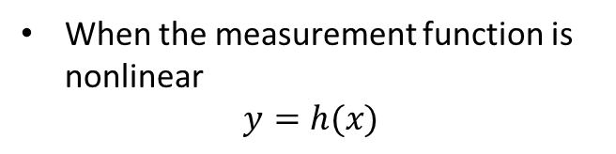
An extension of EnKPF for nonlinear h
$x_{i}^{u}=x_{i}^{f}+K_{1}\left[y−h\left(x_{i}^{f}\right)\right]$
$K_{1}=P^{f}H^{T}{\left(HP^{f}H^{T}+\frac{R}{γ}\right)}^{−1}$ -- EnKF with inflated observational error
$Q=K_{1}RK_{1}^{T}/γ$
$w_{i}=$ $exp\left\{{\left[y−h\left(x_{i}^{u}\right)\right]}^{T}{\left(\frac{R}{1−γ}+HQH^{T}\right)}^{−1}\left[y−h\left(x_{i}^{u}\right)\right]\right\}, w_{i}=\frac{w_{i}}{\sum{w_{i}}}$
-- computed the weights according to the modified likelihood function
Resampling : $x_{i}^{v}=x_{s(i)}^{u}+ε$ where $s\left(i\right)$ is the resampling index
$x_{i}^{a}=x_{i}^{v}+K_{2}\left(y+ε^{′}−h\left(x_{i}^{v}\right)\right)$
$K_{2}=QH^{T}{\left(HQH^{T}+\frac{R}{1−γ}\right)}^{−1}$ -- update the resampled ensemble
When the measurement function is nonlinear
$$y=h(x)$$
nEnKPF
(Frei and Kunsch, 2013)
mEnKPF

Slide 14
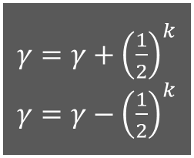





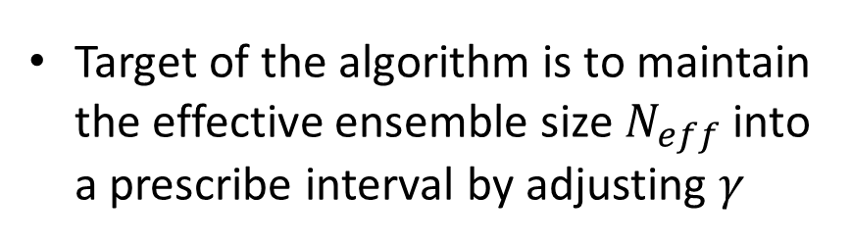
Adaptive algorithm to determine $γ$
Target of the algorithm is to maintain the effective ensemble size $N_{eff}$ into a prescribe interval by adjusting $γ$
Initial guess of $γ$ (typically, 1/2)
Apply EnKF and PF with the parameter $γ$
$γ=γ+{\left(\frac{1}{2}\right)}^{k}$ $γ=γ−{\left(\frac{1}{2}\right)}^{k}$
Compute the $N_{eff}$ according to the weights
no
Is $N_{eff}$ in the interval $N∗[τ_{1},τ_{2}]$?
yes
End the loop

Slide 15

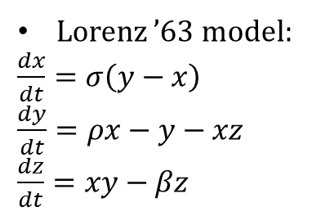
EnKPF in Lorenz models
Lorenz ’63 model:
$\frac{dx}{dt}=σ\left(y−x\right)$
$\frac{dy}{dt}=ρx−y−xz$
$\frac{dz}{dt}=xy−βz$
Nonlinear measurement:
$$y=5tanh⁡(x)$$
N = 64

Slide 16
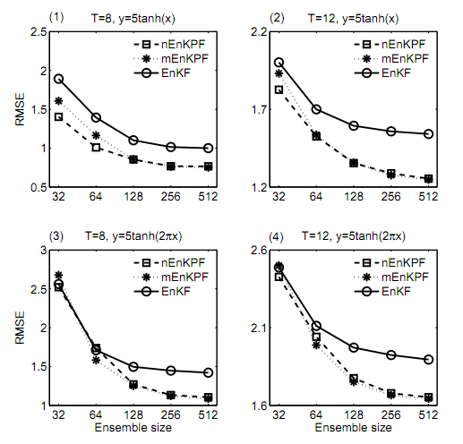
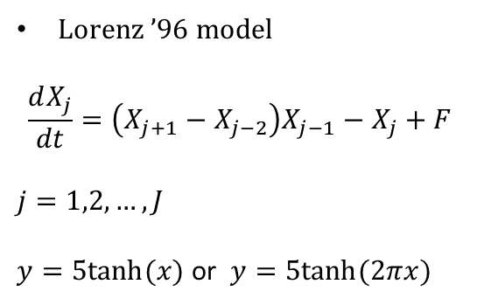
EnKPF in Lorenz models
Lorenz ’96 model
$$\frac{dX_{j}}{dt}=\left(X_{j+1}−X_{j−2}\right)X_{j−1}−X_{j}+F$$
$$j=1,2,…,J$$
$y=5tanh⁡(x)$ or $y=5tanh⁡(2πx)$
Different nonlinear measurement functions
Different data frequencies (nonlinearity of the model)

Slide 17
Conclusions for EnKPF
EnKPF combines the merits of EnKF and SIR-PF, which can assimilate non-Gaussian information with a relatively small ensemble.
The EnKPF algorithm can be extended to cases that the measurement function is nonlinear. Regarding the implicit linearization in nonlinear h, we have proposed two EnKPF schemes, namely, nEnKPF and mEnKPF.
In most cases, mEnKPF performs better than nEnKPF, both outperform EnKF.
References
Frei, M., & Künsch, H. R. (2013). Bridging the ensemble Kalman and particle filters. Biometrika, 100(4), 781-800.
Shen, Z., & Tang, Y. (2015). A modified ensemble Kalman particle filter for non‐Gaussian systems with nonlinear measurement functions. Journal of Advances in Modeling Earth Systems, 7(1), 50 - 66.
Shen, Z., Zhang, X., & Tang, Y. (2016). Comparison and combination of EAKF and SIR-PF in the Bayesian filter framework. Acta Oceanologica Sinica, 35(3), 69-78. doi: 10.1007/s13131-015-0757-x

Slide 18
03
A more practical strategy to avoid filter degeneracy
- Localization in particle filters

Slide 19

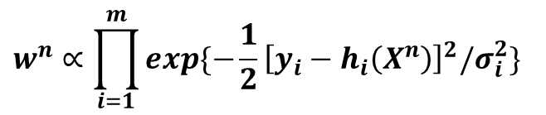
Filter degeneracy and scalar weights
Traditional PF uses scalar weights
$$w^{n}∝\prod_{i=1}^{m}{exp⁡\{−\frac{1}{2}{\left[y_{i}−h_{i}\left(X^{n}\right)\right]}^{2}/σ_{i}^{2}\}}$$
The effect of each observation is accumulated into a single number as a global weight for each particle
Filter degeneracy makes traditional PF invalid with real models
While the dimension of the dynamical model and the number of observations is large, it is very likely to get filter degeneracy

Slide 20
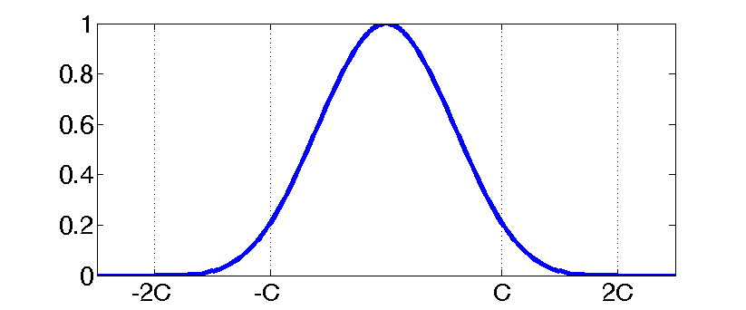
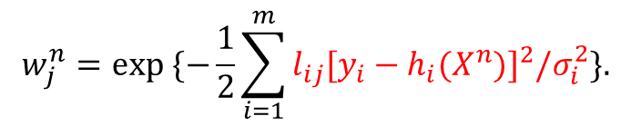

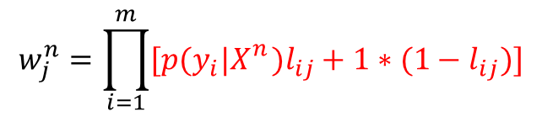


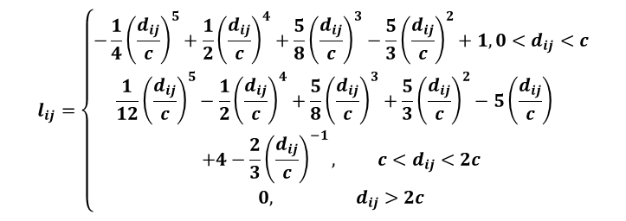
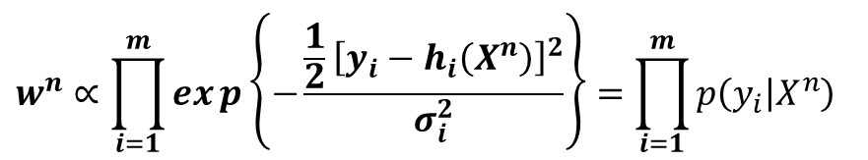
From scalar weights to vector weights
Extending to vector weights
$$w_{1}^{n}$$
$$w_{2}^{n}$$
$$w^{n}∝\prod_{i=1}^{m}{exp\left\{−\frac{\frac{1}{2}{\left[y_{i}−h_{i}\left(X^{n}\right)\right]}^{2}}{σ_{i}^{2}}\right\}}=\prod_{i=1}^{m}{p\left(y_{i} | X^{n}\right)}$$
$$w_{j}^{n}$$
Poterjoy (2016)
$$w_{j}^{n}=\prod_{i=1}^{m}{[p(y_{i}|X_{}^{n})l_{ij}+1∗(1−l_{ij})]}$$
$$l_{ij}=\left\{\begin{matrix}−\frac{1}{4}{\left(\frac{d_{ij}}{c}\right)}^{5}+\frac{1}{2}{\left(\frac{d_{ij}}{c}\right)}^{4}+\frac{5}{8}{\left(\frac{d_{ij}}{c}\right)}^{3}−\frac{5}{3}{\left(\frac{d_{ij}}{c}\right)}^{2}+1, 0<d_{ij}<c \\ \begin{aligned}\frac{1}{12}{\left(\frac{d_{ij}}{c}\right)}^{5}−\frac{1}{2}{\left(\frac{d_{ij}}{c}\right)}^{4}+\frac{5}{8}{\left(\frac{d_{ij}}{c}\right)}^{3}+\frac{5}{3}{\left(\frac{d_{ij}}{c}\right)}^{2}−5{\left(\frac{d_{ij}}{c}\right)}^{} \\ +4−\frac{2}{3}{\left(\frac{d_{ij}}{c}\right)}^{−1}, c<d_{ij}<2c\end{aligned} \\ 0, d_{ij}>2c\end{matrix}\right.$$
Shen et al. (2017)
$$w_{j}^{n}=exp \{−\frac{1}{2}\sum_{i=1}^{m}{l_{ij}[y_{i}−h_{i}(X^{n})]^{2}/σ_{i}^{2}}\}.$$

Slide 21

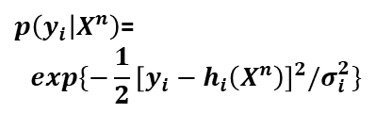


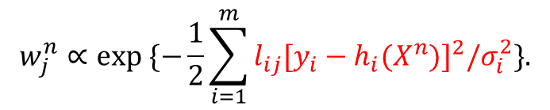

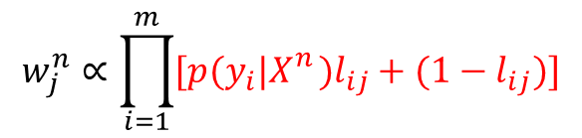




Poterjoy (2016)
Shen et al. (2017)
$$w_{j}^{n}∝\prod_{i=1}^{m}{[p(y_{i}|X_{}^{n})l_{ij}+(1−l_{ij})]}$$
$$w_{j}^{n}∝exp \{−\frac{1}{2}\sum_{i=1}^{m}{l_{ij}[y_{i}−h_{i}(X^{n})]^{2}/σ_{i}^{2}}\}.$$
$$w_{1}^{n}$$
$$w_{2}^{n}$$
$$w_{1}^{n}$$
$$w_{2}^{n}$$
$$w_{j}^{n}$$
$$w_{j}^{n}$$
$p\left(y_{i} | X^{n}\right)$=
$$exp⁡\{−\frac{1}{2}{\left[y_{i}−h_{i}\left(X^{n}\right)\right]}^{2}/σ_{i}^{2}\}$$
$$p(y_{2}|X^{n})$$
$$p(y_{1}|X^{n})$$

Slide 22
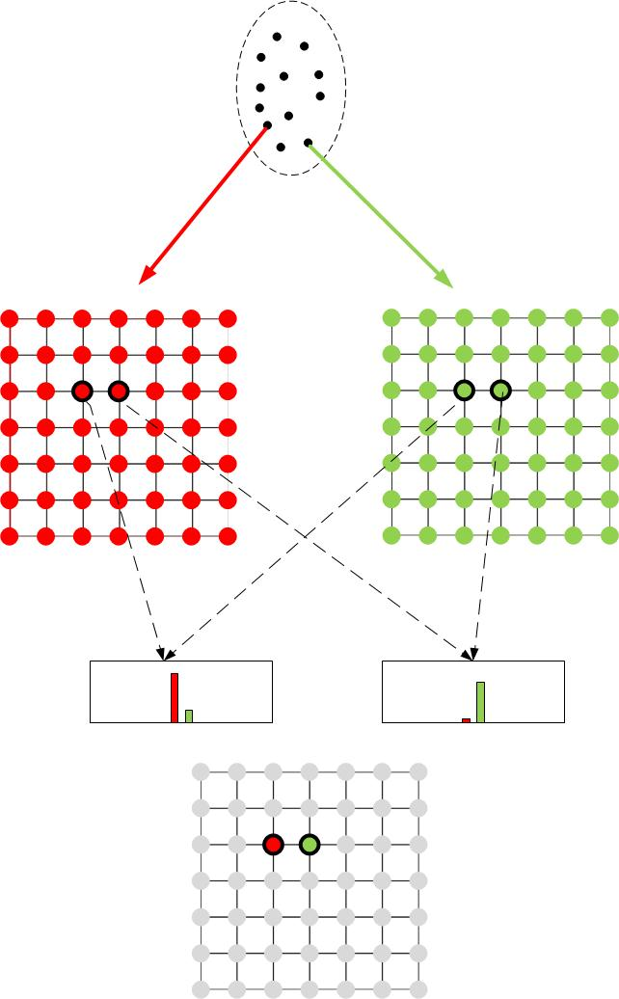
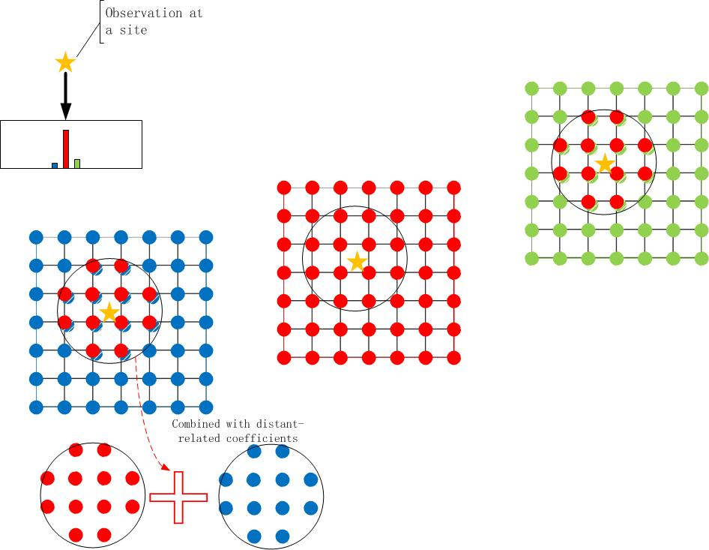

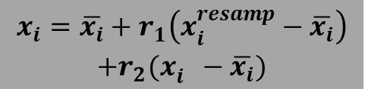
Resampling for vector weights
The problem of discontinuity for vector weights
Merging the resampled and original particles
$$x_{i}=\overline{x_{i}}+r_{1}\left(x_{i}^{resamp}−\overline{x_{i}}\right)$$
$$+r_{2}(x_{i}^{}−\overline{x_{i}})$$

Slide 23
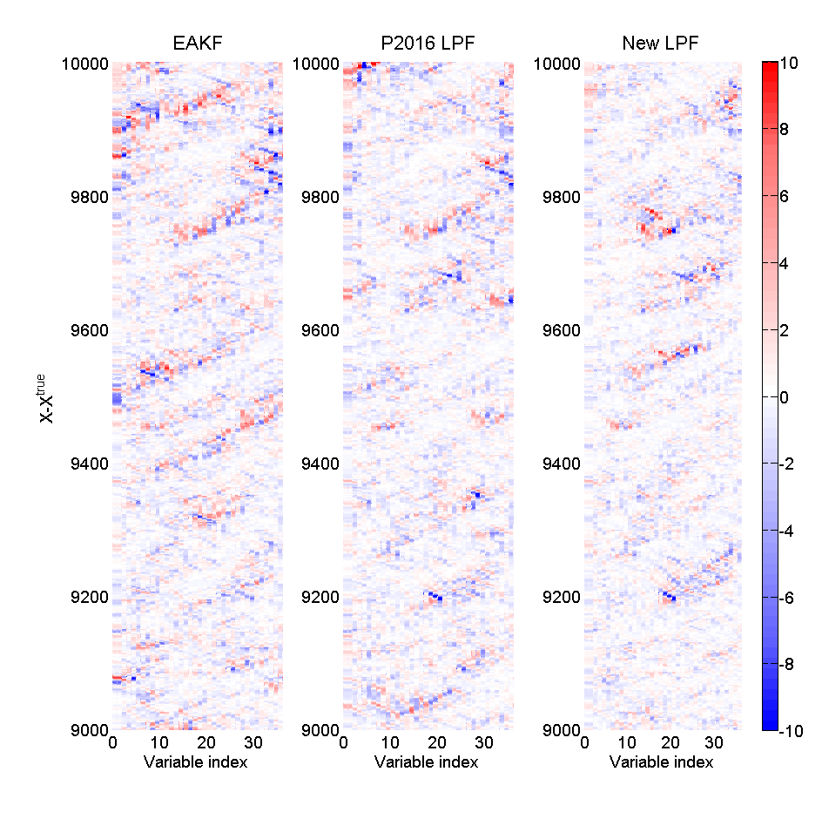
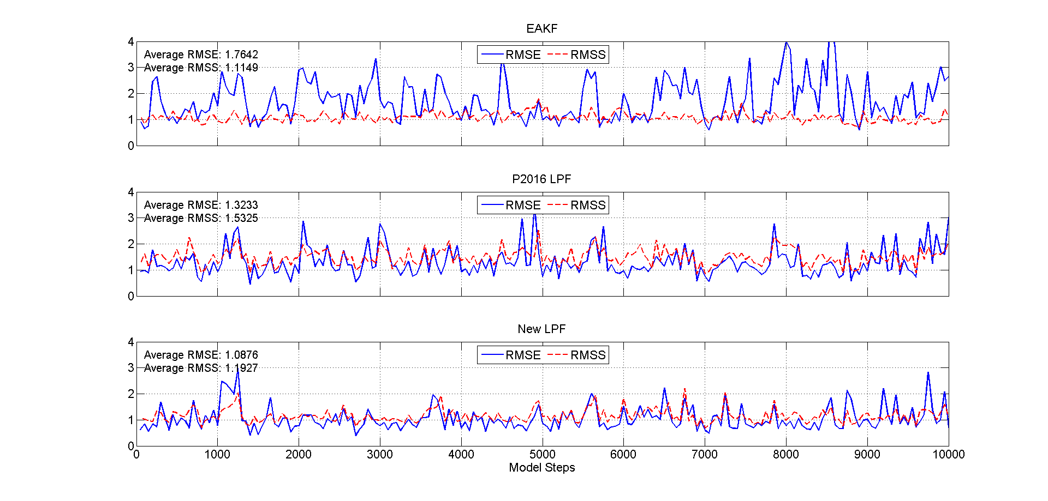
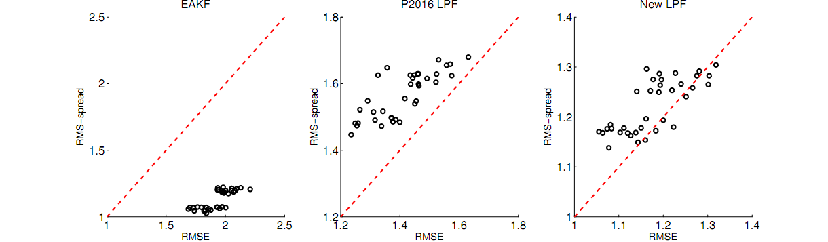
Comparison with P2016 LPF and EAKF
Lorenz ‘96 model
  36 variables
  Nonlinear observation y=|x|
Accuracy and consistency
ensemble size is 80

Slide 24
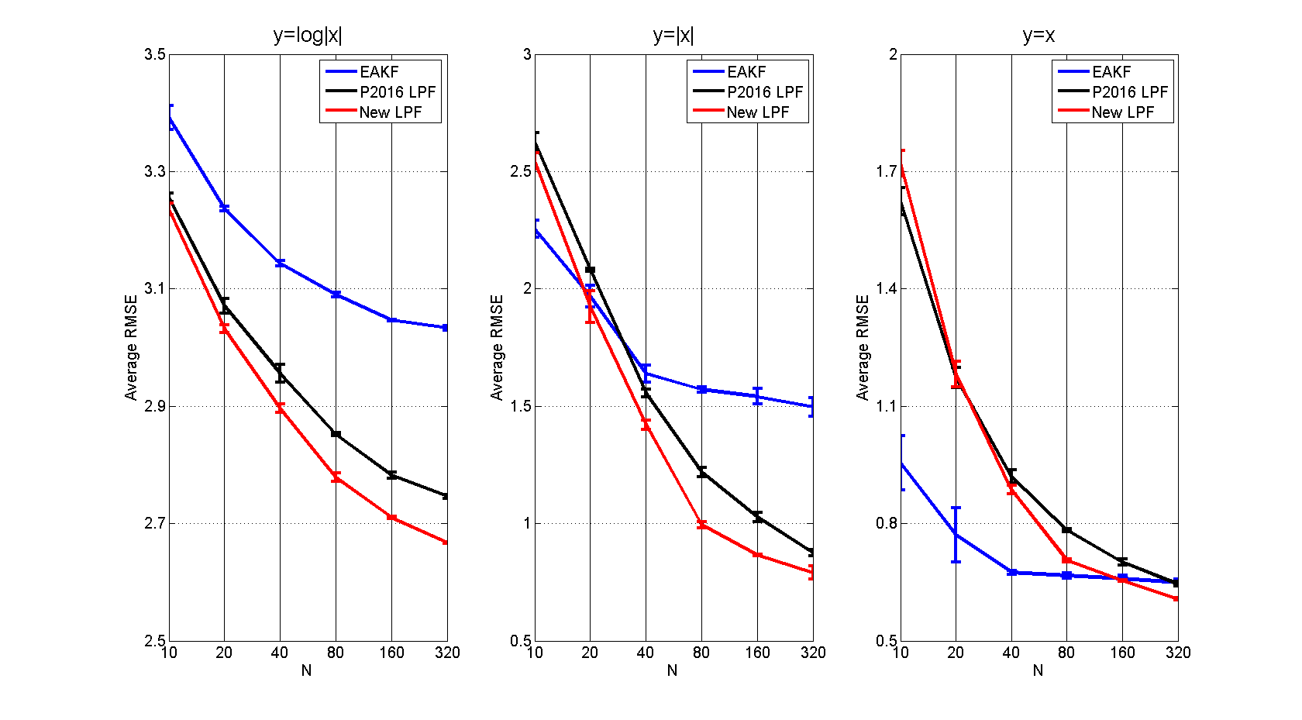
With nonlinear measurement functions
Different nonlinear measurement functions
Different ensemble sizes
The advantage is even more significant when the nonlinearity of h is strong

Slide 25
Conclusions for LPF
We have improved the formula to generate vector weights, the new LPF outperforms both EAKF and P2016 LPF in twin-experiments with nonlinear measurement functions
LPF can avoid filter degeneracy with affordable number of particles (computational resources), has a great potential to be applied in real models.
References
Poterjoy, J. (2016). A localized particle filter for high-dimensional nonlinear systems. Monthly weather review, 144(1), 59-76.
Shen, Z., Tang, Y., & Li, X. (2017). A new formulation of vector weights in localized particle filter. Quarterly Journal of the Royal Meteorological Society. doi: 10.1002/qj.3180

Slide 26
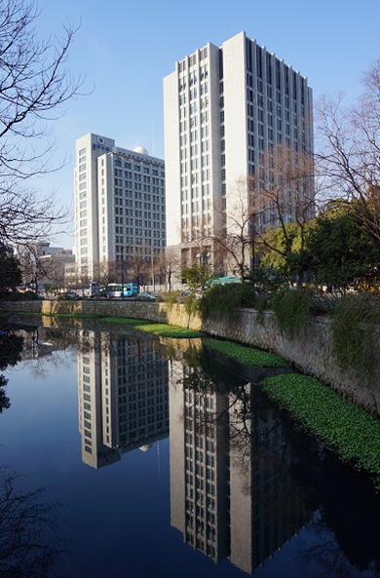
Thanks

