Slide 1
Optimum initialization of South Asian seasonal forecast using climatological relevant singular vectors
Siraj Ul Islam and Youmin Tang
Environmental Science and Engineering,
University of Northern British Columbia,
Prince George, BC, Canada

Slide 2
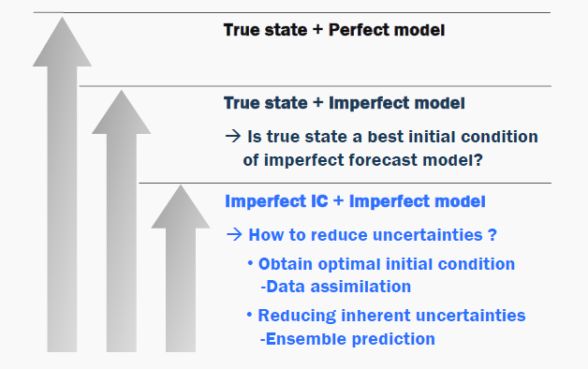
Forecast Errors
Forecast errors comes from model imperfection and poor initial conditions. To improve initialization:
  Knowledge about initial error distribution?
  Infinite ensemble members?
Model improvements and good initialization process is essential to achieve skillful forecast.
Kang et al, 2007

Slide 3
Forecast Initialization Methods
Random Perturbations
  Random perturbation are generated without any consideration of model dynamics.
Time Lag Ensemble
  Ensemble forecast initialized from different IC with time lag (6 hour, 3 hour etc.).
Optimized perturbations
  Maximize the benefit of ensemble prediction with a finite number of ensembles.

Slide 4
Optimum Perturbations
Initial error grows in the forecasts can be explained by a set of ensemble with perturbed forecasts.
Two widely used dynamically constrained methods are
  Breeding vectors
  Singular vectors (SV)
The goal is to generate few ensemble members to efficiently describe forecast uncertainty -> Fast growing perturbations

Slide 5
Breeding method
  Breeding takes a pair of forecast perturbations and periodically rescales them down and adds them to the new analysis state. Perturbations only grossly reflect analysis errors. (Toth and Kalnay, 1993, 1997; Cai et al., 2003; Tang and Deng, 2010, 2011).
BD (+)
perturbation
3(breeding intervals) × 2(mirror images)
= 6 ensemble members
Rescaling factor (percentage) : 10%
Breeding
breeding interval
: 1 day, 3 days, 5 days
BD (-)
perturbation
Notes:
In the SV method, growing perturbations are calculated from the singular vectors of the linear propagator of primitive equations. For obtaining singular vectors, most studies used a simple model because the linearized version of a forecast model is required to obtain SVs (Chen et al., 1997; Xue et al., 1997a,b; Thompson, 1998; Fan et al., 2000).
To compute the SV in a complex model, Kleeman et al. (2003) proposed a method to calculate SVs by perturbing the forecast model. Tang et al. (2006) calculated singular vectors for coupled GCM based on this method; however, dozens of ensemble predictions are required to obtain singular vectors for a single case.

Slide 6
Singular vector (SV)
  SV method (Palmer et al., 1994 etc.) measure the optimal error growth of nonlinear dynamic systems.
  perturbations which grow most rapidly
computationally very expensive for seasonal prediction
  requires a linearized version of a real model.
major difficulty in separating the SVs from the unwanted growing modes
  SV in GCMs (coupled or uncoupled)
This methods has been implemented mainly on ensemble weather forecast.
Tang et al., 2006

Slide 7
Climatically-relevant SV (CSV)
Its is modified SV method where the fast error growth is due to climatically relevant instabilities
  running a large ensemble of integrations to average out the weather noise.
CSV is cost efficient since
  it does not demand tangent linear and adjoint models.
This method derive SVs with an ensemble of 10–30 members in a reduced space based using empirical orthogonal function (EOF) modes.

Slide 8
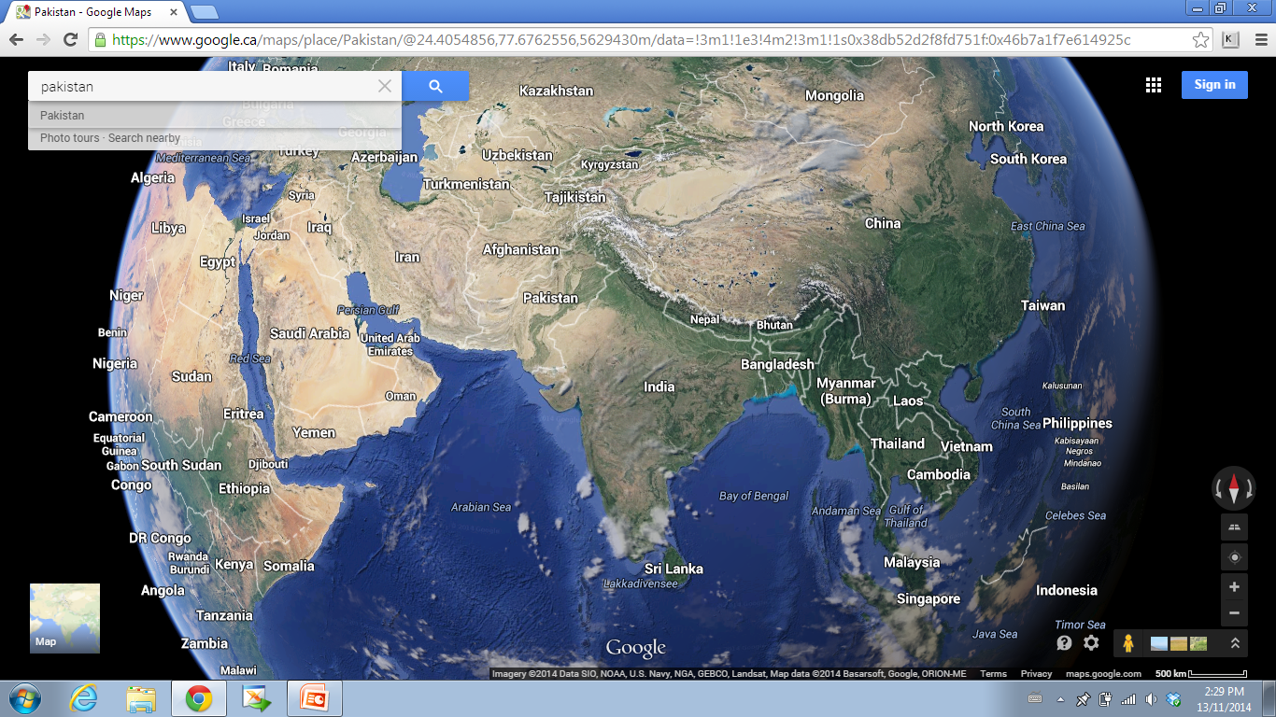
CSV Application
  While the correlation skill of ENSO forecasts have improved remarkably, seasonal prediction of climatic features such as the South Asian Monsoon (SAM) still needs substantial efforts.
  So far most of the optimized initialization methods are applied for ENSO forecast only.
  We have therefore tried to investigate “Can we improve the SAM forecast skill using optimum perturbation?”

Slide 9
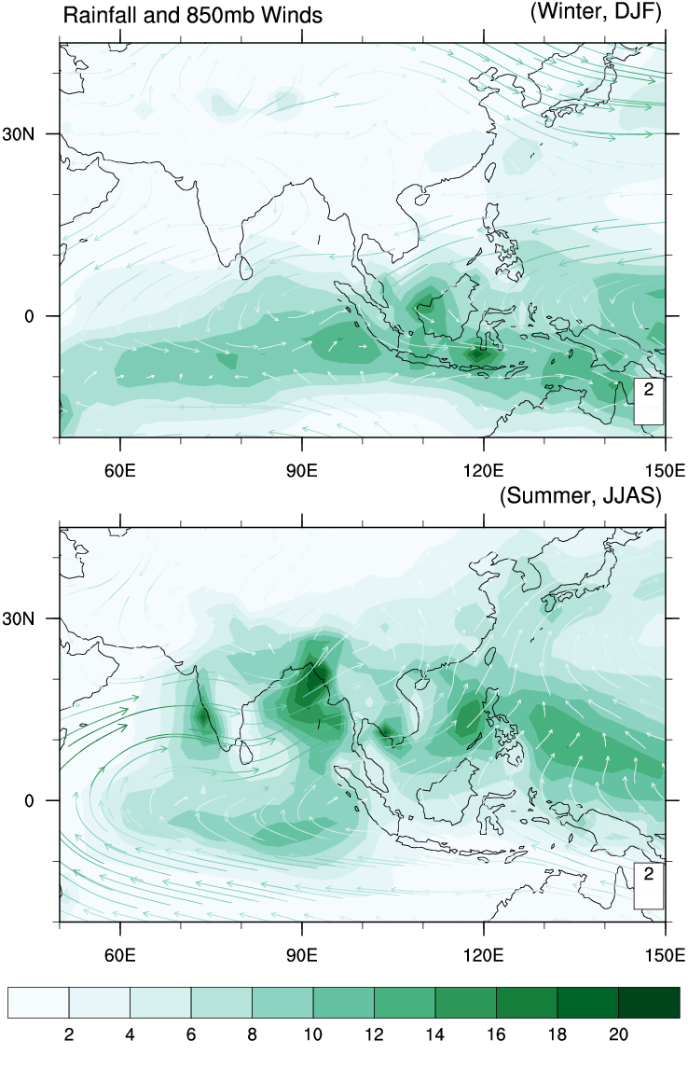
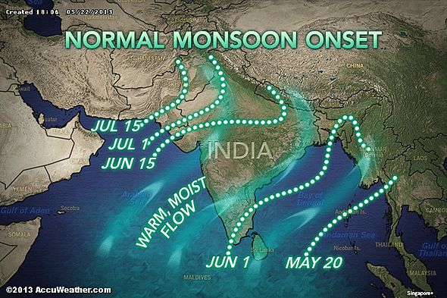
South Asian Monsoon (SAM)
Monsoon systems are caused by the seasonal reversal of winds due to differential heating between land and ocean

Slide 10
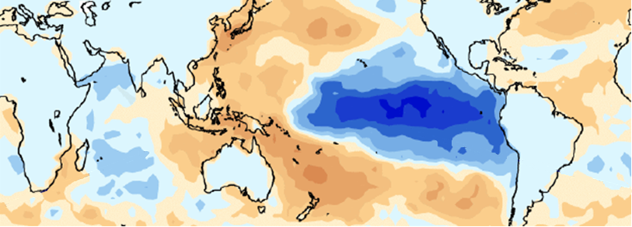
SAM Teleconnections
Weak Monsoon
Strong Monsoon
SAM
-ve IOD
El-Nino
ENSO
+ve IOD
Indian Ocean
La-Nina
IOD and ENSO plays an important role in modulating the SAM depending on the sign and amplitude of these two phenomena. Both influence SAM and interfere constructively or destructively (increase or decrease).

Slide 11
Simulation Tools
Model | CCSM3 | CCSM4 | CESM1
Atmosphere | CAM3 (L26) | CAM4 (L26) | CAM5 (L30)
Dynamics | Spectral | Finite Volume | Finite Volume
Ocean | POP2 (L40) | POP2.2(L60) | POP2.2 (L60)
Land | CLM3 | CLM4 | CLM4
Sea Ice | CSIM4 | CICE | CICE
Coupled
CCSM4
Atmosphere Only
CAM4 (L26)
CAM5 (L30)

Slide 12
Research Framework
CAM4/CCSM4
Acquired from National Center for Atmospheric Research (NCAR)
Model Validation
Control Runs
Sensitivity Runs
Ensemble Runs
Analysis, mean climatology, ENSO teleconnections, air-sea interactions etc.
Seasonal Forecast & Input data preparation
Control Forecast
Time Lag Forecast
CSV Runs
Forecast
Analysis of forecast basic skill, spread etc.
Sensitivity Runs
Ensemble Runs
CSV Forecast
Comparison Analysis

Slide 13
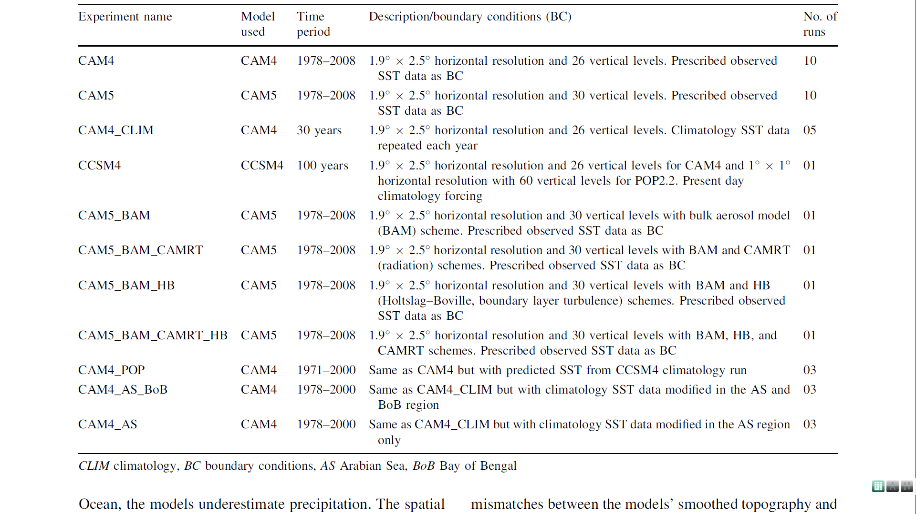
Validations Experiments

Slide 14
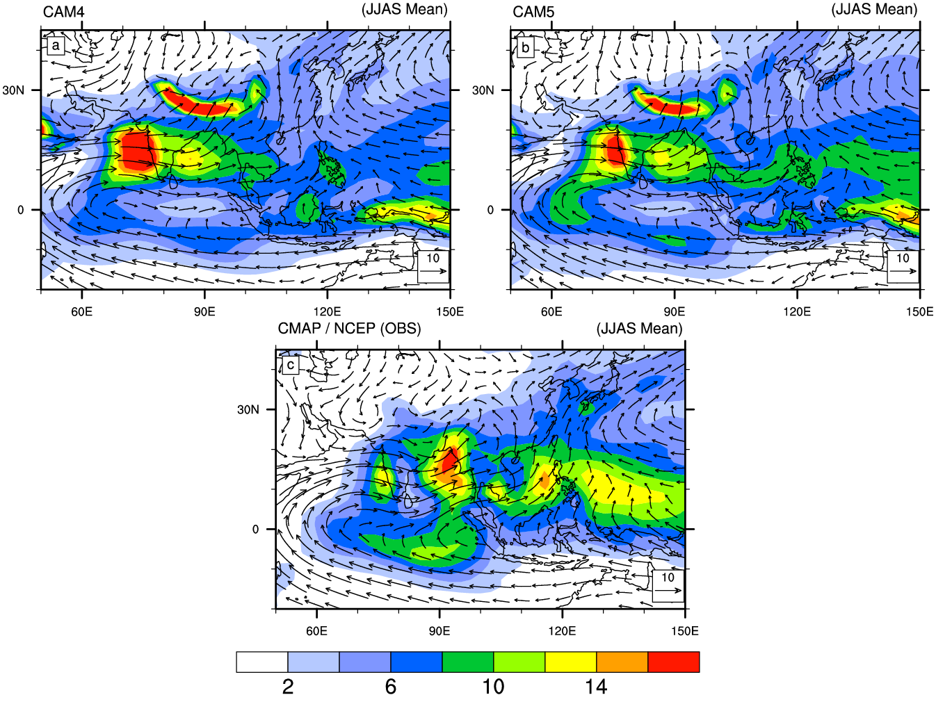
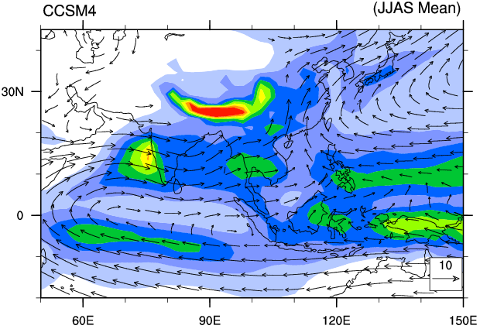
CAM4/5 and CCSM4 Validation
less overestimation

Slide 15
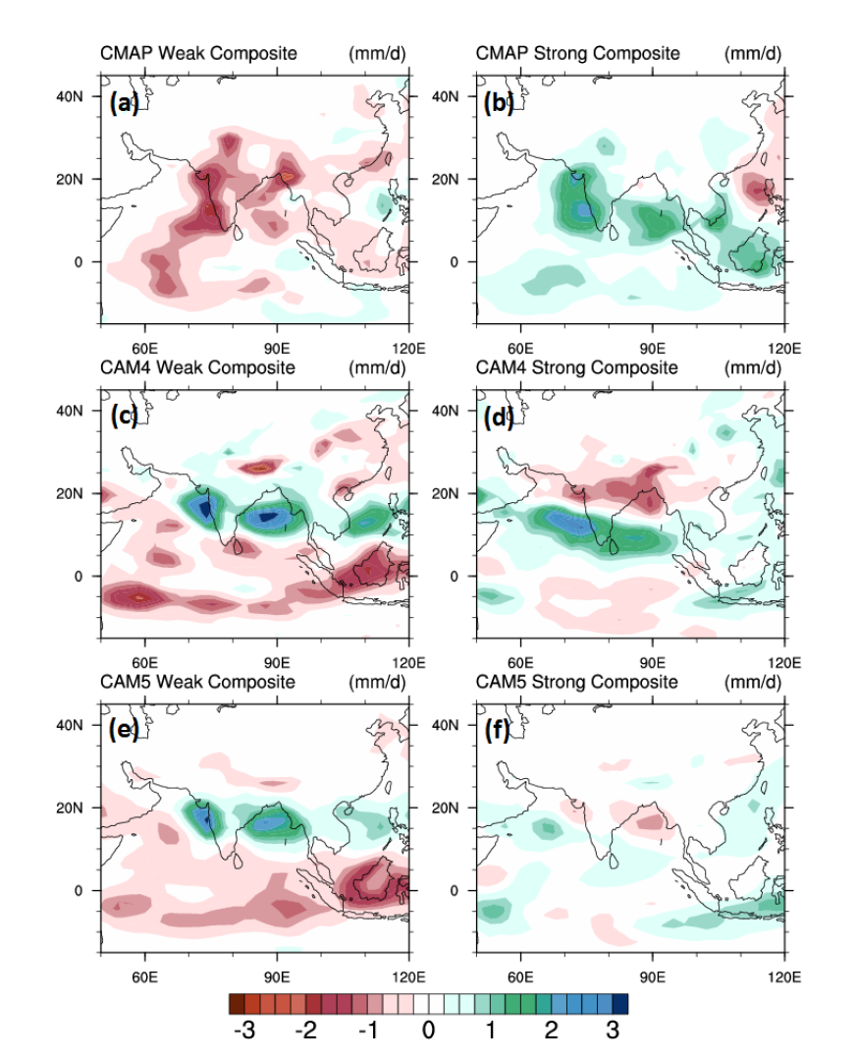
June–September (JJAS) anomaly precipitation composites of and monsoon years
weak (1982, 1984, 1986, 1987, 1989 and 2002)
strong (1980, 1981, 1983, 1988, 1994, 1996, 1998, 2007)

Slide 16
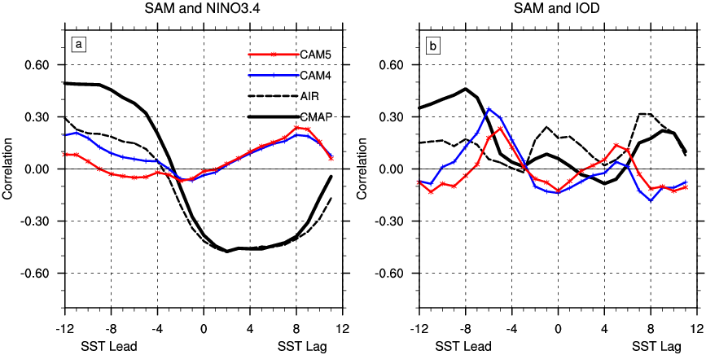
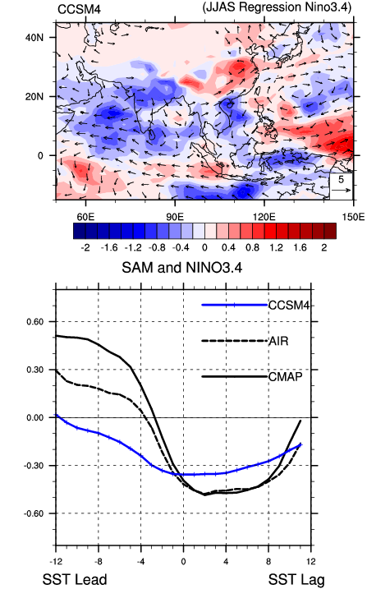
SAM-ENSO Relationship
Predictability
spring barrier
SST simulations in CCSM4 are consistent with atmospheric model in coupled mode.

Slide 17
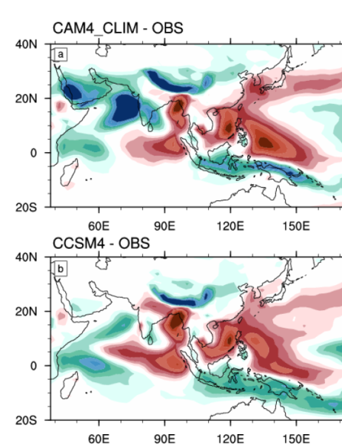
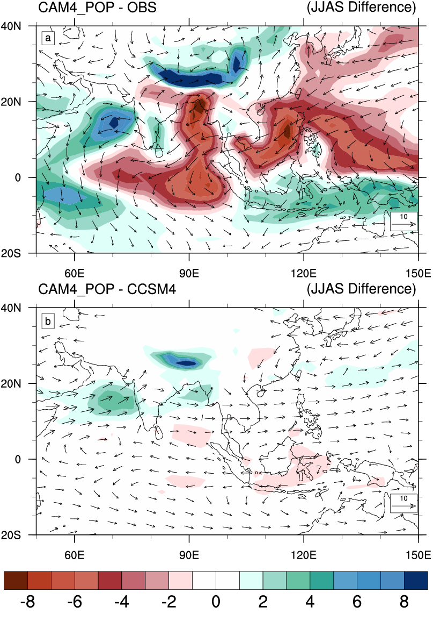
Sensitivity Simulations
Is consistent SST simulated by CCSM4 is responding to less precipitation or air-sea coupling?

Slide 18
Research Framework
CAM4/CCSM4
Acquired from National Center for Atmospheric Research (NCAR)
Model Validation
Control Runs
Sensitivity Runs
Ensemble Runs
Analysis, mean climatology, ENSO teleconnections, air-sea interactions etc.
Seasonal Forecast & Input data preparation
Control Forecast
Time Lag Forecast
CSV Runs
Forecast
Analysis of forecast basic skill, spread etc.
Sensitivity Runs
Ensemble Runs
CSV Forecast
Comparison Analysis

Slide 19
Experiments for CSV Implementation
Exp. Name | Description | Perturbation Domain | Time Span | Initial Conditions (IC) | No of EOFs used | Ensemble Members for each EOF
IO30 | 30 years perturb run using EOFs as perturbations | Indian Ocean | 1980-2009 | Control run IC created with prescribed SST | 3 | 10
IO10 | 10 years perturb run using EOFs as perturbations | Indian Ocean | 2000-2009 | Observed IC from NCAR’s DART system | 3 and 10 | 10 and 20
PO10 | 30 years perturb run using EOFs as perturbations | Pacific Ocean | 2000-2009 | Observed IC from NCAR’s DART system | 3 | 10
IO_CCSM4 | 4 years coupled run using EOFs as perturbations | Indian Ocean | 2000, 2004, 2008 and 2009 | Observed IC from NCAR’s DART system + 100 Year control run SST | 3 | 10
TLE | Time Lag Ensemble forecast | - | 2000-2009 | 6 hours lag observed IC from NCAR’s DART system | - | 6
CSVp | Ensemble forecast using +ve CSV as perturbations | Indian Ocean | 2000-2009 | Observed IC from NCAR’s DART system | - | 10
CSVn | Ensemble forecast using –ve CSV as perturbations | Indian Ocean | 2000-2009 | Observed IC from NCAR’s DART system | - | 10
30CSVp | Ensemble forecast using +ve CSV as perturbations | Indian Ocean | 1980-2009 | Control run IC created with prescribed SST | - | 10
Control Forecast | Ensemble forecast without CSV perturbation | - | 2000-2009 and 1980-2009 | Observed IC from NCAR’s DART system | - | 10
All experiments start from Jun 1st of every year with lead time of 4 months (June, July, August and September, JJAS). In CAM4 experiments, persistence SST is used as boundary conditions (BC) whereas in CCSM4, SST is used from the multiyear year control run of ocean model.

Slide 20
Time Lag Ensemble (TLE)
    We initialized SAM forecast at previous times as well as at the current time.
However, this method do not capture optimal perturbation, which represents the maximum portion of forecast errors with a limited ensemble size.
Initialization
Prediction
6 ensemble members
(6hr lag)

Slide 21
Models = CAM4
Climate System = Monsoon
Season = JJAS
Initial Perturbation Variable = SST
Target Variable = OLR
Time Period = 2000-2009 and 1980-2010
CSV Perturbation and Target Variables

Slide 22
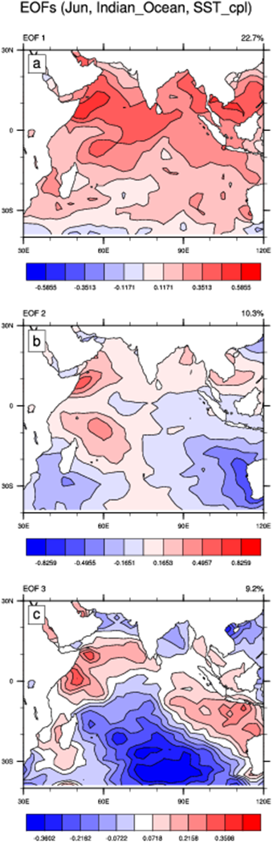
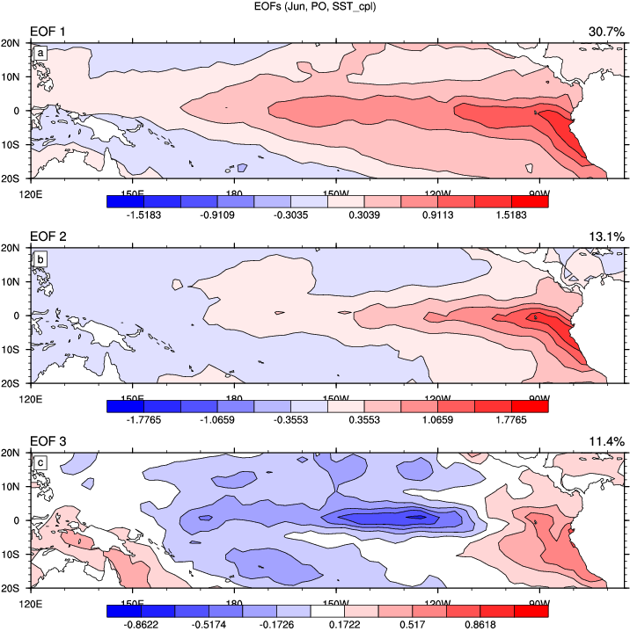
SST EOFs Patterns Used for Perturbation
Indian Ocean
Pacific Ocean

Slide 23
CSV Theory
Perturbed Ensemble Mean
Control
Ensemble Mean
EOF Patterns
SVD analysis of operator R yield SVs, Singular values and Final Patterns (FP)

Slide 24
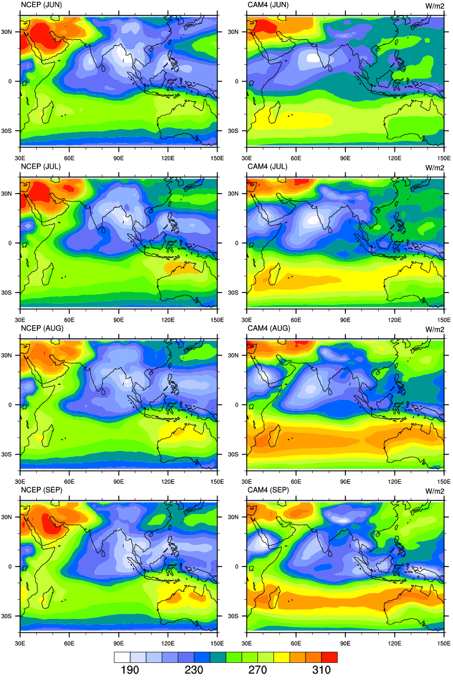
Why only OLR?
Mean climatology of June, July, August and September for Outgoing Longwave Radiation (OLR).
Much better climatology than precipitation

Slide 25
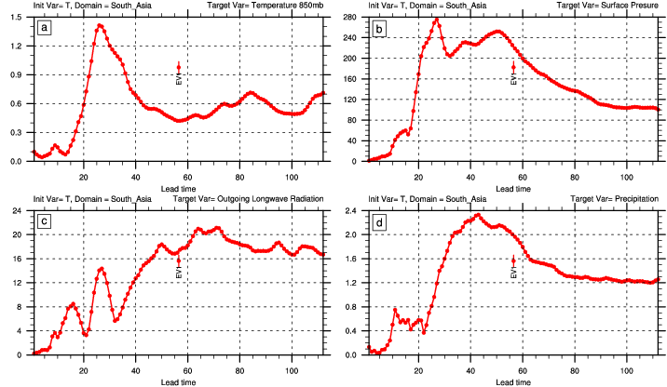
Why only OLR?
Singular values grows fro more than two months.

Slide 26
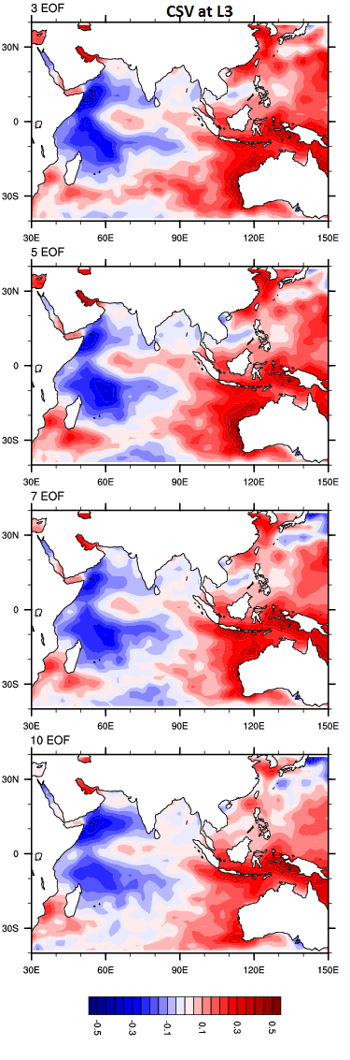
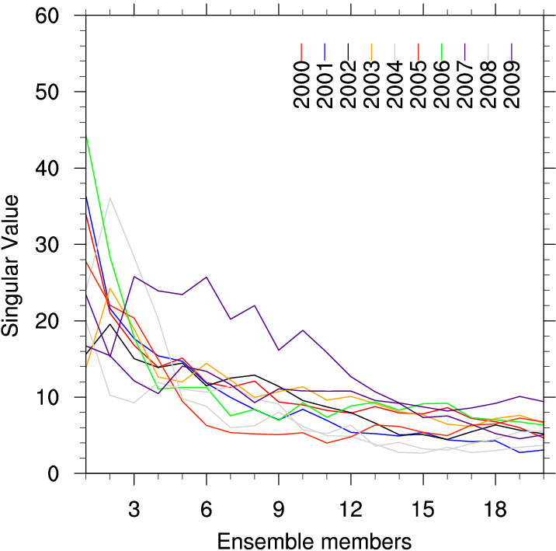
Number of EOFs Vs Ensemble Members
The convergence of the leading singular values with increasing number of ensemble members, optimized for 4 month time interval. Each color line represent individual year. In each year, 20 singular values are calculated by increasing the ensemble size from 1 to 20 in the CSV method.

Slide 27
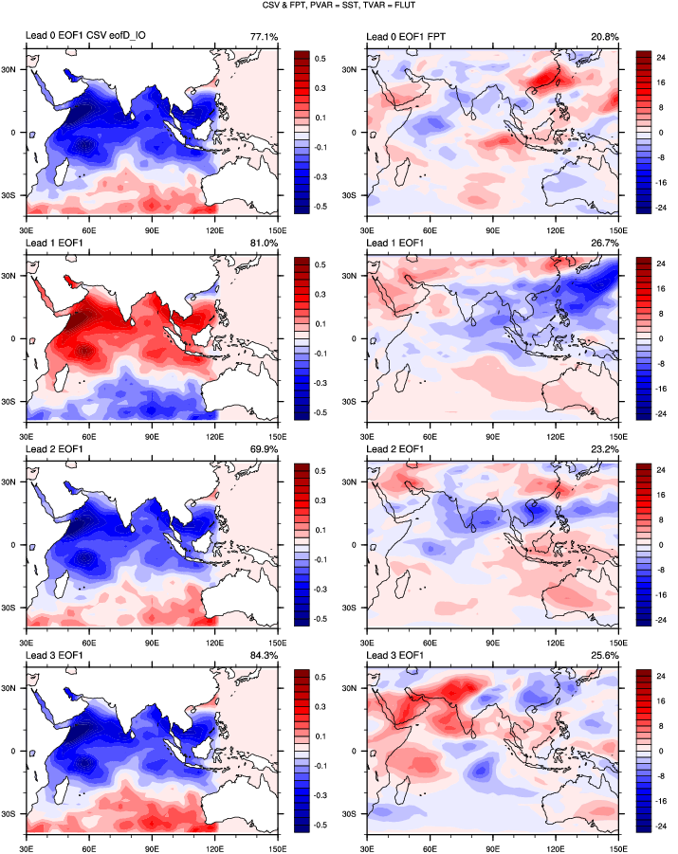
The first leading EOF patterns of the CSVs (left) and FPs (right) computed over 10 individual CSV patterns for all the four lead times. CSVs are extracted over Indian Ocean.

Slide 28
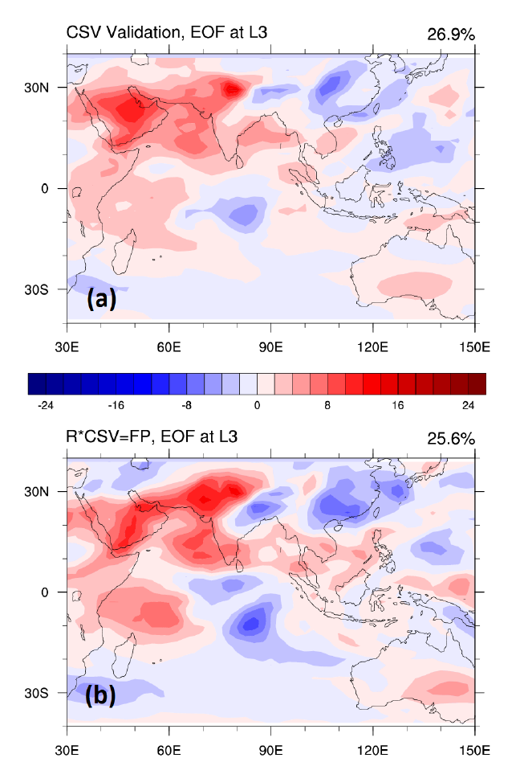
Leading EOF of OLR FPs, at lead time 3
calculated using CSV as perturbation
estimated by applying linear propagator R to CSV

Slide 29
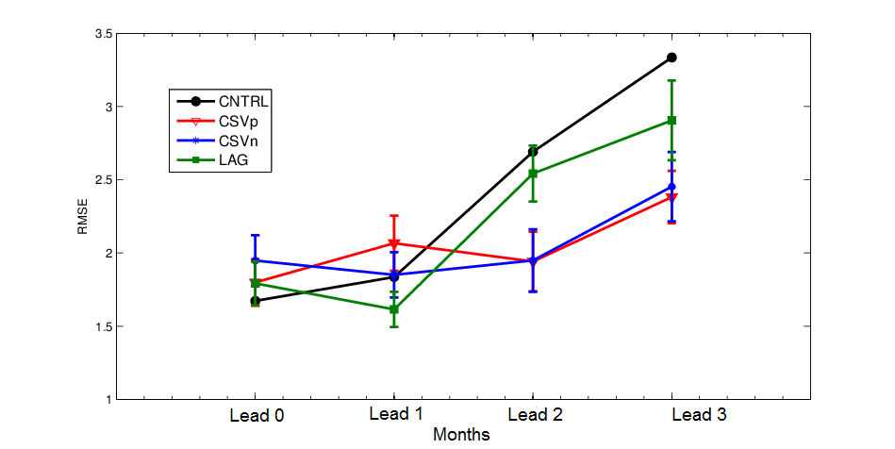
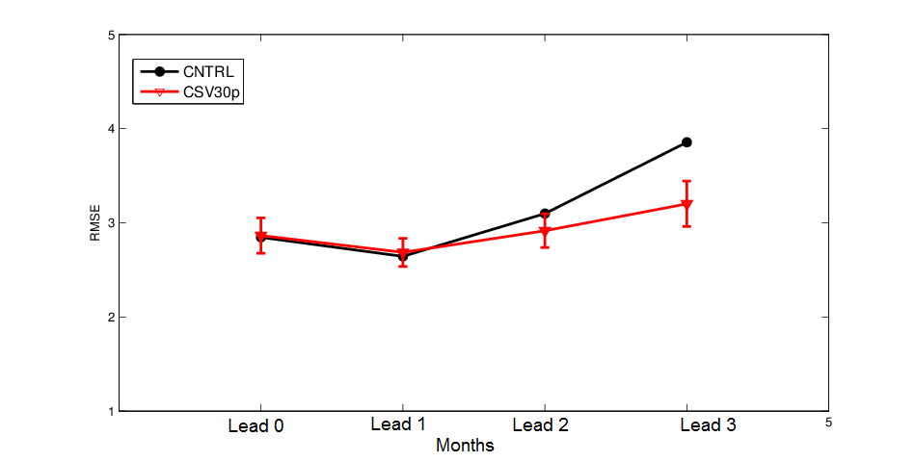
SAM Ensemble Forecast using CSVs as perturbation
RMSE calculated over 10 years (2000-2009 using observed initial conditions)
RMSE is for 30 years forecast (1980-2009 using CAM4 control initial conditions).

Slide 30
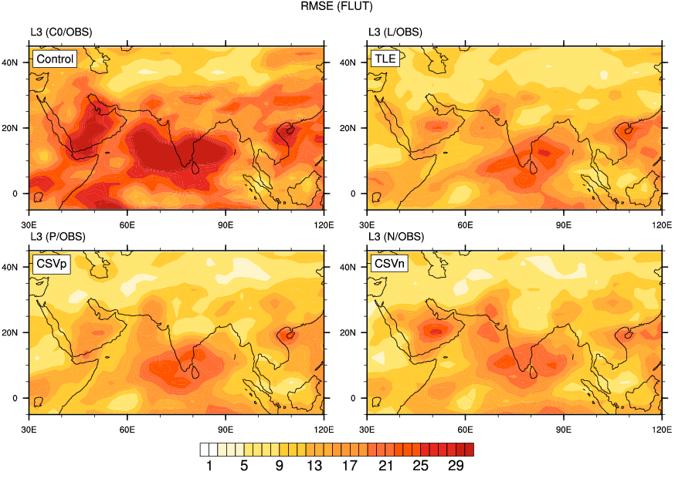

Slide 31
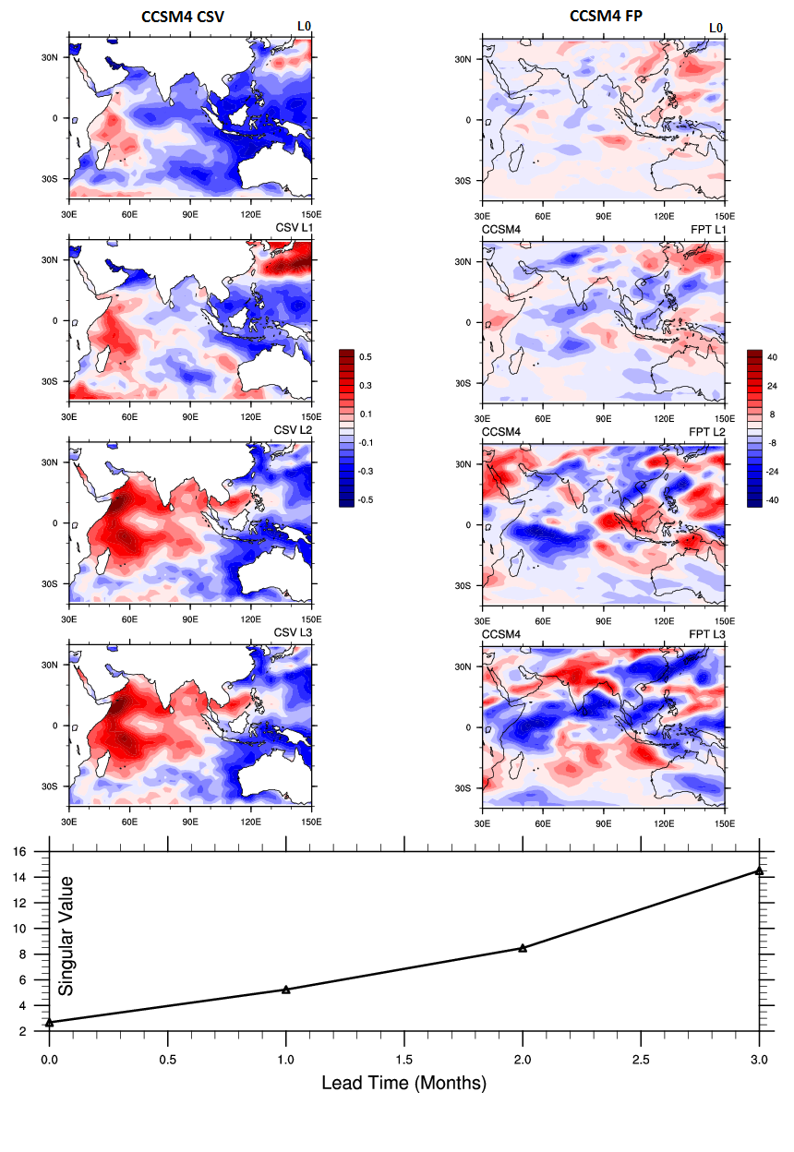
The leading SST CSVs and OLR FPs for lead time 0, 1, 2 and 3 obtained using CCSM4 model.
(Line) Lead time variation of CCSM4 singular values over Indian Ocean
Future Work Using CCSM4

Slide 32
Summary
The structure of monsoon are well reproduced in CCSM4 and CAM4 along with biases (mostly overestimation).
Forcing CAM4 with coupled model SST clarified the impact of the air-sea coupling in the interannual variability of the SAM precipitation.
CSV resembles a dipole-like structure over the Indian Oceans. When the CSVs are extracted over the Indian Ocean, their growth rates are found to be more consistent with the increase of lead time.
Ensemble forecast generated by CSV perturbations has a more reliable ensemble mean compared to both the TLE mean and the control forecast.
Methods such as CSV have potential for long term climate prediction. For example, Hawkins and Sutton (2011) applied this method to decadal predictions of the Atlantic Ocean.

Slide 33
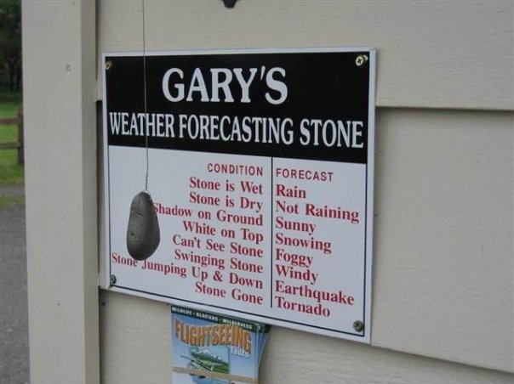
A simple forecast model

Slide 34
Extra

Slide 35
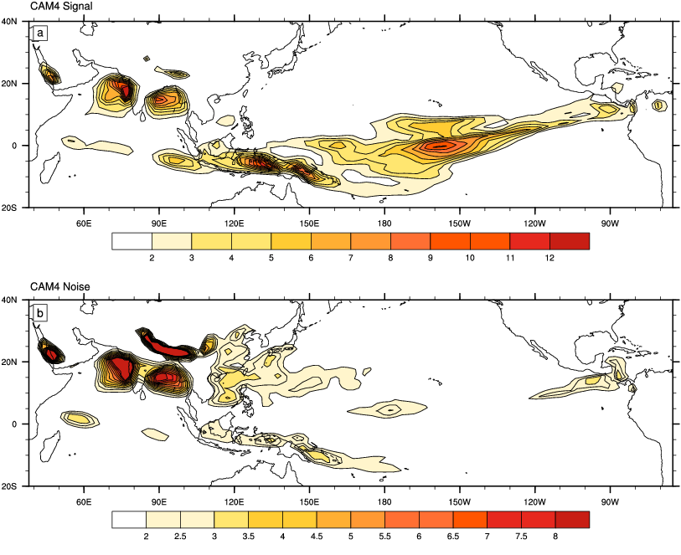

Slide 36
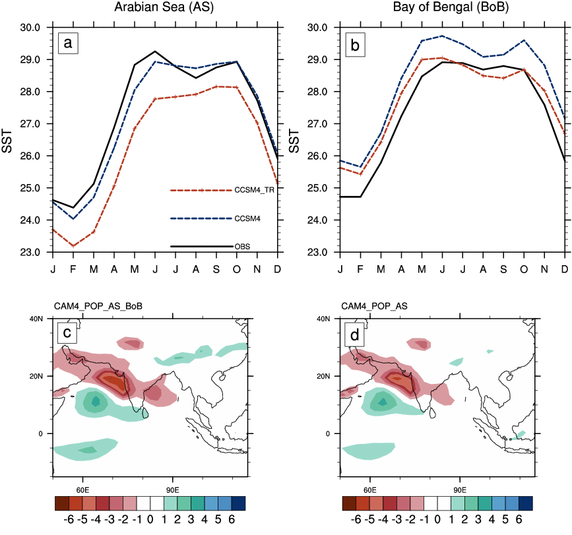
Influence of SST bias (Sensitivity Runs)

Slide 37
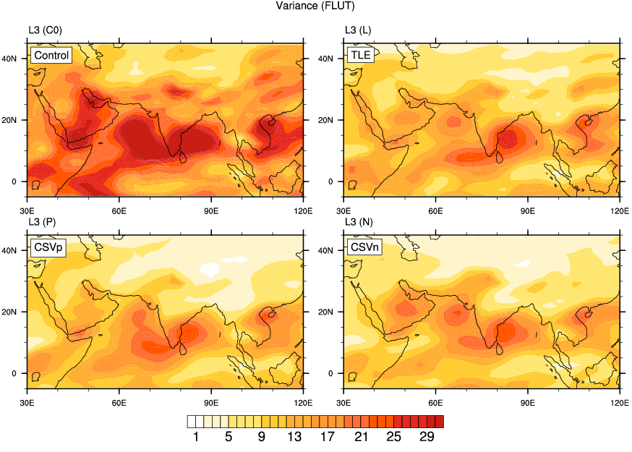

Slide 38
2004 | El Nino
2007 | La Nina
2008 | La Nina
2009 | El Nino
2003 and 2007 IOD

Slide 39
CAM Evolution
Model | CCSM3 ( 2004 ) | CCSM3.5 ( 2007 ) | CCSM4 ( Apr 2010 ) | CESM1 ( Jun 2010 )
Atmosphere | CAM3 (L26) | CAM3.5 (L26) | CAM4 (L26) | CAM5 (L30)
Boundary Layer Turbulence | Holtslag-Boville(93) Dry Turbulence | Holtslag-Boville | Holtslag-Boville | Bretherton Park(09) UW Moist Turbulence
Shallow Convection | Hack (94) | Hack | Hack | Park-Bretherton (09) UW Shallow Convection
Deep Convection | Zhang-McFarlane (95) | Zhang-McFarlane Neale et al.(08) Richter-Rasch(08) | Zhang-McFarlane Neale et al.(08) Richter-Rasch(08) | Zhang-McFarlane Neale et al.(08) Richter-Rasch(08)
Cloud Macrophysics | Zhang et al. (03) | Zhang et al. with Park & Vavrus’ mods. | Zhang et al. with Park & Vavrus’ mods. | Park-Bretherton Rasch (10) Revised Cloud Macrophysic
Stratiform Microphysics | Rasch-Kristjansson (98) Single Moment | Rasch-Kristian. Single Moment | Rasch-Kristian. Single Moment | Morrison and Gettelman (08) Double Moment
Radiation / Optics | CAMRT (01) | CAMRT | CAMRT | RRTMG Iaconoet al.(08) / Mitchell (08)
Aerosols | Bulk Aerosol Model (BAM) | BAM | BAM | Modal Aerosol Model (MAM) Liu& Ghan(2009)
Dynamics | Spectral | Finite Volume (96,04) | Finite Volume | Finite Volume
Ocean | POP2 (L40) | POP2.1 (L60) | POP2.2 -BGC | POP2.2
Land | CLM3 | CLM3.5 | CLM4 -CN | CLM4
Sea Ice | CSIM4 | CSIM4 | CICE | CICE
Slide taken from NCAR CCSM4 tutorials (modified)

Slide 40
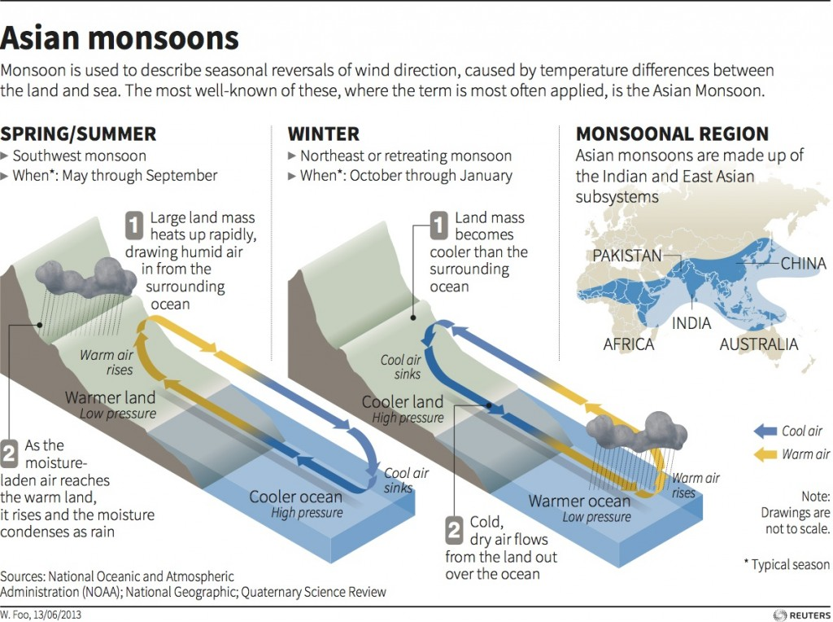

Slide 41
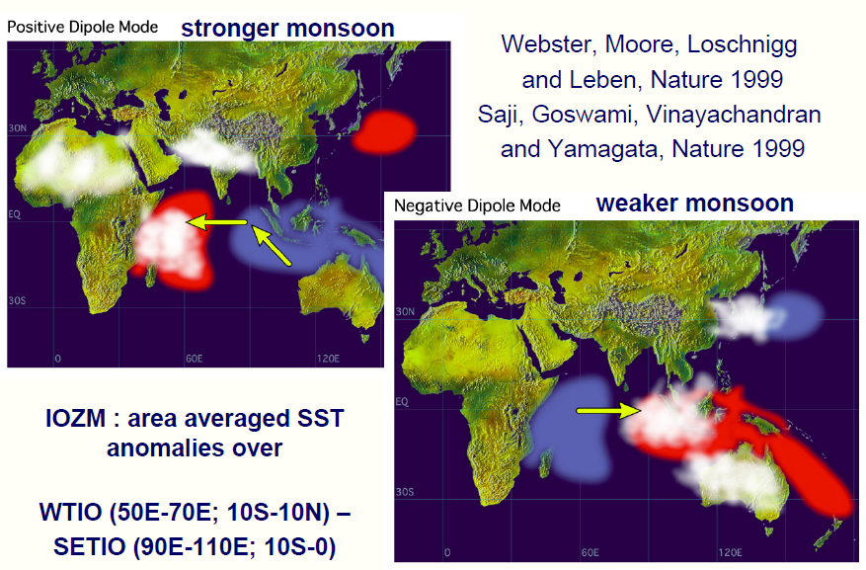
Indian Ocean Dipole (IOD)

Slide 42
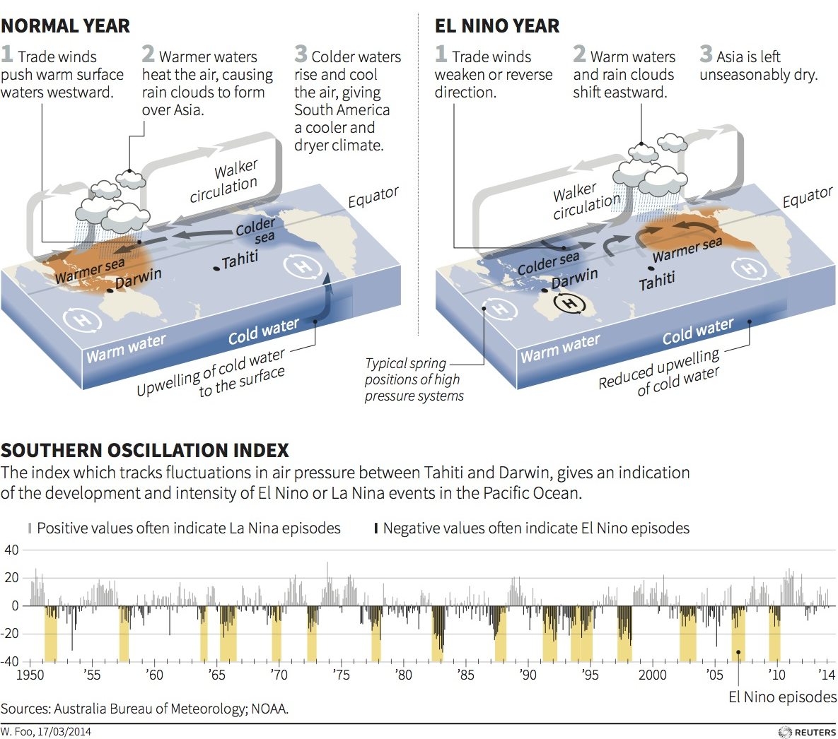
Notes:
How El Nino affects weather
El Niño is a warming of tropical Pacific waters that affects wind circulation patterns, recurring every three to eight years. Its effect on global climate varies from one event to the next.

Slide 43
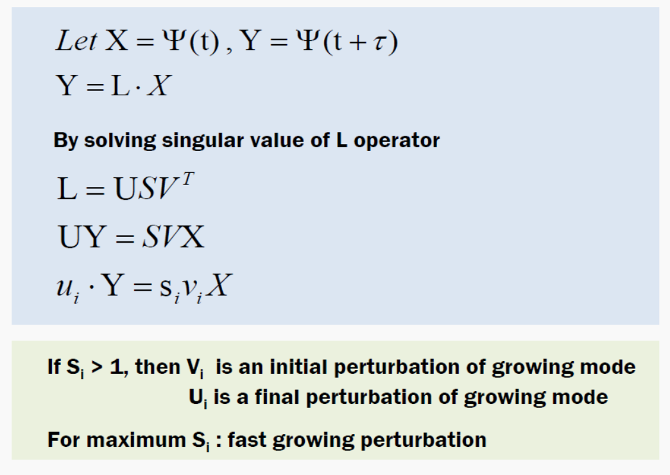
Singular Vector

Slide 45
2-tier Climate prediction system
1-tier Climate prediction system
Atmosphere
Atmosphere
Prescribe SST as boundary condition
SST Prediction
Ocean
SST prediction skill
Coupling of atmosphere and ocean process

