Slide 1



Nonlinear Local Lyapunov Exponent, Attractor Radius and Their Applications to Predictability Study and Ensemble Predictions
Jianping Li^{1,2}, Ruiqiang Ding^{3,4}, Jie Feng⁴, Deqiang Liu, Quanjia Zhong^{3,4}, Zhaolu Hou^{3,4}, Baosheng Li^{3,4}, Xuan Li^{3,4}
1. State Key Laboratory of Earth Surface Processes and Resource Ecology and College of Global Change & Earth System Science, Beijing Normal University
2. Laboratory for Regional Oceanography and Numerical Modeling, Qingdao National Laboratory for Marine Science and Technology, Qingdao
3. State Key Laboratory of Numerical Modeling for Atmospheric Sciences and Geophysical Fluid Dynamics, Institute of Atmospheric Physics, Chinese Academy of Sciences, Beijing
4. College of Earth Science, University of Chinese Academy of Sciences, Beijing
5. School of Meteorology, University of Oklahoma, Norman, OK, USA

Slide 2
Outline
1
Motivation
2
Theories
Nonlinear local Lyapunov exponent (NLLE)
Attractor radius & global attractor radius (GAR)
3
Applications
      Spatial distributions of predictability limits
      Attribution of predictability
      Applications to NWP

Slide 3
Key Questions
Quantifying predictability limit is a major task in the predictability study.
Quantitative approaches
Their applications
Notes:
可预报性研究的方法分为定性和定量两大类。定性的方法主要为信噪比方法；定量方法包括经验、动力学-经验、动力学方法，而后者是目前使用最广泛的，其又包括数值试验方法和动力系统理论方法，由于目前数值模式不完美，估计的可预报性依赖于模式。我们的工作主要基于动力系统理论方法。然而动力系统理论方法以前的研究主要基于线性误差增长理论

Slide 4
2.1 The limitations of linear error growth dynamics
N-dimensional dynamical
system
Error evolution equation
Linear approximation
equation
Linear propagator
The largest Lyapunov exponent (LLE)

Slide 5
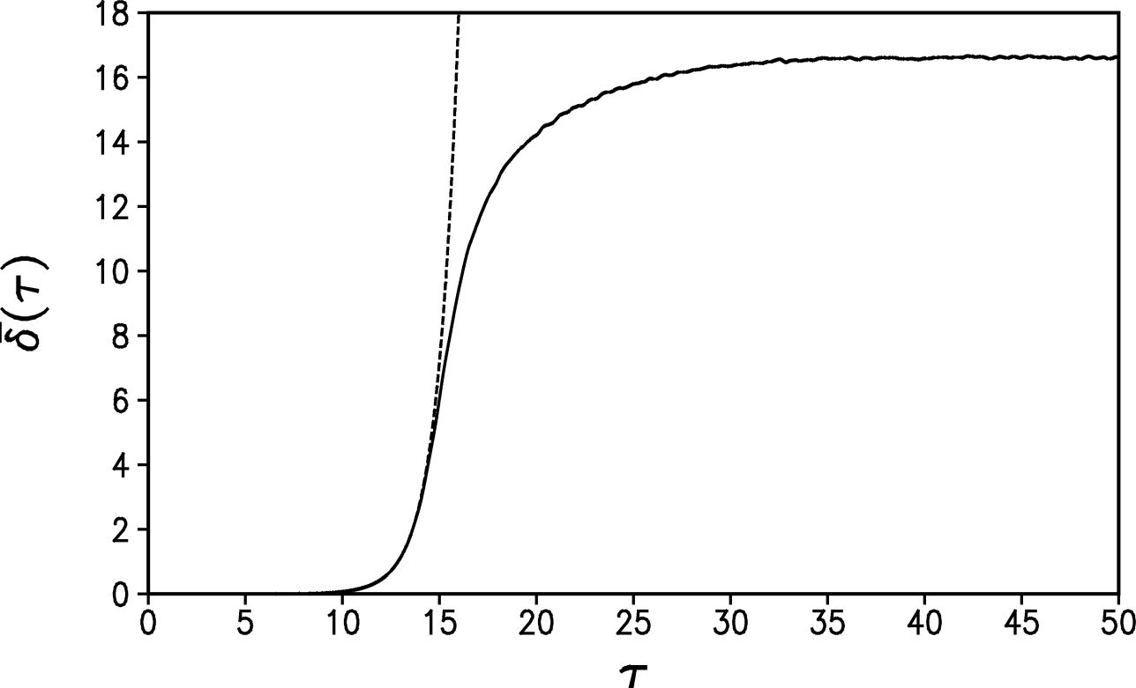
Lorenz system
Here
Mean error growth
Linear -----
Real ——

Slide 6
2.2 Nonlinear error growth dynamics & predictability
Nonlinear propagator
Nonlinear local Lyapunov exponent (NLLE)
Ensemble average
of NLLE
Relative growth of initial error (RGIE)

Slide 7
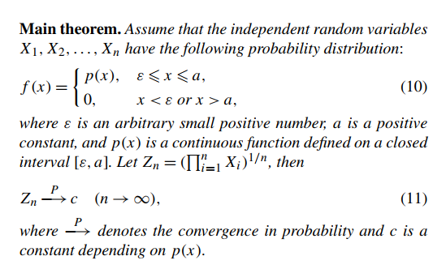
Probability convergence theorem
Saturation theorem of mean RGIE：
For a chaotic dynamical system, the mean RGIE will necessarily reach a saturation value in a finite time interval. The average predictability limit could be quantitatively determined as the time at which the mean RGIE reaches its saturation level.
∃ T_{p} , for t ≥ T_{p}，λ(t) t = C, where λ(t) is NLLE,
T_{p} is the predictability limit.
This theorem provides an approach to quantify the predictability limit of chaotic systems.
(Ding & Li, 2007, Phys. Letters A; Li & Ding, 2011, Mon. Wea. Rev.)
Notes:
几何平均数（Geometric mean）

Slide 8
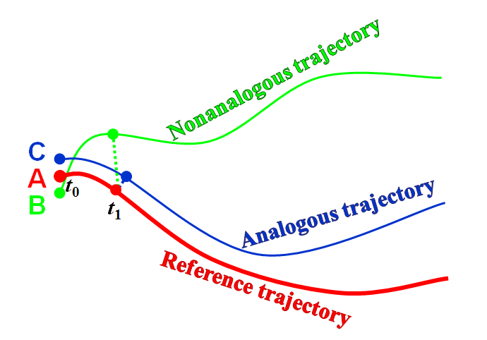
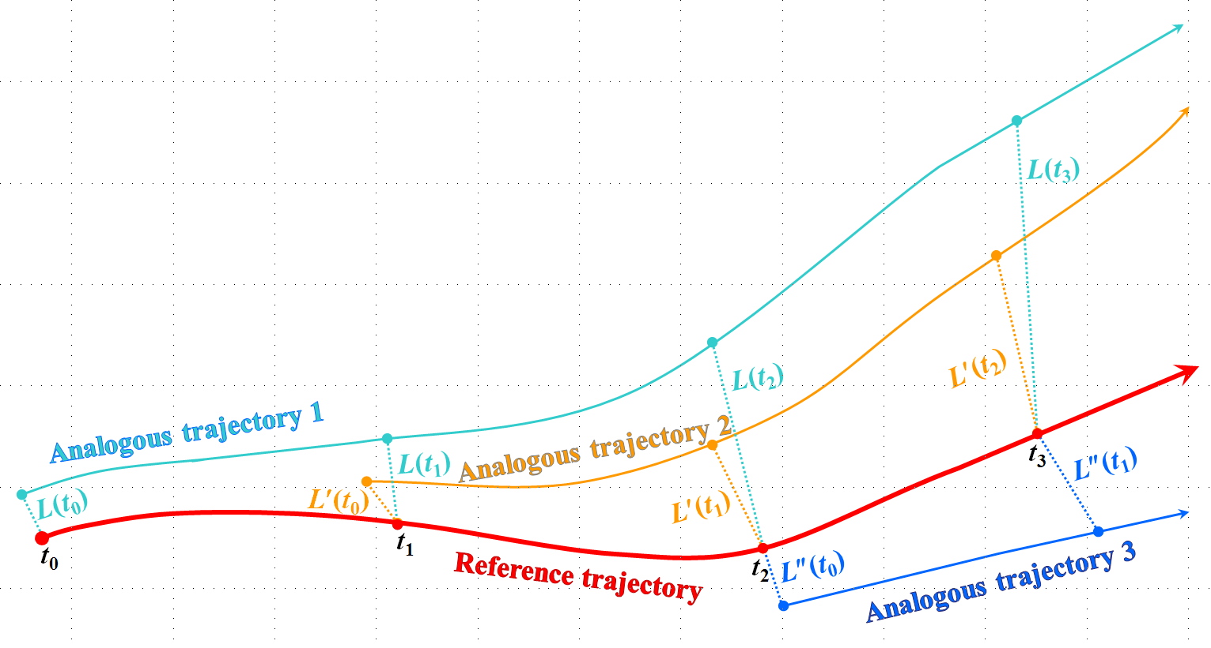
Estimating the NLLE using observation data
Local dynamical analog (LDA)
Step 1. initial distance between two points and the evolutionary distance between their trajectories within a short initial period
Initial Distance
Evolutionary Distance
Step 2.
Step 3.
Step 4.
Step 5.
A schematic representation of the algorithm to search for local dynamical analogs (LDA)
Notes:
A reasonable algorithm is provided to obtain the estimation of the NLLE by using the atmospheric observation or reanalysis data.
The general idea of the algorithm is to find local dynamical analogues from the observational time series. This local analogue is based on the initial information and evolution information at two different time points of time series. The NLLE is estimated by calculating the mean exponential divergence rate of initially analogous points [Li and Ding, 2011].
两种相似：初始相似和演化相似

Slide 9
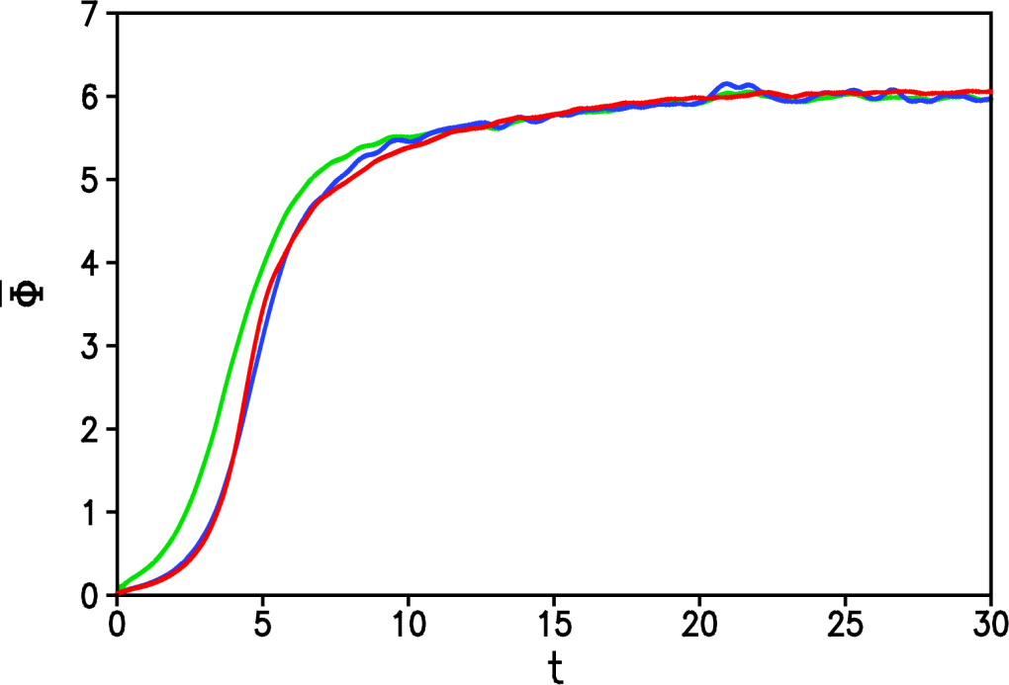
IS
LDA
Error
Real
(Li & Ding, 2011, Mon. Wea. Rev. )

Slide 10
3. Attractor radius & global attractor radius
Let A be a compact attractor of the semigroup S, and x be a state column vector on A . A is a closed, bounded and invariant set, i.e., S(t)A =A .
Probability theory can be used to study the statistical characteristics of the state of attractor A . Let A be the sample space, F be a set of subsets of A and a σ-field, the probability measure P: F→[0, 1]. Then, the triplet (A, F, P) is a probability space.
According to the ergodic theory of attractors (Eckmann and Ruelle, 1985), there are invariant (ergodic) measures and Eckmann and Ruelle (1985) and Farmer et al. (1983) introduced some invariant probability measures such as entropy, dimensions and characteristic exponents (also called Lyapunov exponents) to study the properties of dynamical systems. To quantitatively estimate predictability limit of strange attractors, some other invariant probability measures of attractors are introduced.
(Li, Feng & Ding, 2017)

Slide 11
Concept | Definition
Local attractor radius (LAR) | The expectation of the root-mean-square distance (RMSD) between one specific state and all other states on an attractor.
Attractor radius | The expectation of the RMSD between all states on an attractor and the center of the attractor.
Global attractor radius (GAR) | The expectation of the RMSD between any two randomly chosen points on an attractor.
Local average distance (LAD) | The expectation of the RMSD between one specific state on an attractor A and all states on another attractor B.
Global average distance (GAD) | The expectation of the LAD between the two attractors A and B.
(Li, Feng & Ding, 2017)

Slide 12
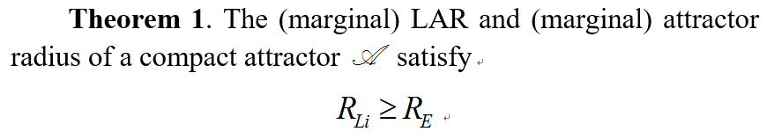
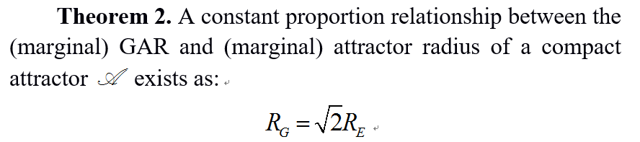
The minimum value of the LAR of an attractor is the attractor radius.
This conclusion is consistent with the error covariance analysis of numerical predictions from Leith (1974) and Kalnay (2003). In addition, Theorem 2 provides a simple, practical approach to calculate the GAR by calculating the attractor radius, which can greatly reduce the computational burden.
(Li, Feng & Ding, 2017)
Notes:
the square root of 2

Slide 13
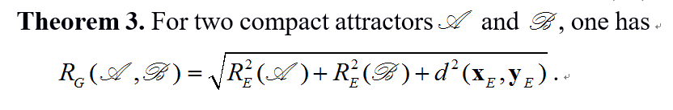
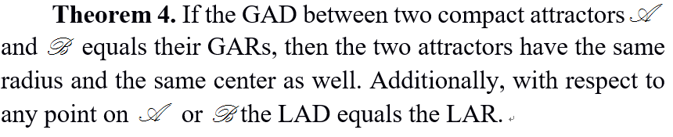
Theorem 3 provides an effective method to calculate the GAD between two attractors, which can save considerable computational time.
Corollary 1. The attractor radius and GAR of a compact attractor and the GAD between two compact attractors are invariant quantities.
(Li, Feng & Ding, 2017)

Slide 14
Schematic illustration of the typical mean error growth (measured as the global ensemble average RMSE) of a nonlinear chaotic system as a function of time, and the relationships of the practical predictability limit (T_{pr}) and potential predictability limit (T_{po}) to the attractor radius (lower dashed line) and GAR (upper dashed line).
GAR R_{G}
AR R_{e}
Mean Error Growth
T_{pr}
T_{po}
0
Time
GAD^{M,O}
Error growth in model
GAR
AR
Mean Error Growth
0
T_{pr}
T_{po}
T_{pr}
T_{po}
T_{po}
Time
(Li, Feng & Ding, 2017)
Notes:
Schematic illustration of the typical mean error growth (measured as the global ensemble average RMSE) of a nonlinear chaotic system as a function of time, and the relationships of the practical predictability limit (T_{pr}) and potential predictability limit (T_{po}) to the attractor radius ( ; lower dashed line) and GAR ( ; upper dashed line).

Slide 15
Lorenz63 model
imperfect Lorenz63 model
GAR
GAD^{M,O}
GAR
Evolution of global ensemble mean RMSE of the vector (x, y, z) in the Lorenz 63 model and imperfect Lorenz 63 model with respect to lead time (unit: tu) and the magnitude of initial error. The magnitudes of initial perturbation are 10⁻², 10⁻³, 10⁻⁴, 10⁻⁵, 10⁻⁶, and 10⁻⁷, from left to right. The straight line represents the corresponding GAR of each variable.
(Li, Feng & Ding, 2017)

Slide 16
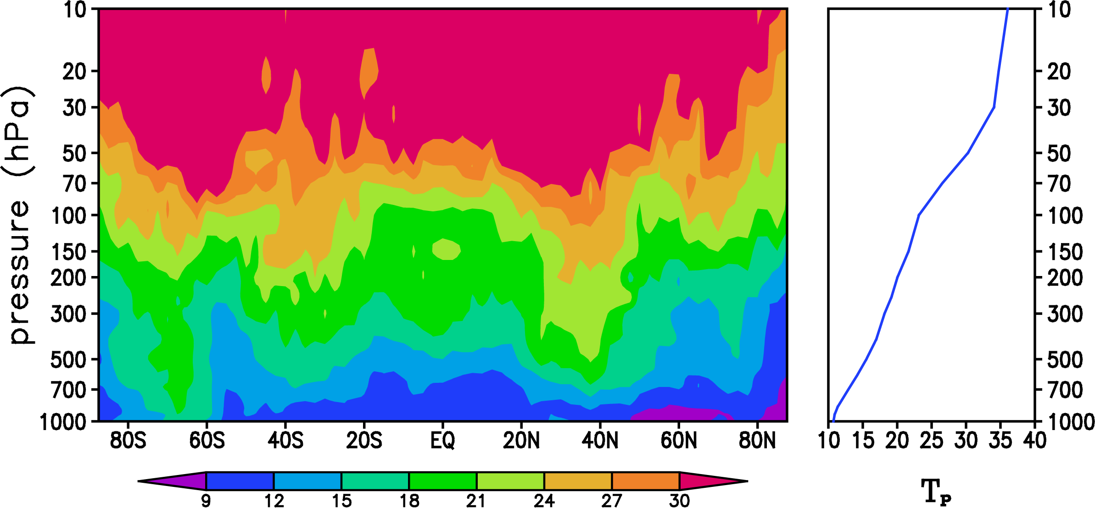
A1：Spatial distributions
Weather
10⁰ –10¹ d
MJO
10¹ d
Short term climate
10² d
Decadal
10³–10⁴ d
…….
500 hPa
Observation
Model CFSv2
Vertical Structure
Spatial distribution of weather predictability limit
Li, Ding, 2014, Encyclopedia of Atmospheric Science;
Li, Ding, 2011, Mon. Wea. Rev.;
丁瑞强, 李建平, 2009, 气象学报;
Ding, Li, Ha, 2008, JGR.

Slide 17
Mean RMSE from Jan 1999 to Dec 2010 of GHT at 500 hPa from CFSv2 operational forecast data averaged (a) globally (90S–90N), and over (b) the extratropical Northern Hemisphere (NH, 20N–90N), (c) the extratropical Southern Hemisphere (SH, 90S–20S), and (d) the tropics (TRO, 20S–20N). Black, red, and blue dashed lines are the error AV, the attractor radius (AR), and the GAR of the time series with 00Z initial conditions, respectively. The numbers (in days) in the legends correspond to the time at which the mean RMSE reaches the AR, GAR, and AV.
(Li, Feng & Ding, 2017)

Slide 18
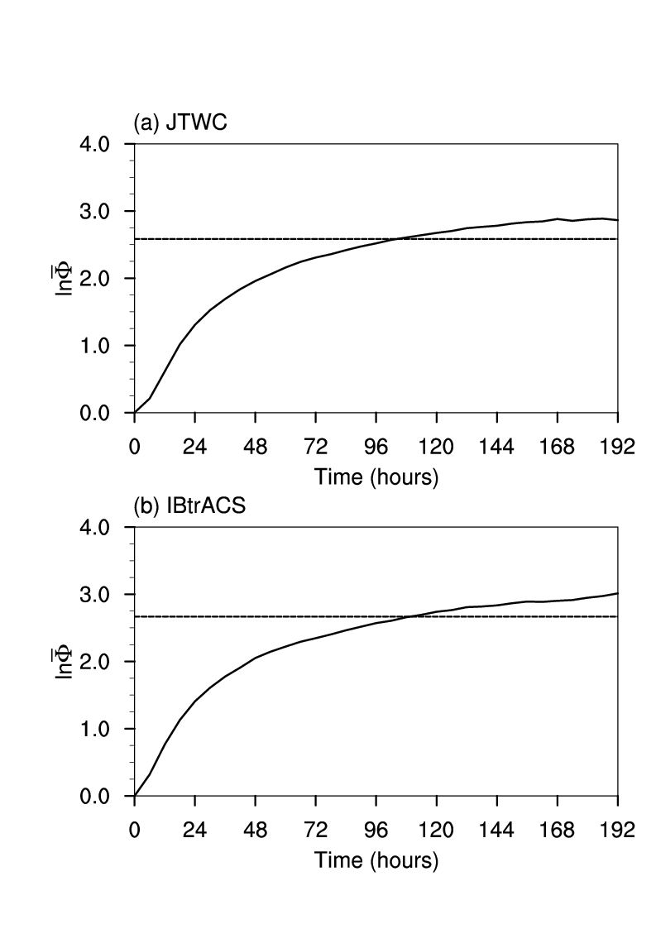
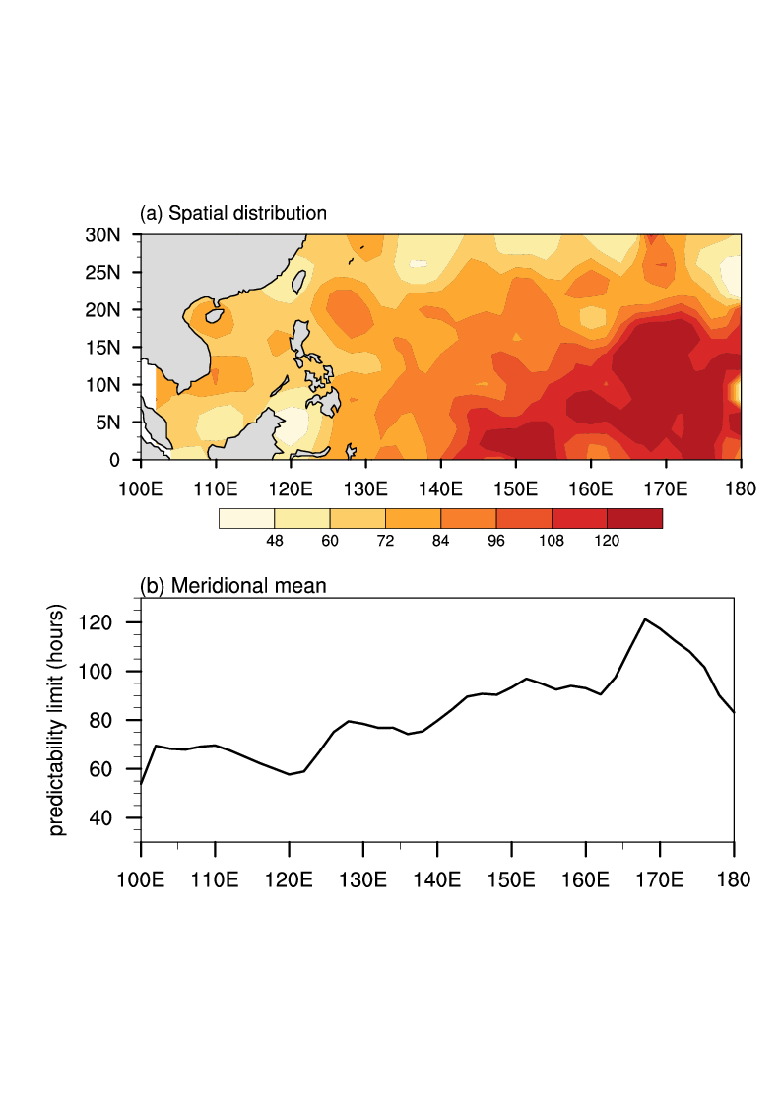
Weather
10⁰ –10¹ d
MJO
10¹ d
Short term climate
10² d
Decadal
10³–10⁴ d
…….
Spatial distribution of the predictability limits of TC tracks
72 to 120 h (3–5 days)
~102 hours (~4.25 d)
~108 hours
(4.5 d)
Track
Joint Typhoon Warning Center (JTWC); International Best Track Archive for Climate Stewardship (IBTrACS)
Notes:
The PLs of all TC tracks over the WNP basin is about 102 hours (4.25 days) or 108 hours (4.5 days) .
The PLs of single TC range from 72 to 120 h (3–5 days) over the WNP basin.
The PLs show a gradual increase from 100°E to 180°, and this is highlighted by the meridional mean.
Joint Typhoon Warning Center (JTWC) 美国联合台风预警中心，空间分布是JTWC资料的结果
International Best Track Archive for Climate Stewardship (IBTrACS) IBTrACS是一个数据集合，由NOAA整理的

Slide 19
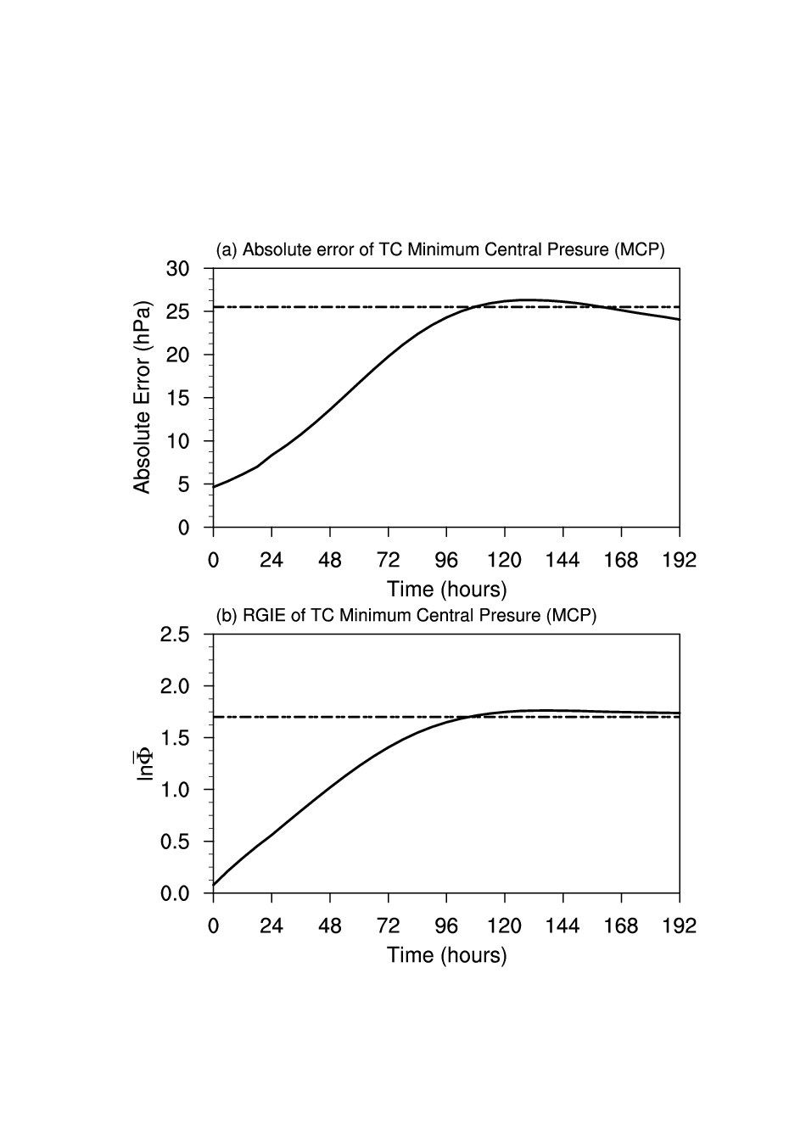
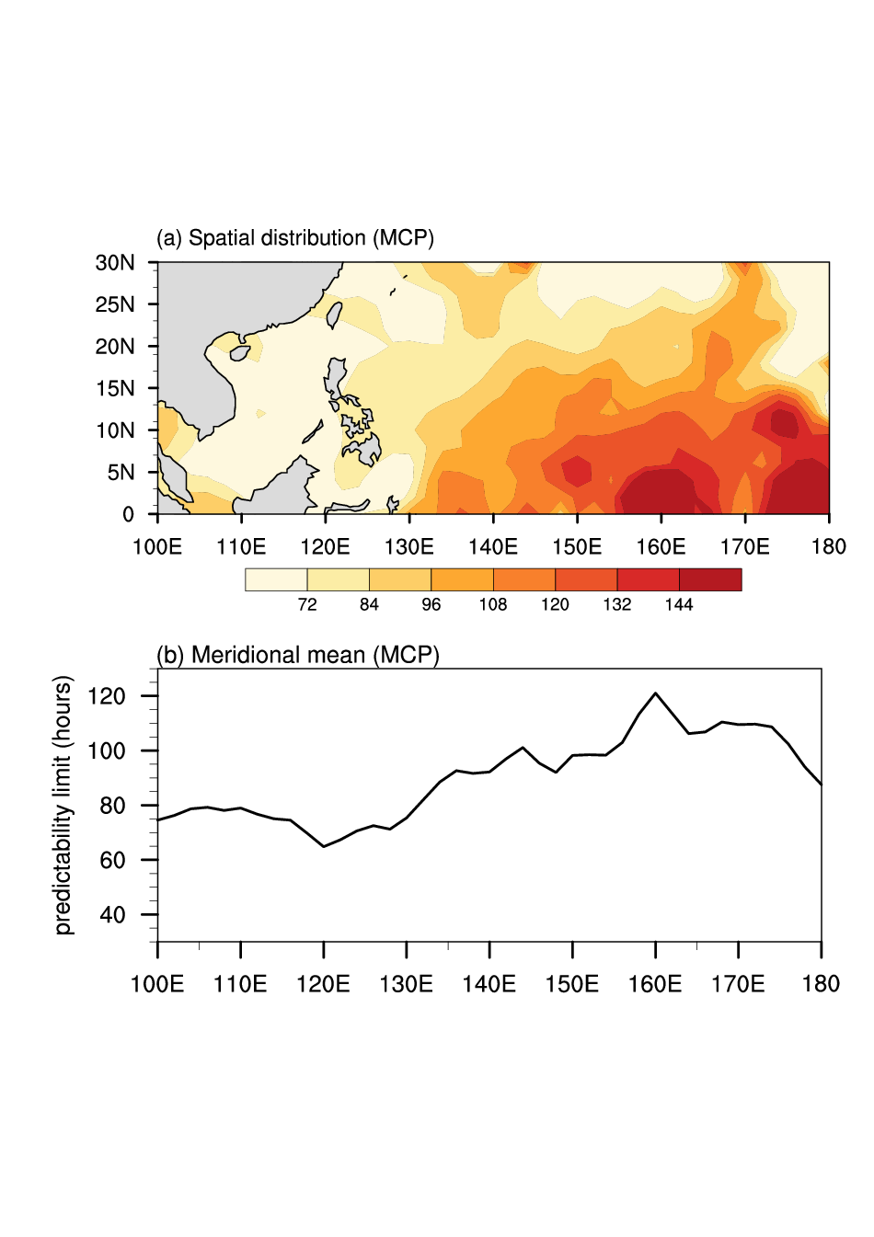
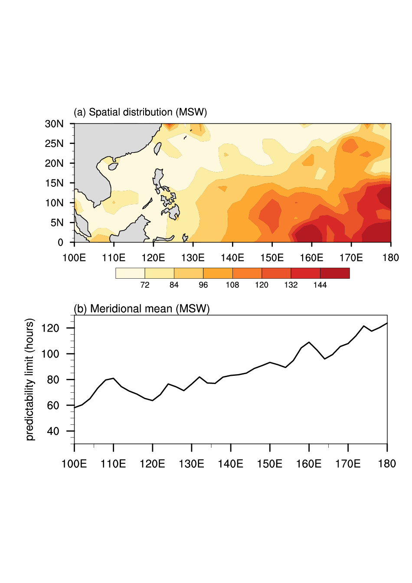
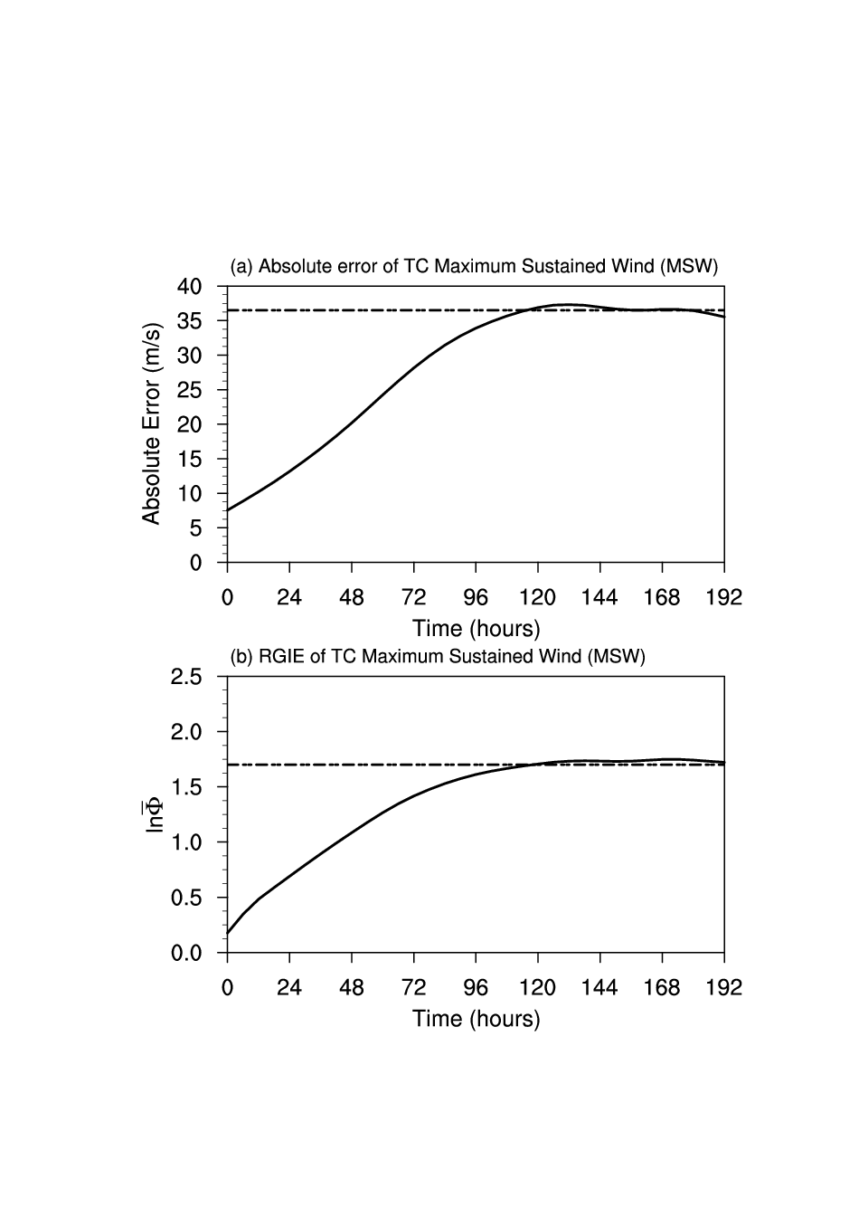
Weather
10⁰ –10¹ d
MJO
10¹ d
Short term climate
10² d
Decadal
10³–10⁴ d
…….
Spatial distribution of the predictability limits of TC intensities
Pattern correlation (MCP and MSW) : 0.75
MCP : ~108 h
(4.5 d)
MSW: ~120 h
(5 d)
PLs: Track
MCP
MSW

Slide 20
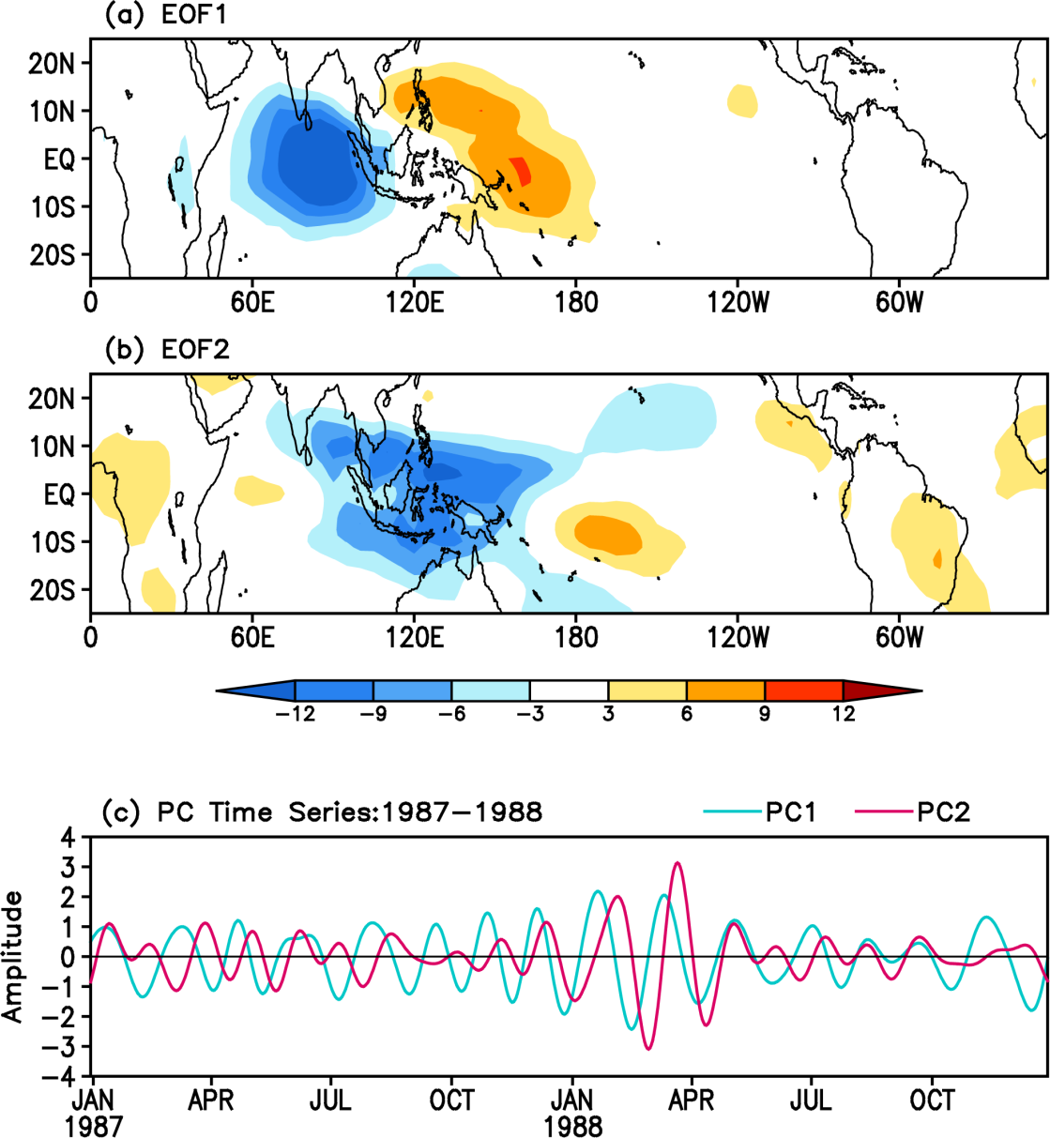
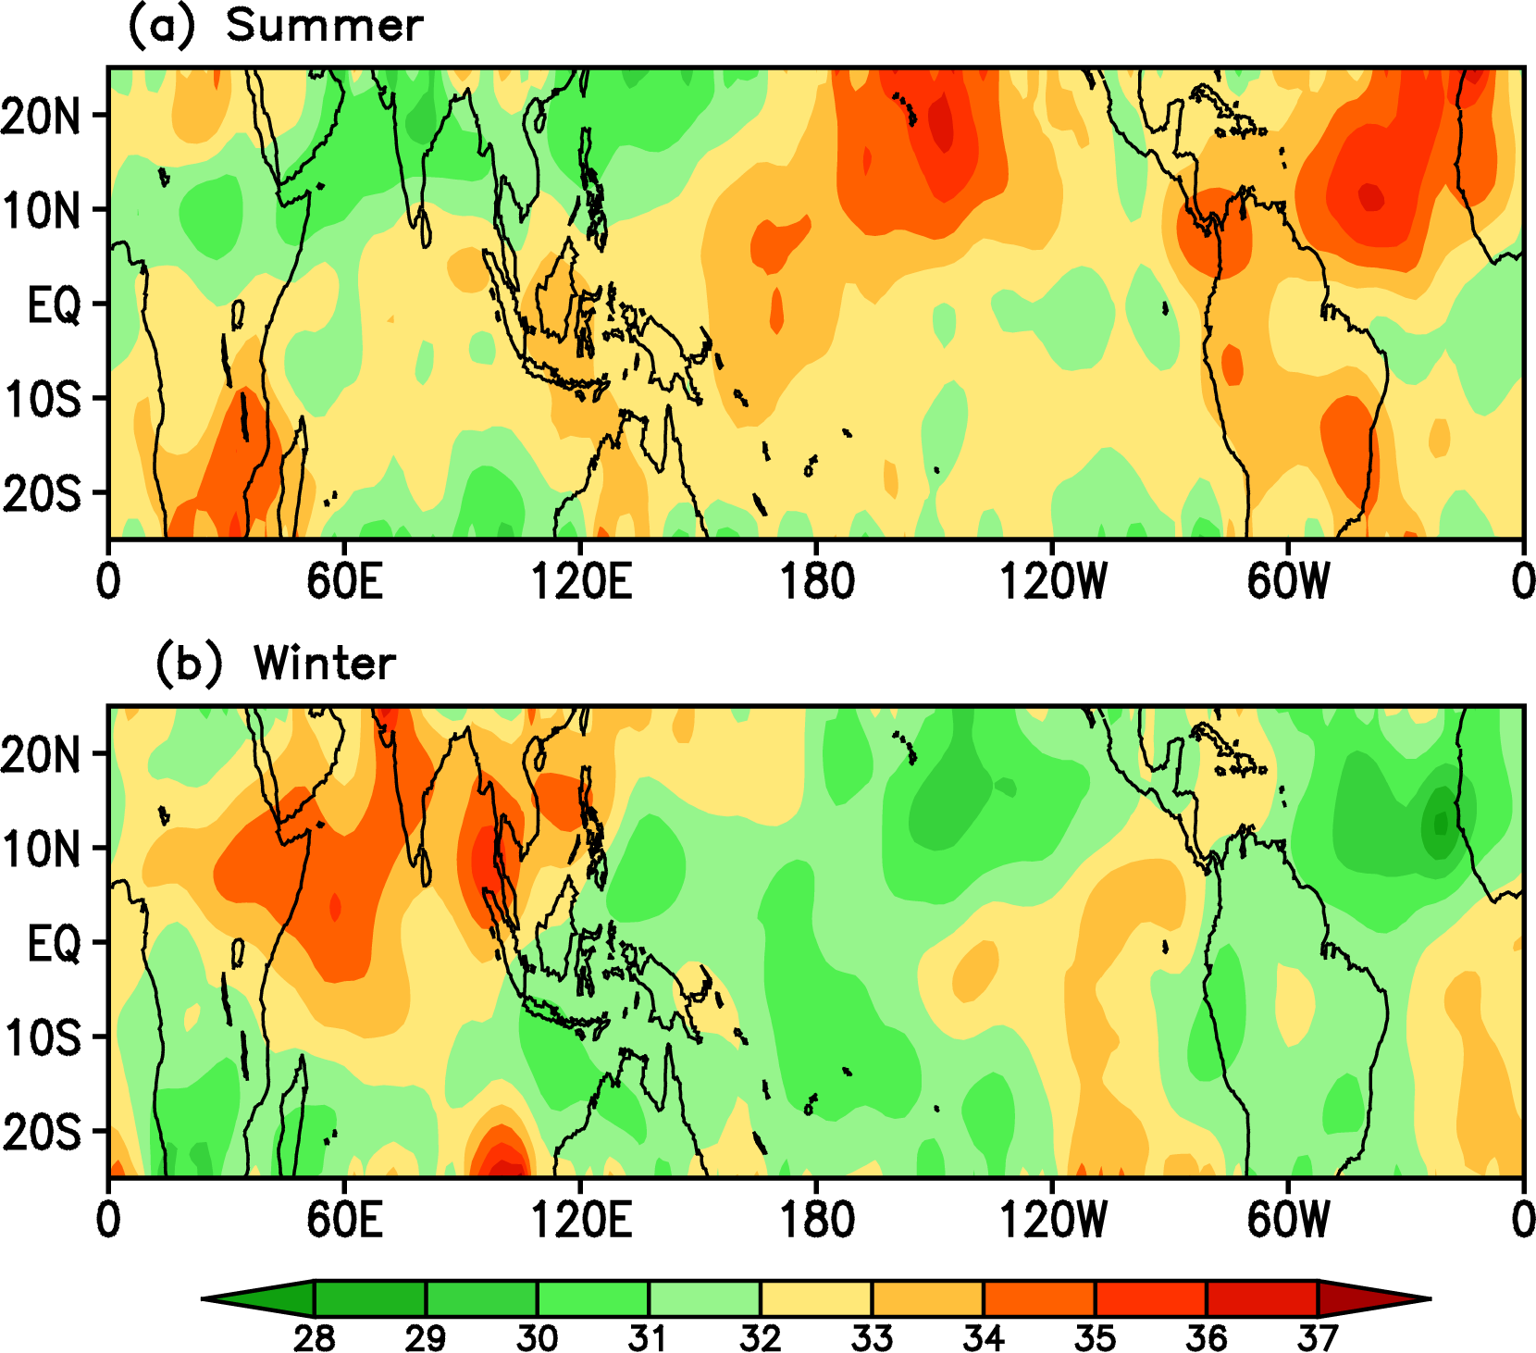
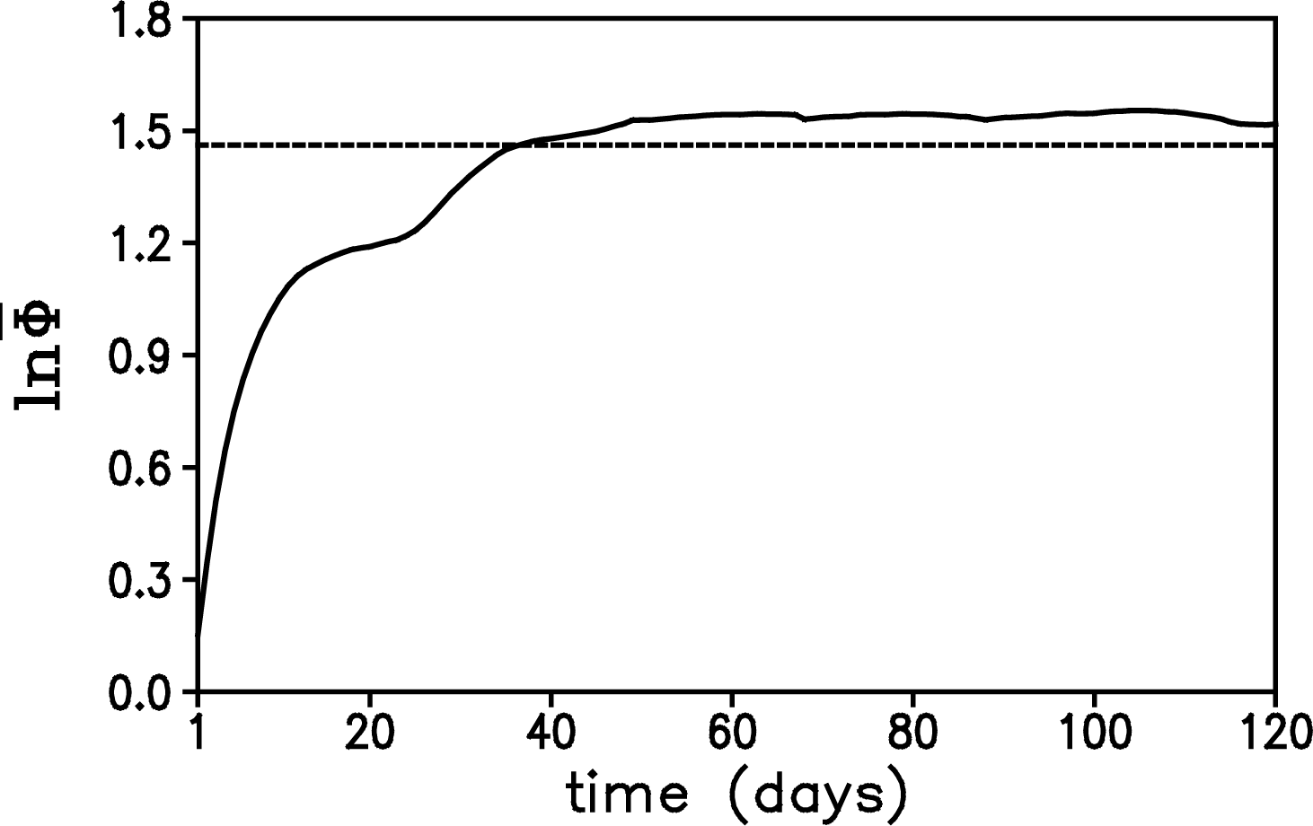
Weather
10⁰ –10¹ d
MJO
10¹ d
Short term climate
10² d
Decadal
10³–10⁴ d
…….
EOFs of tropical 30-80 day filtering OLR data
36 d
Spatial distribution of MJO predictability limit (Days)
Ding, Li, Seo, 2010, Mon. Wea. Rev.;
Ding, Li, Seo, 2011, Mon. Wea. Rev.;

Slide 21
Weather
10⁰ –10¹ d
MJO
10¹ d
Short term climate
10² d
Decadal
10³–10⁴ d
…….
Practical and potential predictability limits of short term climate
⬅ 500 hPa GHT (monthly)
⬅ 500 hPa GHT (seasonal)
⬅ SST (monthly)
Li, Ding, 2014, Encyclopedia of Atmospheric Science;
Li, Ding, 2013, JOC;
Li, Ding, 2011, Mon. Wea. Rev.;

Slide 22
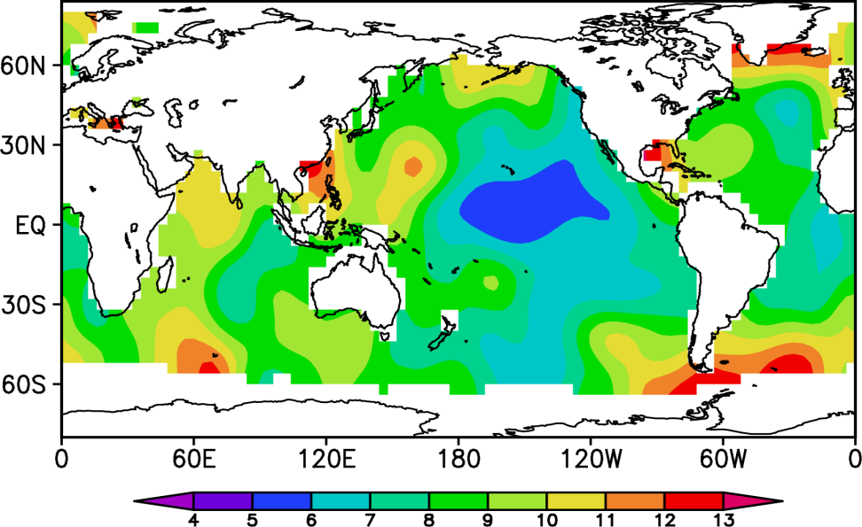
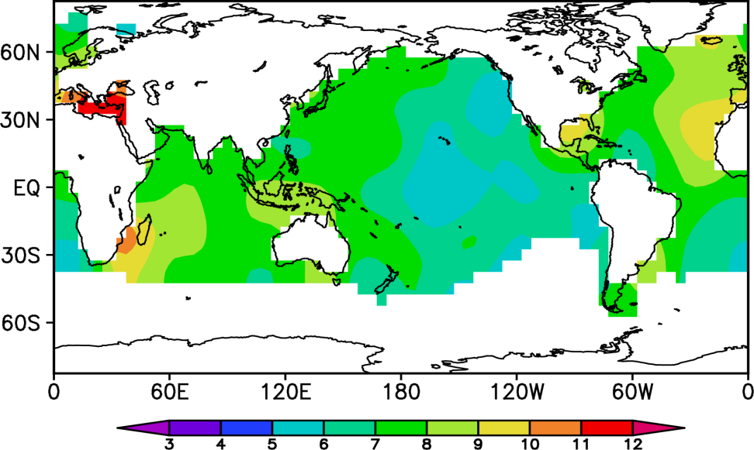
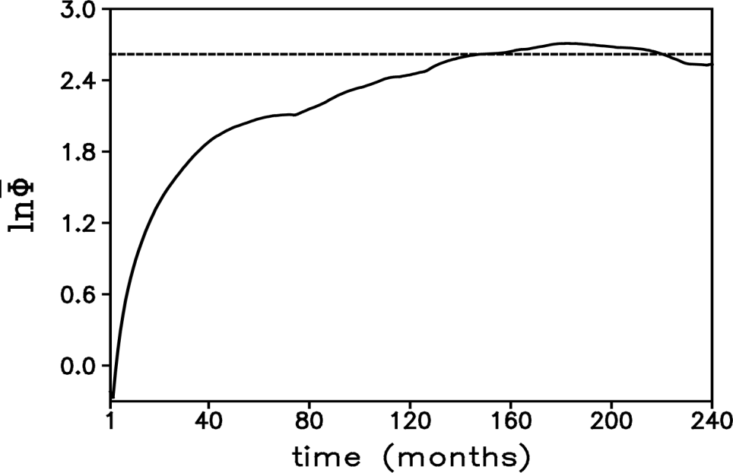
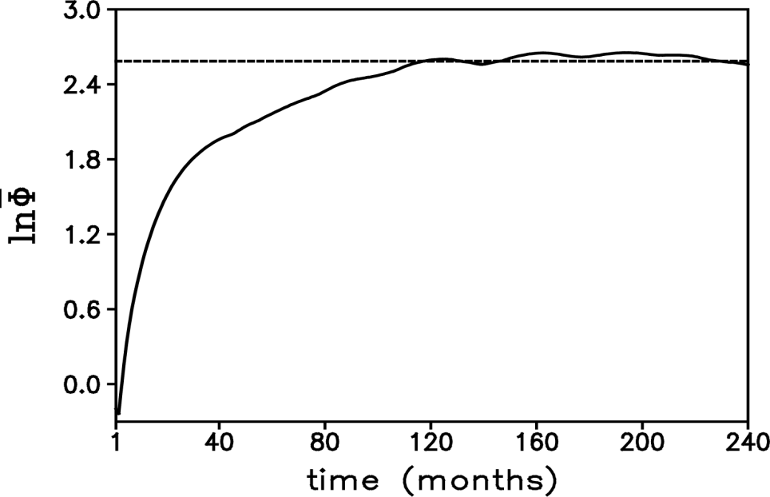
Weather
10⁰ –10¹ d
MJO
10¹ d
Short term climate
10² d
Decadal
10³–10⁴ d
…….
ERSST
Kaplan SST
（Unit：a）
（Unit：a）
12 a
10 a
Error Growth of AMO index
Error Growth of PDO index
Ding, R. Q., J. P. Li, F. Zheng, J. Feng, D. Q. Liu, 2015: Estimating the limit of decadal-scale climate predictability using observational data. Climate Dynamics, 46(5), 1563-1580

Slide 23




A2：Attribution of Predictability
Coupled system-Fast & slow
Predictability Barrier
Internal & external
…….
Forcings
Predictability is controlled by multiple forcing factors, which leads to considerable difficulty in understanding the sources of predictability. Therefore, it is necessary to separately investigate the effect of each forcing factor on predictability.
Conditional predictability can be considered as an estimate of the predictability of a certain variable of dynamical systems due to forcing by, or explained by, one or more factors.
Conditional NLLE is introduced to study the conditional predictability associated with a certain forcing.
Assume that the vector y acts as an external forcing factor for the vector x. To investigate the effect of y on the predictability of x, the conditional NLLE
of x given y is defined as:
(Li & Ding, 2014, Encyclopedia of Atmospheric Science)

Slide 24
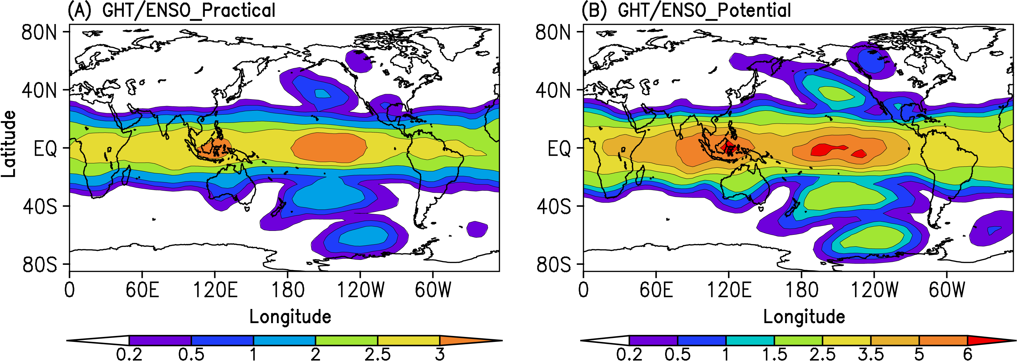
For example, ENSO is one of the primary boundary forcings for the monthly and seasonal predictability of the atmosphere.
Conditional NLLE
y given external forcing
The spatial distributions of the annual mean practical (A) and potential (B) predictability limits (months) of monthly 500 hPa GHT explained by the ENSO component, obtained using the conditional NLLE method.
(Li & Ding, 2014, Encyclopedia of Atmospheric Science)

Slide 25
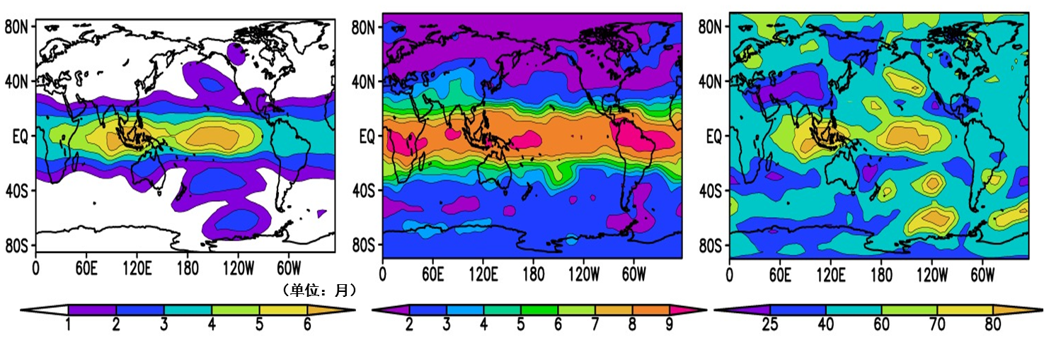
Contribution of ENSO to predictability limit of monthly 500 hPa GHT
Potential predictability limit (month) from ENSO
Potential predictability limit (month)
Contribution (%) of ENSO to the total predictability limit
Contribution of ENSO to the predictability limit of monthly 500 hPa GHT over the tropical Pacific and Indian Ocean exceeds 60% of the total predictability limit
Notes:
过去ENSO对大气可预报性影响的工作很多，但由于受方法的限制缺乏ENSO对大气可预报期限的定量研究。在条件NLLE的基础上，我们定量估计了ENSO对500 hPa月平均位势高度场可预报期限的贡献，可以看到ENSO对大气可预报期限的贡献在热带地区最大，其中在热带太平洋与热带印度洋ENSO的贡献占到总可预报期限的60%以上；我们注意到，在亚洲区域ENSO的贡献率较低，大约40%，这可能反映出该区域可预报性影响因子的复杂性。

Slide 26
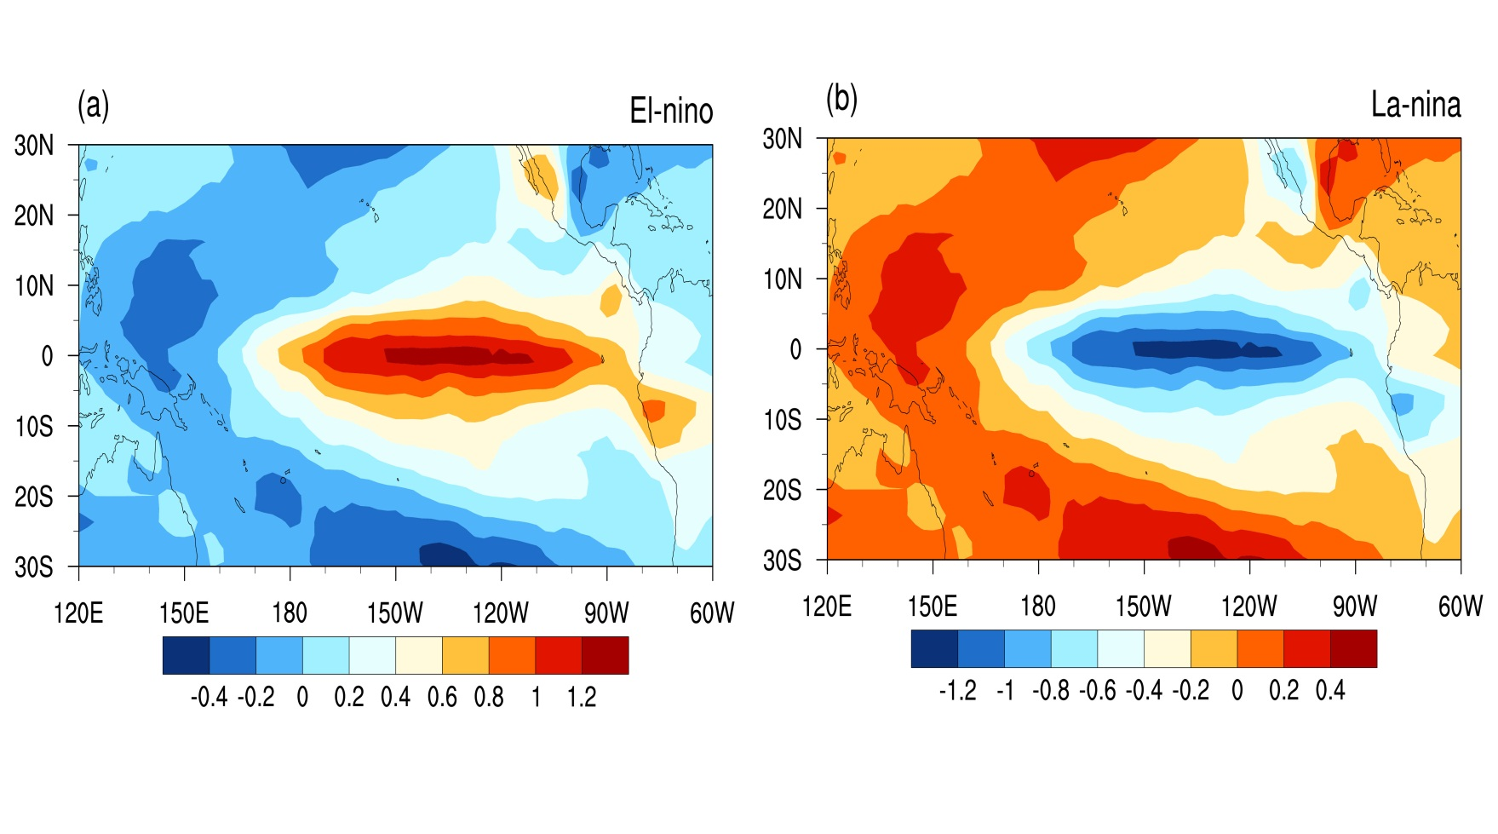
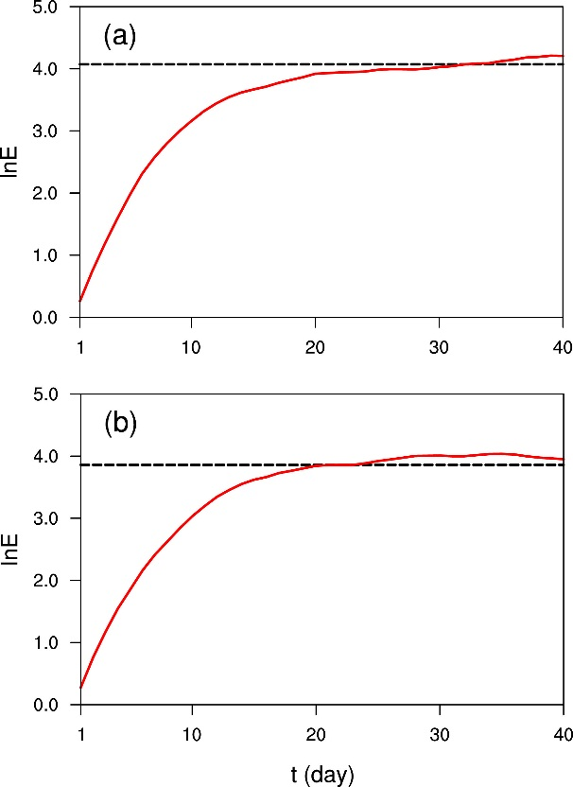
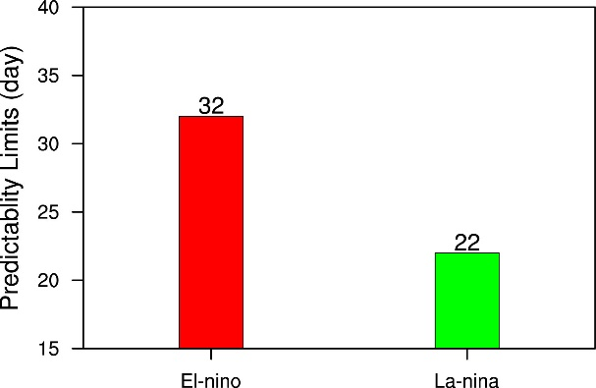
CAM experiment: Hadley climatological SST+SSTA (regressed by Niño3.4 index) for 1850-2012
El-Niño
La-Niña
Predictability limit (d)
Error growth of EASMI

Slide 27
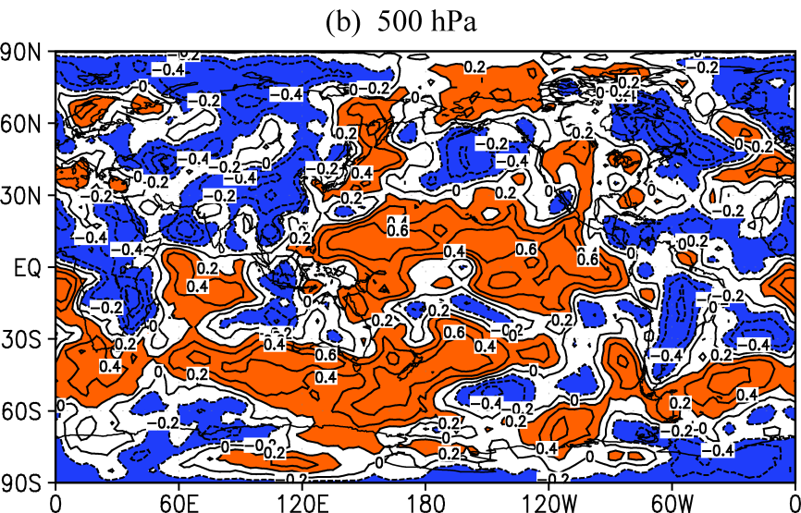
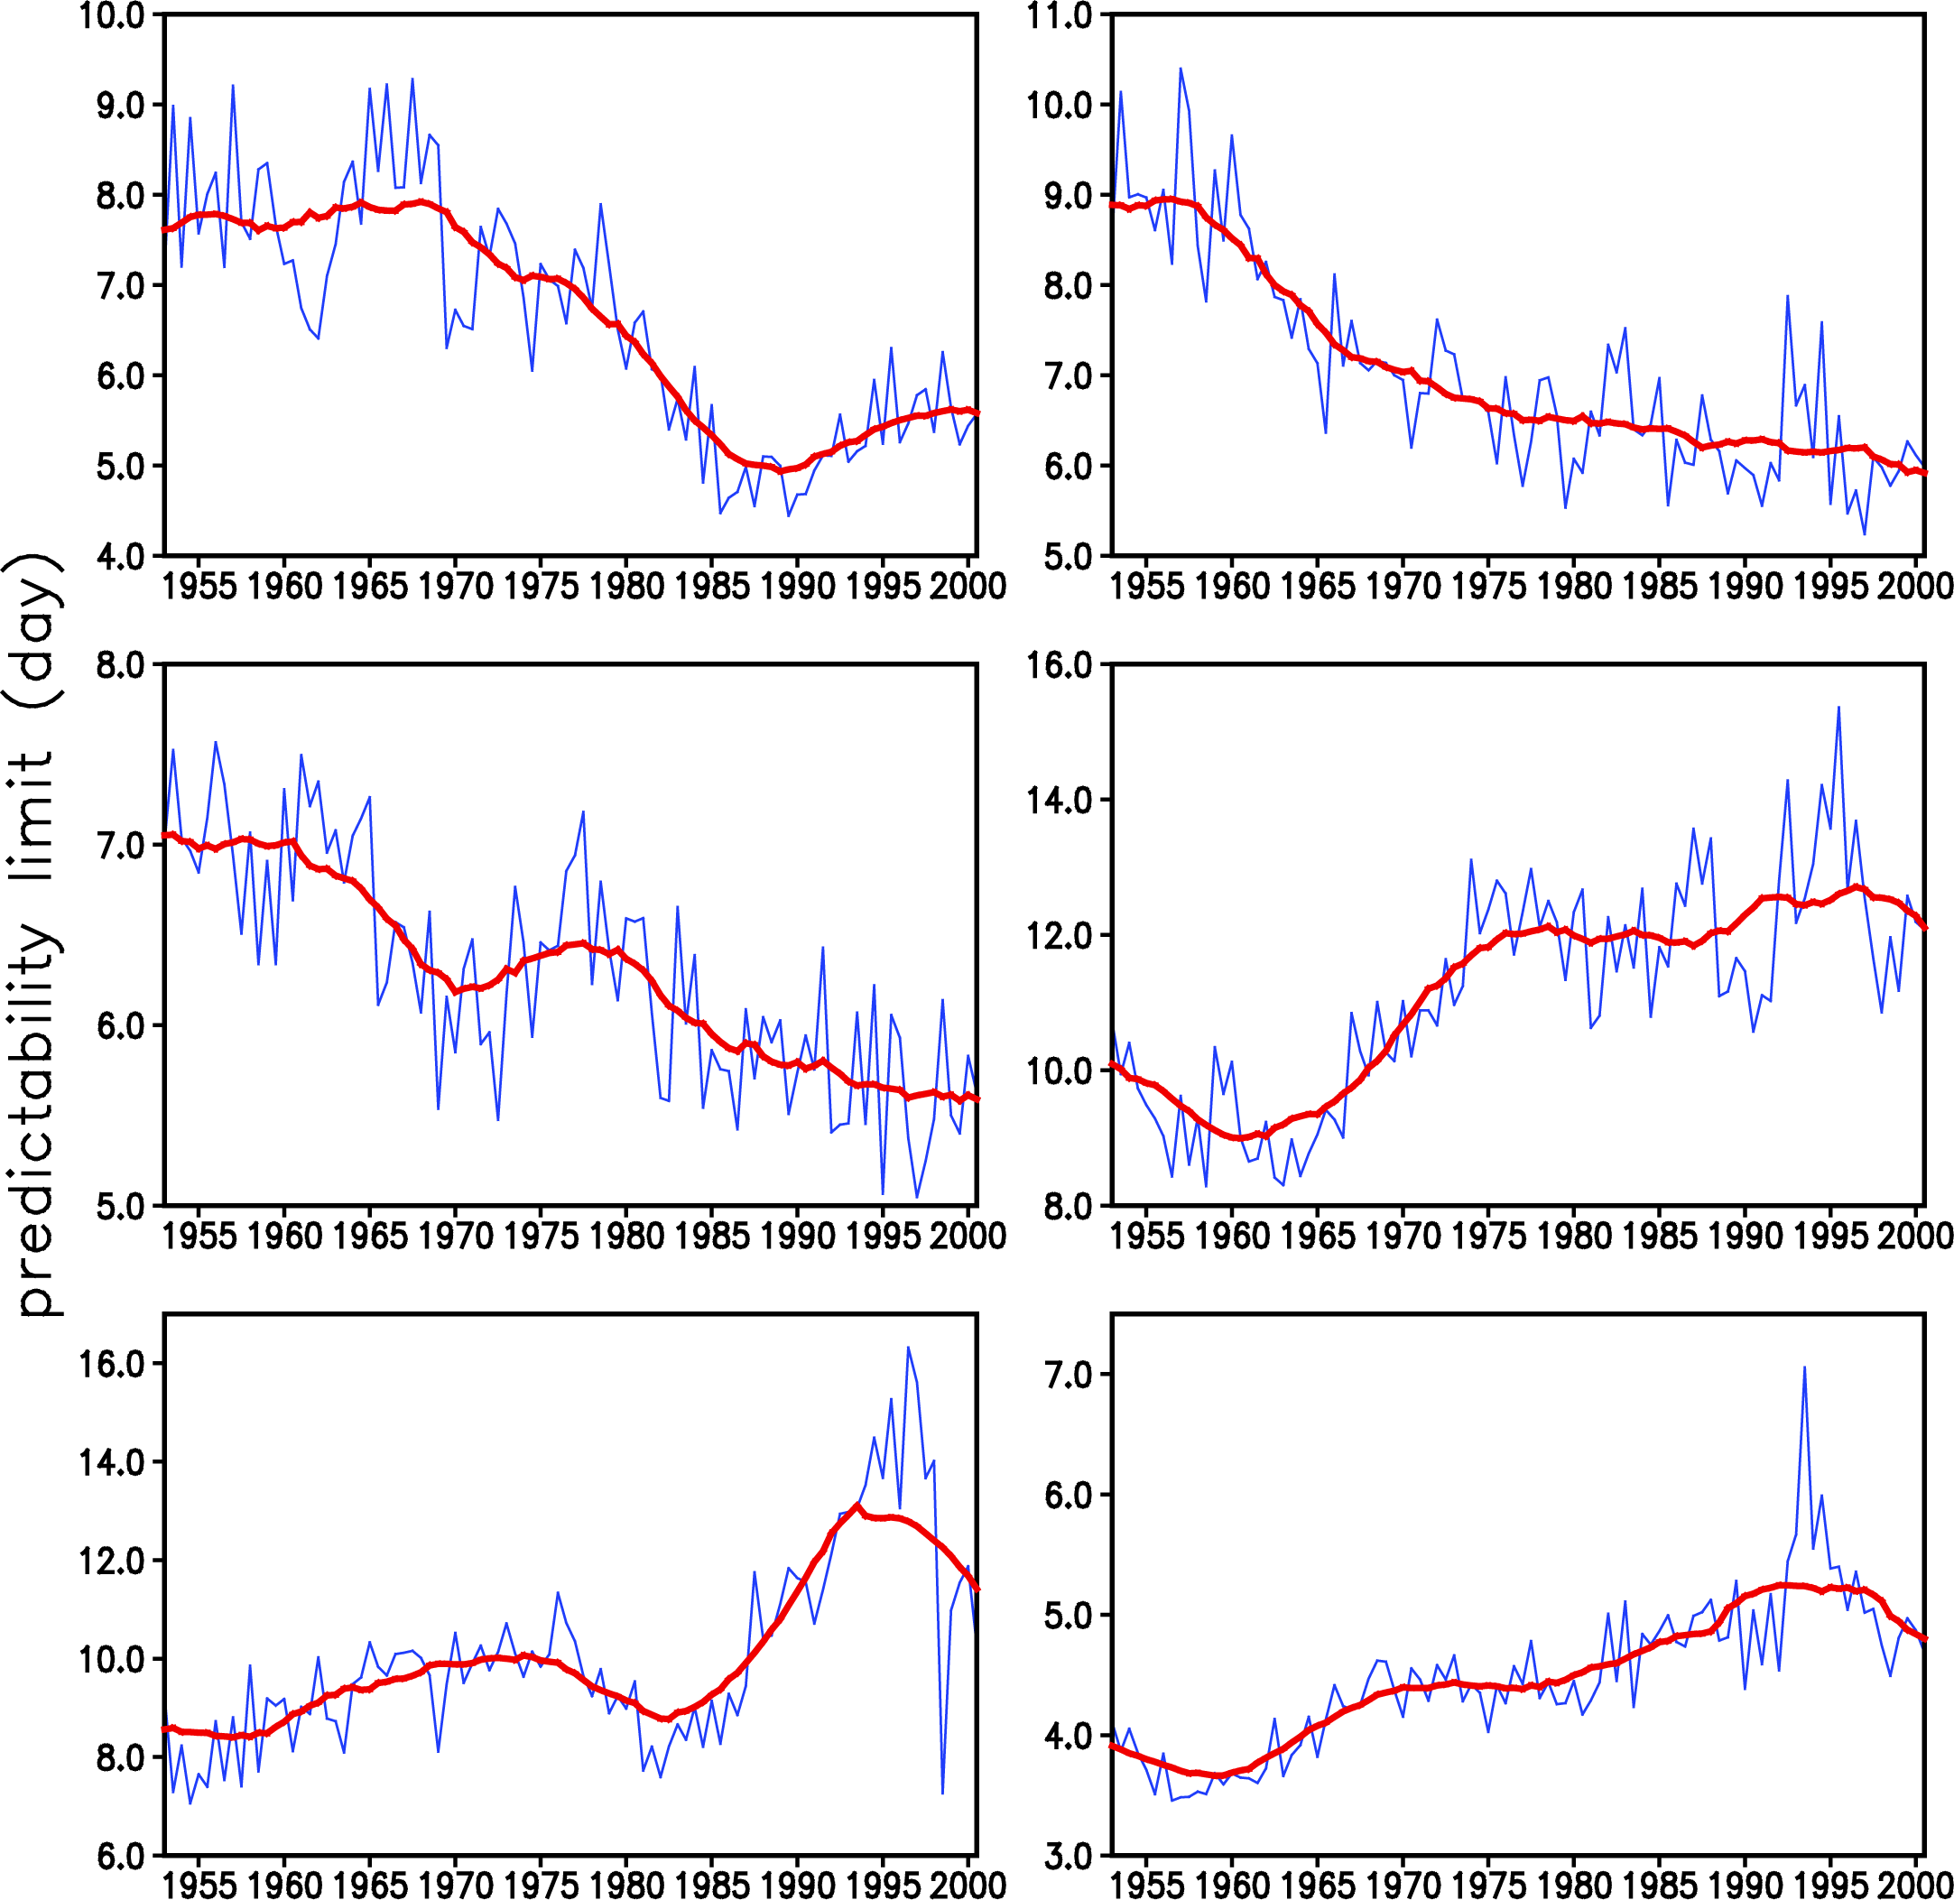
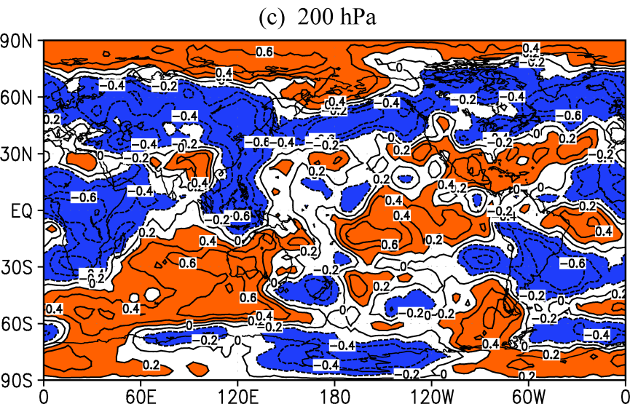
A3：Applications to NWP
Prediction of predictability
Ensemble prediction
Target observation
…….
GHT
Central-eastern China
⬅ Linear trend of the WPPL of GHT for 1953-2000.
Shading: significant at 95% confidence level.
WPPL of GHT at 500 hPa in the two regions➔
GHT
Tropical eastern Pacific
Ding, Li*, Ha, 2008, J. Geophys. Res.;

Slide 28
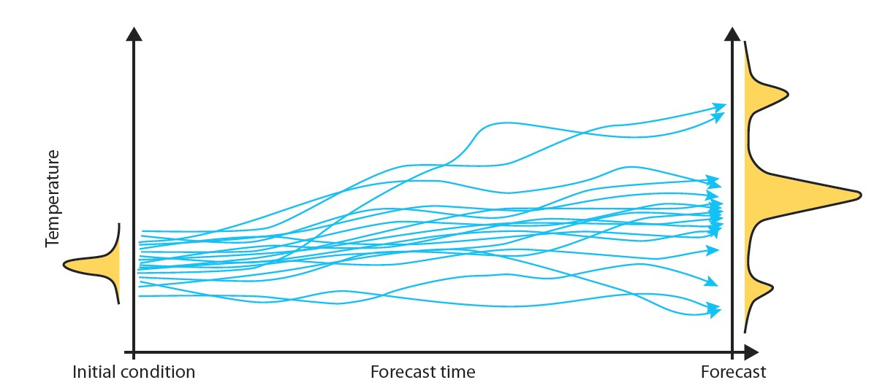
A3：Applications to NWP
Prediction of predictability
Ensemble prediction
Target observation
…….
The atmosphere is a chaotic system, and its predictability is severely limited by the uncertainties related to the initial value and the model. Ensemble forecasting offers a feasible approach to improve a single forecast.
集合预报的优势
集合平均过滤不可预报成分
提供预报状态的可信度
(ECMWF, 2009)
The basic idea behind an ensemble generation scheme is to sample the uncertainties related to errors in the initial conditions.
Notes:
The other important implication of the NLLVs is ensemble forecasting. The NLLVs can provide initial perturbations for ensemble forecasting.

Slide 29
Multi-dimensional NLLEs and NLLV
If the first NLLE along the most rapidly growing direction has been obtained, for an n-dimensional nonlinear dynamic system the first m NLLE spectra along other orthogonal directions can be successively determined by the growth rate of the volume of m-dimensional subspace spanned by the m initial error vectors (m=2,3,……, n):
(Li & Wang, 2008; Ding, Li, Li, 2017)

Slide 30
For a chaotic system, each error vector tends to fall along the local direction of most rapid growth. The collapse toward a common direction causes the orientation of all error vectors to become indistinguishable. This problem could be overcome by the repeated use of the Gram-Schmidt reorthonormalization (GSR) procedure on the vector frame:
(Li & Wang, 2008; Ding, Li, Li, 2017)

Slide 31
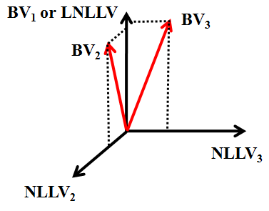
NLLVs span the fast-growing perturbation subspace efficiently, and thus may grasp more components in analysis errors than the BVs.
(Feng, Ding, Li & Liu, JAS, 2014)
Notes:
用ENKF集合扰动的出发点： 在实际数值天气模式中，分析误差并不是随机的。----EnKF initial ensemble perturbations regarded as reliable estimation of analysis uncertainties
更高的相关；不同区域1,2,3 相对强度模拟的NLLV模拟的更好。

Slide 32

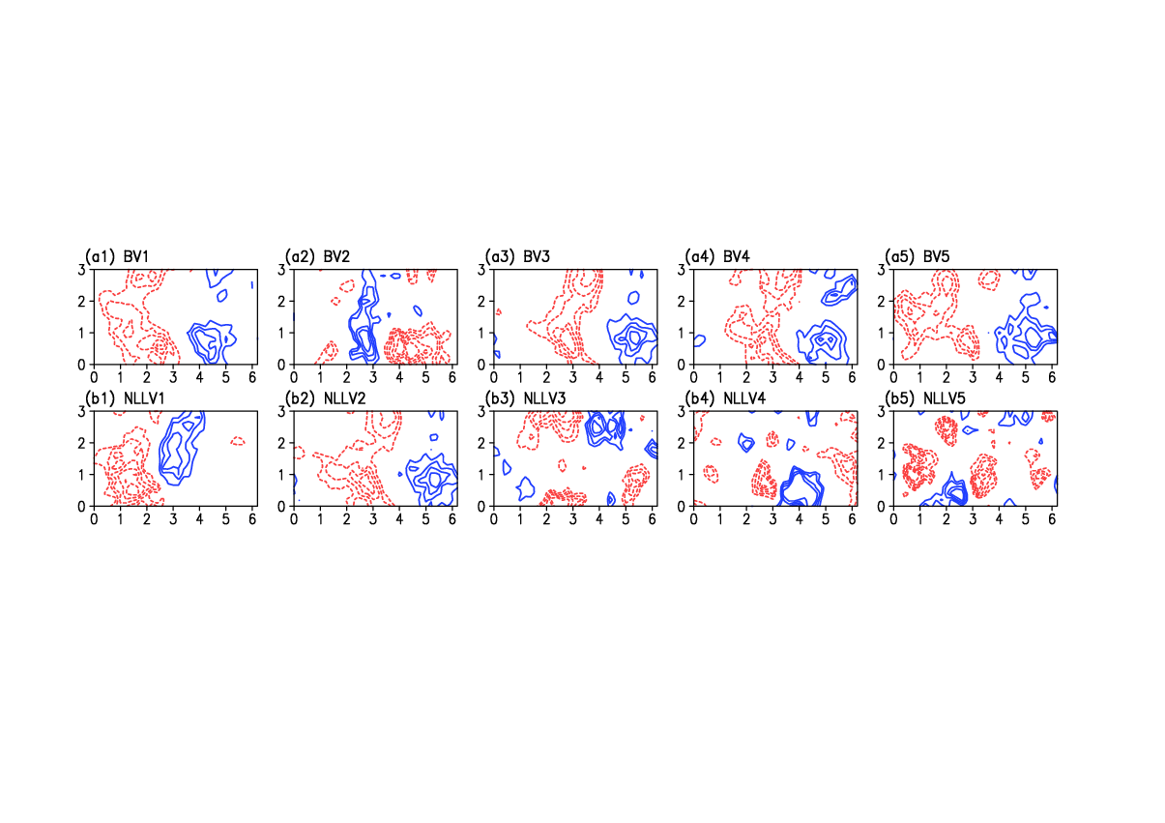
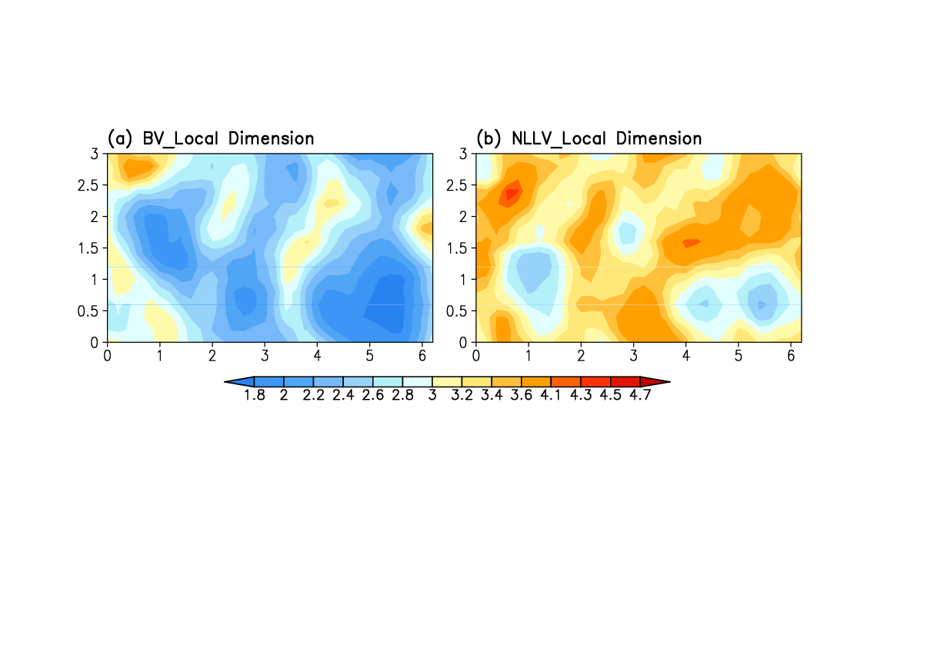
Comparison of local dimension of BVs and NLLVs
Patil et al.(2001)
NLLVs have more independent local structure than the BVs.
(Feng, Ding, Li & Liu, JAS, 2014)
Notes:
First, we compare the local dimension of BVs and NLLVs. Local dimension is calculated by using this equation. This figure shows the first 5 BVs and NLLVs of QT model. We can

Slide 33
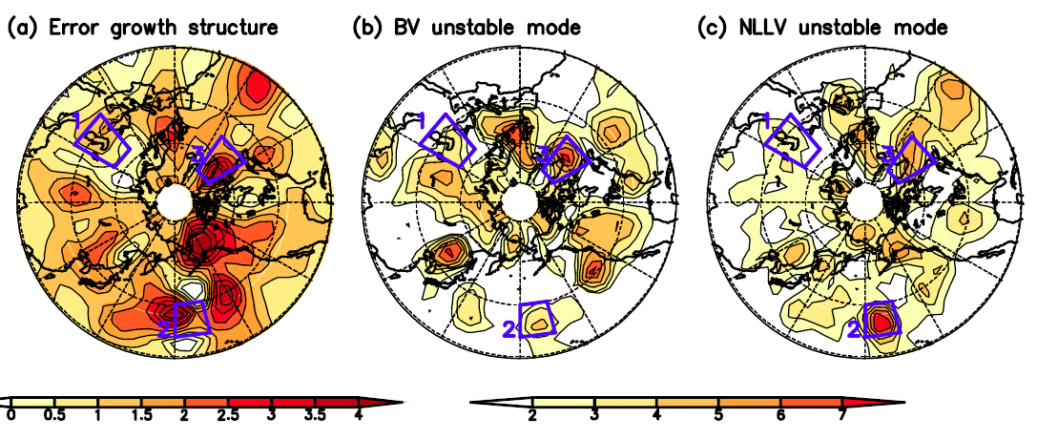
Comparison of the error growth structure
EnKF ensemble perturbations
Corr(a, b)=0.27 Corr(a, c)=0.52
NLLVs can better sample the analysis error than BVs.
Notes:
用ENKF集合扰动的出发点： 在实际数值天气模式中，分析误差并不是随机的。----EnKF initial ensemble perturbations regarded as reliable estimation of analysis uncertainties
更高的相关；不同区域1,2,3 相对强度模拟的NLLV模拟的更好。

Slide 34
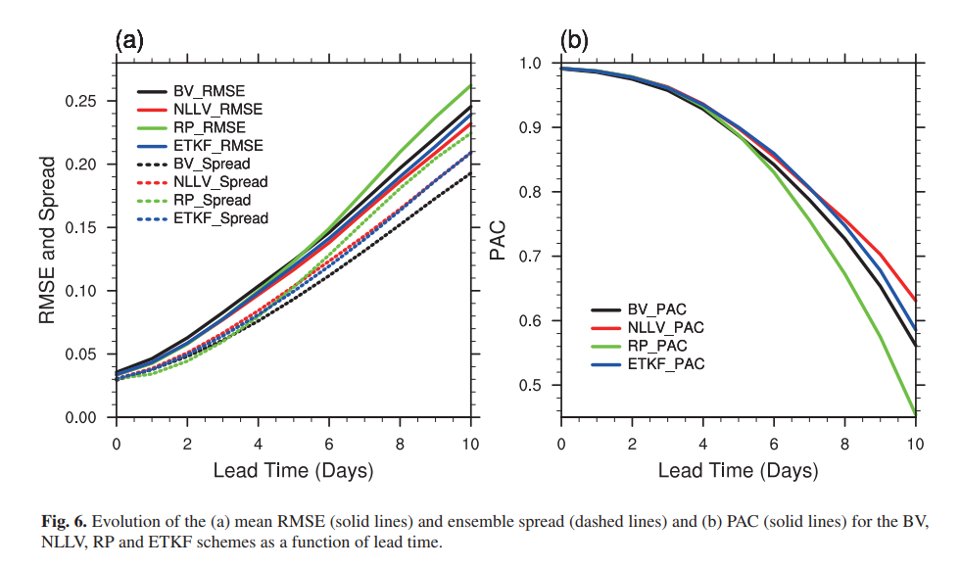
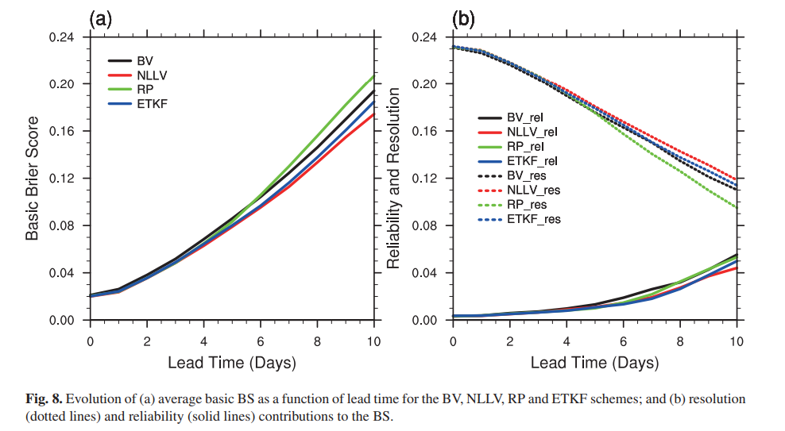
Comparison of ensemble prediction skill
RMSE
PAC
Brier score
(Feng, Ding, Li & Liu, 2016)
Notes:
pattern anomaly correlation (PAC)

Slide 35
感谢聆听
Thank you！

Slide 36
Atmospheric predictability varies obviously with time and depends on the particular state of atmospheric flows [Lorenz, 1965].
Recent studies have found that extreme weather and climate events occur more frequently with the global warming [Schär et al., 2004; Webster et al., 2005].
Interdecadal variability of atmospheric predictability shows some regional characteristics in different regions.
So far, few investigations on the interdecadal changes of weather potential predictability (WPP).
The study of the interdecadal changes of WPP is of significance:
(a) to learn about the changes of internal dynamics variability of the atmosphere.
(b) to know about the effects of the global warming and other external forcings on atmospheric predictability.
(c) to learn about the upper limit of prediction from numerical models.

Slide 37
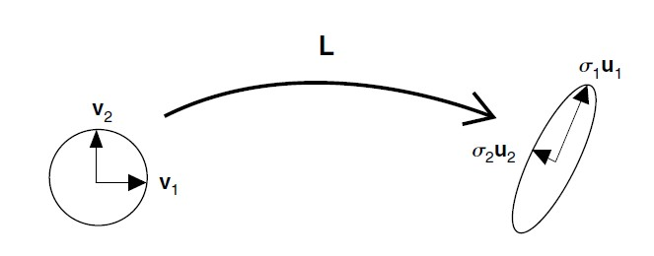


基于动力学意义的快速增长扰动的生成方法
BV生成的示意图
(Toth & Kalnay, 1997)
非线性，省时，随流型变化
仅抓住主导LLV信息，扰动独立性不好，获取增长误差不稳定
SV生成的示意图
(Buizza & Palmer, 1995)
正交，理论基础，随流型变化
线性，计算复杂，耗时
CNOP
Mu, Duan, Wang, 2003, NPG;
Mu, Jiang, 2011, JAS; … …

Slide 38
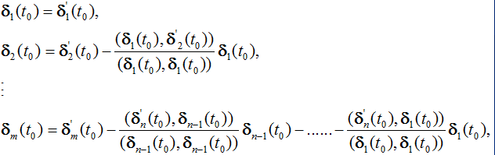

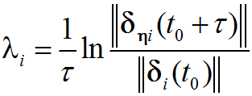
NLLE指数谱(NLLEs)和向量谱(NLLVs)理论
非线性误差增长理论
GSR正交化方法
非线性NLLE指数谱(NLLEs)
NLLE向量谱(NLLVs)
(Li, Wang, 2008: Comput. Phys. Com.)
NLLVs生成的示意图
(Feng, Ding, Li* & Liu, 2014)
NLLVs的优势
非线性
省时
随流型变化
考虑了多个NLLVs信息
严格全局正交，克服了BV扰动不独立的不足

Slide 39
NLLV扰动与BV扰动的比较
NLLV全局严格的正交性，能够较好地反映初始条件的不确定性，因此，能够为集合预报提供好的初始扰动。
(Feng, Ding, Li* & Liu, 2014)

Slide 40

NLLE谱的几点优势
NLLE谱期望能够为集合预报提供好的初始扰动！

Slide 41
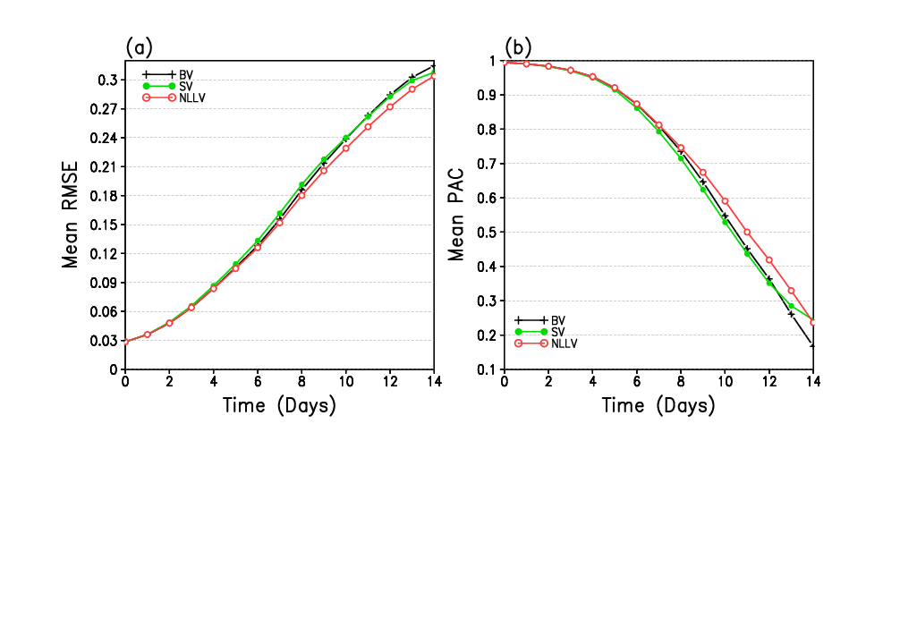
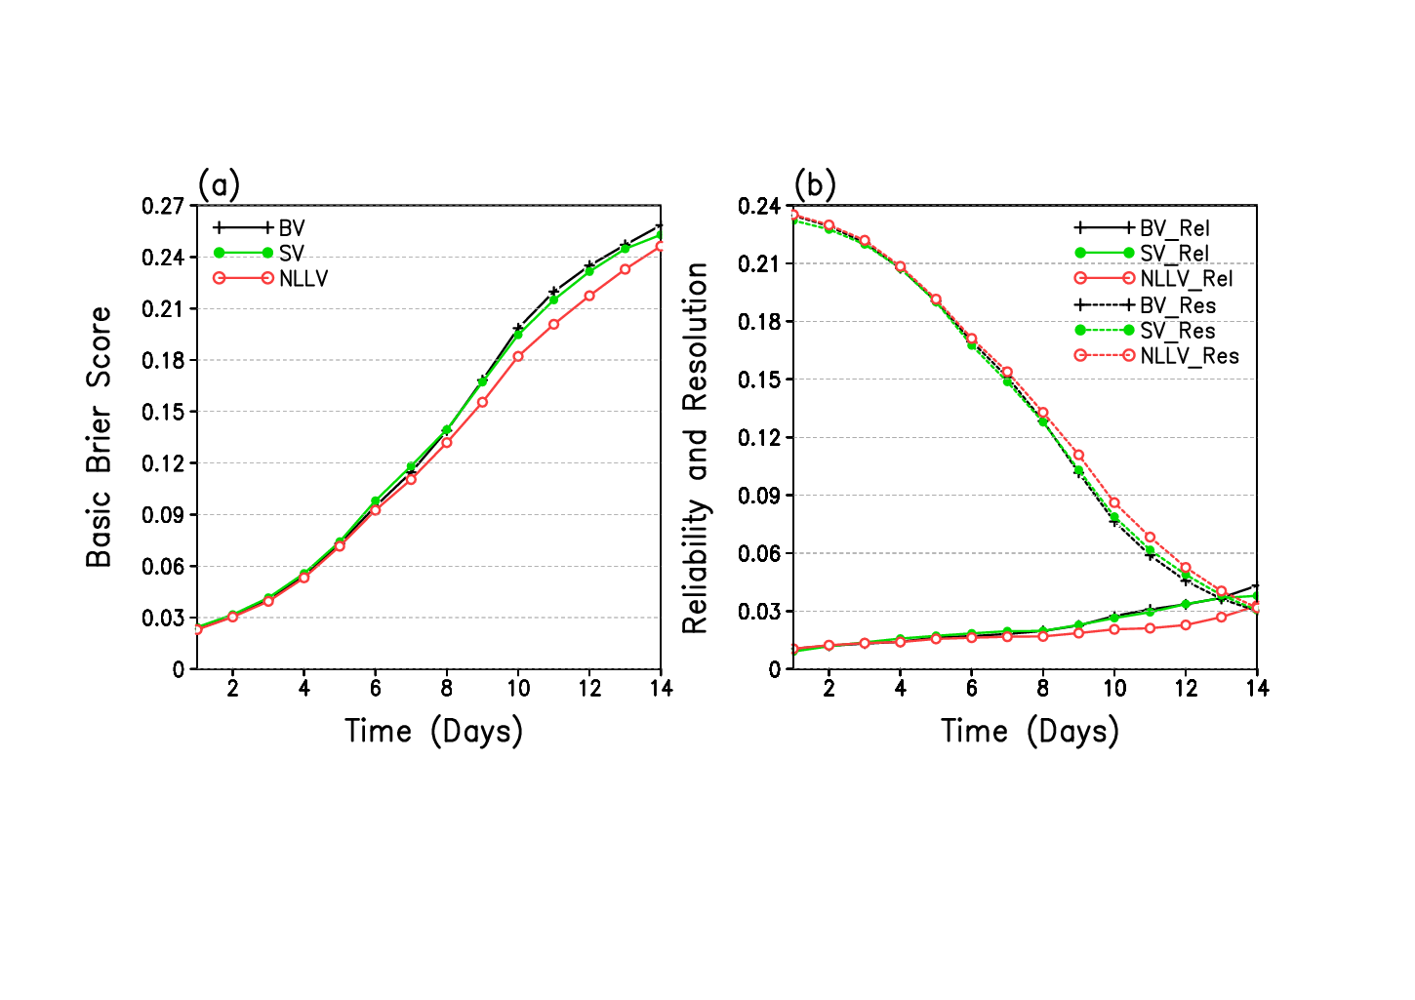
NLLV在集合预报中的应用 (正压准地转模式)
与繁殖模(BV)和奇异向量(SV)方法的比较
(Feng, Ding, Li* & Liu, 2014)

