Slide 1


Understanding Oceans
Sustaining Future
A High-Efficiency Approximate Algorithm of EnKF for Coupled Model Data Assimilation
A Invited Talk at Int’l Workshop on
Nonlinear & Stochastic Problems in Atmospheric & Oceanic Prediction
Nov. 19-24, 2017 in Banff, Alberta, Canada
Shaoqing Zhang
Physical Oceanography Laboratory/Ocean University of China (POL/OUC）
Qingdao National Laboratory for Marine Science and Technology (QNLM)

Slide 2


Slide 3
OUTLINE
Limitation of a finite ensemble EnKF
2. Design of a high-efficiency approximate
algorithm of EnKF (Hea-EnKF)
3. Validation with a low-order coupled “climate”
model
4. Validation with a hybrid-coupled GCM
5. Impact of Hea-EnKF on model forecasts
6. Discussion

Slide 4
Model limitation & Importance of coupled data assimilation (CDA)
CDA is good for ocean & climate studies – All coupled components
adjusted by observed data through instantaneously-exchanged fluxes
Model Does a good job:
Simulate the
interactions
of multi-scale
components
Assess global
changes due to
the changes
of GHG-NA
But:
Different climate
features
Different climate
variability
GHGNA forcings
Atmosphere model
u, v, T, q, ps
Land
model
u^{obs}, v^{obs}, T^{obs}, q^{obs}, p_{s}^{obs}
Ocean model
T,S,U,V,η
Sea-Ice
model
T^{obs},S^{obs}

Slide 5
Ensemble CDA (ECDA)
ECDA is OPTIMAL for ocean & climate studies – An ensemble of model
integrations establishing the background error statistics to extract obs
information, addressing the probabilistic nature of Ocn & Clim evolution
Balanced: Ensemble statistics provides multivariate relationships, such as temperature-salinity relationship and geostrophic balance.
Coherent: A set of self-balanced and coherent initial coupled states generates optimal ensemble initialization of coupled model with minimum initial shocks.
Extendable/Renewable: Ensemble-based CDA is naturally and easily to be extended/renewed as the model becomes more comprehensive.
obs
PDF
Prior
PDF
Data
Assim
Analysis
PDF

Slide 6
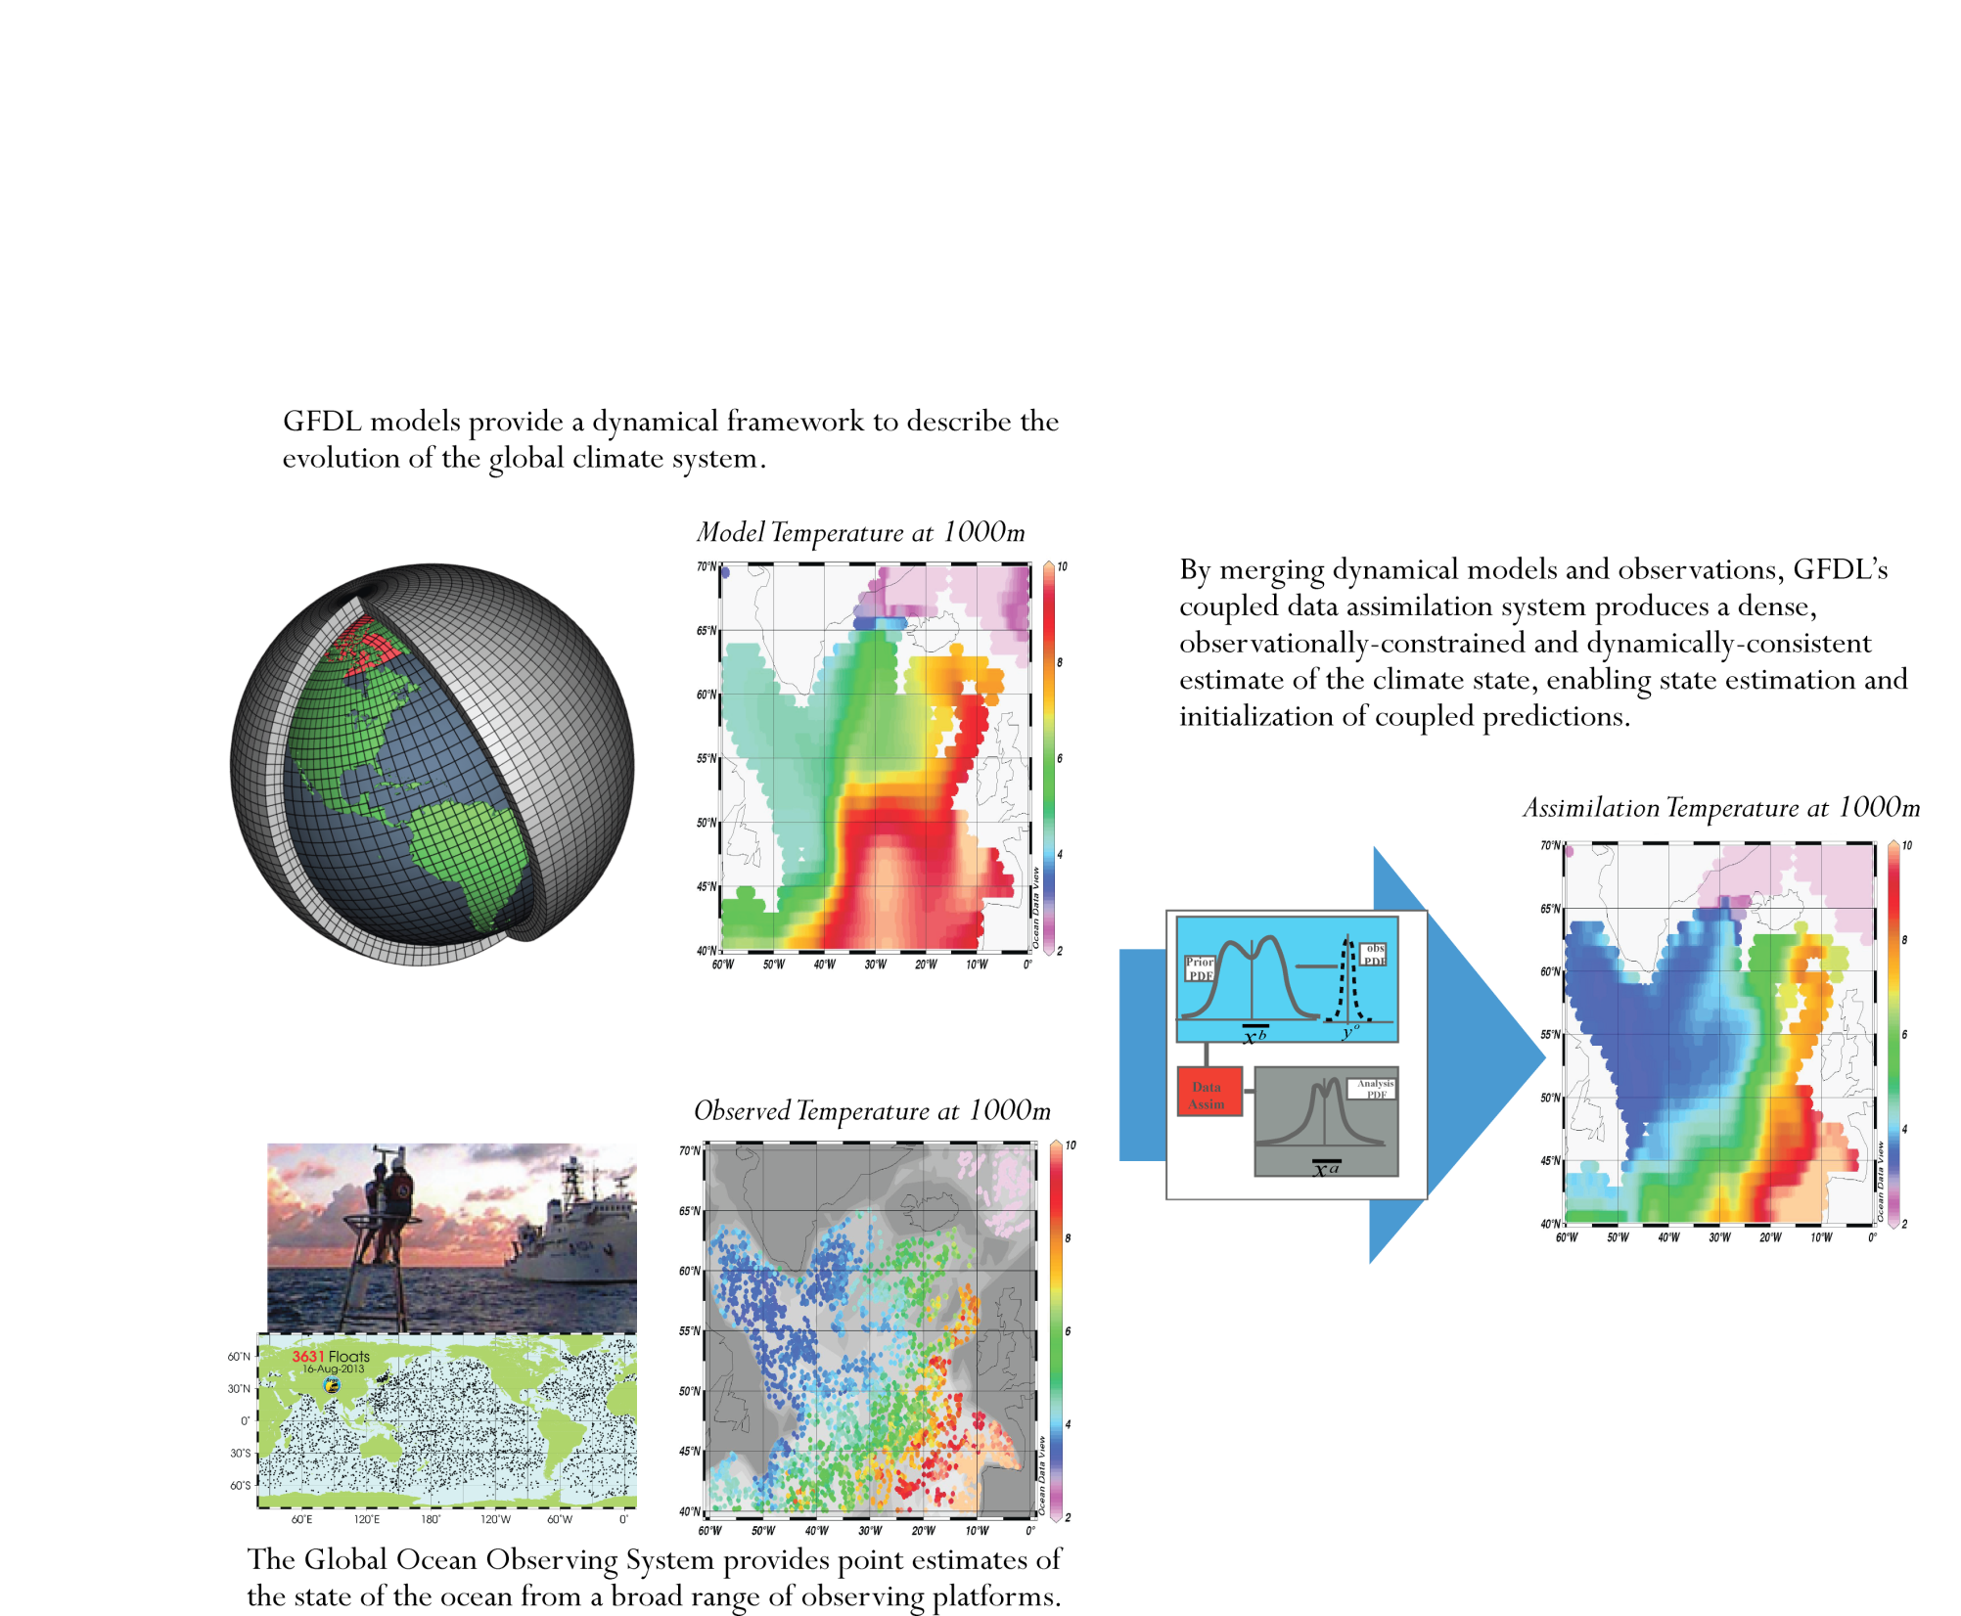
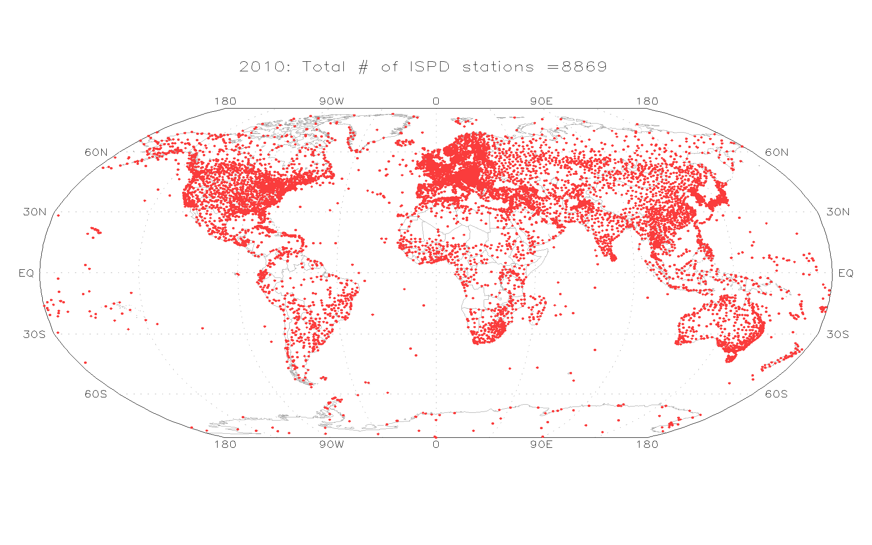
ECDA System Structure
N-member model
ensemble
integrations
Earth System Model
Assimilation
Atmosphere
Earth Observing System
N times of model
CP resource
requirements !
Ocean

Slide 7
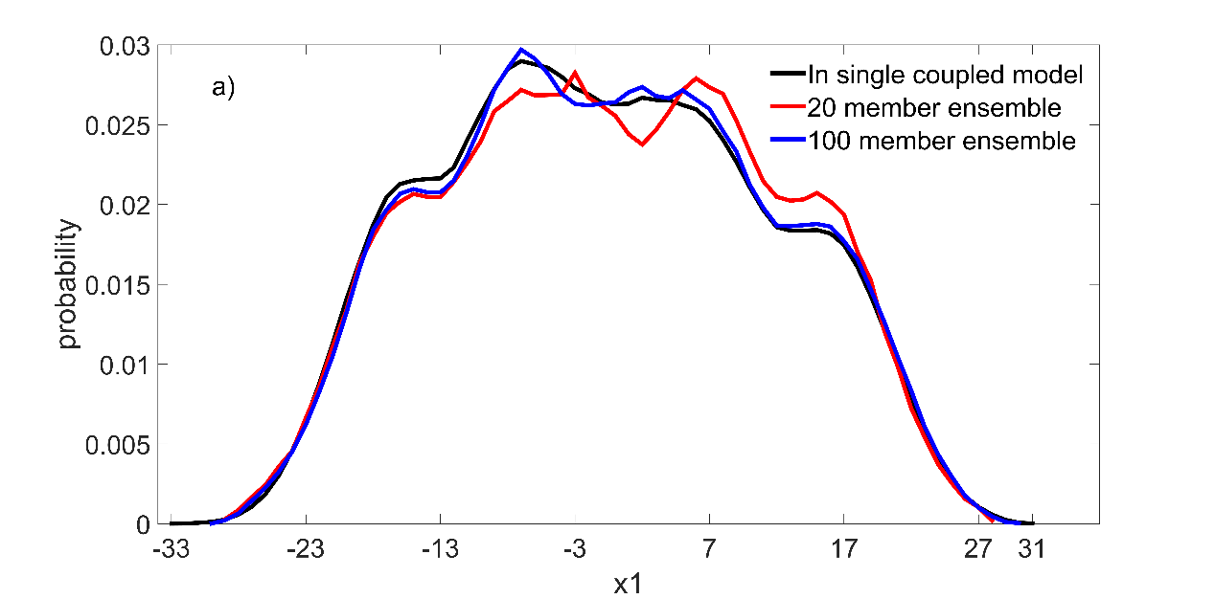
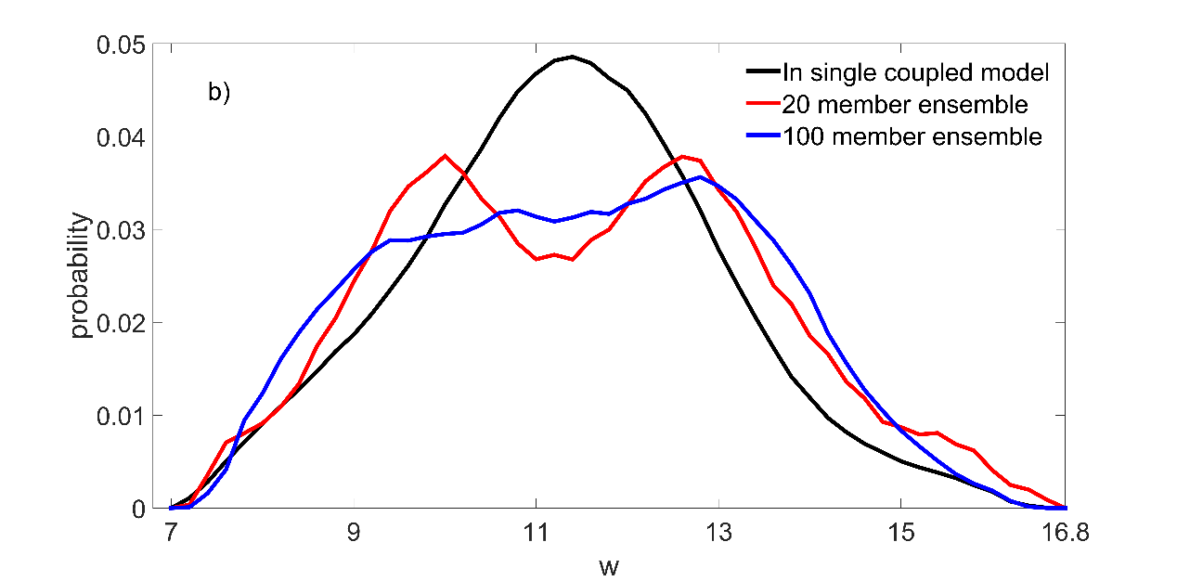
Limitation of traditional finite-size EnKF (Tra-EnKF)
1. Computing power limitation:
N times computing power demanding of model for ensemble
Restricting ECDA only for low-res prediction system
PDF
True PDF
20-m simulated
100-m simulated
2. Science limitation:
Fast-Varying (ATM) Variables
Insufficient representation on statistics of slow-varying flows by a finite ensemble
Restricted accuracy of ocean state estimates
Restricted prediction skill due to limited accuracy of initial conditions
100-m simulated
PDF
20-m simulated
True PDF
Slow-Varying (OCN) Variables

Slide 8
Design of a high-efficiency approximate algorithm of EnKF (Hea-EnKF)
Hea-EnKF idea:
Hea-EnKF breaking CP limitation:
Historical data in single model solution sampling stationary and slow-varying parts of background flow PDF
Currently-updated model integration information sampling fast-varying part of background flow PDF
Single model solution-based
Only a small fraction of Tra-EnKF resources
Applicable to any HR model intractable with current CP power
Scientific advantages:
The co-varying between model locations (variables) is sampled (approximated) by time series instead of different ensemble member values.
Improving representation of statistics on slow-varying background flows with long time data
Improving assimilation quality?
Improving prediction skills?
Hea-EnKF implementation:
Hea-EnKF implementation consisting of 3 filtering processes:
Stationary filtering, Low-frequency filtering & High-frequency filtering
When CP-resources are applicable, the new algorithm could include further EnKF filtering with a small-size Hea-EnKF collections.

Slide 9
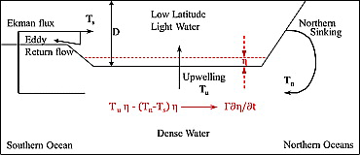
A low-order coupled “climate” model
Lorenz-63 chaotic model
+
Slab ocean
+
Pycnocline predictive model
(Gnanadesikan 1999Science)
(Zhang 2011GRL)
(Zhang et al. 2012Tellus)

Slide 10
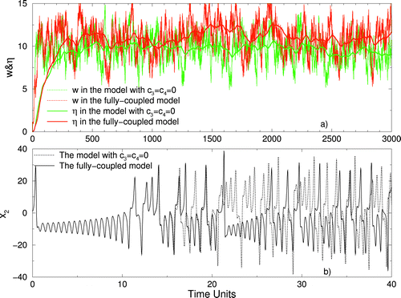
A low-order coupled “climate” model
(Zhang 2013JC)

Slide 11
Implementation of Hea-EnKF with the simple model:
Constructing 3 ensembles to implement filtering
Ensemble 1:
20 members
Each member being the values of 40 time-step average, taking data of steps t₋₇₉₉~t
e.g. m₁: ave[t₋₇₉₉, t₋₇₆₀]…
m₂₀: ave[t₋₃₉, t]
Implementing “stationary” filtering
Representing η scale co-varying
Extracting η scale obs information
Ensemble 2:
20 members
Each member being the values of 4 time-step average, taking data of steps t₋₃₉~t,
e.g. m₁: ave[t₋₃₉, t₋₃₆]…
m₂₀: ave[t₋₃, t]
Implementing low-frquency filtering
Representing w scale co-varying
Extracting w scale obs information
Ensemble 3:
20 members
Each member being the values of last time-step model states, taking data of steps t₋₁₉~t,
e.g. m₁: values at t₋₁₉…
m₂₀: values at t
Implementing high-frquency filtering
Representing x scale co-varying
Extracting x scale obs information
The ensembles are updated with the model solutions are forwarded

Slide 12
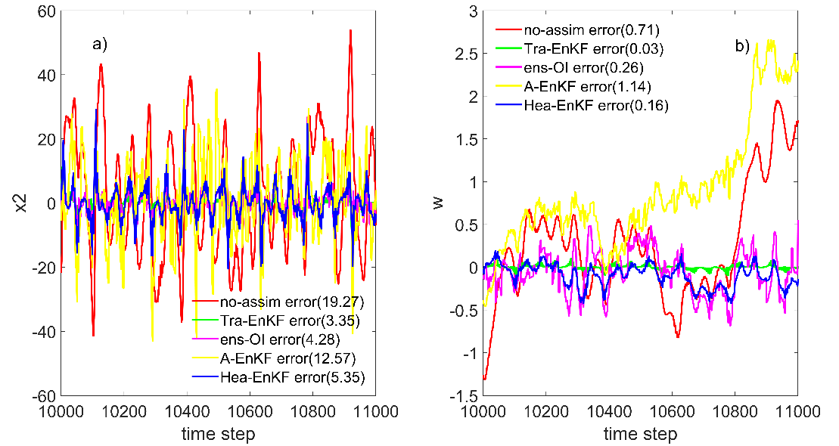
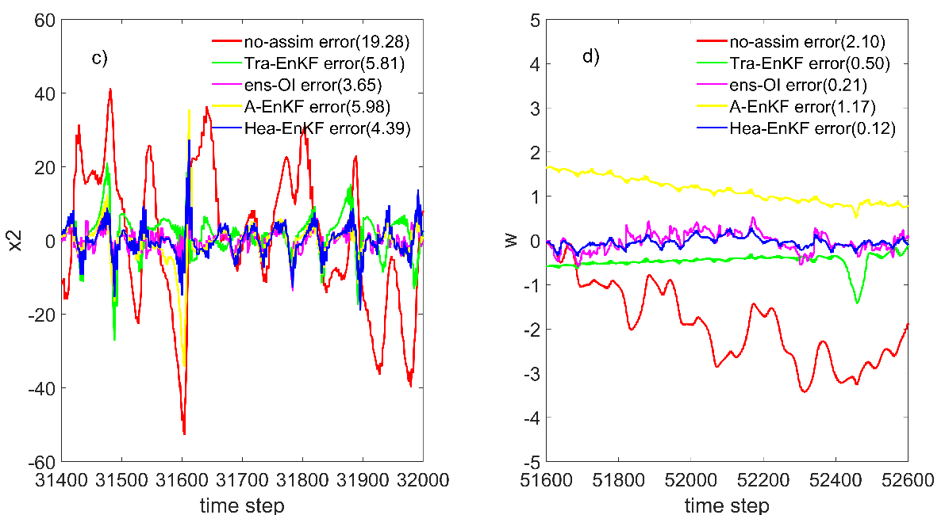
Validation with the low-order coupled “climate” model (1): Analysis errors
Perfect model results
Reducing RMSE of x and w compared with assimilation results with no-assimilation model control
Mdl filtering | Perfect model |  | Biased model
 | x2 | w | x2 | w
Tra-EnKF | 83% | 96% | 70% | 76%
ens-OI | 78% | 64% | 81% | 90%
A-EnKF | / | / | 69% | 44%
Hea-EnKF | 72% | 78% | 77% | 94%
Biased model results
Tra-EnKF
Hea-EnKF
Tra-EnKF
Hea-EnKF

Slide 13
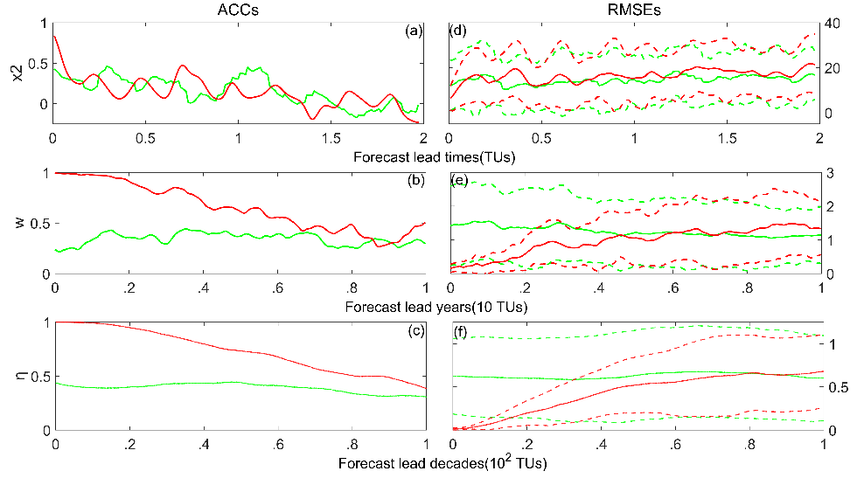
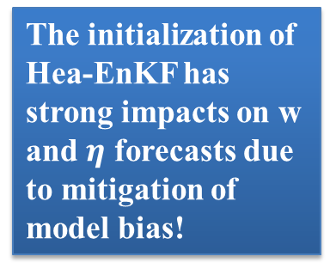
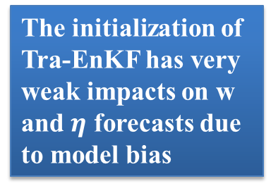
Validation with the low-order coupled “climate” model (2): Forecast errors
Question : Whether or not such an approximation has adverse impact on the balance and coherence of estimated model states? Exam is conducted within biased framework.
Examining the performance of model forecasts initialized by the Hea-EnKF assimilation, compared to the forecasts initialized from the Tra-EnKF
ACCs
RMSEs
The initialization of Tra-EnKF has very weak impacts on w and $η$ forecasts due to model bias
The initialization of Hea-EnKF has strong impacts on w and $η$ forecasts due to mitigation of model bias!

Slide 14
A hybrid-coupled general circulation model
Ocean:
Atmosphere:
The version 4 of Modular Ocean Model (MOM4)
The horizontal resolution: 2º x 2º but meridional telescoping to 0.5º at the equator
Vertical 25 levels with 15m for each level on the upper 150m
Comprehensive model including free surface with explicit freshwater surface fluxes, a quicker advection, nonlocal KPP mixing and Laplacian horizontal diffusion and friction, etc.
Sponge boundary at 45º N(S)
A statistical atmosphere model tries to capturing the relationship of tropical SSTA and surface fluxes:
Wind stresses
Longwave/shortwave radiation
Sensible heat flux
Water flux
A stochastic surface forcing simulated by the residual of total fluxes and SSTA regression fluxes
Advantages:
A “coupled” GCM with reasonable ENSO variability
Implemented EnKF data assimilation
Very cheap (good for EnKF DA tests)
(Wittenberg 2002MWR)
(Harrison 2002MWR)
(Zhang et al 2005MWR)

Slide 15
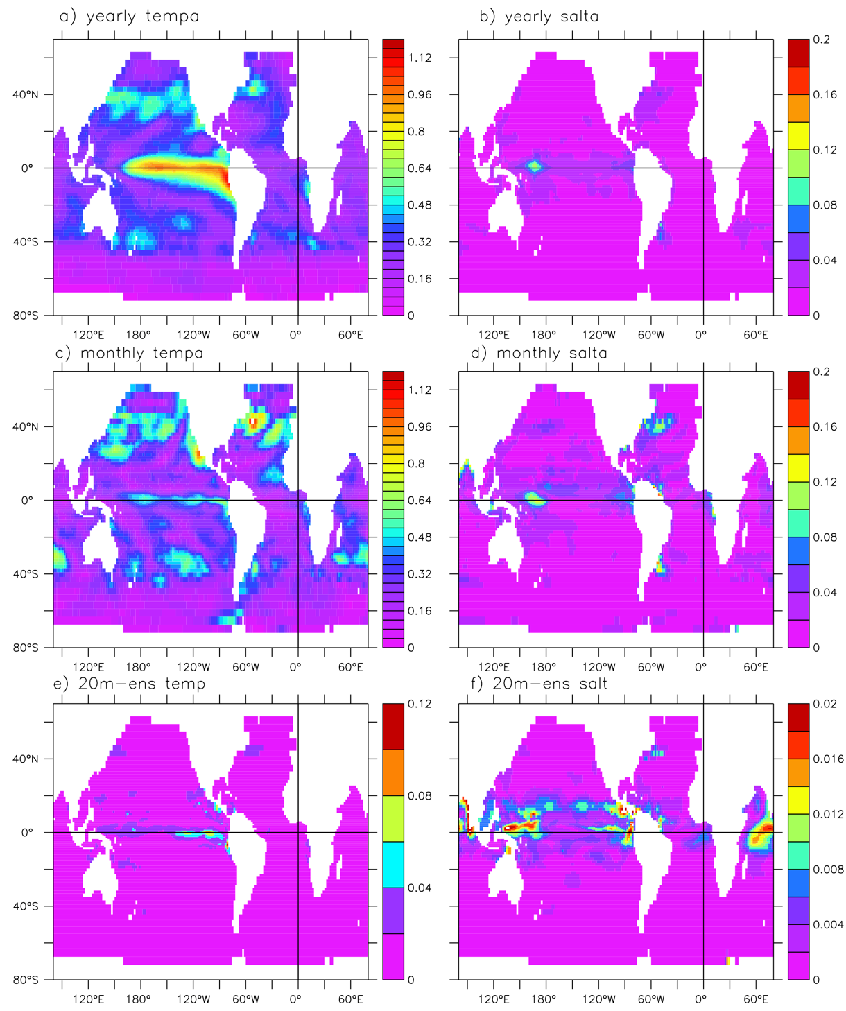
Implementation of Hea-EnKF with the hybrid CGCM:
Constructing 3 ensembles to implement filtering
yearly
Constructing 3 ensembles to implement filtering:
20-m yearly-mean anomalies for “Stationary” filtering
20-m monthly-mean anomalies for low-frequency filtering
20-m time-step values for high-frequency filtering
monthly
The ensemble spread:
“Stationary” filtering mainly reflects ENSO and gyre system variations at yearly scales.
Low-frequency filtering mainly reflects gyre system oscillations at monthly scales.
High-frequency filtering reflects active tropical air-sea interactions.
20m step values

Slide 16
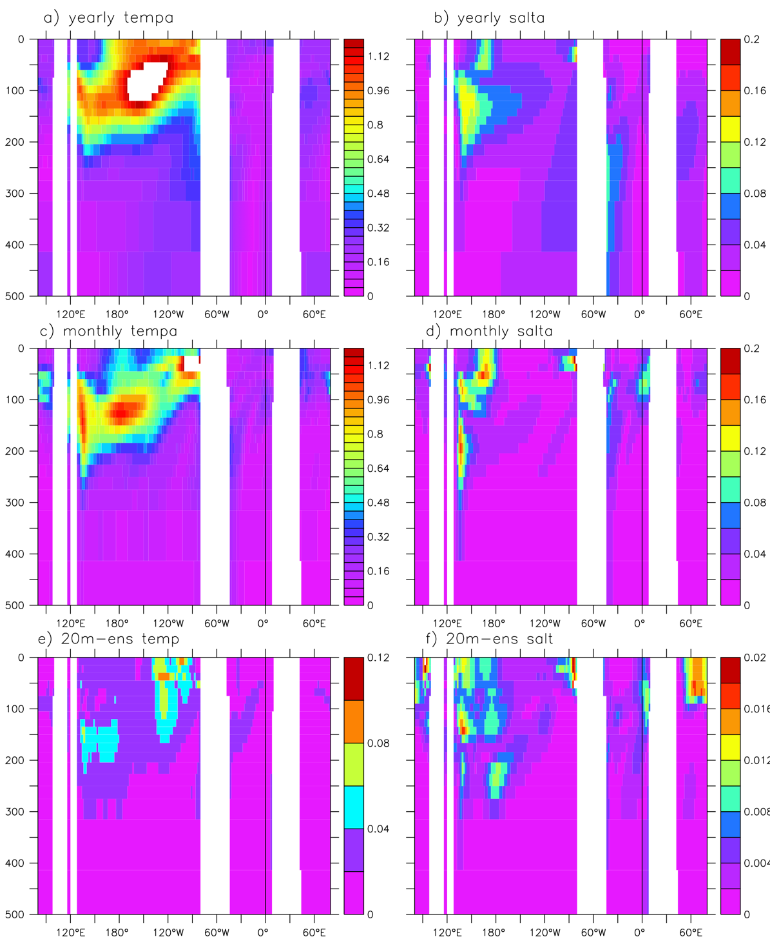
3 filtering ensemble spread at the equator
yearly
In the equatorial area:
The spread has large values along the thermocline.
The spread values in “stationary” and low-frequency filtering are larger than the high-frequency ones by one order in this low-resolution model.
monthly
20m-ens

Slide 17
Design of assimilation experiments
The observations are produced by sampling the “truth,” a run using 100-day climatology restoring time scale and the standard convection coefficient (convc =1.8), called the observational model
The assimilation model uses 80-day climatology restoring time scale and a smaller convection coefficient (convc=1.5), so that is is biased with the observational model.
CTL: An assimilation model run without assimilating any observation
Traditional EnKF (Tra-EnKF): 20-member EnKF assimilation run
Stationary (ens-OIy) filtering: An assimilation run using the 20-member yearly-mean anomalies to assimilate observations
Low-frequency (ens-OIm) filtering: An assimilation run using 20-member monthly anomalies to assimilate observations
High-frequency (A-EnKF) filtering: An assimilation run using 20-member time step values to assimilate observations
Hea-EnKF (combination of 3 filtering processes): An assimilation run using high-efficiency approximation of EnKF

Slide 18
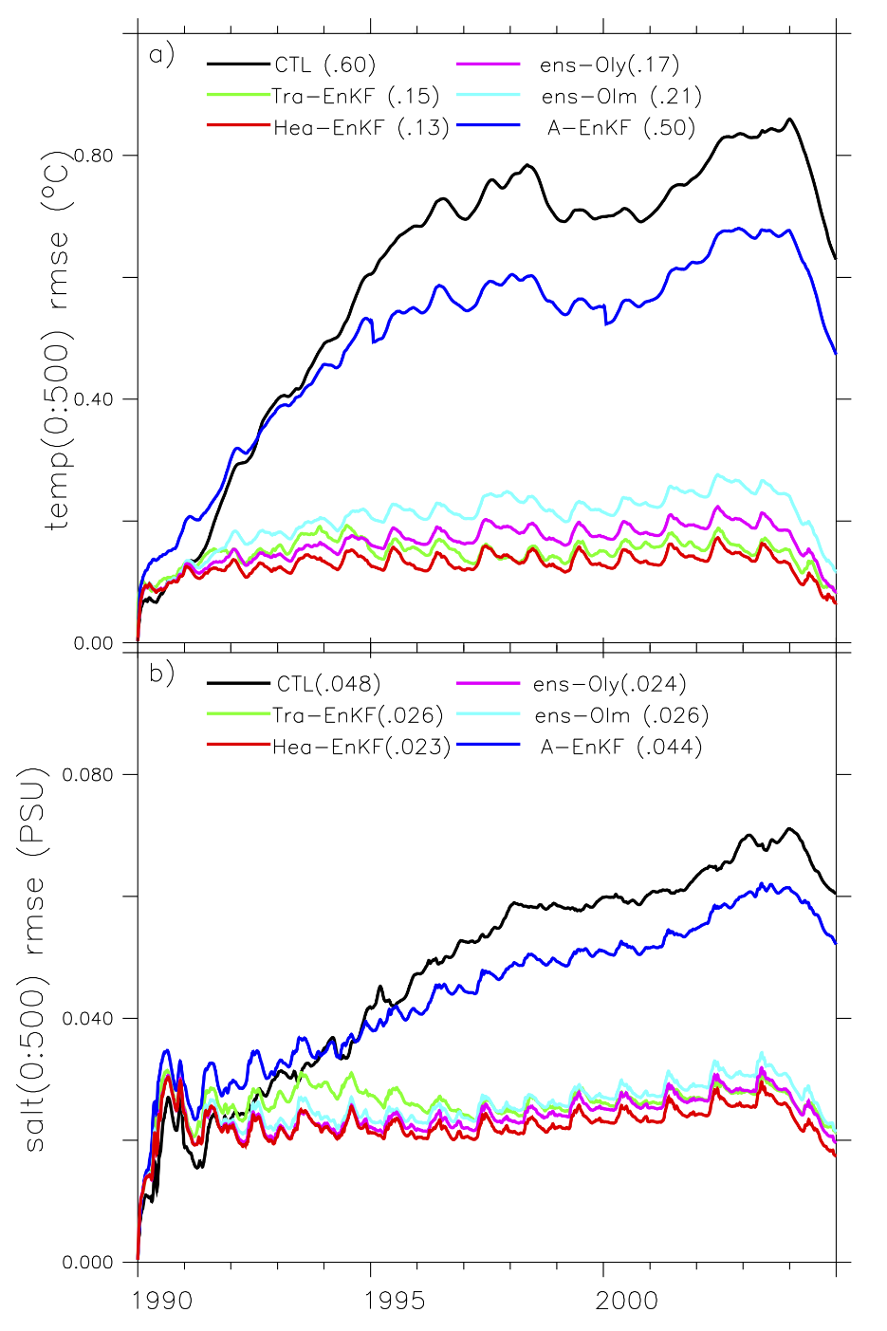
Validation with the hybrid coupled general circulation model (1): Assimilation RMSEs
Reducing the RMSE of the upper 500m ocean temperature and salinity compared to the CTL:
Tra-EnKF
 | temperature | salinity
Hea-EnKF | 78% | 52%
Tra-EnKF | 75% | 46%
Hea-EnKF
temp(0:500) rmse(℃)
The Hea-EnKF produces slightly better results than the Tra-EnKF does.
The “stationary” and low-frequency filters (ens-OI) contribute 87% for the temperature error reduction and 92% for the salinity error reduction.
The high-frequency filter (A-EnKF) contribution is a small fraction.
Tra-EnKF
Hea-EnKF
salt(0:500) rmse(PSU)

Slide 19
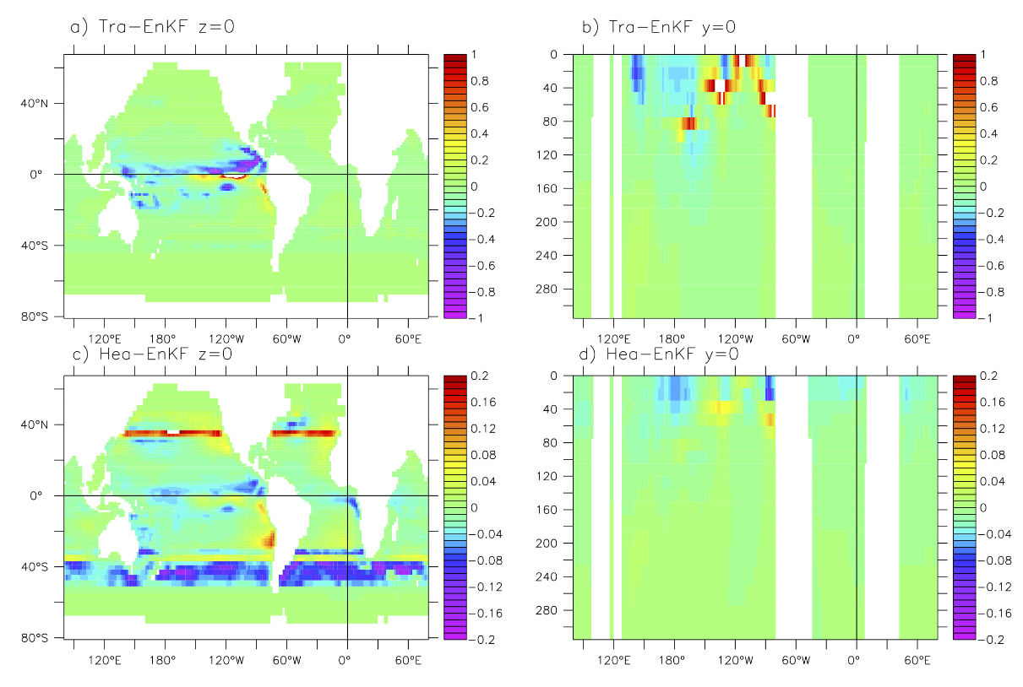
Validation with the hybrid coupled general circulation model (2): Distributions of adjustments
The Tra-EnKF adjustment mainly distributes over tropics
The Hea-EnKF adjustment can be observed in the areas where the circulation has oscillations
Tra-EnKF
Hea-EnKF

Slide 20
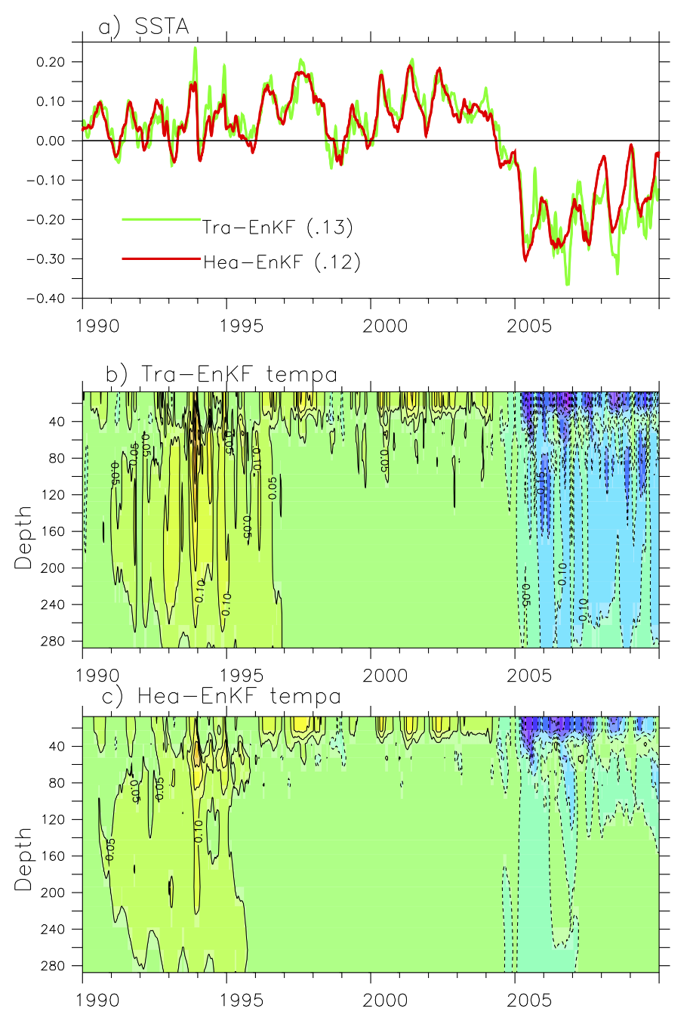
Validation with the hybrid coupled general circulation model (3): ENSO analysis errors
Nino3.4 SSTA index errors
Tra-EnKF Nino3.4 tempa errors
Compred to Tra-EnKF, the Hea-EnKF:
Improved the representation of statistics of slow-varying background flows
Improved ENSO analysis!
Hea-EnKF Nino3.4 tempa errors

Slide 21
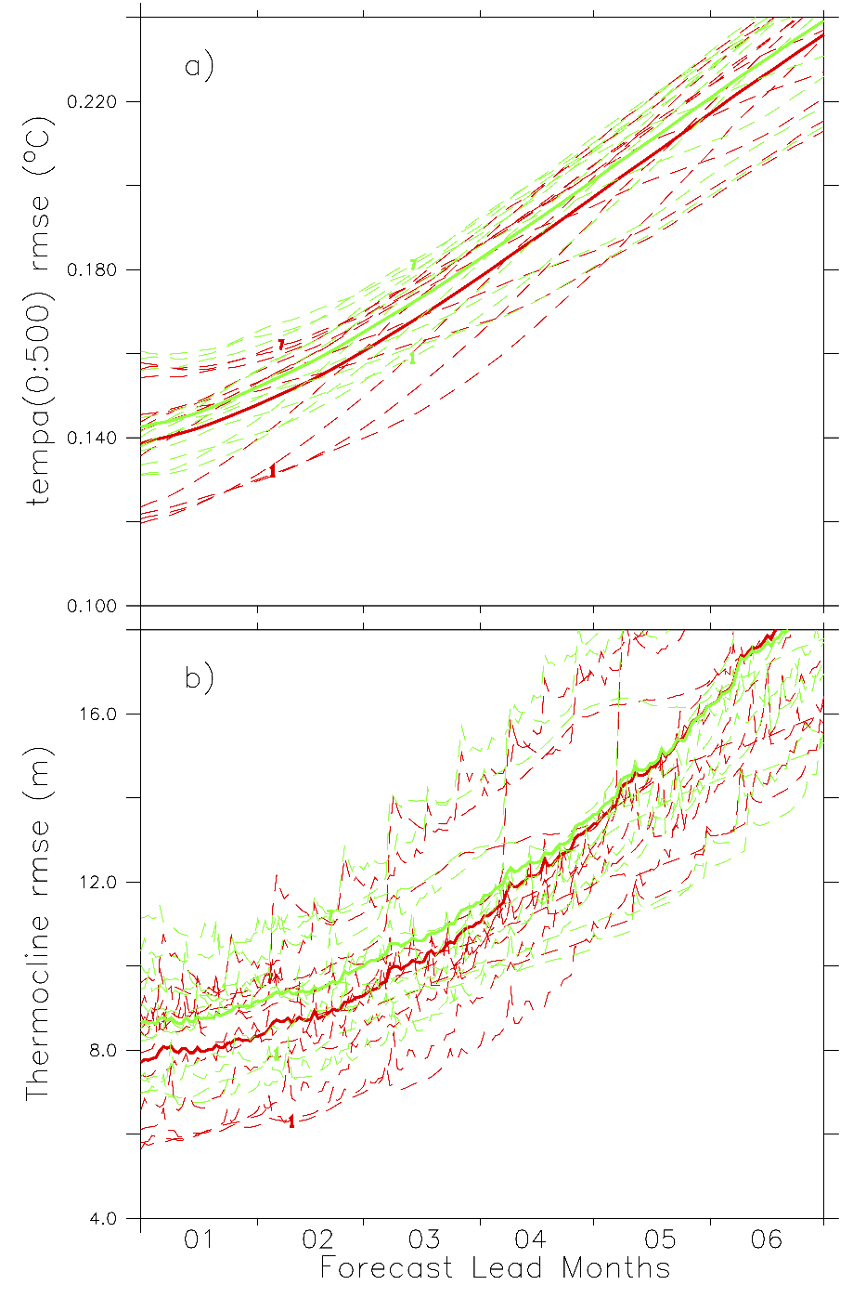
Validation with the hybrid coupled general circulation model (3): Forecast errors
temp(0:500) rmse(℃)
Tra-EnKF
The time series of forecast RMSEs of the a) tropical (20ºS – 20ºN) Pacific upper ocean (0–500 m) temperature and b) thermocline depth (the depth at 20ºC temperature) produced the Hea-EnKF (red) and Tra-EnKF (green) initialization schemes. The model forecasts are initialized at 00UTC of the first day of each month in 1997 (model calendar year) assimilation data (12 dashed lines), and the 12-case average is plotted by solid lines.
Hea-EnKF
thermocline rmse(m)
Tra-EnKF
More accurate initial condition produced by Hea-EnKF assimilation is able to improve the first 4-5 month forecasts of tropical oceans in this CGCM
Hea-EnKF
Forecast lead months

Slide 22
Summary
The traditional EnKF has two significant drawbacks:
Excessive computational resource demanding for ensemble model integrations, thus setting a significant limitation on applications to a high resolution earth system model
Insufficient representation on statistics of slow-varying background flows deteriorating the quality of data assimilation
The high efficiency approximation of EnKF (Hea-EnKF) has two significant advantages:
Dramatically reducing the computational resource demanding
Better representation of statistics of slow-varying background flows
Validated results show that:
Due to improved representation on statistics of slow-varying background flows, the Hea-EnKF while only requiring a small fraction of computer resources can be better than the standard EnKF that uses finite ensemble statistics.
The new algorithm can be applied to any high-resolution coupled model intractable with current super-computing power to assimilate multi-source observations for weather-climate analysis and predictions.

Slide 23
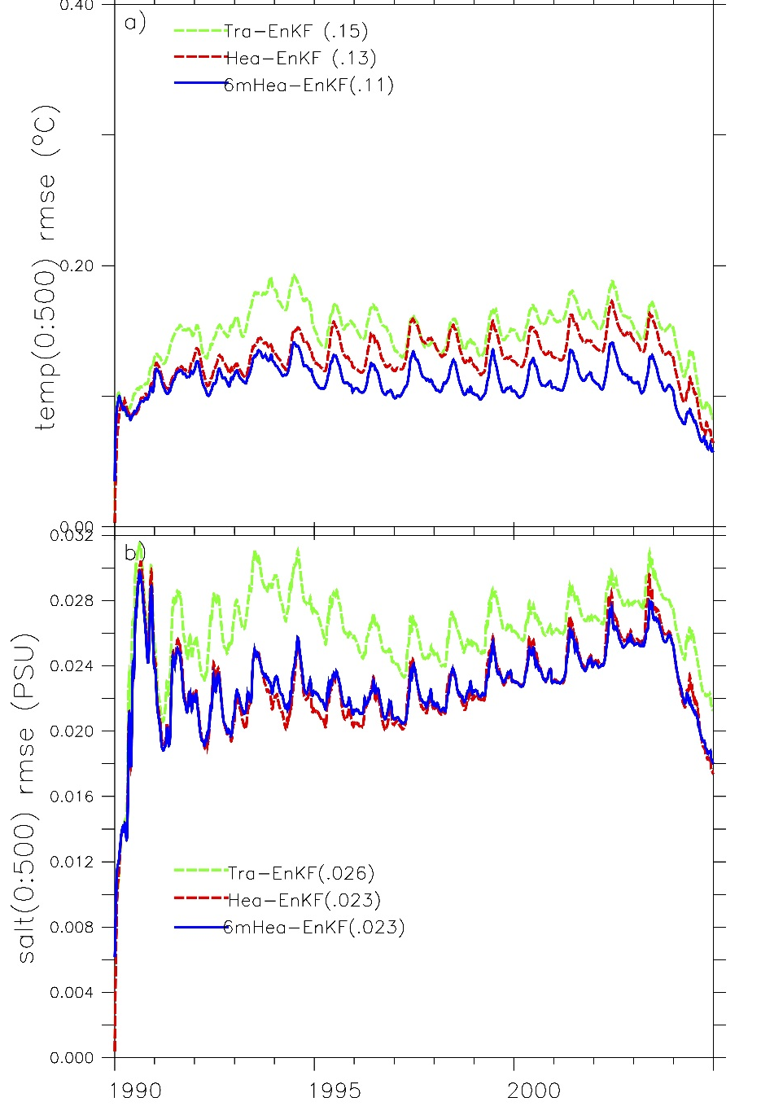
Discussions
Challenges:
It’s difficult to implement online model parameter estimation within the framework of single model solution filtering
It also weakens the nature of flow dependence of background error statistics in the original EnKF
Tra-EnKF
Hea-EnKF
6mHea-EnKF
temp(0:500) rmse(℃)
Try to solve:
An offline parameter estimation scheme with long time offline multiple model integrations
A new EnKF-like filtering algorithm implemented by a small-size ensemble of the single model solutions when the computational resources are applicable
Tra-EnKF
Hea-EnKF
6mHea-EnKF
salt(0:500) rmse(PSU)

Slide 24
Thank you for your attention！

Slide 25
Design of Hea-EnKF algorithm
Control experiment of Hea-EnKF and Tra-EnKF
A low-order coupled “climate” model
A hybrid coupled general circulation model
Twin experiment setup
Validation results of Hea-EnKF
Fail to pass the test
Fail to pass the test
The Generation of New algorithm

