Slide 1
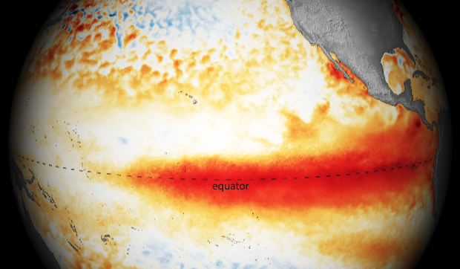



Nonlinear and Stochastic Problems in Atmospheric and Oceanic Prediction Workshop
ENSO Ensemble Prediction for the Past 161 Years from 1856-2016
Ting Liu¹，Youming Tang²， Yanjie Cheng³
1 Second Institute of Oceanography
2 University of Northern British Columbia
3 National climate center, China Meteorological Administration Department

Slide 2
OUTLINE
01
Introduction
02
Data & Model
03
Ensemble Construction
Interdecadal Variation of ENSO Predictability
04
05
Conclusion

Slide 3
01
Introduction

Slide 4

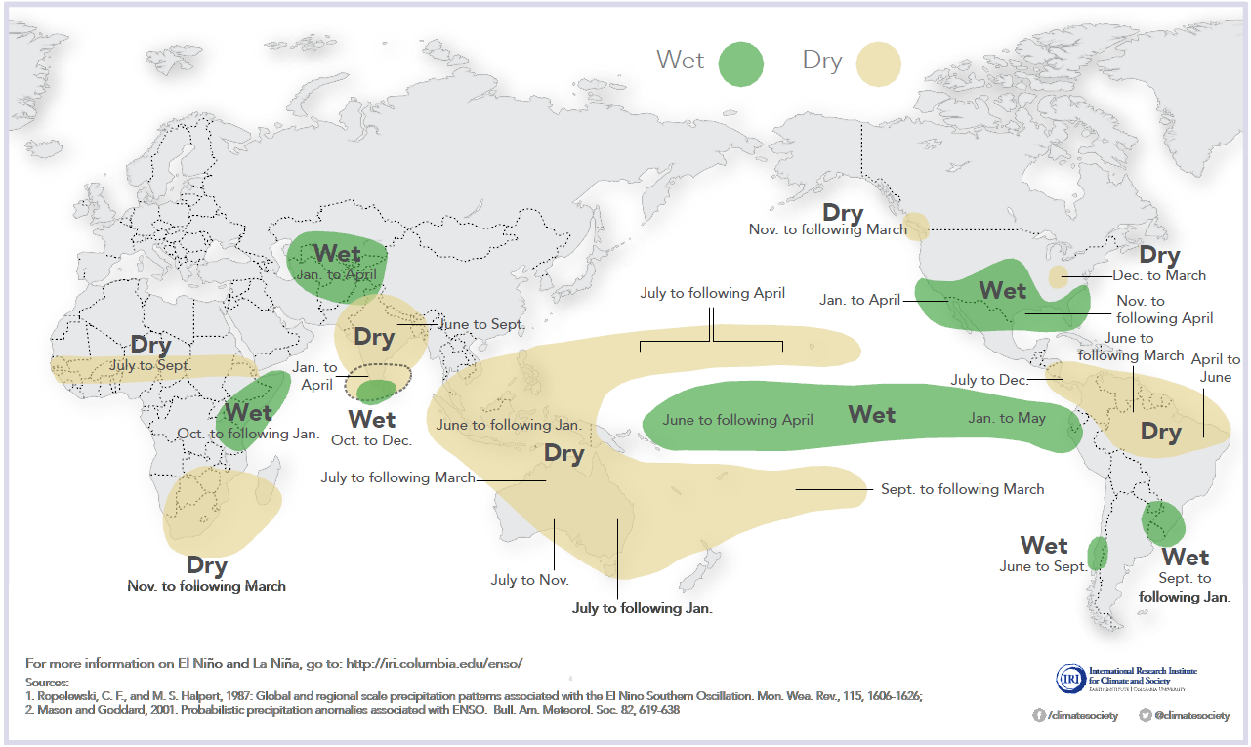
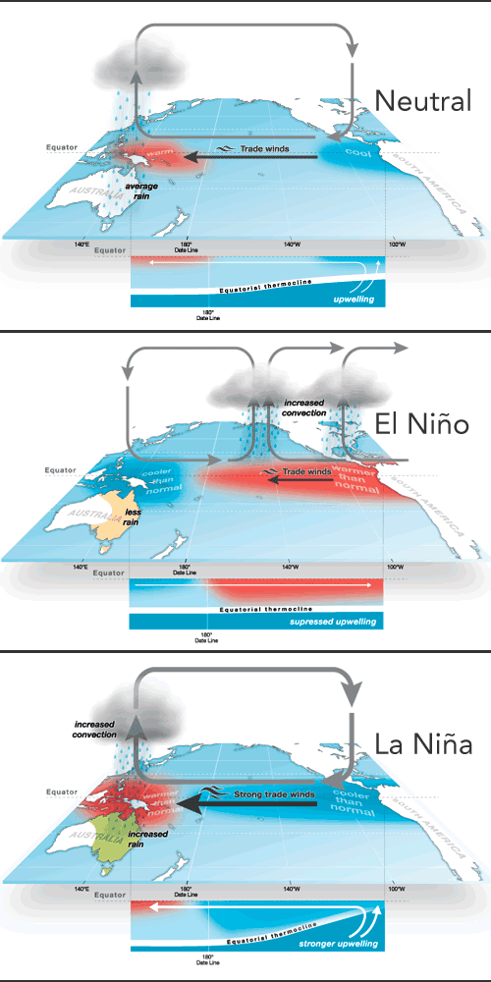
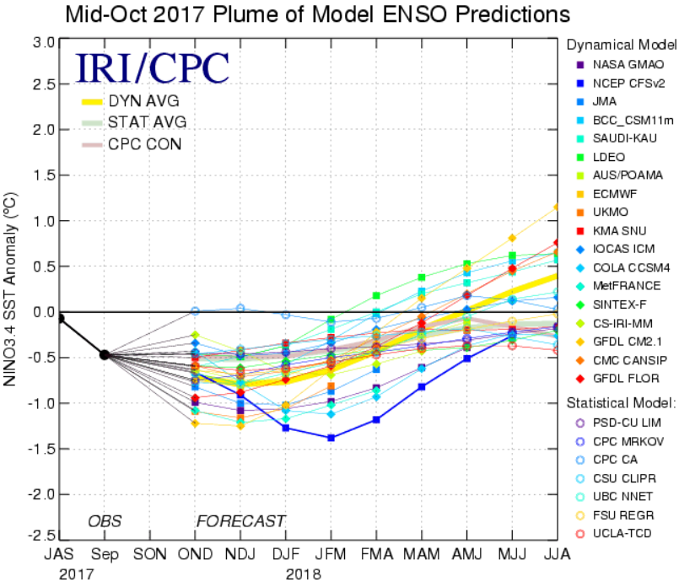
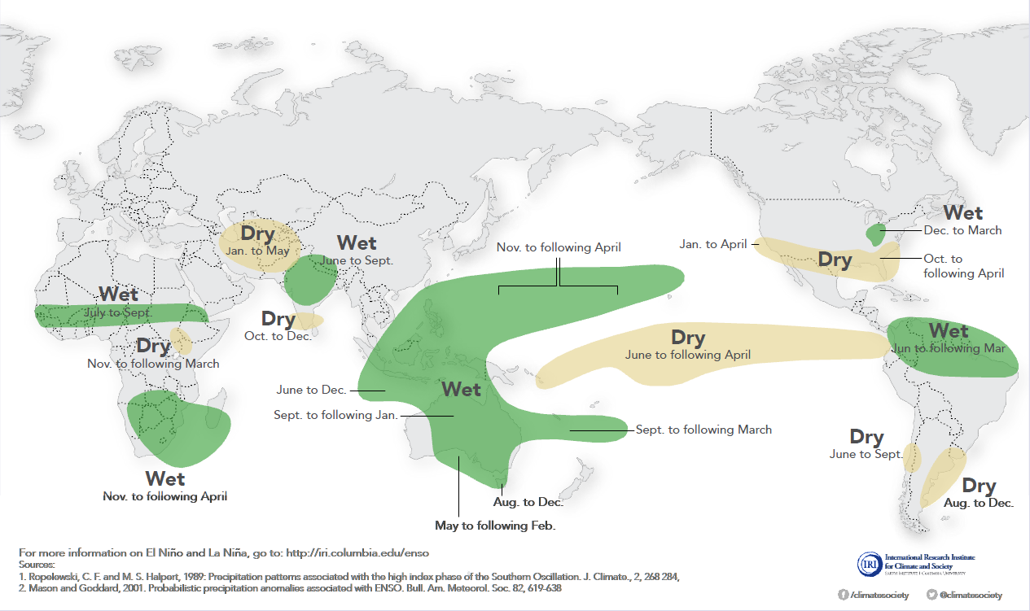
01
Introduction
El Niño and Rainfall
La Niña and Rainfall

Slide 5
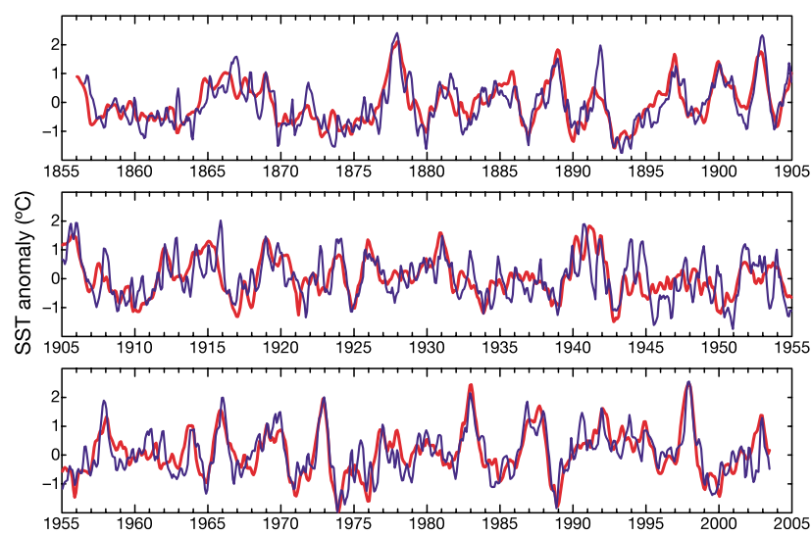
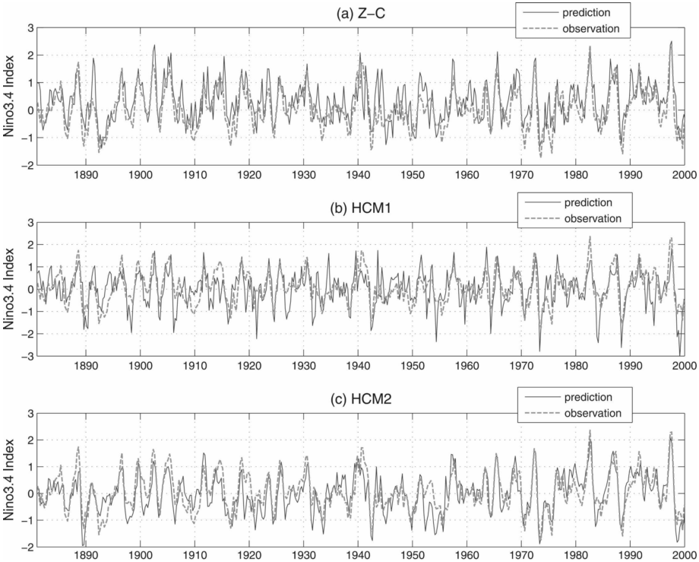
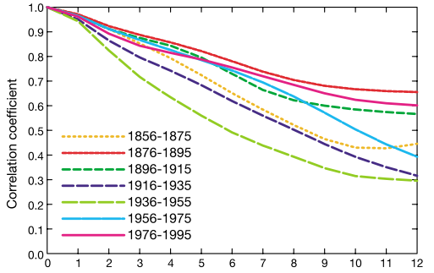
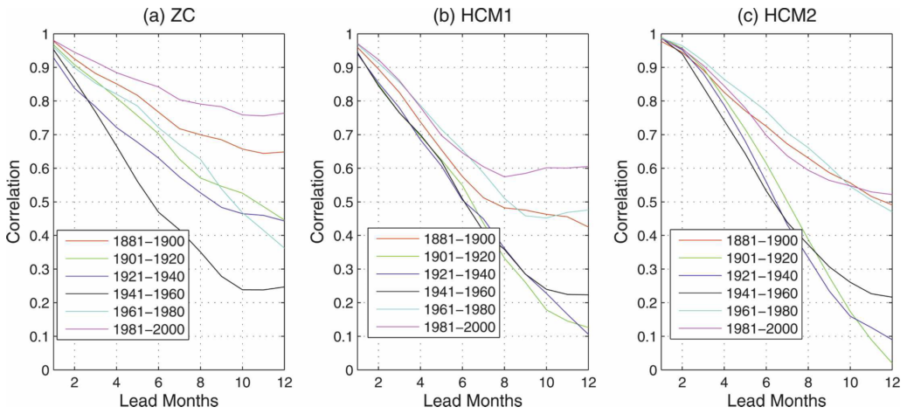
01
Introduction
Chen et al. 2004
Tang et al. 2008

Slide 6
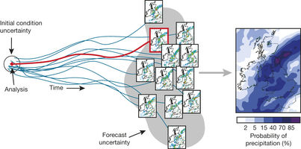
01
Introduction
Advantages
Ensemble averaging removes less predictable parts and keeps more predictable features among the ensemble members.
The loss of ENSO predictability depends on：
Errors in the initial conditions
  Model errors
  Unexpected external stochastic noise
Ensemble prediction provides a practical tool for estimating the possible uncertainties in a forecast system, which are useful in decision making.

Slide 7
02
Data & Model

Slide 8
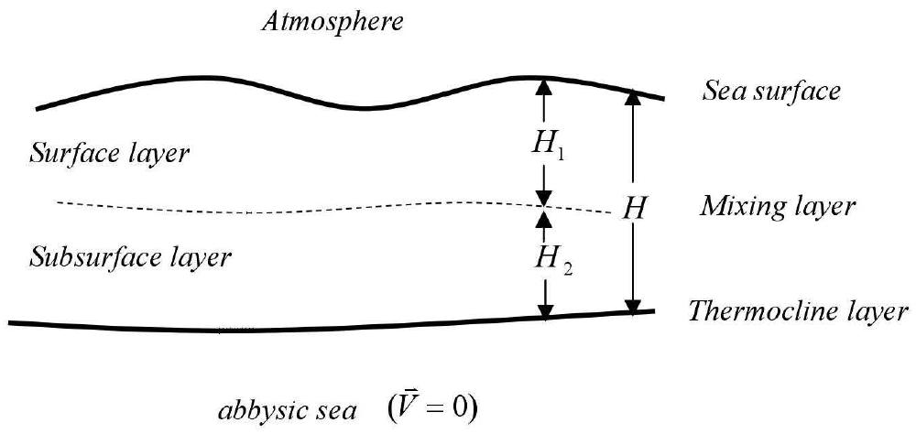
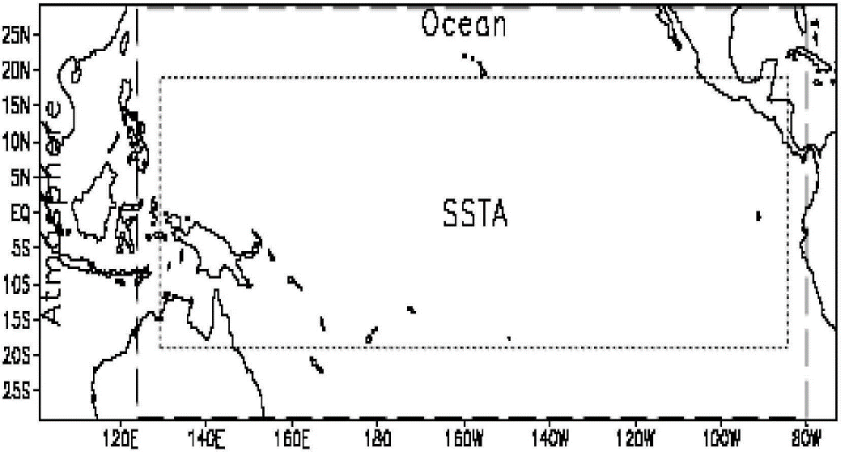
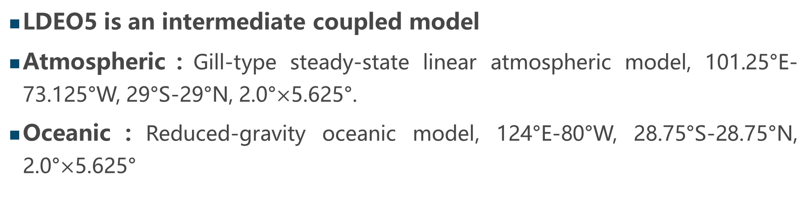
02
Data & Model
LDEO5 is an intermediate coupled model
Atmospheric：Gill-type steady-state linear atmospheric model, 101.25°E-73.125°W, 29°S-29°N, 2.0°$×$5.625°.
Oceanic：Reduced-gravity oceanic model, 124°E-80°W, 28.75°S-28.75°N, 2.0°$×$5.625°
23

Slide 9
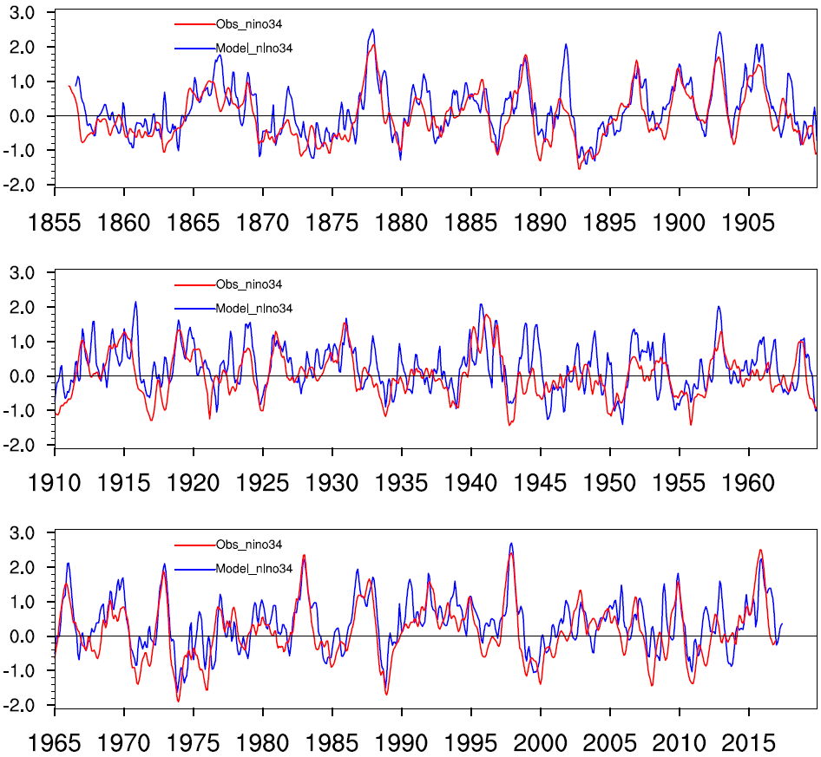
02
Data & Model
Hindcast Period
1856. 01—2016. 12, forcast 24 months
Assimilation
Kaplan SST V2, Chen et al. 2004 Nudging Scheme
Niño 3.4 index 6-month lead from Ldeo5
Evaluation Indicator
Correlation of individual forecast，CIP
L is forecast period.

Slide 10
03
Ensemble Construction

Slide 11
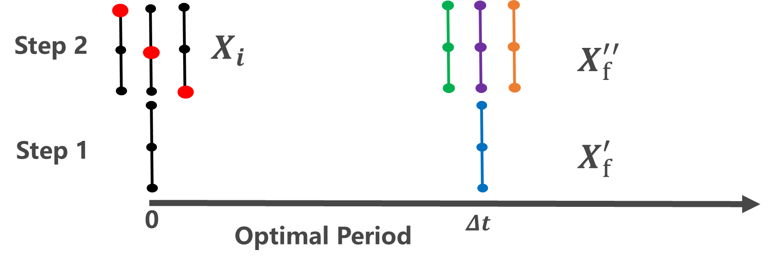
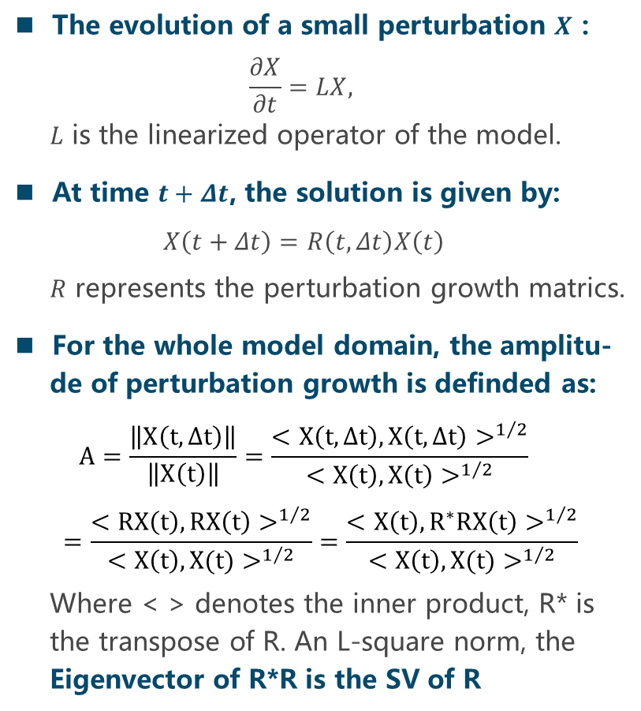
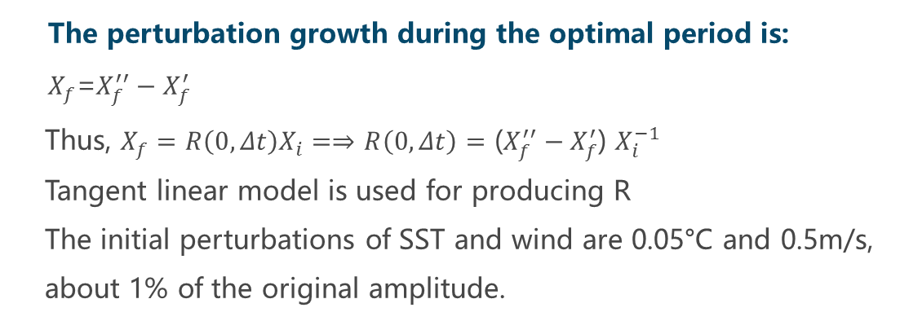
03
Singular Vector (SV) analysis
The evolution of a small perturbation $X$：
$$\frac{∂X}{∂t}=LX,$$
$L$ is the linearized operator of the model.
At time $t+Δt$, the solution is given by:
$$X\left(t+Δt\right)=R\left(t,Δt\right)X\left(t\right)$$
$R$ represents the perturbation growth matrics.
For the whole model domain, the amplitu-
de of perturbation growth is definded as:
$$A=\frac{\left\|X\left(t,∆t\right)\right\|}{\left\|X\left(t\right)\right\|}=\frac{{<X\left(t,∆t\right),X\left(t,∆t\right)>}^{1/2}}{{<X\left(t\right),X\left(t\right)>}^{1/2}}=\frac{{<RX\left(t\right),RX\left(t\right)>}^{1/2}}{{<X\left(t\right),X(t)>}^{1/2}}=\frac{{<X\left(t\right),R^{∗}RX\left(t\right)>}^{1/2}}{{<X\left(t\right),X(t)>}^{1/2}}$$
Where < > denotes the inner product, R* is
the transpose of R. An L-square norm, the
Eigenvector of R*R is the SV of R
The perturbation growth during the optimal period is:
$X_{f}$=$X_{f}^{′′}−X_{f}^{′}$
Thus, $X_{f}=$ $R\left(0,Δt\right)X_{i}=⇒$ $R\left(0,Δt\right)$ $=$ ($X_{f}^{′′}−X_{f}^{′}$) $X_{i}^{−1}$
Tangent linear model is used for producing R
The initial perturbations of SST and wind are 0.05°C and 0.5m/s,
about 1% of the original amplitude.

Slide 12
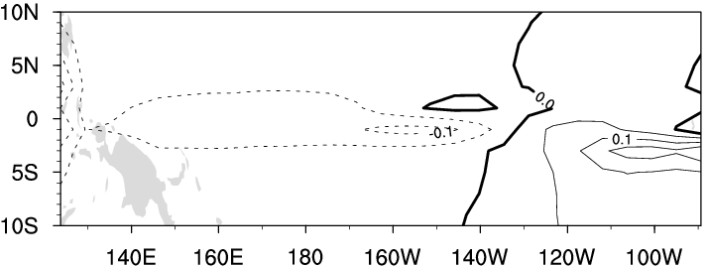
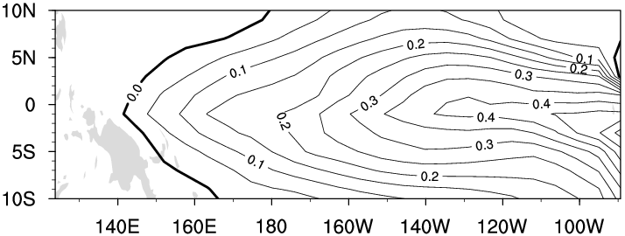
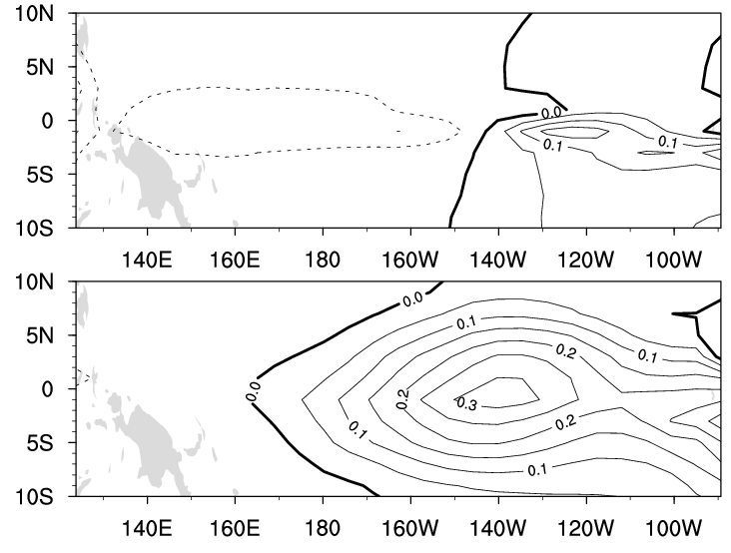
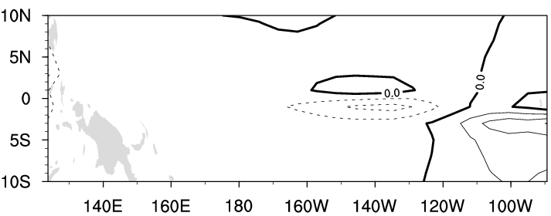
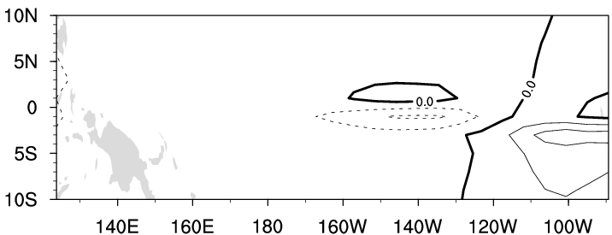
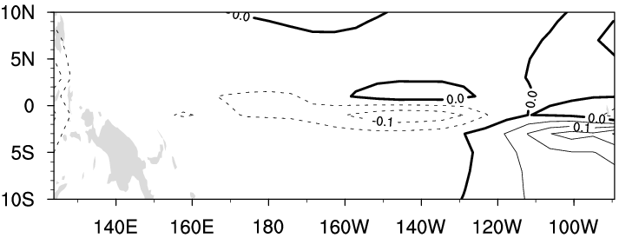
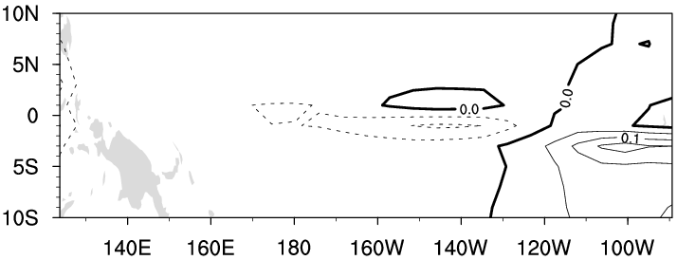
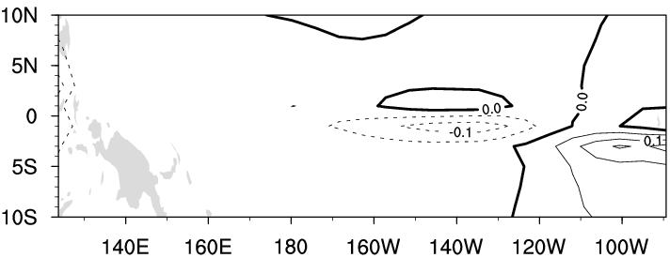
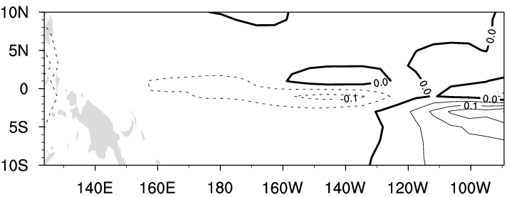
03
SV analysis
SV1
Final pattern 1
3m
15m
6m
18m
9m
21m
12m
24m

Slide 13
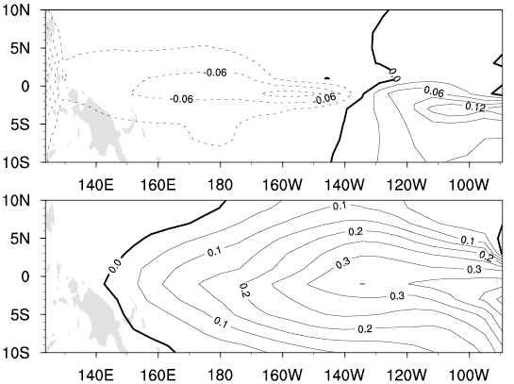
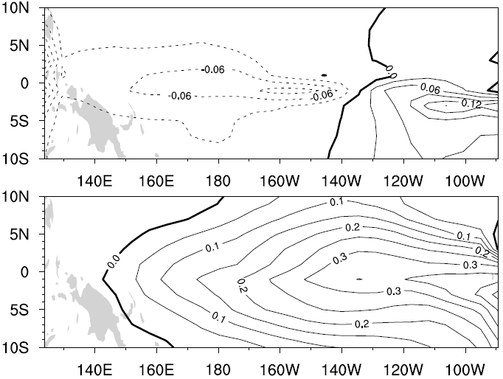
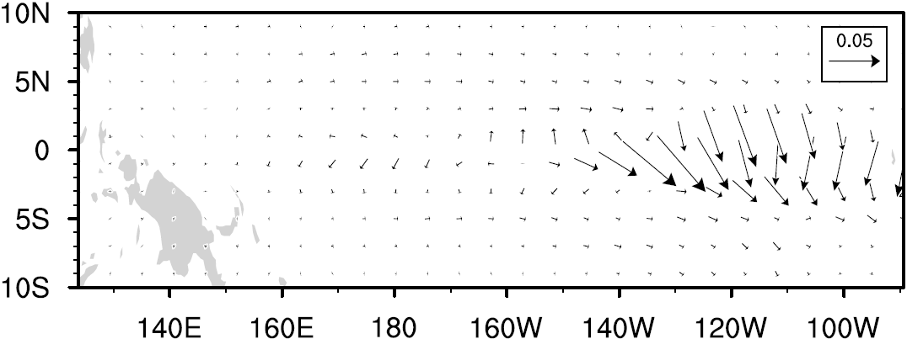
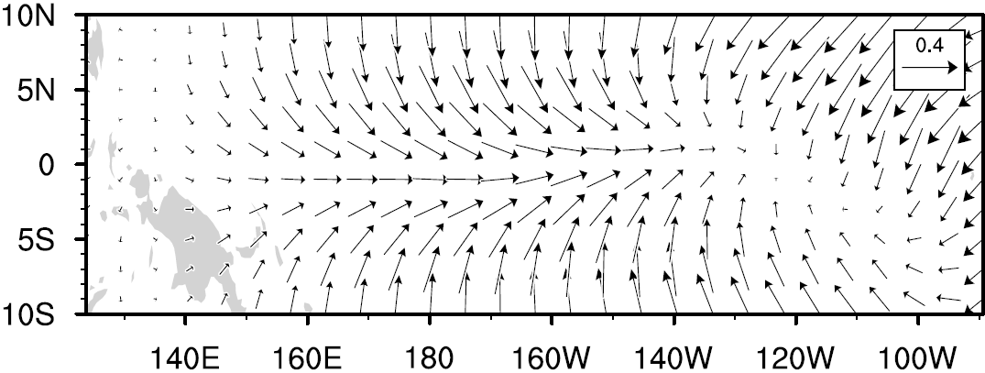
03
SV analysis
SV，SST
SV，SST
SV，UV

Slide 14
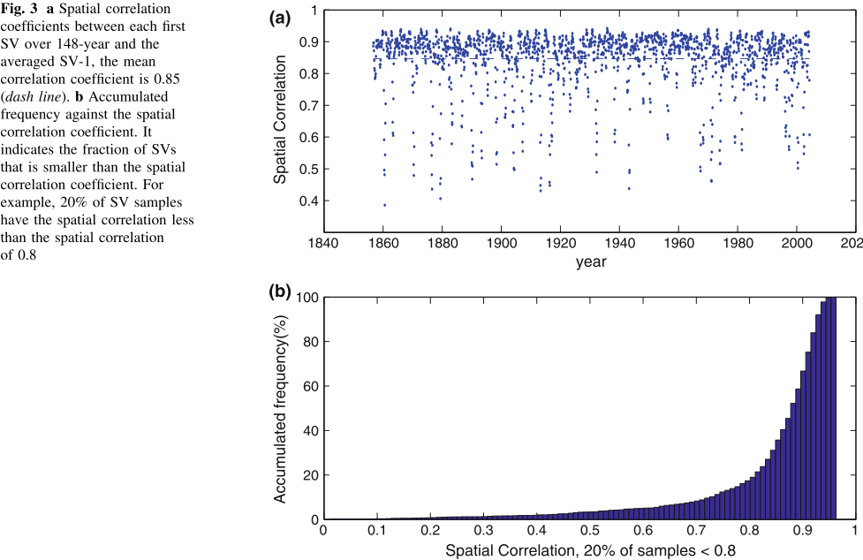
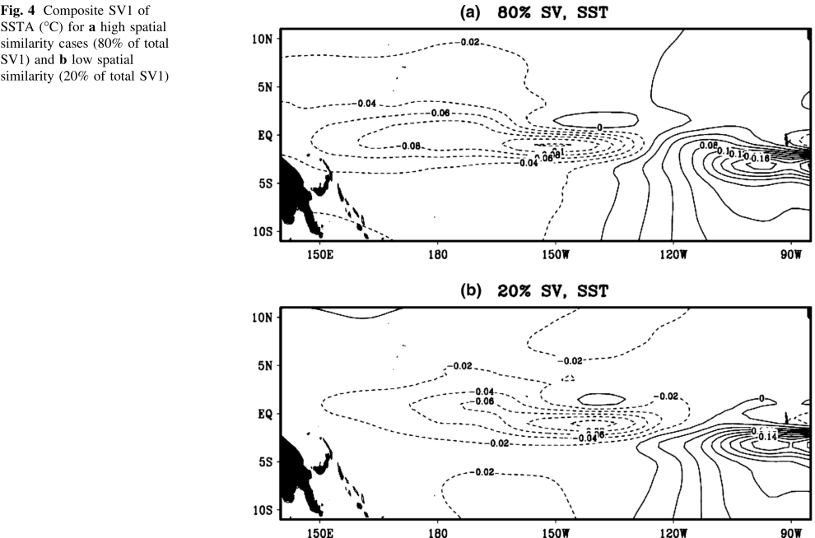
03
SV analysis
Spatial correlation
Composite SV1
Accumulated frequency

Slide 15
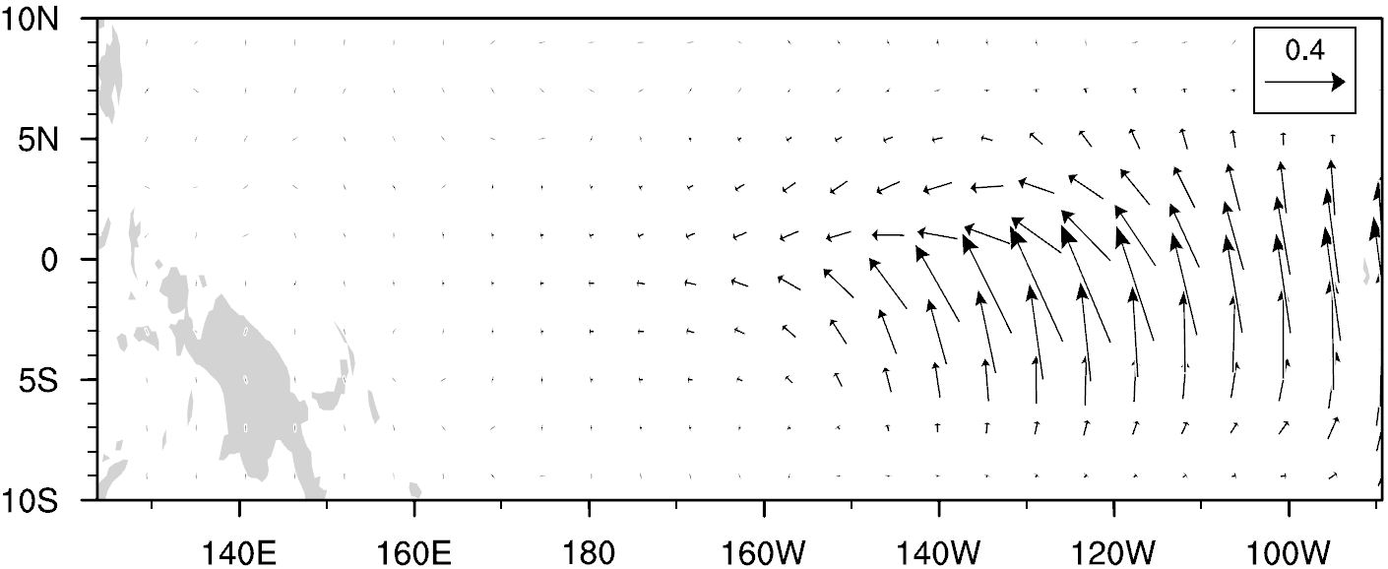
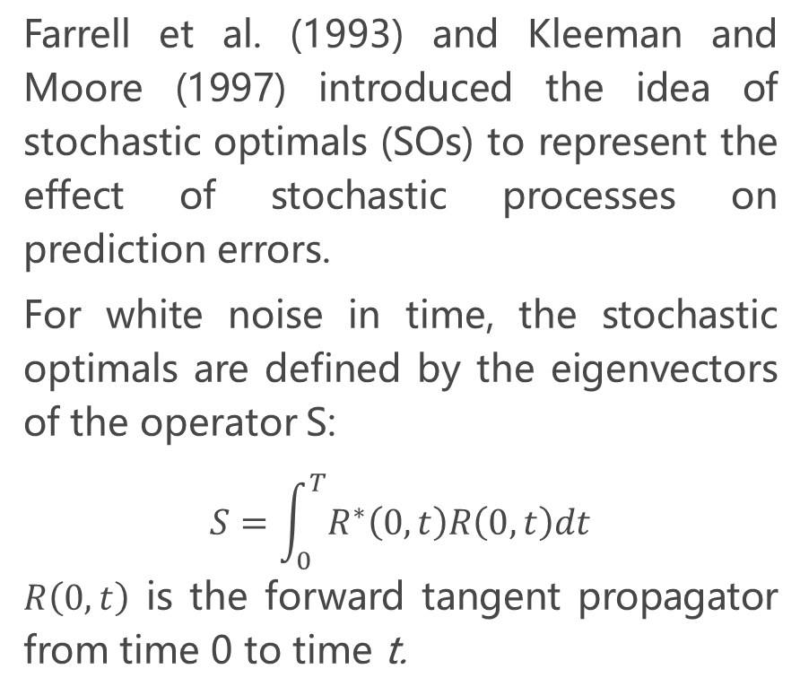
03
Stochastic Optimal (SO) analysis
Farrell et al. (1993) and Kleeman and Moore (1997) introduced the idea of stochastic optimals (SOs) to represent the effect of stochastic processes on prediction errors.
For white noise in time, the stochastic optimals are defined by the eigenvectors of the operator S:
$$S=\int_{0}^{T}{R^{∗}\left(0,t\right)R\left(0,t\right)dt}$$
$R\left(0,t\right)$ is the forward tangent propagator from time 0 to time t.
SO1

Slide 16
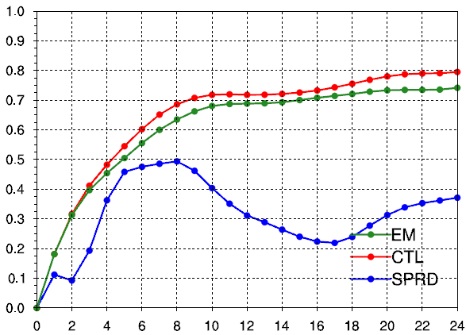
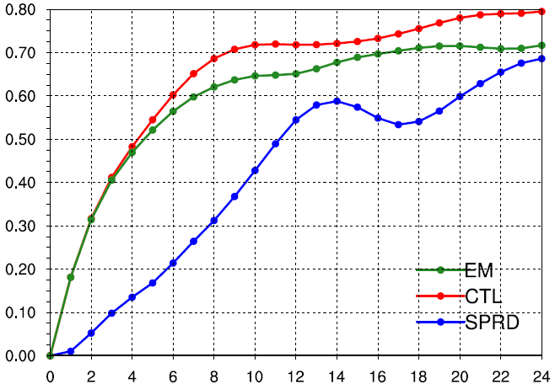
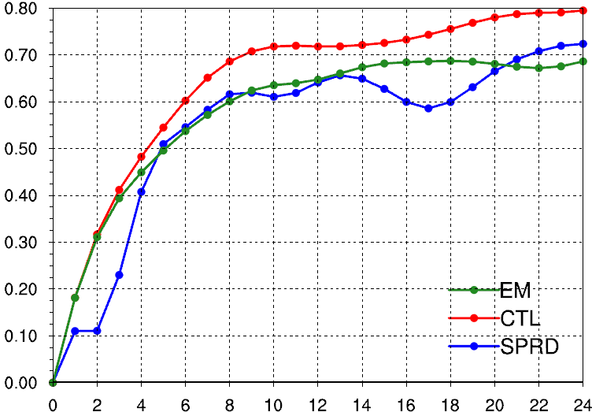

03
Ensemble Prediction
$${SPRD≈RMSE}_{EM}≤{RMSE}_{CTL}$$
SV
SO
SV+SO

Slide 17
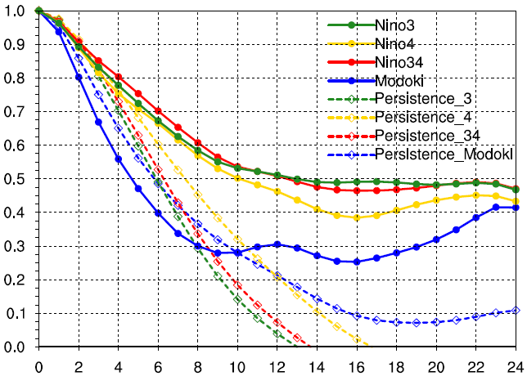
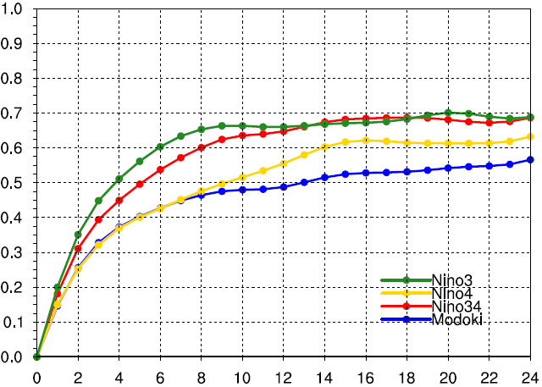
03
Ensemble Prediction
Correlation
RMSE

Slide 18
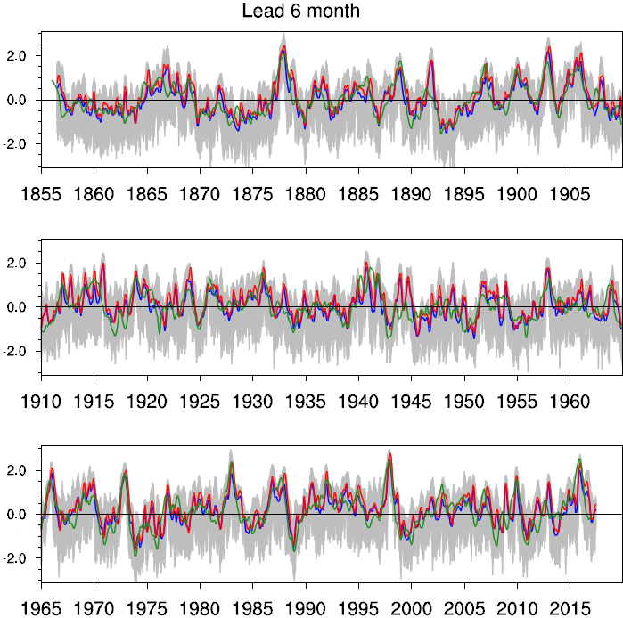
03
Ensemble Prediction
Control Run
Observation
Ensemble Mean
Ensemble Cases

Slide 19
04
Interdecadal Variation of ENSO Predictability

Slide 20
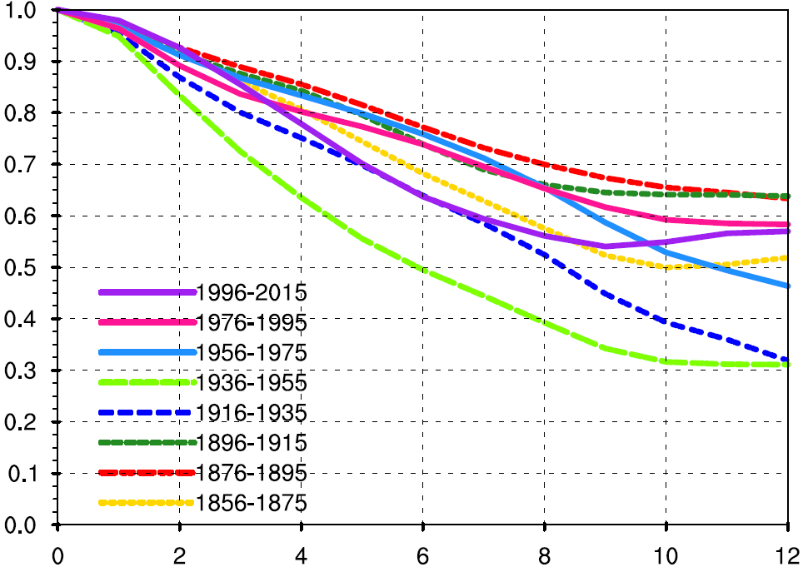
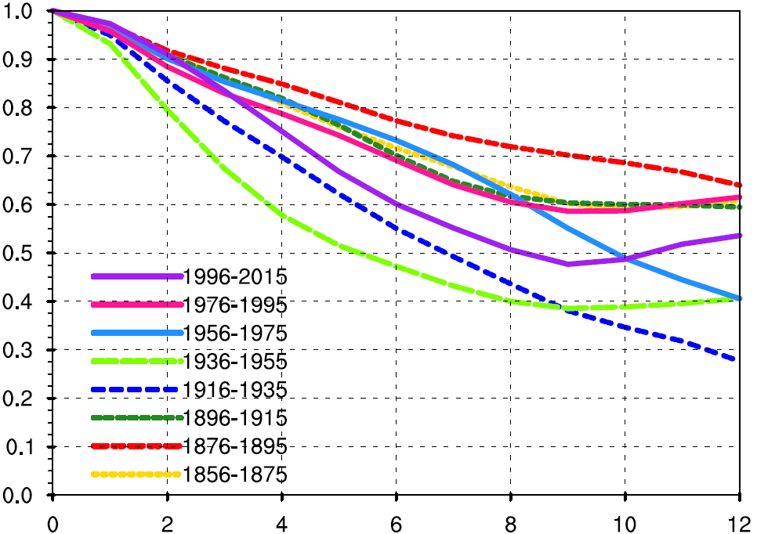
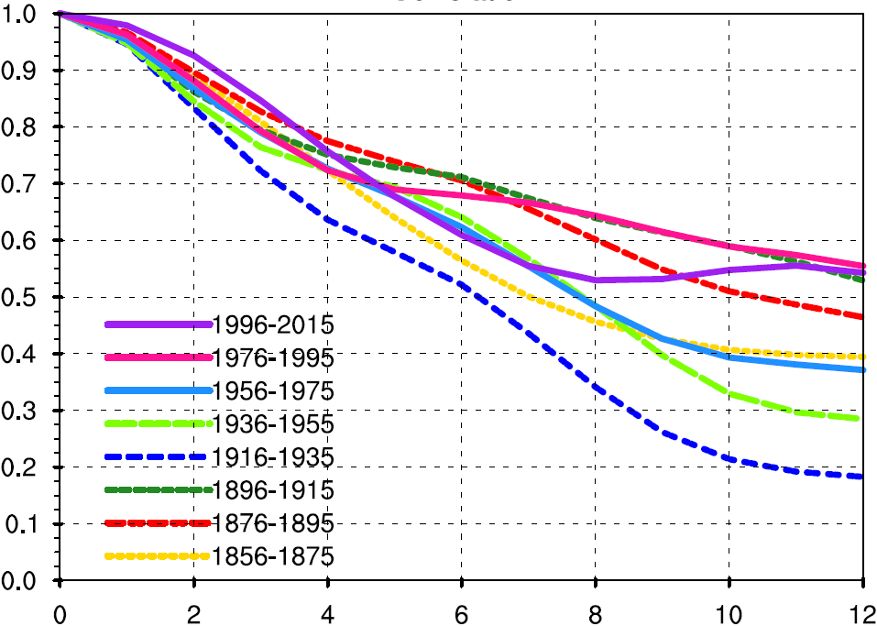
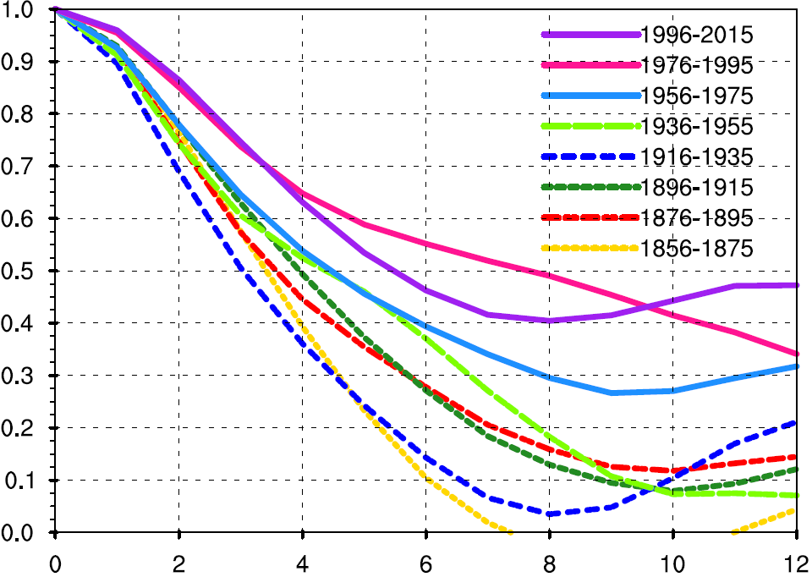
04
Interdecadal Variation
Niño 3.4
Niño 3
Niño 4
Modoki

Slide 21
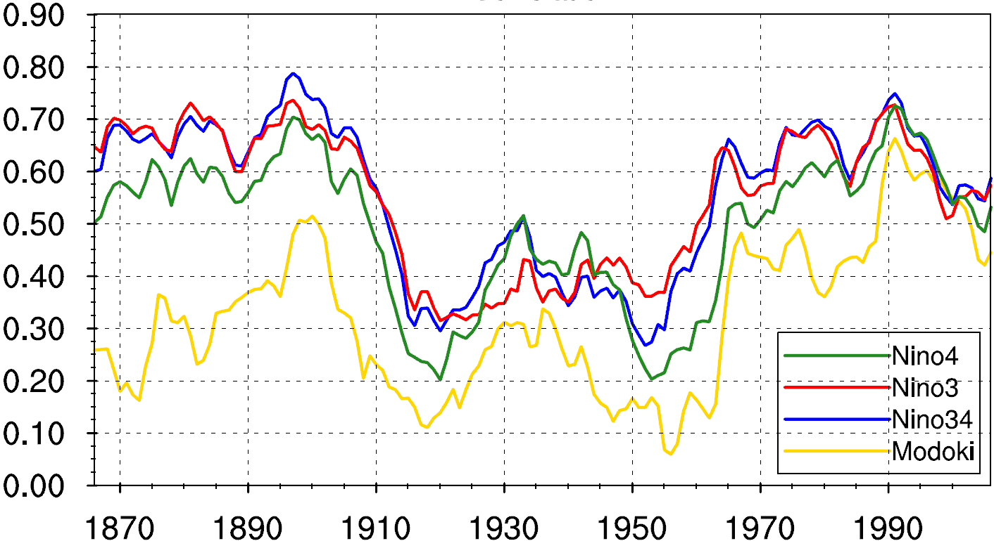
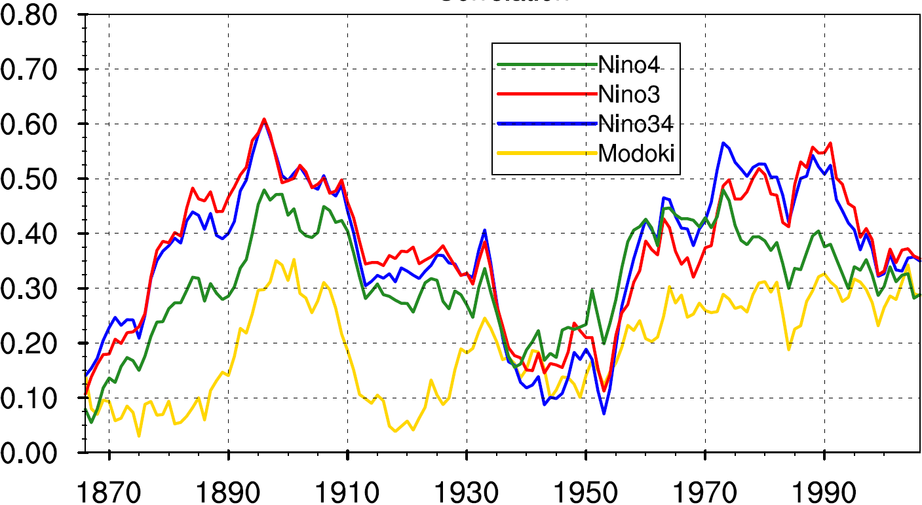
04
Interdecadal Variation
Mean R (Obs, Prediction) lead 1–12m
Mean CIP lead 1–12m

Slide 22
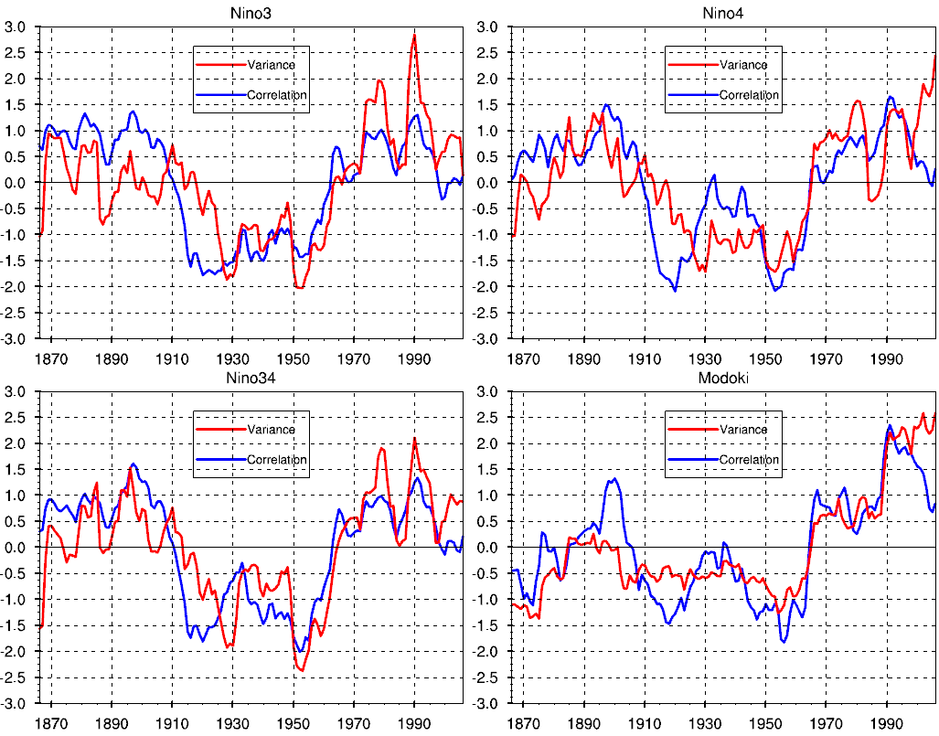
04
Interdecadal Variation
Niño 3
Niño 4
Niño 3.4
Modoki

Slide 23
05
Conclusion

Slide 24

05
Conclusion
The reliability of ENSO ensemble forecast is sensitive to the choice of ensemble construction strategy.
The strategy benefiting from the joint contributions of the SO and SV produces the most reliable and skillful ENSO prediction.
The stochastic optimal winds play an important role in improving the ENSO predictability for the ZC model.
The prediction skill of ENSO indexes are very consistent in interdecadal variation, with decline of the prediction skill in the recent 20 years.
The interdecadal variation in ENSO predictability is in good agreement with that in the signal variability. The signal strength of initial conditions often dominate model prediction skills.

Slide 25

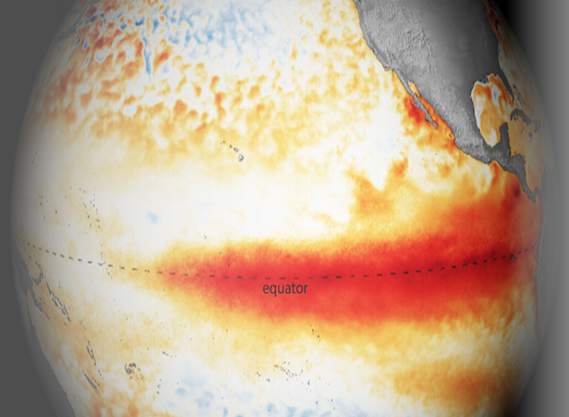
THANKS!
Reference：
Cheng Y. J., Y. M. Tang et al., 2009: Further analysis of singular vector and ENSO predictability in the Lamont model—Part I: singular vector and the control factors. CD, 35(5): 807-826.
Cheng, Y., Y. M. Tang, et al., 2010: Ensemble Construction and Verification of the Probabilistic ENSO Prediction in the LDEO5 Model. JC, 23(20): 5476-5497.

