Slide 1
Rotating-stratified turbulence near an idealized tropopause
with O Asselin and P Bartello
(McGill)

Slide 2
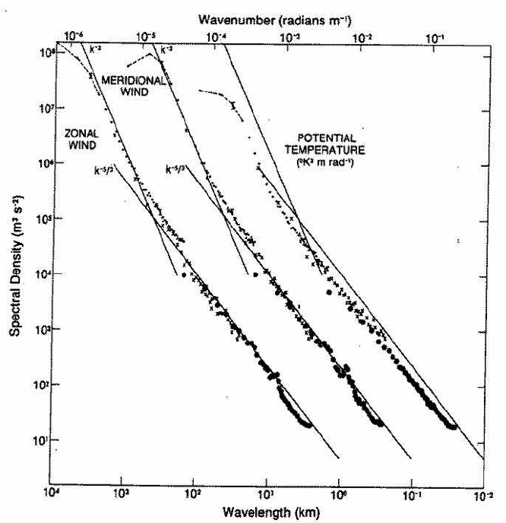
Introduction
Observations show a “mesoscale kink” in the atmosphere’s KE spectrum
Data mostly from near-tropopause commercial airline flights
Most theories to explain this
  Assumes balance at synoptic scales and unbalance in the mesoscale
  But ignore the tropopause per se
Exception: one theory assumes QG dynamics modified by a tropopause
Our work reconciles these viewpoints
Nastrom-Gage Spectrum

Slide 3
Introduction
Our work reconciles these viewpoints
We are also concerned with
  When linear or weakly nonlinear theory makes sense. Eg, W-VW triads or interpretations of the mesocale that use linear dispersion relations
  The role of balanced-to-unbalanced energy transfers or “Stimulated Loss Of Balance”
  (work with S Taylor and A Riopel)

Slide 4
An SQG model of tropopause dynamics
(and why it makes no sense)
QG assumes
  Small Rossby and Froude numbers
  Material conservation of PV in the interior
  Material conservation of buoyancy at lids
For a discontinuous jump in N, the buoyancy equation is replaced with

Slide 5
An SQG model of tropopause dynamics
(and why it makes no sense)
QG assumes
  Small Rossby and Froude numbers
  Material conservation of PV in the interior
  Material conservation of buoyancy at lids
For a discontinuous jump in N, the buoyancy equation is replaced with
QGPV is dominated by the stretching term at the jump, and this leads to
a forward cascade of buoyancy
a -5/3 KE spectrum

Slide 6
An SQG model of tropopause dynamics
(and why it makes no sense)
QG assumes
  Small Rossby and Froude numbers
  Material conservation of PV in the interior
  Material conservation of buoyancy at lids
For a discontinuous jump in N, the buoyancy equation is replaced with
QGPV is dominated by the stretching term at the jump, and this leads to
a forward cascade of buoyancy
a -5/3 KE spectrum
hydrostatic instability

Slide 7
An SQG model of tropopause dynamics
(and why it makes no sense)
Figure: vertical slices or b and w from a QG simulation of decaying turbulence (512³)
The base state N transitions from troposphere to stratosphere levels like a hyperbolic tangent
The buoyancy eqn implies that one of w or b must develop sharp vertical gradients

Slide 8
An SQG model of tropopause dynamics
(and why it makes no sense)
Figure: vertical slices or b and w from a QG simulation of decaying turbulence
The base state N transitions from troposphere to stratosphere levels like a hyperbolic tangent
The buoyancy eqn implies that one of w or b must develop sharp vertical gradients
The omega eqn (and simulations) suggest that it is b that develops sharp gradients

Slide 9
An SQG model of tropopause dynamics
(and why it makes no sense)
So, QG produces shallow spectra (associated with role-ups of pv filaments), but also produces unstable stratification
The buoyancy eqn implies that one of w or b must develop sharp vertical gradients
The omega eqn (and simulations) suggest that it is b that develops sharp gradients

Slide 10
Move to Boussinesq Dynamics
QG predicts its own demise when U/Nh becomes O(1)
Ie, expect departures from QG except for very weak flows

Slide 11
Move to Boussinesq Dynamics
QG predicts its own demise when U/Nh becomes O(1)
Ie, expect departures from QG except for very weak flows
Spectral slopes (following an initial adjustment). Blue: constant N. Red: with a tropopause. Horz. axis is rms U

Slide 12
Move to Boussinesq Dynamics
Expect significant departures from QG when U/Nh becomes O(1)
Ie, expect departures from QG except for very weak flows
Spectral slopes (following an initial adjustment). Blue: constant N. Red: with a tropopause. Horz. axis is rms U

Slide 13
Move to Boussinesq Dynamics
Top Left: weak flow, variable N
Top Right: intermediate flow
Bot Left: const N
Bot Right: strong flow
Note asymmetry between the steepening (btw U = 1, 5) and the subsequent shallowing (U > 5m/s).

Slide 14
Frequency spectra (for different kh) from our U = 20 m/s simulation

Slide 15
Decomposition of the spectra into rotational/divergent
and fast/slow parts
Fast/slow decomposition for select wavenumbers only
Triangles indicate quasi-linear

Slide 16
Linearity as a function of scale
Large scales ~ QG: Coriolis and pressure dominate, tendency and advection comparable (fast modes quasi-linear, but total flow is dominated by slow modes)
Near the kink: fast modes nonlinear
Smaller scales, pressure term larger than Coriolis (“stratified turbulence” --- but note that this range is fed by the larger scale fast modes (which, we claim, are in turn fed by balanced –to –unbalanced transfers)

Slide 17
Sensitivity to initial conditions
Initial conditions respected QG balance (but without higher order corrections)
Note presence of waves. So, is the fast time scale motion we see a remnant of these or does it come from a subsequent loss of balance?

Slide 18
Sensitivity to initial conditions

Slide 19
Sensitivity to initial conditions
Initial conditions do lead to persistent differences (eg, in our t = 5-10 turnover time averaging period)
But this may be in part related to “Stimulated Loss of Balance”
The basic idea is that balanced-to-unbalanced energy transfers depend on the amount of unbalanced energy present

Slide 20
The Xie and Vanneste Model – or SLOB
Separates flow into slow and fast modes
(without assuming WKB)
Conclude that a forward cascade of near-inertial energy implies a sink of geostrophic energy
Fast KE and total E are both conserved
A forward transfer of NIWs implies an increase in fast PE
But since fast KE is conserved, this implies loss of balance
Wagner and Young (2016) have a similar model, but also include frequencies near 2f

Slide 21
Conclusions
Well, I’m probably out of time…
But the main claim is that weakly nonlinear ideas (including SLOB and Bartello 95’s idea that catalytic W-VW triads cascade wave energy to small scales) likely apply at synoptic scales
Whereas assuming weak nonlinearity into the mesoscale is more dubious

