Slide 1
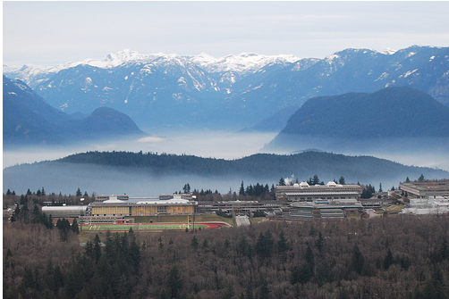
Expanding, evaluating and combining tree shape statistics
Leonid Chindelevitch, School of Computing Science, Simon Fraser University

Slide 2
Presentation outline
Introduction: tree shape statistics
Novel network science-based statistics
Overview of spectrum-based statistics
Evaluation of tree shape statistics
Combination of tree shape statistics

Slide 3
Introduction: tree shape statistics
In this talk, a tree is a rooted binary tree with unordered children
It is easy to decide if two trees are identical, but how similar are they?
How similar are different trees from a given context?
How dissimilar are trees found in two different contexts?
We can define metrics, but they are often computationally expensive

Slide 4
Tree statistics: the Holy Grail
Capture an important feature of a tree with a single number that is:
  easy to compute
  easy to interpret
  good for distinguishing contexts
  useful in ABC algorithms on trees
Tree statistics can be based on:
  branch length
  topology
  shape (combination of both)

Slide 5
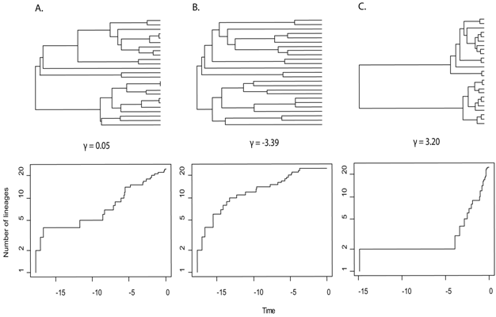
Branch lengths: lineages-through-time plot
From Myers, E. & Burbrink, F. (2012) Ecological Opportunity: Trigger of Adaptive Radiation. Nature Education Knowledge 3(10):23
Notes:
Three different values of an evolutionary parameter give three qualitatively different shapes.

Slide 6
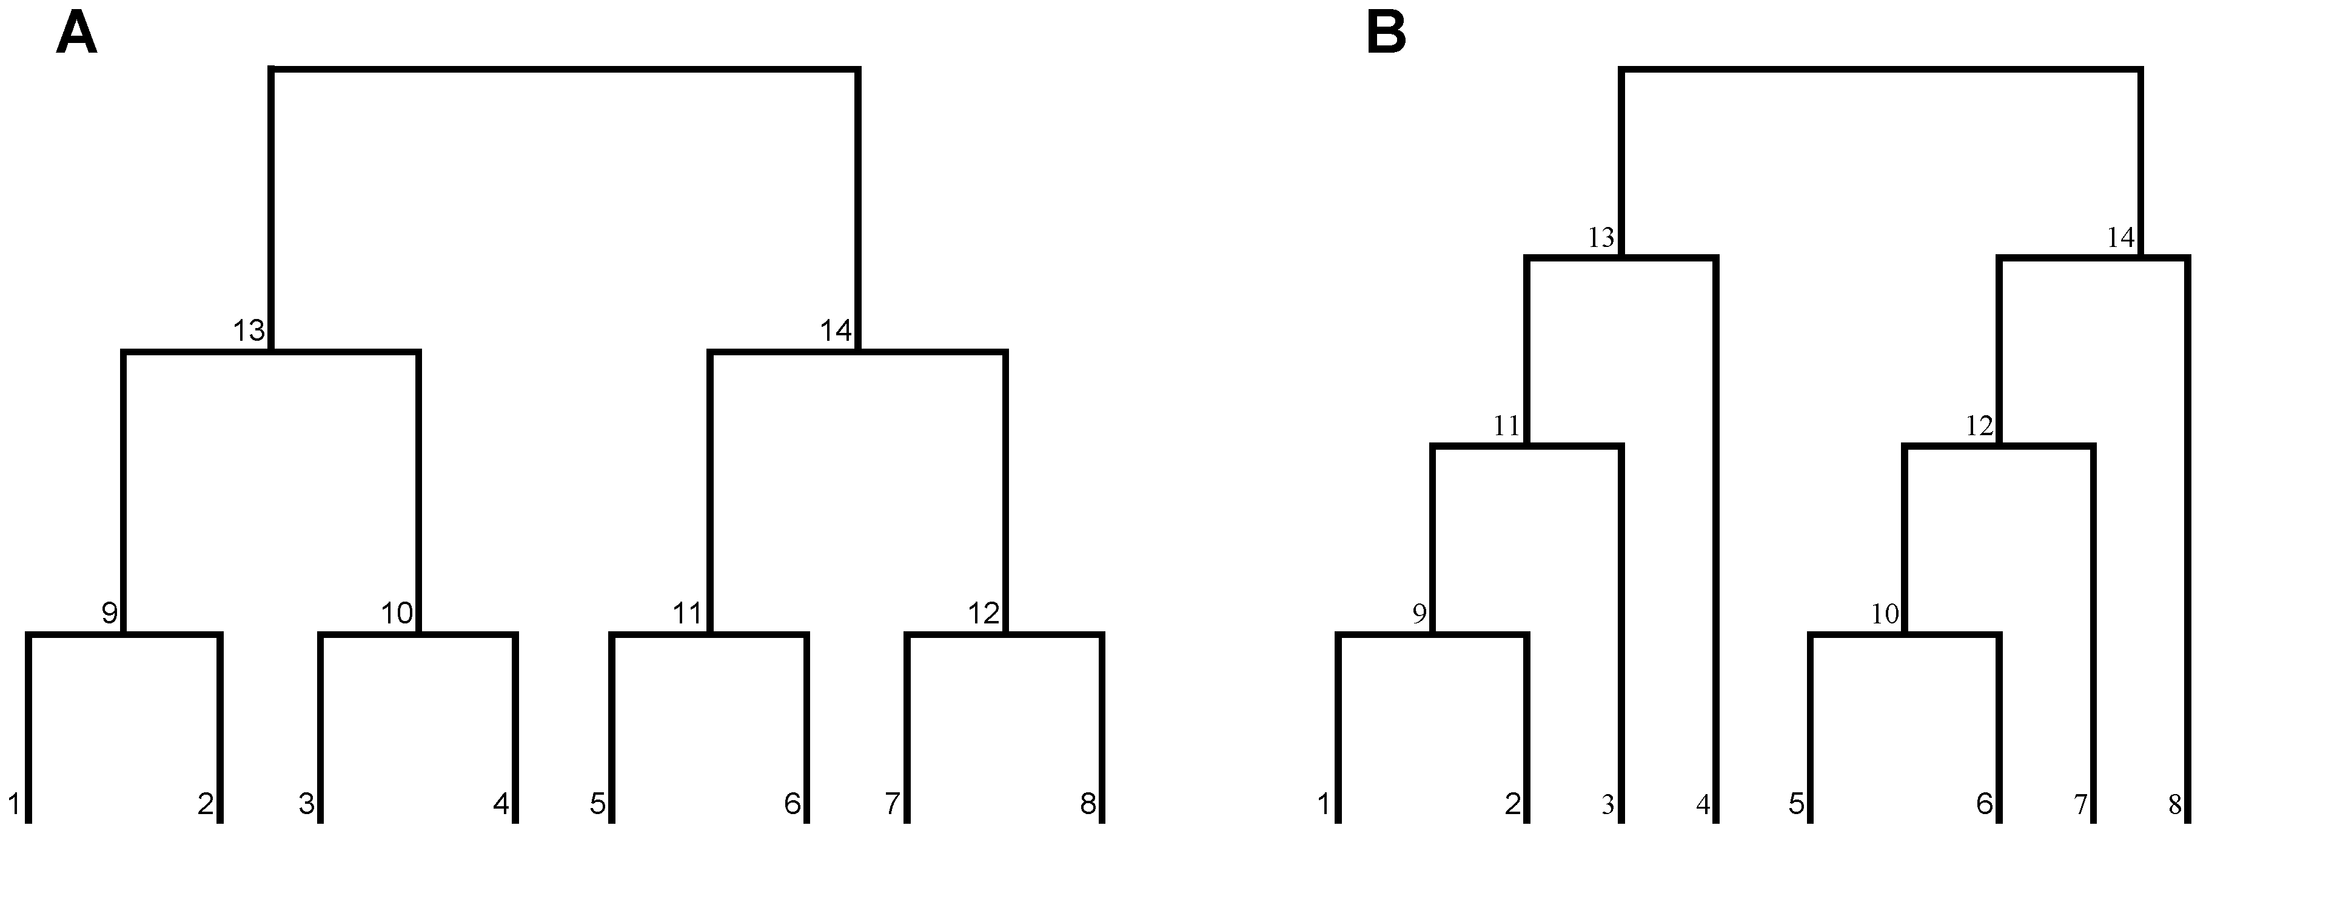
Topology: Sackin’s index, Colless’s imbalance
From Presley SJ, Scheiner SM, Willig MR (2014) Evaluation of an Integrated Framework for Biodiversity with a New Metric for Functional Dispersion. PLoS ONE 9(8): e105818
Notes:
Sackin’s index is the average depth of a tip. Colless’s imbalance measures the sum, over all internal nodes, of the size difference between the left and the right subtrees.

Slide 7
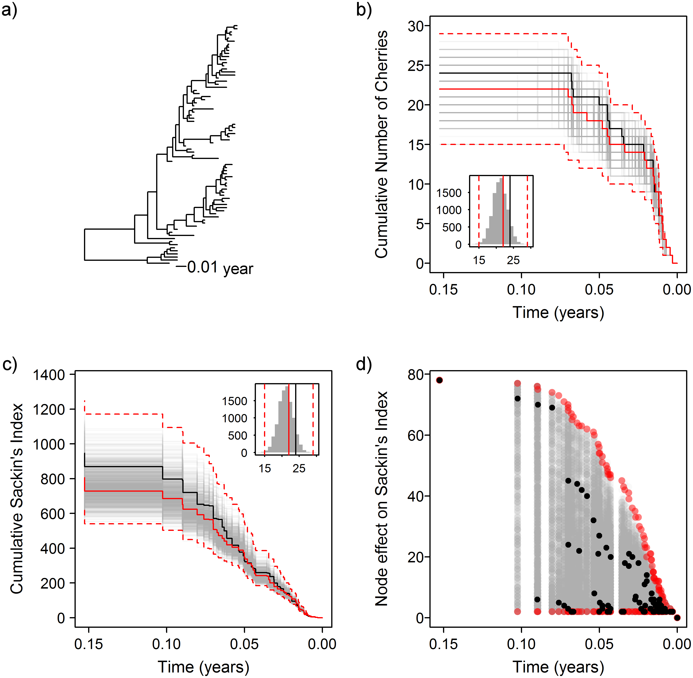
Shape: combining topology and branch length
From Dearlove BL, Frost SDW (2015) Measuring Asymmetry in Time-Stamped Phylogenies. PLoS Comput Biol 11(7): e1004312

Slide 8
But our goal is to do this with a single number
Imbalance statistics
Small substructure statistics
Height/depth-based statistics
Network science-based statistics
Spectrum-based statistics

Slide 9
Let us think of a tree as an (un)directed graph
Density: number of edges/number of nodes
Clustering coefficient: number of triangles/number of node triples
Degree assortativity: correlation between degrees of adjacent nodes
Diameter: maximum length of a shortest path
Mean path: average length of a shortest path

Slide 10
Distribution of diameters and Wiener indices
 | Minimum | Maximum | Mean
Diameter | O(logN) | O(N) | O(N^{1/2})
Wiener index | O(N²logN) | O(N³) | O(N^{5/2})

Slide 11
What about node-centric network science?
Alpha centrality
Betweenness centrality
Closeness centrality
Degree centrality
Eigenvector centrality

Slide 12
Some definitions
The betweenness centrality of node v is the fraction of all shortest s-t paths that it lies on, averaged over all possible s-t pairs not including v
The closeness centrality of node v is the reciprocal of the farness of v, which is the total distance from v to all the other nodes in the graph
The eigenvector centrality of node v is the value assigned to it by the eigenvector of the graph for its leading (Perron-Frobenius) eigenvalue
To reduce to a single number we pick the largest value within the tree

Slide 13
Some key properties
New: the vector of centralities can be computed in linear time (with a factor of log(1/e), where e = machine tolerance, for the eigenvector)
Betweenness centrality is maximized at the tricentre of the tree
Closeness centrality is maximized at the unique (bi)centre of the tree
Eigenvector centrality is maximized at a tree-dependent internal node

Slide 14
Distribution of maximum centrality values
 | Minimum | Maximum | Mean
1/[Closeness centrality] | O(NlogN) | O(N²) | O(N^{3/2})
Betweenness centrality | O(N²) | O(N²) | O(N²)

Slide 15
The same families of trees are extremal
The double caterpillar:
  maximizes the diameter
  maximizes the Wiener index
  maximizes the maximum closeness centrality
  minimizes the maximum betweenness centrality
The pseudo-complete binary tree
minimizes the first three of these
(the fourth one is maximized by a
nearly three-way-balanced tree)

Slide 16
And then there are the spectral statistics…
Adjacency matrix
Laplacian matrix
Normalized Laplacian matrix
Distance matrix
Distance-Laplacian matrix
A_{ij} = 1 if (i,j) is an edge, 0 otherwise
L_{ij} = -1 iff (i,j) is an edge; L_{ii} = deg(i)
N_{ij} = L_{ij} / (deg(i) deg(j))^{1/2}; N_{ii} = 1

Slide 17
Some have suggested the latter is a metric...
However, at least in the case when branch lengths are not restricted to be 1, this is false, and there is a counterexample with only N=3 tips
If they are restricted to be 1, the claim holds for trees up to N=32 tips
For the other spectra, we know [Matsen & Evans] that the fraction of trees distinguishable by them (slowly) tends to 0 as N tends to infinity
The same holds for all network-based centrality measures I described

Slide 18
Finally, some results on a real dataset

Slide 19
A harder task: different flu scenarios

Slide 20
What about evaluating a stat’s performance?
Matsen [‘06] suggested a geometric approach based on NNI distances
The statistic is taken through an MDS:
A resolution is obtained by normalizing the result to the interval [0,1]

Slide 21
There are several challenges with this method
Since the NNI distance is hard to compute, it’s very compute-intensive
Even if we had an oracle for the NNI distance this would still be O(M²) where M is the number of trees with N tips, so that M ~ 2.483^{N}/N^{3/2}
We were unable to push the computation past N=17 (originally, N=15)
An alternative idea is to focus on NNI neighbors only, and see how much the values they obtain for the statistic vary between themselves

Slide 22
Tree space Laplacian-based performance
Substantially reduces the computation time: O(MN) instead of O(M²); thus, can easily be pushed to N=25 and beyond using sparse matrices
Readily interpretable as an energy (i.e. how much energy do nearest-neighbor trees produce when the total energy is normalized to be 1)
Provides comparable insights despite only using “local” information

Slide 23
What is an optimally performing combination?
Let s and t be two different tree shape statistics; we can form linear combinations of these statistics via u(x) = s + xt, for any real number x
Its resolution is computed as Res(u(x)) ⍺ Res(s) + 2x Res(s,t) + x² Res(t)
There will be a unique x that provides the best resolution, which can be computed by solving a quadratic equation with known coefficients
Conjecture: the optimal coefficient x converges as N tends to infinity

Slide 24
Some open questions and conjectures
Can the linear-time computation be generalized to small phylogenetic networks? Alternatively, how about graphs of bounded treewidth?
How quickly does the distance Laplacian spectrum fail to distinguish trees with unit branch lengths?
What is the distribution of these statistics under various tree models?
What is the optimal combination of statistics that distinguishes trees?

Slide 25










Acknowledgments
Caroline Colijn Art Poon Maryam Hayati Cedric Chauve

Slide 26
Some (possibly) useful references
M. Kirkpatrick, M. Slatkin (1993). Searching for evolutionary patterns in the shape of a phylogenetic tree. Evolution, 47 (4): 1171.
M. E. J. Newman. Networks: An Introduction. Oxford University Press.
F. A. Matsen, S. Evans (2012). Ubiquity of synonymity: almost all large binary trees are not uniquely identified by their spectra or their immanantal polynomials. Algorithms for Molecular Biology, 7:14.
F. A. Matsen, M. Steel (2006). A Geometric Approach to Tree Shape Statistics. Syst Biol, 55 (4): 652-661.

Slide 29
Comparison of the two resolution measures
N | Ic | Sackin | Variance | I2 | B1 | B2
7 | 0.902 | 0.907 | 0.892 | 0.888 | 0.882 | 0.901
8 | 0.919 | 0.904 | 0.889 | 0.911 | 0.884 | 0.903
9 | 0.949 | 0.943 | 0.934 | 0.932 | 0.920 | 0.935
10 | 0.967 | 0.962 | 0.953 | 0.947 | 0.937 | 0.955
11 | 0.978 | 0.974 | 0.967 | 0.954 | 0.949 | 0.965
12 | 0.982 | 0.978 | 0.972 | 0.957 | 0.953 | 0.970
13 | 0.984 | 0.981 | 0.976 | 0.959 | 0.956 | 0.972
14 | 0.985 | 0.983 | 0.978 | 0.960 | 0.958 | 0.973
15 | 0.986 | 0.984 | 0.980 | 0.961 | 0.960 | 0.974
16 | 0.987 | 0.985 | 0.982 | 0.962 | 0.961 | 0.975
17 | 0.988 | 0.986 | 0.983 | 0.963 | 0.963 | 0.976
18 | 0.988 | 0.987 | 0.984 | 0.964 | 0.964 | 0.977
19 | 0.973 | 0.972 | 0.971 | 0.959 | 0.959 | 0.966
20 | 0.989 | 0.988 | 0.986 | 0.966 | 0.966 | 0.978
Original table from Erick Matsen’s paper (2006)

Slide 30
A more detailed comparison of the statistics

