Slide 1
A density functional theory of nematic liquid crystals with long-range attractive & short-range repulsive interactions
Peter Palffy-Muhoray Liquid Crystal Institute, KSU
Mikhailo Pevnyi Liquid Crystal Institute, KSU
Epifanio Virga Dept. of Mathematics, U. Pavia
Xiaoyu Zheng Dept. of Math. Sciences, KSU
Notes:
Autonomous: having self-directing freedom

Slide 2
Outline
motivation
background
model
phase separation
Landau expansion
summary

Slide 3
Motivation

Slide 4
Motivation
liquid crystal phase is interesting and important
in spite of considerable study, still incompletely understood
phenomena of particular interest:
  dependence of density and orientational order on temperature and pressure

Slide 5
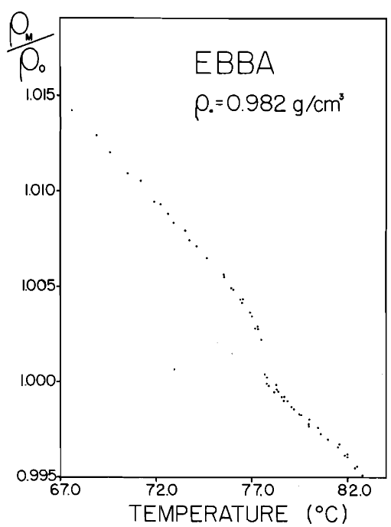
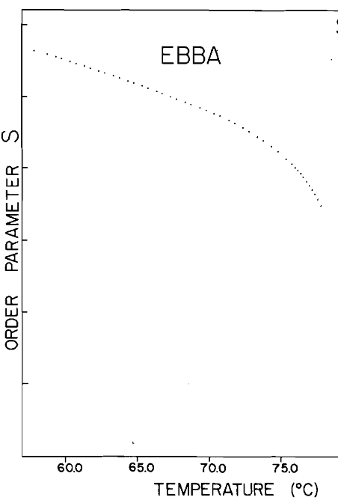
Motivation
temperature dependence of density
P.P-M., D.A. Balzarini, Can. J. Phys., 59, 1981
Notes:
Both steric and attractive interactions play a role.

Slide 6
Motivation
liquid crystal phase is interesting and important
in spite of considerable study, still incompletely understood
phenomena of interest:
  dependence of density and orientational order on temperature and pressure
  phase coexistence in pure materials

Slide 7
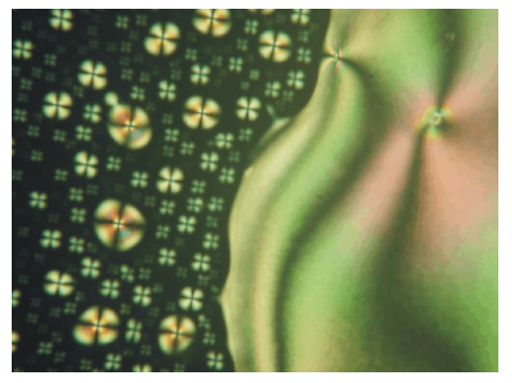
Motivation
coexisting nematic and isotropic phases
O.D. Lavrentovich, priv. comm.
Notes:
Phase rule; P=C - F+2 (F = free intensive variables)

Slide 8
Motivation
liquid crystal phase is interesting and important
in spite of considerable study, still incompletely understood
phenomena of interest:
  dependence of density and orientational order on temperature and pressure
  phase coexistence in pure materials
need complete equation of state to describe phenomena

Slide 9
Background

Slide 10
Background
LCs:
  (usually ) liquids
  characterized by orientational order
  large variety of phases:
  +….etc.

Slide 11
Orientation in Nematic Liquid Crystals
orientation descriptor:
  second rank tensor
orientational order parameter:
  traceless symmetric

Slide 12
Nematic liquid crystals
order parameter:
  symmetric traceless tensor
eigenvectors:
  direction of alignment:
  nematic director
eigenvalues:
  degree of alignment:
  order parameter

Slide 13
Background
nematic LCs:
  thermotropic:
    orientational order & related properties depend on temperature
  lyotropic:
    orientational order & related properties depend on concentration

Slide 14
Models for nematics
thermotropics:
  Maier-Saupe¹
  Frank, Landau – de Gennes
    attractive long-range interactions
    temperature dependent description; density assumed constant
lyotropics:
  Onsager²
    repulsive short-range hard-core interactions
    concentration dependent description; athermal
W. Maier and A. Saupe A., Z. Naturforsch. A 14, 882., (1959).
L. Onsager, Ann. NY Acad. Sci. 51, 627 (1949).

Slide 15
Background
nematic LCs:
  thermotropic:
    orientational order & related properties depend on temperature
  lyotropic:
    orientational order & related properties depend on concentration
but lyotropics respond to temperature,
and thermotropics respond to pressure!

Slide 16
Aim
develop simple model
  incorporating both attractive & steric interactions
  capable of describing multicomponent systems
study predictions & compare with experiment
what is needed in model?
  free energy of multicomponent system in density functional form, including hard and soft interactions

Slide 17
Model

Slide 18
Free energy
Helmholtz free energy
partition function:
    generalized coordinate & momenta
configurational partition function:
  (integrate out momenta)
pairwise interactions:

Slide 19
Free energy
have
one can show
what is the pair potential ?

Slide 20
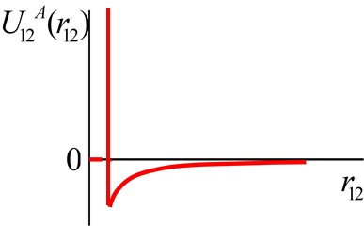
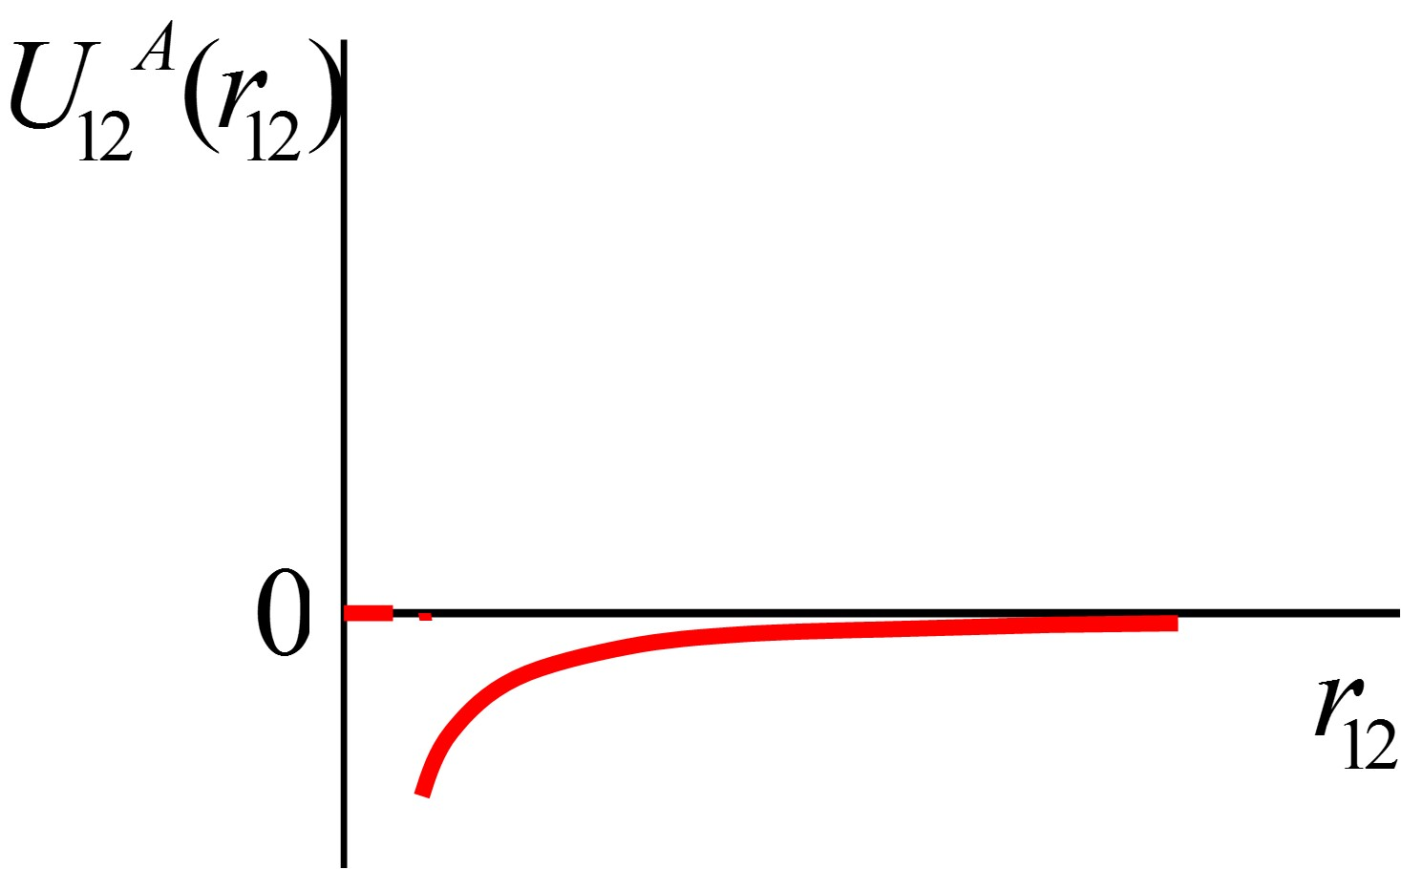
Pair potential
two parts:
attractive London dispersion
  quantum fluctuation creates ‘spontaneous’ dipole in one particle
  the field of this dipole polarizes the second; two dipoles attract
‘hard core’ repulsion
  Pauli exclusion principle forbids overlap of electron orbits
  ‘hard’, overlap energy comparable to ionization

Slide 21
London dispersion
for two spheres,
for ellipsoids,
where
R
Notes:
hv ~ 200kT, if R=2r, U~kT. Things melt, etc. Magic!

Slide 22
London dispersion
for ellipsoids,
or
Notes:
hv ~ 200kT, if R=2r, U~kT. Things melt, etc. Magic!

Slide 23
Hard core repulsion
treat particles as rigid bodies
relevant quantity: excluded volume

Slide 24
Excluded volume
Onsager¹ :
  long cylinders
this work (²)
  ellipsoids
cylinders
ellipsoids
1. L. Onsager, Ann. NY Acad. Sci. 51, 627 (1949).
2. Priestley, Wojtowicz and Sheng, Introduction to liquid crystals. (Plenum , NY 1975)

Slide 25
Free energy
have
for the attractive part, assume
MF energy

Slide 26
Free energy
have
for repulsive part, assume
MF volume

Slide 27
Helmholtz free energy
free energy
becomes
density functional form?

Slide 28
Density functional form
if density is not uniform, we can write locally in region
and summing over all regions of phase space,

Slide 29
Density functional form
and have
where
ideal gas
long range attractive
short range repulsive

Slide 30
Low density regime
expanding the logarithm, have
where
ideal gas
Maier-Saupe
~Onsager

Slide 31
Helmholtz Free Energy (expanded log term)
letting and
substituting for and gives

Slide 32
The Orientational Distribution
minimizing wrt gives
where is the volume fraction,
and is the anisotropic interaction strength

Slide 33
Free energy
with this the free energy density becomes
where and
and minimizing wrt gives the self-consistent equation

Slide 34
Modified Onsager theory (a=b=0)
Order parameter S vs.
stable
nematic
Lyotropic Ordering
Isotropic
unstable
first order
Isotropic
Nematic
metastable

Slide 35
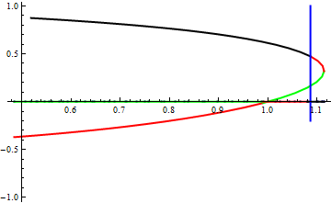
Maier-Saupe theory (c=d=0)
order parameter S vs T
nematic
Thermotropic Ordering
stable
Isotropic
unstable
Isotropic
first order
metastable
Nematic

Slide 36
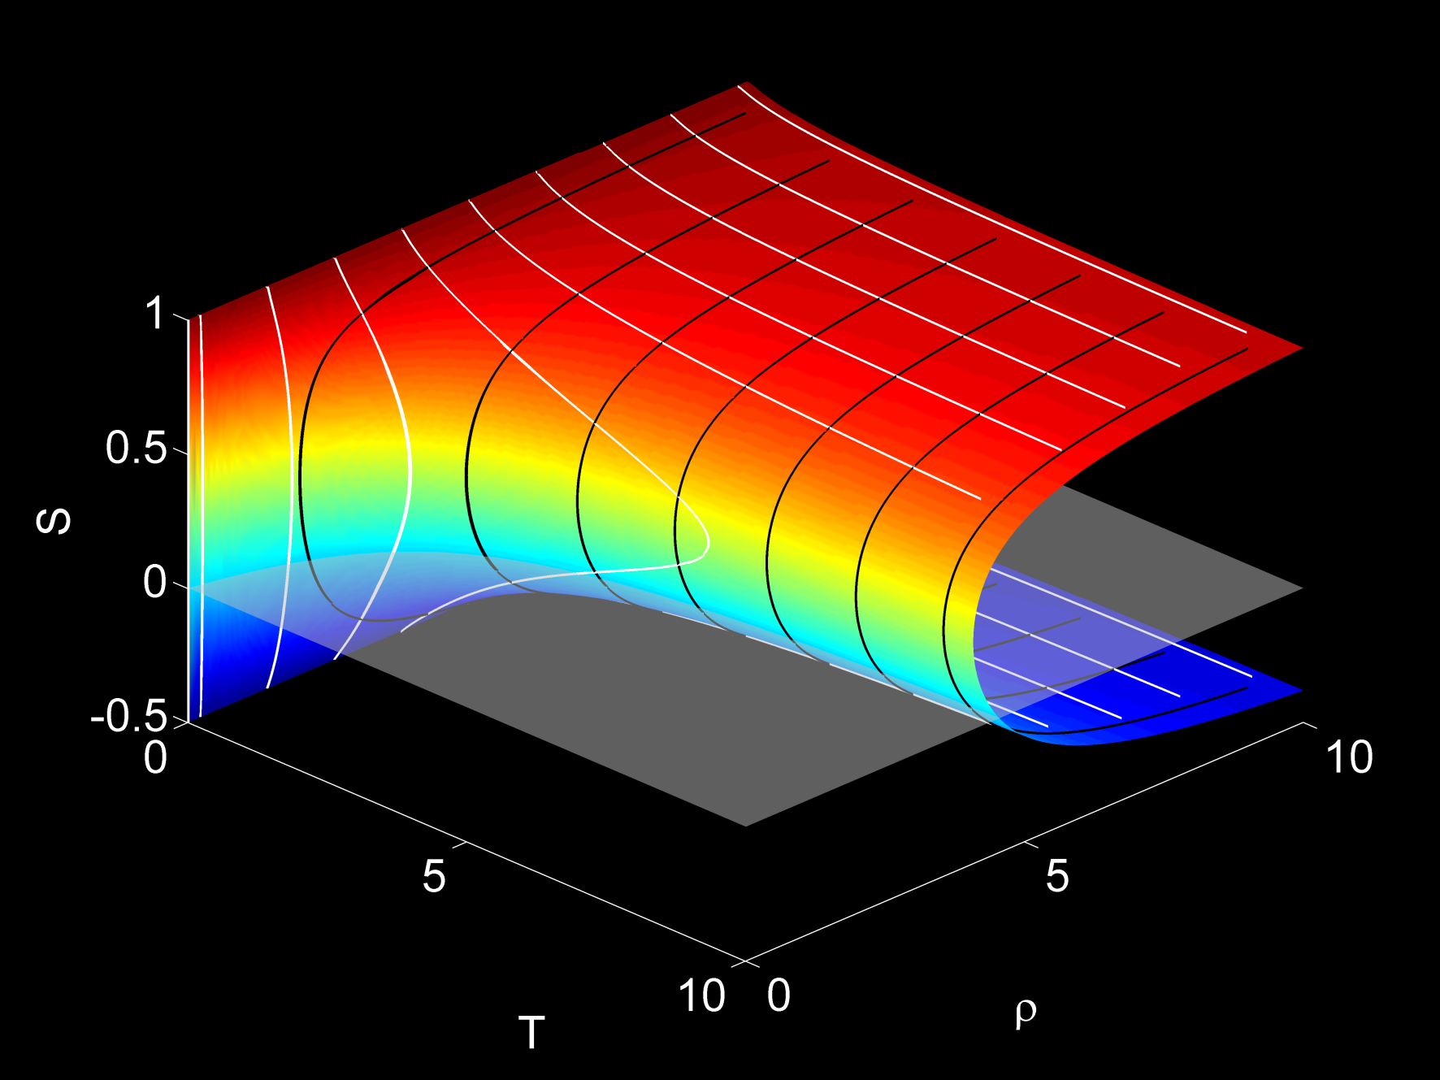
M-S--O Results
Order parameter vs. temp and number density
Notes:
MS: rho=0, O: T=inf

Slide 37

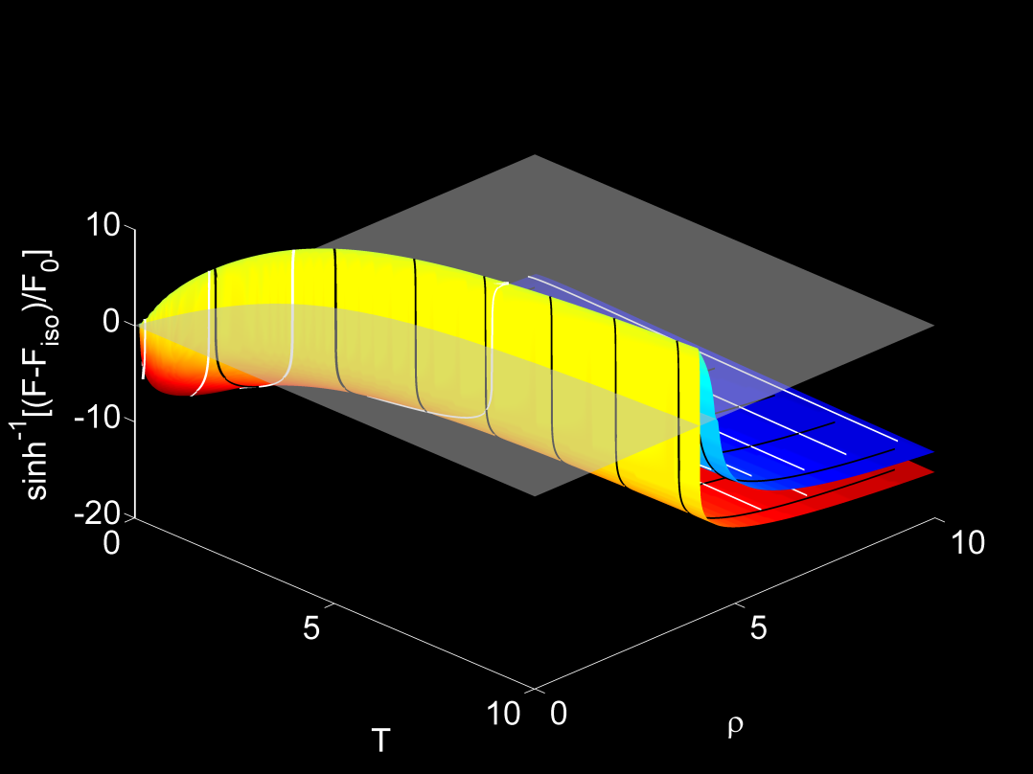
M-S--O Results
Order parameter vs. temp and number density
Free energy for different solutions

Slide 38
Equation of State
change variables:
  single control parameter:

Slide 39
Equation of State
pressure is given by
and substitution gives
in qualitative agreement with experiment

Slide 40
Equation of State
pressure is given by
and substitution gives
in qualitative agreement with experiment
Problem: density remains finite regardless of !

Slide 41
Phase separation in a one component nematic

Slide 42
Phase separation
single component
for coexistence, must have, in each phase, equal
  chemical potential
  pressure
equivalent to double tangent construction on .

Slide 43
Another look at the free energy
change variables:
  single control parameter:

Slide 44
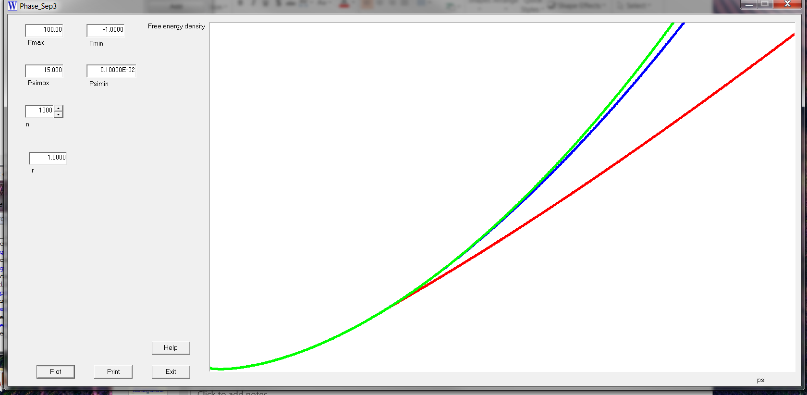
Double tangent construction
plot vs.
  in general, have three branches: , ,
  two
construct
double tangents
challenging!

Slide 45
Another approach:
plot pressure vs. chemical potential
with as parameter
at coexistence, curve should cross over itself

Slide 46
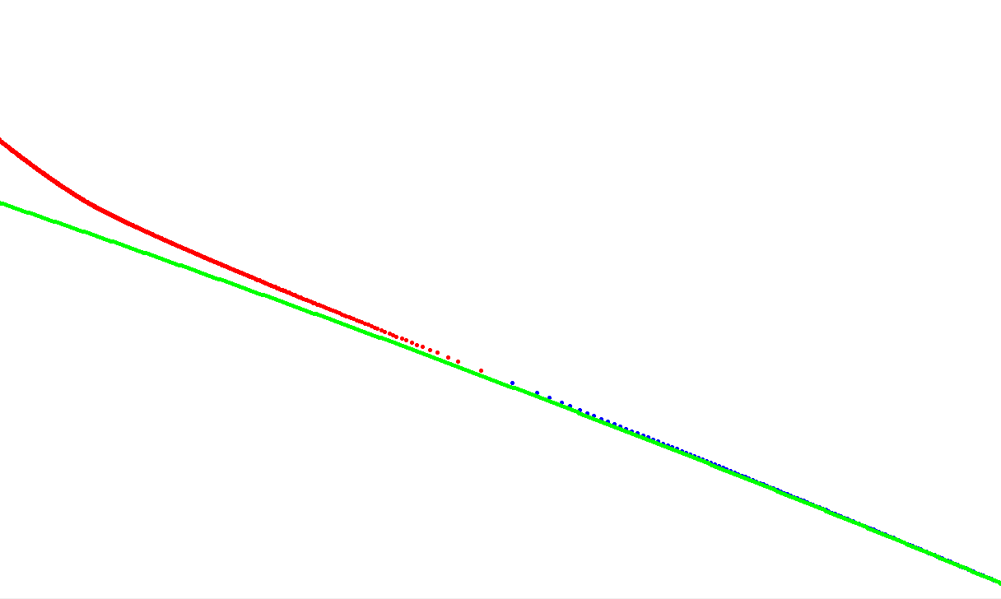
Pressure vs chemical potential
nematic S⁺
isotropic S=0
nematic S⁻

Slide 47
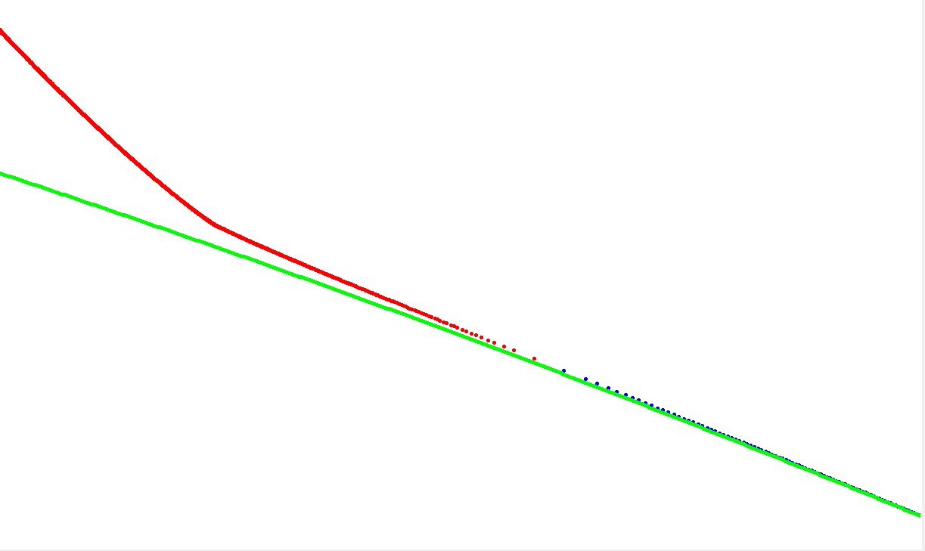
Pressure vs chemical potential
slope becomes
discontinuous

Slide 48
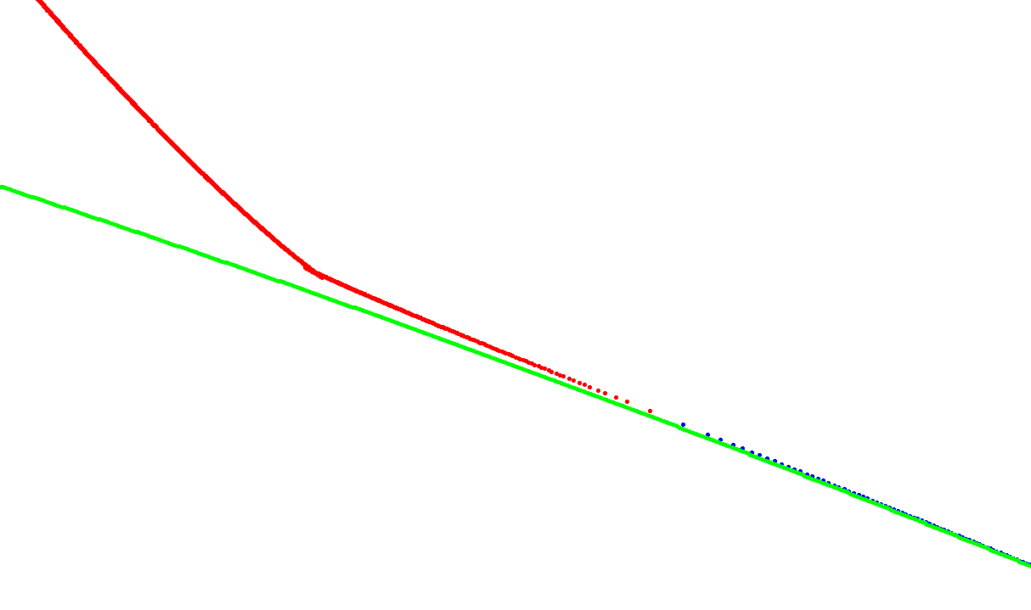
Pressure vs chemical potential
??

Slide 49
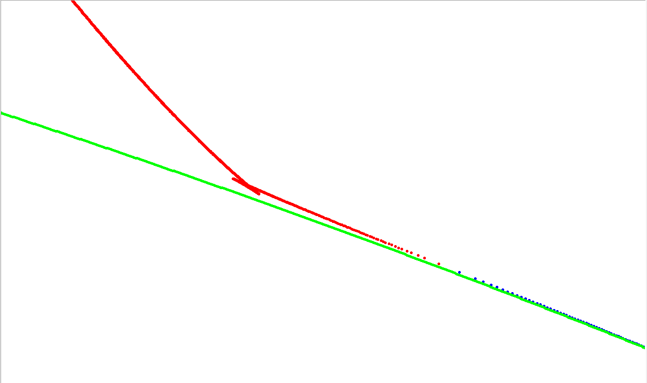
Pressure vs chemical potential
curve folds back
& crosses itself
nematic – nematic
coexistence?

Slide 50
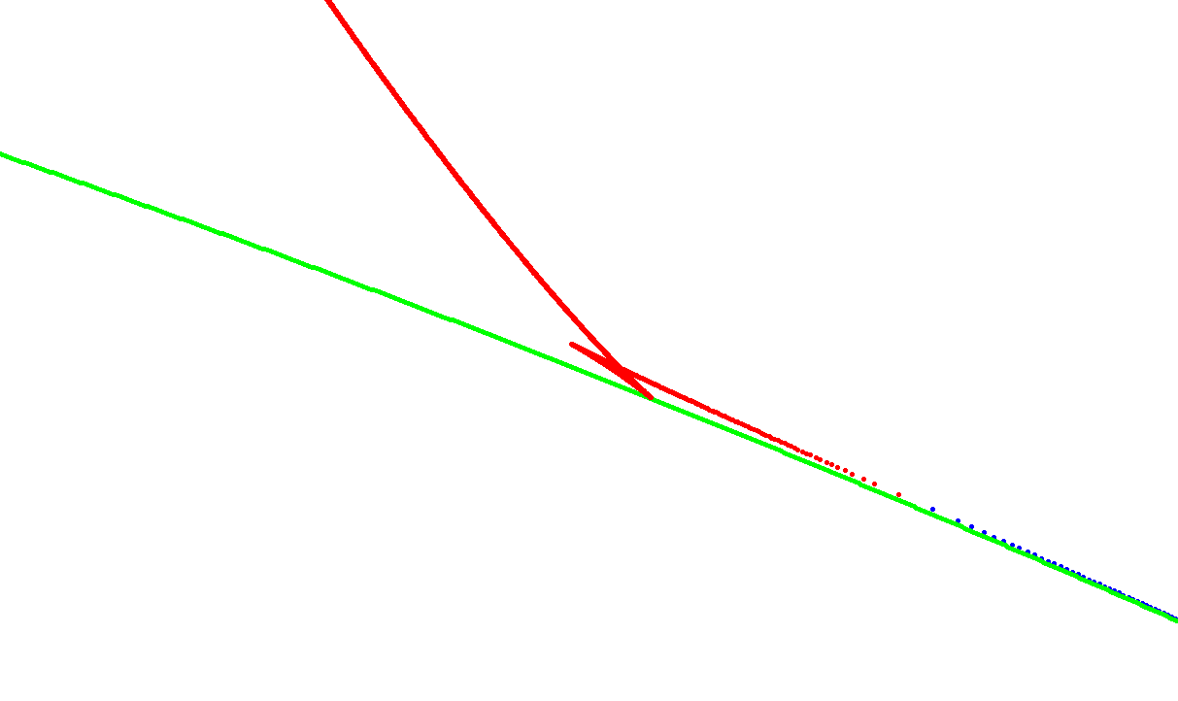
Pressure vs chemical potential
nematic – isotropic
coexistence

Slide 51
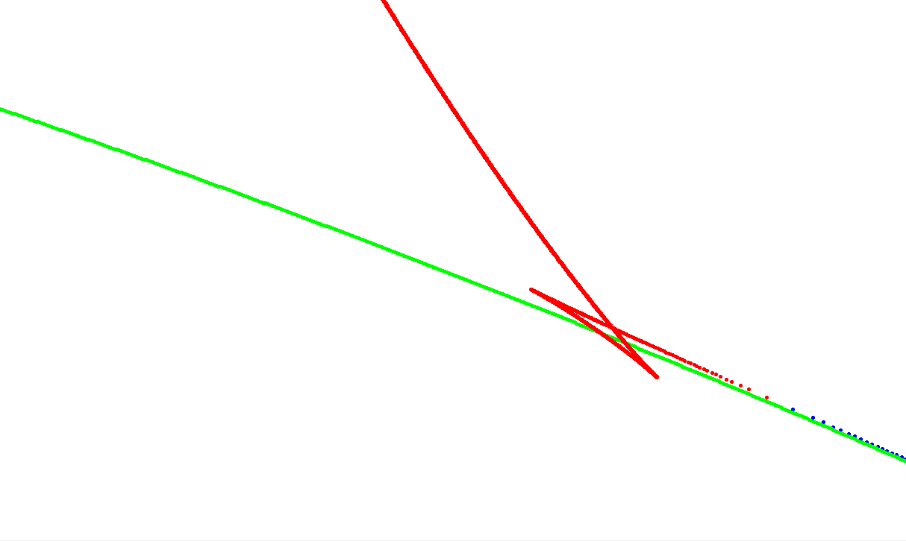

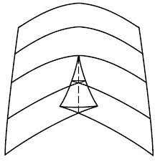
Pressure vs chemical potential
Swallowtail Catastrophe

Slide 52
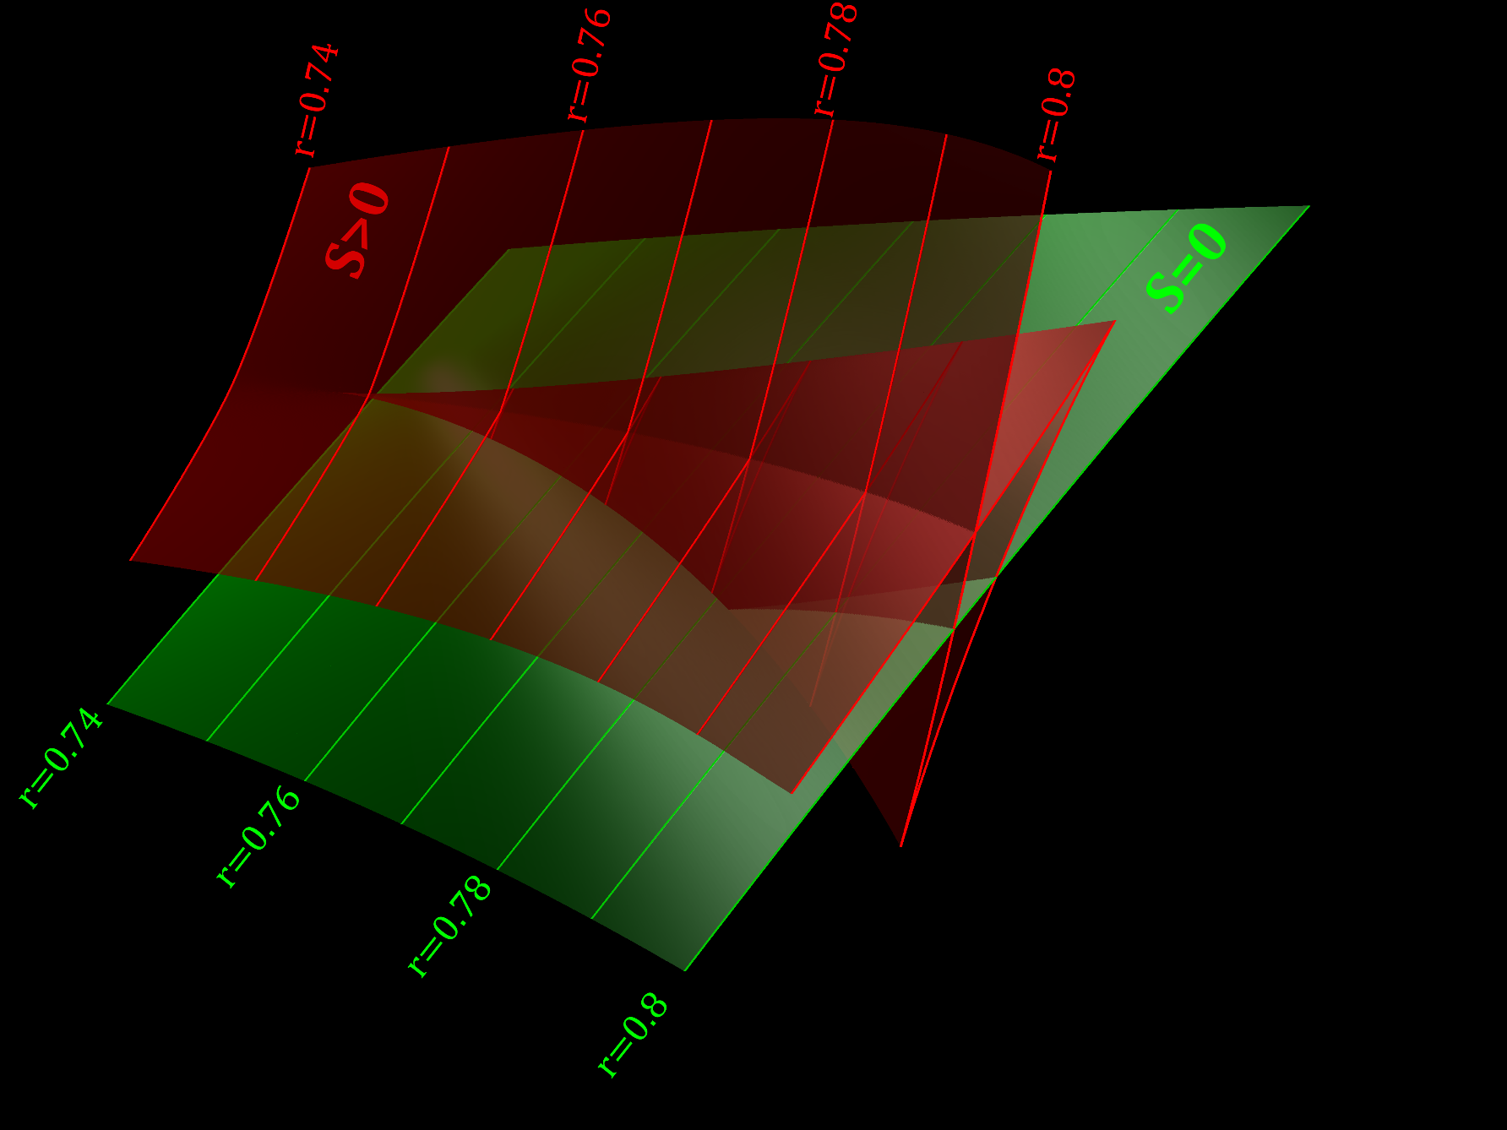
In 3D

Slide 53
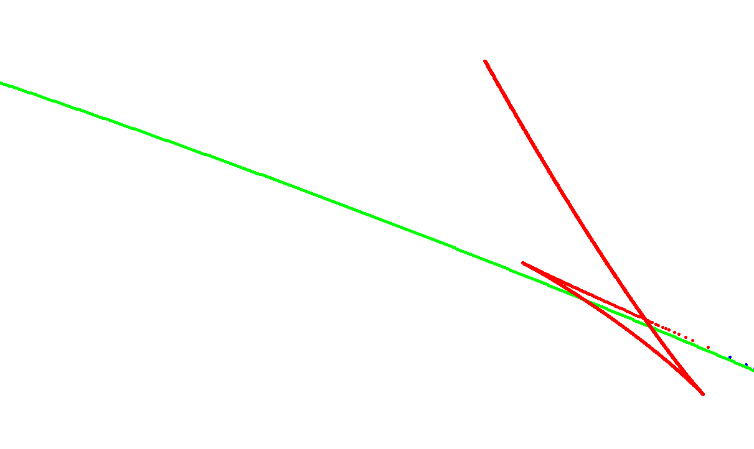
Pressure vs chemical potential
3 crossings:
N-N,
N-I1,
N-I2
3 pairs of coexisting phases??

Slide 54
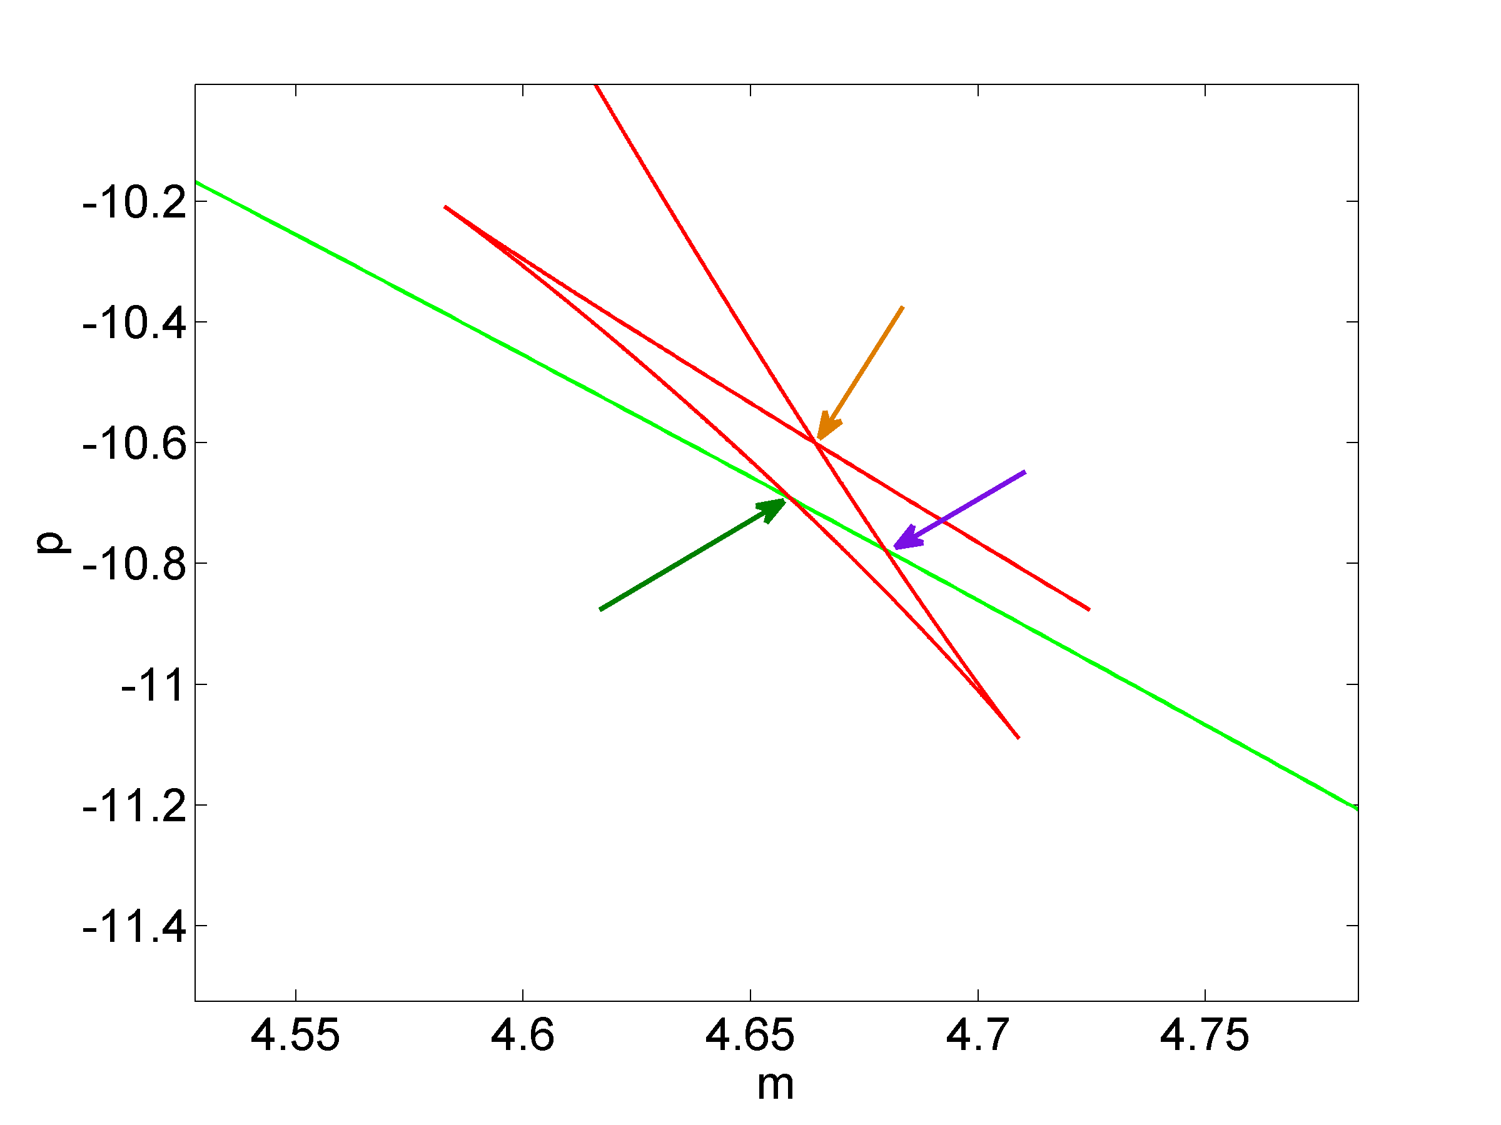
The three instances of equal and equal

Slide 55
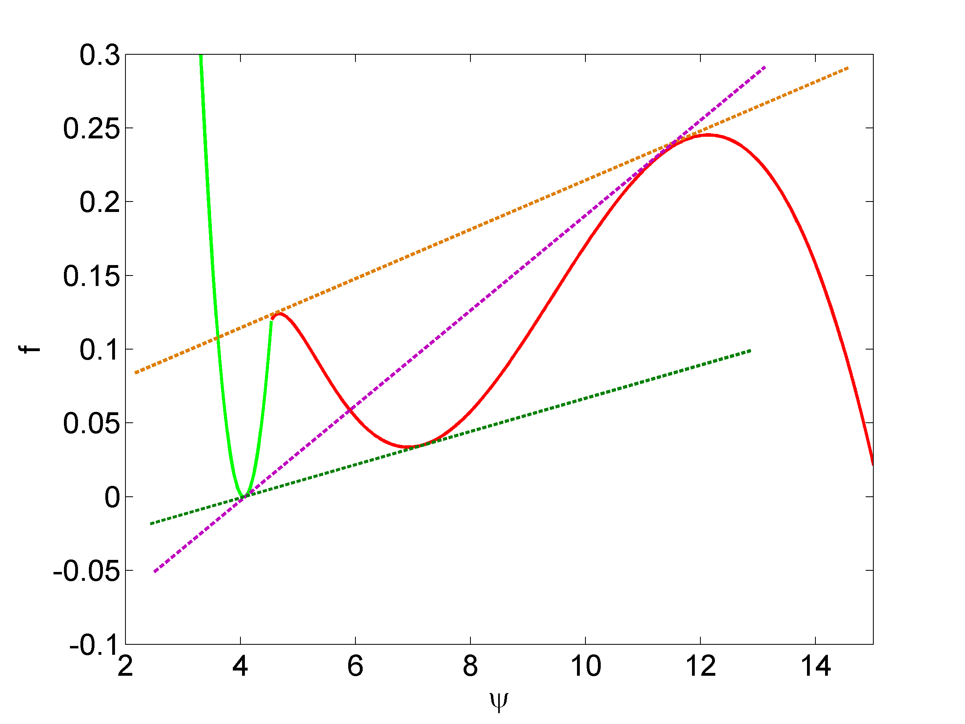
Corresponding double tangent constructions

Slide 56
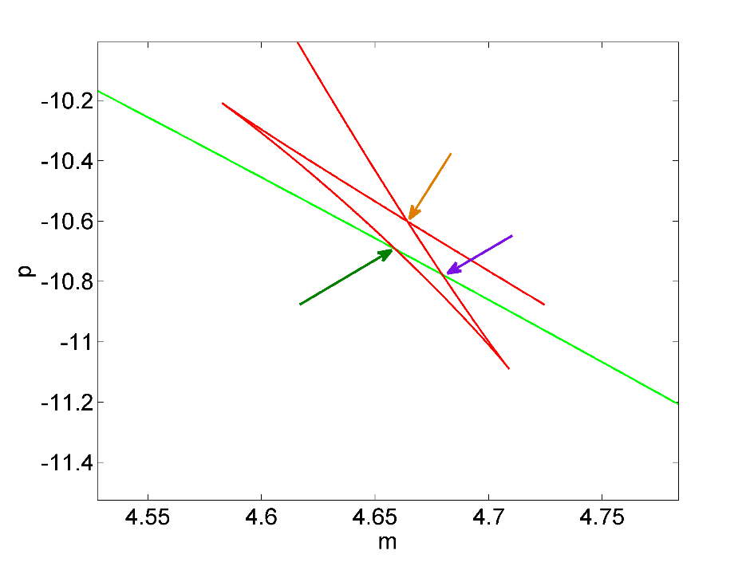
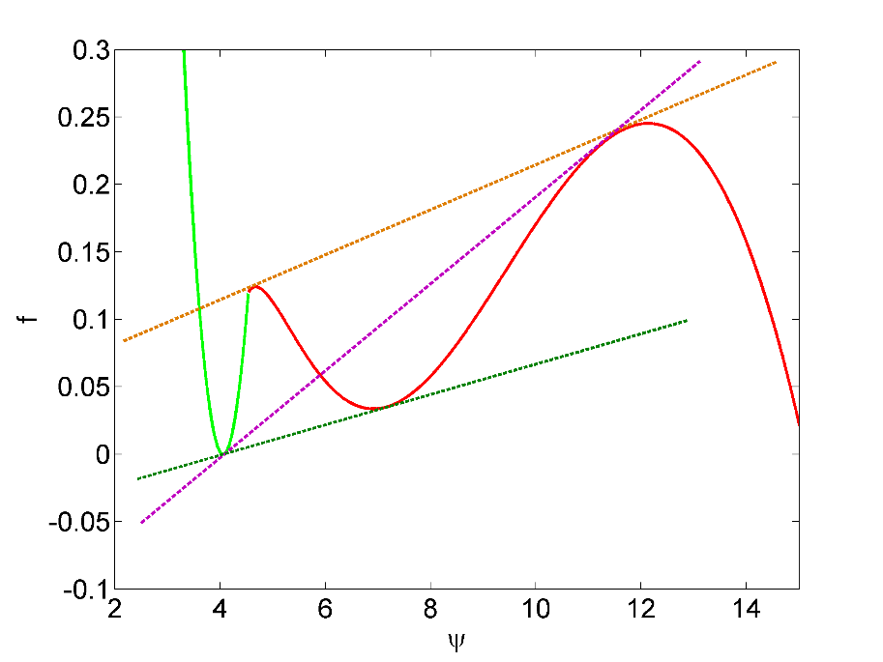
Double tangent constructions
multiple double tangent constructions are possible
(even ignoring S⁻ branch)
only one - nematic-isotropic coexistence - minimizes the free energy

Slide 57
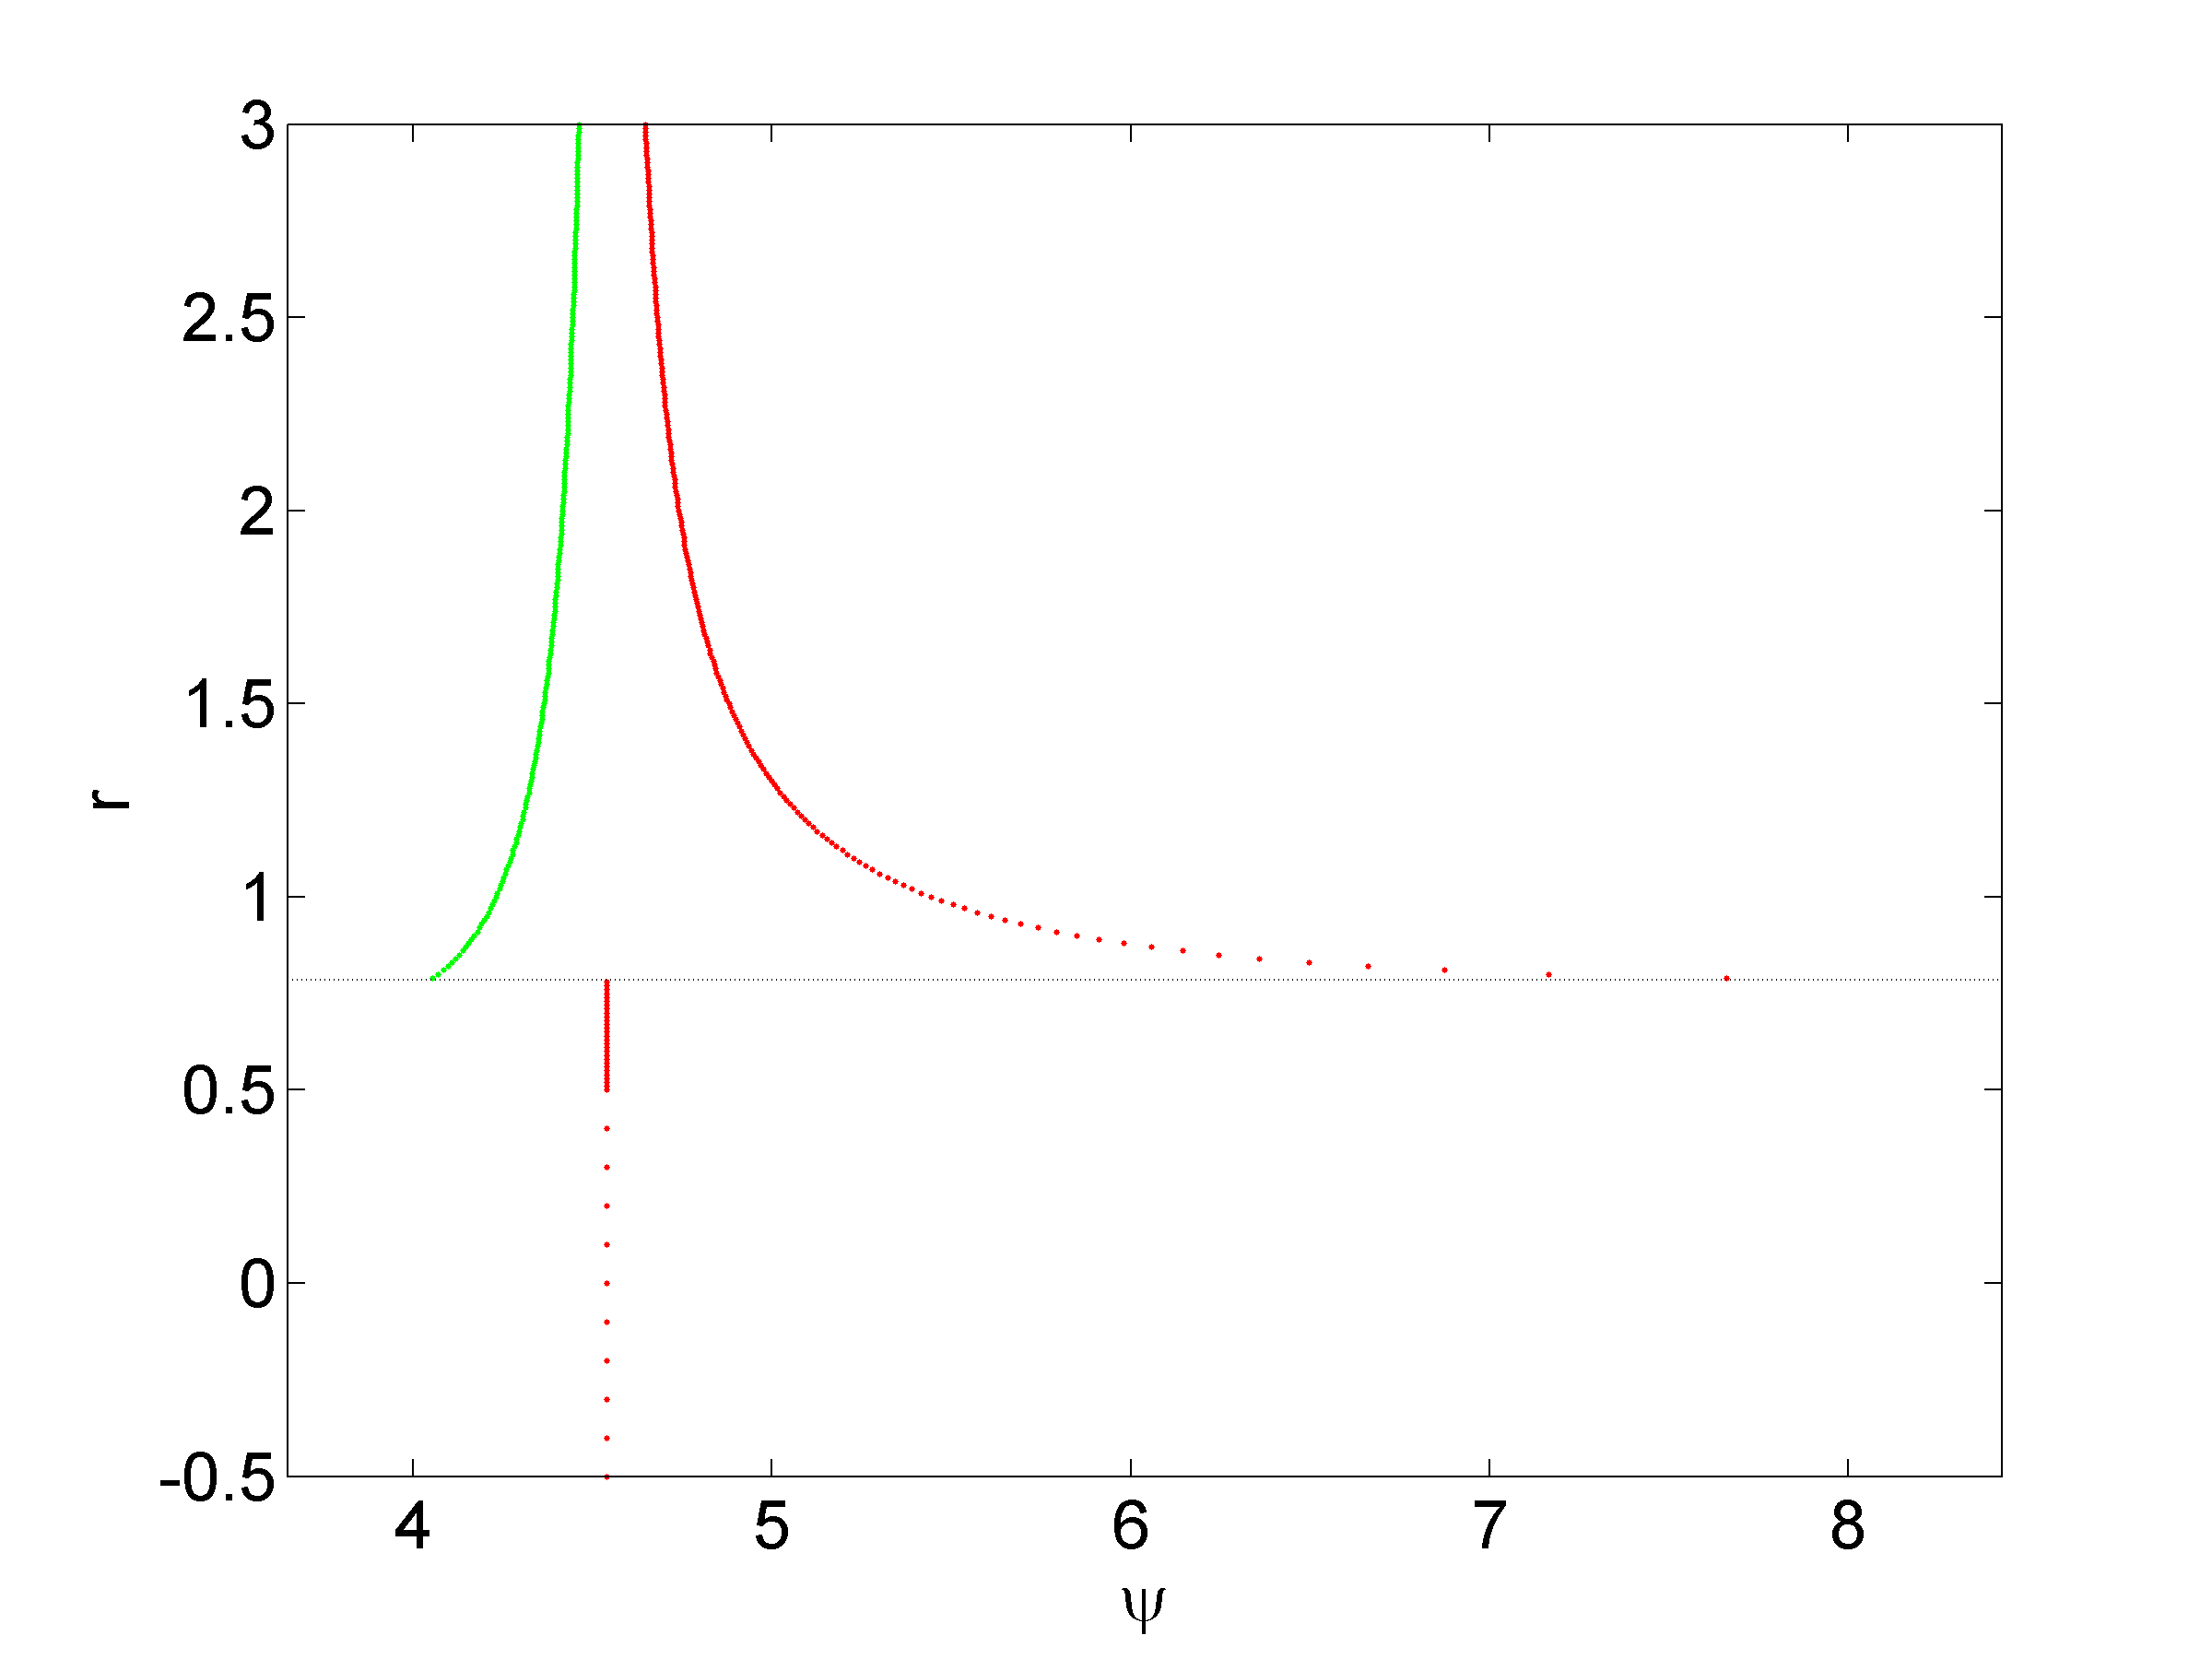
Phase diagram
isotropic
nematic
2-phase
coexistence
0.781
isotropic
nematic

Slide 58
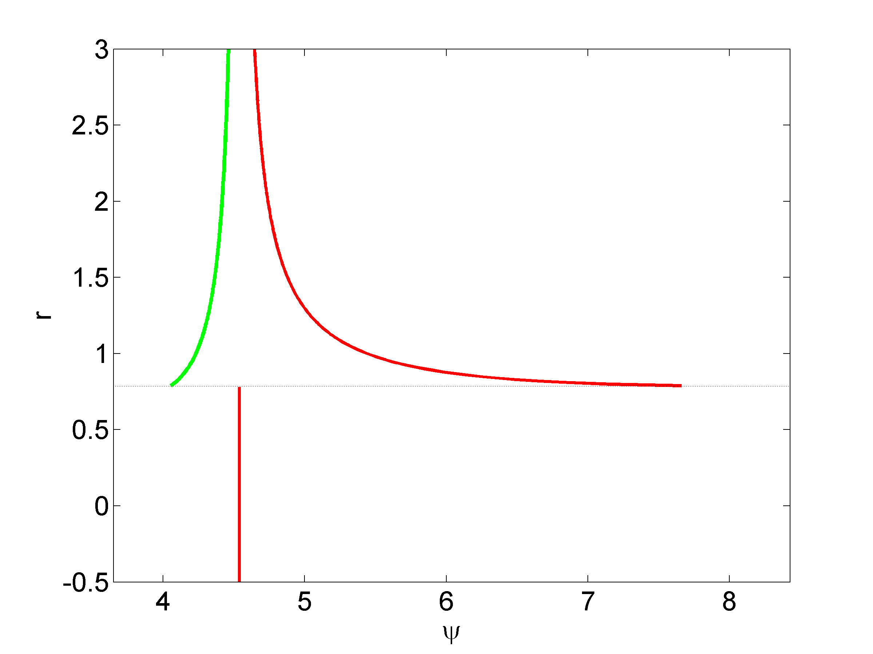
Phase diagram
I
N
0.781
I
N
Notes:
No

Slide 59
Landau Free Energy
can behavior be captured in simpler model?
Landau free energy
  expansion in terms of order parameter

Slide 60
Landau expansion
free energy in Landau form
  where and
have two options:
  keep full dependence
  replace dependent coefficients by constants.

Slide 61
Two phase coexistence
using
carry out double tangent construction

Slide 62
Two phase coexistence
and arrive at phase diagram

Slide 63
Summary
derived density functional form of free energy with attractive and repulsive contributions
steric contributions appear in logarithm
low density approximation, gives simple expression for free energy combining M-S and Onsager
single control parameter
interesting NI coexistence prediction
Landau theory description also possible

Slide 64


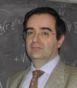

Acknowledgements
Mikhailo Pevnyi
Epifanio Virga
Xiaou Zheng

