Slide 1
Topology-Sensitive Bounds on Communication
Arkadev Chattopadhyay (TIFR)
Based on joint works with
Shi Li (SUNY, Buffalo)
Michael Langer (SUNY, Buffalo)
Jaikumar Radhakrishnan (TIFR)
Atri Rudra (SUNY, Buffalo)

Slide 2
Yao’s Insight from 1979
Unbounded
Computational
Power
Unbounded
Computational
Power
a₁
= a₁(X)
X
b₁
= b₁ (Y,a₁)
Y
110111001
a₂
= a₂(X,b₁)
000111111
n
n
b_{r}
= b_{r}(Y,a₁,☹,a_{r})
Alice
Bob
Alice and Bob collaborate to compute f(X,Y).
Aim to minimize the communication cost.
Complexity of any f is at most n+1.

Slide 3
Many Applications
Data Structures.
Circuit complexity.
Pseudo-randomness.
Combinatorial Optimization.
Property Testing.
Streaming
(Swiss-Army Knife of Computer Scientists)

Slide 4
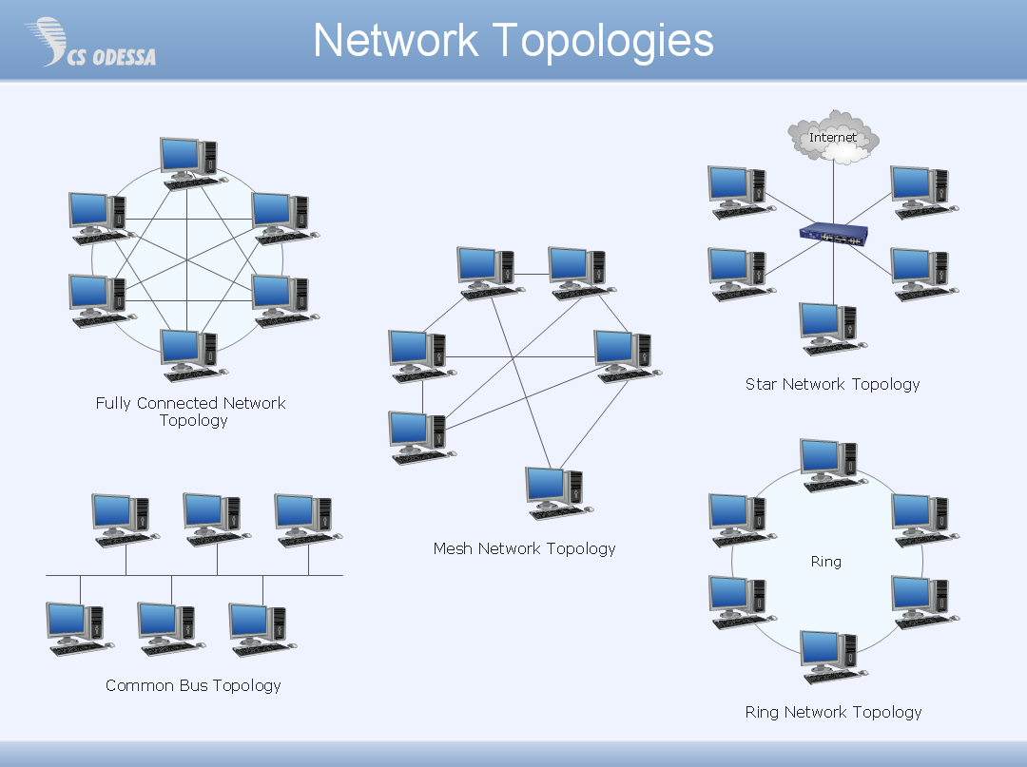
Multi-party communication
Point-to-point
(private channels)
k nodes
Graph G
f(X₁,☹,X_{k})
Public randomness.
Total Communication?
Should depend on f AND G
Little explored…

Slide 5
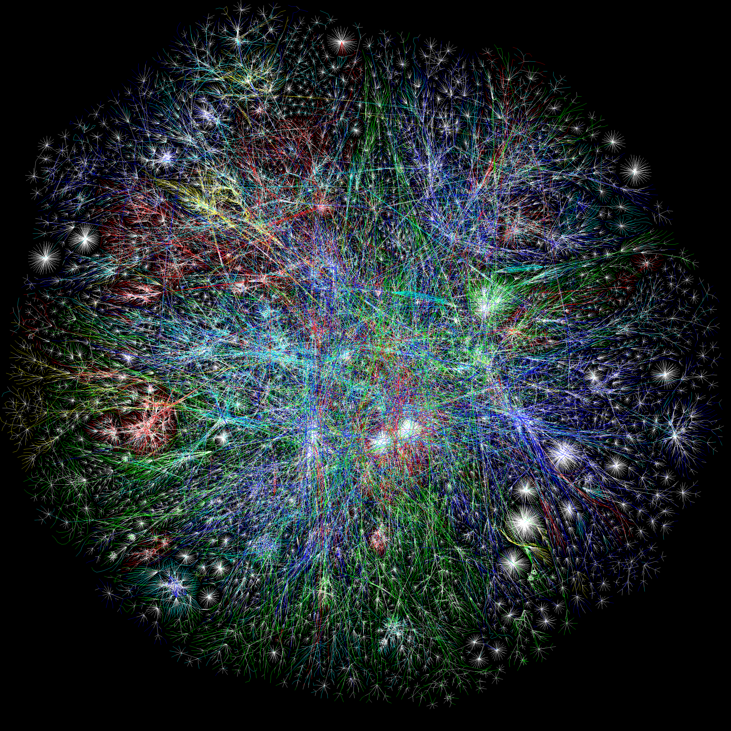
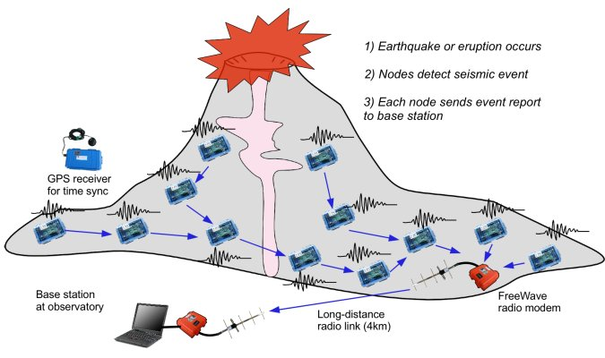
Why care?
Setup natural in distributed computing
http://matthewgress.com/galleries/Web/
Internet-Graph-1069646562-LGL-2D-4096x4096
Distributed functional
monitoring
http://fiji.eecs.harvard.edu/Volcano

Slide 6
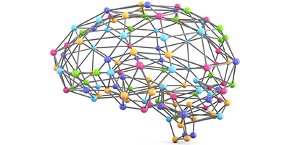
Biology
Simplified Brain Network

Slide 7
A Multiparty Communication Problem
Y
W
A connected graph G = (V,E)
Z
Communicate only over edges
X
Non-player nodes also participate
k players sit on nodes in K subset of V
f(X,Y,Z,W)
Each player has a private n-bit string
Want to compute a function f : ({0,1}^{n})^{k} ➔ {0,1}
Want to minimize total number of bits communicated (worst-case)
Any reasonable model of synchronous communication is OK

Slide 8
Two Functions
1 if X_{i} ≠ X_{j} for all i,j
ED(X₁,☹,X_{k}) =
0, otherwise.
Very different topological behavior!
1 if X_{i} = X_{j} for all i,j
EQ(X₁,☹,X_{k}) =
0, otherwise.

Slide 9
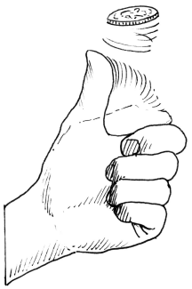
For K=2
Randomized ?
0
0
1
0
1
0
= r
<X,r> mod 2
= 1
<Y,r> mod 2 =0
X ≠ Y
X
0
Y
1 1 0 1 1 1
1 0 1 1 1 0
Alice
Bob
Compute EQ(X,Y).
D(EQ) = n+1.
R_{1/2} (EQ) = 2.
ED(X,Y) = N-EQ(X,Y)

Slide 10
On The Line
Randomized
Protocol : EQ
O(1)
O(1)
O(1)
n bits
n bits
… n bits …
0 in i?
X₁
X₂
X₃
X_{i}
X_{k}
X_{i-1} = X_{i} ?
No
X₁ = X₂ ?
X₂ = X₃ ?
OUTPUT = 0
Yes!
Yes!
No!
0 in i?
Yes!
D(EQ) = (k-1)¢ n
R(EQ) = O(k)
No
0?
Randomized
Protocol : ED
O(log k)
O(2log k)
O((k/2-1)log k)
O((k/2-1)log k)
n bits
2n bits
(k/2-1)¢n bits …
… (k/2-1 )¢n bits …
X₁
X₁
X₂
X₁ , X₂
X₃
X₁, X₂, ☹, X_{i-1}
X_{k/2}
X_{(k/2)+1},☹, X_{k}
X_{k}
OUTPUT
D(ED) = O(k² )¢ n
R(ED) = O(k² log k)

Slide 11
Some Previous Work
Number-On-Forehead Model
Yao’79
Chandra-Furst-Lipton’83
Broadcast Model
Tiwari’84
Deterministic
EQ, ED
Phillips-Verbin-Zhang’12
Woodruff-Zhang’13
Braverman-Ellen-Oshman-Pitassi-Vaikuntanathan’13

Slide 12
Element Distinctness
X₄
X₂
X₆
X₈
Are all inputs X₁,…,X_{k} distinct?
Trivial randomized algorithm
X₃
X₁
X₅
All players send hashes of their inputs
to a “median” node
ED(X₁,…,X₈)
Show a lower bound of σ(G)
Theorem (C-Radhakrishnan-Rudra’14): σ(G) is the cost of the
optimal randomized algorithm (up to log k factor).
Ω(k²)
k-path
√k X √k grid
Ω(k^{3/2})

Slide 13
The Argument

Slide 14
Let’s walk the line
k-path
Ω(k²)
X₁
X₂
X₃
X₄
X_{i}
X_{i+1}
X_{i+2}
X_{k-3}
X_{k-2}
X_{k-1}
X_{k}
Fix a protocol Π
C_{i}
Alice
Bob
Alice has A = {X₁,…,X_{i}}
Bob has B = {X_{i+1},…,X_{k}}
2-party problem induced by C_{i}
Each i might have different hard instance (det l.b.)
Is A disjoint from B?
Cost_{i} ≥* min(i,k-i)
Done?
Total cost = Σ_{i} Cost_{i} ≥* Σ_{i} min(i,k-i) ≥* k²
* Ignoring O(1) factor
Bob: http://lsc.org/see-whats-happening/past-exhibitions/bob-the-builder/
Alice: http://www.imdb.com/media/rm2467478016/ch0408645?ref_=chmi_mi_all_sf_1

Slide 15
RANDOMIZATION HELPS!

Slide 16
Let’s walk the line (with coins now)
Ω(k²)
X₁
X₂
X₃
X₄
X_{i}
X_{i+1}
X_{i+2}
X_{k-3}
X_{k-2}
X_{k-1}
X_{k}
Fix a protocol Π
C_{i}
Hard distr. μ:
(X₁,..,X_{k}) random distinct numbers
Alice has A = {X₁,…,X_{i}}
Bob has B = {X_{i+1},…,X_{k}}
Is A disjoint from B?
E_{μ}[Cost_{i}] ≥* min(i,k-i)
KS-Razborov
E_{μ}[Total cost] = Σ_{i}E_{μ}[ Cost_{i}]
≥* Σ_{i} min(i,k-i) ≥* k²
* Ignoring O(1) factor

Slide 17
Now on to the grid…
√k
Hard distr. μ:
(X₁,..,X_{k}) random distinct numbers
√k
Alice has set A with i •√k elements
Bob has set B with (√k-i) •√k elements
Is A disjoint from B?
i
√k-i
E_{μ}[Cost_{Vi}] ≥* min(i•√k ,(√k-i)•√k )
E_{μ}[Total cost] = Σ_{Vi}E_{μ}[ Cost_{Vi}]≥* k^{3/2}
Similar arguments with horizontal cuts
Also works for higher dimensional grids
V_{i}
* Ignoring O(1) factor

Slide 18
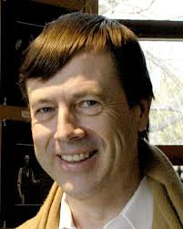
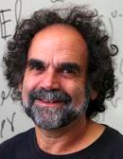
From “grids” to general graphs
Metric embeddings in to l₁
1
Bourgain
London-Linial-Rabinovich
u’
a’
v’
w
u
x
w’
v
b’
x’
For every edge (u,v), ||u’-v’||₁ ≤ log k
High dimensional grid
# horizontal + # vertical cuts that separate a’ and b’ is exactly ||a’-b’||₁
For every pair (w,x), ||w’-x’||₁ ≥ d(w,x)

Slide 19
Towards the σ(G) lower bound
# horizontal + # vertical cuts that separate w’ and x’ is exactly ||w’-x’||₁
Hard distr. μ:
(X₁,..,X_{k}) random distinct numbers
1
Consider all axes parallel cuts separating V
w’
E_{μ}[Cost_{C}] ≥* min(i,k-i)
= i(k-i)
max(i,k-i)
≥ i(k-i)
k
x’
= # pairs cut by C
k
C
* Ignoring O(1) factor

Slide 20
Towards the σ(G) lower bound
1
E_{μ}[Cost_{C}] ≥*
# pairs cut by C
w’
k
Σ_{C}E_{μ}[Cost_{C}]
≥* 1/k• Σ_{C} # pairs cut by C
= 1/k• Σ_{pairs (w,x)} #cuts C cut (w’,x’)
x’
= 1/k• Σ_{pairs (w,x)} ||w’-x’||₁
C
≥ 1/k• Σ_{pairs (w,x)} d(w,x)
For every pair (w,x), ||w’-x’||₁ ≥ d(w,x)
# horizontal + # vertical cuts that separate w’ and x’ is exactly ||w’-x’||₁
= 1/2k• Σ_{w} Σ_{x≠w} d(w,x)
≥ σ(G)/2
* Ignoring O(1) factor

Slide 21
Wrapping it up
1
Σ_{C}E_{μ}[Cost_{C}] ≥* σ(G)
w’
E_{μ}[Total Cost] = Σ_{e}E_{μ}[Cost_{e}]
≥ 1/(log k) •Σ_{C}E_{μ}[Cost_{C}]
i nodes
k-i nodes
x’
≥* σ(G)
C
For every edge (u,v), ||u’-v’||₁ ≤ log k
# horizontal + # vertical cuts that separate w’ and x’ is exactly ||w’-x’||₁
* Ignoring O(log k) factor

Slide 22
Steiner Tree Type Functions
CRR’14 shows many functions to be 1-median type.
Not all…
Steiner-tree type
O(n)
Y
W
Hash = O(1)
O(1)
O(n)
Linear Steiner-tree type
EQ(X,Y,Z,W)
O(1)
BIT-XOR(X,Y,Z,W)
O(n)
O(n)
O(1)
O(1)
O(n)
Z
Cost = O(ST(G,K))
Cost = O(ST(G,K)¢n
X
Proof??

Slide 23
LP’s And Cuts
Goal: f(X,Y,Z,W)
Solve f^{C}
Alice
Bob
Global: ¹
Y
W
Z
X
Alice
Bob
f^{C}
C
Need b(C)
w.r.t ¹_{C}

Slide 24
Steiner Tree Bound
BIT-XOR(X,Y,Z,W)
Solve XOR^{C}
Alice
Bob
Global: U
Theorem:
Y
W
Z
X
Alice
Bob
XOR
C
Theorem: LP(G,K) · ST(G,K) · 2¢ LP(G,K)
Need b(C) = ®¢n
Normalized LP(G,K)
w.r.t U

Slide 25
SET-DISJOINTNESS??
Problem: 2-party commn constraints do not seem to work!

Slide 26
Set-Disjointness
Theorem (C-Rudra’15):
SET-DISJ is (almost) linear steiner-tree type.
Ingredients:
P₁
P_{k}
Co-ordinator
A k-way cut decomposition of G:
uses Boruvska’s MST algorithm
P₂
P₃
Thm (BEPOV’13):

Slide 27
How about Round Complexity?
Edge capacity = 1 bit

Slide 28
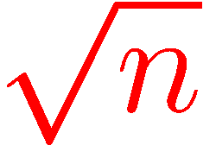
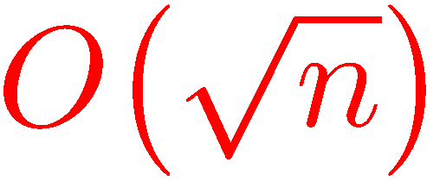
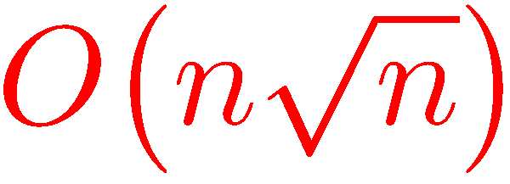
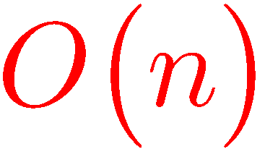
Round Vs. Commn. Tradeoff
2
1’
n
A
1
B
2’
n bits
3’
Question: Cost to transmit from A to B?
Optimal Round =
Commn =
1
n-1’
n’
Optimal Commn =
Round =
n-1

Slide 29
Routing Vs. Computing
1
2
1’
2
n
2’
3
3’
n-1
1
n-1’
n
Routing
n’
n-1
t = 0
t = 1
t = 2
t = 3
Rounds = n+2, Commn = O(n)
t = n+1
t = n+2

Slide 30
Routing Vs. Computing
1
2
x₂,x₃,☹,x_{n}
y
2
n
1’
x₁,x₃,☹,x_{n}
y
2’
3
y
3’
y
n-1
y = x₁ ©☹© x_{n}
y
n
1
n-1’
Computing
x₁,x₂,☹,x_{n-1}
y
n-1
n’
t = 0
t = 1
t = 2
t = 3
Time = 3, Commn = O(n²)
t = n+1
t = n+2

Slide 31
EQUALITY

Slide 32
Fractional Steiner Tree Packing
Input: G, K, ¢
ST(G,K,¢)
Fact: Integral packing value is
t = n+1
t = n+2

Slide 33
Our Results-EQ
Theorem: Deterministic round complexity of EQ is
Theorem: Randomized round complexity of SET-DISJ is

Slide 34
Element-Distinctness

Slide 35
Multicommodity Flow
u 2 K
G
v 2 K
n/k units of flow from u to v, for every pair.
number of rounds to simultaneously route.
t = n+1
t = n+2

Slide 36
Our Results-ED
Theorem: Deterministic round complexity of ED_{n} is
Theorem: Randomized round complexity of ED_{n} is

Slide 37
Overview of EQ
We begin with K = {a ,b}

Slide 38
Alice and Bob on a Graph
a
b
Question: Routing n bits from a to b optimal for EQ?
Yes!
Theorem: Let f be any 2-party function.

Slide 39
Alice and Bob on Layered Graph
V₀
V₁
V_{t}
V_{t+1}
V_{2t}
V_{2t+1}
a
b
G
T=0
T=1
Observation: If f can be solved in time t on G, then f needs no commn. in Yao’s model.
Time
T=t

Slide 40
Almost Layered Graphs
Lemma: If n/2 bits cannot be routed in G in time 2t from a to b, then:
V₀
V₁
V₂
V_{t}
V_{t+1}
V_{2t-1}
V_{2t}
V_{2t+1}
a
b
Special Edges
G

Slide 41
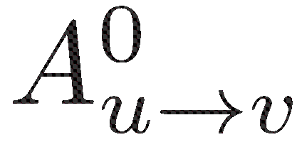
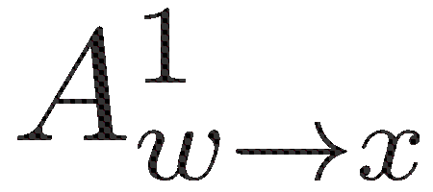
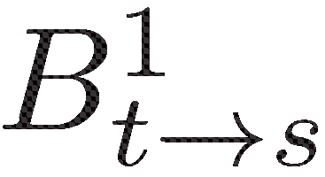
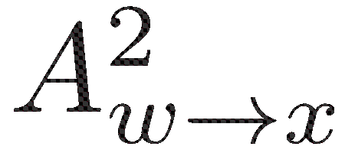
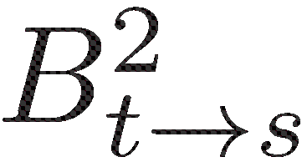
Simulating Almost Layered Graphs
V₀
V₁
V₂
V_{t}
V_{t+1}
V_{2t-1}
V_{2t}
V_{2t+1}
u
v
s
t
a
b
w
x
G
Commn Cost
·

Slide 42
Timed Graph
Y
T
U
Z
G ´
V
T⁰
T¹
T^{t-1}
T^{t}
Y⁰
Y¹
Y^{t-1}
Y^{t}
G^{t} ´
U⁰
U¹
U^{t-1}
U^{t}
Z⁰
Z¹
Z^{t-1}
Z^{t}
V⁰
V¹
V^{t-1}
V^{t}

Slide 43
Our Results-II
Question: What happens when we compose functions?
K ´ K₁ [ K₂ [ ☹ [ K_{t}
Natural Algorithm:
1. Solve each g on K_{i} and store the answer on node u_{i} .
2. Solve f(u₁,☹,u_{t}) optimally.
Question: Is that optimal?

Slide 44
Function Composition
Well studied natural task:
Yao’s XOR lemma in computational complexity
Classical communication complexity
Raz-McKenzie’99
Karchmer-Raz-Wigderson’95
Barak et.al’13
Moos et.al’15
Many more…
Seems natural in distributed setting!

Slide 45
Our Result for Composed Functions
A technique for proving Natural Algorithm is optimal:
Linear Programs represent communication constraints.
Tree embeddings of graphs.

Slide 46
A Special Case
Natural Algorithm for ED ± XOR_{n} on G,K₁,☹,K_{t.}
Replace each input by hash?.
Phase-1. Solve each XOR_{n} on K_{i} and store the answer on node u_{i} .
Phase-2. Solve ED(u₁,☹,u_{t}) optimally.
Replace each u_{i} by a log t bit hash.
Send hashes to median node u.
Phase-2
Phase-1
X₁
» a₁
X₂
» a₂
X₃
» a₃
X_{t/2}
» a_{t/2}
a_{t} »
X_{t}
u₁
u₂
u₃
u_{t/2}
u_{t}
u₁
u₁, u₂
u₁ , u₂ , u₃ ,…
u_{t/2+1} , u_{t/2+2} , …
Y₁
» b₁
Y₂
» b₂
Y₃
» b₃
Y_{t/2}
» b_{t/2}
b_{t} »
Y_{t}
Phase-1:
K_{i} = (X_{i}, Y_{i})
|a_{i}|= |b_{i}|= O(log t)
|X_{i}|= |Y_{i}|= n
u_{i} ´ a_{i} © b_{i}
Phase-2:

Slide 47
Our Lower Bound
Theorem:
ED
XOR
Natural Algorithm is essentially optimal!

Slide 48
Open Problems
Is Natural Algorithm essentially optimal for every f ± g
whenever f is median-type and g is steiner tree type?
Get rid off the log-factor losses in lower bounds.
Prove better deterministic lower bounds .
Develop a general theory of communication complexity
in the point-to-point model.

Slide 49
Thank You!

