Slide 2



March 16-18, 2018
PUTTING WOMEN INTO THE EQUATION
Impact of Women Mathematicians on Research and Education in Mathematics
Introductory Remarks
by
Lillian D. Beltaos
&
Amenda Chow

Slide 3
March 16-18, 2018
PUTTING WOMEN INTO THE EQUATION
Impact of Women Mathematicians on Research and Education in Mathematics
Welcome Participants!
We are finetuning History and Collective Knowledge with this workshop

Slide 4
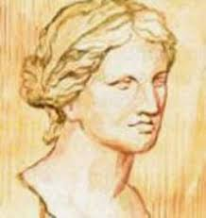
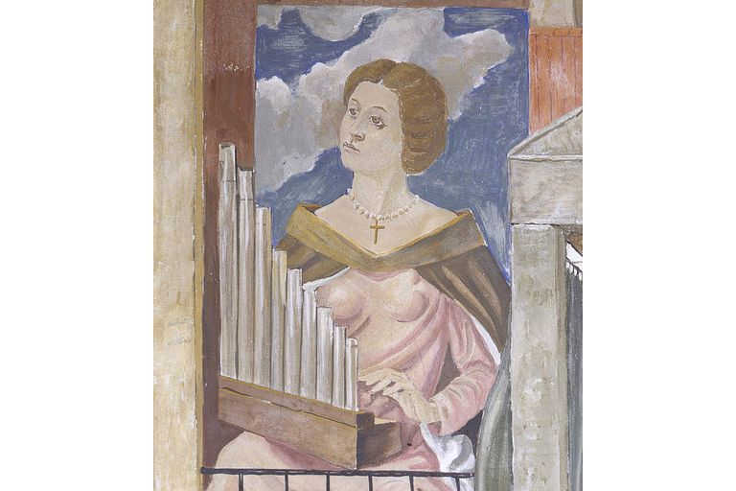
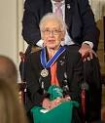
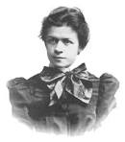
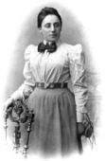
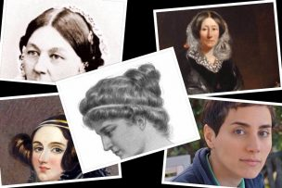
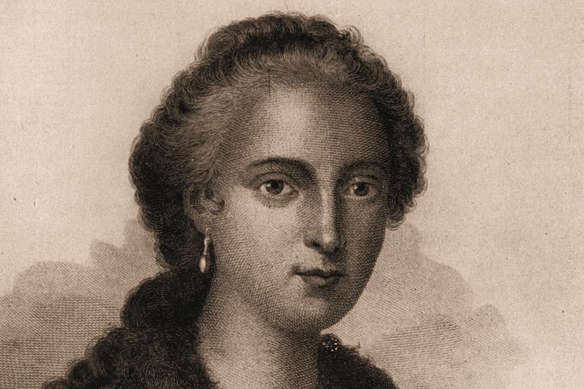
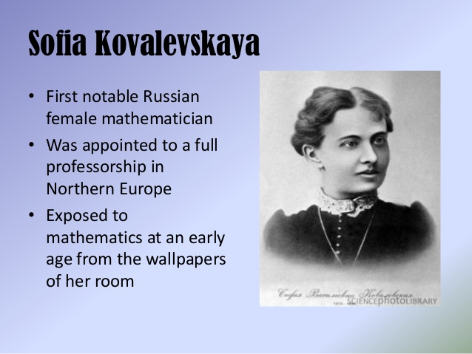
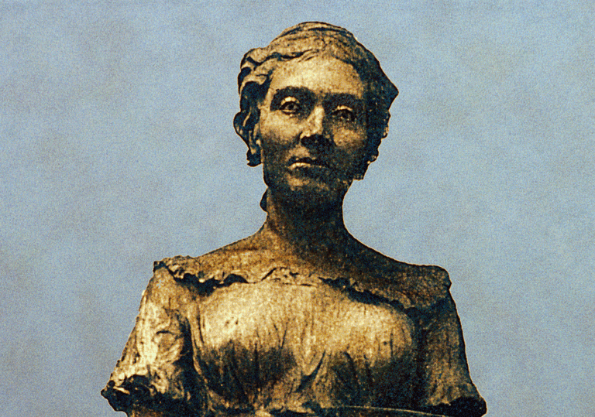
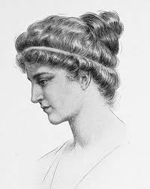
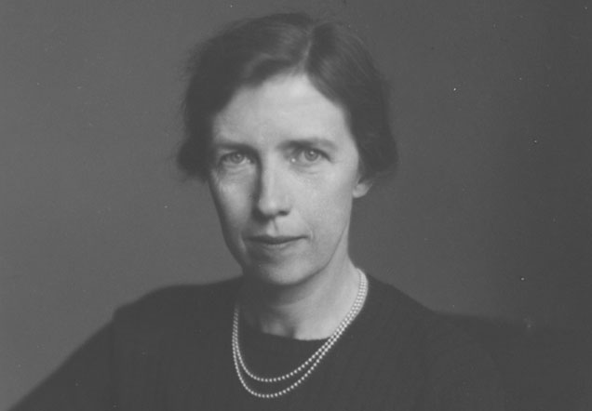
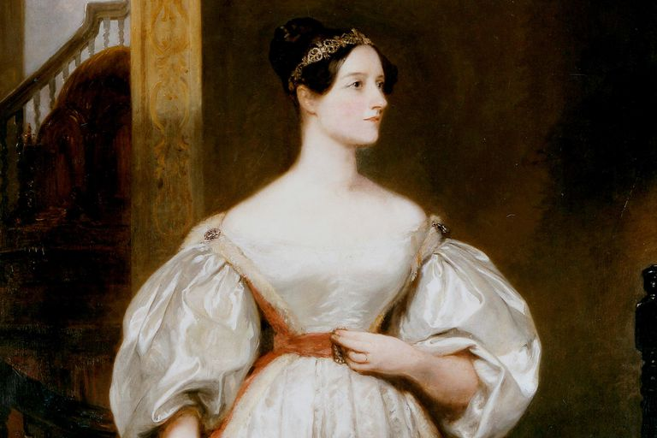
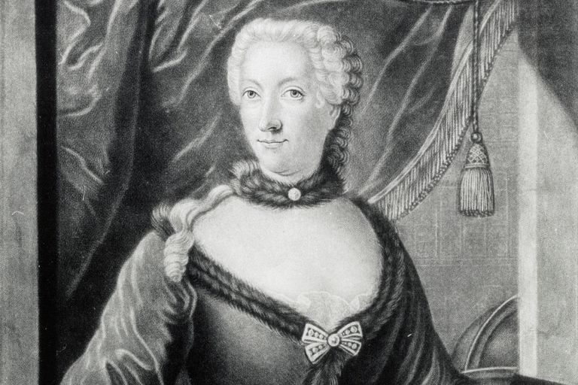
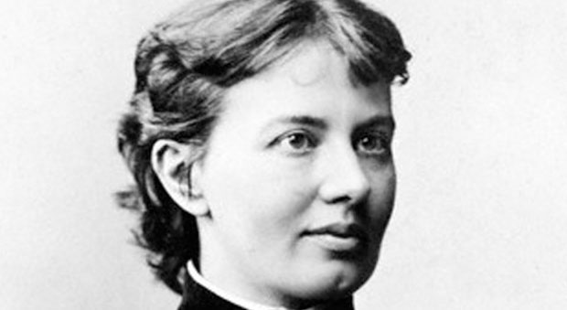
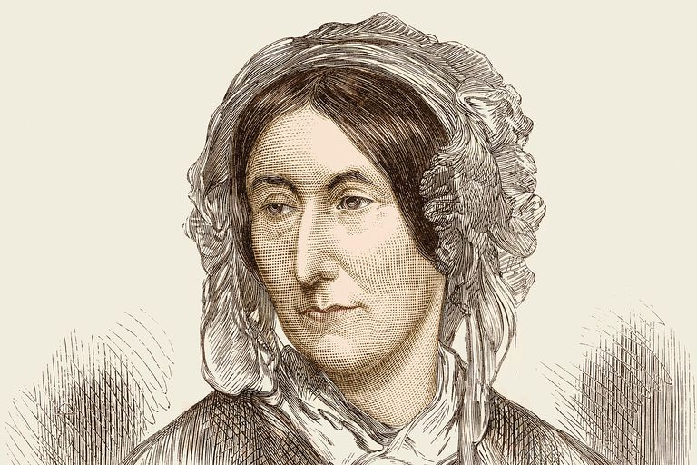
March 16-18, 2018
PUTTING WOMEN INTO THE EQUATION
Impact of Women Mathematicians on Research and Education in Mathematics

