Slide 1
The Structure of Criminological Theory
P. Jeffrey Brantingham
UCLA Anthropology
Notes:
Criminology over the past 100 years can be criticized in general for barely increasing our ability to explain crime. However, this general criticism glosses over significant differences between what Robert Merton identified as low-, middle and high-range theories. Low-range theories are can be described as 'empirical laws', while high-range theories are are grand unifying concepts. Middle-range theories are principles--perhaps law-like statements in themselves--that aggregate empirical laws and are subsumed by high-range theories. This paper surveys explanation at each of these levels and argues that we do quite well with explanation at the scale of empirical laws, but still struggle with grand unifying concepts. Mathematics has the greatest potential to contribute in framing middle-range theory, which we can hope will make high-range theory more tractable.

Slide 2
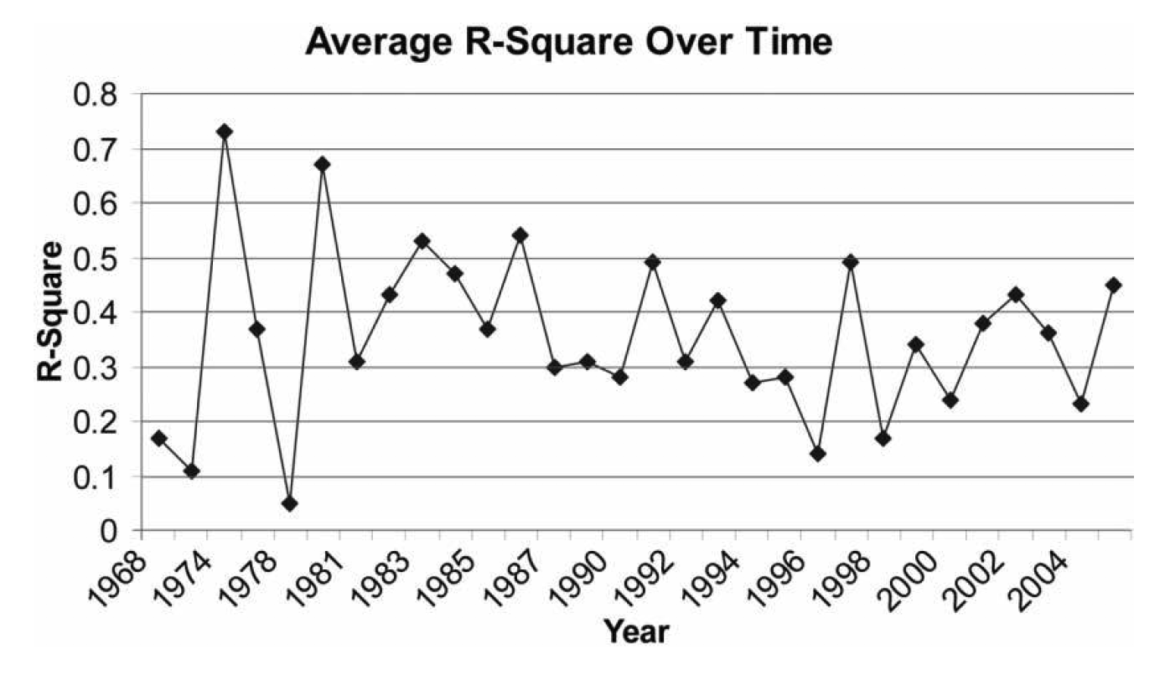
a crisis in explaining crime?
Weisburd and Piquero critique
Weisburd, D. and Alex R. Piquero, How Well Do Criminologists Explain Crime? Statistical Modeling in Published Studies. Crime and Justice, 2008. 37(1): 453-502.
Notes:
In an influential paper from a decade ago, David Weisburd and Alex Piquero suggested that criminologists were not doing a very good job of explaining crime. Over nearly a 50 year period, the proportion of variance explained by multivariate statistical models published in the flagship journal Criminology have barely budged over a paltry 1/3.
I am going to suggest that this result is both too pessimistic and too optimistic, one's outlook dependent upon what level of theory you are looking at.

Slide 3
outline
what are we trying to explain?
what is the structure of criminological theory?
where can mathematic make the greatest contribution?
Notes:
Today I am going to take a step back from a standard talk that focuses on a particular problem and look more broadly three questions:

Slide 4
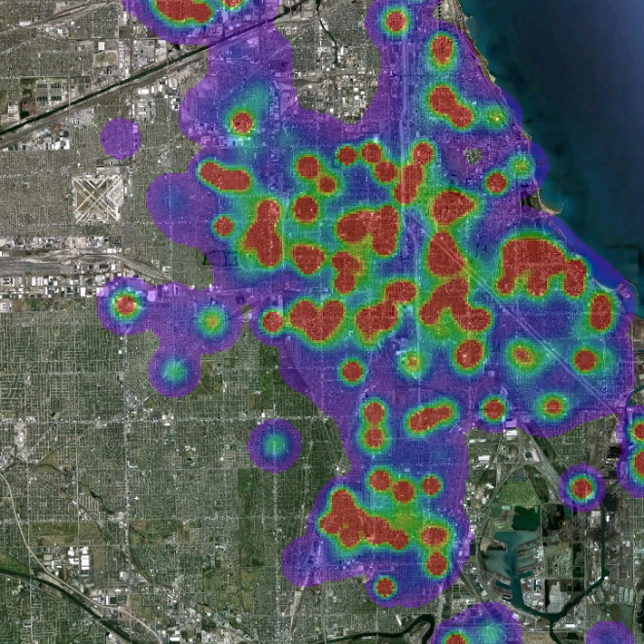
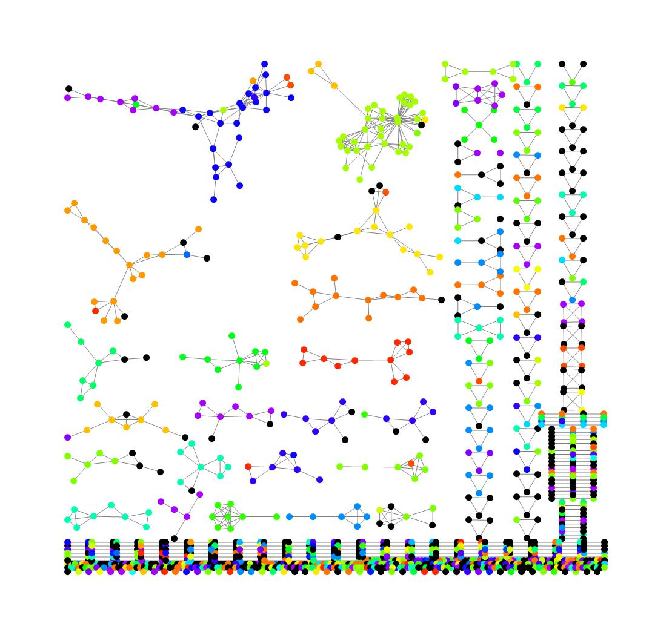
what are we trying to explain?
crime
criminality
Notes:
I would argue that the goal of criminology (in the broadest terms) is to explain observed variability in crime and criminality over time and space. That is answer both proximate "how" questions and ultimate why "questions" for
spatial variation in crime -- Chicago gun crime
temporal variation -- Homicide rates per 100k pop since 1958
individual offending patterns--Doris Payne, booking photo for jewl-store robbery in 1965 and 20017
group offending patterns -- Gang social network in Los Angeles

Slide 5

what is crime?
crime = a behavior that breaks the law and leaves offender liable to public prosecution and punishment
crime event = a crime referenced in geospatial and/or temporal coordinates
A multi-victim gang shooting in Los Angeles,
June 2017
Notes:
crime events vs. criminals

Slide 6
what is criminality?
career criminal = persistent participation in crime at high frequency and sometimes escalating severity
criminal subculture = a group who’s norms support the commission of crime
hardened criminal Lori Laughlin in 2019
Notes:
criminal = a person who has committed a crime
criminality = the state of being a criminal

Slide 7
structure of criminological theory?
high
low
comprehensiveness
empirical content
low
high
Styled after: Schiffer, Michael B. 1988. The structure of archaeological theory. American Antiquity 53 (3):461-485.
Notes:
To understand how "well" criminologists are doing at explaining crime and criminality it is useful to take a look at the structure of criminological theory. My take is is quite general and abstract.
First, I consider theory to be any series of basic premises, postulates or assumptions that specify fundamental entities, processes or mechanisms underlying crime or criminality.
Theories exist on a continuum. At the highest level are theories that seek to explain all crime and criminality regardless of space, time or individual. These are described as “general” or “universal” theories. At the lowest level, are what we might call empirical regularities, or specific patterns of crime and criminality that may or may not be dependent to some degree on the circumstances of observation. Low-level theories are sometimes associated with ”empirical laws”.
In general, as one moves from low-level to high-level theory, the comprehensiveness of the theory increases. In other words, the scope of what is purportedly captured by the theory increases. But it is also true that the empirical content also tends to decrease. High-level theories can be very abstract, while low-level theories tend to be stated in terms of particular empirical patterns.
In general, high-level theories should subsume low-level theories

Slide 8
structure of criminological theory?
high
low
events
criminals
comprehensiveness
empirical content
low-level “empirical laws” abound
low
high
Styled after: Schiffer, Michael B. 1988. The structure of archaeological theory. American Antiquity 53 (3):461-485.
Notes:
I will suggest a first broad division in the structure of criminological theory between those theories that seek to explain criminal events and those that seek to explain criminals. These domain certainly interact, but they are treated quite separately in practice.
Low-level empirical laws abound

Slide 9
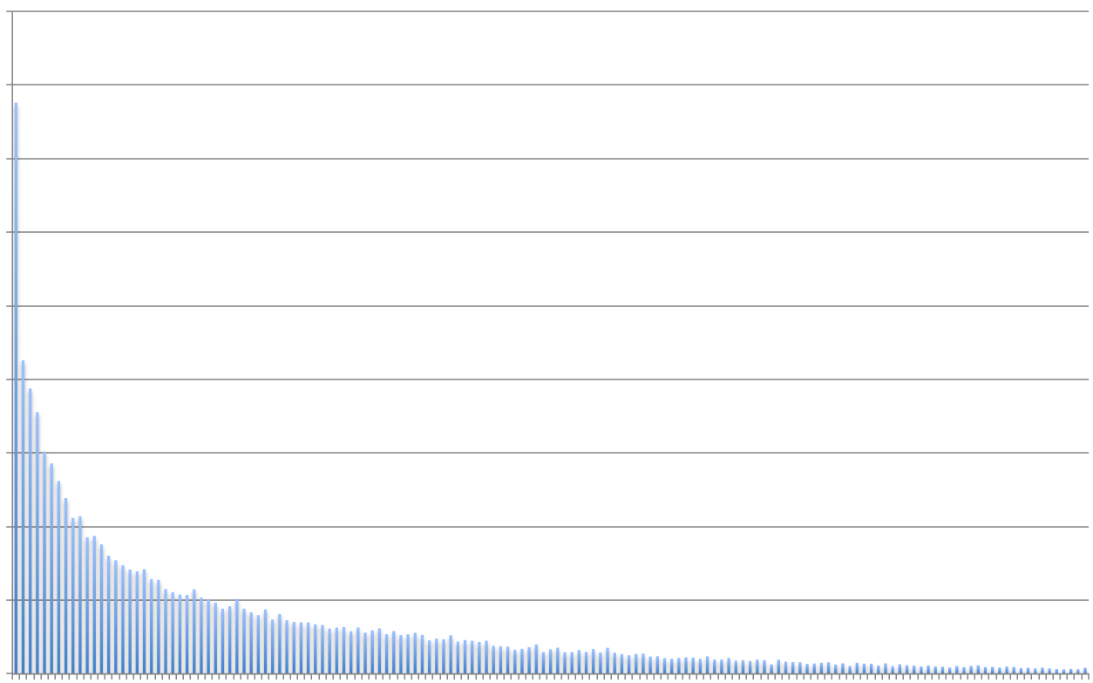
journey-to-crime
all Part I crimes 2003-2009
all Part I crimes
Los Angeles 2003-09
percent of crimes
0 2 4 6 8
social media use maps to
local activity patterns
crime is local
0 2 4 6 8 10 12 14
distance from home (mi)

Slide 10
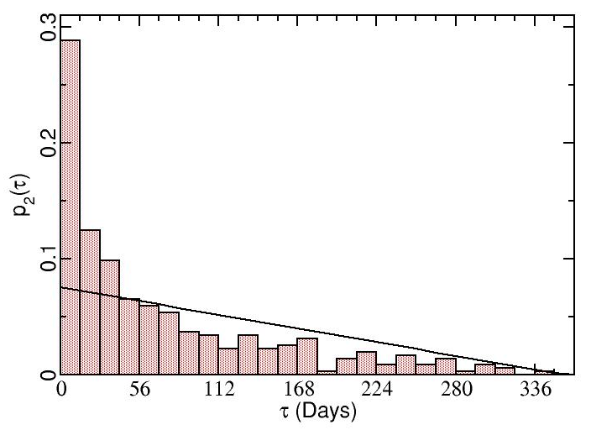
repeat victimization
house much more likely to be revictimized in a two-week interval after initial burglary
Poisson process
Short, Martin B., Maria R. D'Orsogna, P. Jeffrey Brantingham, and George E. Tita. 2009. Measuring and modeling repeat and near-repeat burglary effects. J. Quant. Criminol. 25:325-339.

Slide 11
age-crime curve
Robbery
2017
FBI UCR
GTA
Homicide
Burglary
Rape
Assault

Slide 12
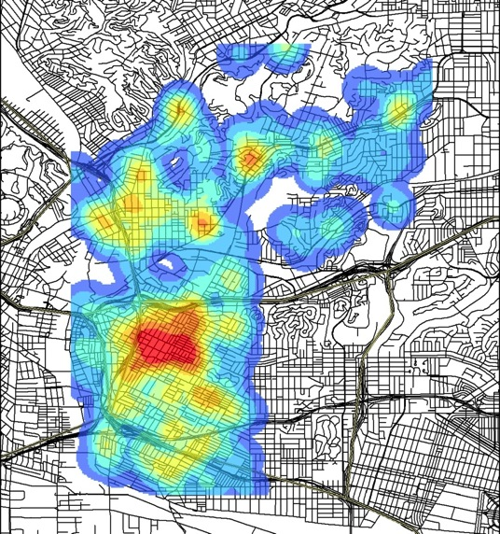
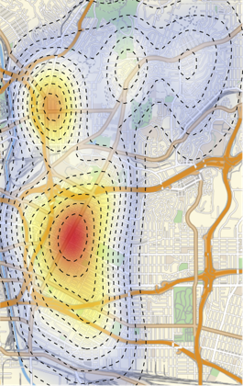
law of crime concentration
2006
2016
gang violent crimes in a Los Angeles Neighborhood

Slide 13
structure of criminological theory?
high
low
events
criminals
high-level explanations abound
comprehensiveness
empirical content
low
high
Styled after: Schiffer, Michael B. 1988. The structure of archaeological theory. American Antiquity 53 (3):461-485.

Slide 14
routine activity theory
motivated offender
law
suitable target
effective security

Slide 15

self-control theory
Gottfredson, M. R., and T. Hirschi. 1990. A General Theory of Crime. Stanford: Stanford University Press.
Notes:
learned control of impulsive behavior before age 10 drives life-time offending

Slide 16
what is the structure of theory?
high
low
events
criminals
comprehensiveness
empirical content
middle-range theory empirically-grounded models of specific mechanisms
low
high
Styled after: Schiffer, Michael B. 1988. The structure of archaeological theory. American Antiquity 53 (3):461-485.
Notes:
I would argue that the greatest challenge that still confronts criminology is making the connection between these empirical laws and higher-level theory.
What we need is concentrated attention of what we might call middle-range theory: Empirically grounded models of explicit mechanisms.

Slide 17
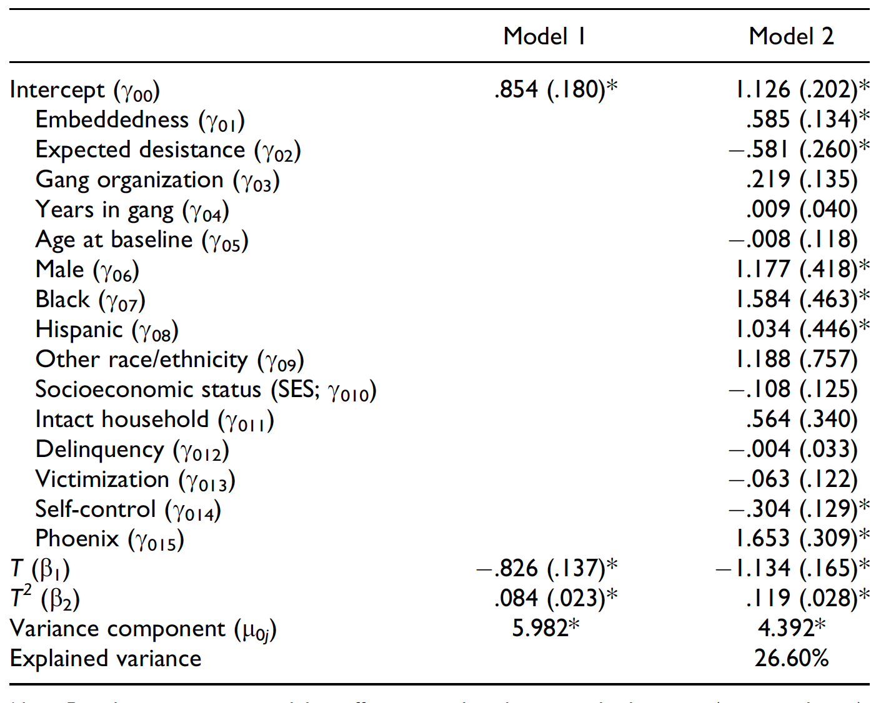
standard MRT in criminology
Notes:
I would argue that the standard for middle-range theory in criminology is not sufficiently mechanistic because it does not seek to model the components of the system and how they coupled via intervening processes. Multivariate statistical models admit only a relatively simple array of structures.
Mechanistic model requires a mathematical description of the entities and processes underlying their interactions.
this is where the big problems come with explanation in sociology

Slide 18
flight distance (δ)
Lévy Distribution
p(δ) = δ^{-μ}
common
p(δ)
rare
distance (δ)

Slide 19
itinerant Levy
central place Levy
β₂,δ₂
β₁,δ₁
β₁,δ₁
β₃,δ₃
β₂,δ₂
β₃,δ₃
β₅,δ₅
β₄,δ₄
β₄,δ₄

Slide 20
central place
frequency
distance km

Slide 21
itinerant search
frequency
distance from origin km

Slide 22
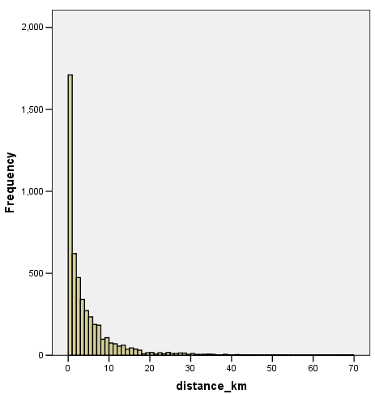
Los Angeles: distance in km between car
theft and recovery location (n = 4847)

Slide 23
9
8
y = -1.9307x + 22.597
R
2
= 0.9149
7
6
5
log frequency
4
3
μ = 1.9308
2
1
0
7
8
9
10
11
log distance

Slide 24
structure of criminological theory?
high
low
events
criminals
offenders
victims
settings
security
law
comprehensiveness
empirical content
low
high
Styled after: Schiffer, Michael B. 1988. The structure of archaeological theory. American Antiquity 53 (3):461-485.
Notes:
for example, bone diagenesis is essential for making archaeological inferences, but is itself not essential for understanding ecology or evolution.
Hmmm. If it does not contribute to ”the” high-level theory it is then “method” (Raab and Goodyear)
true if there are principles about offenders, victims, settings, etc., that are essential for inferences about crime events and criminals, but are not “subsumed” by high-level theory of crime events and criminals

Slide 25
conclusions

Slide 26
stability of patterns
2006
2016
gang violent crimes in a Los Angeles Neighborhood

Slide 27
what is the structure of theory?
high
low
events
criminals
offenders
victims
settings
security
law
comprehensiveness
empirical content
low
high
Styled after: Schiffer, Michael B. 1988. The structure of archaeological theory. American Antiquity 53 (3):461-485.
Notes:
for example, bone diagenesis is essential for making archaeological inferences, but is itself not essential for understanding ecology or evolution.
Hmmm. If it does not contribute to ”the” high-level theory it is then “method” (Raab and Goodyear)
true if there are principles about offenders, victims, settings, etc., that are essential for inferences about crime events and criminals, but are not “subsumed” by high-level theory of crime events and criminals

Slide 28
Schiffer’s
high
crime events
criminals
low

Slide 29
structure of criminological theory?
high
low
events
criminals
comprehensiveness
empirical content
low
high
Styled after: Schiffer, Michael B. 1988. The structure of archaeological theory. American Antiquity 53 (3):461-485.
Notes:
what we should be doing is MRT because this is where the real failures to explain are coming from

Slide 30
Merton’s middle-range theory

Slide 31
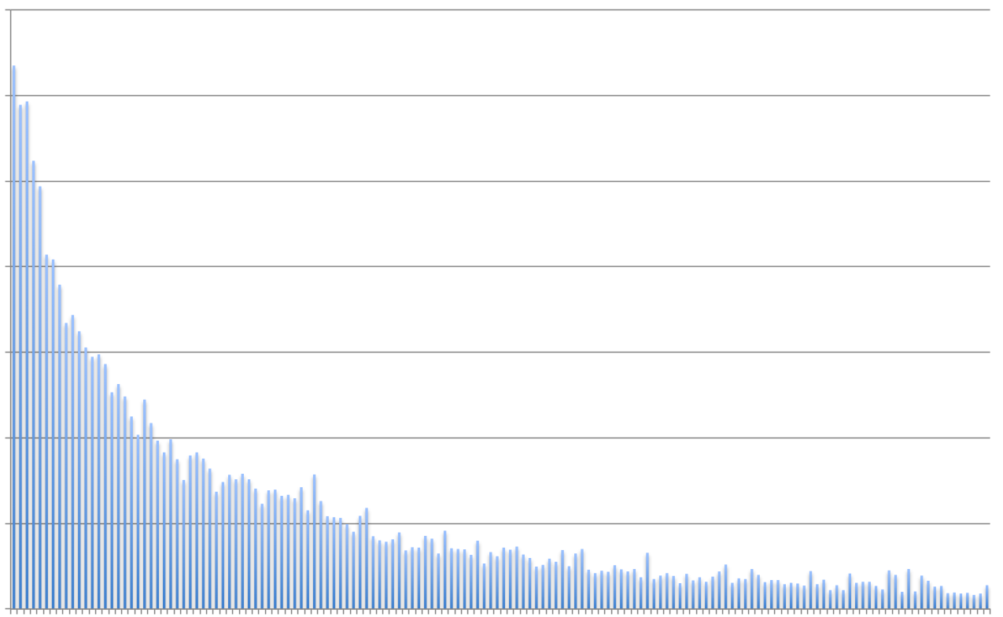
journey-to-tweet
geotagged tweets
in Hollenbeck, LA
218 users, 87k tweets
percent of tweets
0 1 2 3
social media use tied to
local activity patterns
0 2 4 6 8 10 12 14
distance from home (mi)

Slide 32
crime pattern theory
Areas Fitting Crime Template
Work
Home
Shopping & Entertainment

