Slide 1
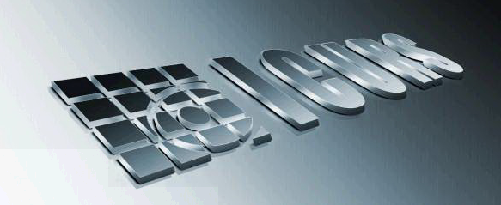
Patterns in Crime: An Overview
CrigPatricia Brantingham
Institute of Canadian Urban Research Studies/
Institut canadien de recherche en études urbaines

Slide 2
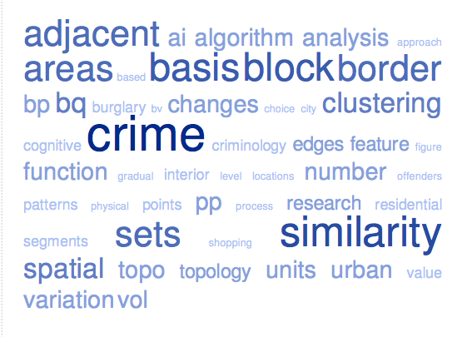
Today
Overview
Crime Pattern Theory
Visual examples
Links to Math
Notes:
Brief overview; available through this workshop to answer questions, point to literature- strong links to urban studies
Primarily visual examples, but examples that hopefully will trigger your mathematical interests
point process models/ movement models
pde in general
graph theory/ network analysis
CNN
topology/ algebraic topology
dimensionality reduction
rough data/ latent variables/…
String theory

Slide 3
Core concepts
Activity space
Awareness space
The push and pull in cities
Crime Attractors and Crime Generators
Directionality
Notes:
Crime is not random
Individual and group patterns of activity (rush hour?)
Individual offending and co-offending patterns
Very strong pattern shaped by structure of city and dynamics of urban living and directionality of travel towards known major nodes

Slide 4
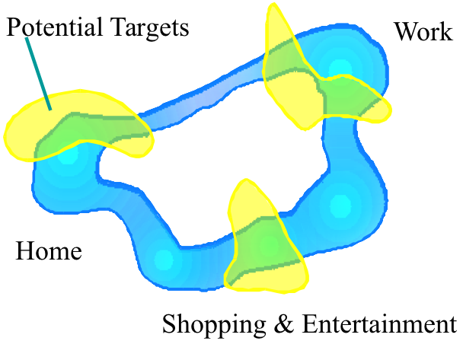
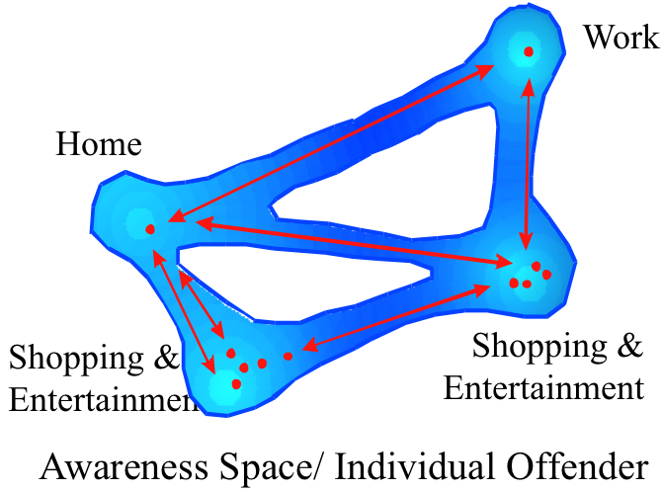
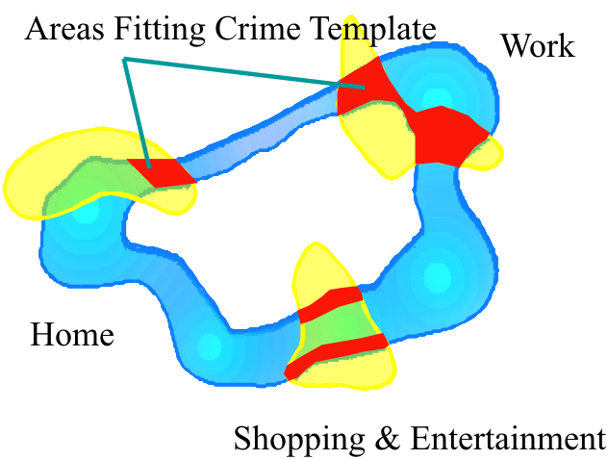
Notes:
Individuals develop awareness space…. Surjective onto a Euclidean Space. But each individual has his or her awareness space.
Drawing from 40 years ago… so not sophisticated, but color represents strength (lighter is stronger)
Width is the bi-product of movement speed. View angle… see more when walking or stationary; less as speed increases (velocity, acceleration)
Red points are activity nodes.
Yellow areas are potential targets; intersect awareness space…. Basically a potential target is not at risk if you are unaware of it….. Crime is a rare event; many potential targets are not at risk. Challenge to research.
Must model mobility, movements, pushes and pulls in an environment to understand risk.
Similarly…. The green areas show likely displacement locations. Unknown potential targets are not likely displacement targets.
Red represents what we call the crime template. Like complex etiology of crime. Individuals make like the same target but for many different reasons…. Challenge to research; looking for groupings of similar views.
Note: I was more into continuous surfaces then…. Visually easier, but targets are points in time and space and moveable in many cases and of varying attraction depending on many surrounding factors.
But over all… we develop habits in our movements; we learn and change; but for any individual this is really a small sub-space… if there is time we’ll get more into this later. Has an impact on research.

Slide 5
Notes:
Surjective mapping of three individuals onto one surface (onto mapping). Term developed by the Bourbaki Group.
Mathematically (or in physics) the movements tend to form bundles, concentrations of travel paths and destination nodes.
Major part of field is how the structure of cities and activities within a city influence and constrain movement…One researcher at ICURS began as an engineer in hydrology… lots of things to be learned from hydrology techniques.

Slide 6
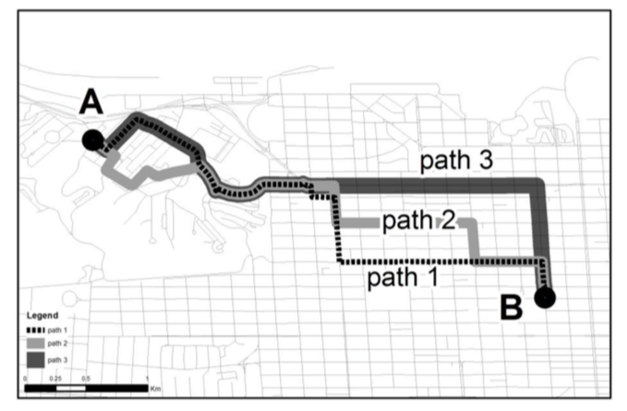

Slide 7
Amsterdam Realtime:
Esther Polak and Jeroen Kee with the Waag Society
http://realtime.waag.org
:
Notes:
Wagg Society Institute for Art, Science and Technology
2 months Oct-Dec 2002

Slide 8
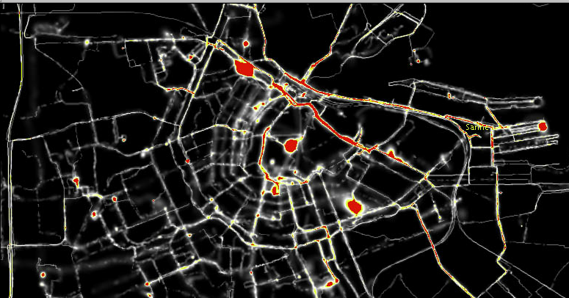
Amsterdam Realtime:

Slide 9
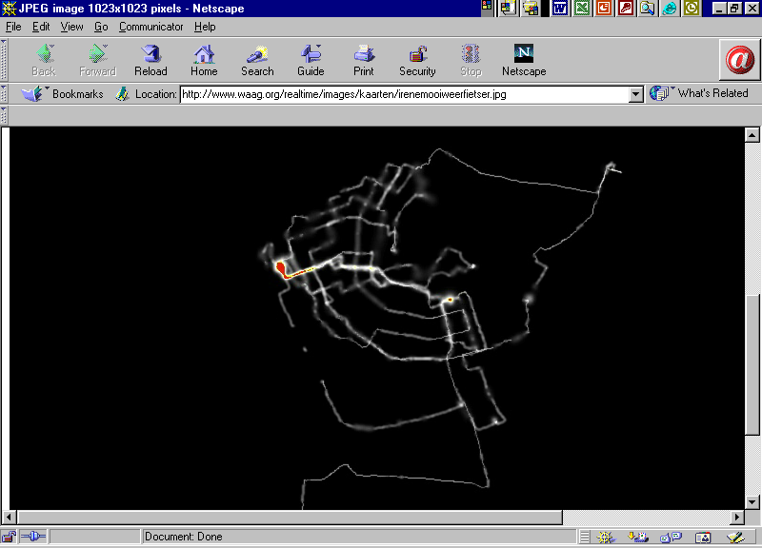
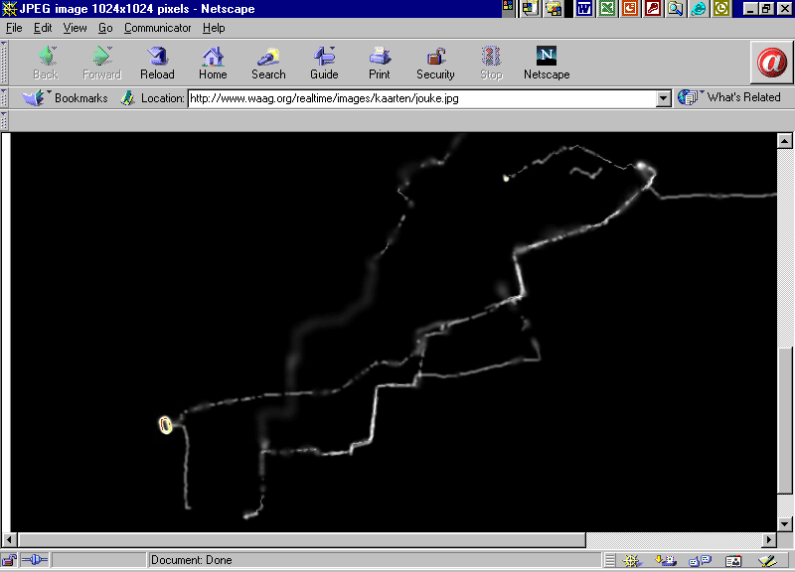
Marathon Runner
Nice Weather Cyclist

Slide 10
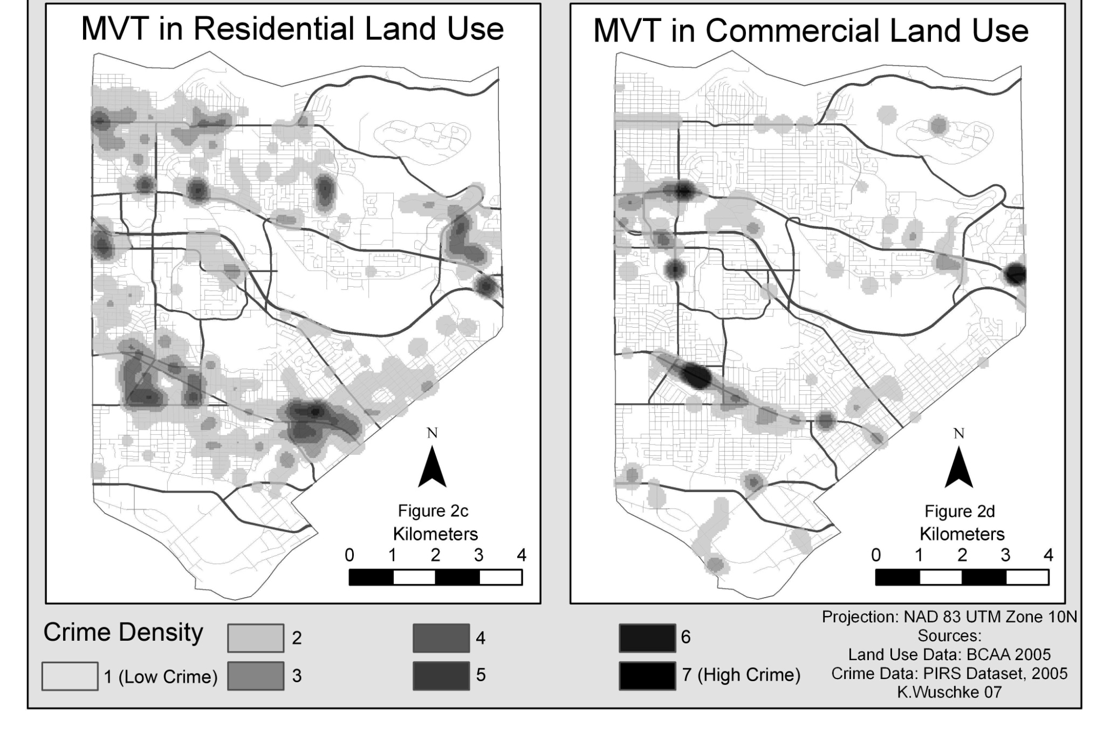
Amsterdam Realtime:

Slide 11
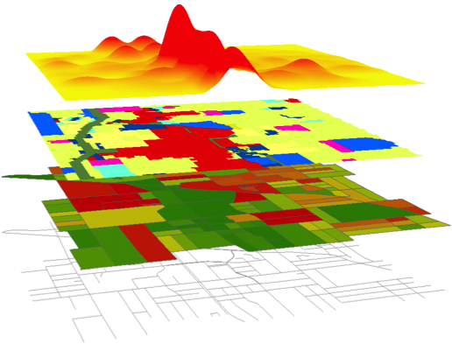
Crime Patterns
Road network
Land use
City infrastructure
Pushes and pulls
Paths – nodes – edges
Attractors – generators
Notes:
Text template

Slide 12
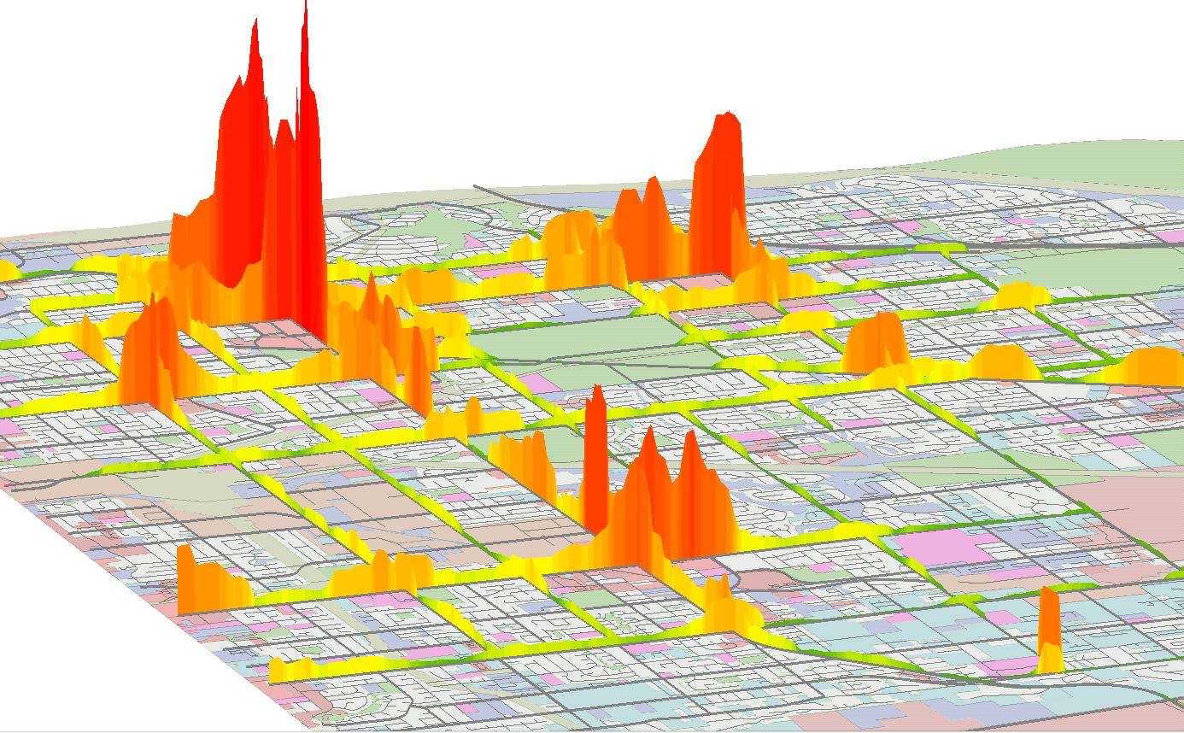
Notes:
Like TRACC Advanced visualization of local congestion patterns can be represented regionally by a “heat plot” algorithm. Slow and standing vehicles create a lot of virtual heat, while moving vehicles do not contribute to the abstract three-dimensional surface.
TRACC, the Transportation Research and Analysis Computing Center ,, USDOT, USDOE Argonne National Laboratory
Crimes in 5 year period for 200 m radius

Slide 13
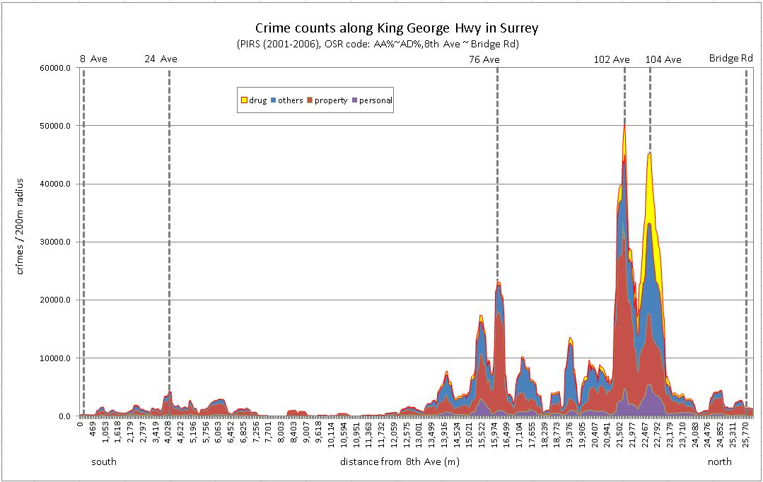
Crime and the Urban Backcloth
Street profile analysis: A new method for mapping crime on major roadways Spicer, V. ; Song, J. ; Brantingham, PL ; Park, A. ; Andresen, M..Applied Geography, 2016, Vol.69, pp.65-74
Notes:
Modeling we are doing now that is like some HPC transportation modeling. How the urban backcloth influences where crimes are highest.
Similar to traffic congestion (non-highways) and co2 emissions
KDD Knowledge Discovery and Data Mining

Slide 14
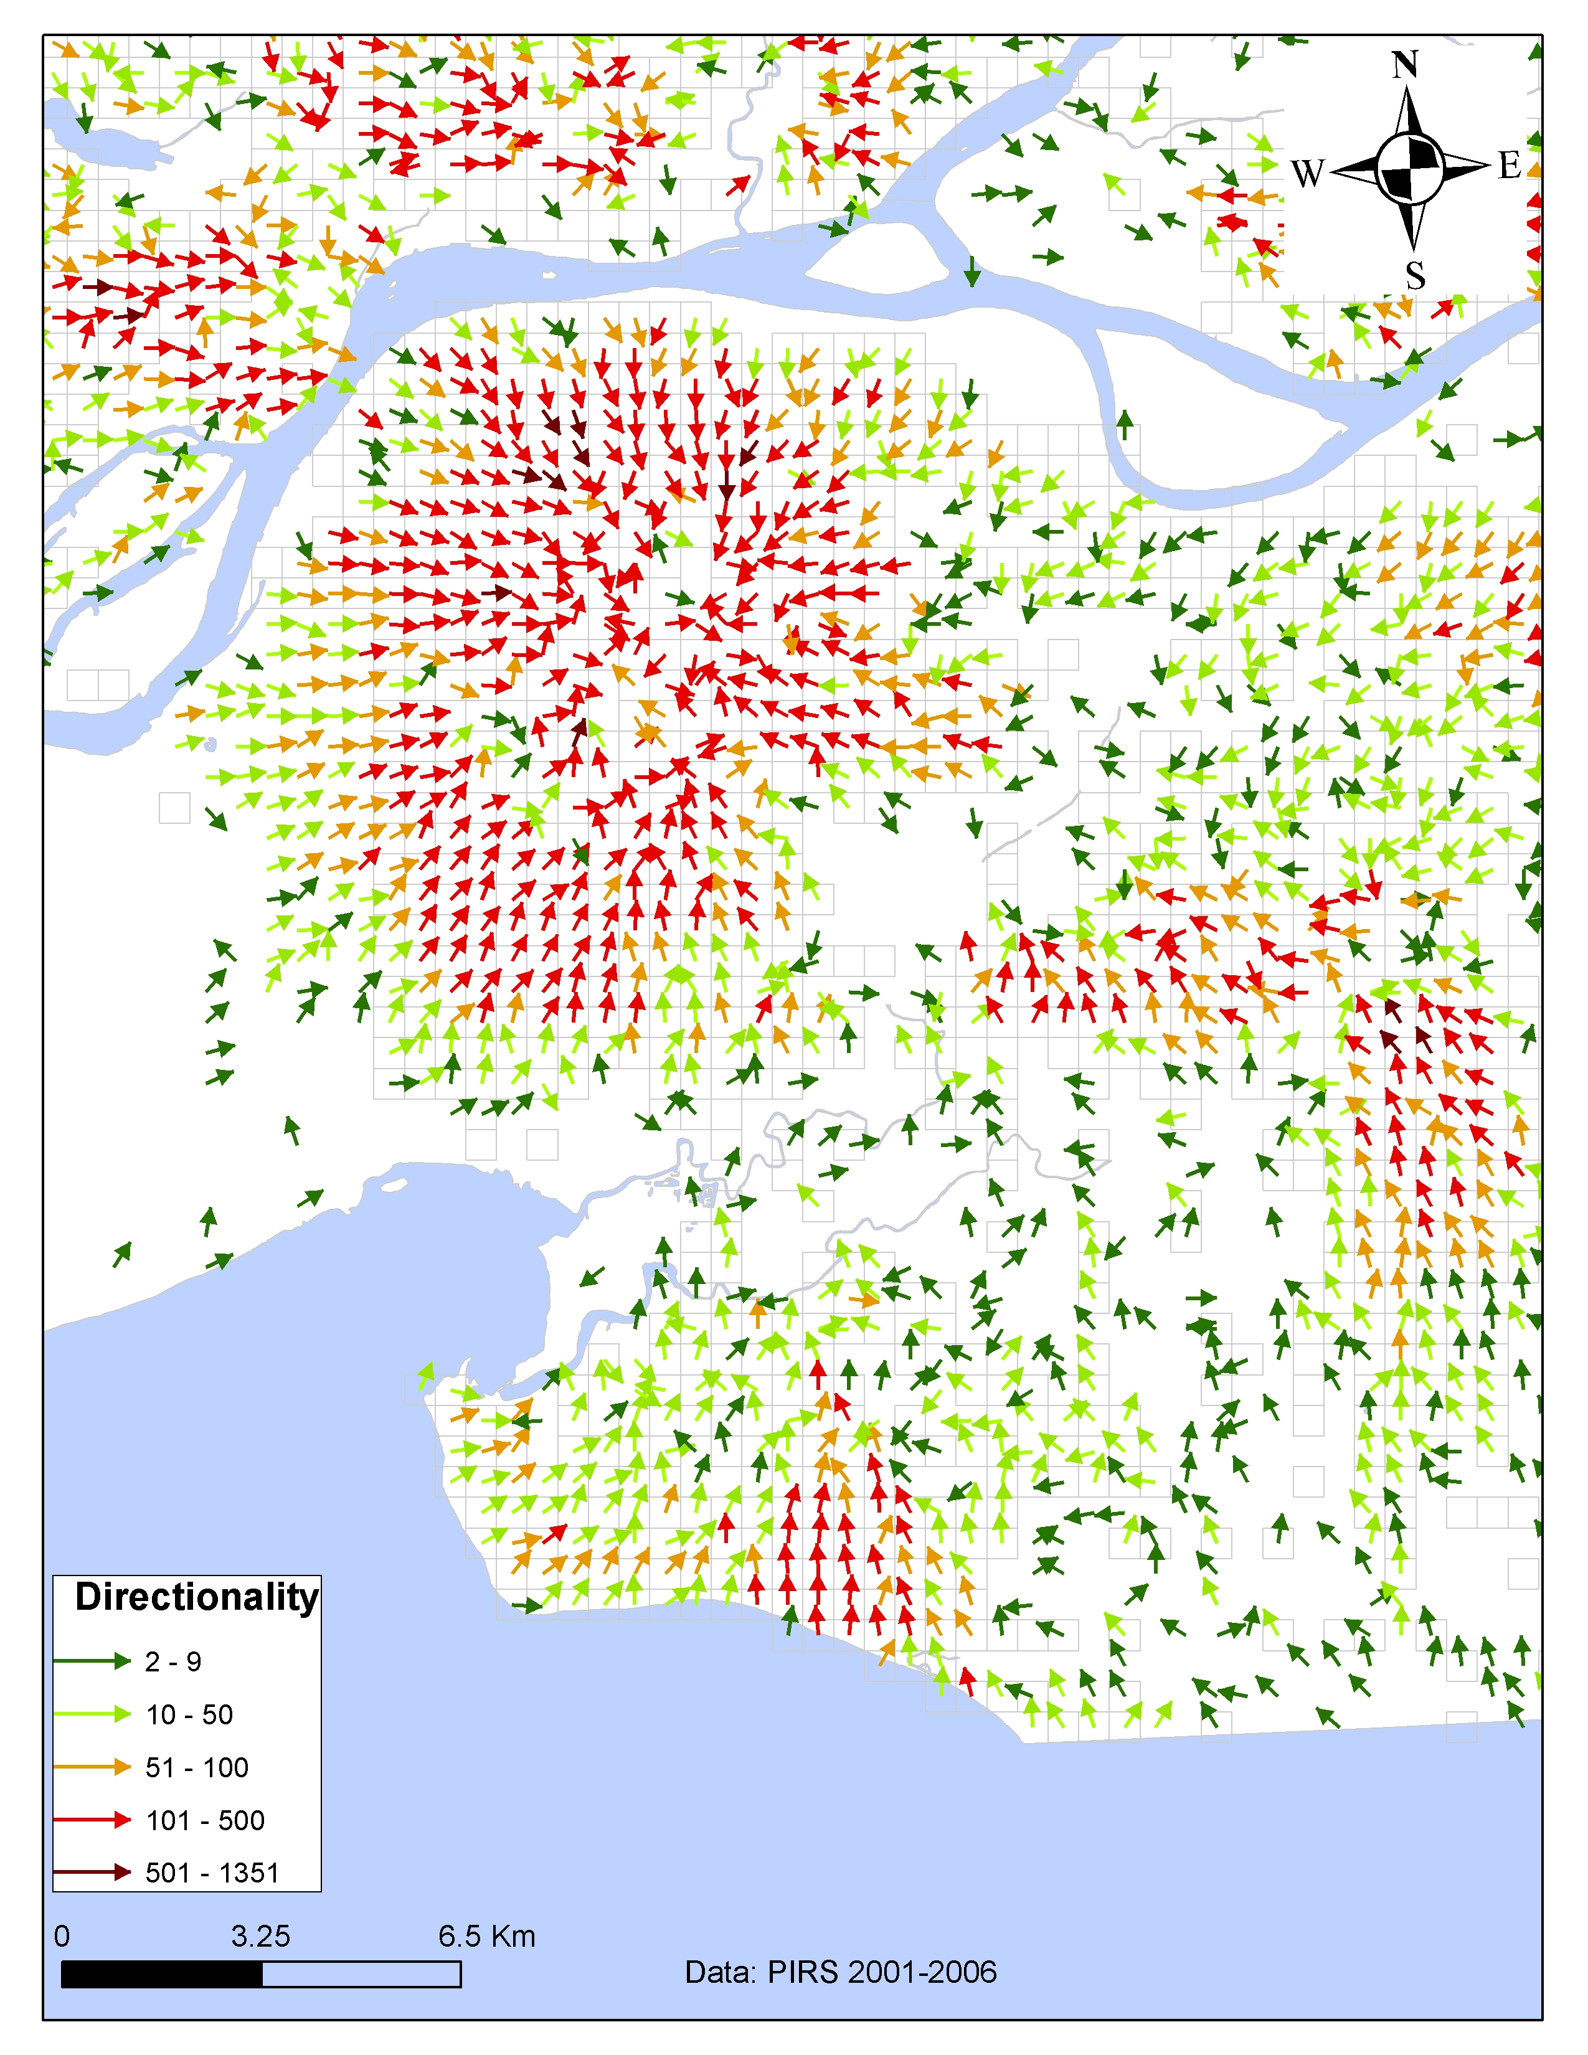
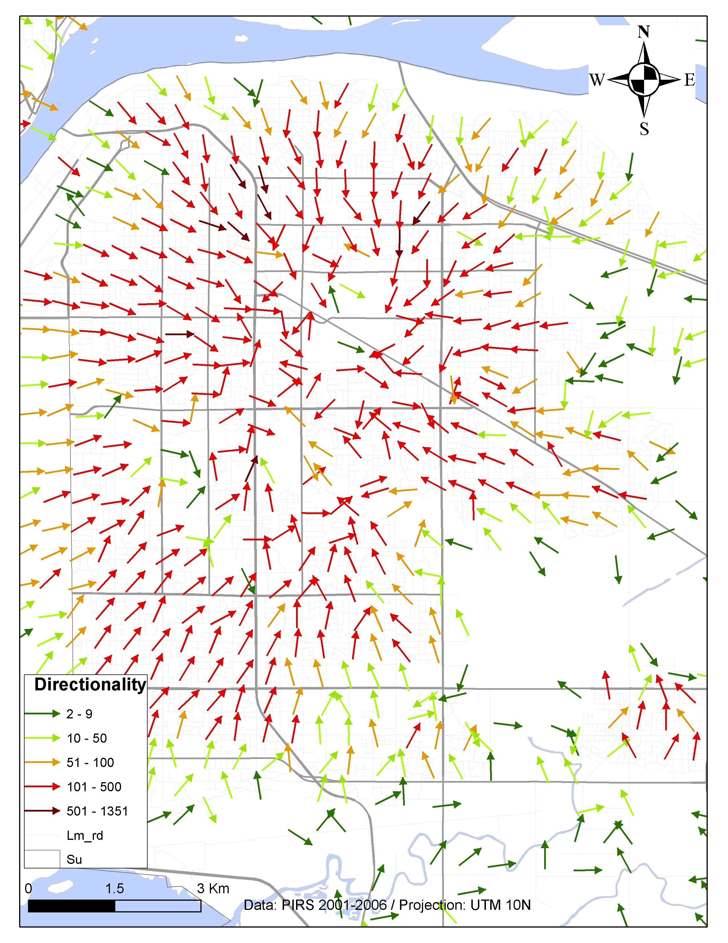
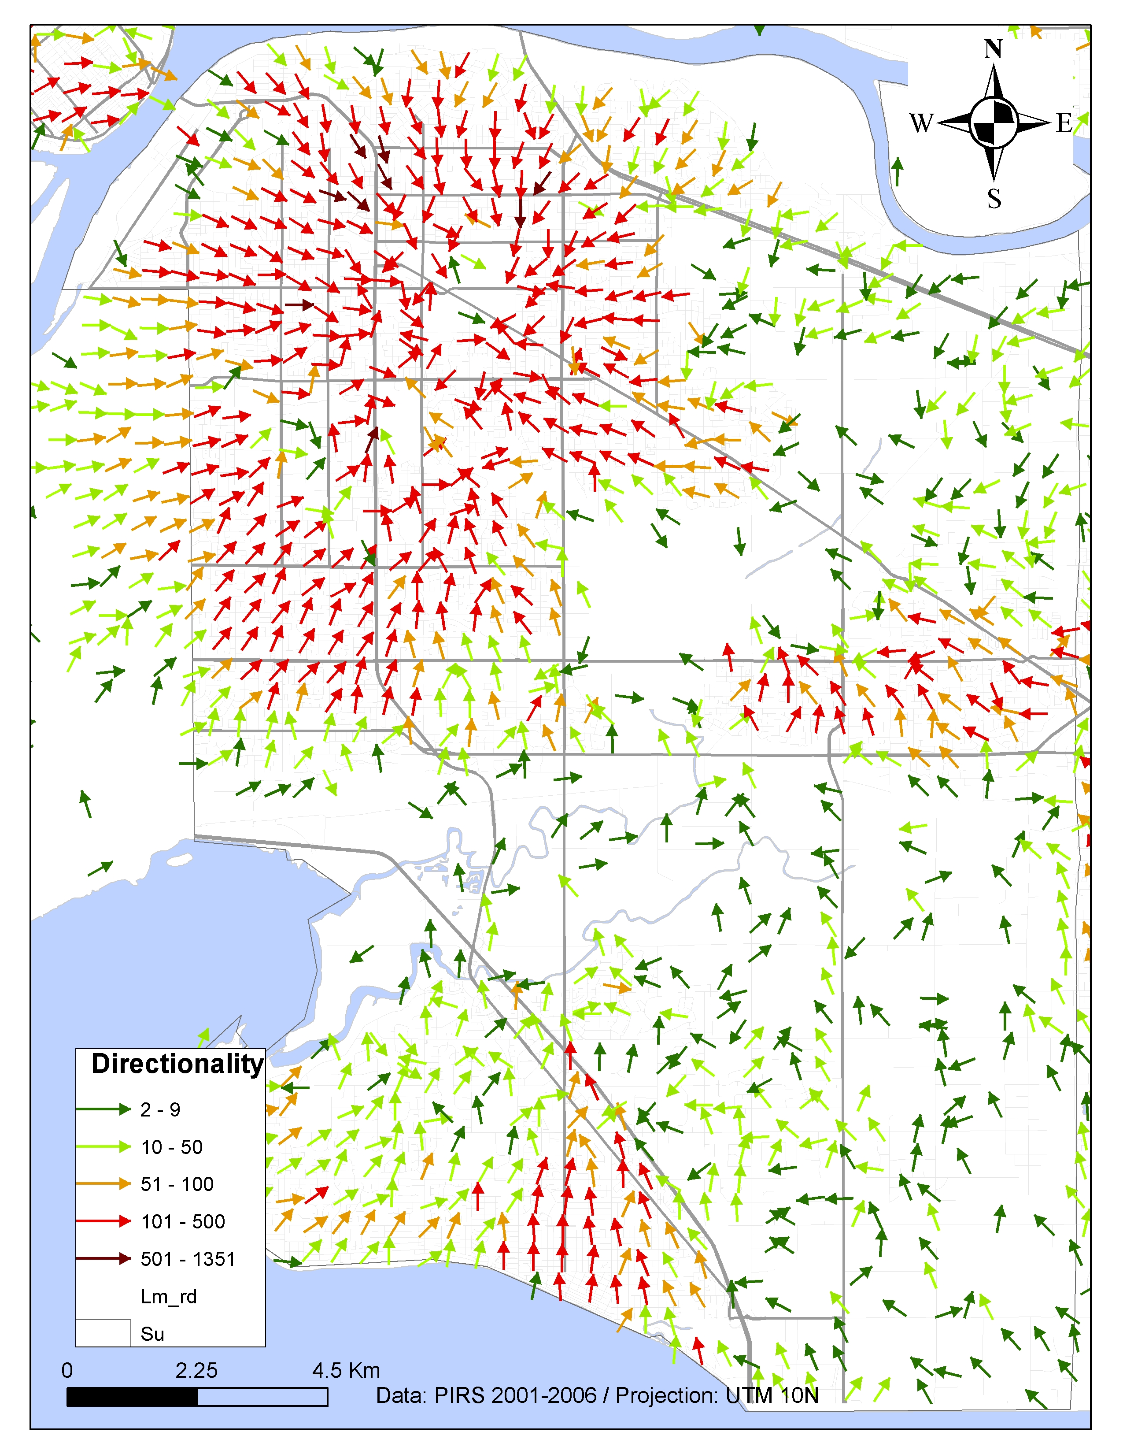
Crime Pattern Visualization (2018), PL Brantingham, PJ Brantingham, J. Song, V. Spicer. In Oxford Handbook on Environmental Criminology (Gerben, Bruinsma and Johnson (eds))

Slide 15
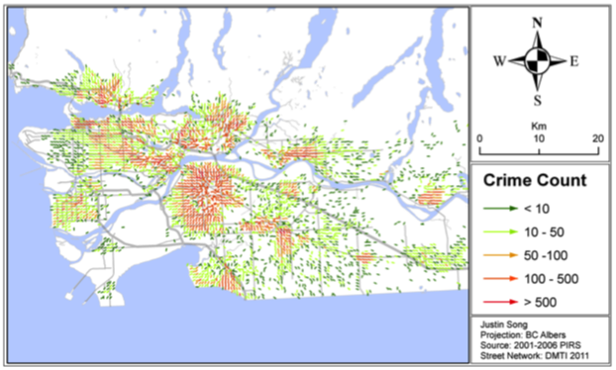
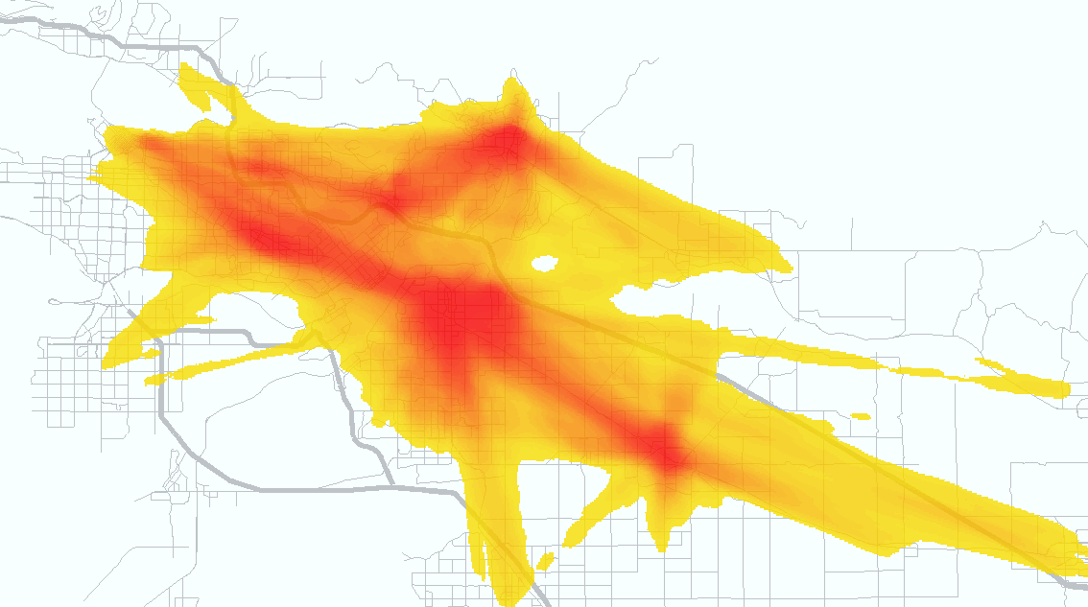
Justin Song

Slide 16
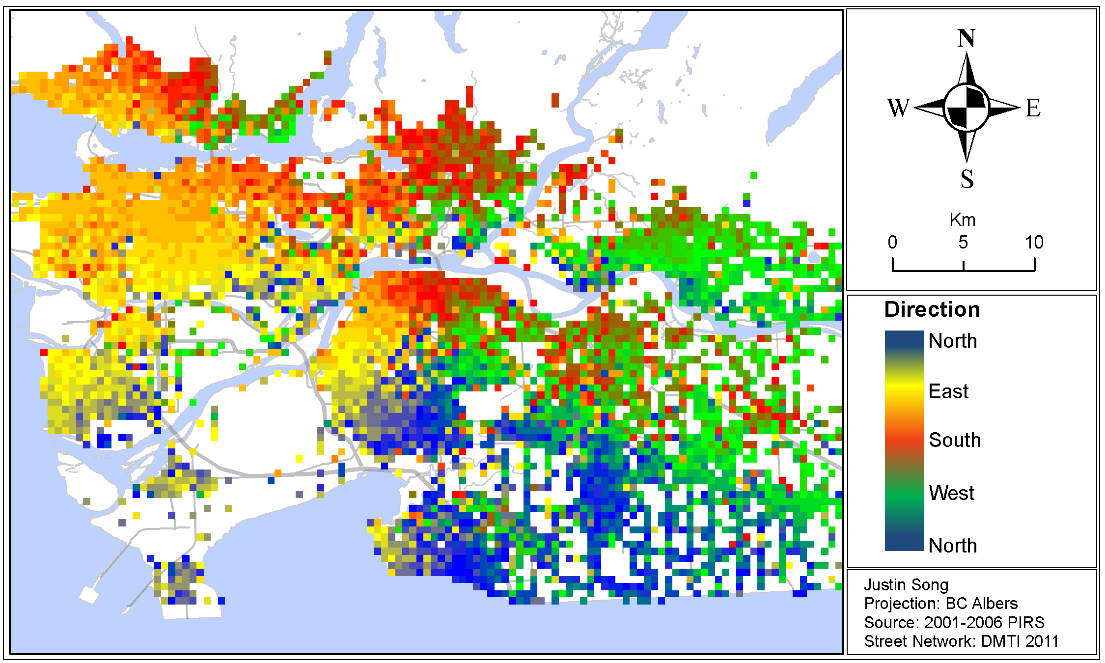
Crime Ridges: Exploring the Relationship between Crime Attractors and Offender Movement Song, Justin ; Spicer, Valerie ; Brantingham, Patricia ; Frank, Richard
2013 European Intelligence and Security Informatics Conference, Au 2013, pp.75-82

Slide 17
Other points
Police data snapped to street addresses/ intersections
Cyberspace
Cognitive space
Directionality
Neighbourhoods, boundaries and interiors (10:1)
Navigation algorithms for street networks
Networks of co-offenders
Target choice

Slide 18
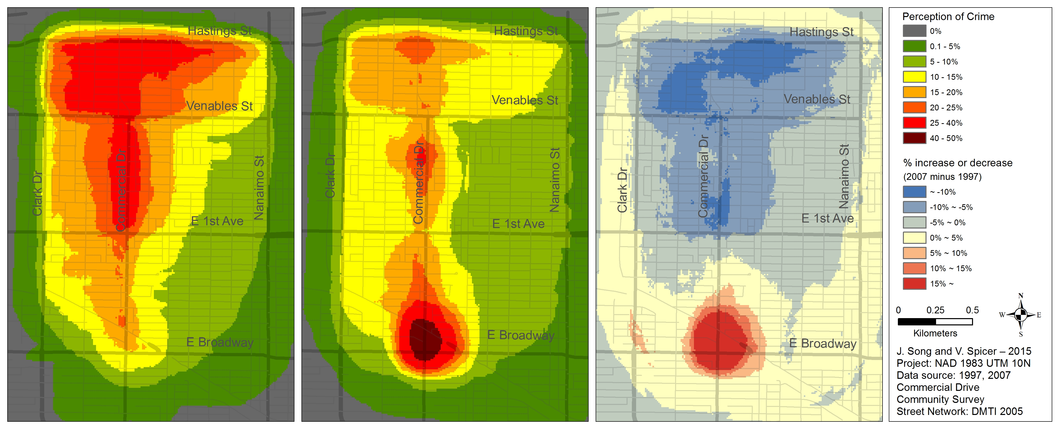
Fear of Crime: Change in mobility patterns
Transit Growth Crime Effect: The Impact of Mass Transportation Hubs on Public Disorder and Fear of Crime, Nov 2015, NARSC
Valerie Spicer; Justin Song; Kathryn Wuschke, and Patricia Brantingham,

Slide 19
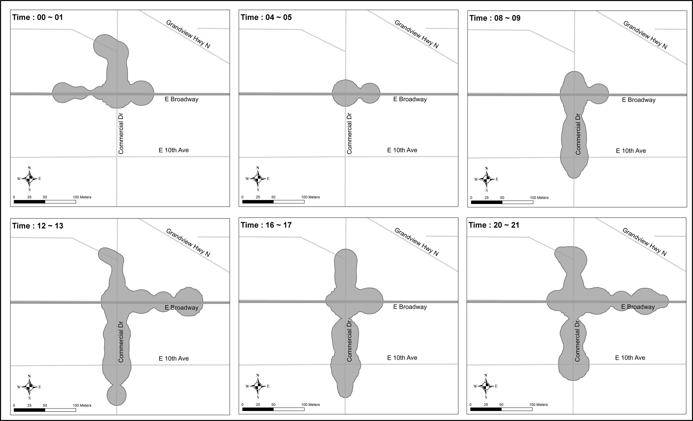
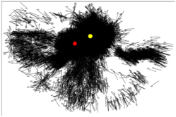
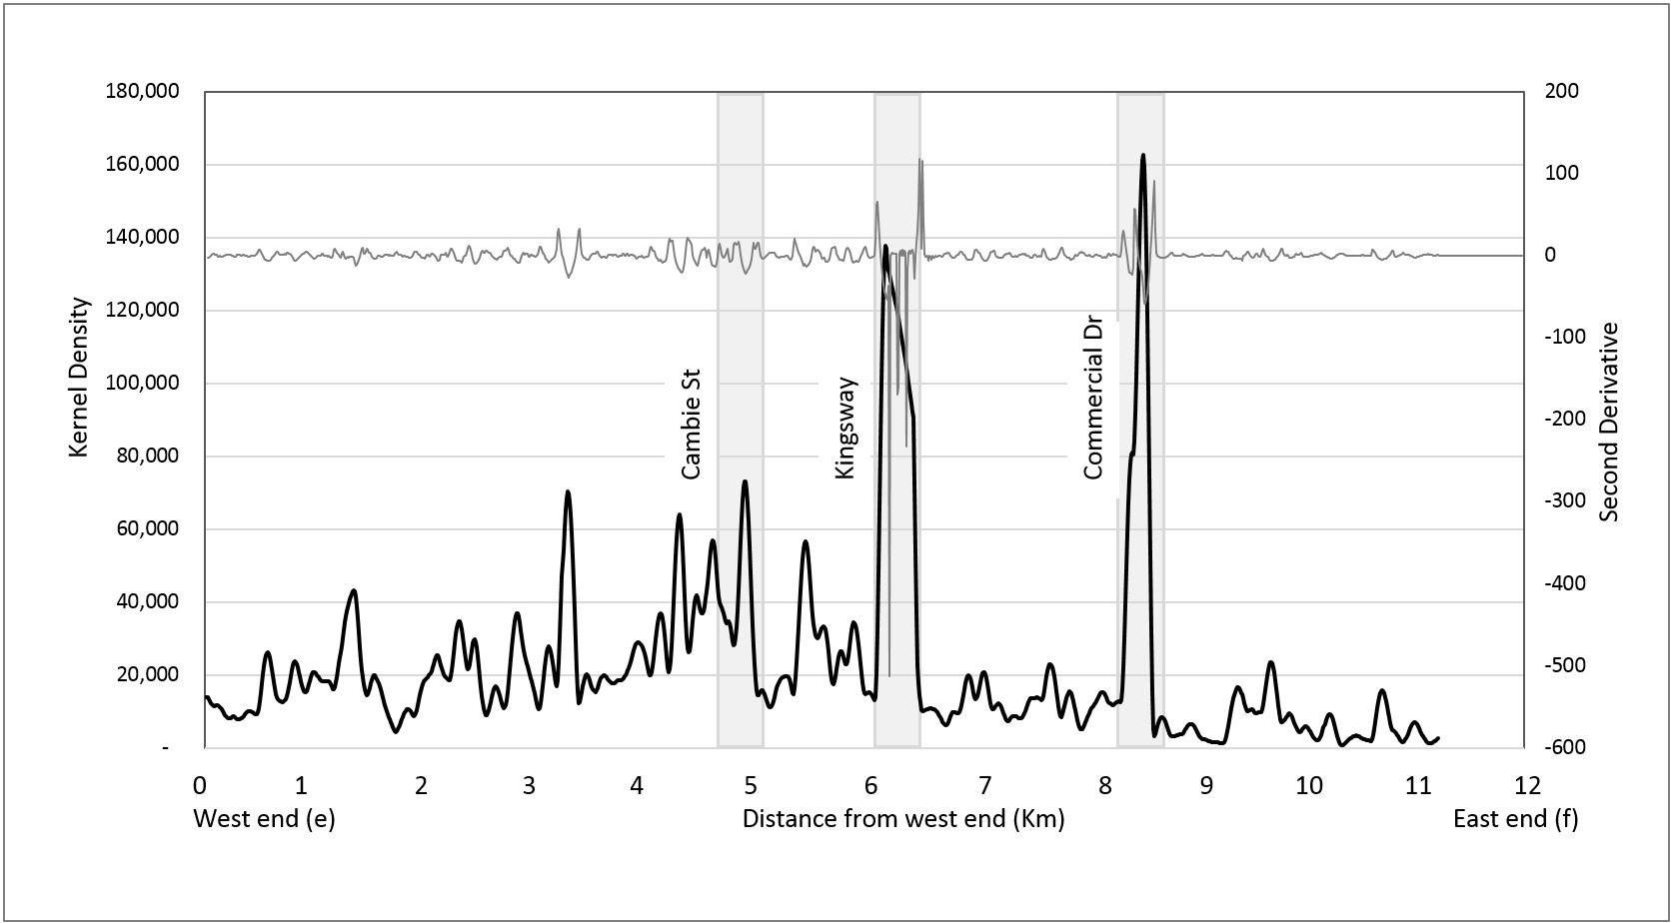
Temporal/ Crime Attractors/ ODE Streets
V. Spicer, J. Song
V. Spicer, J.Song, H.Tsang, A. Park, P. Brantingham

Slide 20
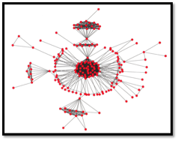
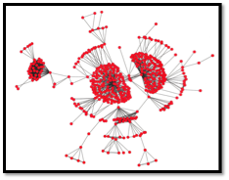
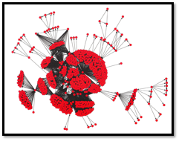
Social Network Analysis
Mohammad A. Tayebi, Martin Ester, Uwe Glässer and Patricia L. Brantingham. 2014. Spatially Embedded Co-offence Prediction Using Supervised Learning. In Proceedings of the 20th ACM SIGKDD International Conference on Knowledge Discovery and Data Mining, KDD 2014, NYC, USA, ACM, 1789–98U

Slide 21
Voronoi Diagrams:
Assaults; Fights; Robberies
Voronoi Diagrams
Patricia Brantingham

Slide 22
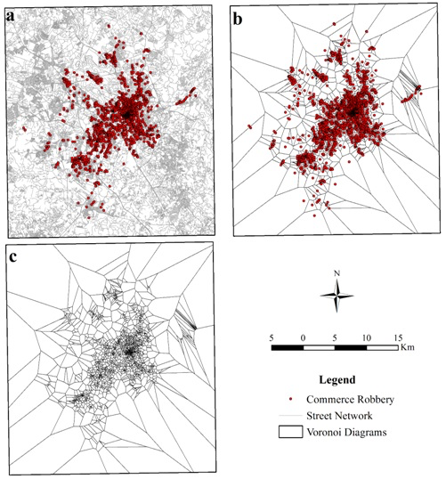
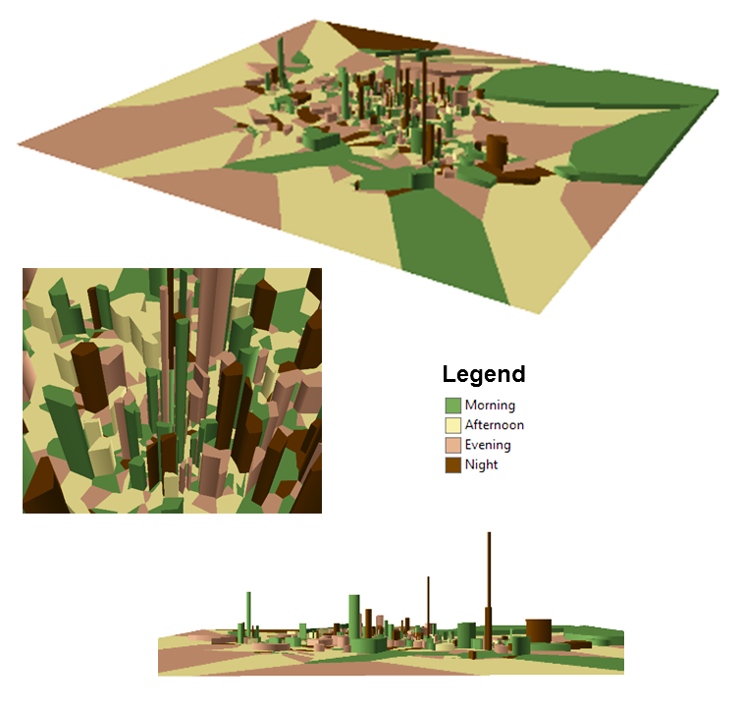
Commercial Robbery
Campinas,Brazil
Voronoi Diagrams and Spatial Analysis, Melo, S. Frank, R, Brantingham, P., The Professional Geographer 07/06/2017 pp. 1-12
Notes:
Campinas, Brazil. We collected 2,673 reports of commerce robbery during the course of four years between 2010 and 2013
Voronoi Diagrams
2,673 events between 2010-2013

Slide 23
Merci
Patricia Brantingham
pbrantin@sfu.ca (778) 782-3515

