Slide 1
Differential Co-Expression Analyses of Pathways
Michael P. Epstein, Ph.D.
Professor of Human Genetics

Slide 2
Dr. Anke Hüls
Dr. Aliza Wingo
Dr. Thomas Wingo

Slide 3
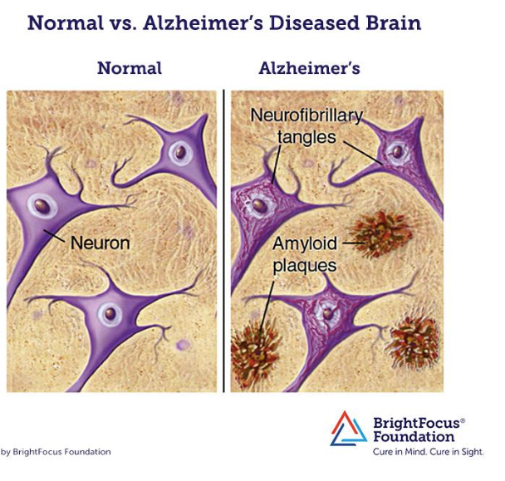
Motivating Study
ROS/MAP cohort study of Alzheimer’s Disease
Free of known dementia at baseline
Phenotyped annually for cognitive decline
Memory (episodic, semantic, working)
Perceptual speed
Visuospatial ability
AD neuropathology
β-amyloid plaques
Neurofibrillary tangles

Slide 4
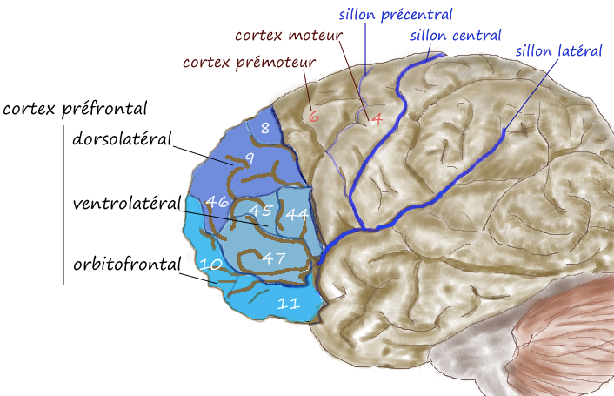
Motivating Study
Possess RNA-seq data from dorsolateral prefrontal cortex (N=565)
Previous research identified key driver genes involved in AD-related pathways
Immune and microglia
Synaptic transmission
Mitochondrial function
Inflammatory response
Focus: Identify risk factors that perturb co-expression of driver genes within these pathways
Seyfried et al., (2017, Cell Systems 4: 60); Zhang et al. (2013, Cell 153: 707)

Slide 5
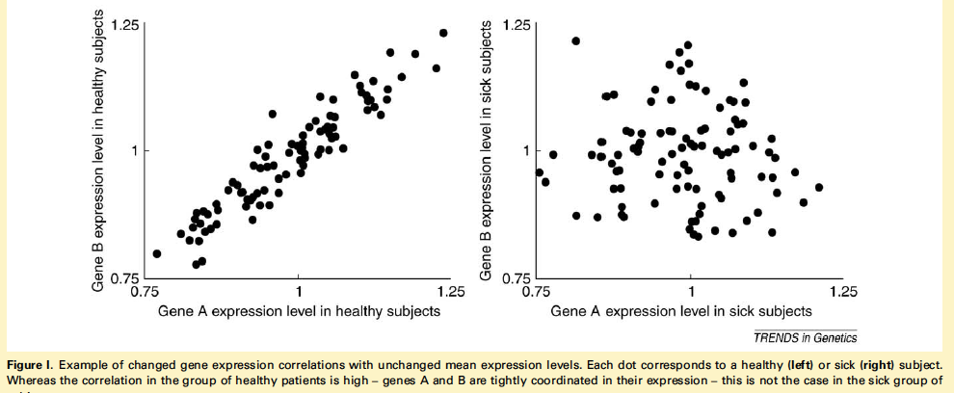
Differential Co-Expression
de la Fuente (2010; Trends in Genetics)

Slide 6
Existing Strategies
GSCA method
P_{C}: Number of gene pairs in pathway
: Correlation of gene pair p (p=1,…,P_{C}) in sample d
Use permutations to establish significance
Eigengenes
Calculate top PC of expression data in pathway
Regress on predictors
Choi and Kendziorski (2009; Bioinformatics); Langfelder and Horvath (2007; BMC Systems Biology)

Slide 7
Notation
: Expression levels for P genes
: Main predictor of interest
: Covariates
Goal: Test whether X_{j} associates with correlation among elements within Y_{j,} adjusting for Z_{j}

Slide 8
Idea
Test whether X_{j} associates with set of cross-product terms in
Adjust Y_{j} for effects of X_{j} , Z_{j} on mean & variance
Can use DGLM
Unadjusted analysis leads to misleading inference
: Standardized outcomes

Slide 9
Idea
: P_{C} cross products
Relate S_{j} to X_{j} , Z_{j} using scaled marginal model
Assumes predictor X has same shared effect on all cross-product terms
Accounts for dependency among cross-products using GEE framework with working correlation matrix
Roy et al. (2003; Biostatistics)

Slide 10
Scaled Marginal Model
Let
Estimation done using estimating equations
R: Working correlation matrix

Slide 11
Simulation Idea
Generate using MVN

Slide 12
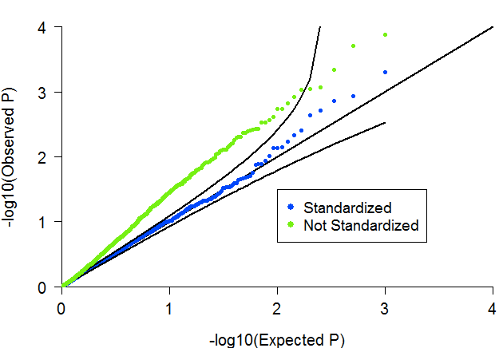
Null Model: 4 Genes in Pathway, 600 Subjects
Binary X, Main Effect on Expression (R²=0.08%)
Similar findings when exposure associates with variance of expression

Slide 13
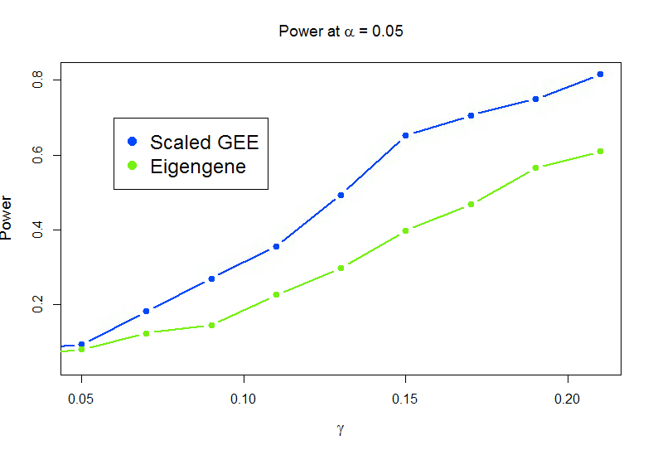
Power Model: 4 Genes in Pathway, 600 Subjects
Exposure: SNP with MAF =0.25

Slide 14
Another Idea
Scaled marginal test assumes common effect on co-expression of all gene pairs in pathway
Desirable to develop a method that allows detection of sparser signals
Also desirable to develop method that allows for simultaneous analysis of multiple predictors
Ex: Multiple genetic variants in promoter region of transcription factor

Slide 15
Set Up
: P_{C} cross products
: Set of C predictors
: : Set of K covariates

Slide 16
Introduction
Goal: Test for association between S and X, adjusting for Z
Idea: Kernel distance-covariance (KDC) framework
Non-parametric test of independence between high-dimensional outcomes and high-dimensional predictors
For sample of N subjects, construct N x N pairwise similarity matrices for outcomes and predictors
Test whether elements of the two matrices are correlated
Gretton (2008; Adv Neural Process System); Zhang et al. (2012; arXivpreprintarXiv:12023775 )

Slide 17
Similarity Matrices
For subjects i and j, define
: Similarity function for phenotypes
: Similarity function for predictors
Use these to create N x N similarity matrices
Phenotypic similarity matrix:
Predictor similarity matrix:

Slide 18
KDC Test
KDC test of independence between phenotype matrix K and genotype matrix L
Center both K and L
KDC statistic:

Slide 19
KDC Test
Under null hypothesis of no association, can show asymptotically follows
: i^{th} ordered eigenvalue of
: j^{th} ordered eigenvalue of
: Independent variables
Use Davies’ method to derive analytic p-value
Broadaway et al. (2016; AJHG)

Slide 20
Covariate Adjustment
Need to adjust for covariates in Z
Create modified similarity matrices
Apply KDC to for inference

Slide 21
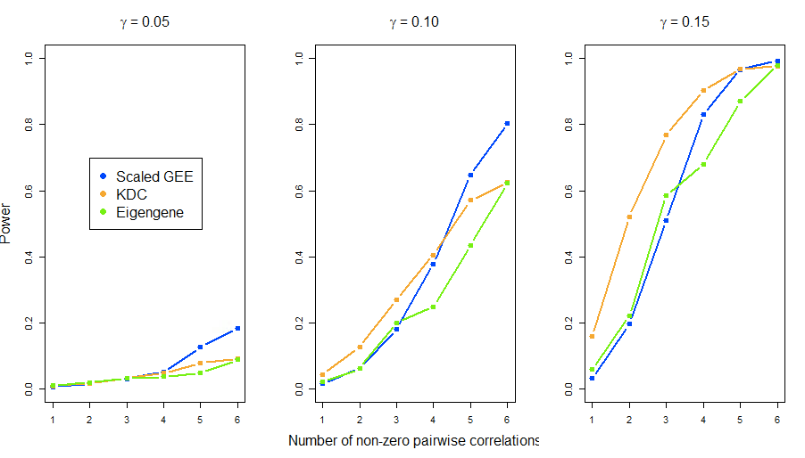
Power Model: 4 Genes in Pathway, 1000 Subjects
Power at α=0.005

Slide 22
High-Dimensional Phenotypes
As number of genes in pathway increases, so do the number of cross product terms
For modest sample sizes, application of KDC and GEE methods to high-dimensional phenotypes runs into challenges
Accumulated estimation error can lead to unreliable asymptotic p-values
Permutation-based p-value possible but slow

Slide 23
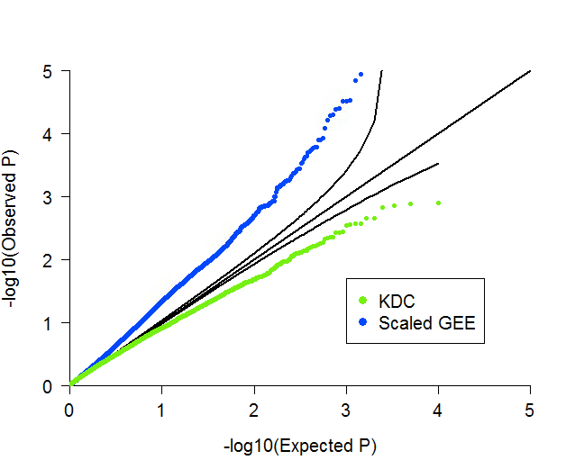
Null Model: 10 Genes in Pathway, 300 Subjects

Slide 24
DKAT
For high-dimensional phenotypes, can use Dual Kernel Association Test (DKAT)
Similar in structure to KDC
However, DKAT uses fast pseudopermutation method to evaluate p-value
Approximates empirical distribution of all potential permuted DKAT tests using moment matching
Zhan et al. (2018; Genetics)

Slide 25
DKAT
DKAT statistic
Similar in form to the RV coefficient
Pseudopermutation often used to obtain p-values for RV-coefficient models (Josse et al. 2008)
Employ similar technique to evaluate DKAT

Slide 26
DKAT
Approximate the permutation null distribution using Pearson Type III distribution via matching the first three moments

Slide 27
DKAT

Slide 28
DKAT
Standardized test:
Approximate permutation null distribution of T by Pearson Type III Distribution with mean 0, unit variance, and skewness

Slide 29
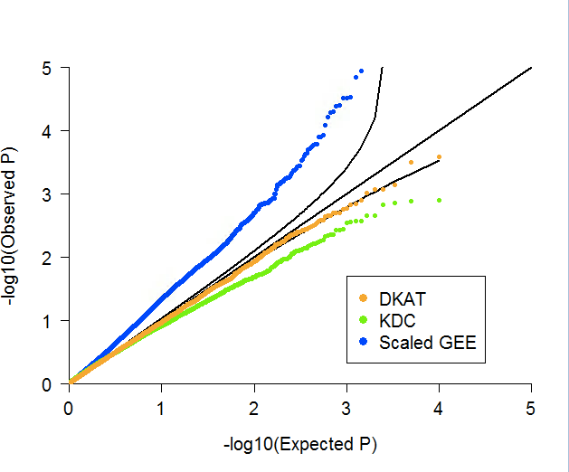
Null Model: 10 Genes in Pathway, 300 Subjects

Slide 30
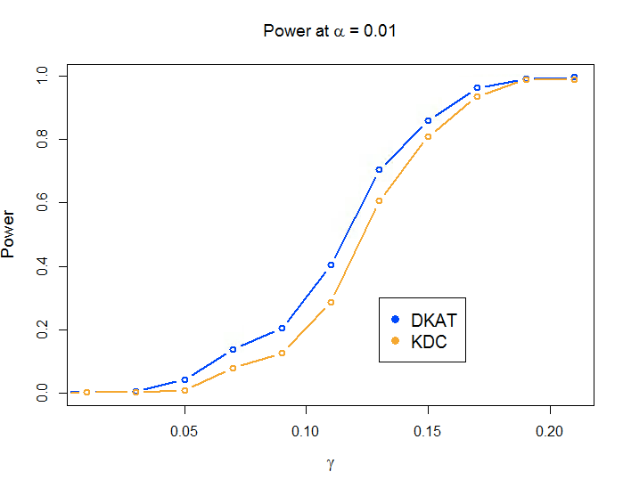
Power Model: 10 Genes in Pathway, 300 Subjects
Exposure: SNP with MAF =0.25

Slide 31
ROS/MAP Analyses (N=565)
Post-mortem dorsolateral prefrontal cortex
RNA sequenced using Illumina HiSeq with 101-bp paired-end reads
Target coverage of 50 million reads
Used STAR for alignment and gene-level counts
QC
Genes with < 1 count per million in at least 50% of the samples and with missing length and percent GC content were removed
Variance stabilization normalization was applied to normalize for library size and enhance homoskedasticity
Dobin et al. (Bioinformatics 29: 15 )

Slide 32
ROS/MAP Analyses (N=565)
Considered 5 different sets of gene drivers
Synaptic Transmission pathway (6 genes)
Mitochondrial pathway (6 genes)
Inflammatory response (6 genes)
Immune/microglia (3 genes)
Neuronal (3 genes)
For each set, tested for differential co-expression with
Episodic memory
Beta-amyloid levels
Neuronal tangle count
Adjusted for
Gender, postmortem interval, age of death, RIN
Cell-type fractions

Slide 33
ROS/MAP Results
 | P-Value (DKAT)
Pathway | Episodic Memory | Β-Amyloid | Tangles
Synaptic Transmission¹ | 0.294 | 0.076 | 0.453
Mitochondrial¹ | 0.399 | 0.022 | 0.235
Inflammatory¹ | 0.281 | 0.00032 | 0.102
Immune/Microglia² | 0.387 | 0.599 | 0.092
Neuronal² | 0.236 | 0.039 | 0.253
¹Seyfried et al. (2017; Cell Systems); ²Zhang et al. (2013; Cell)

Slide 34
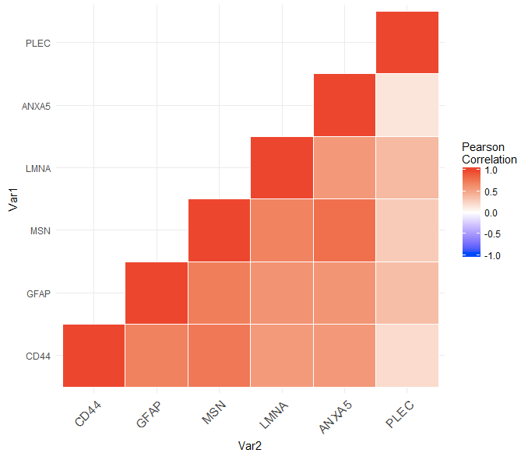
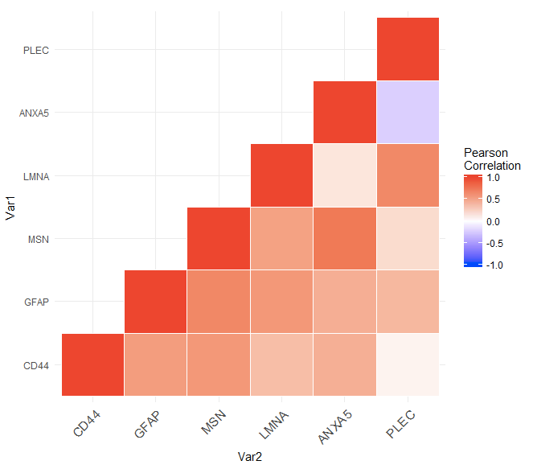
Inflammatory Pathway Results
Lower Tertile of Amyloid
Upper Tertile of Amyloid

Slide 35
Conclusions
Flexible test of co-expression
Allows for continuous exposures and covariates
P-values can be derived analytically
Extendable to analysis of secondary expression data collected in case-control study
Can use IPW weights (Schifano et al. AJHG) or propensity scores (Ray and Basu; Gen Epi)
Current work: Scaling methods to larger gene sets
ACAT to the rescue?

Slide 36
Acknowledgements
Epstein lab
Dr. Anke Huels
Dr. Andrei Todor
Taylor Fischer
Aaron Holleman
ROS/MAP study
Aliza Wingo
Thomas Wingo

Slide 37
Analyses of Secondary Exposures
Idea: Test for dysregulation patterns of secondary exposure from case-control study
Issue: Spurious associations possible if case-control status not accounted for
Pathway gene expression
Disease
Sampling
indicator
Exposure

Slide 38
Analysis of Secondary Exposures
Covariate adjustment for disease status insufficient for resolving bias
Idea: Use inverse probability weighting (IPW)
Can incorporate weights into estimation equations to fit scaled marginal model
Schifano et al. (2013; AJHG)

Slide 39
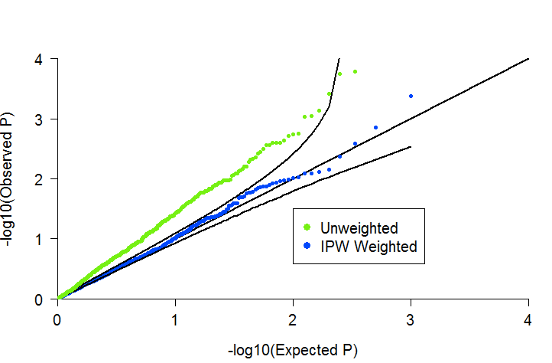
-700 cases, 300 controls
-Disease prevalence=0.05
-3 genes in pathway, each gene with OR=1.7
-SNP with MAF of 0.2 and OR=2

