Slide 1

Estimate Overall Contribution of Oral Microbiome to the Risk of Developing Cancers in Prospective Studies
Jianxin Shi
Senior Investigator
Biostatistics Branch
Division of Cancer Epidemiology and Genetics
National Cancer Institute
Notes:
First of all, I would like thank the organizers to invite to attend such a wonderful workshop.

Slide 2

NCI/DCEG Microbiome Working Group: Moving Microbiome Research into Population Studies
Perform high-quality population studies to better understand cancer etiology,
to improve risk prediction and prevention of cancers.
Notes:
Before I start, I will first briefly talk about the microbiome working group in our division and projects we have been working on.
The mission of the group is to performed ……
This group was formed in 2010. Since then, Dr. Gail and I have been the statistical investigator, involed in design, bioinformatic and statistical analysis, results interpretation.

Slide 3
DCEG Microbiome Studies
Methods studies
  Technical reproducibility & overtime stability
  Lab sample processing optimization
Cross-sectional studies
  Breast, colorectal, gastric and pancreatic cancers
  NHANES oral microbiome study (~12K samples)
Prospective studies
  DCEG oral microbiome studies (ongoing)
  DCEG new cohort study for gut microbiome (planning)

Slide 4
Prospective Microbiome Epidemiology studies
Etiology
  Identify taxa/microbiome features associated with the risk of developing cancers
Cancer prevention
  Risk prediction models incorporating microbiome risk factors
Notes:
Our branch has been extensively collaborated with both intramural and extramural research programs. In particular, we collaborate with all branches within DCEG of NCI, playing a leadership on developing novel analytic methods to push forward epiedelogical studies and genomic studies.

Slide 5
Oral Microbiome and Cancer Risk:
Prospective Studies
Agriculture Health Study (AHS)
1993
1997
1999
2003
2012
Recruitment
n = 89,655
Mouth Wash Collection
n = 34,827
Current Follow-Up
Prostate, Lung, Colorectal, and Ovarian Screening Trial (PLCO)
1993
2001
2009
2004
Recruitment
n = 75,000
Mouth Wash Collection
n = 47,250
Current Follow-Up
NIH-AARP Diet and Health Study (NIH-AARP)
1995
1996
2005
2011
Recruitment
n = 566,990
Mouth Wash Collection
n = 34,000
Current Follow-Up
Abnet, Sinha, Vogtmann
Notes:
Since 2014, the working group has been working on prospective studies of oral microbiome, including three cohort studies.
The average is about 10 years.

Slide 6
Oral Microbiome and Cancer Risk:
Prospective Studies
Cancer site | AHS | PLCO | NIH-AARP | Total
Bronchus/lung | 204 | 751 | 542 | 1497
Colorectum | 294 | 525 | 331 | 1150
Esophagus | 26 | - | 43 | 69
Head/neck | 57 | - | 60 | 117
Hepatobiliary tract | 19 | 91 | 47 | 157
Pancreas | 43 | - | 129 | 172
Small intestine | 14 | 31 | 29 | 74
Stomach | 44 | 60 | 58 | 162
Sum of cases | 701 | 1458 | 1239 | 3398
Referent group | 1000 | 1289 | 1000 | 3289
Grand Total |  |  |  | 6687
AHS: Agricultural Health Study
PLCO: Prostate, Lung, Colorectal and Ovarian Cancer Screening Trial
Notes:
This table summarizes the number of cancer patients.

Slide 7
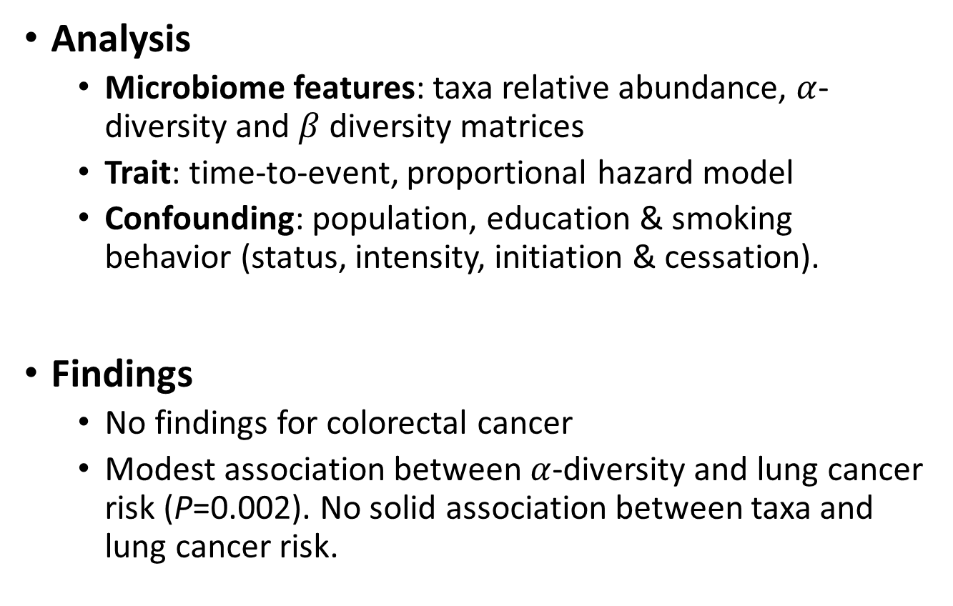
What We Have Found for Lung Cancer and Colorectal Cancer?
Analysis
  Microbiome features: taxa relative abundance, $α$-diversity and $β$ diversity matrices
  Trait: time-to-event, proportional hazard model
  Confounding: population, education & smoking behavior (status, intensity, initiation & cessation).
Findings
  No findings for colorectal cancer
  Modest association between $α$-diversity and lung cancer risk (P=0.002). No solid association between taxa and lung cancer risk.

Slide 8
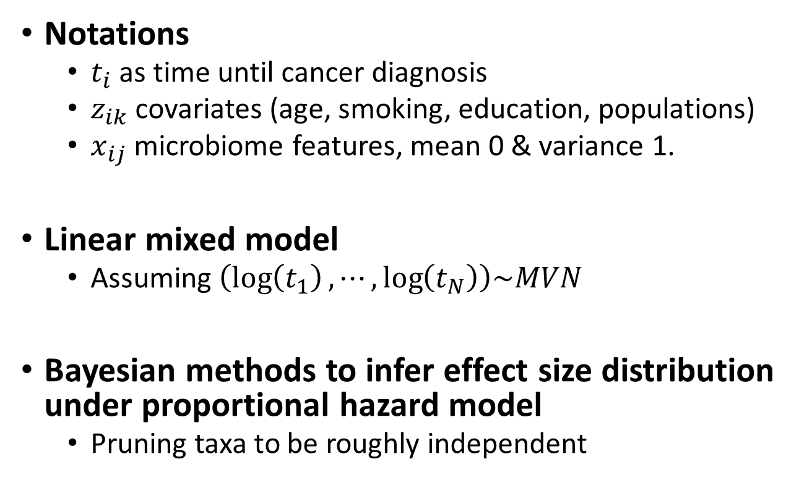
Two Complementary Methods for Estimating Overall Contribution
Notations
  $t_{i}$ as time until cancer diagnosis
  $z_{ik}$ covariates (age, smoking, education, populations)
  $x_{ij}$ microbiome features, mean 0 & variance 1.
Linear mixed model
  Assuming $\left(\log\left(t_{1}\right),⋯,\log\left(t_{N}\right)\right)\sim MVN$
Bayesian methods to infer effect size distribution under proportional hazard model
  Pruning taxa to be roughly independent

Slide 9
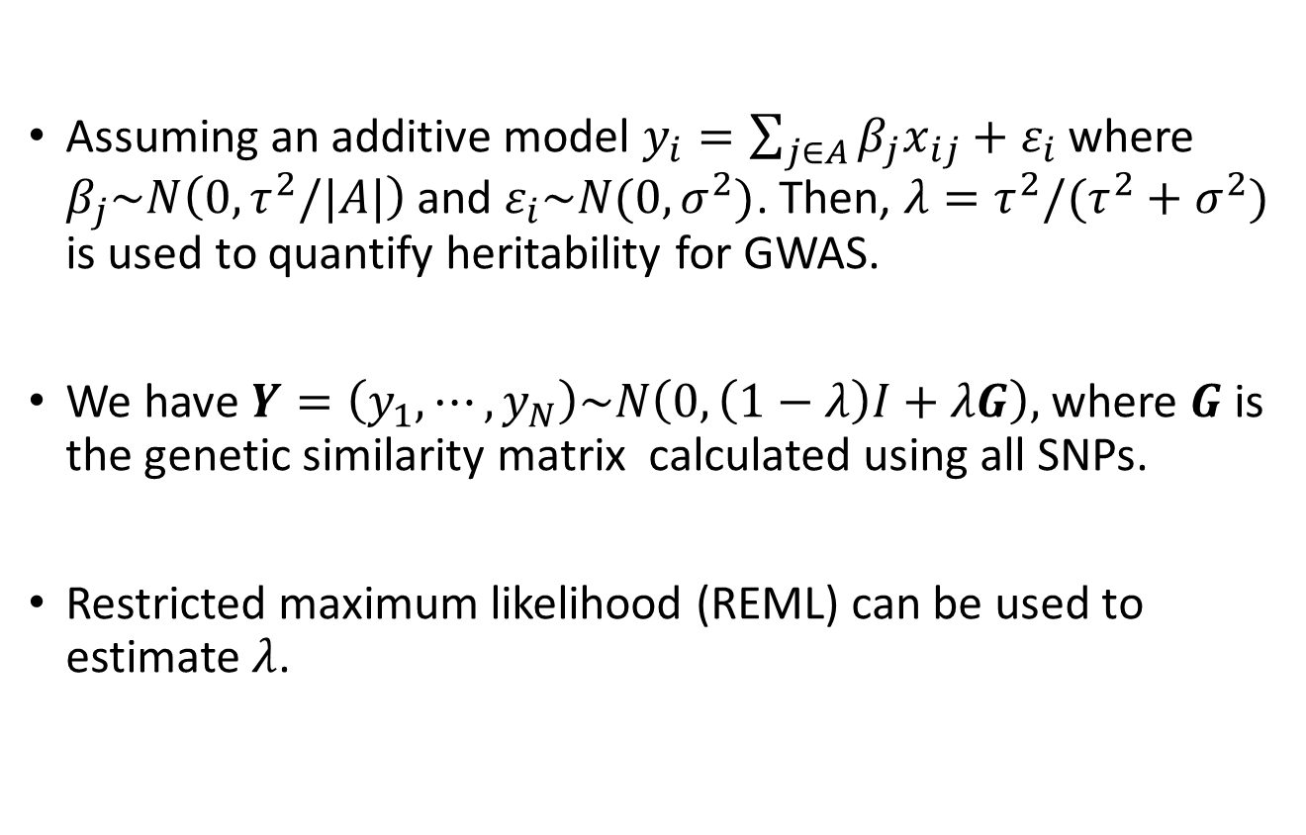
Linear Mixed Model for
Estimating Heritability of A Quantitative Trait
Assuming an additive model $y_{i}=\sum_{j∈A}{β_{j}x_{ij}+ε_{i}}$ where $β_{j}\sim N\left(0,τ^{2}/|A|\right)$and $ε_{i}\sim N(0,σ^{2})$. Then, $λ=τ^{2}/(τ^{2}+σ^{2})$ is used to quantify heritability for GWAS.
We have $Y=\left(y_{1},⋯,y_{N}\right)\sim N\left(0,\left(1−λ\right)I+λG\right),$ where $G$ is the genetic similarity matrix calculated using all SNPs.
Restricted maximum likelihood (REML) can be used to estimate $λ$.
Yang et al., Nature Genetics, 2010

Slide 10
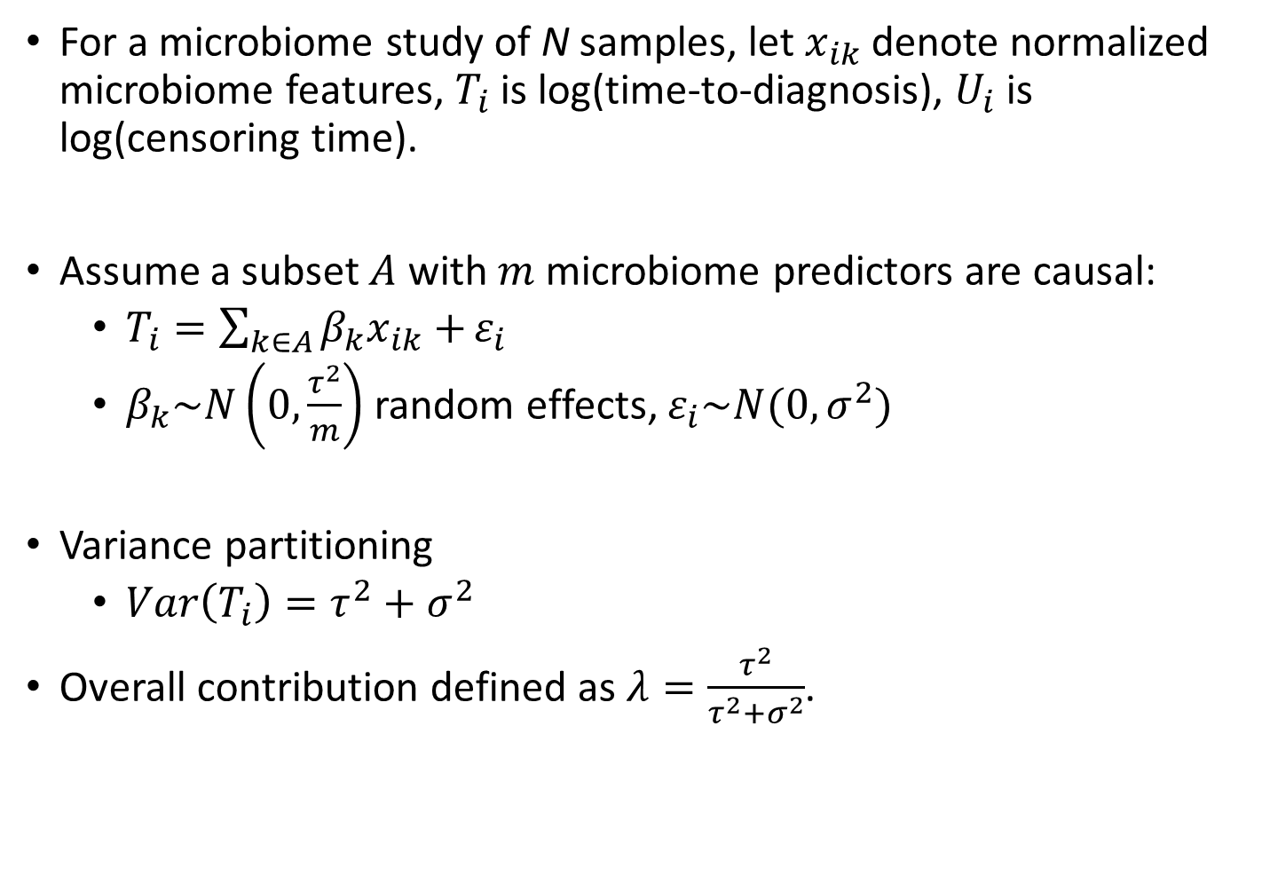
Overall Contribution of Oral Microbiome to Risk of a Cancer
For a microbiome study of N samples, let $x_{ik}$ denote normalized microbiome features, $T_{i}$ is log(time-to-diagnosis), $U_{i}$ is log(censoring time).
Assume a subset $A$ with $m$ microbiome predictors are causal:
  $T_{i}=\sum_{k∈A}{β_{k}x_{ik}+}ε_{i}$
  $β_{k}\sim N\left(0,\frac{τ^{2}}{m}\right)$ random effects, $ε_{i}\sim N(0,σ^{2})$
Variance partitioning
  $Var\left(T_{i}\right)=τ^{2}+σ^{2}$
Overall contribution defined as $λ=\frac{τ^{2}}{τ^{2}+σ^{2}}$.

Slide 11
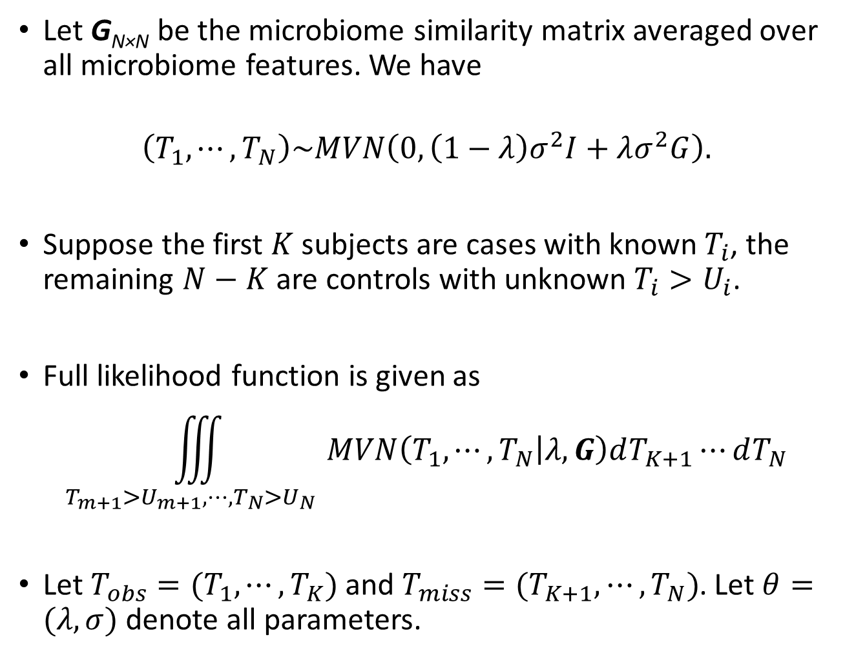
Let G_{N×N} be the microbiome similarity matrix averaged over all microbiome features. We have
$$\left(T_{1},⋯,T_{N}\right)\sim MVN\left(0, \left(1−λ\right)σ^{2}I+λσ^{2}G\right).$$
Suppose the first $K$ subjects are cases with known $T_{i}$, the remaining $N−K$ are controls with unknown $T_{i}>U_{i}$.
Full likelihood function is given as
$$\iiint_{T_{m+1}>U_{m+1},⋯,T_{N}>U_{N} }{MVN\left(T_{1},⋯,T_{N} | λ,G\right)dT_{K+1}⋯dT_{N}}$$
Let $T_{obs}=(T_{1},⋯,T_{K})$ and $T_{miss}=(T_{K+1},⋯,T_{N})$. Let $θ=(λ,σ)$ denote all parameters.

Slide 12
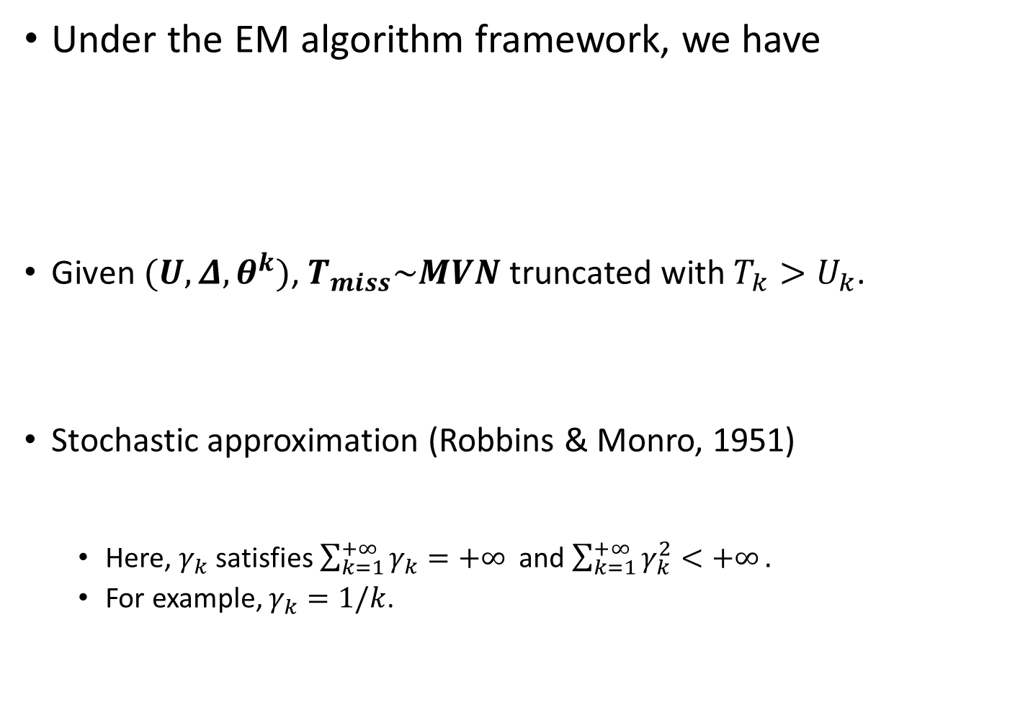
Under the EM algorithm framework, we have
Given $(U,Δ,θ^{k})$, $T_{miss}\sim MVN$truncated with $T_{k}>U_{k}$.
Stochastic approximation (Robbins & Monro, 1951)
  Here, $γ_{k}$ satisfies $\sum_{k=1}^{+∞}{γ_{k}=+∞}$ and $\sum_{k=1}^{+∞}{γ_{k}^{2}<+∞}.$
  For example, $γ_{k}=1/k$.

Slide 13
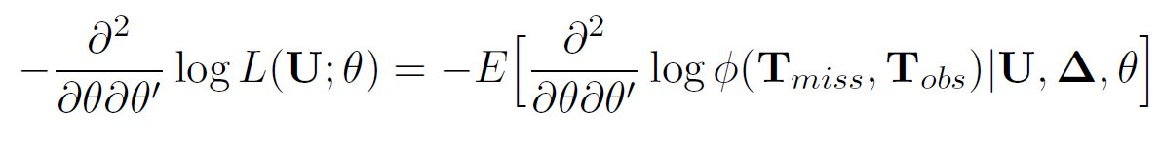
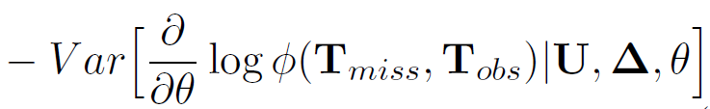

Covariance Matrix Approximation
If $λ$ not on boundary ($λ≫0$), we obtain covariance matrix by the Louis’s missing-information identity (JRSSB, 1982):
If $λ$ is close to boundary, we use parametric bootstrap to obtain confidence interval.
If complete data
Extra variability due
to missing data

Slide 14
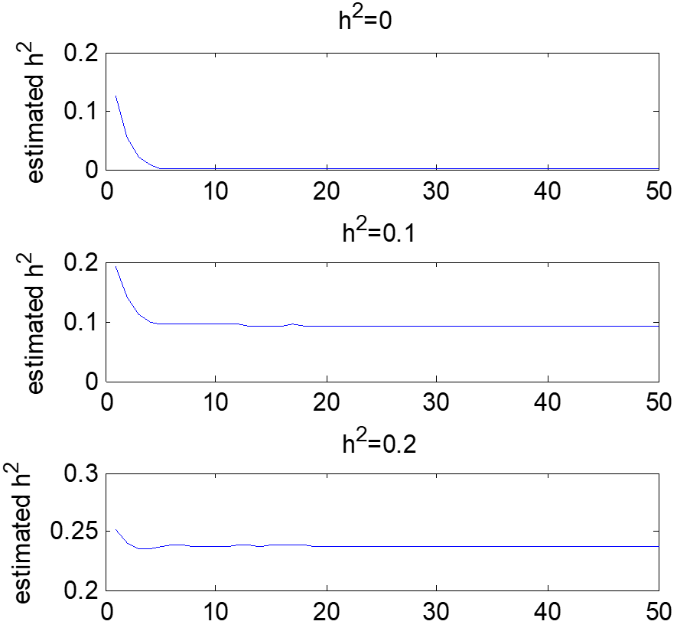
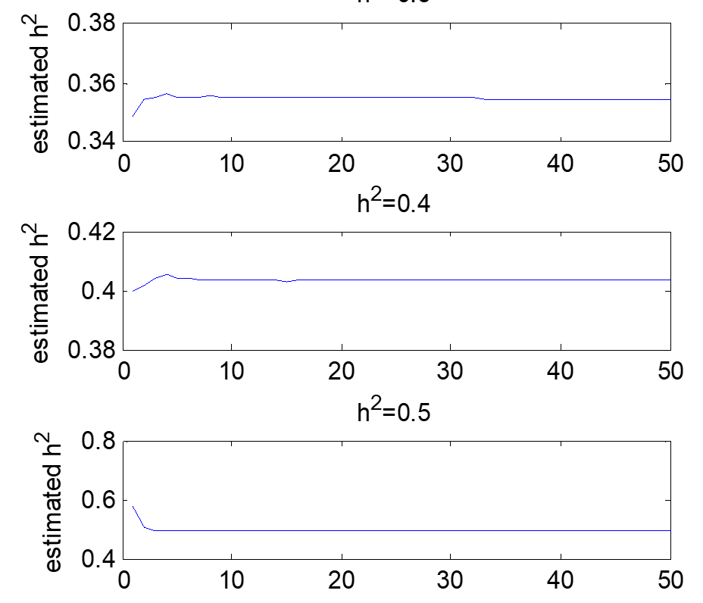
Fast Convergence
2000 subjects, ~700-1000 controls, 1000 OTUs

Slide 15
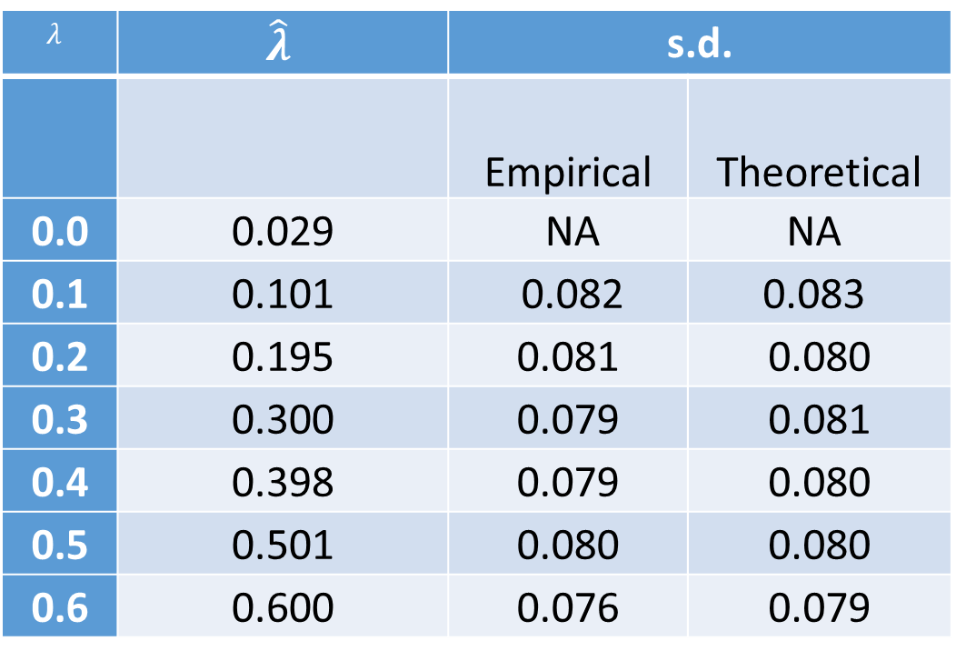
Simulations
2000 subjects, ~ 700-1000 OTUs
Results based on 1000 simulations
$$λ$$ | $$\hat{λ}$$ | s.d.
 |  | Empirical | Theoretical
0.0 | 0.029 | NA | NA
0.1 | 0.101 | 0.082 | 0.083
0.2 | 0.195 | 0.081 | 0.080
0.3 | 0.300 | 0.079 | 0.081
0.4 | 0.398 | 0.079 | 0.080
0.5 | 0.501 | 0.080 | 0.080
0.6 | 0.600 | 0.076 | 0.079

Slide 16
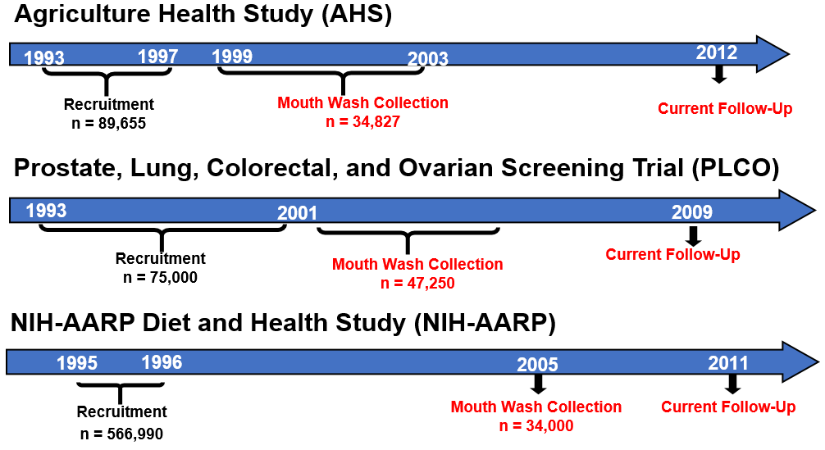
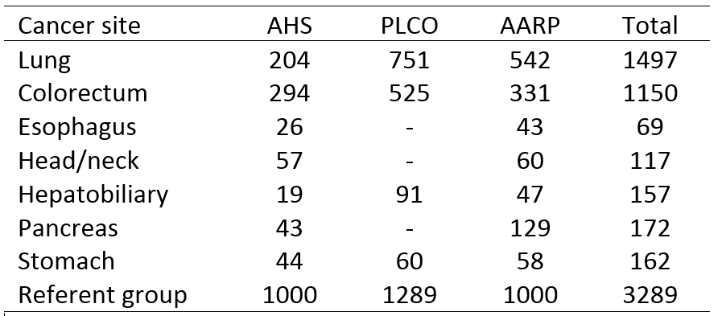
Analyzing NCI/DCEG Case-Cohort Data
2004
Relative abundance (RA) of OTUs (average RA>0.05%, ~1000-1500 OTUs)
 | PLCO | AHS | ARPP | Combined | 95% CI
Lung cancer | 16.3% | 0.3% | 5.7% | 6.8% (3.2%) | (0.6%,13.5%)
Colorectal cancer | 0.5% | 0.2% | 0.2% | 0.3% (2.4%) | (0.0%, 4.7%)
Presence v.s. absence (PA) of OTUs (average PA>0.5%, ~1000-1500 OTUs)
 | PLCO | AHS | ARPP | Combined | 95% CI
Lung cancer | 16.7% | 3.2% | 13.4% | 10.9% (3.9%) | (3.3%, 18.5%)
Colorectal cancer | 0.3% | 0.7% | 0.1% | 0.4% (2.7%) | (0.0%, 5.7%)
Adjusted for smoking behavior, including status, intensity, initiation age and quit time.

Slide 17
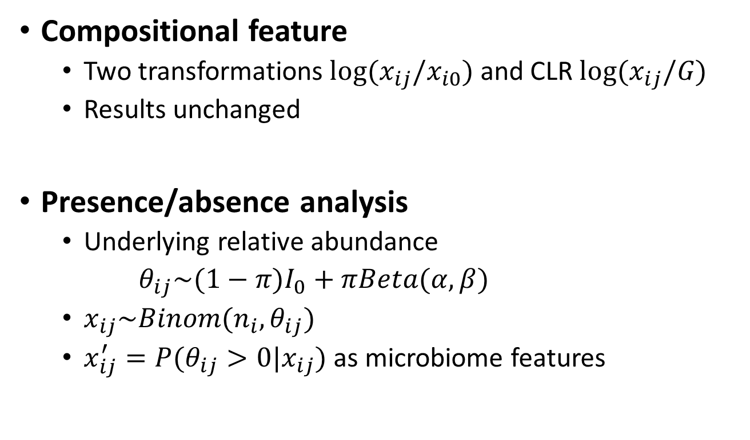
Refined Microbiome Features
Compositional feature
  Two transformations $log⁡(x_{ij}/x_{i0})$ and CLR $log⁡(x_{ij}/G)$
  Results unchanged
Presence/absence analysis
  Underlying relative abundance
  $θ_{ij}\sim (1−π)I_{0}+πBeta(α,β)$
  $x_{ij}\sim Binom(n_{i},θ_{ij})$
  $x_{ij}^{′}=P(θ_{ij}>0|x_{ij})$ as microbiome features

Slide 18

Overall Oral Microbiome Contribution Under a Proportional Hazard Model
We assume the following Cox proportional hazards model
$$S\left(t_{i} | X_{i} \right)=exp\left(−H_{0}\left(t_{i}\right)×e^{\sum_{m=1}^{M}{β_{m}x_{im}}}\right)$$

Slide 19
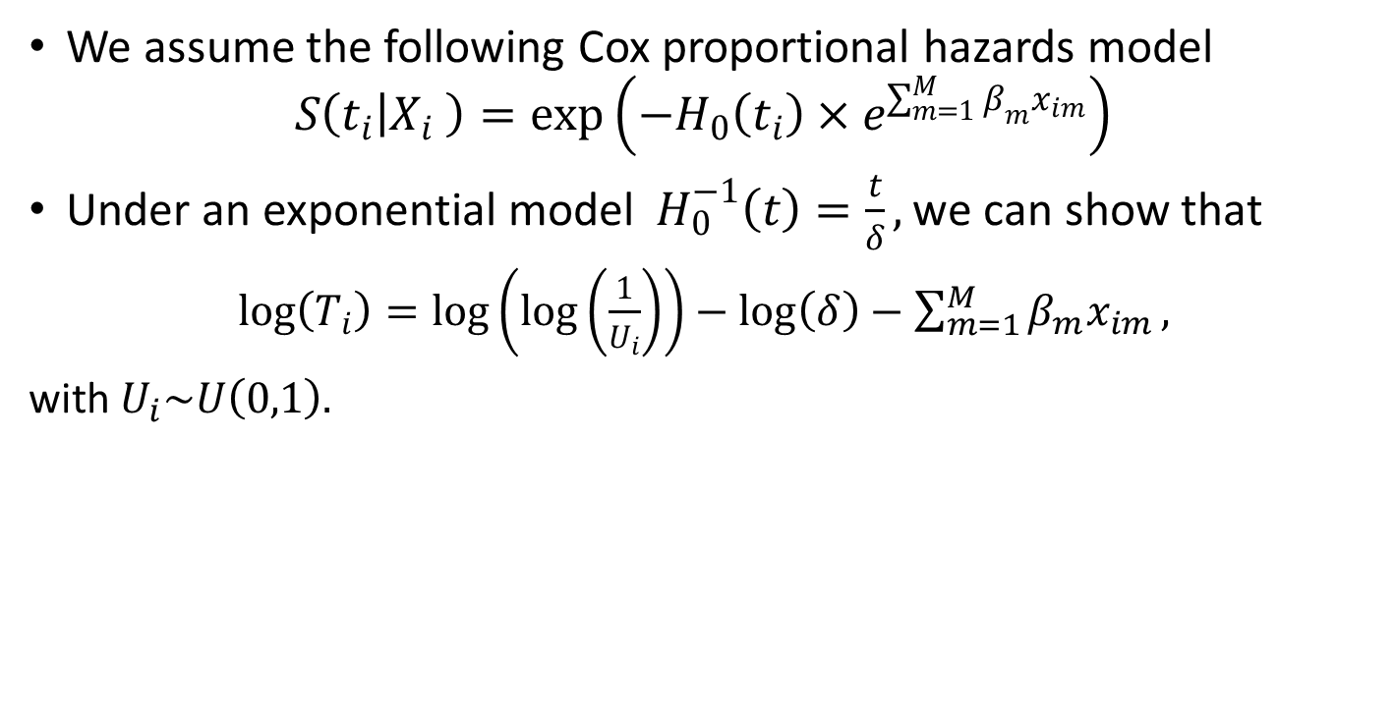
Overall Oral Microbiome Contribution Under a Proportional Hazard Model
We assume the following Cox proportional hazards model
$$S\left(t_{i} | X_{i} \right)=exp\left(−H_{0}\left(t_{i}\right)×e^{\sum_{m=1}^{M}{β_{m}x_{im}}}\right)$$
Under an exponential model${ H}_{0}^{−1}\left(t\right)=\frac{t}{δ},$we can show that
$\log\left(T_{i}\right)=\log\left(\log\left(\frac{1}{U_{i}}\right)\right)−\log\left(δ\right)−\sum_{m=1}^{M}{β_{m}x_{im}},$
with $U_{i}\sim U\left(0,1\right).$

Slide 20
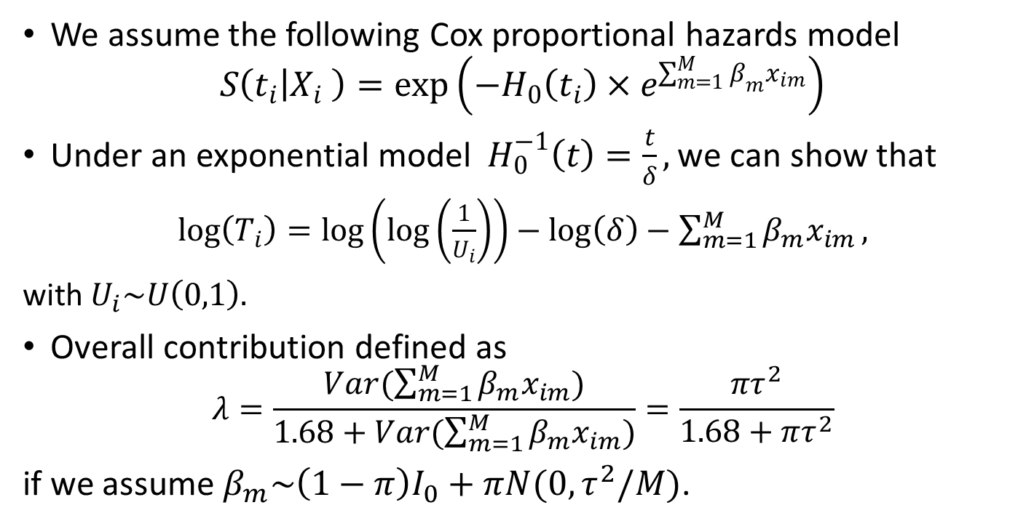
Overall Oral Microbiome Contribution Under a Proportional Hazard Model
We assume the following Cox proportional hazards model
$$S\left(t_{i} | X_{i} \right)=exp\left(−H_{0}\left(t_{i}\right)×e^{\sum_{m=1}^{M}{β_{m}x_{im}}}\right)$$
Under an exponential model${ H}_{0}^{−1}\left(t\right)=\frac{t}{δ},$we can show that
$\log\left(T_{i}\right)=\log\left(\log\left(\frac{1}{U_{i}}\right)\right)−\log\left(δ\right)−\sum_{m=1}^{M}{β_{m}x_{im}},$
with $U_{i}\sim U\left(0,1\right).$
Overall contribution defined as
$$λ=\frac{Var(\sum_{m=1}^{M}{β_{m}x_{im}})}{1.68+Var(\sum_{m=1}^{M}{β_{m}x_{im})}}=\frac{πτ^{2}}{1.68+πτ^{2}}$$
if we assume $β_{m}\sim \left(1−π\right)I_{0}+πN(0,τ^{2}/M)$.

Slide 21
Overall Oral Microbiome Contribution Under a Proportional Hazard Model
We assume the following Cox proportional hazards model
$$S\left(t_{i} | X_{i} \right)=exp\left(−H_{0}\left(t_{i}\right)×e^{\sum_{m=1}^{M}{β_{m}x_{im}}}\right)$$
Under an exponential model${ H}_{0}^{−1}\left(t\right)=\frac{t}{δ},$we can show that
$\log\left(T_{i}\right)=\log\left(\log\left(\frac{1}{U_{i}}\right)\right)−\log\left(δ\right)−\sum_{m=1}^{M}{β_{m}x_{im}},$
with $U_{i}\sim U\left(0,1\right).$
Overall contribution defined as
$$λ=\frac{Var(\sum_{m=1}^{M}{β_{m}x_{im}})}{1.68+Var(\sum_{m=1}^{M}{β_{m}x_{im})}}=\frac{πτ^{2}}{1.68+πτ^{2}}$$
if we assume $β_{m}\sim \left(1−π\right)I_{0}+πN(0,τ^{2}/M)$.

Slide 22


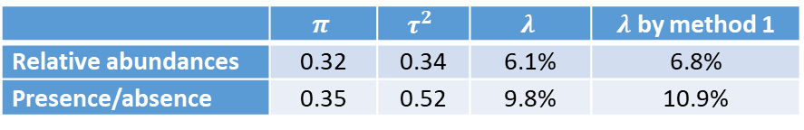
Parameters Estimate
Dr. Sung Duk Kim estimated parameters using Gipps sampling:
$$β_{m}\sim \left(1−π\right)I_{0}+πN(0,τ^{2}/M)$$
Analysis results for lung cancer, ~1500 OTUs
 | $$π$$ | $$τ^{2}$$ | $$λ$$ | $λ$ by method 1
Relative abundances | 0.32 | 0.34 | 6.1% | 6.8%
Presence/absence | 0.35 | 0.52 | 9.8% | 10.9%

Slide 23
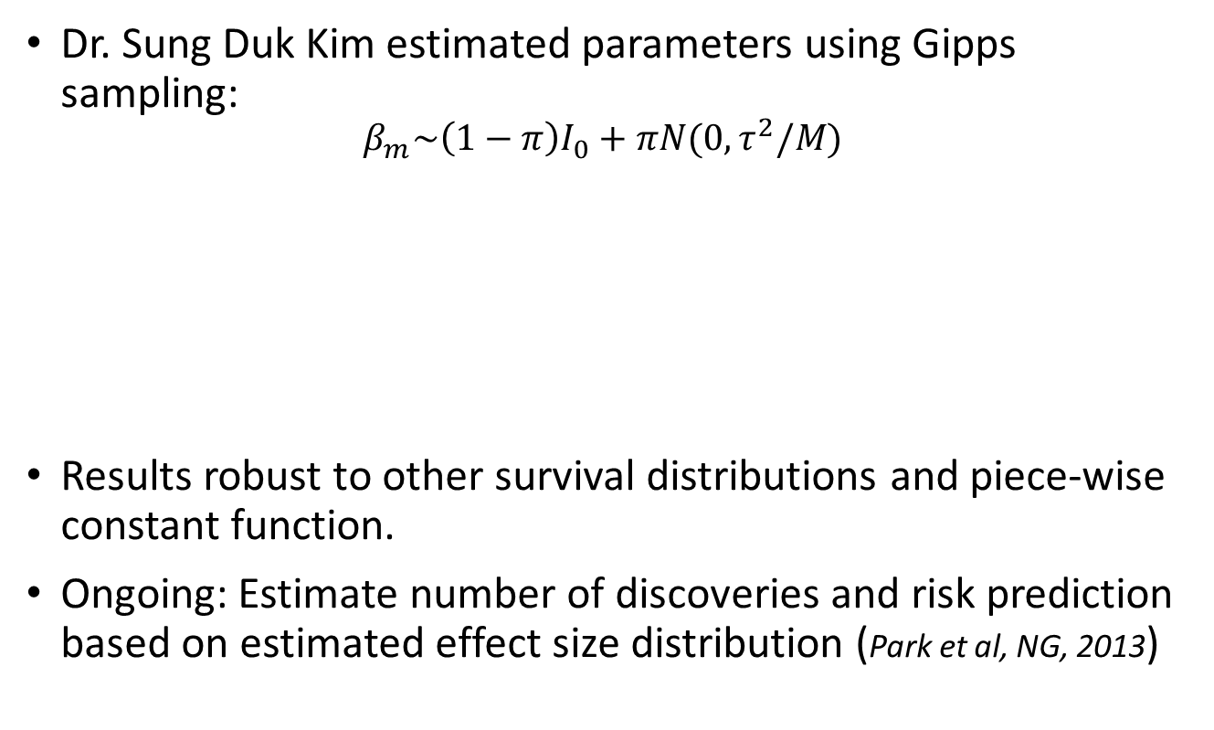
Parameters Estimate
Dr. Sung Duk Kim estimated parameters using Gipps sampling:
$$β_{m}\sim \left(1−π\right)I_{0}+πN(0,τ^{2}/M)$$
Results robust to other survival distributions and piece-wise constant function.
Ongoing: Estimate number of discoveries and risk prediction based on estimated effect size distribution (Park et al, NG, 2013)
Analysis results for lung cancer, ~1500 OTUs
 | $$π$$ | $$τ^{2}$$ | $$λ$$ | $λ$ by method 1
Relative abundances | 0.32 | 0.34 | 6.1% | 6.8%
Presence/absence | 0.35 | 0.52 | 9.8% | 10.9%

Slide 24
Summary
Estimating overall contribution of microbiome and the association architecture is crucial for planning, statistically & financially, a large prospective study and to understand the upper limit of risk prediction.
Two complementary methods consistently suggest that oral microbiome modestly contributes to the risk of lung but not for colorectal cancer.
Accounting for temporal instability, measurement error in predictors.
Methods can be immediately used to estimate heritability of survival traits.

