Slide 1
Dry mass adjustment for a fixed pressure coordinate
Bryce Harrop
Michael Pritchard, Hossein Parishani,
Andrew Gettelman, Samson Hagos,
Peter Lauritzen, Ruby Leung,
Jian Lu, Kyle Pressel, Koichi Sakaguchi

Slide 2
What is the adjustment?
Vertical coordinate for the physics is pressure (dry air pressure plus vapor pressure) which is assumed to be invariant throughout the physics parameterizations.
Vapor pressure changes with water vapor concentrations during physics parameterizations. Left unchecked, this would imply a spurious change in dry air mass (since mass is computed using the pressure thickness).
A routine in CAM (physics_dme_adjust) corrects for the change in pressure that conserves dry air mass, as well as the mass of each tracer.
This adjustment does not conserve energy.

Slide 3
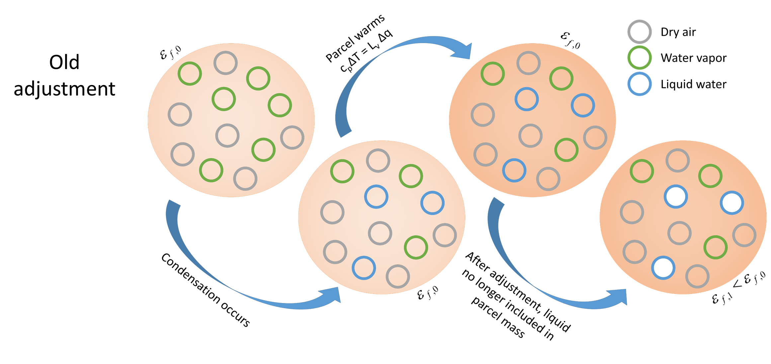
What is the adjustment?
Notes:
Imagine a parcel that is a mix of dry air and water vapor undergoing condensation. Some of the water vapor is converted to liquid water. The parcel is warmed following c_{p}dT = -L_{v}q_{v,} but because the pressure is fixed, the heating is applied to the total mass of the parcel (including the newly formed liquid). After the adjustment, the pressure decreases to match the dry air pressure plus vapor pressure, which is equivalent to removing the mass of the liquid from the total parcel mass. The heating that went into warming that liquid from before simply disappears, leaving the parcel energy lower than in its initial state.

Slide 4
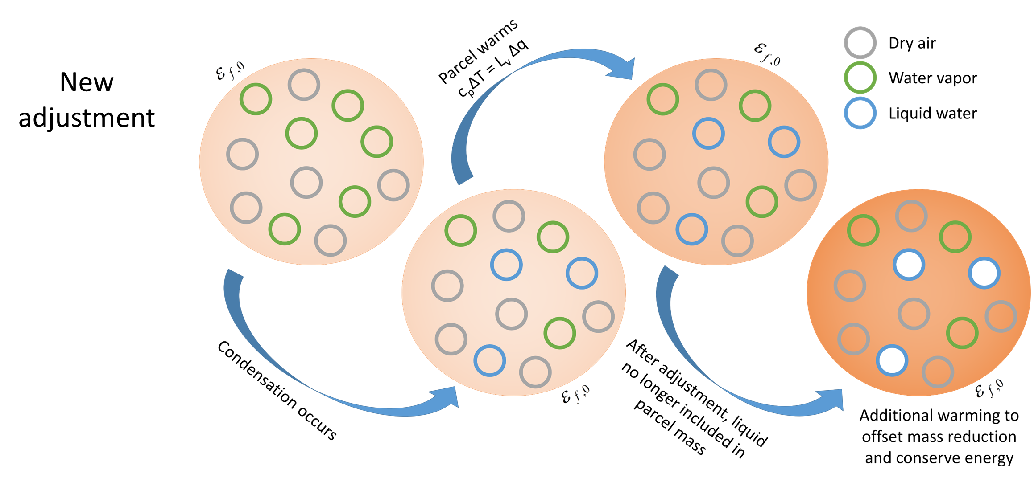
What is the adjustment?
Notes:
Like before, only during the adjustment, we retroactively take back the heating that went into the liquid and apply it to the remaining dry air and uncondensed water vapor. This method now conserves the energy of the parcel. While far from perfect (it does not address the implicit contribution of water vapor to the internal energy), this is the simplest test of how important the energy tendency related to the adjustment is for the simulated climate.

Slide 5
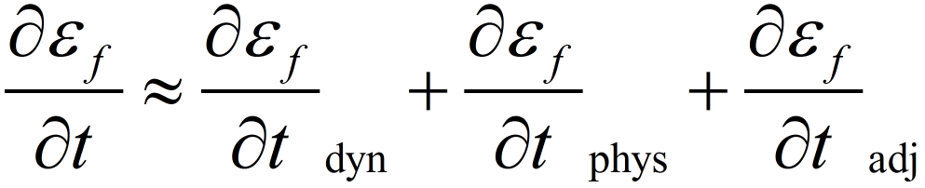
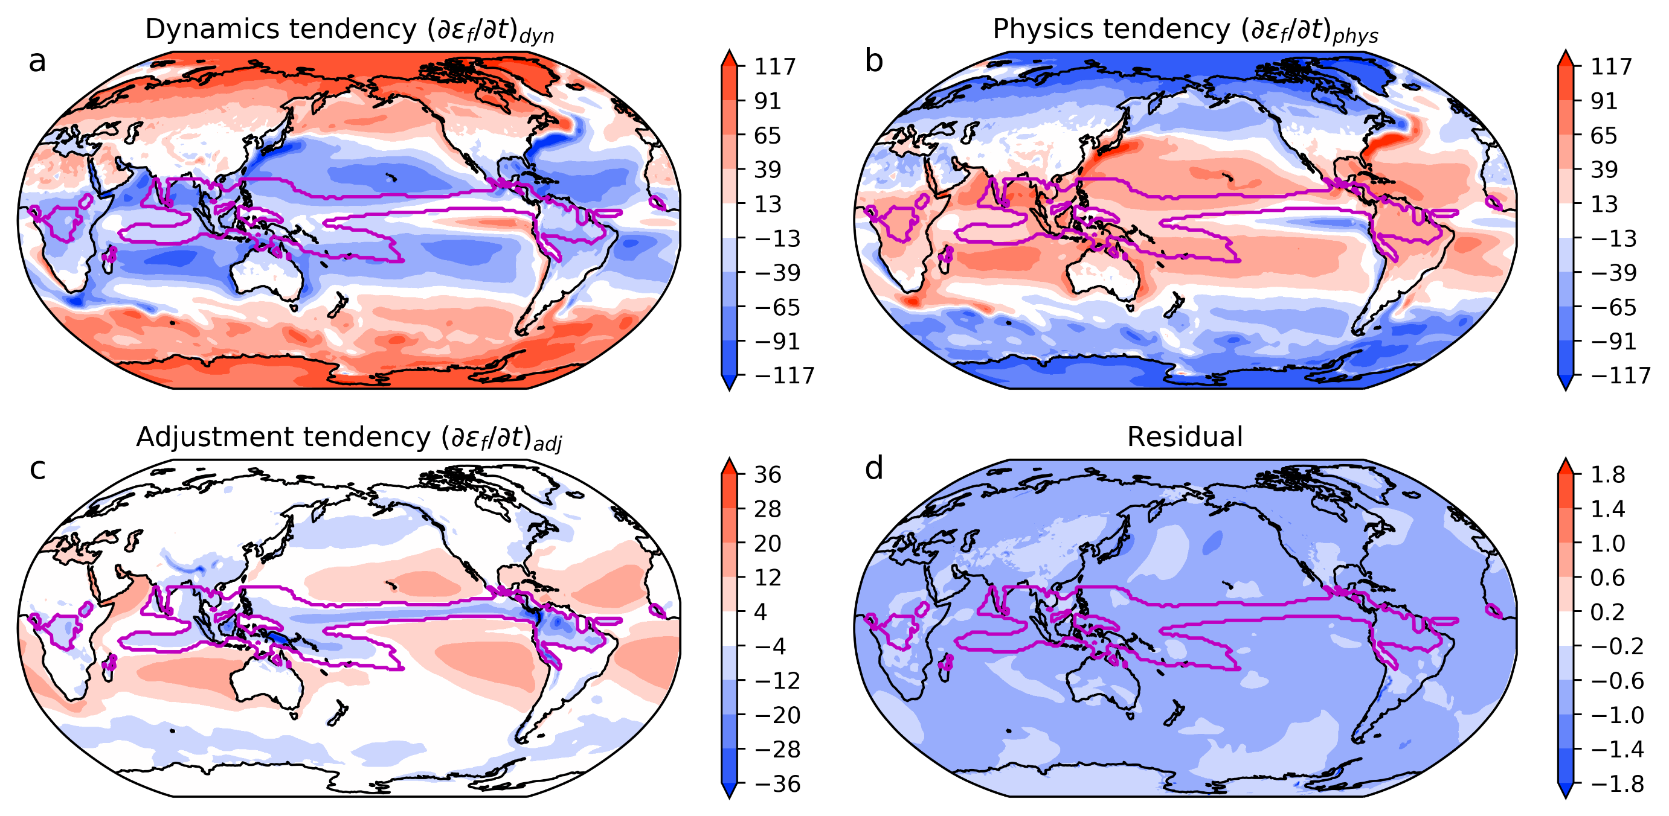
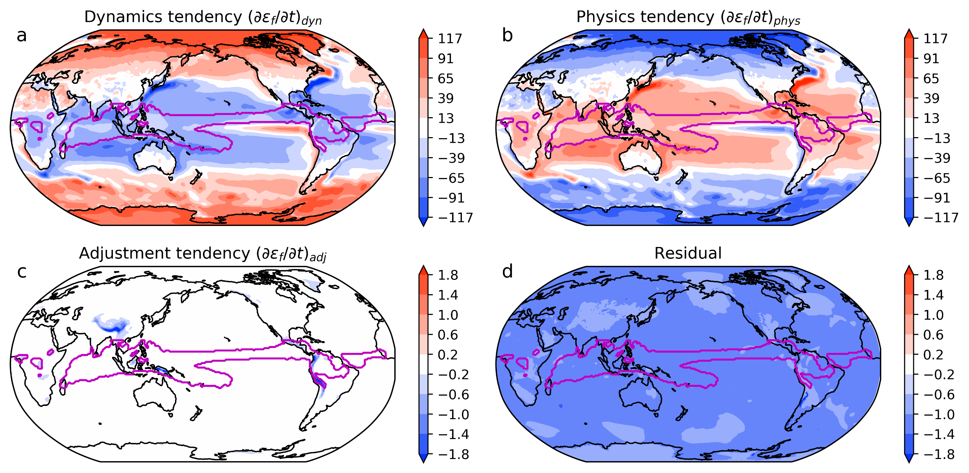
Does this matter?
Total column energy tendency is roughly equal to the sum of the dynamics, physics, and adjustment tendencies.
dynamics
physics
adjustment
Notes:
Demonstration of major energy terms: dynamics, physics, and adjustment. Adjustment tendency has a similar spatial pattern to surface E-P, as expected. With our new adjustment (bottom row), the tendency is zero, except over regions where the surface geopotential is non-zero because we do not address that term in the energy equation.

Slide 6
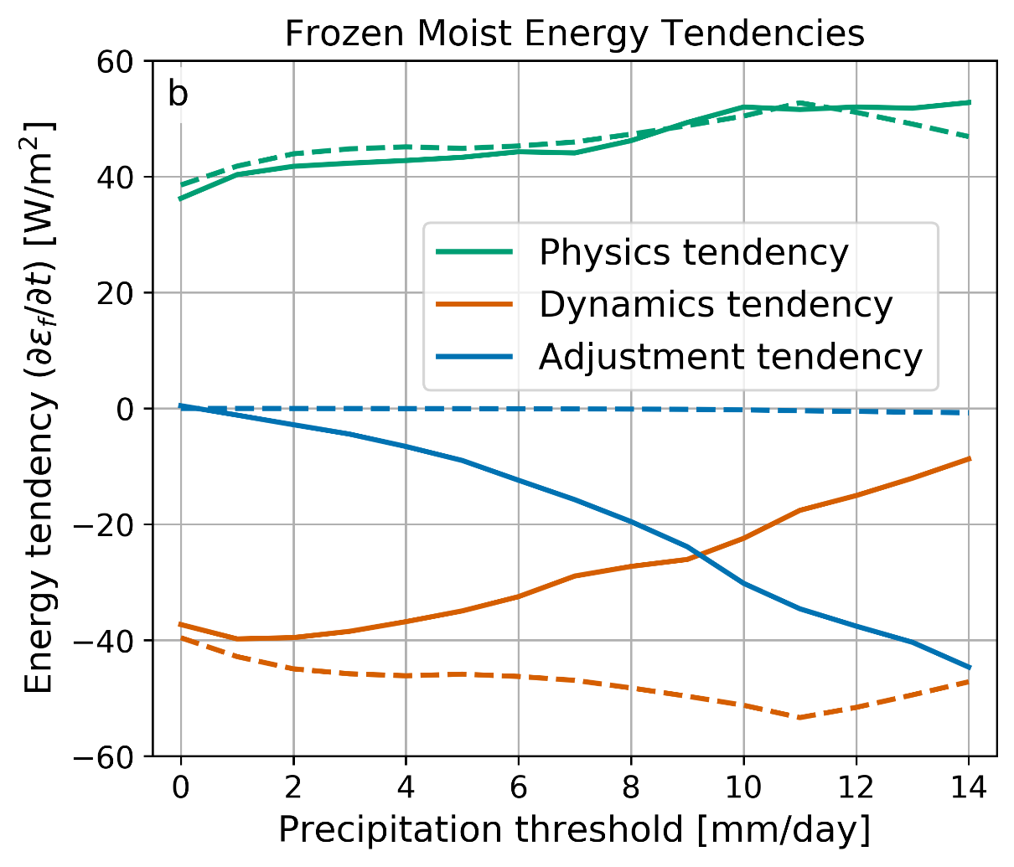
Does this matter?
Use of the energy-conserving adjustment scheme results in little change to the physics tendency, but has a large impact on the dynamics tendency. At high precipitation rates (stronger convection) energy sink owing to adjustment is so strong that the dynamics tendency is nearly zero. Results suggest dynamics tendency computed indirectly from radiative heating and turbulent heat fluxes is an overestimate when the adjustment is active. Solid lines (control) and dashed lines (experiment).

Slide 7
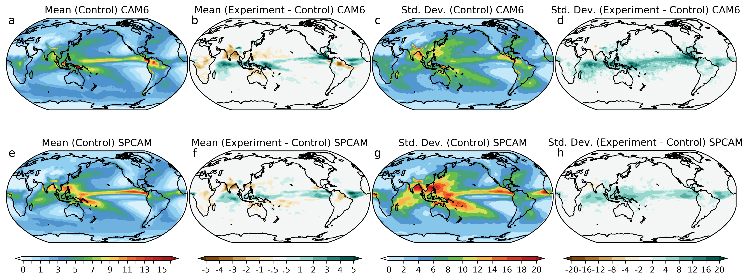
Does this matter?
Notes:
The hydrological cycle is particularly sensitive to the energy tendency of the adjustment, both in the mean and its variability. Large increases in precipitation and daily rainfall variability are demonstrated over the equatorial belt in both the standard CAM6 model and in SPCAM.

Slide 8
Outstanding issues & caveats
Ignoring extra terms from quotient rule
Ignoring work done by parcel expansion
Ignoring enthalpy of water species
Notes:
Our energy-conserving adjustment is nice, but it isn’t a good long term solution. There are a number of outstanding issues related to ignoring extra terms in how latent heating is done, ignoring the work done during parcel expansion, and, perhaps most importantly, ignoring the enthalpy of water species. In our energy-conserving adjustment, we gave the energy taken up by the liquid back to the parcel, but in reality the liquid should take that energy with it out of the column.

Slide 9
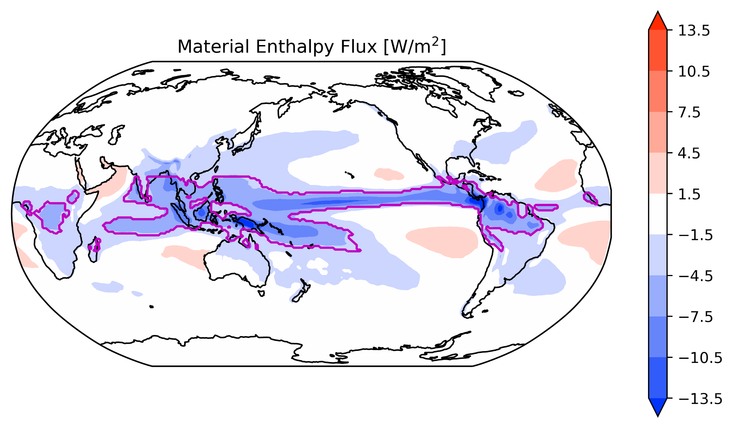
Why does this really matter?
Notes:
The energy tendency associated with the adjustment is a qualitatively reasonable energy pattern for the surface exchange of enthalpy associated with the internal energy of water species. We can estimate from the model the magnitude of what this flux should be.

Slide 10
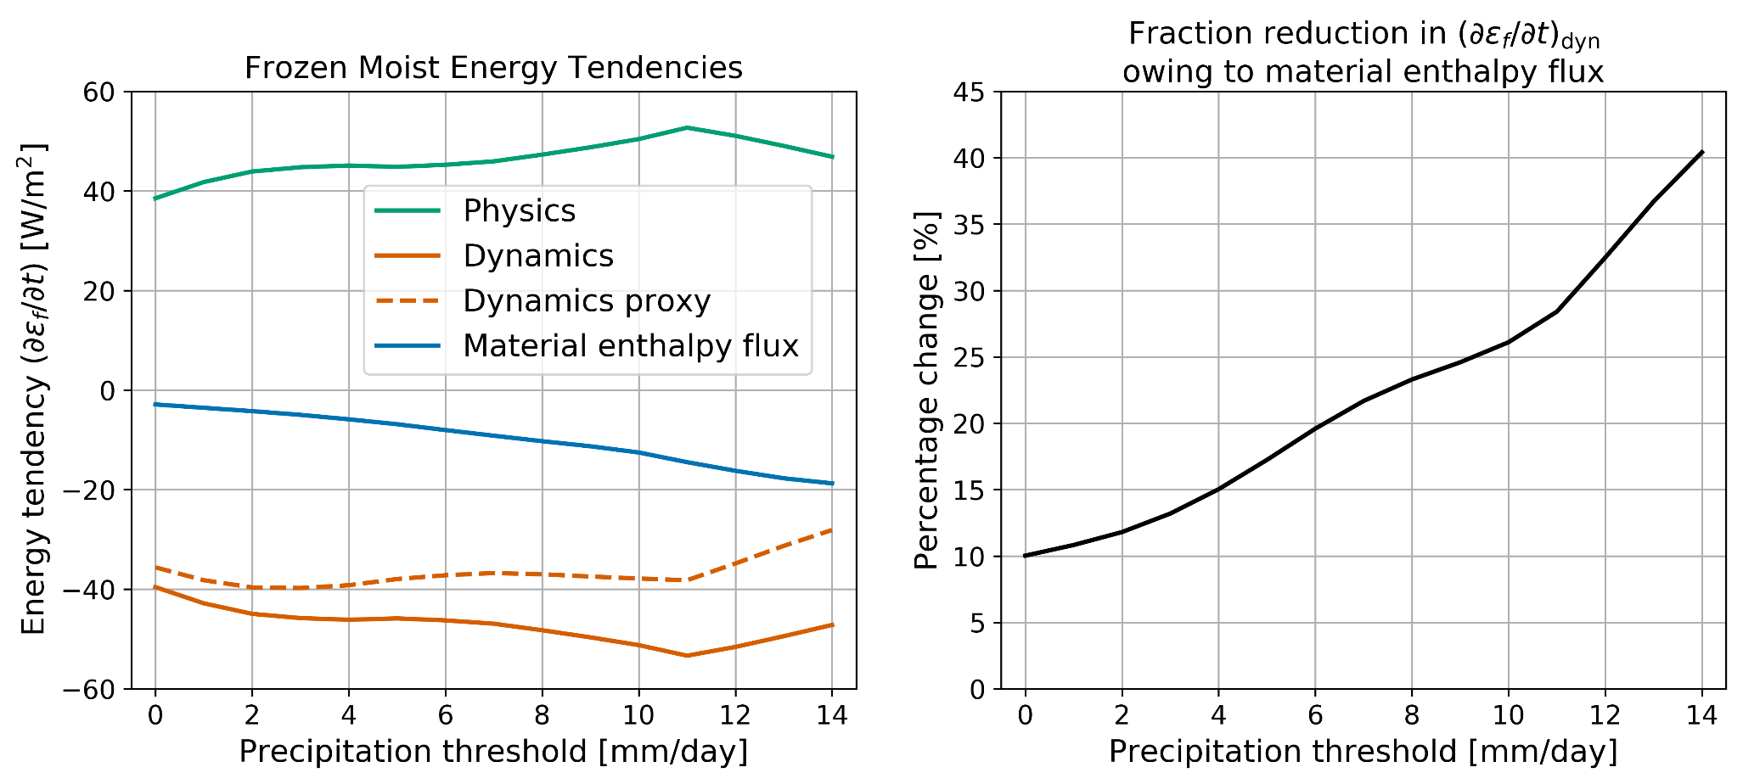
Why does this really matter?
Notes:
If we assume that the material enthalpy flux, like the adjustment tendency, is balanced entirely by changes in energy transport by the circulation, we can estimate the bias in energy transport by tropical circulations. In regions of heavy rainfall, like in the core of the ITCZ or in monsoon regions, this bias can easily exceed 25%.

