Slide 1
Real Options in Energy Finance
Matt Davison,
Professor of Applied Mathematics and Statistical & Actuarial Sciences
Dean of Science, Western University Canada, London Ontario
BIRS
Thursday Sept 26 2019

Slide 2
Collaborators
Matt Thompson (Queens Business School)
Lindsay Anderson (Cornell University)
Guangzhi Zhao (Royal Bank)
Natasha Burke (née Kirby), (TD Bank)
Walid Mnif (TD Bank)
Christian Maxwell (Bank of Montreal)
Behzad Ghafouri (entrepreneur)
Nicolas Merener, Dean of Business, Universidad Torcuata di Tella, Buenos Aires, Argentina
Somayeh Moazeni, Stevens Institute of Technology
Junhe Chen (Current Western PhD student)

Slide 3
The Canadian Economy in 2017
Canada has world leading companies in banking, insurance, and mining
(Data StatsCan)
Sector | Fraction
Real Estate | 13.4%
Manufacturing | 10.4%
Mining/Oil&Gas | 8.2%
Finance & Ins | 7.1%
Utilities | 2.2%
Ag & Fishing | 1.5%

Slide 4
Infrastructure can “create” a commodity or “transform” it
“Create”
Hydro dam
Wind Turbine
Copper Mine
“Transform”
Corn Ethanol Plant
Coal power plant
Gas power plant

Slide 5
Need expensive, long-lived infrastructure
Expensive
LNG terminal in Kitimat BC cost $40BB to build
Wind turbine $2MM to build each– and farm has 50-100
Long Lived
Bruce power plant first begun in 1970
Parts of the Niagara Falls Beck power plant were built in the 1920s in about their current form

Slide 6
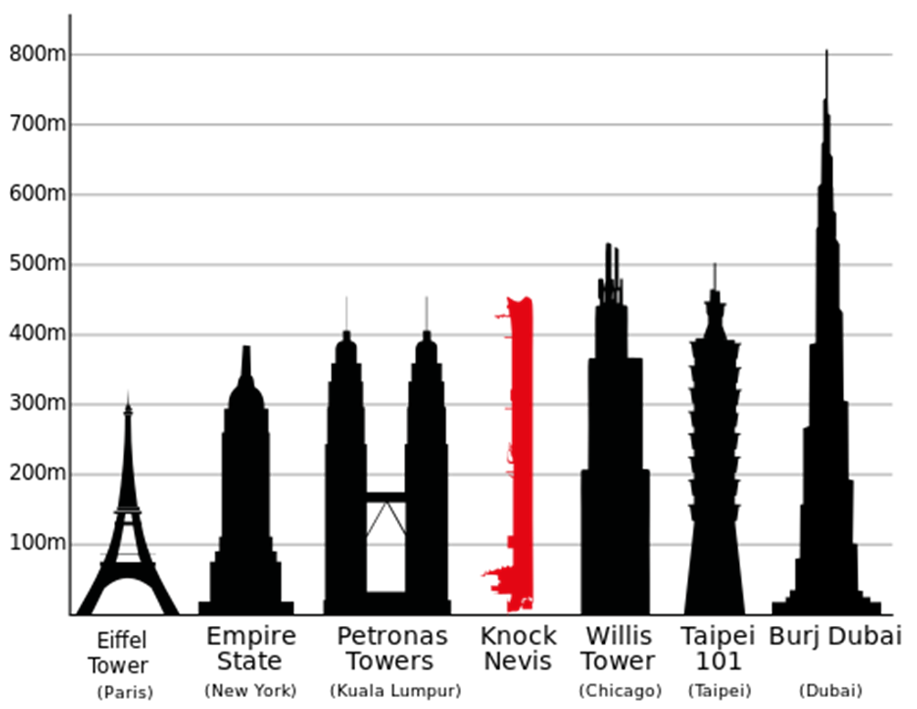
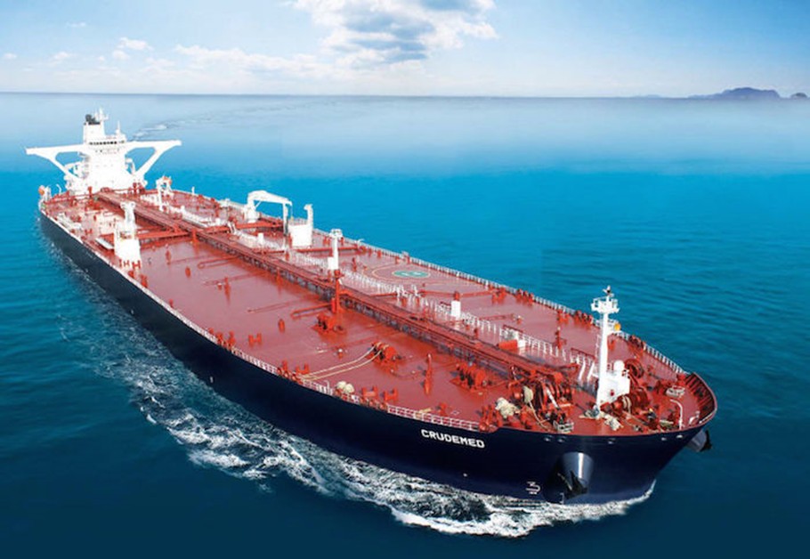
Infrastructure is also BIG

Slide 7
Risks Commodity Finance Must Solve
Price Risk
Supply Risk
Demand Risk
Regulatory Risk
Geopolitical Risk
Technological Risk
Hedging
Insurance
Storage
+ Operational Flexibility for all categories!

Slide 8
Questions
Value infrastructure?
The Value of a piece of infrastructure is the value of the infrastructure when optimally operated
Operate Infrastructure?
This depends on the value of plant, as we shall see
This circularity and the corresponding nonlinearity is nothing new in quant finance!

Slide 9
Real Business Decisions
Discounted Cash Flow
Real Options
Estimate all costs and incomes from a given project
In each year, net cash flow is Income – Costs
Discount cash flows by “hurdle rate”: higher uncertainty, higher hurdle rate
If DCF > 0 proceed, otherwise do not
But projects may have optionality.
For instance, if project works, it may have long sequence of profitable years
If it doesn’t work it can be cancelled
Looks like an option

Slide 10
Commodity Finance
Uses many of the same tools as regular quantitative finance
Emphasis on spreads: Calendar, location, spark/dark/crush spreads
Real things with real physical properties implement these spreads.
Political risk and government subsidies key
Often regional in nature with oligopolistic structure.

Slide 11
Corn Ethanol
Schmitt and his colleagues at Cornell
Gonzalez et al. 2013
Schmitt & Luo (Energy Economics 2011)
N. Kirby & MD (2010). Energy Economics
C. Maxwell & MD (2014). Energy Economics 42, pp. 140-151
C. Maxwell & MD (2015). In Commodities, Energy, and Environmental Finance. M. Ludkowski,

Slide 12
Ethanol
(Corn) ethanol biofuel production in North America has become popular
Encouraged by government subsidies (“green”, “safe”, also good politics).
Market is fairly easy to understand, model, and quantify
Looking at ethanol gives insights about energy finance in general.

Slide 13

An Ethanol Plant

Slide 14
Corn model
Corn + nat gas → Ethanol + Distiller’s dried grains
Very simple model: net the grains out to get
1.25 bushels of corn → 1 gallon of ethanol

Slide 15
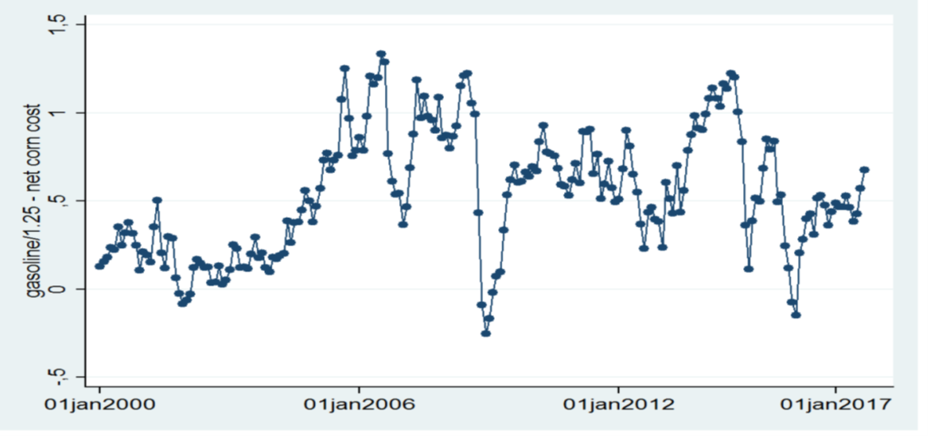
Gasoline/Corn Spread (USDA)

Slide 16
Simple example
Model spread y_{t} as very simple arithmetic Brownian motion
dy_{t} = bdW_{t} (no drift); W_{t} a Wiener process
If spread is positive, run the plant and get one gallon of gasoline per time unit
If spread is negative, idle the plant
Assume plant lasts forever
Don’t worry, we’ll relax all these crazy assumptions later. This is just for insight

Slide 17
Value integral
Value depends on spread and state and time
V₀(y) is value if off and spread is y (y < 0)
V₁(y) is value if on and spread is y
V= max(V₀,V₁)
V = E{∫_{t}∞ f(y_{s})exp[-r(s-t)]ds}
f(y_{s}) = max(y_{s},0)
V’(∞) = 1/r; V(-∞) = 0

Slide 18
ODE
V(y,t) = (1-rdt)V(y+dy,t+dt) + f(y)dt
-rVdt + V(y+dy,t+dt)-V(y,t) + f(y)dt
Cancel higher order terms and use Ito:
-rVdt + E{bV’(y)dW + ½ b² V’’(y)dt} + f(y)dt
E{dW} = 0 and cancel dt’s to get:
-rV(y) + ½ b² V’’(y) + f(y) = 0
This holds both for on and off states so:

Slide 19
Two ODEs
y < 0
½b²V₀’’(y) - rV₀ = 0
V₀(-∞) = 0
Smooth pasting →
y > 0
½b²V₁’’(y) - rV₁ + y = 0
V₁’(∞) = 1/r
V₀(0) = V₁(0)
V₀’(0) = V₁’(0)

Slide 20
Solution
Eigenvalues +/- √(2r)/b
Very simple ODE problem to find:
V₀(y) = b/(2r)^{1.5} exp[√(2r)y/b]
V₁(y) = b/(2r)^{1.5} exp[-√(2r)y/b] + y/r

Slide 21
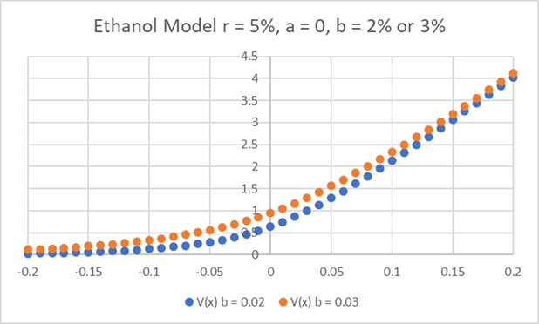
You just blew my mind!
dy = bdW; b is risk
More risk to price, more value to plant!
Makes sense…
But mind bending to traditional thinkers
See Lehmberg & Davison 2014

Slide 22
Stuff we ignored
Spread really not simple ABM ✓
Costs money to turn plant on and off ✓
Inputs can include government subsidies: time varying and to some degree unpredictable ✓
{Subsidies not just explicit but also implicit through regulations – current work with Merener not discussed today}

Slide 23
My research program for past decade
Look at real options model of corn ethanol plant with successively more realism
  Real Options model including realistic cost structure
  Including stochastic subsidy model
  Considering bigger complexity of rules (not just money: ethanol mandate and blending wall

Slide 24
The Ethanol Market in the USA
209 plants produced 13.3 billion gallons in 2012
Subsidies a big part of this: Began with $0.40 per gallon in 1978 (Energy Tax Act) and then changed a lot over time; subsidies expired in 2012.

Slide 25
U.S. Energy Subsidies
Act | Year | per gallon subsidy
Energy Tax Act | 1978 | $0.40
Surface Transportation Assistance Act of 82 | 1983 | $0.50
Tax Reform Act | 1984 | $0.60
Omnibus Budget Reconciliation Act | 1990 | $0.54
1998 policy adjustment effective 2001 | 2001 | $0.53
1998 policy adjustment effective 2003 | 2003 | $0.52
Extension of policy with adjustment | 2005 | $0.51
Farm Bill | 2008 | $0.45
Expiration of Tax Credits | 2012 | $0.00

Slide 26
Empirical impact of subsidy change
In 2013 about ¼ of Nebraska’s energy plants were idle
Loss of subsidies are a possible contributing factor as many suggest that corn ethanol is not sustainable without subsidies.
We use a real options analysis to discover how plants will be operated knowing that subsidies may change.

Slide 27
Mini Outline
1. Plant Characteristics, Management Decisions, Associated costs and profits
2. Stochastic Optimal Control for optimal plant operating rule/plant value
3. Numerical Results & Policy Conclusions

Slide 28
What is the real option?:
Run plant when ethanol is worth more than cost of inputs; idle plant when it is not
There are switching costs between “on” and “off” –, this will lead to hysteresis

Slide 29
Assembling the model
A model for policy impact on ethanol production requires:
  A model for the plant including flexibility of control, capitalized construction costs, profit as a function of ethanol/corn prices, costs to pause/resume production
  Stochastic models for corn & ethanol prices and for subsidy level
  Optimal operating rule which maximizes future profits

Slide 30
Management Flexibility
Management can:
  Start/Stop production to avoid running at a loss over sustained periods or to recapture profits if price spread becomes favourable again
  Two main states: on (1), off (0).
    Turn production “on” from “off”: penalty $D₀₁ per gallon
    Turn production “off” from “on”: penalty $D₁₀ per gallon

Slide 31
Profit functions
In regime i running profit is f_{i}(…)
Corn → ethanol + by-products
Yield (gallons ethanol/bushel corn): κ
Ethanol $L_{t}/gallon; Corn $C_{t} (/bushel)
Subsidy: $Z_{t}/gallon
Running costs = $K₁/gallon; Idle cost $K₀
So f₁ = κ(L_{t}+ Z_{t} - K₁)-C_{t}
Also f₀ = -κ(K₀)

Slide 32
Stochastic Subsidy Model
Model stochastic subsidy by pure Poisson jump process with
  arrival rate λ
  jumps of size J (lognormally distributed with parameters α and β)
dZ_{t} = (J-Z_{t})dN_{t}
N_{t} is a counting process for which dN_{t} = 1 with probability λdt and 0 otherwise.

Slide 33
The Moving Boundary PDE
Either it is optimal to stay in the current state i, in which case this PDE is satisfied:
δV_{i}/δt + L[V_{i}] + I[V] + f_{i}(t,L,C,Z) – rV_{i} = 0,
V_{i} ≥ V_{j} – D_{ij}
Or it is optimal to switch in which case:
V_{i}(t,L,C,Z) = V_{j}(t,L,C,Z) – D_{ij}

Slide 34
Qualitative Results (1)
This implies the more uncertainty about subsidies (and prices) the better.
This arises from the ability to react to uncertainty by idling the plant
We can hedge price uncertainty, not subsidy uncertainty.
This makes the uncertainty in knowing the parameters of the subsidy uncertainty critical

Slide 35
Uncertainty Aversion: same PIDE
With different parameters for bid/offer price:
Theorem (Worst case Price) The option price is bounded above by the worst case price for which α = α_{min}
and λ = λ_{min} if E[V(l,c,z+J)]-V(l,c,z) >= 0; otherwise λ = λ_{max.}
Similar result holds for best-case price.

Slide 36
Simplified model
Look at “stripped down” model where we model the crush spread as a shifted ABM that best fits the same data
In other words, y_{t} = κ L_{t} – C_{t}

Slide 37
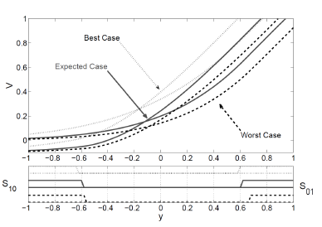
Switching Decisions

Slide 38
Switching decisions
The operator switches production on later (and production off earlier) given worst case regulatory uncertainty parameters relative to expected case.
Risk aversion destroys money
Effect is not huge for our model parameters.

Slide 39
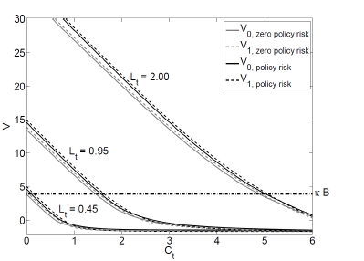
The complete model

Slide 40
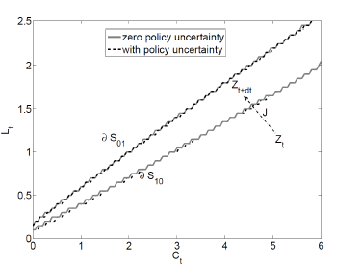
Exercise Boundaries: full model

Slide 41
Commodities: low value density
Corn $7/bushel (76 pounds)
WCS Oil $50/barrel (160 litres)
Electricity $100/MWh (energy content of 1,250,000 AA batteries!)
Gold $2000/oz… but need to mine/mill/refine 30,000 pounds of ore to get that ounce!

Slide 42
Difficult or costly to store or move
Corn and wheat are perishable
Oil is dangerous and dirty to store
Electricity is very costly to store
Oil is dangerous to move
Transmission lines and pipelines are controversial to build

Slide 43
Financial markets consider this
Forward markets: Agree on price today for trade of money for commodity at some future time.
Money changes hands later
Futures – Forwards with margin account to handle counterparty risk.
Distinction not crucial for this talk
How can these financial markets play?

Slide 44
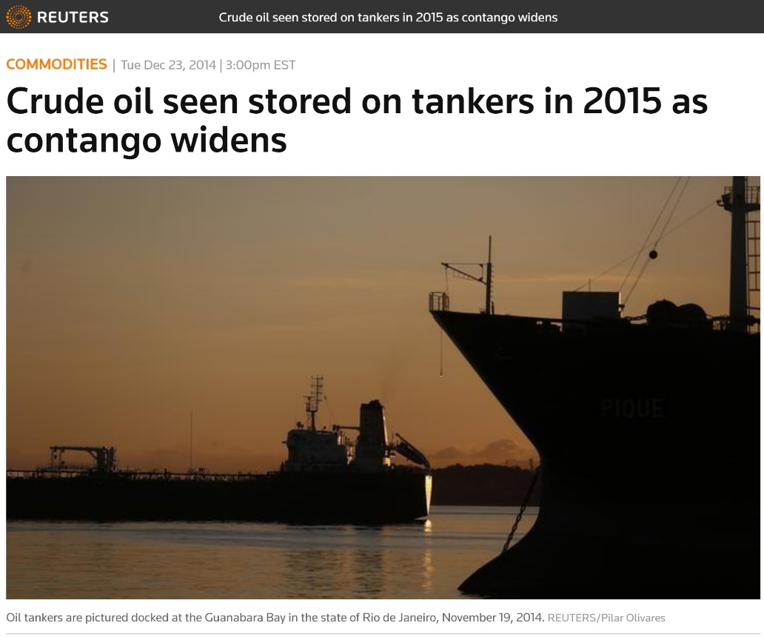
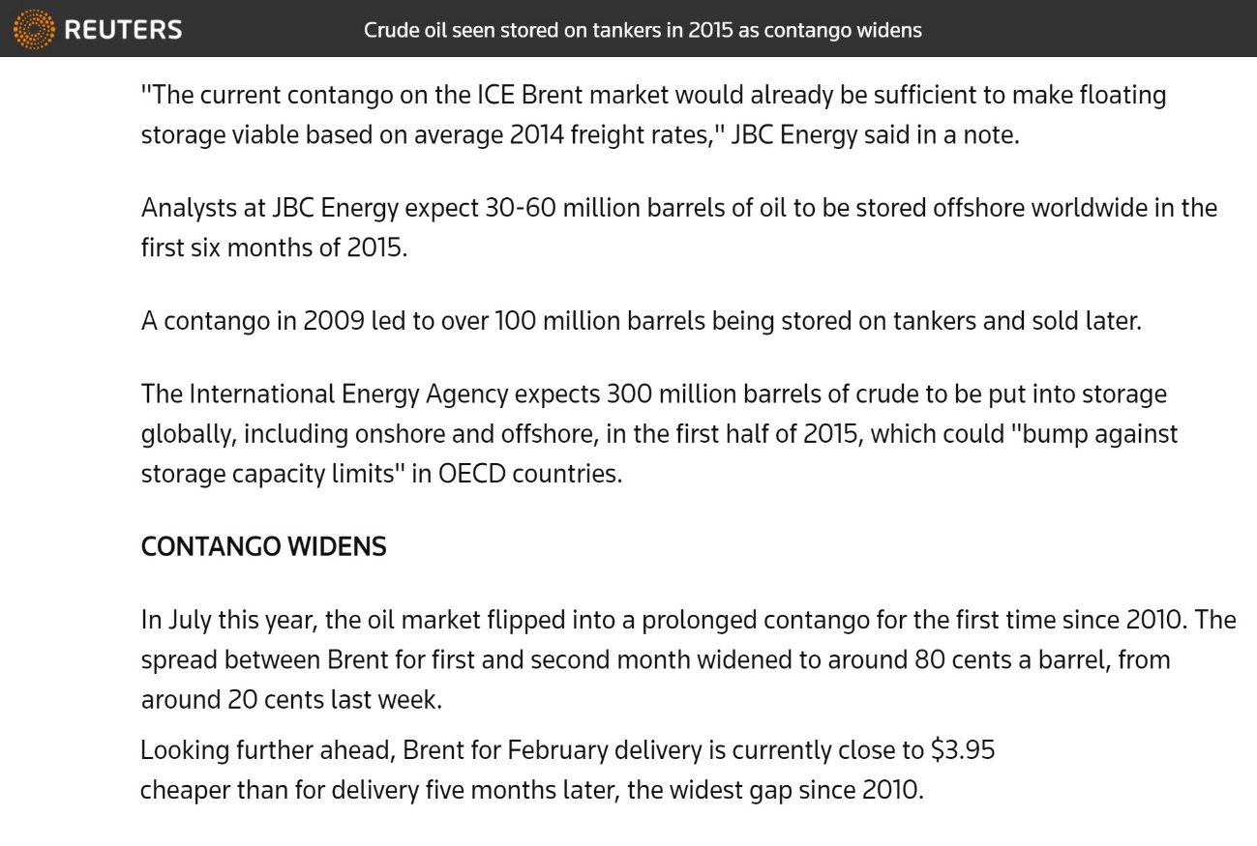
Introduction
Source: http://www.reuters.com/article/us-oil-storage-floating-idUSKBN0K11P320141223
Notes:
Dec 2014
Analysts expect 30-60 MB in the first half of 2015
Contango condition of 2009: 100 MB floating storage
5 month spread of about $4

Slide 45
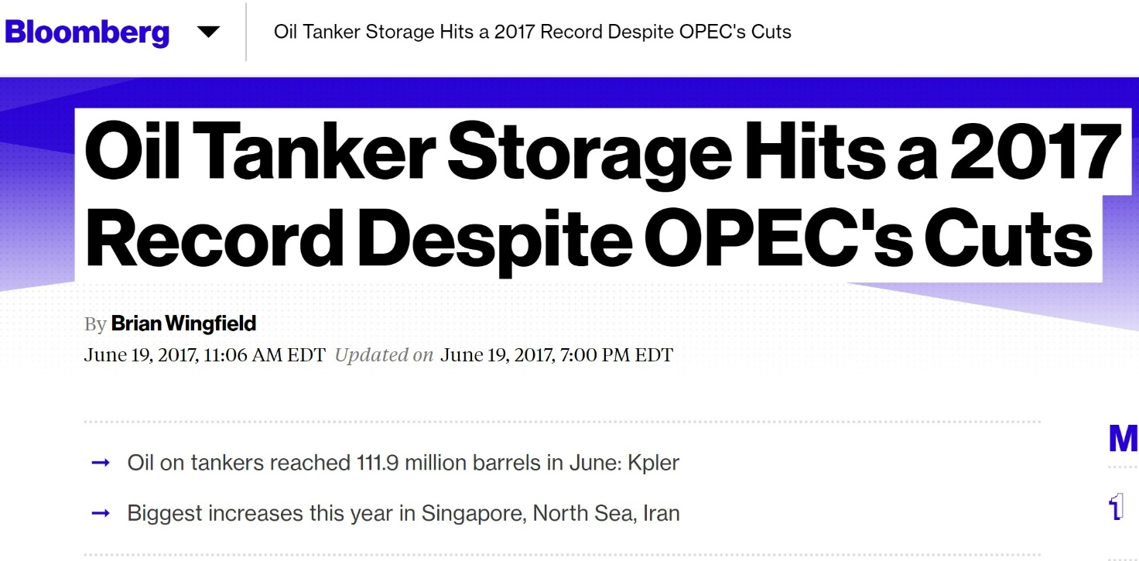
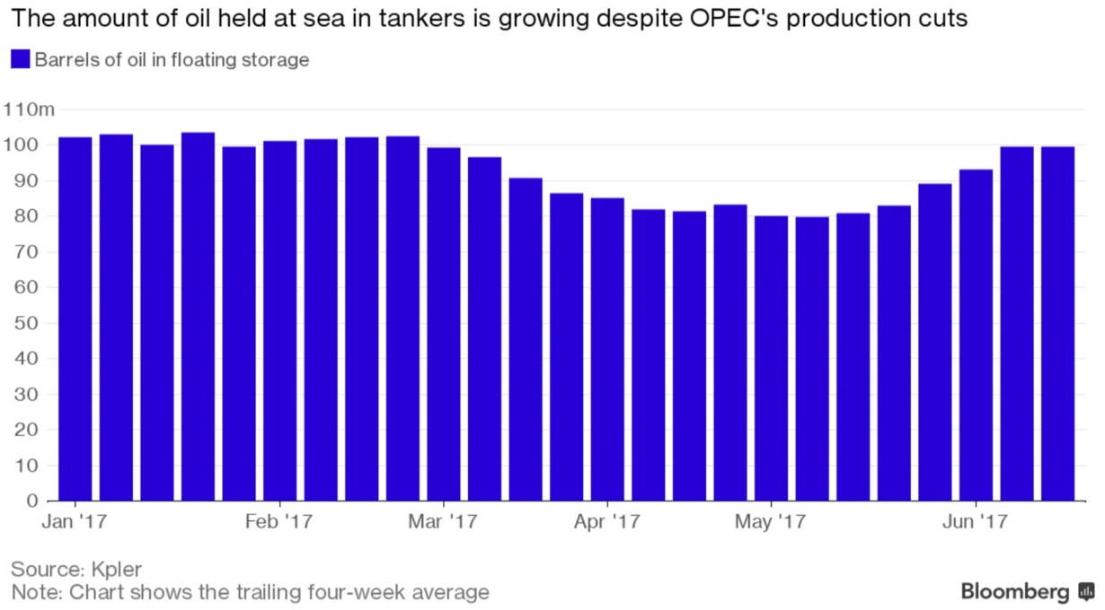
Introduction
Source: https://www.bloomberg.com/news/articles/2017-06-19/oil-tankers-store-most-oil-this-year-as-glut-proves-hard-to-kill

Slide 46
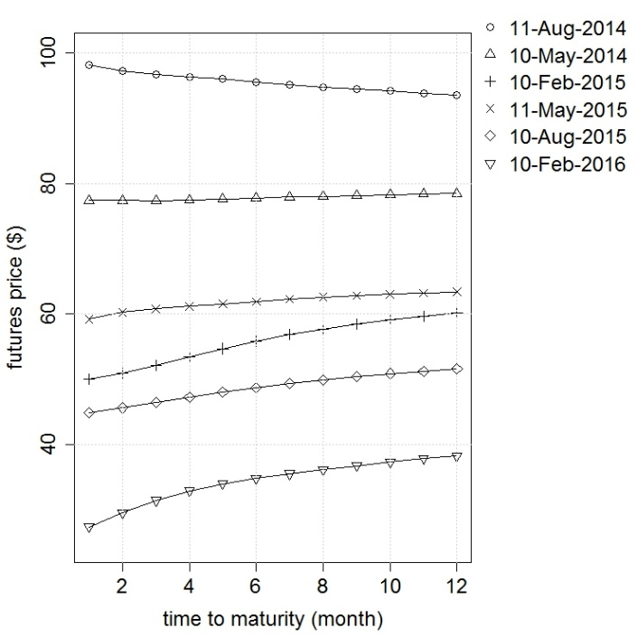
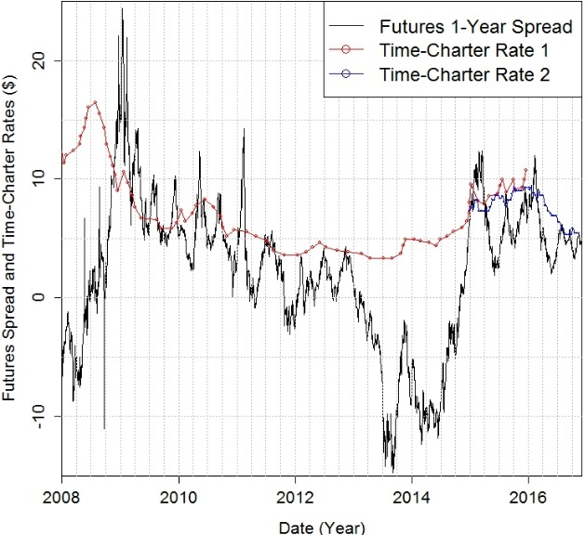
Motivation
Historical 1-year crude oil futures spread (CME NYMEX WTI )
VLCC 1-year time charter rates (sources: Rate 1 BIMCO, Rate 2 Charles R. Weber Co.)
Crude Oil Futures Contracts
Historical NYMEX WTI (CL#1 to CL#12)
Contango vs Backwardation
Notes:
Periods where the spread is higher than the cost
Creates an incentive to engage in the cash-and-carry

Slide 47
Problem Overview
The cash and carry arbitrage (also contango and carry in oil storage trading)
Additional flexibility:
Re-adjust the forward maturity in response to changes in market
Re-fill the storage
Optimal initiation time
FORMULATE A DYNAMIC CASH-AND-CARRY FRAMEWORK AND
STUDY OPTIMAL TRADING IN THE FORWARD MARKET
Dynamic is more interesting!!!
Optimal maturity?
Notes:
Explain the standard cash-and-carry arbitrage
Buy spot (low) & sell forward (high)
Minus the storage cost → profits
Practical implications: Might increase the profits for traders
Theoretical: think about Static vs Dynamic trade? which forward maturity is the best??

Slide 48
Roadmap
 | Modelling Framework
Solution Techniques | Model 1 Stochastic Oil Prices | Model 2 Stochastic Oil Prices & Storage Cost
Forward Dynamic Optimization (Sub-optimal) | ✓ | -
Exact Dynamic Programming (Optimal) | ✓ | -
Approximate Dynamic Programming (Optimal) | ✓ | ✓
Notes:
Real option; decision wrt operation of a storage facility
Sources of uncertainty

Slide 49
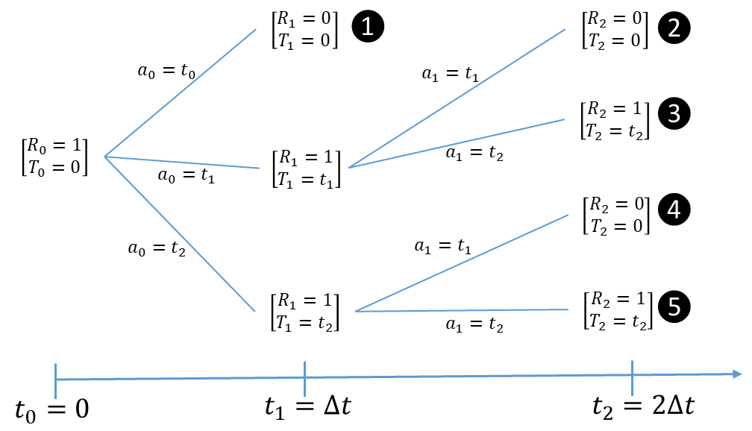
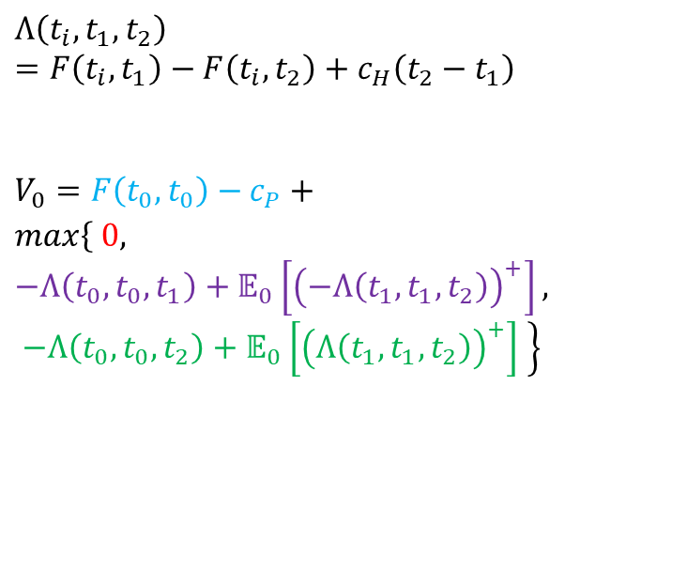
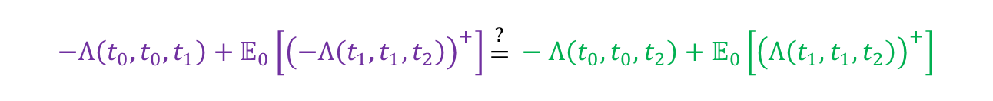
Problem Overview: A Simple Two-Period Example
$$Λ\left(t_{i},t_{1},t_{2}\right)=F\left(t_{i},t_{1}\right)−F\left(t_{i},t_{2}\right)+c_{H}\left(t_{2}−t_{1}\right)$$
$$V_{0}=F\left(t_{0},t_{0}\right)−c_{P}+$$
$$max\left\{ 0,\right.$$
$$\left.−Λ\left(t_{0},t_{0},t_{1}\right)+𝔼_{0}\left[{\left(−Λ\left(t_{1},t_{1},t_{2}\right)\right)}^{+}\right], −Λ\left(t_{0},t_{0},t_{2}\right)+𝔼_{0}\left[{\left(Λ\left(t_{1},t_{1},t_{2}\right)\right)}^{+}\right] \right\}$$
$$−Λ\left(t_{0},t_{0},t_{1}\right)+𝔼_{0}\left[{\left(−Λ\left(t_{1},t_{1},t_{2}\right)\right)}^{+}\right]\begin{matrix}\begin{aligned} \\ ?\end{aligned} \\ \begin{aligned}= \\ \end{aligned}\end{matrix} −Λ\left(t_{0},t_{0},t_{2}\right)+𝔼_{0}\left[{\left(Λ\left(t_{1},t_{1},t_{2}\right)\right)}^{+}\right]$$
$$Λ\left(t_{0},t_{1},t_{2}\right)≠𝔼_{0}^{ℙ}\left[Λ\left(t_{1},t_{1},t_{2}\right)\right]$$
Notes:
You don’t need to worry about the details of this simple example as I will present the main general model
The point I am trying to make here is that when you consider the forward market compared to the spot only
there are many more choices , and it will become an interesting question to find the optimal decision
Ignore interest rate
5 different possible scenarios…
Lambda is the payoff from advancing a sale from t2 to t1
Negative lambda is the reverse, it means postponing

Slide 50
Related Literature
Real options monetizing the flexibility of storage assets:
Optimal (Stochastic DP) vs heuristic (eg, Forward Dynamic Optimization (FDO))
Eydeland and Wolyniec, 2003; Gray and Khandelwal, 2004; Maragos, 2002
Based on spot price or forward curve
  Spot:
    Bjerksund, Stensland & Vagstad, 2011; Boogert & de Jong, 2008, 2011; Carmona & Ludkovski, 2010; Chen & Forsyth, 2007; Felix & Weber, 2012; Secomandi, 2010; Thompson, Davison & Rasmussen, 2009
  Forward (only information not trading):
  Lai, Margot & Secomandi, 2010; Nadarajah, Margot & Secomandi, 2015, 2017
  Forward (both information and trading):
  Löhndorf & Wozabal, 2017
Notes:
Secomandi… Risk-neutral valuation and linear profit functions → don’t consider forward trading
Do consider forward trading, but in an incomplete market and for gas storage pricing
Very high dimensional that is intractable to be solved with the established ADP methods
They found that suboptimal methods are not working as well as optimal in these cases
Gas storage contracts in an incomplete market → Indifference pricing solve → a high-dimensional SDP under a specific risk measure (nested cVaR)
Develop a method by combining stochastic dual dynamic programming and a quantization method
quantization approximates the continuous price process with a discrete scenario lattice (and moment matching)

Slide 51
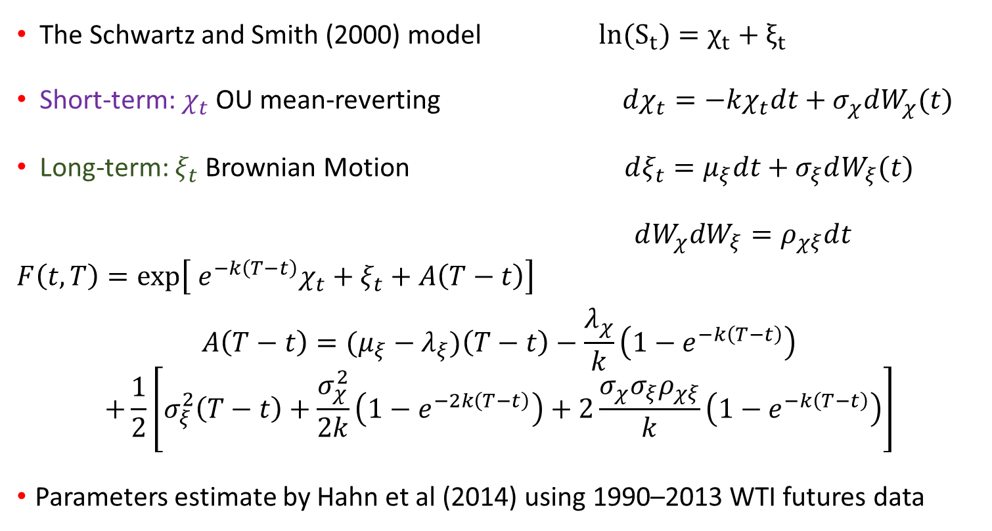
Oil Price Model
The Schwartz and Smith (2000) model $ln(S_{t})=χ_{t}+ξ_{t}$
Short-term: $χ_{t}$ OU mean-reverting $dχ_{t}=−kχ_{t}dt+σ_{χ}dW_{χ}(t)$
Long-term: $ξ_{t}$ Brownian Motion $dξ_{t}=μ_{ξ}dt+σ_{ξ}dW_{ξ}(t)$
$dW_{χ}dW_{ξ}=ρ_{χξ}dt$
$$F\left(t,T\right)=exp\left[{ e}^{−k\left(T−t\right)}χ_{t}+ξ_{t}+A\left(T−t\right)\right]$$
$$A\left(T−t\right)=(μ_{ξ}−λ_{ξ})\left(T−t\right)−\frac{λ_{χ}}{k}\left(1−e^{−k\left(T−t\right)}\right)$$
$$+\frac{1}{2}\left[σ_{ξ}^{2}\left(T−t\right)+\frac{σ_{χ}^{2}}{2k}\left(1−e^{−2k\left(T−t\right)}\right)+2\frac{σ_{χ}σ_{ξ}ρ_{χξ}}{k}\left(1−e^{−k\left(T−t\right)}\right)\right]$$
Parameters estimate by Hahn et al (2014) using 1990–2013 WTI futures data
Notes:
Plotting a lot of variables in chi-ksi domain
Remember short term and long term factors
But they do not have really a financial meaning
Level and slope can change with time stochastically

Slide 52
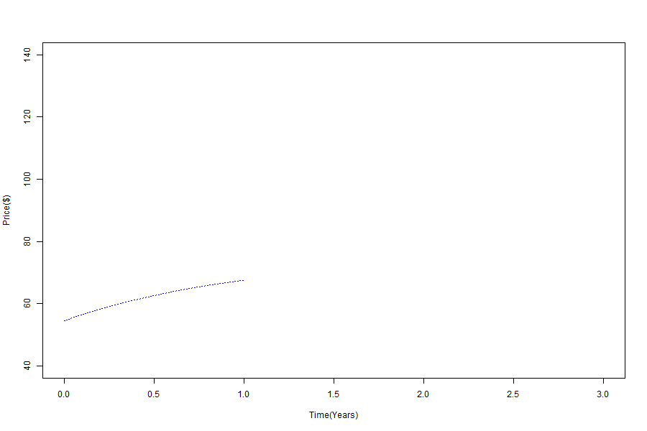
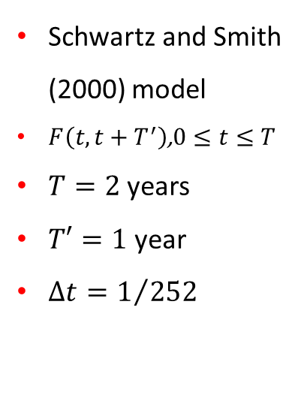
Simulation of Oil Prices: Spot & Forward
Schwartz and Smith (2000) model
$F\left(t,t+T^{′}\right)$,$0≤t≤T$
$T=2$years
$T′=1$ year
$Δt=1/{252}$

Slide 53
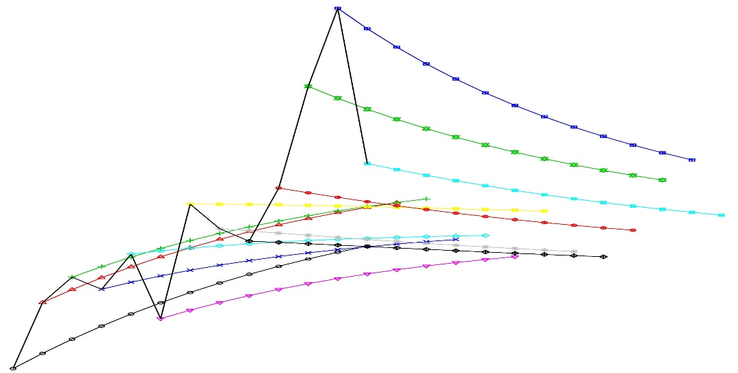

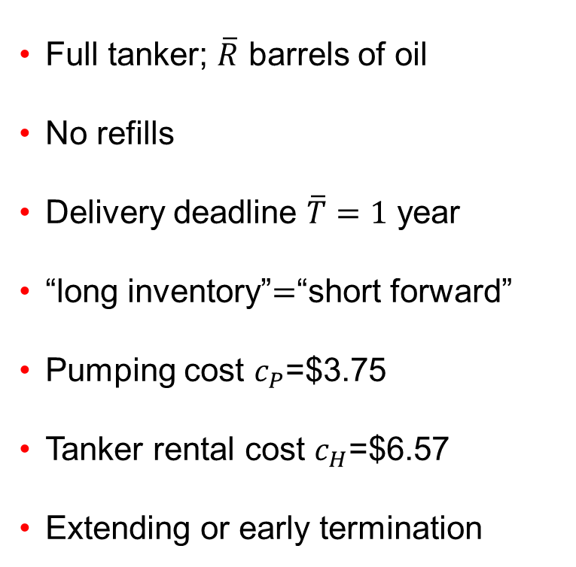





Model: Assumptions and Structure
Full tanker; $\overline{R}$ barrels of oil
No refills
Delivery deadline $\overline{T}=1$ year
“long inventory”$=$“short forward”
Pumping cost $c_{P}$=$3.75
Tanker rental cost $c_{H}$=$6.57
Extending or early termination
$$F(t_{i},T_{i})$$
$$t_{0}$$
$$t_{1}$$
$$t_{2}$$
$$t_{3}$$
$$t_{N}=\overline{T}$$
Sold so far
Completely sold
Remaining inventory
$$Schematic diagram of the model setup (decision‑making example)$$

Slide 54
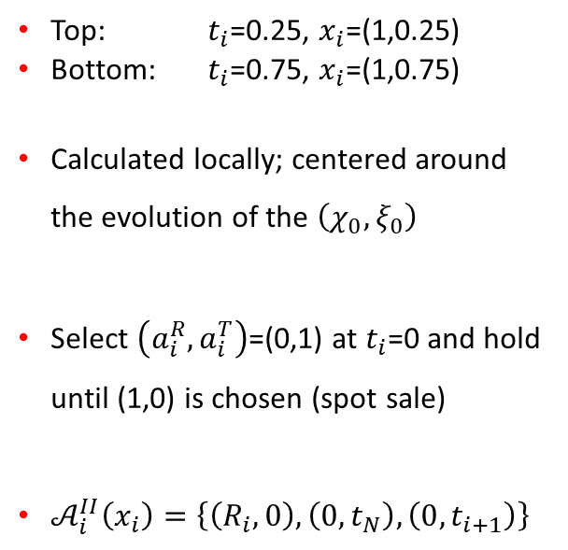
Optimal Policy $\left(a_{i}^{R},a_{i}^{T}\right)$: ADP vs Exact
Top: $t_{i}$=0.25, $x_{i}$=(1,0.25)
Bottom: $t_{i}$=0.75, $x_{i}$=(1,0.75)
Calculated locally; centered around the evolution of the $\left(χ_{0},ξ_{0}\right)$
Select $\left(a_{i}^{R},a_{i}^{T}\right)$=(0,1) at $t_{i}$=0 and hold until (1,0) is chosen (spot sale)
$𝒜_{i}^{II}\left(x_{i}\right)=\left\{\left(R_{i},0\right), \left(0,t_{N}\right),\left(0,t_{i+1}\right)\right\}$
Notes:
SPEND MORE TIME
Financial meaning of different regions: the state you are in: Full inventory and immediately maturing contract
$a_{i}^{R}$: Blue region means sufficiently upward sloping forward curve → not to sell and postpone it by entering into a forward contract
$a_{i}^{R}$: Red region means almost flat or downward sloping forward curve → I will sell everything on the spot price
Exact: fixed grid points
ADP: dense cluster of simulated paths
Good agreement
Vertical boundary moves to the left

Slide 55
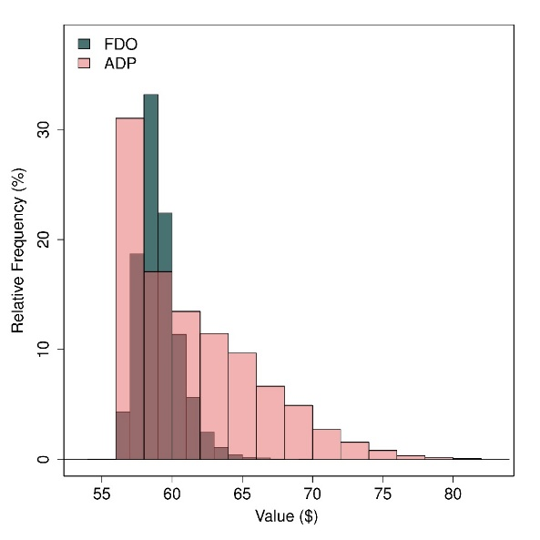
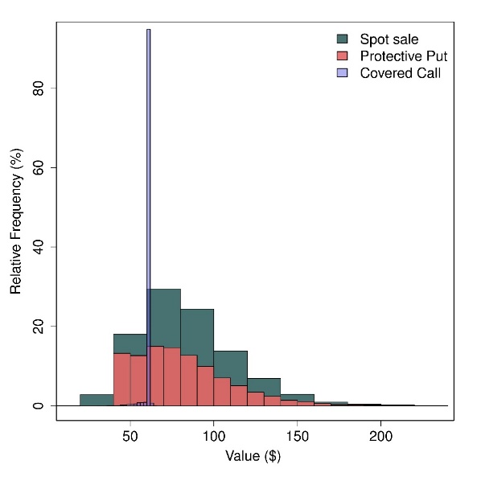
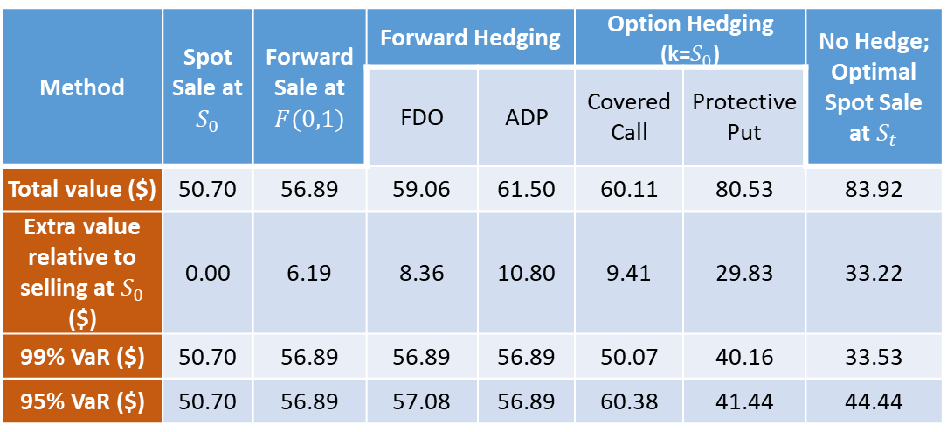
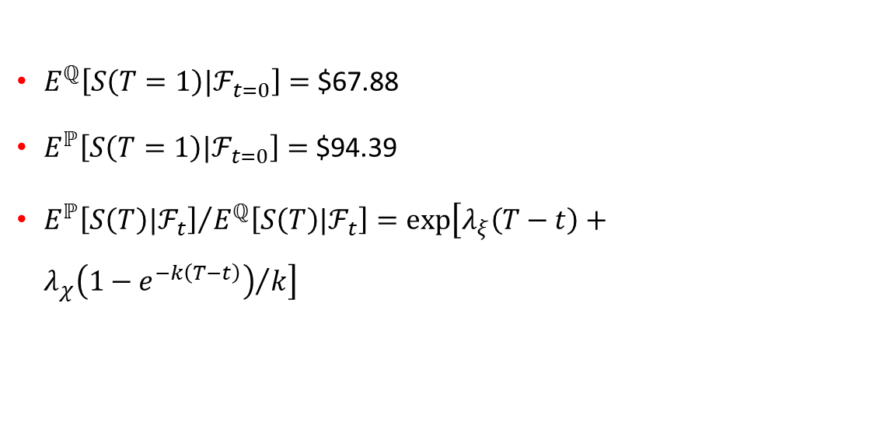
Alternative Selling Strategies
Method | Spot Sale at $S_{0}$ | Forward Sale at $F(0,1)$ | Forward Hedging |  | Option Hedging (k=$S_{0}$) |  | No Hedge; Optimal Spot Sale at $S_{t}$
 |  |  | FDO | ADP | Covered Call | Protective Put
Total value ($) | 50.70 | 56.89 | 59.06 | 61.50 | 60.11 | 80.53 | 83.92
Extra value relative to selling at $S_{0}$ ($) | 0.00 | 6.19 | 8.36 | 10.80 | 9.41 | 29.83 | 33.22
99% VaR ($) | 50.70 | 56.89 | 56.89 | 56.89 | 50.07 | 40.16 | 33.53
95% VaR ($) | 50.70 | 56.89 | 57.08 | 56.89 | 60.38 | 41.44 | 44.44
$E^{ℚ}\left[S\left(T=1\right)|ℱ_{t=0}\right]=$ $67.88
$E^{ℙ}\left[S\left(T=1\right)|ℱ_{t=0}\right]=$ $94.39
${E^{ℙ}\left[S\left(T\right)|ℱ_{t}\right]}/{E^{ℚ}\left[S\left(T\right)|ℱ_{t}\right]}=exp\left[λ_{ξ}\left(T−t\right)+{λ_{χ}\left(1−e^{−k\left(T−t\right)}\right)}/k\right]$
Notes:
Spend more time about covered call and protective put
Leave the cash-and-carry setup;
Sell directly on the spot market
No forward hedge: with or without some other form of hedging
Higher expected reward,
Higher risk
ADP > FDO with comparable VaR

Slide 56
Conclusions
Energy Finance is rich with interesting financial mathematics problem
Financial, Engineering, and Operational details must be incorporated to the right degree if results are to be useful
Modelling at a premium!

Slide 57
Thank you!
mdavison@uwo.ca

