Slide 1

Discovering Genetic Network Interactions Through Iterative Hypothesis Reduction
BIRS
Sept 29, 2021
Bree Cummins (Montana State), Rob Moseley (Duke), Francis Motta (Florida Atlantic), Anastasia Deckard (GDA), Steve Haase (Duke), Sophie Campione (Duke), Shaun Harker (GDA), Marcio Gameiro (Rutgers), Tomas Gedeon (Montana State), Konstantin Mischaikow (Rutgers)
Funding: NSF, NIH, DARPA

Slide 2
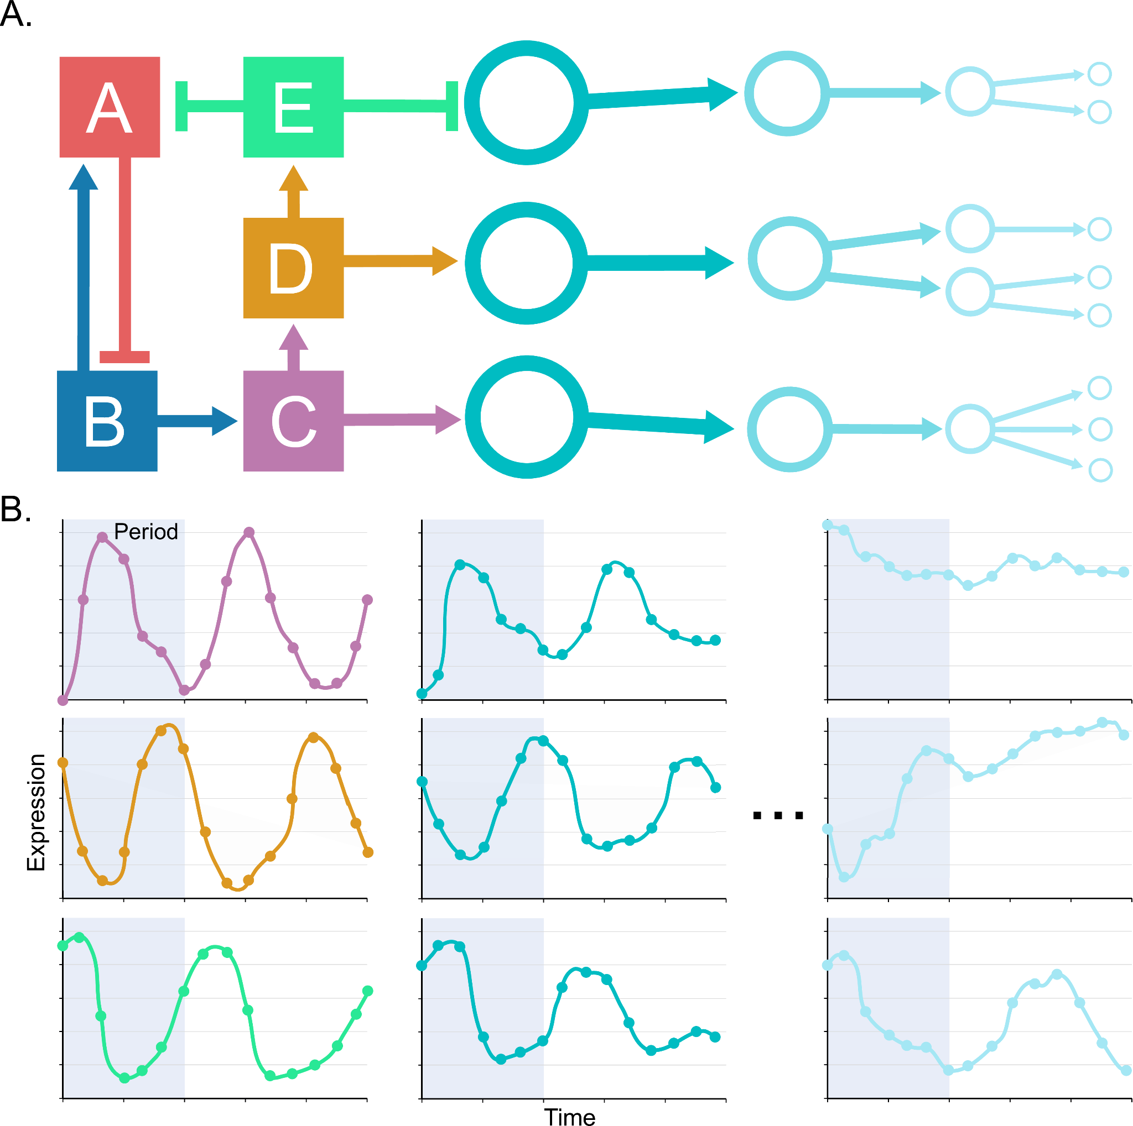
Cellular clocks represented as genetic regulatory networks
Nodes represent abundances of a gene product
Edges represent either activating or repressing interactions via some mechanism
A core oscillator is a minimal strongly connected network with negative feedback that drives downstream activity
Goal: Reduction of the hairball in non-model organisms
x
y
z

Slide 3
Deducing causation
Experimental Question
Analysis Result
Regulatory interactions indicate causality, i.e. a change in the concentration or activity of one gene product causes a change in another
Causality is time dependent, cannot be recovered by snapshots
Methods for attempting to deduce causality from time series
  Topological relationships between dynamical manifolds
  Mutual information
  Bayesian techniques
  Boolean models
  Ordinary differential equations
  Hybrid discrete/ODE modeling -- us!!
Experimentalist
Analyst
Data
Data type request

Slide 4
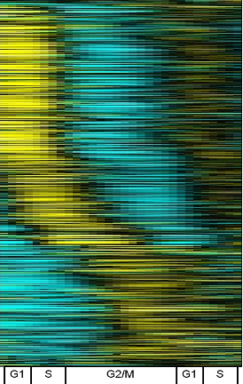
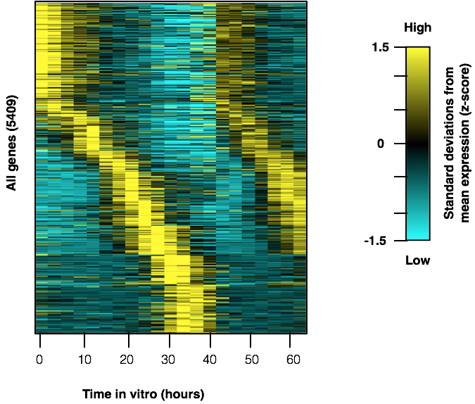
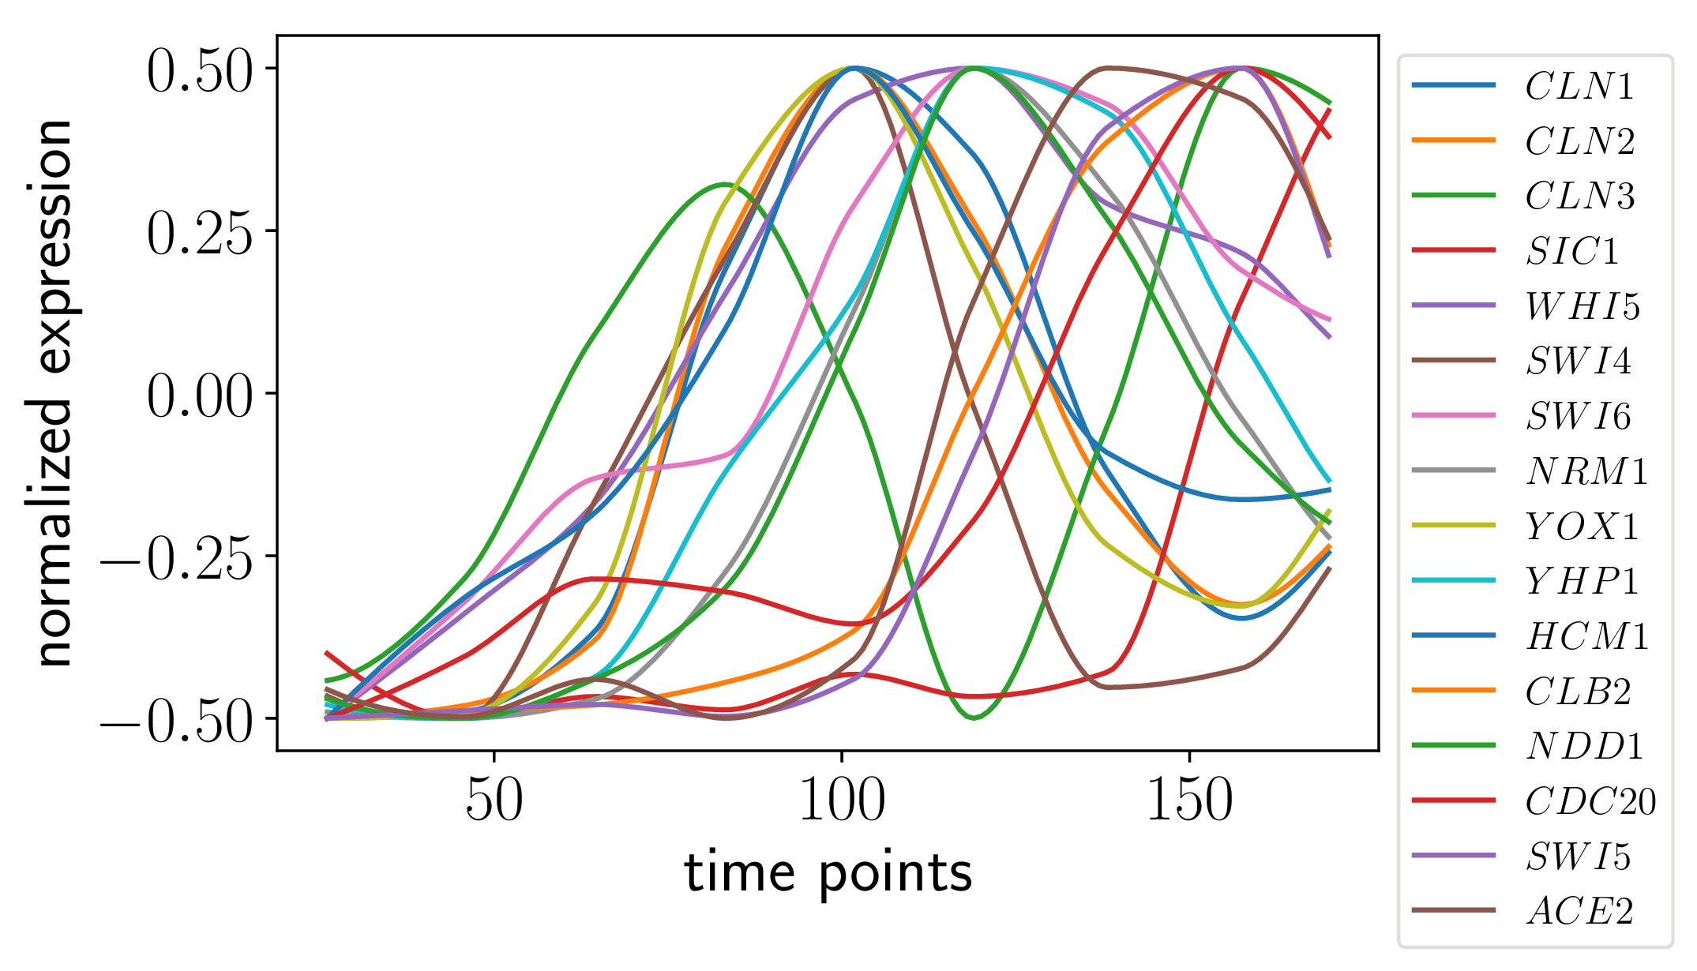
Hypotheses from transcriptomics time series data
Hundreds to thousands of gene products measured using transcriptomics
We seek core oscillators on the order of 10 genes
Inherent Dynamics Pipeline: Reduce the number of genes (nodes), then reduce the number of pairwise regulatory interactions (edges), then reduce the space of global interactions (networks)
Orlando et al., 2008

Slide 5
Inherent Dynamics Pipeline
Goal: Provide guidance for experimental perturbations
Main tools
  DLxJTK for node reduction
  Local Edge Machine (LEM) for edge reduction
  Dynamic Signatures Generated by Regulatory Networks (DSGRN) for network reduction
Each tool uses different features of the time series data to reduce hypothesis space
Each tool reduces a higher dimensional hypothesis space than the one before
  Node reduction operates on single nodes
  Edge reduction operates on pairs of nodes
  Network reduction operates on groups of nodes

Slide 6
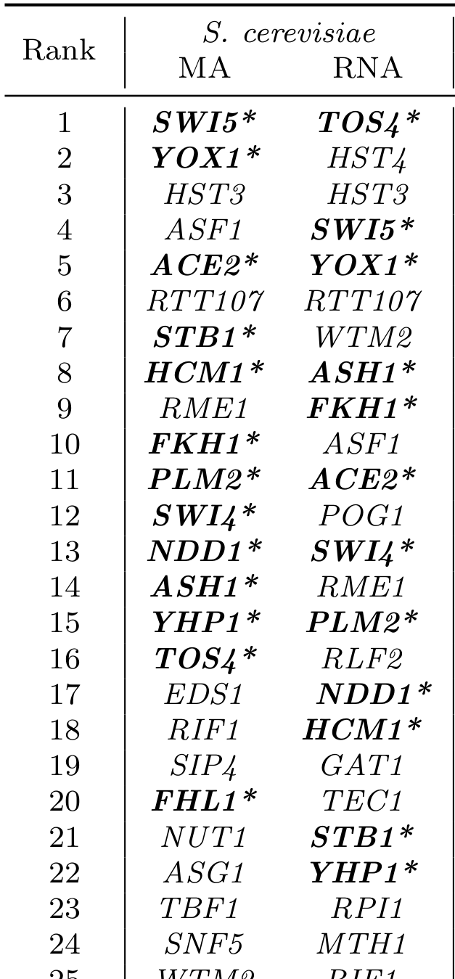
Node Reduction
Score individual time series using strength of periodicity and amplitude vs a baseline (DLxJTK)
Helped by manual curation of transcription factors
Metaparameters: number of iterations, range of periods, performance threshold for top scorers
Moseley et al., submitted

Slide 7
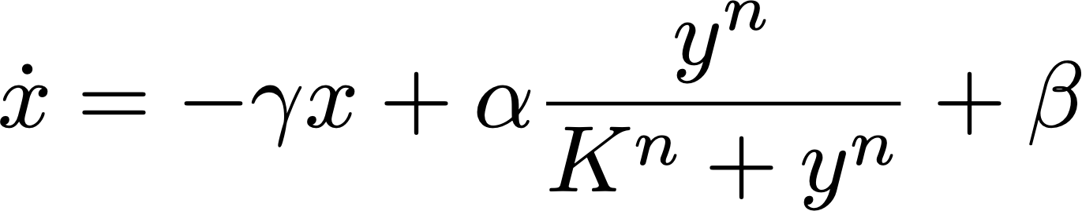
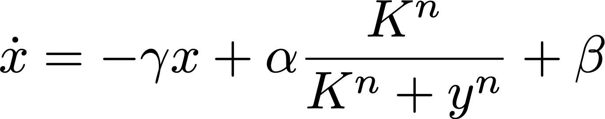
Edge Reduction
Optimization of pairwise Hill models of regulation (LEM) using loss and parameter space concavity
Probability score for most probable regulation events over all targets combined
Metaparameters: number of iterations, constraints on ODE simulations, performance threshold for top scorers
Activator Hill model
Repressor Hill model
McGoff et al., 2016

Slide 8
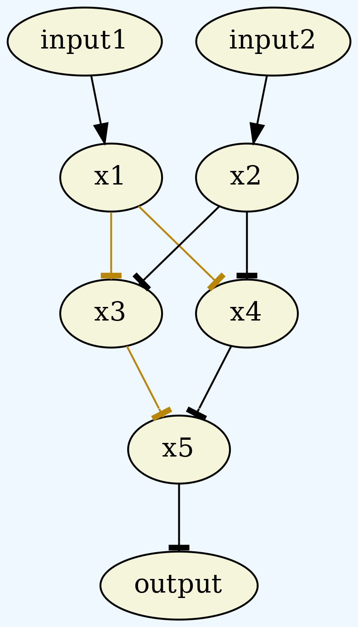
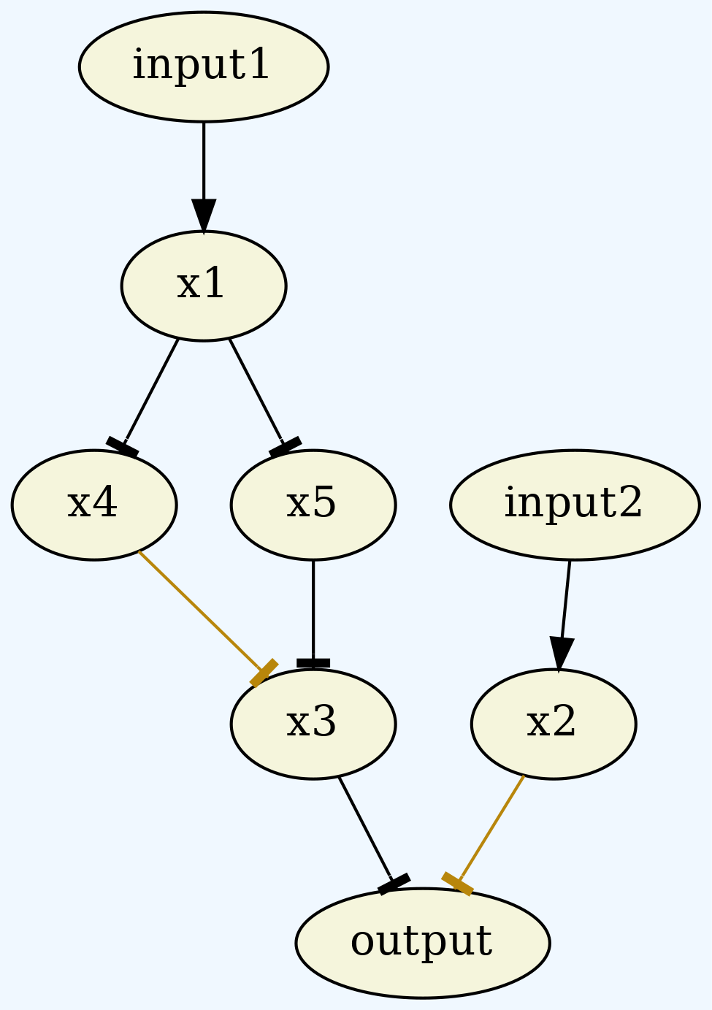
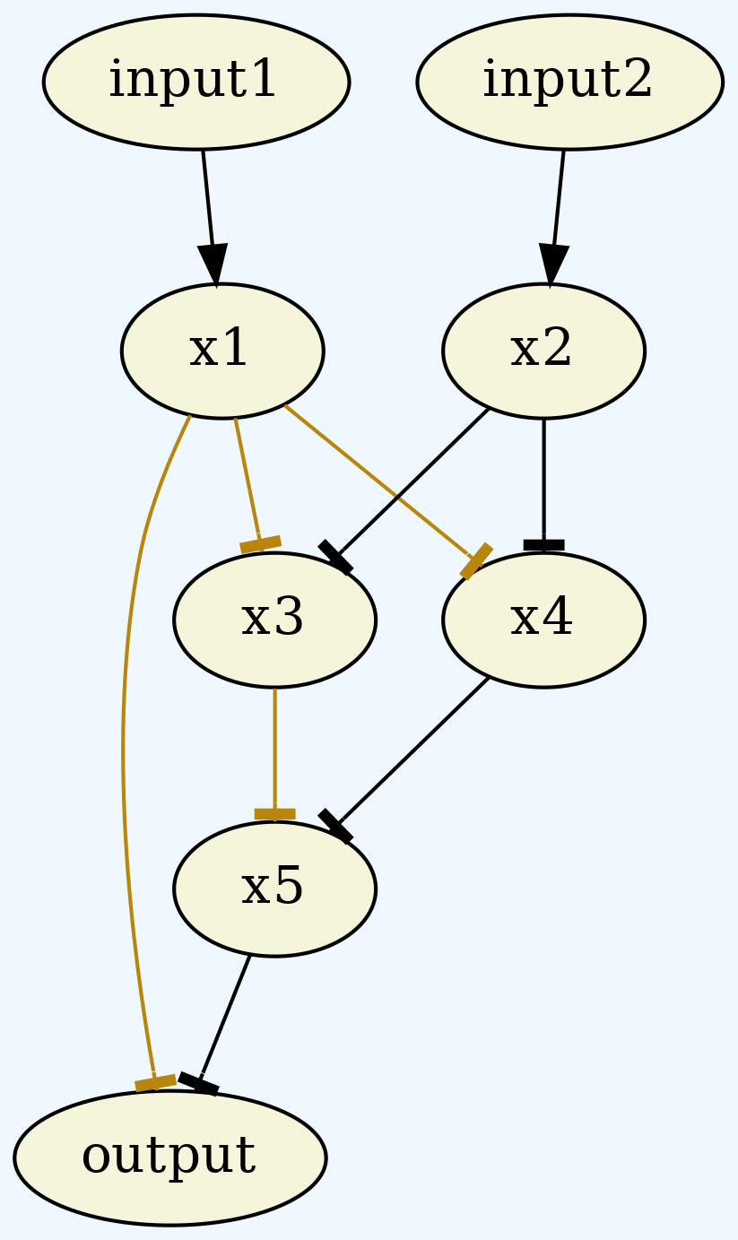
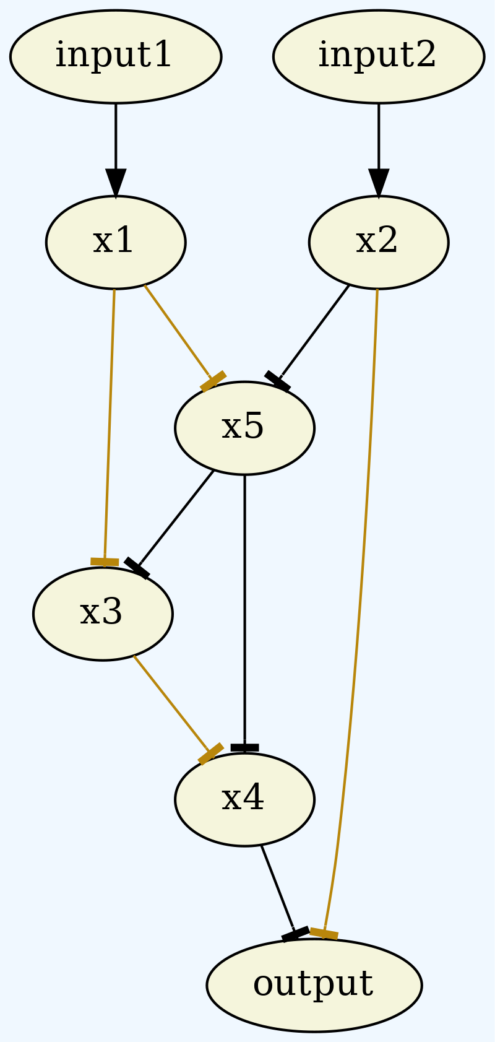
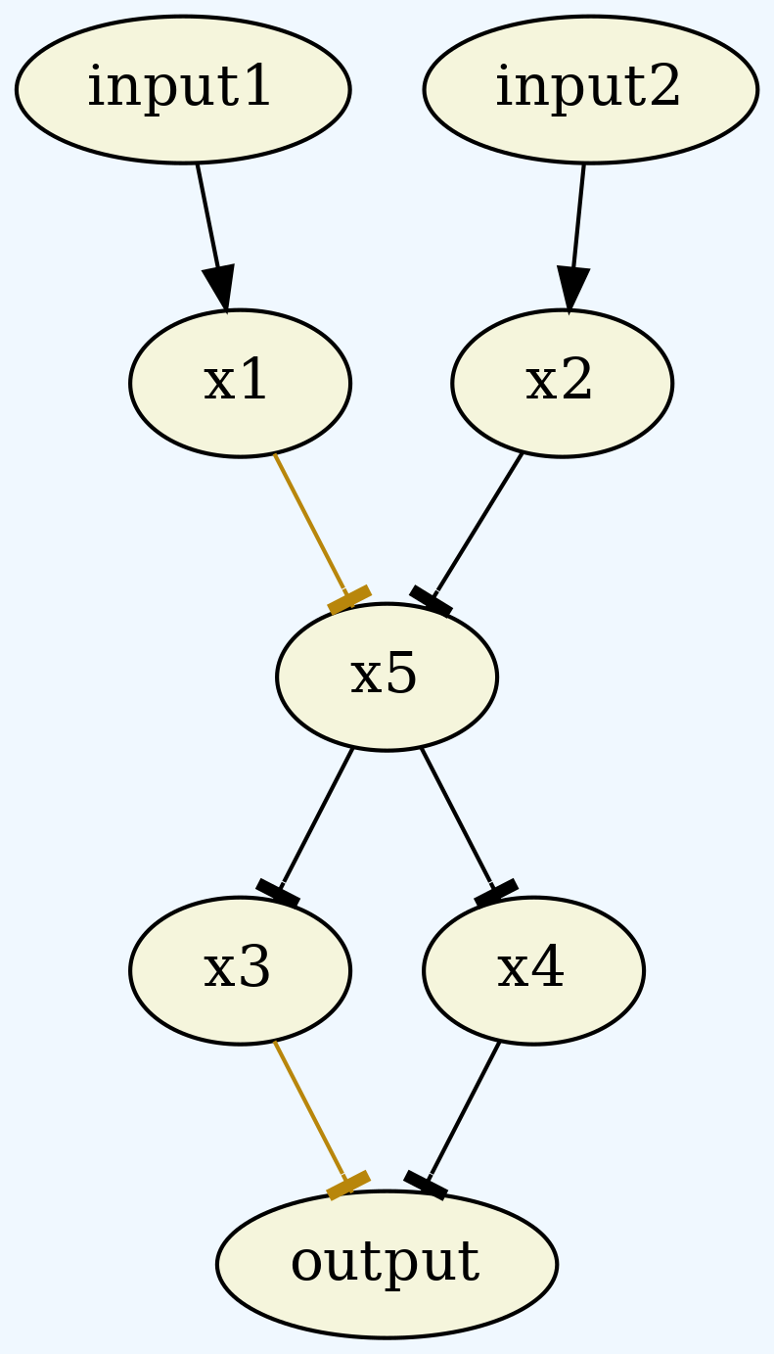
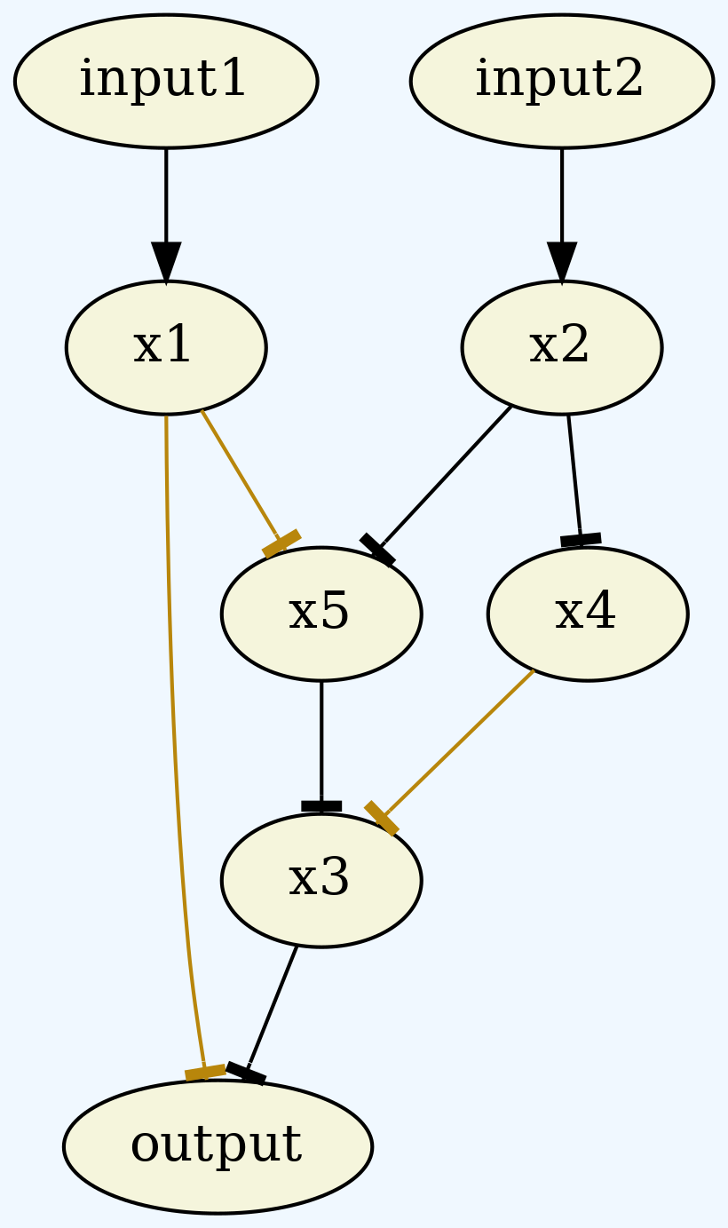
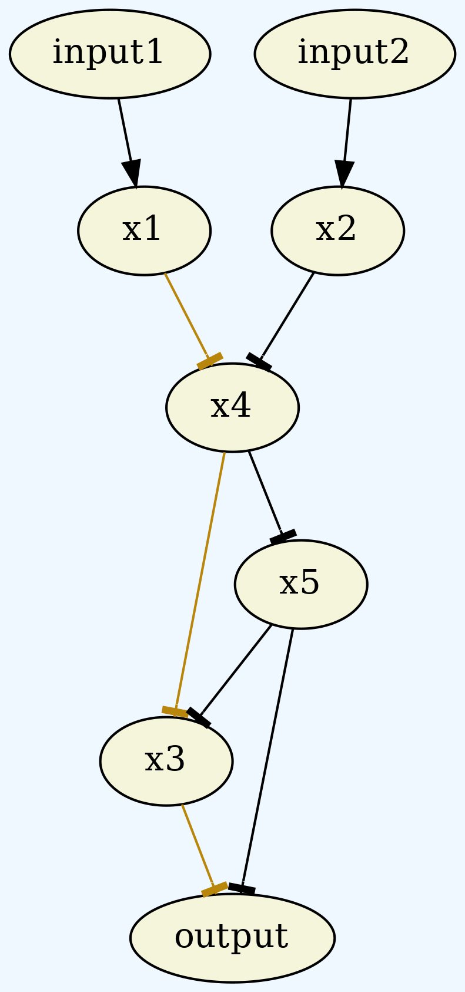
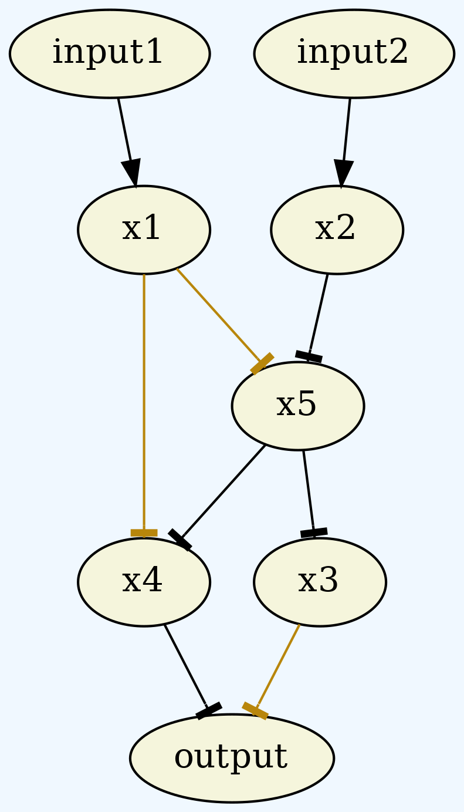
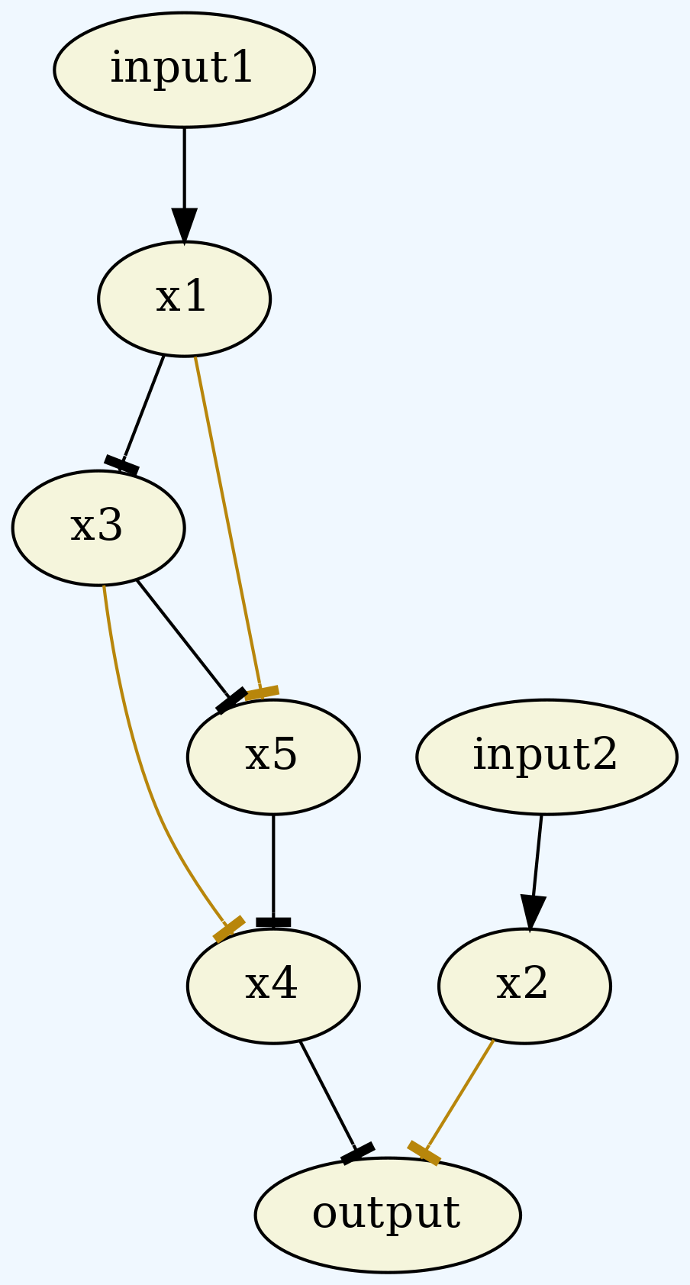
Network Reduction
Combinatorialized network dynamics (DSGRN) using graph matching
Sampling method in network space rather than exhaustive method
Uses a seed network from very top LEM edges for a local search in network space
LEM top edges put us in a highly oscillating region of network space
Metaparameters: Constraints on searchable network space, performance threshold for top scorers

Slide 9
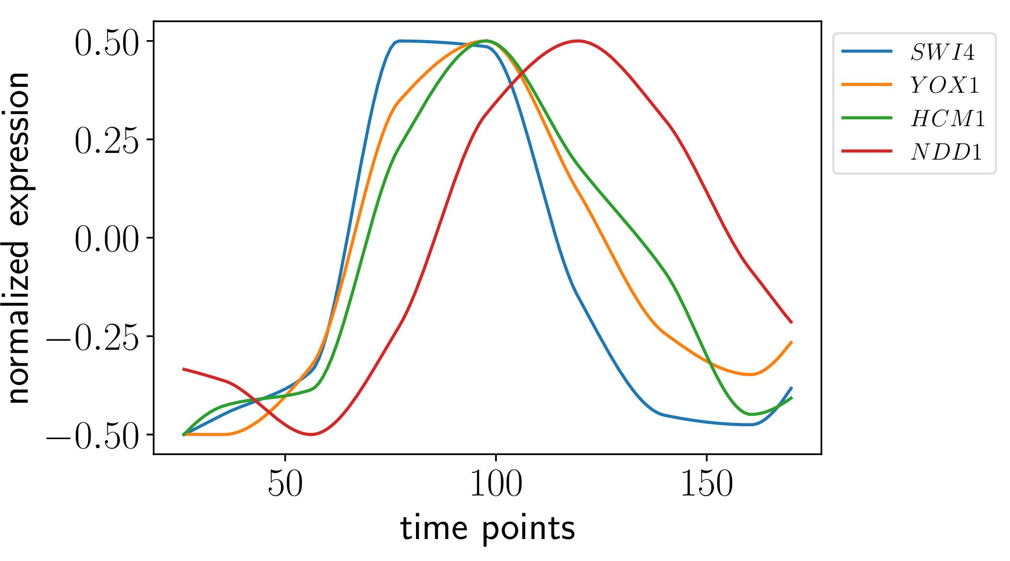
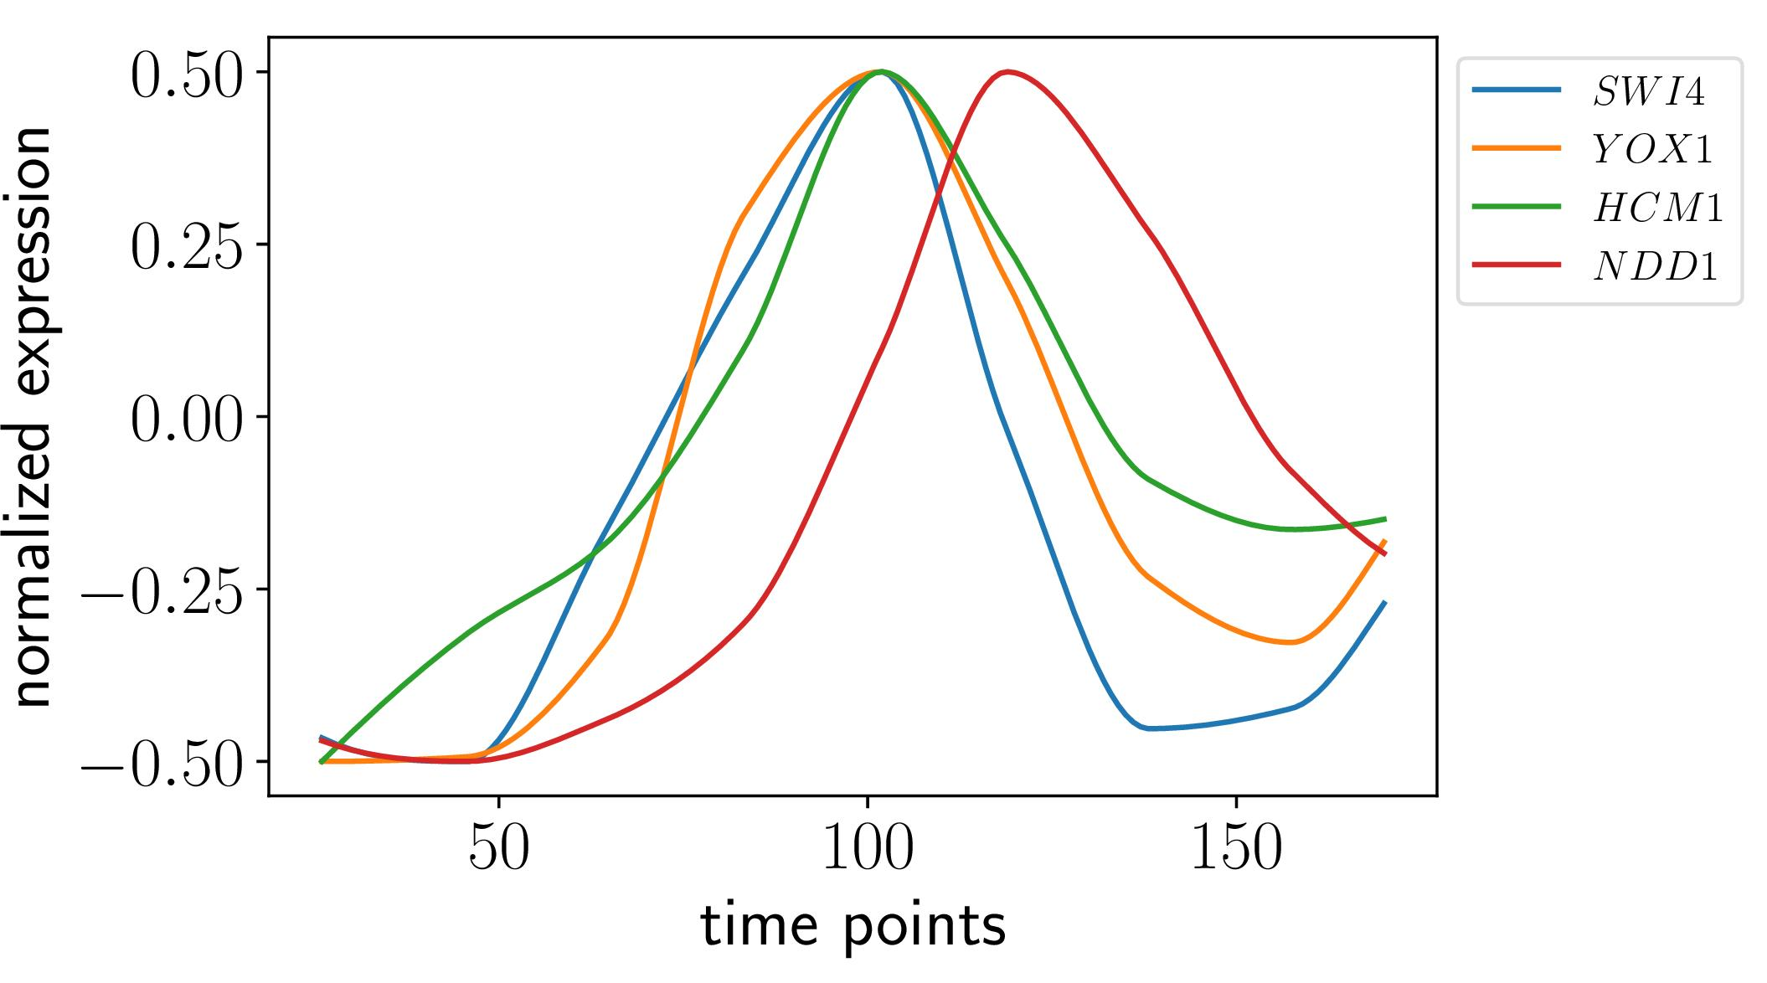
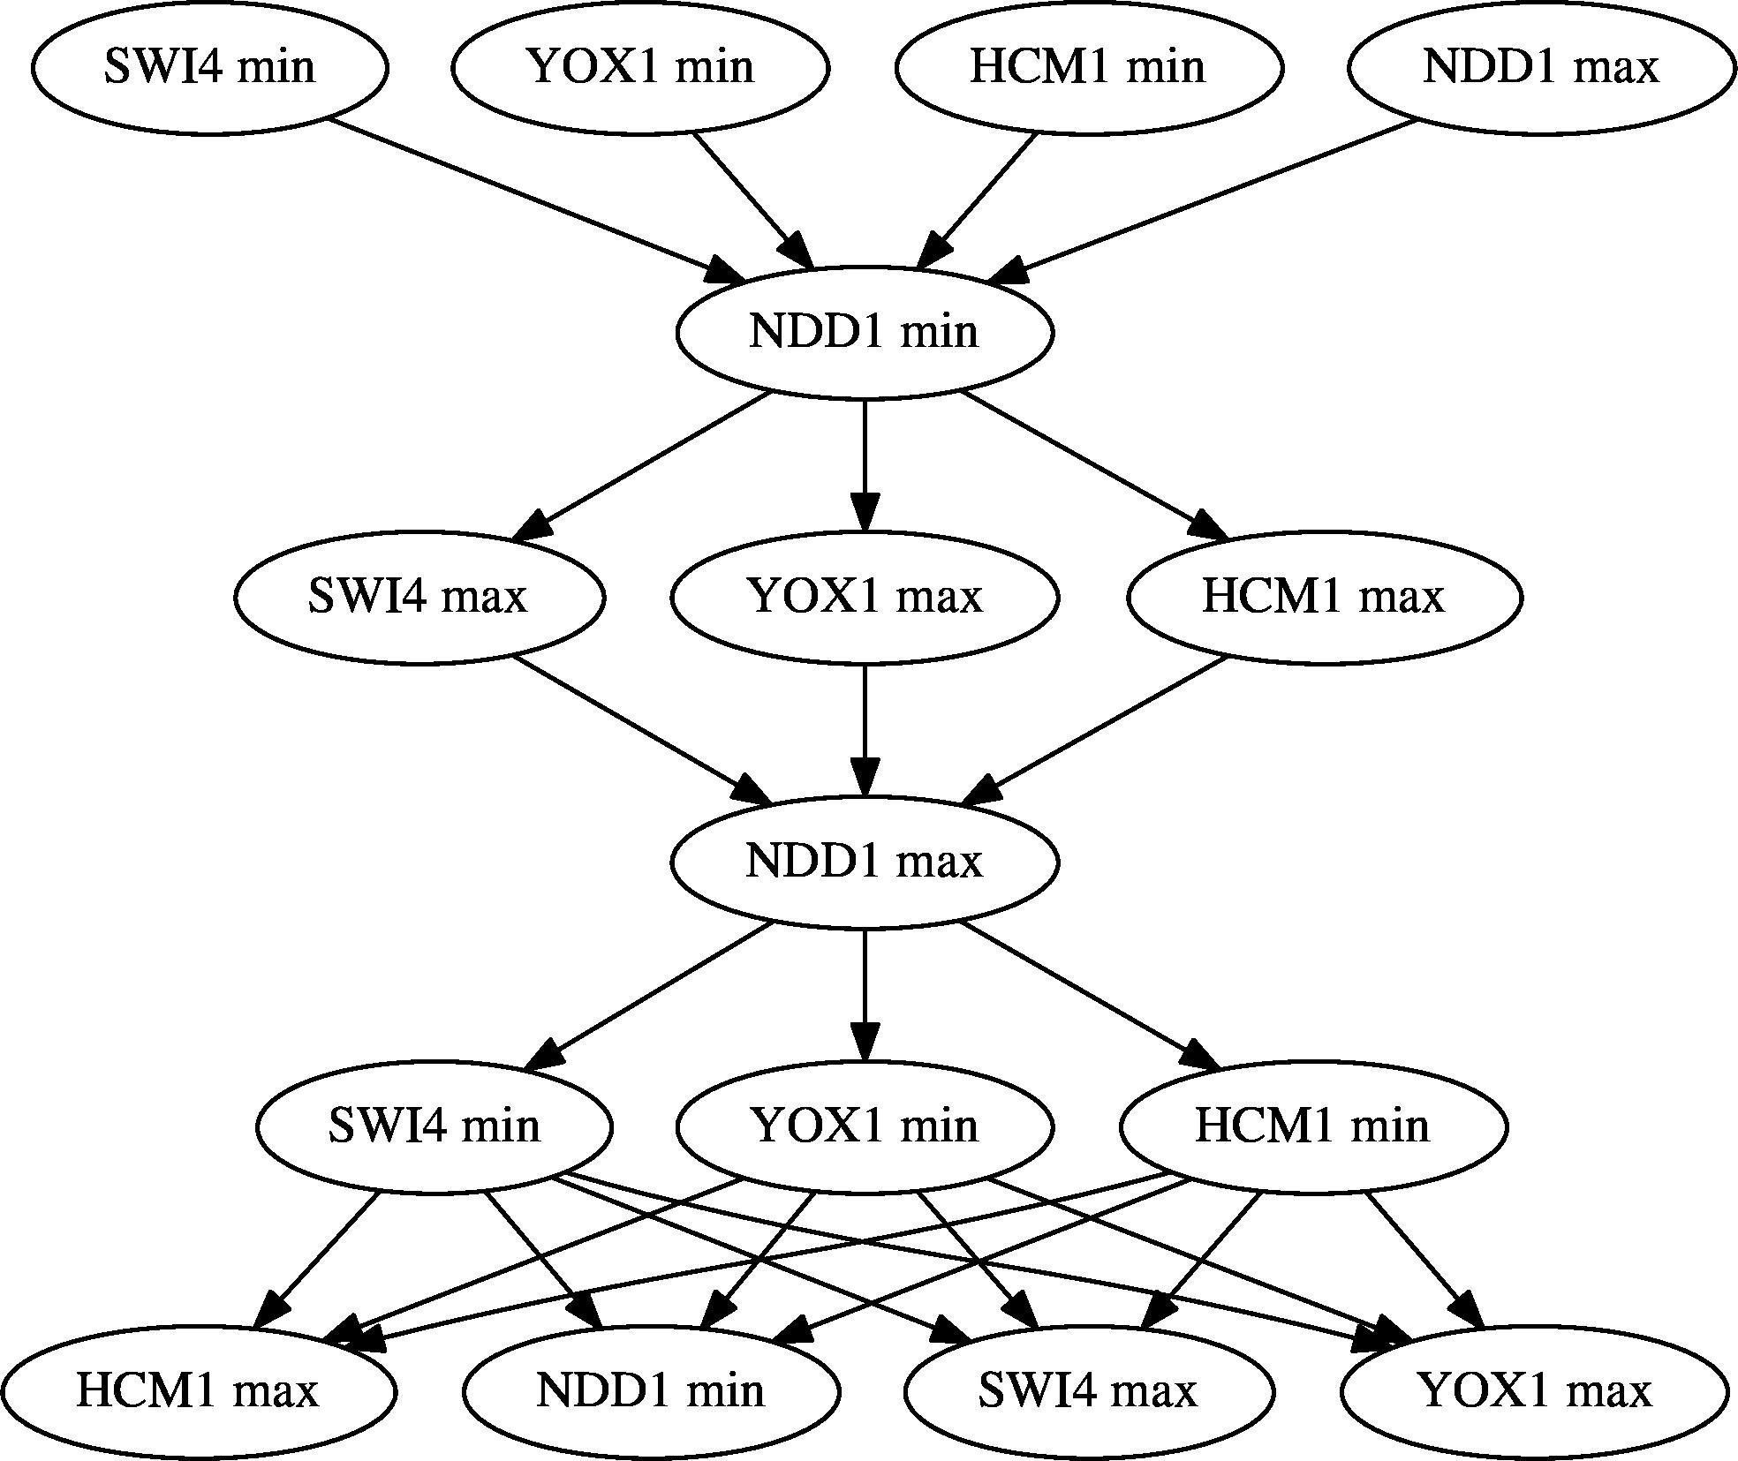
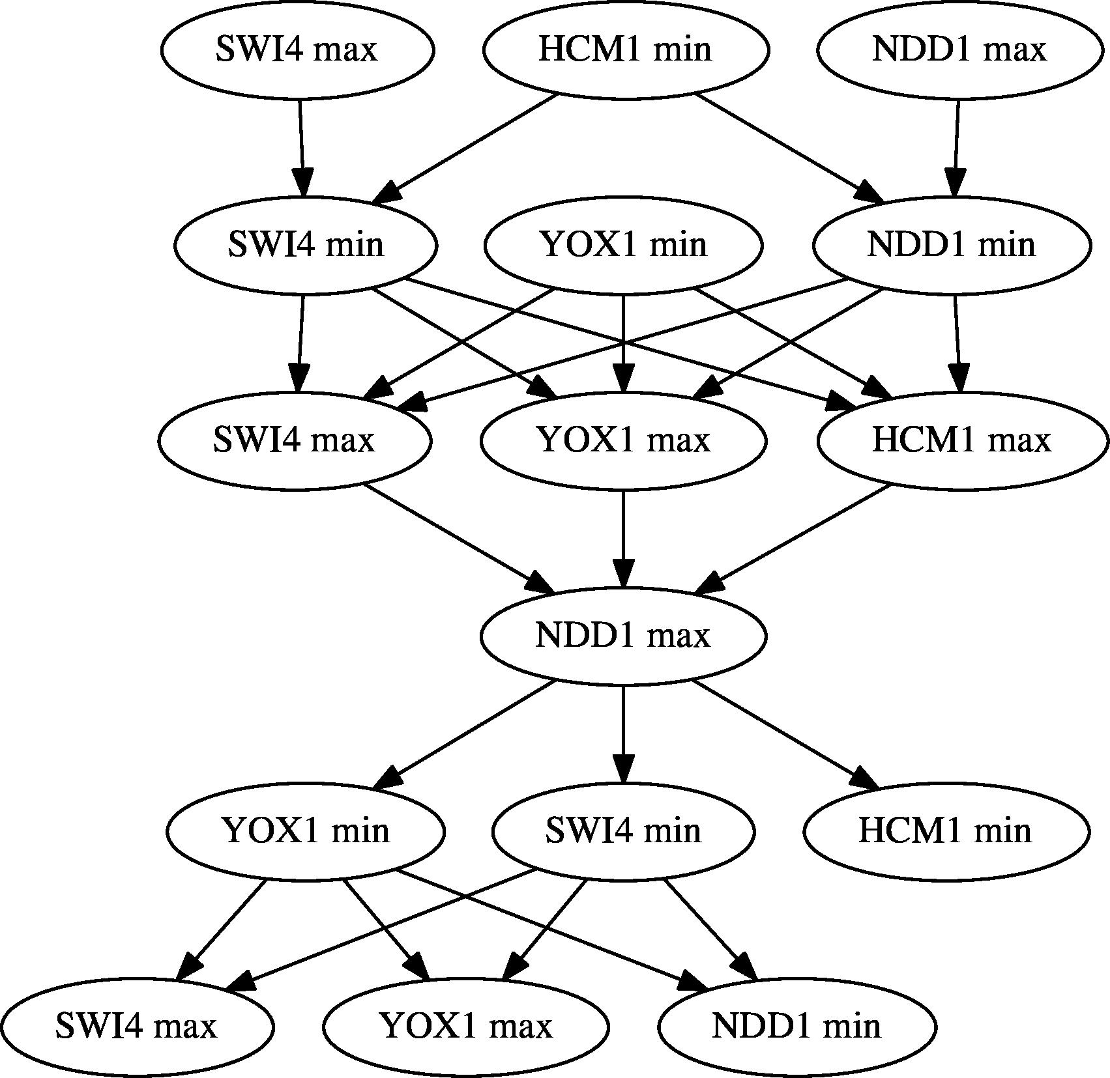
Combinatorializing Time Series: Extremal Partial Orders
1% noise
Berry et al., 2020

Slide 10
Any linear extension of the partial order is representative of the (noisy) data
SWI4 min
These four extrema can occur in any order but must occur before the NDD1 minimum.
YOX1 min
HCM1 min
NDD1 max
NDD1 min
SWI4 max
HCM1 max
YOX1 max
NDD1 max

Slide 11
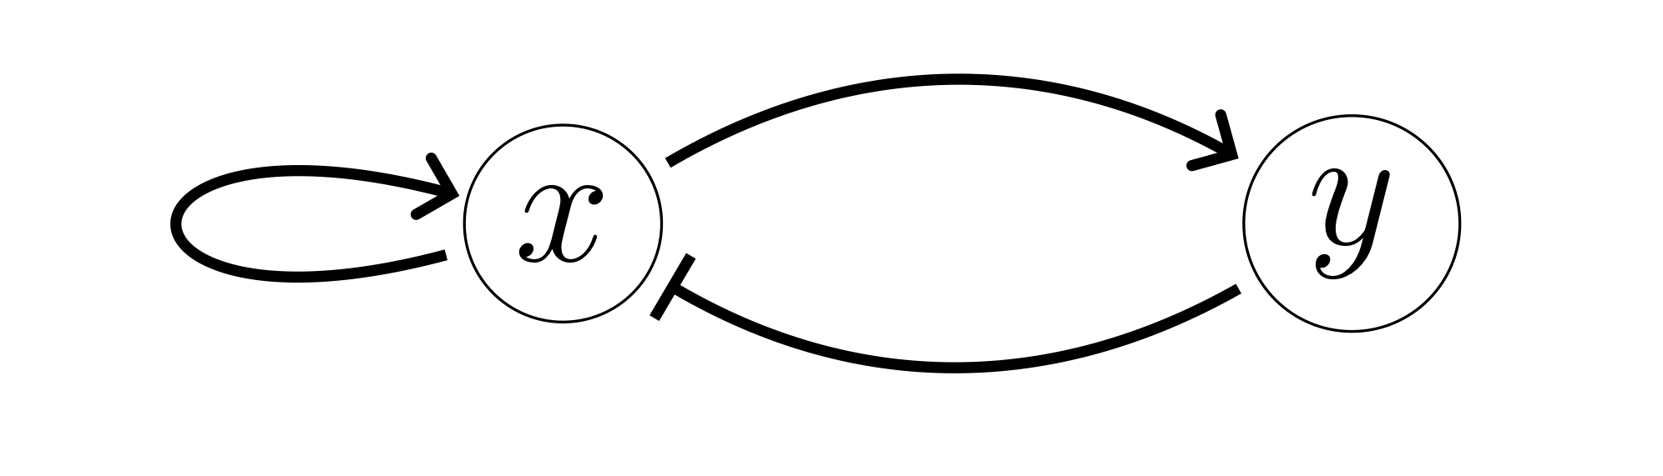
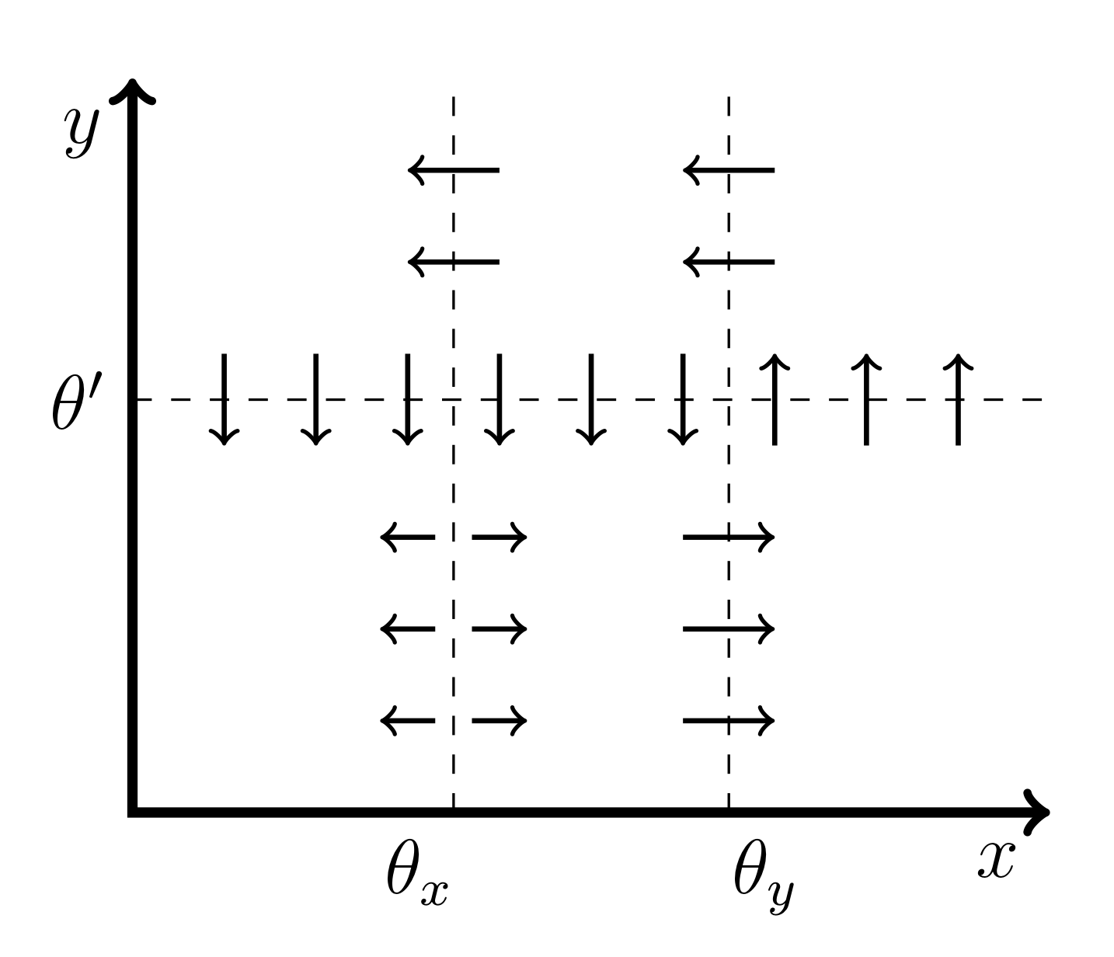
Combinatorializing dynamics
𝜃_{y}
𝜃_{x}
𝜃′
y max
Phase space divided into boxes by thresholds
DSGRN parameter regions (120 total) determine the normal component of the vector field at the boundaries
Fact: local extrema can only occur on boundaries
x min
x max
y min
Conserved dynamical quantity:
State transition graph
Cummins et al., 2018

Slide 12
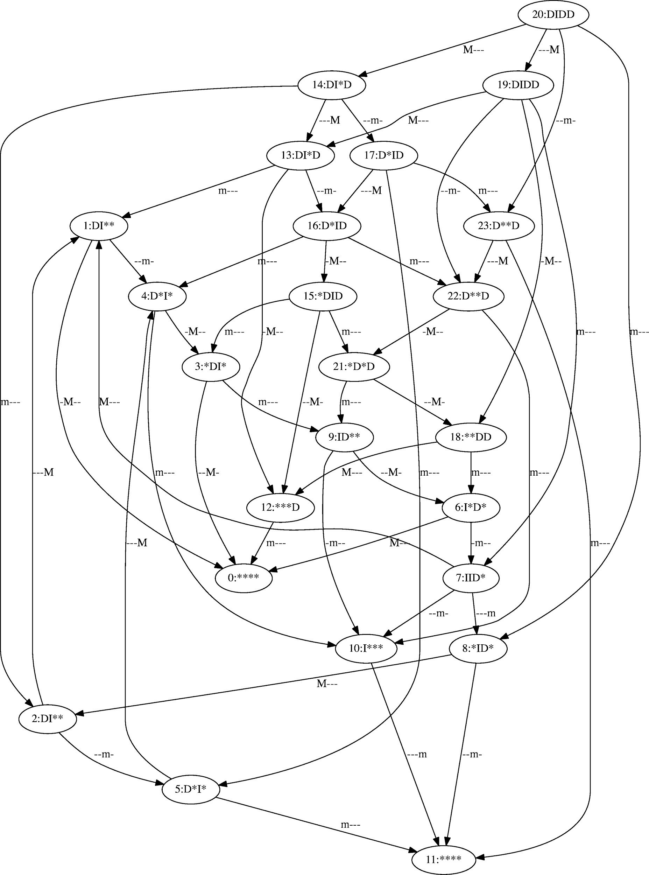
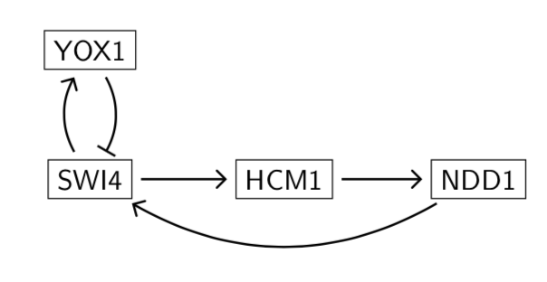
Pattern matching: Locate a path with matching extrema to any linear extension to conclude model consistency
Data
Network model and STG
There’s a match (trust me)

Slide 13
Inherent Dynamics Pipeline Dataset Characteristics
Top nodes from DLxJTK
Top edges from LEM
Top networks from DSGRN
Amplitude and period
Choose top N
Normalized continuous trajectory
Choose all edges above a probability threshold
Choose a seed network
Timing of extrema
Choose all networks above a scoring threshold

Slide 14
How to quantify success?
There is no single “correct” network model. From long experience, we know that there are many network models that can match data given some parameterization.
How can we extract guidance for the experimentalist from our output?
Current choice: Using network performance, rerank edge list from LEM
  Scoring criteria for top networks: robustness of oscillations, ability to pattern match
  Prevalence score: Percentage of times an edge appears in the collection of top networks to provide ranking
  Edges with a zero score are dropped from the reranked list
High ranking edges are predictions for important regulations to the core oscillator
Lower numbers are better than high numbers: first rank 1 is better than rank 20

Slide 15
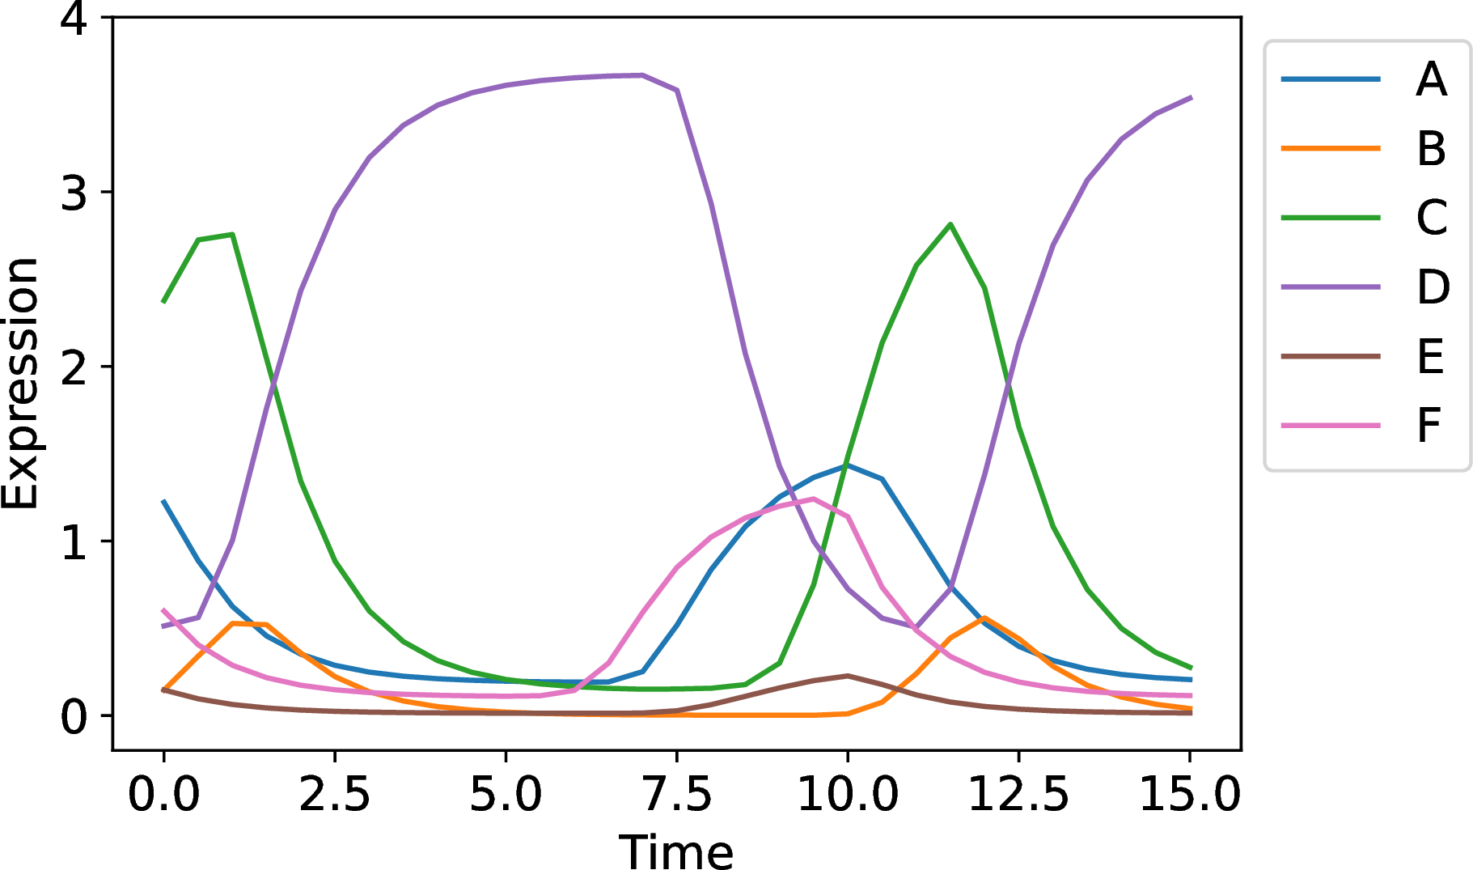
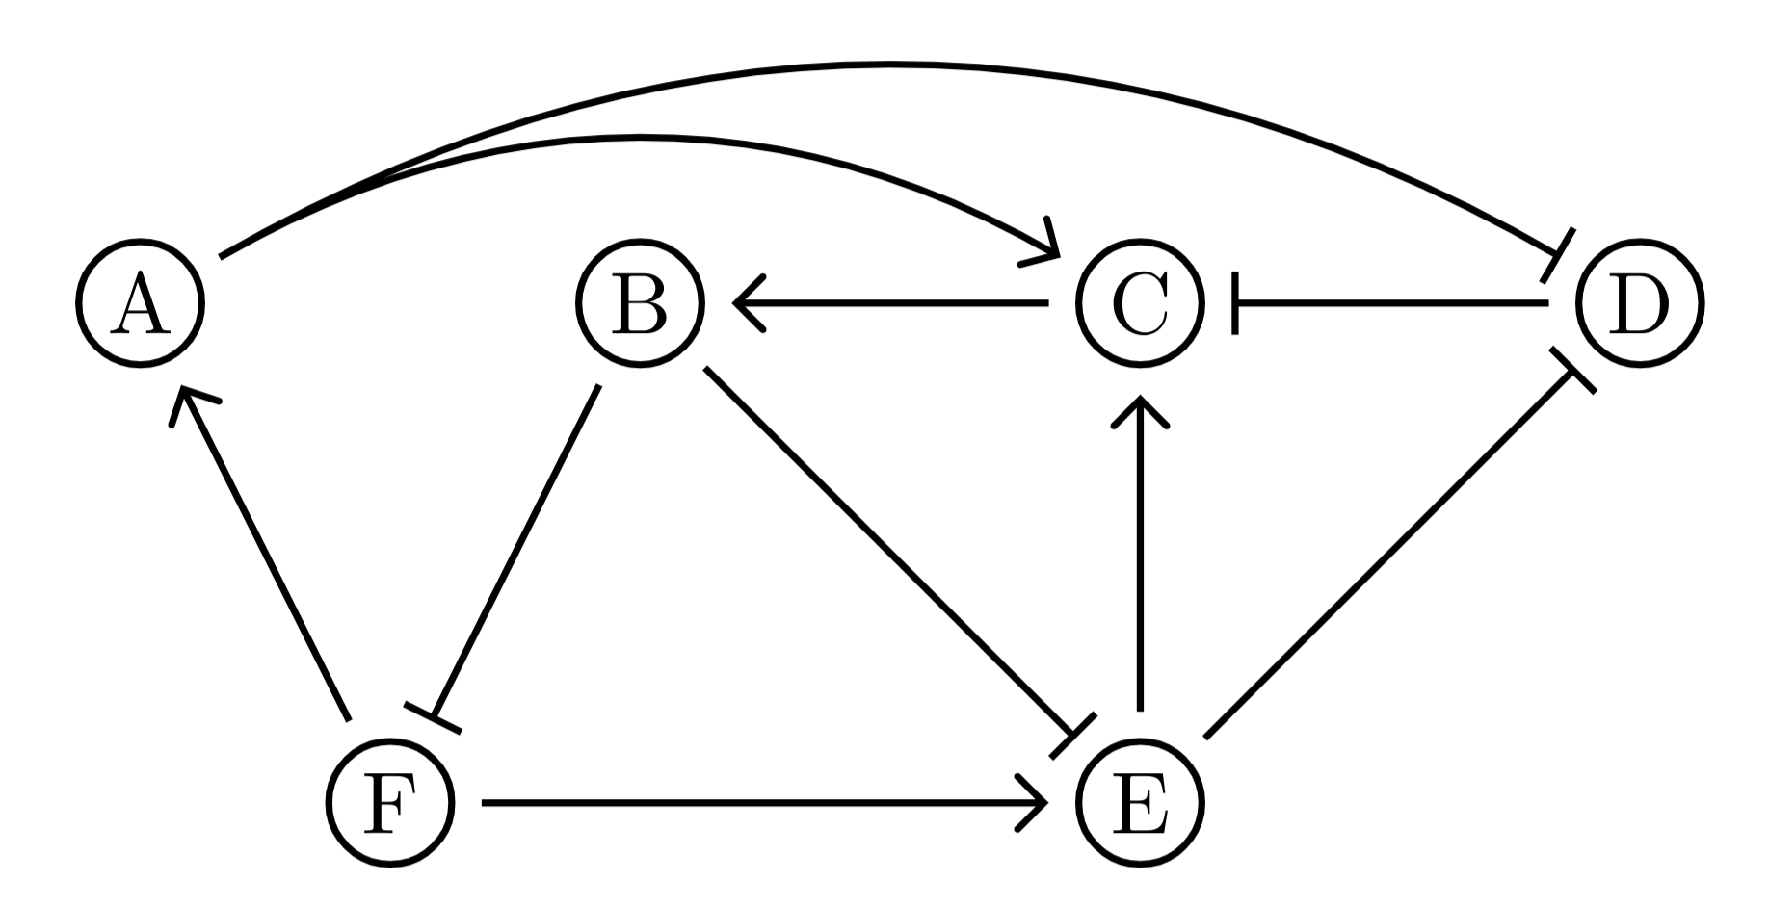
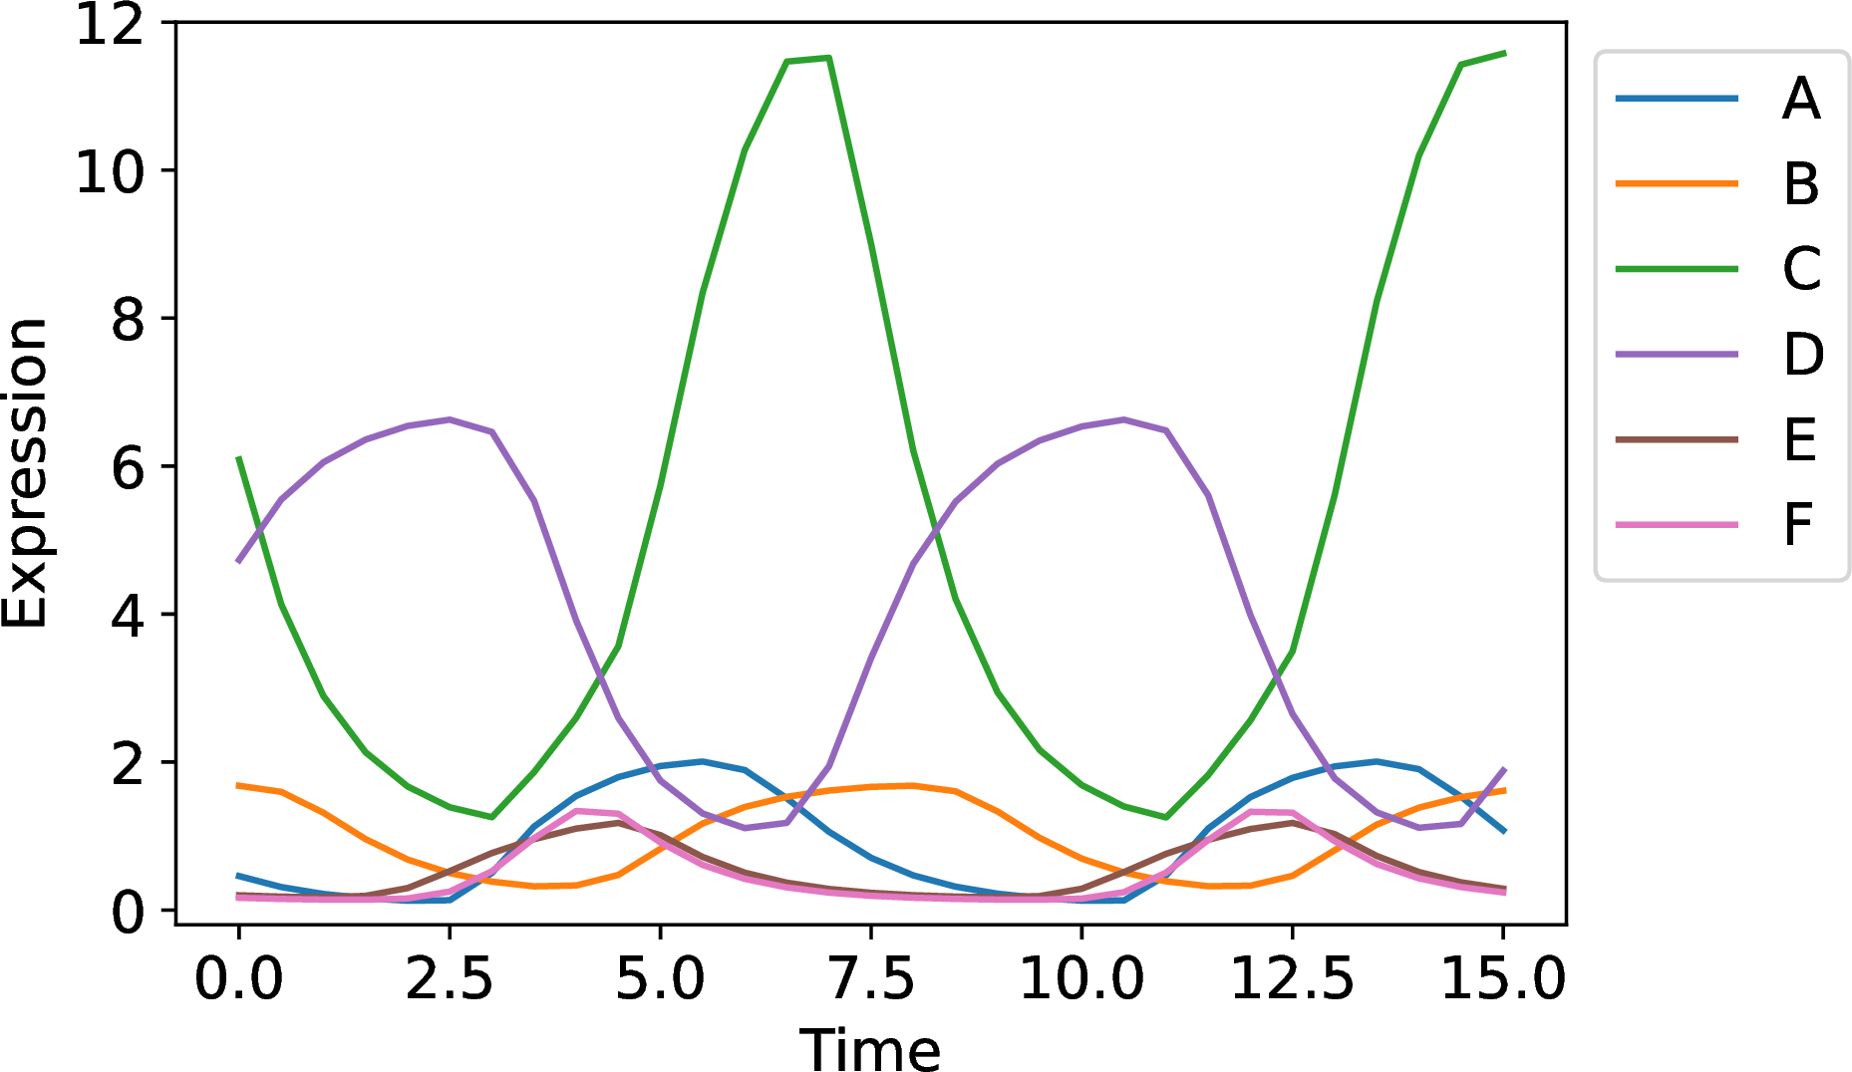
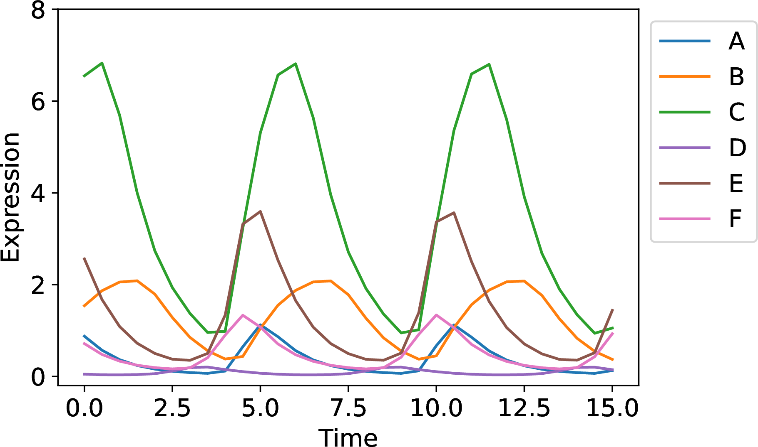
Synthetic Core Oscillator Test Case
Chose highly oscillatory network
Found 3 parameter sets with big distances between extremal partial orders
Goal: The interactions in the network are highly ranked

Slide 16
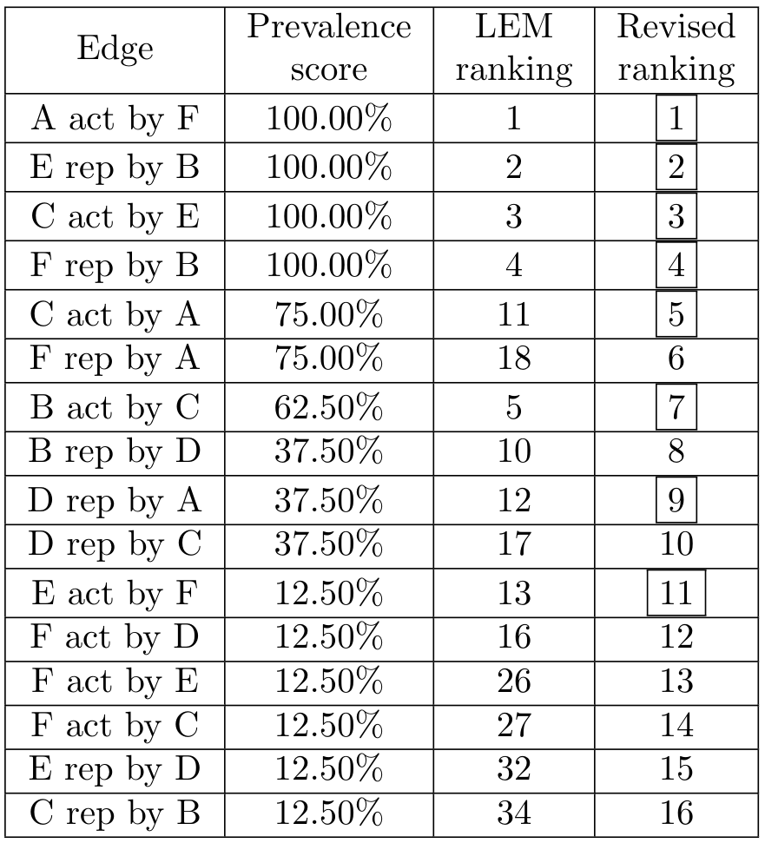
Reranking of edges according to global network dynamics
Only 16 out of 34 top LEM edges have a nonzero prevalence score after network finding
Boxed ranks correspond to ground truth edges
Scoring: 100% oscillations, 50% pattern matching

Slide 17
Quantitative Results
Simulation | Validated networks | # Top networks | Mean, Median LEM rank | Mean, Median network rank | # False positives dropped | # True positives dropped
Top | 1757/2000 | 66 | 6.2, 5.5 | 5.9, 5.5 | 14 | 0
Middle | 1708/2000 | 36 | 9.2, 5.5 | 7.4, 6.0 | 14 | 0
Bottom | 1200/2000 | 8 | 6.4, 4.5 | 5.3, 4.5 | 17 | 1
Scoring: 100% oscillations, 50% pattern matching
Many models fit the data

Slide 18
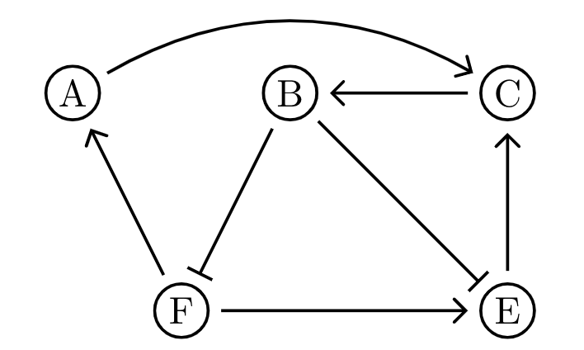
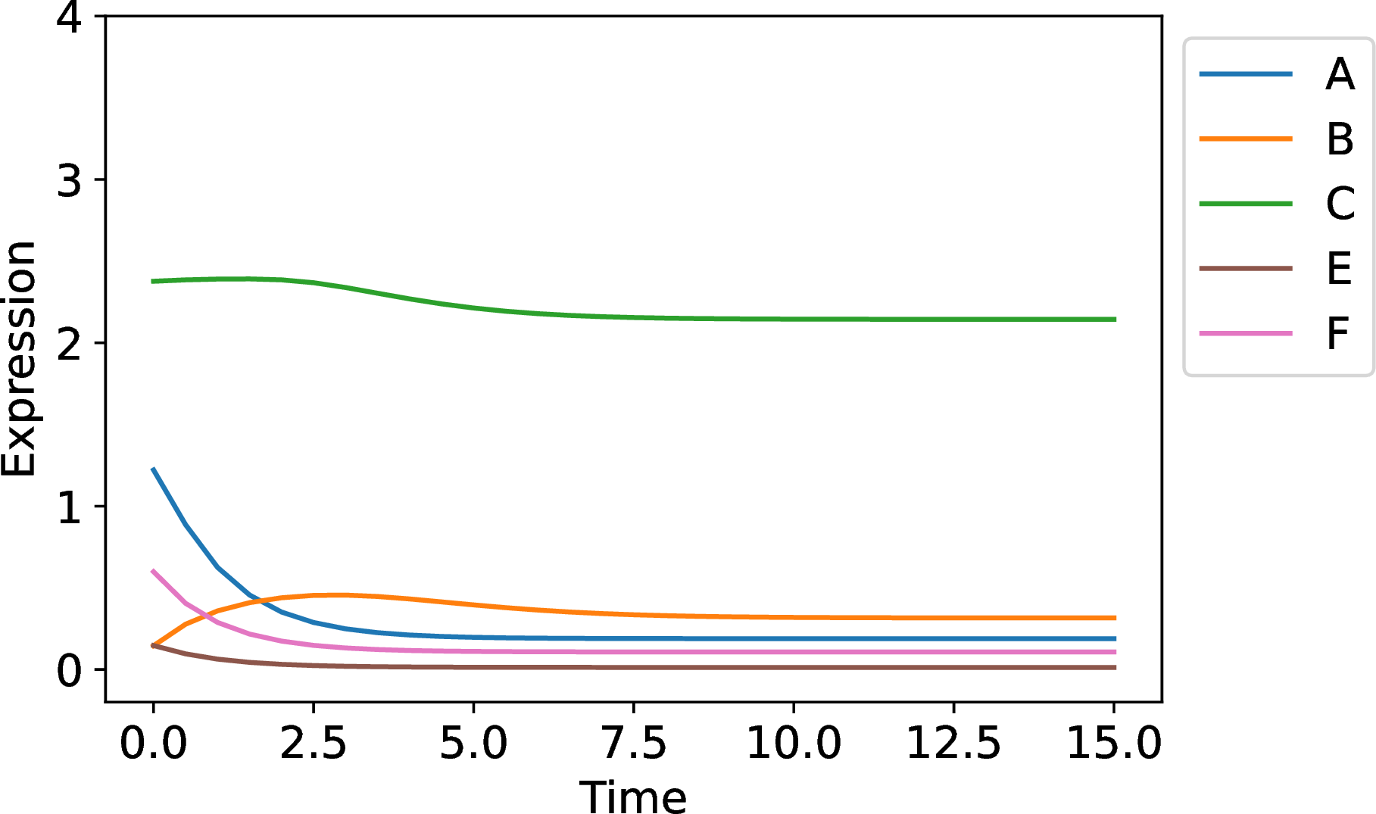
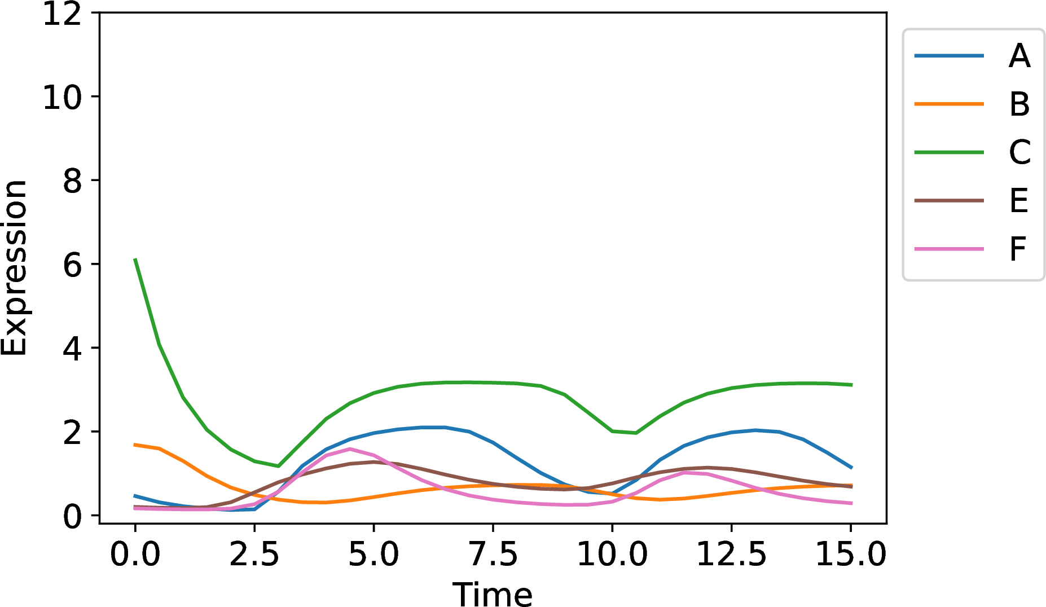
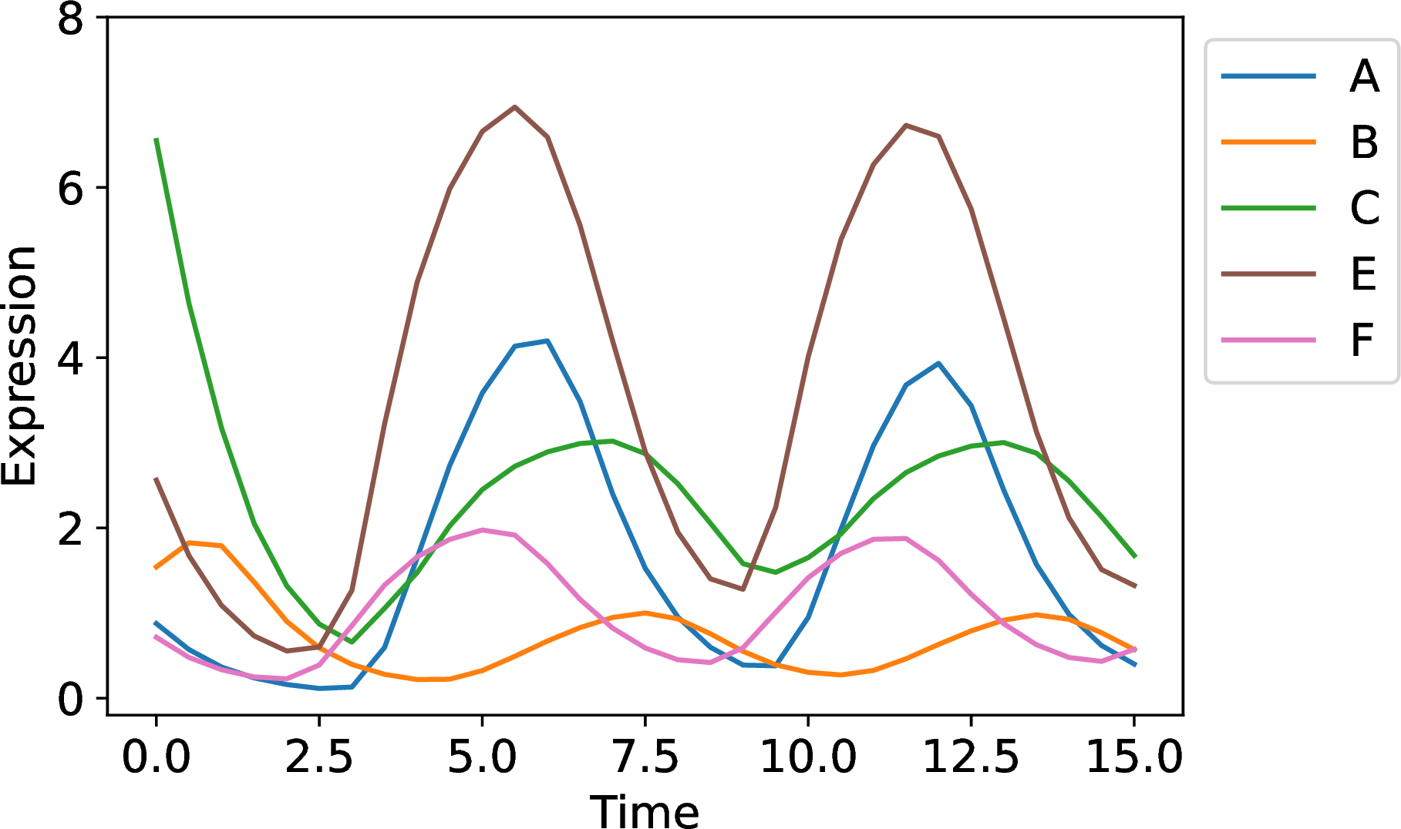
Unexpected result: node D edges down-regulated in last dataset
Is node D really part of the core oscillator in the third dataset?
Simulation | Mean, Median LEM rank | Mean, Median no D, LEM | Mean, Median network rank | Mean, Median no D, network
Top | 6.2, 5.5 | 6.7, 5.0 | 5.9, 5.5 | 6.3, 5.0
Middle | 9.2, 5.5 | 10.3, 6.0 | 7.4, 6.0 | 7.7, 7.0
Bottom | 6.4, 4.5 | 5.6, 4.0 | 5.3, 4.5 | 4.7, 4.0

Slide 19
Constructing a “ground truth” core oscillator doesn’t necessarily mean it’s a core oscillator!

Slide 20
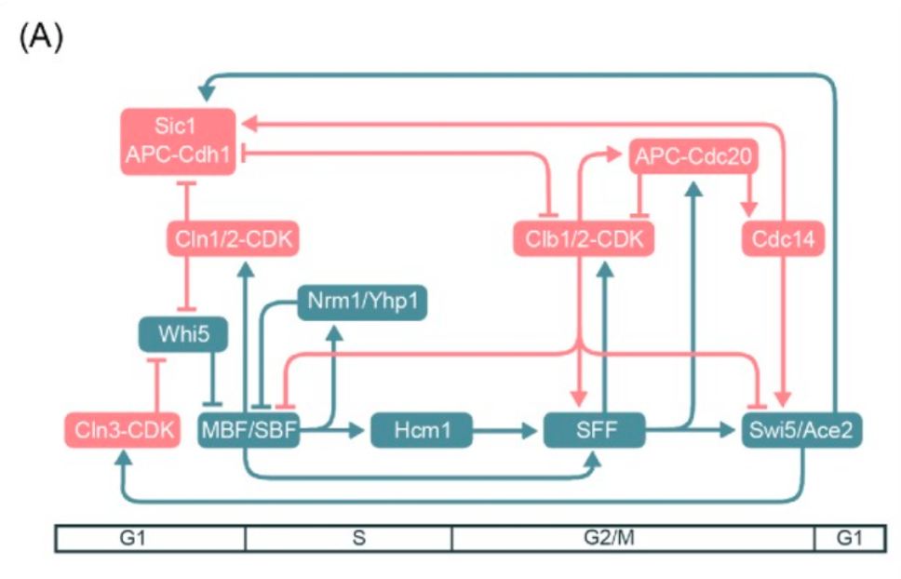
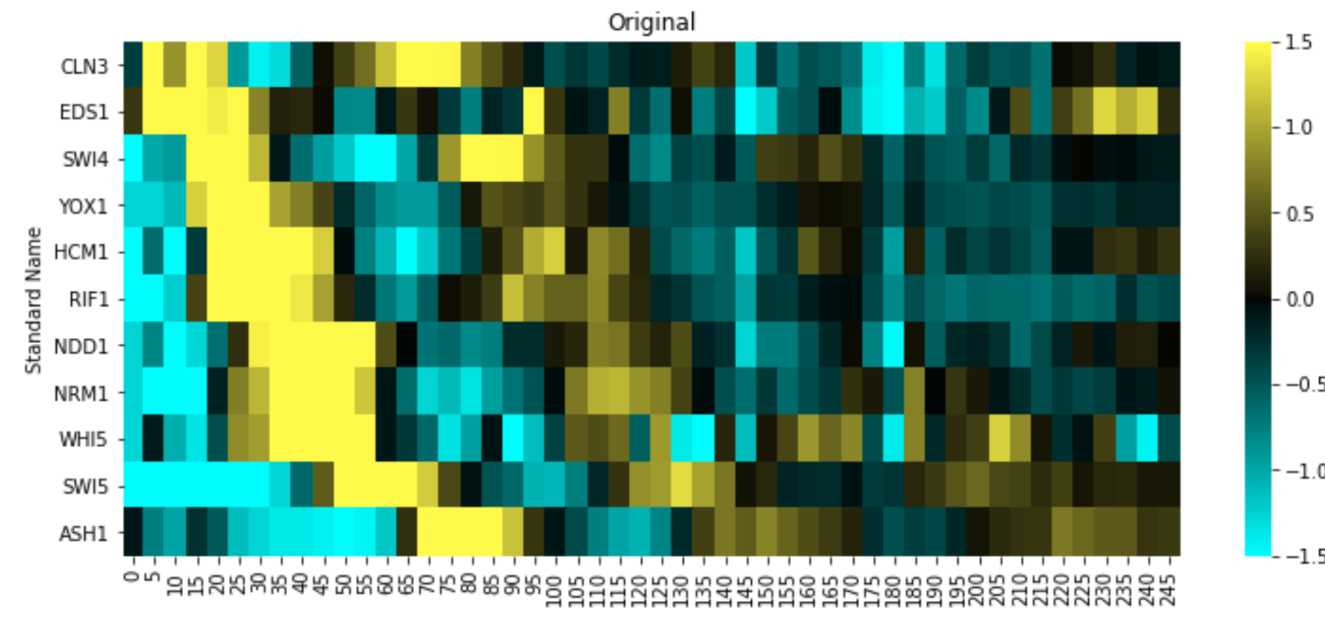
Yeast Cell Cycle Data Test Case
Ground truth nodes:
  “True positives” : experimental evidence
  “True negatives” : output of DLxJTK
Ground truth edges: “True positives” : YEASTRACT + model
Ground truth network: None
Cho et al., 2017

Slide 21
Yeast Cell Cycle Results
Amount of information | Validated networks | # Top networks | Mean, Median LEM rank | Mean, Median network rank | # False positives dropped | # True positives dropped
Annotations | 2017/4000 | 302 | 21.2, 13.0 | 25.4, 22.0 | 23 | 6
No annotations | 2940/4000 | 1269 | 28.3, 17.5 | 26.9, 25.0 | 11 | 1
True negatives w/ annotations | 2592/4000 | 291 | 23.6, 14.5 | 18.5, 9.5 | 32 | 3
True negatives w/o annotations | 2733/4000 | 544 | 35.3, 42.0 | 15.7, 12.5 | 28 | 3
Scoring: 10% oscillations, 100% pattern matching
DSGRN most useful when there are true negatives in the node set

Slide 22
Interesting Result: Network reduction down-ranks node CLN3
Amount of information | Mean, Median LEM rank | Mean, Median No CLN3 LEM rank | Mean, Median network rank | Mean, Median No CLN3 network rank
Annotations | 21.2, 13.0 | 22.2, 14.0 | 25.4, 22.0 | 23.7, 15.0
No annotations | 28.3, 17.5 | 29.8, 17.5 | 26.9, 25.0 | 22.1, 21.0
True negatives w/ annotations | 23.6, 14.5 | 23.7, 14.5 | 18.5, 9.5 | 10.75, 8.5
True negatives w/o annotations | 35.3, 42.0 | 37.5, 44.0 | 15.7, 12.5 | 12.0, 12.0

Slide 23
Is CLN3 part of the pulse generator?
CLN3 may not be important for the cell cycle oscillator under the experimental conditions used.
Evidence:
LEM removes some CLN3 edges when there are true negative nodes.
DSGRN removes some CLN3 edges when there are annotations.
Caveats:
CLN3 may need proteomics data rather than transcriptomics, even though CLN3 mRNA oscillates
DSGRN may not model post-transcriptional modification correctly.
Dataset dependent

Slide 24
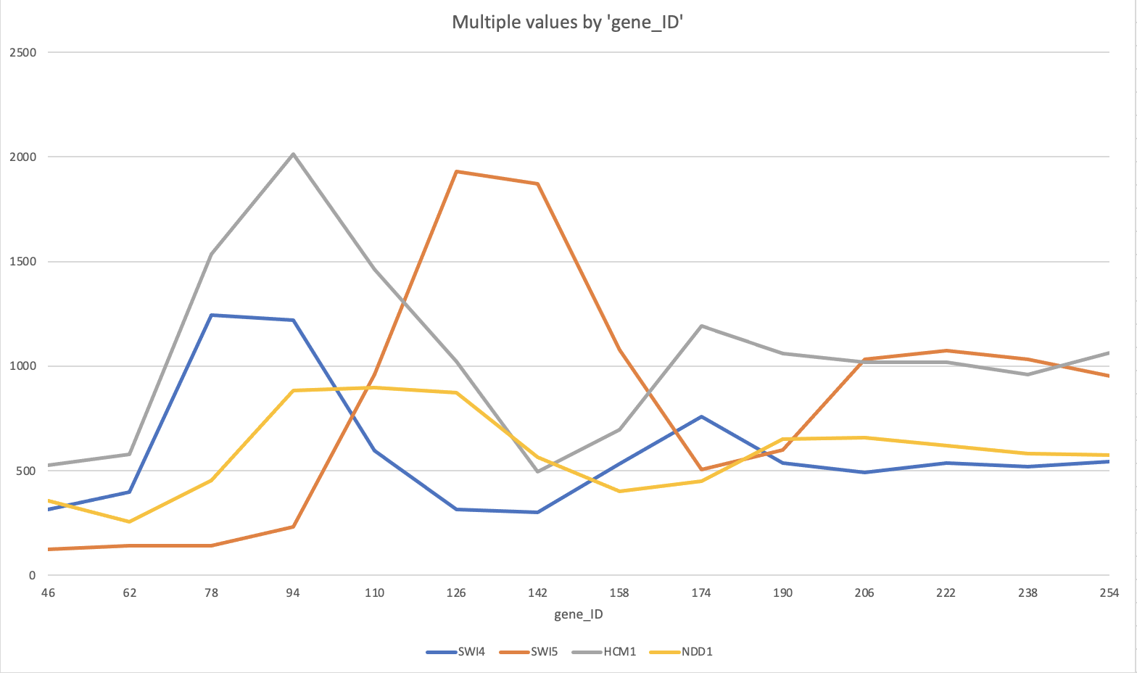
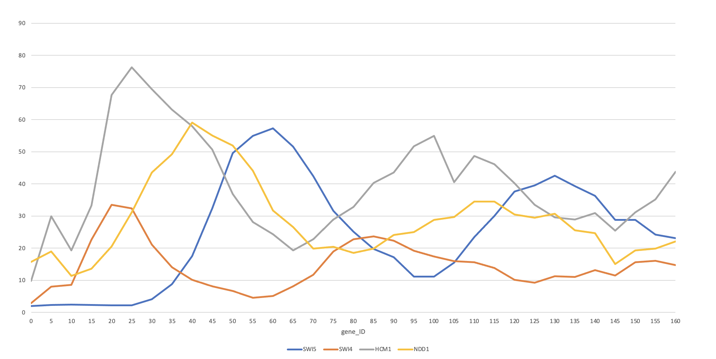
Not all datasets work so well
Microarray
Microarray transcriptomics vs RNAseq
Coarse sampling vs fine sampling
Different number of periods
Slightly different experimental conditions
Different types of preprocessing
Different levels of noise
RNAseq

