Slide 1

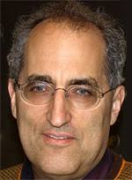
String scale black holes
Juan Maldacena
Based on work with Yiming Chen and Edward Witten
October 2021

Slide 2
Outline
Consider black holes in weakly coupled string theory.
When the black hole size is close to the string scale, they are supposed to turn into highly excited strings.
We will discuss some aspects of this transition.
Surprisingly, the situation is different in the heterotic and type II string cases.
We will discuss the implications for charged black holes.

Slide 3
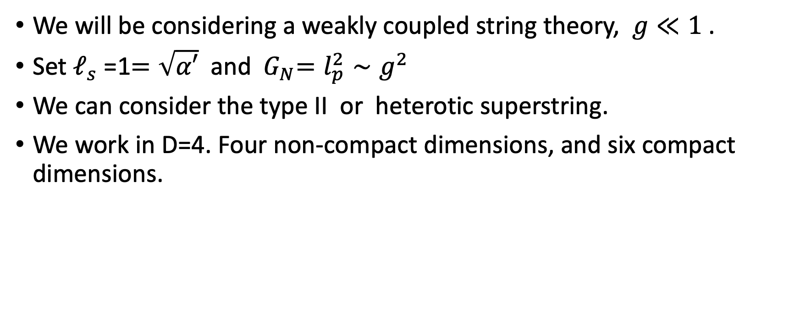
Assumptions
We will be considering a weakly coupled string theory, $g≪1$ .
Set $ℓ_{s}$ =1$=\sqrt{α′}$ and${ G}_{N}=l_{p}^{2}∼g^{2}$
We can consider the type II or heterotic superstring.
We work in D=4. Four non-compact dimensions, and six compact dimensions.

Slide 4

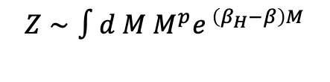


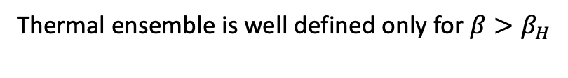
Highly excited string
$$S=β_{H}M , β_{H}=2π\sqrt{2}l_{s}$$
$β_{H}=$Hagedorn (inverse) temperature.
Size $∼\sqrt{M}$
Thermal ensemble is well defined only for $β>β_{H}$
$$Z∼∫d M M^{p}e^{ \left(β_{H}−β\right)M}$$

Slide 5
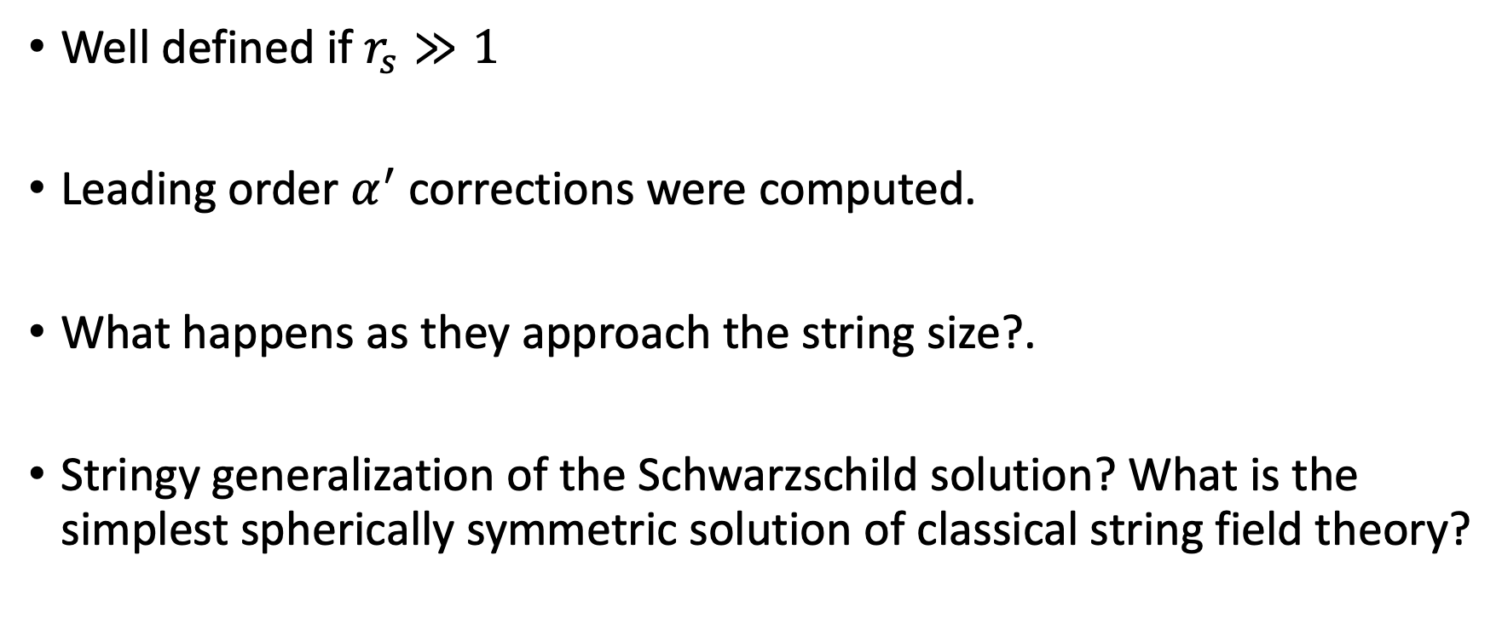
Black holes
Well defined if $r_{s}≫1$
Leading order $α^{′}$corrections were computed.
What happens as they approach the string size?.
Stringy generalization of the Schwarzschild solution? What is the simplest spherically symmetric solution of classical string field theory?
Callan, Myers, Perry;
Myers, Chen (type II).

Slide 6
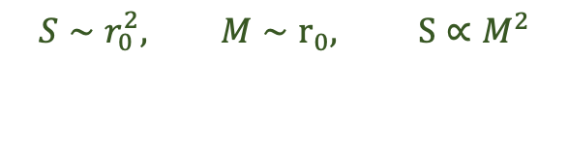
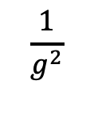

Black hole
$$S∼r_{0}^{2}, M∼r_{0}, S∝M^{2}$$
Entropy
String size black hole ? “Correspondence point”
$$r_{0}∼1$$
Free string
$$\frac{1}{g^{2}}$$
Mass
Bowick, Smolin, Wijewardhana; Susskind; Horowitz, Polchinski;
Damour, Veneziano; …
Corrections are important before we can reach the correspondence point.

Slide 7
Is there a smooth transition between black holes and highly excited strings ?
Motivation:
String picture: Microstates are explicit, but no interior.
Black holes: there is an interior, but not obvious microstates.
How does string theory change black hole thermodynamics?

Slide 8
Black hole
Entropy
Modifications from
the black hole side
Modifications
from the string side
String size black hole ?
Free string
$$\frac{1}{g^{2}}$$
Mass

Slide 9
Some comments on strings at finite temperature

Slide 10

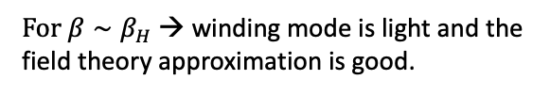

Winding mode formalism
Sathiapalan; Kogan; Atick, Witten
Finite temperature → compactify the Euclidean time direction
$$β$$
Winding mode.
$S=\frac{1}{g^{2}}∫{\left|∇χ\right|}^{2}+m^{2}\left(β\right){\left|χ\right|}^{2}, m^{2}\left(β\right)∝(β^{2}−β_{H}^{2})$
When $β<β_{H}$winding mode is tachyonic → instability
Self interactions → most important one is gravity. It is attractive → somewhat like a negative $χ^{4}$term.
$$S= \frac{1}{g^{2}}∫\sqrt{g}R+\frac{1}{g^{2}}∫{\left|∇χ\right|}^{2}+m^{2}\left(β\right){\left|χ\right|}^{2},$$
$For β∼β_{H}$ → winding mode is light and the
field theory approximation is good.

Slide 11
This leads to an interesting solution

Slide 12
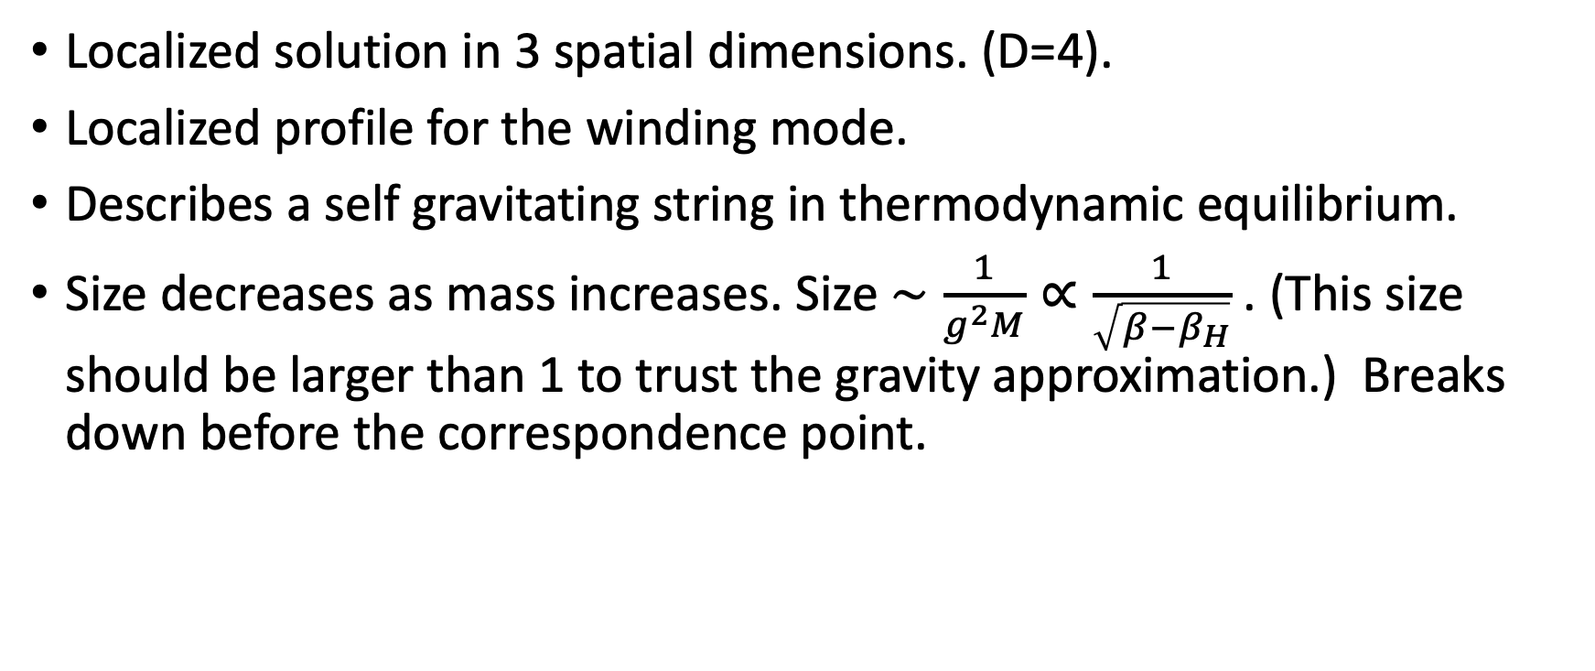
Self gravitating string
Horowitz-Polchinski
(see also Damour & Veneziano)
Localized solution in 3 spatial dimensions. (D=4).
Localized profile for the winding mode.
Describes a self gravitating string in thermodynamic equilibrium.
Size decreases as mass increases. Size $∼\frac{1}{g^{2}M}∝\frac{1}{\sqrt{β−β_{H}}}$ . (This size should be larger than 1 to trust the gravity approximation.) Breaks down before the correspondence point.
size

Slide 13


Entropy of the self gravitating string
We can compute the entropy from the classical action.
Entropy of order $\frac{1}{g^{2}}$.
$S=\left(1−β∂_{β}\right)\left(−I\right)=\frac{β}{g^{2}}∫d^{D−1}x (β ∂_{β}m^{2}\left(β\right){) \left|χ\right|}^{2}$ = 2 $\frac{β}{g^{2}}∫d^{D−1}x \left(\frac{β^{2}}{4π^{2}}\right){\left|χ\right|}^{2}$
Only a contribution from the explicit dependence on $β.$
Non local term in D dimensions.
To leading order this gives $S=βM+⋯$
size

Slide 14
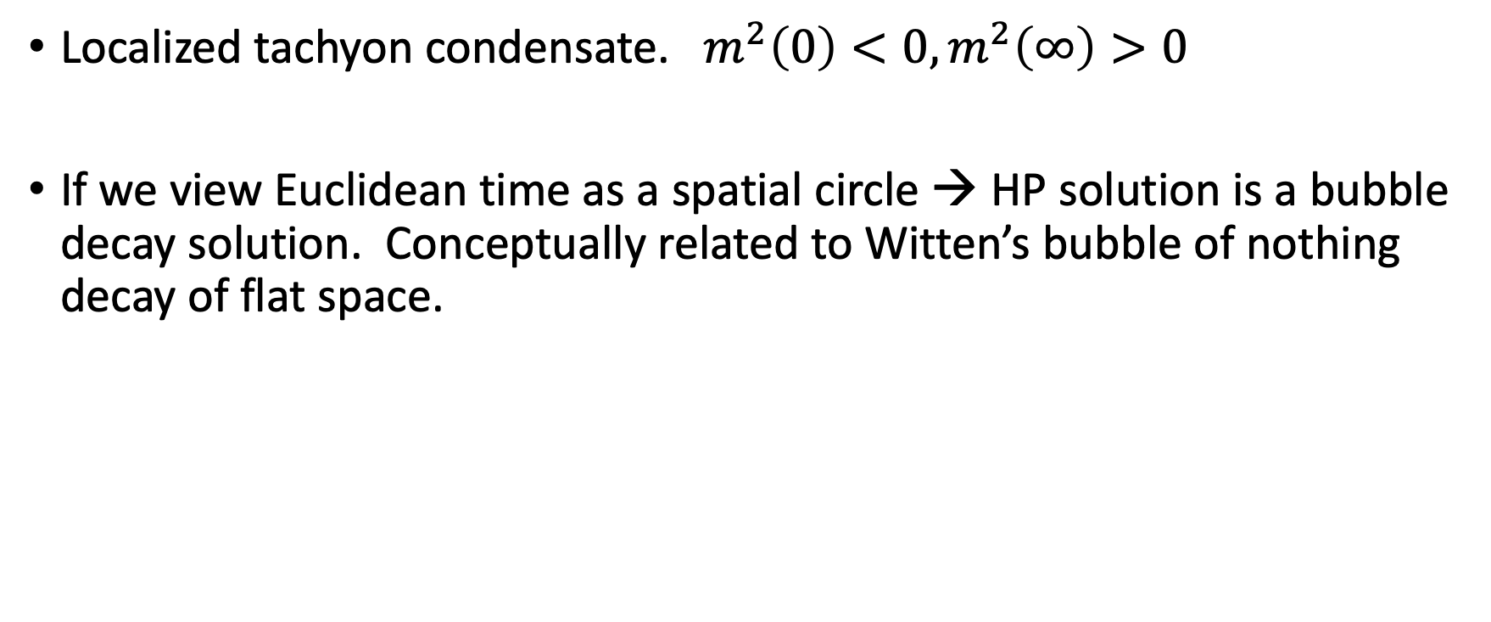
Side comments
Localized tachyon condensate. $m^{2}\left(0\right)<0, m^{2}\left(∞\right)>0$
If we view Euclidean time as a spatial circle → HP solution is a bubble decay solution. Conceptually related to Witten’s bubble of nothing decay of flat space.

Slide 15
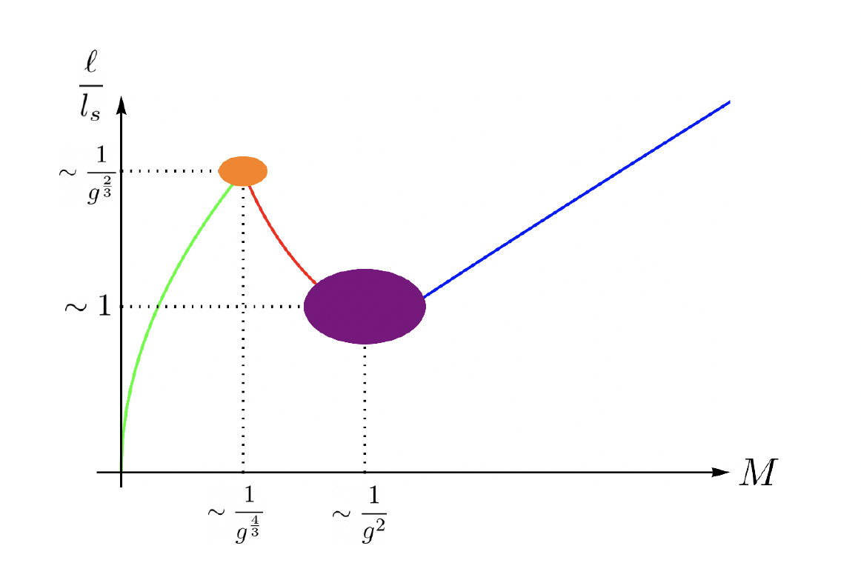
Size of the configuration
Black hole
HP
Free
string

Slide 16
Euclidean black holes
Geometry of the Euclidean black hole.
Transverse sphere
Euclidean time

Slide 17

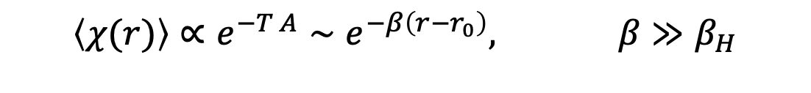

Black holes and winding condensates
r₀
r
Winding one point function → computed by a worldsheet wrapping the cigar.
$$\left\langle χ(r)\right\rangle ∝e^{−T A}∼e^{−β\left(r−r_{0}\right)}, β≫β_{H}$$
Breaking of the winding symmetry. Phase of $χ$ → integral of $B_{μν}$ field over the cigar.
Integrating over it → restores symmetry. But ${\left|χ\right|}^{2} ≠0.$
We can view it as a thermal atmosphere of strings.
Strings coming out of the horizon and back in.
It is a classical contribution to the entropy, formally of order $\frac{1}{g^{2}}$, but not calculable (to my knowledge),
since it is concentrated near the horizon.
(Some authors have conjectured, or claimed to prove, it is all the entropy. No convincing argument. )
Susskind, Uglum ; Dabholkar

Slide 18
Comment on the broken symmetries.
Notice that the winding symmetry is spontaneously broken both on the black hole phase and the highly excited string phase.
In both cases there is a winding condensate.
This is consistent with the suggestion that they could be continuously connected.

Slide 19

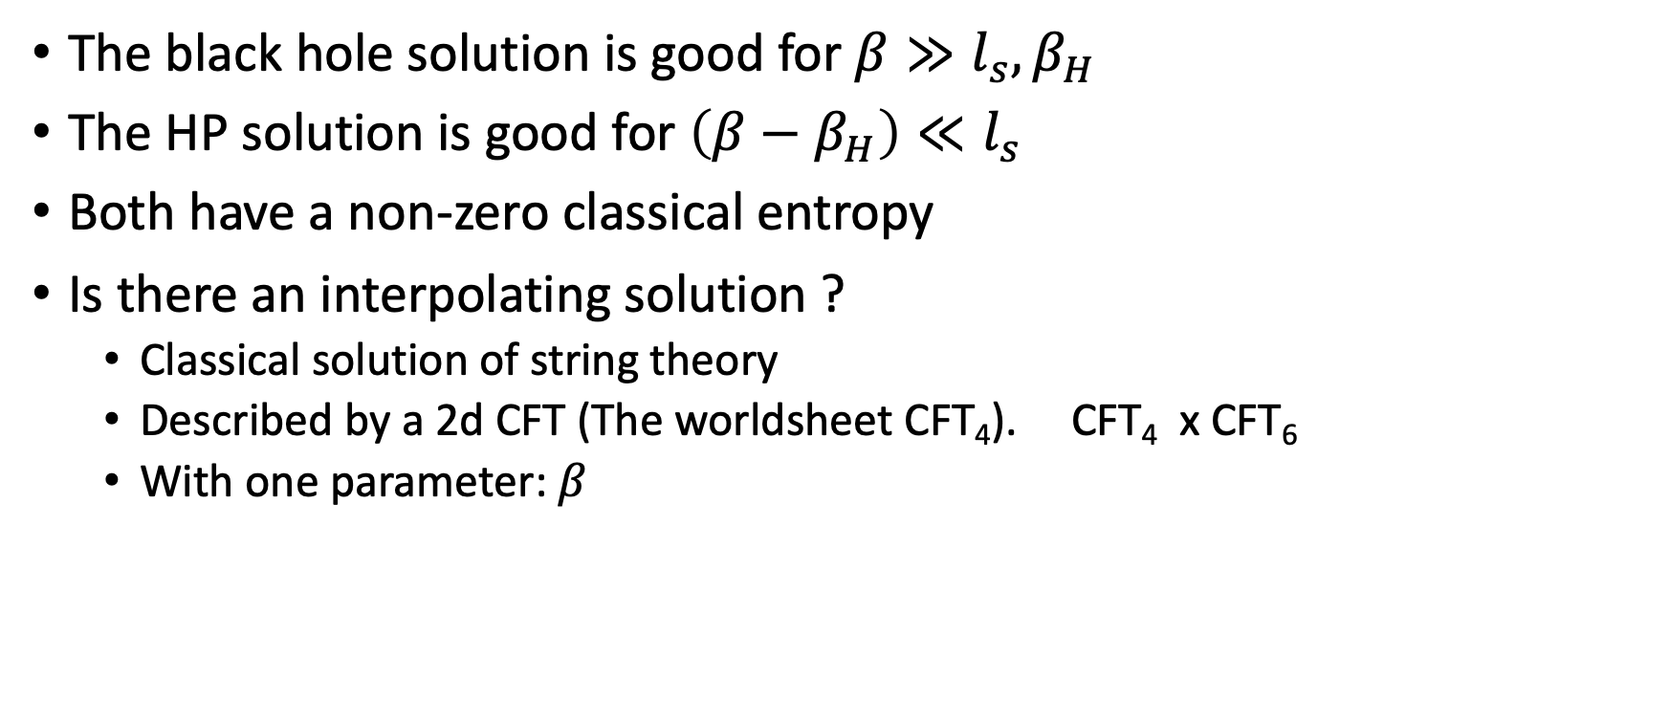
The black hole solution is good for $β≫l_{s},β_{H}$
The HP solution is good for $\left(β−β_{H}\right)≪l_{s}$
Both have a non-zero classical entropy
Is there an interpolating solution ?
  Classical solution of string theory
  Described by a 2d CFT (The worldsheet CFT₄). CFT₄ x CFT₆
  With one parameter: $β$
$$β_{H}$$
HP
Interpolating solution?
Black hole

Slide 20
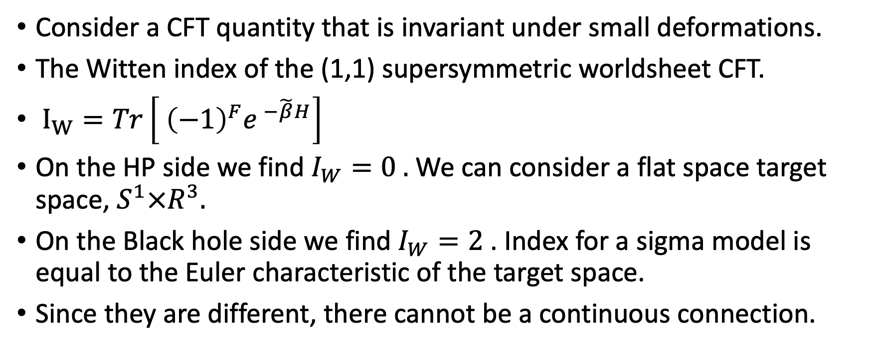
No smooth interpolation for type II
Consider a CFT quantity that is invariant under small deformations.
The Witten index of the (1,1) supersymmetric worldsheet CFT.
$I_{W}=Tr\left[ {\left(−1\right)}^{F}e^{ −\tilde{β}H}\right]$
On the HP side we find $I_{W}=0 .$We can consider a flat space target space, $S^{1}×R^{3}.$
On the Black hole side we find $I_{W}=2$. Index for a sigma model is equal to the Euler characteristic of the target space.
Since they are different, there cannot be a continuous connection.
$$β_{H}$$
x
HP
Black hole

Slide 21
Heterotic theory
Now we have a (1,0) CFT.
The index can also be computed and it is equal to zero on both sides.
Other known invariants are also the same.
There is a linear sigma model analysis which suggests that they continuously connected.

Slide 22

Heterotic linear sigma model
Construct the worldsheet CFT as the IR limit of a simpler problem involving free fields + a potential.
$b−\frac{c}{a}>0$ → HP topology
$b−\frac{c}{a}<0$ → Black hole topology
As we vary the parameters the classical vacuum manifold similar to the HP or the black hole topology.

Slide 23
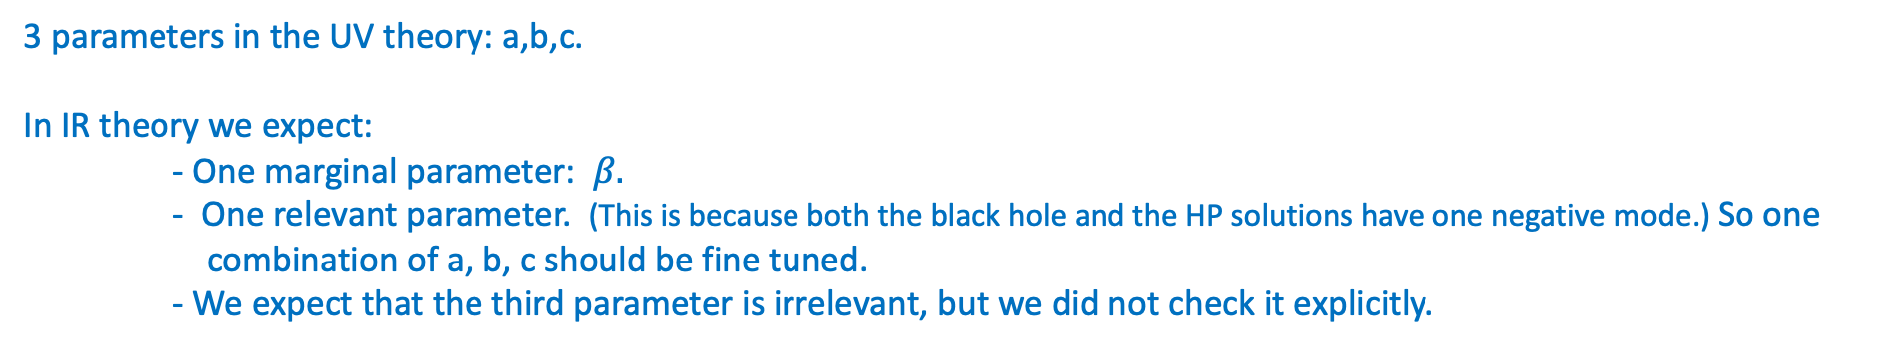
UV
Free fields + potential
Classical vacuum manifold given by W =0
Flow to a CFT , metric is adjusted. (we did not analyze this in detail)
IR
CFT
3 parameters in the UV theory: a,b,c.
In IR theory we expect:
- One marginal parameter: $β.$
- One relevant parameter. (This is because both the black hole and the HP solutions have one negative mode.) So one combination of a, b, c should be fine tuned.
- We expect that the third parameter is irrelevant, but we did not check it explicitly.
As we vary the parameters nothing special happens when b-c/a=0. There is no new branch appearing there. So we expect that the flow to an IR CFT does not show any surprise.
In the intermediate stage the two theories are continuously connected, after we flow all the way to the IR we expect that to be the case too, but this is not a proof. We view it simply as an indication for a continuous connection.

Slide 24

Type II linear sigma model
Construct the CFT as the IR limit of a simpler problem involving free fields + a potential.
P is a new superfield
$b−\frac{c}{a}>0$ → HP topology
$b−\frac{c}{a}<0$ → Black hole topology
$$P=0$$
When b-c/a =0 , a new classical branch appears with $P ≠0, \vec{ X}=\vec{Y}=0$

Slide 25
On this classical P branch a superpotential is generated. Depending on the sign of b-c/a we do or do not have isolated vacua
on this branch.
These isolated vacua are massive.
Now the index has the same value on both sides, in the full UV theory.
What happens is that the UV theory flows in the IR to a CFT + isolated massive vacua
UV
Free fields + potential
Classical vacuum manifold given by W =0
Flow to a CFT , metric is adjusted. (we did not analyze this in detail)
IR
CFT + possible massive vacua.
Appear only for one sign of b-c/a.
Index of the full theory is the same for both signs of b-c/a. But the index of the CFT part in the IR is different due to the extra massive vacua.

Slide 26
Index and D-branes
There are some D-branes that exist on the HP side but not the BH side and vice versa.
For example, a D0 brane localized at the origin and wrapping the time circle exists on the HP side.
There is no such brane on the black hole side (the Euclidean time circle is contractible)
These branes generate some fluxes at infinity. On the black hole side the flux is carried as an electrically charged black hole,
without an explicit brane source.
$$β_{H}$$
x
HP
Black hole

Slide 27
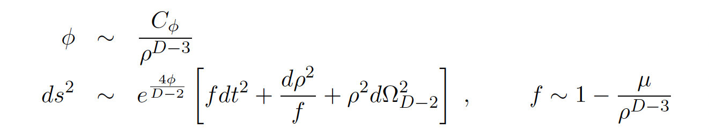
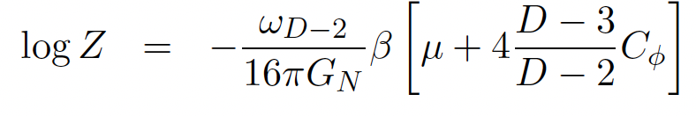
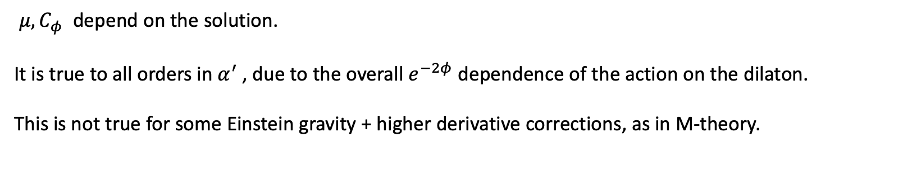
A curiosity
The on shell action of classical string theory solutions is purely given by a boundary term.
Kazakov, Tseytlin
$μ, C_{φ}$ depend on the solution.
It is true to all orders in $α^{′}$, due to the overall $e^{−2φ}$ dependence of the action on the dilaton.
This is not true for some Einstein gravity + higher derivative corrections, as in M-theory.

Slide 28
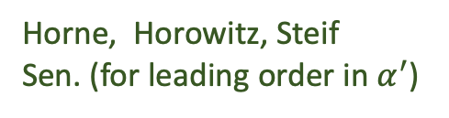
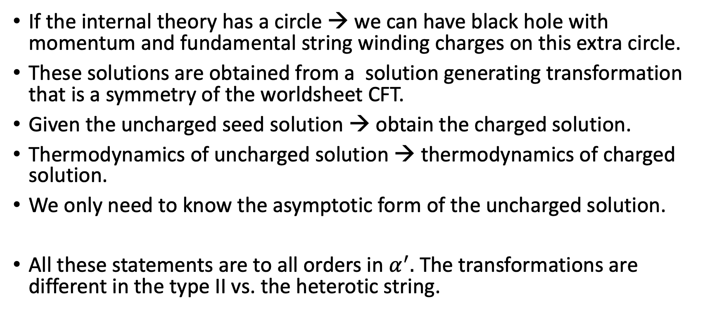
Charged black holes
Horne, Horowitz, Steif
Sen. (for leading order in $α^{′}$)
If the internal theory has a circle → we can have black hole with momentum and fundamental string winding charges on this extra circle.
These solutions are obtained from a solution generating transformation that is a symmetry of the worldsheet CFT.
Given the uncharged seed solution → obtain the charged solution.
Thermodynamics of uncharged solution → thermodynamics of charged solution.
We only need to know the asymptotic form of the uncharged solution.
All these statements are to all orders in $α^{′}.$ The transformations are different in the type II vs. the heterotic string.

Slide 29
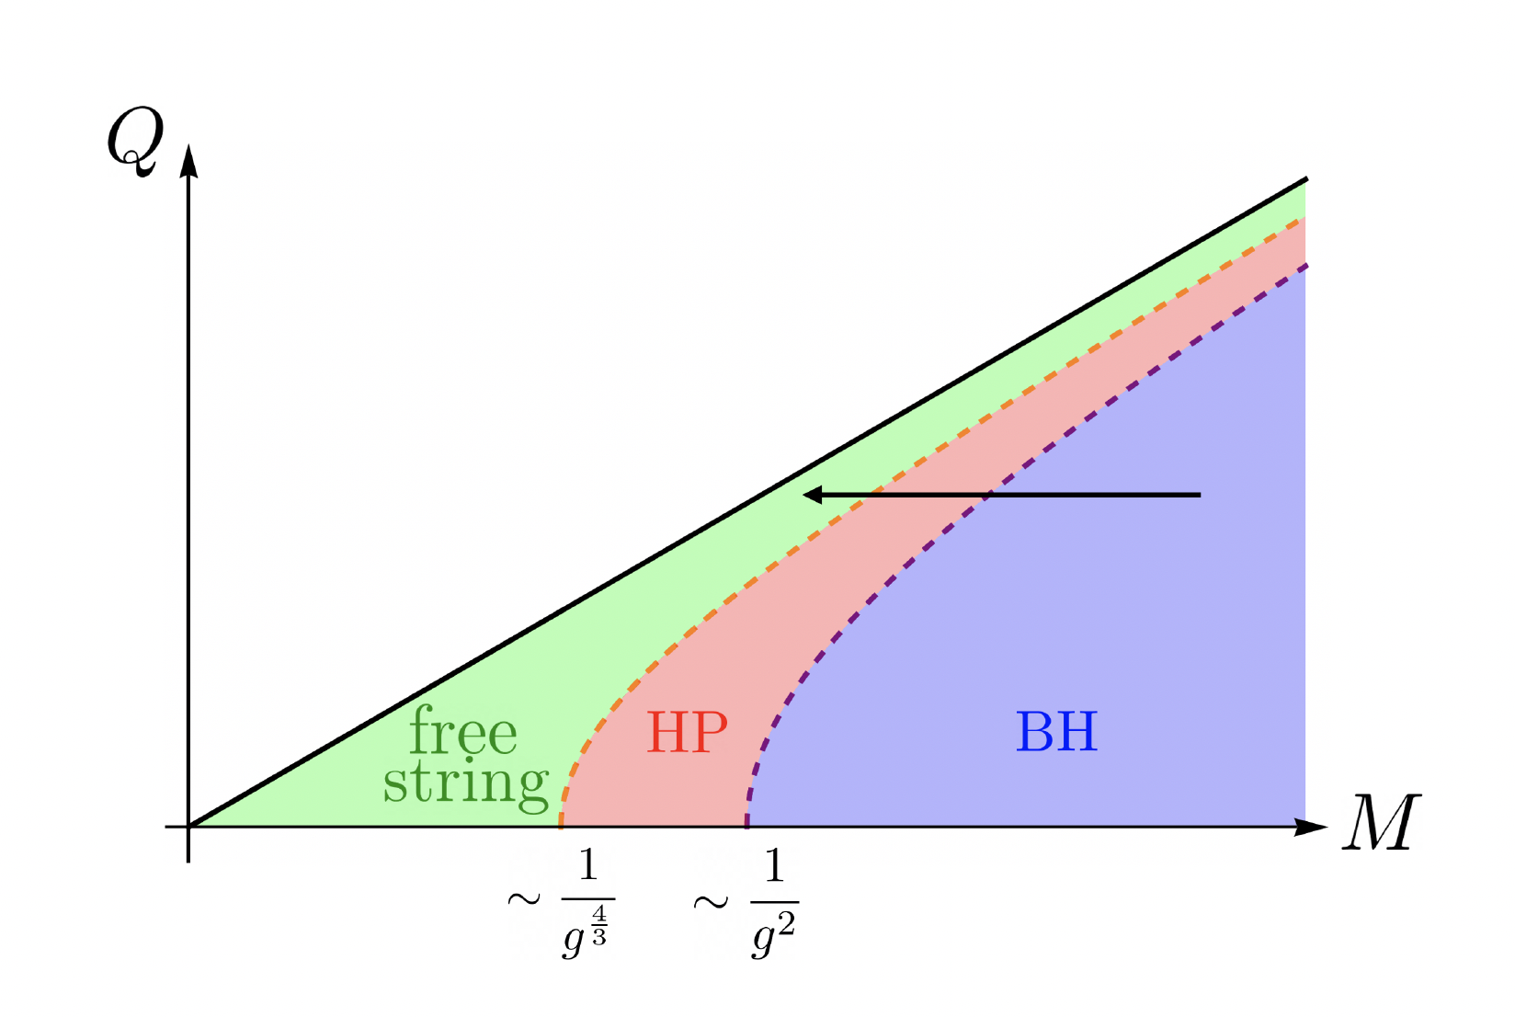
Charged black holes
The transitions happen as we approach extremality.
Go over to a free string phase as we approach extremality.
Their entropies qualitatively agree (up to a numerical factor)
The HP or free string phases look a bit like a fuzzball (a configuration whose microstates are very clear)
Sen
Damour Veneziano
Mathur

Slide 30
Conclusions
We discussed the possible connection between the black hole and the self gravitating string solution of Horowitz and Polchinski.
For the type II case, we showed that the two could not be continuously connected as classical solutions.
For the heterotic case, it seems that they could be continuously connected.
We also discussed how to generate the charged solutions. The transition is relevant when we approach extremality.

Slide 31

Questions
Can we say more about the CFT at intermediate values of $β?$
Can we track the picture of the microstates through this intermediate region?.
Why is the heterotic and type II picture different ?

