Slide 1
Multitaper estimates of solid Earth tidal constituents from Plate Boundary Observatory borehole strainmeters, western USA
Linda A. Hinnov¹, Jood A. Al Aswad²
¹Department of Atmospheric, Oceanic, and Earth Sciences, George Mason University, Fairfax, VA, USA
² Department of Geological Sciences, Stanford University, Palo Alto, CA, USA
Notes:
https://www.unavco.org/instrumentation/geophysical/borehole/bsm/bsm.html

Slide 2
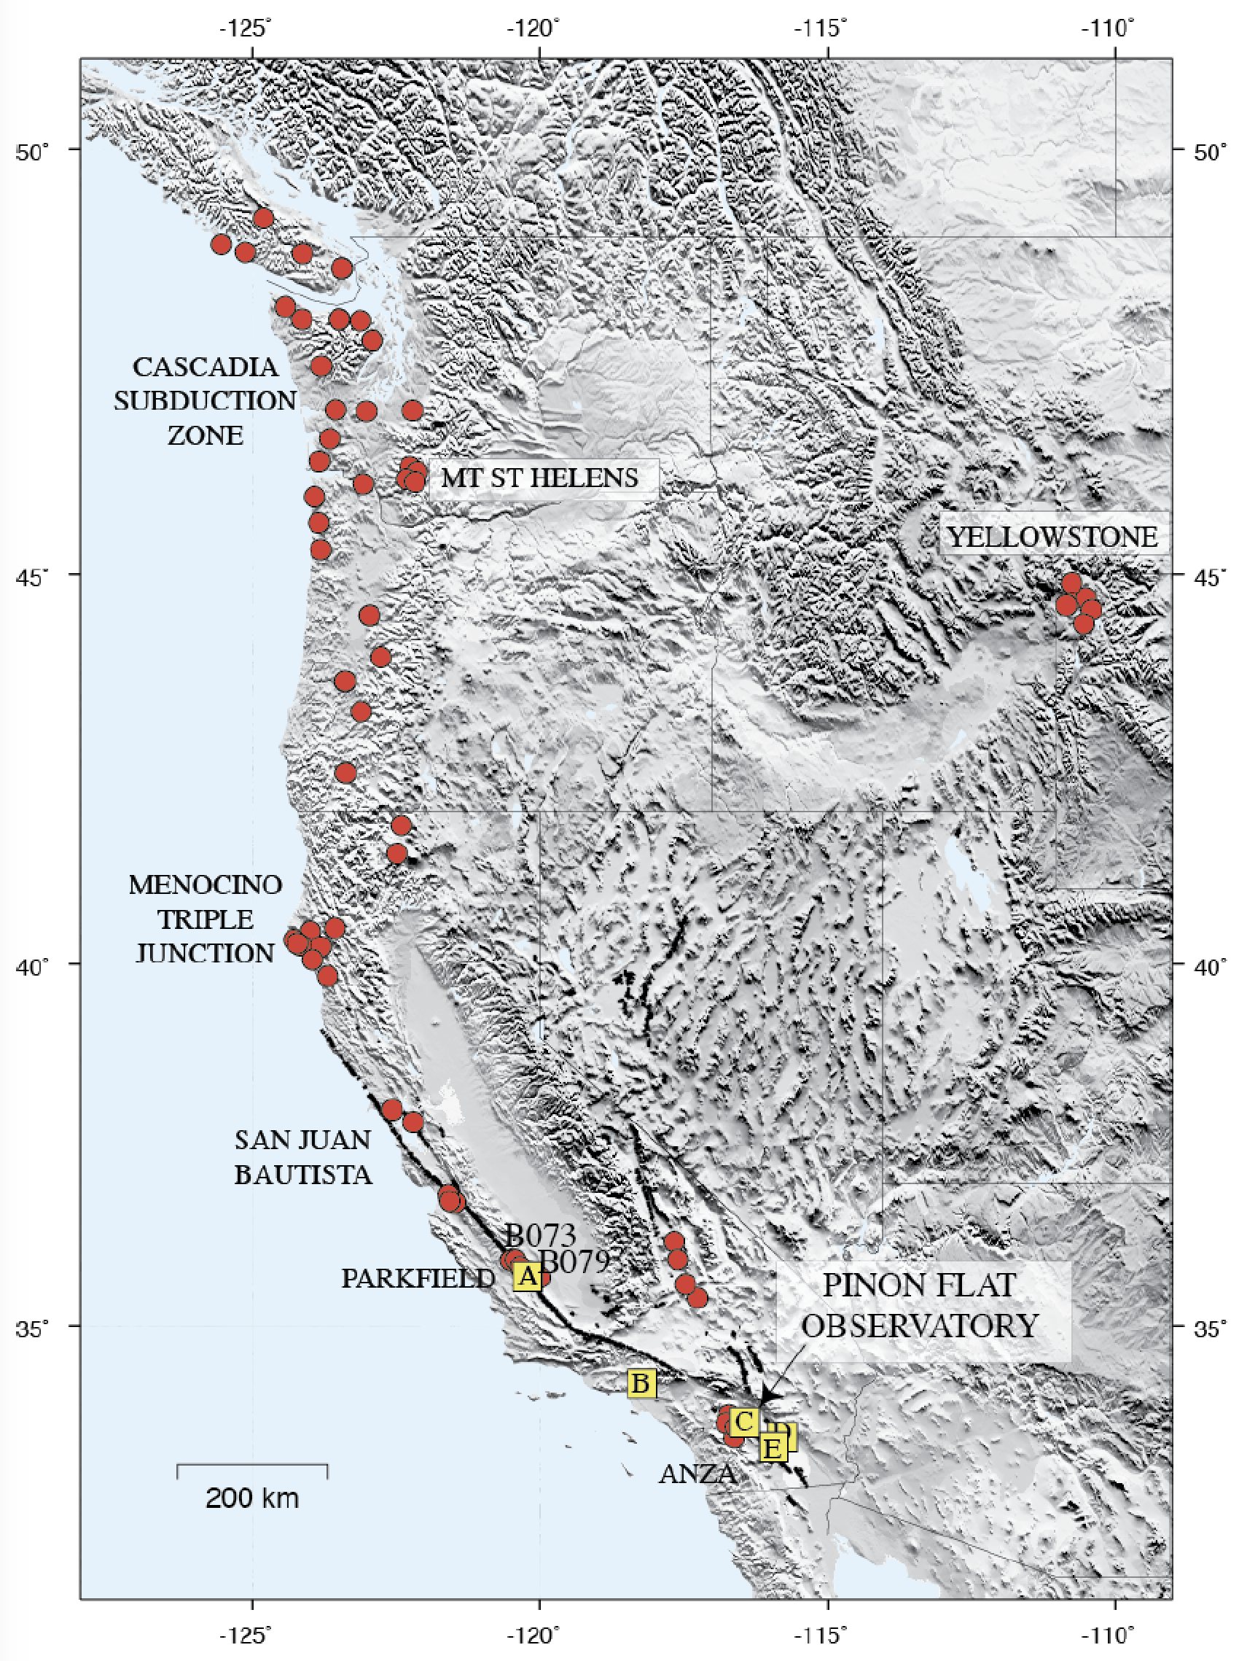
Plate Boundary Observatory
strainmeters
The Plate Boundary Observatory (PBO) is the geodetic component of EarthScope, with 75 borehole strainmeters (red) and 6 laser strainmeters (yellow) at the western U.S. plate boundary, Mount St. Helens and Yellowstone - the first were installed in 2003.
They have recorded multiple Episodic Tremor and Slip (ETS) events, aseismic creep events, coseismic deformation, seiches and tsunami-related strain signals, and Earth tides.
From UNAVCO’s “2012_Strain_Workshop.pdf”

Slide 3
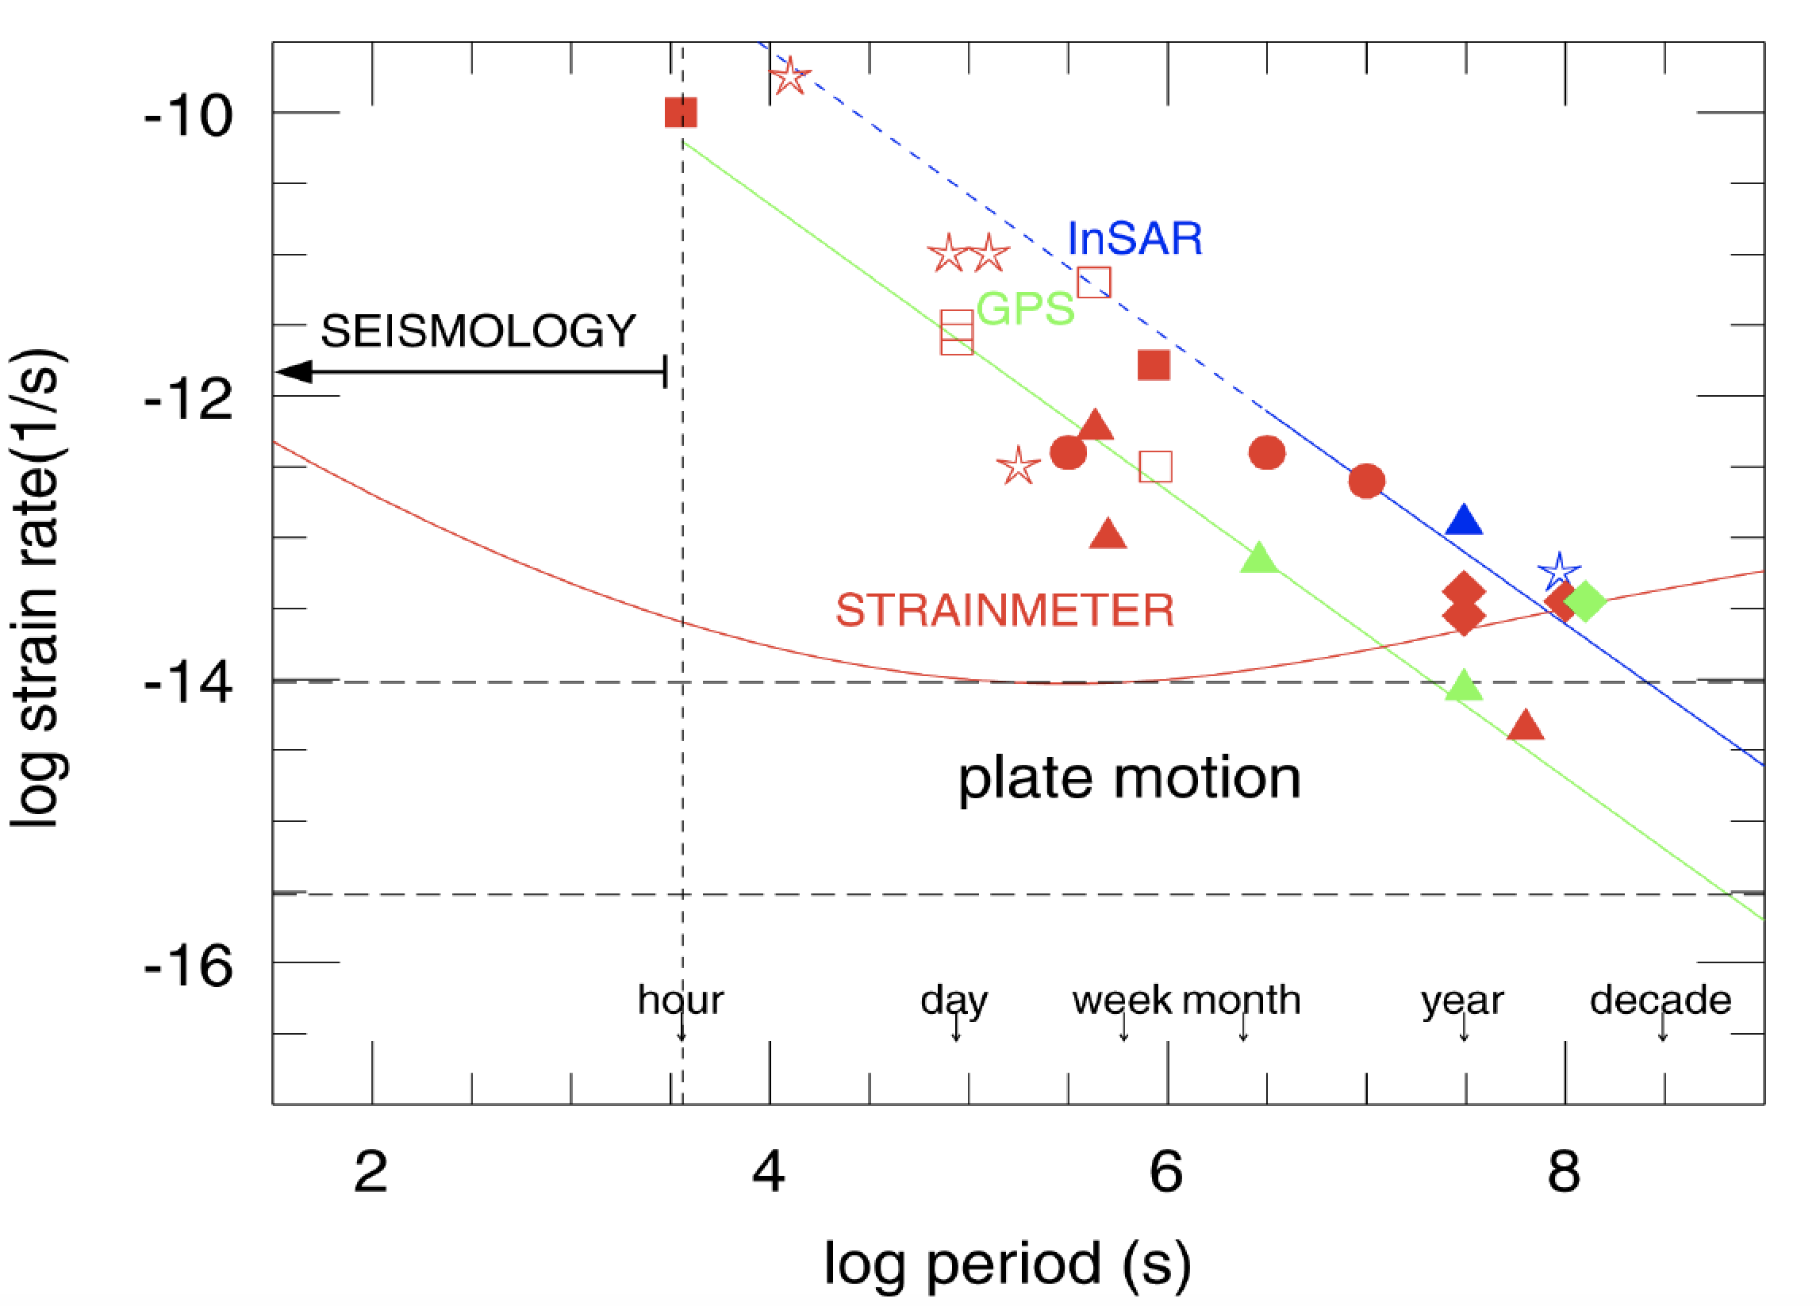
GPS (green) and
InSAR (blue)
detection
thresholds
Strain rate sensitivity
Strainmeters bridge the gap between the detection envelopes of GPS and seismology.
At long periods (months to a decade) GPS has greater sensitivity than strainmeters by 1 to 2 orders of magnitude.
At intermediate periods (one week to months) sensitivities are comparable, and
At short periods (seconds to a month) strainmeter sensitivity is 1 to 3 orders of magnitude greater than GPS.
Strain-rate sensitivity for borehole strainmeters, GPS (=Global Positioning System), and InSAR (= Interferometric Synthetic Aperture Radar) is shown as a function of period.
Post-seismic deformation (triangles)
slow earthquakes (squares)
long-period aseismic deformation (diamonds)
preseismic transients (circles)
volcanic strain transients (stars)
Silver et al., 1999, 2000
Notes:
Silver, P. G., Y. Bock, D. Agnew, T. Henyey, A. T. Linde , T. V. McEvilly, J. B. Minster, B.
Romanowicz , I. S. Sacks, R. B. Smith, S. C. Solomon, and S. A. Stein, A Plate Boundary
Observatory, IRIS Newsletter,16, 3-9, 1999.
https://www.usgs.gov/centers/land-subsidence-in-california/science/interferometric-synthetic-aperture-radar-insar

Slide 4
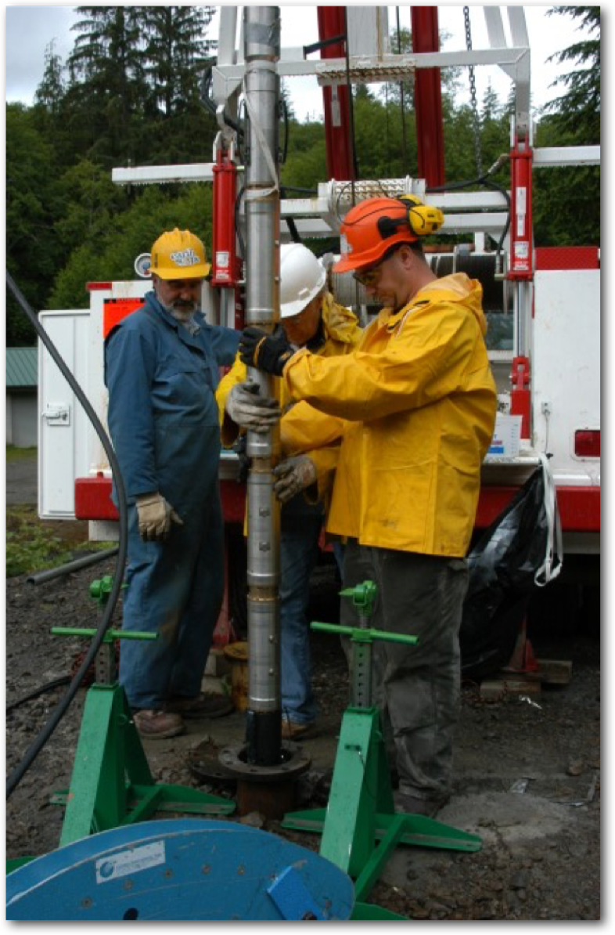
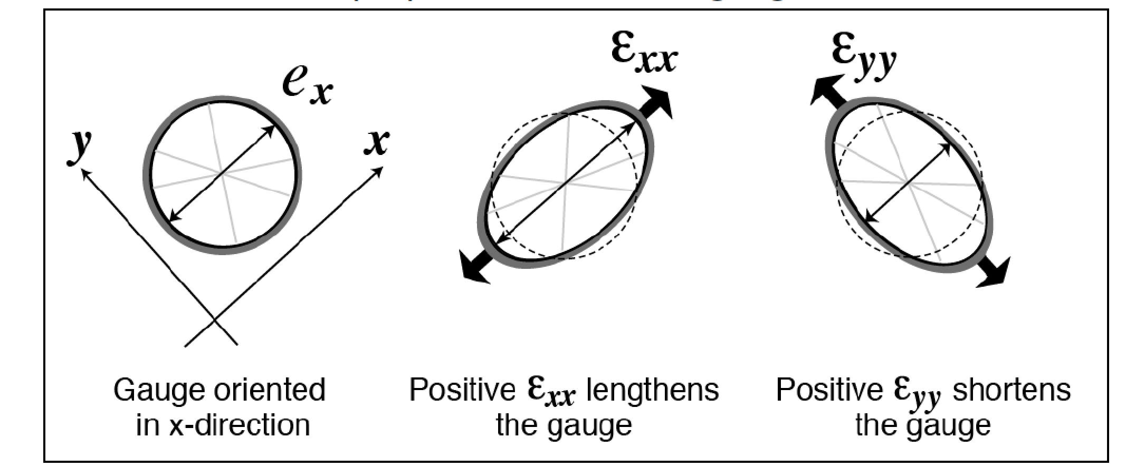
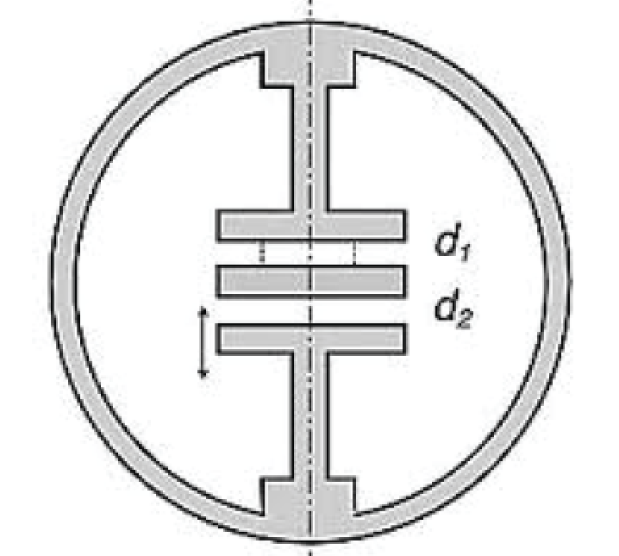

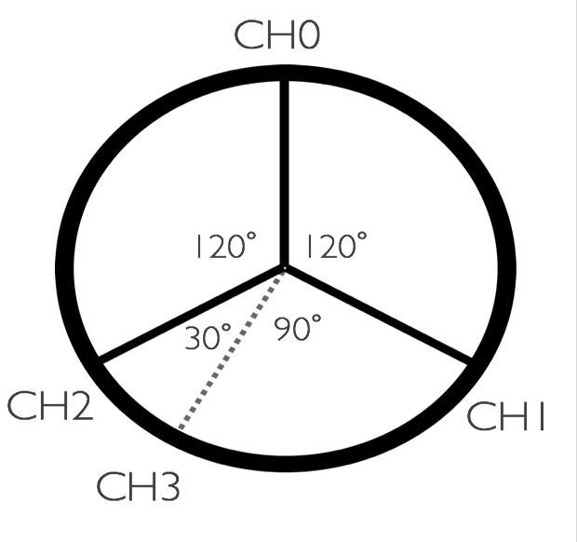
Borehole strainmeters
→ 4 vertically equally spaced gauges that measure strain extension and compression at different orientations.
→ Grouted into boreholes in competent rock (~100 m).
→ Gauges change diameter in response to strain along gauge axis, recorded by capacitance change across gap d₂.
A change of 4 picometers horizontally along the 10 cm width of the strainmeters equates to approximately 0.05 nanostrain
Strains induced by earth tides, are 10's of nanostrain (1000’s picometers) in this environment
Recording is at 5-minute intervals
UNAVCO
http://www.gtsmtechnologies.com/
IntroToStrain_Roeloffs_2018.pdf
Notes:
IntroToStrain_Roeloffs_2018.pdf
A typical installation starts with a borehole that is 15 cm in diameter and approximately 200 m deep, the actual depth depends on the location of desirable rock. A strainmeter is installed at the bottom of the borehole with specialized expansive grout. A seismometer is then installed from three to ten meters above the strainmeter. The upper portion of the borehole is used for auxiliary instruments such as: pore pressure transducers, tiltmeters and continuous thermal measurements. In total the borehole network contains nearly 300 instruments and produces close to 1800 channels of data.
The GAGE Facility uses a instrument developed and constructed by GTSM Technologies which measure the change in borehole diameter along three azimuths separated by 120 degrees perpendicular to the borehole. Strainmeters can detect changes in the diameter of a borehole on the order of four picometers, about one ten millionth of the width of a human hair and smaller than the width of a Hydrogen atom. A change of four picometers along the ten cm width of the strainmeters equates to approximately 0.05 nanostrain while signals of geophysical interest range from several nanostrain to many hundreds of nanostrain. For example the strains induced by earth tides, the effect of the Sun and Moon on the Earth's crust, are ten's of nanostrain.
4 picometers = 0.05 nanostrain
40 picometers = 0.5 nanostrain
400 picometers = 5 nanostrain
4000 picometers = 50 nanostrain

Slide 5
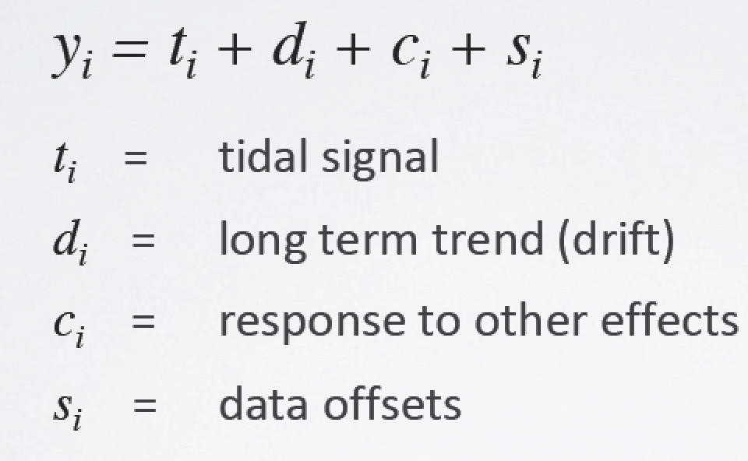
The borehole strainmeter signal
Strain signal y_{i} at time i -
Earth tides
borehole relaxation
air pressure, temperature, rainstorms
deformation, instrument issues
Hodgkinson, 2018, UNVACO
Baytap-intro-Hodgkinson.pdf
Notes:
Hodgkinson et al., 2013. Tidal calibration of PBO borehole strainmeters, JGR.

Slide 6
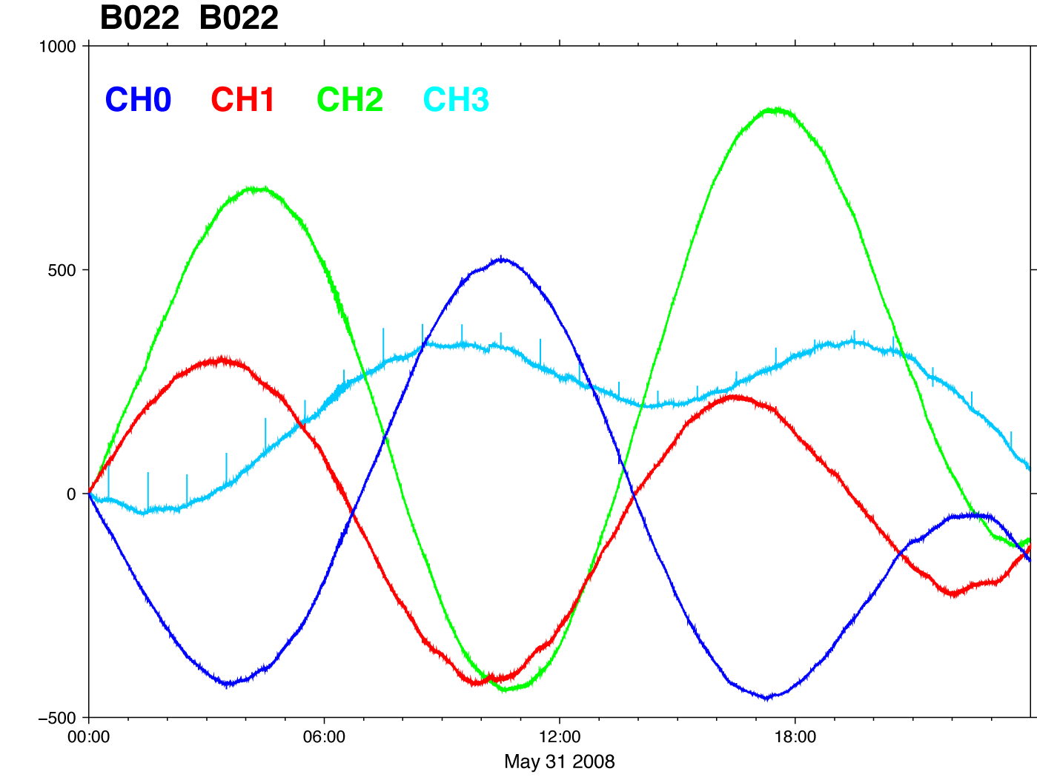
High frequency strain signals
Sea Side, Oregon, B022 , May 31, 2008, 1-sps data
B022 , May 31, 2008, 1-sps data
ONE DAY
Orientations:
CH0=199.2
CH1=139.2
CH2=79.2
CH3=49.2
Digital Counts
Close to the gauge
orientations of our
two stations (see next).
2009_Signals_and_trends-strainmeter-course.pptx

Slide 7
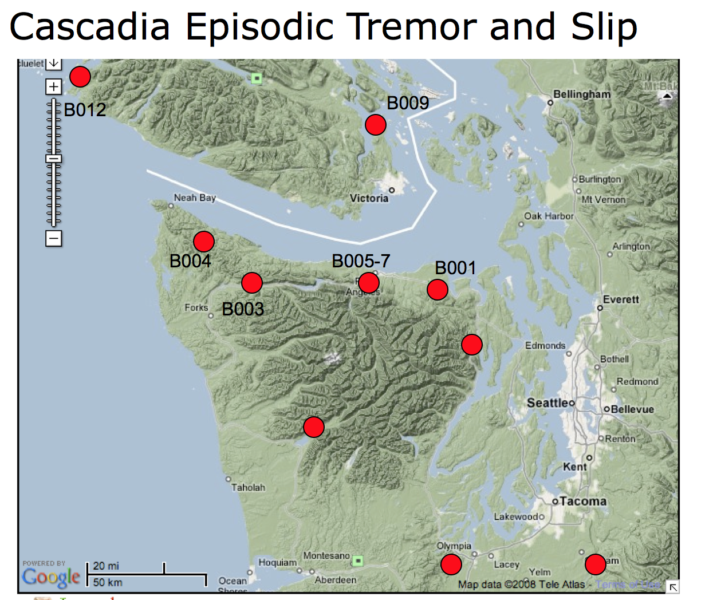
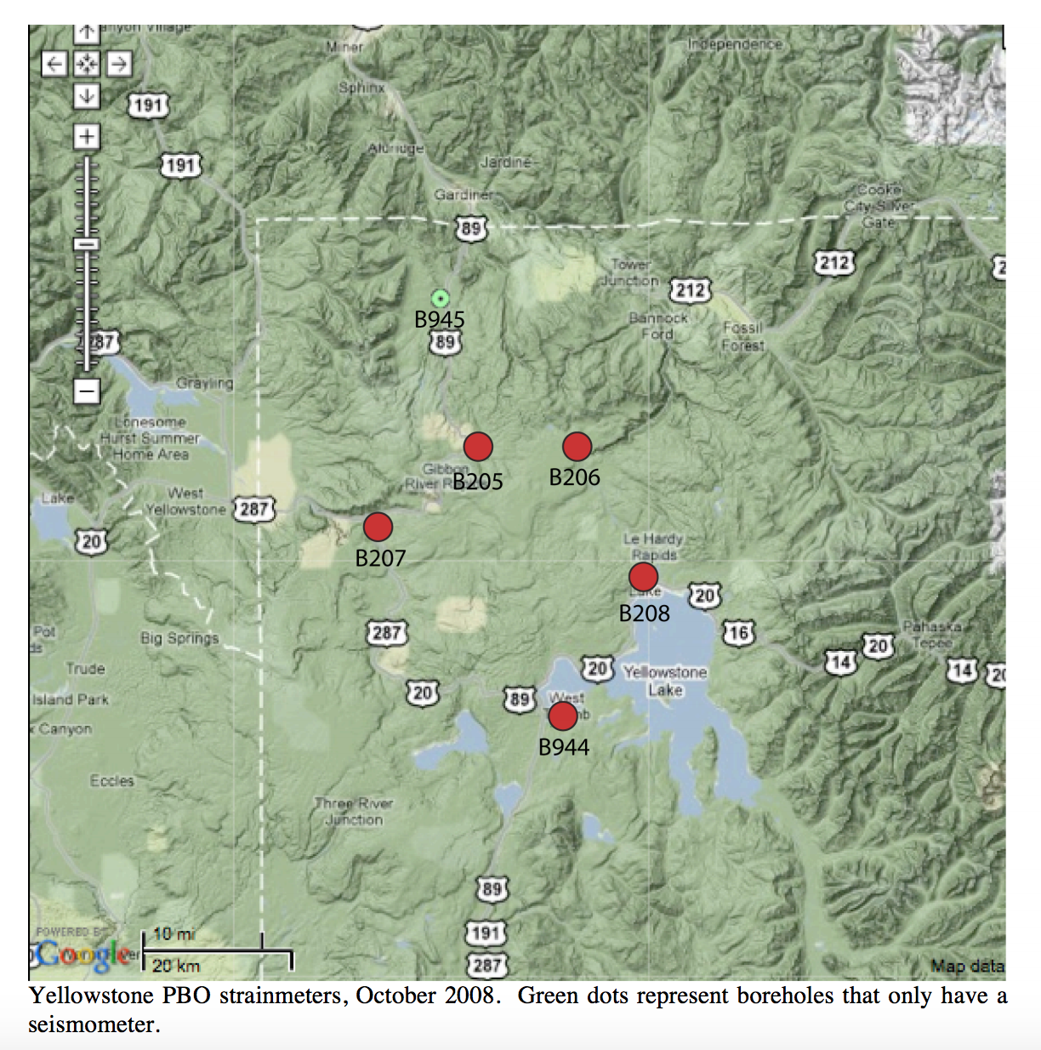
2 borehole strainmeters; 5 years of synchronized 5-minute data
Strainmeter B001, Sequim, Washington
→Gauge 0, oriented at 200.2º east of north
• Cascadia subduction zone
• Pacific Ocean
• maritime climate
Strainmeter B944, Yellowstone, Wyoming
→Gauge 2, oriented at 205.1º east of north
• mantle plume
• ~100 m from Yellowstone Lake
• continental climate
B001: Olympic Peninsula
B944: Yellowstone Caldera
Notes:
~1,000,000 data points
B001
Cascadia Subduction Zone
Pacific Ocean
Maritime climate
B944
Mantle Plume
~100 m from Yellowstone Lake
Continental climate

Slide 8
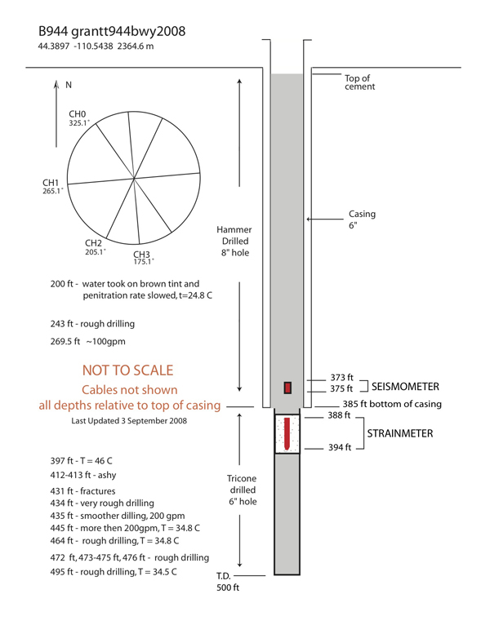
Sequim, WA
Yellowstone, WY
Installed: 2005-06-29
Installed: 2008-08-06
Notes:
A typical installation starts with a borehole that is 15 cm in diameter and approximately 200 m deep, the actual depth depends on the location of desirable rock. A strainmeter is installed at the bottom of the borehole with specialized expansive grout. A seismometer is then installed from three to ten meters above the strainmeter. The upper portion of the borehole is used for auxiliary instruments such as: pore pressure transducers, tiltmeters and continuous thermal measurements.

Slide 9
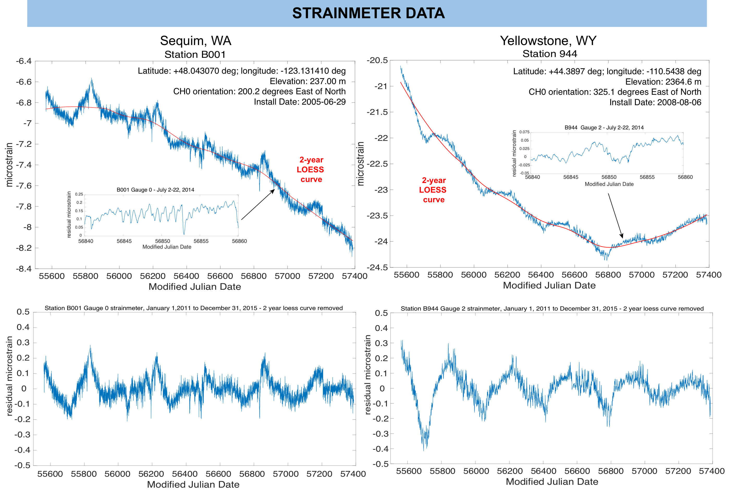
CH2 orientation: 205.1 degrees East of North

Slide 10
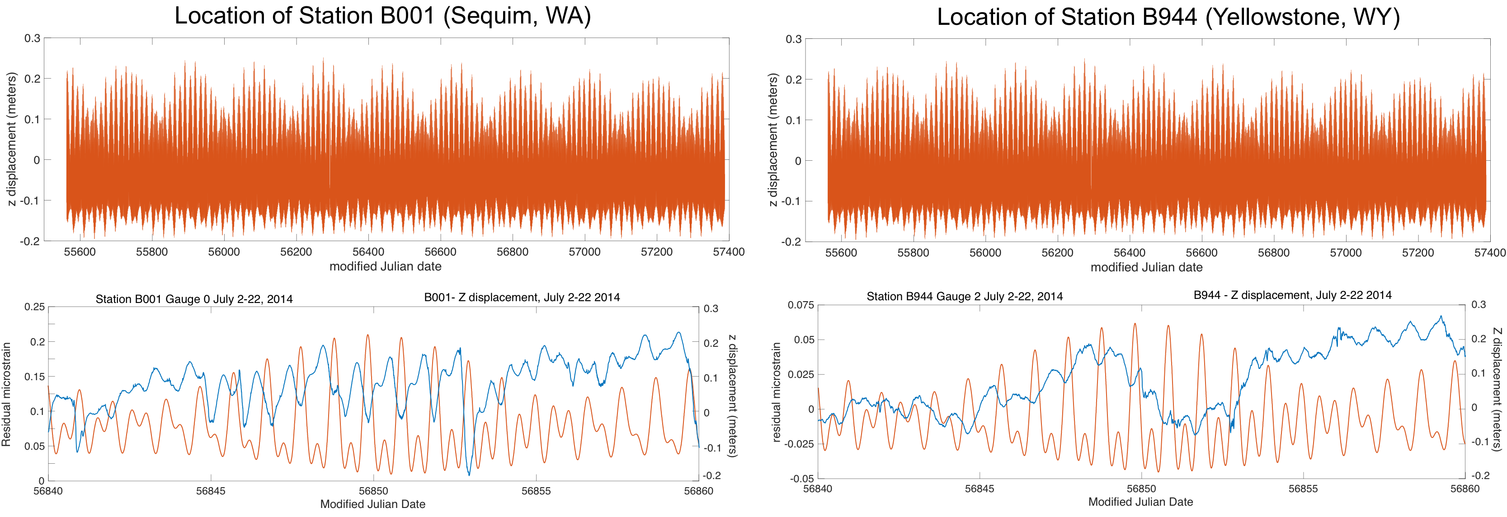
Solid Earth tidal model
• Program solid.f computes cyclic and permanent tidal deformation; 2018 version references UTC time
• Based on dehanttideinelMJD.f by V. Dehant, S. Mathews, J. Gipson and C. Bruyninx
• The 2018 version of solid.f references UTC time
• Output solid earth tide u,v,w components in meters, North, East, and Up in the local geodetic (ellipsoidal) horizon system at 1 minute intervals.
• Includes degree 2 and 3 Love/Shida displacement corrections
• No ocean, atmospheric loading, or polar motion deformation

Slide 11
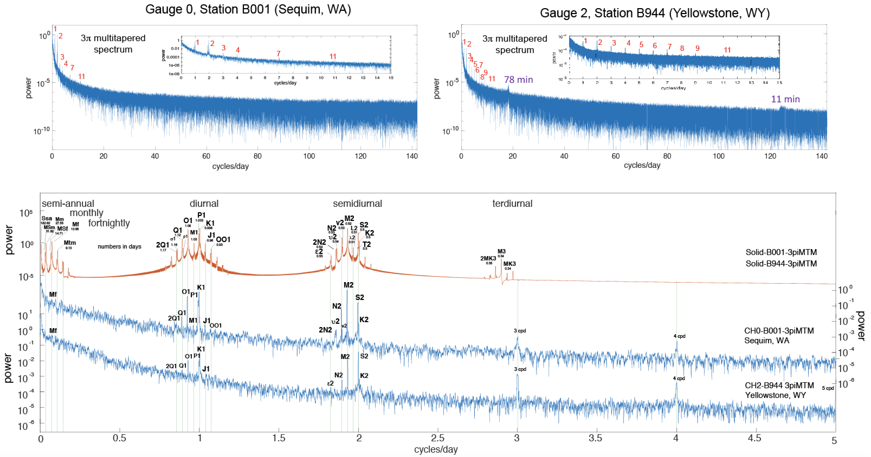
Power spectral analysis

Slide 12
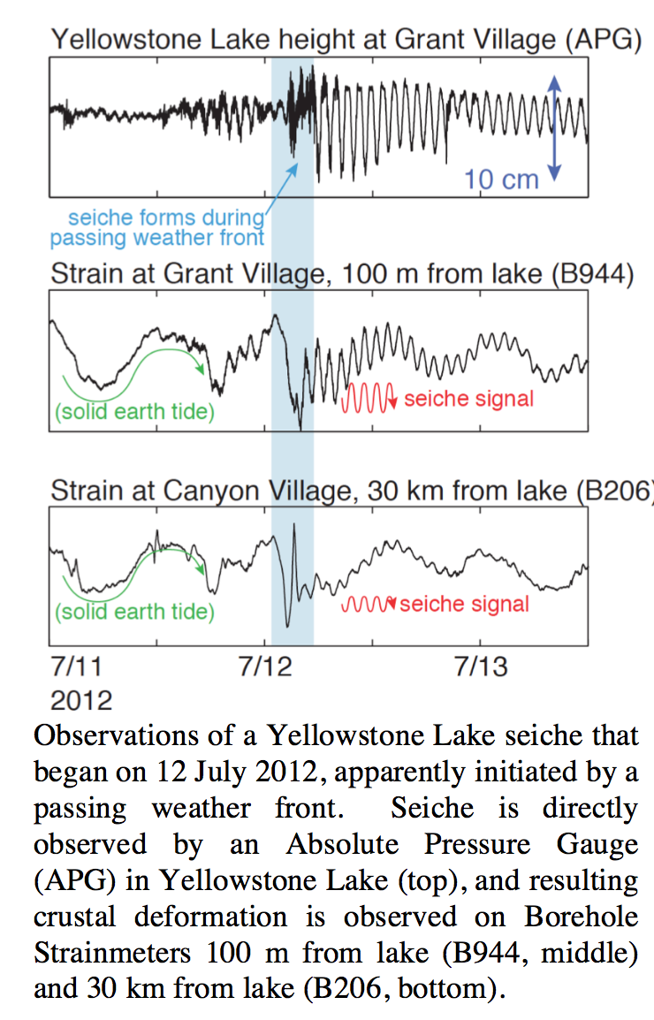
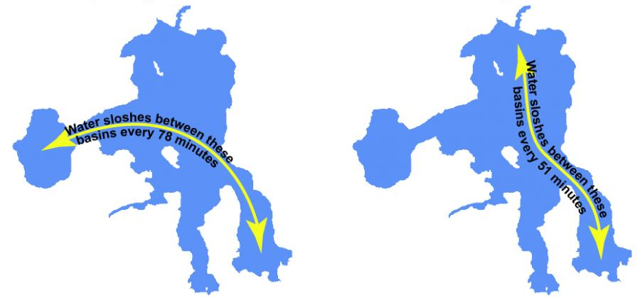
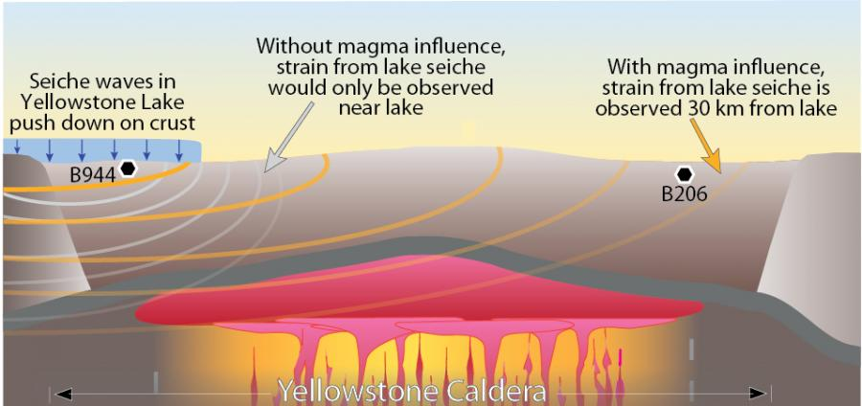
Yellowstone Lake Seiches
B206
B206
B944
B944
B944
B944
Lutrell et al., 2013

Slide 13
M₂
Harmonic analysis
Diurnal band lines:
P1 – 0.997258 cycles/day (Solar diurnal)
Temp – 1 cycles/day (seasonal temperature effect)
K1 – 1.002758 cycles/day (Lunar diurnal)
ψ₁ – 1.005488 cycles/day
φ₁ – 1.008234 cycles/day
Semi-diurnal band lines:
T2 -- 1.997262 cycles/day (Larger solar elliptic)
S2 – 2.000000 cycles/day (Principal solar semidiurnal)
K2 – 2.005515 cycles/day (Lunisolar semidiurnal)
Notes:
psi1
phi1

Slide 14
Observed vs. predicted time lag

Slide 15
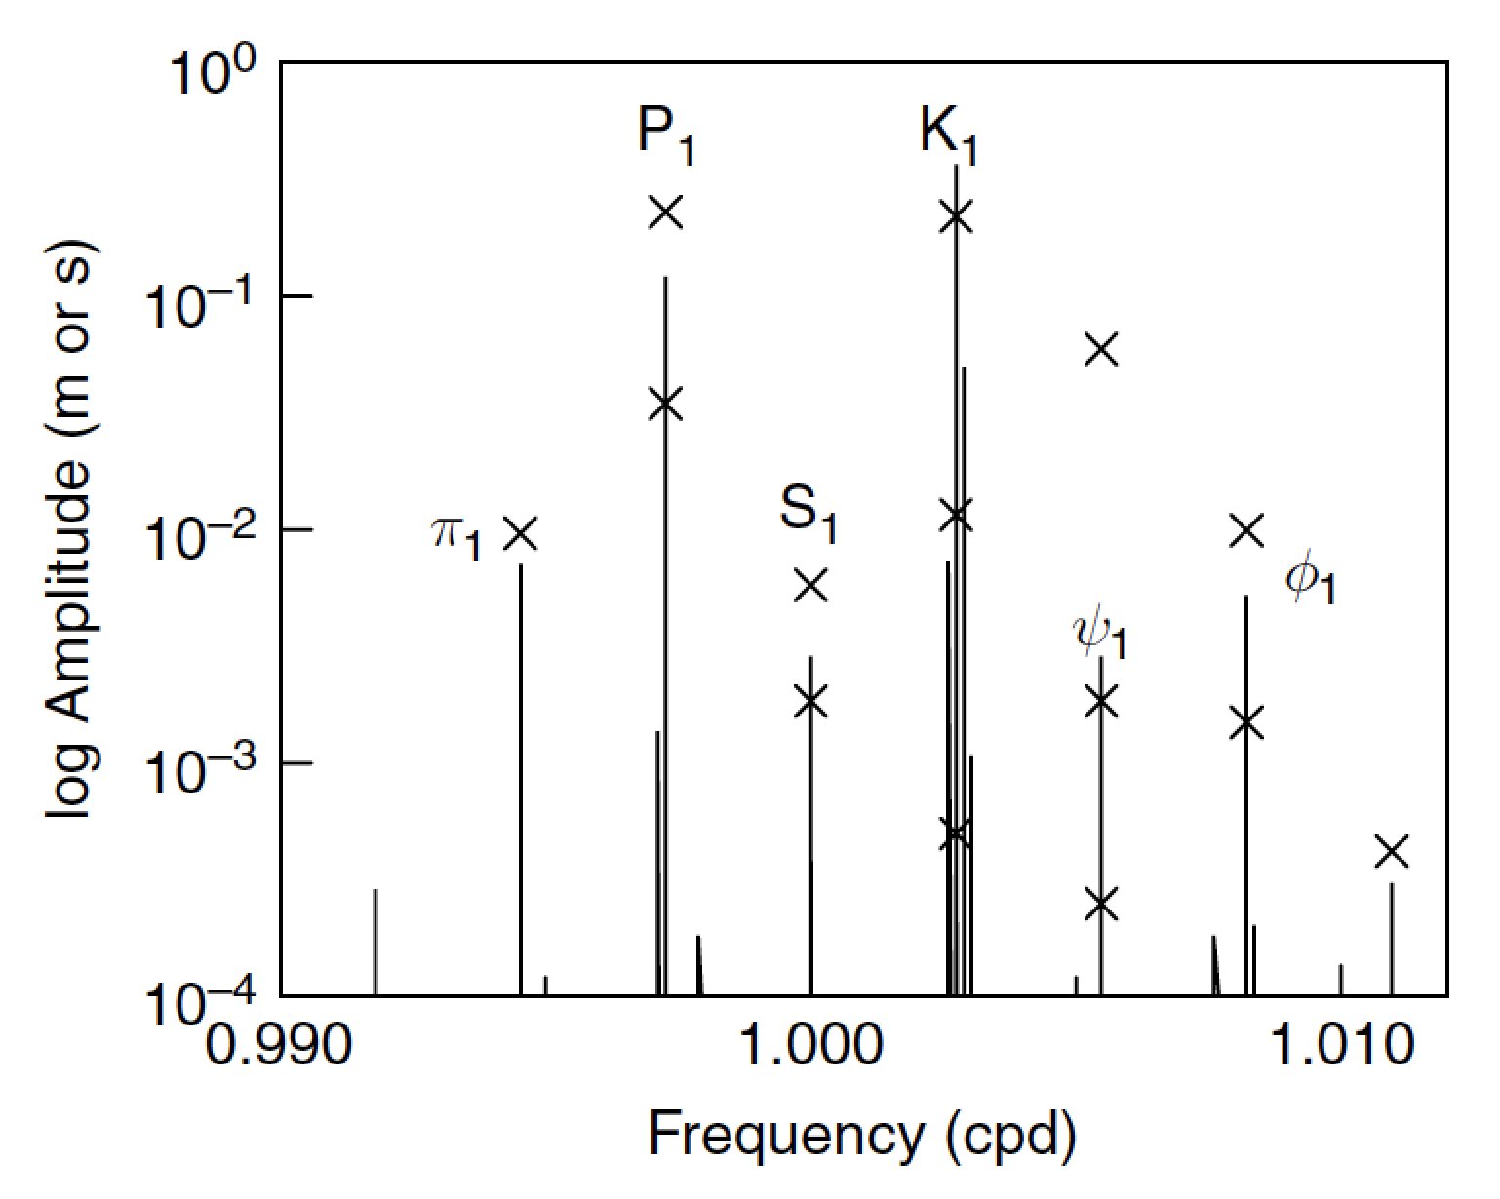
Radiational tides
Changes in solar irradiation drive changes in ground temperature fairly directly, and changes in air temperature and pressure in very complicated ways. Ground-temperature changes cause thermoelastic deformations with tidal periods. Air pressure changes, usually known as ‘atmospheric tides’, load the Earth enough to cause deformations and changes in gravity.
The crosses show the amplitudes of the radiational tidal harmonics (degree 1 and 2) from Cartwright and Tayler (1971); the amplitudes are for the solar constant S being taken to be 1.0. The lines are harmonics of the gravitational tides.
Agnew, 2007

Slide 16
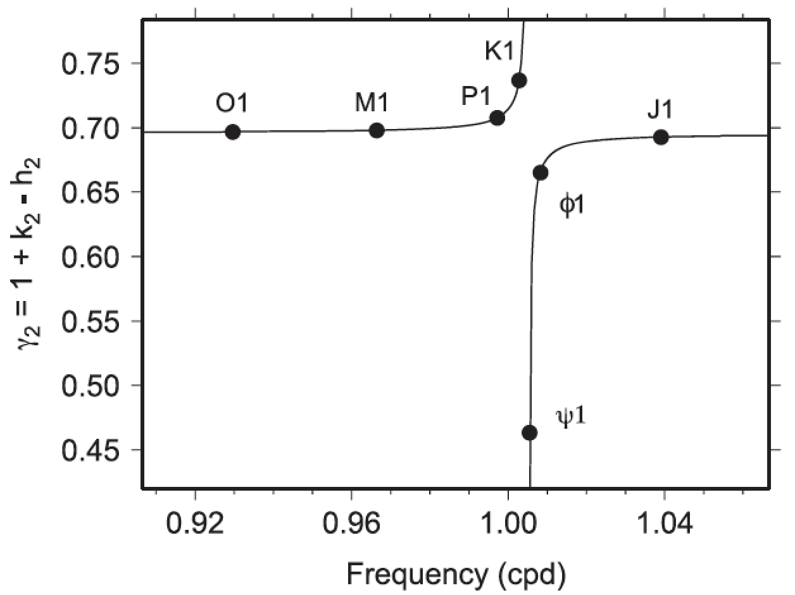
Nearly Diurnal Free Wobble (NDFW) resonance
The Love number combination γ₂ = 1 + k₂ − h₂ across the diurnal tidal band. The nearly diurnal free wobble (NDFW) resonance, sitting between constituents K₁ and ψ₁ at approx. frequency 1.005067 cpd is evident; the resonance affects primarily ψ₁. Displayed values of γ₂ are taken from Mathews et al. (1995); the solid line follows their eq. (35).
Ray et al., 2021

Slide 17
What next?
Future tasks:
• Analyze additional PBO strainmeter records to develop robust tidal lag information for the PBO region (western USA)
• Investigate ocean tidal records for effects on strainmeter Earth tide signals
• Analyze meteorological records for radiational tidal corrections to ψ₁ and φ₁.
Goals:
• Construct a tidally derived crustal gravity profile across the western US
• Apply strainmeter ψ₁ and φ₁ tidal constituents to the NDFW resonance model
Thank you!

Slide 18
Extras follow…

Slide 19
GAGE Facility Borehole Strainmeter Network
https://www.unavco.org/instrumentation/geophysical/borehole/bsm/lib/images/pbo_borehole_network.jpg
Notes:
https://www.unavco.org/instrumentation/geophysical/borehole/bsm/lib/images/pbo_borehole_network.jpg

Slide 20
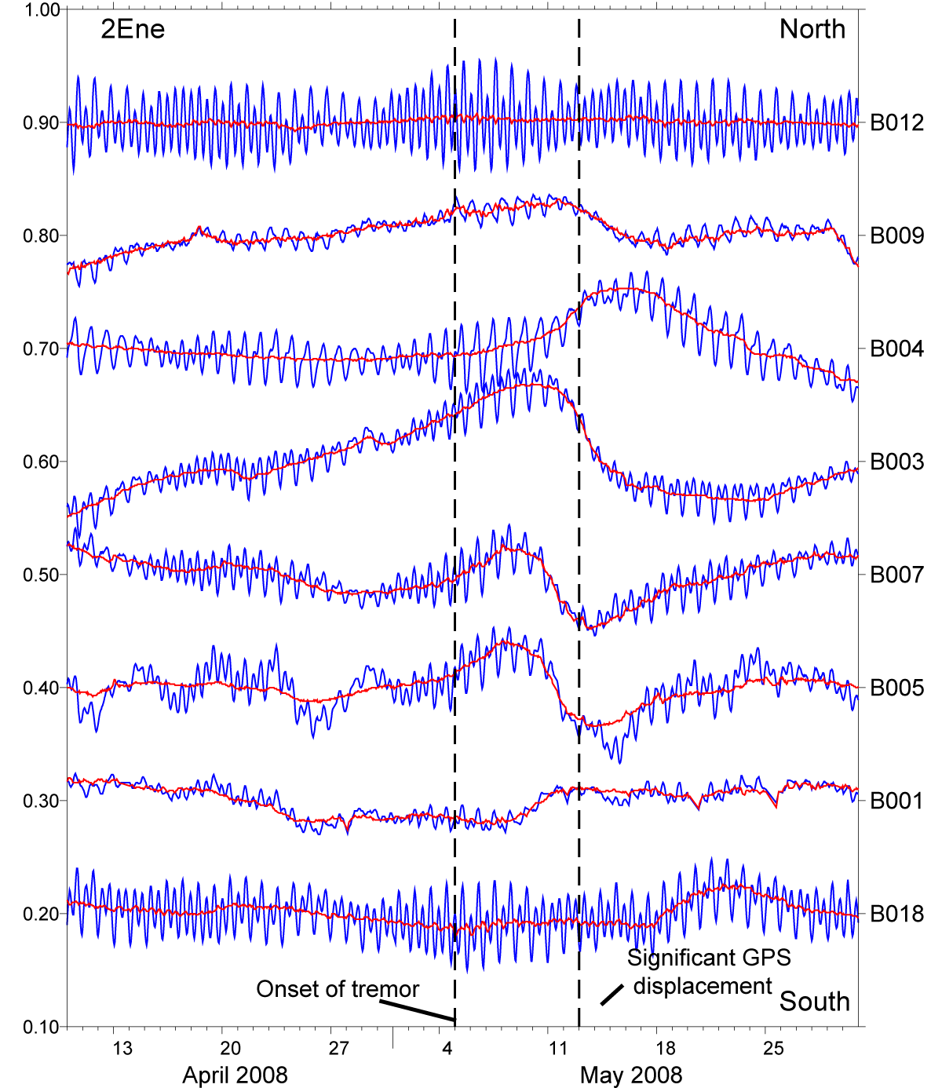
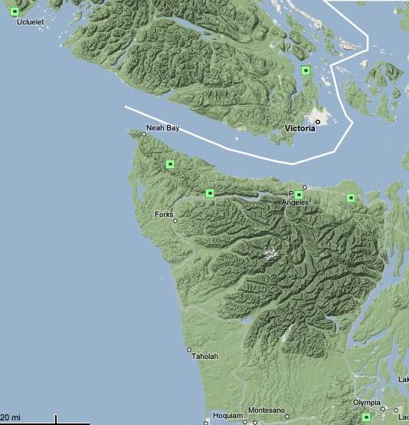
April 2008 - May 2008
Spring 2008 Cascadia ETS
Pacific Northwest BSMs: Shear strain
B012
May 31
B009
May 15
B004
B005-7
microstrain
B001
B003
propagation of tremor (www.pnsn.org)
May 4
B018
2009_Signals_and_trends-strainmeter-course.pptx

