Slide 1
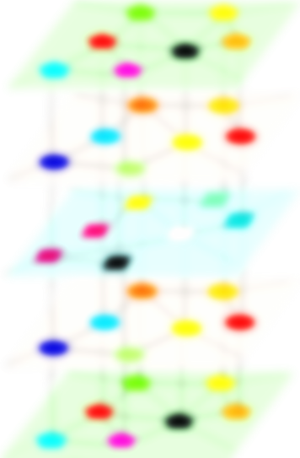
Banff 2022
Relay synchronization
in multiplex networks
I. Leyva
inmaculada.leyva@gmail.es
Complex Systems Group, Universidad Rey Juan Carlos & GISC, Spain
Center for Biomedical Technology, Universidad Politécnica de Madrid, Spain
In collaboration with:
I. Sendiña-Nadal (URJC), R. Sevilla-Escoboza (Univ. of Lagos, Mexico)
Notes:
<número>
<número>

Slide 2

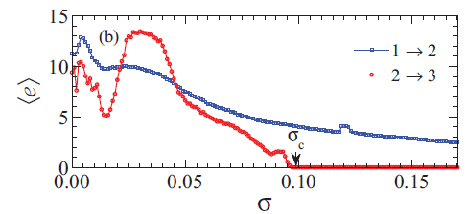
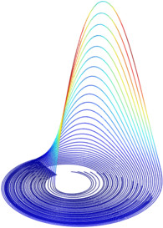
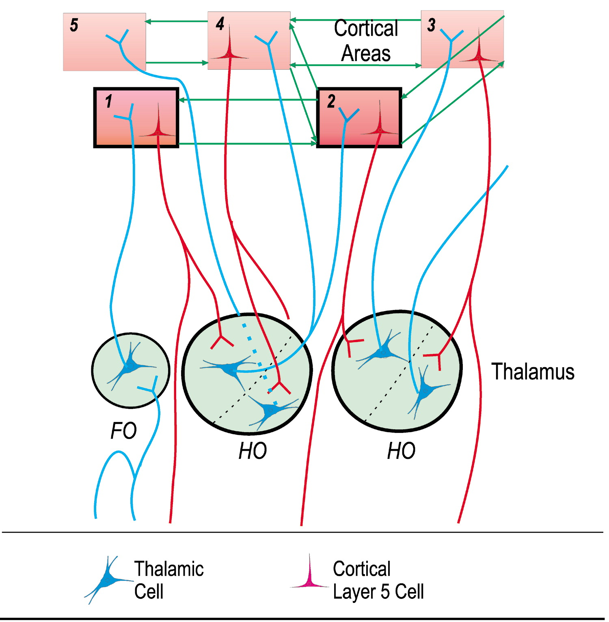
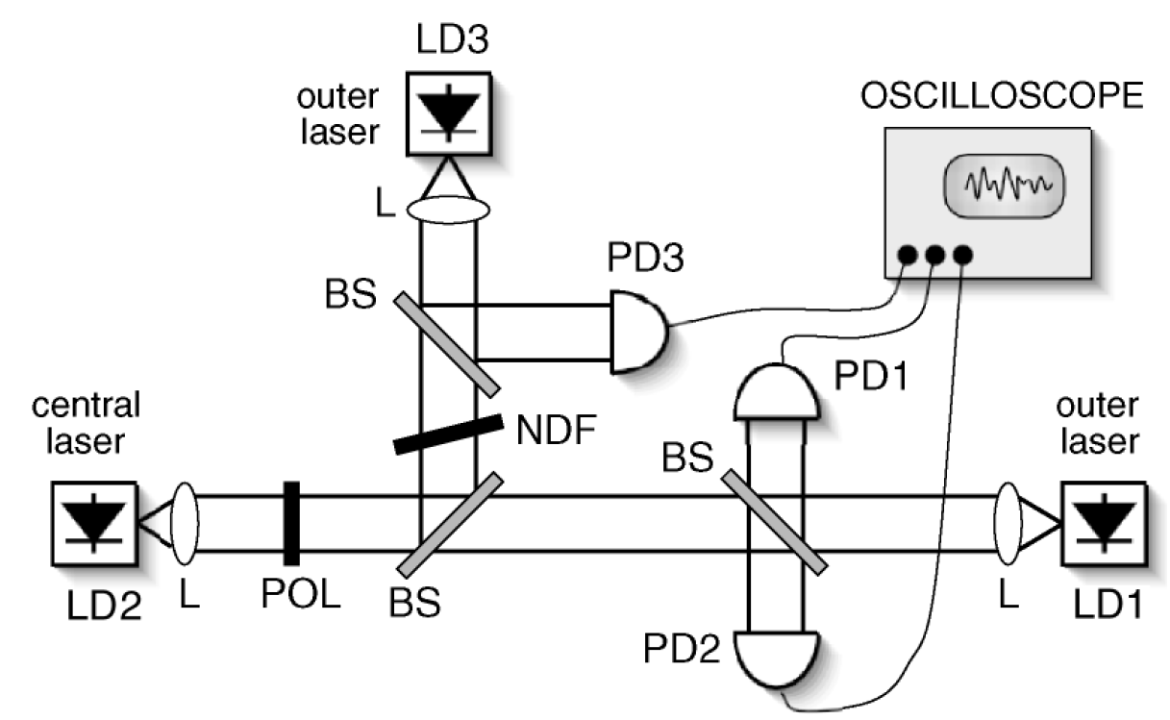
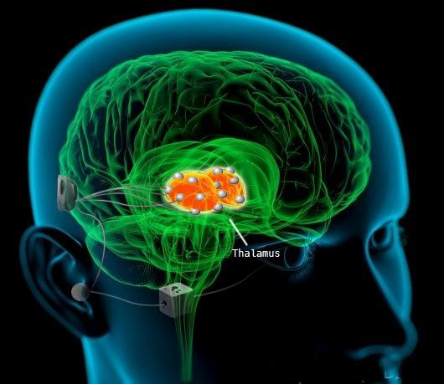
Relay and remote synchronization
Synchronization of two unlinked dynamical units mediated by a different one,
which does not synchronize with them
Circuits. R. Gutierrez PRE 88, 052908 (2013)
Brain Thalamo-cortical pathways
Lasers. I. Fisher, PRL 97, 123902 (06)
Traub, Nature 383 (96)

Slide 3
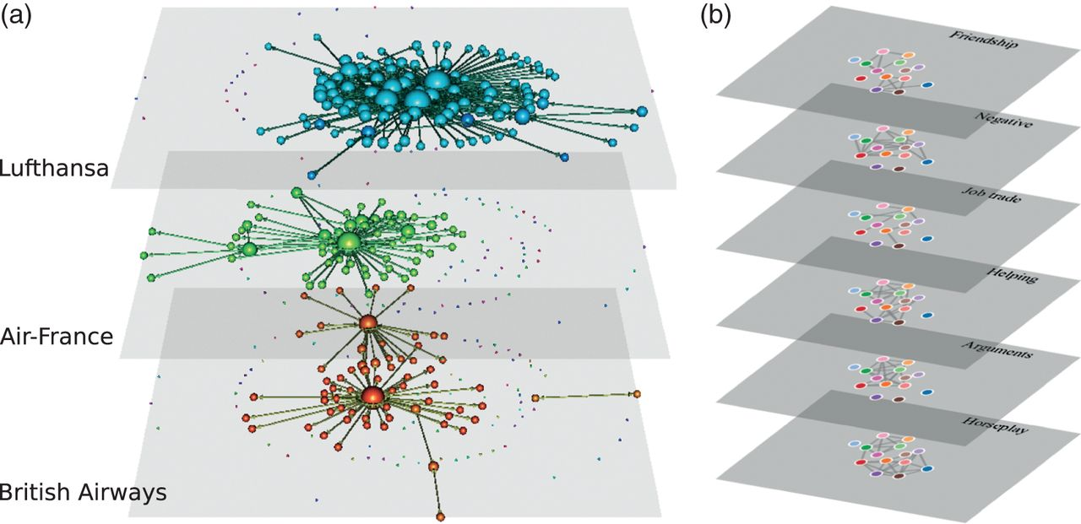
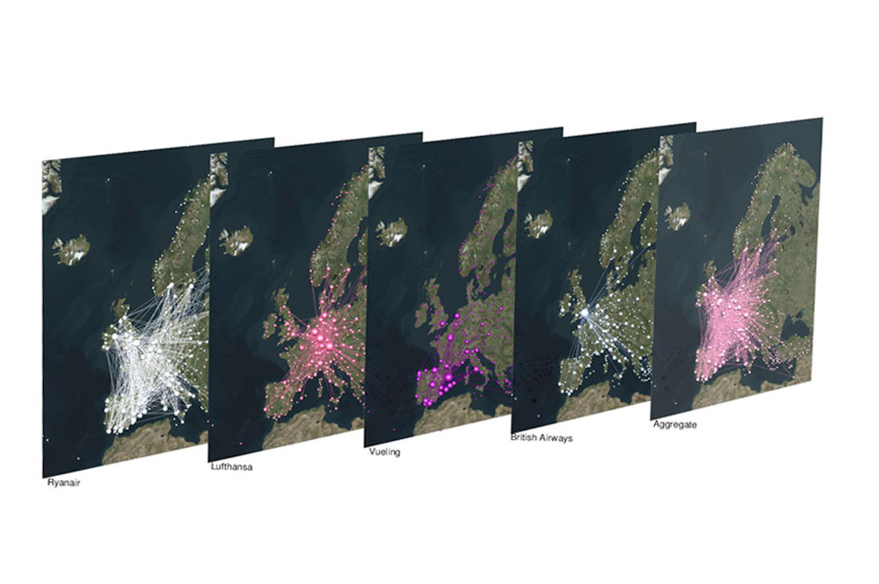
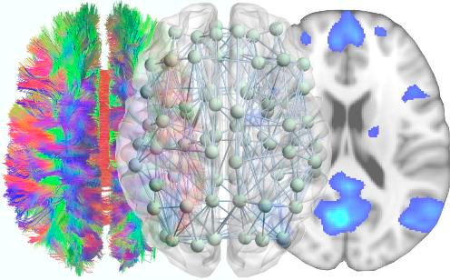
Multilayer networks
The units of the network are related using different types of relations which can be mapped into different layers
Transportation networks
Neural networks
Social networks
Structure of multilayer networks:
Networks of networks, interdependent networks, hypergraphs, multiplex networks, ...
See Phys. Rep. 544 (2014) for a review in multilayer networks
Notes:
<número>
As you probably know, in last years a lot of work has been made in multilayer network, a special kind of complex networks in which the nodes can be mapped into different layers, each one of them accounting for different types for relationships or different aspects of a larger structure.
A number of real networks respond to this kind of structure, as the different layer in a transportation network, the different levels of connectivity in the brain, o the social networks, in which a same person can be simultaneously part of a working networks, a friendship group, a family, etc.
Depending on the structure, the multilayers can be classified in multiplex, interdependent, hypergraphs, network of networks. You can see a recent review on the subject in this refecence.
<número>

Slide 4

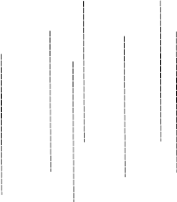

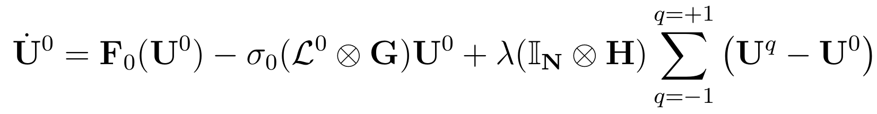
Relay synchronization in multiplex networks
U¹
σ₁
λ
Dynamics
Intra-layer
Inter-layer
σ₀
U⁰
λ
U⁻¹
σ₁
Dynamics:
N=500 chaotic Rössler oscillators by layer
Structure:
ER and SF networks
Notes:
Now instead of three units we are going to have a
network with three layers with the same number of nodes, two of them the grey U ones are identical both in dynamics and topology, and differents from the relay layer V, which are going to have different dynamics and can have different stucture. For the interlayer we are going to have a multiplex structure, meaning that each node are linked only to the counterpart.
In this system we do not look for complete intralayer synchronization, but interlayer synchronization, in which the U layers remain in a turbulent state, the same for both of them.
In our simulations we are goingo use Rossler ocillators with two set of paramenters, and different topologies to see their influence.
<número>

Slide 5
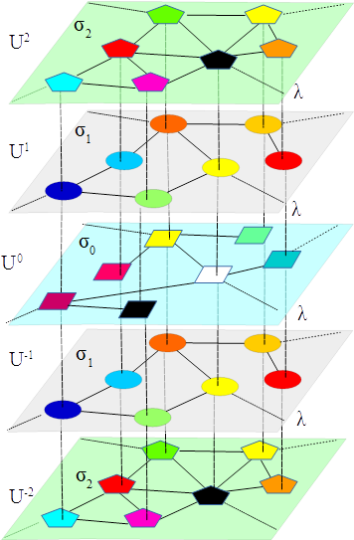
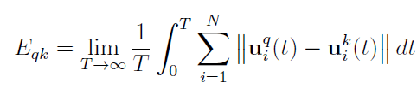
.
High order relay synchronization in multiplex networks
.
.
In general, 2M+1 layers
k=-M,-M+1..0…M
Specular symmetry
  Dynamical F_{k}=F_{-k}
  Structural L^{k} =L^{-k}
Interlayer synchronization error
.
.
.

Slide 6
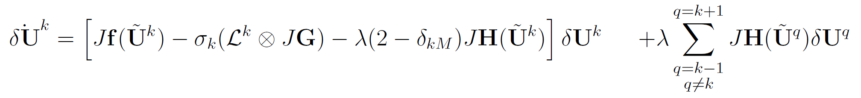
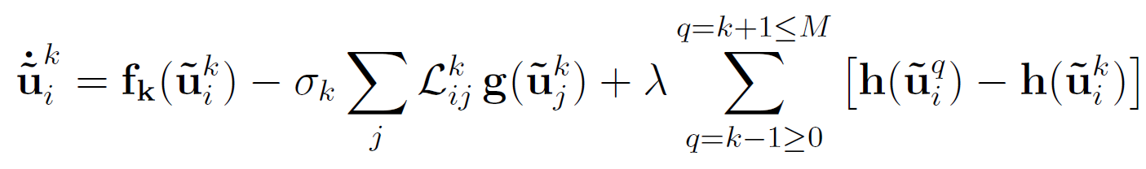
Master Stability Function in the relay synchronization in multiplex networks
In case of relay synchronization
U^{k} = U^{-k}
δU^{k} = U^{k} - U^{-k}
We can use perturbative approach:
U¹
U⁰
0
MLE < 0
When inter-layer synchrony:

Slide 7
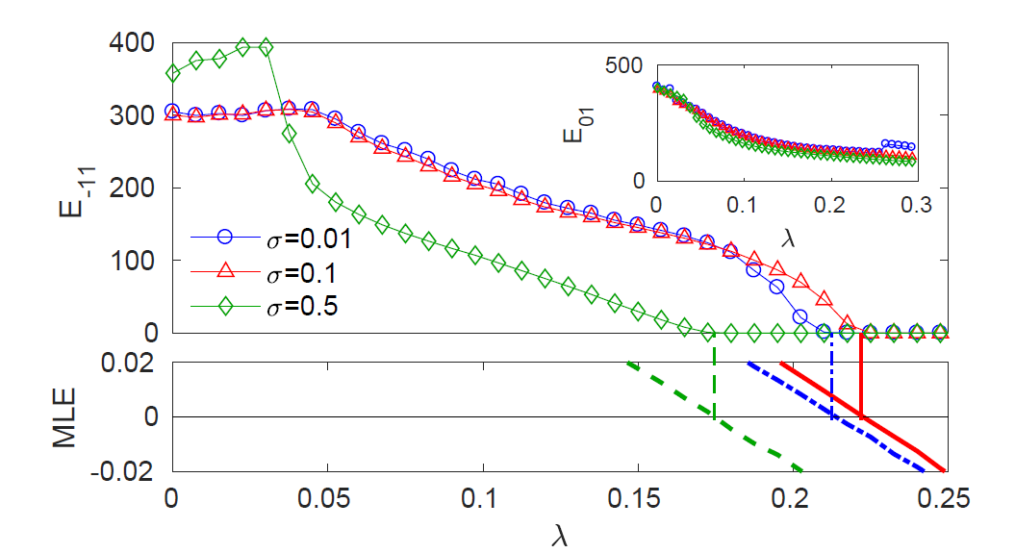
Relay synchronization in triplex networks (M=1)
Simplest case: TRIPLEX same topology L¹ =L⁰ and coupling σ₀= σ₁
Relay synchronization for high enough interlayer coupling λ
No synchronized
to relay layer
MLE perfectly fits
the dynamics.
∗
λ∗
Critical
couplings
Notes:
<número>

Slide 8
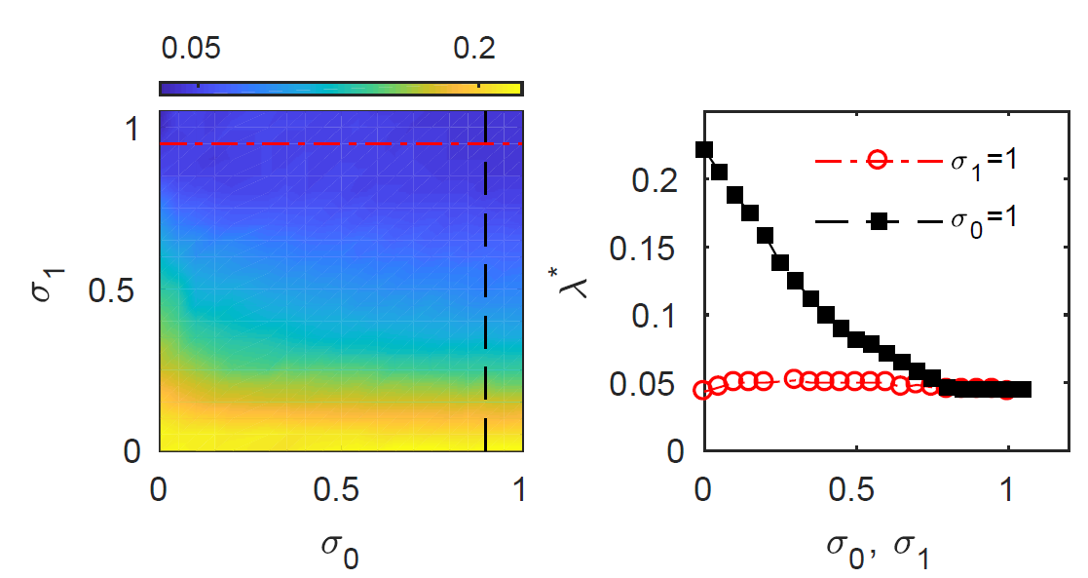
Relay synchronization in triplex networks with same topology L¹ =L⁰
Simplest case: TRIPLEX same topology L¹ =L⁰ and diffent coupling
Relay synchronization for high enough interlayer coupling λ
decreases with σ₁
∗
λ
barely depends on σ₀
Notes:
<número>

Slide 9
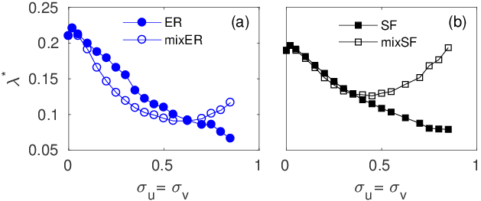
Relay synchronization in triplex networks with different topology
Triplex with different topology L⁰ ≠ L¹
σ₁= σ₀
ER
SF
SF
ER
ER
SF
Relay SF layer improves the synchronization betweneen ER layers
Relay ER layer difficults the synchronization betweneen SF layers

Slide 10

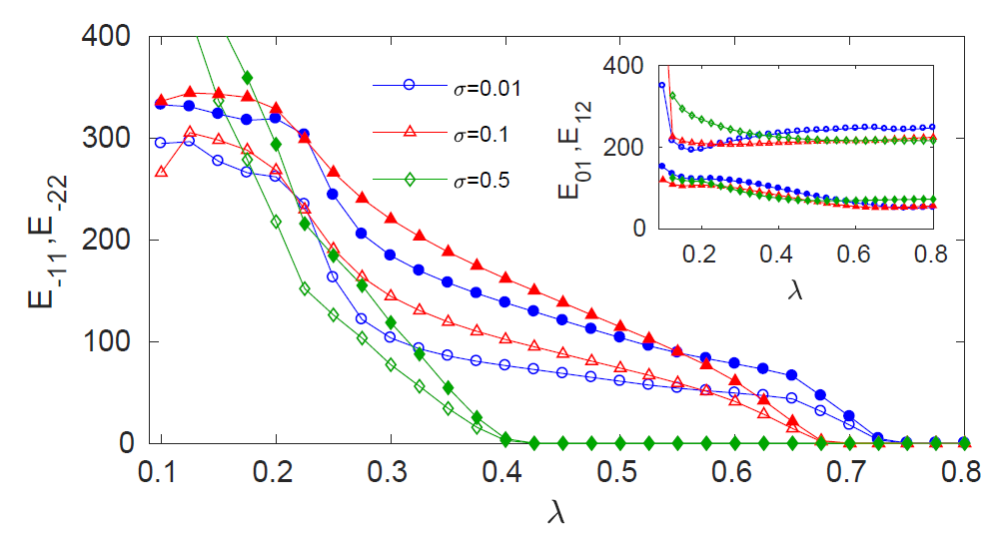
High order relay synchronization M=2
Pentaplex networks with same topology
All mirror pairs synchronize at the same interlayer coupling

Slide 11
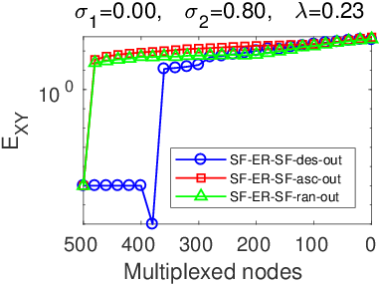
Robustness: relay under demultiplexing
Interlayer links are removed until relay synchrony is lost
Criteria:
      Random
      Ascending degree of U¹ layers
      Descending degree of U¹ layers
The hubs can be demultiplexed without affecting the relay !
E₋₁₁
Notes:
<número>

Slide 12
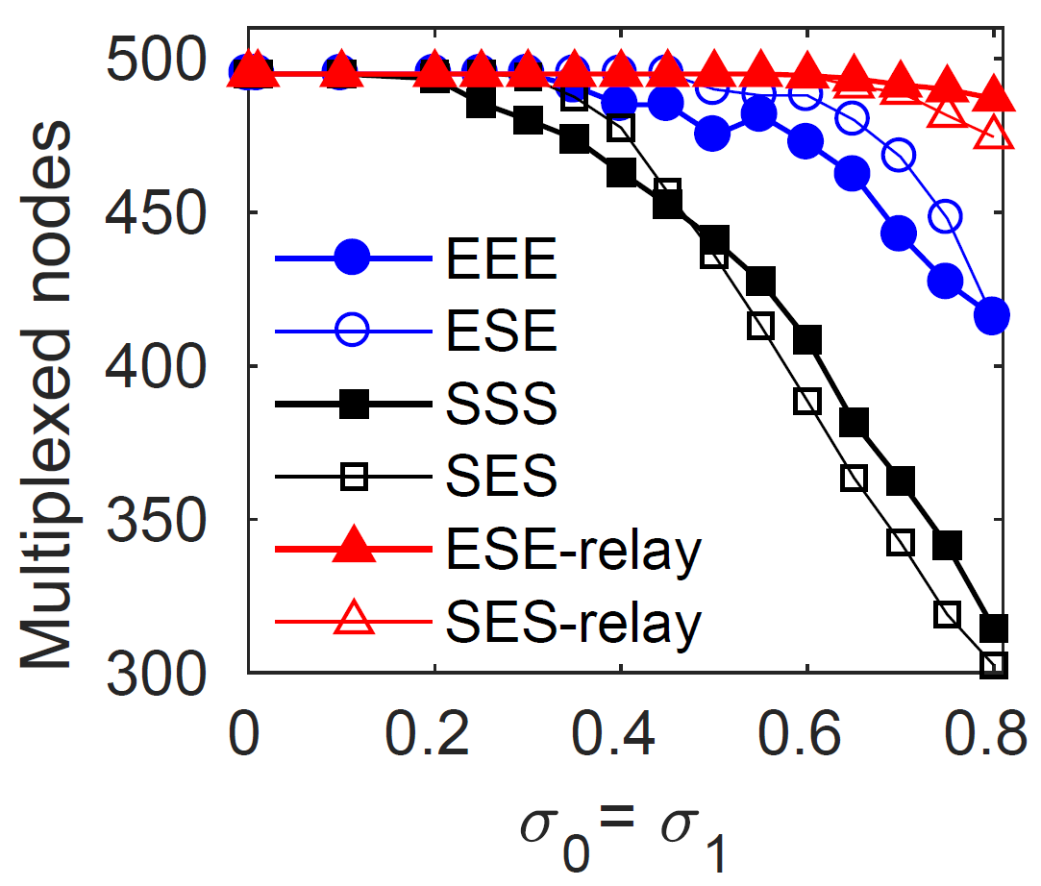
Robustness: relay under demultiplexing
Only demultiplexing in descending order
Demultiplexing along the degree order of the relay layer is equivalent to random order.
SF networks are very robust to demultiplexing
The leaves sustain the synchronization

Slide 13
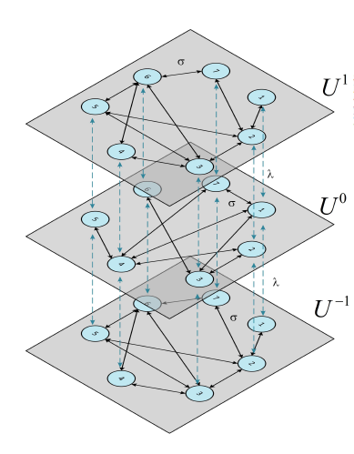
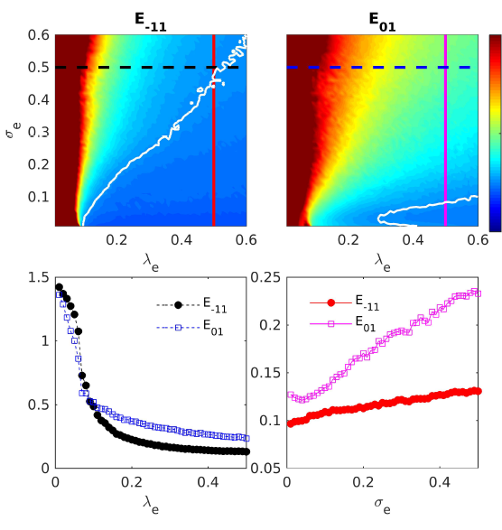
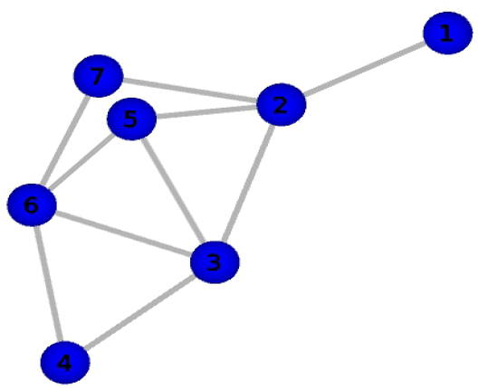
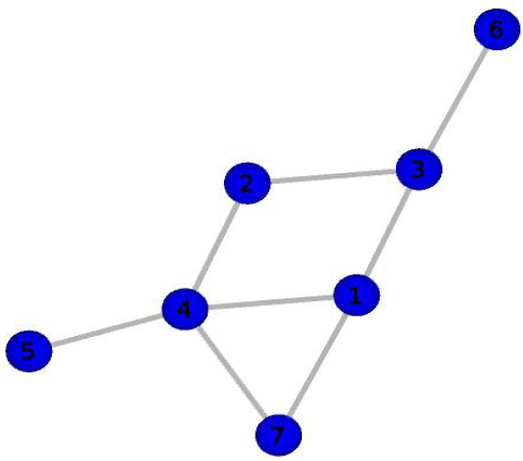
Experimental network relay synchronization
The experiment consist of 3 nets of 7 electronic Rössler-like oscillators each

Slide 14
Conclusions
Study of inter-layer high order relay synchronization in multiplex
MSF framework for inter-layer dynamics in general multiplex:
- Existence and stability of relay inter-layer sync solution in identical layers.
Robustness against demultiplexing.
  The relay synchrony depends on the low degree nodes.
Experimental demostration in electronical multiplex layers
Related publications:
Relay synchronization in multiplex networks
I. Leyva, I. Sendiña-Nadal, R. Sevilla-Escoboza, V. P. Vera-Avila, P. Chholak
Scientific Rep. 8, 8629 (2018)
Inter-layer synchronization in multiplex networks of non-identical layers
I. Leyva, R. Sevilla-Escoboza, I. Sendiña-Nadal R. Gutiérrez, J.M. Buldú, and S. Boccaletti
Scientific Rep. 7, 45475 (2017).
Inter-layer synchronization in multiplex networks of identical layers,
R. Sevilla-Escoboza, I. Sendiña-Nadal, I. Leyva, R. Gutiérrez, J.M. Buldú, and S. Boccaletti,
Chaos 26, 065304 (2016).
Notes:
<número>

Slide 16
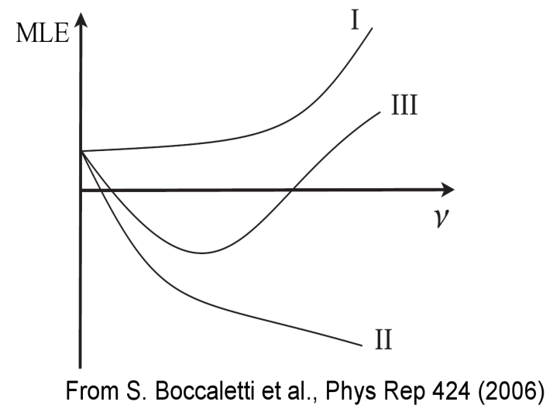
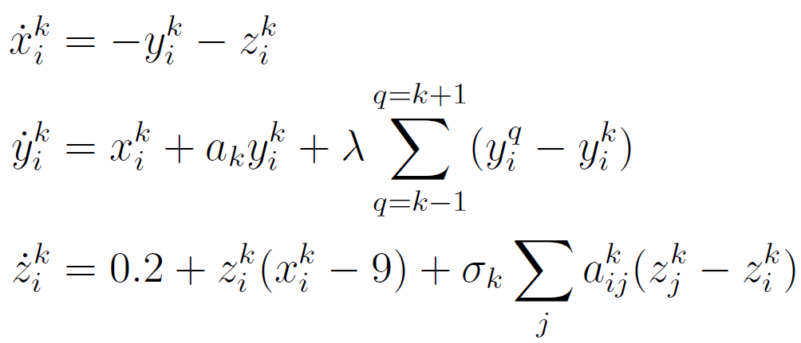
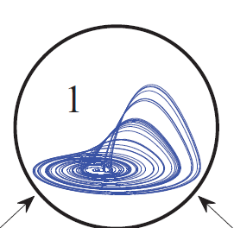
Relay synchronization in multiplex networks
Single unit dynamics: Rossler
H=(0,y,0)
Class II
for inter-layer sync
G=(0,0,z)
Class I
for intra-layer sync
Chaotic for every a_{k}
Intralayer
synchronization error
Notes:
<número>
Let’s go to our example: we use networks of Rossles oscillators, for both Erdos-Reyni and scale-free topologies, and initially we set them to be class I for intralayer solution, and class II for interlayer, which means that interlayer synchrony is possible, but intralayer it is not. To check if our linear aproximation is a good one, are going to run simultaneously the full and the reduced system, and we monitor the inter, intra synchronization error, and the interlayer lyapunov exponent.
<número>

Slide 17
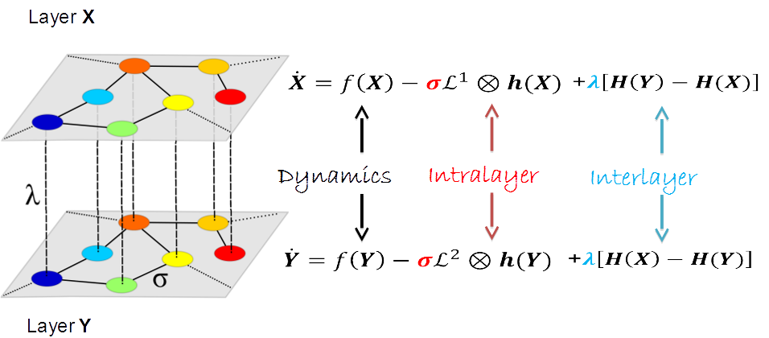
Inter-layer synchronization in multiplex networks
Intra-layer
synchro
Intra + Inter
Inter-layer
synchro
Chaos 26, 065304 (2016)
Sci. Rep. 7, 45475 (2017).
Notes:
<número>
In this works we want to give a step in this direction by studying the intra and, very specially, the interlayer synchronization properties of the mutiplex networks formed by N identical m dimensional dynamical systems whose states are X and Y respectively. We consider that The laplacian matrices can in principle be differnect, and sigma and lambda are the intra and interlayer coupling. Therefore this is a 2*N* m dynamical system.
<número>

