Slide 1

Low Dimensional Manifolds for
Neural Dynamics
Sara A. Solla
Northwestern University
Dynamical Principles of Biological and Artificial Neural Networks
Banff International Research Station
January 10, 2022

Slide 2
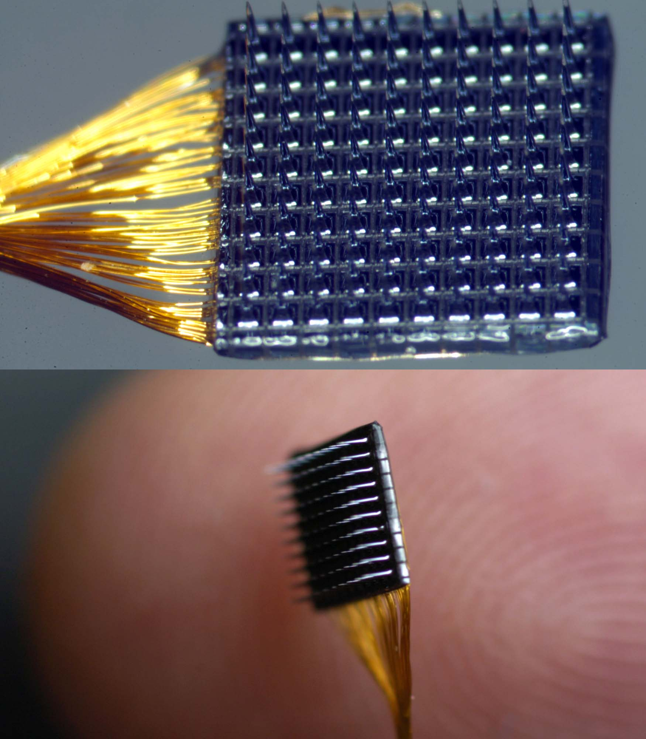
Multi Electrode Arrays (MEAs)

Slide 3
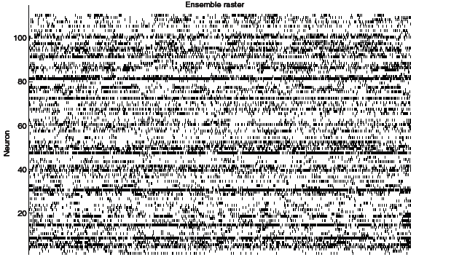
Population activity
110 neurons, M1, hS3

Slide 4
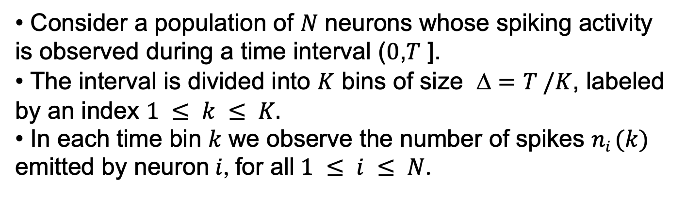
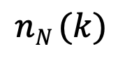
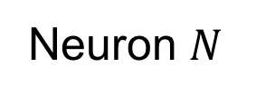
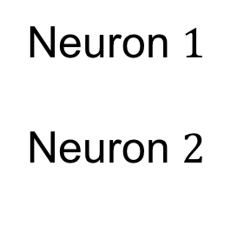
Analysis of population activity
Consider a population of $N$ neurons whose spiking activity is observed during a time interval ($0$,$T$ ].
The interval is divided into $K$ bins of size $=T /K$, labeled by an index $1 ≤ k ≤ K.$
In each time bin $k$ we observe the number of spikes $ni (k)$ emitted by neuron $i$, for all $1 ≤ i ≤ N$.
Neuron $1$
Neuron $2$
Neuron $N$
3
2
1
0
0
4
3
0
0
2
1
0
$$nN (k)$$

Slide 6
Neural population activity
A simple motor task
Neural manifolds for motor control
The unreasonable effectiveness of linear methods

Slide 7
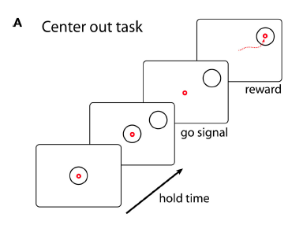
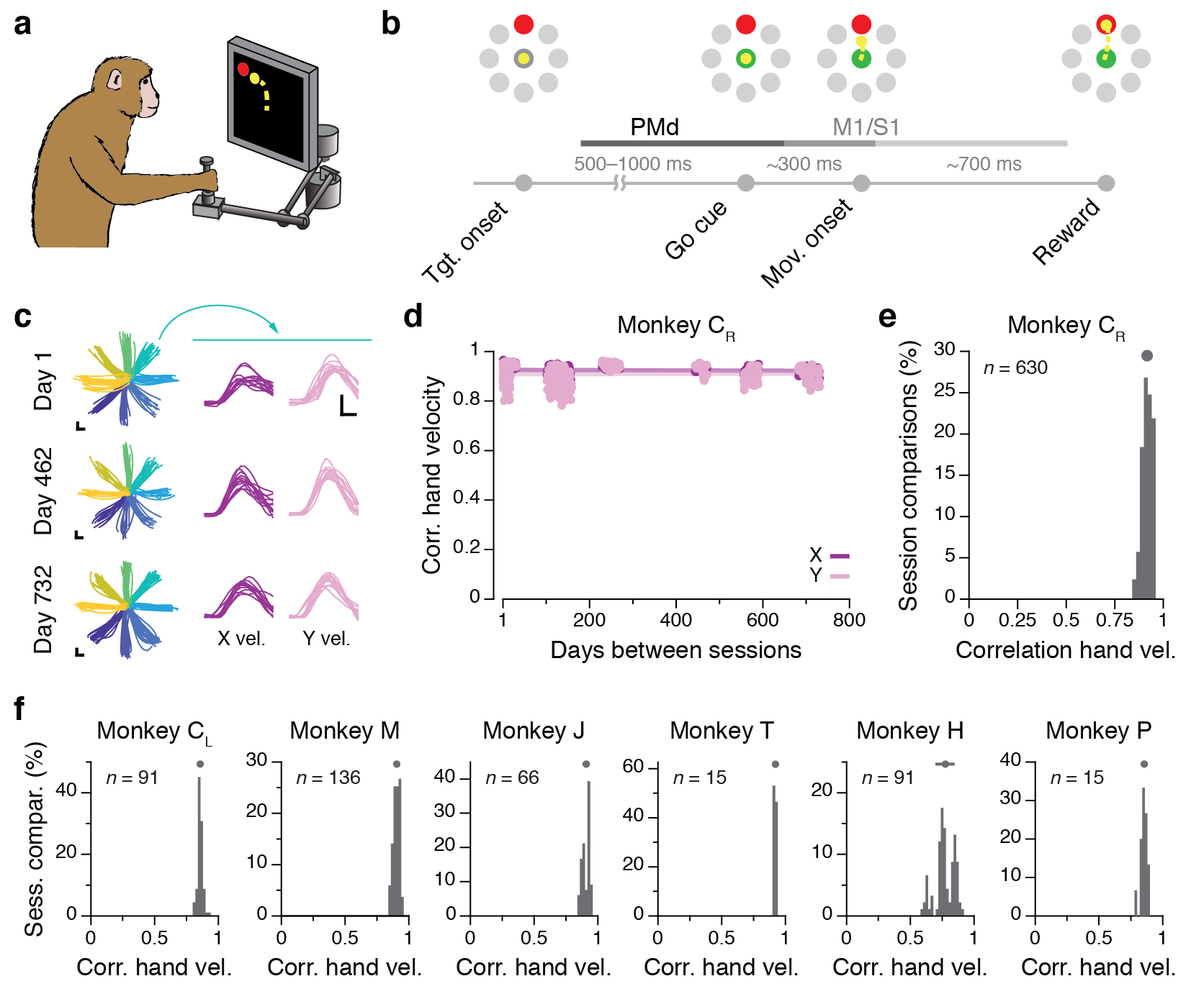
A simple motor task: center-out reaches
Instructed delay center-out reaching task

Slide 8
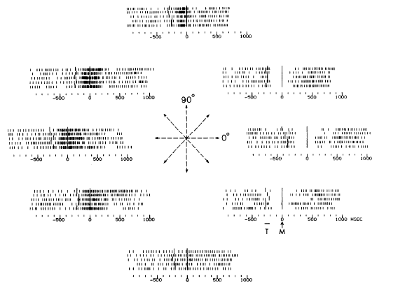
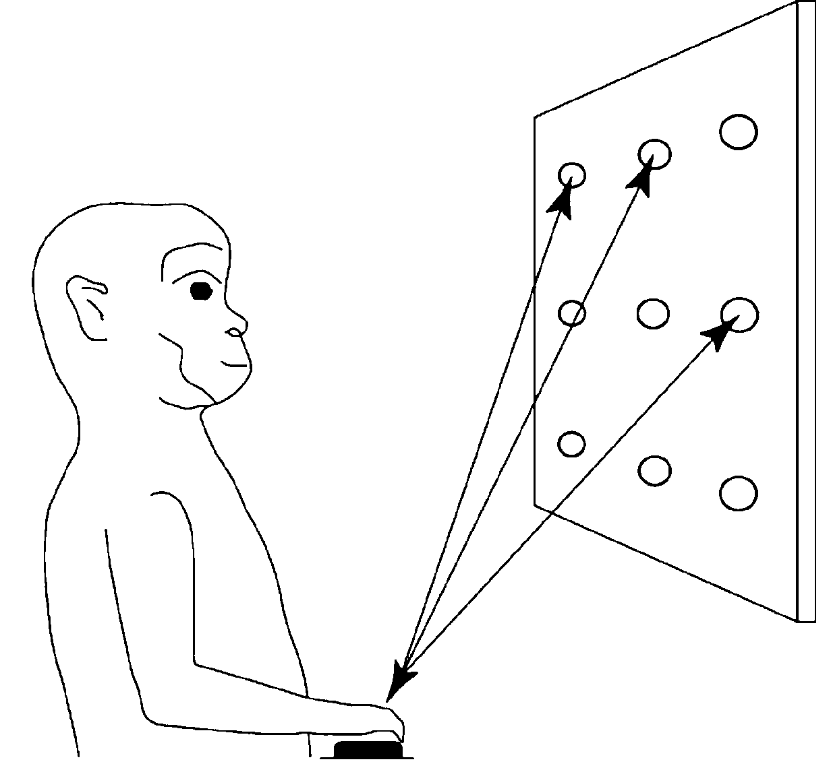
Neural activity: variability and specificity
Single neuron recordings
Georgopoulos, Kalaska, Caminity, Massey, J of Neurosci (1982)

Slide 10
Santhanam, Yu, Gilja, Ryu, Afshar, Sahani, Shenoy, J Neurophysiol (2009)

Slide 11
Neural population activity
A simple motor task
Neural manifolds for the control of movement
The unreasonable effectiveness of linear methods

Slide 13
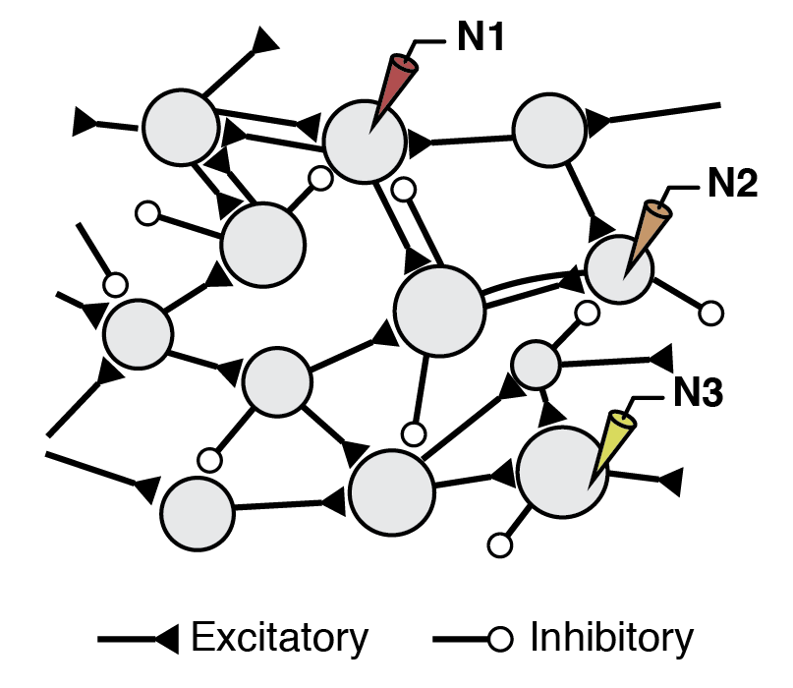
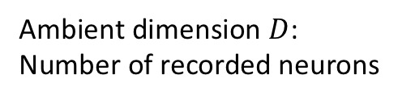
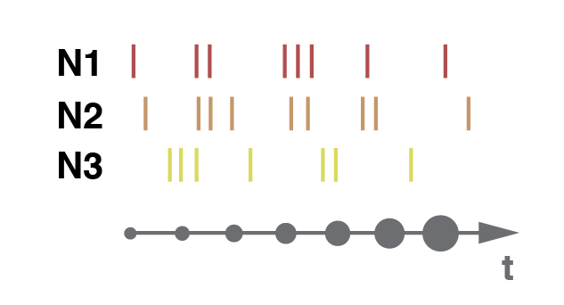
Population dynamics: the empirical neural space

Slide 14
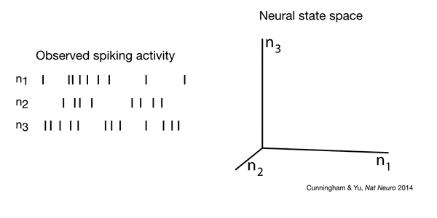
Population dynamics: the empirical neural space
n₁
n₂
n₃

Slide 15
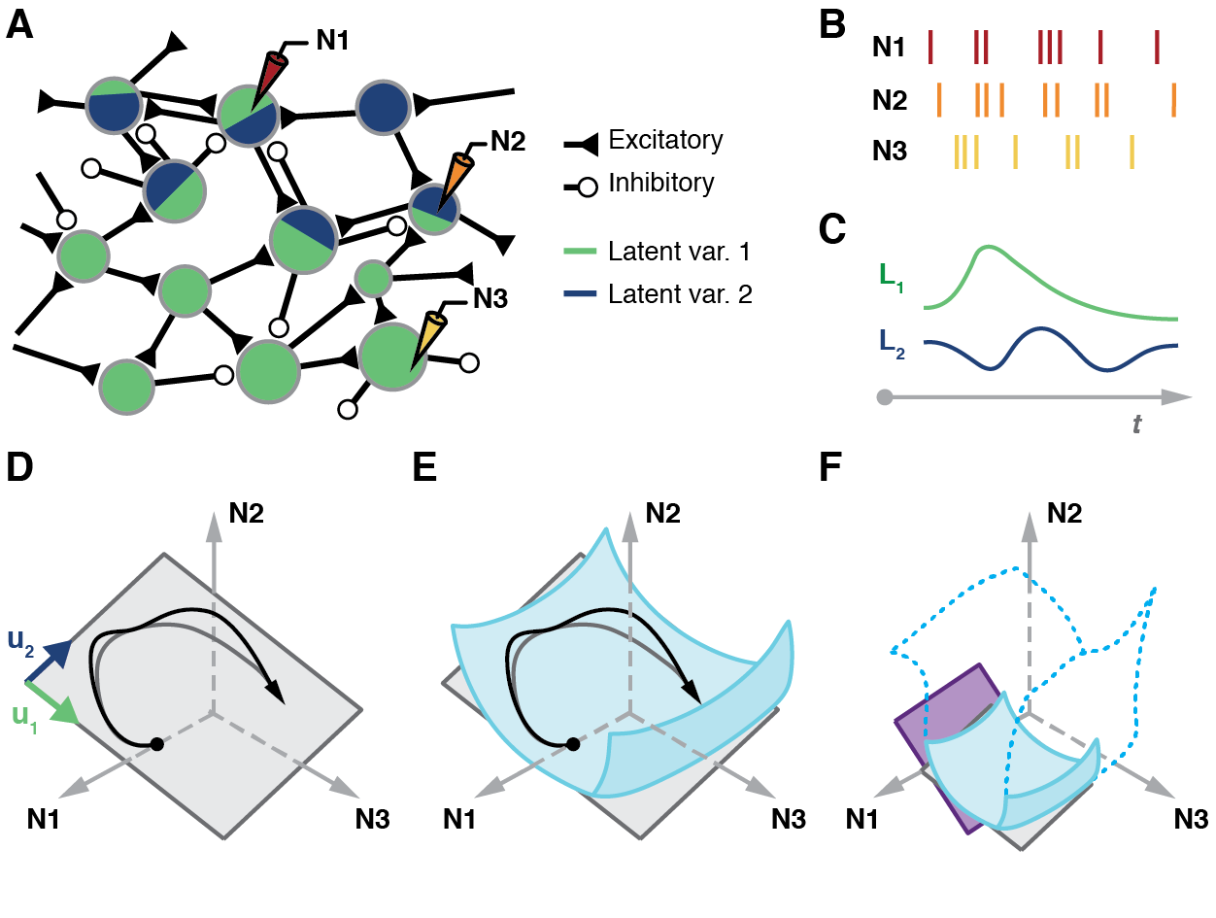
Dimensionality reduction: neural modes and latent variables
n₁
n₁
n₂
n₂
n₃
n₃
n₃
neural modes
n₁
n₂
n₃
neural manifold
DIMENSIONALITY REDUCTION
linear or nonlinear?
n₁
n₂

Slide 16
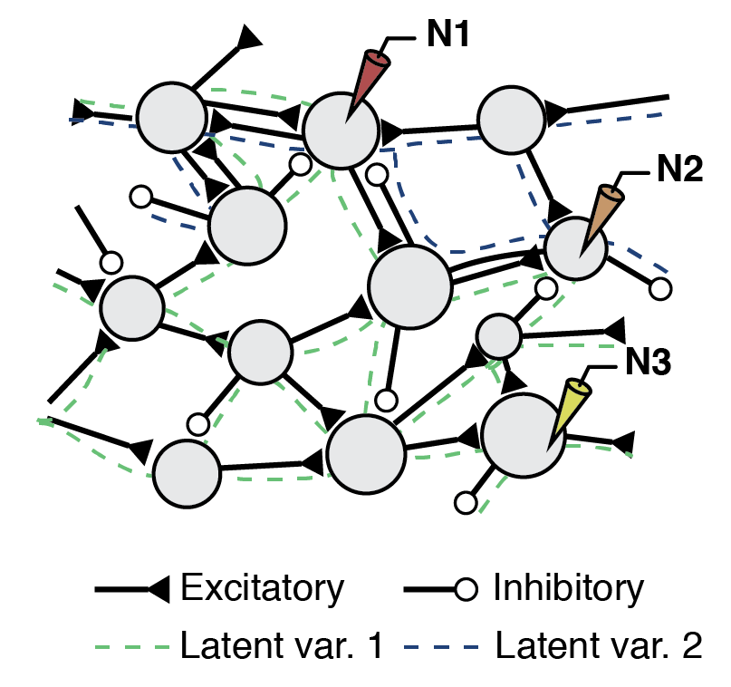
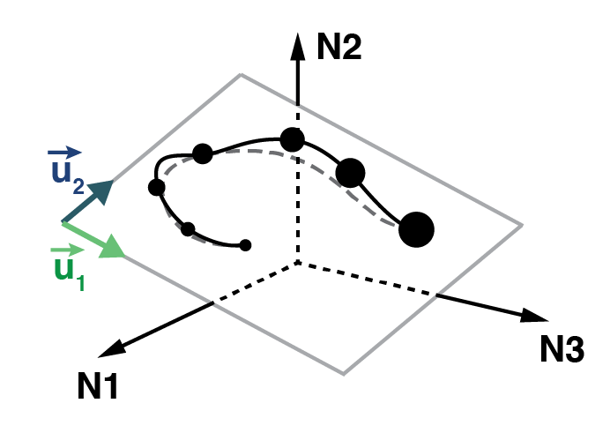
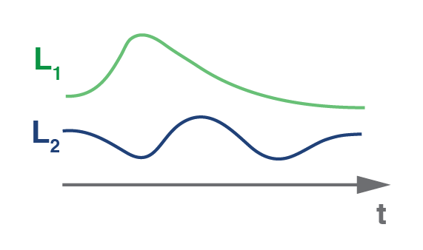
Dimensionality reduction: neural modes and latent variables
n₁
n₃
n₂
n₃
n₂
n₁

Slide 17
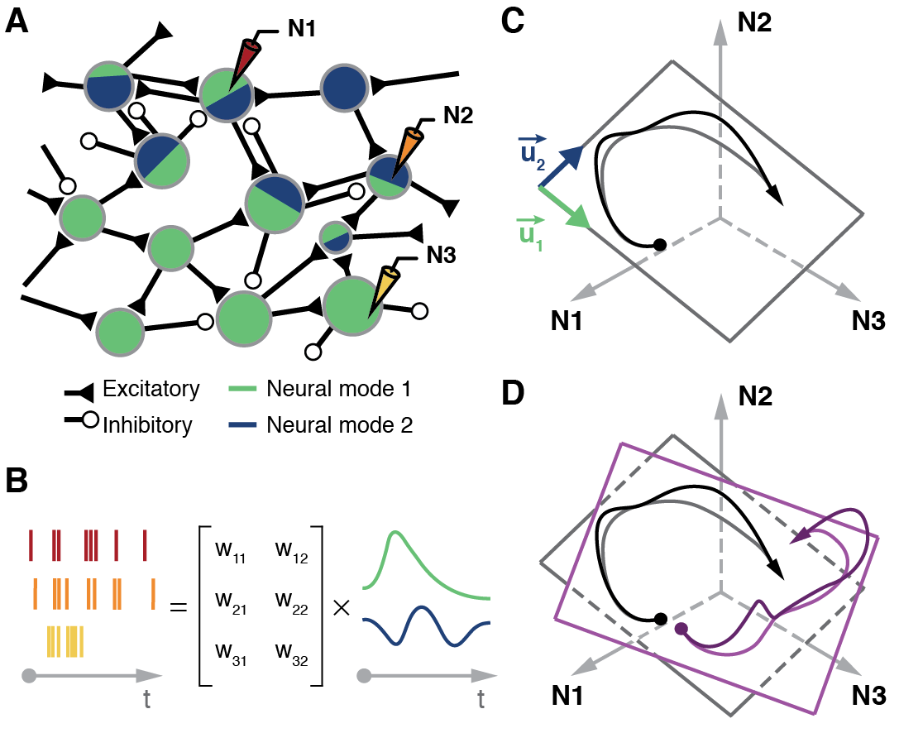
Population dynamics: latent variables as a generative model
n₁
n₁
n₂
n₂
n₃
n₃
n₃

Slide 18
Neural population activity
A simple motor task
Neural manifolds for the control of movement
The unreasonable effectiveness of linear methods

Slide 19
Behavioral stability

Slide 20
In order to verify this hypothesis, we need to compensate for the fact that the true latent dynamics is being projected onto different empirical manifolds on different days.

Slide 21
Alignment of latent dynamics

Slide 22
Day-specific neural modes and manifolds

Slide 23
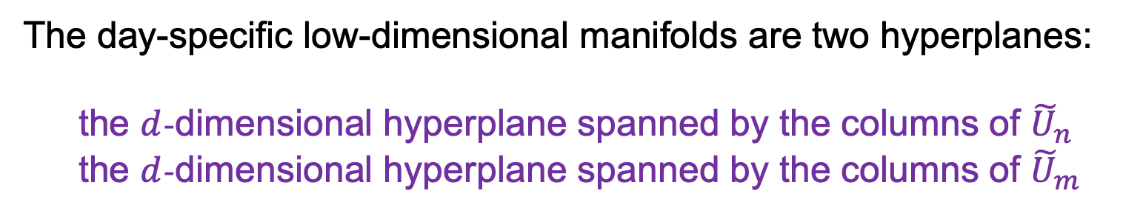
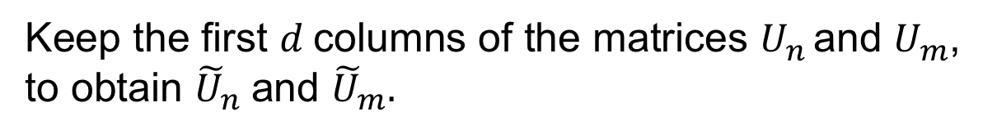





Day-specific neural modes and manifolds
Keep the first $d$columns of the matrices $U_{n}$and $U_{m}$, to obtain ${\tilde{U}}_{n}$and ${\tilde{U}}_{m}.$
$$D$$
$$\tilde{U}$$
$$U$$
$$d$$
$$D$$
The day-specific low-dimensional manifolds are two hyperplanes:
the $d$-dimensional hyperplane spanned by the columns of ${\tilde{U}}_{n}$
the $d$-dimensional hyperplane spanned by the columns of ${\tilde{U}}_{m}$
These column vectors are the day-specific neural modes
$d$is the flat dimension of the day-specific manifolds

Slide 24







$$D$$
$$d$$
$$d$$
$$L$$
=
$${\tilde{U}}^{T}$$
*
$$X$$
$$T$$
$$D$$
$$T$$

Slide 25
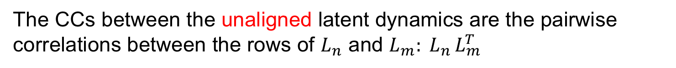
Canonical Correlation Analysis (CCA)
The CCs between the unaligned latent dynamics are the pairwise correlations between the rows of $L_{n}$ and $L_{m}: L_{n }L_{m}^{T}$

Slide 26
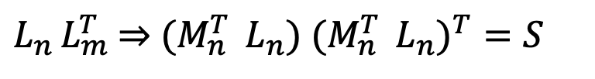
$L_{n }L_{m}^{T}$ $⇒$ ${(M}_{n}^{T }$ $L_{n}) {{(M}_{n}^{T } L_{n})}^{T}=S$

Slide 27
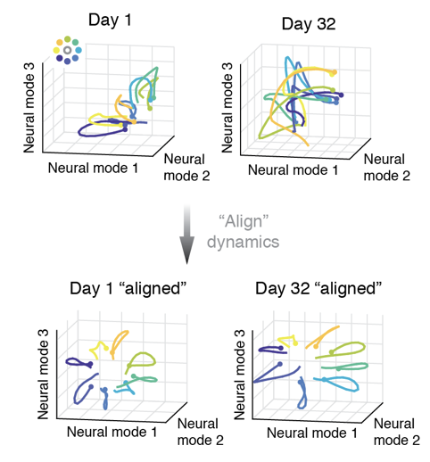
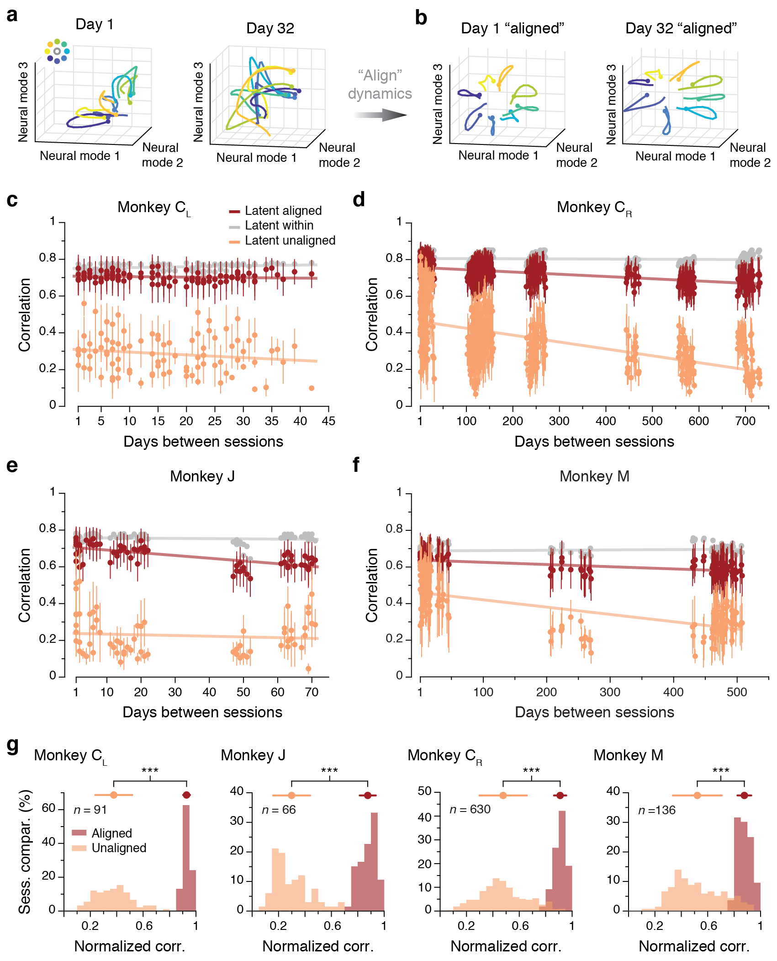
Stability of M1 latent dynamics

Slide 28
Alignment of latent dynamics
Gallego, Perich, Chowdhury, Solla, Miller, Nature Neurosci (2020)

Slide 29
Neural manifolds for the control of movement
Juan A. Gallego Matthew G. Perich
Raeed H. Chowdhury Lee E. Miller
Northwestern University

Slide 30
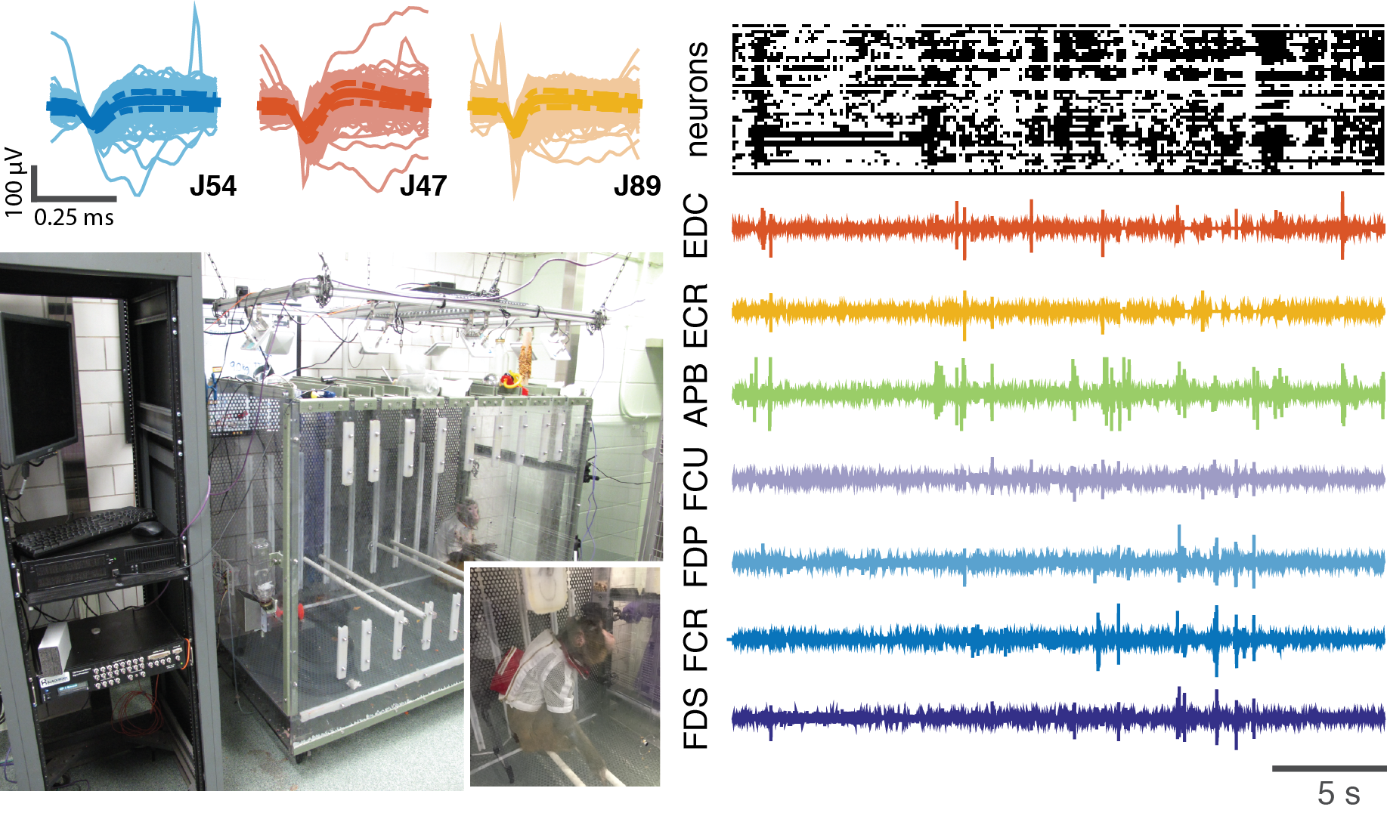
The future: natural behavior
Notes:
Connection with Ganguli’s ideas.
Do we have enough neurons in an array to map the `universal manifold’ that encompasses all natural behaviors?
Nonlinear methods for extending these various approaches to dimensionality reduction.

Slide 31
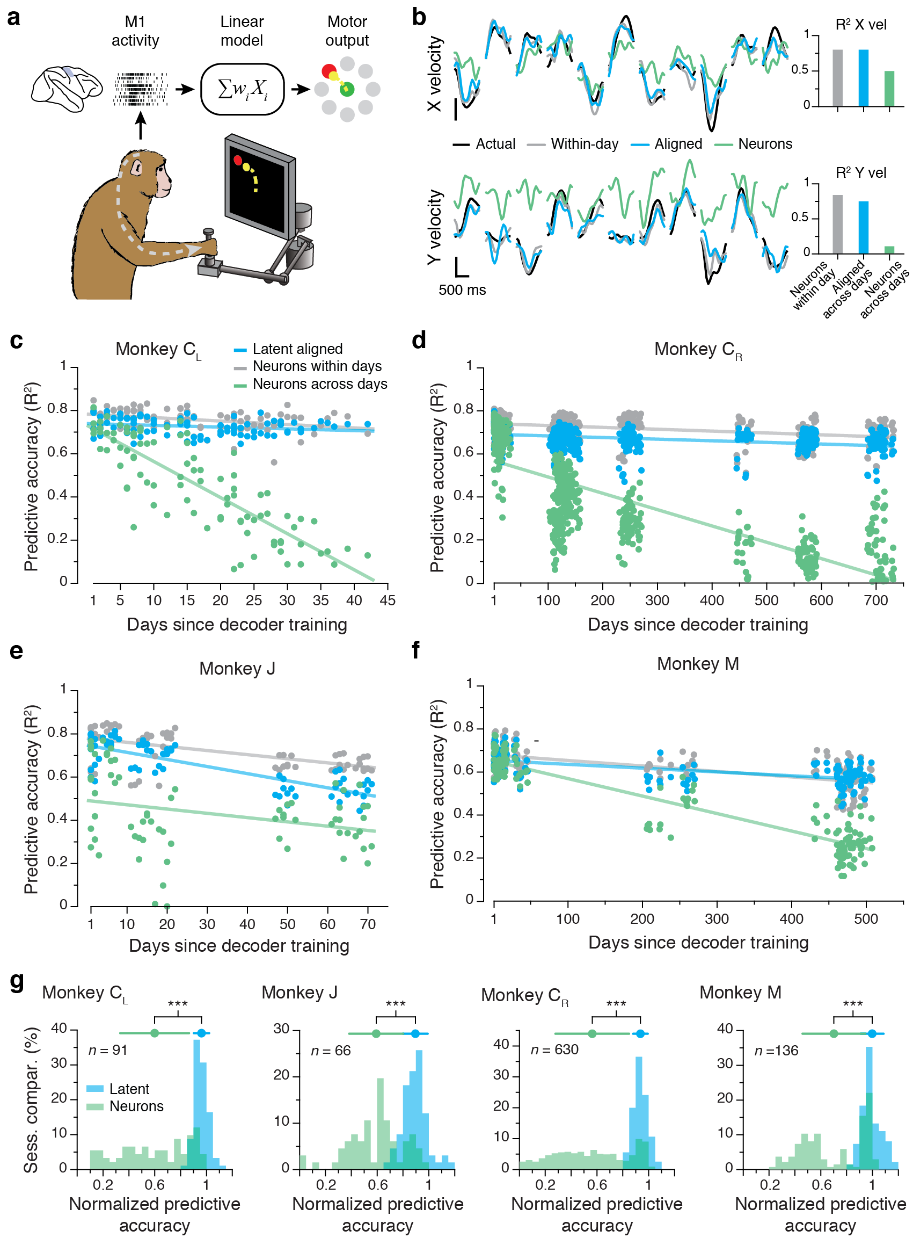
Stable prediction of movement kinematics

Slide 32
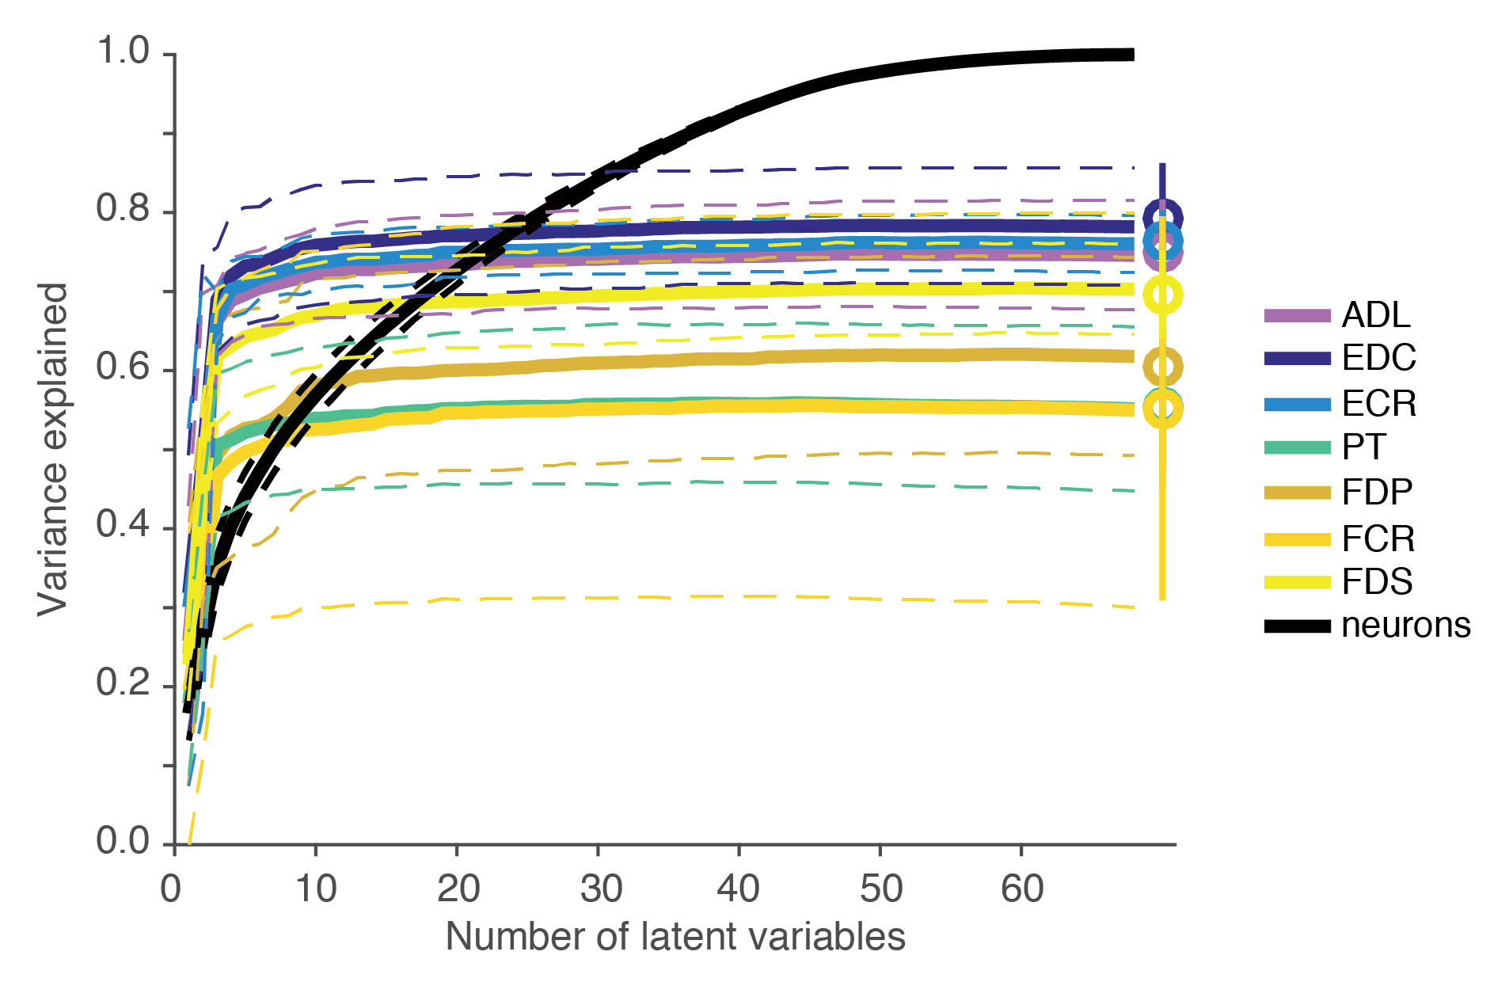
Prediction of muscle activity

