Slide 1


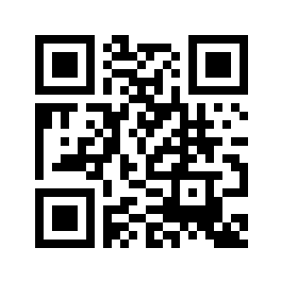

Learning biology from the data with interpretable machine learning
Interpretability in Artificial Intelligence
1-6 May 2022, BIRS, Canada
Joaquín Dopazo
Clinical Bioinformatics Area, Fundación Progreso y Salud,
Instituto de Biomedicina de Sevilla (IBIS)
FPS/ELIXIR-es, RD-Bioinformatics CIBERER)
Hospital Virgen del Rocío, Sevilla, Spain
http://www.clinbioinfosspa.es
@xdopazo, @ClinicalBioinfo

Slide 2
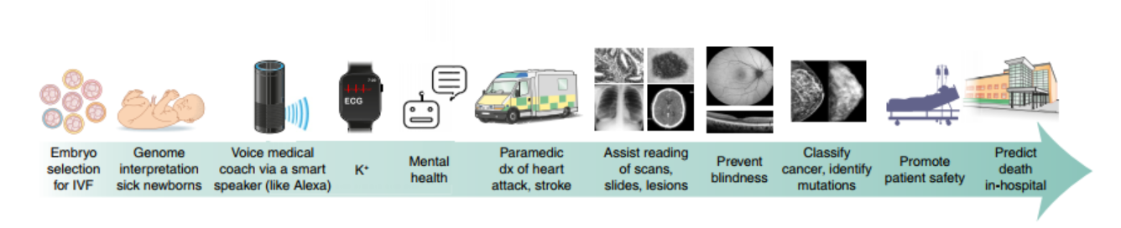
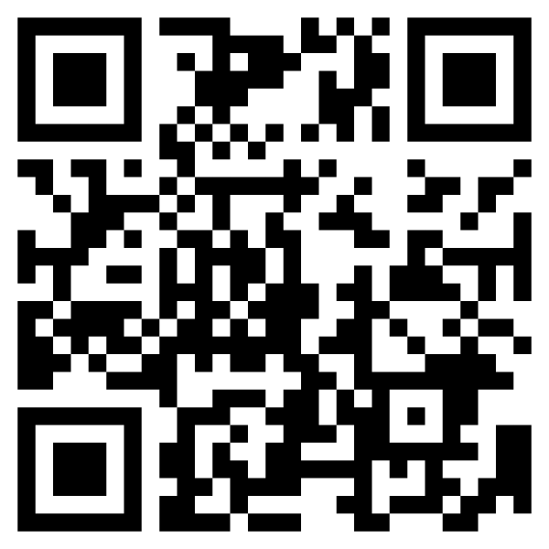
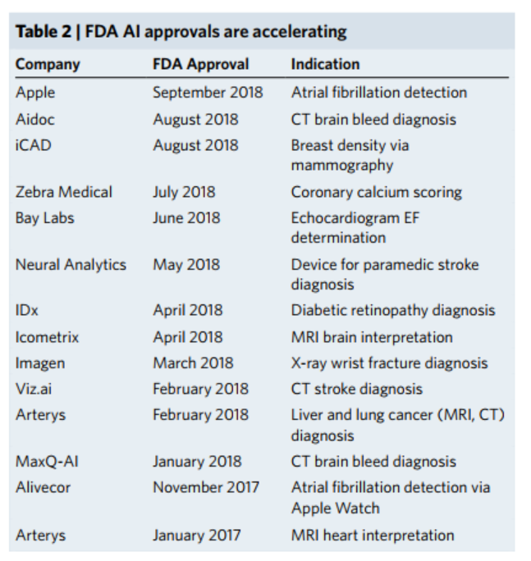
AI applications in health
https://www.nature.com/articles/s41591-018-0300-7
Successful AI applications are related with image, text and signal analysis (see Topol, 2019, Nat. Med.) Properties of these data:
Easy encoding,
Simple relationships between features (time or space proximity)
Many data
Contrarily, genomic data:
Complex encoding (different questions different encodings)
Complex relationships among features (systems biology)
Not so many data

Slide 3
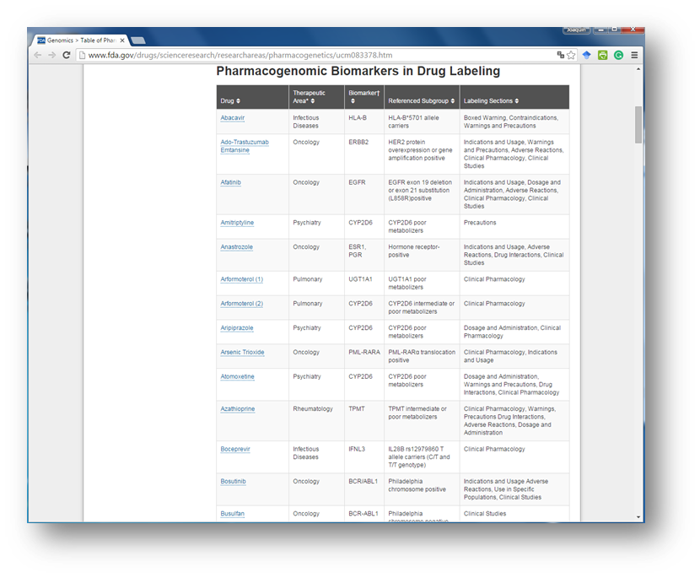
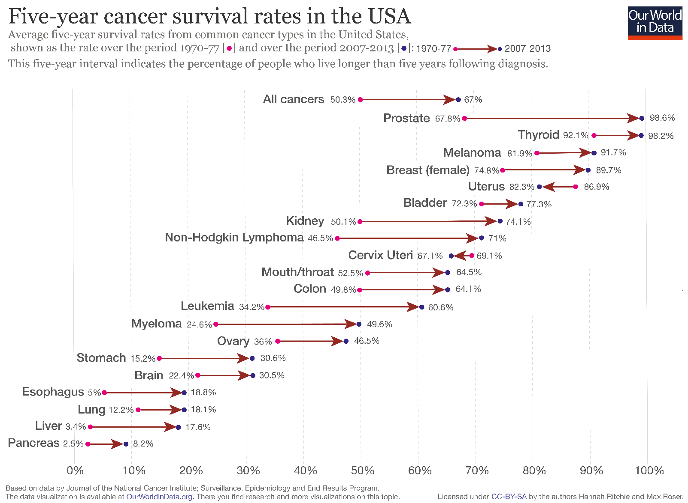
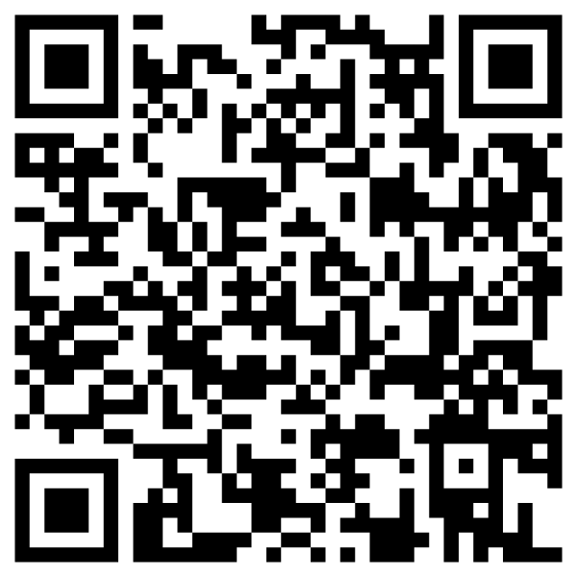
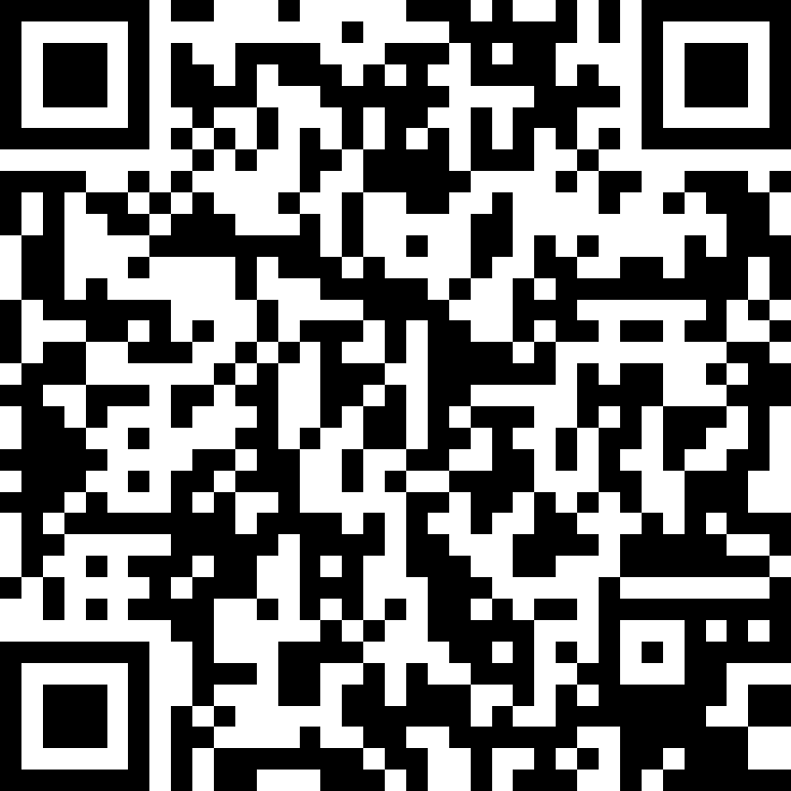
Biomarkers as proxies of phenotypes
Single-gene biomarkers are the result of probabilistic associations between genetic variants and traits (mainly response to drugs) and have had a clear clinical impact.

Slide 4
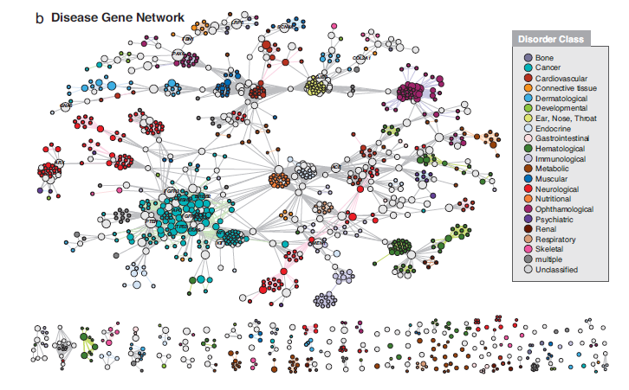
While most biomarkers are single gene variants, most human genetic diseases have a modular nature
Conventional single-gene biomarkers have a demonstrated clinical utility. However, their success is purely probabilistic, often modest and frequently lack any mechanistic anchoring to the fundamental cellular processes responsible for the disease or therapeutic response.
Modular nature of genetic diseases: Causative genes for the same or phenotypically similar diseases generally belong to the same biological module (either a protein complex, a sub-network of protein interactions, a pathway, etc.)
Disease genes are close in the interactome (Goh 2007 PNAS)

Slide 5
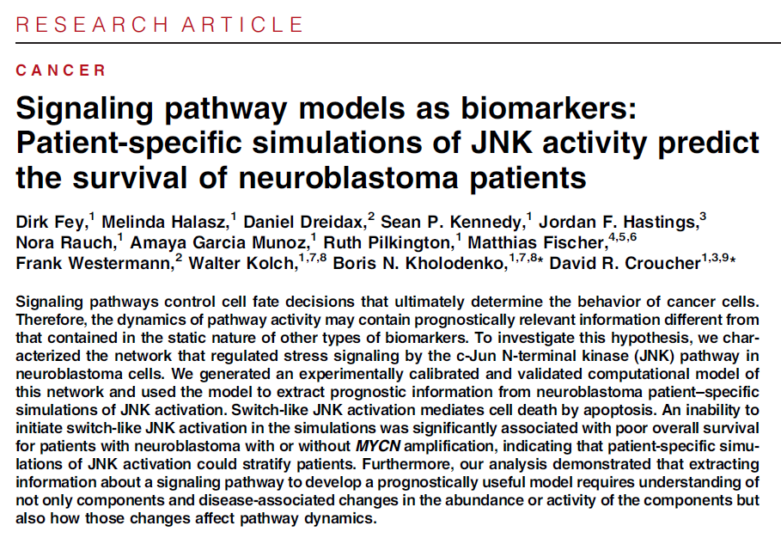
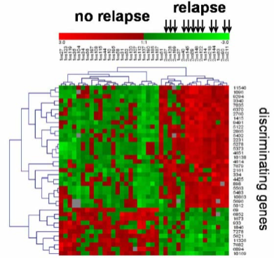
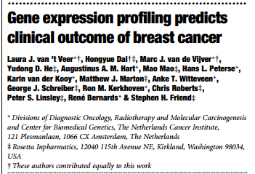
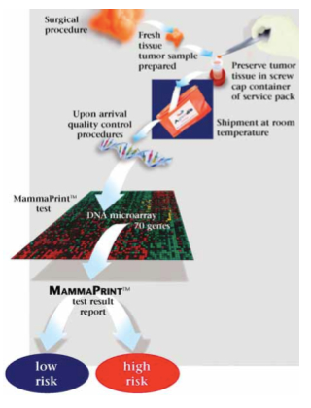
Multigenic biomarkers: towards mechanistic biomarkers
MammaPrint, an example of successful breast cancer decision support test based on a multigenic biomarker
Beyond static biomarkers—The activity of signalling networks as an alternate biomarker?
Fey et al., Sci. Signal. 8, ra130 (2015).
Inability of JNK activation (that mediates apoptosis) is associated to bad prognostic, irrespective of MYCN amplification status. JNK activity was more associated to survival than any component gene
risk= f(gene₁, gene₂, … gene₇₀)
Construct: activity inferred

Slide 6

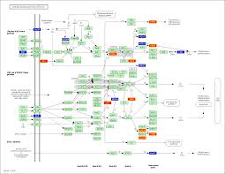
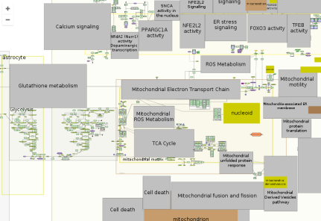

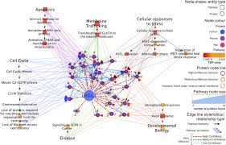
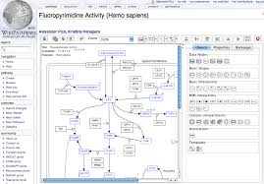
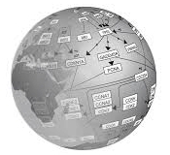
Defining the disease map.
Pathways: maps of cell activity
disease-maps.org/
www.genome.jp/kegg
Oncogenesis
Alzheimer
More disease maps…
Parkinson
reactome.org
www.wikipathways.org/

Slide 7
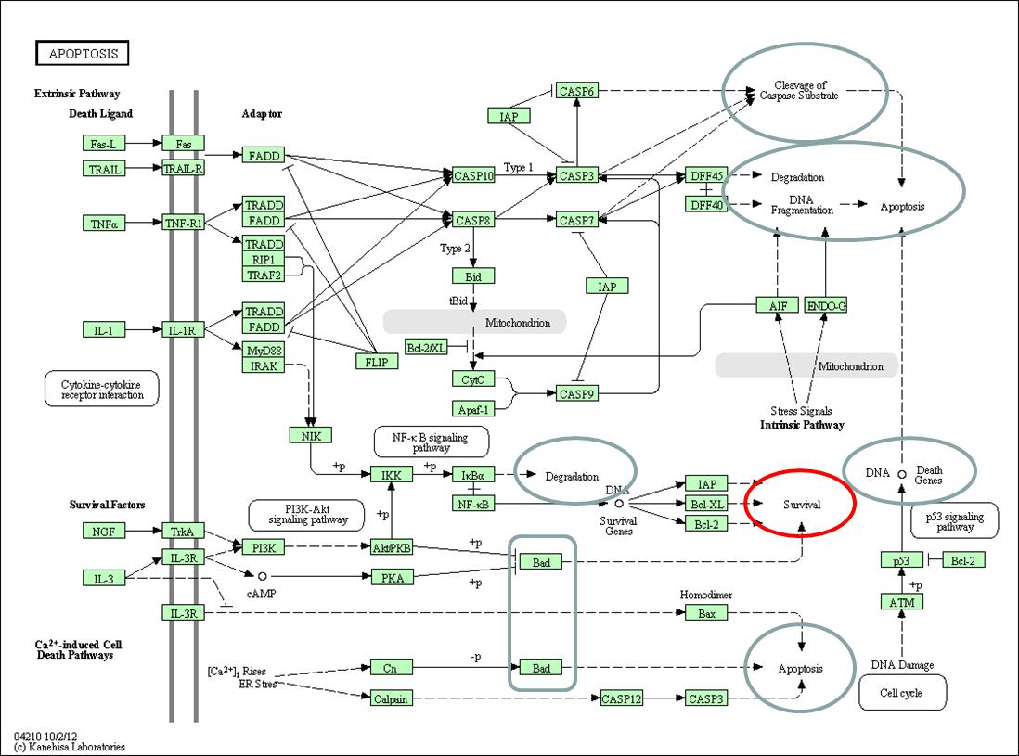
Defining the activity of the disease map
Gene sub-pathway pathway
Enrichment methods (pathway-level): Different and often opposite cell behaviors are triggered by the same pathway.
E.g.: death and survival
Death
Sub-pathway (elementary circuit) connects stimulus to response
Survival
If certain genes are active (transcriptomics), what parts of the pathway are active (signaling)?
Gene level: The same gene can trigger different (and often opposite) responses, depending on the stimulus

Slide 8
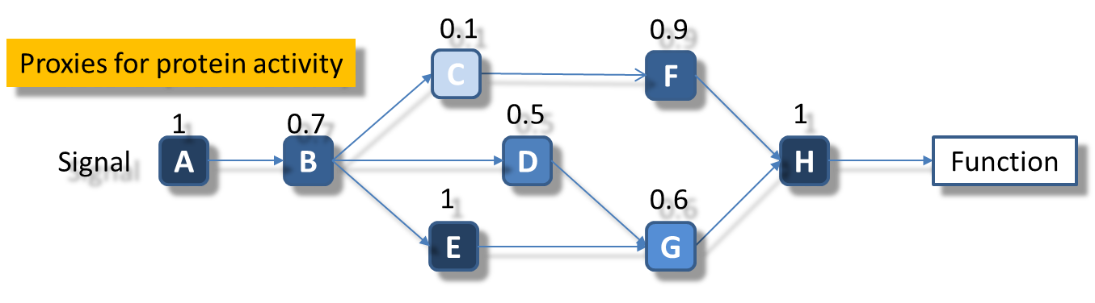
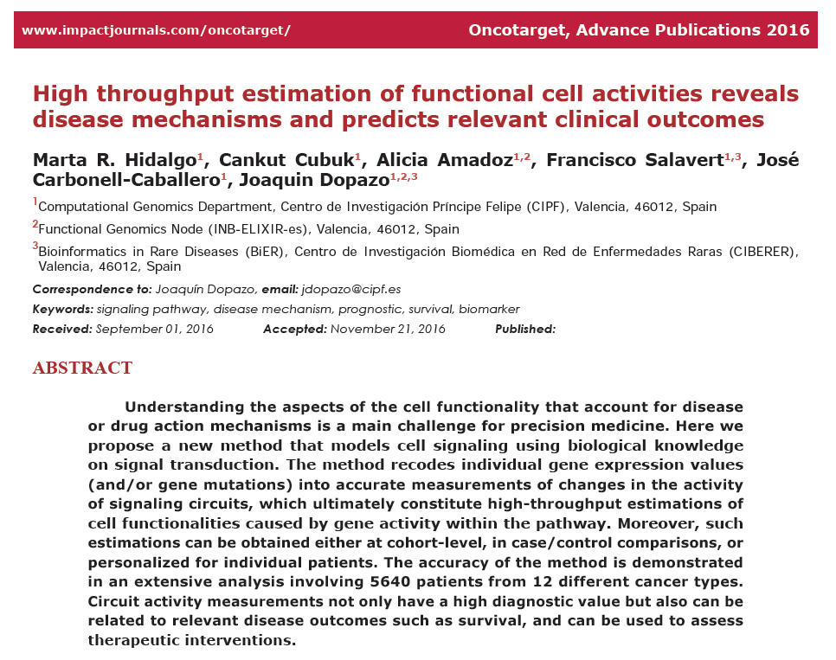
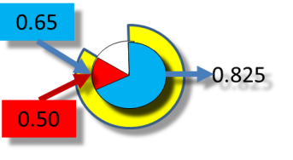
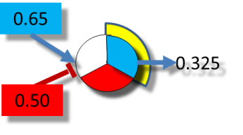
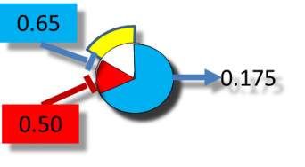
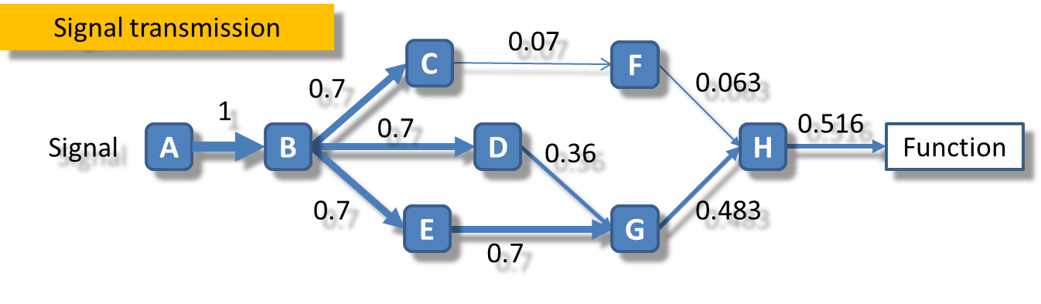
Modeling signaling pathways with signal propagation models
From individual gene expression profiles…
Two types of activities
…to profiles of circuit activity (and functional activity)

Slide 9
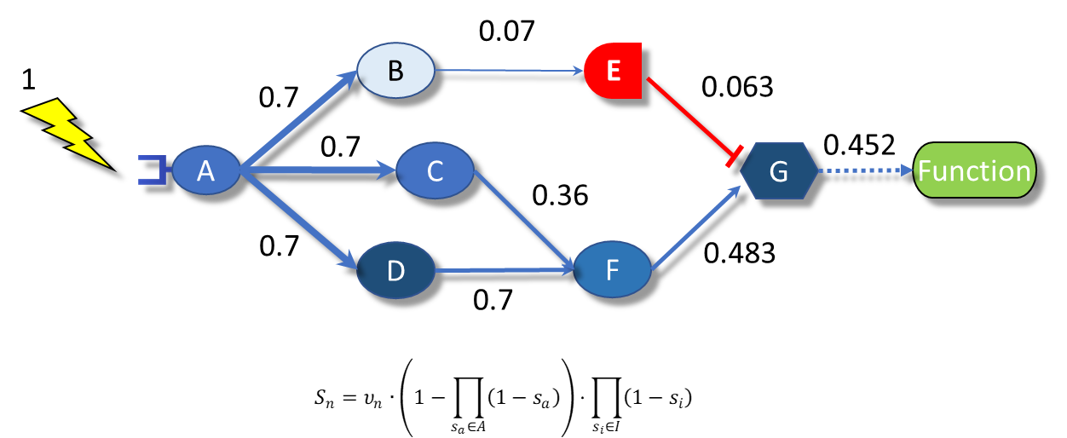
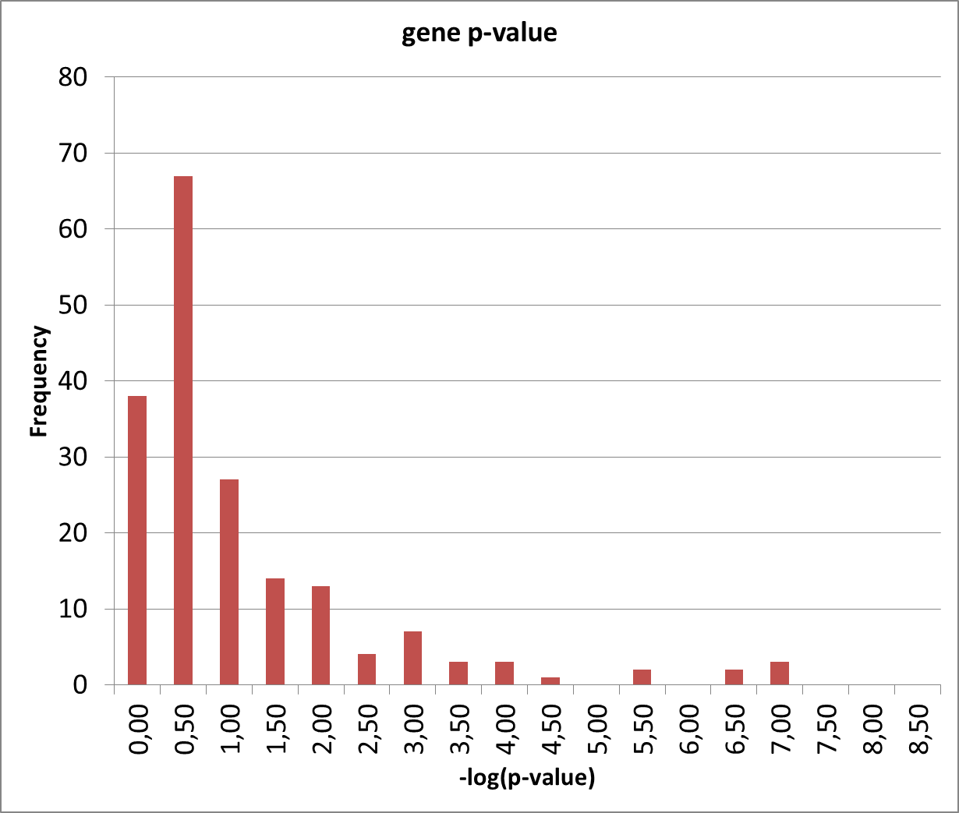
Mechanistic models of pathways convey causality
The functional activity is a predictable consequence of the activity of the genes
The (inferred) functional activity is more associated to the phenotype tan the activity of any of the involved genes

Slide 10
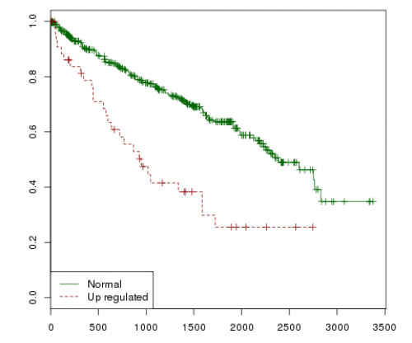
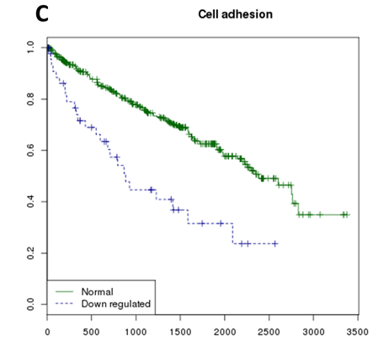
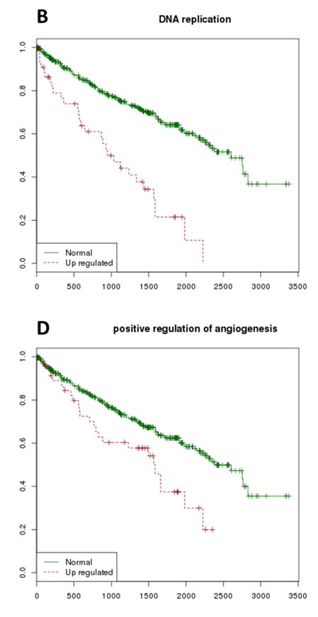
Mechanistic models explain molecular mechanisms of disease
Anti-apoptosis
Hanahan, Weinberg, 2011 Hallmarks of cancer: the next generation. Cell 144, 646

Slide 11
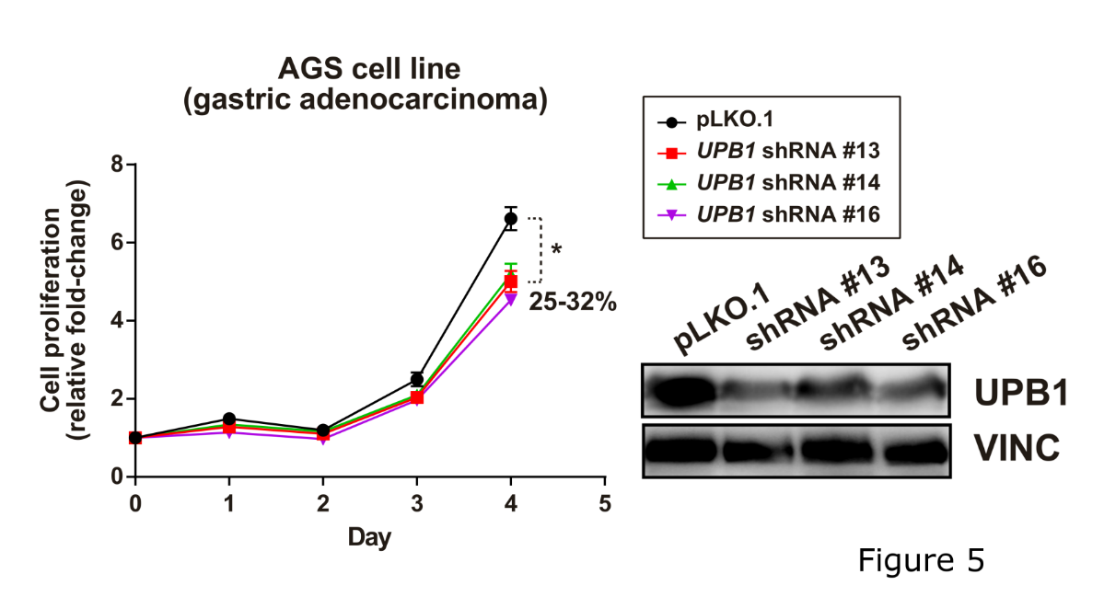
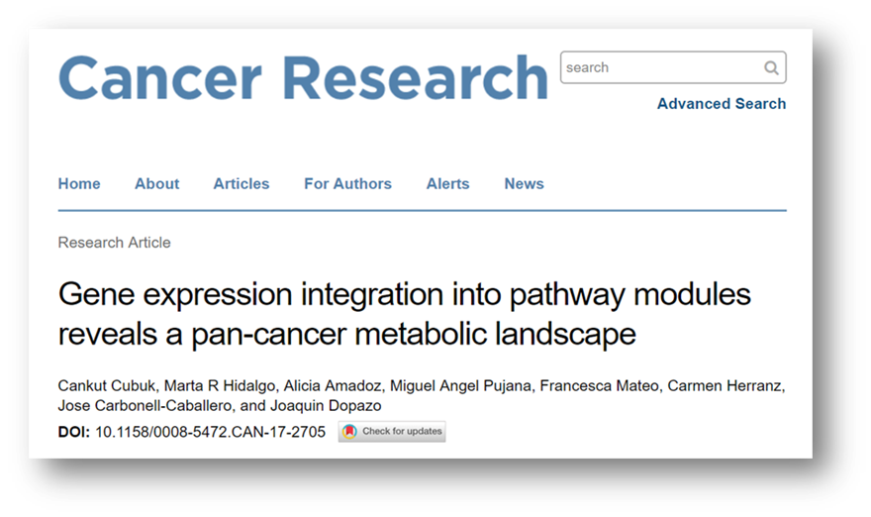
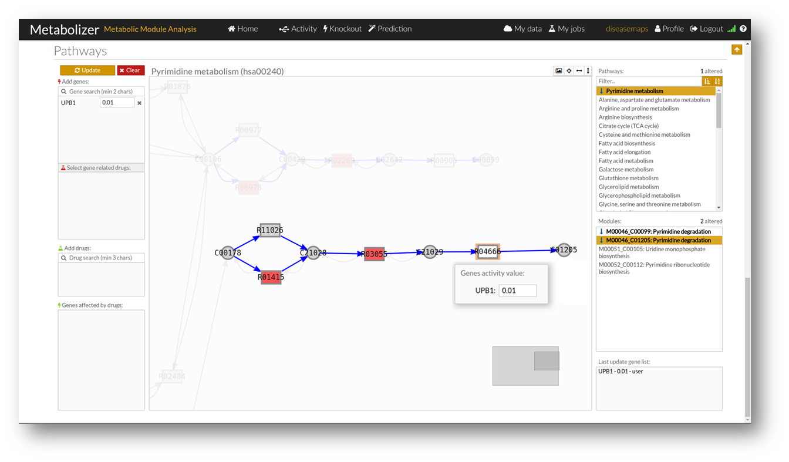
Mechanistic models predict the effect of interventions
Pyrimidine degradation pathway was predicted to be an onco-module in gastric cancer cell lines. Predicted genes that switch the pathway off are DPYD, DPYS (confirmed in Achilles) and UPB1

Slide 12
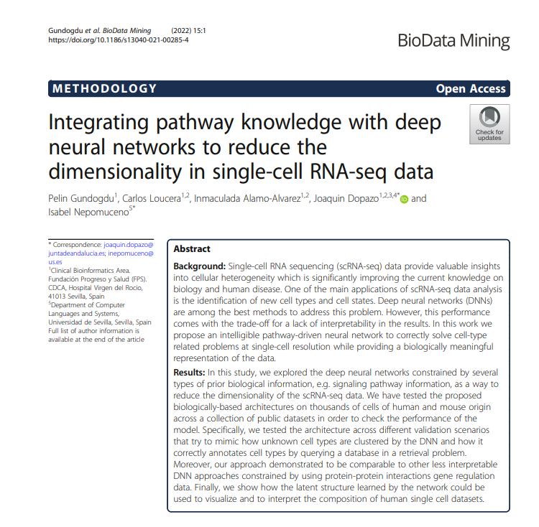
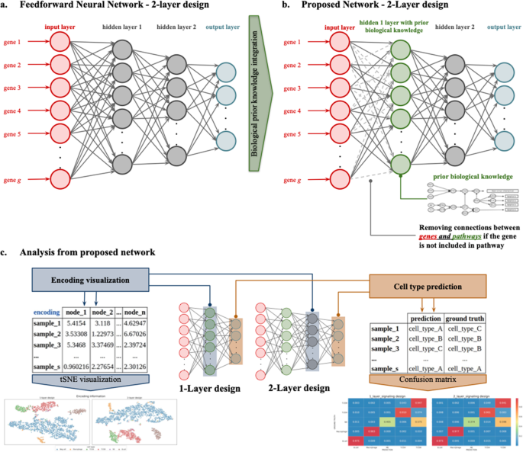
Gene circuitry can be integrated in NN architectures

Slide 13
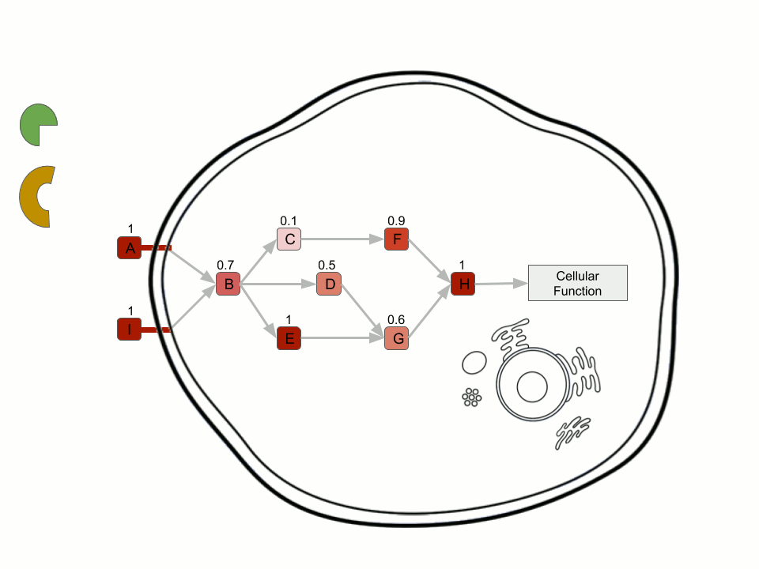

Terra incognita: beyond the modellable part of the genome
Limitation: the whole architecture of feature relationships relies on biological knowledge, represented as pathways that describe the functional interplay of molecules in the cell, and how cells behave
Currently, only one third of the genome can be modelled
Causal relationships gene activity/integrity to effect cannot be modelled and extended beyond all the pathway information available

Slide 14
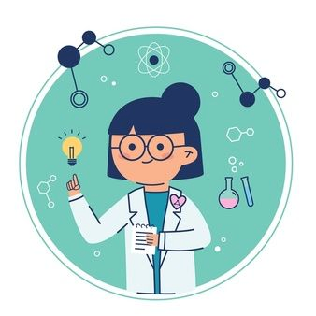
The generation of biological knowledge is a slow process
Pathways represent the current biological knowledge with arrows, that account for functional relationships, which connect nodes, that represent molecules (proteins or others)
The generation of these “arrows” requires years of laboratory work by formulating and testing specific hypothesis on particular relationships between molecules.

Slide 15
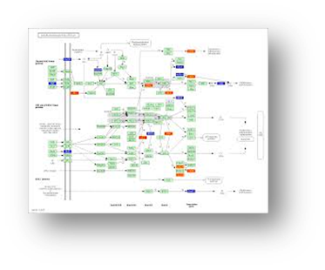
But… would it be possible to use machine learning to generate biological knowledge from data?
Samples
Curse of dimensionality
Learning biological knowledge from the data is currently quite complex.
Knowledge-based dimensionality reduction
Features
EG
EG
EG
EG
External gene
Pathway gene
Learning biology from the data is (at least partly) possible
EG
PG
Signal
PG
PG
PG
PG
Cell function
Signal
PG
By reducing the number of potential causal relationships to learn, we can learn from genomic data such relationships between a few external proteins and the current biological knowledge (pathways)

Slide 16






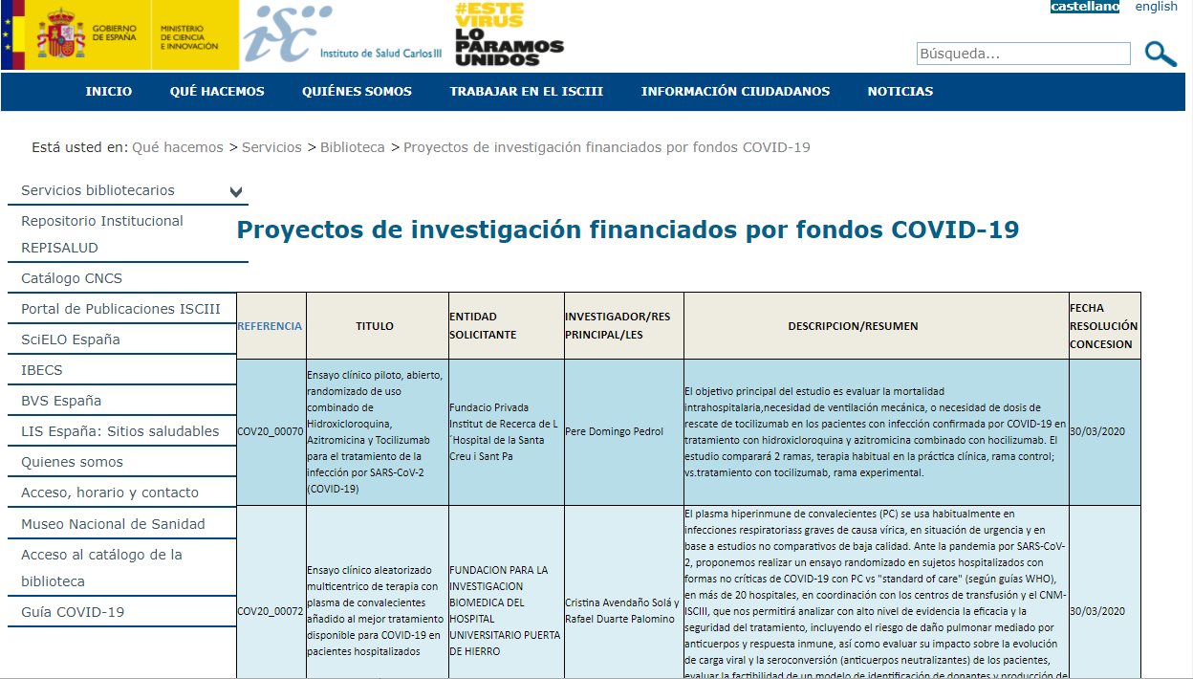
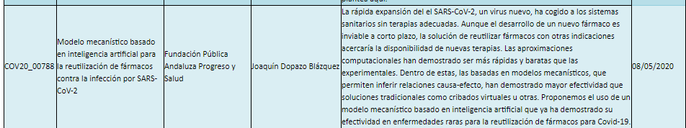
Systematic drug repurposing in SARS-CoV-2 with machine learning and mechanistic models
Funded by the ISCIII
Marina Esteban-Medina
María Peña-Chilet
Carlos Loucera
Kinza Rian
Matias M Falco
Joaquin Dopazo

Slide 17
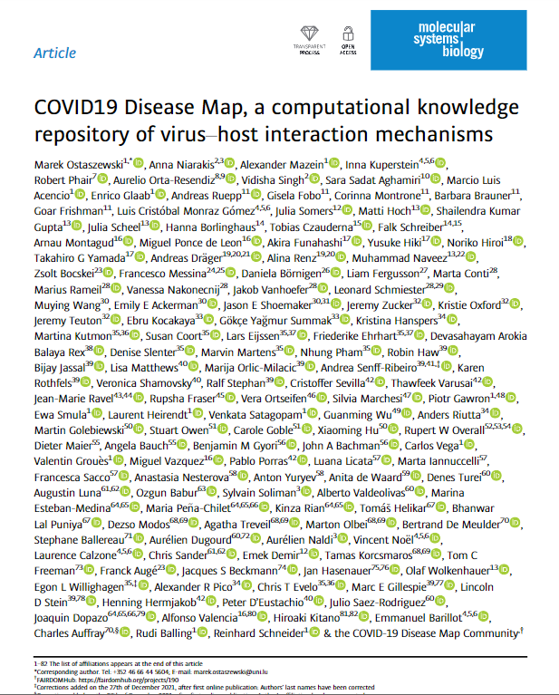
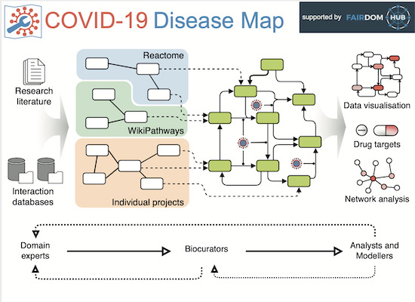
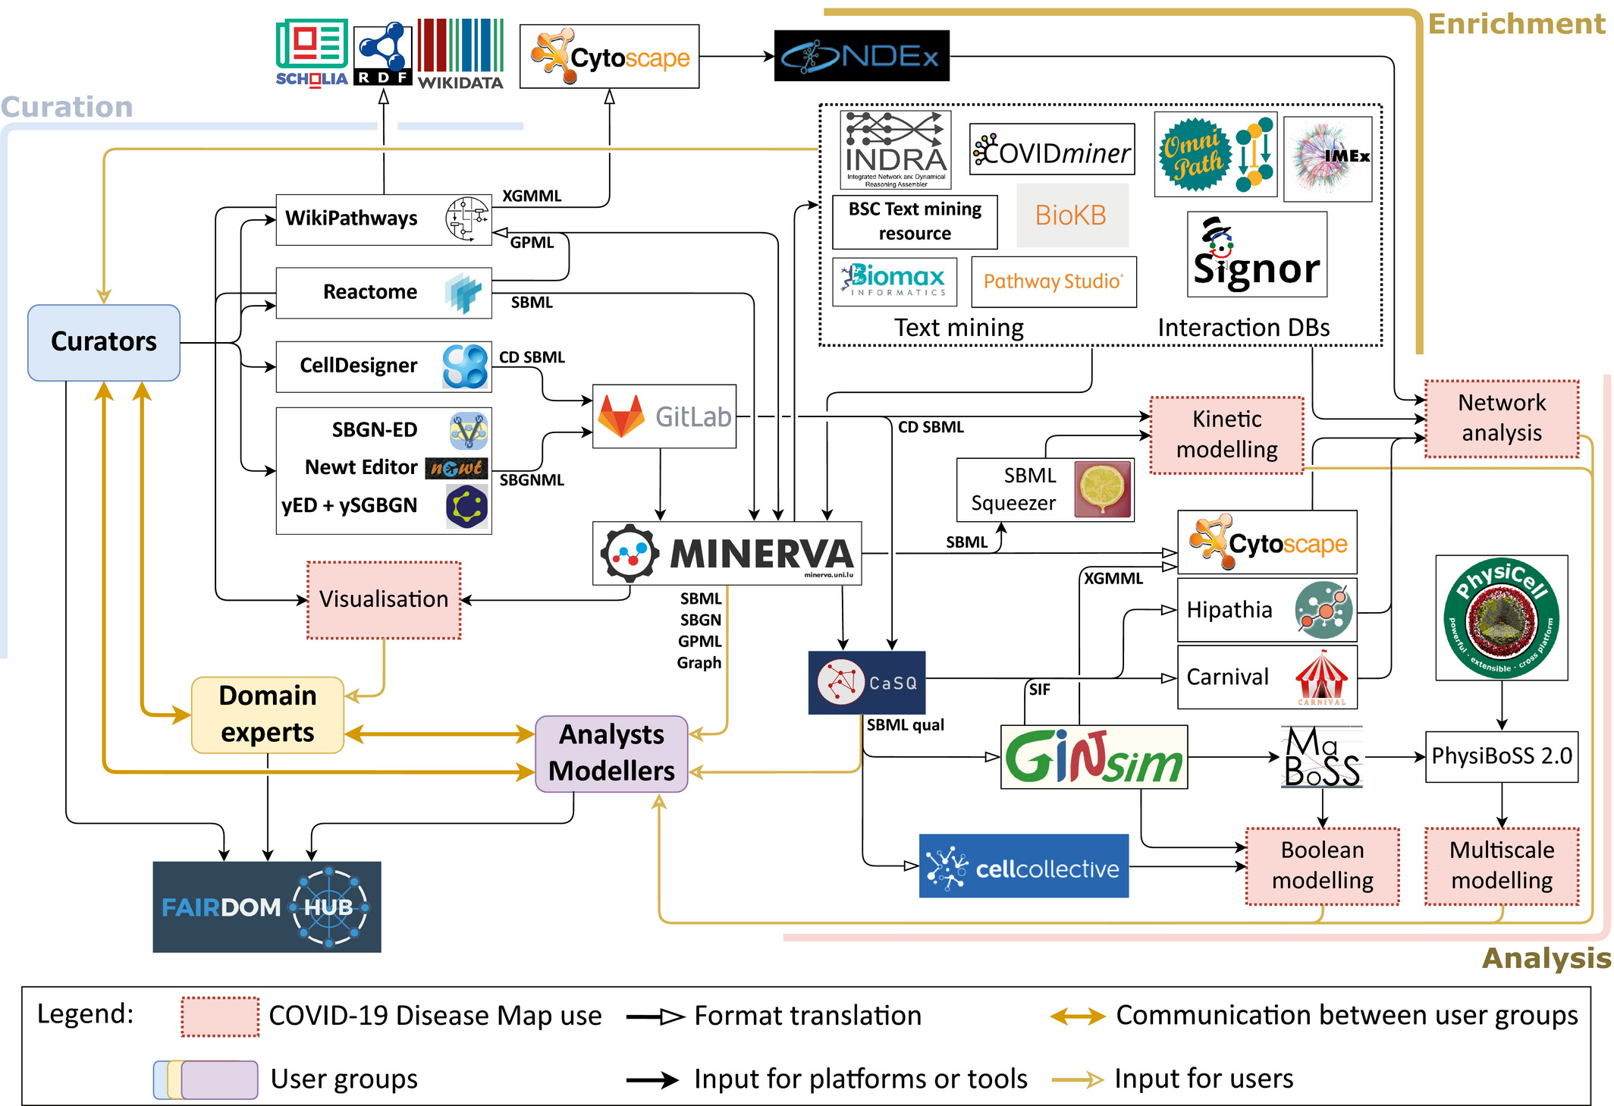
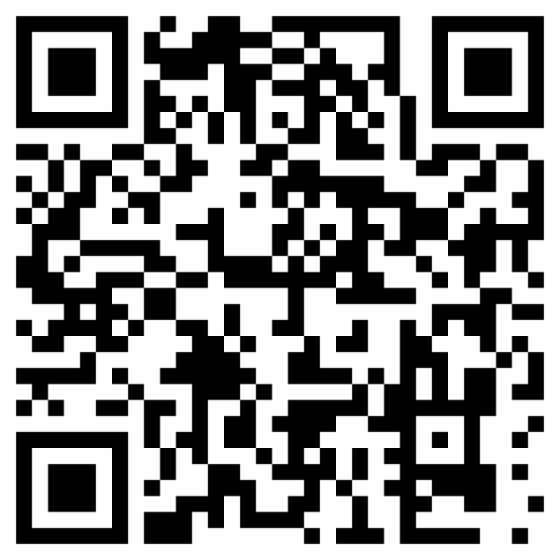
The COVID-19 disease map community
COVID-19 Disease Map is a large-scale collection of curated computational models and diagrams of molecular mechanisms involved in SARS-CoV-2 infection. The map supports the computational exploration of pathways affected by the virus.
Collaborative effort involving over 230 biocurators, domain experts, modelers and data analysts from 120 institutions in 30 countries
Biocuration efforts were assisted by the systematic use of text- and AI-assisted mining of relevant bioinformatic databases and platforms.

Slide 18
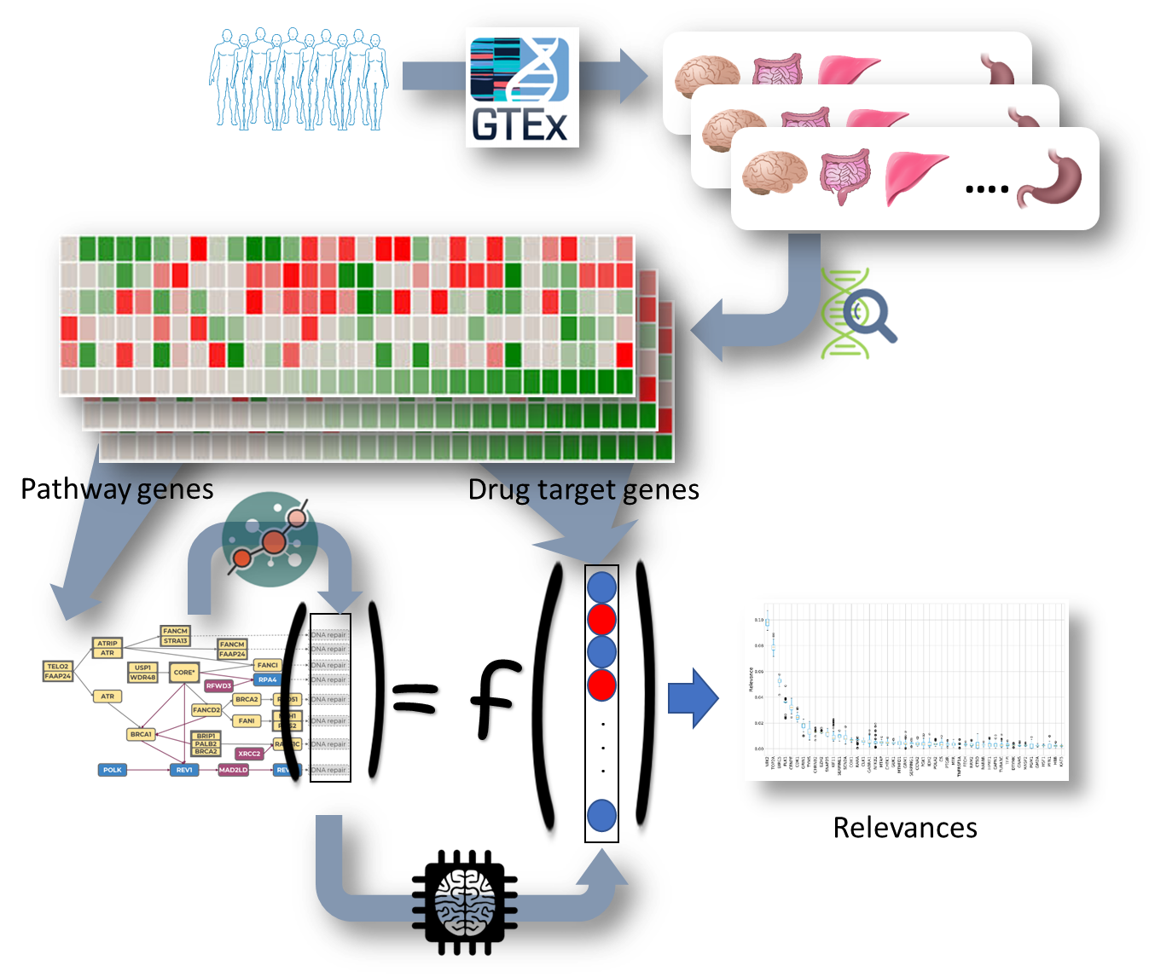
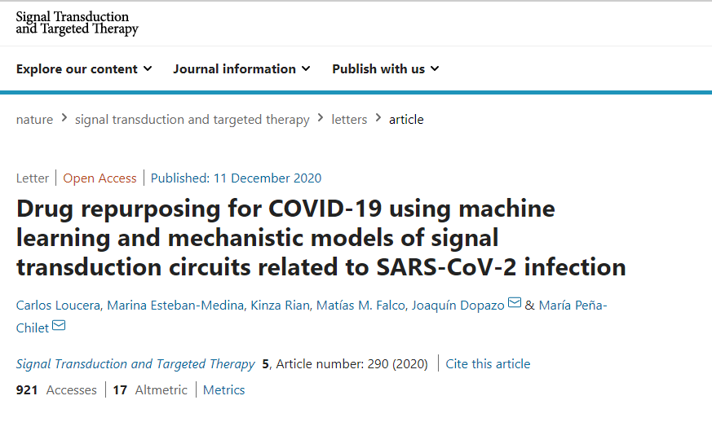
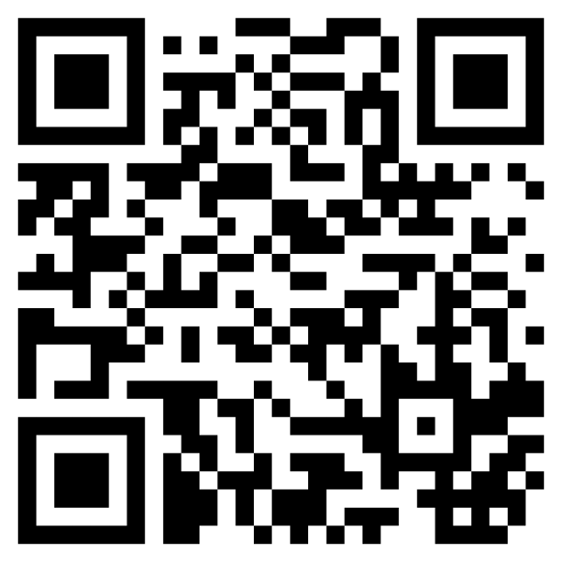
Machine learning to find potential causal relationships
Machine learning (Multi-Output Random Forest regressor combined with SHapley Additive exPlanations) are used to detect potential causal relationships between known drug targets and the activity of COVID-19 hallmarks

Slide 19
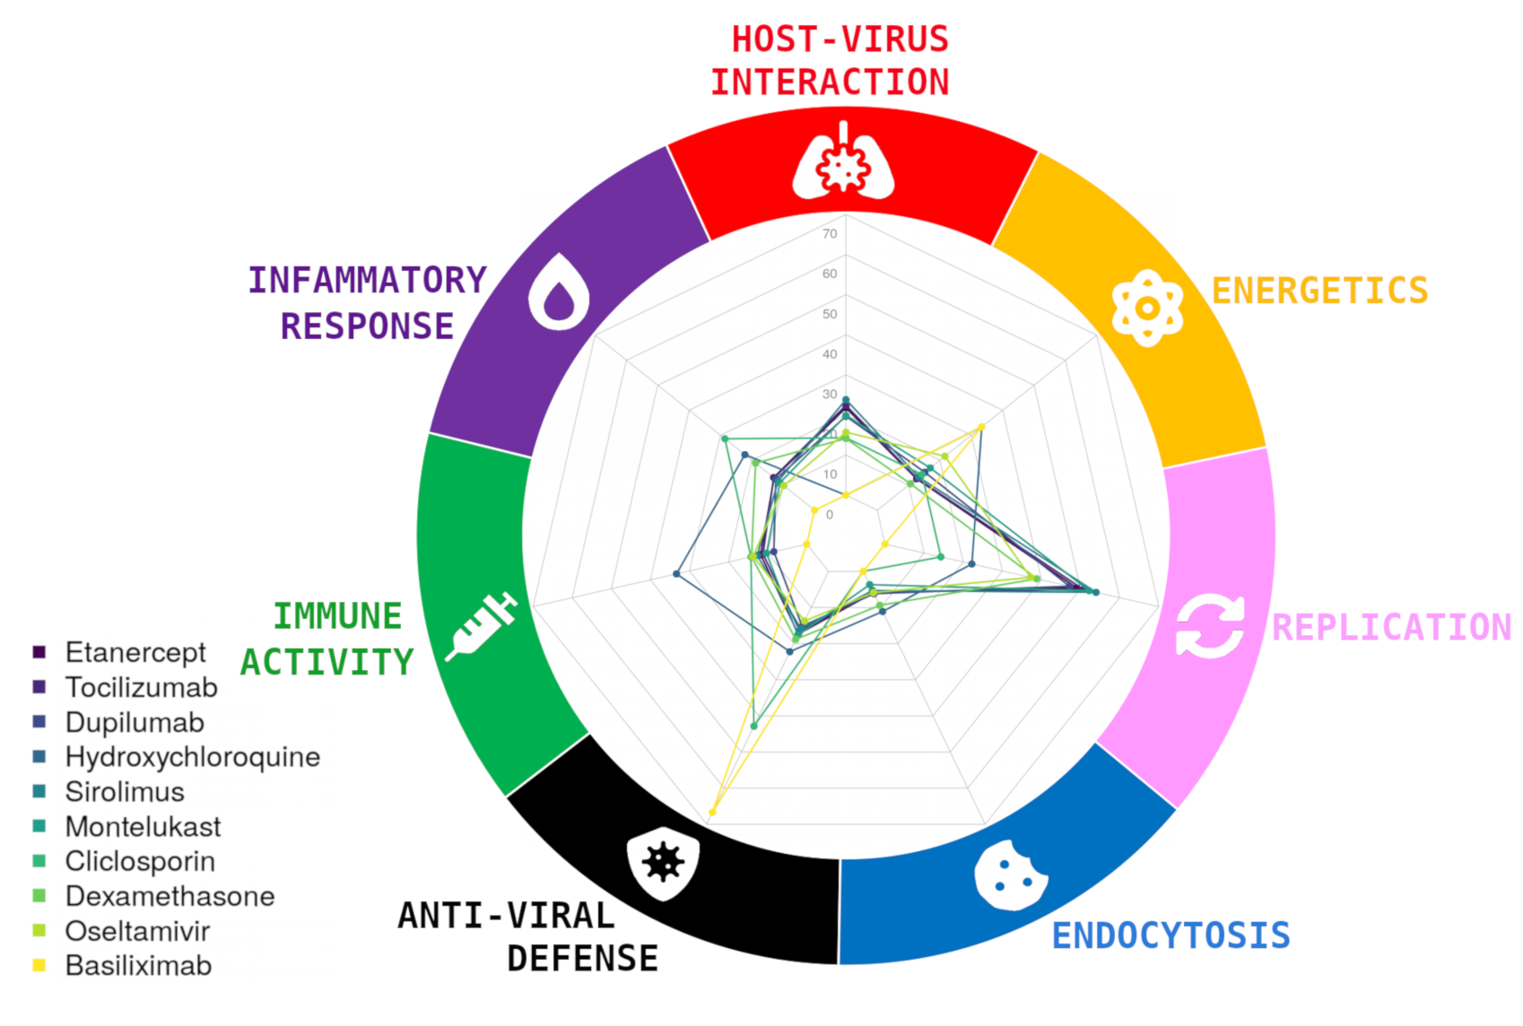
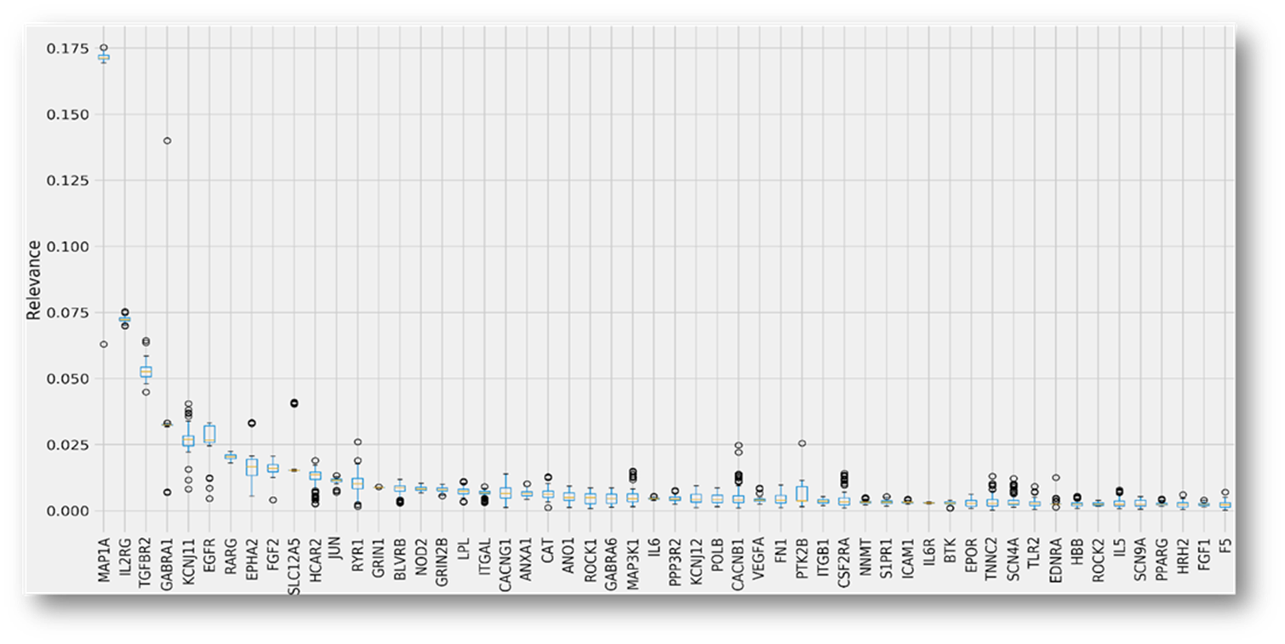
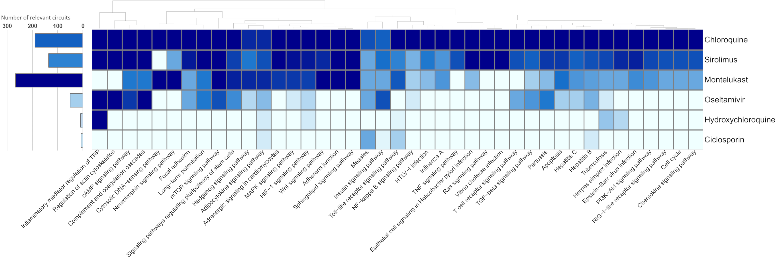
Relevance: impact of potential therapeutic targets over the COVID-19 disease map
Best therapeutic target for each signaling circuit
Specific hallmarks of the Disease can be targeted.
Some drugs affect to many signaling circuits (and consequently many hallmarks) and other ones ara highly specific of hallmark and even of circuit

Slide 20




The COVID-19 druggable space
All targeted drugs in clinical trials (listed in a recent review) were predicted by the algorithm

Slide 21




Model of patient disease + RWD = RWE
Drugs predicted by the model to have activity over the COVID-19 disease mechanism can be further validated using real patient data.
Population Health Database, contains detailed clinical information of 13 million patients

Slide 22



An example with the protective effect of vitamin-D over COVID-19 patient mortality
A retrospective cohort of 16.401 patients was used to demonstrate a protective effect (>30%) of calcifediol in COVID-19 hospitalized patients

Slide 23




Moreover: RWE validated the protective effect of prioritized drugs against COVID-19
Real world evidence of the relationship between the use of drugs previously prioritized by the mechanistic model and mortality rate by COVID-19 in a large retrospective cohort of 15,968 hospitalized Andalusian patients
Using BPS, a comprehensive repository with all the clinical information (EHRs) of more tan 13 million patients of the Andalusian Public Health System.
BPS is used for secondary analysis of clinical data
21 drugs validated: (significant LHR < 0)
Age
Gender
Comorbilities
Vaccines
Other treatments
…
Survival
Drug 1
Drug 2
…
….

Slide 24



Whole cycle from the hypothesis to the validation: data science with no experiments
1. Modeling Biological knowledge
2. Learning from genomic big data
A new paradigm for knowledge generation
3. Real World Evidence Validation

Slide 25


















Clinical Bioinformatics Area, Fundación Progreso y Salud, Hospital Virgen del Rocío, Sevilla, Spain;
Computational Systems Medicine, IBIS, Sevilla, Spain
and ...the FPS/ELIXIR-ES and the BiER (CIBERER)
Follow us on twitter
@xdopazo
@ClinicalBioinfo

