Slide 1
Representation Learning for Subtyping Colo-Rectal Cancer
A Deep Learning Approach to Patient Stratification
Nikita Janakarajan, Pre-Doctoral Researcher @ IBM x ETHZ
May 03, 2022

Slide 2
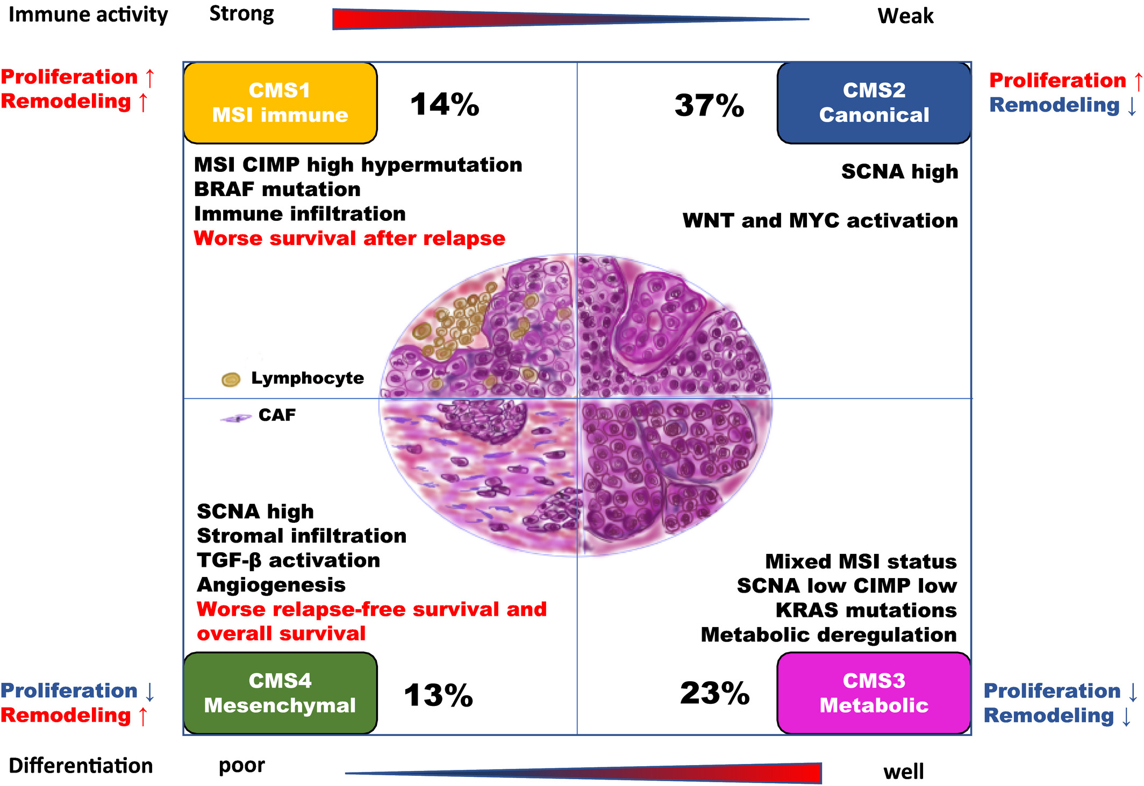
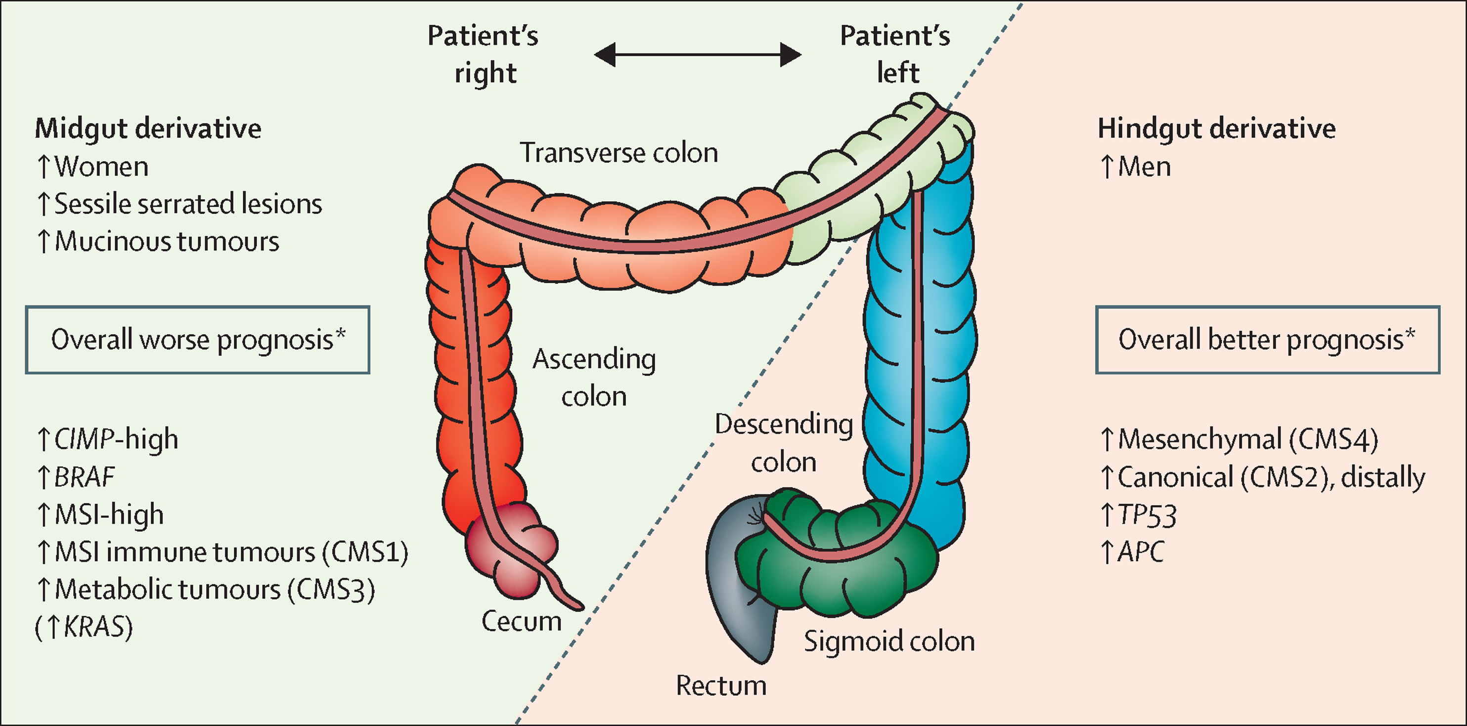
'Sidedness’ and mutation status of RAS/RAF genes influence colorectal cancer treatment strategy
Source: Evelien,Dekker et al. "Colorectal cancer." The Lancet 394.10207 (2019): 1467-1480.
Source: Sawayama, Hiroshi, et al. "Investigation of colorectal cancer in accordance with consensus molecular subtype classification." Annals of Gastroenterological Surgery 4.5 (2020): 528-539.

Slide 3
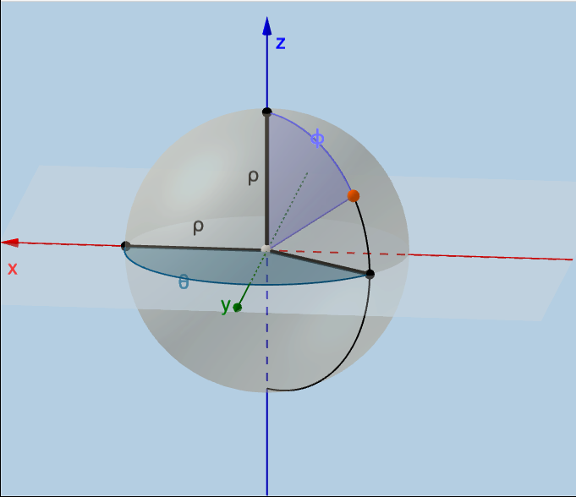
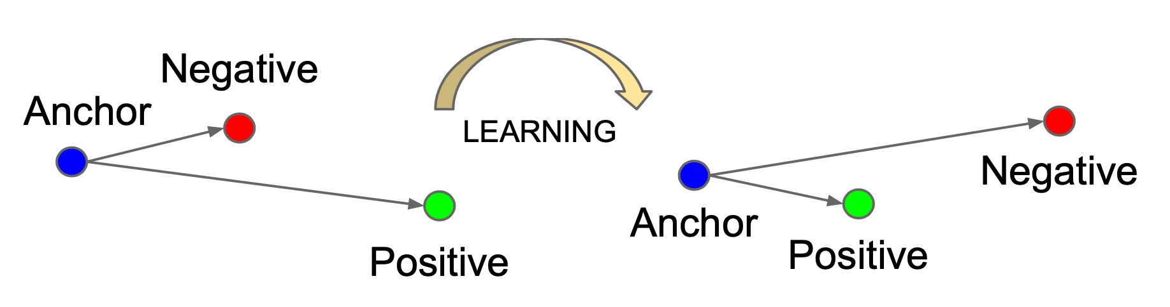
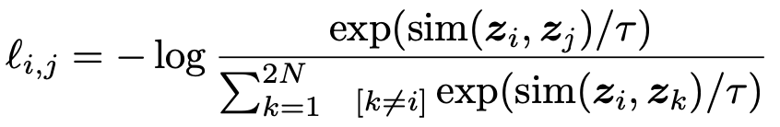
Learn a hyperspherical embedding for each patient using self-supervised contrastive learning.
Notes:
https://www.geogebra.org/m/gD7Rygd2
Uniformly distributing K classes on a D-dimensional unit hypersphere $S^{D−1}$ can be approximated by a differentiable loss function and optimisation. For D=2 and for a certain cases of D=3, exact optimal positions for these classes can be obtained such that there is a large margin separation between these classes, i.e, placing them uniformly on the hypersphere - Mettes, Pascal, Elise van der Pol, and Cees Snoek. "Hyperspherical prototype networks." Advances in Neural Information Processing Systems 32 (2019): 1487-1497.

Slide 4
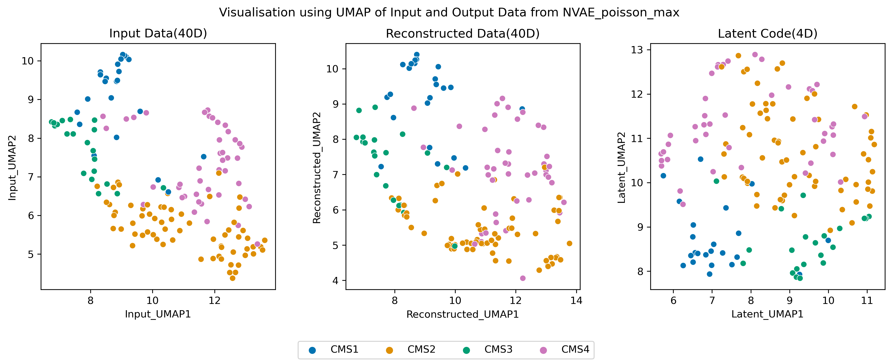
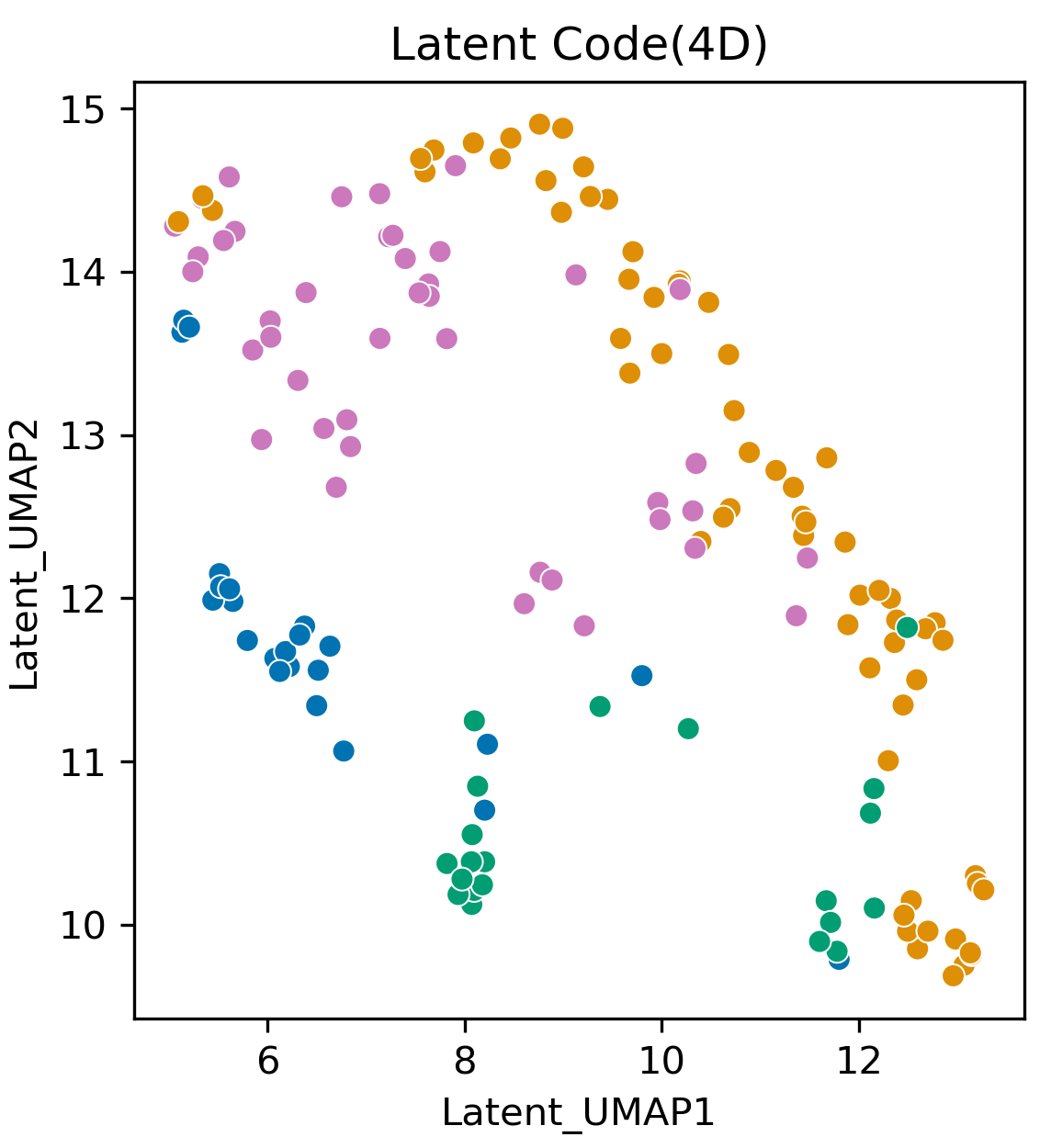
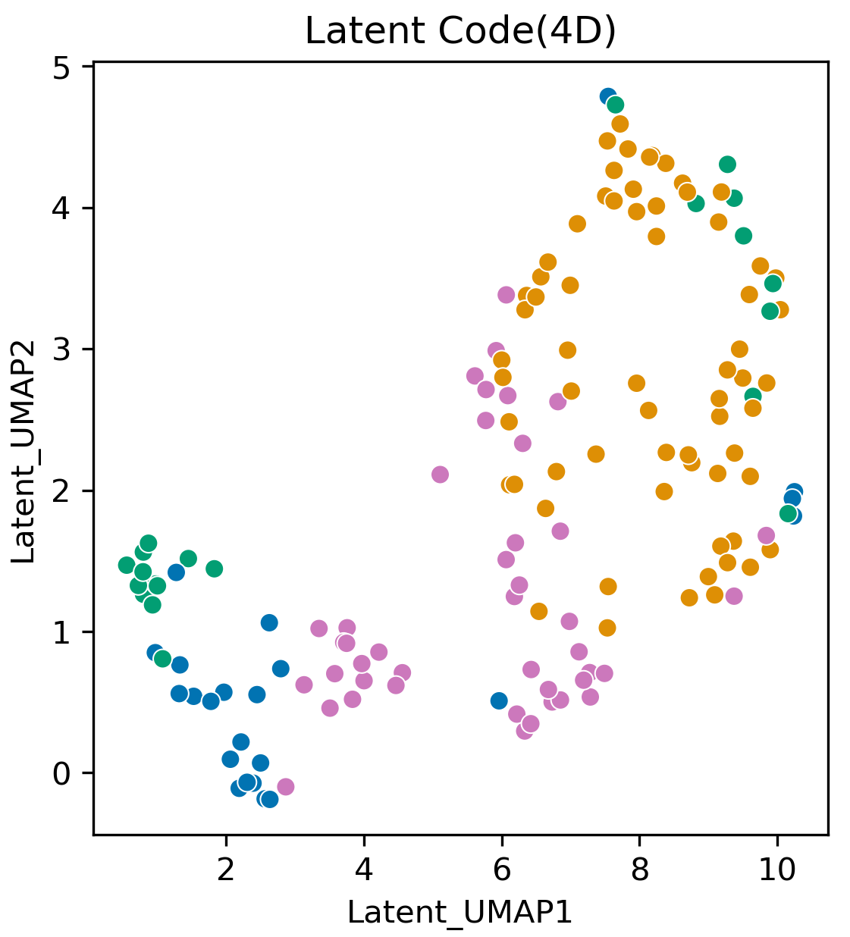
Proof of Concept : Latent space visualisation
AutoEncoder
Silhoutte Score = 0.15 ± 0.03
Variational AutoEncoder
Silhoutte Score = 0.12 ± 0.01
Hyper-Spherical Variational AutoEncoder*
Silhoutte Score = 0.17 ± 0.02
* Davidson, Tim R., et al. "Hyperspherical variational auto-encoders." arXiv preprint arXiv:1804.00891 (2018).

Slide 5
Takeaways
Learning representations on non-euclidean spaces may provide valuable insights into non-linear biological relationships.
Constrained topology as a means to quantify heterogeneity.
Bijective-mapping between sub-regions of the learnt space and a biological feature space would be a step towards interpreting sub-region creation.
Notes:
Biological characteristics of the sub-region

