Slide 1
Beta-Cell Modeling Vignette
Artie Sherman
NIH/NIDDK
Laboratory of Biological Modeling

Slide 2
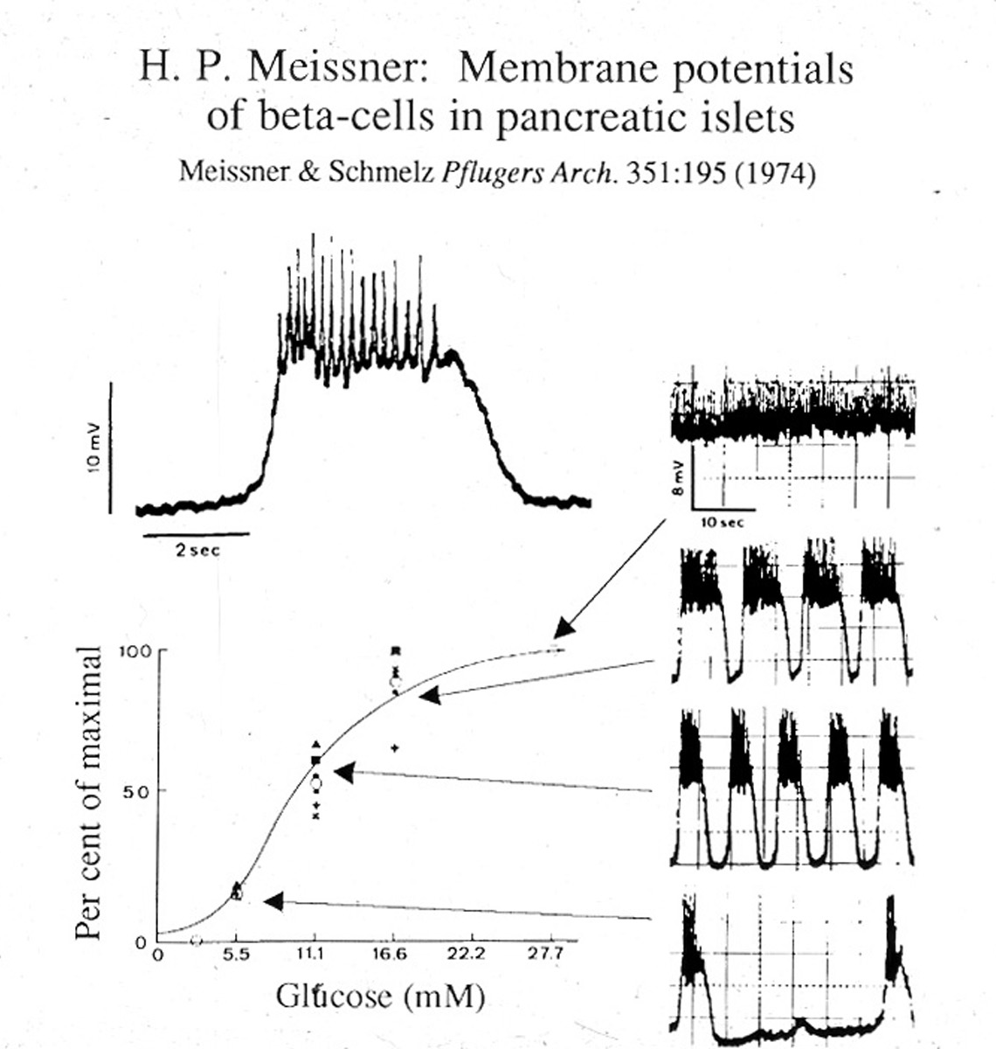
Humble Beginnings – A Half Century Ago
Glucose modulates plateau fraction of fast bursting
Beta-cell failure
at the heart of
diabetes pathogenesis

Slide 3
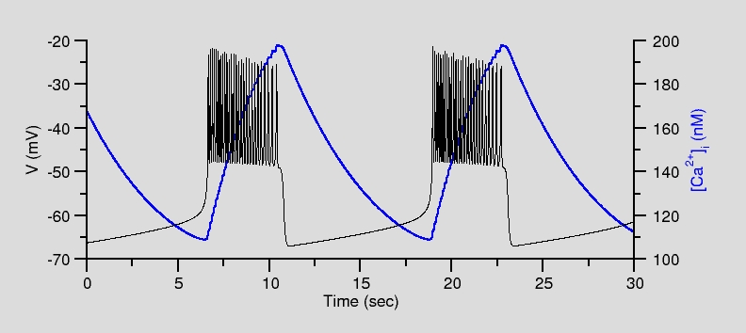
Chay-Keizer Model for Bursting
Fast positive feedback
Slow negative feedback
Produces bistability
Cell can be spiking or silent at a given value of Ca
Biophys. J. 1983 42:181

Slide 4
Chay-Keizer Model
Biophys. J. 1983 42:181

Slide 5
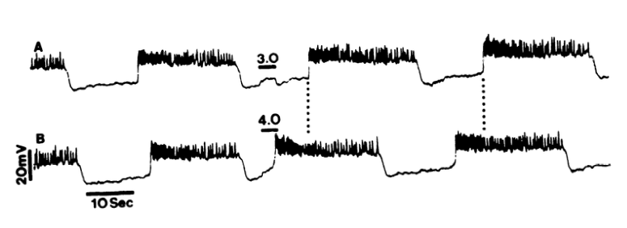
Bistability Demonstrated by Resetting
Cook, Porte, Crill, Am. J. Physiol. 1981, E290

Slide 6
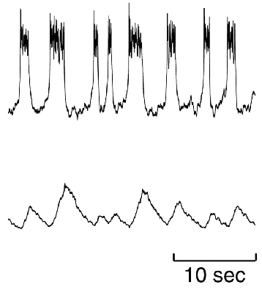
Isolated Rat Somatotroph
Looks similar, similar
channel mechanism
But math says
it’s different – no bistability
A missing element in the
“periodic table” of
bursting

Slide 7
Effect of Increasing Glucose
Increased Ca²⁺ pump rate
Decreased K(ATP) conductance

Slide 8
Chay-Keizer Prediction: Slow, Sawtooth Calcium

Slide 9
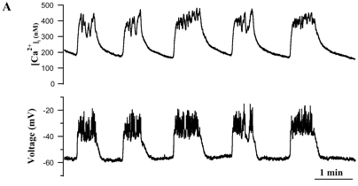
Calcium Oscillates, but not a Sawtooth
Zhang .. Satin, Biophys. J. 84:2852, 2003

Slide 10
Resolve by Adding Endoplasmic Reticulum
J_{out}
ER
J_{in}
Cytoplasm
J_{in,er}
J_{out,er}
Endoplasmic
Reticulum

Slide 11
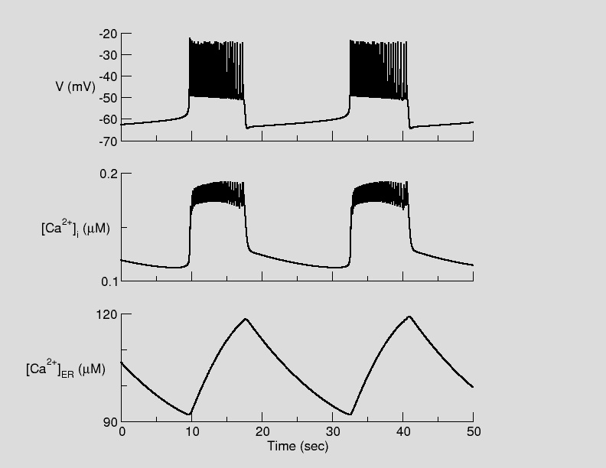
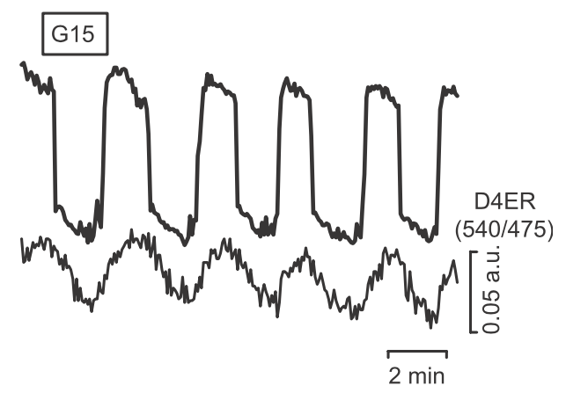
Chay-Keizer with ER
Predicted 2004, measured 2011
Ravier et al, Diabetes 60:2533

Slide 12
Summary
Positive and negative feedback combine for complex dynamics
  Threshold
  Bistability
  Oscillations
Slow variables sweep fast variables through a range of quasi-steady states
  Bursting
Models can be tested by predictions (binary/qualitative)
  Cycles of prediction and modification
Theory goes beyond fitting data to a coherent matrix into which disparate observations can be explained
Guides therapy

