Slide 1
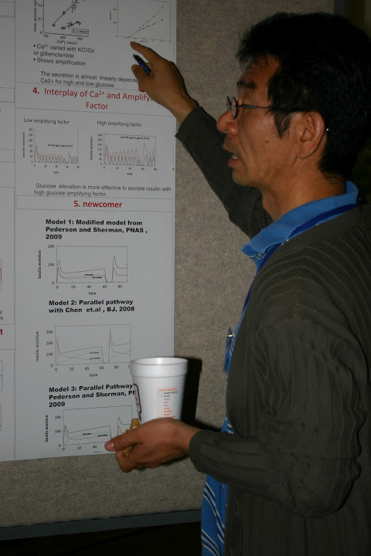
Diabetes Modeling Vignette
Artie Sherman
NIH/NIDDK
Laboratory of Biological Modeling
Joon Ha, Howard University

Slide 2
Recap and Introduction
Yesterday we discussed the importance of dynamical features for modeling beta cells
  fast positive feedback, slow negative feedback
  bistability
Today, the same concepts will show up in a model for T2D progression
Beta cells are again central, but now with regard to the long term success or failure of adaptation to insulin resistance
Focus question: what are the relative contributions of insulin resistance of beta cell failure?
  spoiler: it depends, so therapy should depend

Slide 3
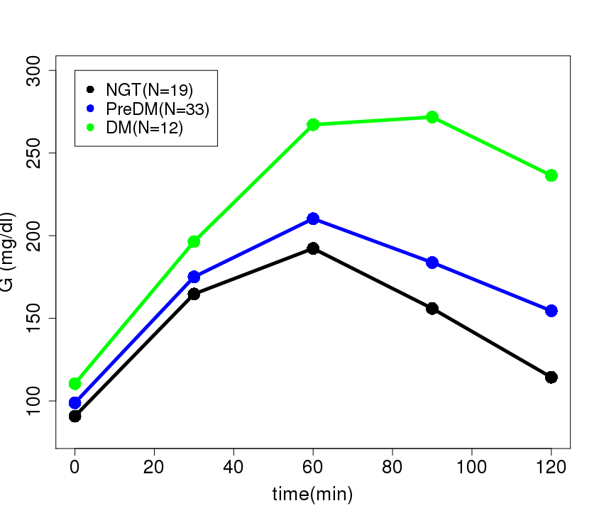
Oral Glucose Tolerance Test (OGTT)
Adolescents with Cystic Fibrosis
[Compress into one slide?]
University of Colorado School of Medicine
Kristen
Nadeau
Christine
Chan
Melanie
Cree-Green

Slide 4
Oral Glucose Tolerance Test (OGTT)
Adolescents with Cystic Fibrosis
PreDM Thresholds

Slide 5
Oral Glucose Tolerance Test (OGTT)
Adolescents with Cystic Fibrosis
DM Thresholds

Slide 6
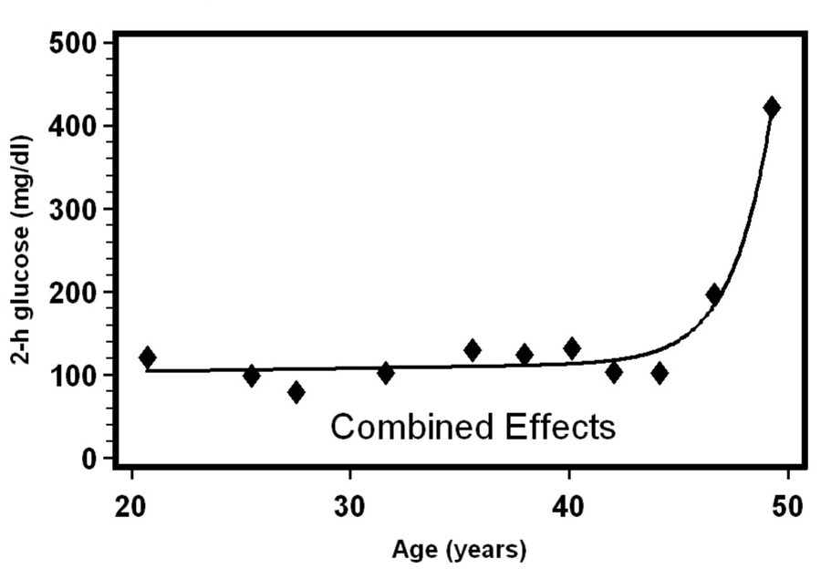


What We Want to Explain
Longitudinal Two-Hour Glucose Measurements
Clinically important:
Progression is almost
irreversible once the
diabetes threshold is crossed
Means of 55 subjects
Bo Bogardus
NIDDK
Phoenix
Branch
Copyright © 2011 American Diabetes Association, Inc.
Mason et al., Diabetes 2007;56:2054-2061
Notes:
Individual subjects all showed sharp jump despite different patterns before (rising, flat, falling)

Slide 7
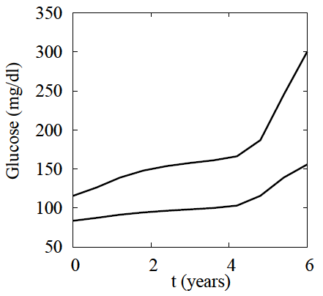
Model Simulation
2-hour
glucose
Fasting glucose
If only measure fasting
glucose, detection
may be delayed
NGT
IGT
IFG
T2D

Slide 8
Tipping Point Model
Normally, insulin secretion keeps glucose variation in check:
fast negative feedback
Obesity causes insulin resistance
Beta cells try to compensate:
slow negative feedback
If resistance is mild or develops slowly, compensation is more likely to be successful
If resistance is severe or develops rapidly, compensation is more likely to fail: positive feedback
Once this threshold is crossed, very hard to go back

Slide 9
Bergman-Cobelli Minimal Model (MINMOD)
I, I_{b} from FSIGT
Am J Physiol Endocrinol Metab 236:E667, 1979

Slide 10
Adaptation of MINMOD for Longitudinal Simulations
Ha et al, Endocrinology, 157(2):624-635; Am. J. Physiol. 319(2):E410-E426

Slide 11
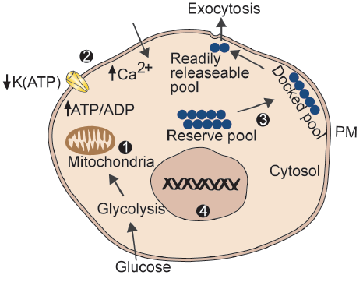
Hierarchy of Compensatory Mechanisms in Beta Cells
γ
σ
R_{IS}
β
Satin, Ha, Sherman, Diabetes 65:2470 2016
Notes:
gamma: left-shift of DRC

Slide 12
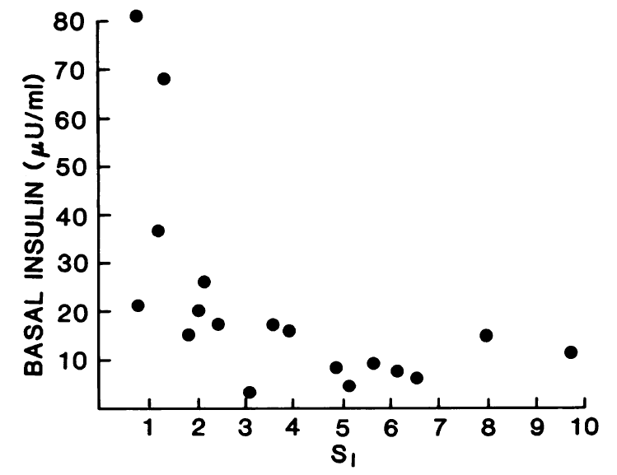
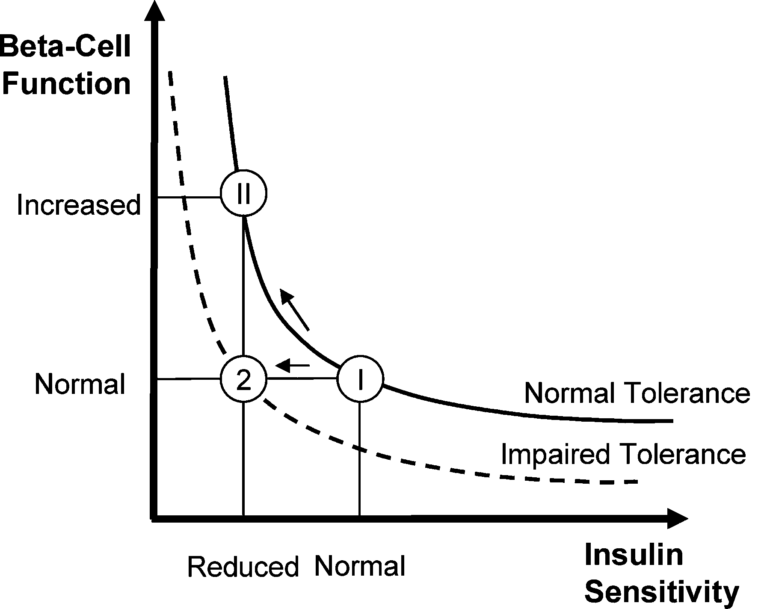
Disposition Index
Fasting Insulin
is a good marker
for insulin resistance
Bergman .. Cobelli, JCI 68:1456 1981

Slide 13
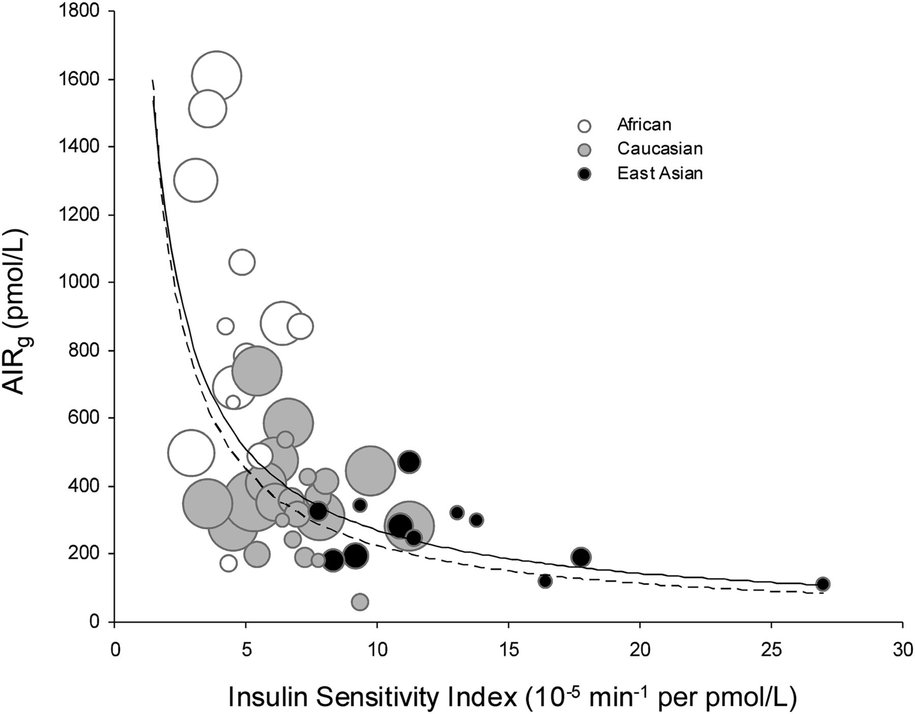

Ethnic Differences in Secretion vs. Insulin Resistance
This is only a static picture
Everyone starts in lower right,
moves leftward and upward
©2013 by American Diabetes Association
Kodama et al. Diabetes Care, 2013 36:1789

Slide 14
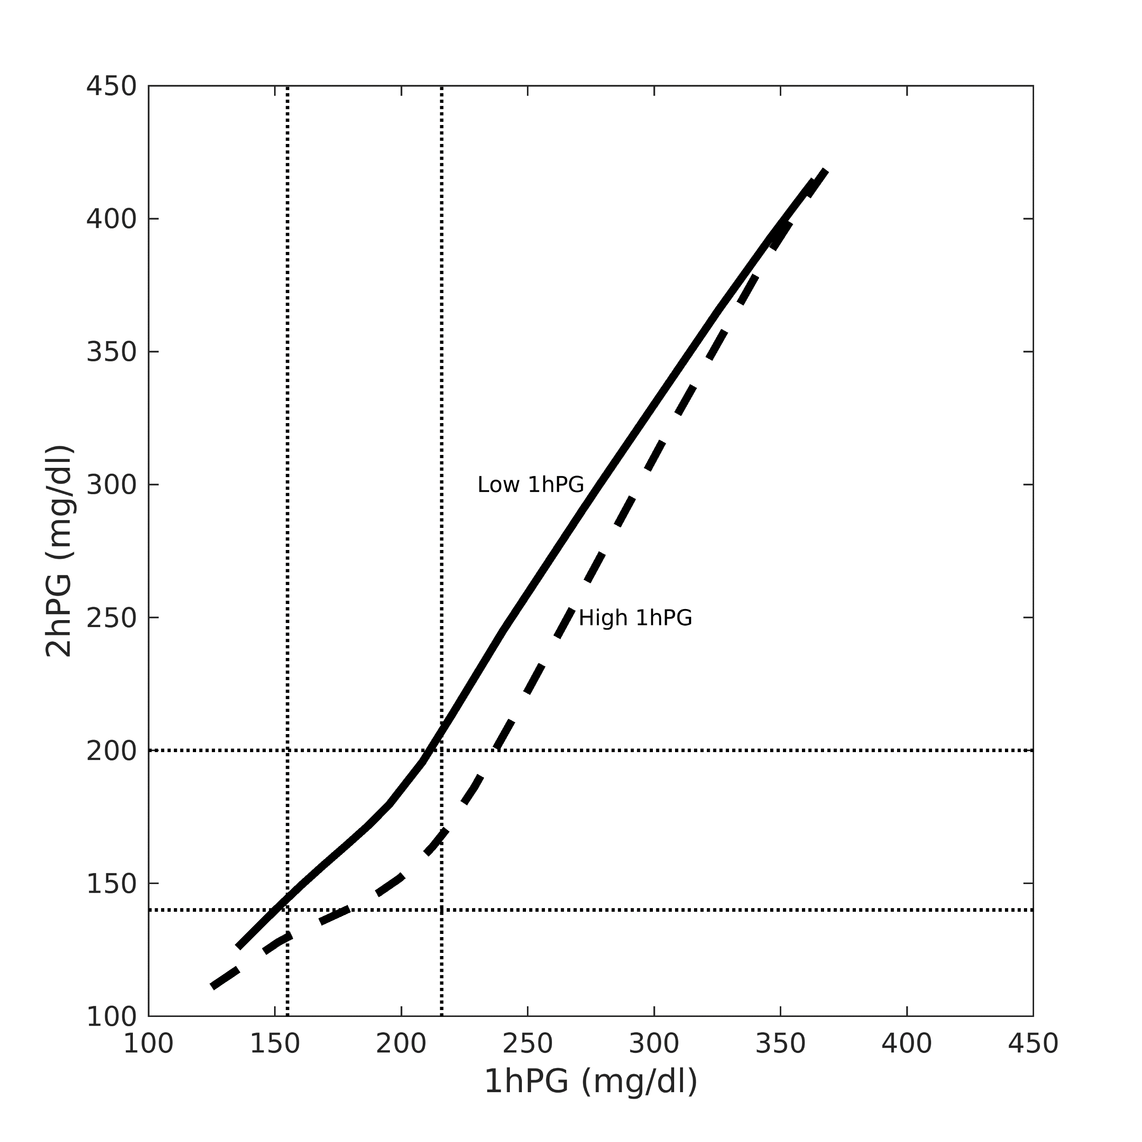
Simulations: How Insulin Resistance vs Beta-Cell Function Show up in OGTTs
Among obese insulin-resistant people,
1hG tracks 2hG
But among lean, insulin-deficient people,
1hG rises much earlier
(modeled as impaired insulin granule
priming)
Severe insulin
resistance,
Strong secretion
Mild insulin
resistance,
Weak secretion

Slide 15
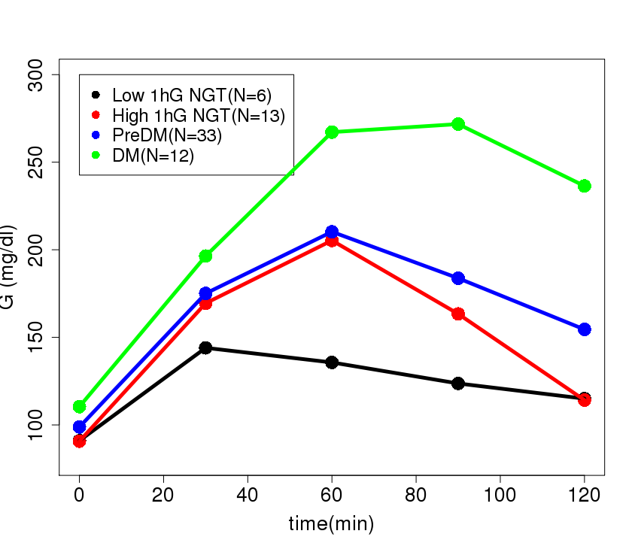
CF Adolescents – Subdividing by 1h G
University of Colorado School of Medicine
Kristen
Nadeau
Christine
Chan
Melanie
Cree-Green
High 1hG picks up people missed by 2hG
They already have insulin resistance and impaired insulin secretion

Slide 16
2hG
Pima,
African
American
White
E. Asian
Cystic
Fibrosis,
pre-T1D
140
mg/dl
1hG
155
mg/dl

Slide 17
Summary
G and I are fast – respond to meals (hours)
Beta-cell mass and function are slow – respond to insulin resistance (days, months, years)
Tipping point: slow negative feedback gives way to slow positive feedback
  better to intervene before diabetes is established
Model confirms classic trade-off between insulin resistance and insulin secretion (Disposition Index)
  Predicts that impaired exocytosis leads to high 1-hour glucose
  1hG better than 2hG for lean, insulin deficient people

Slide 19
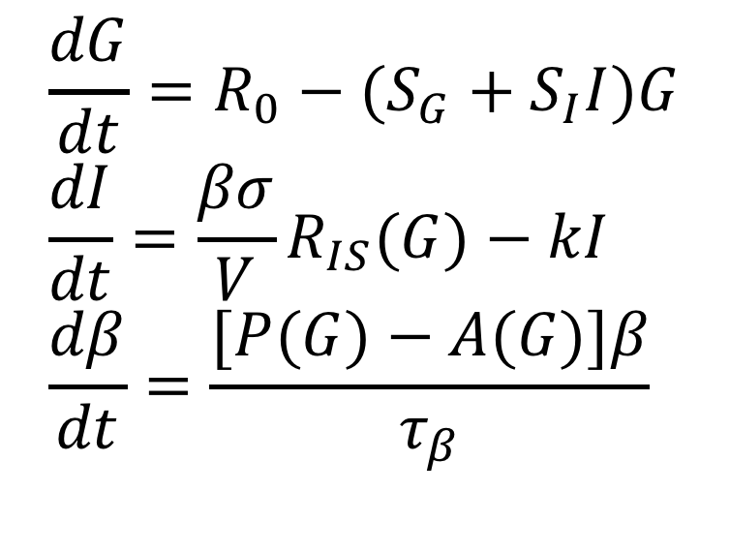
The Topp Model
$$\frac{dG}{dt}=R_{0}−(S_{G}+S_{I}I)G \\ \frac{dI}{dt}=\frac{βσ}{V}R_{IS}(G)−kI \\ \frac{dβ}{dt}=\frac{[P(G)−A(G)]β}{τ_{β}}$$
Fast
Slow
In words:
small rise in G, mass increases (negative feedback)
Large rise in G, mass decreases (positive feedback)
Topp … de Vries … Miura … Finegood, J. Theor. Biol. 206:605 2000

Slide 20
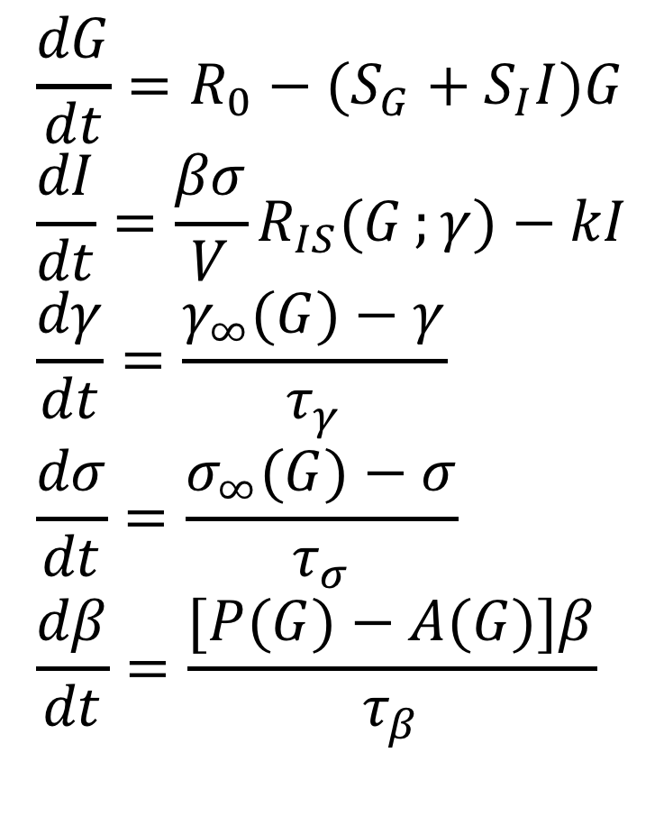
The Full Equations
$$\frac{dG}{dt}=R_{0}−(S_{G}+S_{I}I)G \\ \frac{dI}{dt}=\frac{βσ}{V}R_{IS}(G;{γ})−kI \\ \frac{dγ}{dt}=\frac{γ_{∞}(G)−γ}{τ_{γ}} \\ \frac{dσ}{dt}=\frac{σ_{∞}(G)−σ}{τ_{σ}} \\ \frac{dβ}{dt}=\frac{[P(G)−A(G)]β}{τ_{β}}$$
Fast
Intermediate
Slow
Ha et al, Endocrinology, 157:624 2016

