Slide 1
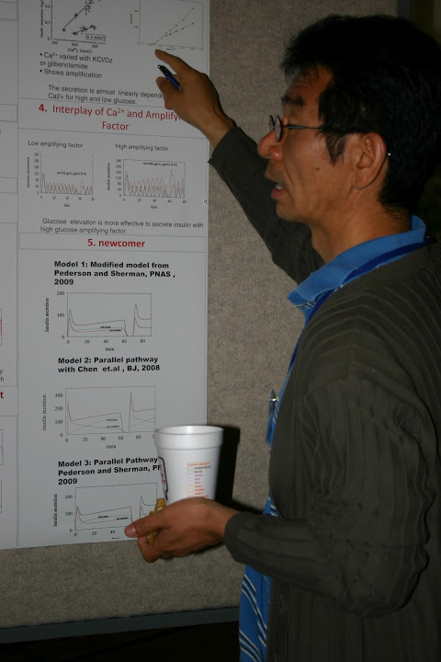

Validation and UQ for a New Model to Estimate Insulin Resistance and Beta-Cell Function
Artie Sherman
NIH/NIDDK
Laboratory of Biological Modeling
Max Springer, U Maryland
Joon Ha, Howard University

Slide 2
Recap and Introduction
Yesterday we discussed a longitudinal model for T2D progression based on:
  fast positive feedback, slow negative feedback
  bistability
We saw that insulin resistant vs insulin deficient had different OGTT patterns
But how can we decide which group a patient belongs to?
We will explore whether the longitudinal model can be adapted to estimate insulin resistance and beta-cell function

Slide 3
Goals
We seek something that:
  uses OGTT data (simpler, less invasive than clamp or FSIGT)
  easier to implement than Cobelli Oral Minimal Model
  more complex than existing algebraic indices (Matsuda, HOMA, etc.) but with better properties

Slide 4
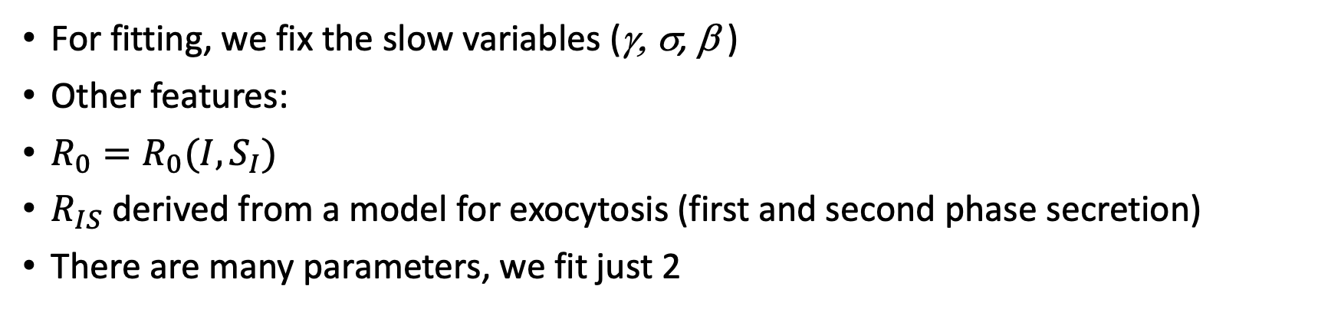
Adaptation of Longitudinal for Parameter Estimation
For fitting, we fix the slow variables (γ, σ, β )
Other features:
$R_{0}=R_{0}(I, S_{I})$
$R_{IS}$ derived from a model for exocytosis (first and second phase secretion)
There are many parameters, we fit just 2
Ha et al, Endocrinology, 157(2):624-635; Am. J. Physiol. 319(2):E410-E426

Slide 5


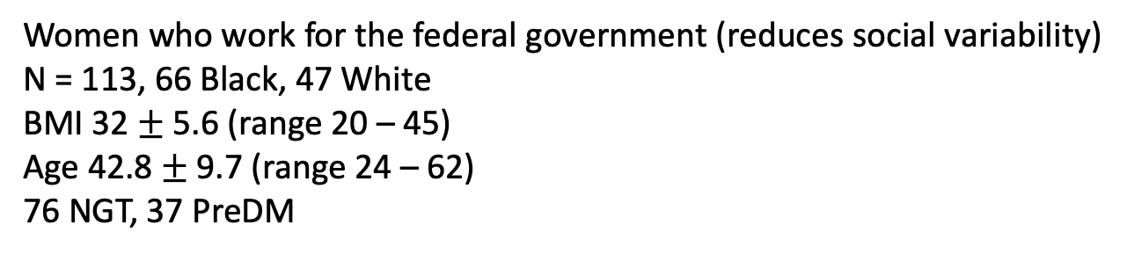
Federal Women Study
Stephanie Chung, NIDDK
Anne Sumner, NIDDK
Women who work for the federal government (reduces social variability)
N = 113, 66 Black, 47 White
BMI 32 $±$ 5.6 (range 20 – 45)
Age 42.8 $±$ 9.7 (range 24 – 62)
76 NGT, 37 PreDM

Slide 6
Mean Fits to Data

Slide 7
Error Histograms
Error distribution is skewed but good for most individuals

Slide 8
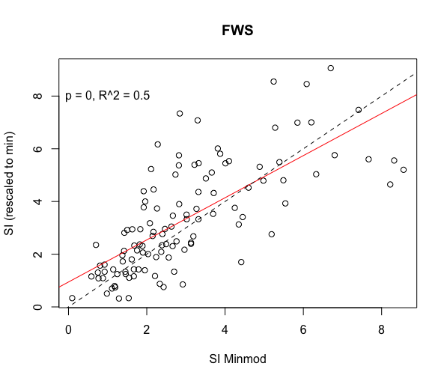
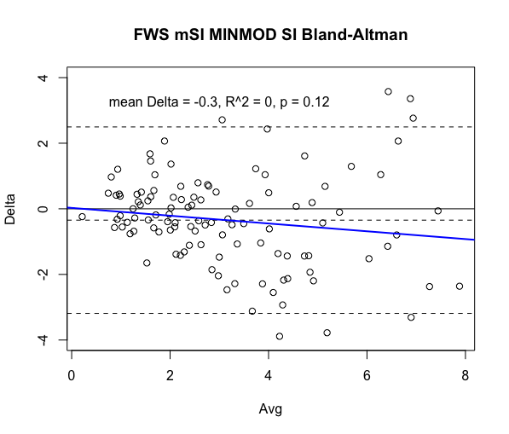
FWS mSI vs MINMOD SI: Correlation and Agreement
No systematic deviation

Slide 9
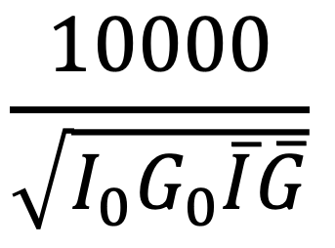
Matsuda Index
$$\frac{10000}{\sqrt{I_{0}G_{0}\overline{I}\overline{G}}}$$

Slide 10
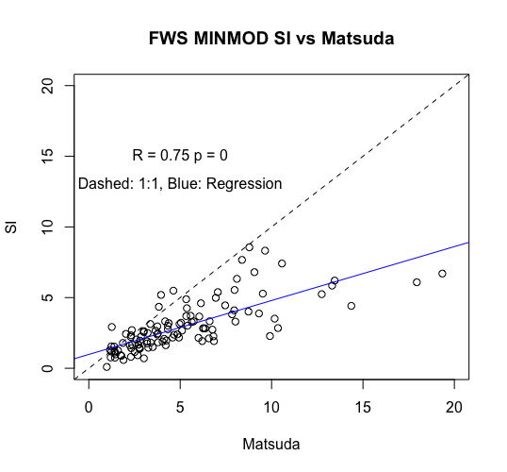
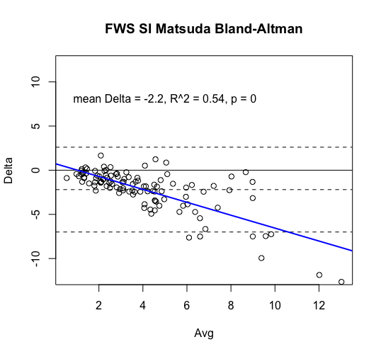
FWS Matsuda vs MINMOD SI
Matsuda correlation with MINMOD similar to mSI
but agreement with MINMOD much poorer:
systematic overestimation

Slide 11
Comparison of sigma with AIR
Correlation good
but scales very
different

Slide 12
Comparison with HOMA-IR
[This must be 1/HOMA-IR]

Slide 13
Precision of Estimates, Identifiability of sigma, SI

Slide 14
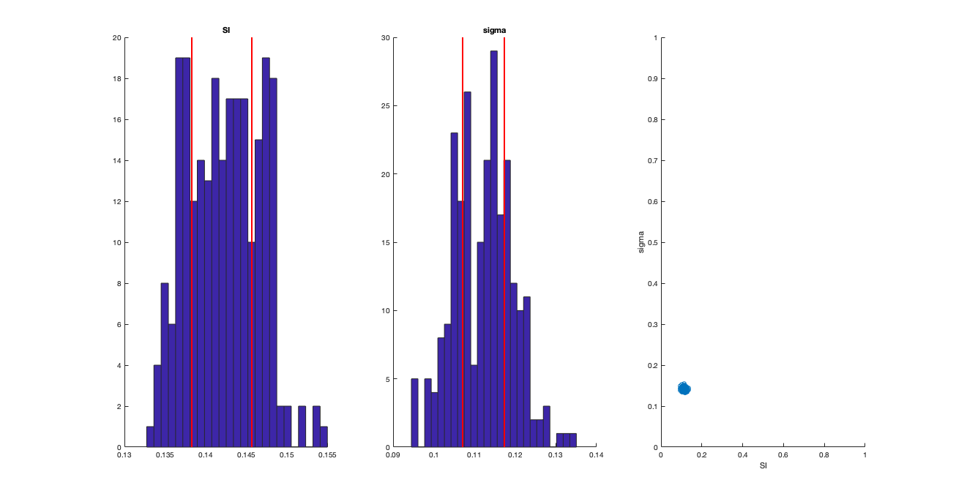


Subject #51
0.130 0.155
0.09 0.14
$±$1 SD
$±$1 SD

Slide 15
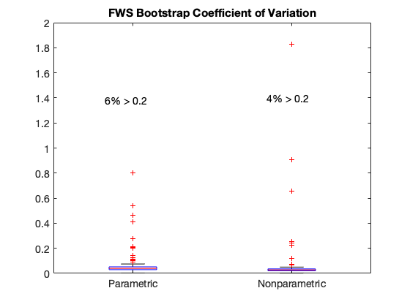
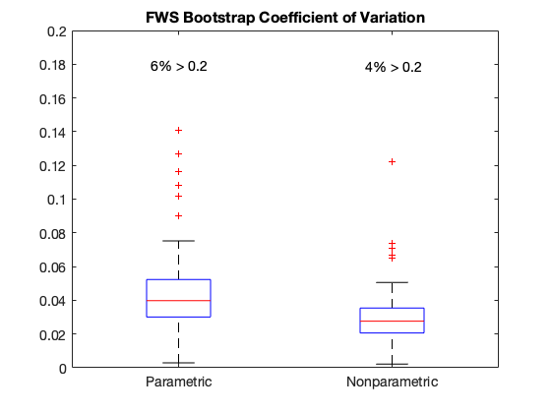
Zoomed
9% > 0.1
5% > 0.1

Slide 16
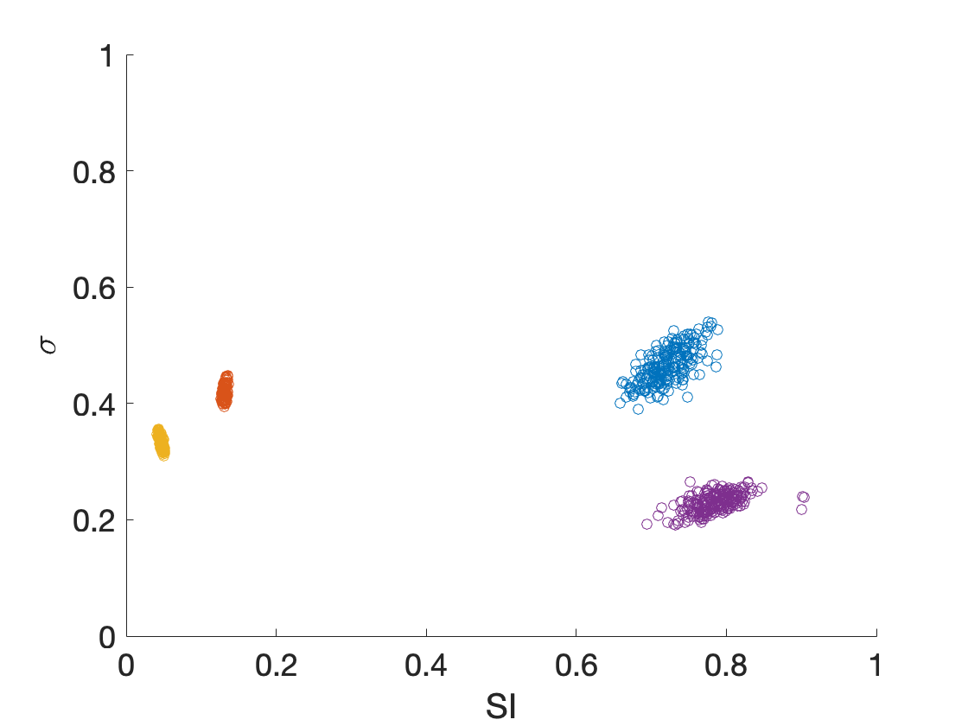

Slide 17
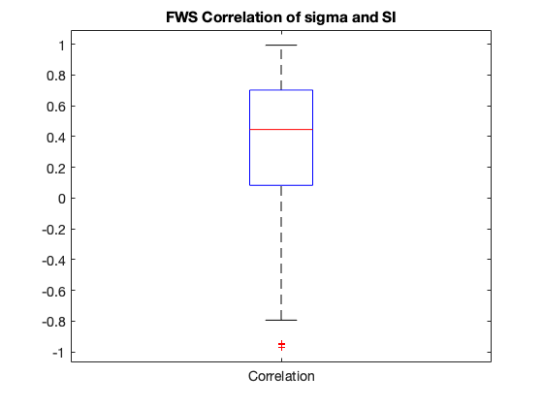

Slide 18


UPMC
Silva Arslanian, MD
Joon Young Kim, Ph. D.
UPMC Children's Hospital of Pittsburgh
Syracuse University, NY

Slide 19
Study Details
Study population (n=130)
  Age 10 – 20
  BMI ≥ 85%ile
  60 boys & 70 girls; 57 African-American & 73 American-White
  68 with NGT, 33 with IGT, 29 with T2D
2-hr OGTT
hyperinsulinemic-euglycemic clamp to measure insulin sensitivity
Hyperglycemic clamp for 1st- and 2nd-phase insulin secretion

Slide 20
Mean Data Fits

Slide 21
Error Histograms
Error somewhat bigger than with FWS

Slide 22
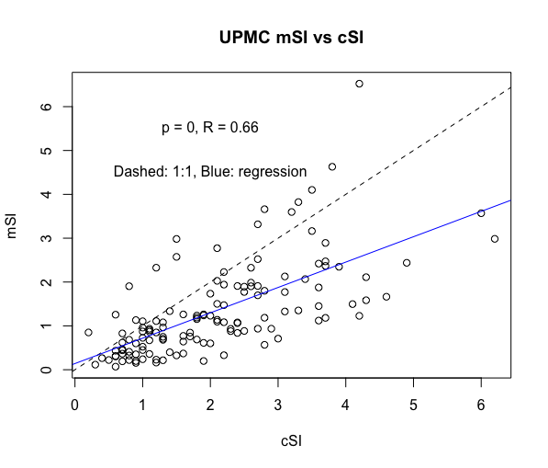
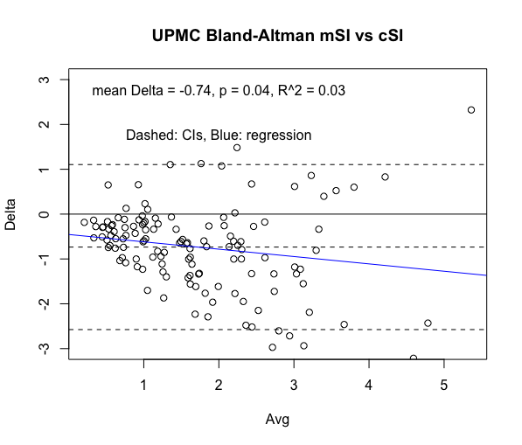
UPMC SI vs Clamp SI: Correlation and Agreement
mSI systematically smaller than cSI,
scatter and error increase with cSI
Correlation OK

Slide 23
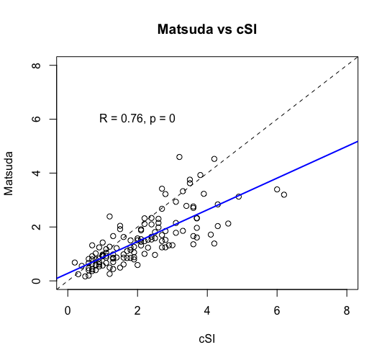
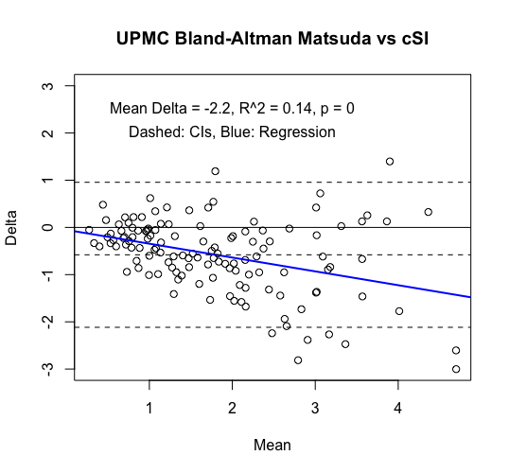
UPMC Matsuda vs cSI: Correlation and Agreement
Matsuda also systematically underestimates cSI
Performance of mSI, Matsuda are similar (they agree well – not shown)
Could be an issue of OGTT-based measures? Cobelli?

Slide 24
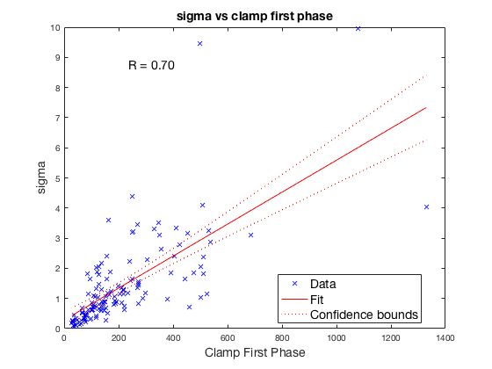
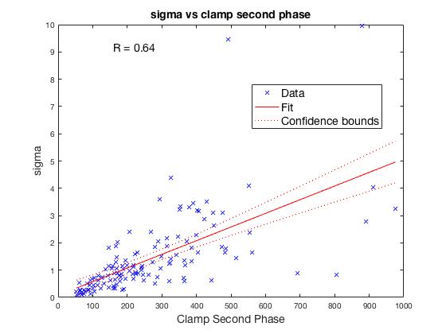
sigma vs clamp BCF

Slide 25
Other Comparisons
From the literature

Slide 26
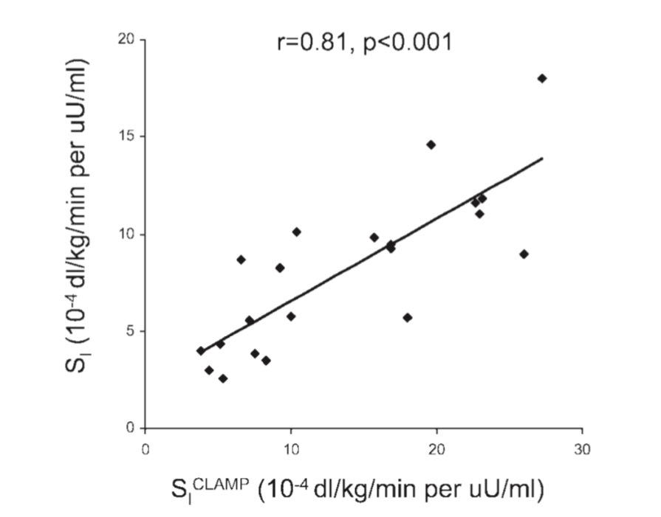
OMM vs Clamp, mSI vs Clamp
Dalla Man et al, AJP-Endo 289:954 2005
Correlation good
but systematically
lower than clamp
Correlation lower,
also systematically
lower than clamp
OGTT or MMT?

Slide 27
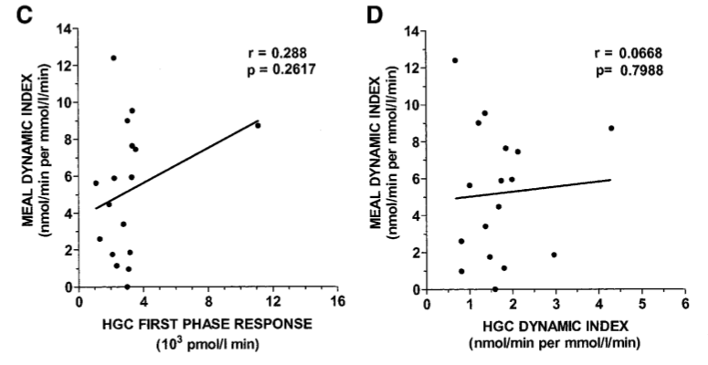
Cobelli phid vs clamp – MMT; sigma vs clamp
Steil, Diabetes 2004 53(5):1201-7
No Correlation
Also no correlation with AIR:
R = 0.28, p = 0.27

Slide 28
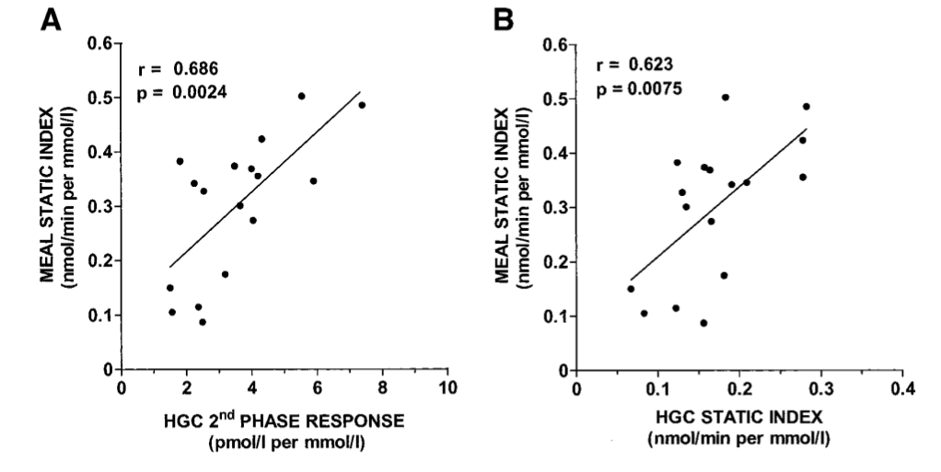
Cobelli phis vs clamp – MMT; sigma vs clamp
Steil, Diabetes 2004 53(5):1201-7

Slide 29
Conclusions
Simpler to implement than clamp, FSIGT, needs less data
Not much more complex than algebraic measures (HOMA, Matsuda, IGI)
Agrees well with MINMOD SI and AIR
  better than Matsuda
Agreement with clamp not as good but perhaps acceptable
  similar to Matsuda
  Correlation with 1st phase clamp BCF much better than OMM
  Correlation with 2nd phase clamp BCF similar to OMM
Precision good (mostly < 5%)
Correlation poor, but may not matter because bounds are tight

Slide 31
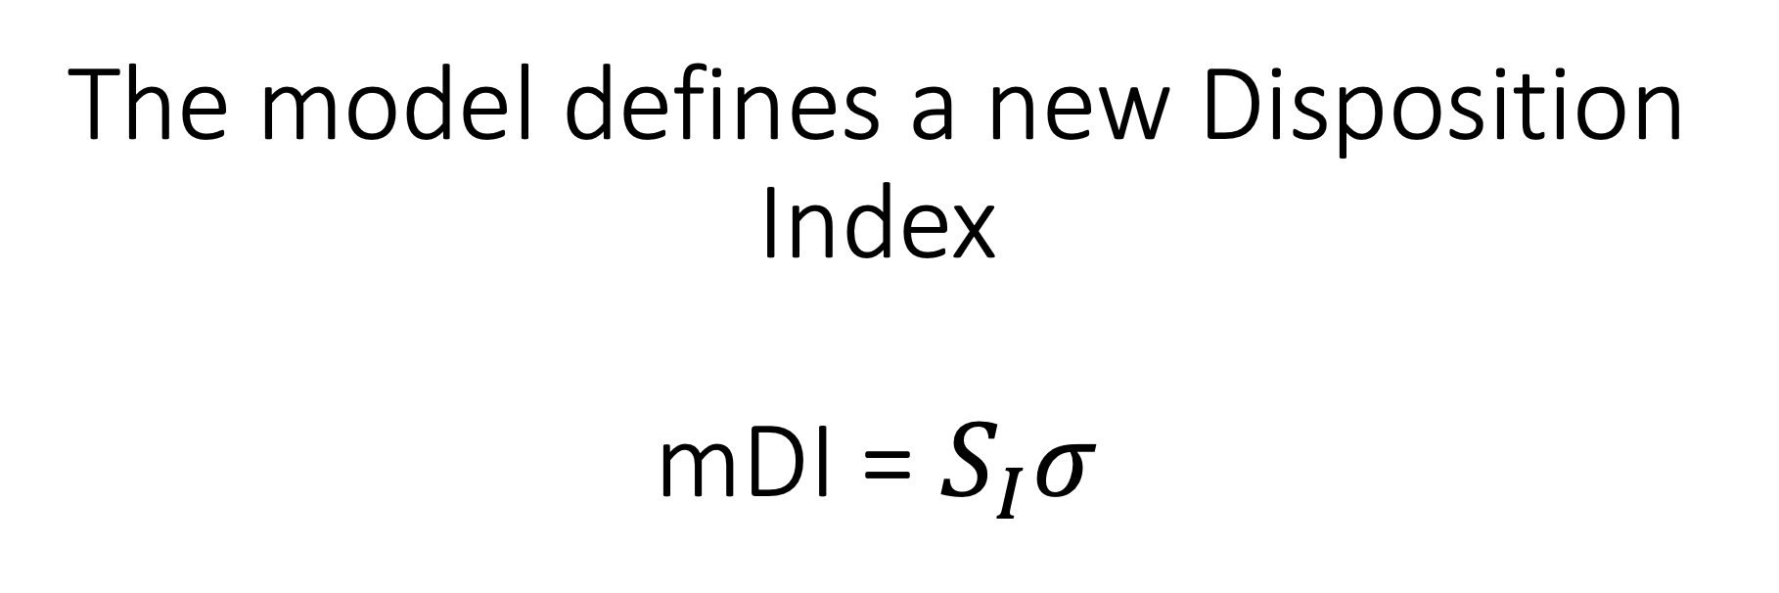
The model defines a new Disposition Index mDI = $S_{I}σ$

Slide 32
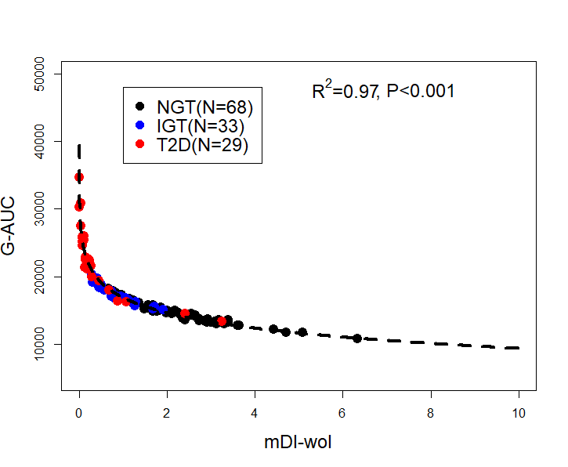
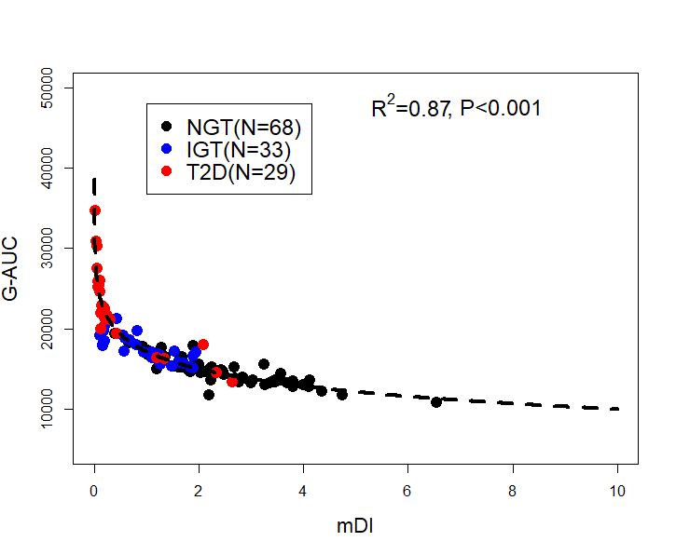
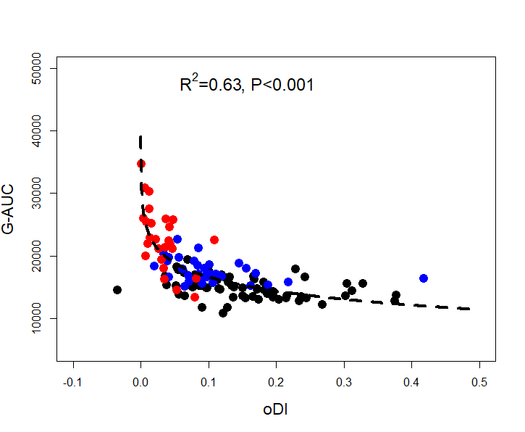
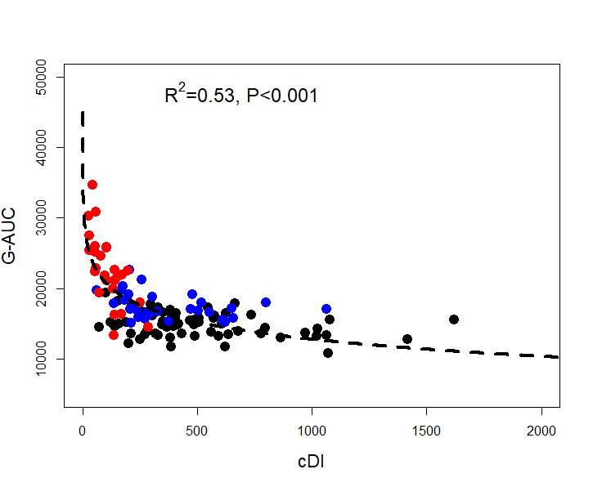
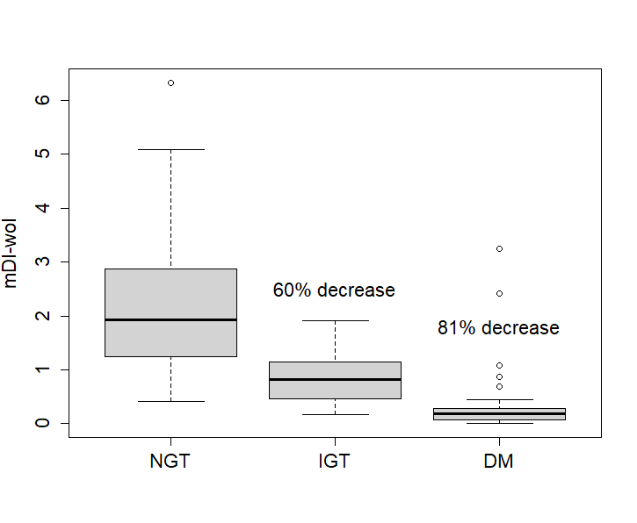
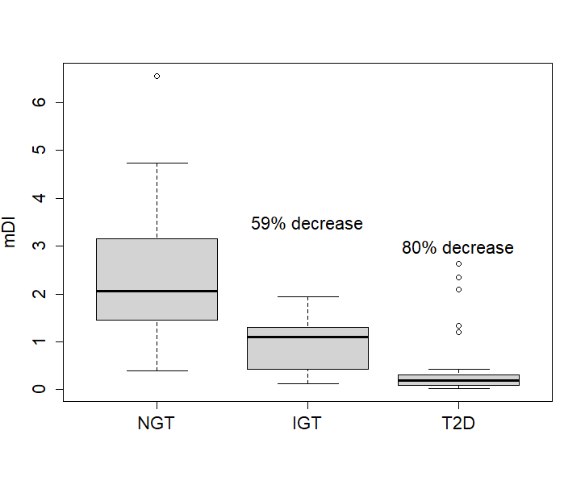
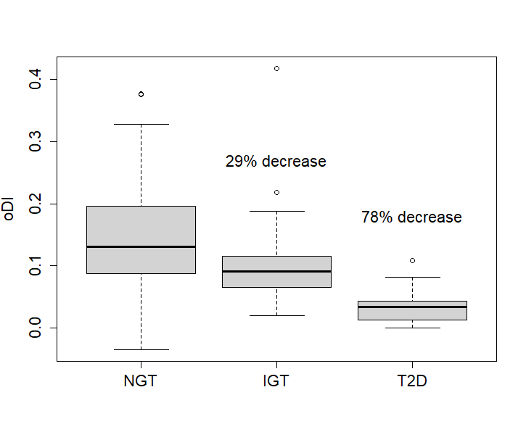
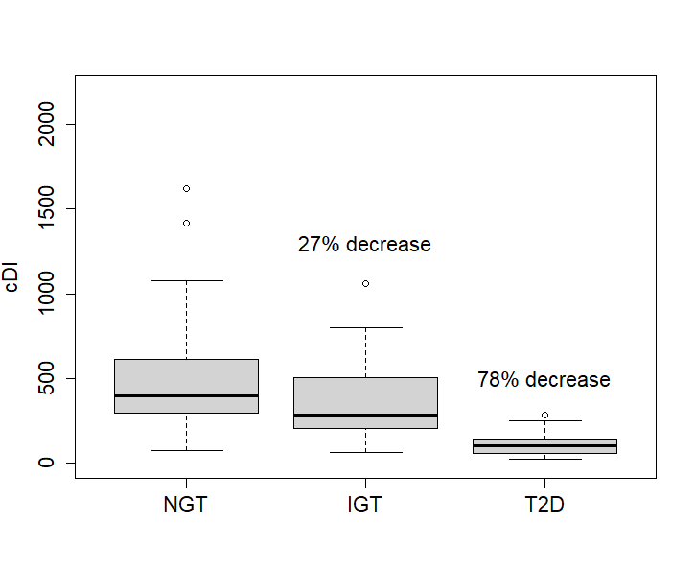
A
B
C
D
E
F
G
H
mDI-woI decreases vs. NGT
mDI decreases vs. NGT
oDI decreases vs. NGT
cDI decreases vs. NGT

Slide 33
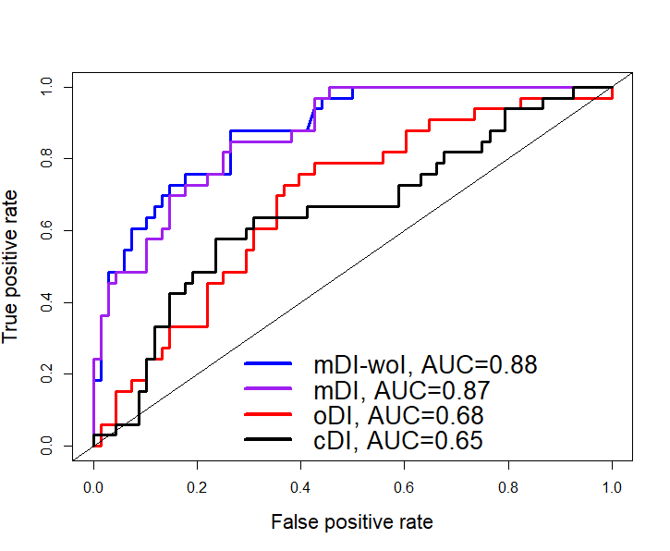
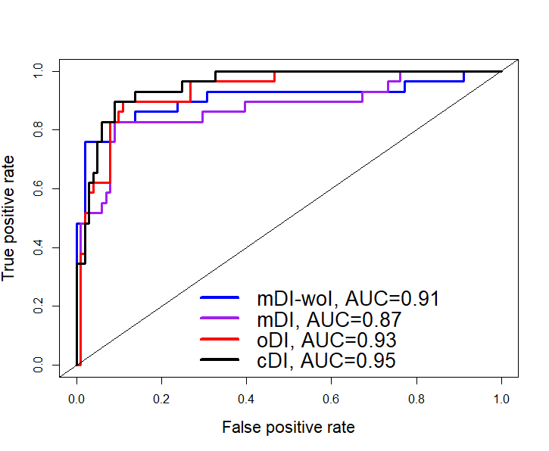
ROC Analysis: Detecting IGT, T2D Cross-Sectionally
IGT
T2D
mDI is better than oDI, cDI at detecting IGT, equally good at detecting T2D
reason: mDI drops more sharply between NGT and IGT

Slide 34
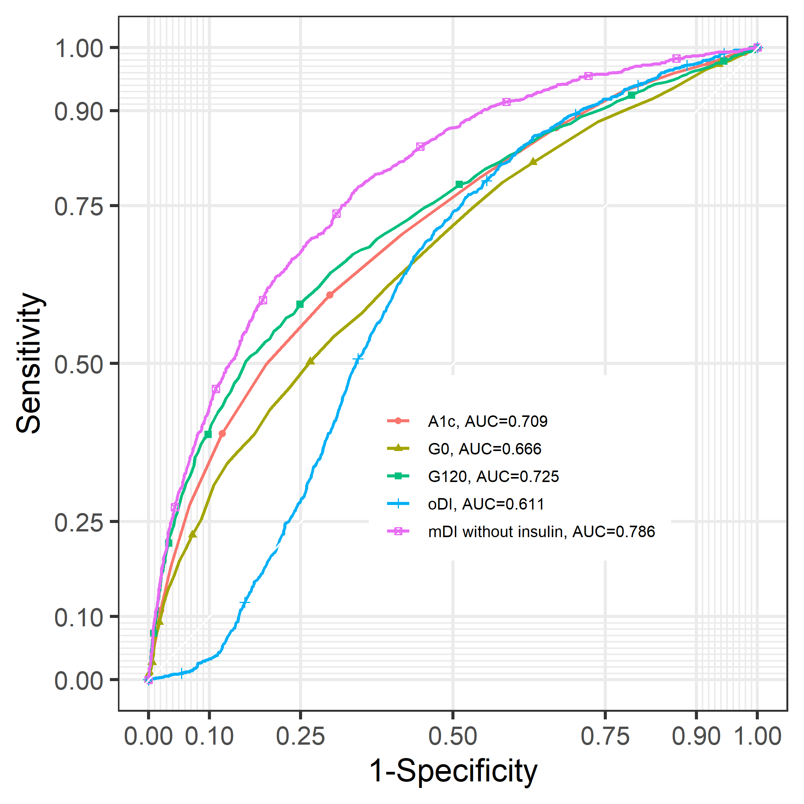
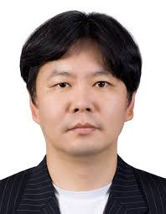
ROC Analysis for T2D Prediction
Sangsoo Kim, MD, PNUH
Korean Genome and
Epidemiology Study
N = 6639
OGTTs (0, 60, 120 min)
Every 2 years for 14 years
Event: Converted to T2D
any time between years
4 and 14

