Slide 1


Optimizing Lung Protective Ventilation to Improve ARDS Outcomes
Background and Vision
Brad Smith, PhD
University of Colorado Denver | Anschutz Medical Campus
Departments of Bioengineering and Pediatrics

Slide 2
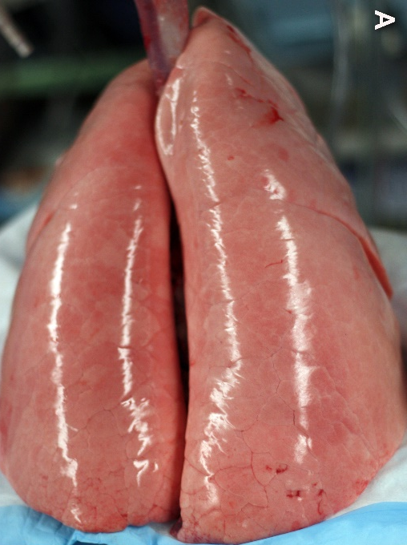
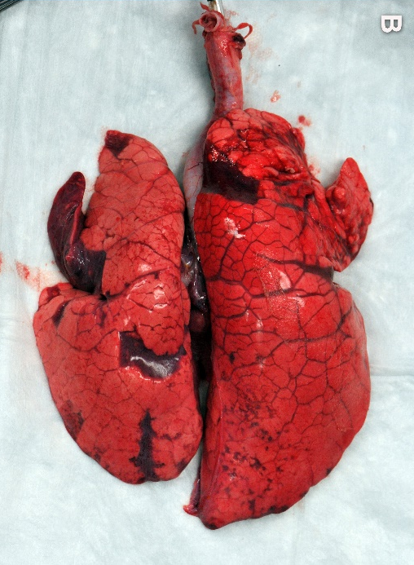
Background and Motivation
Safe Ventilation
Acute respiratory distress syndrome (ARDS)
  Fluid in airspace (Edema)
  Surfactant dysfunction (high surface tension)
  Collapse of small airways and alveoli (derecruitment)
  Respiratory failure that requires mechanical ventilation
High mortality and incidence
  ~30-40% mortality
  ~60,000 deaths/year in USA (in a normal year)
Dramatic increase in ARDS due to COVID19 pandemic
  1m dead in USA
  Assuming 80% had ARDS, and 30% COVID19 ARDS mortality:
  2.6m COVID19 ARDS cases!
Even small improvements in survival will have huge benefits
Injurious Ventilation
Images courtesy of G. Nieman
Notes:
Set up the problem:
- We care about ARDS because

Slide 3
Background and Motivation
Safe Ventilation
ARDS stiffens the lung so the patient cannot breath on their own; mechanical ventilation is required
Ventilator-induced lung injury (VILI) leads to worse outcomes
  Must prevent VILI to improve survival
  Lung protective ventilation settings are different for each patient and change over time
  Patient effort (ventilator dyssynchrony, VD) is also associated with worse outcomes
Injurious Ventilation
Images courtesy of G. Nieman
Notes:
Set up the problem:
- We care about ARDS because

Slide 4
VILI: A positive feedback mechanism
Initial acute injury alters lung dynamics
Ventilator and patient effort cause damaging stresses/strains
  Repeated collapse/reopening: atelectrauma
  Overdistension (volutrauma)
  Further degrades lung function
How can we break this feedback loop?
Optimization problem: minimize the microscale stresses/strains of ventilation
Surfactant Insufficiency
Recruitment/Derecruitment
Overdistension
Epithelial/Endothelial Injury
Inflammation
Leak, Edema, and Surfactant Inactivation

Slide 5
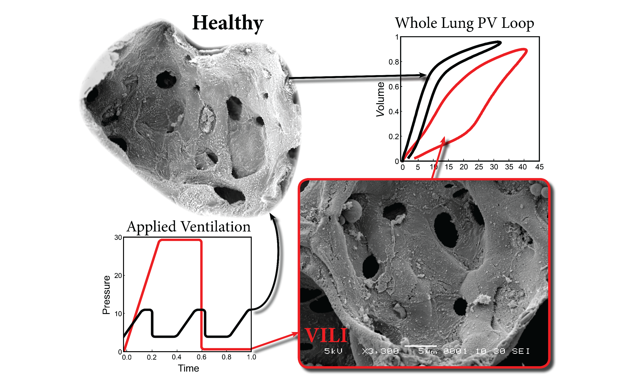
Notes:
Mechanical ventilation causes injury, VILI depends both on ventilator settings and the condition of the lung
Lung injury also changes readouts on the ventilator. For example, decreased compliance (stiffer lung) and increased hysteresis (due to recruitment)

Slide 6
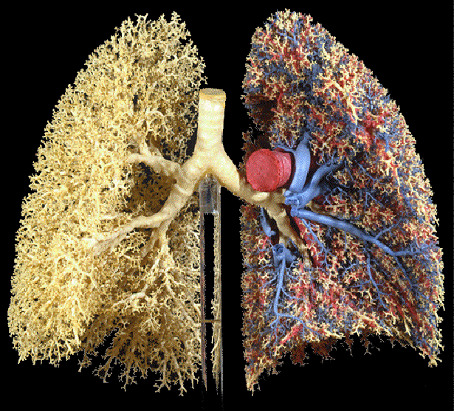
Some Background on the Lung
Airways (white); Vessels (blue/red)
Primary purpose: gas exchange
  Tremendously complex multiscale system
Gas carried to alveoli by a branching network of airways
Blood carried to and from the alveoli by a branching network of vessels
Gas exchange occurs in alveoli

Slide 7
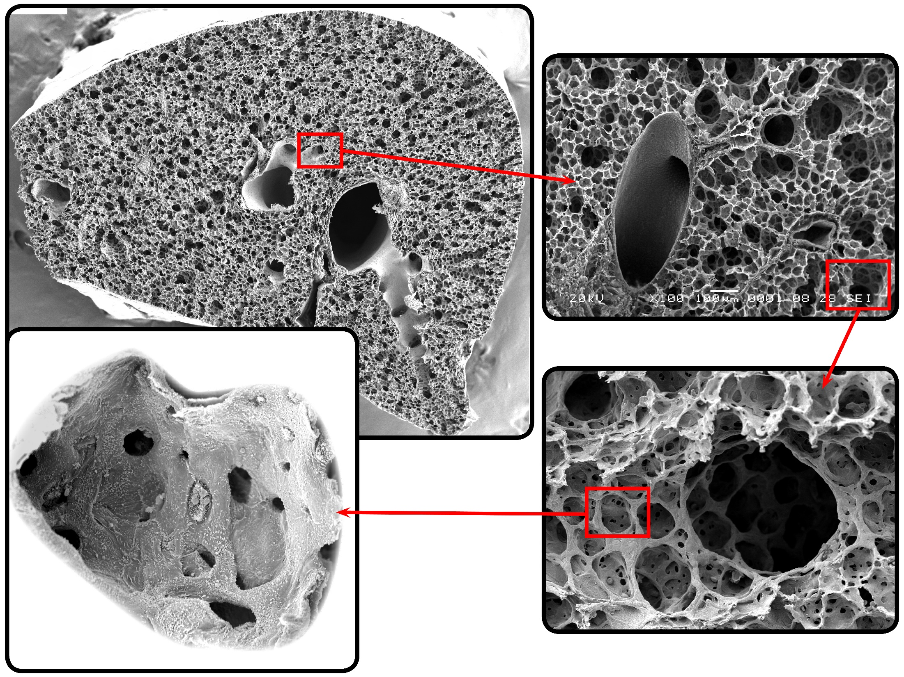
Notes:
Mouse lung images with scanning electron microscopy
Walk through each level of zoom, focusing on the airways
About 300m alveoli in the human lung
So this is a hugely multiscale problem

Slide 8
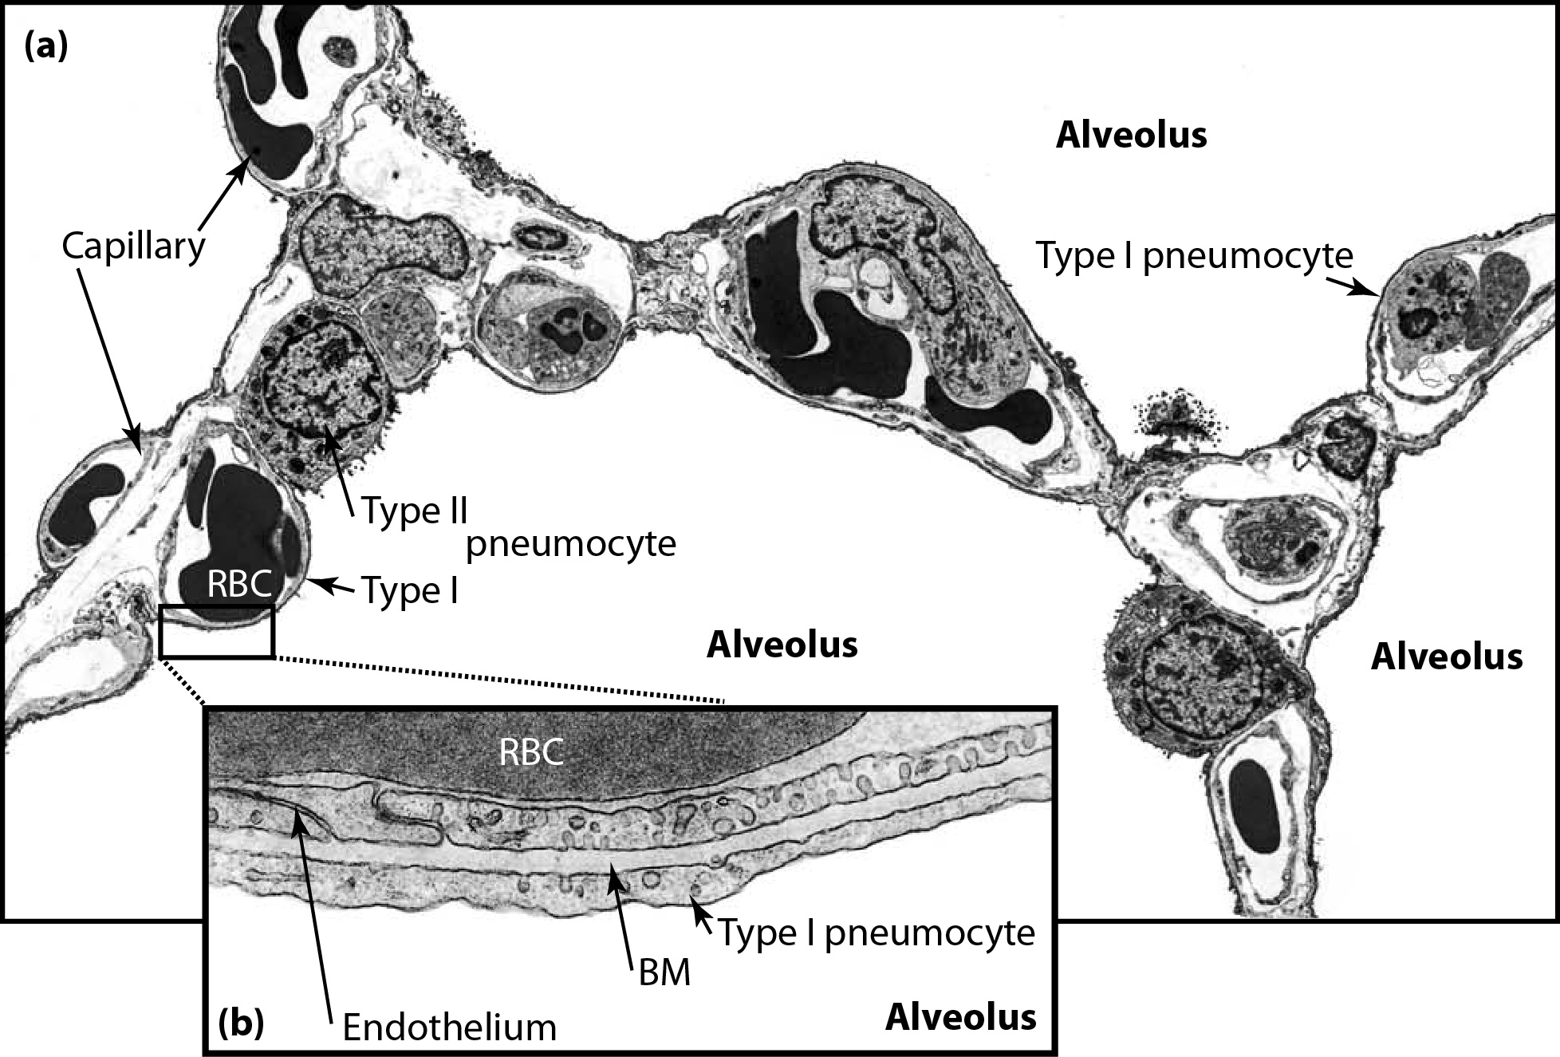
Notes:
Moving in even closer – we look at the delicate microstructure of the lung
Point out type 1 cells – thin to allow gas exchange
Capillaries are all over the place – gas exchange
Type II cells are there to produce surfactant, and differentiate into type I cells during lung repair

Slide 9
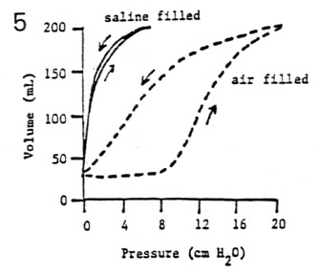
Pulmonary System Compliance
Tissue : ~20% of stiffness
Surface tension forces: ~80% of stiffness
Pulmonary surfactant:
    Dynamic reduction in surface tension
    Essential to lung function
    Example: premature babies with RDS (no surfactant)
Notes:
The tissue properties are important but not the only governing factor
The lung is lined with a thin layer of fluid to keep the delicate cells happy
This fluid has a surface tension that opposes lung expansion
In order to reduce surface tension, and allow breathing, the type II cells secrete pulmonary surfactant. This is a complex mixture of phospholipids and proteins.
Without surfactant respiration is impossible. One example of this is neonates born before the 28th week gestation. They lack mature type II cells and can’t produce surfactant. So they can’t breath on their own. Talk about improved survival with surfactant.

Slide 10
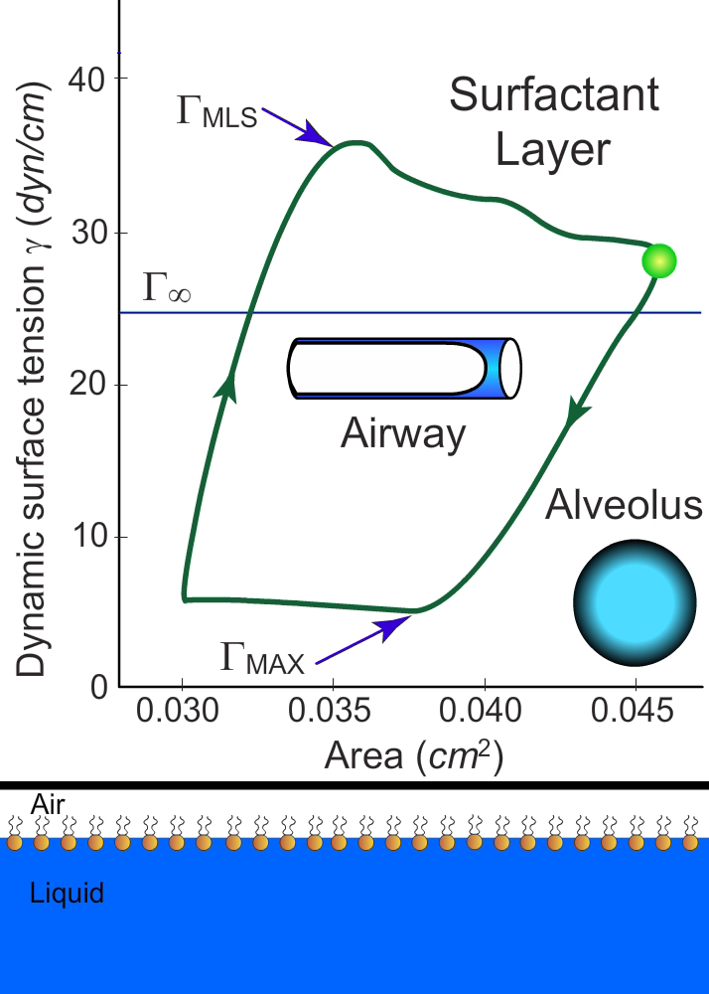
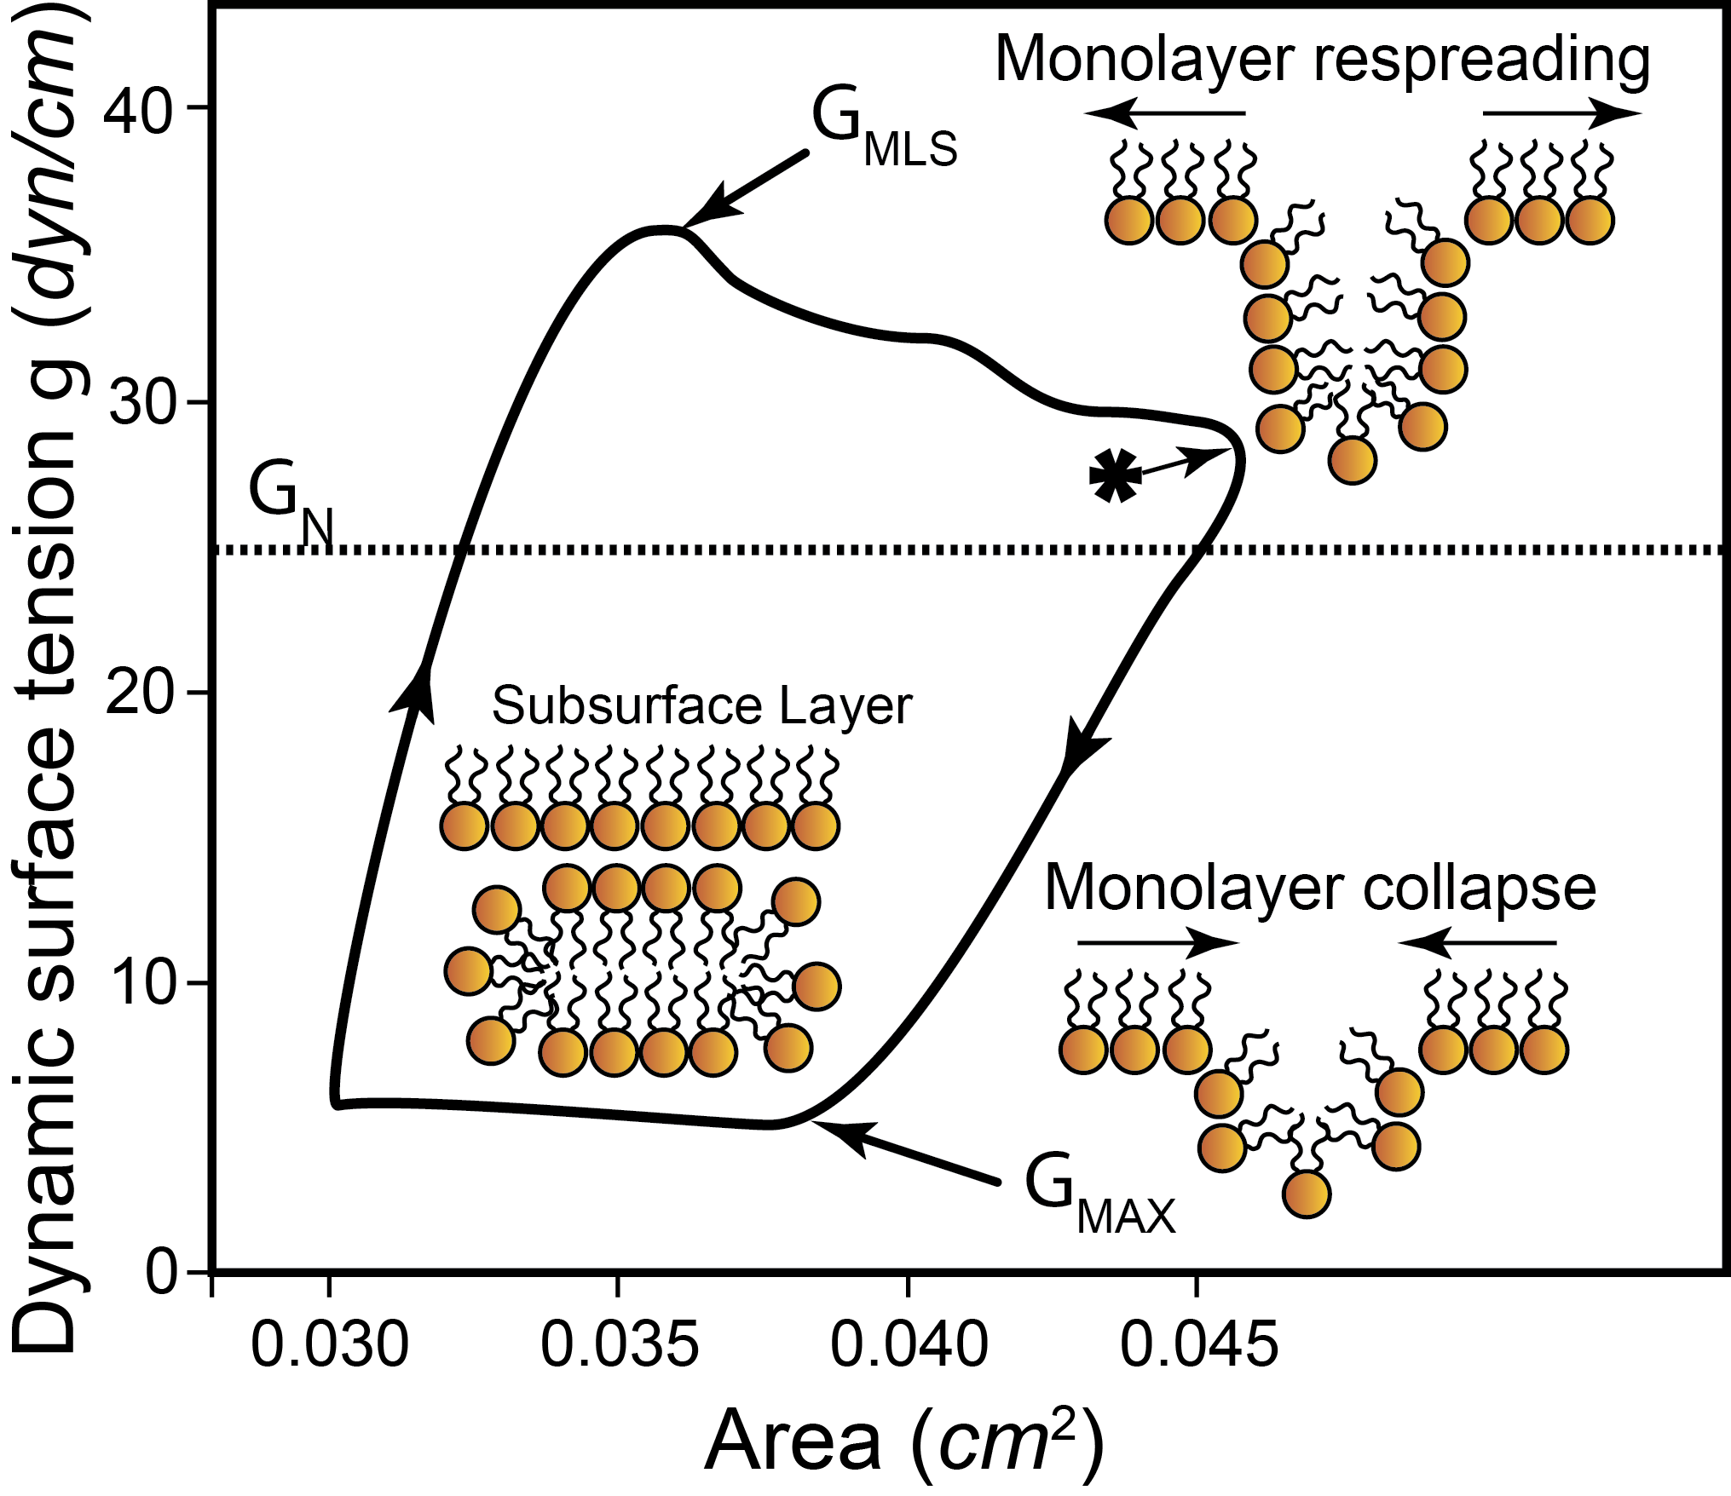
Surfactant: Dynamic Surface Tension
Notes:
At the smallest scale in the lungs is the surfactant system
This is a complex molecular microstructure, and it’s essential to lung function
This simplified diagram shows how surfactant can reduce surface tension to near zero, preventing collapse at low volumes
Walk through the loop and animation

Slide 11
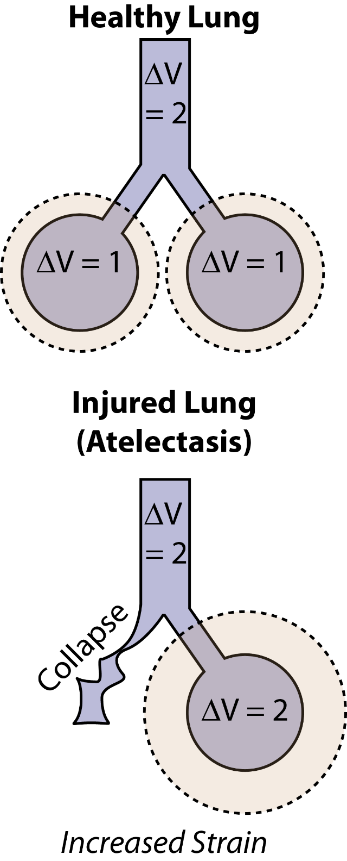
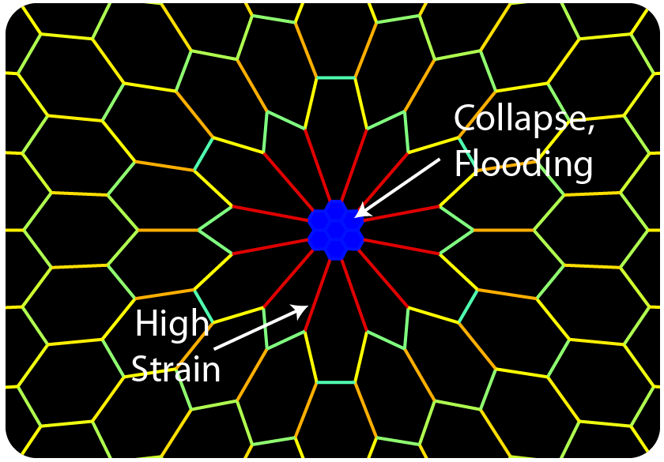
Mechanisms of VILI: Volutrauma
Damage from excess tissue stretch
Exacerbated by ‘Baby lung’
  Effective size of the ventilated lung is reduced by collapse/flooding
  More distension with the same tidal volume
Parenchymal interdependence
  Increased strain from tethering forces

Slide 12
Mechanisms of VILI: Volutrauma
Damage from excess tissue stretch
Exacerbated by ‘Baby lung’
  Effective size of the ventilated lung is reduced by collapse/flooding
  More distension with the same tidal volume
Parenchymal interdependence
  Increased strain from tethering forces

Slide 13
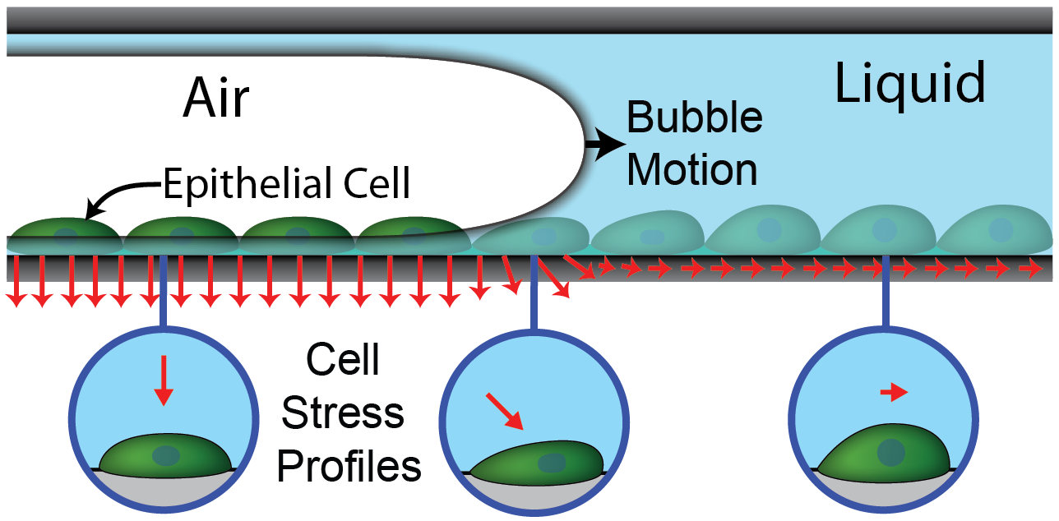
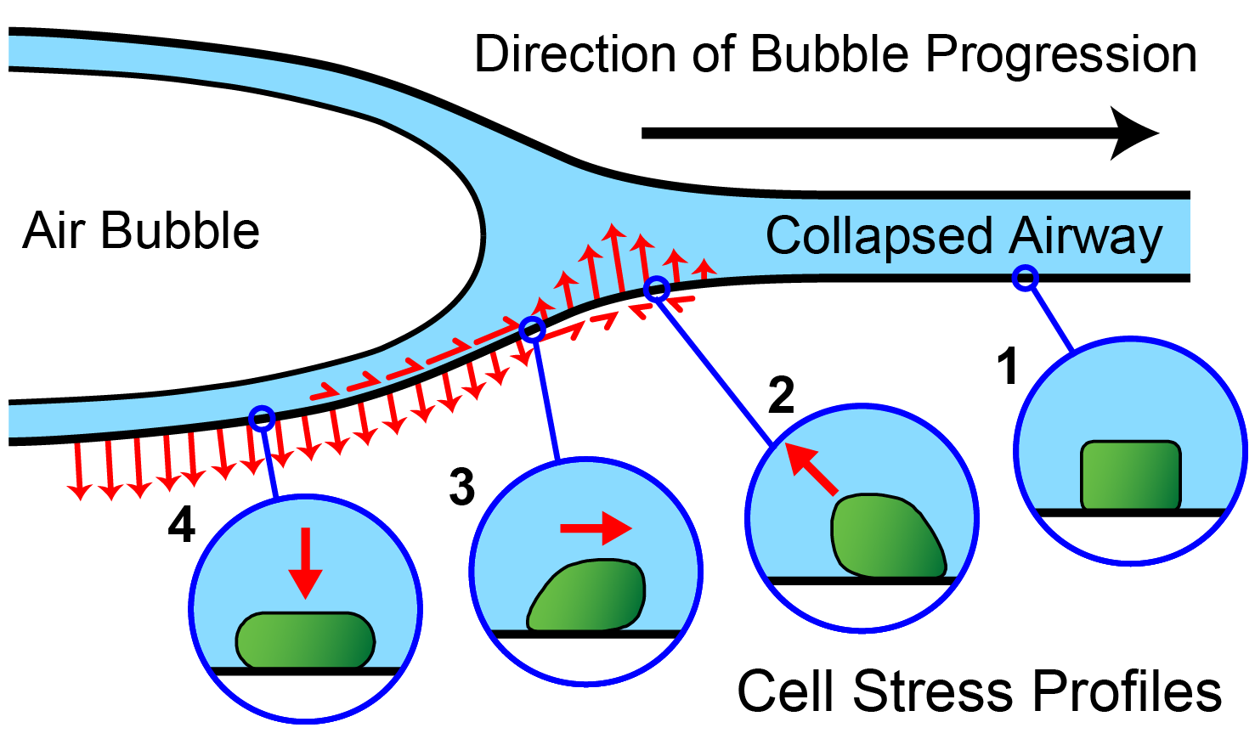
Mechanisms of VILI: Atelectrauma
Injury caused by cyclic collapse and reopening
  Small airways and alveoli
Fluid-mechanical forces
  High pressure gradients
  Cell membrane stress failure
High surface tension: more injury
Injured alveoli are more unstable
There’s both a short- and long-timescale delay!

Slide 14
Respiratory Efforts (Ventilator Dyssynchrony, VD)
An added complication
Clinical mechanical ventilation is messy
Ventilator support (breaths) commonly triggered by patient effort
Patient and efforts and ventilator may be dyssynchronous
  Many different types (effort timing and magnitude)
  May cause injury depending on timing and magnitude
Can prevent VD with neuromuscular blockade (NMB)
  But NMB needs to be balanced against costs
  Neuromuscular weakness, difficulty weaning

