Slide 1


Optimizing Lung Protective Ventilation to Improve ARDS Outcomes
Barriers to Impact
Brad Smith, PhD
University of Colorado Denver | Anschutz Medical Campus
Departments of Bioengineering and Pediatrics

Slide 2
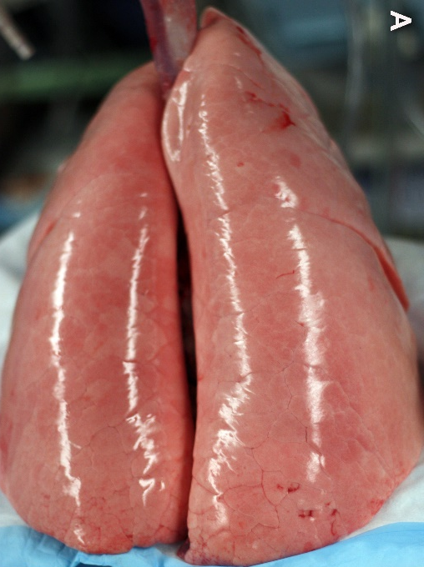
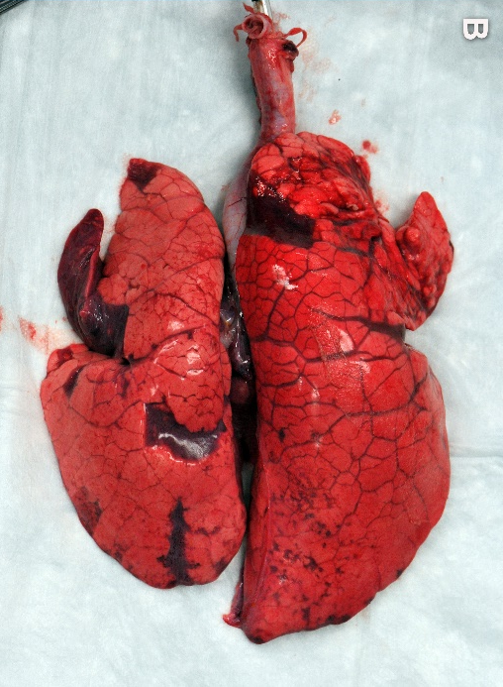
Long Term Goals
Safe Ventilation
Acute respiratory distress syndrome (ARDS) requires ventilation
  Can cause ventilator-induced lung injury (VILI)
  Worse outcomes
Our goals for reducing VILI:
Identification of injurious ventilation
Identification/classification of ventilator dyssynchrony
Predicting optimally lung-protective ventilator settings for each patient
Injurious Ventilation
Images courtesy of G. Nieman

Slide 3
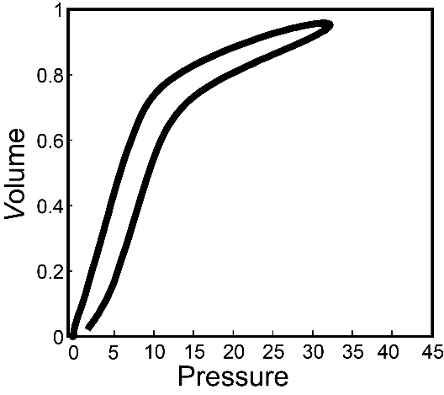
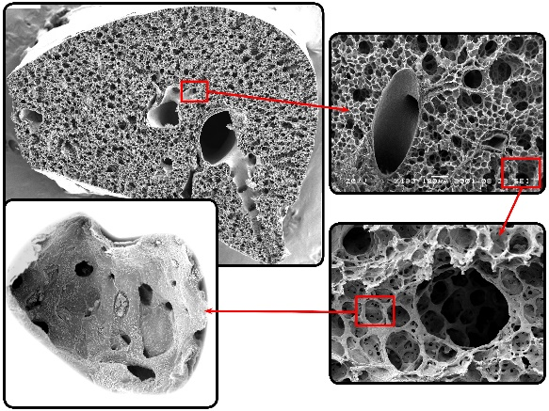
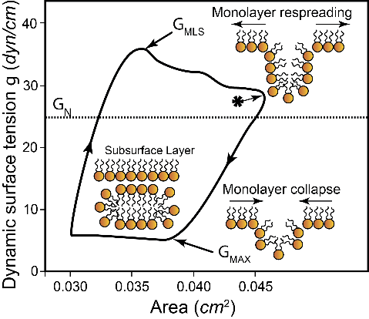
Problem: Models are gross and corrupted measures of microscale behavior
Macroscale models can recapitulate (some) clinical measurements but not linked to microscale processes
  We do not predict macro from micro (e.g. surfactant)
  In other words, there are fundamental microscale dynamics that are not used at the macroscale
Data availability is a limiting factor
  Most things not measurably clinically, or even in the same animal in the lab
  E.g. no surfactant function and morphometry in the clinic or same experimental mouse
  Data does not capture nonlinearity and time delays
Notes:
Macroscale models can recapitulate clinical measurements, but it not usually linked to microscale changes (predict macro from micro)
Or, there are microscale dynamics that we know about and are not used at the macroscale
Common threads: what kinds of things are clinically measurable vs. experimentally measurable?
Clinical = macro
Experimental = Macro and micro
How much detail do we need?
Can you get it done without linking the micro to the macro?

Slide 4
Problem: Models are gross and corrupted measures of microscale behavior
Complexity of the ‘full model’ is intractable
300m alveoli that interact with each other
Each is a hard fluid-structure interaction problem
Patient-ventilator interactions
And then there’s the rest of the body (multi organ system failure kills a lot of ARDS patients)
We will have a colony on Mars before we have a full-scale patent-specific predictive models
Notes:
Macroscale models can recapitulate clinical measurements, but it not usually linked to microscale changes (predict macro from micro)
Or, there are microscale dynamics that we know about and are not used at the macroscale
Common threads: what kinds of things are clinically measurable vs. experimentally measurable?
Clinical = macro
Experimental = Macro and micro
How much detail do we need?
Can you get it done without linking the micro to the macro?

Slide 5
What are we trying to achieve?
1) Identification of injurious ventilation
  Stresses and strains at the alveolar scale (average): atelectrauma, volutrauma, inflammation
  Does not necessarily need to be mechanistic
2) Identification and classification of ventilator dyssynchrony
  ‘Just’ need to classify breaths
  Would like to determine if they cause injury
  Does not necessarily need to be mechanistic
3) Prediction of optimally lung-protective ventilator settings for each patient
  How the patient responds to changes in ventilation
  Which ventilation will cause the least injury
  Will likely need to be mechanistic
Notes:
Macroscale models can recapitulate clinical measurements, but it not usually linked to microscale changes (predict macro from micro)
Or, there are microscale dynamics that we know about and are not used at the macroscale
Common threads: what kinds of things are clinically measurable vs. experimentally measurable?
Clinical = macro
Experimental = Macro and micro
How much detail do we need?
Can you get it done without linking the micro to the macro?

Slide 6
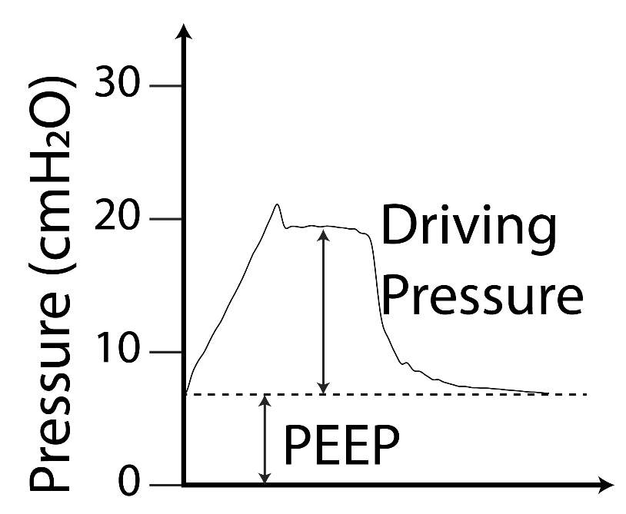
Unmet Clinical Need: VILI Warnings and Treatment Suggestions
Identification of injurious ventilation
No established metrics (VILI cost functions)
A warning system that the ventilator is hurting the patient, and how bad
  Will need to explain why!
In order to phenotype (per George) we may need to summarize the waveforms (dimension reduction)
Keep doctors from making silly mistakes!

Slide 7
Problem 1: Identification of injurious ventilation
Current approach: simple waveform
properties like tidal volume, driving pressure
Easy to calculate, easy to understand
Limited fidelity
Confounding factors
  Tidal volume: baby lung
  Ventilator settings and lung condition intertwined

Slide 8
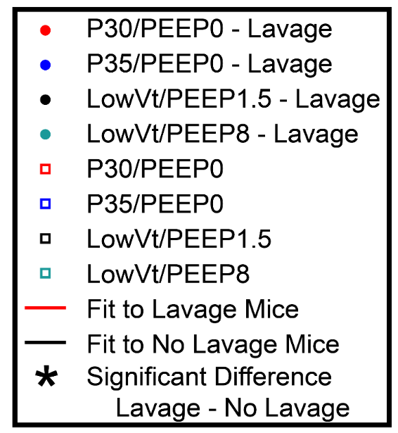
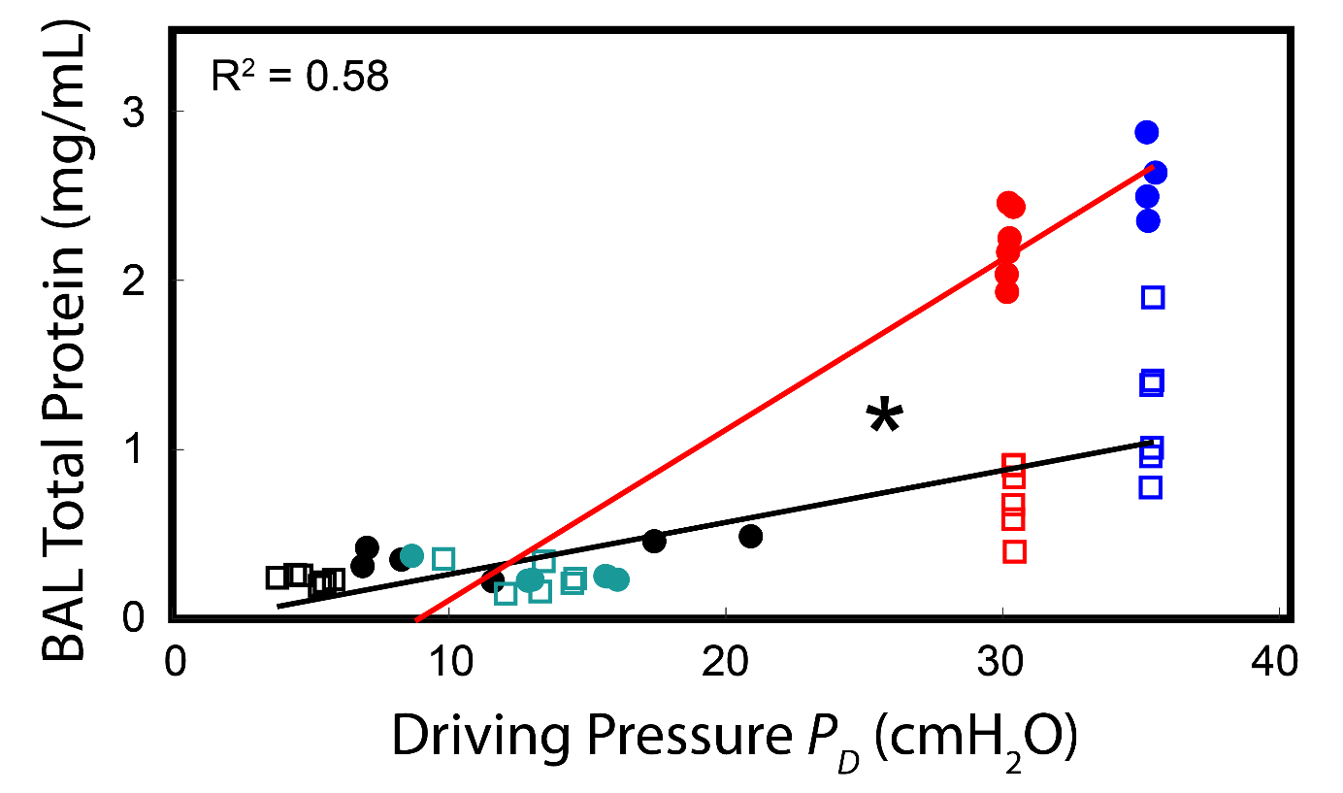
VILI cost function:
Driving pressure (P_{D})
P_{D} popular in the clinic
Tested in mice with and without lavage-induced lung injury
Injury dependent!
More VILI in lavaged lungs

Slide 9
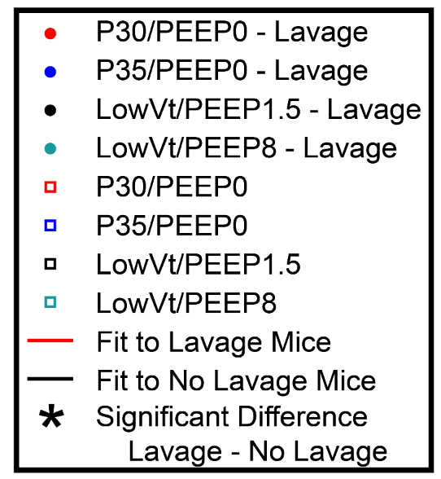
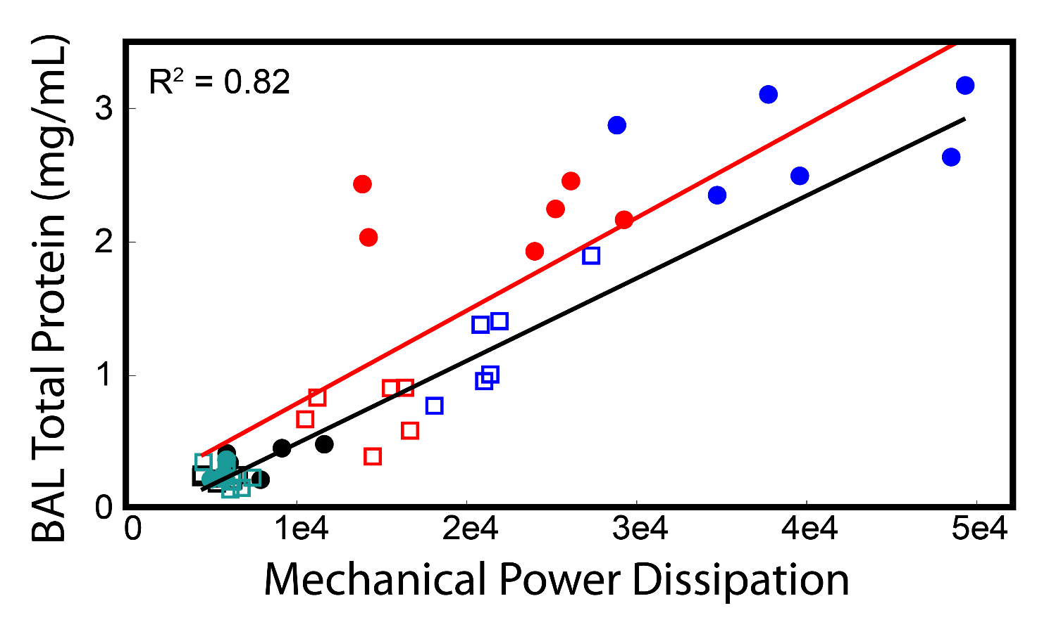
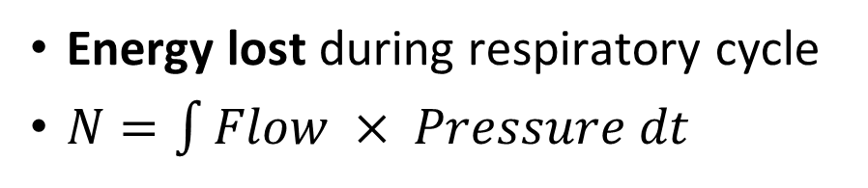
Mechanical Power Dissipation
Energy lost during respiratory cycle
$N=\int{Flow × Pressure dt}$
Strong correlation with BAL total protein (leak)
Independent of injury
Sensitive to small changes in VILI
Potential Energy Losses: recruitment, tissue damping

Slide 10
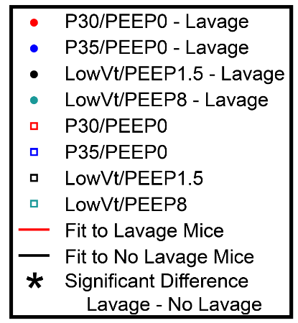

Future Needs
Link to multiple outcomes – not just alveolar leak
Experimentally test
  Different acute injures
  More relevant ventilation patterns
  More outcomes (structure, function, ect)
Clinical extension
  Need to get the data!
  Confounding factors
  Time lag between injury and effect
Jake and Dave will show an exciting new way to approach this challenge later in the meeting

Slide 11
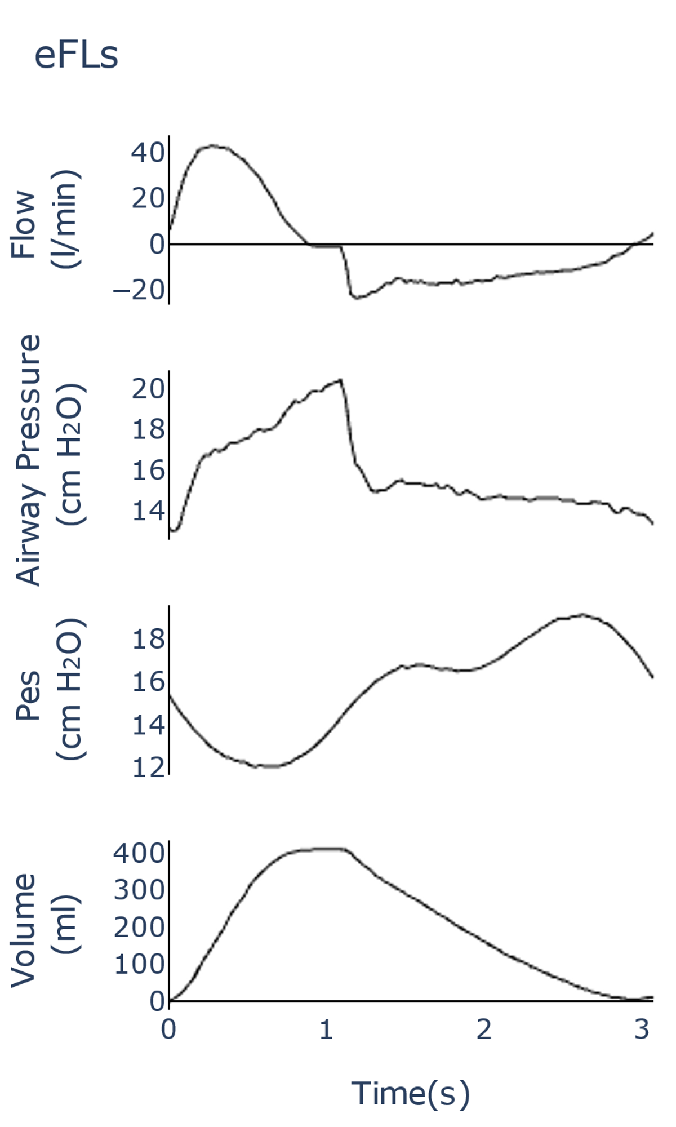
Unmet Clinical Need: VD Warnings and Treatment Suggestions
Current approach:
  Watch patient, pressure/volume on the ventilator
  This takes expertise
Limited use: esophageal manometry
  Balloon with a pressure sensor in esophagus
  Use not widespread, hard to set up and interpret
Effort
High Vt

Slide 12
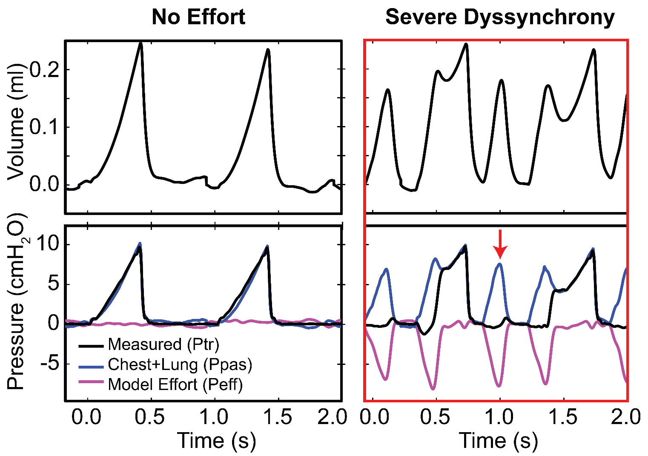
Problem 2: Identification/classification of ventilator dyssynchrony
Phenotype breaths by type of dyssynchrony and dyssynchrony severity
Algorithmically predict interventions to cause the least harm
  Will need to explain why to the physician
ML methods for detection in research stage (e.g. Sottile)

Slide 13


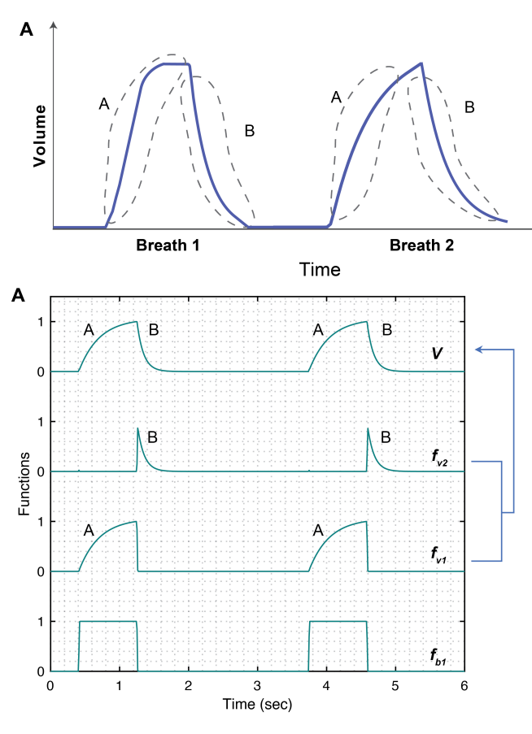
The Damage Informed Lung-Ventilator Model
Each breath modeled as hypothesis-driven deviation
  Pressure and Volume waveforms: sum of time-limited functions
Estimate model for each breath
  Model is identifiable, unique solution due to time-limited support
Notes:
Effectively hard code knowledge into a hybrid ML model by considering deviations—that are hypothesis-driven—from a nominal state.
Model creation:
1. begin with a nominal baseline for healthy/normal/whatever that vary over a parameter, e.g., time;
2. create support-limited (e.g., time-limited) deviations from the normal that are hypothesis driven;
3. estimate the model parameters and states of the now-deformable model.

Slide 14
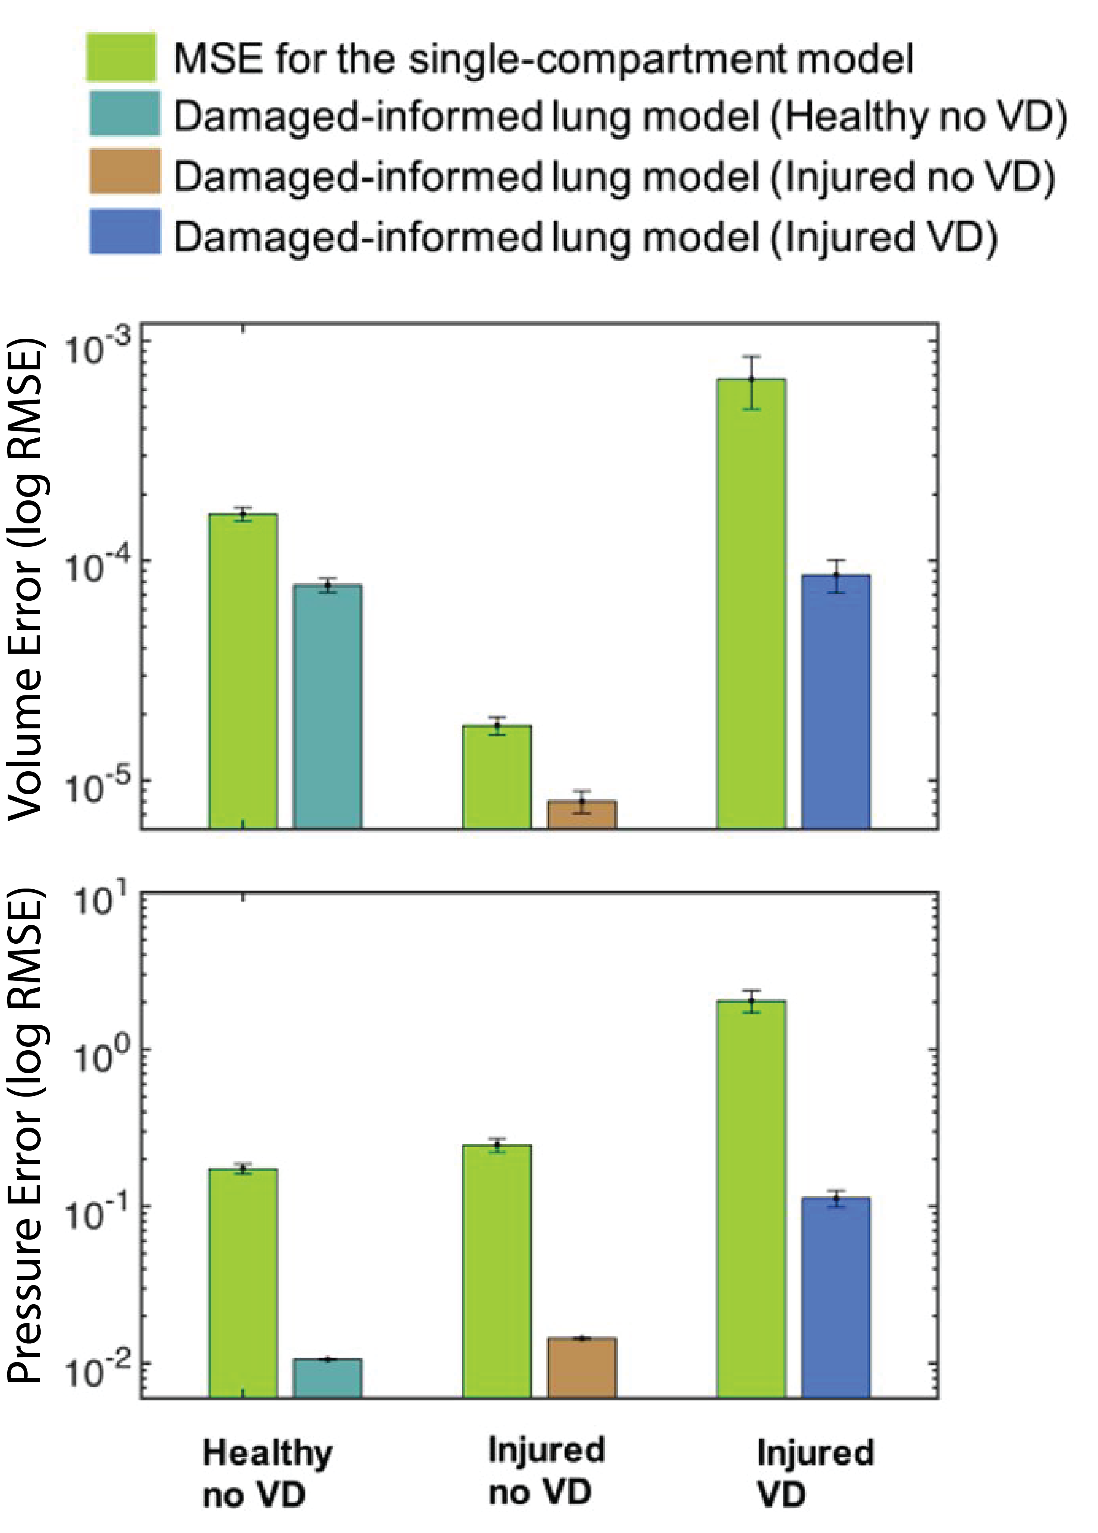
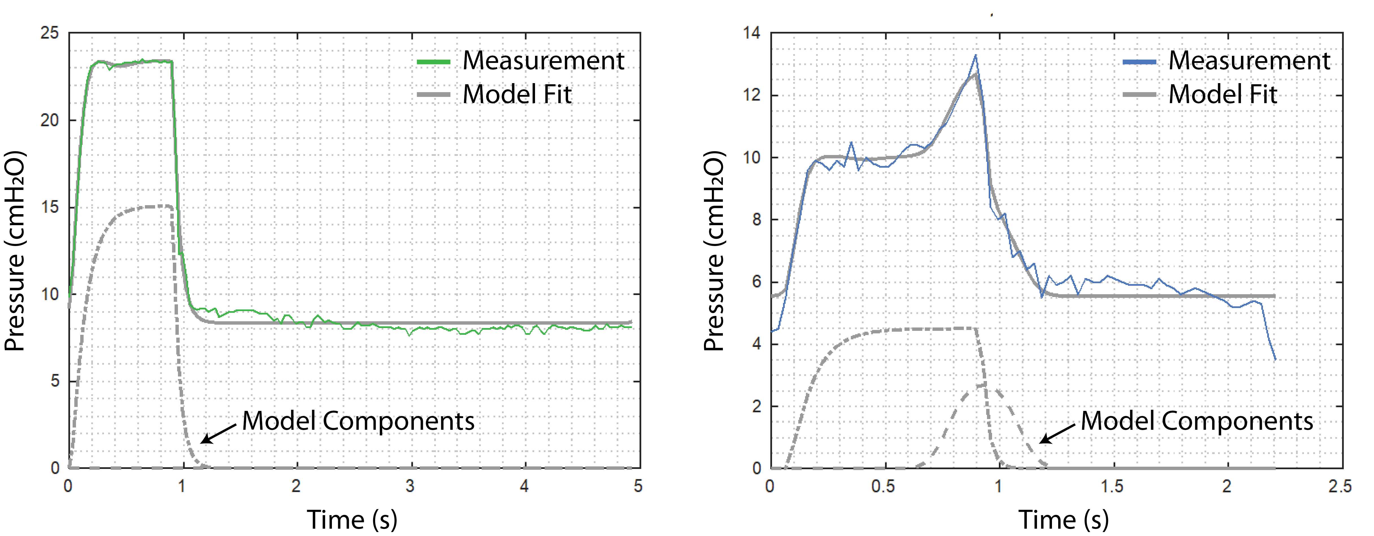
Fits to human data
The model
Is flexible and generalizable enough to represent the waveforms with respiratory effort
Accurately recapitulates the measurements
  Low pressure and volume errors
Resolves by-breath phenotypes
Normal Breath
Flow Limited
Notes:
model-based/ML hybrid computational approach.
The damage-informed lung-ventilator model:
1. is flexible and generalizable enough to represent the waveforms that we thing we should care about;
2. is hypothesis driven and interpretable;
3. can be validated in humans and mice (in similar situations);
4. resolves by-breadth phenotypes;
5. differentiates damaged lungs continuously

Slide 15
Inter-Breath Heterogeneity in Patient Effort
Patient 1
Model-detected respiratory efforts for two representative patients
Marked variation in respiration over time
  Ventilator settings, sedation, NMB, etc
Next steps
  Determine causative factors (time correlations)
  Linking detected VD to patient outcomes
    Time-lagged info from EMR
    Experiments to induce VD
Patient 2

Slide 16
Unmet Clinical Need: Determine ‘Safest’ Ventilation
Current approach: manual adjustment of ventilator settings
  Physician-dependent, high skill, some risk to patient
Inter-patient differences (need to personalize)
Temporal changes (need to continuously update)
A hugely complex system (spatial heterogeneity)
What defines ‘bad’ ventilation (VILI cost functions)?
Measure Pressure and Volume
Identify Patient-Specific Model
Predict and Apply Optimally-Protective Ventilation

Slide 17
Problem 3: Predicting optimally lung-protective ventilator settings for each patient
Long-term goal: prediction of optimally lung-protective ventilator settings for each patient
This physiologist’s approach:
  Define a patient-specific model
  Need a robust VILI cost function to describe injury during ventilation
  Numerically optimize ventilation settings to achieve lowest cost function value
Measure Pressure and Volume
Identify Patient-Specific Model
Predict and Apply Optimally-Protective Ventilation

Slide 18
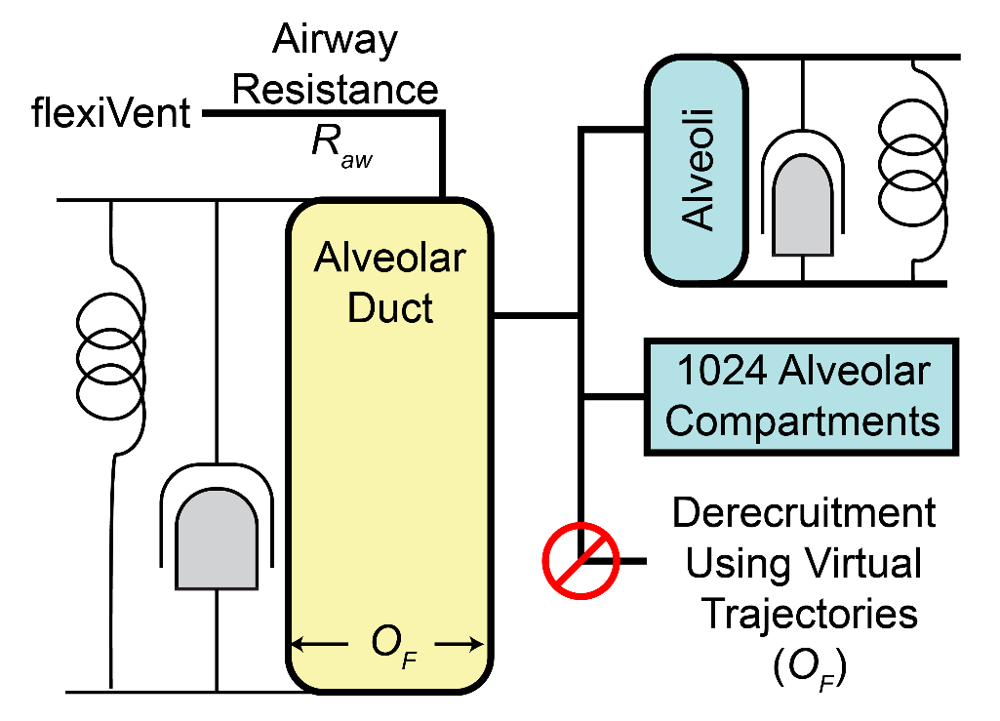
Predicting Optimal Ventilation:
Bleomycin Treated Rats
Injury
Acute phase of injury
Widespread alveolar collapse
Alveolar volumes increase with injury
The Model:
  Nonlinear elastance for ducts and alveoli
  Airflow resistance
  Time- and pressure-dependent recruitment
  1024 alveolar compartments

Slide 19
Predicting Optimal Ventilation:
Bleomycin Treated Rats
Injury
Multi-compartment simulations fit to
Lung function (flexiVent)
  Measurements at wide range of pressures
Morphometry
  Alveolar number
  Alveolar volume
  Alveolar duct volumes

Slide 20
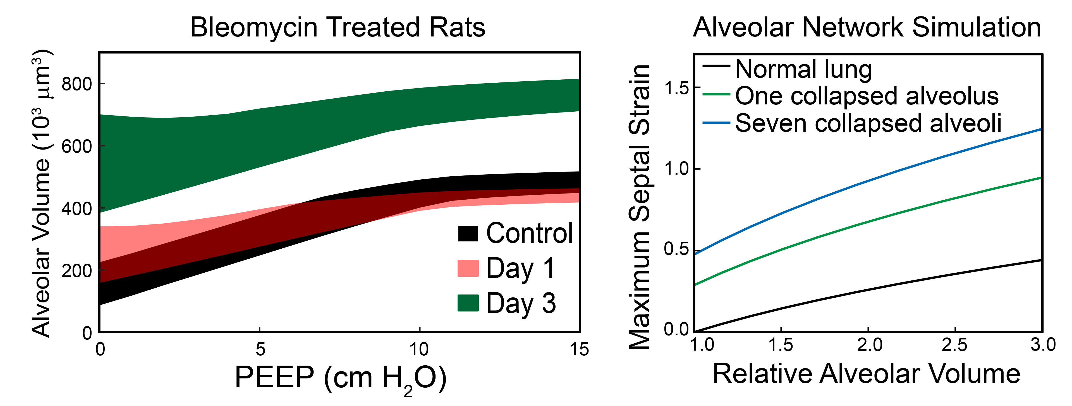
Bleomycin Treated Rats
Predicted alveolar volume during low-Vt ventilation
  Enlargement of remaining open alveoli
Elevated mechanical power dissipation, driving pressure
FEA analysis: tethering forces increase volume

Slide 21

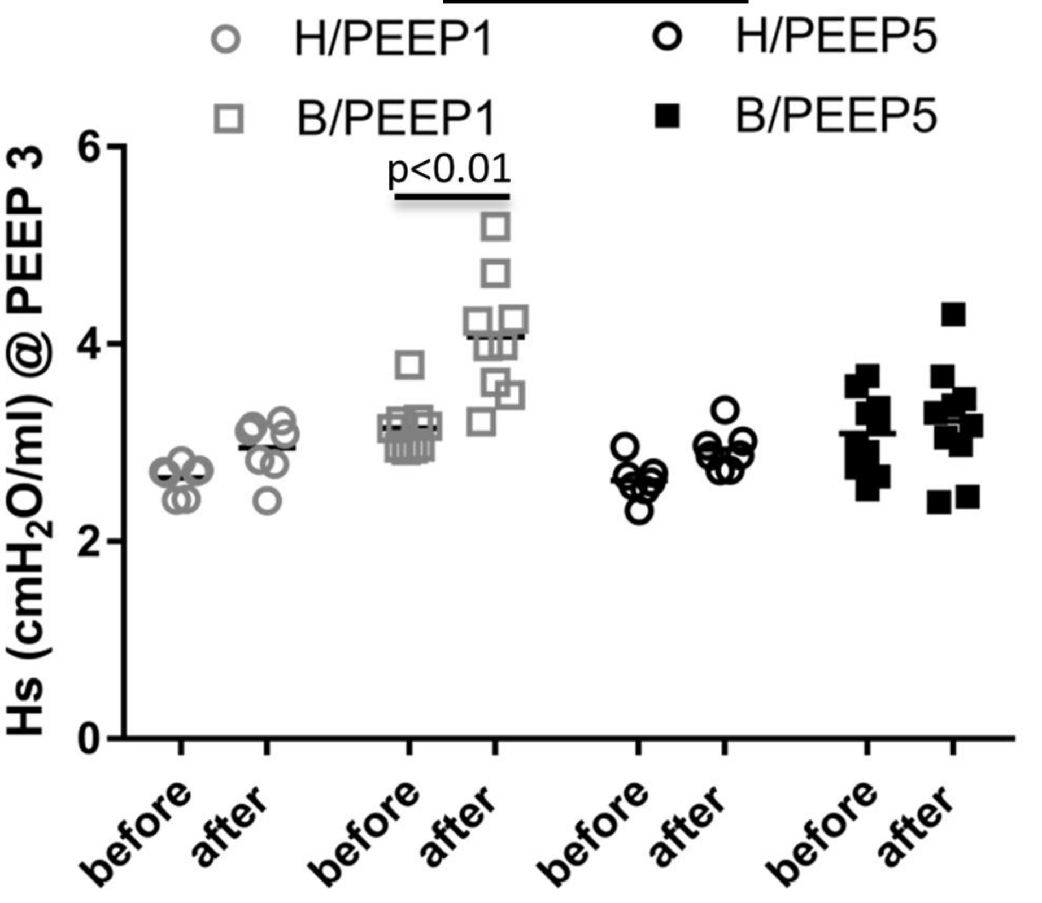
We may have been correct!
Mechanical ventilation of Bleo injured rats 1 day after injury
More VILI at PEEP=1: only with Bleo
  Corresponds to increased strain in model, experimental measurements of increased strain
But that model is way too complicated to be useful
Impossible to get the source data
Will need a simpler solution…

