Slide 1


Optimizing Lung Protective Ventilation to Improve ARDS Outcomes
Modeling Recruitment, Derecruitment, and Dyssynchrony
Brad Smith, PhD
University of Colorado Denver | Anschutz Medical Campus
Departments of Bioengineering and Pediatrics

Slide 2
VILI: A positive feedback mechanism
How can we break this feedback loop?
Optimization problem: minimize the microscale stresses/strains of ventilation
Surfactant Insufficiency
Recruitment/Derecruitment
Overdistension
Epithelial/Endothelial Injury
Inflammation
Leak, Edema, and Surfactant Inactivation

Slide 3
Optimizing Ventilation
Prediction of optimally lung-protective ventilator settings for each patient
  Define a patient-specific model
  Need a robust VILI cost function to describe injury during ventilation
  Numerically optimize ventilation settings to achieve lowest cost function value
Measure Pressure and Volume
Identify Patient-Specific Model
Predict and Apply Optimally-Protective Ventilation

Slide 4
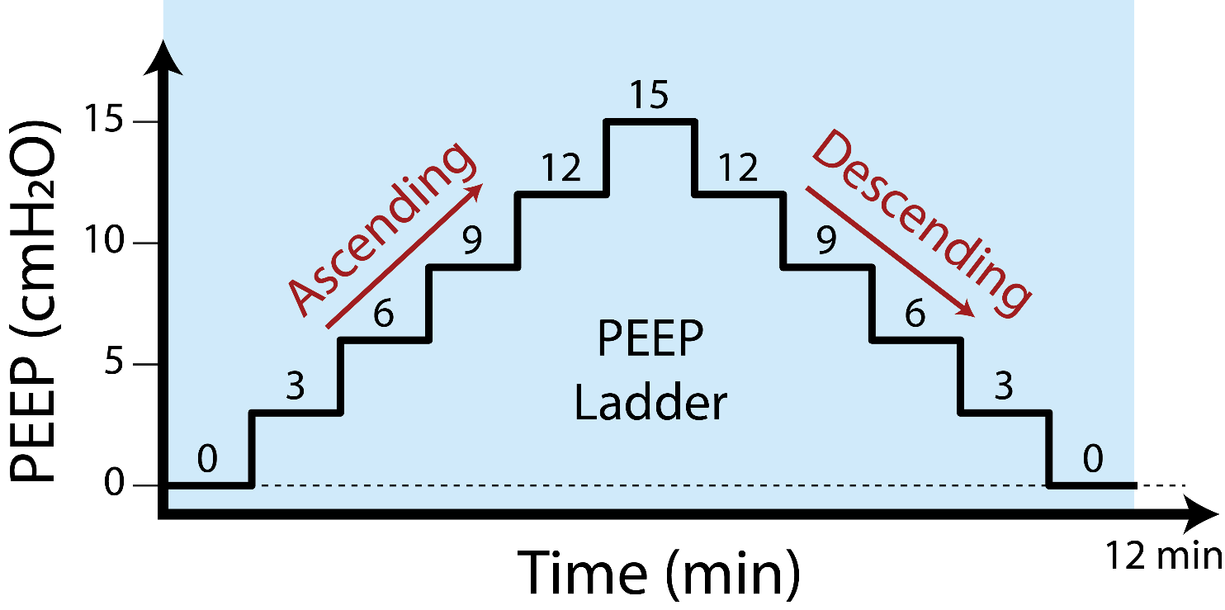
Experimental Design
Groups of Mice:
Control (CTL): Uninjured
Lavage + VILI (LAV): 0.15 mL 0.9% saline
Endotoxin + VILI (LPS): 50 µg of LPS via IT
Hydrochloric Acid + VILI (HCL): 50 µL IT HCL
VILI is 25 minutes ventilation at :
Plateau Pressure = 37.5 cmH2O
Positive End Expiratory Pressure (PEEP) = 0 cmH₂O
LPS or HCL
or Lavage
48hrs prior
Ventilation Start
Intratracheal Instillation
VILI
(25 minutes)

Slide 5
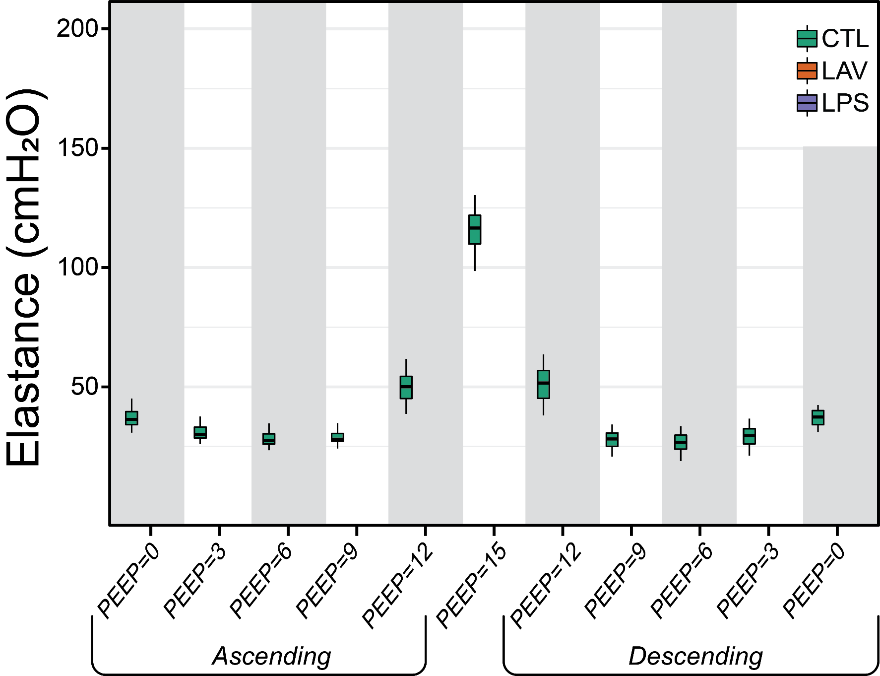
Control PEEP Ladder
Elastance = lung stiffness
Increasing pressure: strain stiffening
No difference between ascending and descending ladders (hysteresis)

Slide 6
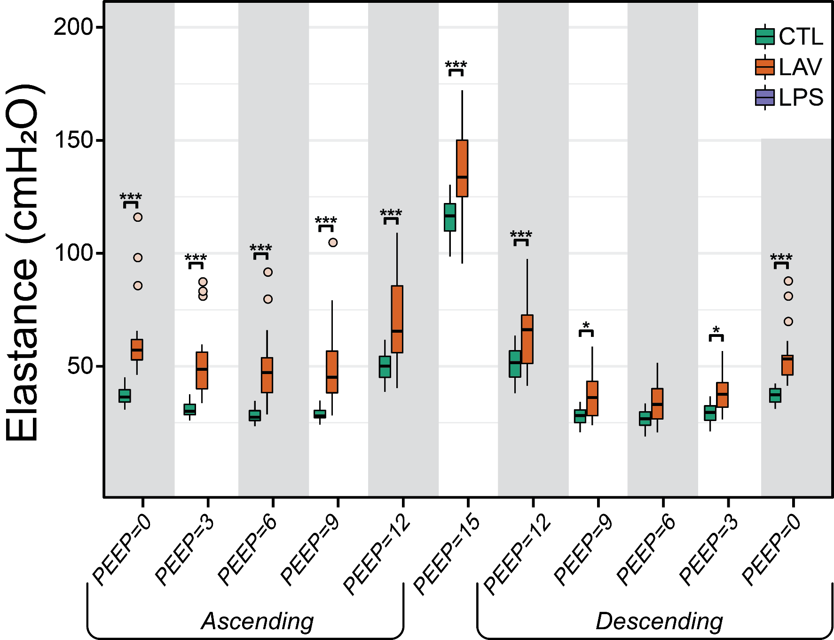
Lavage vs. Control
LAV much stiffer than CTL on ascending
LAV recruits at high PEEP: smaller difference on descending
Progressive derecruitment (stiffening) at lower PEEPs on descending ladder

Slide 7
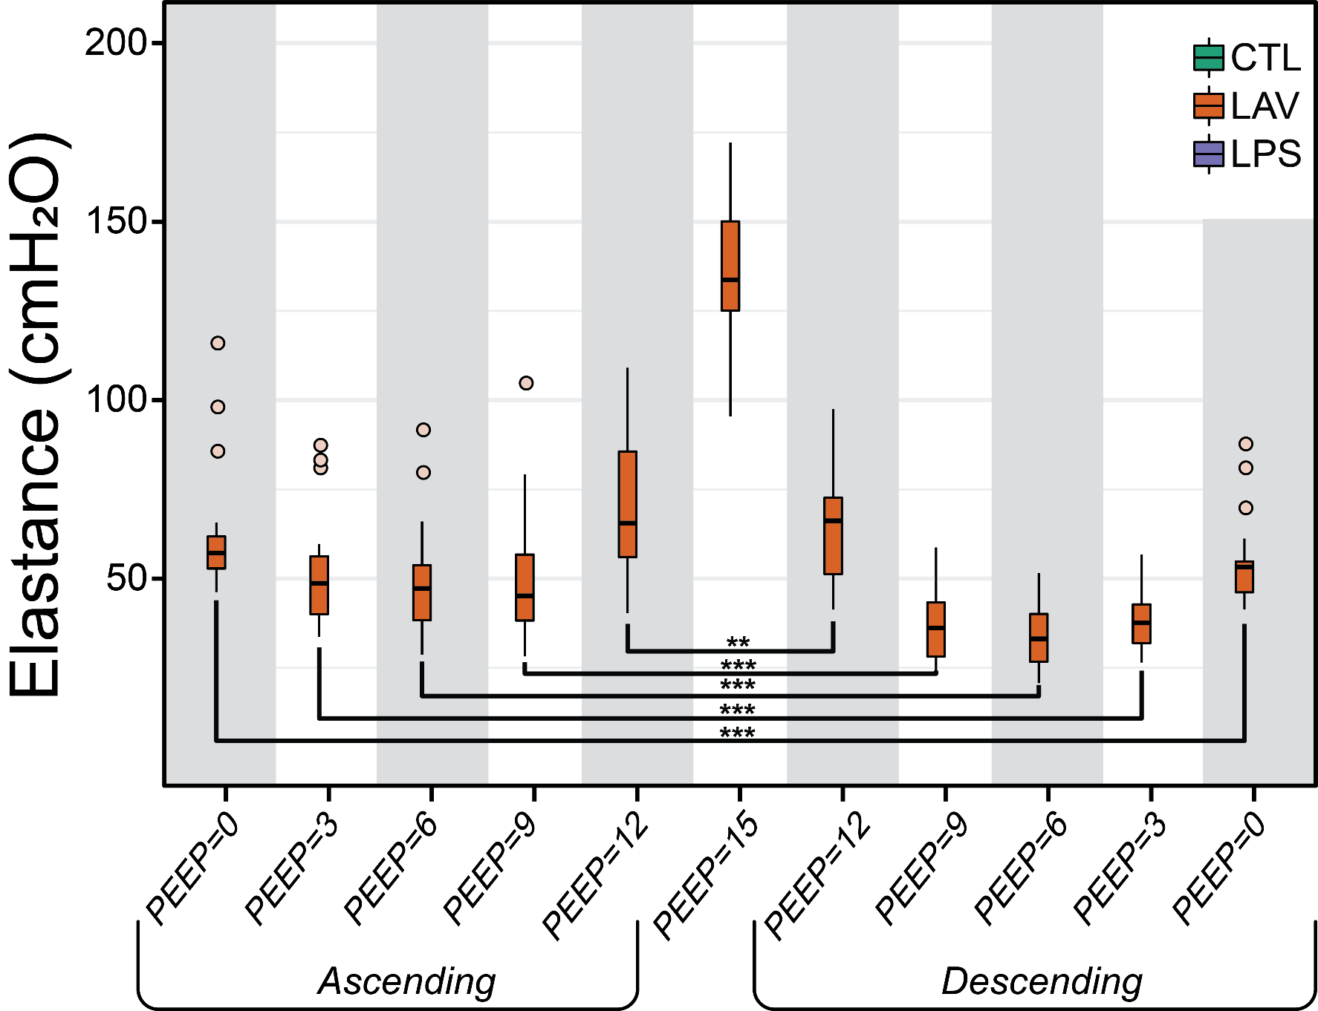
Lavage Ascending vs. Descending
LAV lungs much less stiff on descending ladder
High recruitability in this surfactant washout injury

Slide 8
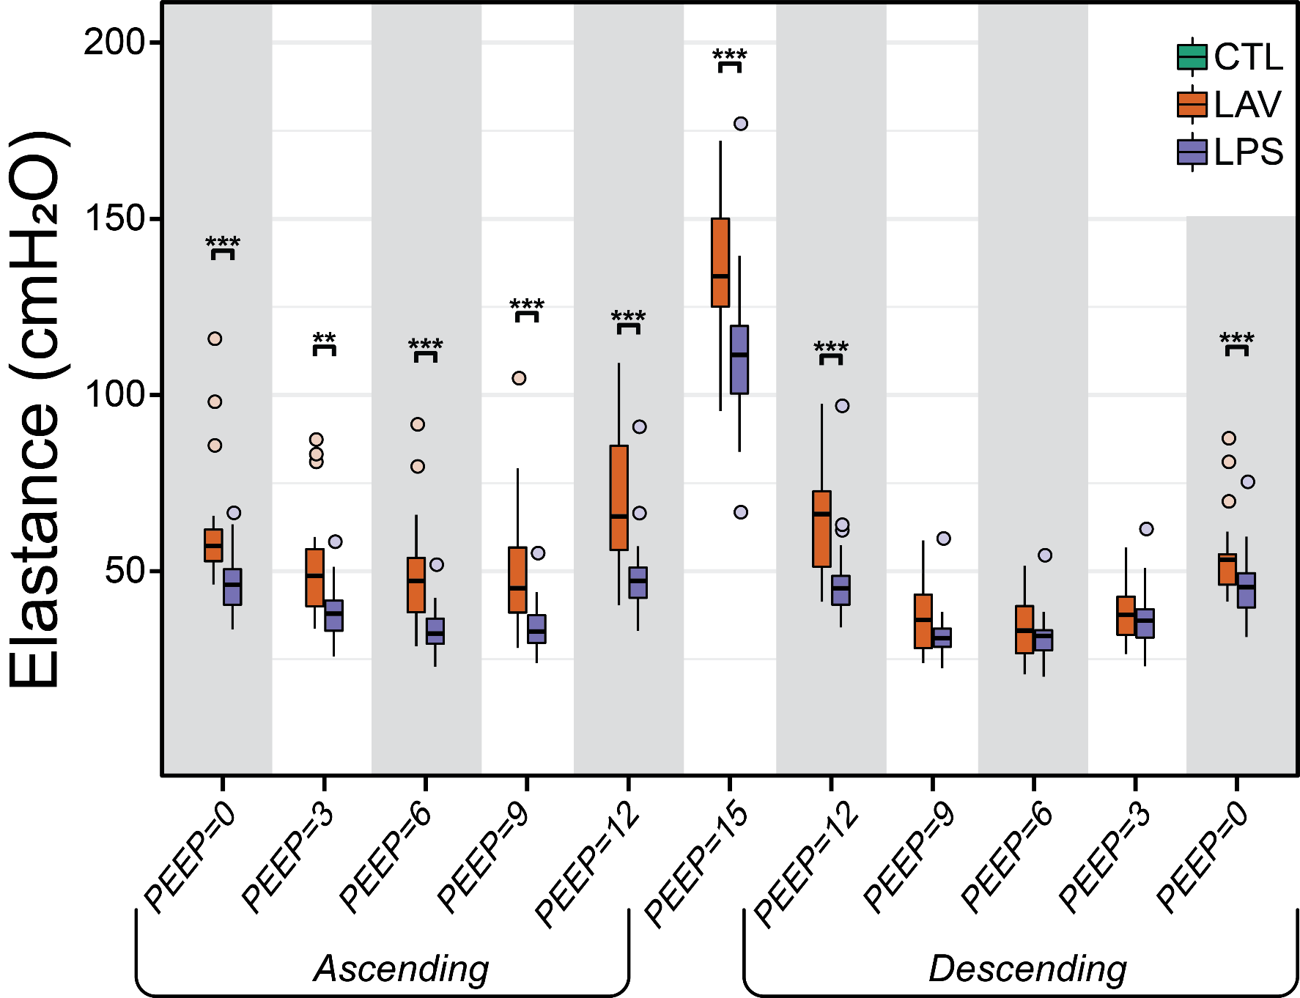
Lavage vs. LPS
LAV much stiffer than LPS on ascending
LAV recruits at high PEEP: lower elastance on descending
Recruitment shown in lung structure

Slide 9

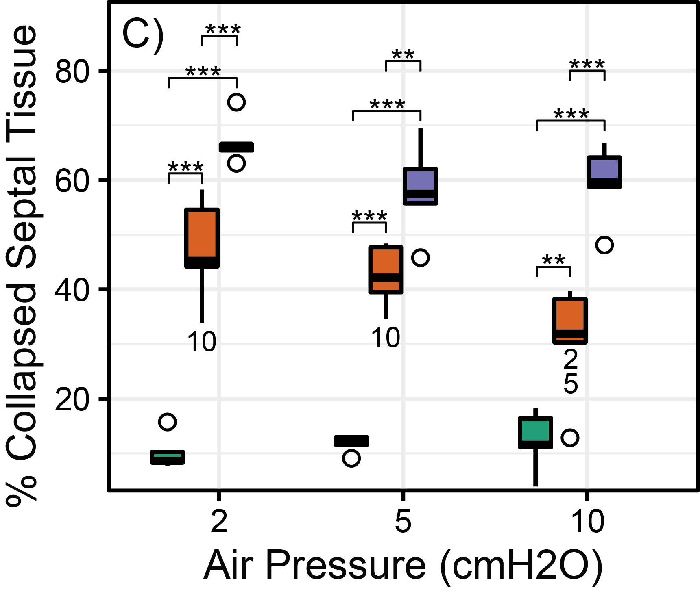
Morphometry: Alveolar Collapse
LAV: Progressive decrease in collapsed septal tissue
LPS: No change in collapsed septal tissue
LAV is more recruitable than LPS

Slide 10
Lavage vs. LPS
Lavage has higher elastance at PEEP 15 than LPS
Attributed to stiffening of the open lung

Slide 11
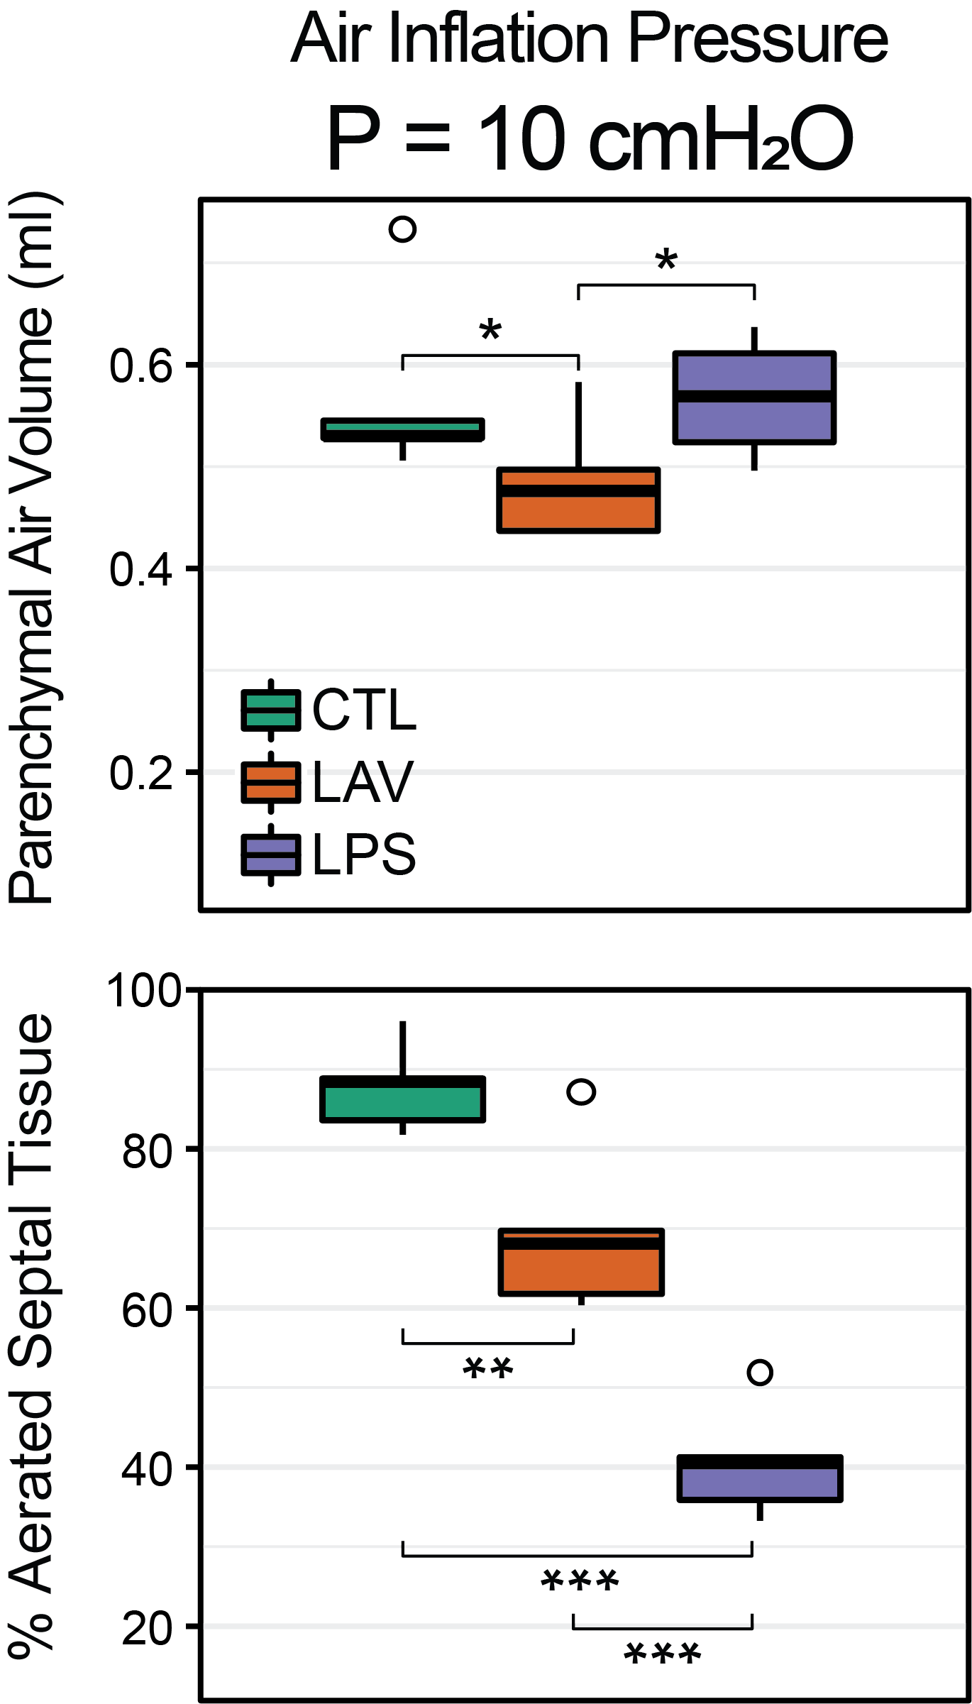
Lavage Characterized by Stiffer Open Lung
At high pressures:
LAV: ↓ air volume, ↑ open alveoli
So alveoli are smaller (thus stiffer) in LAV than LPS at higher pressures
Attributed to impaired surfactant function
Reflected in high elastance at high PEEPs

Slide 12
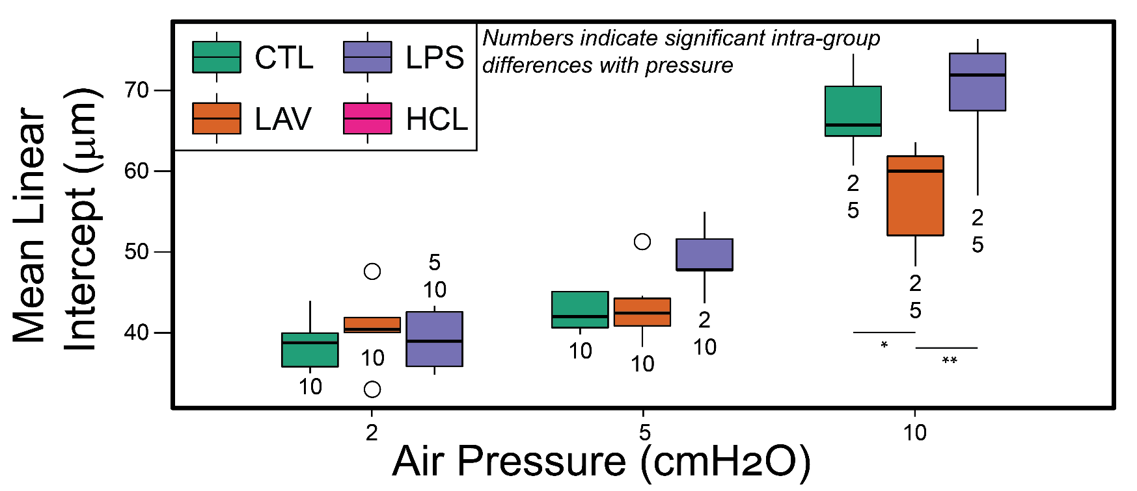
Lavage Characterized by Stiffer Open Lung
Mean linear intercept: measure of average airspace size (alveoli and ducts)
Increased stiffness in LAV: Smaller MLI at high pressure (P=10)
No effects at lower pressures
  Differences in mechanics
  due to derecruitment

Slide 13
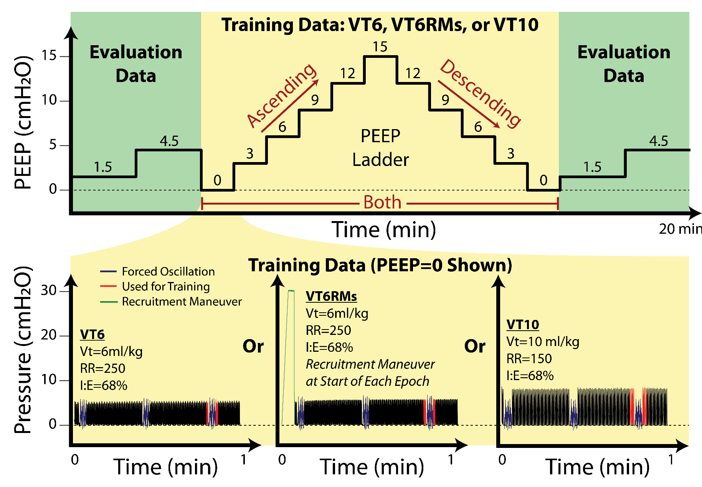
Modeling: The Training Dataset
Experiments just described used for model testing
Record pressure and flow (volume)
Training data: Used for model fitting
PEEP ladders with three different ventilations

Slide 14
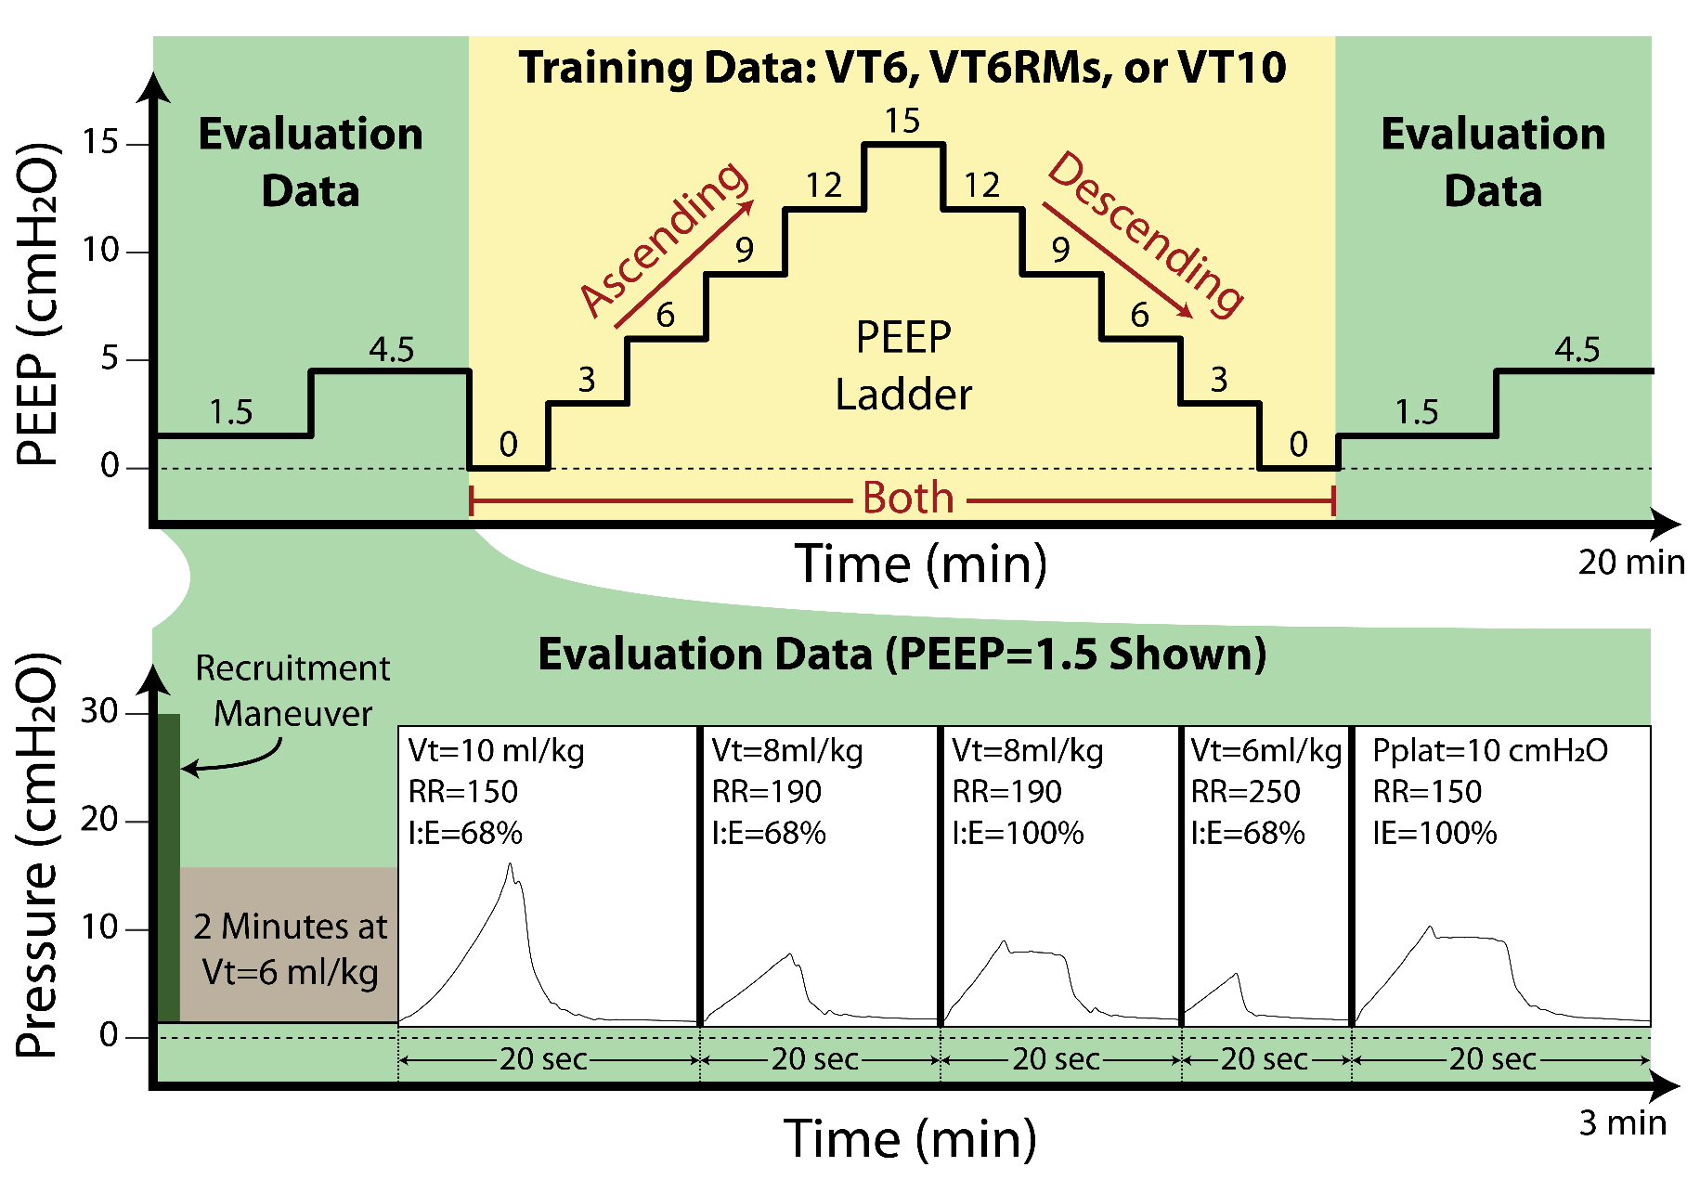
Modeling: The Evaluation Dataset
Evaluation data: Used to test model predictive accuracy
Five ventilation patterns
Two PEEPs
Before and after training data
Not used for model fitting

Slide 15
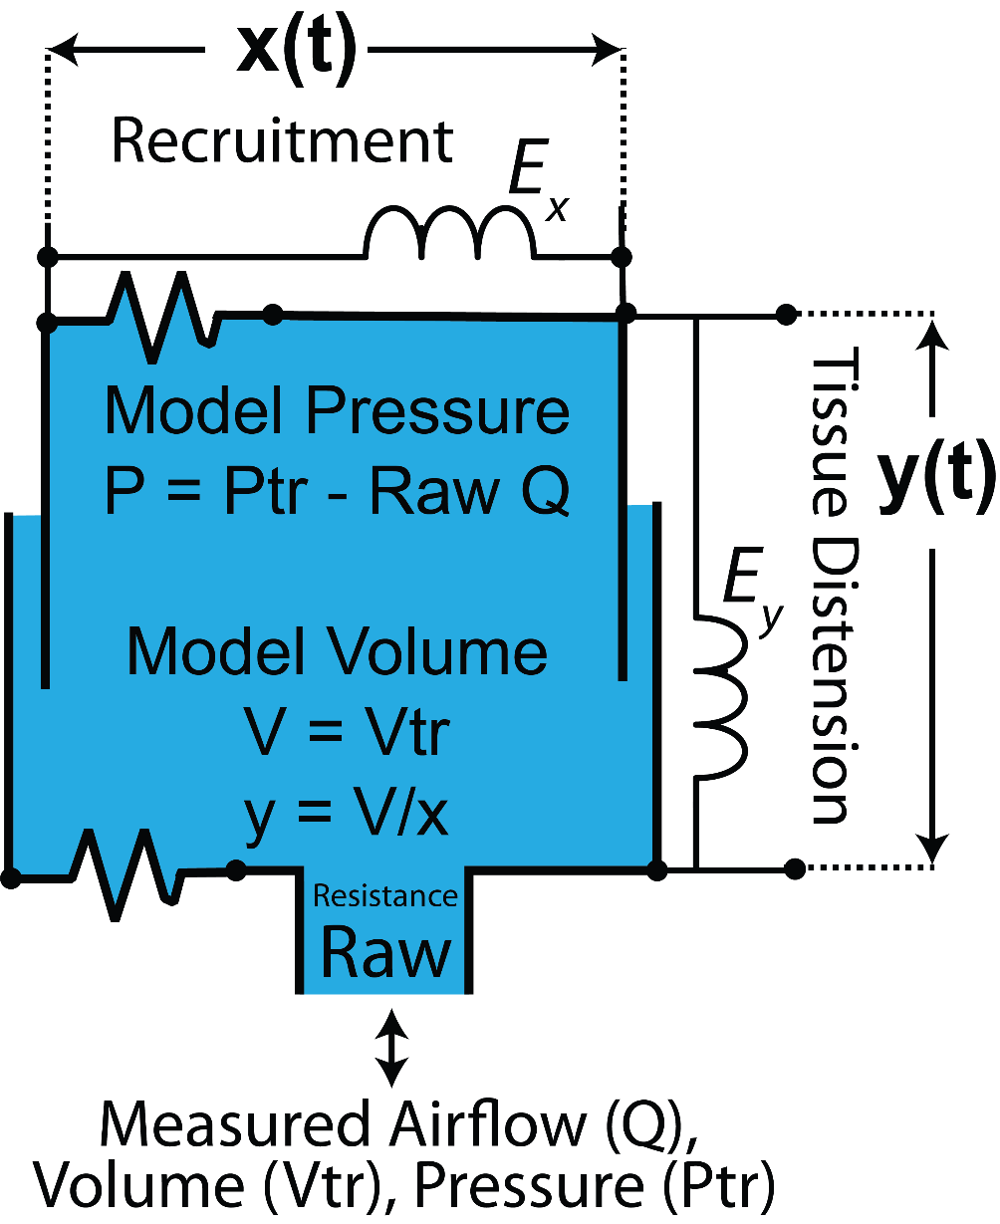
The Model
Compartment model
Vertical expansion: inflation of open lung tissue
Horizontal expansion: recruitment of collapsed lung
Includes airway resistance
Driven by measured volume/flow
Fit to measured pressure (particle swarm optimization)

Slide 16
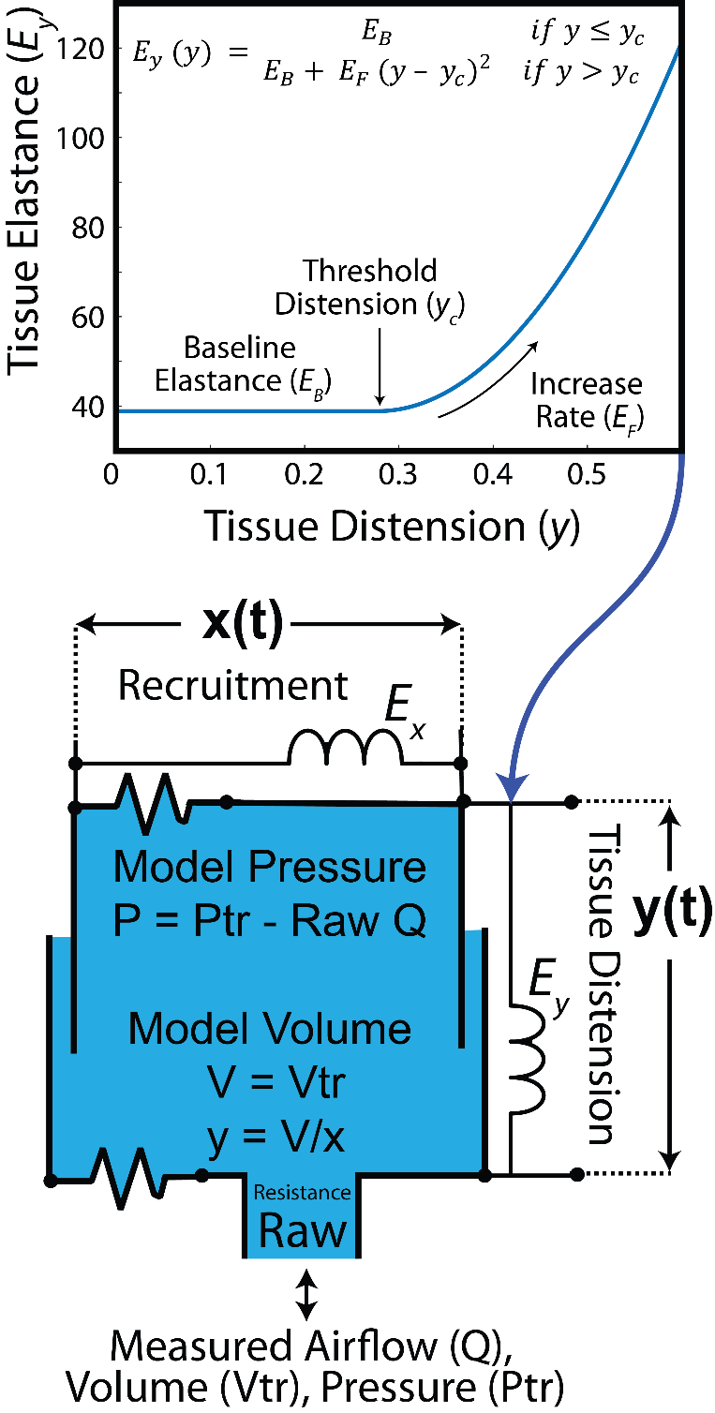
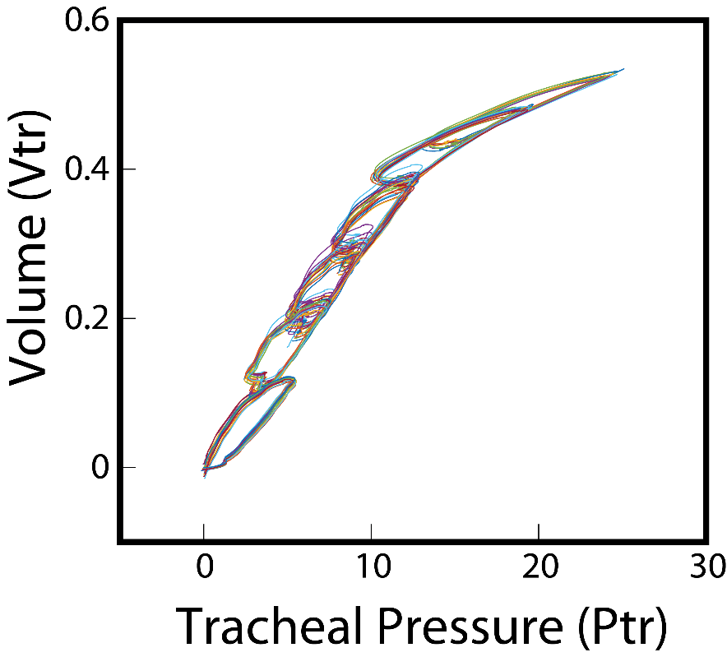
The Model: Tissue Elastance
Model elastance (E) increases with lung inflation (strain stiffening)
Essential to reproduce characteristic ‘beak’ of PV loops
Necessary to define
the upper bound
of optimal ventilation

Slide 17
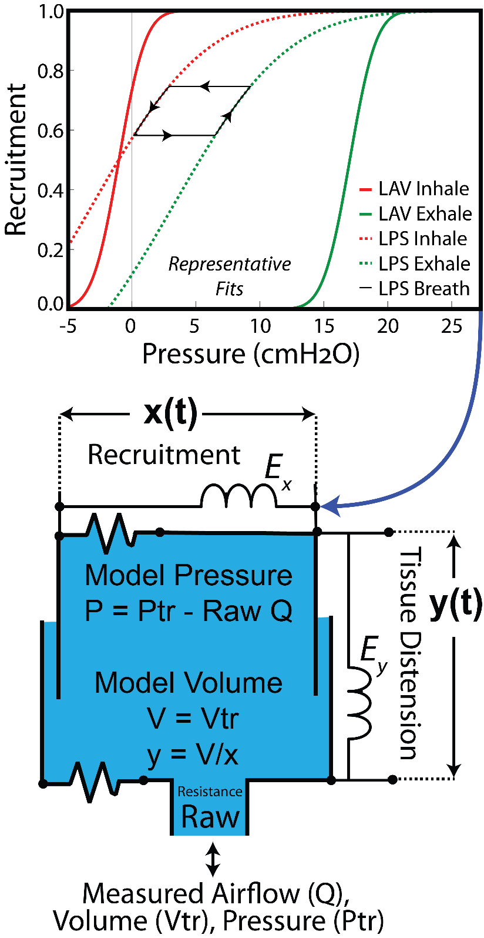
The Model: Recruitment &
Derecruitment
Sigmoidal recruitment/derecruitment; functions of inflation pressure
Offset between recruitment/derecruitment
  Recruits at higher pressures
Three parameters to identify
Necessary to define the lower bound of optimal ventilation

Slide 18
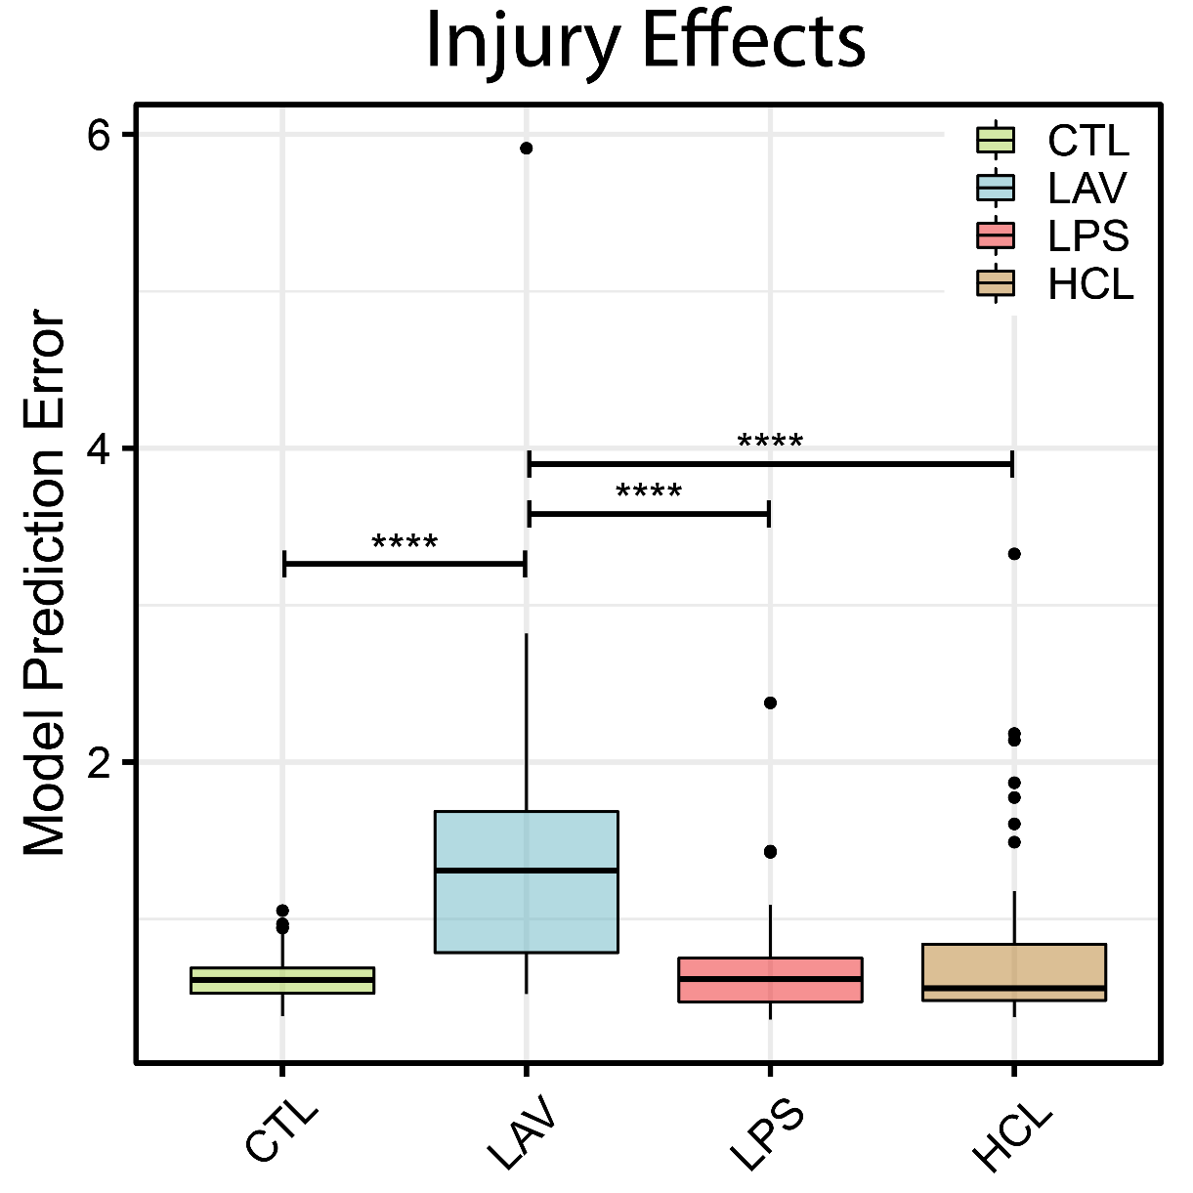
Predictive Accuracy: Injury Type
Subject-specific model for each mouse
Fit to training data (PEEP ladder)
Predict evaluation data
Lavage (LAV) harder to model than all other groups
  Highly recruitable (physically unstable) lungs
  Some recovery of lung function during experiments

Slide 19
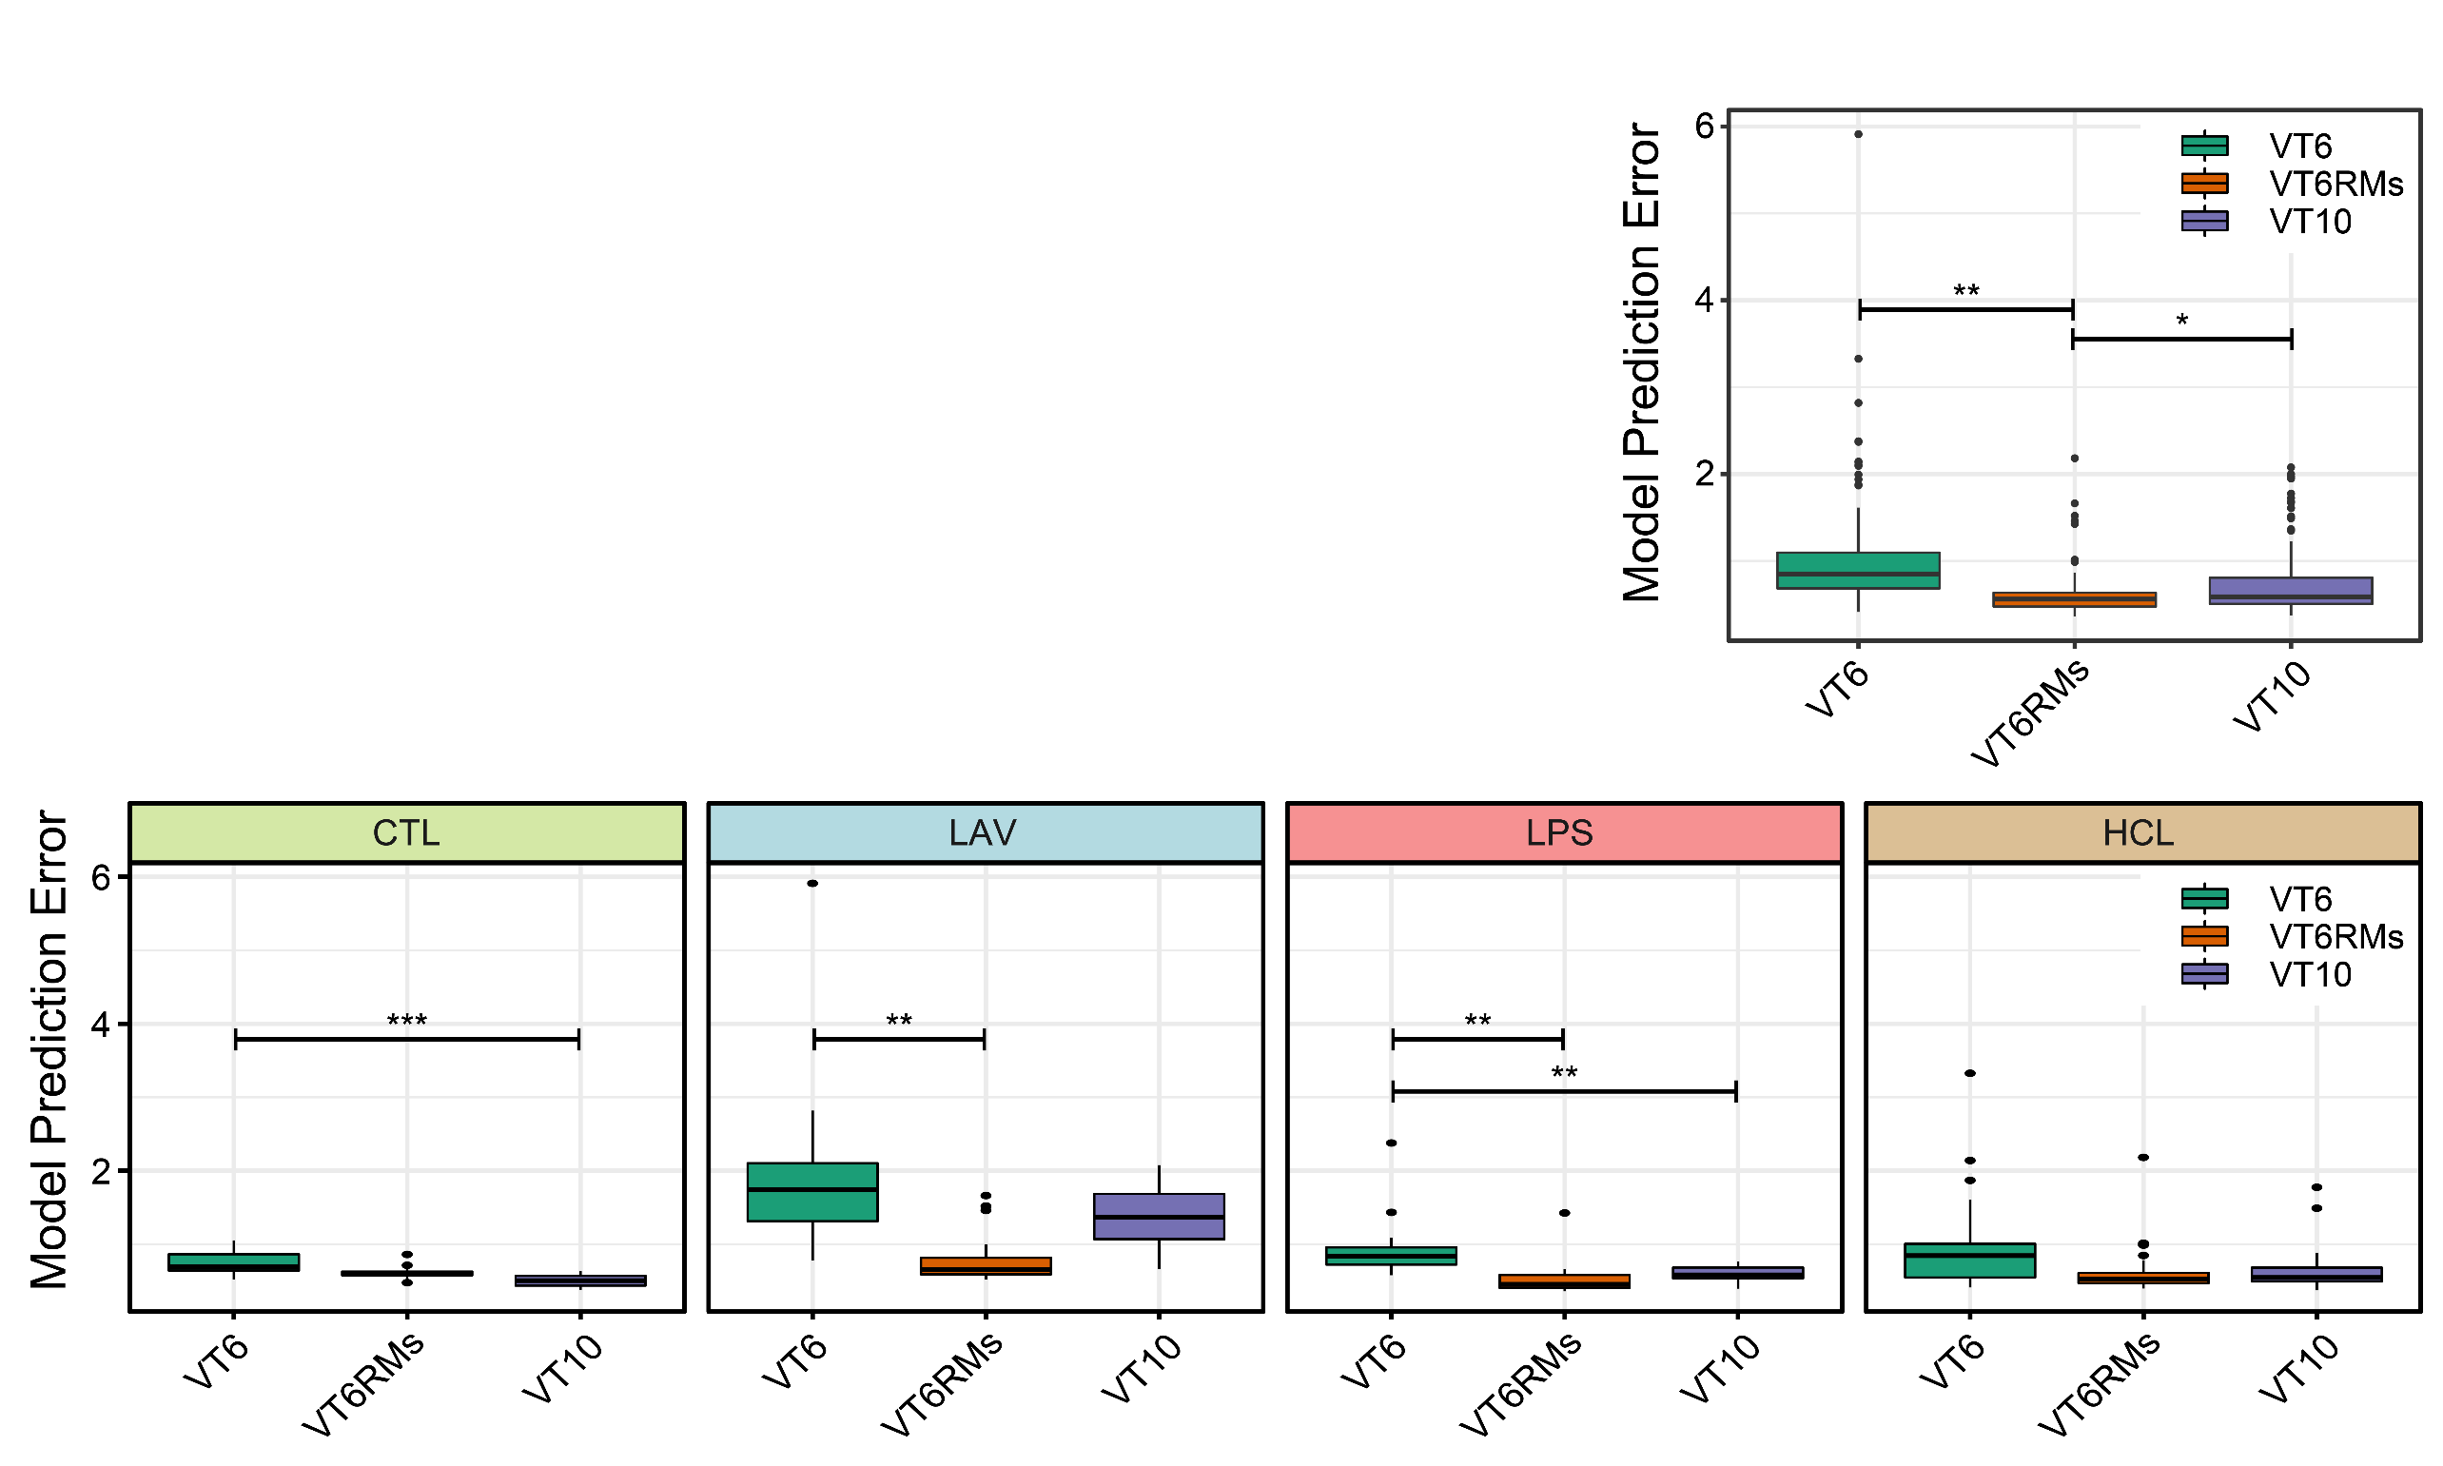
Model Predictive Accuracy:
Ventilation Type
Best training data has recruitment maneuvers
  Standardize volume history
Most substantial effects in Lavage injury

Slide 20
Predicted Optimal PEEP
For each mouse: Iteratively evaluate model to find PEEP that minimizes driving pressure
Optimization goals:
  Minute ventilation = 1500 ml/kg/min
  Lowest driving pressure
  No auto PEEP
LAV best PEEP significantly lower than others because
  LAV very stiff at high pressure
  Derecruitment occurs at low pressures

Slide 21
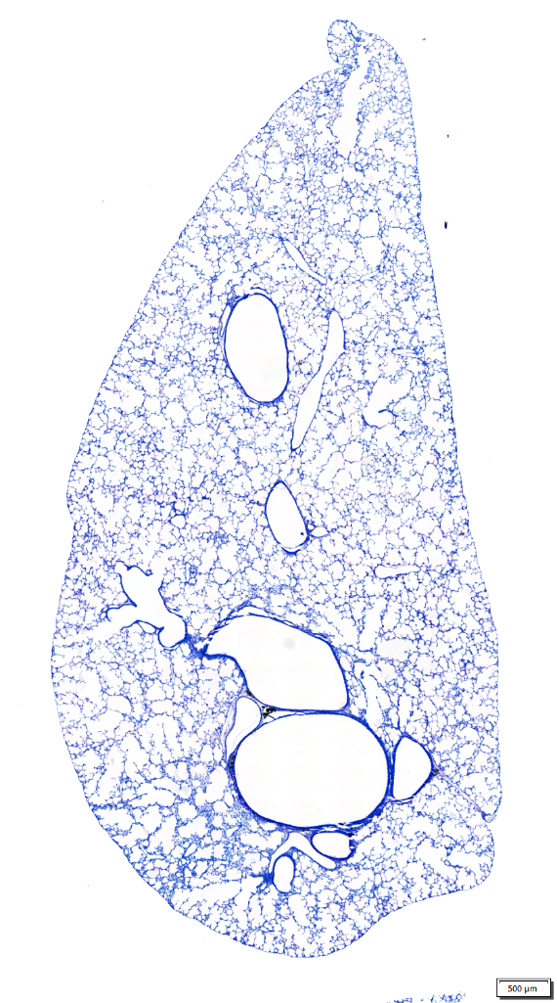
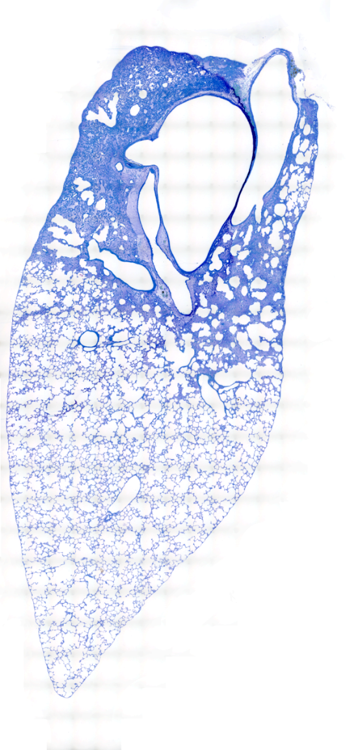
Next Steps
LPS Inured,
P = 10
Lavage Injured,
P = 10
Test models of increasing complexity
  What’s the simplest model that works?
Test decreasing fractions of training data
  How far can we predict outside of the training data range?
Predict and test optimal ventilation settings
  Minimize driving pressure, power, ???
Test models with clinical data
  Can we predict mechanics during changes that occur during normal care?

Slide 22
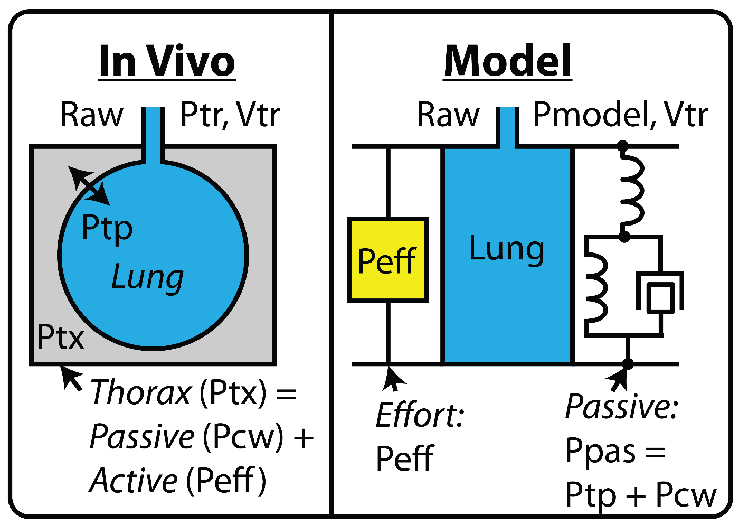
Ventilator Dyssynchrony
In vivo, pressure is from
  Passive elastic recoil (chest wall and lungs)
  Active (muscle contraction)
Modeling approach
  Passive elastic recoil (as before)
  Active component: Gaussian pressure pulse
    Fit timing, magnitude, and width

Slide 23
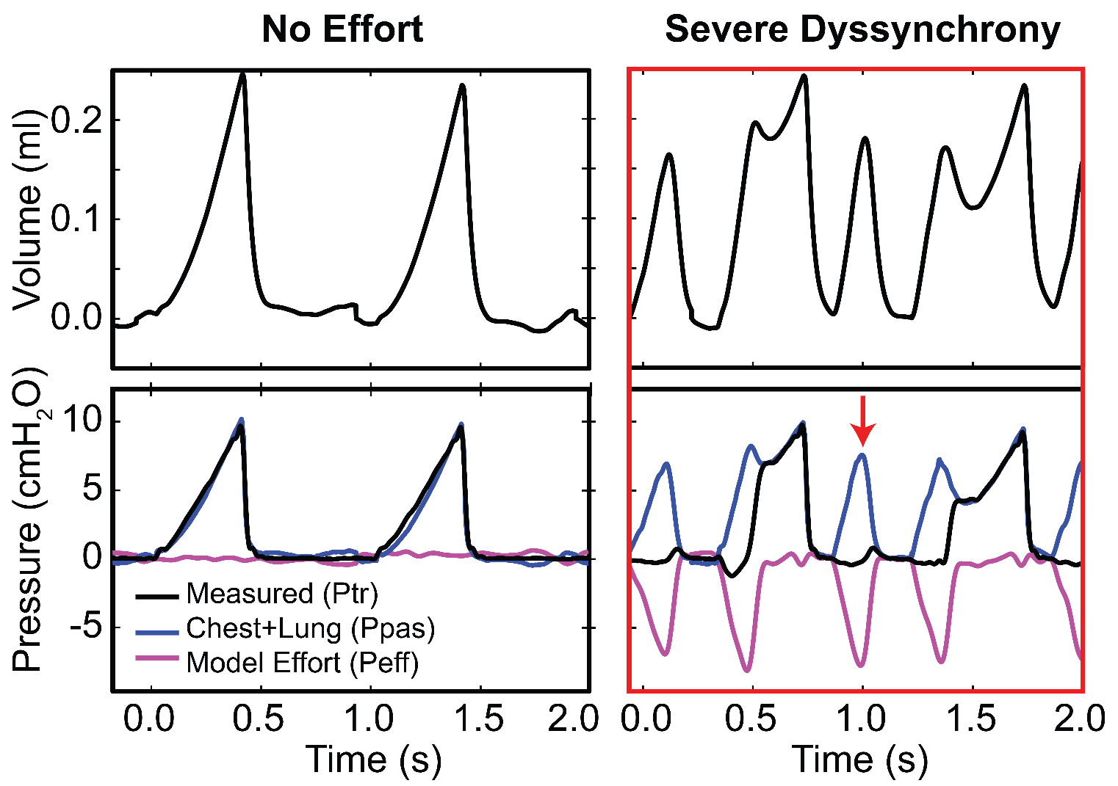
Ventilator Dyssynchrony
Fit to mouse data
Initial simulations show efficacy
Can calculate the magnitude of the effort
Next steps:
  Working up a dyssynchrony model in mice
  Clinical data
  Compare to outcomes

Slide 24
Questions:
How can we continuously update the model?
  More data (other pressures); changes in lung function
Better ways to identify model parameters?
  Changing the model is ok…
Other ways to model the mechanical response to ventilation
  Nonlinear elastance
  Recruitment/derecruitment: time- and pressure-dependence
  Account for changing ventilator waveform
Can we handle recruitment with a delay equation(s)?

Slide 25
Acknowledgements
University of Colorado
Dr. David Albers
Dr. Richard Albert
Dr. Deepak Agrawal
Courtney Mattson
Kayo Okamura
Dr. Peter Sottile
Alex Sosa
Alison Wallbank
Outside Collaborators
Dr. Jason Bates
Dr. Lars Knudsen
Dr. Matthias Ochs
Dr. Carrie Perlman
Funding
K99/R00 HL128944 (Smith)
R01 HL151630 (Smith)
F31 HL149628 (Mattson)
R01 HD107700 (Wright)

