Slide 1

Data assimilation on mechanistic models of glucose metabolism predicts glycemic states in adolescents following bariatric surgery
Biomedical Informatics
discovery and impact
Lauren R. Richter, Benjamin I. Albert, Linying Zhang, Anna Ostropolets, Jeffrey L. Zitsman, Ilene Fennoy, David J. Albers, George Hripcsak
Columbia University, University of Colorado

Slide 2
Type 2 diabetes mellitus
Obese adolescents with T2DM have more severe disease than adults
  Quicker decline in pancreatic beta cell function
Bariatric surgery can produce weight loss, reverse pre-diabetes, prevent diabetes
  But not everyone improves

Slide 3
Type 2 diabetes mellitus
Prediction has not worked (and mainly adult)
  Measurements: weight, height, BMI
  DM severity, medications, comorbidities
  Biomarkers: fasting glucose, insulin, C-peptide, triglycerides, C-reactive protein, HbA1c
  Genetics
  Oral glucose tolerance test (OGTT), homeostatic model assessment of insulin resistance (HOMA-IR), frequently sampled intravenous GTTs (FSIVGTT), clamp studies

Slide 4
Can data assimilation help?
Include physiologic parameters in a prediction model
  Maximal insulin secretion capacity, σ
  Insulin sensitivity, S_{I}
  Their product
Other insulin-related measurements
EHR clinical variables

Slide 5
Models
Ordinary differential equations
  Meal model
  Oral minimal model
  Ultradian model
  Topp et al. – beta cell mass
  Ha et al. – diabetes pathology (incl. beta cell regulation)

Slide 6
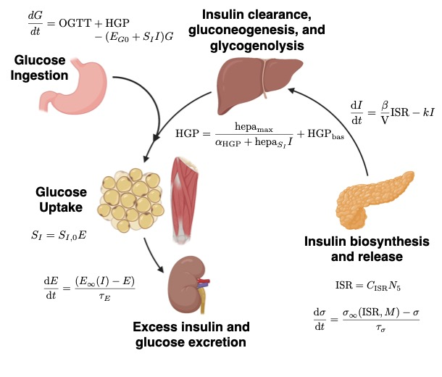

Slide 7
“Clinical” variables
HbA1c
pre-operative thyroid stimulating hormone (TSH)
thyroxine (T4)
free T4 (FT4)
triiodothyronine (T3)
aspartate transaminase (AST)
alanine transaminase (ALT)
total cholesterol (TC)
high-density lipoprotein (HDL)
low-density lipoprotein (LDL)
triglycerides (TG)
C-peptide
age
surgery type
demographic (race, ethnicity, sex)
liver disease
polycystic ovary syndrome (PCOS)
dyslipidemia
hypertension (HTN)
obstructive sleep apnea (OSA)
thyroid disease
metabolic syndrome (MetS)
T2DM
abnormal glucose metabolism

Slide 8
OGTT and insulin-related variables
OGTT glucose with and without insulin
HOMA-IR
DA mean and stddev for
  maximal insulin secretion capacity σ
  insulin sensitivity S_{I}
  their product σS_{I}

Slide 9
Data assimilation
Estimated insulin sensitivity, S_{I}, and
maximal insulin secretion capacity, σ
Rosenbrock-W method within the bounds of [0.005,3] for S_{I}, and [0.01, 10] for σ
Posterior distributions of the parameters based on a 500,000 iteration Random Walk Metropolis-Hastings MCMC chain

Slide 10
Outcomes
Any of these 6–18 months post-operatively
  > 2 elevated HbA1c values
  post-operative OGTT G0 > 100 mg/dL
  post-operative OGTT G120 > 140 mg/dL
  anti-diabetic drug use (including metformin)
  presence of diagnosis codes for T2DM or abnormal glucose metabolism in > 25% of encounters in the post-op window

Slide 11
Regression
Regularized logistic regression
  L1 vs L2
  Lambda regularization constant
  Learning rate
  Maximum iterations
Stochastic gradient descent with adaptive learning rate, and used balanced class weight
Measured ROC AUC and average precision

Slide 12
Results
Out of 396 adolescents who underwent bariatric surgery, 248 of those had pre-operative OGTTs. Of 202 patients without any missing values in their pre-operative OGTT glucose and insulin measurements, 176 had follow-up within the appropriate time window and were further analyzed.

Slide 13
Insulin parameters NGM vs IGM
They differ in expected direction
Variable Name | Post-operative NGM n = 120 | Post-operative IGM n = 56 | p-value
S_{I} (+ insulin) | 0.356 (0.284, 0.420) | 0.155 (0.129, 0.178) | 0.0000
σ*S_{I} (+ insulin) | 0.908 (0.763, 1.510) | 0.255 (0.146, 0.547) | 0.0000
σ (+ insulin) | 3.424 (2.627, 4.630) | 1.596 (1.195, 3.169) | 0.0003

Slide 14
Model performance (ROC; MAP similar)
Adding DA (but not HOMA-IR) produces the best model
DA without insulin can surpass insulin without DA
 | Model 1 | ROC AUC Mean (95% CI) | Model 2 | ROC AUC Mean (95% CI) | p-value
a1 | Clinical Vars + σ*S_{I} | 0.7700 (0.7665, 0.7734) | Clinical Vars | 0.7655 (0.7622, 0.7689) | 0.0728
a2 | Clinical Vars + HOMA-IR | 0.7659 (0.7625, 0.7692) | Clinical Vars | 0.7655 (0.7622, 0.7689) | 0.8942
b1 | OGTT Glucose + Insulin + σ + S_{I} + σ*S_{I} | 0.7463 (0.743, 0.7496) | OGTT Glucose + Insulin | 0.7337 (0.7303, 0.7371) | 0.0000
b2 | σ*S_{I} | 0.7380 (0.7346, 0.7415) | OGTT Glucose + Insulin + HOMA-IR | 0.7317 (0.7283, 0.7350) | 0.0089
b3 | Clinical Vars | 0.7655 (0.7622, 0.7689) | Clinical Vars –I + σ*S_{I} | 0.7511 (0.7475, 0.7547) | 0.0000

Slide 15
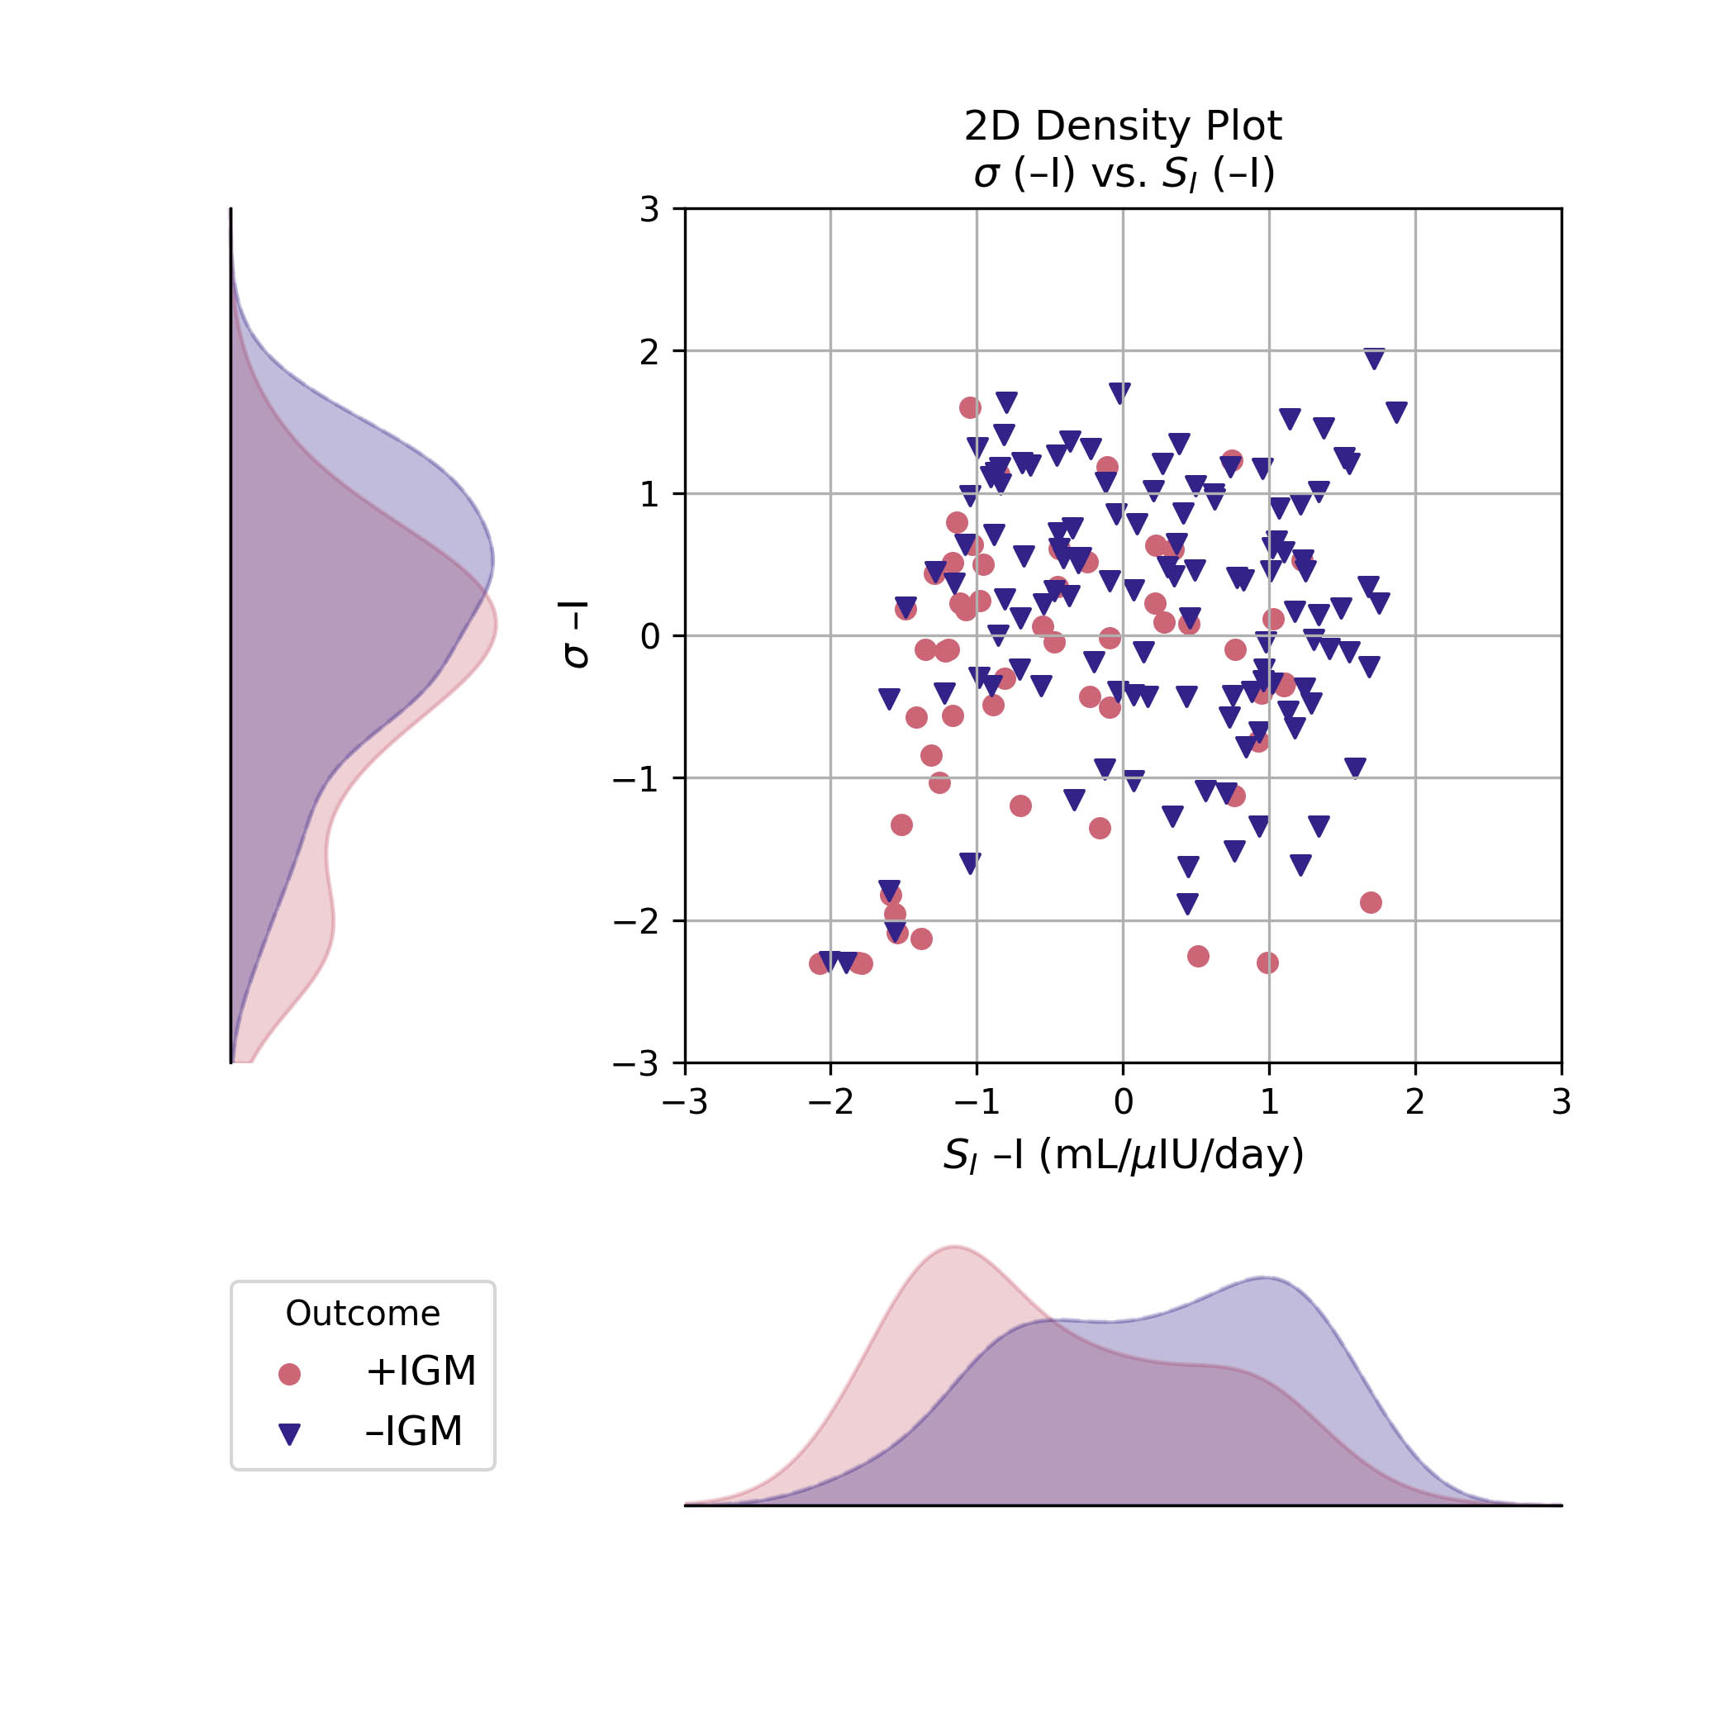
Maximal insulin secretion capacity, σ
versus
Insulin sensitivity, S_{I}

Slide 16
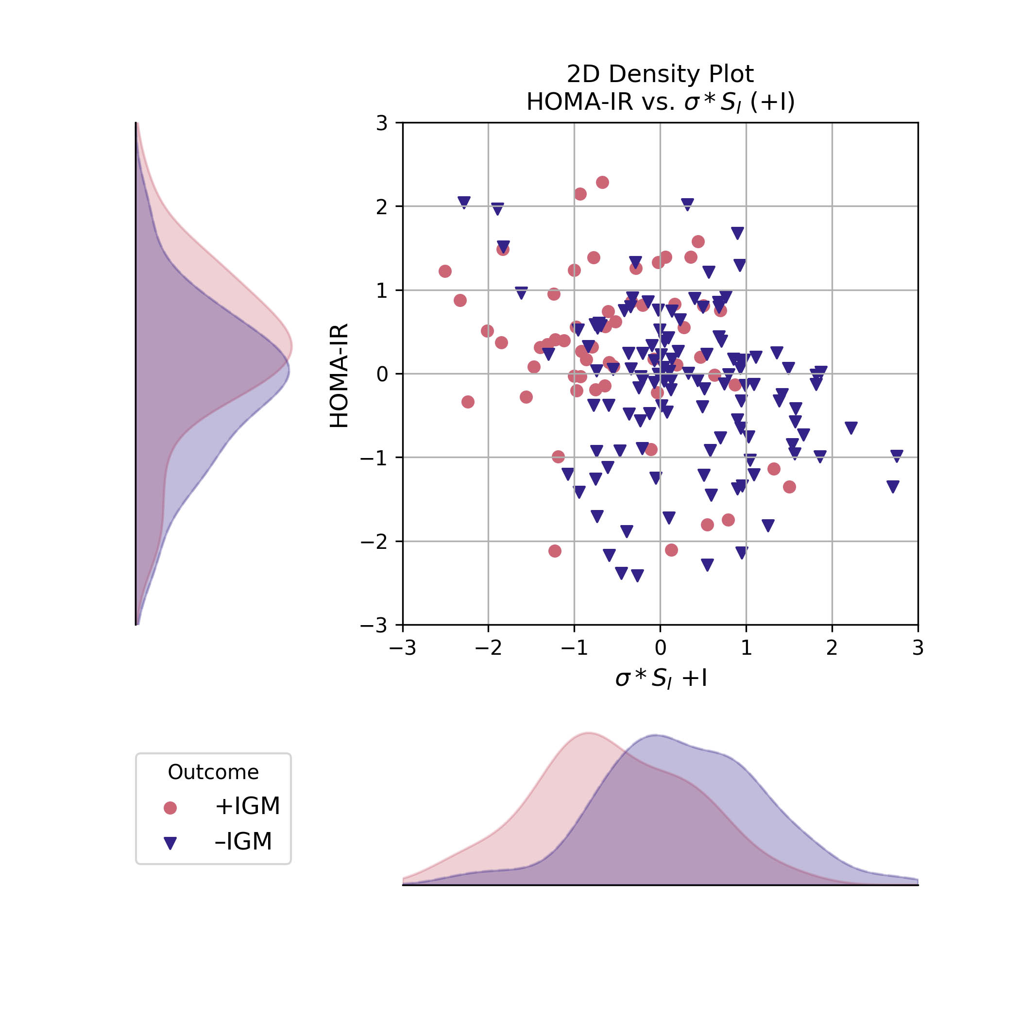
HOMA-IR
versus
σ ・S_{I}

Slide 17
Discussion
Data assimilation estimates can add clinical information that improves prediction
Data assimilation estimates can infer missing information encoded in insulin measurements
The mechanistic models were validated using clinical data
Uncertainty of DA estimates results in reduced performance in logistic regression
Disease subtypes can be described by parameter estimations
Fixed mechanistic model parameters may differ between adolescents and adults
Binary classification of outcomes obscures a heterogenous population
Funding
  National Library of Medicine
    R01 LM006910 (2000-2024)
    T15 LM007079 (1994-2027)
  NIDDK R01 DK090372

