Slide 1
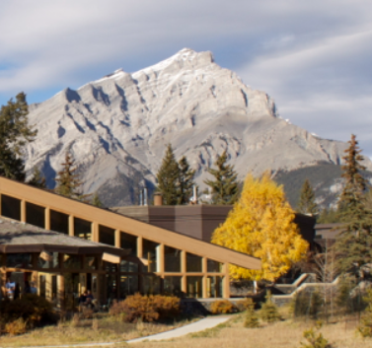
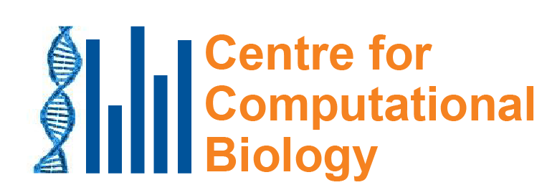
What can mutational signatures tell us about causes of mutations?
May 17, 2023
Steve Rozen
steverozen@pm.me
Notes:
25 minute talk

Slide 2
Concept of “mutational signature”
Examine mutation patterns in a tumor (or other tissue) to infer mutational exposures or processes that led to the mutations
There can be different types of mutation patterns
single base mutations in the context of preceding and following bases
different kinds of short insertions or deletions
patterns of clustered single base mutations
information about whether the transcribed versus the non-transcribed strands of genes have more mutations
and so on …

Slide 3
Concept of “mutational signature”
Examine mutation patterns in a tumor (or other tissue) to infer mutational exposures or processes that led to the mutations
There can be different types of mutation patterns
single base mutations in the context of preceding and following bases
different kinds of short insertions or deletions
patterns of clustered single base mutations
information about whether the transcribed versus the non-transcribed strands of genes have more mutations
and so on …

Slide 4
Discovery
Analysis of large databases
Experimental delineation
Mutational Signatures

Slide 5
Discovery
Analysis of large databases
Experimental delineation
Mutational Signatures
Molecular cancer epidemiology
Which mutational processes cause oncogenic mutations?
Understanding
DNA damage &repair
Applications

Slide 6
Outline
Example mutational signature: AA (aristolochic acid) and liver cancer
Techniques for mining mutational signatures from somatic mutations in 23,000 tumors
Discovery of the cause of an insert-and-deletion hypermutator phenotype in human cancer

Slide 7
Outline
Example mutational signature: AA (aristolochic acid)
Techniques for mining mutational signatures from somatic mutations in 23,000 tumors
Discovery of the cause of an insert-and-deletion hypermutator phenotype in human cancer

Slide 8
Why is AA important?

Slide 9
1990s: AA emerged as a human health problem
~100 young women developed end stage kidney disease
Single weight-loss clinic in Europe
汉(漢)防己, hàn fáng jǐ replaced by 广(廣)防己, guǎng fáng jǐ
Notes:
Dose: (Cosyns 2003; Nortier et al. 2000)
Adducts: Nortier et al., 2000

Slide 10
漢防己, 汉防己, hàn fáng jǐ (genus Stephania – no AA)

Slide 11
廣防己, 广防己, guǎng fáng jǐ (genus Aristolochia – has AA)
Notes:
Total of 0.5 g over average of 13 months
AA adducts

Slide 12
AA identified as a carcinogen:
Many of the AA-kidney-failure victims developed upper tract urothelial cancer
(Nortier et al., 2000, NEJM)

Slide 13
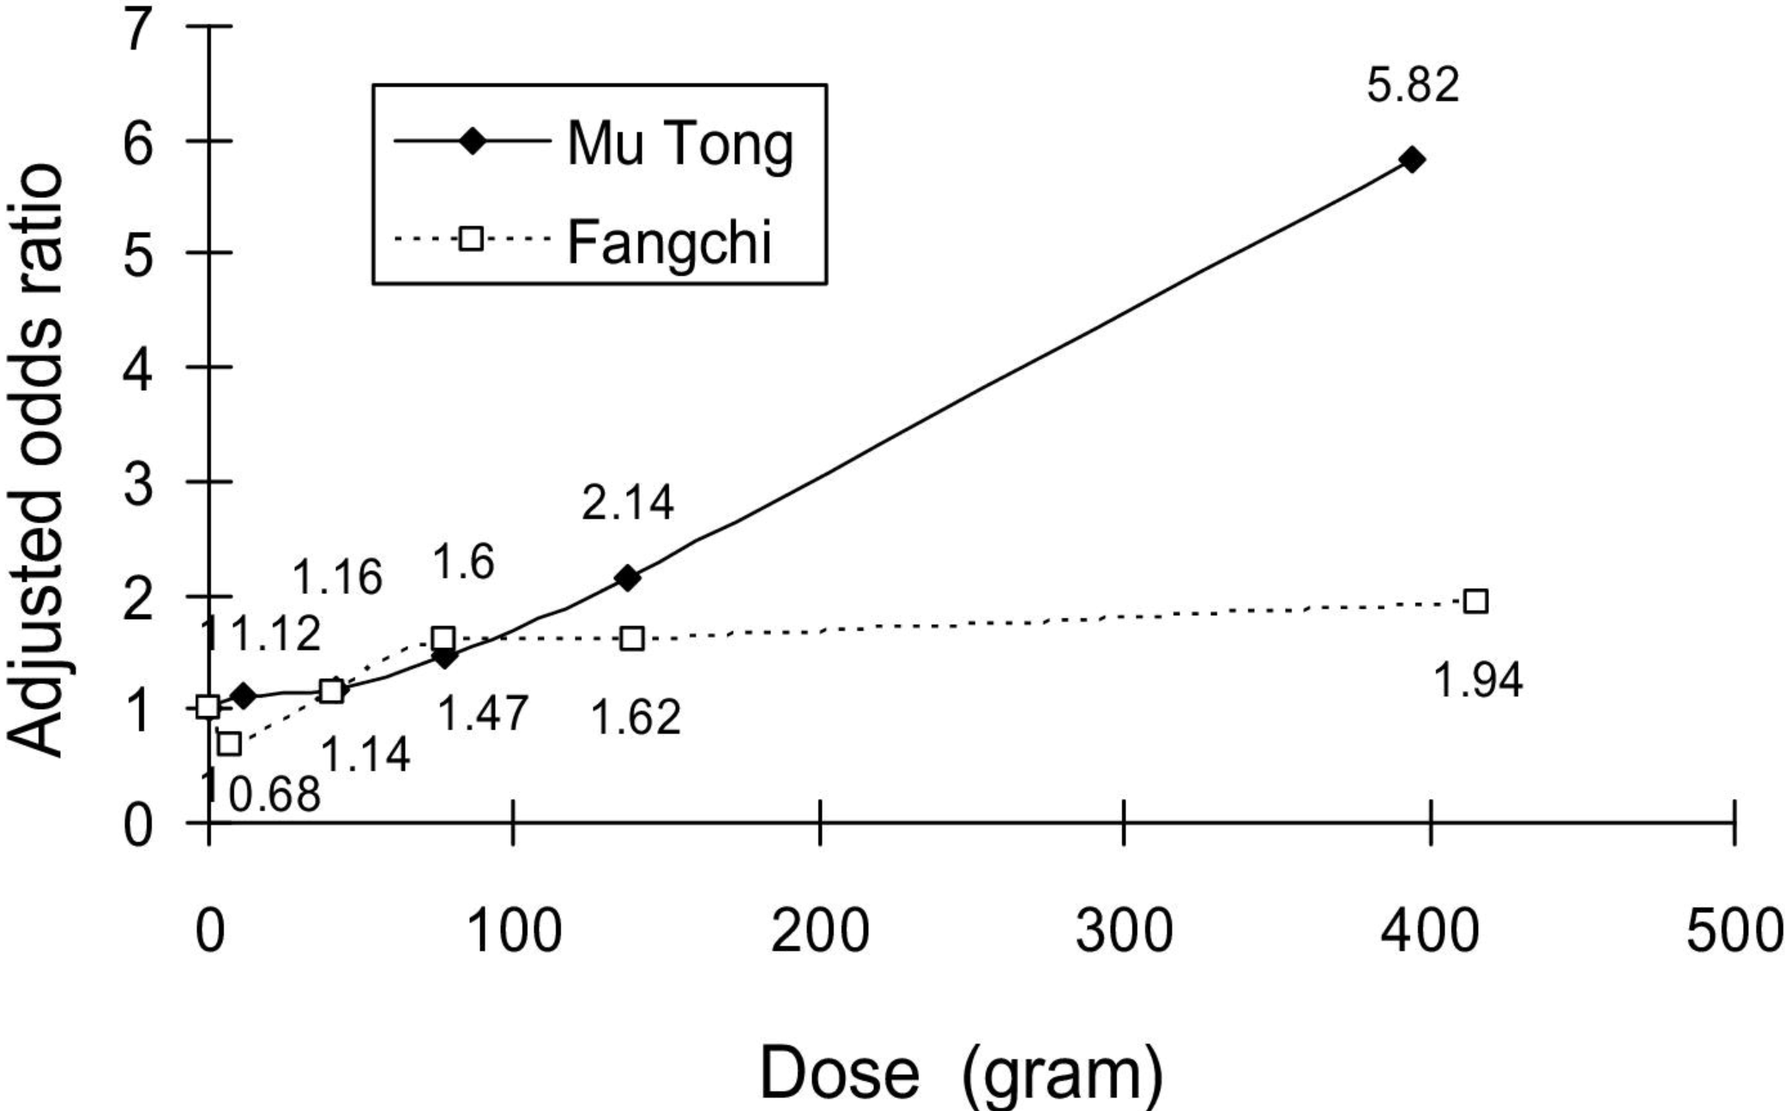
2010: AA-containing herbs causes kidney disease in Taiwan
End-stage renal disease caused by 2 herbs
Adjusted odds ratio for end-stage renal disease
防己
Lai et al, 2010 10.1053/j.ajkd.2009.10.055

Slide 14
2013 Excess upper tract urothelial cancer versus bladder cancer in Taiwan presumably caused by AA
Incidence ratio of
upper-tract urothelial cancer to bladder cancer
Chen et al, 2012 10.1073/pnas.1119920109

Slide 15
Mutational signature in an AA-exposed upper tract urothelial carcinoma from Taiwan
More
mutations
Each bar represents the total number of single nucleotide mutations in a particular context
Highest bar represents the number of CAG to CTG mutations across the entire genome
The higher the bar, the more CAG to CTG mutations
Songling
Poon
Poon et al. and Hoang et al. , Science Translational Medicine, 2013

Slide 16
Mutational signature in an AA-exposed upper tract urothelial carcinoma
More
mutations
AAG > ATG mutations
Not as many
Highest bar represents the number of CAG to CTG mutations across the entire genome
The higher the bar, the more CAG to CTG mutations
Mutations from C to A, C to G, C to T
Almost none
Poon et al. and Hoang et al. , Science Translational Medicine, 2013

Slide 17
2013: AA mutational signature in upper tract urothelial cancer and cell lines
Upper tract urothelial
AA exposed cell line
Poon et al. and Hoang et al. , Science Translational Medicine, 2013

Slide 18
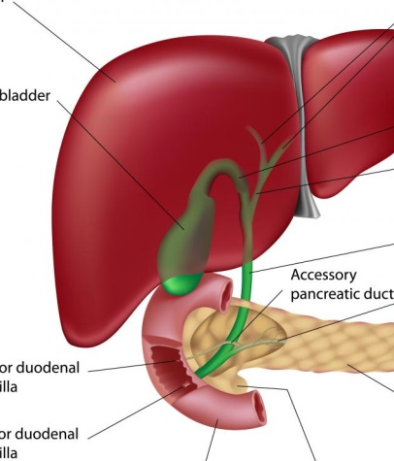
2016: AA mutational signature in multiple tumor types
Liver
Bile duct
Kidney
Upper tract urothelial
Bladder
Poon et al., 2013 and subsequent data (liver - hepatocellular carcinoma [HCC])
Zou et al., 2015, Jusakul et al., 2017 (bile duct carcinoma)
Scelo et al., 2014, Jelakovic et al., 2014 (kidney/renal cell carcinoma)
Poon et al., 2013, Hoang et al., 2013, many others (upper tract urothelial carcinoma)
Poon et al., 2015, others (bladder urothelial carcinoma)

Slide 19
2016: Taiwan a known hotspot for AA kidney failure and AA upper-tract urothelial cancer A good place to investigate AA in liver cancer
Chen, …., Grollman, PNAS, 2012
Map created by Freepik

Slide 20
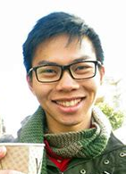
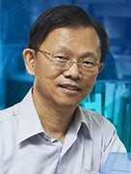
2017: 78% of Taiwan liver cancers (HCCs) had the AA signature (paper from my lab)
Red bars show
numbers of
mutations
caused by AA
Alvin Ng Sen-Yung Hsieh
Ng, Poon, et al., Oct 2017 DOI: 10.1126/scitranslmed.aan6446

Slide 21
Today: 2,000 liver cancers – AA exposure is prevalent
AA mutations
No AA mutations
“Asian” patients with no “country” – Overseas patients?
Ng, Poon, et al., Oct 2017 DOI: 10.1126/stranslmed.aan6446 and subsequent publications; Zhang et al., 2017, Gastroenterology, 10.1053/j.gastro.2017.03.024; Xue et al., 2019, Cancer Cell,10.1016/j.ccell.2019.04.007, 2021 Unpublished data, 2021

Slide 22
Many AA-exposed liver cancers have multiple known cancer driver genes with AA mutations (as of 2017)
Number of AA mutations
in known driver genes,
per tumor
Taiwan
Mainland China
Other SE Asia
Vietnam
Korea
Japan
North America
Europe
Mayo Clinic
Unknown
Geographical region
Ng, Poon, et al., Oct 2017 DOI: 10.1126/scitranslmed.aan6446

Slide 23
AA can cause liver cancer
AA mutations
No AA mutations
Known mutagen and urinary tract carcinogen
Multiple known cancer driver genes with AA mutations
Linear relationship between AA dose and risk of liver cancer in hepatitis-B-infected and hepatitis-C-infected patients
AA causes liver cancer in mice
“Asian” patients with no “country” – Overseas patients?
Ng, Poon, et al., Oct 2017 DOI: 10.1126/stranslmed.aan6446 and subsequent publications; Zhang et al., 2017, Gastroenterology, 10.1053/j.gastro.2017.03.024; Xue et al., 2019, Cancer Cell,10.1016/j.ccell.2019.04.007; Hsieh et al., 2008, 10.1186/1749-8546-3-13; Chen et al., 2018, International Journal of Cancer, 10.1002/ijc.31544; Chen et al., 2019,Cancer Epidemiology, Biomarkers & Prevention, 10.1158/1055-9965.EPI-19-0023; Lu et al. 2019 Hepatology, 2019, 10.1002/hep.30863

Slide 24
But it’s not a problem, because it’s banned

Slide 25
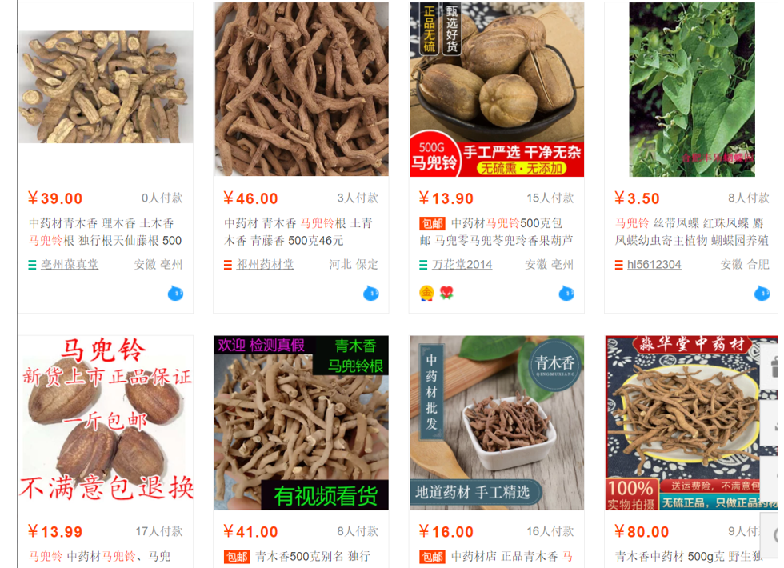
July, 2021

Slide 26
AA is not just an Asian problem
Romania
India
Aristolochia indica
Brazil
Aristolochia clematitis
Combats cancer, ulcers, prevents hair loss and hemorrhoids
Aristolochia cymbifera

Slide 27
Outline
Example mutational signature: AA (aristolochic acid)
Techniques for mining mutational signatures from somatic mutations in 23,000 tumors
Discovery of the cause of an insert-and-deletion hypermutator phenotype in human cancer

Slide 28
Mutational spectrum = sum of mutations due to several signatures
Liu, Wu et al. 2023 10.1093/nargab/lqad005

Slide 29
Most common approach to mutational signature discovery (data mining) uses non-negative matrix factorization (NMF)
Each cell contains level of exposure of 1 tumor to 1 signature
23,000 tumors
W
X
H
N
signatures
96 mutation types
23,000 tumors
N
signatures
≈
V (observed mutations)
96 mutation types
Alexandrov, …., Rozen, Stratton, 2020, 10.1038/s41586-020-1943-3

Slide 30
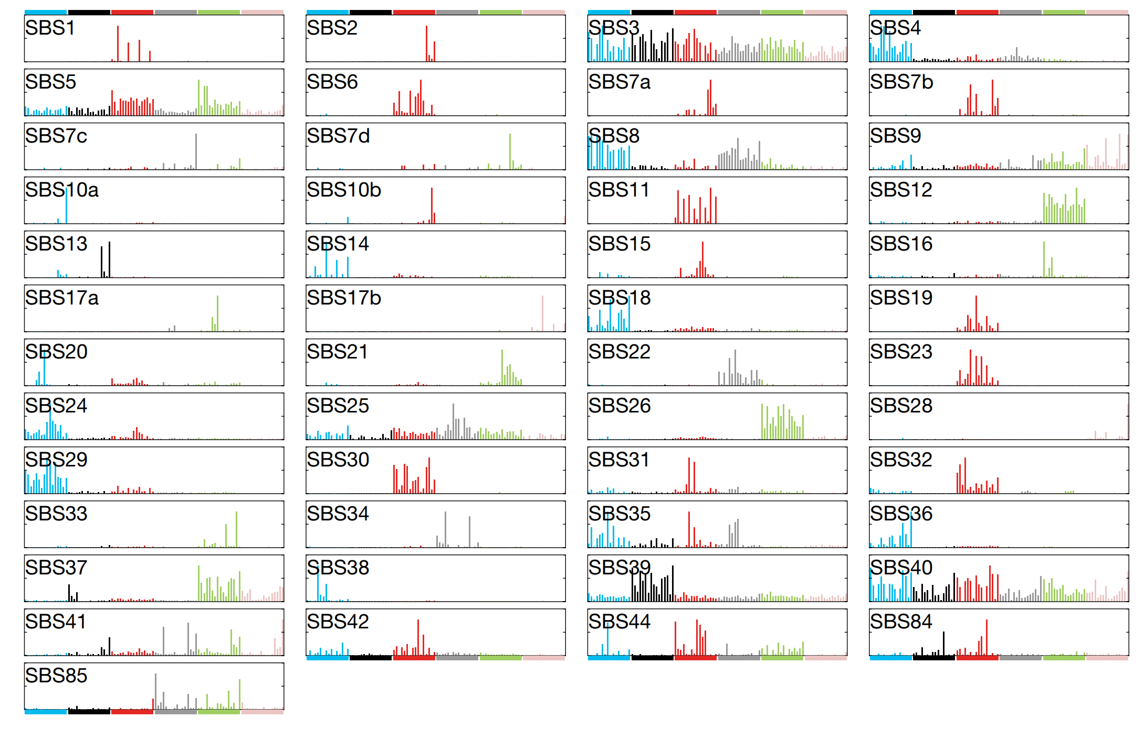
We used NMF to create a reference set of signatures mined from 23,000 tumors -- paper cited 1900 times since 2020
Alexandrov, …., Rozen, Stratton, 2020, 10.1038/s41586-020-1943-3

Slide 31
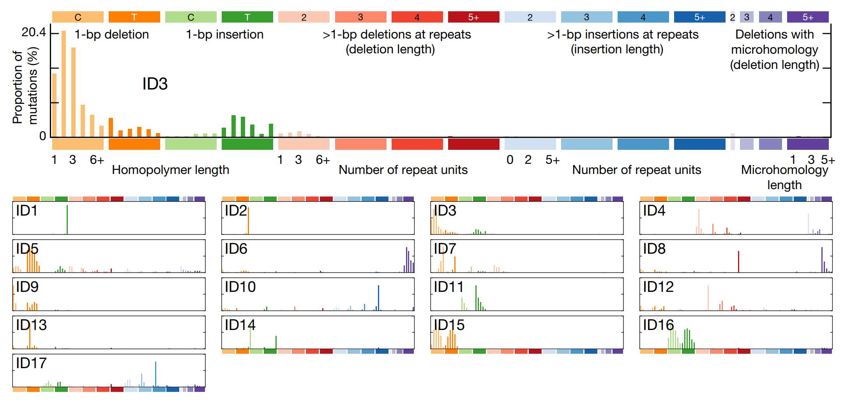
Insertion and deletion mutational signatures
Alexandrov, …., Rozen, Stratton, 2020, 10.1038/s41586-020-1943-3 cited 1900 times

Slide 32
Most common approach to mutational signature discovery (data mining) uses non-negative matrix factorization (NMF)
Each cell contains level of exposure of 1 tumor to 1 signature
23,000 tumors
W
X
H
N
signatures
96 mutation types
23,000 tumors
N
signatures
≈
V (observed mutations)
96 mutation types
Alexandrov, …., Rozen, Stratton, 2020, 10.1038/s41586-020-1943-3

Slide 33
My lab worked on an orthogonal approach to discovering mutational signatures “hierarchical Dirichlet processes” Discovers signatures similar to those discovered by non-negative matrix factorization methods
Extension of work by Yee Whye Teh and Nicola Roberts
Mo Liu
Yang Wu

Slide 34
An orthogonal approach to discovering mutational signatures by data mining
Hierarchical Dirichlet processes (Teh, …, Blei, 2006)
Mutational signature discovery is isomorphic to probabilistic topic modeling in document classification
Document ←→ Tumor (i.e. set of mutations observed in a tumor)
Word ←→ mutation type (e.g. ACT → AGT)
A topic in the document ←→ a mutational process in a tumor
Topics (mutational processes) generate word (mutation) instances by draws from a multinomial distribution = “mutational signature”

Slide 35
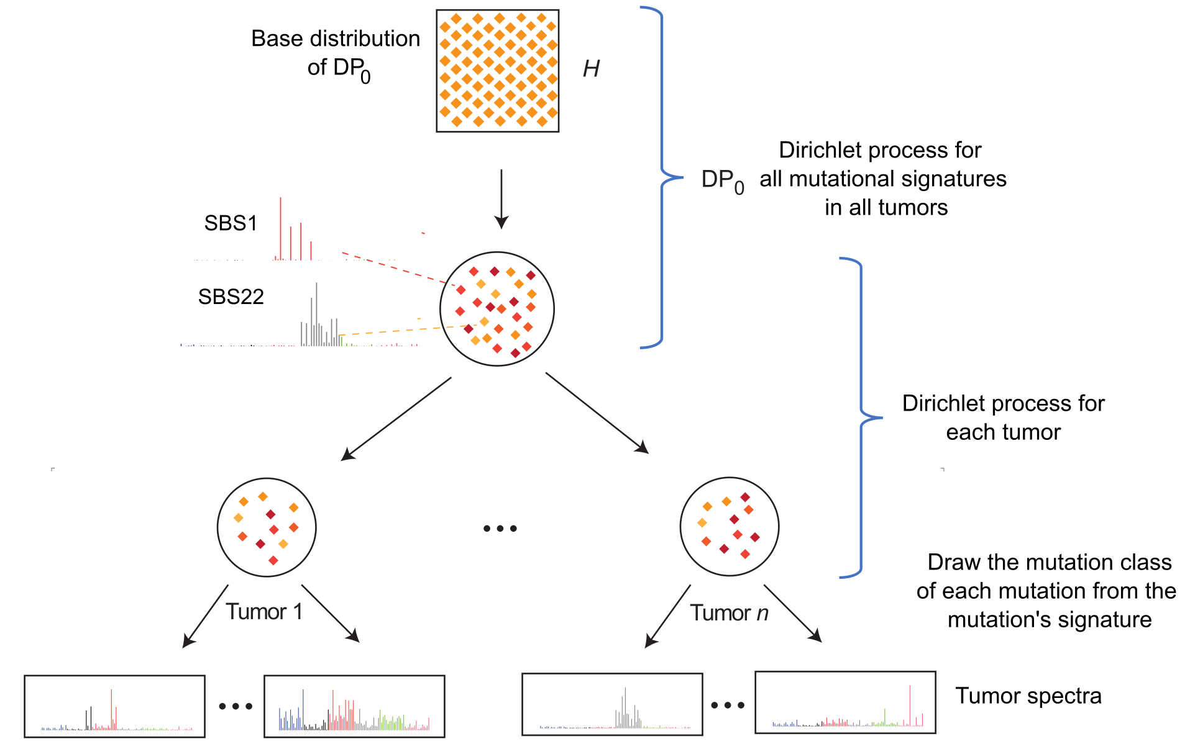
Mutational signature discovery using hierarchical Dirichlet processes
“Partial spectra” – mutations due to 1 mutational process
Liu, Wu et al. 2023 10.1093/nargab/lqad005

Slide 36
Generative model:
Each dot represents a mutational process, and dark versus light color indicates frequency
“Partial spectra” – mutations due to 1 mutational process
Liu, Wu et al. 2023 10.1093/nargab/lqad005

Slide 37
Generative model:
A mutation “arrives” at a tumor, and the mutational process generating it is selected from a Dirichlet process
“Partial spectra” – mutations due to 1 mutational process
Liu, Wu et al. 2023 10.1093/nargab/lqad005

Slide 38
Generative model:
Usually, the mutational process already in the tumor, but sometimes not
“Partial spectra” – mutations due to 1 mutational process
Liu, Wu et al. 2023 10.1093/nargab/lqad005

Slide 39
Generative model:
If not already in the tumor, then select the mutational process from the parent Dirichlet process
“Partial spectra” – mutations due to 1 mutational process
Liu, Wu et al. 2023 10.1093/nargab/lqad005

Slide 40
Generative model:
Again (hierarchically) the mutational process is probably known , ….
Liu, Wu et al. 2023 10.1093/nargab/lqad005

Slide 41
Generative model:
but if not, draw the process from the “base distribution”,
H
“Partial spectra” – mutations due to 1 mutational process
Liu, Wu et al. 2023 10.1093/nargab/lqad005

Slide 42
Generative model:
but if not, draw the process from the “base distribution”
“Partial spectra” – mutations due to 1 mutational process
Liu, Wu et al. 2023 10.1093/nargab/lqad005

Slide 43
Generative model:
Once the mutational process is known, select the actual mutation type (e.g. CTG → CAG)
from the signature associated with the process
“Partial spectra” – mutations due to 1 mutational process
Liu, Wu et al. 2023 10.1093/nargab/lqad005

Slide 44
Generative model:
Once the mutational process is known, select the actual mutation type (e.g. CTG → CAG)
from the signature associated with the process
“Partial spectra” – mutations due to 1 mutational process
Liu, Wu et al. 2023 10.1093/nargab/lqad005

Slide 45
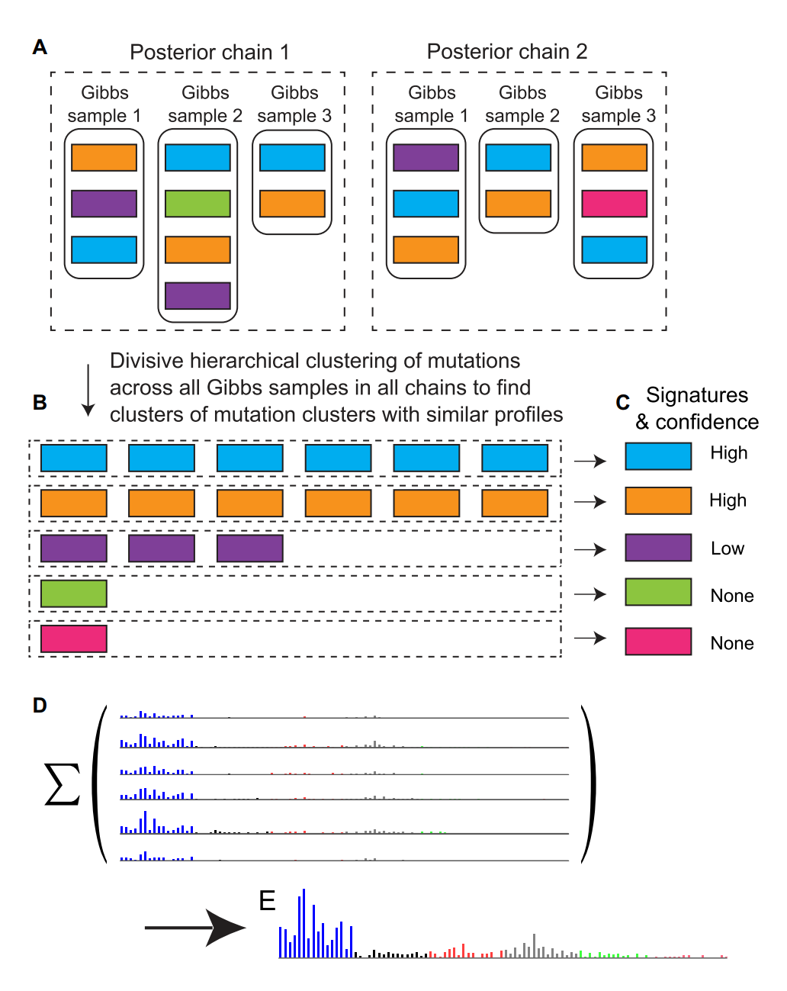
Used Bayesian formulation with Gibbs sampling (from Yee Whye Teh) to estimate
posterior probabilities of the number of mutational processes
the “partial spectra”, which have the “shape” of their signatures (i.e. the associated multinomial distribution)
Liu, Wu et al. 2023 10.1093/nargab/lqad005
Notes:
At each sample we get an idea of which parts of all the mutations in all of the tumors are due to each signature

Slide 46
We combine “partial spectra” with similar shapes from multiple Gibbs samples to estimate the number of signatures and the “shape” of each process’s signature
Liu, Wu et al. 2023 10.1093/nargab/lqad005
Notes:
At each sample we get an idea of which parts of all the mutations in all of the tumors are due to each signature

Slide 47
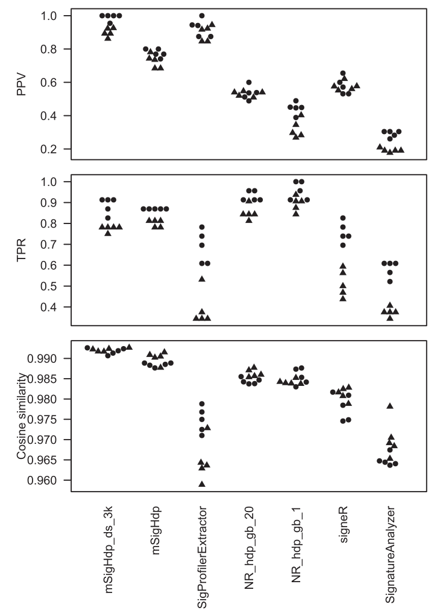
Importance of benchmarking
Synthetic
single-base-substitution data with resampling noise
Positive predictive value
True positive rate
Liu, Wu et al. 2023 10.1093/nargab/lqad005,
Our approach
Top NMF

Slide 48
Importance of benchmarking
Synthetic
single-base-substitution data with resampling noise
Positive predictive value
True positive rate
Liu, Wu et al. 2023 10.1093/nargab/lqad005,
Our approach
Top NMF

Slide 49
Hierarchical Dirichlet process approach discovers signatures similar to those discovered by non-negative matrix factorization
Neither approach is perfect
Assess results in the light of all available evidence!
In practice it is often best to use both approaches
Our code released as R packages on GitHub and in a Singularity/Apptainer container
mSigHdp – mutational Signature Hierarchical Dirichlet process

Slide 50
Outline
Example mutational signature: AA (aristolochic acid)
Techniques for mining mutational signatures from somatic mutations in 23,000 tumors
Discovery of the cause of an insert-and-deletion hypermutator phenotype in human cancer

Slide 51
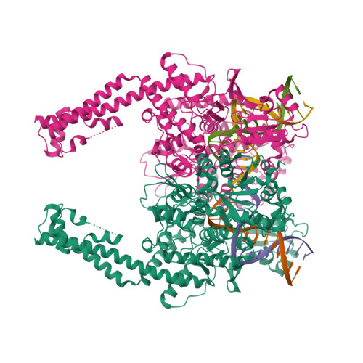
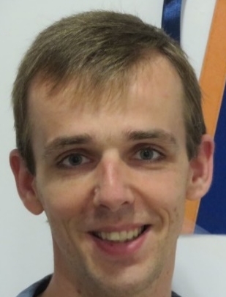
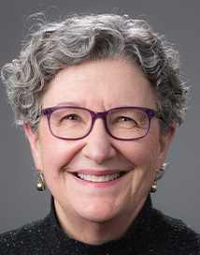
A hotspot mutation in topoisomerase IIα (TOP2A) causes an indel mutator phenotype in human
Topoisomerases cut and re-join DNA strands to let them untangle or to let supercoiled duplexes unwind
Arnoud Boot Mo Liu Sue Jinks-Robertson Nicole Stantial
Stantial, https://doi.org/10.1073/pnas.2008721117 PNAS 2020

Slide 52
A hotspot mutation in topoisomerase IIα (TOP2A) causes an indel mutator phenotype in human
One mutant in the yeast topoisomerase II gene causes duplications of 4, 3, or 2 base pairs, for example:
CGATAC → CGATAGATAG (4 base-pair duplication)
ACATG → ACATCATG (3 base-pair duplication)
CATG → CATATG (2 base-pair duplication)
Stantial, https://doi.org/10.1073/pnas.2008721117 PNAS 2020

Slide 53
This matched mutational signature ID17 ID17 is an indel (insertion/deletion) signature discovered by mining cancer mutation data
E.g. ACATG → ACATCATG
(3 base-pair duplication)
E.g. CGATAC → CGATAGATAG
(4 base-pair duplication)
E.g. CATG → CATATG
(2 base-pair duplication)
Boot, Liu, et al., 2023, 10.1073/pnas.2114024119

Slide 54
Average spectrum of all 7 tumors with ID17
E.g. ACATG → ACATCATG
(3 base-pair duplication)
E.g. CGATAC → CGATAGATAG
(4 base-pair duplication)
E.g. CATG → CATATG
(2 base-pair duplication)
Boot, Liu, et al., 2023, 10.1073/pnas.2114024119
Notes:
Bars are SEM

Slide 55
All 7 tumors had identical mutations in a human ortholog of yeast Top2
Lysine to asparagine at residue 743 in topoisomerase II alpha: TOP2A p.K743N
Among > 12,000 tumors (PCAWG), 4 and only 4 had K743N and ID17
P < 10⁻¹⁴
We think the ID17 duplications arise from erroneous repair of double strand breaks that the mutant TOP2A cannot re-ligate – the mechanism observed in yeast
Boot, Liu, et al., 2023, 10.1073/pnas.2114024119

Slide 56
But besides the ID17 duplications, K743N tumors also have deletions that are not in ID17
Hypothesis: deletions due to human TOP2A K743N stem from repair of double strand breaks by theta-mediated end joining – a pathway yeast does not have
E.g. ACATG → ACATCATG
(3 base-pair duplication)
E.g. CGATAC → CGATAGATAG
(4 base-pair duplication)
E.g. CATG → CATATG
(2 base-pair duplication)
Deletions of 5 or more base pairs
For example
ACTACAGGT → ACGT
ACTACAGGT → AT
Deletions of 5 or more base pairs
with “microhomology”, e.g.
ACTACACTAG → ACTAG
ACTACAGGCA → ACA

Slide 57
2 sequence motifs associated with duplications and deletions in human K743N tumors
Type 1
Type 2
Duplications
Deletions

Slide 58
K743N probably contributes to oncogenesis
6 of the 7 K743N tumors had presumably inactivating indels in tumor suppressor genes PTEN or TP53 that were probably due to K743N
1 known oncogenic deletion in oncogene BRAF
One or both K743N sequence motifs were present at each of these sites
In total, K743N tumors had 45 indels in known cancer-driver genes
One or both K743N sequence motifs were present at 36 of the 45 indels
Odds ratio for enrichment for these motifs at indels in driver genes in the K743N tumors vs indels in cancer-driver genes in 4,645 other tumors: 177, p < 10⁻⁴⁷

Slide 59
Acknowledgements - Funding
Singapore National Medical Research Council
Singapore Ministry of Health via the Duke-NUS Signature Research Programmes
Chang Gung Medical Foundation
Duke-NUS Khoo Postdoctoral Fellowship Award
United States National Institutes of Health

Slide 60
Acknowledgements
Singapore (Duke NUS,
National Cancer Centre
Singapore, and Johns Hopkins Singapore,
TOP2 and AA)
Arnoud Boot
Mo LIU (刘陌)
Alvin NG Wei Tian (黄伟添)
Nanhai JIANG (蒋南海)
Shenli Zhang
Szu-Chi Ho
Willie Yu
Cedric C. Y. Ng
Patrick Tan
Bin Tean TEH
Alex Chang
(AA, UTUC, HCC)
Sen-Yung Hsieh (谢森永)
Hao-Yi Huang
Ming-Chin Yu
Po-Hung Lin (林柏宏)
Jacob See-Tong PANG
(TOP2A)
Sue Jinks-Robertson
Nicole Stantial
(TOP2A)
John L. Nitiss
Viraj Shah
Karen C. Nitiss

Slide 61
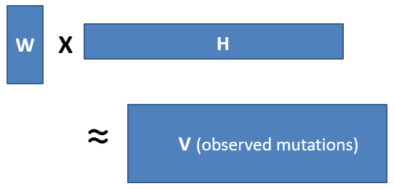
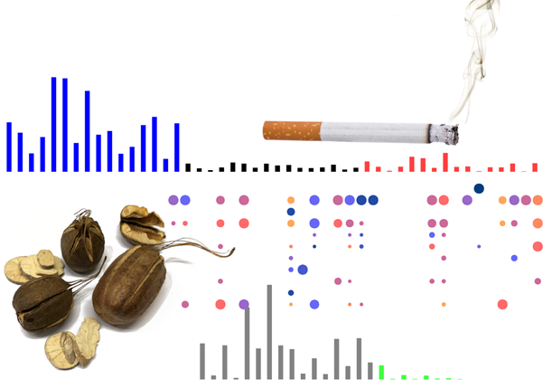
Questions?
https://www.rcsb.org/structure/4FM9

Slide 62
Backup slides

Slide 63
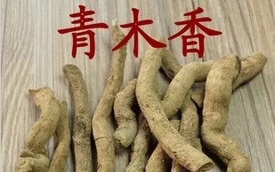
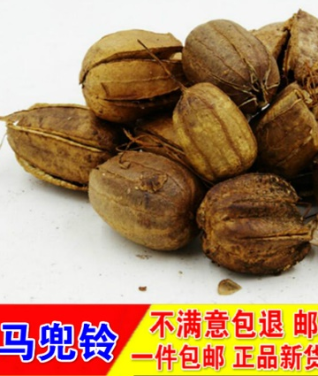
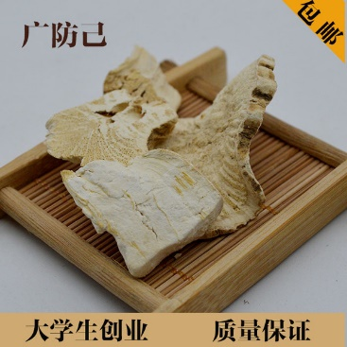
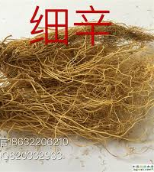
Aristolochic acid (AA) occurs naturally in plants widely used as herbal medicine

Slide 64
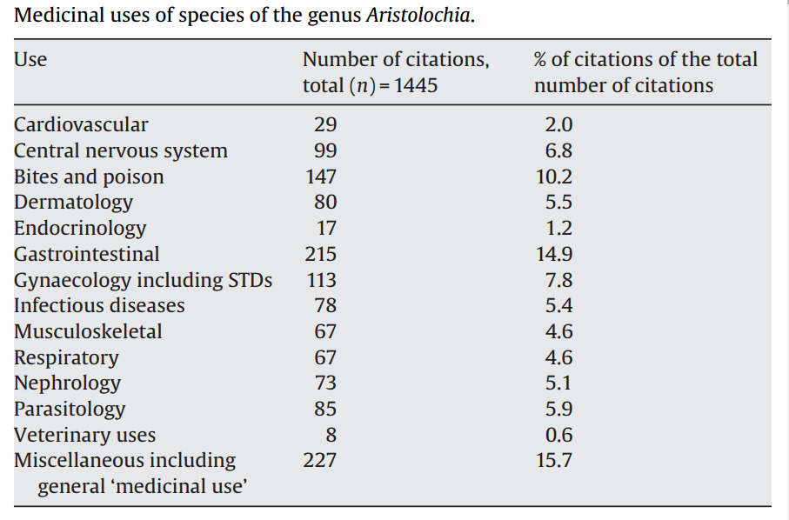
M. Heinrich et al 2009
doi:10.1016/j.jep.2009.05.028

Slide 65
Table S6. Drivers identified by MutSigCV or 20/20+ in 98 Taiwan HCCs.
Gene | Proportion of Taiwan HCCs with mutation | Classification in Cancer Gene Census | Notes | Proportion with mutations in TCGA 2017
TP53 | 0.54 | TSG | Commonly mutated in HCC | 0.31
CTNNB1 | 0.24 | oncogene | Commonly mutated in HCC | 0.27
ALB | 0.21 |  | Commonly mutated in HCC, status as driver controversial | 0.13
AXIN1 | 0.17 | TSG | Commonly mutated in HCC | 0.08
DOCK8 | 0.11 |  | Not expressed in liver or liver cancer (http://www.proteinatlas.org/ENSG00000107099-DOCK8/cancer); not observed in any other HCC genomic study | NR
BRD7 | 0.09 |  | Observed in Totoki et al., 2014 , Fujimoto et al., 2016 | NR
ARID2 | 0.09 | TSG | Observed in multiple other HCC genomic studies | 0.05
RPS6KA3 | 0.08 |  | Observed in multiple other HCC genomic studies | 0.04
IRF2 | 0.06 |  | Reported as an HCC TSG in Guichard et al., 2012 | NR
RAG1 | 0.06 |  | Activation of immunoglobulin V-D-J recombination.; not likely to have a role in hepatocytes or liver cancer | NR
RB1 | 0.06 | TSG | Observed in multiple other HCC genomic studies | 0.04
PBRM1 | 0.05 | TSG | Observed in multiple other HCC genomic studies | NR

Slide 66
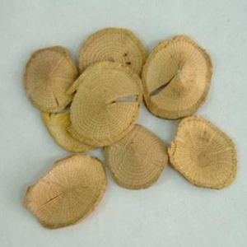
Variable and diverse AA content
Each column is a sample
关木通 guān mù tōng (stem of
Aristolochia manshuriensis)
High concentration
Each row is a different AA analog
Low concentration
Michl et al., 2015, J. Natural Products doi:10.1021/acs.jnatprod.5b00556
Notes:
https://www.e138.net/zhongyao/cai-141.html

Slide 67
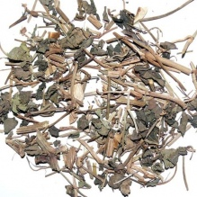
Variable and diverse AA content
Each column is a sample
天仙藤 tiān xiān téng (thin stems and leaves of Aristolochia debilis)
High concentration
Each row is a different AA analog
Low concentration
Michl et al., 2015, J. Natural Products doi:10.1021/acs.jnatprod.5b00556

Slide 68
2021 AA adducts and mutations in normal and other non-cancer tissue
Liver - adducts and mutational signature (Brunner et al, 2019, doi: 10.1038/s41586-019-1670-9)
Bladder and upper tract urothelia - mutational signature (Du et al., 2016; Lu et al., 2020, 10.7150/thno.43251; Li et al., 2020, 10.1126/science.aba7300)
Kidney - adducts
White blood cells - mutational signature (our unpublished results here)
Notes:
Poon et al., 2013 and subsequent data (liver - hepatocellular carcinoma [HCC])
Zou et al., 2015, Jusakul et al., 2017 (bile duct carcinoma)
Scelo et al., 2014, Jelakovic et al., 2014 (kidney/renal cell carcinoma)
Poon et al., 2013, Hoang et al., 2013, many others (upper tract urothelial carcinoma)
Poon et al., 2015, others (bladder urothelial carcinoma)

Slide 69
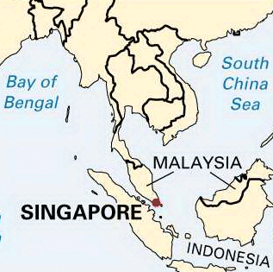
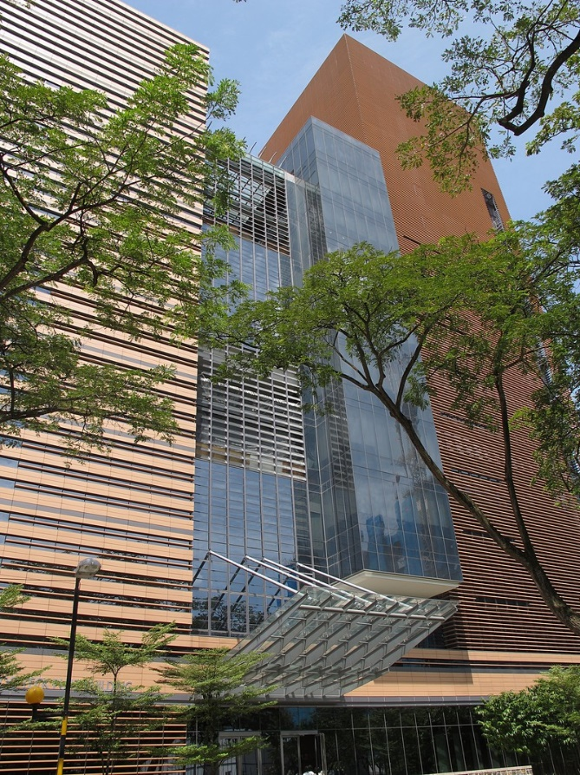
Where I work: Duke-NUS Medical School
China
Nonprofit partnership
Duke in North Carolina, USA
National University of Singapore (NUS)
SingHealth, largest public healthcare provider, 6 hospitals, 5,500 beds
60 MDs / year
15 PhD students / year
PhD program in biostatistics and bioinformatics (Google “Duke-NUS QBM”)
http://kids.britannica.com/comptons/art-55105/Singapore

Slide 70
Where I live: Singapore
Tiny, wealthy country
50 km (31 mi) east-west; 26 km (16 mi) north-south
5.87 million people
per capita GDP > US (purchasing power parity, includes non-citizens)
Good public health
Life expectancy at birth 86.19 (US is 80.43, Aus, 82.89)
Infant mortality: 1.56/1,000 (US is 5.22, Aus, 3.29)
China
http://kids.britannica.com/comptons/art-55105/Singapore
Stats: CIA World Factbook downloaded 2022 03 22

