Slide 1
Machine Learning Tools for Reduction of the Effect of Systematic Uncertainties
BIRS Workshop, Banff - April 27, 2023
Tommaso Dorigo
INFN, Padova
4/27/2023

Slide 2
The Next Paradigm Shift: End-To-End Optimization and co-design
BIRS Workshop, Banff - April 27, 2023
Tommaso Dorigo
INFN, Padova
4/27/2023

Slide 3
Contents
ML for Nuisance parameters in HEP
What we want: fully sufficient statistic summaries
One slide in place of a whole talk
Nuisance-parametrized models
Feature decorrelation, penalized methods, and adversary losses
Semi-supervised approaches
Inference-aware approaches
INFERNO
Recent developments
New - Demonstration of INFERNO on a CMS analysis, and a reproducibility study
Where all this logically leads: co-design
Summary

Slide 4
1. ML for Nuisance Parameters in HEP
Supervised classifiers can be used to construct low-dimensional summary statistics
→ carry out statistical inference on parameters of interest
The compression is informed by simulated observations produced by a forward model (MC), whose fidelity is limited by known factors:
Known limitations in the model (e.g. “NLO accuracy”)
Imprecise simulation of the detector response (calibration constants, etc.)
Uncertainty in fundamental parameters (top mass, α, sin θ_{W} ...)
Finiteness of available data samples (e.g. due to CPU limitations)
The above are typical nuisance parameters relevant to our measurement goals
Notably, our model can also be affected by unknown factors
→ we have no way to assess their impact → not discussed today
One further part of the general framework which is outside our reach is the error of the third kind
→ also a topic for another workshop

Slide 5
Effects of Nuisances in Statistical Inference
To account for imperfections described by nuisance parameters α, we need to enlarge our model to p(x|θ,α) (if we can). The latter may be used in the construction of a likelihood function or whatever other estimator we choose.
This allows us to account for the variability of the nuisances in our inference
The inclusion of nuisances is expected to widen resulting confidence intervals on θ
A similar effect occurs if we use the model in hypothesis testing → power reduction
→ The presence of nuisance parameters (and our struggling with properly accounting for their effect) limits measurement precision and discovery reach in fundamental science

Slide 6
2. What We Want: Sufficient Statistic Summaries
ML applications usually focus on the goal of minimizing the statistical uncertainty on the estimates of parameters of interest θ.
The summary statistic they provide should enable the extraction of the highest amount of information on θ; but this is not granted – it is conditional to
validity of the underlying model used to generate the samples
assumptions made on the value of nuisance parameters α.
The conditionality is hard to get rid of!, as e.g.
Problems are complex and high-dimensional
Nuisance parameters have ill- or un-known PDF
Effect of nuisances on the default model is not easy to parametrize
This implies that the summary statistic is not usually sufficient: being oblivious of a part of feature space, it does not retain all the information relevant to the parameter estimation task

Slide 7
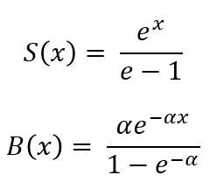
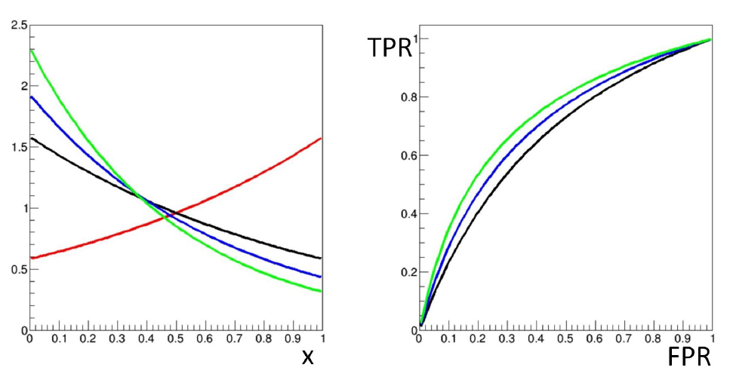
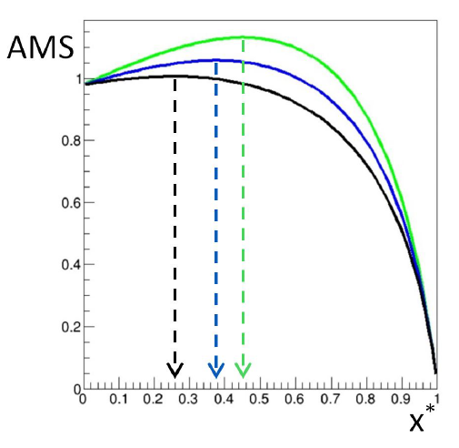
A Toy Example
B
S
By writing B(x) as above, we assert we know that dependence perfectly. Let our task be to estimate the signal fraction in a mixture model.
We must define a prescription to decide on the critical region, i.e. the value of x*. In order to claim we are optimizing x*, we need a figure of merit. Let us use the “approximate median significance” (AMS):
$$AMS=\sqrt{2\left[\left(N_{s}+N_{b}+N_{r}\right)\ln\left(1+\frac{N_{s}}{N_{b}+N_{r}}\right)−N_{s}\right]}$$
AMS is a robust surrogate of the significance of an excess of events if a signal of mean N_{s} contributes to a dataset including background sampled from a Poisson of mean N_{b}. N_{r} regularization against divergences; N_{r}=10 is a sensible choice.
What happens to our toy problem? Let us consider N_{s}=20, N_{b}=400

Slide 8
What We Get
→ If we train a classifier with a given value of α, the performance is going to be under- or over-estimated if the true value of α is different; the choice of a critical region x>x* corresponding to a pre-defined FPR will similarly be affected, as will the value of TPR.
→If we do not know what α is, we cannot “optimize” our critical region, as the optimal choice of x* strongly depends on the unknown value of α
→ Nuisance parameters affect the optimal working point, as well as the performance of the classifier and in fact the relative merits of different classifiers (which produce different summaries x)
→ Standard supervised classification techniques may not reach optimality unless they address the conditionality issue discussed supra.

Slide 9
One Slide in Place of a Whole Talk
In the past decade ML has provided tools and inspiration for a number of solutions to the problem of nuisances effect reduction in HEP:
Nuisance-parametrized models (e.g. n-subjettiness ratio [9,10])
Adding the nuisance to training features (e.g. X→tt in ATLAS, [15,16])
Decorrelation (planing, Uboost, ...[18,19,22-24])
Penalization (DisCo, gaussian smoothing [25,26])
Adversarial setups (pivoting) [28-32], autoencoders, etc. [33-37]
Semi-supervised methods (CWOLA et al.), [38,39,56-58]
A problem in making sense of all this wealth of results is that they target different problems... It is great when we can focus on specific benchmarks and compare

Slide 10
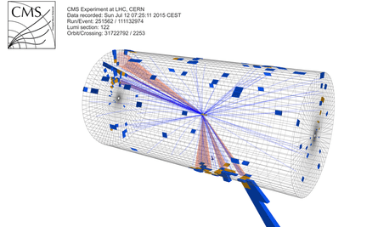
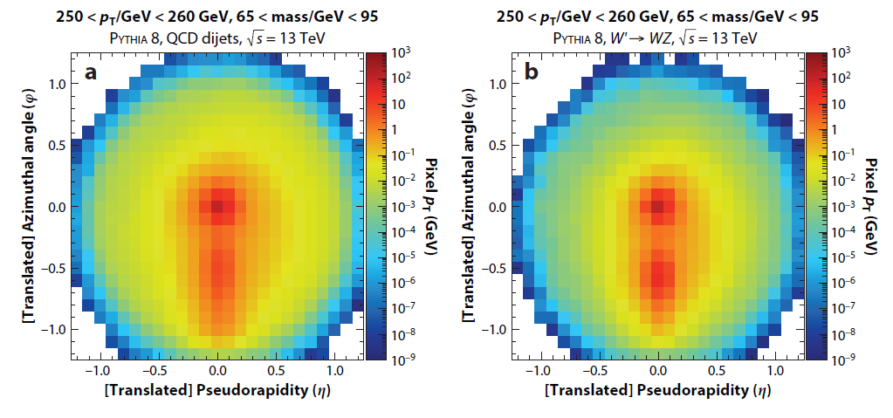
One Good Benchmark: Decorrelating the Mass
The W boson (1983) and the top quark (1995) were discovered using decays to electrons and muons, as the more frequent quark decays are difficult to distinguish from backgrounds
We later realized that if top quark, W, Z, H bosons have high energy, the jets of hadrons they produce in hadronic decays are distinguishable in highly granular calorimeters from backgrounds through their inner structure
Today the most sensitive searches for new massive particles benefit from CNN-powered imaging techniques
In this context, the mass of the heavy particle you are trying to reconstruct can be treated as a nuisance parameter which you want to decorrelate from classifiers that enhance the
signal purity
Above: a background jet image (left) and a W-quark jet image (right)

Slide 11
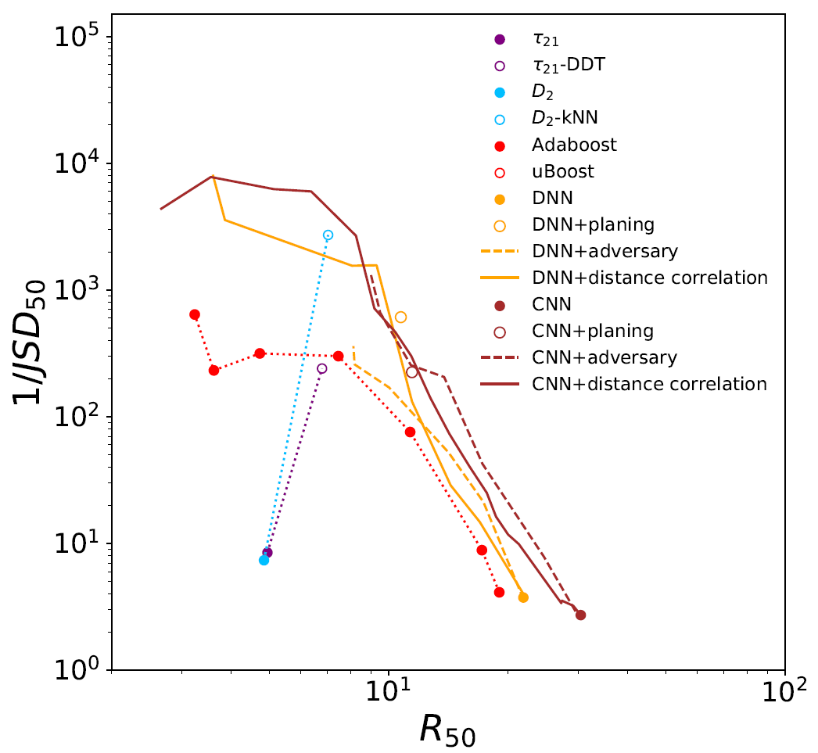
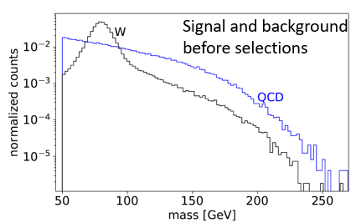
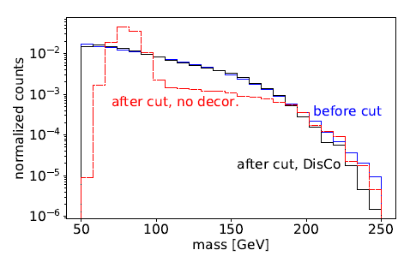
Comparisons
A comparison of the background rejection (x axis) of different W-boson taggers, retrofitted with decorrelation methods (planing, adversarial NN, and DisCo regularization)
Above: a measure of decorrelation (inverse of Jensen-Shannon
divergence between QCD bgr before and after 50%TPR selection)
as a function of background rejection at 50%TPR.

Slide 12
3. Inference-aware neural optimization
Idea of P. de Castro and TD [49]: make the loss of a NN aware of what we really want to make of the NN output, and simultaneously inject in it a notion of the relevant nuisances, so that a loss minimization perfectly matches the (stat+syst) variance minimization of the final measurement.
If the NN constructs summaries that are differentiable WRT the nuisances, and this property is propagated to the inference step, a global minimization can be performed.
Problem 1: need to produce differentiable map of nuisance effect on features
Not necessarily dramatic, but
→ calls for custom solutions in HEP problems of different complexity
Problem 2: how to estimate the final variance on the parameter of interest?
→ Use the inverse of the information matrix of a likelihood constructed with the summary statistic provided by the NN

Slide 13
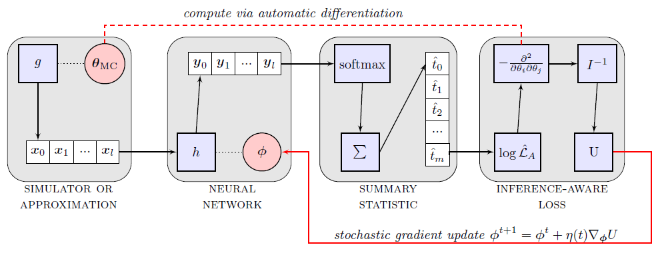
3.1 INFERNO
Βlock 1: A simulator or an approximation of it is used to sample observations given parameters θ
Block 2: NN with parameters φ produces outputs y
Block 3: A one-dimensional summary statistic, as a smoothed version of y, is produced by softmax
Block 4: A saturated likelihood is constructed with the summary (e.g. a histogram of Poisson counts), and used to get a Hessian matrix, yielding expected variance on parameter of interest
Autodiff allows to update the NN parameters given the value of the variance, to navigate with SGD to
the optimal solution

Slide 14
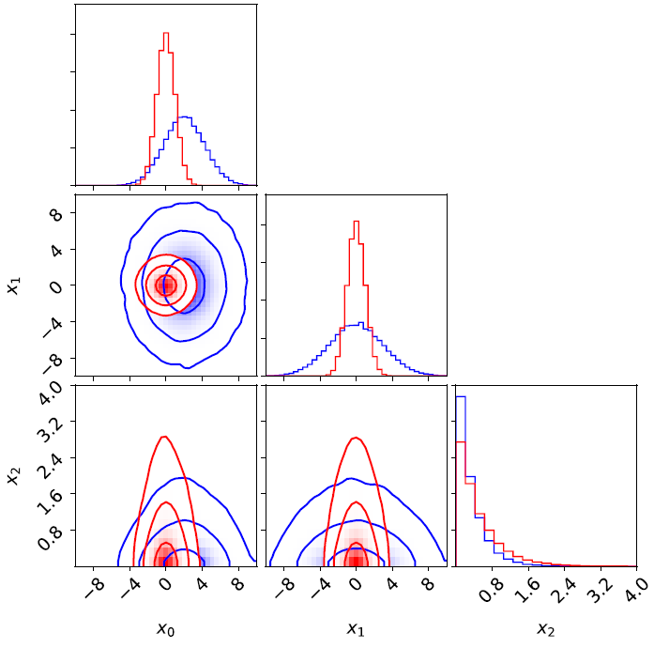
INFERNO Synthetic Example
In [49] a simple example with 3 nuisances affecting the background of a 2-component mixture problem is considered:
r shifts the background mean, λ changes the slope, and b is background normalization. The model is then
and the optimization of the NN is tested with several benchmarks, releasing nuisances (see below)

Slide 15
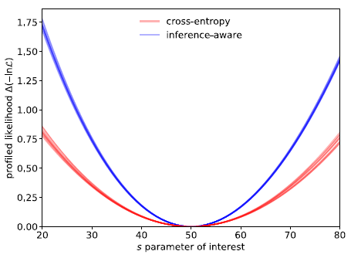
INFERNO Results
INFERNO consistently outperforms the bce-maximizing NN and has performance which approaches that of the analytical likelihood result.

Slide 16
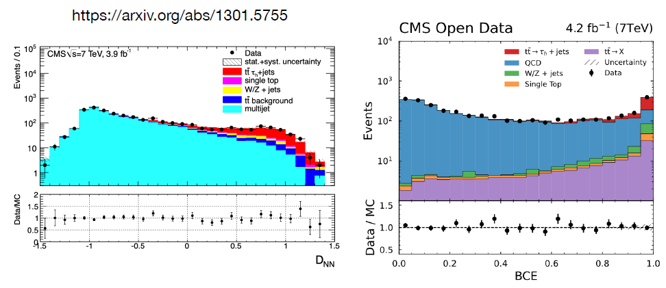
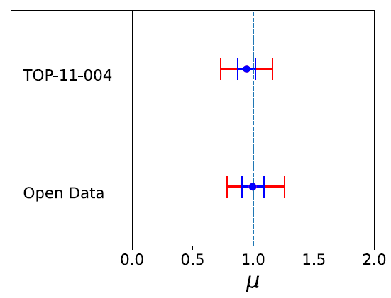
3.3 Test of INFERNO on a Real Physics Analysis
An issue in INFERNO is how to model HEP nuisances and effect on observations: must e.g. transform input features, interpolating simulated observation weights, or interpolate histogram counts.
To test the applicability of INFERNO on a real HEP analysis and benchmark it, we chose a
result reproducible on open data, based on NN classification, and with large systematic uncertainties: CMS cross section of tt → τh + jets (TOP-11-004)
An initial test with normal BCE loss produces consistent results on the cross section

Slide 17
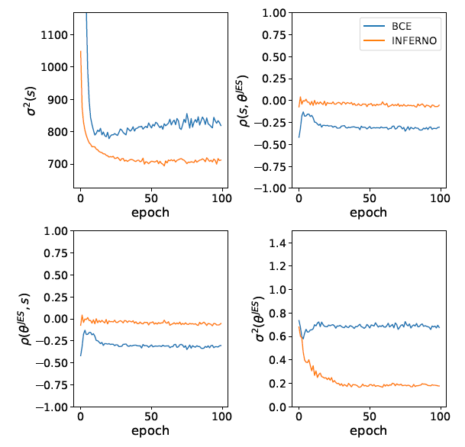
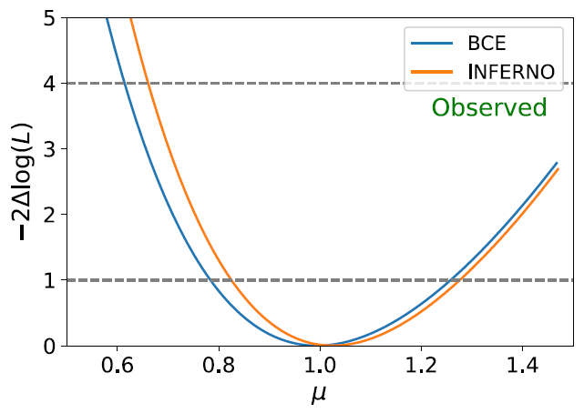
Results and Lessons Learned
On the σ(tt) measurement INFERNO produces a moderate improvement: it constrains the jet energy scale systematic (by decorrelating the effect of that uncertainty from the summary statistic); but since it cannot reduce systematic uncertainties affecting only the data normalization, overall benefit is not large.
The reproduced analysis is a valid benchmark where to test other approaches. For details see Layer, Dorigo, Strong, arXiv:2301.10358

Slide 18
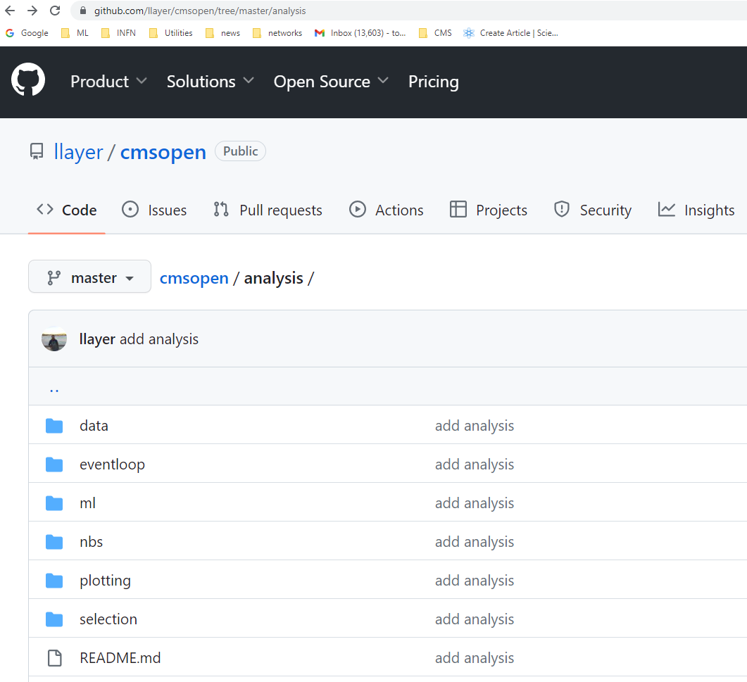
A valid benchmark for future studies!
Reproducing the original CMS analysis using open data was the hardest part of L.Layer’s work
Now there is a benchmark that can be used, with already processed data
Can use to compare different systematic mitigation techniques on a real-world analysis!
See github.com/llayer/cmsopen

Slide 19
3.4 Bonus track – End-to-End Models
The idea of INFERNO – a DL-powered realignment of inference tools and experimental goals – brought a few of us into looking into end-to-end models for co-design of hardware and software
The design space of complex experiments is too large to be probed in discrete fashion based on expert bias. In addition, until inference extraction is considered at design stage, misalignment will result
→ We need to develop methods to do this in continuous fashion with DL, as in high complexity hide wonderful opportunities for improvement!
Two examples:
MUonE → factor of 2 improvement over expert layout [Dorigo20] (see below)
SHIP → factor of 2 improvement over Bayesian optimized magnet shielding scheme [Shirobokov20]
The above use cases involved rather simple design questions
NB for statisticians:
a factor of 2 in
the relevant figure
of merit in HEP is
HUGE

Slide 20
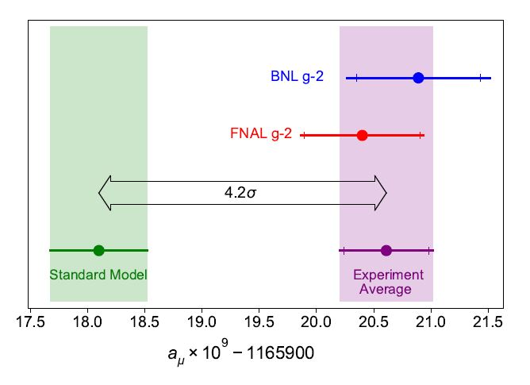
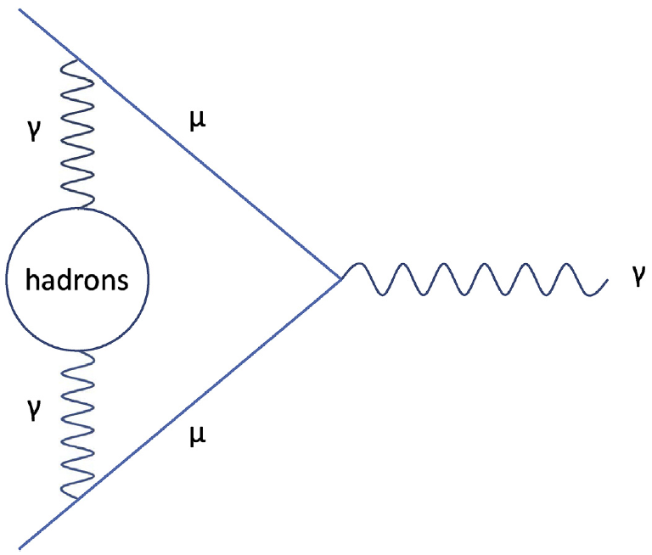
One Example of Geometry Optimization: MUonE
MUonE aims to determine with high precision the probability of elastic muon-electron scattering, as this number may reduce the theory systematics of the g-2 muon anomaly
The experiment must be sensitive to the rate of interactions as a function of momentum transfer, with 10⁻⁴ precision
Above: a long-standing anomaly in the Standard Model, the muon g-2 value
Below: a muon-photon interaction, with a hadronic quantum loop
Beam
Above: layout of one of 40 1m-long MUonE stations

Slide 21
MUonE Optimization
To study alternative layouts, I wrote a simulation of muon scatterings and event reconstruction, then optimized the geometry of the apparatus accounting for every part of the problem affecting the precision of the inference
This identified a layout different from the one chosen by detector experts, with a factor of 2 improvement in the relevant metric without increase in detector cost
After some digestive trouble, MUonE adopted most of my proposed improvements

Slide 22
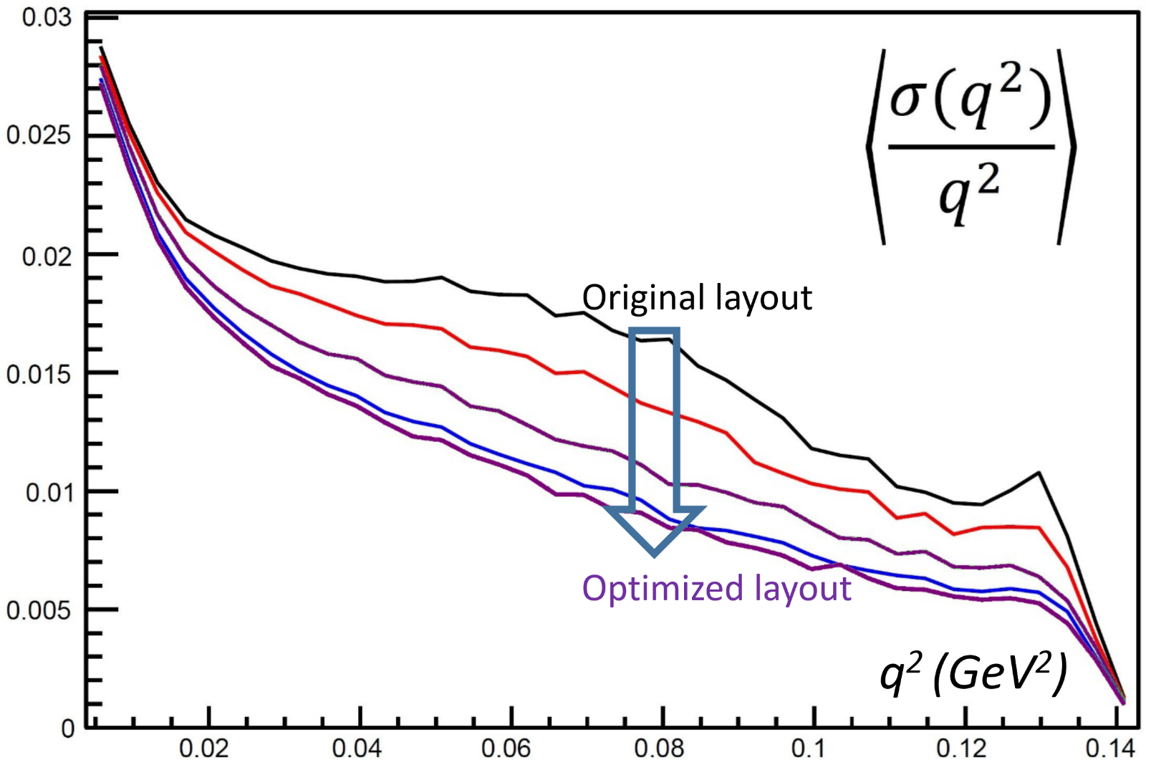
MUonE Optimization
Relevant figure of merit: relative resolution on momentum transfer q²
To study alternative layouts, I wrote a simulation of muon scatterings and event reconstruction, then optimized the geometry of the apparatus accounting for every part of the problem affecting the precision of the inference
This identified a layout different from the one chosen by detector experts, with a factor of 2 improvement in the relevant metric without increase in detector cost
After some digestive trouble, MUonE adopted most of my proposed improvements
Above: relative resolution in event q² for different configurations (the higher, black line is the original proposal by the MUonE coll.)

Slide 23
Event Reconstruction in MUonE
The scattering involves an incoming muon and outgoing muon and electron
→ it seems proficuous to fit the trajectories to a common vertex
However, if one is not thinking in terms of co-design, the advantage of a full 3D vertex fit looks like a detail worth leaving to final tweaks. It is instead crucial!
Here is a correct «holistic» way of thinking at the matter:
Interactions mostly take place in Be target, which is thick so it does not offer z-position constraints
hence a fit involving the z coordinate is useless Hence we should rethink the layout to exploit the constraint: use thin layers spaced in vacuum or air!
Large systematics on measured angles are lurking, due to relative z positioning errors; hard to position elements with sufficient precision. Hence thin layers layouts are impractical By exploiting vertex fit to many events we should manage to reduce effect of positioning systematics

Slide 24
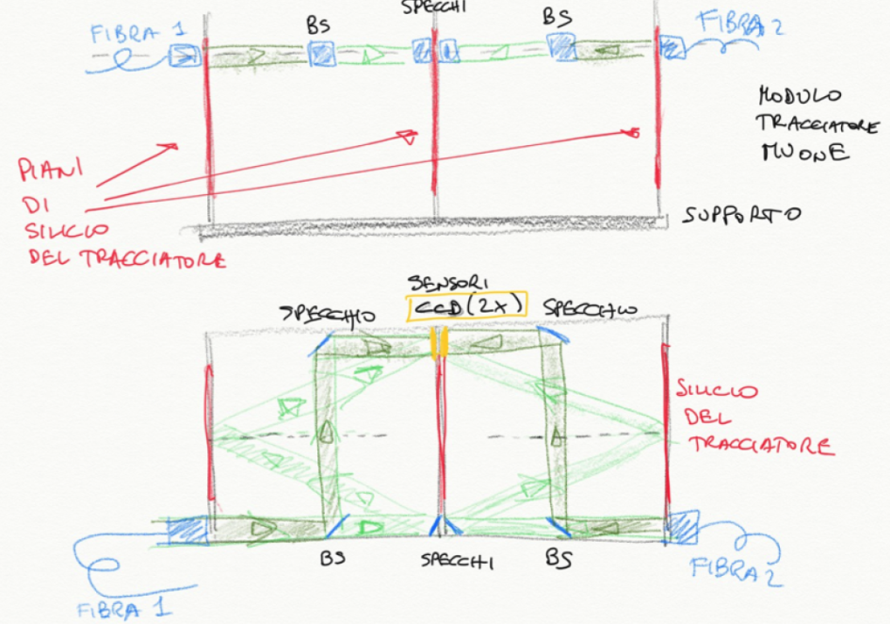
Reducing Positioning Systematics
The MUonE collaboration envisioned a holographic laser system to measure the position along z of modules and targets with 10μm precision (roughly required threshold for wanted q² resolution).
Cost: one 10k euro system per meter-length muon station, 40 stations → 400k euro budget

Slide 25
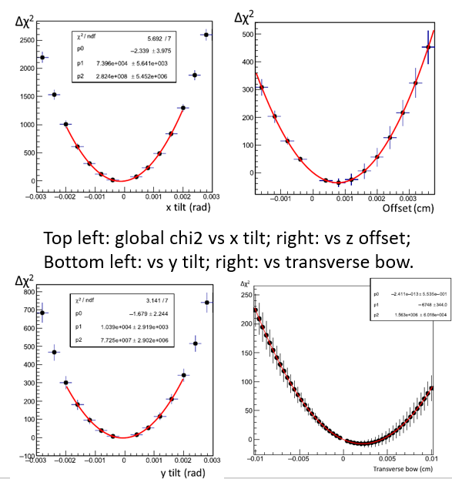
Effect of Thin Layers and Vertex Fit
Once you realize the benefit of thin layers, a simulation proves that the holographic shebang is useless:
by using 5 minutes worth of beam data, layouts that involve thin target layers allow to fit for the position z of individual elements, as well as for their tilt and bow, to sub-micron accuracy!
Δχ²

Slide 26
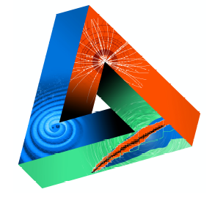
Machine-Learning Optimized Design of Experiments
MODE Collaboration
https://mode-collaboration.github.io
M. Aehle¹⁷, A. G. Baydin⁵, A. Belias¹⁰, A. Boldyrev⁴, K. Cranmer⁸, P. de Castro Manzano¹, T. Dorigo^{1,14}, C. Delaere², D. Derkach⁴, J. Donini³, P. Elmer¹⁸, F. Fanzago¹, N.R. Gauger¹⁷, A. Giammanco², C. Glaser¹¹, L. Heinrich¹², R. Keidel¹⁷, J. Kieseler²², C. Krause¹³, L. Kusch¹⁷, M. Lagrange², M. Lamparth¹², M. Liwicki²¹, G. Louppe⁶, L. Layer¹, F. Nardi^{3,14}, P. Martinez Ruiz del Arbol⁹, F. Ratnikov⁴, R. Roussel²⁰, F. Sandin²¹, P. Stowell¹⁵, G. Strong¹, M. Tosi^{1,14}, A. Ustyuzhanin⁴, S. Vallecorsa⁷, Xabier C. Vidal²³, P. Vischia², G. Watts¹⁹, H. Yarar¹, H. Zaraket¹⁶
Sponsored by
1 INFN, Italy
2 Université Catholique de Louvain, Belgium
3 Université Clermont Auvergne, France
4 Laboratory for big data analysis of the HSE, Russia
5 University of Oxford, UK
6 Université de Liege, Belgium
7 CERN, Switzerland
8 University of Madison, Wisconsin, US
9 IFCA, Spain
10 GSI, Germany
11 Uppsala Universitet, Sweden
12 TU Munchen, Germany
13 Rutgers University, US
14 Università di Padova, Italy
15 Durham University, UK
16 Lebanese University, Lebanon
17 Kaiserslautern-Landau University, Germany
18 Princeton University, US
19 University of Washington, US
20 SLAC, US
21 Lulea University of Technology, Sweden
22 Karlsruhe Institute of Technology, Germany
23 Universidad de Santiago de Compostela, Spain
JENAS

Slide 27
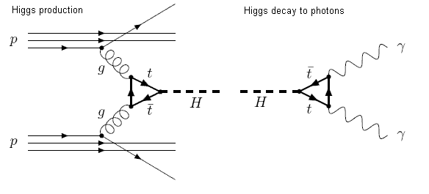
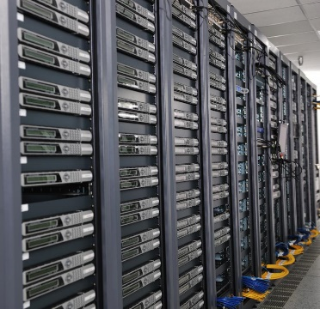
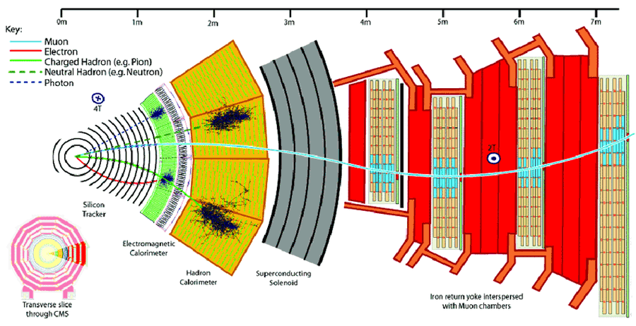
Four-Slide Description of a Differentiable Model for Design Optimization - 1
An end-to-end detector design optimization task can be briefly formalized in the following way.
(1) We start with a simulation of the physics processes of relevance, which generates a multi-dimensional, stochastic input variable x, distributed with a PDF f(x)
(2) The input is turned by the simulation of the detection apparatus into sensor readouts z distributed with PDF
p(z|x,θ).
z are observed low-level features of the physical process; they depend through p( ) on parameters θ describing physical properties of detector and geometry.
x
z

Slide 28
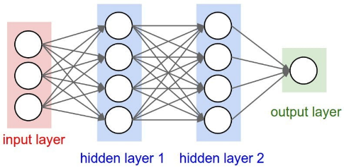
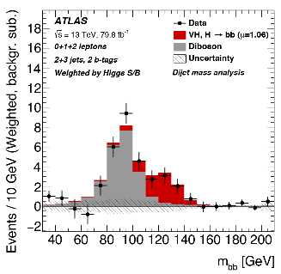
Four-Slide Description of a Differentiable Model for Design Optimization - 2
z
(3) Detector readouts z are used by a reconstruction model R( ) that produces high-level features
ζ(θ) = R[z,θ,ν(θ)]
(e.g. particle four-momenta), by employing knowledge of detector parameters θ as well as a model of nuisance parameters ν(θ) which affect the pattern recognition task.
(4) In turn, high-level features ζ(θ) constitute the input of a further dimensionality reduction, typically powered by a neural network NN( )
Once trained for the task at hand, the network produces a low-dimensional summary statistic
s = NN[ζ(θ)].
(5) With s, inference can finally be carried out to infer back x. This completes our model of the inference process...
ζ
s
L(s|x)
x

Slide 29
Four-Slide Description of a Differentiable Model for Design Optimization - 3
The problem of detector optimality is that of finding estimators $\hat{θ}$that satisfy
$$\hat{θ}=arg\min_{θ}{\int{L\left[NN\left(ζ\right),c\left(θ\right)\right]p\left(z | x,θ\right)f\left(x\right)dxdz}}$$
c(θ) models the cost of a detector of parameters θ, and the loss function L[NN,c] appraises the result, obeying cost constraints and other limitations.
The PDF p(z|x,θ) is not available in closed form –models are implicit–, so we rely on forward simulation: we approximate $\hat{θ}$ with a sample of n events:
$${\hat{θ}}_{a}=arg\min_{θ}{\frac{1}{n}}\sum_{i=1}^{n}{L\left[NN\left(R\left(z_{i}\right)\right),c\left(θ\right)\right]}$$
where z_{i} is distributed as F(x_{i},θ) to emulate p(z|x,θ) as x_{i} is sampled from its PDF f( ). We thus obtain detector parameters which minimize the loss.

Slide 30
Four-Slide Description of a Differentiable Model for Design Optimization - 4
In some cases we will need to approximate the non-differentiable stochastic simulator F( ) with a local surrogate model:
z = S(y,x,θ),
that depends on a parameter y describing the stochastic variation of the approximated distribution. This allows to descend to the minimum of the approximated loss $\hat{L(z)}$ by following its surrogate gradient
$$∇_{θ}\hat{L(z)}=\frac{1}{n}\sum_{i=1}^{n}{∇_{θ}L[NN\left(R\left(S\left(y_{i},x_{i},θ\right)\right)\right),c(θ)]}.$$
The above recipe requires one to learn the differentiable surrogate S( ): this is a task liable to be carried out independently from the optimization procedure.

Slide 31
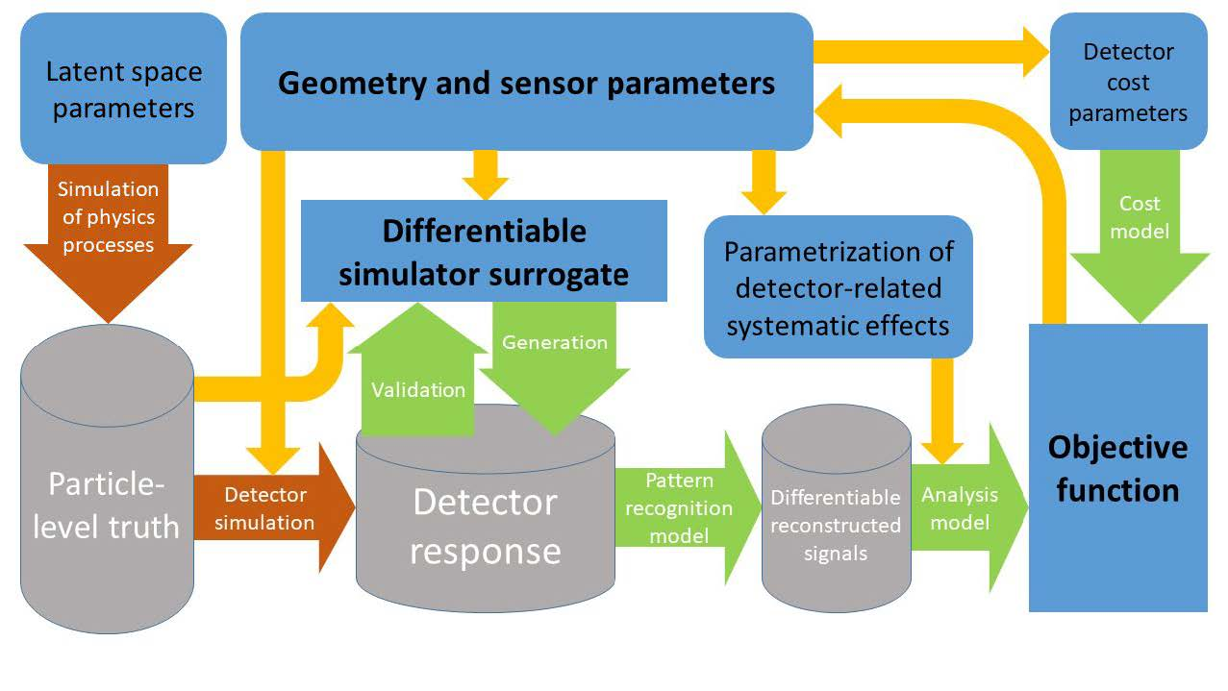
Putting It All Together
If the simulation can be bypassed by a differentiable surrogate, we remove the stochasticity of the physics and strongly simplify the problem
θ
c
ν
x
z or S
ζ = R(z)
L=NN(ζ)

Slide 32
Putting It All Together / 2
The model must
include a model of the absolute state-of-the-art (or even extrapolated future performance!) of reconstruction and inference to avoid any misalignment

Slide 33
Putting It All Together / 3
Backpropagation of the gradient of the objective function then allows to find optimal parameters θ → obtain end-to-end optimality of the instrument

Slide 34
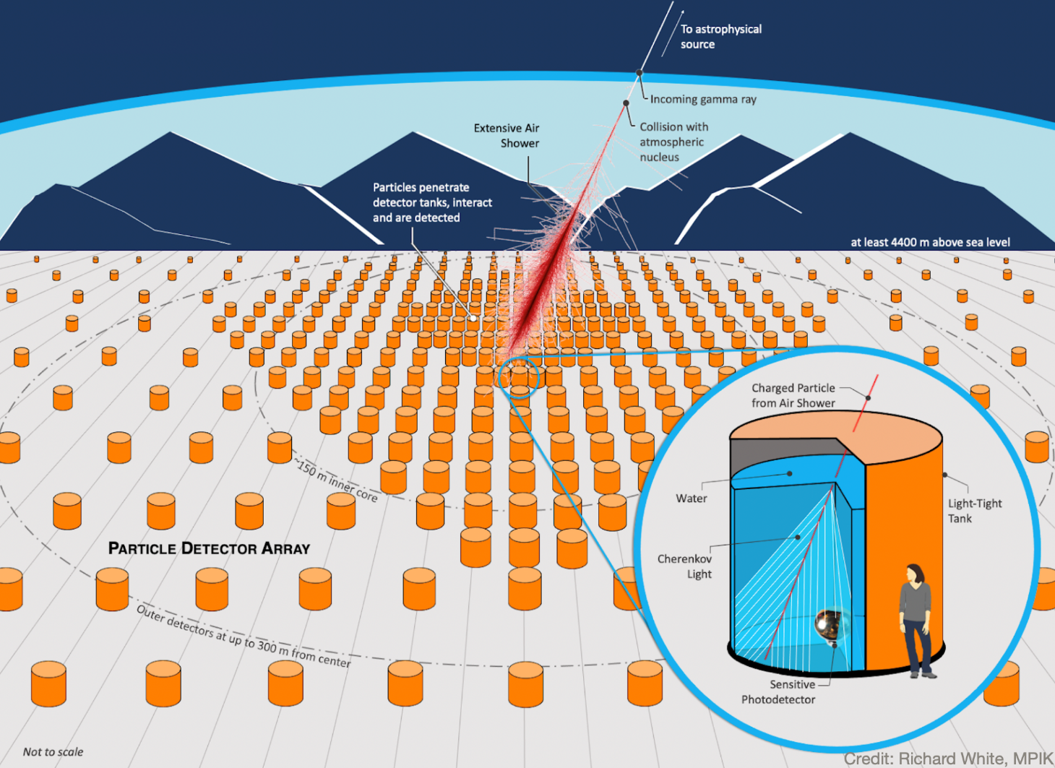
A Current Effort: Optimizing SWGO Array Layout
As the reconstruction of atmospheric showers was discussed on Monday afternoon, let us see what we are doing on the optimization of the layout of the 6000 tanks of Cherenkov detectors that SWGO plans to deploy at high altitude in South America
As a reminder: to extract scientific output we need to classify photon vs proton induced showers, and to determine their energy and direction

Slide 35
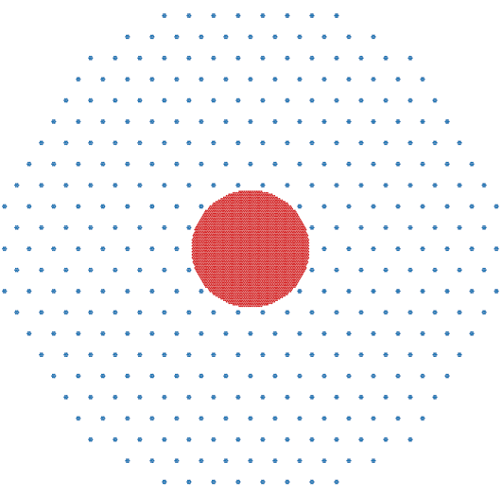
The Question
Several layouts have been proposed for the SWGO detection elements. They are a set of reasonable choices, sharing the idea of a decreasing density profile vs D from center.
Which one is the best layout (in terms of science output per invested $) among the eight proposed?
We can simulate showers and obtain an answer, if we
endow ourselves with a precise model of the best achievable inference extraction
agree on a Utility function, as e.g. the weights w_{E} of
$U=\sum_{E=E_{1}}^{E_{n}}{w_{E_{i}}}\frac{Φ_{i}}{σ_{Φ_{i}}}$
U here is a relative precision achievable on the gamma flux, modulated with the scientific value we give to different energy points.
Yet the more principled question, «what is the best possible layout given X detectors?» is on another league – it demands the sorting out of R^{2X-3} choices, not 8!
This can NOT be answered by the above discrete-sampling technique.

Slide 36
The Question and a Possible Answer
Several layouts have been proposed for the SWGO detection elements. They are a set of reasonable choices, sharing the idea of a decreasing density profile vs D from center.
Which one is the best layout (in terms of science output per invested $) among the eight proposed?
→ We can simulate showers and obtain an answer, if we
endow ourselves with a precise model of the best achievable inference extraction
agree on a Utility function, as e.g. the weights w_{E} of
$U=\sum_{E=E_{1}}^{E_{n}}{w_{E_{i}}}\frac{Φ_{i}}{σ_{Φ_{i}}}$
Above, U corresponds to the inverse relative resolution φ/σ_{φ} expected on the gamma flux φ, modulated by the scientific value we give to different energy points.

Slide 37
The Principled Question!
Several layouts have been proposed for the SWGO detection elements. They are a set of reasonable choices, sharing the idea of a decreasing density profile vs D from center.
Which one is the best layout (in terms of science output per invested $) among the eight proposed?
→ We can simulate showers and obtain an answer, if we
endow ourselves with a precise model of the best achievable inference extraction
agree on a Utility function, as e.g. the weights w_{E} of
$U=\sum_{E=E_{1}}^{E_{n}}{w_{E_{i}}}\frac{Φ_{i}}{σ_{Φ_{i}}}$
Above, U corresponds to the inverse relative resolution φ/σ_{φ} expected on the gamma flux φ, modulated by the scientific value we give to different energy points.
Yet the more principled question, «what is the best possible layout given X detectors?» is in another league – it demands the identification of a point in R^{2X-3}, not one among eight!
This cannot be answered by the above discrete-sampling technique.

Slide 38
A Tentative Solution to the Principled Question
Besides its high dimensionality, our problem is also that atmospheric showers are a stochastic phenomenon: the model is implicit
Yet the quantities we need – time-modulated number densities of muons, electrons, photons detectable on the ground as a function of shower parameters ω (distance D from shower axis and primary Id, E, θ) – are simple enough (and sufficiently decoupled to specific tank designs) that we may cook up a parametric model
F [ N_{μ}(t), N_{γ}(t), N_{e}(t) | ω ] .
Given an analytical form for F, we can compute in closed form the utility function for any detector configuration. This enables gradient descent to the maximum of –U!

Slide 39
Layout Optimization Pipeline
Simulate an initial layout for detector array
Stop when satisfied
Update layout (x,y of each tank) following gradient of U
Obtain the utility and its gradient with respect to each detector x,y position
Use RCF bound to estimate the expected variance of the signal flux measurement
Compute the likelihood of the observed batch as a function of the fraction of gammas in the batch; compute the second derivative of the likelihood
Simulate a set of gamma and proton showers hitting array
Reconstruct shower parameters ω in each hypothesis by likelihood maximization
Derive log-likelihood ratio of the two hypotheses
Obtain PDFs of LLR for the gamma and proton hypotheses given current layout
Simulate a batch of gammas and protons and reconstruct them; obtain the TS of each shower

Slide 40
Sample Run
Below is shown a run where the initial position of detector elements placed in a uniform circular pattern (black points in second and third diagram) gets updated as the system maximizes U, finding layouts that better discriminate p/γ and improve/extend reconstruction
c
Starting
layout
Learned
layout
Utility function
y (meters)
y (meters)
Number of tanks
<Variance on ω>
Epoch
x (meters)
x (meters)
Radius from center
Epoch
Center of generated showers is shown in the second diagram overlaid to detector positions, with a color scale indicating
the precision of their reconstruction (blue – good, red – bad)

Slide 41
A Better Solution!?
After I showed the above few slides to Ann Lee, she thought for three seconds and then bolted out that an alternative better, more elegant, and MUCH CPU-lighter) solution involves enforcing sparsity in an initially tightly packed array of M>>N detectors (where N is the target) with Lasso regression for feature selection.
She definitely has a point!
→ We will pursue that method for a better/faster solution
Corollary 1: DL might not be the most viable solution for even complex problems like the one described...
Corollary 2: to me the above incident sounds like a great example of why we do need in-person workshops...

Slide 42
4. Summary
A wide arsenal of ML/DL techniques that try to remove the impact of systematic uncertainties in supervised classification for HEP problems has been developed in recent years
The focus in many cases is achieving a decorrelation of salient features, to maximize discovery significance
Here, several methods successfully achieve the desired goal, with minor performance loss
Today we could not go over it, too much stuff! But I left ample references below.
The real issue is however how to minimize the effect of systematic uncertainties whatever their origin, with tools of more general applicability
Important steps have been made but the topic is still an active area of research in ML
DL solutions to this problem also become drivers of upping the ante –we must grow greedier and consider the bigger picture of co-design
solutions for reduction of systematics should be our top priority
this is only possible by including pattern recognition, inference extraction in the model

Slide 43
Third MODE Workshop – Princeton Jul 24-26
https://indico.cern.ch/event/1242538/
Please consider joining us in
Princeton July 24-26 – we will
have sessions on:
computer science developments
optimization in HEP
optimization in astro-HEP
optimization in nuclear/neutrino
optimization of muon tomography

Slide 44
References
[1] P. De Castro Manzano. Statistical Learning and Inference at Particle Collider Experiments. PhD thesis (2019). URL https://cds.cern.ch/record/2701341.
[2] K. Cranmer, G. Lewis, L. Moneta, A. Shibata, and W. Verkerke, HistFactory: A tool for creating statistical models for use with RooFit and RooStats (June 2012).
[3] K. Cranmer. Practical Statistics for the LHC. In 2011 European School of High-Energy Physics, pp. 267{308 (2014). doi: 10.5170/CERN-2014-003.267.
[4] L. Lista. Practical Statistics for Particle Physicists. In 2016 European School of High-Energy Physics, pp. 213{258 (2017). doi: 10.23730/CYRSP-2017-005.213.
[5] W. M. Pateeld, On the maximized likelihood function, Sankhya: The Indian Journal of Statistics, Series B (1960-2002). 39(1), 92{96 (1977). URL http://www.jstor.org/stable/25052054.
[6] D. R. Cox and O. E. Barndor-Nielsen, Inference and Asymptotics. CRC Press (Mar., 1994). URL https://play.google.com/store/books/details?id=KxYeBQAAQBAJ.
[7] F. James and M. Roos, Minuit - a system for function minimization and analysis of the parameter errors and correlations, Comput. Phys. Commun. 10 (6), 343{367 (Dec., 1975). URL http://www.sciencedirect.com/science/article/pii/0010465575900399.
[8] G. Cowan, K. Cranmer, E. Gross, and O. Vitells, Asymptotic formulae for likelihood-based tests of new physics, Eur. Phys. J. C. 71, 1554 (2011). doi: 10.1140/epjc/s10052-011-1554-0. [Erratum: Eur. Phys. J. C73, 2501 (2013)].
[9] J. Thaler and K. Van Tilburg, Maximizing Boosted Top Identication by Minimizing N-subjettiness, JHEP. 02, 093 (2012). doi: 10.1007/JHEP02(2012)093.

Slide 45
References / 2
[10] J. Dolen, P. Harris, S. Marzani, S. Rappoccio, and N. Tran, Thinking outside the ROCs: Designing Decorrelated Taggers (DDT) for jet substructure, JHEP. 05, 156 (2016). https://doi.org/10.1007/JHEP05(2016)156.
[11] I. Moult, B. Nachman, and D. Neill, Convolved Substructure: Analytically Decorrelating Jet Substructure Observables, JHEP. 05, 002 (2018). doi: 10.1007/JHEP05(2018)002.
[12] R. M. Neal, Computing likelihood functions for high-energy physics experiments when distributions are defined by simulators with nuisance parameters (2008). URL http://cds.cern.ch/record/1099977.
[13] T. Aaltonen et al., Evidence for a particle produced in association with weak bosons and decaying to a bottom-antibottom quark pair in Higgs boson searches at the Tevatron, Phys. Rev. Lett. 109, 071804 (2012). doi: 10.1103/PhysRevLett.109.071804.
[14] S. Chatrchyan et al., Combined results of searches for the standard model Higgs boson in pp collisions at sqrt(s) = 7 TeV, Phys. Lett. B. 710, 26{48 (2012). doi: 10.1016/j.physletb.2012.02.064.
[15] P. Baldi, K. Cranmer, T. Faucett, P. Sadowski, and D. Whiteson, Parameterized neural networks for high-energy physics, Eur. Phys. J. C. 76(5), 235 (2016). doi: 10.1140/epjc/s10052-016-4099-4.
[16] J. de Favereau, C. Delaere, P. Demin, A. Giammanco, V. Lemaitre,A. Mertens, and M. Selvaggi, DELPHES 3, A modular framework for fast simulation of a generic collider experiment, JHEP. 02, 057 (2014). doi: 10.1007/JHEP02(2014)057.
[17] K. Cranmer, J. Pavez, and G. Louppe, Approximating likelihood ratios with calibrated discriminative classifiers (June, 2015). URL http://arxiv.org/abs/1506.02169.
[18] J. Aguilar-Saavedra, J. H. Collins, and R. K. Mishra, A generic anti-QCD jet tagger, JHEP. 11, 163 (2017). doi: 10.1007/JHEP11(2017)163.

Slide 46
References / 3
[19] S. Chang, T. Cohen, and B. Ostdiek, What is the Machine Learning?, Phys. Rev. D. 97(5), 056009 (2018). doi: 10.1103/PhysRevD.97.056009.
[20] K. Datta and A. Larkoski, How Much Information is in a Jet?, JHEP. 06,073 (2017). doi: 10.1007/JHEP06(2017)073.
[21] R. Dalitz, On the analysis of tau-meson data and the nature of the tau-meson, Phil. Mag. Ser. 7. 44, 1068{1080 (1953). doi: 10.1080/14786441008520365.
[22] J. Stevens and M. Williams, uBoost: A boosting method for producing uniform selection efficiencies from multivariate classifiers, JINST. 8, P12013 (2013). doi: 10.1088/1748-0221/8/12/P12013.
[23] Y. Freund and R. E. Schapire, A decision-theoretic generalization of on-line learning and an application to boosting, Journal of Computer and System Sciences. 55(1), 119{139 (Aug., 1997). doi: 10.1006/jcss.1997.1504.
[24] A. Rogozhnikov, A. Bukva, V. Gligorov, A. Ustyuzhanin, and M. Williams, New approaches for boosting to uniformity, JINST. 10(03), T03002 (2015). doi: 10.1088/1748-0221/10/03/T03002.
[25] G. Kasieczka and D. Shih, DisCo Fever: Robust Networks Through Distance Correlation, arXiv:2001.05310 (Jan 2020).
[26] S. Wunsch, S. Jorger, R. Wolf, and G. Quast, Reducing the dependence of the neural network function to systematic uncertainties in the input space (July, 2019). URL http://arxiv.org/abs/1907.11674.
[27] C. Adam-Bourdarios, G. Cowan, C. Germain-Renaud, I. Guyon, B. Kegl, and D. Rousseau, The Higgs Machine Learning Challenge, J. Phys. Conf. Ser. 664(7), 072015 (2015). doi: 10.1088/1742-6596/664/7/072015.
[28] S. Ben-David, J. Blitzer, K. Crammer, and F. Pereira. Analysis of representations for domain adaptation. In eds. B. Scholkopf, J. C. Platt, and T. Homan, Advances in Neural Information Processing Systems 19, pp. 137-144. MIT Press (2007). URL http://papers.nips.cc/paper/2983-analysis-of-representations-for-domain-adaptation.pdf.

Slide 47
References / 4
[29] S. Ben-David, J. Blitzer, K. Crammer, A. Kulesza, F. Pereira, and J. W. Vaughan, A theory of learning from different domains, Machine Learning. 79 (1-2), 151{175 (Oct., 2009). URL https://doi.org/10.1007/s10994-009-5152-4.
[30] H. Ajakan, P. Germain, H. Larochelle, F. Laviolette, and M. Marchand, Domain-adversarial neural networks, arXiv:1412.4446 (2014).
[31] G. Louppe, M. Kagan, and K. Cranmer. Learning to pivot with adversarial networks. In eds. I. Guyon, U. V. Luxburg, S. Bengio, H. Wallach, R. Fergus, S. Vishwanathan, and R. Garnett, Advances in Neural Information Processing Systems 30, pp. 981{990. Curran Associates, Inc. (2017). URL http://papers.nips.cc/paper/6699-learning-to-pivot-with-adversarial-networks.pdf.
[32] M. H. Degroot and M. J. Schervish. Probability and statistics, Carnegie-Mellon Univ., 1977.
[33] C. Shimmin, P. Sadowski, P. Baldi, E. Weik, D. Whiteson, E. Goul, and A. Sgaard, Decorrelated Jet Substructure Tagging using Adversarial Neural Networks, Phys. Rev. D. 96(7), 074034 (2017). doi: 10.1103/PhysRevD.96. 074034.
[34] V. Estrade, C. Germain, I. Guyon, and D. Rousseau. Adversarial learning to eliminate systematic errors: a case study in high energy physics. In NIPS 2017 (2017).
[35] P. Simard, B. Victorri, Y. LeCun, and J. Denker. Tangent prop - a formalism for specifying selected invariances in an adaptive network. In eds. J. E. Moody, S. J. Hanson, and R. P. Lippmann, Advances in Neural Information Processing Systems 4, pp. 895{ 903. Morgan-Kaufmann (1992). URL http://papers.nips.cc/paper/536-tangent-prop-a-formalism-for-specifying-selected-invariances-in-an-adaptive-network.pdf.
[36] A. Blance, M. Spannowsky, and P. Waite, Adversarially-trained autoencoders for robust unsupervised new physics searches, JHEP. 10, 047 (2019). doi: 10.1007/JHEP10(2019)047.

Slide 48
References / 5
[37] C. Englert, P. Galler, P. Harris, and M. Spannowsky, Machine Learning Uncertainties with Adversarial Neural Networks, Eur. Phys. J. C. 79(1), 4 (2019). doi: 10.1140/epjc/s10052-018-6511-8.
[38] L. M. Dery, B. Nachman, F. Rubbo, and A. Schwartzman, Weakly supervised classification in high energy physics, J. High Energy Phys. 2017(5), 145 (May, 2017). URL https://doi.org/10.1007/JHEP05(2017)145.
[39] E. M. Metodiev, B. Nachman, and J. Thaler, Classication without labels: learning from mixed samples in high energy physics, J. High Energy Phys. 2017(10), 174 (Oct., 2017). URL https://doi.org/10.1007/JHEP10(2017) 174.
[40] T. Cohen, M. Freytsis, and B. Ostdiek, (machine) learning to do more with less, J. High Energy Phys. 2018(2), 34 (Feb., 2018). URL https://doi.org/10.1007/JHEP02(2018)034.
[41] P. T. Komiske, E. M. Metodiev, B. Nachman, and M. D. Schwartz, Learning to classify from impure samples with high-dimensional data, Phys. Rev. D. 98(1), 011502 (July, 2018). URL https://link.aps.org/doi/10.1103/ PhysRevD.98.011502.
[42] K. Cranmer, J. Brehmer, and G. Louppe, The frontier of simulation-based inference, arXiv:1911.01429 (Nov. 2019).
[43] J. Neyman and E. S. Pearson, On the problem of the most efficient testsof statistical hypotheses, Philosophical Transactions of the Royal Society of London. Series A, Containing Papers of a Mathematical or Physical Character. 231, 289{337 (1933). ISSN 02643952. URL http://www.jstor.org/stable/91247.
[44] J. Brehmer, G. Louppe, J. Pavez, and K. Cranmer, Mining gold from implicit models to improve likelihood-free inference, arXiv:1805.12244 (2018).
[45] J. Brehmer, K. Cranmer, G. Louppe, and J. Pavez, Constraining Effective Field Theories with Machine Learning, arXiv:1805.00013 (2018).
[46] J. Brehmer, K. Cranmer, G. Louppe, and J. Pavez, A Guide to Constraining Effective Field Theories with Machine Learning, Phys. Rev. D 98, 052004 (2018), DOI: 10.1103/PhysRevD.98.052004.

Slide 49
References / 6
[47] M. Stoye, J. Brehmer, G. Louppe, J. Pavez, and K. Cranmer, Likelihood-free inference with an improved cross-entropy estimator, arXiv:1808.00973 (2018).
[48] J. Brehmer, F. Kling, I. Espejo, and K. Cranmer, MadMiner: Machine learning-based inference for particle physics, Comput. Softw. Big Sci. 4(1), 3 (2020). doi: 10.1007/s41781-020-0035-2.
[49] P. de Castro and T. Dorigo, INFERNO: Inference-Aware neural optimisation, Comput. Phys. Commun. 244, 170-179 (Nov., 2019). URL http://www.sciencedirect.com/science/article/pii/S0010465519301948.
[50] T. Charnock, G. Lavaux, and B. D. Wandelt, Automatic physical inference with information-maximizing neural networks, Phys. Rev. D. 97(8), 083004 (Apr., 2018). URL https://link.aps.org/doi/10.1103/PhysRevD.97.083004.
[51] J. Alsing and B. Wandelt, Nuisance hardened data compression for fast likelihood-free inference, Mon. Not. R. Astron. Soc. 488(4), 5093{5103 (Oct., 2019). URL https://academic.oup.com/mnras/article-abstract/488/4/5093/5530778.
[52] S.Wunsch, S. Jorger, R.Wolf, and G. Quast, Optimal statistical inference in the presence of systematic uncertainties using neural network optimization based on binned poisson likelihoods with nuisance parameters, arXiv:2003.07186 (Mar., 2020). URL http://arxiv.org/abs/2003.07186.
[53] L. Heinrich and N. Simpson. pyhf/neos: initial zenodo release, URL https://doi.org/10.5281/zenodo.3697981 (Mar., 2020).
[54] A. Elwood and D. Krucker, Direct optimisation of the discovery significance when training neural networks to search for new physics in particle colliders, arXiv:1806.00322 (June, 2018). URL http://arxiv.org/abs/1806.00322.
[55] L.-G. Xia, QBDT, a new boosting decision tree method with systematic uncertainties into training for high energy physics, arXiv:1810.08387 (Oct., 2018). URL http://arxiv.org/abs/1810.08387.

Slide 50
References / 7
[56] CMS collaboration,
[57] ATLAS collaboration, Dijet resonance search with weak supervision using sqrt(s)=13 TeV pp collisions in the ATLAS detector, arXiv:2005.02983 (hep-ex), 2020.
[58] F. de Almeida Dias, talk at Anomaly detection mini-workshop, July 16th 2020.

Slide 51
Profiling Them Away
It is useful to recall how nuisance parameters are “profiled away” from a likelihood function in the extraction of confidence intervals
In statistical parlance, our measurements constitute a problem of parameter estimation, whose solution is provided by specifying a statistical model where nuisance parameters are free and unknown.
We solve the measurement problem by constructing estimators using the likelihood function. Let
x_{i}, i=1…N be our observations: random i.i.d variables
θ be the parameters of interest
α be the nuisance parameters
We may write the joint PDF as p(x,θ,α) and with it the likelihood,

Slide 52
Profiling and Marginalizing
If there are no nuisance parameters, the estimation problem is solved by constructing estimators as
When nuisances α are present, the profile-likelihood method consists in first obtaining the profile PL(θ) by maximizing over nuisances,
αnd then proceeding as above[5][6]. MIGRAD[7] can do this for you, as other more recent packages. However, this assumes that L be differentiable, and can become an impractical solution for large dimensionality of parameters.
Similar issues affect the main alternative, a Bayesian solution, which marginalizes by integration in the nuisance space over the nuisance prior p(α):
Knowledge (or assumption) of the PDF p(α) is necessary, and there is the rub – that is not always given. But even then, nuisance parameters affect inference by widening our confidence intervals.

Slide 53
Statistical Sufficiency
Fisher-Neyman factorization criterion: a summary statistic s(x) for a set of n i.i.d. observations D={x_{i}}, i=1…n is sufficient WRT a statistical model and a set of parameters θ iff the generating probabilty density function of the data, p (x|θ), can be factorized as
p(x|θ) = q(x) r(s(x)|θ)
where q is a non-negative function not depending on θ, and r() is another non-negative function for which dependence on x occurs only through the summary statistic s(x).
s then contains all the information provided by D needed to estimate model parameters θ, and no other statistic may add information from D
If we do not know p(x), we cannot solve the estimation problem analytically!
However, in 2-mixture models where the signal fraction is the only parameter, the density ratio s(x)=p_{s}(x)/p_{b}(x) is a sufficient summary.
→ Hence the attractiveness of probabilistic classification to approximate density ratios.

Slide 54
2.1 Nuisance-Parametrized Models
A straightforward attempt at accounting for nuisance parameters is to parametrize their effect on the observable features
→ this requires injecting a priori knowledge of their PDF
In low-dimensional cases a fully analytical solution may be sought, when the parametrization of the nuisance allows to “decorrelate” its effect on the salient features of the events.
One of the earliest examples of this in HEP was proposed in a study of the n-subjettiness ratio τ₁₂ [9]
→ but we have no time to discuss that (see backup)

Slide 55
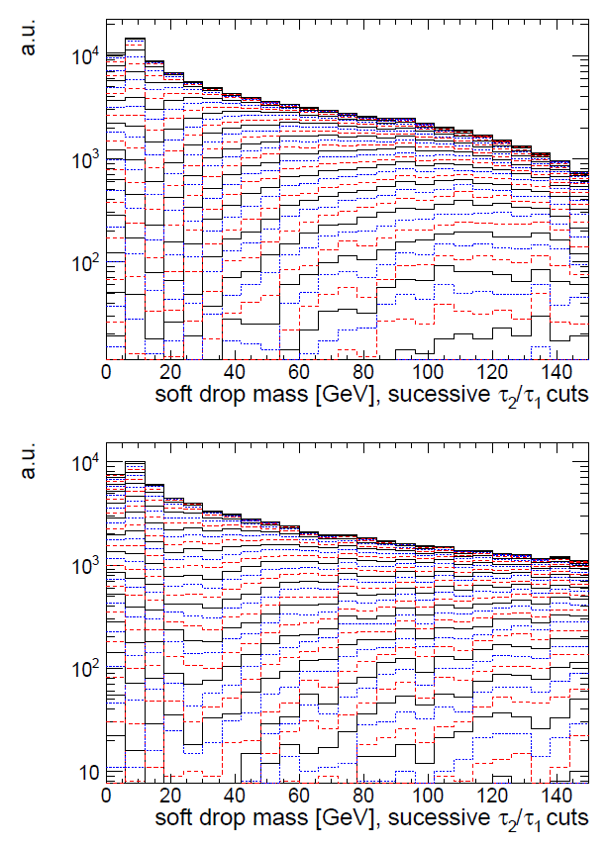
Example: N-Subjettiness in Boosted Decays
A number of observable features of fat energetic jets have been constructed to separate the hadronic 2- and 3-prong decay of heavy objects (W,Z,H,t) from QCD jets.
Useful variable to discriminate two-body decays: τ₂₁=τ₂/τ₁, where taus are functions of the energy distribution within subjets
The problem is that the “soft-drop” mass M that can be constructed with the two subjets is correlated with τ₂₁: a cut on the latter increases S/B but distorts the distribution of M, because of the mutual dependence on jet p_{T}. In statistical parlance we may consider p_{T} a nuisance parameter – it reshapes the variable we want to use for inference.
Dolen et al.[10] use an analytical parametrization of the nuisance to decorrelate its effect in the variable of interest

Slide 56
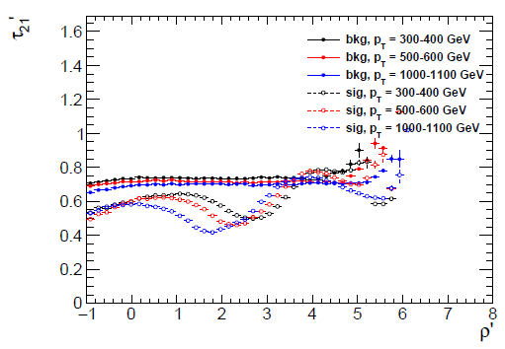
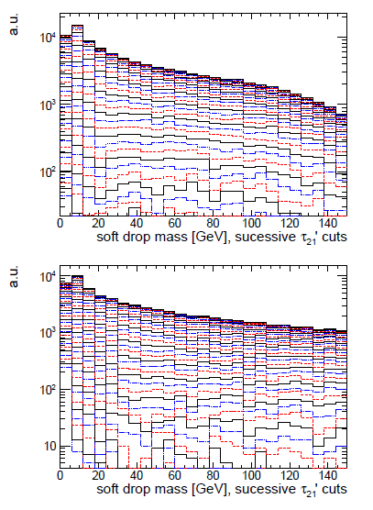
Correcting for the Nuisance
Define ρ = log(m²/p_{T}²), an appropriate scaling variable for QCD jets
Compute average of τ₂₁ as f(ρ): it shows linear behaviour
Define ρ’=ρ + log(p_{T}/GeV); then define τ’₂₁=τ₂/τ₁-Mρ’
Observe that new variable has flat behaviour for QCD
→ τ’₂₁ decorrelates the p_{T} dependence on mass, allowing selection that preserves ability to use sidebands, etc.
Same signal efficiency, better behaviour for decorrelated tagger (right)

Slide 57
What If We Have No Prior ?
The absence of information on a nuisance parameter is more common in HEP. We can still solve the problem by a parametrization of its effect.
Consider a search for a new particle of unknown mass M: usually, M influences in a smooth manner the event features x. If a classifier assumes a value M₁=M+α in training, its performance will degrade if α <> 0. M is thus in earnest a nuisance parameter.
One may train many classifiers using data simulated at different M values, but the solution is sub-optimal (1/N use of available data)
Better solution: include the effect of M in the classifier [15]. The training data may be constructed as a mixture of different M hypotheses if M is included among the features.
→ note: one must decide what to do with the background (for which M is undefined).
→ also note: this is not a Bayesian technique – the chosen admixture is not a prior on M, and it only affects the power of the classifier.
The advantage is that the network may meaningfully classify events for M* values not seen during training. An interpolation of the score for different mass hypotheses is also possible.

Slide 58
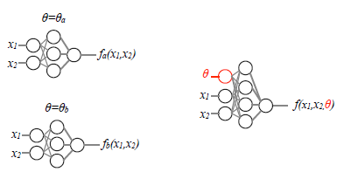
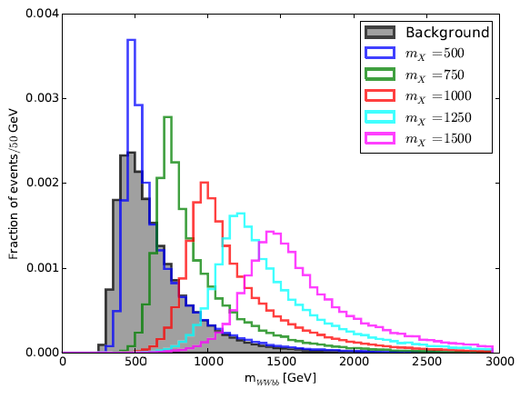
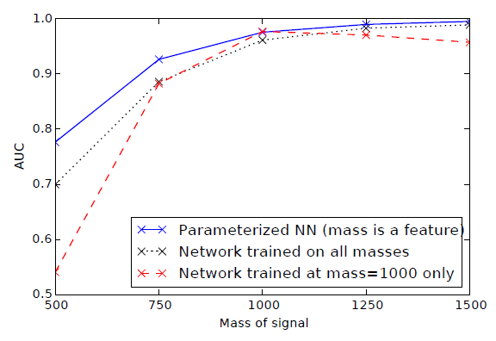
Example: X→tt in ATLAS
The technique proposed by Baldi et al. in[15] was tested with DELPHES[16] simulations, searching for a ttbar resonance within non-resonant ttbar backgrounds.
Random M values were used for the background in the training.
The network provides different scores for same features x, depending on the value of the nuisance M.
The parametrized network was shown to perform as well as individual NN on the mass points at which the latter were trained, but better than a NN trained on a mixture.

Slide 59
2.2 Decorrelation, Penalization, Adversaries
When a direct parametrization of nuisances proves impractical to implement, there are several alternatives. We can broadly lump them into three classes:
Techniques that operate a preprocessing of training data to reduce or remove the dependence of classifier score on the nuisance parameters
Construction of a robust optimization objective for the classification task, by penalizing the loss such that it becomes insensitive to α
Can use adversarial setups to achieve the above result
In what follows we look at a few examples of these methods, to gauge their applicability and merits

Slide 60
Mass decorrelation
Probably the most important use case of the first technique in HEP addresses the issue of keeping the background mass distribution unbiased.
The simplest way to avoid a reshaping of the mass PDF of background events is called planing[18,19]. One may implement it by pre-selecting training samples for S and B such that they have the same PDF on the variable to be planed; this is however sub-optimal.
Better strategy: weight each training event with w(M) as follows:
For signal, w(M_{rec}) = 1/p_{S}(M_{rec}) For background, w(M_{rec}) = 1/p_{B}(M_{rec})
Weights enter the calculation of the loss during training, but are not used in validation or testing.
Planing is more effective than its simplicity would suggest! (some evidence is shown later)
Limitations occur when other event features indirectly inform the classifier on the value of the planed variable, when it carries discriminating power.

Slide 61
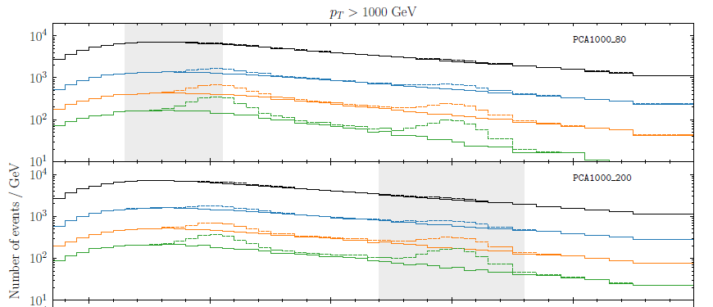
Mass decorrelation in boosting
Another way to preprocess the data before a NN, to decorrelate the classifier output from the jet mass, is to use PCA on the NN inputs[18].
In the considered case the 17 inputs were a basis set of n-subjettiness variables, and the data was binned in jet mass and p_{T}, PCA acting on each bin separately.
The technique was tested on searches for H→AA→bbbb and H→WW →qq’qq’ with several mass hypotheses.
The discriminants are shown to preserve the mass distribution and are effective also outside of the range of masses where they are trained (grey areas)

Slide 62
Modified boosting and penalized methods
Searches for low-mass resonances in Dalitz plots provide a 2D use case: striving for uniform selection efficiency in the plane.
Uboost [22] relies on BDTs to improve signal purity, and a boosting technique to avert biases built on AdaBoost [23], a standard technique for boosting based on increasing weight of misclassified events during the DT generation sequence.
Uboost has the following rule:
where
is the AdaBoost weight (γ=+-1 for signal and background, and p is the prediction of the previous iteration), and u is the inverse of the density of signal in proximity of the tested event, computed with kNN (u=1 for background).

Slide 63
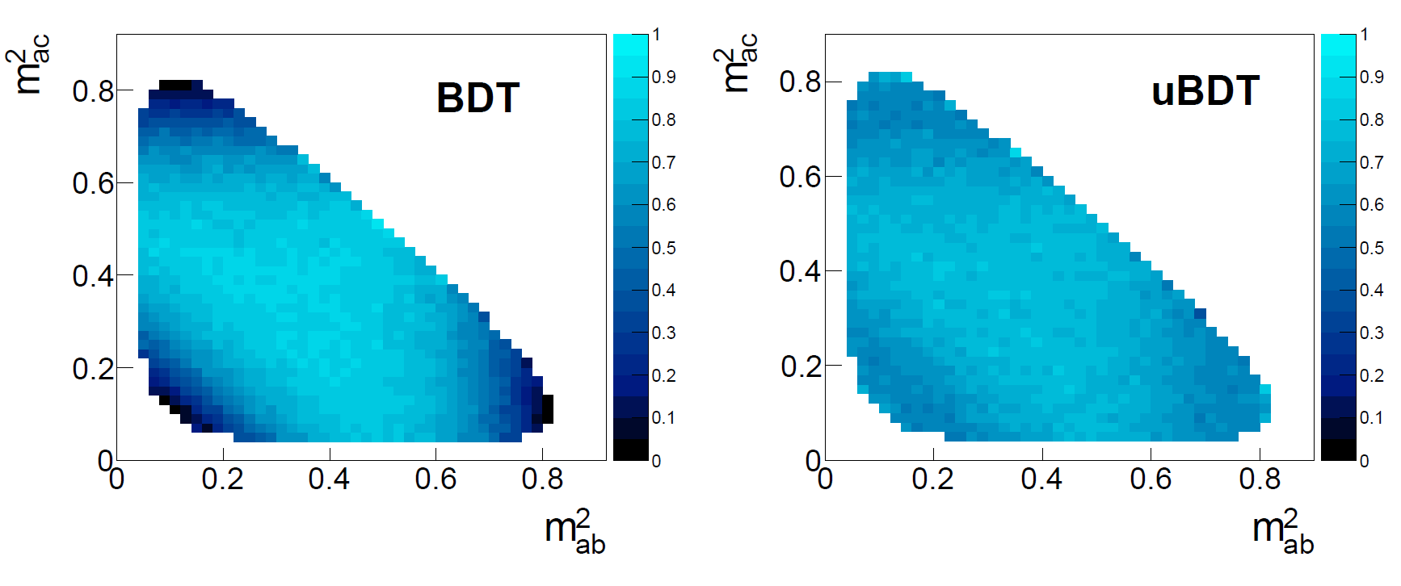
Uboost performance
Uboost was shown to work well in the considered application, despite the considerable CPU cost (due to use of kNN method and consideration of different efficiency values in constructing the BDT score).
E.g., here are the maps for average selection efficiency
of 70% obtained with a regular BDT and with Uboost.
Almost no loss in performance was seen, while achieving the wanted uniformity.

Slide 64
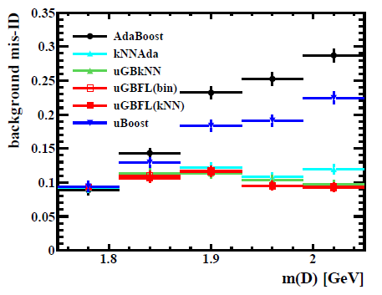
Building on UBoost
The thread started by Uboost was followed by a number of other studies. An alternative also targeting Dalitz analysis is kNNAdaBoost[24], which achieves the uniformity of acceptance in the Dalitz variables by modifying the weights, including information on the classification probability of k nearest neighbors to each event:
The a_{ij} matrix contains information on the density of events of the same class around event i by setting a_{ij}=1/k for them, 0 otherwise.
Rogozhnikov et al.[24] have investigated a number of variants of this concept for an application targeting the D_{s}→π⁺π⁻π⁻ signal, finding good results and better generalization vs training in different regions of the mass of the D candidate

Slide 65
DisCo – Distance Correlation
A few years ago Kasieczka and Shih published [25] a method to decorrelate a nuisance parameter by incorporating a «distance-correlation»-inspired regularization term in the loss of a NN.
One first defines a «distance covariance»
where |.| is the Euclidean norm, and (X,Y), (X’,Y’), (X’’,Y’’) are i.i.d. pairs from the joint PDF. The so-named distance correlation, defined as
is then a [0,1] measure, null only if x,y are fully independent. Crucially, it is differentiable and computable with data samples, so it can be included in the loss function (for label y and mass m) with a penalty regularization factor λ
L = L_{class}(y,y_{true}) + λ dCorr²(m,y)

Slide 66
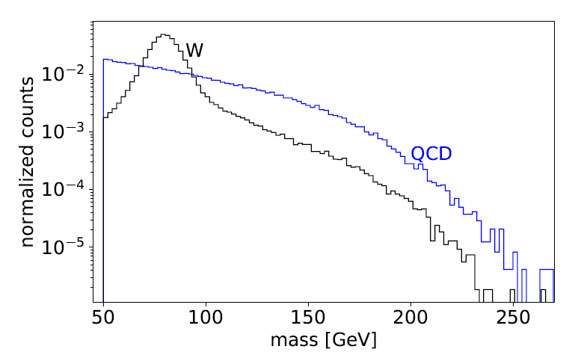
DisCo in action
Kasieczka and Shih test DisCo on W-boson tagging in simulated ATLAS data, reweighted to have a flat p_{T} distribution. They show that a NN discrimination of W-like jet images produces a biased mass distribution for QCD backgrounds, while DisCo preserves the QCD mass shape (bottom left).
Signal and background
before selections

Slide 67
Comparisons
A comparison of the background rejection (x axis) of different W taggers, retrofitted with decorrelation methods (planing, adversarial NN, and DisCo regularization) shows that DisCo performs well.
Surprisingly, also planing seems to do a great job in this particular task.
More studies / more use cases are advisable…
Above: a measure of decorrelation (inverse of Jensen-Shannon
divergence between QCD bgr before and after 50%TPR selection)
as a function of background rejection at 50%TPR.

Slide 68
Another penalization scheme
Wunsch et al.[26] more directly target situations when the nuisance parameter is a systematics source liable to modify the PDF of the observable features of data. They create a differentiable model of the NN-transformed features x by Gaussian smoothing of their histograms:
Above, k is the bin index, and the sum runs on events in a batch; f(x) is the NN output for x. The loss of a classifier may then be complemented with a term describing the difference between smoothed PDF of NN output for x and x+α:

Slide 69
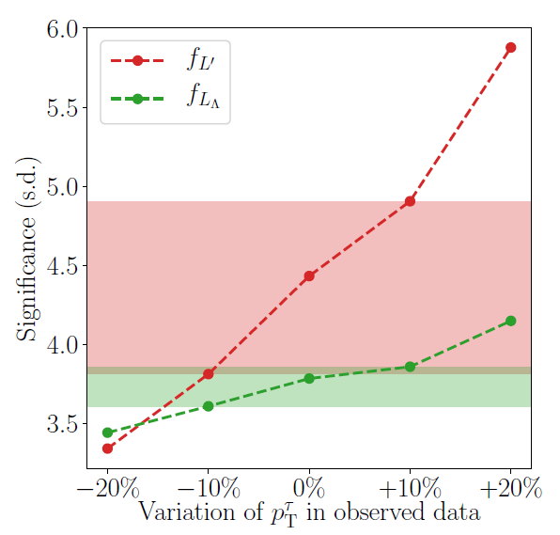
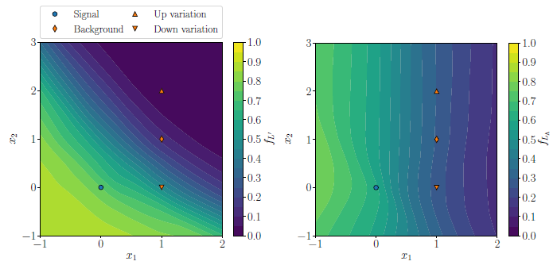
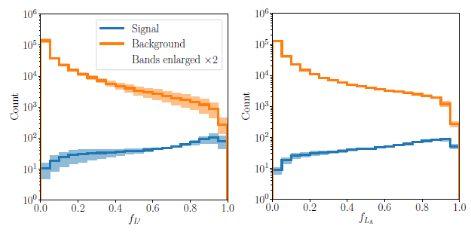
Examples
The method is proven to effectively decouple the classifier output from the systematic source in a synthetic 2D Gaussian example (left). It also works in Higgs Kaggle challenge data, where the systematic is the momentum scale of the tau leptons (right).
For the latter, the penalization reduces the dependence on significance on systematic source, but it does not increase the significance of the observable signal (top), so the advantage of the technique should still be proven in other situations.

Slide 70
Adversarial Techniques
Adversarial setups attacking the decorrelation problem should be considered an extension of the penalized loss methods seen above.
The loss is still the combination of two parts – a BCE term and a penalization contributed by the adversary, modulated by a hyperparameter.
Adversarial architectures were investigated in computer science to achieve domain adaptation of discriminative classifiers[28][29] much before they were adopted in HEP.
General issue: training and test data are not drawn from same PDF
This may arise when they come from different domains, or if the simulation (used for training) is imperfect model of (real) test data.
Solutions usually involve finding a data representation that is maximally insensitive to their source
→ task an ANN to learn such representation, while competing with the one that tries to separate labelled classes of training data[30]

Slide 71
Learning to pivot
The first use of ANNs to achieve robustness to systematics in HEP comes from the work of Cranmer, Kagan and Louppe[31] who sought pivotal [32] classification scores f(x;θ_{f}): ones independent on nuisance α (θ_{f} are the classifier parameters).
The adversary, with parameters θ_{r}, tries to guess α from f(x;θ_{f}), and the loss is defined globally as
The minimax solution of this problem is reached for
A convergence of the above constrained problem cannot be guaranteed in general; a hyperparameter λ can be used to tune the adversary term.

Slide 72
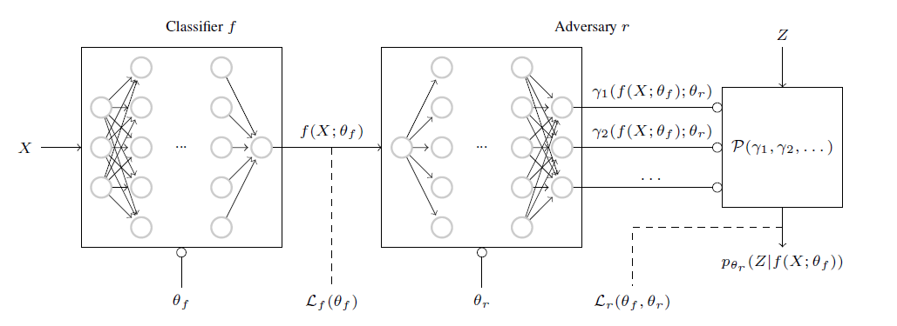
Pivoting ANN architecture
The architecture is a series of two discriminative classifiers: the adversary tries to model p(z|f(x)), and the global loss forces this toward the unconditional prior p(z). When this happens, f is independent on z.

Slide 73
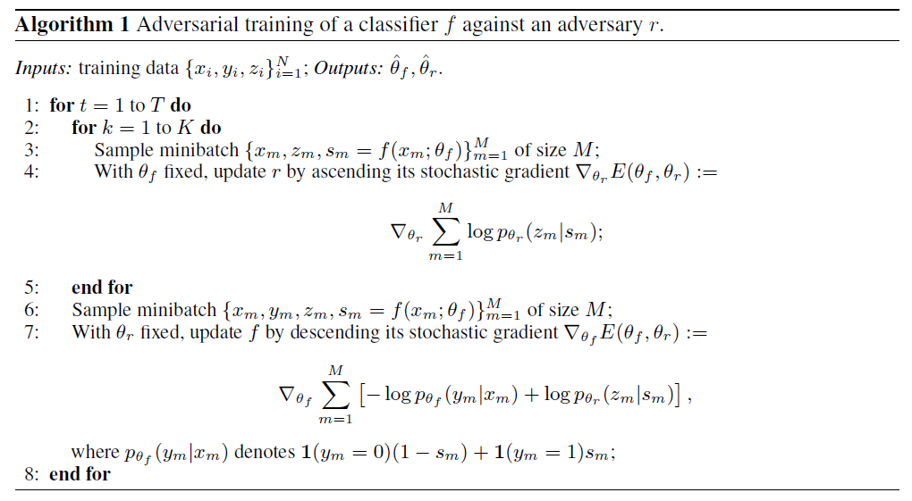
The Learning To Pivot Algorithm

Slide 74
Experiments with the pivot
The graphs below describe the same synthetic example we saw earlier from Wunsch et al. (publication order is inverted).
Left: a standard NN produces f(x) depending on nuisance Z (the vertical location of the signal 2D Gaussian PDF)
Right: the pivoting setup makes f(x) independent on Z.

Slide 75
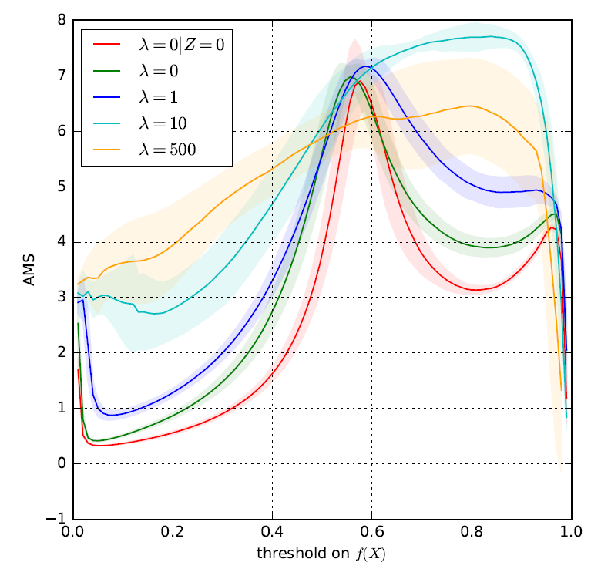
HEP example
The technique is demonstrated on boosted W tagging in ATLAS, with pile-up being the nuisance (Z=0 no pileup, Z=1 PU-50 conditions).
As in this case finding a f that is pivotal while minimizing the loss Lf is probably not possible, one must optimize a suitable objective (AMS) WRT the hyperparameter.
For a suitable choice of λ (10) the AMS reaches a higher maximum

Slide 76
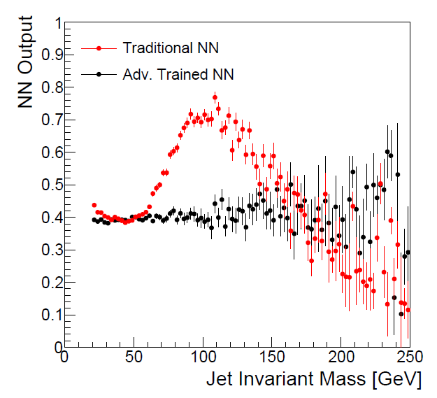
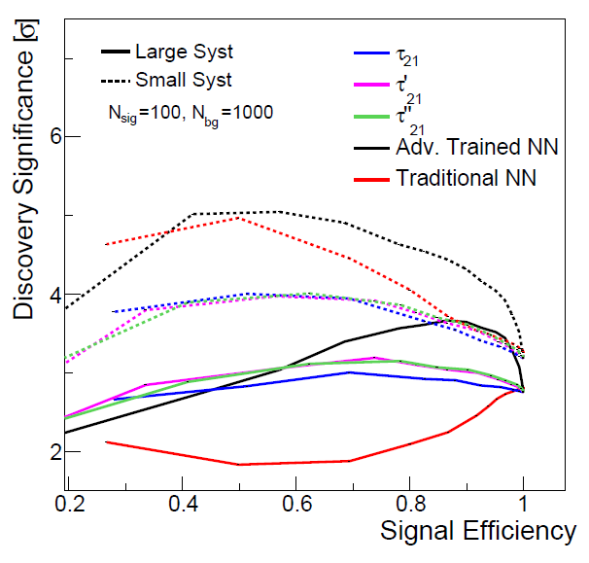
Further developments / 1
The adversarial setup seen above was tested and compared with other decorrelation techniques [33], again in boosted jet tagging
The dependence on jet mass is effectively absorbed by the pivotal properties of the ANN (top).
Authors further consider the full effect of the reduced mass dependence on background shape deformations, extracting significance (bottom) for a NN, the ANN, and subjettiness selection with and without the analytical decorrelation already discussed before, for different levels of systematic uncertainties on the QCD background shape.

Slide 77
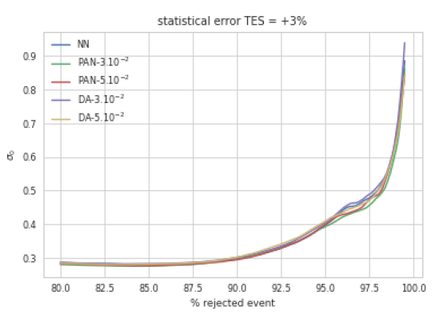
Further developments / 2
Estrade et al.[34] compared the pivot ANN technique of Louppe et al. to a data augmentation technique and to a tangent propagation method, using the H→ττ kaggle challenge data with a systematic uncertainty added on the tau jet energy scale, similarly to [28].
The systematic is sampled from a Gaussian (1%,3%,5% nuisance) in training data, but is fixed in test data.
Data augmentation: the training data is mixed at different values of the nuisance – rationale is that with sufficient data the NN should be able to learn the manifold
Tangent propagation: consider the systematic as a coherent geometrical transformation, f(x,α), differentiable, and the model is regularized by partial derivative of NN score WRT nuisance parameter.
Results are not conclusive, only seem to favor ANN over plain NN

Slide 78
Further developments /3
Blance, Spannowsky, and Waite[36] use ANN as a preliminary step to use of autoencoders for unsupervised classification, to reduce impact of systematics in the task. Their goal is to search for NP without being dependent on MC mismodeling. They smear MC reconstructed objects and use ANN to desensitize AE response to smearing; use case X→tt resonances. Show that ANN+AE provide reasonable solution
Englert et al[37] consider theoretical uncertainties, which affect the data in a more coherent way than other nuisances do. Large theoretical scales uncertainties affecting H+jet production at high p_{T} are considered. Sensitivity to the process can be retained by training an ANN to make robust classification WRT the scale.

Slide 79
2.4 Semi-Supervised Approaches
Weakly-supervised and semi-supervised learning techniques have been proposed to close the gap between learning from simulated and real data:
Simulated data are fully labeled, but they are often an imperfect model
Real data are unlabelled or only partly labelled
The approaches strive to learn useful models from partial, non-standard, or noisy label information. They are thus potentially useful for reduction of the impact of certain systematic uncertainties in HEP problems.
The challenge is that these methods typically rely on assumptions (known fractions, independence of PDF of features) that are hardly met in practice. We see a few examples in what follows.

Slide 80
LLP (Learning from Label Proportions)
LLP is a weak-supervision approach that may allow the training on real data (Dery et al.[38]). While in a full supervision setup one tries to find a score fulfilling
(l is a loss, e.g. mean squared error, and t is the target label), in LLP one only exploits knowledge of the fraction of each label in training data:
The problem is thus very ill-constrained, but a minimization of the loss can still be performed with batches of data of different proportions, as long as the PDFs of the features do not change in the batches.

Slide 81
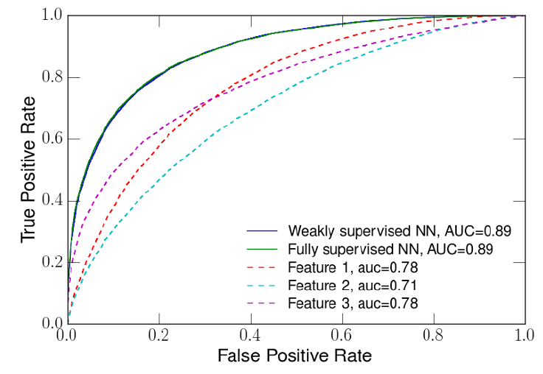
LLP Proof of Concept
Using a 3-layer NN and synthetic data with class proportions between 0.2 and 0.4, with three features, allows LLP to perform equally as well as a fully supervised method.
The range of performances, due to randomness of the inputs, decreases when training data has wider range of class proportions (Δy on x axis, bottom)

Slide 82
Test of LLP on Q/G Discrimination
Authors of [38] argue that quark/gluon jet separation lends well to this method, as a priori fractions in different physical processes are well estimated a priori from QCD+PDF theory.
12 different samples are obtained by binning in dijet pseudorapidity difference (quark fractions vary from 0.21 to 0.32).
Distortion of real data is mimicked by modeling previous studies; then a comparison with a full supervised classifier shows 10% advantages (lower G efficiency for given Q efficiency)

Slide 83
CWoLa – Classification Without Labels
One limitation of LLP is the need to precisely know the class labels of training subsets. A technique by Metodiev et al.[39], CWoLa, overcomes this by using as labels the identifiers of the different mixed samples.
CWoLa is based on the fact that the optimal binary classifier is a function of the density ratio between the components, so the discrimination of the two mixed samples works also for pure classes:

Slide 84
CWoLa at work
Tested on the same problem of Q/G discrimination, and with a NN as classifier, the CWoLa concept was shown to performs as well as a NN working on pure classes if trained on classes with 80%-20% class proportion split.
Of course the algorithm still
requires labelled data for tests of performance and choice of operating point, but the proof of principle is
encouraging.

Slide 85
CWoLa applications to LHC data
Two recent applications of CWoLa:
CMS used it in a recent ttbb measurement[56]
ATLAS used in a search for resonances A→BC in dijets [57], where the plane of two fat-jet masses is scanned by weak supervised NN learning where training data are extracted from sidebands in M_{jj} in 8 bins (right, figure from F. de Almeida Dias talk at Anomaly detection mini-workshop[58])

Slide 86
INFERNO Details
Given a sample of data D, the output of the NN (of parameters φ) is a set f_{i}(x|φ), with which we may construct a non-parametric binned likelihood by simply counting how often the data have maximum output on the ith node:
and using the summary t to write $L\left(D | φ\right)=\prod{Pois\left[t\left(D | φ\right)|{t(G}_{MC};φ)\right] }$
where G_{MC} is the generated simulation used for calibration.
The argmax is non-differentiable, so we can approximate the summary with the softmax operator:
where τ is a temperature HP.
Instead of real data, if we use simulated data we may construct an Asimov likelihood, whose maximization will provide the true parameter as MLE:
(n/l factors account
for different fractions
of S and B simulation data)

Slide 87
INFERNO Details / 2
The Asimov likelihood we have written,
is maximized by the value of simulation parameters θ_{ΜC} used to generate the data G_{MC}.
We may then take the second derivative, expanded in θ around θ_{MC}, of the Asimov likelihood and interpret it as the Fisher information matrix,
whose inverse, by the Cramer-Rao lower bound, is a lower limit on the covariance: we may use it as an estimator of the variances of our parameters of interest in the loss function, e.g.

Slide 88
3.2 Recent developments
Two recent works have built on the idea of INFERNO for HEP applications.
Wunsch et al.[52] use a single-output NN to construct a Poisson-count likelihood instead of a softmax, and make the histogram differentiable by smoothing it with a Gaussian kernel.
Heinrich and Simpson[53] use “fixed-point differentiation” to compute gradients of a profile likelihood, aiming at directly minimize the expected upper limits on sought processes with CLs. Also in their work (NEOS) the modelling of the nuisances is restricted to histogram interpolation.
In addition there have been
a proposal to use the AMS in a single bin counting experiment including a single systematic in the loss function[54]
A variation of BDT training (QBDT) targets directly signal significance with an approximate model of nuisances[55].
The field is in rapid evolution and new ideas are possible. The bottomline is that if one can realign the MVA target to be the final desired goal, results will be close to optimal, in the sense of maximizing the use of the available information.

Slide 89
Looking into the Matter
In several cases of HEP interest, the data contain information on the nuisance parameter, and one may then try to exploit it to construct robust estimators.
Consider the problem of extracting a sufficient summary statistic for the signal fraction θ with a binary classifier, in presence of a nuisance α that modifies the P_{s}(x,α) and P_{b}(x,α) PDFs. The likelihood
may be rewritten as
Observe that the first term is not a constant: its omission would throw information away (bgr events carry constraining power on the nuisance).
→this shows that the task of learning the density ratio p_{s}/p_{b} usually performed by binary classifiers is no longer sufficient.

Slide 90
Neal’s Solution
In [12] Neal proposes to construct summaries for both the nuisances and the observed features, using e.g. a neural network. One trains the NN to discriminate S from B given values from the nuisances α, taken from their prior. If the NN is constructed to reduce the dimensionality of the inputs, the probability of signal and background as seen by the classifier can then be written
P(S|x,α) = F_{S}(f₁(α),f₂(x))
P(B|x,α) = F_{B}(f₁(α),f₂(x))
where S₁ = f₁(α), S₂ = f₂(x) are the two summarized forms of nuisances and event features.
If the above can be parametrized, and the mappings f₁, f₂ do not lose too much information in the compression, one may obtain approximate sufficiency. What is needed is a regression model r(x) that approximates the nuisances α given data x. One may then obtain P(S,B) = F_{S,B}(f₁(r(x)), f₂(x)) if the models are good enough, and use it for classification.
This scheme is untested AFAIK, but has become the basis of a wide range of studies of likelihood-free inference methods. We discuss them later.

Slide 91
Calibrated Discriminative Classifiers
Cranmer et al.[17] have produced a general proof of the viability of parametrized classification, by studying approximations of the likelihood ratio.
They showed how the likelihood ratio of two PDFs can be kept invariant under dimensionality reductions, if the transformation is itself monotonic with the LR. I.e.,
$$LR\left(x,θ_{0},θ_{1}\right)=\prod_{x}{\frac{p_{X}(x|θ_{0})}{p_{X}(x|θ_{1})}}=\prod_{x}{\frac{p_{U}(u=s(x)|θ_{0})}{p_{U}(u=s(x)|θ_{1})}}$$
provided that U=s(X) is based on a parametrized function s which is monotonic with the ratio p_{X}(x|θ₀)/p_{X}(x|θ₁).
Since the Neyman-Pearson lemma proves that the LR is the most powerful test statistic for simple hypotheses, one tries to construct classifiers that approximate it, and the above equivalence proves quite effective as one may construct s(x) as a discriminative classifier (NNs will work better as they provide smoother variation of s(x) as x varies).
The map s is one-dimensional, so evaluating p(s(x)|θ) is a much simpler task than evaluating p(x|θ). Histograms or KDE algorithms can be used. A calibration is necessary to approximate the probability ratio given the estimate of s(x); examples show this can be done and the technique is effective.

Slide 92
3. Inference-aware approaches
What we have seen so far are ways to cope with the imperfect knowledge of the generative model of our data, which affects the power of our simulation-based classification tasks.
There are now solutions that try to move away from the proxy classification task, and address directly the optimization of simulation-based statistical inference.
→ This realigns task and objective
The area of research[42] is often called «Likelihood-free inference», although many (me included) prefer the term «simulation-based inference».
Here we discuss how some of these inference-aware approaches may be used to tame nuisance parameters in HEP.

Slide 93
Estimates of the likelihood ratio
As discussed earlier, a reparametrization and approximation of the likelihood ratio for all possible pairs of relevant parameters θ₀,θ₁ of a generative model p(x|θ) may allow[17] to efficiently solve the problem of inference in the presence of nuisances.
The method may be too CPU intensive to be practical in hig-dim cases, as large datasets are required to approximate the LR.
A number of techniques were published by Brehmer et al.[44-46] to evaluate the LR in a data-effective manner, using information from the simulator to augment the training data.
These techniques may collectively be addressed as «learning efficiently from the simulator».
A meaningful discussion of the wealth of ideas deployed for this is beyond the scope of this talk.

Slide 94
Inference-aware summary statistics
A complementary family of techniques to “likelihood-free inference methods” tries to construct summaries that are better aligned with inference goal, once nuisance parameters are accounted for.
Typical procedure in HEP:
“optimize” a classifier f(x) to best distinguish S(θ) from B (e.g., θ=σ, cross section of signal process), e.g. focusing on maximizing AUC or other figures of merit connected to observability of S (pseudo-significances)
2a. Choose operating point (e.g. cut on f), maybe accounting for variability of S and B PDFs, and perform a counting experiment on data above f cut;
2b. Parametrize shape and fit for signal fraction, accounting for nuisances as shape variations
→ In both cases, the optimization target (discrimination of S/B in absence of nuisances) is different from the true objective of the analysis (minimize uncertainty on parameter of interest)
For a realignment, we must inform the classifier of the effect of nuisances on the final measurement goal

Slide 95
INFERNO Pseudo-Code

