Slide 1
Perspectives on Matrix Computation
Robust and Practical Solution of Laplacian Equations by Approximate Elimination
Rasmus Kyng | ETH Zurich
 | March 7th, 2023
Joint work with Yuan Gao (MPI Informatics)
and Daniel Spielman (Yale)

Slide 2
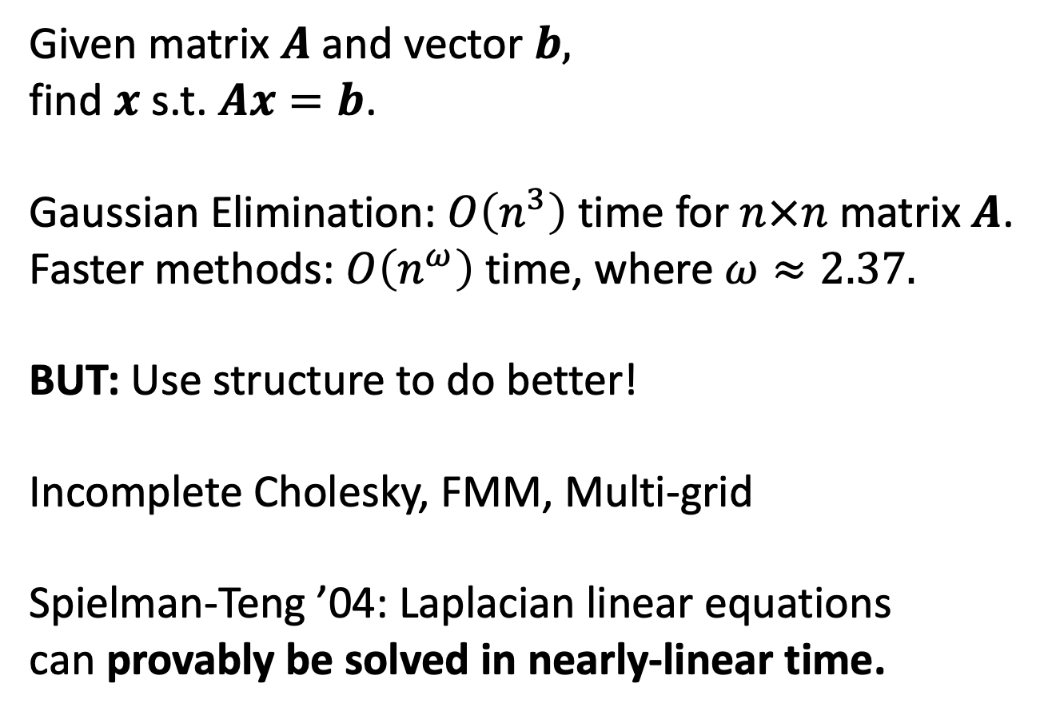
Linear Equation Solvers
Given matrix $A$ and vector $b,$
find $x$ s.t. $Ax=b$.
Gaussian Elimination: $O\left(n^{3}\right)$ time for $n×n$ matrix $A$.
Faster methods: $O\left(n^{ω}\right)$ time, where $ω≈2.37.$
BUT: Use structure to do better!
Incomplete Cholesky, FMM, Multi-grid
Spielman-Teng ’04: Laplacian linear equations
can provably be solved in nearly-linear time.
Notes:
Say?
asymptotically fastest

Slide 3
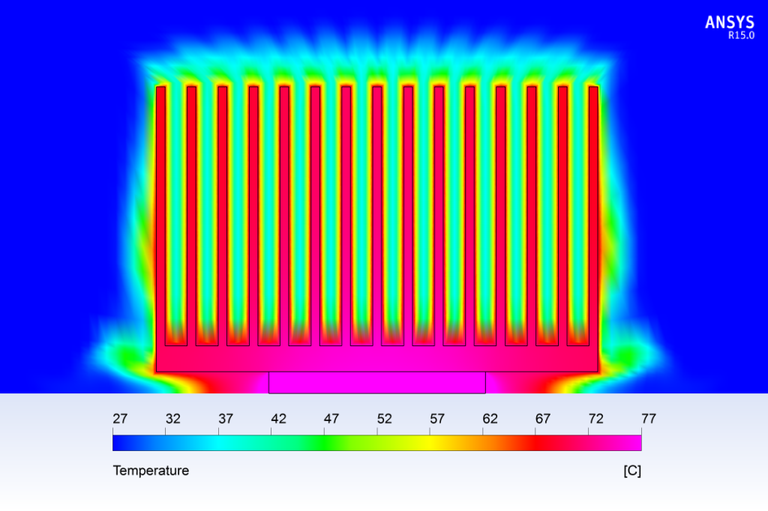
Linear Equation Solvers
Heat Diffusion
Notes:
https://www.computationalfluiddynamics.com.au/conjugate-heat-transfer/
Heat Exchanger
(Company: Leap Australia)

Slide 4
Linear Equation Solvers
Heat Diffusion
In practice:
Solve in time nearly linear in
# non-zeros of matrix
(Incomplete Cholesky Factorization, Multi-grid methods)
Laplacian Matrix
Notes:
https://www.computationalfluiddynamics.com.au/conjugate-heat-transfer/
Heat Exchanger
(Company: Leap Australia)

Slide 5
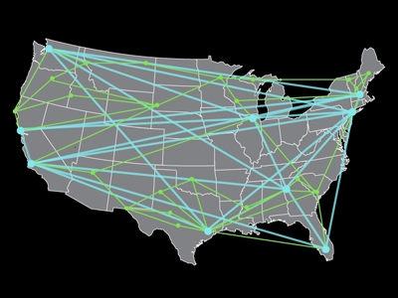
Laplacians in TCS Applications
Solving convex programs via IPMs and other methods

Slide 6
Laplacian Solvers in TCS
Many papers improving the Laplacian Solver:
[KMP10,KMP11,KOSZ13, LS13,CKM+14,PS14,KLPSS16,KS16,JS21]
Simpler, faster, parallelizable
Practical?

Slide 7
A New Algorithm and Implementation
Robust and Practical Solution of Laplacian Equations
by Approximate Elimination
manuscript w. Gao & Spielman
Paper arxiv.org/abs/2303.00709
Code “ApproxChol” github.com/danspielman/Laplacians.jl/
Benchmark rjkyng.github.io/SDDM2023/
A variant of the approximate Gaussian elimination
from Kyng-Sachdeva FOCS’16
Key new idea: Maintain connectivity when sampling

Slide 8
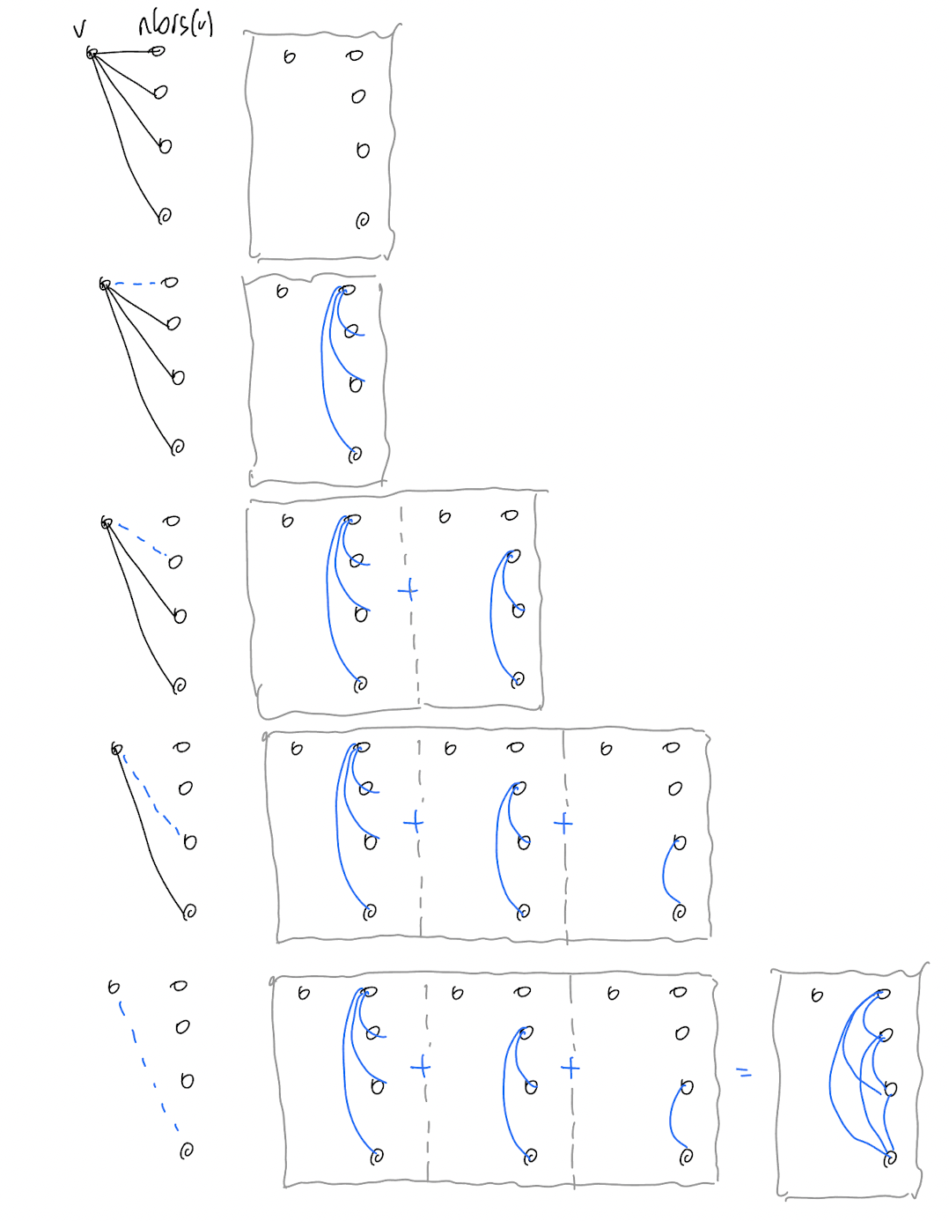
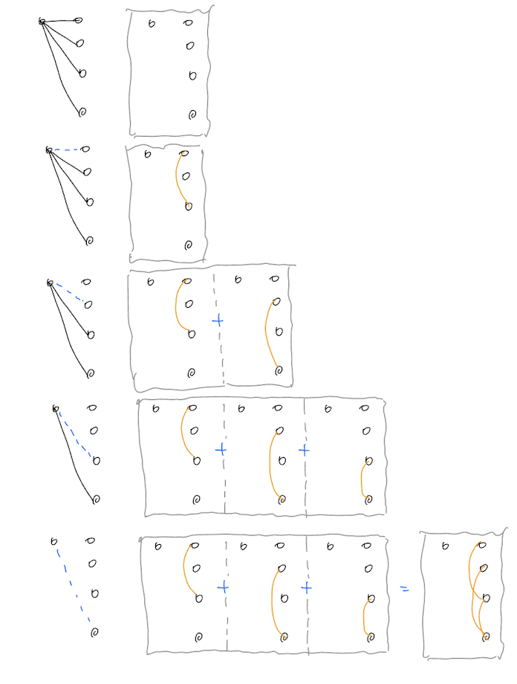
Approximate Elimination – with a tree

Slide 9
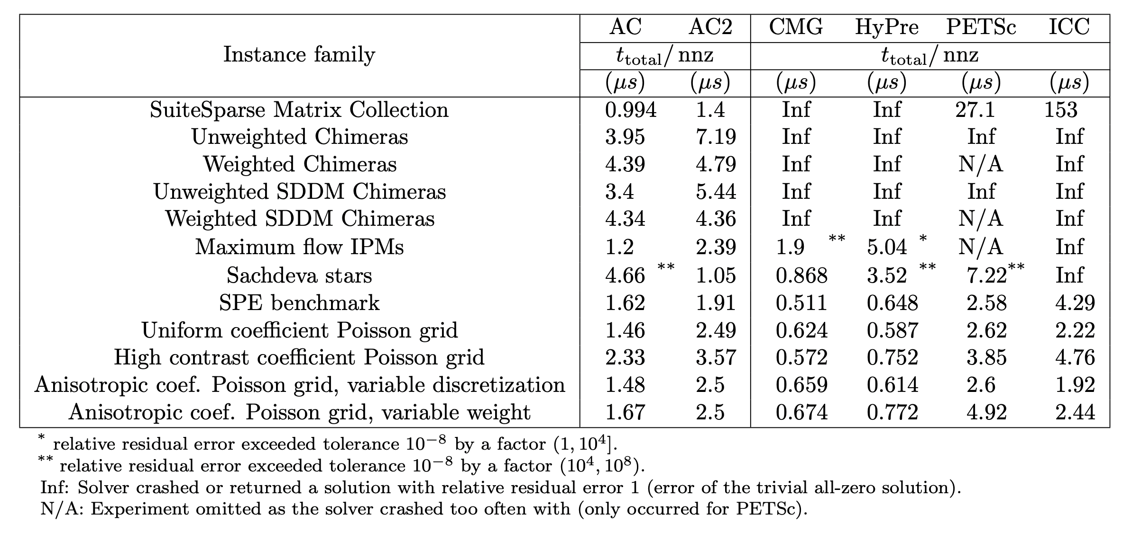
ApproxChol Experiments

Slide 10
ApproxChol Experiments
All SDDM matrices
on SuiteSparse
w/ at least 1000 nnz.
28 matrices
aside: also works as well on the smaller ones

Slide 11
ApproxChol Experiments
Programmatically generated instances
up to 250 mil. nnz

Slide 12
ApproxChol Experiments
Solve max-flow LP using IPM
on ‘most challenging’ Chimeras
NB: the IPM is inefficient

Slide 13
ApproxChol Experiments
Graph designed by S. Sachdeva
to break our algo

Slide 14
ApproxChol Experiments
3D diffusion problems from
The 10th Society of Petroleum Engineers Comparative Solution Project:
A Comparison of Upscaling Techniques
M. A. Christie and M. J. Blunt, 2001
SPE Reservoir Simulation Symposium

Slide 15
ApproxChol Experiments
Suite of Poisson problems from
Parallel geometric-algebraic multigrid on unstructured forests of octrees
H. Sundar, G. Biros, C. Burstedde, J. Rudi, O. Ghattas, and G. Stadler.
SC ’12: Proceedings of the International Conference on High Performance Computing

Slide 16
ApproxChol Experiments
Experiments were run with single-threaded versions of each solver
24 Core Intel Xeon Gold 6240R 2.4GHz Processor
with 512 GB memory
AC & AC2: Our solver with 1 or 2 samples per original entry
CMG: Combinatorial Multigrid by Koutis
HyPre: HyPre Krylov-space solver with BoomerAMG precond
PETSc: PETSc Krylov-space solver with BoomerAMG precond
ICC: MATLAB PCG with Incomplete Cholesky precond
LAMG: Lean Algebraic Multigrid (omitted, failed on all instance families)

Slide 17
ApproxChol Experiments
Worst case total solve time per non-zero
One of these columns is not like the others?

Slide 18
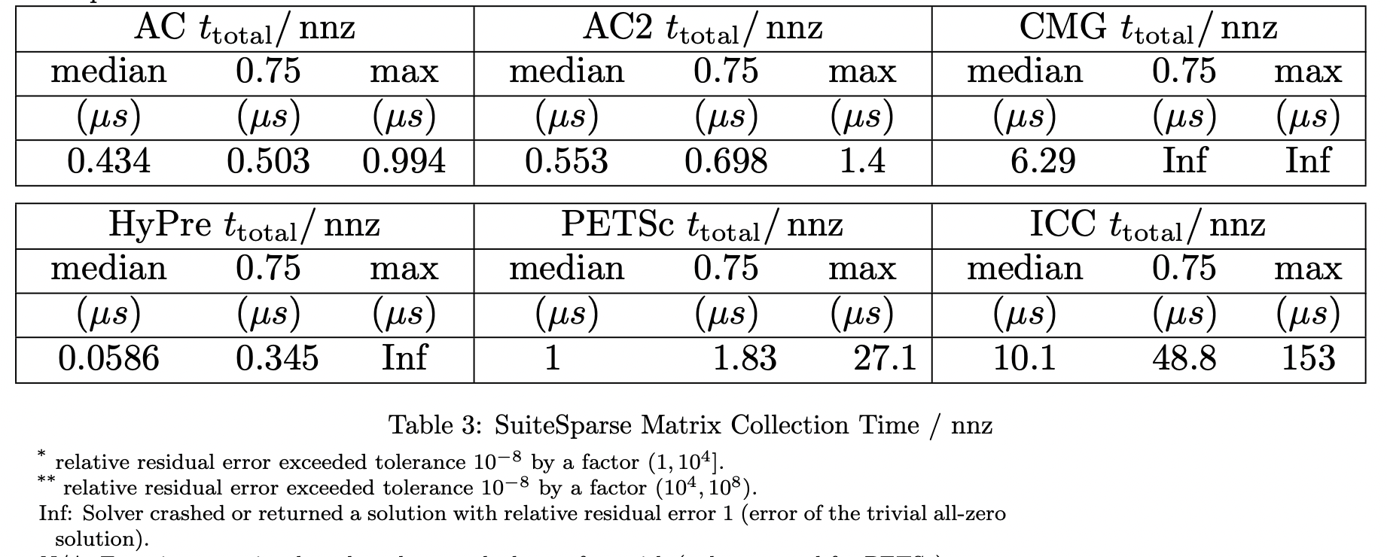
ApproxChol Experiments
SuiteSparse total solve time per non-zero

Slide 19
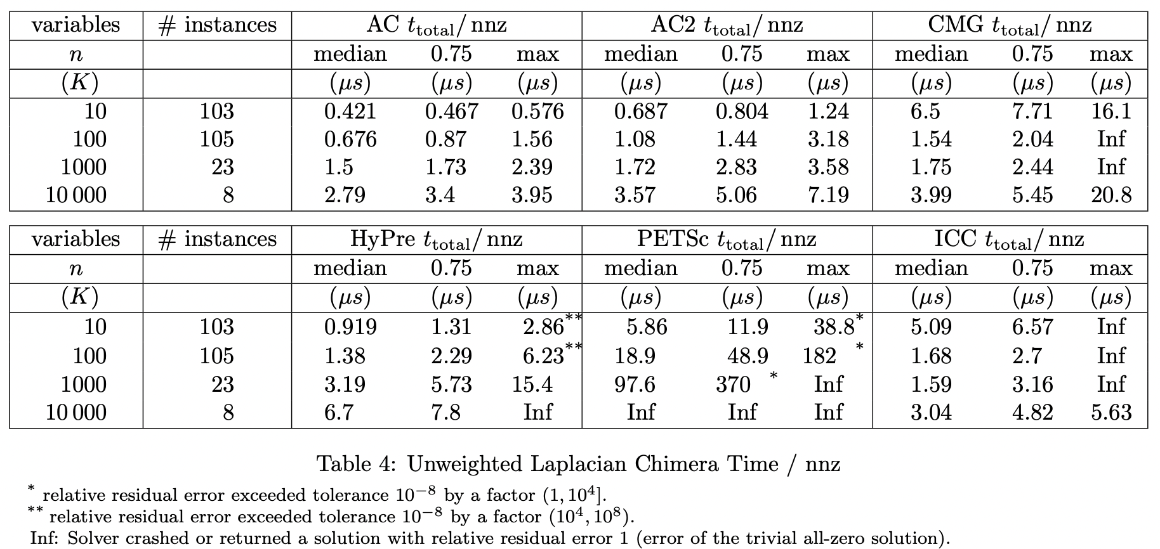
ApproxChol Experiments
Unweighted Laplacian Chimera total solve time per non-zero

Slide 20
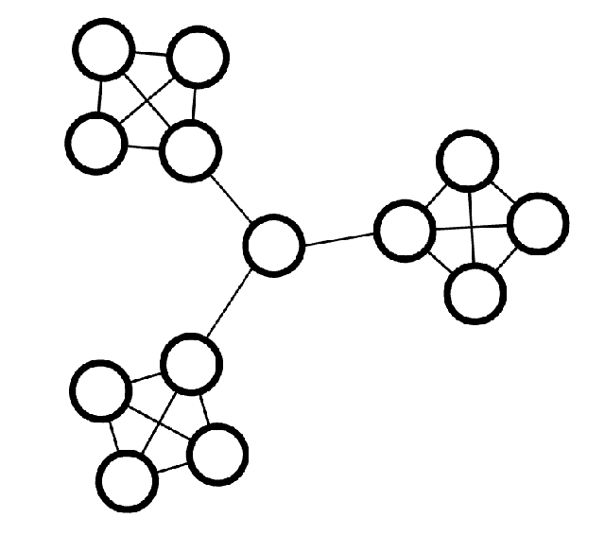
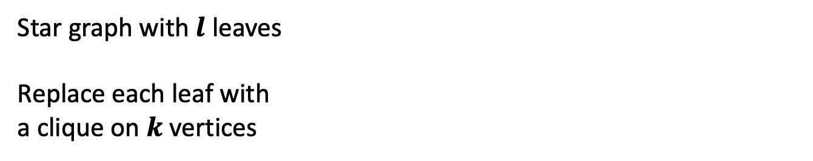
ApproxChol Experiments
Sachdeva star
Star graph with $l$ leaves
Replace each leaf with
a clique on $k$ vertices

Slide 21
ApproxChol Experiments
Sachdeva star, $l=k/2$

Slide 22
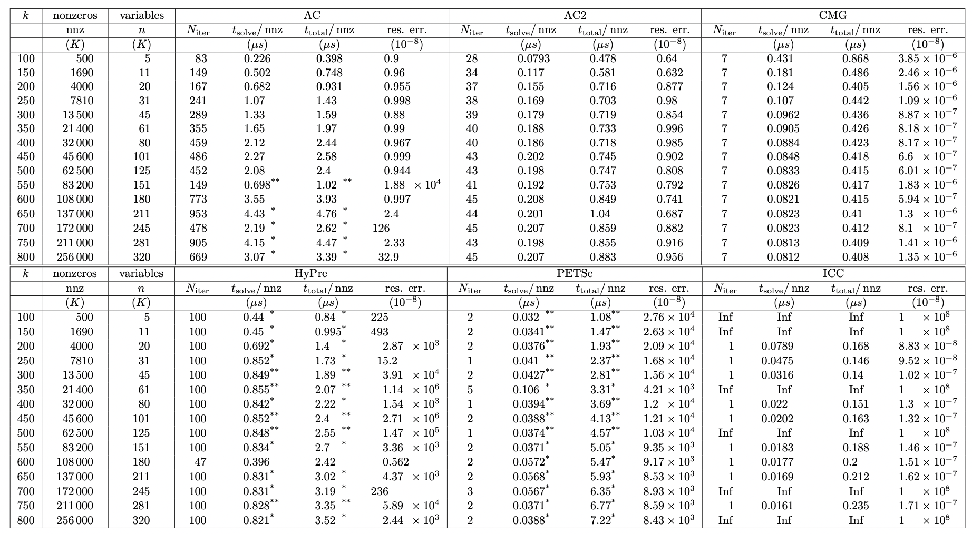
ApproxChol Experiments
Sachdeva star, $l=k/2$

Slide 23
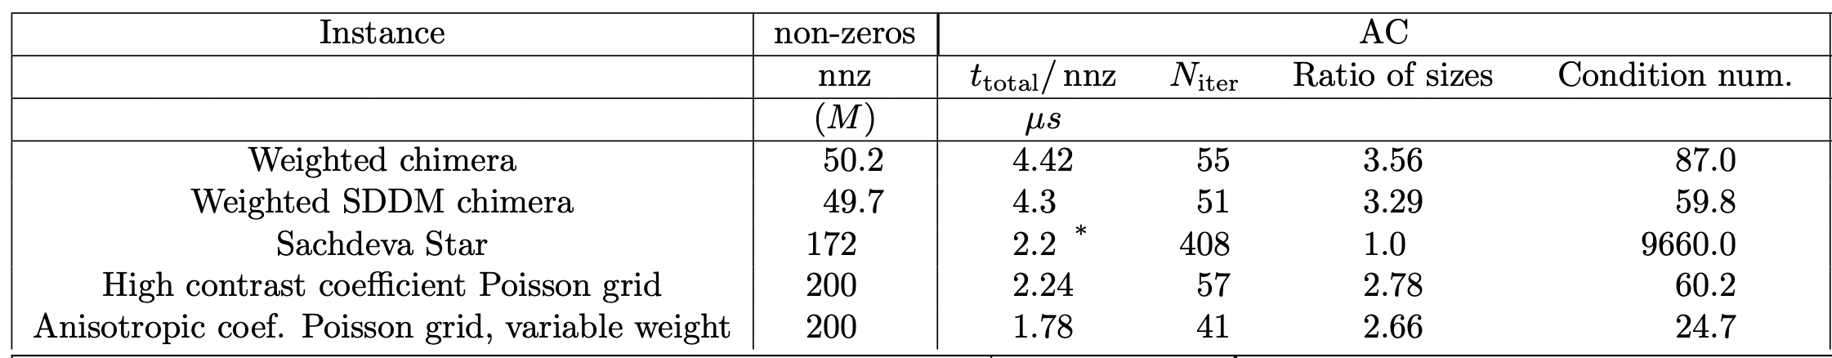
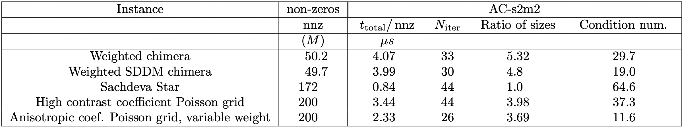
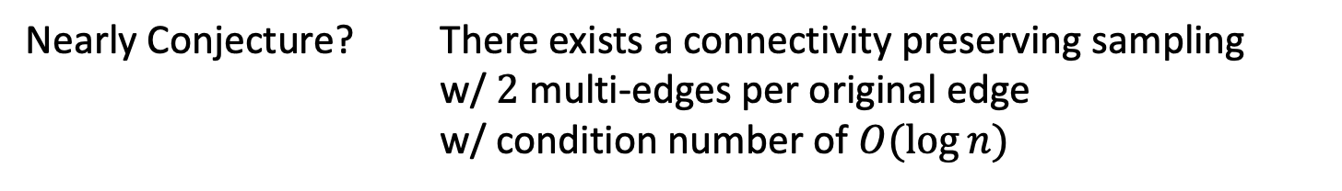
What’s going on?
Almost Conjecture? AC2 achieves a condition number of $O(\log{n)}$
Nearly Conjecture? There exists a connectivity preserving sampling
w/ $2$ multi-edges per original edge
w/ condition number of $O(\log{n)}$

Slide 24
Practical for what?
Physics/Engineering?
Scalar Elliptic PDEs?
Only 3D Meshes?
High accuracy?
Operations Research/Optimization/Logistics?
Interior Point Methods?
What graphs?
High accuracy?
Machine Learning / Data Science
Regressions?
What graphs?
Low accuracy?

Slide 25
Conclusions and Open Questions
A reliable and efficient solver for all SDDM matrices?
What can we build on top?
What should we extend it to?
Parallel & connectivity-preserving?

Slide 26
Thanks!
Robust and Practical Solution of Laplacian Equations
by Approximate Elimination
manuscript w. Gao & Spielman
Paper arxiv.org/abs/2303.00709
Code “ApproxChol” github.com/danspielman/Laplacians.jl/
Benchmark rjkyng.github.io/SDDM2023/
A variant of the approximate Gaussian elimination
from Kyng-Sachdeva FOCS’16
Key new idea: Maintain connectivity when sampling

