Slide 1




Antigenic evolution of SARS-CoV-2 in immunocompromised hosts
Ben Ashby
Dept. Mathematics, SFU

Slide 2


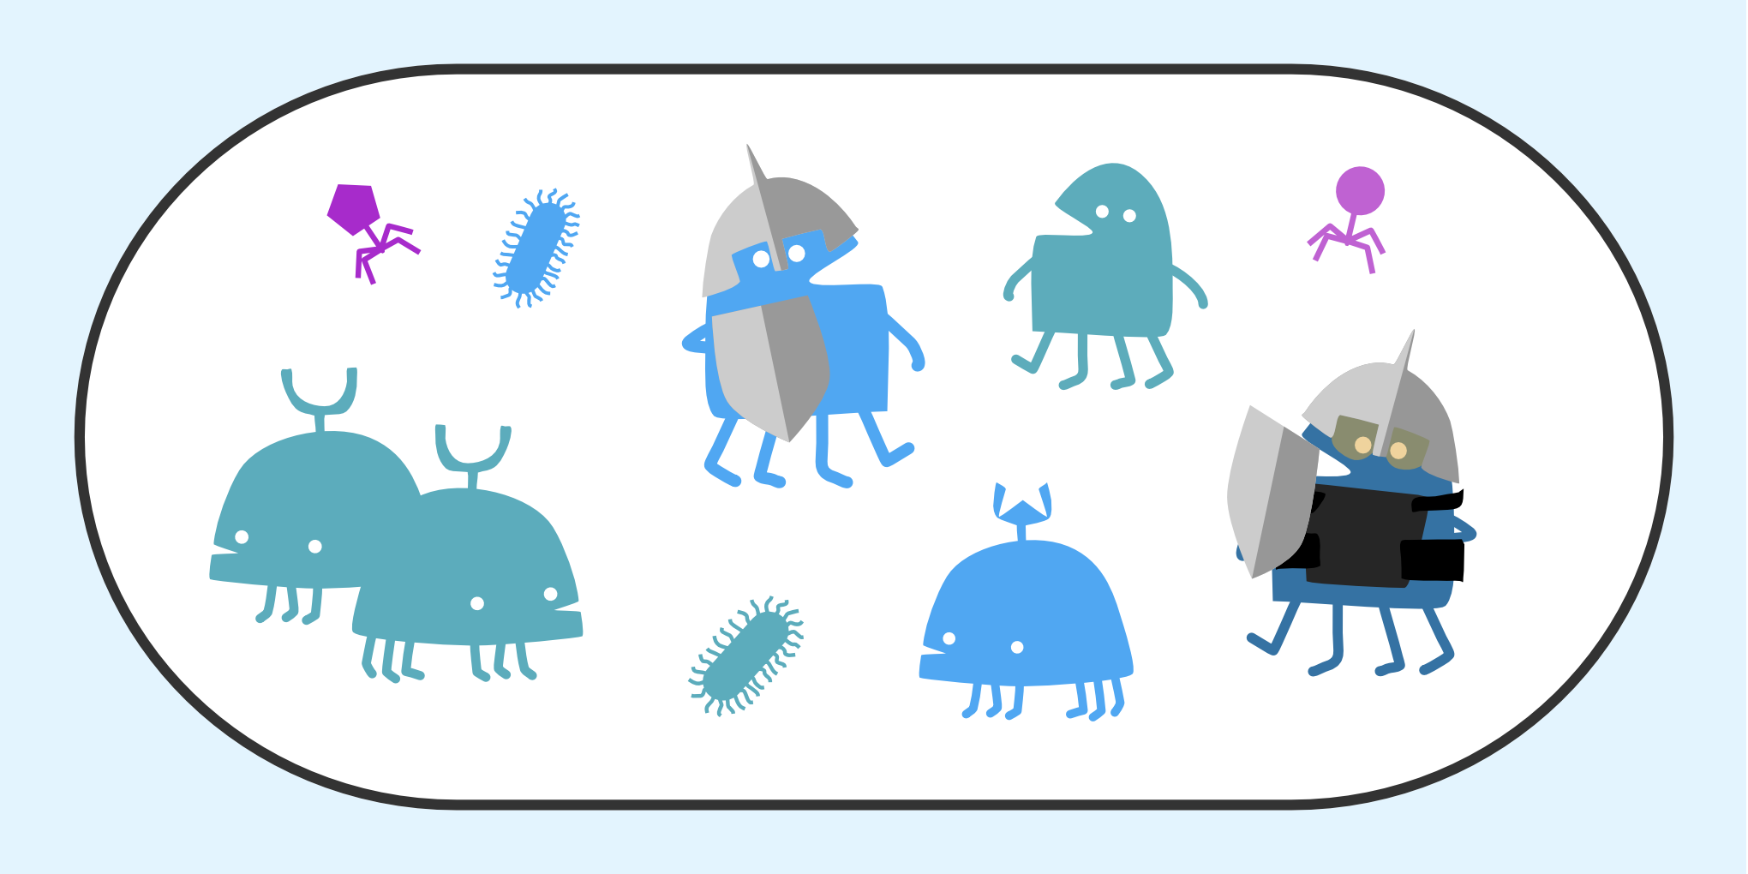




How do environmental and genetic factors affect host-parasite coevolution?
How do parasites influence the evolution of host reproductive strategies?
How do hosts and parasites (co)evolve in complex communities?
How do species evolve to occupy distinct niches?
How does ageing affect immunity, and vice versa?
How can we manage disease spread and evolution in pandemics?

Slide 3
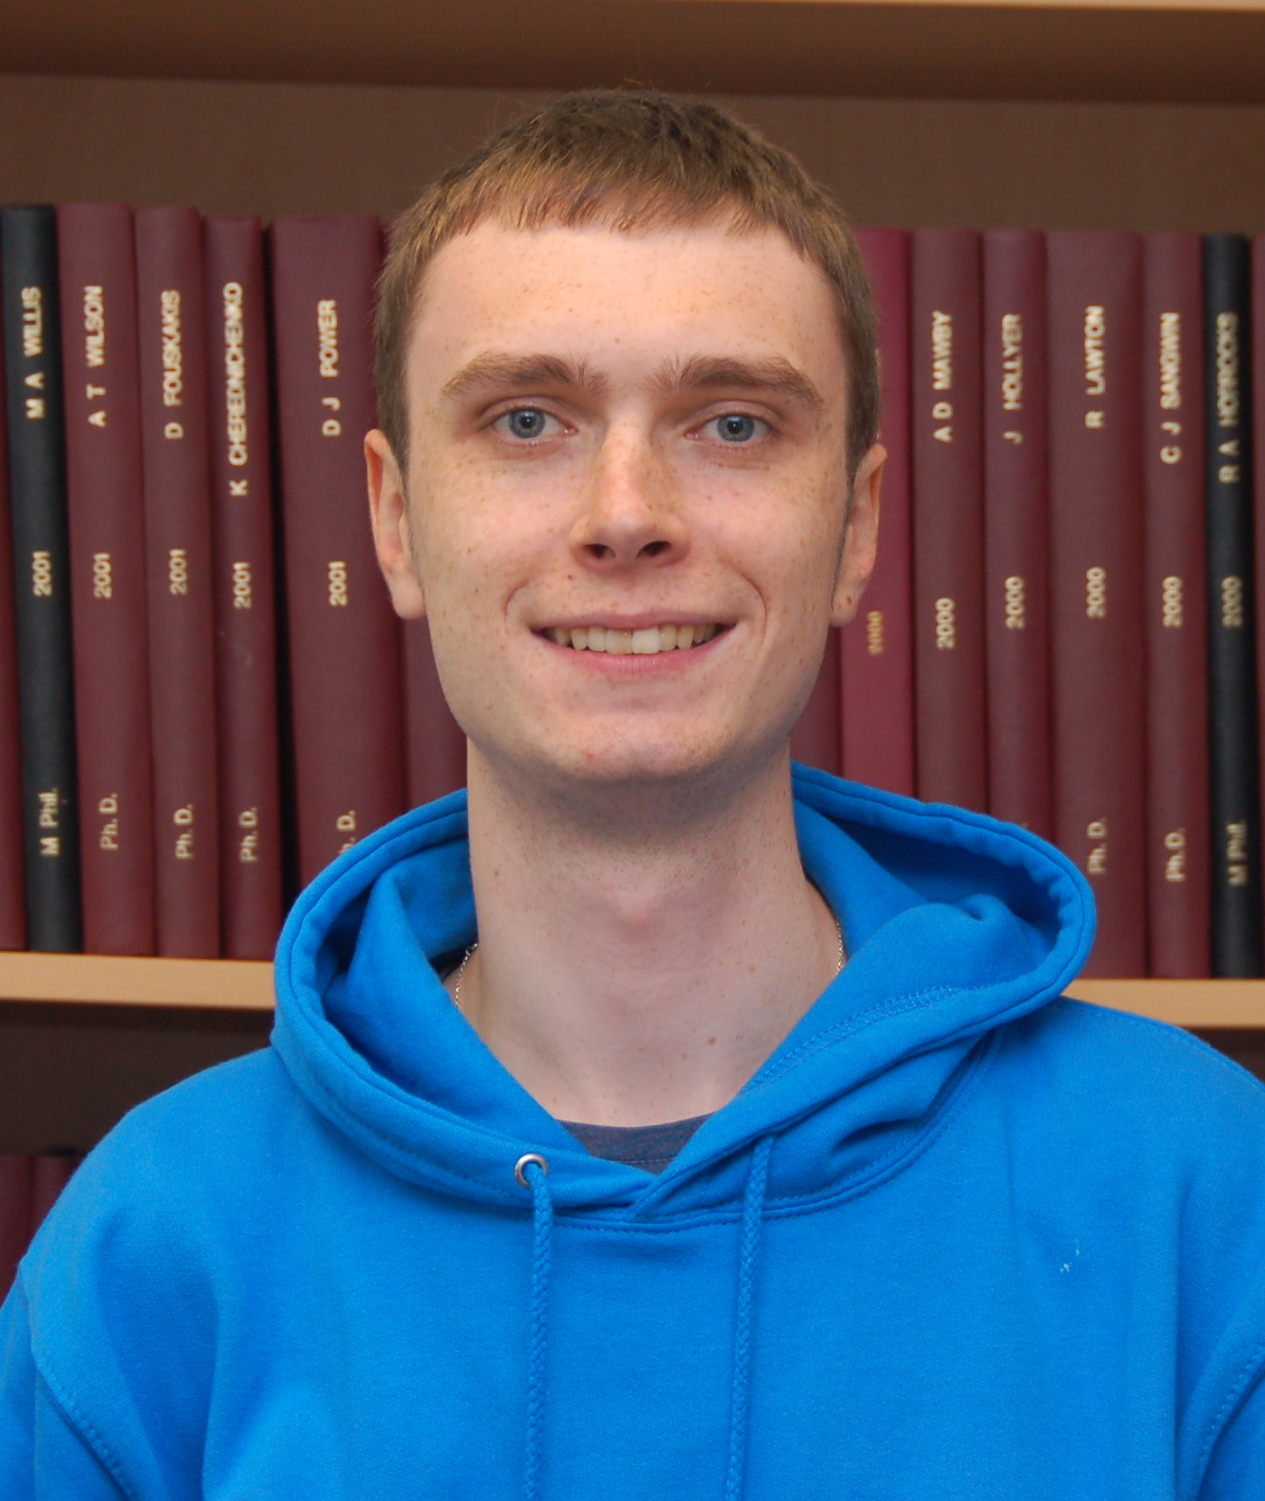
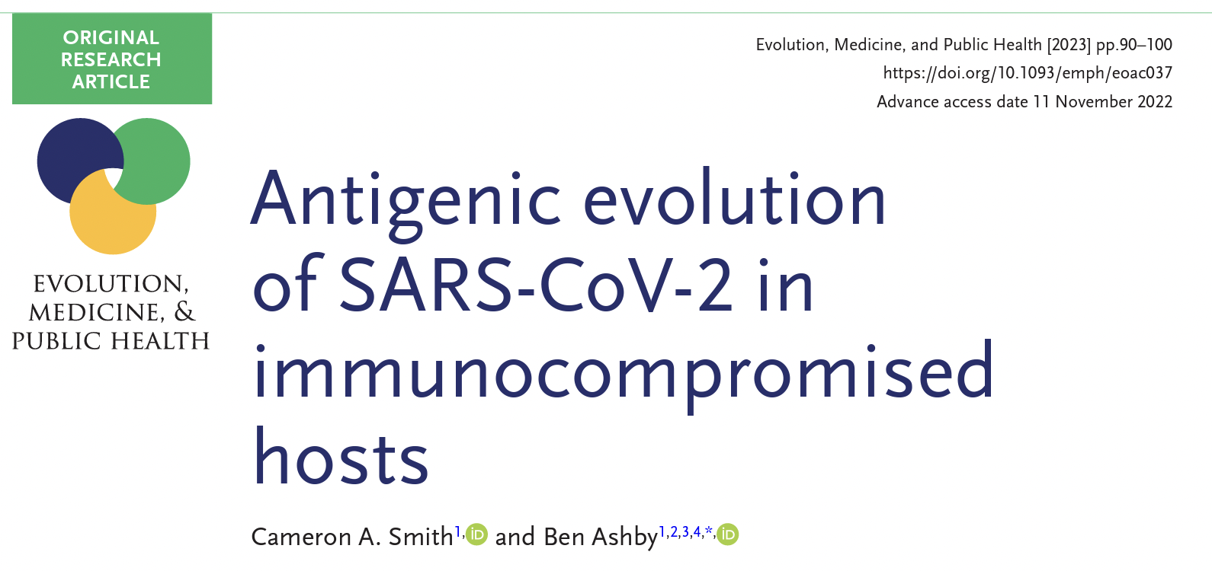






Acknowledgements
Cameron Smith
(Postdoc, now at Oxford)
Smith & Ashby (2023)
Evol. Med. Pub. Health. 11:90-100
Lucy Thorne
(Imperial)

Slide 4
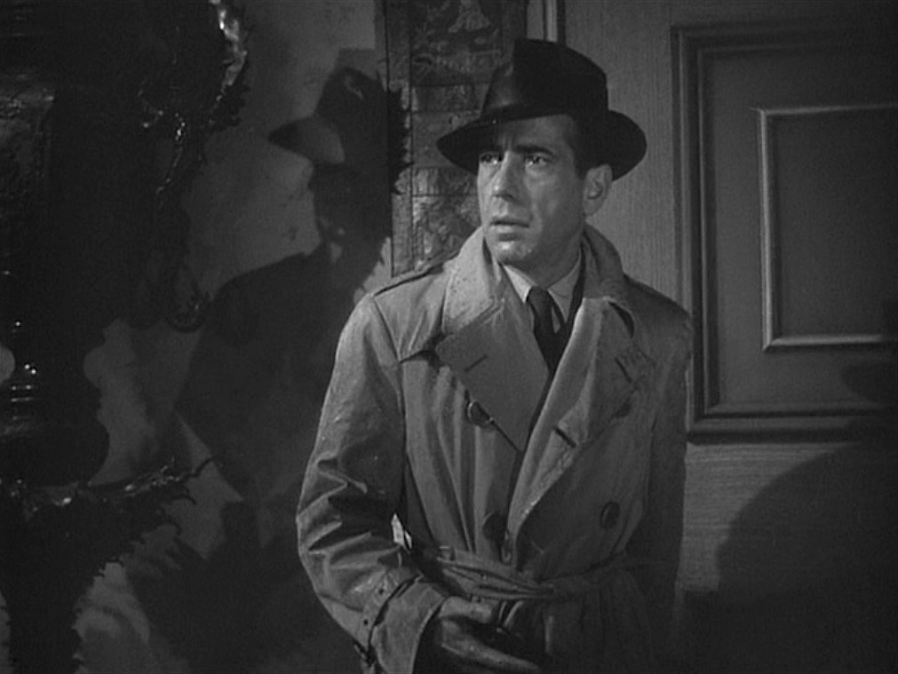

Slide 5
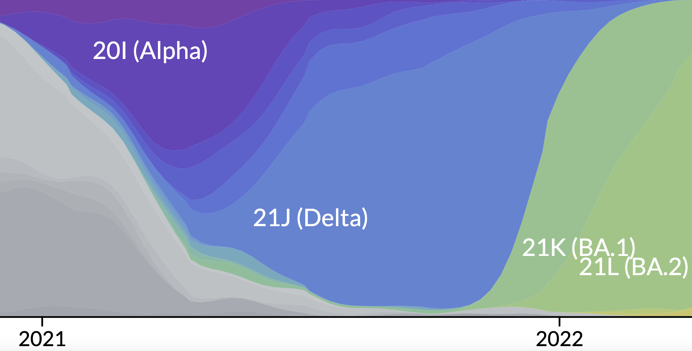
Where did omicron come from?

Slide 6
Where did omicron come from?

Slide 7
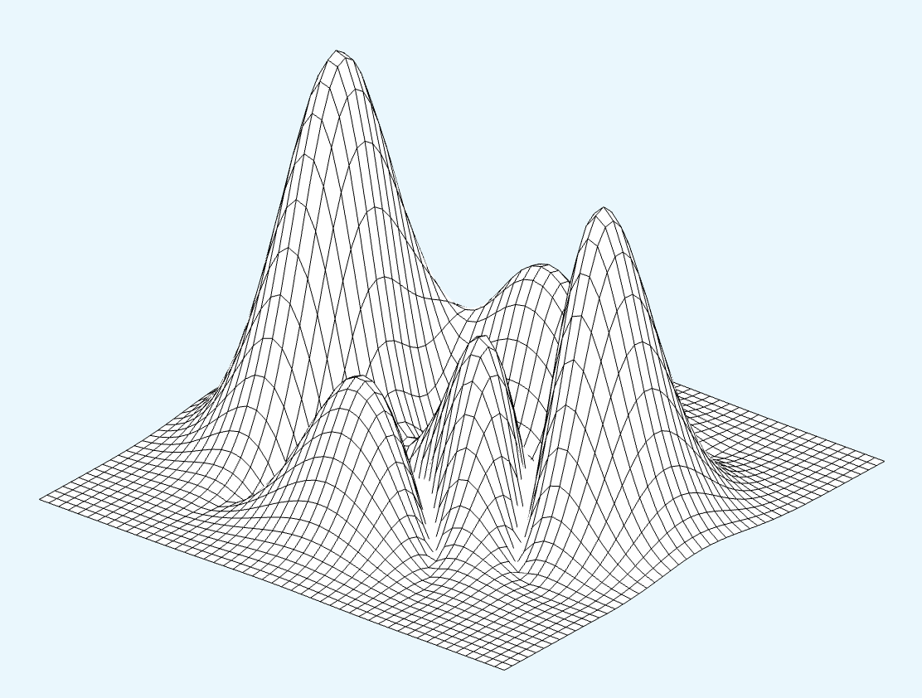
Where did omicron come from?
Omicron?
Delta?

Slide 8


Where did omicron come from?
Animal host
Isolated population
Immuno-compromised host

Slide 9
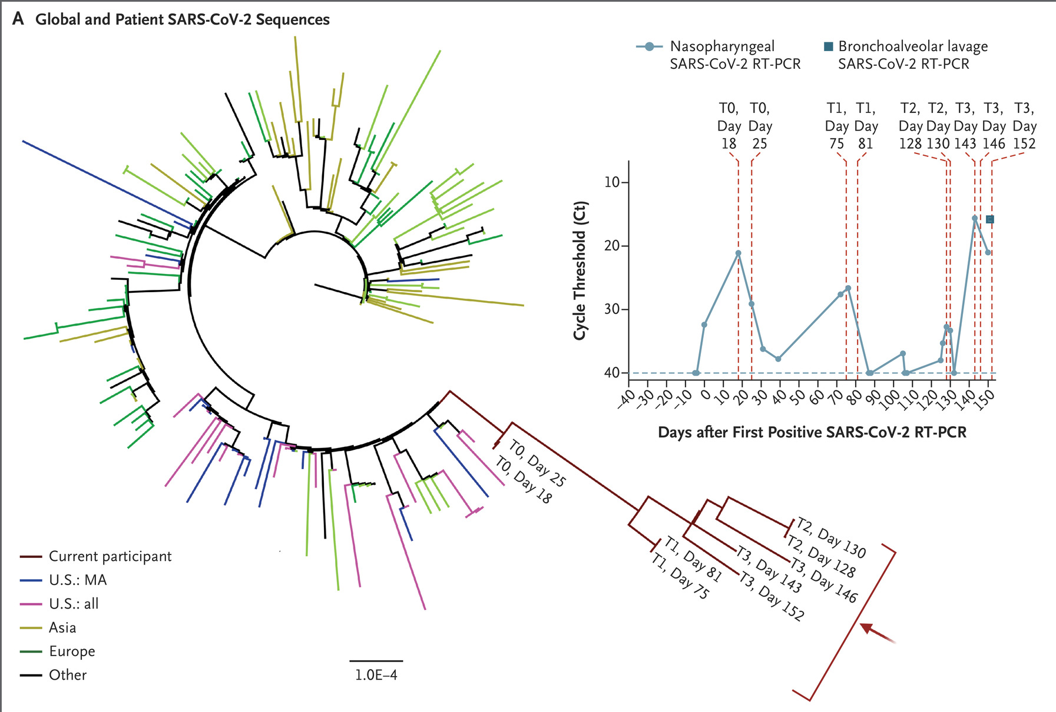
Evolution in prolonged infections
Choi et al (2020) N Engl J Med 383:2291-2293

Slide 10
When do immunocompromised hosts promote the emergence of novel variants?

Slide 11
Model description: host types
Immuno-competent
Immuno-compromised
“short” infections
“long” infections

Slide 12





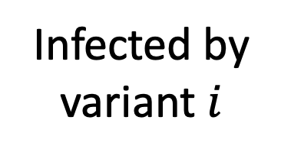
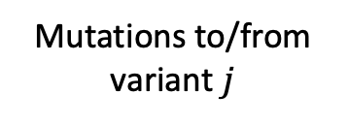
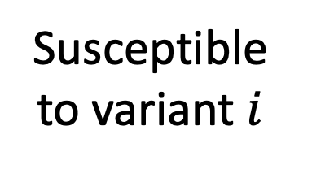

Model description: schematic
Immunocompetent (“healthy”)
Immuno-compromised
Cross-immunity from other variants
Susceptible to variant $i$
$$S_{H}^{i}$$
$$S_{C}^{i}$$
Infection by variant $i$
Mutations to/from variant $j$
Infected by variant $i$
$$I_{H}^{i}$$
$$I_{C}^{i}$$
Recovery from variant $i$

Slide 13
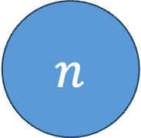
Model description: antigenic space
1
2
3
…
$$n$$

Slide 14

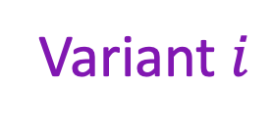
Model description: cross-immunity
high
Strength of cross-immunity
Variant $j$
low
Variant $i$

Slide 15
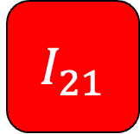

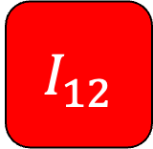
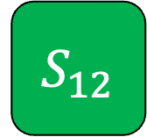
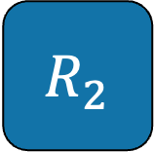


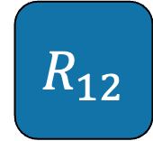
Model description: cross-immunity
A full infection history approach
(non-overlapping classes)
$${ I}_{1}$$
$${ R}_{1}$$
$${ I}_{12}$$
$${ S}_{12}$$
$${ R}_{12}$$
$${ I}_{2}$$
$${ R}_{2}$$
$${ I}_{21}$$

Slide 16
Model description: cross-immunity
Overlapping classes
Sus: 1
Sus: 2
Sus: 3
Sus: 1
Sus: 2
Sus: 3

Slide 17

Results: “antigenic drift”
Without immuno-
compromised hosts
With immuno-
compromised hosts

Slide 18
Fitness valley?
Omicron?
Delta?

Slide 19
Model description: fitness valley
Relative transmission rate
Variant index

Slide 20
Results: “antigenic shift”
Without immuno-
compromised hosts
With immuno-
compromised hosts

Slide 21
When do we see ”antigenic shift”?
high
Strength of epistasis
Max distance between VOCs
low
low
high
Strength of cross-immunity

Slide 22
When do we see “antigenic shift”?
Relative infectious period for immuno-compromised hosts
Max distance between VOCs
0
10
% immunocompromised

Slide 23
Tentative conclusion
An immunocompromised host could have been the source of Omicron…
…but only if there was a large fitness valley to traverse

Slide 24
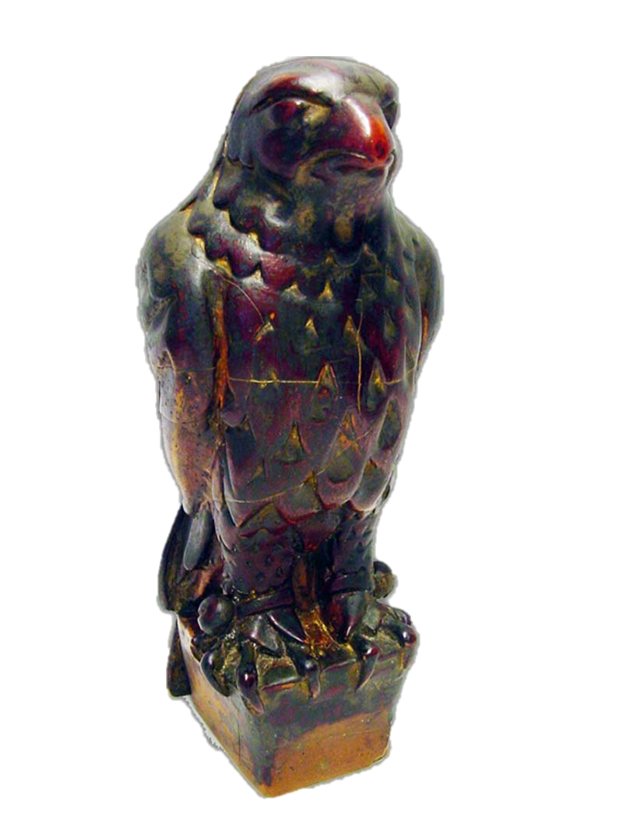
The stuff that dreams are made of
How does within-host adaptation to immunocompromised hosts affect epidemiological/immunological outcomes in immunocompetent hosts?

Slide 25
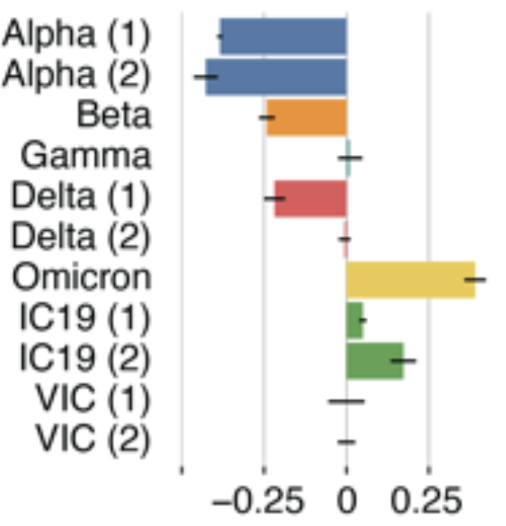
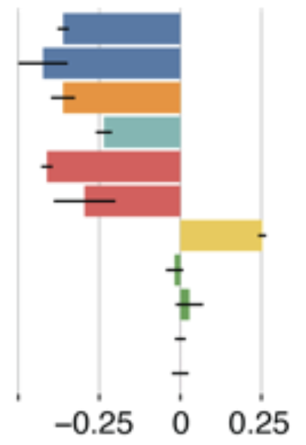
Some clues
Interferon stimulated genes
RNA
Protein
Other VOCs
Controls
Expression vs control (VIC)
Bouhaddou et al. (2022) bioRxiv 2022.10.19.512927

Slide 26
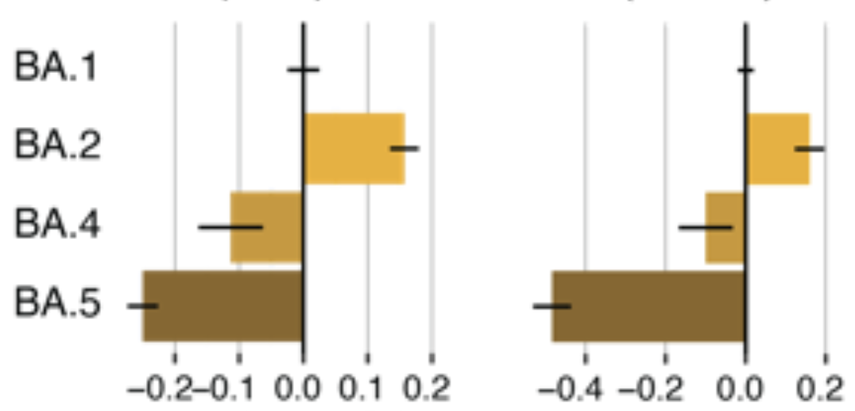
Some clues
Interferon stimulated genes
RNA
Protein
Other VOCs
Expression vs BA.1
Perhaps BA.1 was well-adapted to the innate immunity of an immunocompromised host?

Slide 27
Acknowledgements
Cameron Smith
(Postdoc, now at Oxford)
Smith & Ashby (2023)
Evol. Med. Pub. Health. 11:90-100
Lucy Thorne
(Imperial)

