Slide 1
Learning to Communicate
Robert Calderbank
Duke University
Abstract: We describe how pulsones interpolate between TDM and FDM, and when it is possible to learn input-output relations without learning the channel, opening the door to machine learning.
Learn More - IEEE BITS Magazine: A Mathematical Foundation for Communications and Sensing in the Delay-Doppler Domain, Parts I and II – in collaboration with Saif Khan Mohammed, Ronny Hadani, and Ananthanarayanan Chockalingam
Disclosure: Advisor to Cohere Technologies

Slide 2
So Many Channels, So Little Time
Doppler
Leo-Satellite Channel
UAV/Aeronautical Channel
mmWave Mobile Channel
Terrestrial Mobile Channel
Terrestrial Pedestrian Channel
6G
Doppler Spread
4G
Delay
Today we design wireless systems using mathematical models
This approach is losing ground as wireless channels become more complex and Doppler becomes more significant
Might it be possible to operate model-free

Slide 3
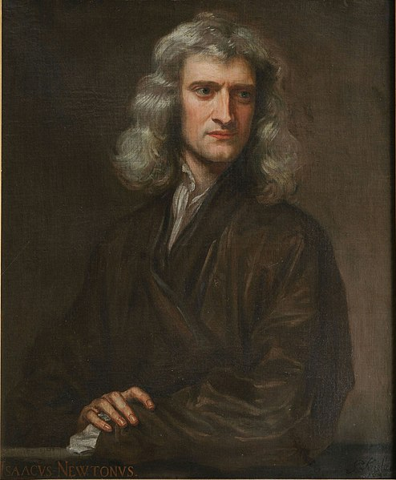
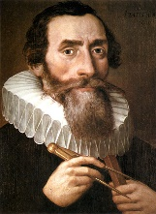
We have Asked This Question Before
Newton’s Laws of Motion
Model-based approach that develops understanding
at the most fundamental level.
Kepler’s Laws of Planetary Motion
Model-free approach that uses data to make predictions

Slide 4
Why Ask It Now?
Machine learning has revolutionized image and natural language processing
Data-driven discovery has revolutionized bioinformatics
Machine learning (ML) is about approximating functions – broad impact comes from the fact that it is particularly effective in high dimensions
Classically we measure complexity of functions by smoothness – how many times the function can be differentiated
ML measures complexity by how well the function can be approximated by a particular neural network model – reproducing kernel Hilbert spaces, for example
*Weinan E, The Dawning of a New Era in Applied Mathematics, Notices of the American Mathematical Society, May 2021

Slide 5
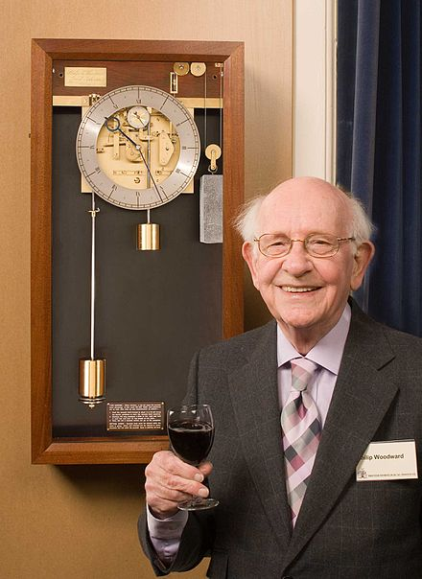
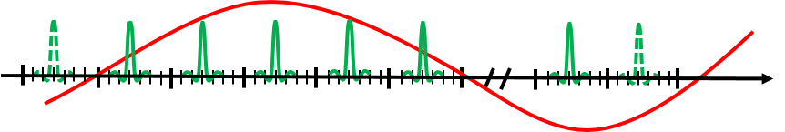
Localization in Delay and Doppler
Radar as a game of 20 questions with an operator
P.M. Woodward: Probability and Information Theory, with Applications to Radar, Pergamon Press, 1953
He viewed the problem of localizing a scatterer in delay and Doppler as using a waveform to ask questions of the operator defined by the radar scene
How to Design a Question:
Prediction as a game of 20 questions with a doubly spread channel

Slide 6






















Reflector 3
Representing Doubly Spread Channels
Reflector 1
Taps in Delay and Doppler
$$h_{3}x\left(t−τ_{3}\right)e^{j2πν_{3}(t−τ_{3})}$$
Doppler
shift
$$h_{1}x\left(t−τ_{1}\right)e^{j2πν_{1}(t−τ_{1})}$$
$|h(τ, ν)$|
$$(ν)$$
UE
$$|h_{1}|$$
BS
$$x(t)$$
$$h_{2}x\left(t−τ_{2}\right)e^{j2πν_{2}(t−τ_{2})}$$
$${|h}_{3}|$$
$${|h}_{4}|$$
$$h_{4}x\left(t−τ_{4}\right)e^{j2πν_{4}(t−τ_{4})}$$
$$ν_{4}$$
Reflector 2
$${|h}_{2}|$$
Reflector 4
$$τ_{1}$$
$$τ_{2}$$
$$τ_{4}$$
$$ν_{2}$$
$$τ_{3}$$
Delay
$(τ$)
What is the right question?

Slide 7
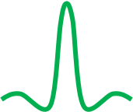

What Constitutes a Good Question?
Doubly Spread Channel: A sum of operators D(τ_{i}, ν_{j}) introducing path
delay τ_{i} and Doppler shift ν_{j}
Waveforms are questions, returns are answers, objective is prediction
Time Domain (TD) Pulse: Good question for pure delay channels
Frequency Domain (FD) Pulse: Good question for pure Doppler channels
Delay-Doppler (DD) Domain Pulse: Good question for doubly spread channels

Slide 8
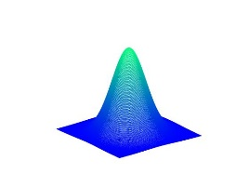


























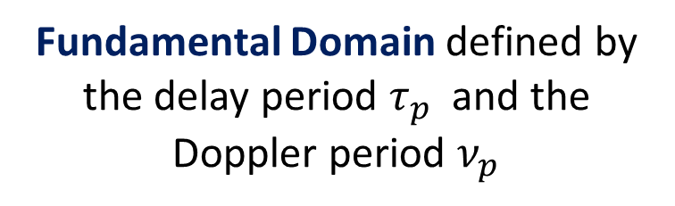
A Pulse in the
Delay-Doppler Domain
$$ν \left(\text{Doppler}\right)$$
Quasi-periodicity
$$…$$
$$…$$
$$…$$
$$…$$
q
q
q
$$(−τ_{p},{2ν}_{p})$$
$$(0,{2ν}_{p})$$
$$(τ_{p},{2ν}_{p})$$
$$({2τ}_{p},{2ν}_{p})$$
$$e^{j2πυτ_{p}}$$
The DD realization of a TD signal is a quasi-periodic function
$$(−τ_{p},ν_{p})$$
q
q
q
$$({2τ}_{p},ν_{p})$$
$$(0,ν_{p})$$
$$(τ_{p},ν_{p})$$
$$τ (\text{delay})$$
q
q
q
$$(−τ_{p},0)$$
$$(0,0)$$
$$(τ_{p},0)$$
$$(2τ_{p},0)$$
Fundamental Domain defined by the delay period $τ_{p}$ and the Doppler period $ν_{p}$
$$…$$
$$…$$
$$(−τ_{p},−ν_{p})$$
$$(0,−ν_{p})$$
$$(τ_{p},−ν_{p})$$
$$({2τ}_{p},−ν_{p})$$
$$…$$
$$…$$

Slide 9
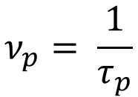












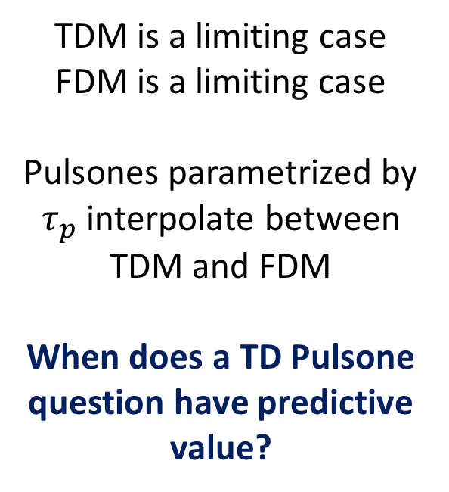


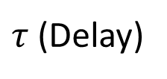

TD Pulsone from a Quasi-Periodic DD Domain Pulse
$$T$$
$$R\left\{x(t)\right\}$$
TD Pulsone
$$t$$
$$B^{−1}$$
$$τ_{0}$$
$$τ_{p}$$
$$\cos\left(2πυ_{0}(t−τ_{0})\right)$$
TDM is a limiting case
FDM is a limiting case
Pulsones parametrized by $τ_{p}$ interpolate between TDM and FDM
When does a TD Pulsone question have predictive value?
$$Z_{t}^{−1} : x_{dd}\left(τ, ν\right) →x(t)$$
$ν$ (Doppler)
$$x\left(t\right)=\sqrt{τ_{p}} \int_{0}^{ν_{p}}{x_{dd}\left(t, ν\right) dν}$$
$$B^{−1}$$
$$T^{−1}$$
$$ν_{p}= \frac{1}{τ_{p}}$$
$$υ_{0}$$
$$τ_{0}$$
$$τ_{p}$$
$τ$(Delay)
Notes:
9

Slide 10
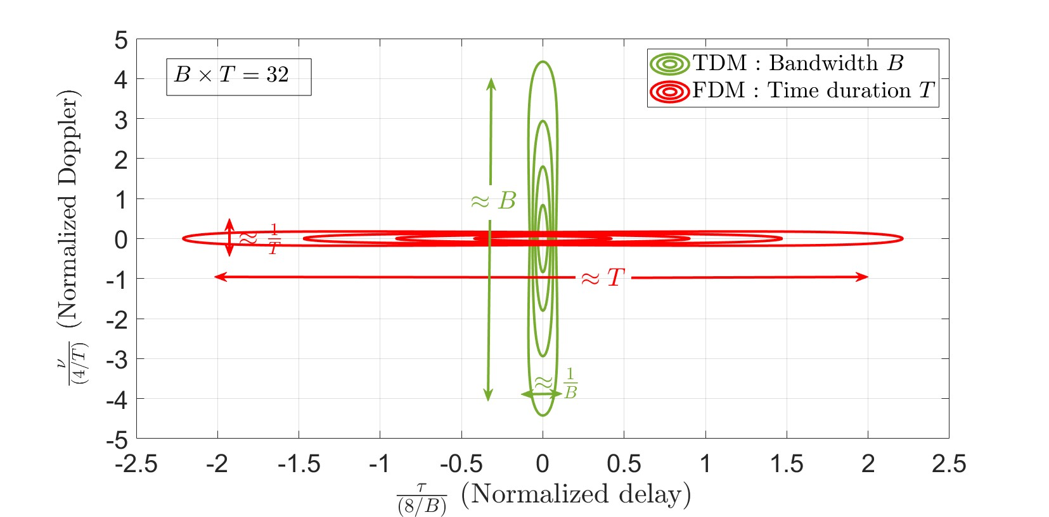
What Constitutes an Ambiguous Answer?
Ambiguity Function|A_{s,s}(τ, ν)|² We transmit a waveform s to illuminate a radar scene, then correlate the result with the transmitted waveform
sinc((B - |ν|)τ)
TDM: Not able to separate targets in Doppler
sinc((T - |τ|)ν)
FDM: Not able to separate targets in delay

Slide 11
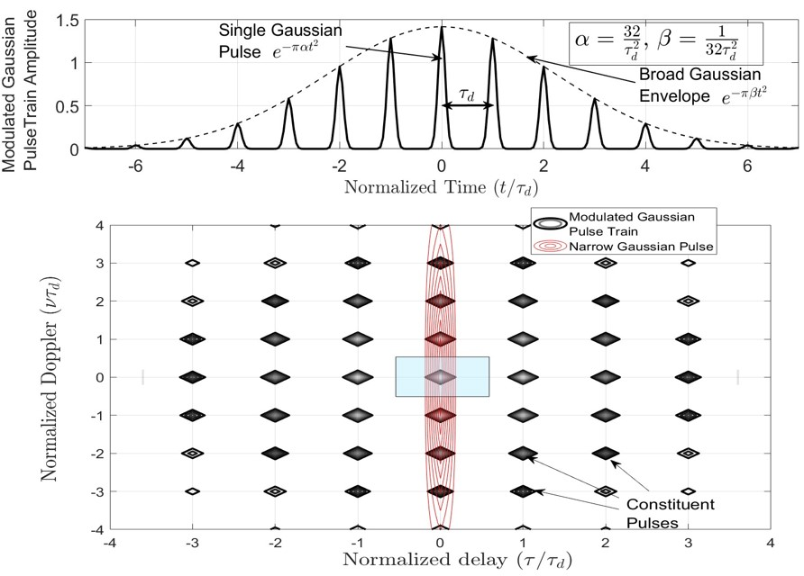
Woodward, 1954
Volume under|A_{s,s}(τ, ν)|² fixed by Moyal’s Identity but can be redistributed to enable resolution of radar targets
Red Ellipse: Ambiguity function of narrow Gaussian pulse
Modulate a train of narrow TD Gaussian pulses with a broad Gaussian envelope
Black Ellipses

Slide 12
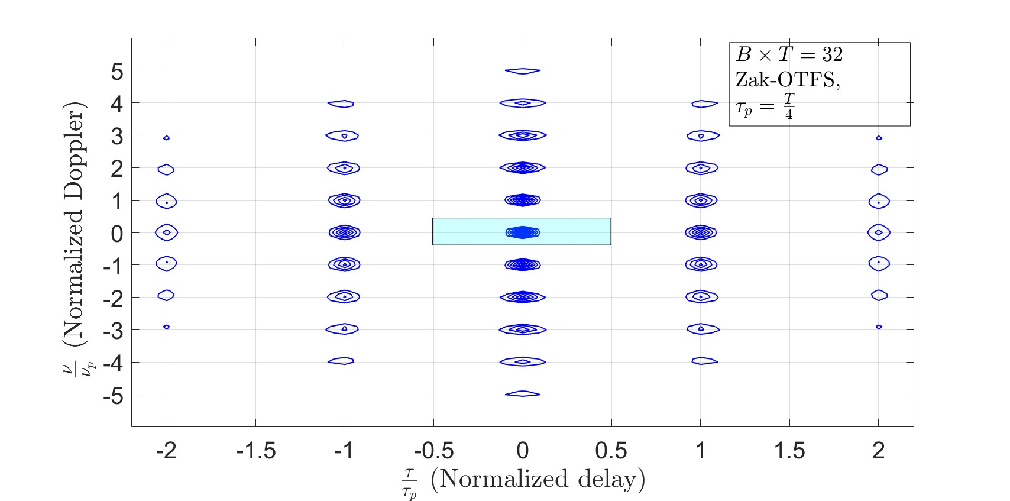
Pulsones, 2023
Ambiguity Function |A_{s.s}(τ,ν)|² - pulsone carrier waveform
Narrow DD domain impulses separated by τ_{p} along the delay axis and ν_{p} along the Doppler axis
Each impulse has a spread of 1/B along the delay axis and 1/T along the Doppler axis

Slide 13
Doubly Spread Channels Acting on Pulsones
Twisted convolution:
Crystalline Regime: The delay domain period τ_{p} is greater than the channel path delay spread, and the Doppler domain period ν_{p} is greater than the path Doppler spread:
τ_{p} > delay spread and ν_{p} > Doppler spread
The interaction of a doubly spread channel with a TD pulsone is predictable and geometric

Slide 14

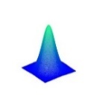


$$ν \left(\text{Doppler}\right)$$
The Origins of Unpredictability
Delay spread
Unpredictability results from aliasing in the DD domain
Aliasing occurs when the DD spreads of the channel are bigger than the DD periods of the pulsone
Doppler spread
$$τ (\text{delay})$$
Doppler period
Doppler spread > Doppler period
self- interaction leads to unpredictability
Delay period

Slide 15
$$ν \left(\text{Doppler}\right)$$
What is Different in the Crystalline Regime?
Delay spread
Doppler spread
Doppler spread < Doppler period
Delay spread < Delay period
No DD Aliasing - the DD spreads of the channel are smaller than the DD periods of the pulsone.
$$τ (\text{delay})$$
Doppler period
No Self-Interaction means the channel response is predictable
Delay period

Slide 16
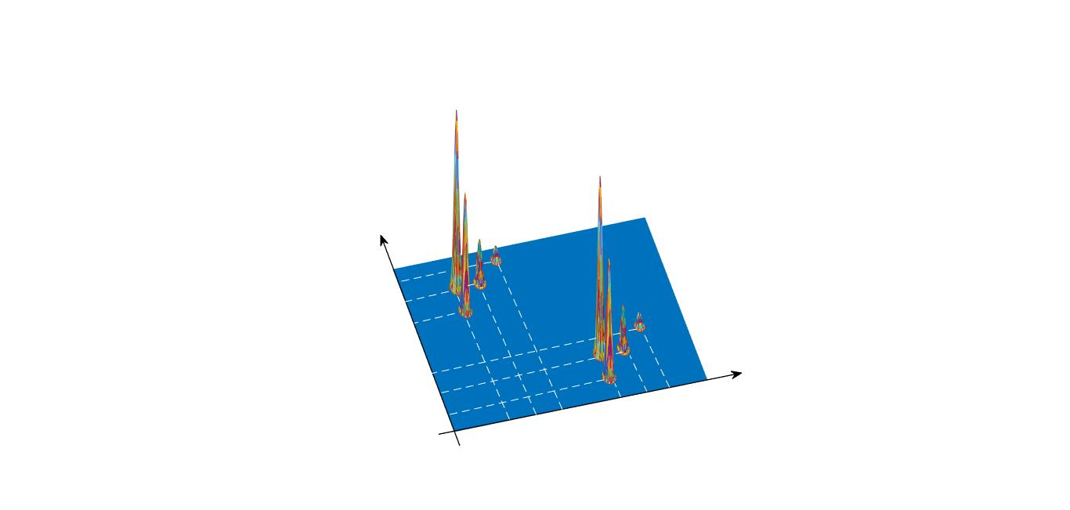
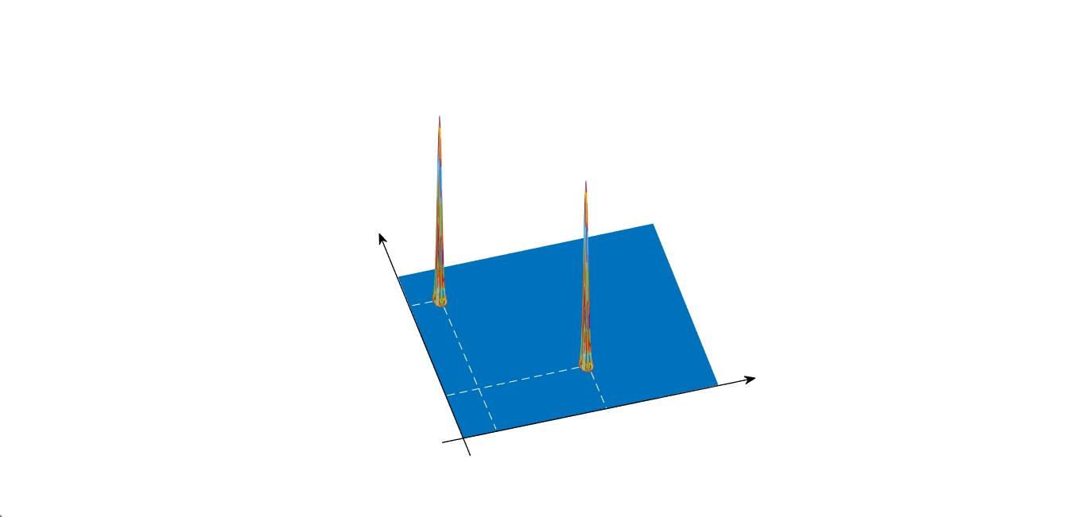




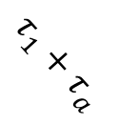


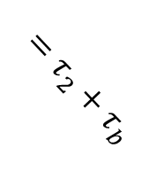




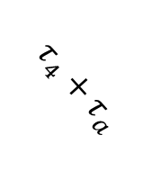






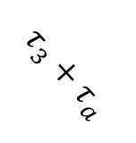

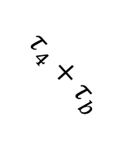







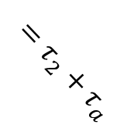



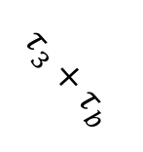



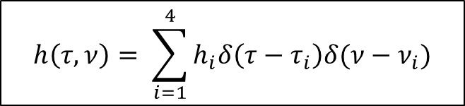

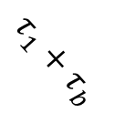



Picturing Predictability
$${\left|h_{1}e^{j2πν_{1}τ_{a}}\right|}^{2}$$
$${\left|X\left(τ, ν\right)\right|}^{2}$$
Wireless channel dynamics lead to replicas
$${\left|Y\left(τ, ν\right)\right|}^{2}$$
$${\left|h_{2}e^{j2πν_{2}τ_{a}}\right|}^{2}$$
$${\left|h_{1}e^{j2πν_{1}τ_{b}}\right|}^{2}$$
$$1$$
$${(τ}_{4} ν_{4})$$
$${\left|h_{3}e^{j2πν_{3}τ_{a}}\right|}^{2}$$
$${(τ}_{1}, ν_{1})$$
$$ν$$
$$1$$
$${\left|h_{2}e^{j2πν_{2}τ_{b}}\right|}^{2}$$
$$ν$$
$${(τ}_{3}, ν_{3})$$
$${\left|h_{4}e^{j2πν_{4}τ_{a}}\right|}^{2}$$
$${\left|h_{3}e^{j2πν_{3}τ_{b}}\right|}^{2}$$
$$ν_{4}+ν_{a}$$
$${(τ}_{2}, ν_{2})$$
$$ν_{1}+ν_{a}$$
$$ν_{a}$$
$$ν_{3}+ν_{a}=$$
$$ν_{2}+ν_{a}$$
$${\left|h_{4}e^{j2πν_{4}τ_{b}}\right|}^{2}$$
$$ν_{4}+ν_{b}$$
$$ν_{1}+ν_{b}$$
$$τ$$
$$ν_{3}+ν_{b}=$$
$$ν_{2}+ν_{b}$$
$$τ_{4}+τ_{b}$$
$$τ_{3}+τ_{b}$$
$$ν_{b}$$
$$τ$$
$$τ_{1}+τ_{b}$$
$$τ_{4}+τ_{a}$$
$$τ_{3}+τ_{a}$$
$$τ_{b}$$
$$τ_{1}+τ_{a}$$
$$τ_{a}$$
$$h\left(τ, ν\right)= \sum_{i=1}^{4}{h_{i}δ\left(τ−τ_{i}\right)δ(ν−ν_{i})}$$
$$=τ_{2}+τ_{b}$$
$$=τ_{2}+τ_{a}$$
Twisted convolution:
$$Y\left(τ, ν\right)=h\left(τ, ν\right)∗_{σ}X(τ, ν)$$

Slide 17
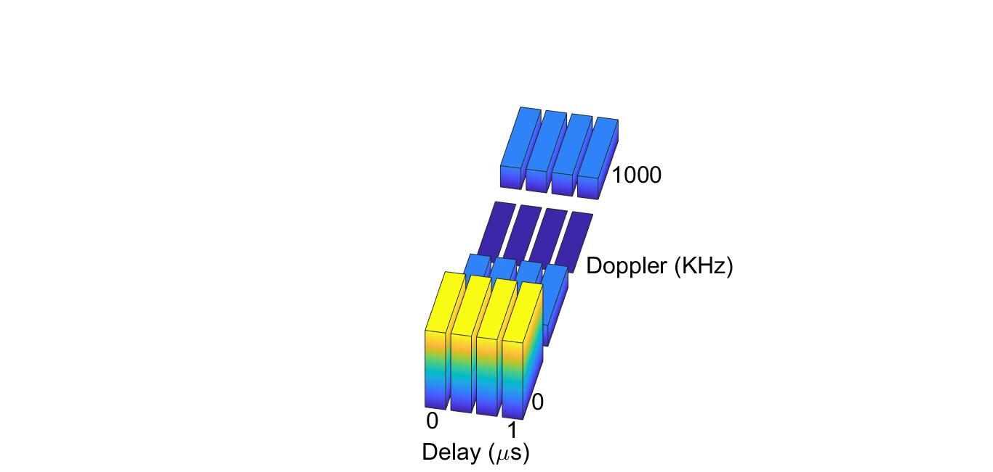
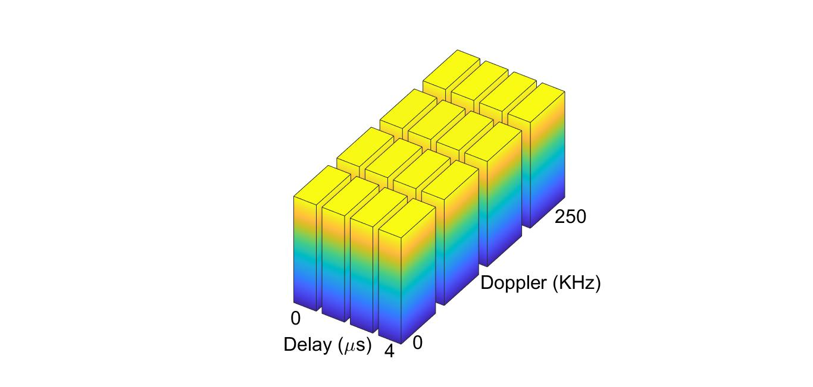
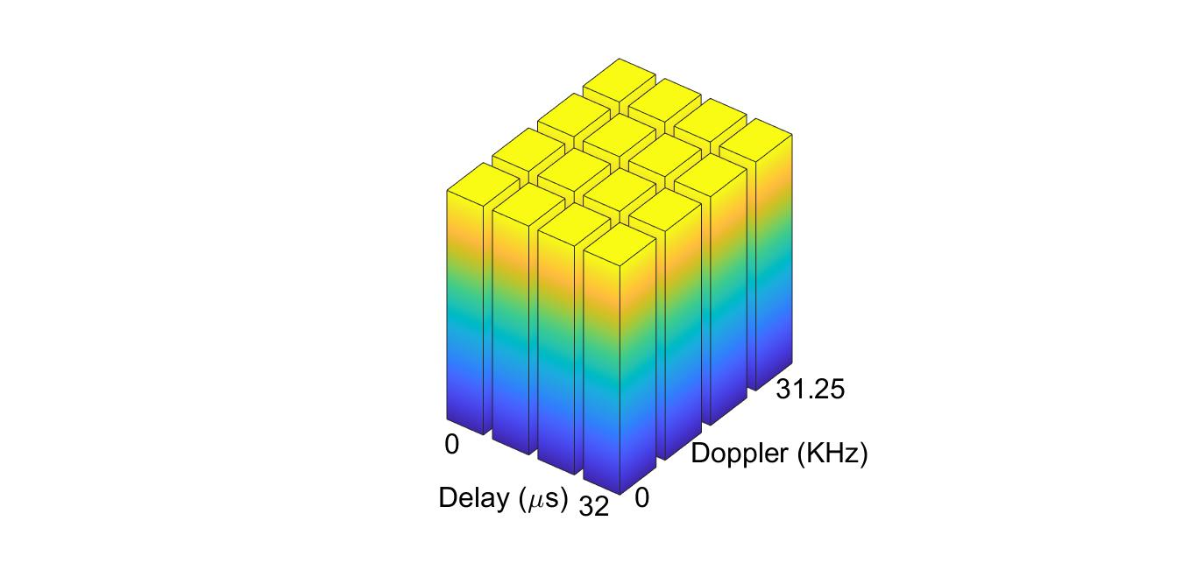
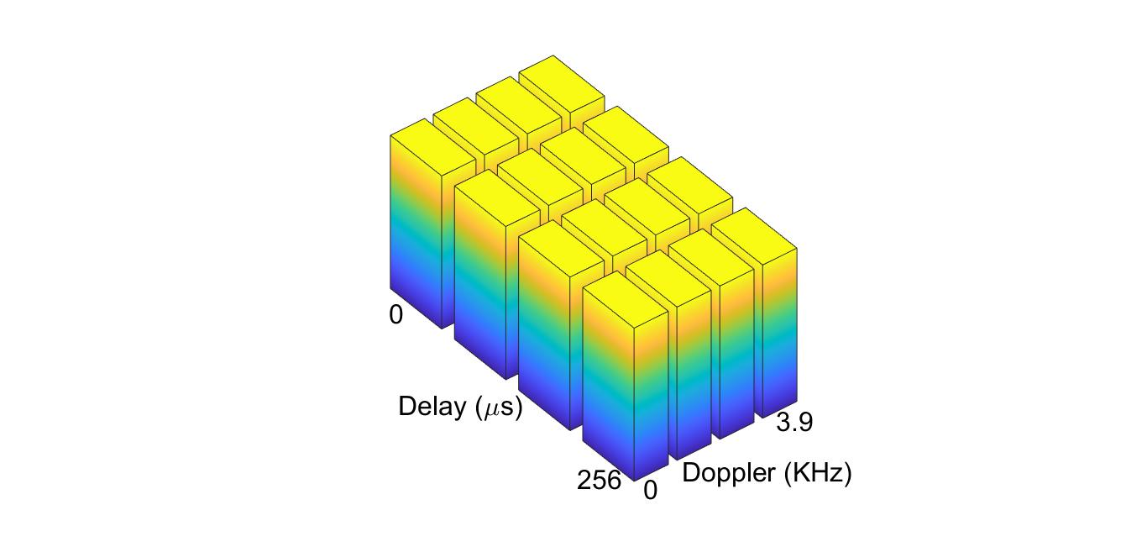
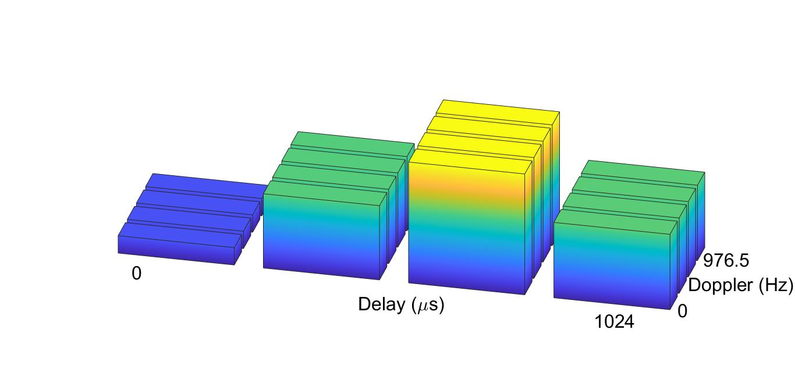
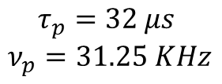

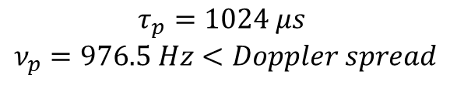

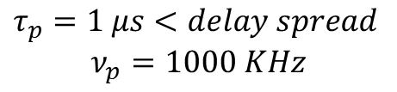
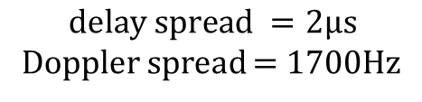

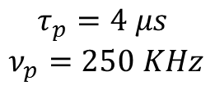
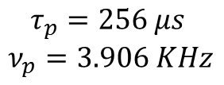
Crystalline Regime
FDM
Frequency Selectivity
$$ν_{p}→∞$$
$$τ_{p}=1 μs<delay spread$$
$$ν_{p}=1000 KHz$$
Channel:
$$delay spread =2μs$$
Doppler spread = 1700Hz
When the fundamental period captures the channel spread the received power profile is flat and the input-output relation is predictable
$$τ_{p}=4 μs$$
$$ν_{p}=250 KHz$$
$$τ_{p}=32 μs$$
$$ν_{p}=31.25 KHz$$
Time Selectivity
$$τ_{p}=256 μs$$
$$ν_{p}=3.906 KHz$$
$$τ_{p}=1024 μs$$
$$ν_{p}=976.5 Hz<Doppler spread$$
$$τ_{p}{.ν}_{p}=1$$
TDM
$$τ_{p}→∞$$

Slide 18
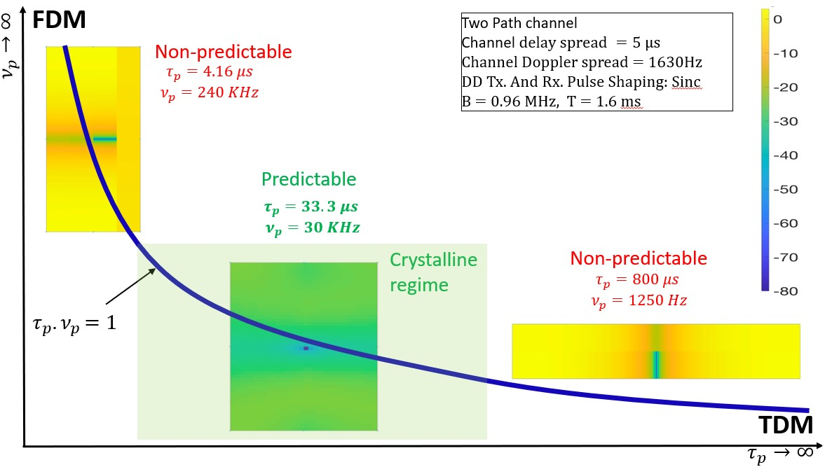
Predictability of the I/O Relation
Relative Prediction Error (RPE) in dB, as a function of delay (horizontal axis) and Doppler (vertical axis) with sinc pulse-shaping filters
RPE minimized at the pulse location
RPE significantly smaller in the crystalline regime

Slide 19
Block Diagram of Broadcasting
[B,K]
CHIRRUP
Encoder
Zak-OTFS baseband Modulation
Channel
Zak-OTFS baseband Demodulation
CHIRRUP
Decoder
1
2
K messages (or users) with B bits each
Delay Doppler
Channel
2
UT_{K}
1
2
UT_{K-1}
2
BS
2
UT₃
2
UT₂
BS - Base Station
UT - User Terminal
UT₁

Slide 20
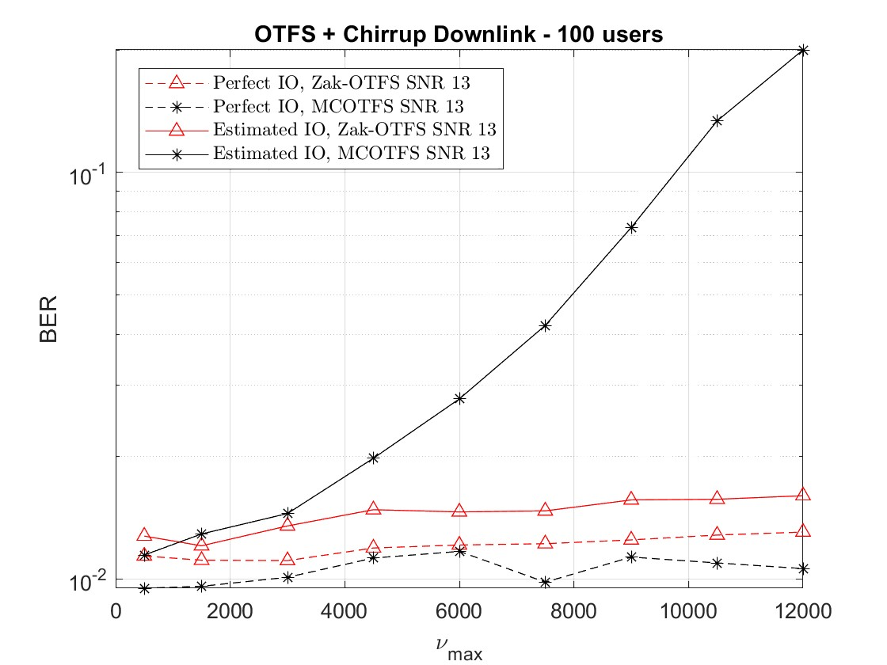
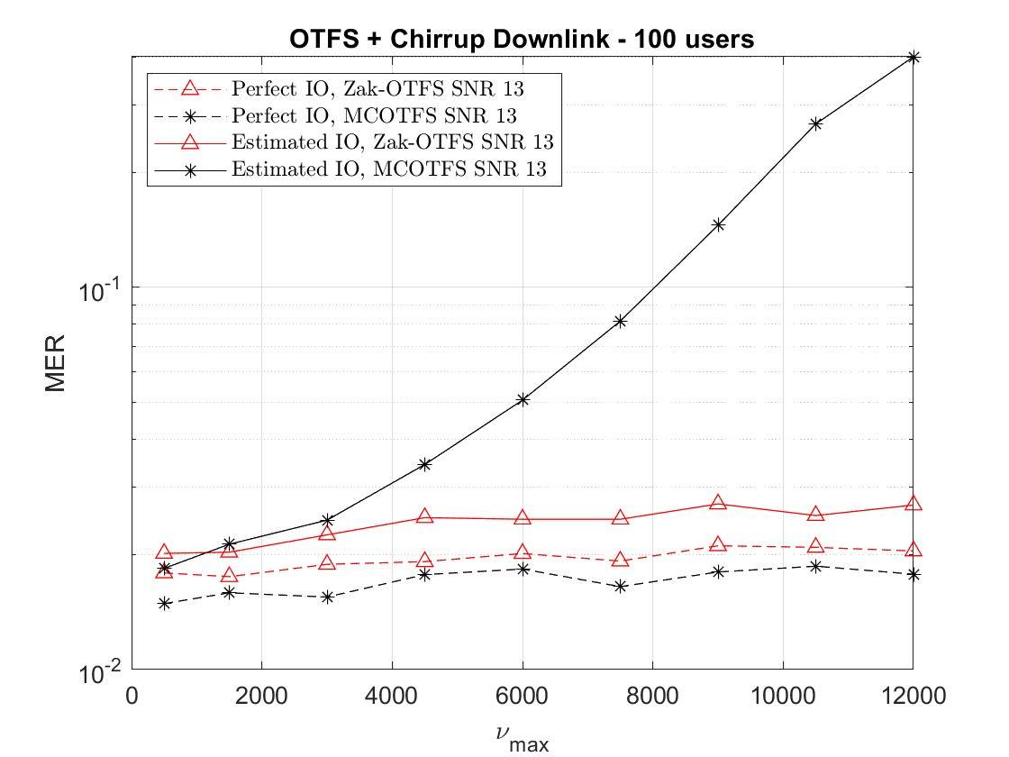
Results (Zak vs MC-OTFS)
BER versus max. Doppler at SNR = 13dB
MER versus max. Doppler at SNR = 13dB

Slide 21
Non-Fading and Predictable Operation
Pulsones in the Crystalline Regime
TDM
FDM
Delay Spread Only
Doppler Spread Only
Doubly Spread

Slide 22



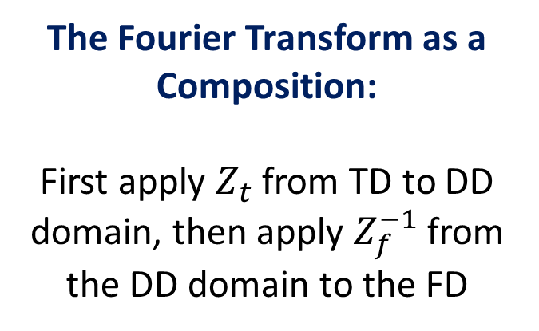





Signal Processing in the DD Domain
Time
$$x(t)$$
OTFS
The Fourier Transform as a Composition:
First apply $Z_{t}$ from TD to DD domain, then apply $Z_{f}^{−1}$ from the DD domain to the FD
FDM
$$Z_{t}^{−1}:X\left(τ, ν\right) →x(t)$$
$$FT= Z_{f}^{−1}∘ Z_{t}$$
$$x\left(t\right)=\sqrt{τ_{p}} \int_{0}^{ν_{p}}{X\left(t, ν\right)dν}$$
Frequency
$$X(f)$$
Delay Doppler
$$Z_{f}^{−1}:X\left(τ, ν\right) →X(f)$$
$$X(τ, ν)$$
$$X\left(f\right)=\sqrt{ν_{p}} \int_{0}^{τ_{p}}{X\left(τ, f\right)e^{−j2πfτ}dτ}$$
Not more complicated than the Fourier Transform

Slide 23
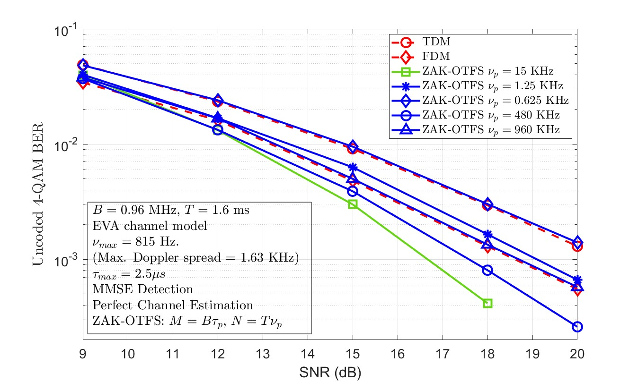
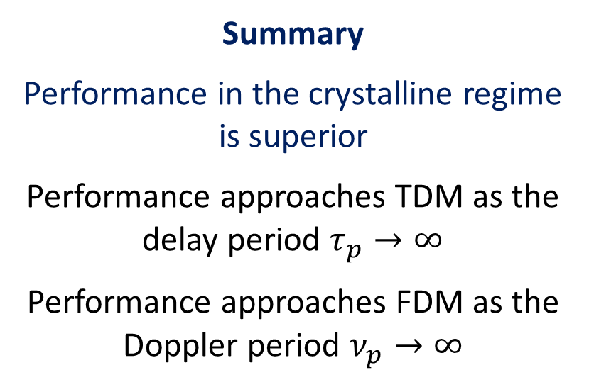
Impact of Fading in the Crystalline Regime
Perfect Channel Estimation: VehA Channel Model
Summary
Performance in the crystalline regime is superior
Performance approaches TDM as the delay period $τ_{p}→∞$
Performance approaches FDM as the Doppler period $ν_{p}→∞$

Slide 24
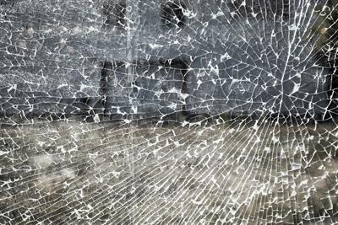
Predictable means Learnable
Doubly Spread Channels are becoming infinitely complicated
Input-Output Relations can be comparatively simple
Model-Free Operation: It is possible to use pulsones to learn the input-output relation directly without learning the channel

Slide 25
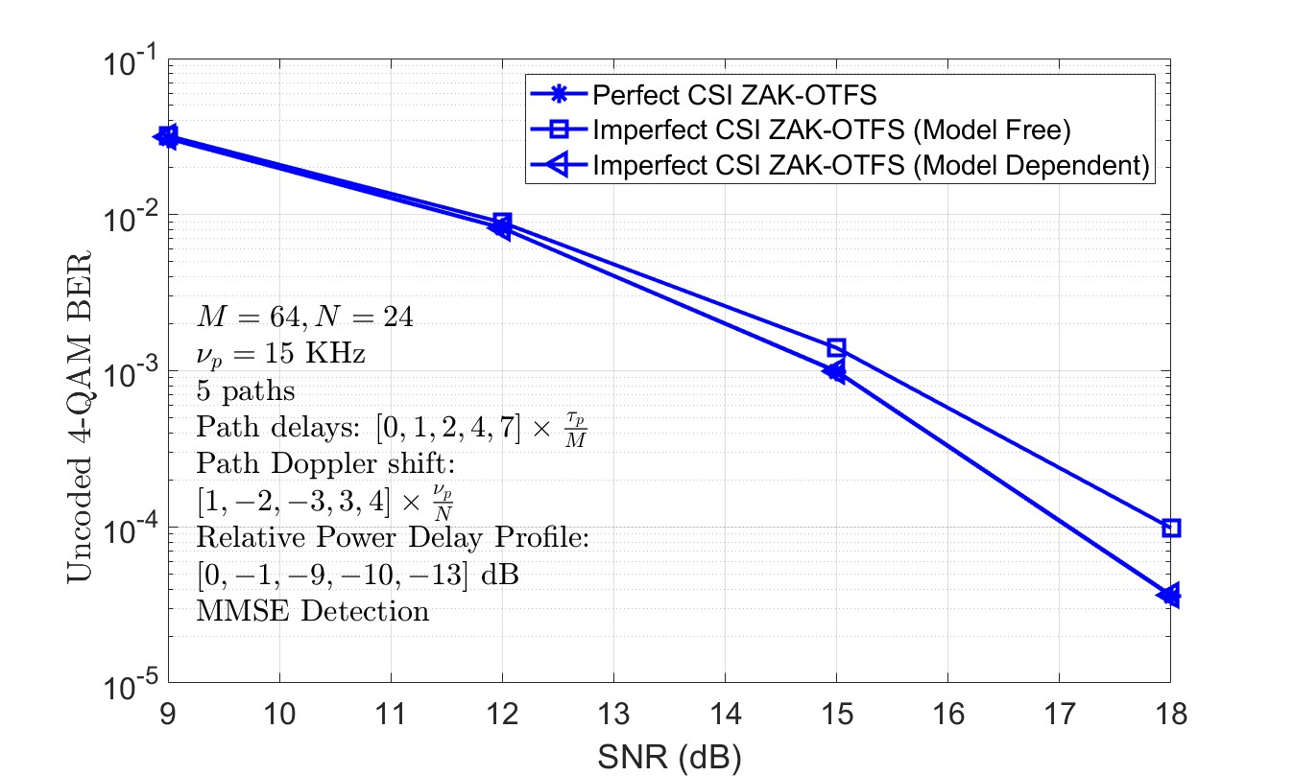
Model-Free vs Model-Dependent
In the crystalline regime, when it is possible to learn the channel:
Model-Dependent pulsone performance coincides with ideal performance
Model-Free pulsone performance is only slightly inferior

Slide 26
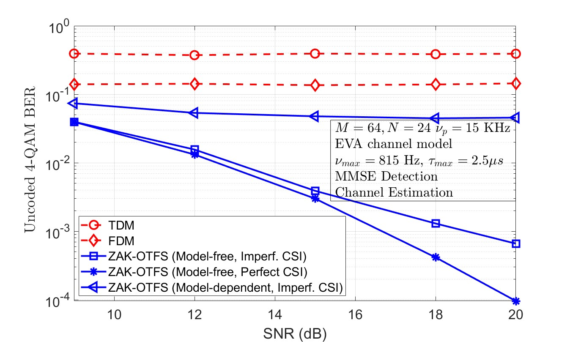
Model-Free vs Model-Dependent
When it is not possible to learn the channel:
Pulsones support model-free operation in the crystalline regime
Not shown: Improvements in filtering – root raised cosine vs. sinc – extend the region of reliable operation

Slide 27
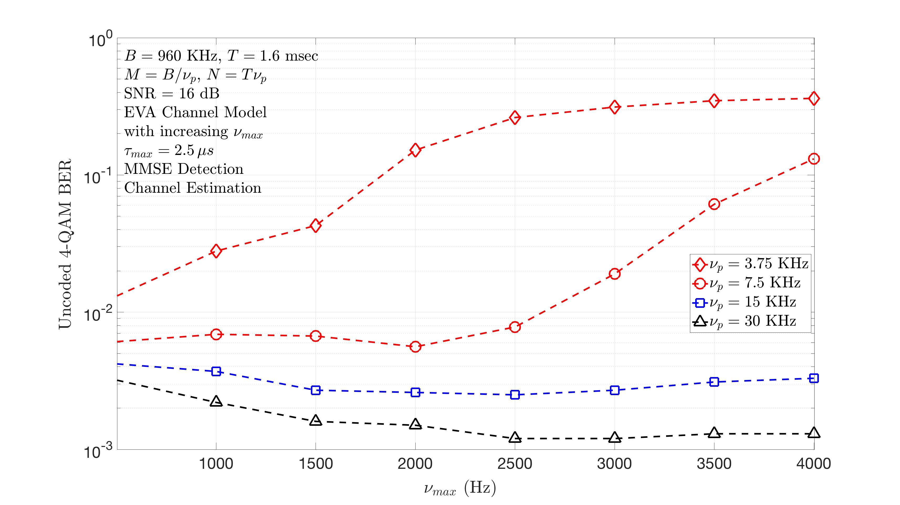
Pushing the Envelope – Impact of High Doppler
Model-Free operation in the crystalline regime:
When the Doppler spread 2ν_{max} is bounded away from ν_{p} then pulsone performance does not degrade as ν_{max} increases
When the Doppler spread 2ν_{max} is close to ν_{p} then performance degrades because of Doppler domain aliasing

Slide 28
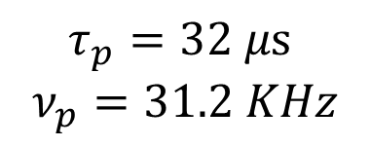
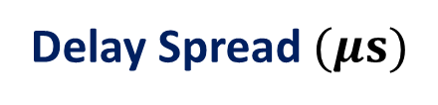
Navigating Orders of Magnitude in Doppler Spread
$$τ_{p}=32 μs$$
$$ν_{p}=31.2 KHz$$
Delay Spread $(μs)$
Doppler Spread (KHz)
Leo-Satellite Channel
0.8
82
7.0 (Take Off)
33-60 (En-Route)
UAV/Aeronautical Channel (GHz)
7.68 (En-Route)
mmWave Mobile Channel (28GHz)
1.0
3.0
Terrestrial Mobile Channel (GHz)
5.0
0.3
Terrestrial Pedestrian Channel (GHz)
0.41
0.005

Slide 29

Signal Processing in Zak-OTFS
Zak-OTFS I/O Relation
$y_{dd}^{w_{rx}}\left(τ,ν\right)$ = $w_{rx}\left(τ, \right) ∗_{σ} h\left(τ, \right) ∗_{σ }w_{tx}\left(τ, \right)∗_{σ }x_{dd}\left(τ, \right) =h_{dd}\left(τ, \right)∗_{σ }x_{dd}\left(τ, \right)$

Slide 30

Signal Processing in MC-OTFS
MC-OTFS I/O Relation
$y^{w_{rx}}\left(τ,ν\right)$ = $w_{rx}\left(τ, \right) ⋆ \left[G_{dd}^{∗}\left(τ,\right) ⋅ \left(h\left(τ, \right) ∗_{σ }\left\{G_{dd}\left(τ, \right) ⋅ \left[w_{tx}\left(τ, \right)⋆x\left(τ, \right)\right]\right\}\right)\right]$

Slide 31


Zak-OTFS vs MC-OTFS
Predictability of the I/O Relation
Zak-OTFS
MC-OTFS

Slide 32

Zak-OTFS vs MC-OTFS in the Crystalline Regime
When it is not possible to learn the channel
Performance of model-free Zak-OTFS is superior to that of MC-OTFS because the Zak-OTFS I/O relation is more predictable

Slide 33

George Orwell: Every generation imagines itself to be more intelligent than the one that went before it, and wiser than the one that comes after it.
Scalable OFDM
mmWave
TDMA vs CDMA
CDMA
OFDMA
Mobile
Broadband
(MBB)
Voice
Beyond
MBB
Voice / SMS
Data / Voice
GSM (pre 3GPP)
IS 95 (pre 3GPP2)
WCDMA (3GPP)
cdma2000 (3GPP2)
LTE (3GPP)
UMB (3GPP2)
WiMax (IEEE)
Analog
NR (3GPP)
1G (1980s)
2G (1990s)
3G (2000s)
4G (2010s)
5G (2020s)

Slide 34







Reconnecting with CDMA
FDM
Discrete
DD Domain
$$w_{tx}^{d}$$
$$w_{rx}^{d}$$
period curve τ_{p}ν_{p}=1
lift
sample
OTFS
Continuous
DD Domain
$$w_{tx}^{c}$$
$$w_{rx}^{c}$$
$$Z_{t}^{−1}$$
$$Z_{t}$$
CDMA
TDM
${discrete filter w}_{tx}^{d}$ in DD domain
Time Domain

Slide 35
The Mathematics of Hopping and Spreading
Nτ_{p}
(kDt,lDn)
Information Lattice
τ_{p}= MΔτ
Mν_{p}
(kMΔτ,lNΔν)
Period Lattice
ν_{p}= NΔν
(kMNΔτ,lMNΔν)
Δν
Dual of the Information Lattice
Δτ

Slide 36
Conclusions
Doppler
Bad News: It is becoming impossible to learn channels
Good News: It is still very possible to learn input-output relations
6G
4G
Delay
In the crystalline regime: Pulsones enable model-free operation, opening the door to machine learning
What makes this possible? We are using the operators that define doubly spread channels both to probe the channel, and to transmit information

Slide 37



Pulsones in the Crystalline Regime
$$υ_{p}→∞$$
4G/5G
Live here, You must
Nonfading, Predictable, Resilient to Doppler
6G
2G
$$τ_{p}→∞$$

