Slide 1
Space-filling experimental designs using sequences of lattices
Derek Bingham
Department of Statistics and Actuarial Science
Simon Fraser University
Steven Bergner
FinCad Corporation

Slide 2
Outline
Computer experiments and designs
Applications
New type of lattice design
Nested structure
Application in predictive science
Re-cap

Slide 3

Many processes are investigated using computational models
Many scientific applications use deterministic mathematical models to describe physical systems
To understand how inputs to the computer code impact the system, scientists adjust the inputs to computer simulators and observe the response
The computer models frequently:
  require solutions to PDEs or use finite element analyses
  have high dimensional inputs
  have outputs which are complex functions of the inputs
  require a large amounts of computing time
  have features from some of the above
Notes:
Idea is to use all known features of the process to help make inference
Should be better in some sense than a sparsely sampled empirical model

Slide 4
Use Gaussian processes (GP’s) for emulating computer model output
GP’s have proven effective for emulating computer model output (Sacks et al., 1989; Jones, Schonlau and Welch, 1998) and also data mining
Emulating computer model output
  output varies smoothly with input changes
  output is essentially noise free
  passes through the observed response
  GP’s outperform other modeling approaches in this arena

Slide 5
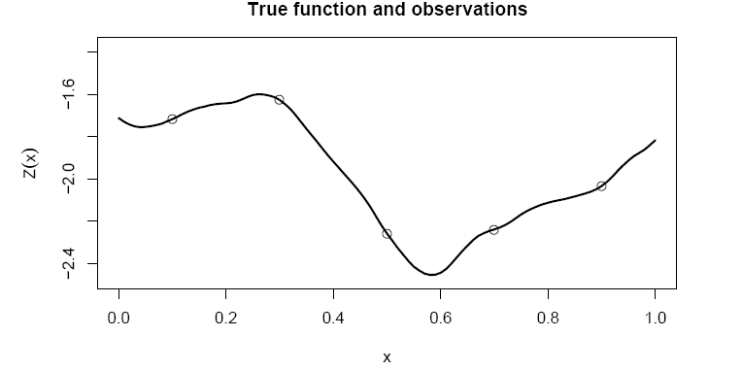
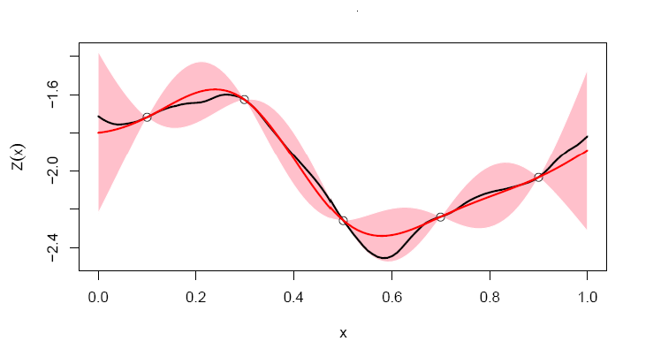
Why use a GP for emulation?
Notes:
Have a computer model
Blck curve
But only have a few trials of the code … dots
Basically a regression problem

Slide 6
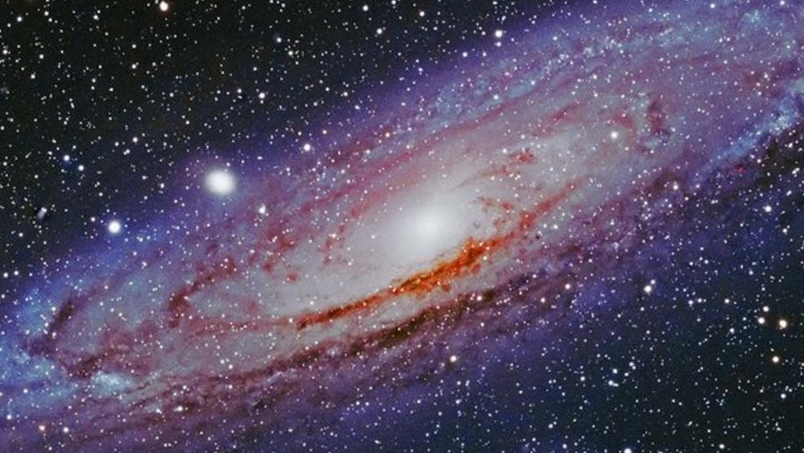
Applications of interest
Upcoming space based cosmology missions promise exquisite measurements of the large-scale structure distribution of the Universe (e.g., including weak lensing, baryon acoustic oscillations, clusters of galaxies, and redshift space distortions)
Currently exploring an 8-dimensional input space that, when combined with observations, should shed light into the initial conditions of the Universe and also the nature of dark energy
Notes:
space including massive neutrinos and variable dark energy equation of state that,

Slide 7
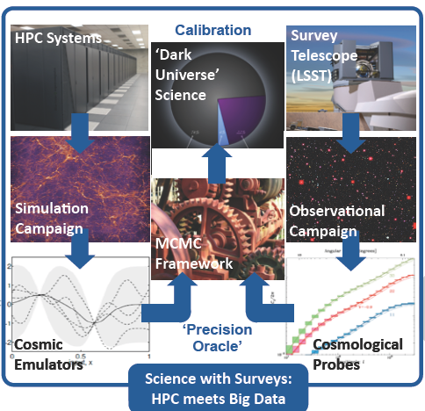
Applications of interest
Notes:
space including massive neutrinos and variable dark energy equation of state that,

Slide 8
Applications of interest
Will be running about 100 simulations that should take between 1 and 2 years to complete … can run several of these in sequence
Can investigate the response in intermediate stages while other simulations are running
Notes:
space including massive neutrinos and variable dark energy equation of state that,

Slide 9
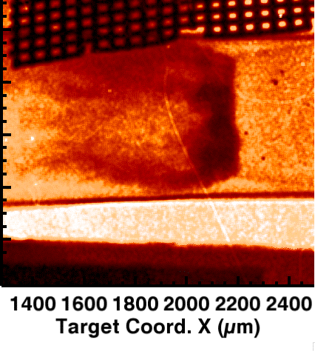
Applications of interest
At the Center for Radiative Shock Hydrodynamics (CRASH), computational models were employed to simulate features of radiative shocks
The CRASH codes consisted of high and low fidelity models
It was helpful the run the high and low fidelity codes with the same inputs to explore the discrepancy between to two models
The low fidelity code was run at far more input settings (high fidelity design was nested within the low fidelity design)
Notes:
Eventually used in a calibration experiment

Slide 10
Design for computer experiments
Johnson et al. (1990) and others (e.g., Kunsch et al., 2005) demonstrate that designs with good space-filling properties are essential for prediction using GPs
Latin hypercube designs (McKay et al, 1989) and other variants (Tang, 1993) have proven popular
For type of sequence of designs and low/high fidelity models, work by Qian (2009), Qian, Tang and Wu (2009) is related
Designs based on Cartesian lattices have also been proposed (Beattie and Lin, 2004; Qian and Ai, 2010)
Single state lattice designs have been discussed (Bates et al., 1996; Pronzato and Müller, 2012; He 2016, 2017)
Here, a new type of lattice design is proposed (based on Heitmann, Bingham et al., 2016)

Slide 11
Would like our designs to have specific properties
Would like n-run designs where each design point is a d-dimensional input vector to the computer model
In our setting would like experiment designs (D) with good d-dimensional space-filling properties
Would like the designs to have the nesting property
  Important for applications where good intermediate-stage designs are required, as well as the final experiment design
  Important for applications with high- and low-fidelity simulators where the high-fidelity simulator design is a sub-set of the larger, low-fidelity simulator design

Slide 12
Suggestion …
Use a lattice
For one-stage designs, can use already computed lattices (Conway and Sloane, 1999) that have good space filling properties
Not quite as easy as you might think …
Is more challenging for our setting where nesting is required

Slide 13
Example
First stage (high-fidelity) design
First and second stage (low-fidelity) design

Slide 14
Notation and definitions
A point lattice is an infinite, discrete set of points in that is constructed from integer multiples of a set of basis vectors in the columns of a d x d generating matrix, G,
A lattice design is the intersection of a point lattice and region that is shifted by a vector, p
See Conway and Sloane, 1999 or Patterson, 1954
Usually the d-dimensional unit hypercube

Slide 15
Fun facts about lattices
As a linear transformation of the integers, lattices inherit their abelian group structure
  … this implies that the neighborhood around each lattice point is the same
  This region is also called the Vornoi cell
The space between the lattice points are described by the fundamental parallelepiped

Slide 16
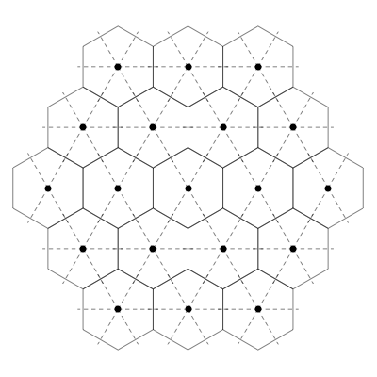
Fun facts about lattices

Slide 17
Example
Factorial design (Cartesian lattice):
Have d inputs with levels s =(s₁, s₂, …, s_{d})
Here G=I_{d} and the lattice is
Region of interest is [0,1)^{d} scaled by diag(s )

Slide 18
We are looking for specific designs
A sequence of designs, is said to be nested if
Increasing l is called a refinement and decreasing l is called coarsening

Slide 19
We are looking for specific designs
A sequence of designs, is said to be nested if
Increasing l is called a refinement and decreasing l is called coarsening
Will be considering sequences of nested lattices

Slide 20
We are looking for specific designs
A sequence of designs, is said to be nested if
Increasing l is called a refinement and decreasing l is called coarsening
Will be considering sequences of nested lattices
                THE END

Slide 21
A result
For two lattices, and , iff there exists a matrix that relates the generating matrices of the two lattices by . And under these conditions, if then .

Slide 22
More notation and definitions
A dilation matrix, , with , applied to a lattice forms a nested sequence of lattices, , via

Slide 23
More notation and definitions
A dilation matrix, , with , applied to a lattice forms a nested sequence of lattices, , via
Sub-sampling a lattice such that the chosen sample is also a lattice is performed by right-multiplying an integer dilation matrix onto G

Slide 24
More notation and definitions
A dilation matrix, , with , applied to a lattice forms a nested sequence of lattices, , via
For this setting, an admissible dilation matrix is one where
  (a) K is a dilation matrix;
  (b) magnitude of all eigen-values of K are larger than 1; and
  (c) det K = , where is the eignen-value for K

Slide 25
Theoretical results we can prove
In [0,1)^{d}, the expected number of lattice points is 1/det G
K must be an integer matrix
For refinement (i.e., l goes up) the volume of the fundamental parallelepiped decreases by |det K| = β
Can show that to get a nested lattice β >1, thus best refinement is to half the volume between points as the run-size is doubled

Slide 26
Why do all this fancy stuff?
Dyadic sub-sampling is impossible for Cartesian lattices with d > 2
For Cartesian lattices, number of lattice points grows exponentially with dimension
The main idea is to:
  use more general, non-diagonal generators, G
  allow for sub-sampling rates that are 2, 3, 5, … (2 is most useful)

Slide 27
Why do all this fancy stuff?
Benefits:
  Sometimes can use general bases for known best packing or covering lattices, leading to a direct construction of maxi-min or mini-max designs, respectively
  can consider virtually any run size
  allows a sequence of designs that can be used in practical applications
  Once bases are computed, do not need to recompute

Slide 28
How do we find designs
Assume that the design region is [0,1)^{d}
n is the experiment run size
looking for a non-singular lattice generating matrix G that, when sub-sampled by a dilation matrix K with reduction rate β = |det K|
Need to find
  G
  K
  Shift, rotation and scaling to fit n points in the design region

Slide 29
How do we find designs
Need some more theory:
Restrict attention to designs where sub-sampled lattice is a scaled or rotated version of the original lattice
GK=QG
Preserves nice geometric properties… rotationally similar
Imposes restrictions on K

Slide 30
How do we find designs… more theory
The restriction (GK=QG) implies the choice of G up to rotation and scale … reason is that this implies that K and Q have same characteristic polynomial
Can prove that: (i) for even d , there are 5 different K; and (ii) for odd d there is only 1 K
Restricting to diagnolizable K and Q, finding K allows us to find G and Q
We can still warp these G and we do so to optimize a desirable property (e.g., mini-max, maxi-min, correlation between columns of the design matrix)
Finally, G is scaled so that G*=det cG = 1/n …

Slide 31
How do we find designs
Finally, we can use the generating matric G* and K to construct our lattice design
However, the number of points in the region of interest is only expected to be n
So, we randomly rotate G* and also shift the lattice to achieve the desired run-size in [0,1)^{d}

Slide 32
Algorithms
Algorithm 1: Obtain a lattice with isotropic dilation matrix K
  For given input dimension and sub-sampling rate construct isotropic dilation matrix K
  Form the generating matrix, G
Algorithm 2: Produce a lattice design in the unit hypercube
  Consists of finding possible designs under random shifts, p, of the lattice given G, Q and K
  Effective to first determine points in a bounding box of design region and then find which of these points are in design region
Algorithm 3: Can further refine based on random shifts, p, and rotations Q*, to optimize additional properties

Slide 33
Example
First stage (high-fidelity) design
First and second stage (low-fidelity) design

Slide 34
Cosmology – what did we do?
Had 8-dimensional input space, n=100 runs in 3 stages:
Notes:
space including massive neutrinos and variable dark energy equation of state that,

Slide 35
Cosmology – what did we do?
Had a low-fidelity model (linear power spectrum) to test the efficacy of the designs
Used a 3-stage lattice design n₁=25; n₂=25; n₃=50 (optimized via maximin criterion)
  Ran each design on the low-fidelity code and did intermediate analyses (i.e., after 25 runs, 50 runs and finally 100 runs)
  Turned out that several of the runs produced non-physical results
  Had to do with implicit constrains on the dark energy parameters
Notes:
space including massive neutrinos and variable dark energy equation of state that,

Slide 36
Cosmology – what did we do?
Instead, re-did the design procedure using the constraint w_{a}+w_{o} < 0
Notes:
space including massive neutrinos and variable dark energy equation of state that,

Slide 37
Re-cap
  Have proposed a new type of lattice design that is useful in a variety of applications
  Can be used to find designs with good space filling properties
  Can find large designs from small ones
  We are pre-computing good bases for different d

Slide 38
Thank you for indulging me

Slide 39
More notation and definitions
A dilation matrix, , with , applied to a lattice forms a nested sequence of lattices, , via
For this setting, an admissible dilation matrix is one where (a) K is a dilation matrix; and (b) , where is the eignen-value for K
Sub-sampling a lattice such that the chosen sample is also a lattice is performed by right-multiplying an integer dilation matrix onto G
Dyadic sub-sampling: discards every second point in each basis vector direction (K=2I; 2^{d} )

