Slide 1



中国科学院大气物理研究所
大气科学和地球流体力学数值模拟国家重点实验室
Target observations for improving initialization of two types of El Nino events predictions
Wansuo Duan, Ben Tian, Lei Chen, Xuquan Li
LASG , Institute of Atmospheric Physics, Chinese Academy of Sciences
Beijing 100029, China
Email: duanws@lasg.iap.ac.cn
Notes:
Ladies and Gentleman, Good afternoon. In my presentation, I would talk about the initial errors most likely to cause a significant SPB for two types of El Nino events.

Slide 2
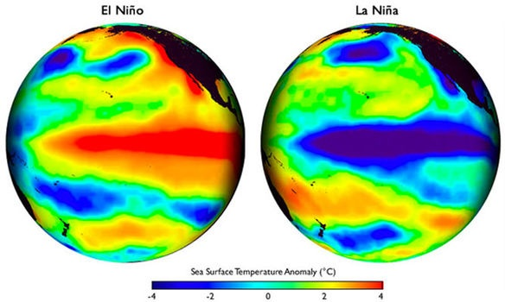
Introduction
El Nino-Southern Oscillation (ENSO)
ENSO is the dominant inter-annual climate mode in the ocean-atmospheric coupled system.
Notes:
We know the ENSO. It is the dominant inter-annual mode in the ocean-atmospheric system and includes the warm phase El Nino and cold phase La Nina. This picture shows the typical El Nino with warm SST center in equatorial east Pacific.

Slide 3
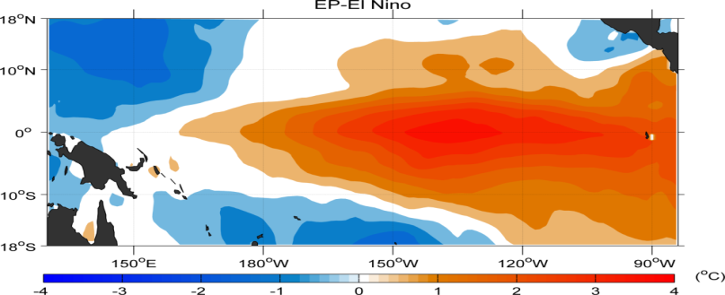
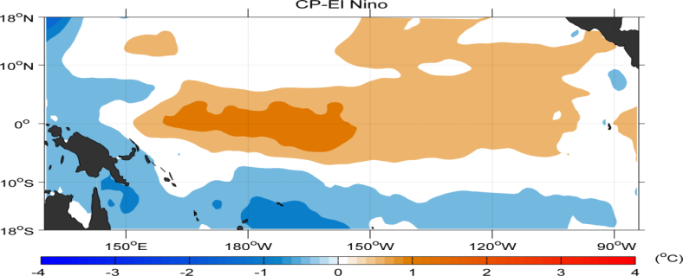
Two types of El Nino events (Diversity of ENSO)
Sea surface temperature anomaly (SSTA)
EP-El Nino
CP-El Nino
(Larkin and Harrison, 2005; Ashok et al., 2007; Kug et al., 2009; Kao and Yu, 2009; Takahashi et al., 2011)
1
Notes:
After 1990s, a new type of El Nino started to frequently occur after 1990s. And the El Nino is classified into EP- and CP-types of El Nino.

Slide 4
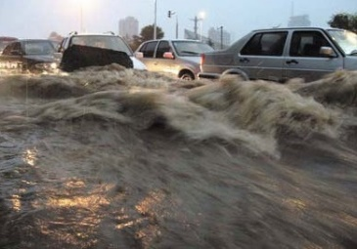

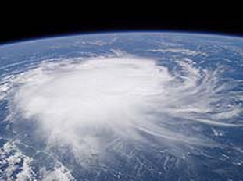
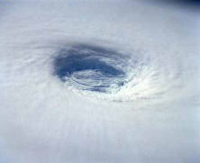
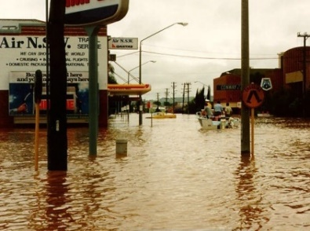
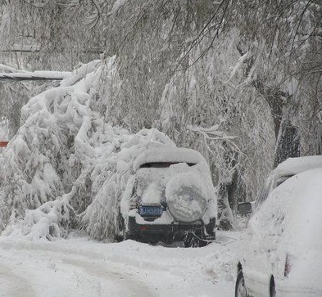
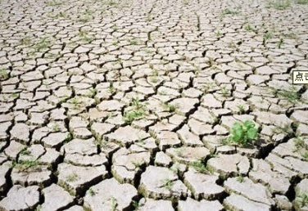
Influences of ENSO on global weather and climate
Warm winter in Canada and north US.
Fewer tropical cyclones in Atlantic.
Fewer tropical cyclones in northwest Pacific.
More rains in the south US.
China: warm winter; more rains in the north and less rains in the south.
Drought in northeastern Brazil and Central America.
More tropical cyclones in eastern Pacific.
Drought in Indonesia and eastern Australia.
More rains in eastern Africa.
More rainstorms in South America.
Drought in South Africa.
El Nino influence the global weather and climate and often plays precursor of weather
and climate anomalies.
Differences between EP- and CP-El Nino exist in influences on weather and climate
It is great value to forecast successfully the El Nino, and even types of El Nino.
Notes:
The El Nino and La Nina, especially the El Nino significantly influence the global weather and climate and often regarded as the precursors of weather and climate anomalies. Furthermore, there are significant differences between EP- and CP-El Nino in their influences on weather and climate. SO it is great value to successfully forecast ENSO, especially predict which type of El Nino will occur.

Slide 5
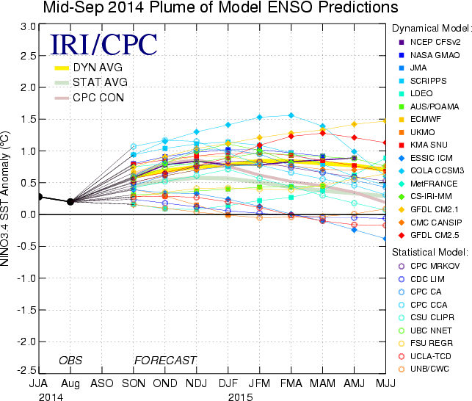
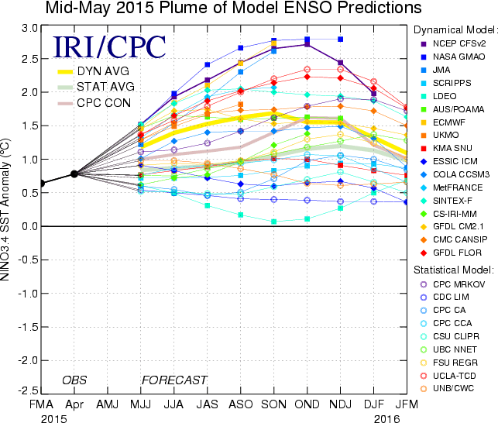
Prediction uncertainty for ENSO
Considerable uncertainties still exist in realistic ENSO predictions (Jin et al., 2008; Luo et al., 2008; Kirtman et al., 2012; Jeoung 2012)
The forecast of Nino3.4 index during 2014/15
The forecast of Nino3.4 index during 2015/16
Challenges: Details (amplitude, onset time; Kirtman et al., 2012); Diversity (1-4 months lead time) （ Jeong et al. 2012）
Notes:
The ENSO prediction is most successful among climate predictions. But the predictions cannot exactly give the details. It is also hard for the predictions to distinguish the types of El Nino and so there still exist considerable uncertainties in realistic ENSO predictions.

Slide 6
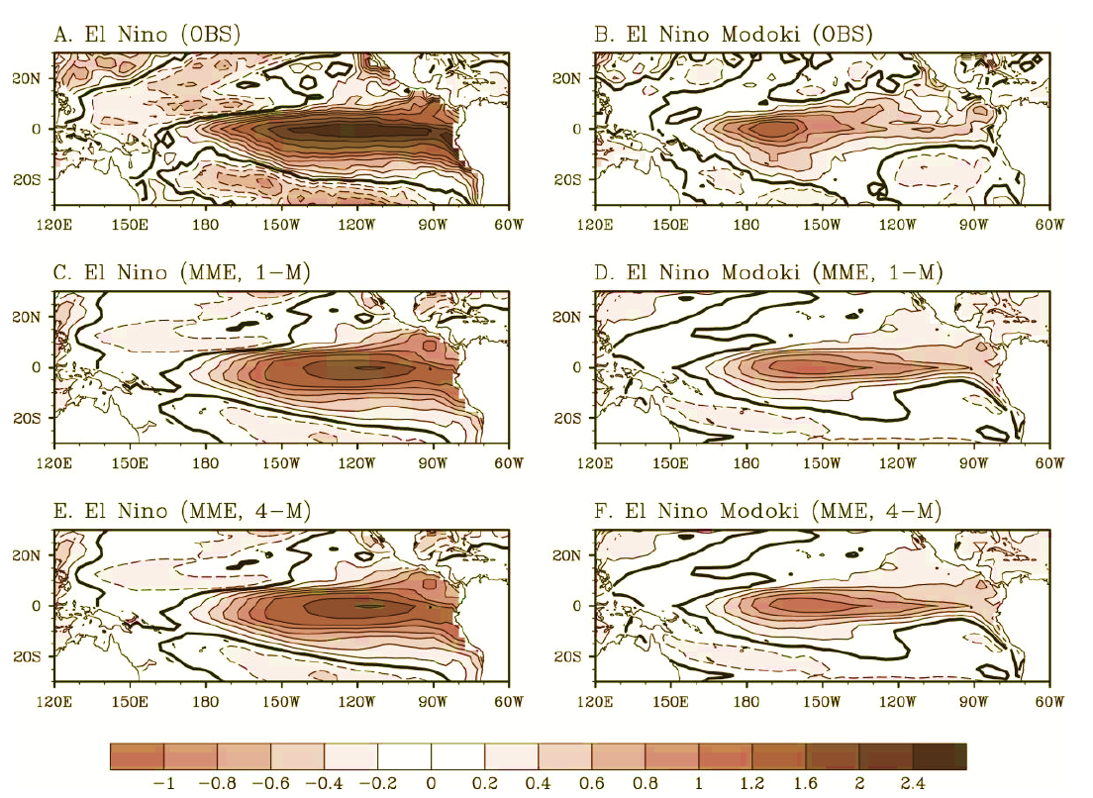
Role of initial condition accuracy in distinguishing two types of El Nino
(Jeong et al. 2012；Luo et al., 2014；Duan an Tian, 2015; Tian and Duan, 2016)
EP-El Nino
CP-El Nino
Difference between EP- and CP-El Nino. The effective prediction skill holds only one month ahead
MME shows a skillful forecast at leading 4 months；
Memory for the evolution of the two types of El Niño reside in the differences of initial conditions.
Notes:
For predictions of two types of El Nino, some studies showed that the effective skill holds only one month ahead. Even if using the multi-models ensemble, the skillful forecast is only at leading 4 months. And they also showed that for a good model, the memory for the evolution of ……

Slide 7
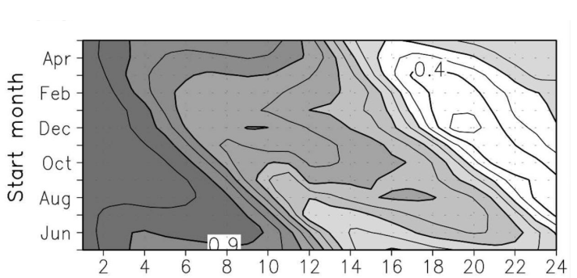
Spring predictability barrier (SPB) for ENSO
Initial errors can cause significant SPB and significantly contributes to the prediction uncertainties for ENSO (see review of Duan et al., 2016)
Luo, J.-J., S. Masson, S. Behera, and T. Yamagata 2008:. J. Climate, 21(1), 84-93.
SPB: an apparent drop in ENSO prediction skill in spring and the beginning of summer (Webster and Yang,1992);
---- The fastest error growth occurring in spring and the beginning of summer (Moore and Kleeman, 1996; Mu et al., 2007; Duan et al., 2009; Duan et al., 2015)
Notes:
Therefore, to improve the EP and CP-El Nino events forecast skill,we should improve the accuary of initial fields.

Slide 8
The accuracy of initial field could help improve the forecast skill of EP- and CP-El Nino events.
Sufficient observations are fundamental to the accurate initial conditions.
Field observations are costly and will never be dense enough to fully cover the vast space.
Find the areas where the observations should be preferentially deployed for improving forecast skill much more
-------Target observation

Slide 9
Target observations
（Snyder, 1996）
t_{d}: decision time；t_{o}: target time；t_{v}: verification time
Sensitive areas
Verification
areas
t_{d}
t_{o}
t_{v}
To better predict an event at a future time t_{v} (verification time) in a focused area (verification area), additional observations are deployed at a future time t₀ (target time, t₀ < t_{v}) in some special areas (sensitive areas) where the additional observations, when assimilated to initial field, are expected to have the largest contribution to reducing the prediction errors in the verification area
Notes:
Actually, we can improve the accuracy of initial conditions by target observation, also the adaptive observations. The so-called target observation is a new observational strategy. It idea is as follows. To better predict an event at a future time t1 (verification time) in a focused area (verification area), additional observations are deployed at a future time t2 (target time, t2 < t1) in some special areas (sensitive areas) where the additional observations are expected to have a large contribution to reducing the prediction errors in the verification area
Why target observation? All observations? In the data assimilation, there exist some observations whose errors the prediction uncertainties are sensitive to while other observations whose errors are not important for the prediction errors. So assimilating the latter observations would increase the computational costs and errors and, due to effect of model errors, play negative role in improving forecast skill. So we should assimilating the useful observations and therefore increase the additional observations in the useful observation-related areas. That is the target observation.

Slide 10
The key of the target observation is to determine the sensitive areas.
Eastern-Pacific El Nino (EP-El Nino) Central Pacific–El Nino (CP-El Nino)
To identify the areas where the observations should be preferentially deployed to improve initialization and then the forecast skill for two types of El Nino events.
Notes:
From the definition of target observation, we can see that …… . So how to ,.. . Particularly, for the new type of CP, its frequently occurring increases the challenge of ENSO predictions.

Slide 11

Purpose: optimizing the observational array of TAO\ TRITON and making it play important role in predicting which type of El Nino will occur.
How to optimize the TAO/TRITON array?
Notes:
To improving the forecast skill of two types of El Nino events, a new tropical observational strategy has been suggested to optimizing the TOGA/TAO.SO this new observational strategy further emphasized the importance of additional observations. So where the additional observations should be preferentially deployed? Actually the target observation may provide useful information for TPOS2020.

Slide 12
Questions:
Which regions are the sensitive areas for targeting observations associated with EP- and CP-El Nino events predictions?
Can the additional observations in the sensitive areas improve the forecast skill for EP- and CP-El Nino events?
How to optimize the TAO/TRITON array?
Notes:
In this study, we have the questions in this study:

Slide 13
The corrected Zebiak-Cane model
The Zebiak-Cane model is a nonlinear coupled anomaly model for
ENSO (Zebiak and Cane 1987)
The first coupled ocean–atmosphere model to simulate the observed
ENSO interannual variability
Widely used in ENSO predictions and predictability studies
(Blumenthal 1991; Chen et al. 2004; Tang et al. 2008; Mu et al. 2007; Duan et al. 2009; Yu et al. 2012; Duan et al., 2013; 2014)
Notes:
Here, this is the model used in the present study. The Zebiak-Cane model is ……, which is the first ….., and has been widely used in ENSO predictions and predictability.

Slide 14
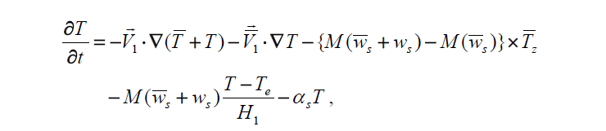
Most models can reproduce EP-El Nino well, but fails to generate CP-El Niño
(Duan et al. 2014; Jeong et al. 2012; Kim et al. 2012; Kug et al. 2012; Hendon et al. 2009)
The model bias (i.e the annual-mean SST, convective precipitation, nonlinear temperature advection, etc.) may induce the systematic errors for the simulation of the two types of El Niño.
The optimal forcing vector (OFV) approach is proposed and used to correct the Zebiak-Cane model, finally reproducing successfully the observed two types of El Niño events. (Duan et al. 2014)
The corrected Zebiak-Cane model can be a platform for studying the predictability of two types of El Niño events.
The corrected Zebiak-Cane model
An optimal correct term is added to the temperature equation of Zebiak-Cane model.
Notes:
The present study focus on two types of El Nino events. But we know most climate models can only reproduce EP-El Nino well, but fails to generate CP-El Nino. The Zebiak-Cane model is also in this case. This is certainly due to the effect of model errors. This study used an approach of optimal forcing vector to correct the model and finally reproduce the observed two types of El Nino events. So it seems that the corrected ZC model can reproduce the two types of El Nino events, so as to be a platform for studying target observations for two types of El Nino predictions. Exactly, the corrected ZC model is based on the Zebiak-Cane model. An external forcing is added to the temperature equation of the model and make the model simulation closest to the observations.

Slide 15
Method: conditional nonlinear optimal perturbation
Sensitive areas for target observation
Sensitive initial errors
Conditional nonlinear optimal perturbation-type initial errors
(CNOP-type initial errors; Mu et al., 2003; Duan and Mu, 2009)
Cost function:
CNOP
CNOP represents the initial error that cause the largest prediction error at prediction time, i.e. the most sensitive initial error.
Notes:
Our purpose is to find the optimal observational layout and the target observation can provide useful information. We know, the key of the target observation is to find the sensitive areas. The sensitive areas mean that the initial errors in the sensitive areas contributes most to the prediction errors. That is to say, the prediction errors are most sensitive to the initial errors in the sensitive areas. So to find the most sensitive areas, we use the approach of conditional nonlinear optimal perturbation. For short, CNOP. The CNOP can be obtained by this optimization problem, where MT is the nonlinear propagator of a model and U_0 is the initial value of events to be predicted and u_0 is initial error. This inequality is constraint condition, which is used to constrain the amplitude of initial errors. The CNOP represents the initial error that cause the largest prediction error at prediction time. Therefore, the CNOP-type errors are the most sensitive initial errors.

Slide 16
Reproduced CP- and EP-El Niño events
(to be predicted)
An optimal forcing vector approach was applied to correct the Zebiak–Cane model and EP- and CP-El Nino events were reproduced based on observations (Duan et al., 2014).
CP-El Nino events
EP-El Nino events
1990/91
2002/03
2004/05
1982/83
1987/88
1997/98
Notes:
These are the reference state CP- and EP-El Nino events reproduced by the Zebiak-cane model and the OFV approach. There are three CP- and three EP-El Nino events. Now we predict these El Nino events for one year lead time with the start month January and calculate the most sensitive initial errors by using CNOP.

Slide 17
Results: the most sensitive error for CP-El Nino
CNOP-type initial errors for CP-El Nino events
CP-type-1 error
CP-type-2 error
Both of these two errors cause much larger prediction error for CP-El Nino events.
Notes:
Ok, this is the most sensitive initial errors described by CNOP-type errors for CP-El Nino events. They can be classified into two types. That is CP-type-1 and -2 errors. This is the SSTA component and this is the thermocline depth anomaly component. Both of these two errors cause much larger prediction errors for CP-El Nino events.

Slide 18
Season-dependent growth of CP-type-1 and -2 errors
The CP-type-1 errors tend to occur a significant SPB
The CP-type-2 errors fail to result in a prominent SPB
Notes:
But we find that the CP-type-1 errors tend to make the CP-El Nino events to occur a significant SPB; while the CP-type-2 errors fail to result in a prominent SPB for CP-El Niño. Exactly, this figure shows the growth rate of prediction errors caused by CP-type-1 and -2 errors with start months being jan, Apr. Jul, and Oct. We can see that the CP-type-1 errors tend to grow significantly in AMJ and JAS, indicating a SPB occurring. But for the CP-type-2 errors, the seasons with the largest error growth rate are dependent on start months. The growth of the prediction errors caused by the CP-type-2 errors does not phase-lock to any season; this implies that SPB does not occur, despite generating a large prediction error.

Slide 19
Predicted CP-El Nino with CP-type-1 and -2 errors
Both CP-type-1 and -2 CNOP errors represent the most sensitive initial errors for CP-El Nino and mainly exert their influence on the spatial structure of the CP-El Niño, make the CP-El Nino to be predicted into EP-El Nino-like events.
Notes:
This figure shows the predicted SSTA. We find that these CP-El Nino events, due to the effect of CP-type-1 and -2 errors, are often predicted into EP-El Nino–like events. So

Slide 20
Results: the most sensitive errors for EP-El Nino
CNOP-type errors for reproduced EP-El Nino events
EP-type-1 errors
EP-type-2 errors
Notes:
These are the most sensitive errors for EP-El Nino events. EP-type-1 and -2 errors have almost opposite patterns. But both of them cause the largest prediction error for EP-El Nino events.

Slide 21
Point: Both EP-type-1 and -2 cause a significant SPB for EP-El Nino.
Different from CP-El Nino: CP-type-1 causes a significant SPB while CP-type-2 fails to do it for CP-El Nino.
Point: EP-type-1 and -2 represent the most sensitive initial error for EP-El Nino events and mainly exert their influence on the intensity of EP-El Nino events (over-predicted or under-predicted).
Different from CP-El Nino: the CP-type-1 and -2 mainly exert their influence on the structure of CP-El Nino.
Notes:
Furthermore, both of them cause a significant SPB for EP. This result is different from CP: as we showed, CP also has two types of most sensitive initial errors CP-type-1 and -2 errors, but CP-type-1 …. We have show that the CP-type-1 and -2 make the

Slide 22
Comparing the most sensitive initial error for EP- and CP-El Nino
EP-type-1 errors = CP-type-1 errors;
They make both EP- and CP-El Nino events to occur a significant SPB and cause the largest predictions errors
but they make the corresponding EP-El Nino to be over-predicted, but cause the CP-El Nino to be predicted into EP-El Nino-like events.
Point: Such initial error represents the most sensitive error for two types of El Nino events (this result is for predictions with start month January).
Notes:
These results are for the predictions with the start month January. Actually, when we calculate the most sensitive errors for the predictions with other start months. And we find that….

Slide 23
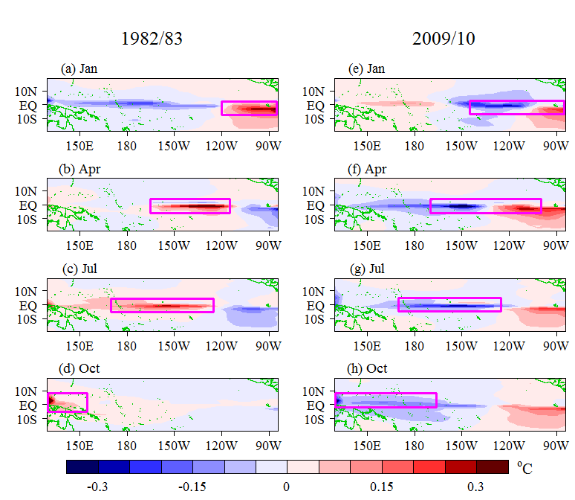
Dependence of most sensitive initial errors on start months
The SSTA components of the most sensitive initial errors
EP-El Nino
CP-El Nino
Areas of large errors
Sensitive areas
The west pole of the most sensitive errors move towards west with the start month changing from Jan (0) →April (0) → July (0) → Oct (0)
The sensitive areas are dependent on the start months of predictions
Notes:
The EP- and CP-El Nino events have the most sensitive error of similar structure. And the SSTA component presents its west pole westward with the start month changing from Jan, through April and Jul, to Oct. We notice that these errors mainly centralize in few regions, which indicates that the initial errors in these regions contribute to most of the prediction errors for two types of El Nino events and the prediction errors for two types of El Nino events are most sensitive to the initial errors in these regions. SO if we are preferentially increase additional observations in these regions and assimilate them to the model initial fields, the forecast skill for both two types of El Nino could be greatly improved. Such regions represent the sensitive areas for two types of El Nino events. From this figure, we can see that the sensitive areas are dependent of the start months of predictions.

Slide 24
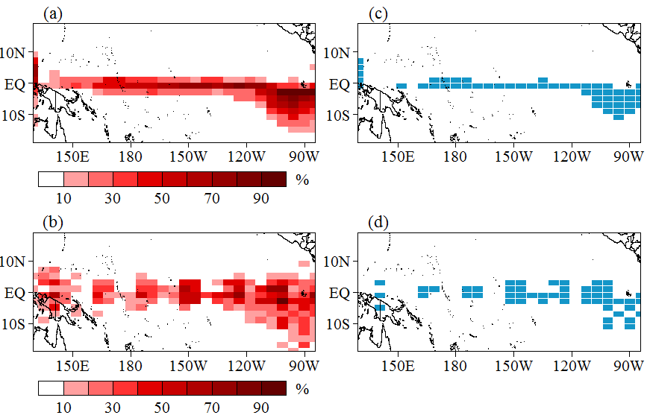
Determine the optimal observational array for El Nino diversity predictions
6 EP- and CP-El Nino events and 4 start months
24 predictions
24 most sensitive initial errors
Frequency of grid point whose location is in the sensitive areas determined
by 24 most sensitive errors. This frequency measures the ability of the grid
observation in improving the skill of the 24 predictions. The first 50 grid points
with large frequency are chosen as the optimal observational array.
Frequency
Observational array
SSTA
SA_{SST}
Thermocline depth
SA_{THD}
Notes:
Now we use the information of sensitive areas for two types of El Nino events to design the optimal observational layout. Actually, for the chosen 6 El Nino events, we predicted them with the start months Jan, Apr, Oct, Jul, and Oct. Then we can get 24 predictions for these El Nino events and then we can calculated 24 most sensitive errors. For these 24 initial errors, we calculate the frequency of the grid points whose locations are in the sensitive areas determined by the 24 most sensitive errors.

Slide 25
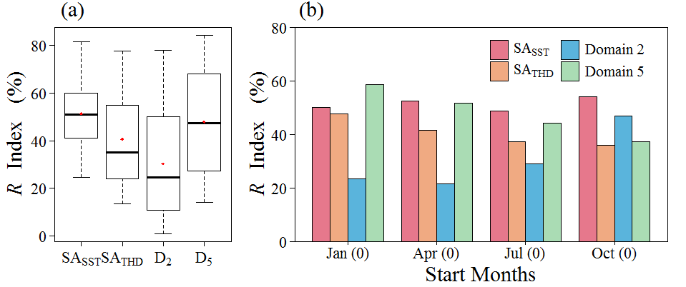
The improvement of prediction skills
when target observation is deployed in SA_{SST} and SA_{THD}
R=(|Pred. errors with target obs.
− those without target obs|) / Pred errors without target obs.
The target observations in SA_{SST} is always more useful for improving two types of El Niño events predictions.
The improvement of prediction skills when eliminating the initial errors in SA_{SST} is independent on start months.
Notes:
Now we examine the improvement of prediction skills for two types of El Nino events when target observations are deployed in the SA_SST and SA_THD. We define an index R, which is formulated by the prediction errors with target observations minus those without target observations and then divided by the latter, which indicates that the improvement rate of the forecast skill. This figure shows the R index. It is shown that the R index when the target is in the SA_SST is much larger than that when the target in SA_THP and other regions. This means that the target is deployed in the SA+SST, the prediction errors for two types of El Nino can be much largely reduced and the forecast skill can be much greatly improved.

Slide 26
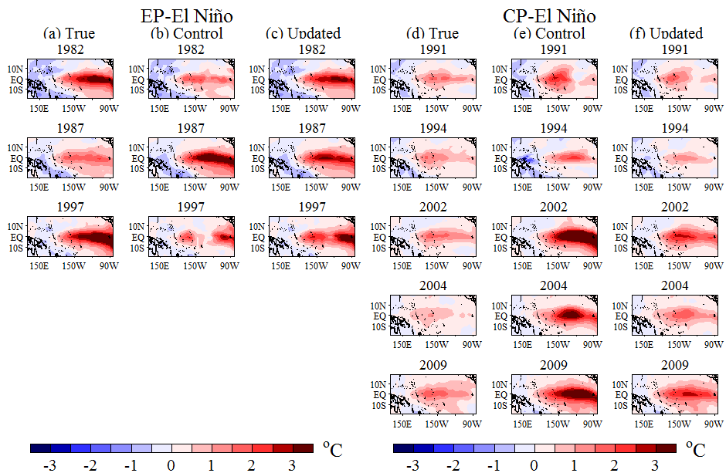
Predicted SSTA patterns during El Niño mature phase
The updated predictions when targeting in SA_{SST} can give much better SSTA pattern during El Nino peak phase; especially for the CP-El Niño, control predictions cannot give its SSTA pattern while the update predictions do it well.
Notes:
Also the predicted SSTA patterns during El Nino mature phase are greatly improved. We further look at the predicted El Nino mature phase SSTA patterns when targeting. This figure shows real El Nino, control forecast, and updated forecast with targeting. This is for EP and this is for CP. We can see that the updated forecasts predict out much better pattern for these El Nino events, especially for the CP-El Nino events.

Slide 27
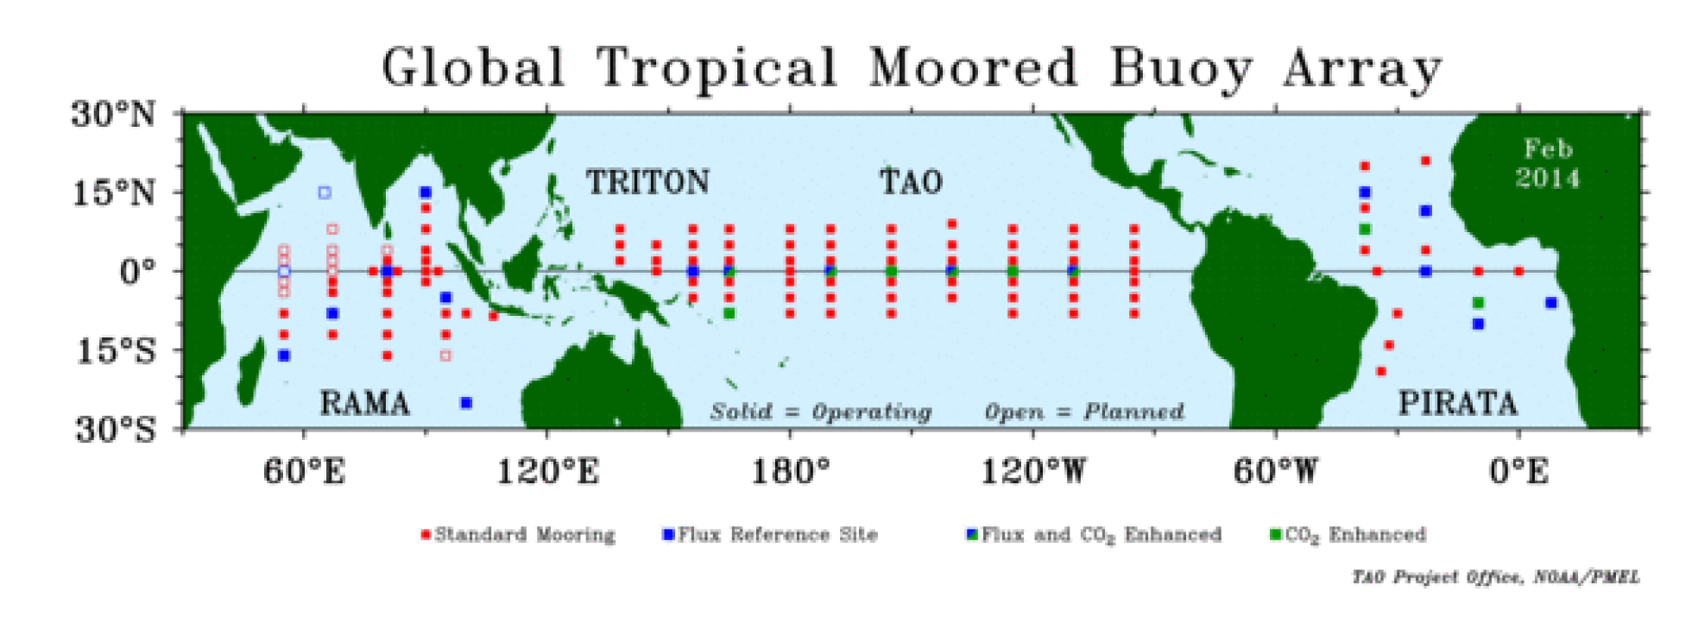
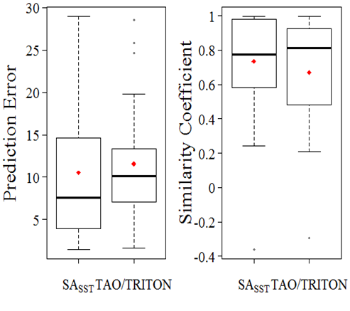
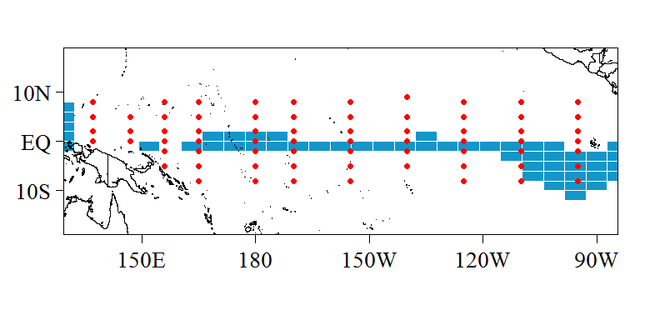
Comparision with the TAO/TRITON array
Prediction skill
Red points: TAO/TRITON
Blue points: SA_{SST}
The prediction errors are much smaller when assimilating in SA_{SST} while the similarity coefficients are similar for both SA_{SST} and TAO/TRITON.
However, the SA_{SST} has less grid points (50 for SA_{SST} and 65 for TAO/TRITON).
Notes:
Ok, we make another comparison. As you know, the TOGA project has achieved a TAO/TRITON array for tropical SST observations, as shown in these red points. This array has helped get great achievement in ENSO researches and predictions. Now we compare the prediction skill of two types of El Nino events when assimilating the observations in TAO/TAITON and SASST.

Slide 28
Optimizing TAO/TRITON (TPOS2020)
One should preferentially deploy additional observations in SA_{SST} areas
Notes:
In this sense, we think the SASST is the optimal observational array for two types of El Nino events predictions. And we can use this array to optimize the TAO/TRITON.

Slide 29
Summary
Find out the most sensitive initial errors for both EP- and CP-El Nino events;
----- Such errors cause SPB for EP- and CP-El Nino, over-predict EP but make CP to be predicted into EP-like.
Reveal the sensitive areas for target observations for two types of El Nino events predictions
----- The sensitive areas are the same for EP and CP.
----- The sensitive areas are dependent on start months
Provide ideas for optimizing the TAO/TRITON (TPOS2020)
---- One should preferentially deploy additional observations in the optimal array shown in the present study, which has been shown to be more useful in predicting EP and CP.

Slide 30
Thank you!

Slide 31
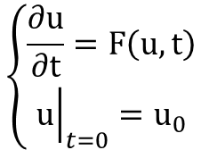

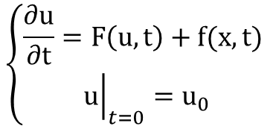


The Optimal Forcing Vector (OFV) approach（Duan et al., 2014）:
$$\left\{\begin{aligned}\frac{∂u}{∂t}=F\left(u,t\right) \\ {\left.u\right|}_{t=0}=u_{0}\end{aligned}\right.$$
$$\left\{\begin{aligned}\frac{∂u}{∂t}=F\left(u,t\right)+f(x,t) \\ {\left.u\right|}_{t=0}=u_{0}\end{aligned}\right.$$
$$M_{T}^{f}\left(u_{0}\right)\left(f\right)$$
The nonlinear propagator from 0 to T.
$J$(f)=$\left\|M_{T}^{f}\left(u_{0}\right)\left(f\right)−u_{T}^{obs}\right\|$
$$f^{∗}=arg\min_{f}{J\text{(}\text{f}\text{)}}$$
The OFV makes model simulation closest to observation
Notes:
The OFV is derived by this optimization problem. For this equation, it has model errors and cannot reproduce the

Slide 32
Implication and Discussion
The most sensitive initial errors for EP- and CP-El Nino
They present their largest errors for SSTA in localized regions: the tropical central and eastern Pacific.
Point：These regions represent sensitive areas for targeting observation (optimal observational locations) for advancing both EP- and CP-El Niño events forecasting skill beyond spring.

Slide 33
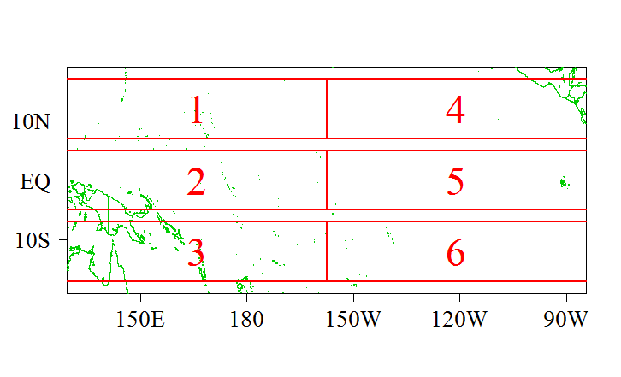
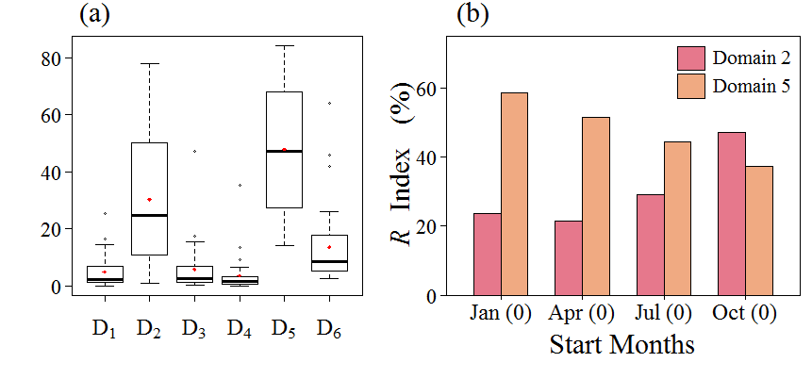


Target observation for two types of El Niño events
Additional observations in certain area
Improvement of prediction skills
The improvement of prediction skills when target observation in Domain 1-6
6 equal-sized areas
$R=\frac{E_{c}−E_{u}}{E_{c}}×100\%$,
$E={\left\|T^{′}\right\|}_{2}=\sqrt{\sum_{i, j}{{T_{i, j}^{′}}^{2}}}$.
The eastern tropical Pacific and the western tropical Pacific are the most important in target observation of two types of El Niño events ;
The sensitive areas for targeting observation of two types of El Niño events vary with the start months.
Westward Jan (0) →April (0) → July (0) → Oct (0)
Notes:
Actually, we only choose the most sensitive initial errors with the start month Jan to determine the

Slide 34
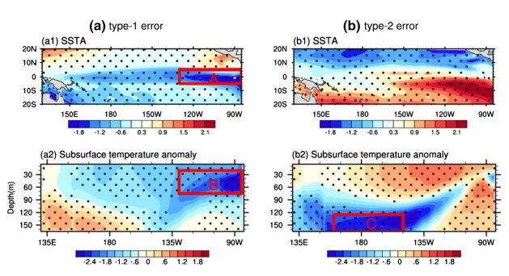
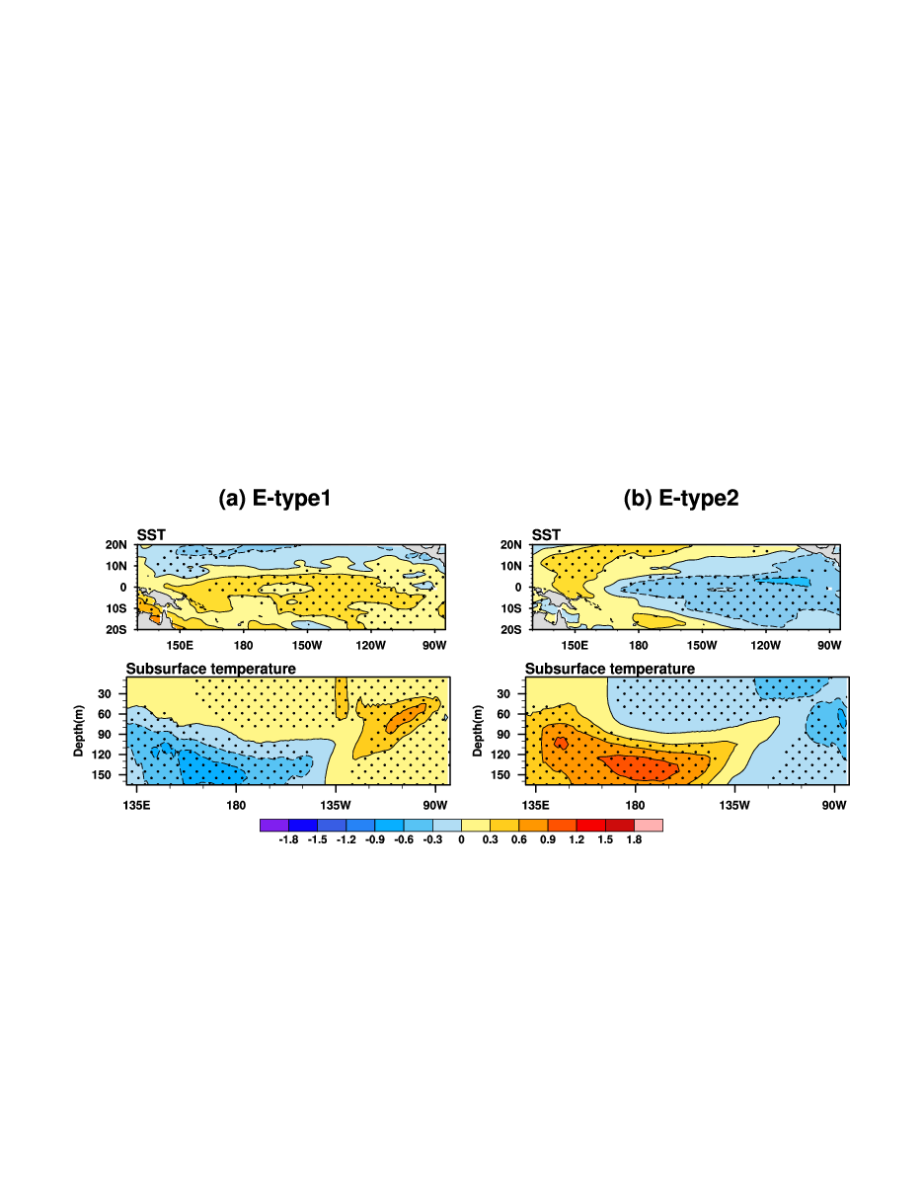
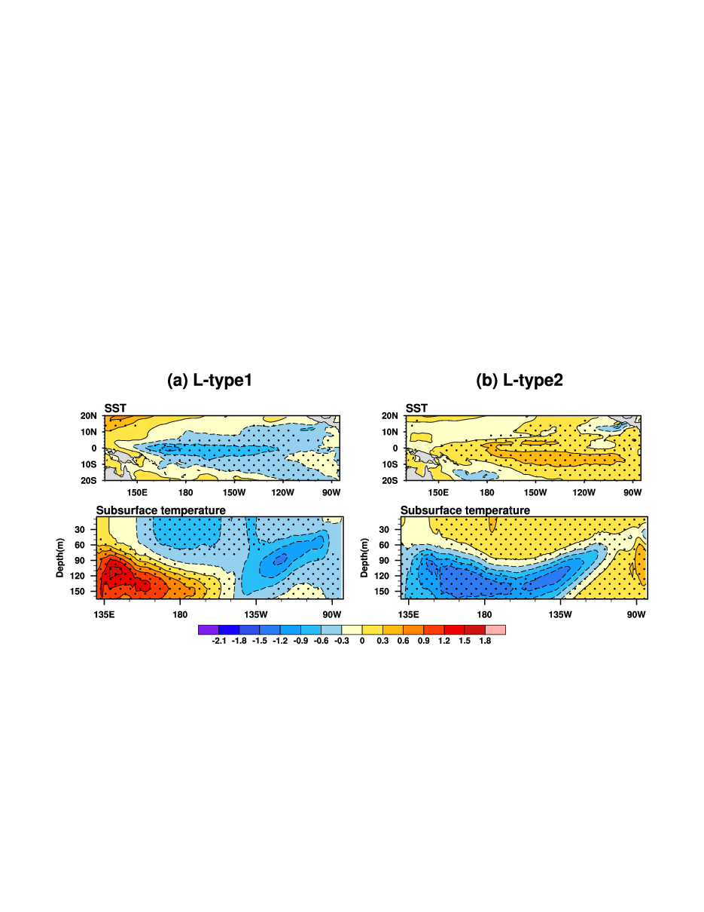
Results-CESM
CNOP-like initial errors and optimal precursor for ENSO
CNOP-like errors
Optimal precursors
for El Nino and La Nina
El Niño
La Niña
Similarity coefficient
El Niño | CNOP error
E-type2 | Whole layer: -0.62
 | Section: -0.90
La Niña | CNOP error
L-type2 | Whole layer：0.62
 | Section：0.94

Slide 35
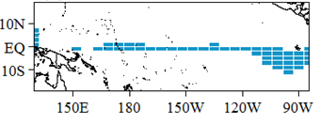
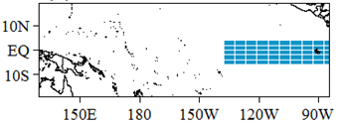
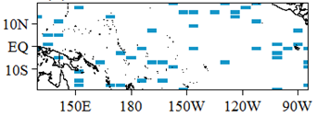
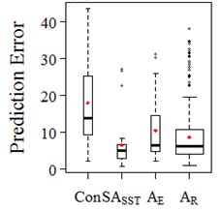
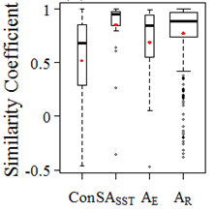
Verification of the sensitive area
Control forecast:
Initial state derived form Chen et al (1995)
Updated forecasts:
Assimilate “observations” in
1、SA_{SST} 2、A_{E}
3、10 random areas
SA_{SST}
The eastern Pacific A_{E}
One of the random areas A_{R}
The prediction skills are the highest when assimilating in SA_{SST} .
SA_{SST} are the most sensitive area for targeting observations.

Slide 36
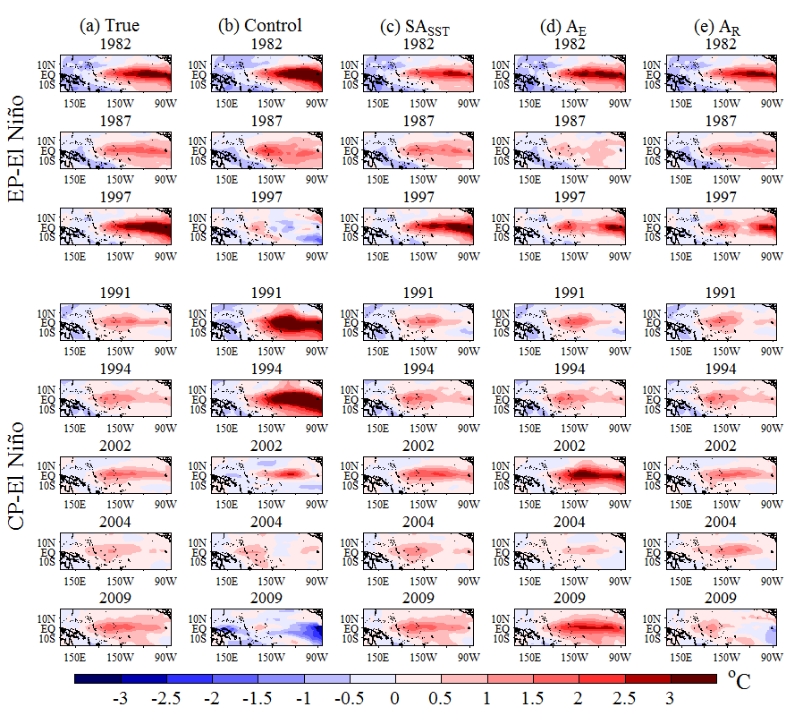
SSTA patterns during El Niño mature phase [Start at Apr (0)]
The improvement for the SSTA pattern of the predictions are the most obvious when target observation is deployed in SA_{SST}.
The improvement for CP-El Niño is more obvious than that of EP-El Niño.

Slide 37
Summary:
Start month: Jan (0) →April (0) → July (0) → Oct (0)
The large error regions of OGEs tend to move westward.
The sensitive areas for target observation of two types of El Niño tend to move westward.
Based on a quantitative frequency method, the sensitive area for target observation (SA_{SST} ) is determined.
When target observation is deployed in SA_{SST}, the prediction skills of two types of El Niño can be largely improved and the improvement is independent on the start months.
Compared to the TAO/TRITON array, SA_{SST} is more efficient in target observation.
From the view of the first kind problem of predictability, CP-El Niño is more predictable than EP-El Niño.

Slide 38
The source of prediction errors
（Lorenz 1975）
The first kind problem of predictability
Initial Errors
Model Errors
The second kind problem of predictability
Singular Vector (SV) (Lorenz 1965)
Breeding Vector (BV) (Lorenz and Emanuel 1998)
Conditional Nonlinear Optimal Perturbation (CNOP)(Mu et al.2003)
Nonlinear Local Lyapunov Vector (Ding and Li 2007)
Conditional Nonlinear Optimal Perturbation about Parameter (CNOP-P) (Mu et al.2010)
Nonlinear Forcing Singular Vector（NFSV）（Duan and Zhou 2011、Duan et al.2014）
The first kind problem of predictability for ENSO forecasts
Initial errors play an important role in ENSO forecasts. (Chen et al. 1995, 2004; Moore and Kleeman 1996; Mu et al. 2007; Thompson 1998; Xue et al. 1997a, b)
The structure of initial error has great impact on ENSO forecasts. (Duan and Hu 2016; Mu et al. 2007; Tian and Duan 2016; Yu et al. 2009)
Prediction Skills can be improved when the initial states are improved. (Chen et al. 1995, 2004； Yu et al. 2012)

Slide 39
The role of initial errors in SPB (Chen et al., 1995, 2004; Moore and Kleeman, 1996; Mu et al., 2007; Duan et al., 2009)
The initial error with a particular structure is most likely to cause a significant SPB (Mu et al., 2007; Duan et al., 2009; Yu et al., 2009)
Conditional nonlinear optimal perturbation-type initial error (CNOP-type error; Mu et al., 2003; Duan and Mu, 2009): the initial error that causes the largest prediction error at prediction time.
Type-1 CNOP error （SSTA）
Type-2 CNOP error（SSTA）
Yu et al., 2009 (Zebiak-Cane model)
Notes:
Quite a few studies explored the SPB and emphasized the role of initial errors in SPB and suggested that the prediction skill of ENSO bestriding spring can be greatly enhanced through improving initialization. Especially, these studies emphasized that the initial error with a particular structure is most likely to cause a significant SPB. More specified, CNOP-type error causes the most significant SPB for ENSO. Furthermore, the CNOP-type errors can be observed in realistic ENSO predictions.

Slide 40
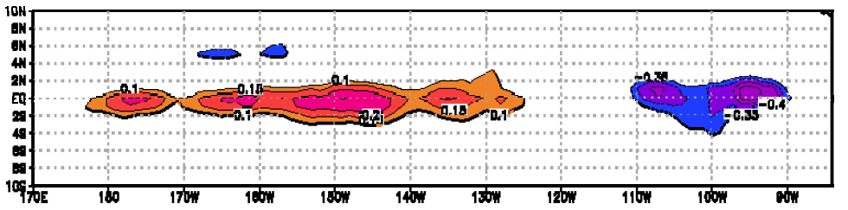
Such initial error can be observed in realistic ENSO predictions (Duan and Wei, 2012;Yu et al., 2013)
Filtering out this kind of initial errors from the realistic predictions, SPB effect can be reduced and ENSO prediction skill can be greatly improved.
Linear function of ENSO prediction error with respect to similarity coefficient between initial analysis error and CNOP-type error indicates existence of CNOP error in realistic prediction of Zebiak-Cane model
CNOP-like errors in the ENSO hindcast generated
by the FGOALS (a GCM developed by LASG)
CNOP-like-1
CNOP-like-2
Non-CNOP-like
Notes:
These results focus on EP-El Nino events but little is known about the SPB for CP-El Nino events. Actually, If we consider the predictions of CP-El Nino, it must be involved with the distinguishing of two types of El Nino events. Here, for the EP-El Nino events, the results emphasized the role of initial errors.

Slide 41
CP-type-2 errors different from the EP-type-2 errors.
The former fails to cause a SPB for CP-El Nino but causes CP-El Nino to be predicted into EP-El Nino-like events;
The latter causes a prominent SPB for EP-El Nino and makes it to be under-predicted.

Slide 42
The key of the target observation is to determine the sensitive areas.
Sensitive areas for ENSO predictions
(Zebiak-Cane model; Duan et al.,2009; Yu et al.,2009)
Large errors concentrate in few localized regions, in which the initial errors may cause much large prediction error compared to other regions.
The most disturbing initial error
Typer-1 CNOP error （SSTA）
Typer-2 CNOP error（SSTA）
A
B
A
B
These regions represent the sensitive areas for ENSO predictions (Yu et al., 2013).

Slide 43
CP-El Niño becomes more common after the 1990s (Ashok et al., 2007; Kao and Yu, 2009; Kug et al., 2009)
CP-El Niño also significantly influence weather and climate, but in different manner from EP-El Nino (Weng et al., 1997)
Frequent occurrence of CP-El Nino after 1990s increases the uncertainties of ENSO forecast (Duan et al., 2016)
Notes:
These above studies mainly paid attention to traditional El Nino, that is, eastern Pacific El Nino (EP-El Nino). But little is known to the central Pacific El Nino (CP-El Nino). Considering that EP-El Nino became less frequent and CP-El Nino more common after the 1990s and CP-El Nino significantly influence weather and climate over globe in a manner but different that of EP-El Nino, it is very neccesary to investigate the predictability for CP El Nino events.

Slide 44
Evolutions of prediction errors caused by CP-type-1 and -2 errors
(SSTA component)
CP-type-1 error has an evolving mode, similar to the growth phase of an EP-El Niño-like event;
CP-type-2 error initially experiences a process similar to a La Niña-like decay prior to a transition to the growth phase of an EP-El Niño-like event
Notes:
This figure shows the evolution of prediction errors caused by CP-type-1 and -2 errors for three CP-El Nino events. We can see that This difference may illustrate CP-type-1 and 2 errors show different behaviors in occurring SPB. Especially, we notice that these two types of initial errors tend to evolve into an EP-El Nino-like event.

Slide 45
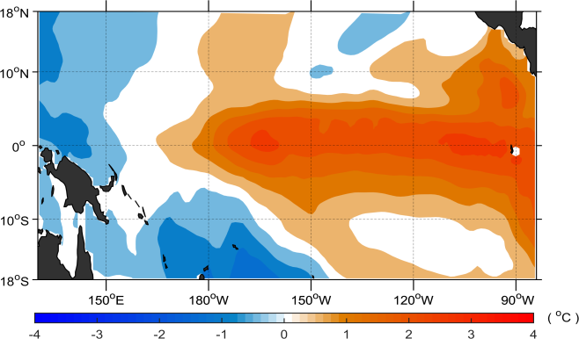
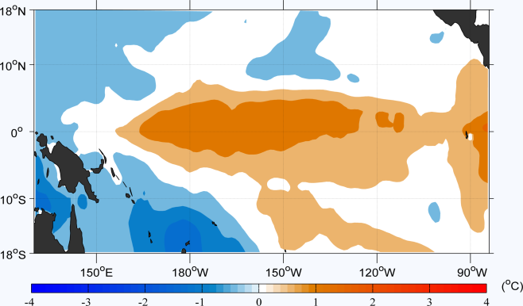
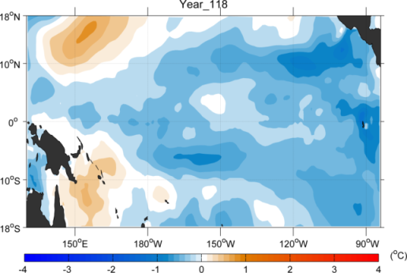
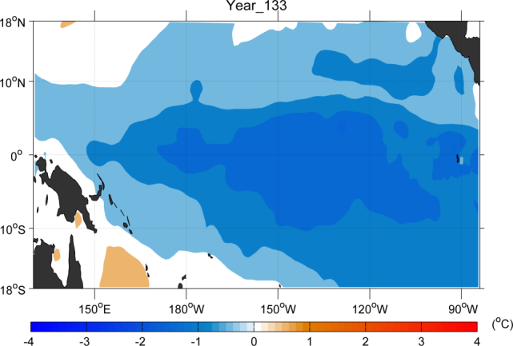
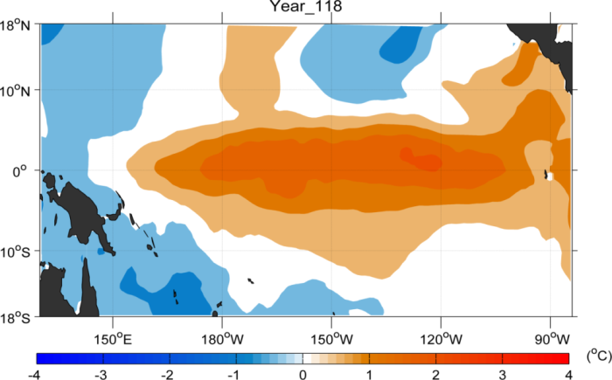

Validity of target observation in improving El Nino forecast skill
EP-El Niño
CP-El Niño
Reference state to be predicted
Control forecast
The forecast after removing initial errors in sensitive area
Idealized forecast generated by the CESM

Slide 46
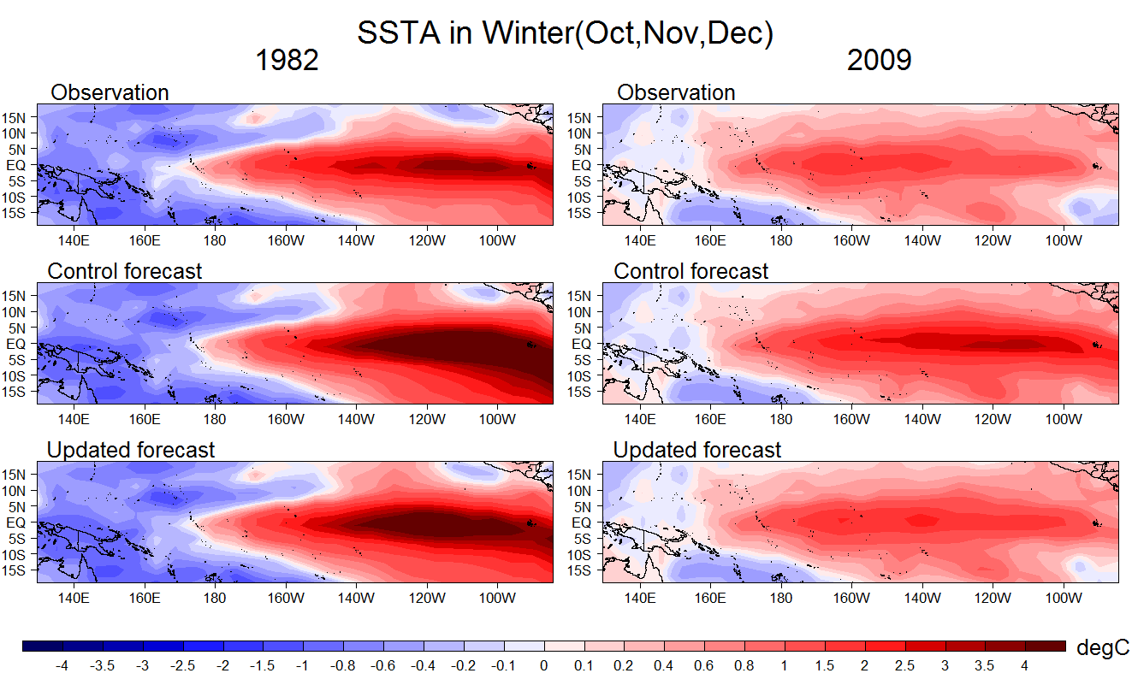
Validity of target observation in improving El Nino forecast skill
Hindcast experiments generated by the Zebiak-Cane model

Slide 47
The target observations in the sensitive areas revealed by the CNOP-type errors are much useful in reducing initial errors and predicting which type of El Niño will occur.
although the most sensitive initial errors play different roles in perturbing EP- and CP-El Niño events

Slide 48
Warm winter in Canada and north US.
Fewer tropical cyclones in Atlantic.
Fewer tropical cyclones in northwest Pacific.
More rains in the south US.
China: warm winter; more rains in the north and less rains in the south.
Drought in northeastern Brazil and Central America.
More tropical cyclones in eastern Pacific.
Drought in Indonesia and eastern Australia.
More rains in eastern Africa.
More rainstorms in South America.
Drought in South Africa.
ENSO can influence the global weather and climate.
It is great value to forecast successfully ENSO.

Slide 49
How to filter out CNOP errors? Target observations
（Snyder, 1996）
t_{d}: decision time；t_{o}: target time；t_{v}: verification time
Sensitive areas
Verification
areas
t_{d}
t_{o}
t_{v}
TARGET OBSERVATION: an observation strategy, to BETTER PREDICT an event at the future time t_{v} in the verification area, the ADDITIONAL OBSERVATIONS are deployed at previous time t_{o} in some SPECIAL AREAS (called as SENSITIVE AREAS)
The predictions are most sensitive to the initial errors in sensitive areas
Notes:
where the additional observations are expected to have a considerable impact on the forecasts in the verification area (Snyder 1996).

