Slide 1
Estimating the effects of copy number variants on intelligence quotient using hierarchical Bayesian models
LAI jIANG
Lady Davis Institute, McGill University

Slide 2
Outline
Context and Problem
Data sets
  IMAGEN
  Saguenay Youth Study
  (Generation Scotland)
Hierarchical Bayesian model
Results
Discussion

Slide 3
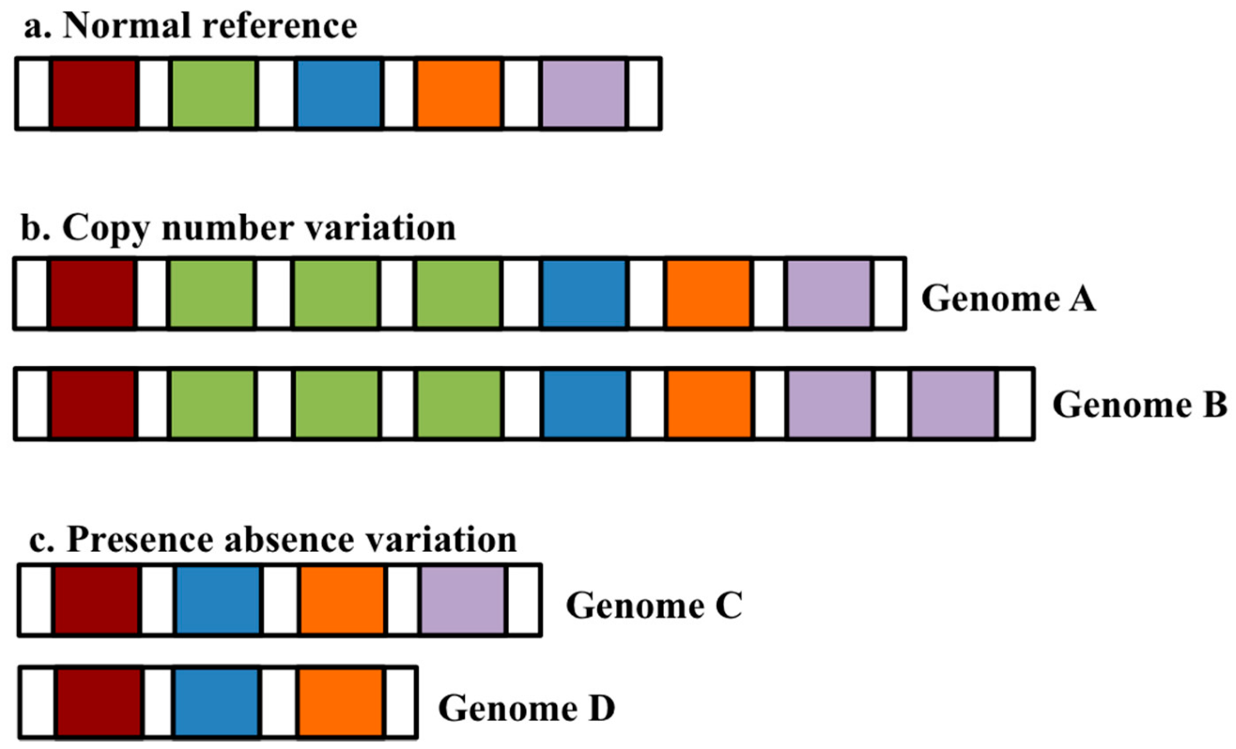
Copy number variation
Image from MDPI

Slide 4
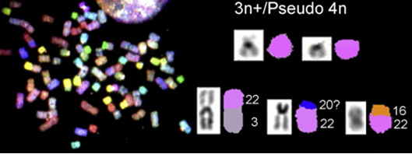
Variation in copy number:
Small : ‘indel’
AAACATAAAGA
AAACAAGA 3bp deletion
AAACATATCTTAAGA 4bp insertion
Medium-sized : « CNVs» Often inferred from genotyping data
Large : chromosomal re-arrangements

Slide 5
Intelligence Quotient (IQ)
Score derived from standardized tests designed to assess general intelligence.
  General population mean = 100
  General population standard deviation = 15
First behavioral trait studied
  Spearman, 1904; Binet, 1905
Associated with many physical and mental illnesses
Strong genetic contribution (80%)
  Plomin, 2015
Sub-scores:
  Verbal IQ (VIQ)
  Non-verbal or Performance IQ (PIQ)

Slide 6
Data Sets
 | Sample | Measure of intelligence | Genotyping
IMAGEN (Europe) | N = 2090 adolescents | Wechsler IQ (verbal and performance) | Illumina 610K
Saguenay Youth Study (Quebec) | N = 1983 (486 families) | Wechsler IQ (verbal and performance) | Illumina 610K (N=599); HumanOmniExpress Beadchip (N=1395)
Generation Scotland (Scotland) | N = 13,597 | G-score | Human Omni Express Exome-8

Slide 7
Team
Sebastien Jacquemont, Ste. Justine Hospital, Montreal
  Guillaume Huguet, Catherine Schramm
Tomas Paus, Baycrest Centre for Geriatric Care, Toronto
Zdenka Pausova, Hospital for Sick Children, Toronto
Gunter Schumann, King’s College London, UK
Ian Deary, University of Edinburgh, UK
Aurélie Labbe, HEC, Montreal
Celia Greenwood, Jewish General Hospital, Montreal
Lai Jiang, postdoctoral fellow

Slide 8
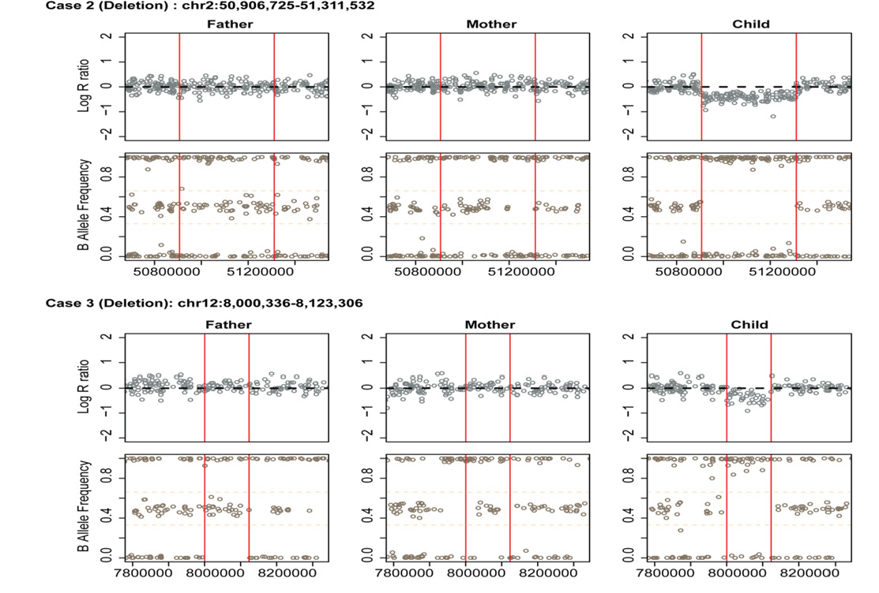
Calling CNVs from genotyping data
Algorithms: PennCNV and QuantiSNP
Cleaning here: At least 50Kb in size
Partially overlapping CNVs were merged
Manually curated for rare and psychiatric CNVs
De novo deletions:
From Huguet et al. 2018; JAMA Psychiatry

Slide 9
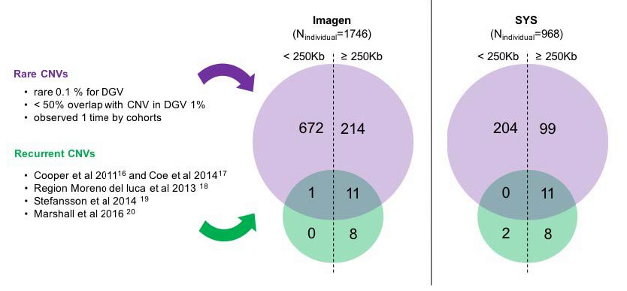
IMAGEN and SYS - numbers of CNVs

Slide 10
Context:
CNVs contribute to neurodevelopmental disorders
  Intellectual disability
  Autism spectrum disorders
  Schizophrenia
Impact of most identified CNVs is unknown
  Unique to family seen in clinic
  Extremely rare
Goal: predict effect of CNVs on IQ and other neurodevelopmental traits
  i.e. Predict effect of rare features

Slide 11
Can predictions be based on annotation information?
Schematic layout of region deleted or duplicated
in the “reference” genome
Gene 1
Gene 2
Gene 3
Size of CNV; Number of genes in CNV;
Expected deleterious effects of mutations in each gene and other gene-based annotation scores
eQTL for genes expressed in brain

Slide 12
Details
Scores included
  Mutation Intolerance scores
    pLI: Lek et al.2016; RVIS: Petrovski et al.2013; DEL: Ruderfer et al. 2016)
  Number of protein-protein interactions
    PPI: Szklarczyk et al., 2015
  Differential stability (DS)
    DS: Hawrylycz et al. 2015
  Genes involved in postsynaptic density of the human cortex
    PSD: Bayés et al. 2011
  Genes regulated by protein FMRP
    FMRP: Darnell et al. 2011
  Expression quantitative trait loci (eQTL) expressed in brain
Some CNVs contained no genes
  Most models assumed all gene scores were zero except for eQTL

Slide 13
Details: scoring CNVs
CNV 1
Gene 1
Gene 2
CNV 2
Gene 3
Gene 4
Gene 5
score
gene 1
+
+
+
score
gene 2
score
gene 3
score
gene 4
score
gene 5
score
CNV 1
+
score
CNV 2
score
individual 1
Annotation by individual
Removed individuals carrying very large CNVs (>10MB)
Deletions and duplications were analyzed separately
Huguet G., Schramm C., Douard E. et al; 2018 JAMA Psy

Slide 14
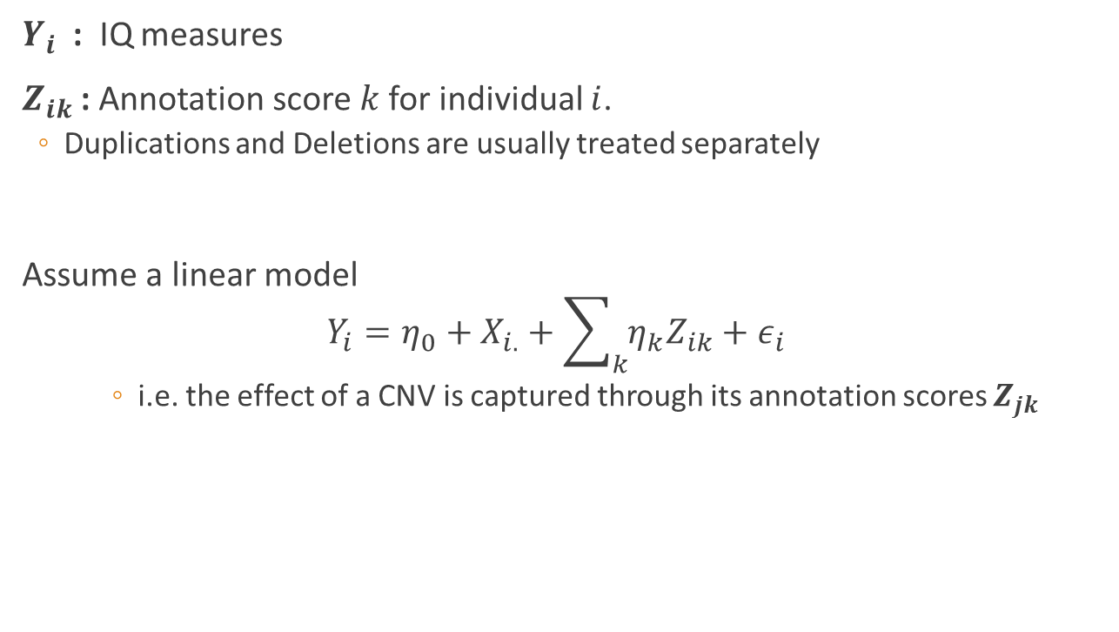
Hypothesis 1
$Y_{i}$ : IQ measures
$Z_{ik}$ : Annotation score$k$ for individual $i$.
  Duplications and Deletions are usually treated separately
Assume a linear model
$$Y_{i}=η_{0}+X_{i.}+\sum_{k}{η_{k}Z_{ik}}+ε_{i}$$
  i.e. the effect of a CNV is captured through its annotation scores $Z_{jk}$

Slide 15
IMAGEN and SYS – linear model
Huguet et al. (2018) JAMA Psychiatry
Stepwise regression
  One annotation feature predicted IQ : pLI
    the probability of being “loss of function intolerant”.
    PIQ: Slope = −2.74, SE = 0.68, p=8x10⁻⁵
    VIQ: Slope - -2.52, SE = 0.71, p= 7x10⁻⁴

Slide 16
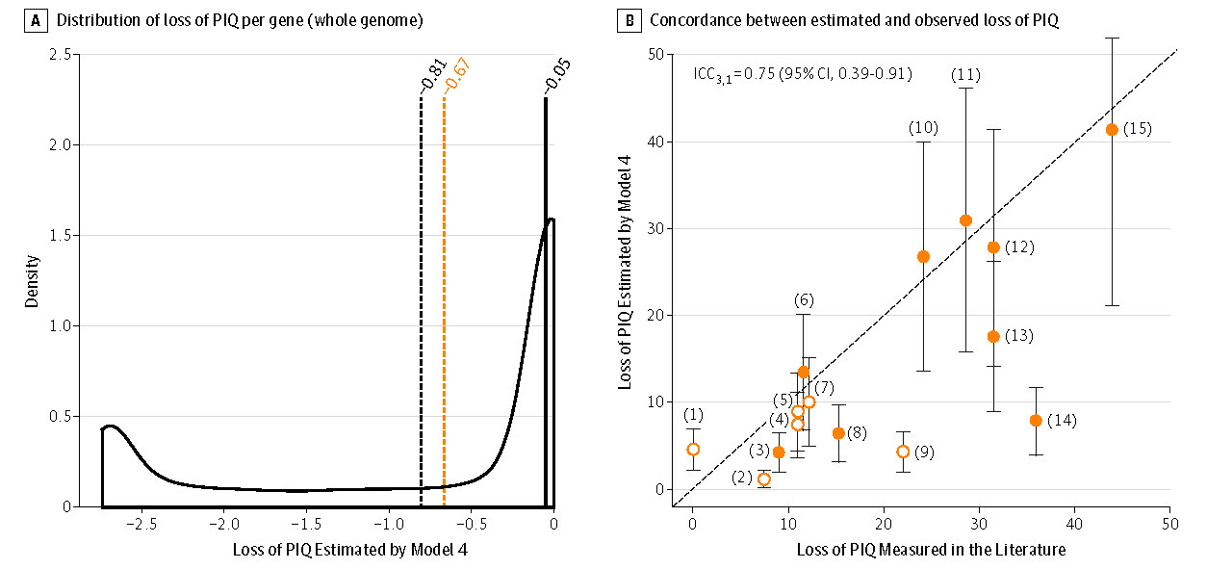
IMAGEN and SYS
Figure 2 from Huguet et al. 2018

Slide 17
Possible deficiencies of Model
Effects of individual CNVs are lost
Interpretation is (possibly) unsatisfactory

Slide 18
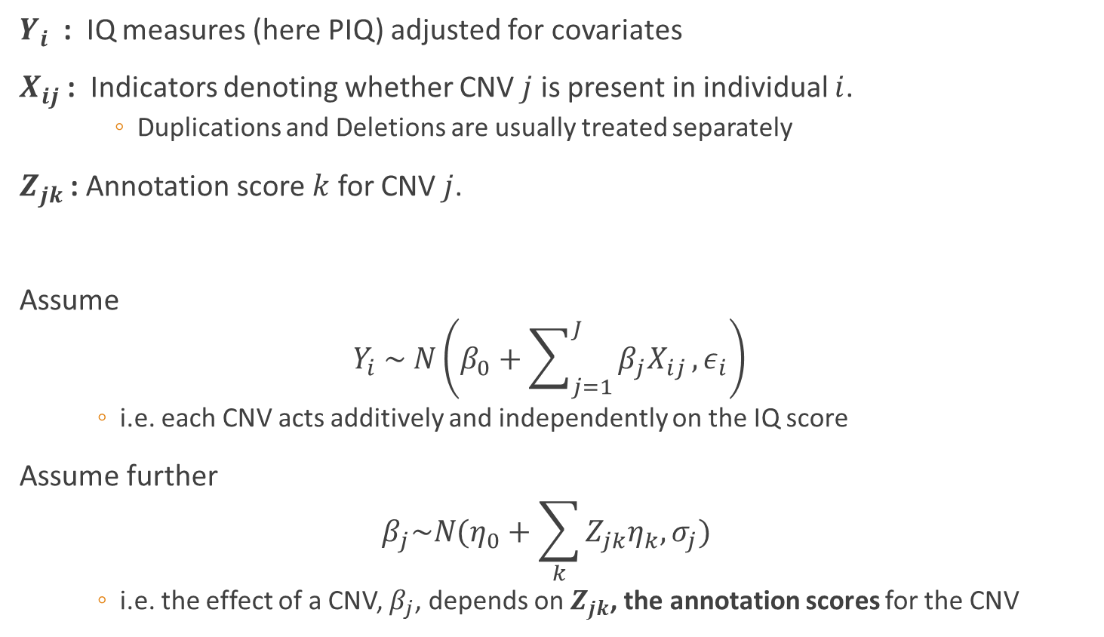
Hypothesis 2
$Y_{i}$ : IQ measures (here PIQ) adjusted for covariates
$X_{ij}$ : Indicators denoting whether CNV $j$ is present in individual $i$.
  Duplications and Deletions are usually treated separately
$Z_{jk}$ : Annotation score $k$ for CNV $j$.
Assume
$$Y_{i} \sim N\left(β_{0}+\sum_{j=1}^{J}{β_{j}X_{ij}},ε_{i}\right)$$
  i.e. each CNV acts additively and independently on the IQ score
Assume further
$$β_{j}\sim N(η_{0}+\sum_{k}{Z_{jk}η_{k}, σ_{j})}$$
  i.e. the effect of a CNV, $β_{j}$, depends on $Z_{jk}$, the annotation scores for the CNV

Slide 19
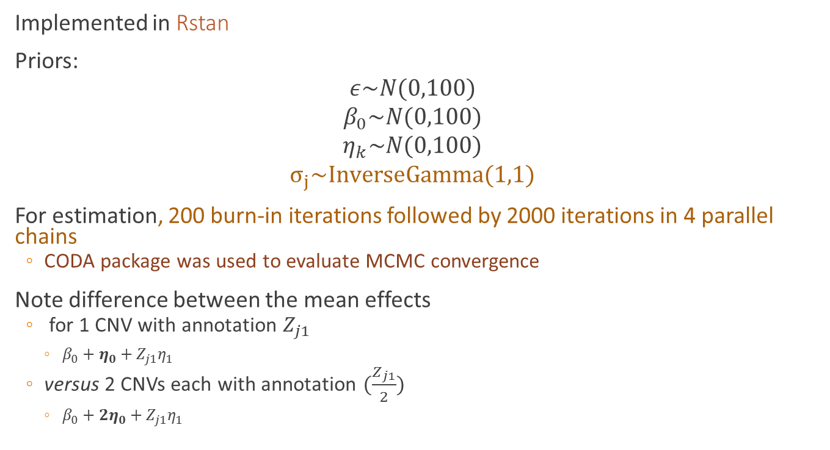
Estimation :
Implemented in Rstan
Priors:
$$ε\sim N(0,100)$$
$$β_{0}\sim N(0,100)$$
$$η_{k}\sim N(0,100)$$
$$σ_{j}\sim InverseGamma(1,1)$$
For estimation, 200 burn-in iterations followed by 2000 iterations in 4 parallel chains
  CODA package was used to evaluate MCMC convergence
Note difference between the mean effects
  for 1 CNV with annotation $Z_{j1}$
    $β_{0}+η_{0}+Z_{j1}η_{1}$
  versus 2 CNVs each with annotation $(\frac{Z_{j1}}{2})$
    $β_{0}+2η_{0}+Z_{j1}η_{1}$

Slide 20
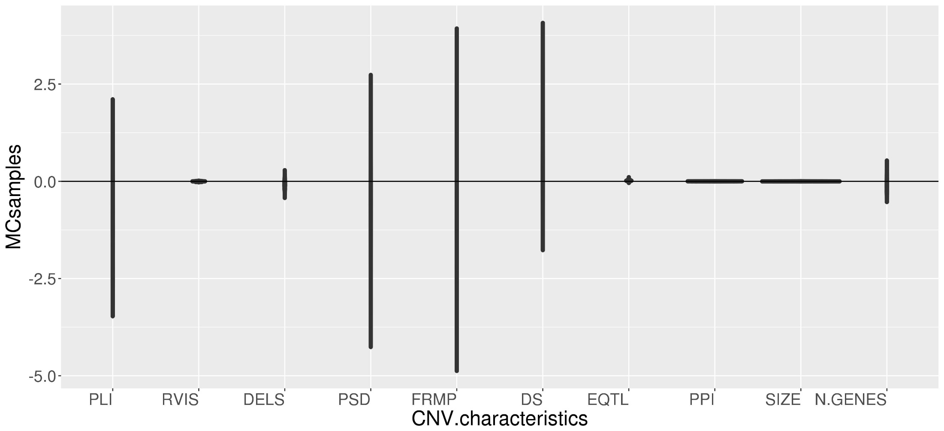
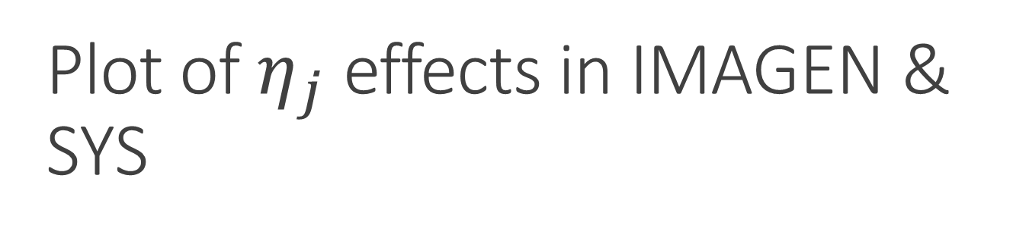
Plot of $η_{j}$ effects in IMAGEN & SYS

Slide 21
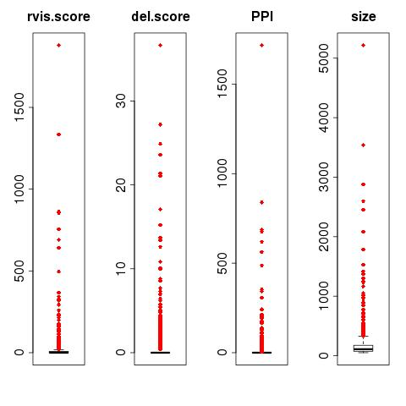
Skewed distributions of scores

Slide 22
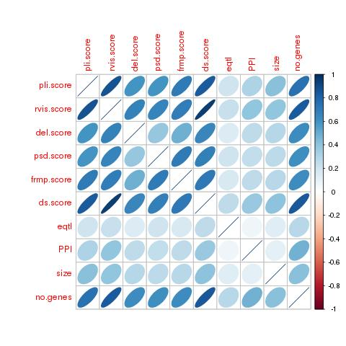
Correlated scores

Slide 23
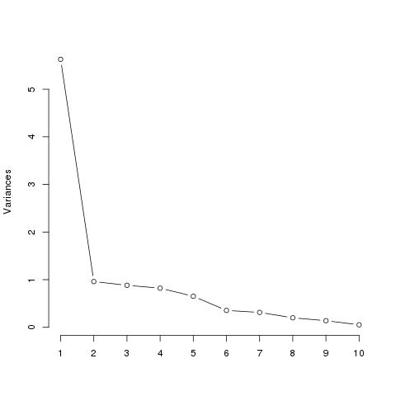
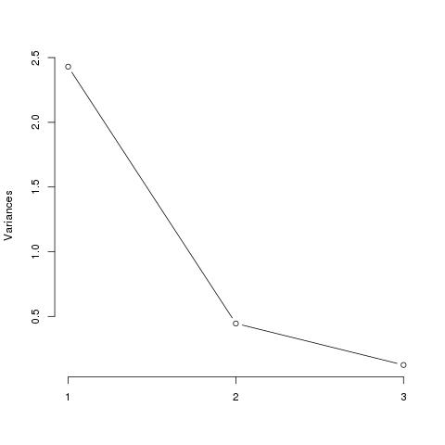
Model tweaks (2):
PCA of annotation scores
Scree plot of all scores
Scree plot of mutation severity scores

Slide 24
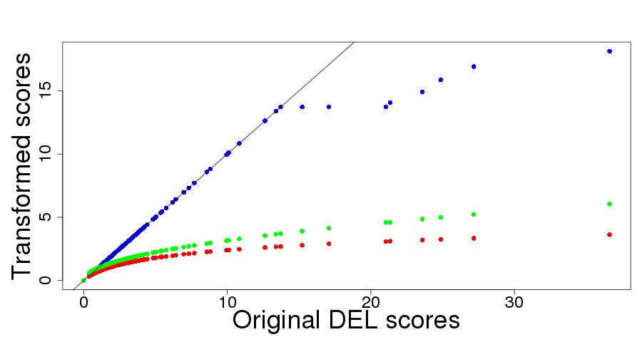
Model tweaks: (1) Winsorizing
RED: log
GREEN: square root
BLUE: winsorized

Slide 25
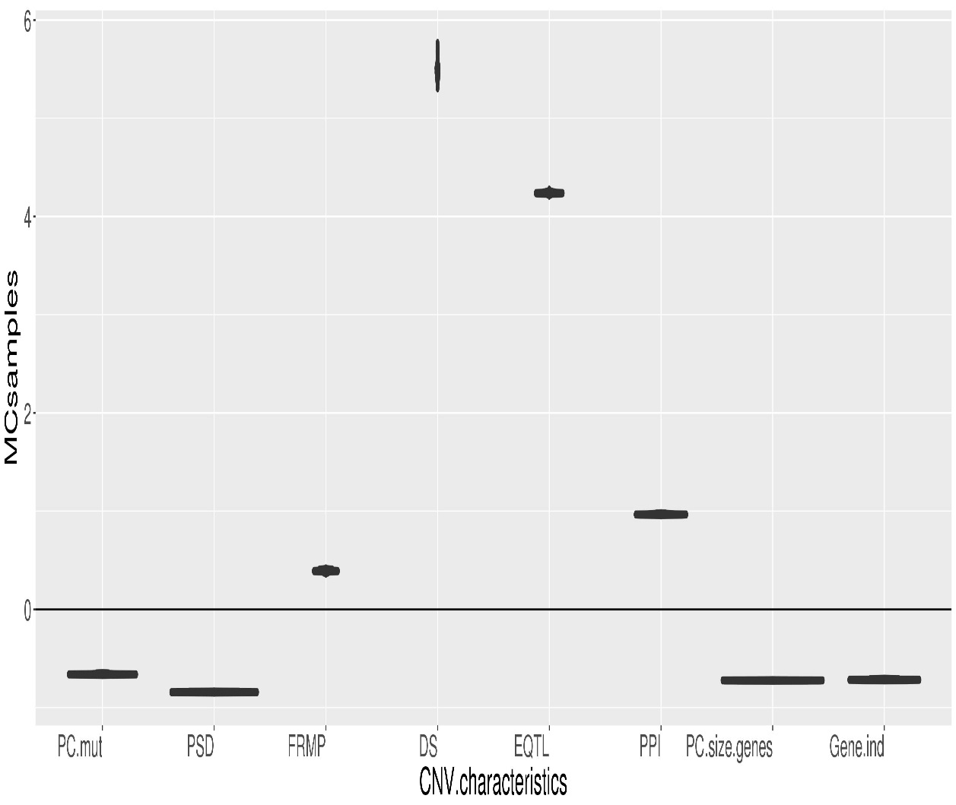
IMAGEN and SYS – Model 1
Bayesian R² =0.014
PC.mut: 1st PC of pLI, RVIS,
DEL, mutation intolerance
PSD: post-synaptic density of the
cortex
FRMP: Genes regulated by
FRMP protein
DS: Differential stability score
EQTL: expression quantitative
trait locus
PPI: protein-protein interactions
PC.size.genes: 1st principal
component of size and number
of genes in CNV
Gene.ind: # of genes and indels
in CNV

Slide 26

Model tweaks (3) :
Non-linear transformations
The previous model
  Assumes linear effects of CNV annotation scores on $β_{j}$
  Assumes additivity across CNVs
  Has no maximum effect

Slide 27
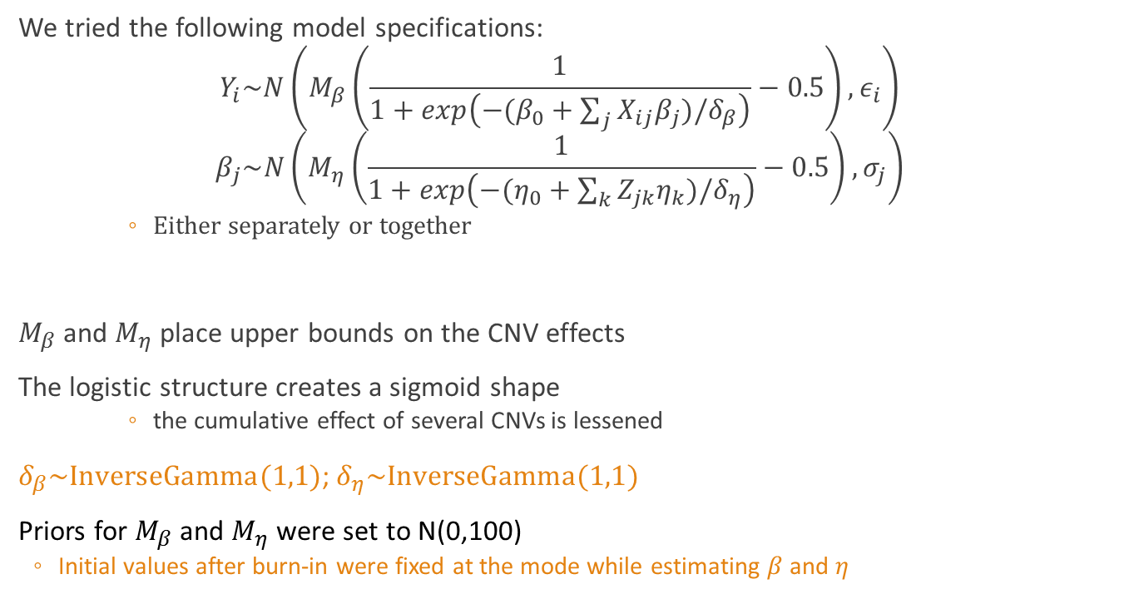
Model tweaks (3) :
Non linear transformations
We tried the following model specifications:
$$Y_{i}\sim N\left(M_{β}\left(\frac{1}{1+exp\left(−(β_{0}+\sum_{j}{X_{ij}β_{j}})/δ_{β}\right)}−0.5\right),ε_{i}\right)$$
$$β_{j}\sim N\left(M_{η}\left(\frac{1}{1+exp\left(−(η_{0}+\sum_{k}{Z_{jk}η_{k})/δ_{η}}\right)}−0.5\right),σ_{j}\right)$$
  Either separately or together
$M_{β}$ and $M_{η}$ place upper bounds on the CNV effects
The logistic structure creates a sigmoid shape
  the cumulative effect of several CNVs is lessened
$δ_{β}\sim InverseGamma(1,1)$; $δ_{η}\sim InverseGamma(1,1)$
Priors for $M_{β}$ and $M_{η}$ were set to $\text{N}\text{(0,100)}$
  Initial values after burn-in were fixed at the mode while estimating $β$ and $η$

Slide 28
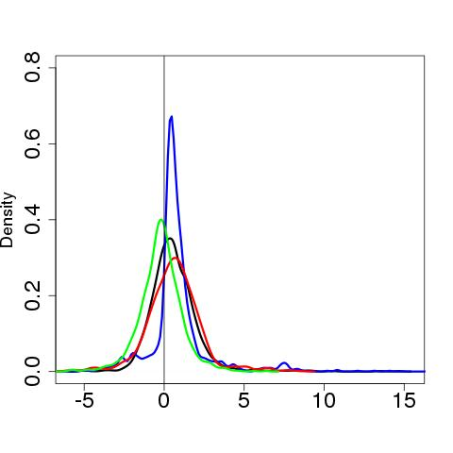

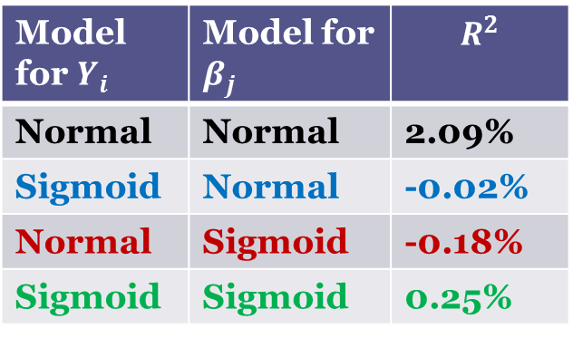
IMAGEN and SYS:
Posterior distributions of $β_{j}$
Model for $Y_{i}$ | Model for $β_{j}$ | $$R^{2}$$
Normal | Normal | 2.09%
Sigmoid | Normal | -0.02%
Normal | Sigmoid | -0.18%
Sigmoid | Sigmoid | 0.25%

Slide 29
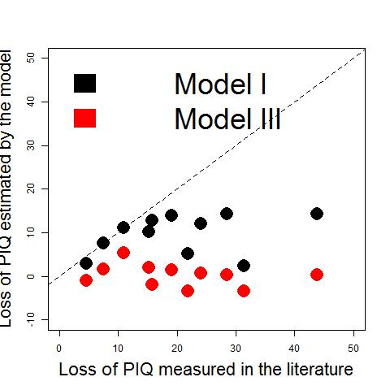
IMAGEN and SYS: concordance

Slide 30
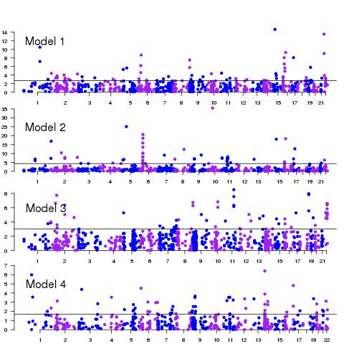
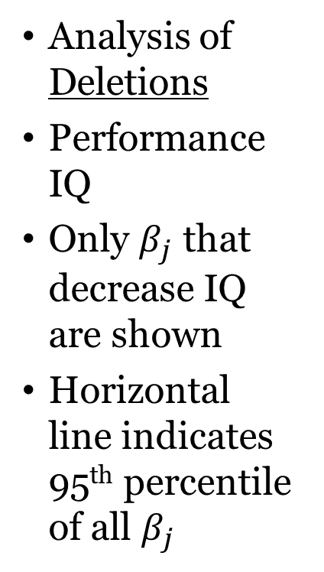
IMAGEN and SYS: Manhattan
Analysis of Deletions
Performance IQ
Only $β_{j}$ that decrease IQ are shown
Horizontal line indicates 95th percentile of all $β_{j}$

Slide 31
Validation in Generation Scotland
Deletions: 0 – 6 per person with mean 0.60
Duplications: 0 – 7 per person with mean 0.64
Analysis is ongoing

Slide 32
Generation Scotland – G factor
First PC of several cognitive evaluation tests
  Zscore (Logical Memory Immediate + Logical Memory Delay)
  Zscore (Digit-Symbol Coding)
  Zscore (Verbal Fluency total)
  Zscore (Mill Hill Vocabulary)
Typical correlations with IQ
  0.4- 0.5

Slide 33
Discussion
Estimating the effects of rare events is always difficult – by definition!
The Bayesian approach allows us to obtain estimates for each CNV,
  but of course the priors play a larger role when the CNV is extremely rare
For prediction purposes, the Bayesian model may not be the best choice
  However, for inferring new genomic regions, it may have promise

Slide 34











Acknowledgements
www.mcgill.ca/statisticalgenetics
Celia
Greenwood
Catherine
Schramm
(postdoc)
Guillaume
Huguet
(postdoc)
Sebastien
Jacquemont
Aurélie
Labbe

